Slide 1
RICH bias correction
C. Delgado
F. Giovacchini

Slide 2
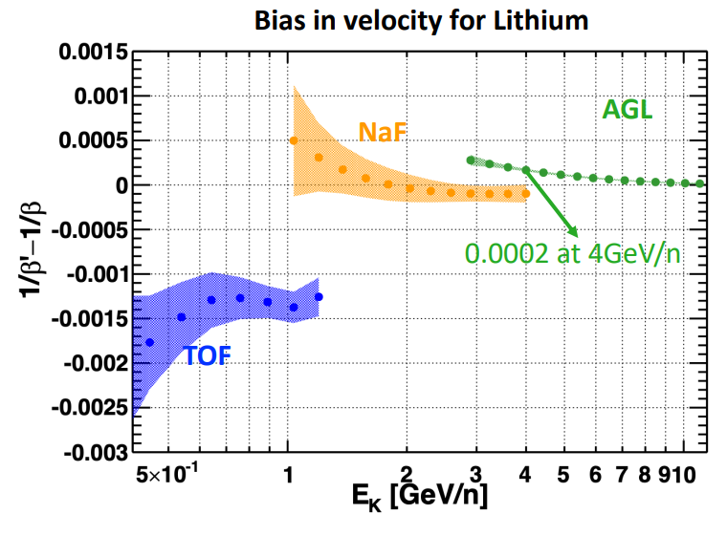
Introduction
Bias observed in Li analysis (as presented by Yi Jia)
For Agl it is of order 0.5 times the resolution.
Notes:
\frac{\beta_{rec}-\beta}{\beta} = && - n^2\beta^2 \frac{\delta n}{n}\\
&& - \frac{n^2\beta^2-1}{\beta^2}(1-(n^2-1)\beta^2)\frac{\delta H}{H}\\
&& - \frac{n^2\beta^2-1}{\beta^2}\sqrt{1-(n^2-1)\beta^2}\frac{\delta h}{H}

Slide 3
Introduction
A possibility is due to residual systematics after the RICH geometry and radiator has been calibrated.
The Geometry was measured at the mm level, but could deform during launch.
The geometry is calibrated using NaF at beta=1, since the refractive index (including chromatic dispersion, optical transmission and detection efficiencies) are know at the 0.1% level.
Notes:
\frac{\beta_{rec}-\beta}{\beta} = && - n^2\beta^2 \frac{\delta n}{n}\\
&& - \frac{n^2\beta^2-1}{\beta^2}(1-(n^2-1)\beta^2)\frac{\delta H}{H}\\
&& - \frac{n^2\beta^2-1}{\beta^2}\sqrt{1-(n^2-1)\beta^2}\frac{\delta h}{H}

Slide 4
Parameters under consideration
Expansion height: H ~ 47 cm
Refractive index: n ~ 1.05
I ignore the mirror parameters for the moment, which should be not very important close to the threshold for agl
Misalignment is second order so I neglect it.
Notes:
\frac{\beta_{rec}-\beta}{\beta} = && - n^2\beta^2 \frac{\delta n}{n}\\
&& - \frac{n^2\beta^2-1}{\beta^2}(1-(n^2-1)\beta^2)\frac{\delta H}{H}\\
&& - \frac{n^2\beta^2-1}{\beta^2}\sqrt{1-(n^2-1)\beta^2}\frac{\delta h}{H}

Slide 5
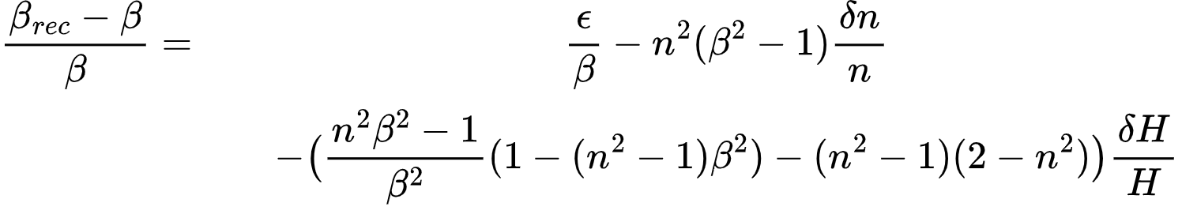
After calibrating, the bias is
Notes:
\frac{\beta_{rec}-\beta}{\beta} = && \frac{\epsilon}{\beta}- n^2(\beta^2-1) \frac{\delta n}{n}\\
&& - \big(\frac{n^2\beta^2-1}{\beta^2}(1-(n^2-1)\beta^2)-(n^2-1)(2-n^2)\big)\frac{\delta H}{H}\\
&& - \big(\frac{n^2\beta^2-1}{\beta^2}\sqrt{1-(n^2-1)\beta^2}-(n^2-1)(2-n^2)\big)\frac{\delta h}{H}

Slide 6
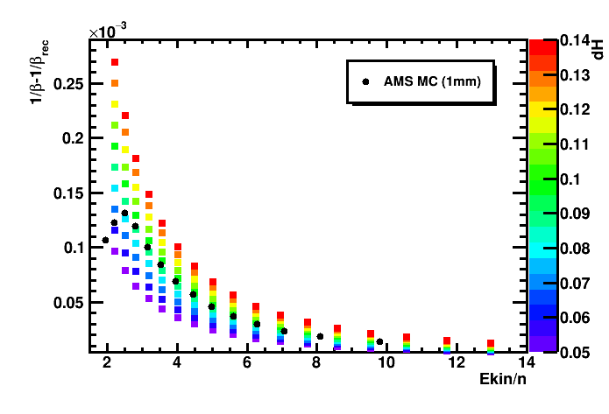
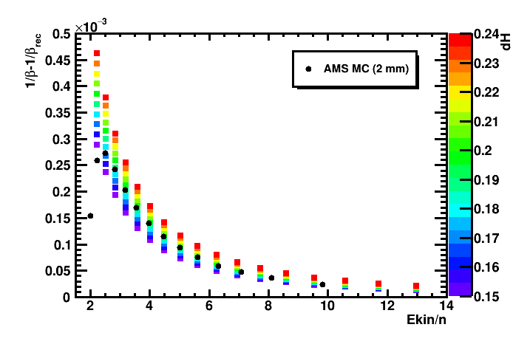
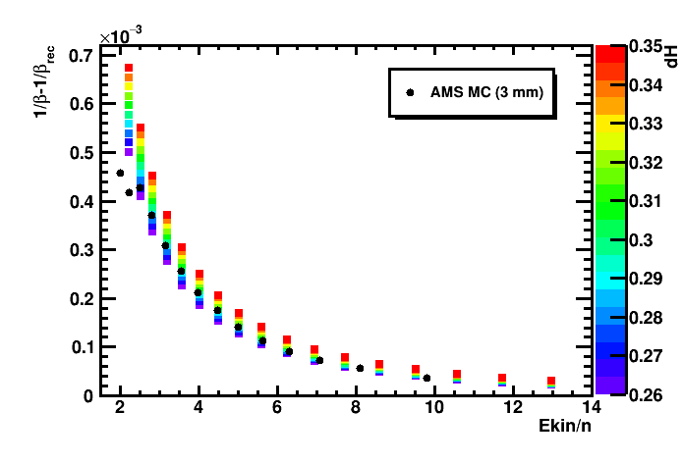
Cross check with AMS MC: aerogel
Notes:
\frac{\beta_{rec}-\beta}{\beta} = && - n^2\beta^2 \frac{\delta n}{n}\\
&& - \frac{n^2\beta^2-1}{\beta^2}(1-(n^2-1)\beta^2)(\frac{\delta H}{H}-\frac{\delta p}{p})\\
&& - \frac{n^2\beta^2-1}{\beta^2}\sqrt{1-(n^2-1)\beta^2}\frac{\delta h}{H}\\
&& + \frac{n^2(1-\beta^2)}{n^2-1}\sqrt{\frac{n^2\beta^2-1}{\beta^2}(1-(n^2-1)\beta^2)}\frac{\delta x}{H}

Slide 7
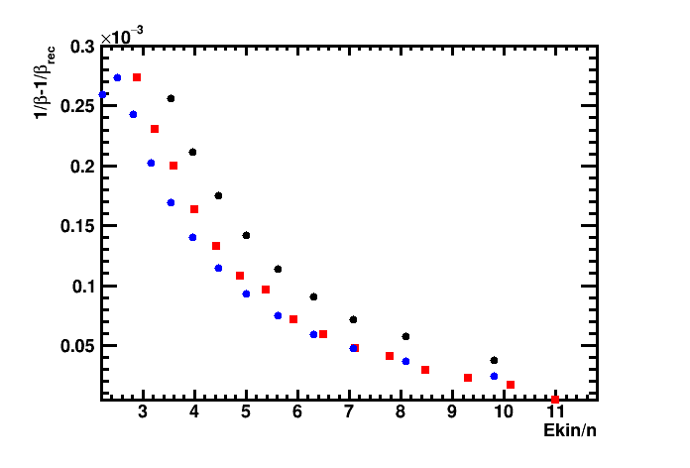
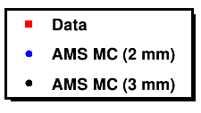
“Fit” with AMS MC Expansion Length (cm)
Aerogel

Slide 8
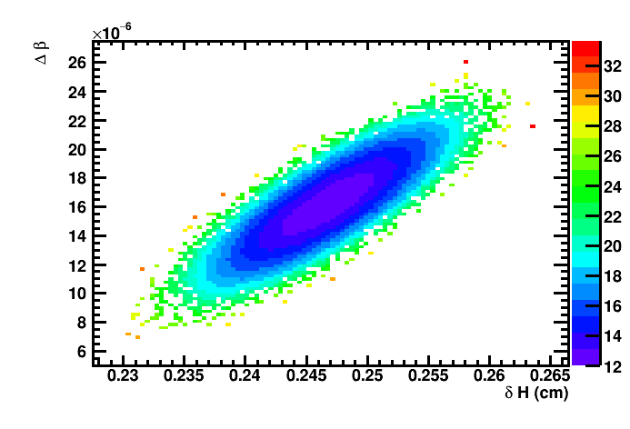
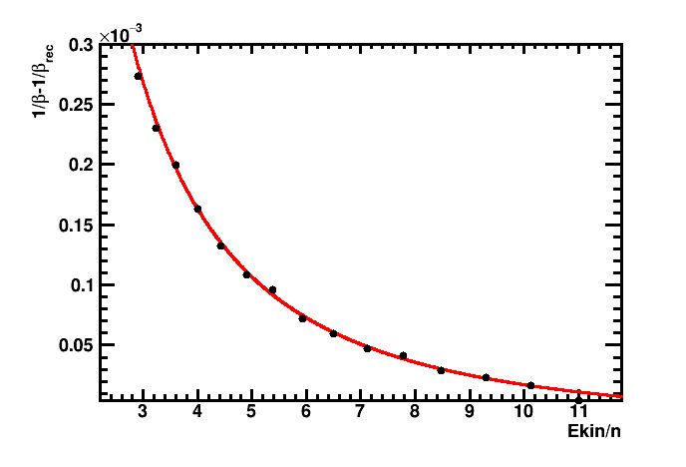
Fitting bias and H for Aerogel
δH =0.247 +- 0.004 ,
Δβ = 1.6e-05 +- 0.2e-05
χ2/ndof =12.2/13
(with invented common error for all points)
OR
There is a Complete degeneracy between n and H biases,
δn =4.67e-3 +- 0.006e-3 ,
Δβ = 2.0e-05 +- 0.2e-05
χ2/ndof =12.0/13
(with invented common error for all points)

Slide 9
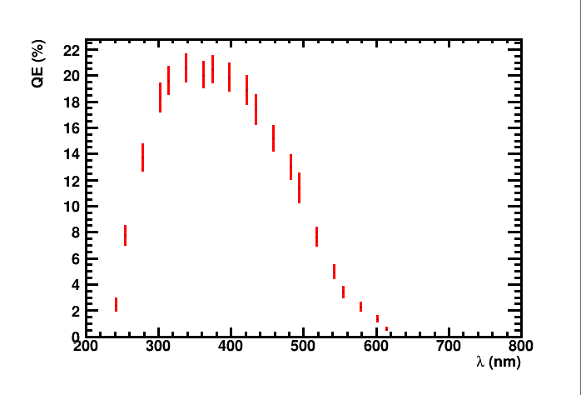
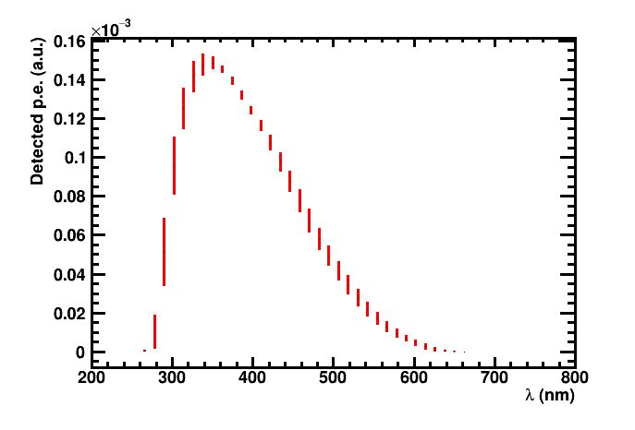
Introduction: uncertainties in PMT, and spectrum of detected photons for NaF
Spectrum
(Cherenkov spectrum + abs + QE)
Characteric dispersion between PMT prod. batches (private comm.)
Due to differences in collection eff. & uniformity of photocathode
Include estimate uncertainties in optical length within light guides
Notes:
\frac{\beta_{rec}-\beta}{\beta} = && - n^2\beta^2 \frac{\delta n}{n}\\
&& - \frac{n^2\beta^2-1}{\beta^2}(1-(n^2-1)\beta^2)\frac{\delta H}{H}\\
&& - \frac{n^2\beta^2-1}{\beta^2}\sqrt{1-(n^2-1)\beta^2}\frac{\delta h}{H}

Slide 10
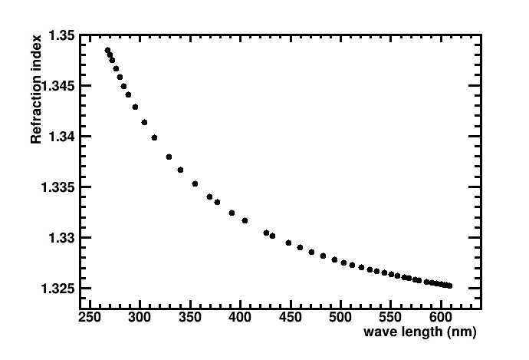
Introduction: NaF properties
NaF Chromatic dispersion
Spectrum
(Cherenkov spectrum + abs + QE)
Notes:
\frac{\beta_{rec}-\beta}{\beta} = && - n^2\beta^2 \frac{\delta n}{n}\\
&& - \frac{n^2\beta^2-1}{\beta^2}(1-(n^2-1)\beta^2)\frac{\delta H}{H}\\
&& - \frac{n^2\beta^2-1}{\beta^2}\sqrt{1-(n^2-1)\beta^2}\frac{\delta h}{H}

Slide 11
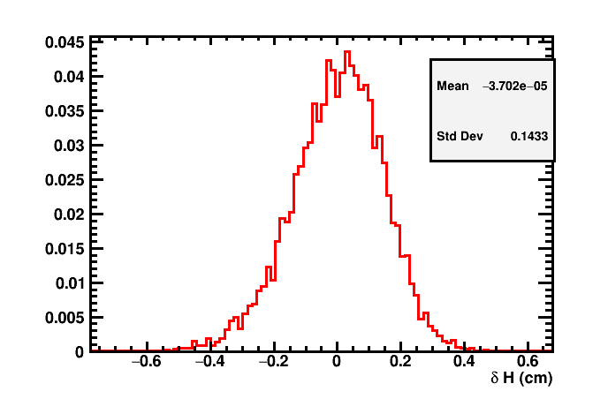
Introduction: NaF properties
Notes:
\frac{\beta_{rec}-\beta}{\beta} = && - n^2\beta^2 \frac{\delta n}{n}\\
&& - \frac{n^2\beta^2-1}{\beta^2}(1-(n^2-1)\beta^2)\frac{\delta H}{H}\\
&& - \frac{n^2\beta^2-1}{\beta^2}\sqrt{1-(n^2-1)\beta^2}\frac{\delta h}{H}

Slide 12
Bias determination with He data

Slide 13



Methodology (with He)
Select fine bins in RICH beta
  For tracker these are “Dirac delta” distributions in rigidity
Infer the beta from the rigidity distribution
  Use a fit to two Gaussians to get the position of the He4 peak
  This is valid as far as
Compute for the same
Fit the obtained curve with the previous formulae
  There should be a small systematic since the x axis is the beta at the tracker instead of at the RICH

Slide 14
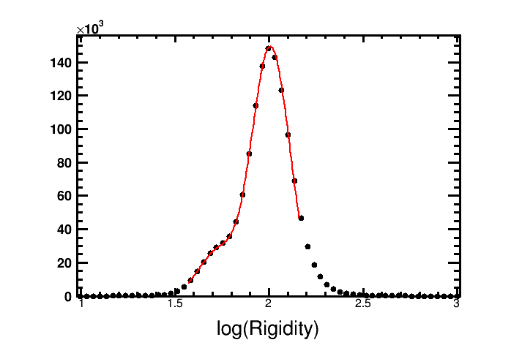
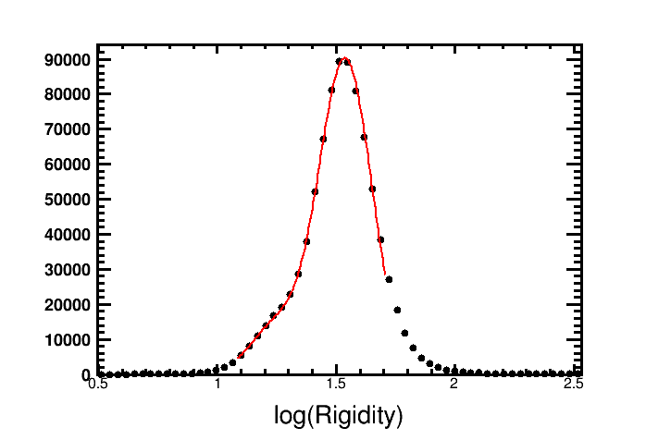
Methodology (with He)
beta=0.975
beta=0.92
Agl
NaF

Slide 15
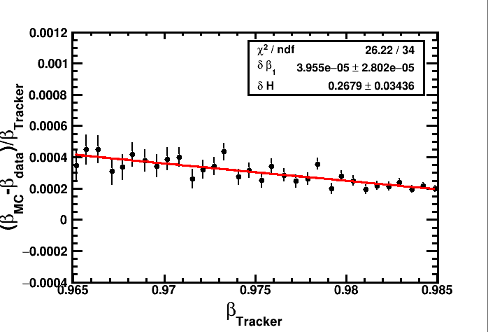
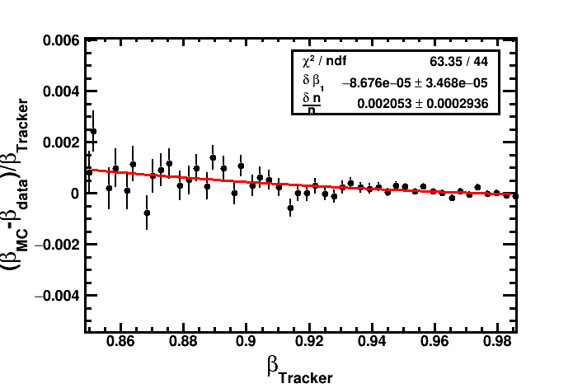
Results
Agl
NaF

Slide 16
Summary
Function introduced in AMS core to compute the unbiased beta for aerogel.
We asked Yi Jia to test it, before public release.
Once this is checked and confirmed, we will need to confirm the bias correction with NaF
Right now it is compatible with the estimate by Yi, but the latter has very large errors.
Once confirmed, the geometry description will be modified to account for it without additional corrections.

Slide 17
Other improvements
Update RICH uniformity corrections for beta to latest version in AMS Code
This is currently done with an adhoc distributed code
Requires some refurbishing of the current RICH reconstruction offline AMS code due to some backwards incompatibility

Slide 19

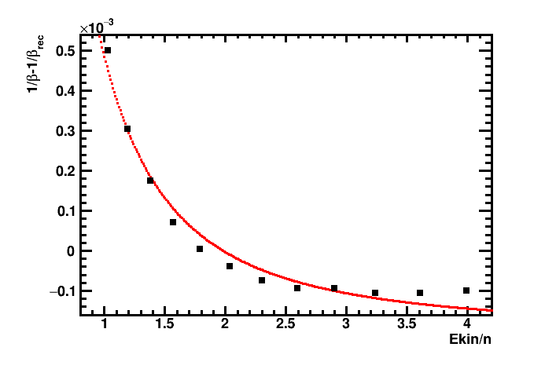
Combined NaF and Agl fit
δH =0.247 +- 0.004 cm ,
Δβ (NaF) = 2.0e-04 +- 0.2e-04
Δβ (Agl) = 1.6e-05 +- 0.2e-05
δn (NaF) =2.5e-3 +- 0.2e-3
χ2/ndof =20.3/23
(with invented errors)
This does not work if dH=0 and a bias in AGL index is used instead.
Leaving all free results in the bias in AGL being compatible with 0.

Slide 20
Summary
The bias observed in both Agl and NaF can be explained by this H shift together with an additional bias in the refractive index of NaF (which should be there to explain the one in H)
Numerically, though, the shift in the refractive index is too large.
However the errors for NaF are poorly accounted, and is biasing the results
And the validity of the analytical estimate is not confirmed.
A calibration at ꞵ~1/n for aerogel could be used to reduce the systematic:
Take events with 3<Ek<4 selected with Tracker R
Determine <beta> with NaF crossing events (we know NaF systematics are small in this range)
Determine <beta> for Aerogel crossing events
Correct Aerogel beta bias accordingly
In practice this will introduce the shift we have already parameterized.

