Slide 1
Unspooling of SC links in UR: Sequence and space requirements
R. Perez Martinez, on behalf of WP6a

Slide 2
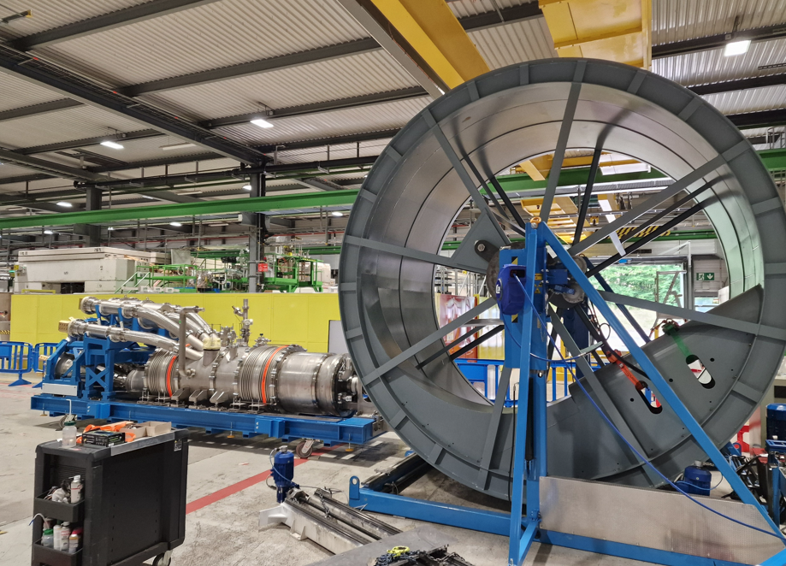
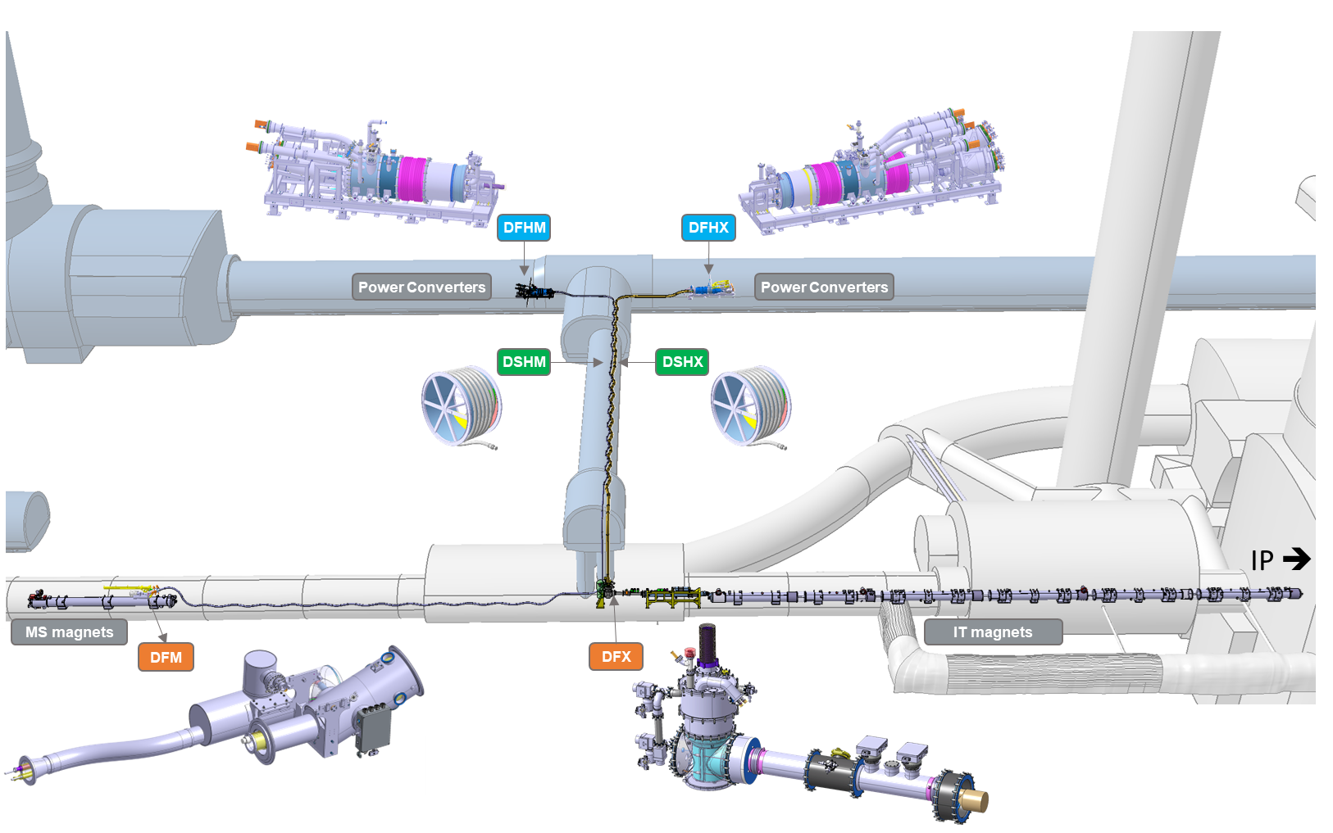
Index
Identification of the most delicate phases during the SClinks unspooling in service caverns
Highlight of potential interferences found during kinematics study and agreed mitigation actions.
Conclusions
Next steps
Installation of the Cold Powering system (WP6a)

Slide 3
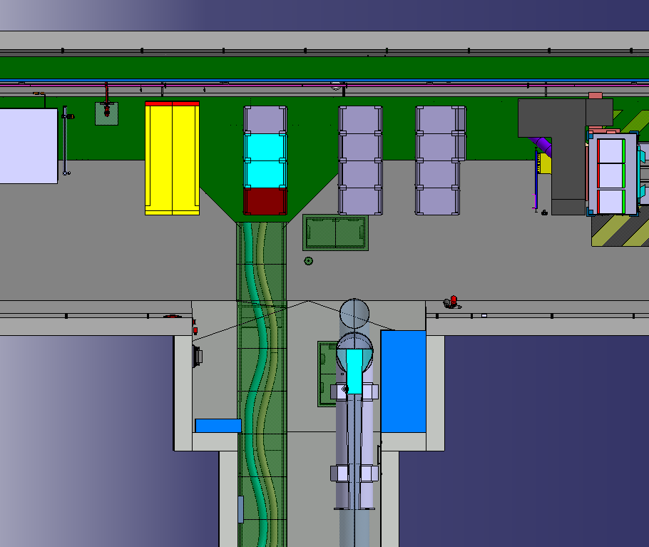
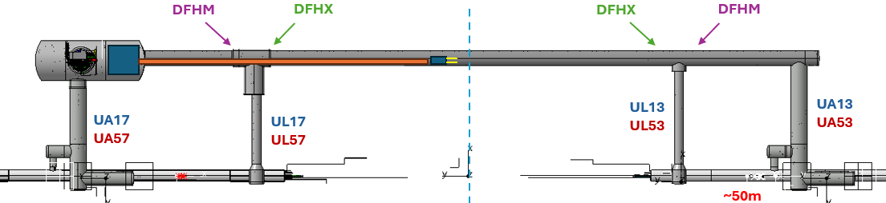
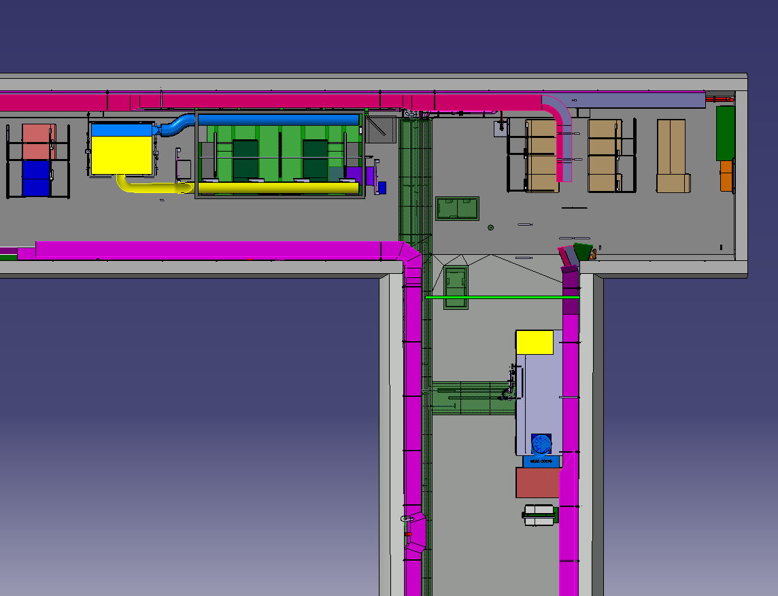
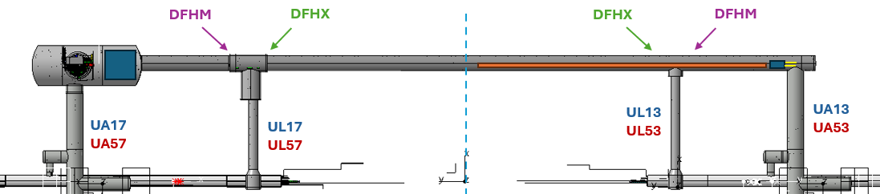
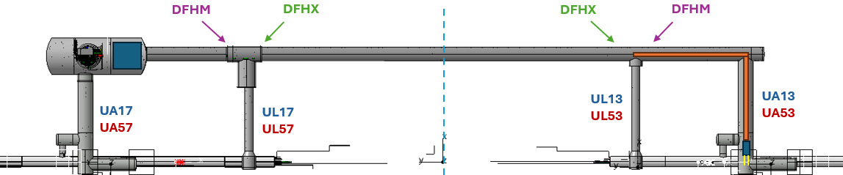
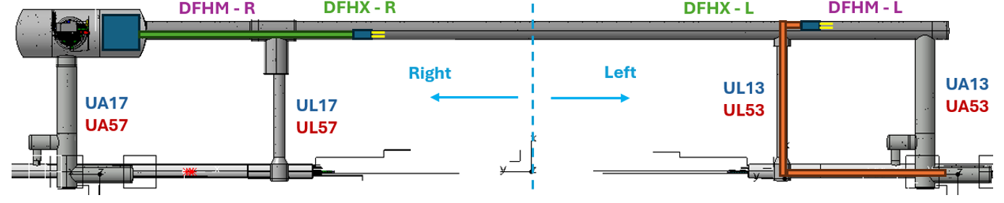
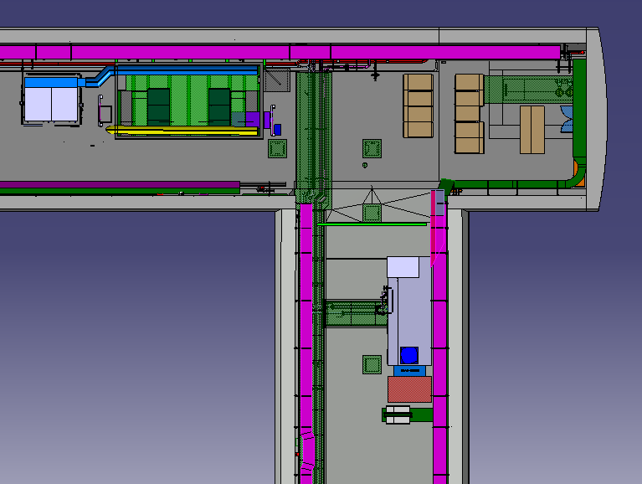
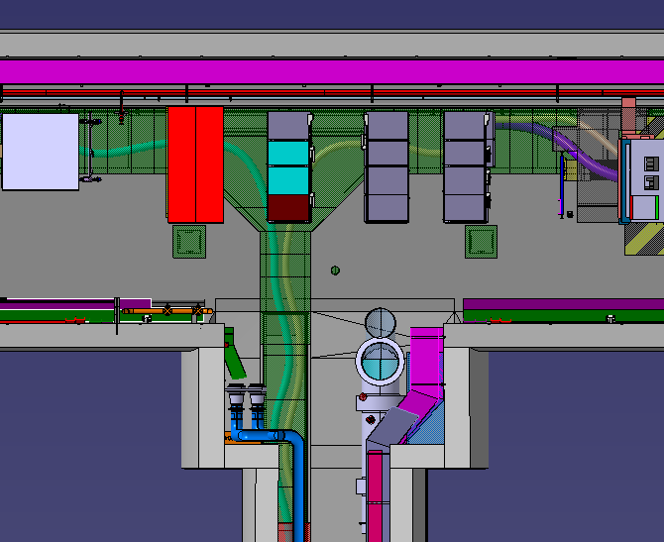
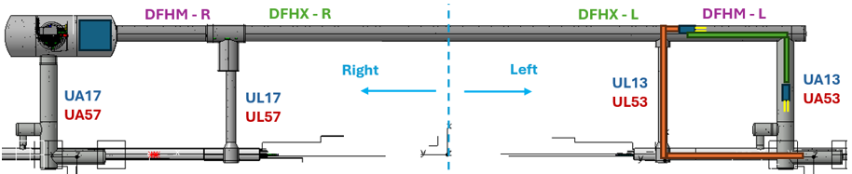
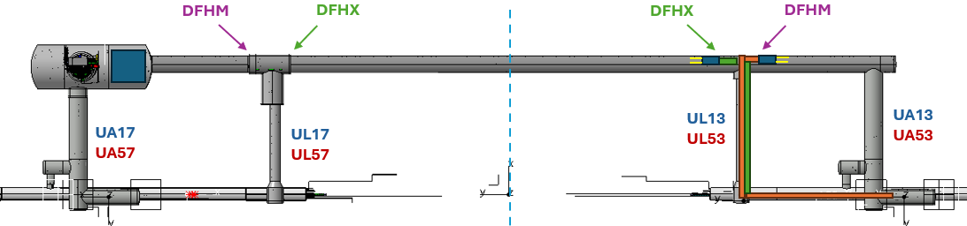
1. Identification of the most constrained phases during SClinks unspooling in service caverns
90 degrees turn DFHM into UA
Storage of DSHM in UA + UR, for insertion of SClink head into UL
Top view corner UR55 – UA53
Top view area UR55 – UL53
90 degrees turn DFHX into UA – longer than the DFHM
180 degrees turn DFHX by the level of the UL, with DFHM in place
Top view corner UR15 – UA13
Top view area UR15 – UL13

Slide 4
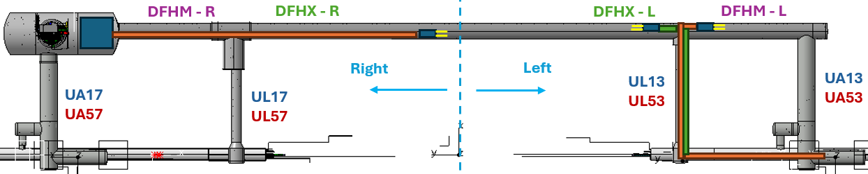
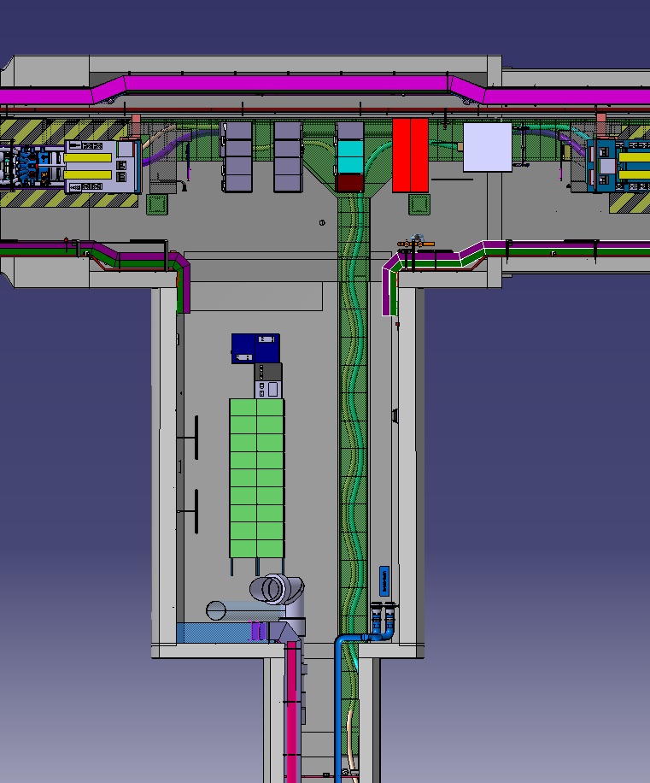
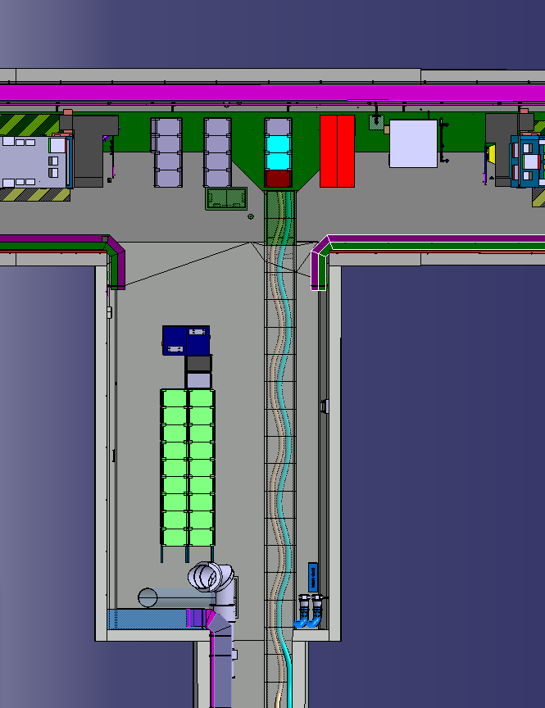
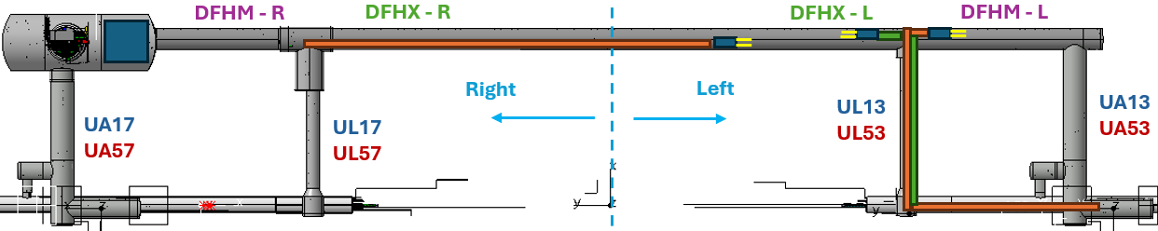
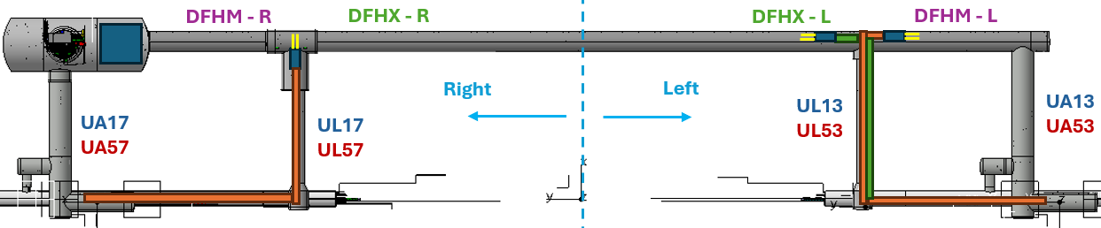
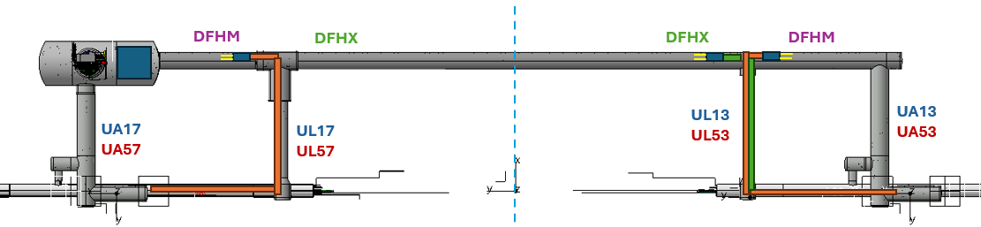
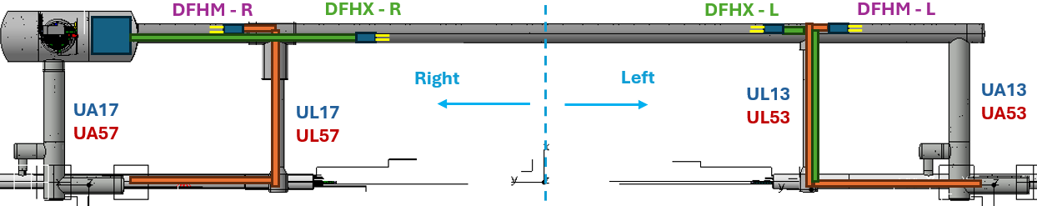
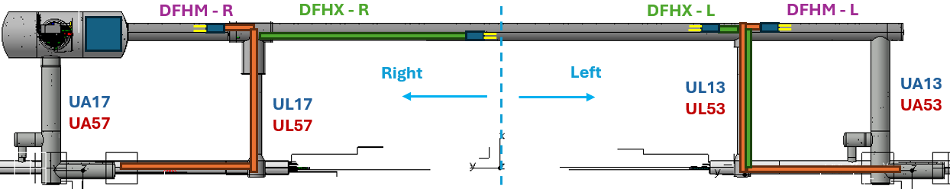
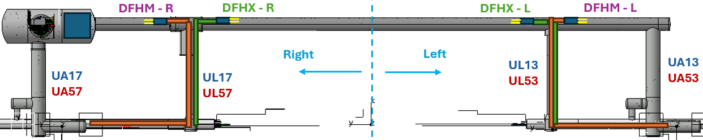
1. Identification of the most constrained phases during SClinks unspooling in service caverns
Top view area UR55 – UL57
Top view area UR15 – UL17
No issues are identified for the maneuvers on the right side:
Larger area at the start of the UL.
The full length of the cryostats can be stored straight in the UR.
The DFHM will be rotated 180 degrees by the level of the UL before the DFHX is in place.

Slide 5
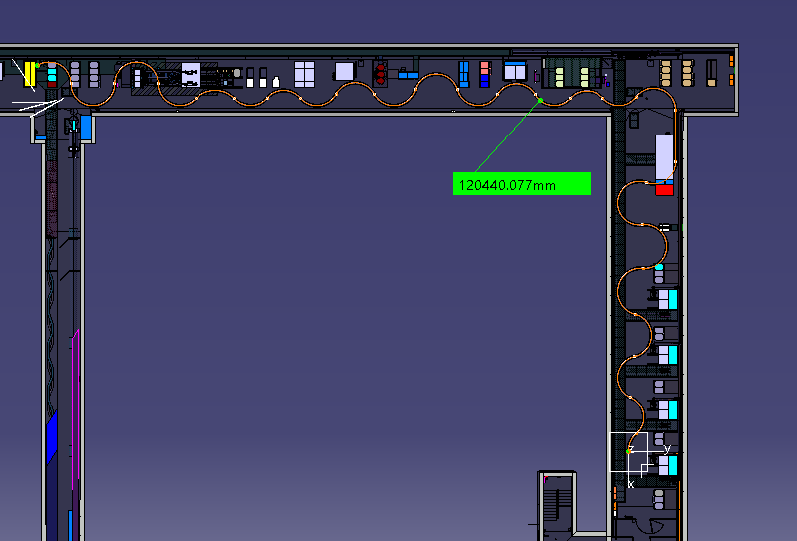
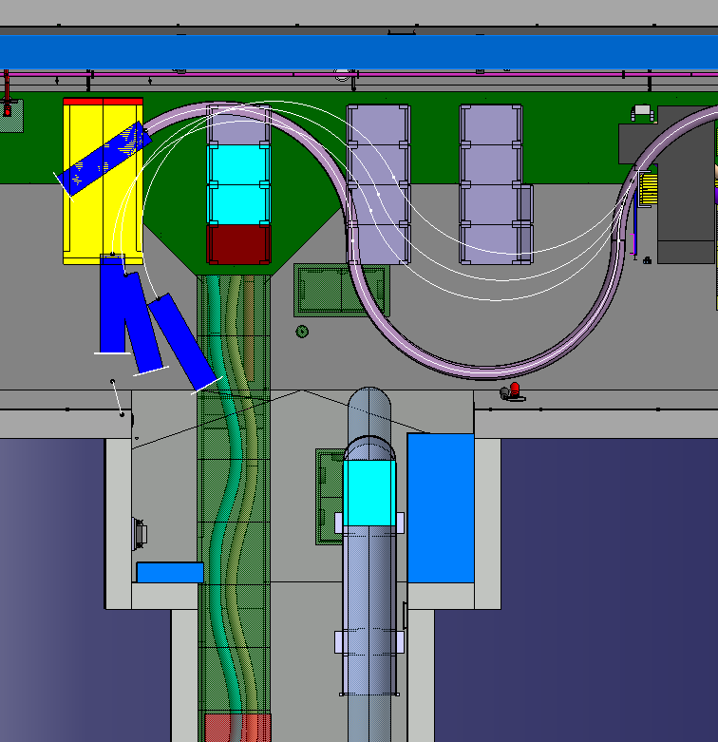
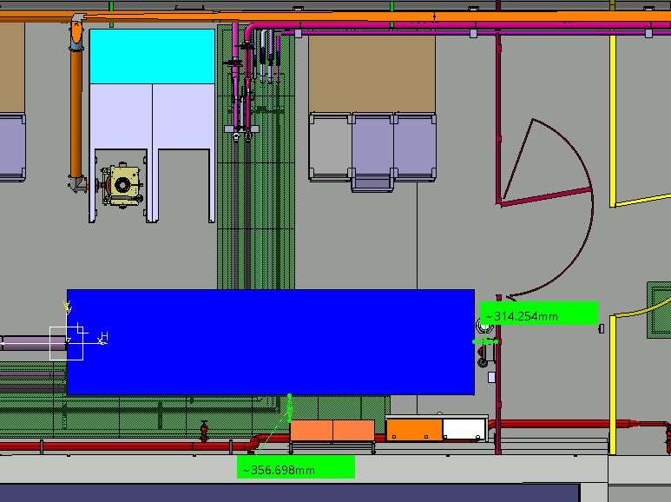
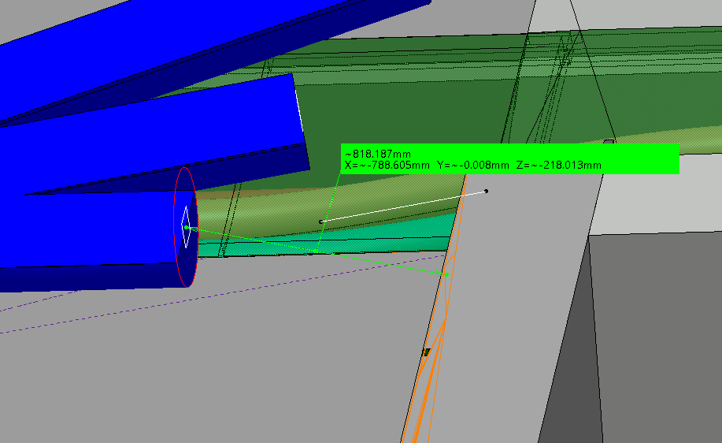
2. Potential interferences found during kinematic studies and compensatory measures agreed
2.1. Installation of DFHM Left side
Interference identified | Agreed mitigation action involving other WPs | Other options being studied
Location of electrical rack in an inconvenient location for waves distribution | Relocation of electrical rack by EN-EL (WP17.2) | -
Available space too tight to stock the 120.4m of DSHM allowing the safe insertion of SC link (splices protection cover and NbTi extension) in the UL | To be able to cross the doors at the end of the UA: removal of the last RF rack to allow alignment DFH-doors (Possibility confirmed by SY-RF- WP4). | Modification of the doors so they are aligned with the transport area (study and budget estimated by EN-ACE: 50k in total)

Slide 6
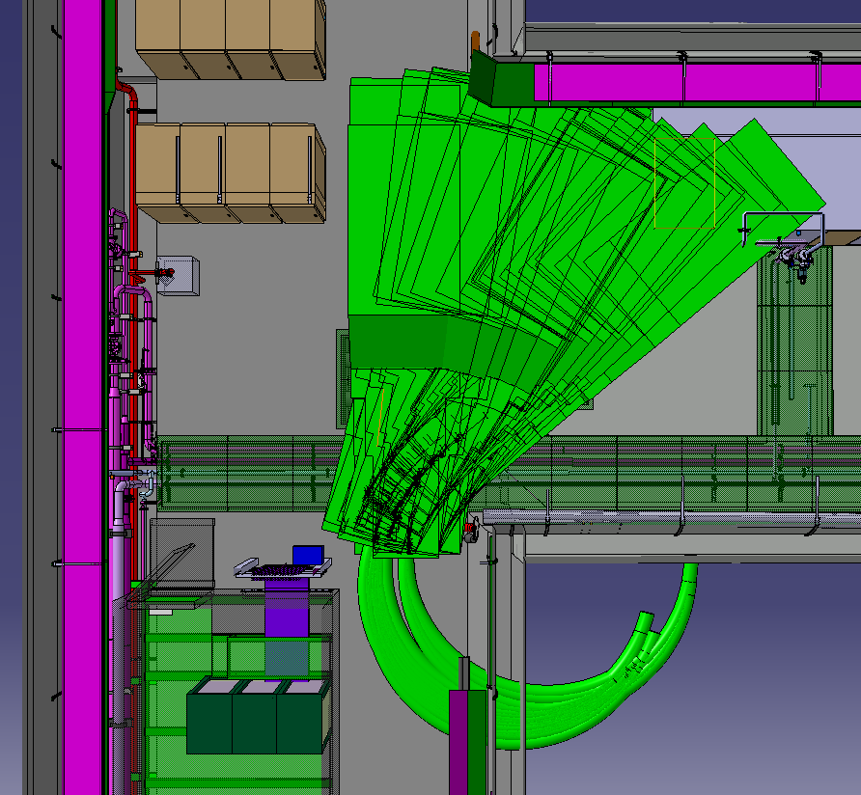
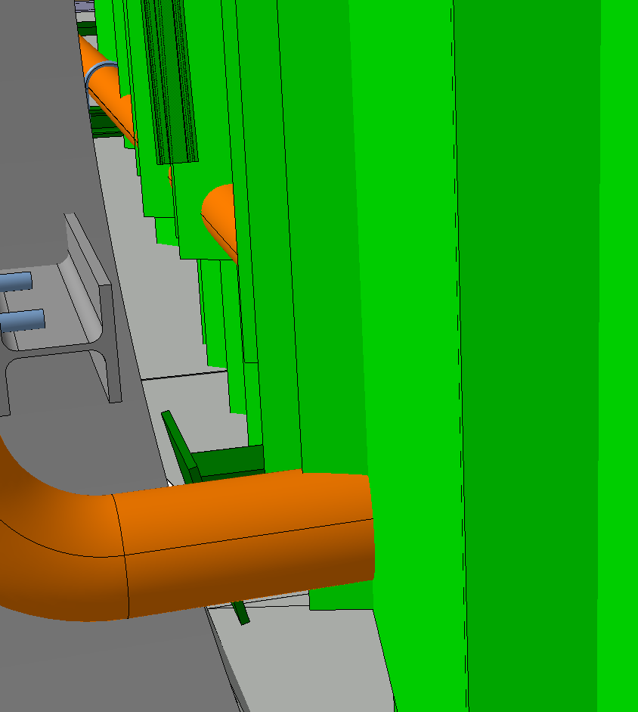
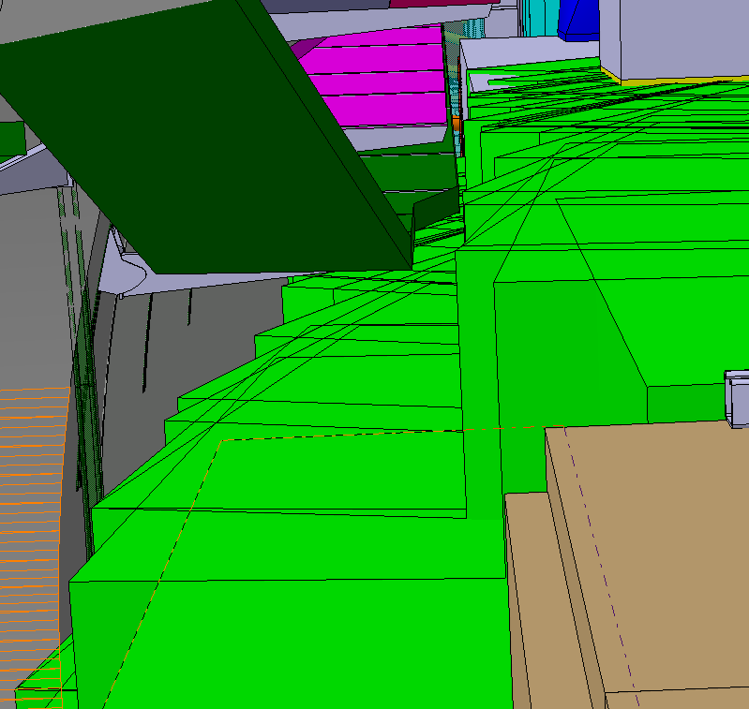
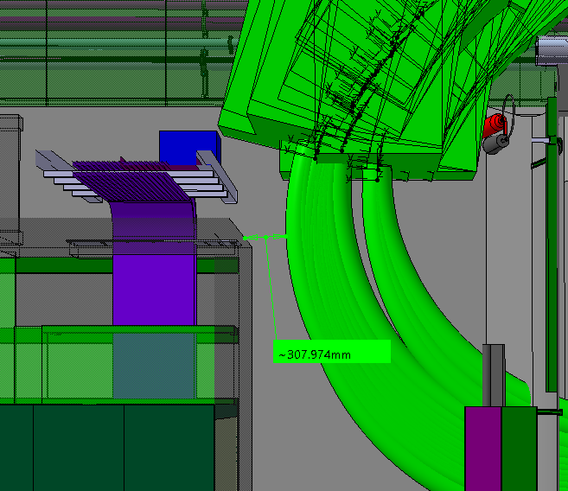
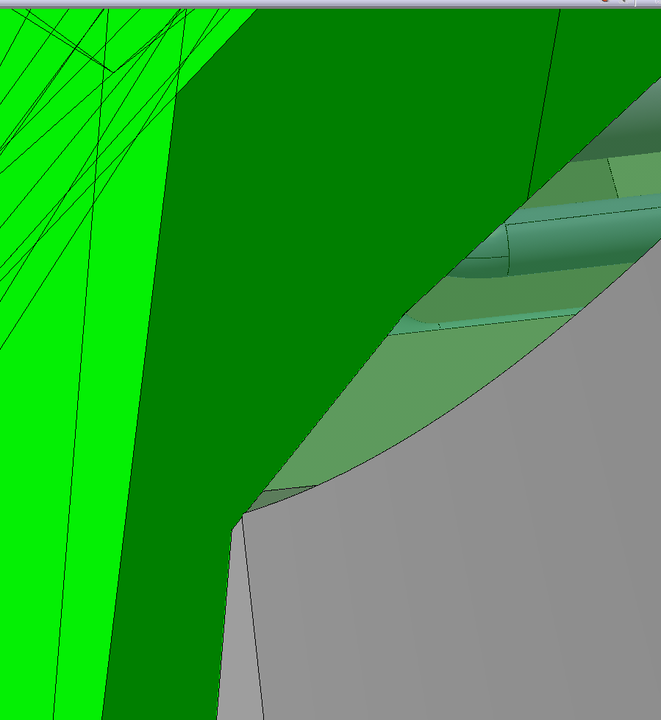
2. Potential interferences found during kinematic studies and compensatory measures agreed
2.2. Storage of 75m for DSHX – 90 degree turn of DFHX into UA
1- 2
Interference identified | Agreed mitigation action involving other WPs | Other options being studied Need TBC after practice in Nov.25
1. Collision with cryogenic pipe | Addition of flanges and temporary removal of the pipe during SC links installation (agreed by TE-CRG, WP9) | -
2. Small margin with cable trays in the UA | Cable trays will be lifted up during the SC link installation (agreed by EN-EL) | -
3. Small margin to Faraday cage (fragile equipment) | A protection cover will be included around the Faraday cage, respecting the current envelope (agreed by SY-RF, WP4) | -
4. Corner of the UA-UR complexify the kinematics | No showstopper | Possibility of cutting the corner and filling it up after ~4months. Studies performed by SCE.
4
3
1
2
3
4

Slide 7
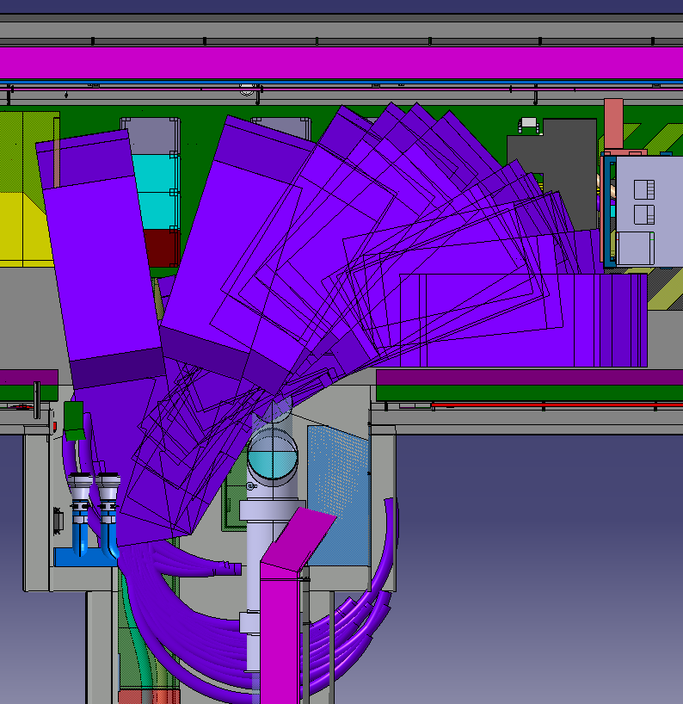
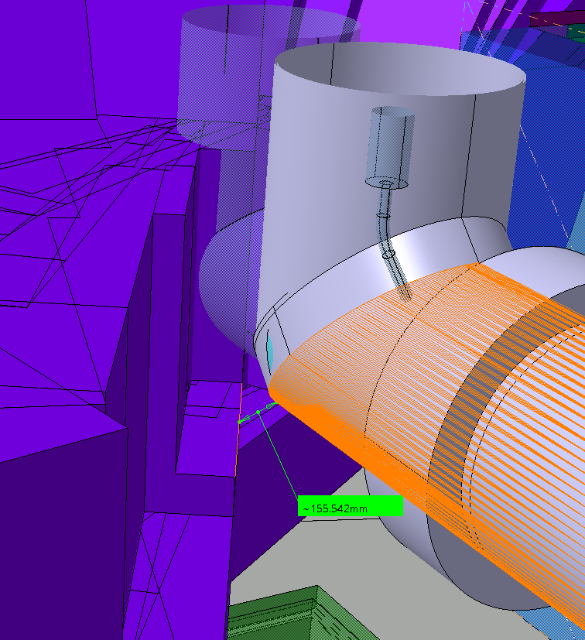
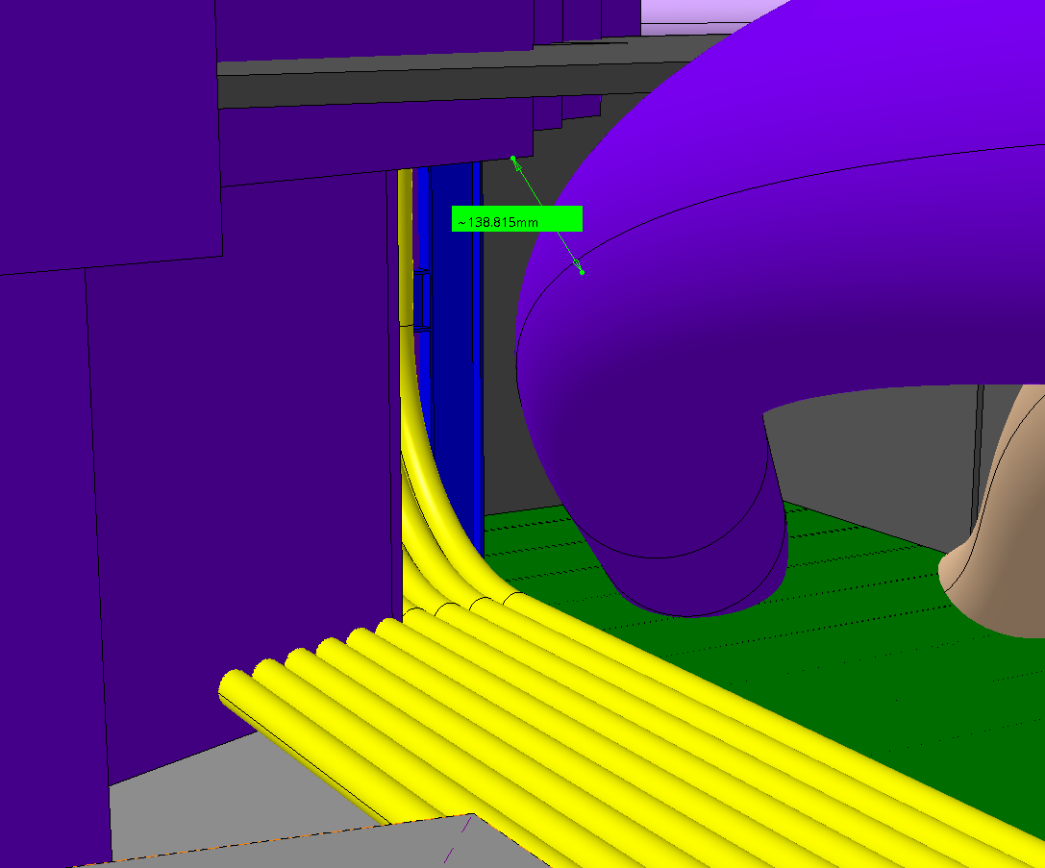
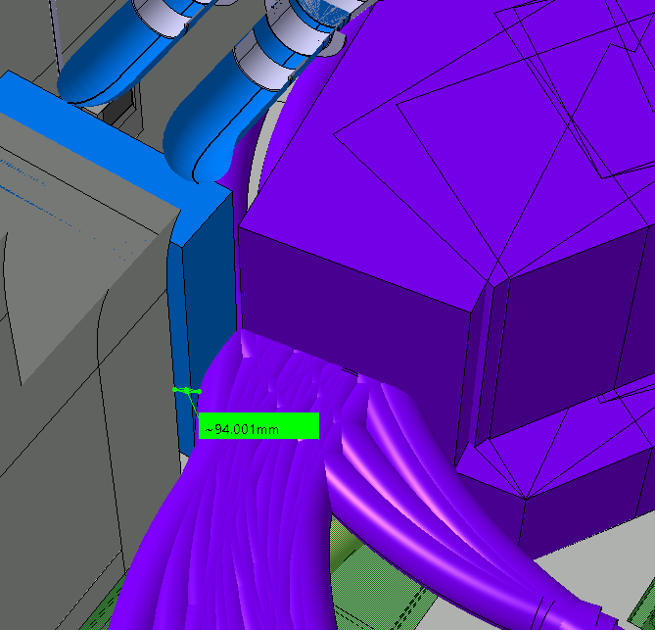
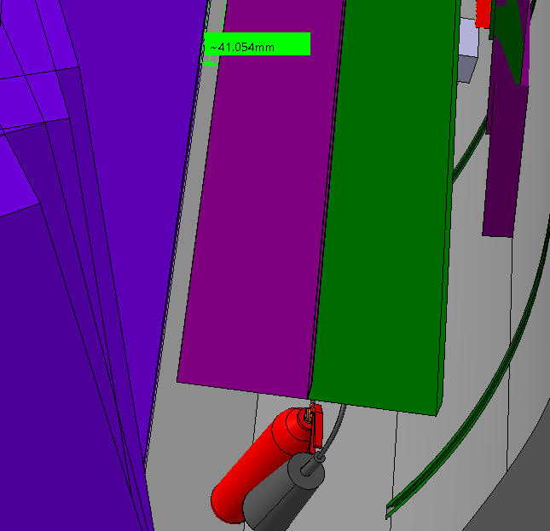
2. Potential interferences found during kinematic studies and compensatory measures agreed
2.3. 180 degree turn of DFHX in UL area. Part 1
Interference identified | Agreed mitigation action involving other WPs | Other options being studied Need TBC after practice in Nov.25
1. Small margin with QXL | No showstopper WP9 agrees that they would respect the QXL envelope reservation Necessary to remove trolleys and install a replacement tooling to ensure the minimum 2 m radius by WP6a. | -
2. Small margin with installed DSHM |  | Limited displacement of DFHM possible if needed.
3. The corner of the UR is close to the envelope requiring complex Kinematics |  | Possibility of cutting the corner and filling it up after ~4months. Studies performed by SCE.
4. Small margin with the cable trays in the UR when the turn starts | Reduction of the cable trays in the UR by EN-EL. | -
2
4
1
3
This remains the more constrained maneuver
1
2
3
4

Slide 8
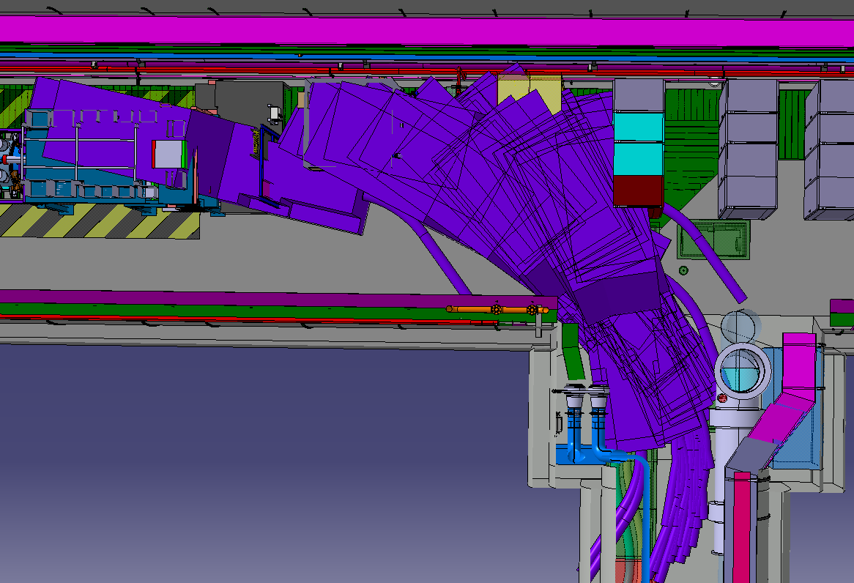
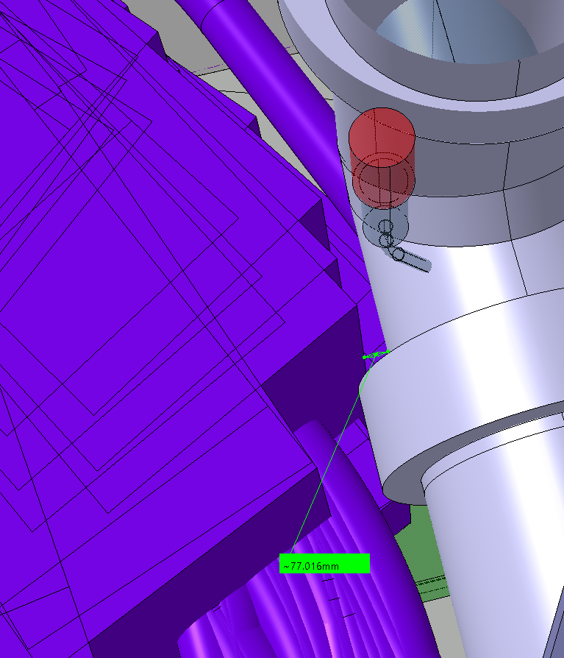
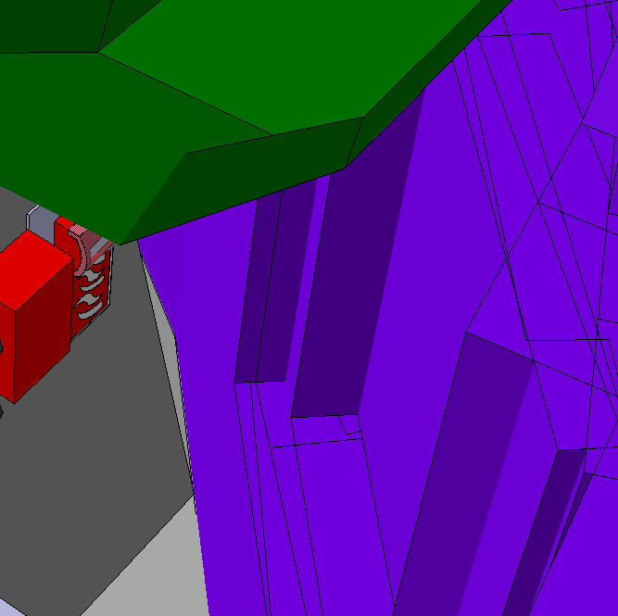
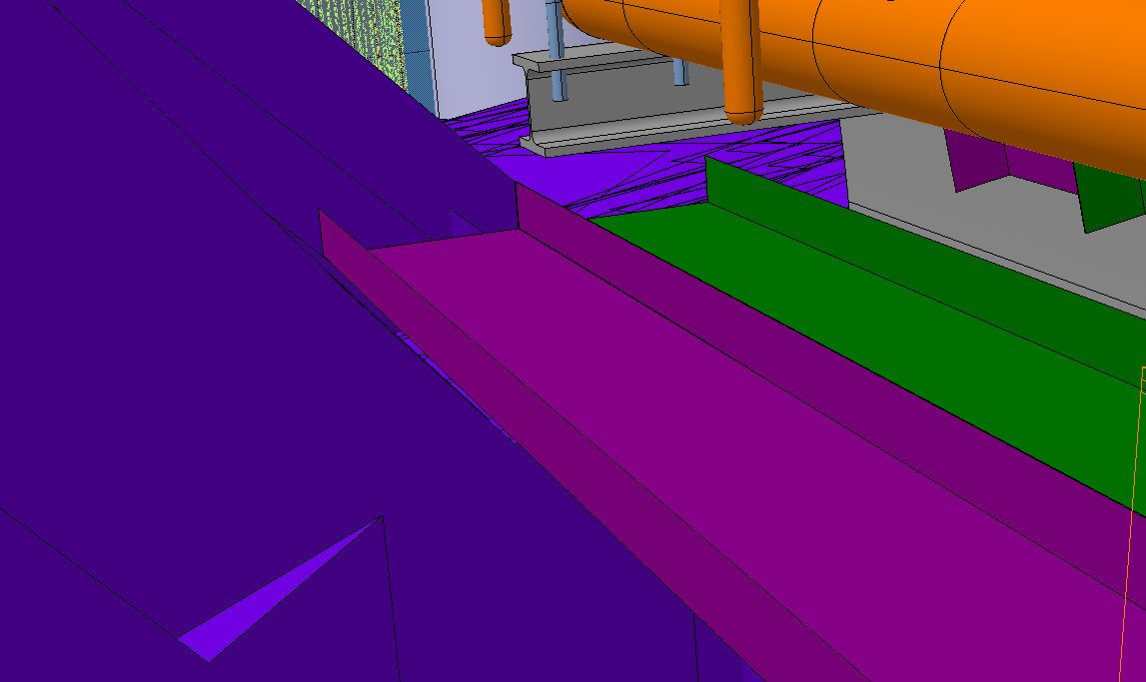
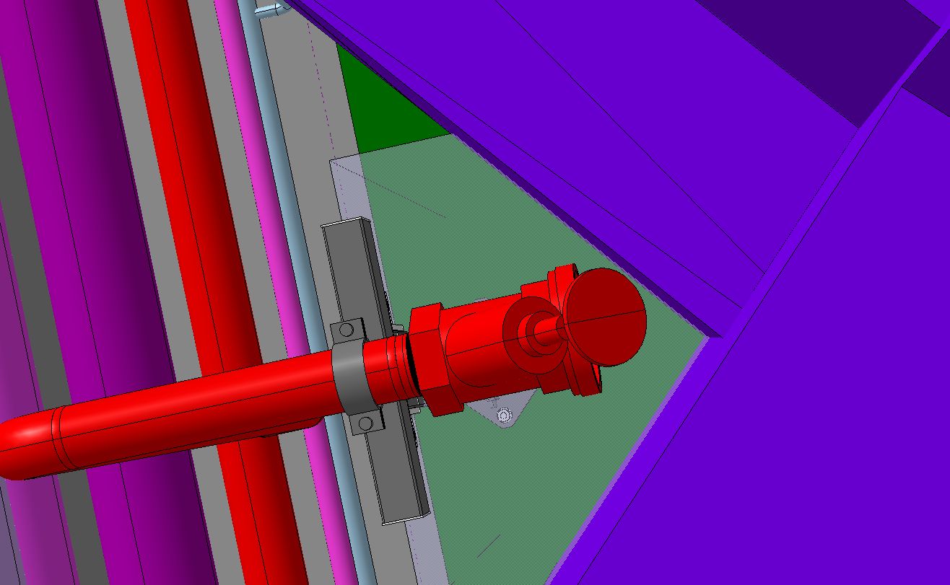
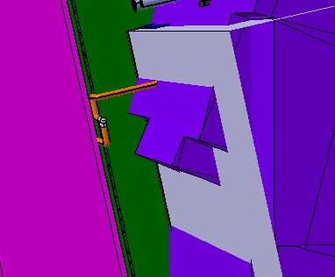
2. Potential interferences found during kinematic studies and compensatory measures agreed
2.4. 180 degree turn of DFHX in UL area. Part 2
4
3
Interference identified | Agreed mitigation action involving other WPs | Other options being studied Need TBC after practice in Nov.25
1. Small margin with QXL and SC link | The cable trays in the UR have been reduced of ~0.5m by EN-EL, which allows an easier turn, increasing the margin to the QXL. The removal of trolleys and use of an alternative support system by WP6a may be necessary. | -
2. Small margin with cable trays in UR |  | -
3. Fire extinguishing pipe hinders the cinematic | The pipe will be cut, and an interface will be included by the level of the ground, agreed by EN-CV | -
4. Pipe from CV unit hampers the cinematic | The pipe will not be in place during the installation of the SC links, confirmed by EN-CV | -
5. The corner of the UR is close to the envelope requiring complex Kinematics | No showstopper | Possibility of cutting the corner and filling it up after ~4months. Studies performed by SCE
1
2
5
1
5
2
3
4

Slide 9
3. Conclusions
The kinematic study allowed to anticipate potential interferences during the unspooling of the SC link and installation process of the cold powering system in the service caverns and implement mitigation actions.
Thanks to the flexibility and mitigation actions agreed by different WPs, some margin has been included for the maneuvers.
This study does not account for the tooling needed for the handling and transport of the equipment. During the study, there have been multiple discussions with Transport and they have not identified issues to perform the maneuvers. Further analysis are to be done by Transport to define the tooling and exact cinematic.
There are other options studied to increase the margin, based on their complexity and associated cost, implementation will be later discussed. A mock-up test in November 2025 is planned, to validate the 3D model analysis and identify if any of those mitigation actions are necessary.

Slide 10
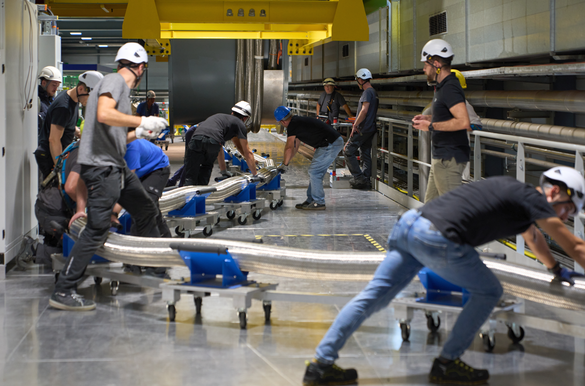
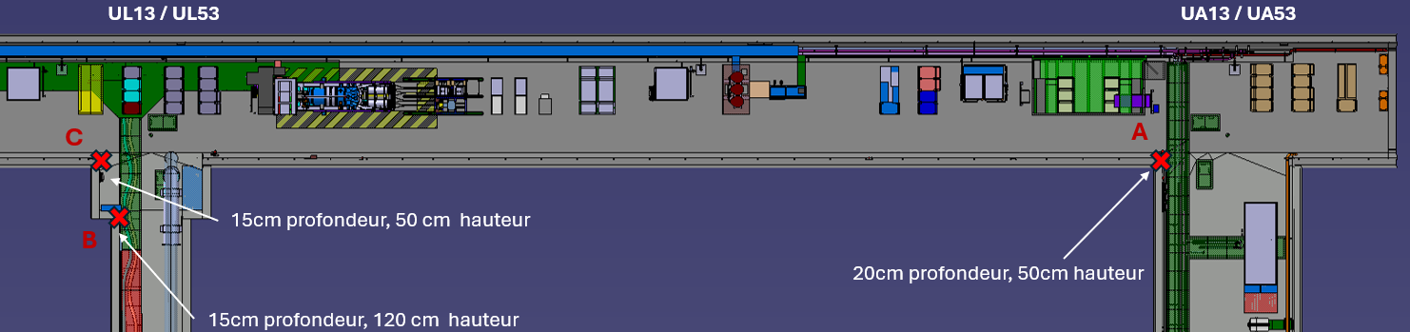
4. Next steps
Test | When | Location |  | Description | Other options studied, to be identify if needed
 |  | UR - UL - UA | US
Unspooling in UR (Point 1 or 5, TBD) | November 2025 (duration : 1 week) | x | Access of single components | 90 degree turn of DFHX dummy in UA corner 180 degree turn of DFHX dummy in UL area Handling of DFHX dummy and trolleys in the slope, controlling the bending radius | Temporary modification of the 3 identified corners in UR, UL, UA.
Lowering dummy in puit 1&5 | Mid 2026 (TBC) |  | x | Validate kinematics and integration | -
Lowering dummy system in puit 1&5 | Q1 2028 (TBC) |  | x | Validate kinematics and integration of the final system 2 months before installation | -

Slide 11
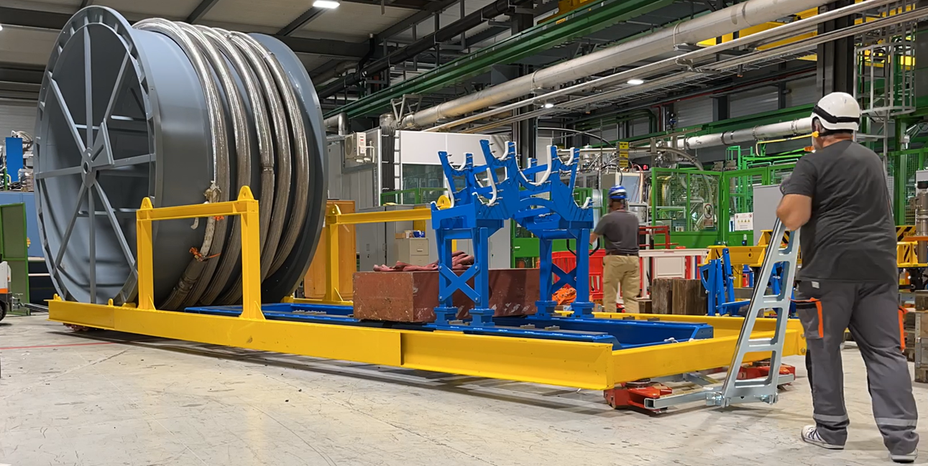
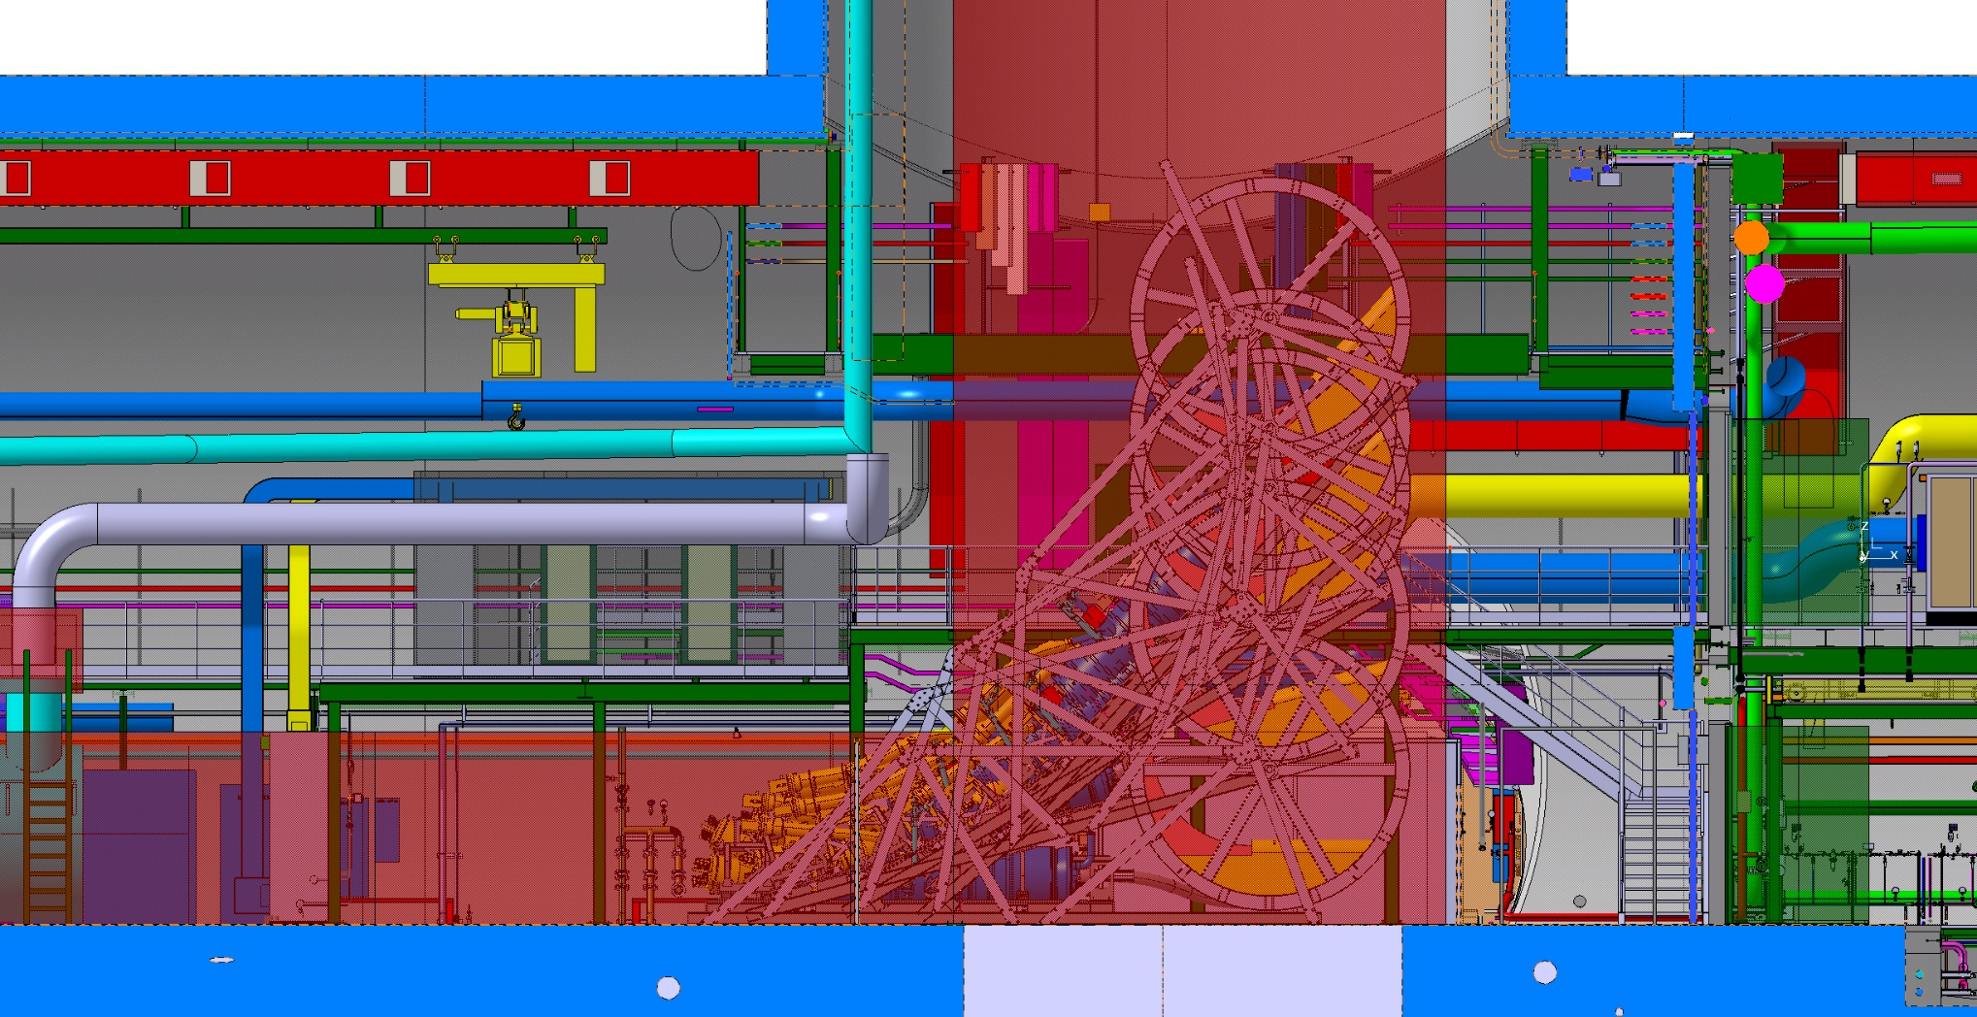
4. Next steps
Test | When | Location |  | Description | Other options studied, to be identify if needed
 |  | UR - UL - UA | US
Unspooling in UR | November 2025 (duration : 1 week) | x | Access of single components | 90 degree turn of DFHX dummy in UA corner 180 degree turn of DFHX dummy in UL area Handling of DFHX dummy and trolleys in the slope, controlling the bending radius | Temporary modification of the 3 identified corners in UR, UL, UA.
Lowering dummy in puit 1&5 | Mid 2026 (TBC) |  | x | Validate kinematics and integration of a representative system | -
Lowering dummy system in puit 1&5 | Q1 2028 (TBC) |  | x | Validate kinematics and integration of the final system 2 months before installation | -

Slide 12
Thank you for your attention

