Slide 1

HL-LHC New Infrastructure Integration – Status Update & Key Deadlines
Stephane Maridor, Paolo Fessia, Miguel Navarro Baeza
HL-LHC WP15 Integration
28/03/2025
INDICO

Slide 2
Introduction to Integration Review
Provide each service and equipment a reserved space in HL-LHC integration 3D models of each facility according to project baseline.
Overview of HL-LHC new underground integration review:
  Performed by HL-LHC WP15 in collaboration with the ‘HL-LHC Installation Review Mailing List’
  Discussed and approved in “HL-LHC WP15 Monday Integration Meetings”
  Pertinent members of the HL-LHC project's relevant WPs invited.
Due to key equipment installation timelines, integration approval has been phased to maintain coherence with installation planning.
Once a Phase is approved by HL-LHC Technical De-/Installation Coordinator it becomes integration baseline that consolidates equipment space allocation.
INTEGRATION APPROVAL
INSTALLATION

Slide 3
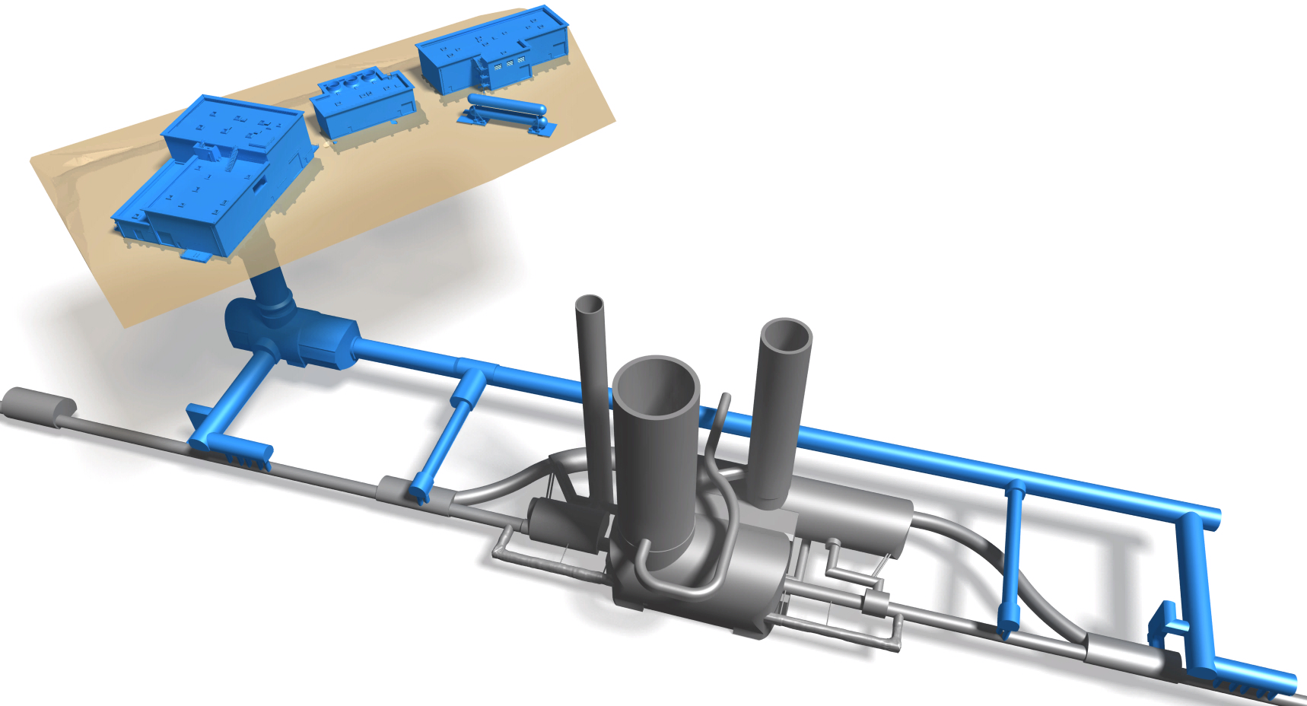
HL-LHC new technical infrastructure integration completion
100%
100%
SHMx7
80%
SFx7
SDx7
100%
SHEx7
SEx7
100%
100%
SUx7
PMx7
100%
USx7
UWx7
90%
100%
URx5
UAx7
90%
ULx7
100%
70%
LHC Tunnel
ULx3
70%
UAx3
IP1/5
100%

Slide 4
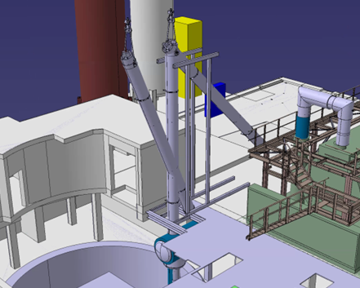
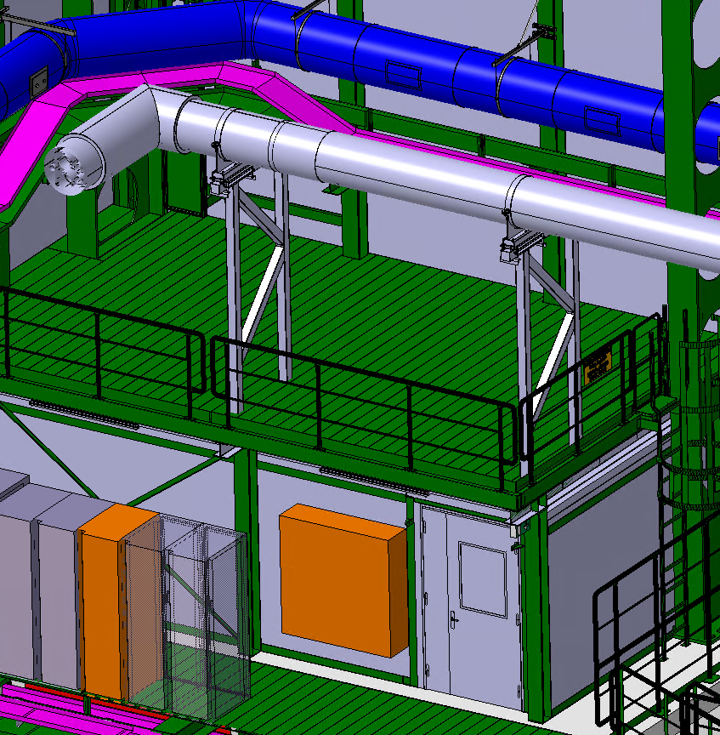
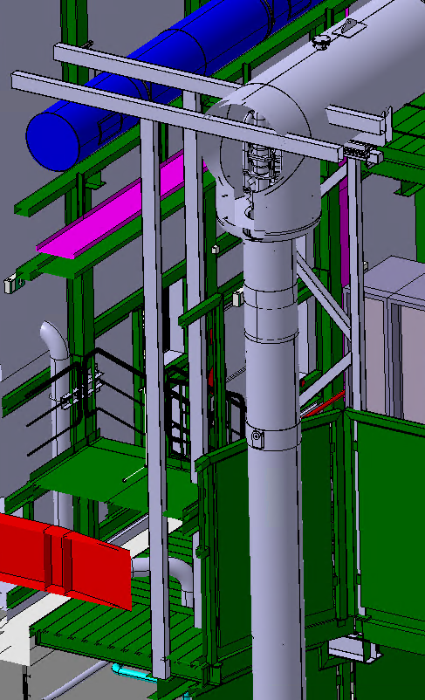
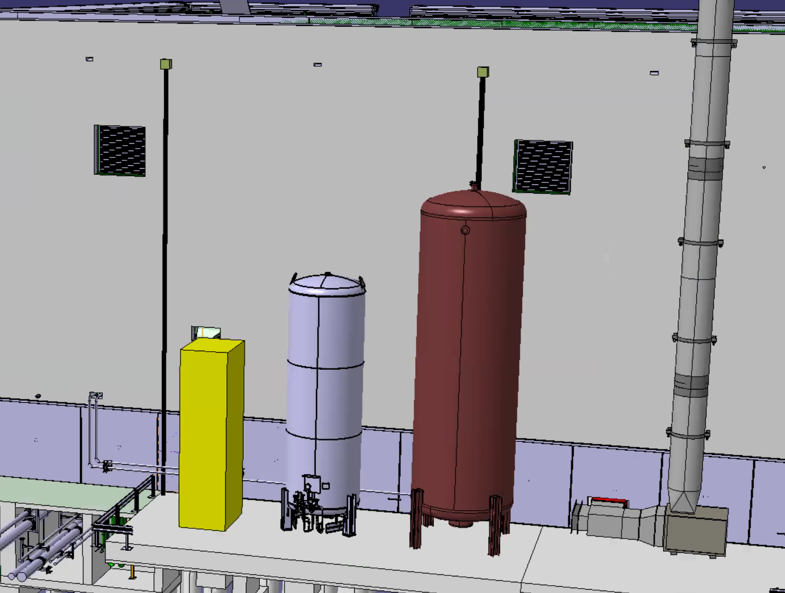
Pending ITEMs for Surface Integration Approval
HL-LHC - P1/P5 Surface buildings - Phase II - Weekly integration review for installation, EDMS 2922909
ITEM | Facility | Description | Actions Pending | Responsible | Deadline
41 | SD57 | Transportability Study for QPLG Installation in the PM57 | Provide QPLG design to transport and design tooling | TE-CRG, EN-HE | ?
45 | SD17 SD57 | Integration of cryogenic line supporting structure on top of control room. | WP9 contact SCE for feasibility study once design is received. | WP9, SCE | 31/03/2025
48 | SD17 SD57 | Tank installation outside of SD17 and SD57 | TE-CRG | TE-CRG, SCE | ?
41
48
45

Slide 5
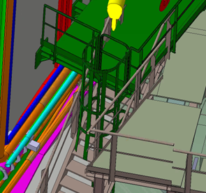
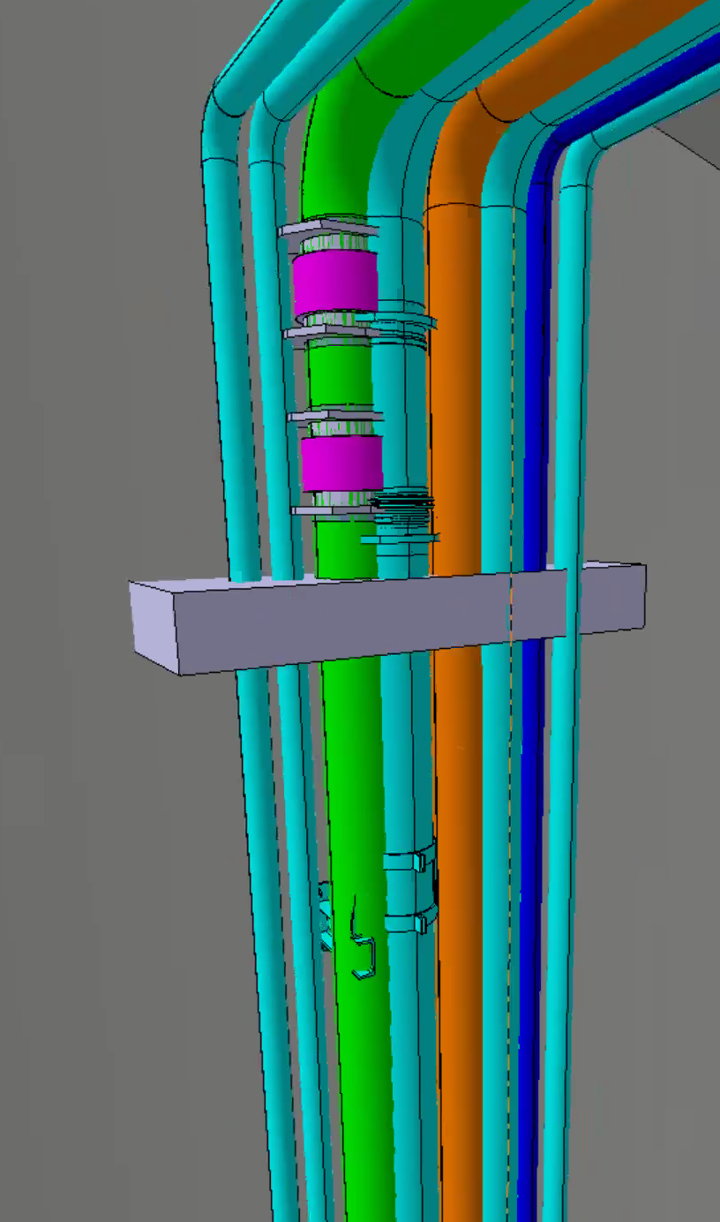
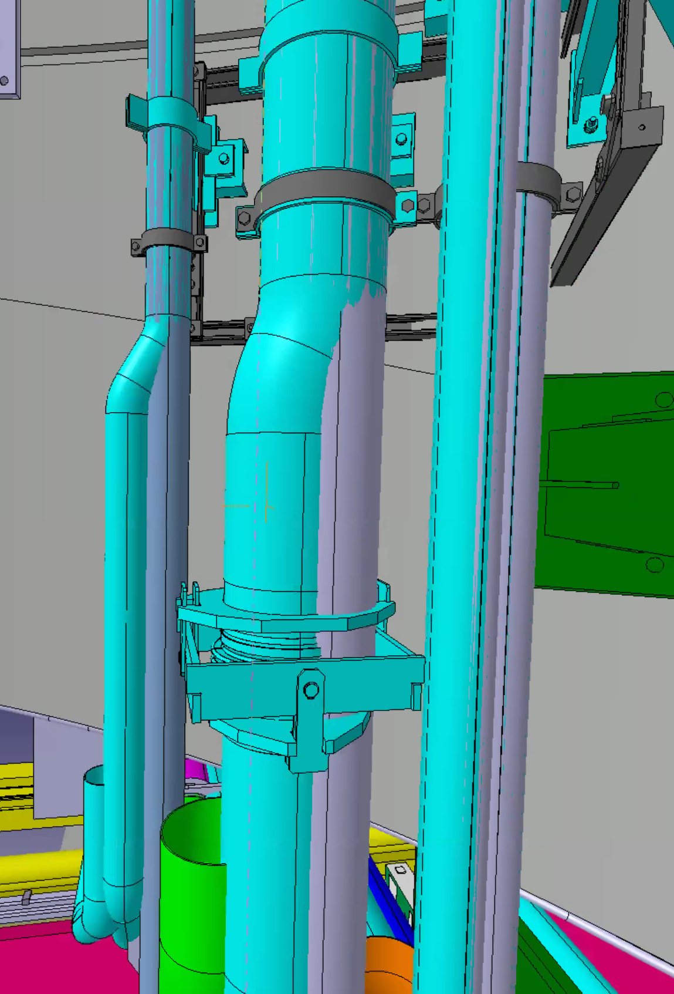
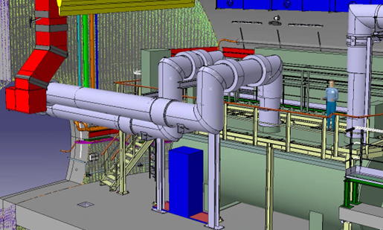
Pending ITEMs for US17/US57 Integration Approval
HL-LHC - US17/US57 - Weekly integration review for installation, EDMS 2804653
ITEM | Facility | Description | Actions Pending | Responsible | Deadline
60 | US17 US57 | US17/57 cold box metallic structure modification. | SCE to provide 3D Model and TE-CRG confirm with LINDE | TE-CRG, SCE | 07/04/2025
61 | US17 US57 | Integration of warm pipes and their supports at US17/57 vault. | Final integration to be confirmed when design available. | WP9, EN-EL | 31/03/2025
62 | US17 US57 | Positioning of 24V control racks for cold box. | Converge on final position. | WP9 | 31/03/2025
60
61
62

Slide 6
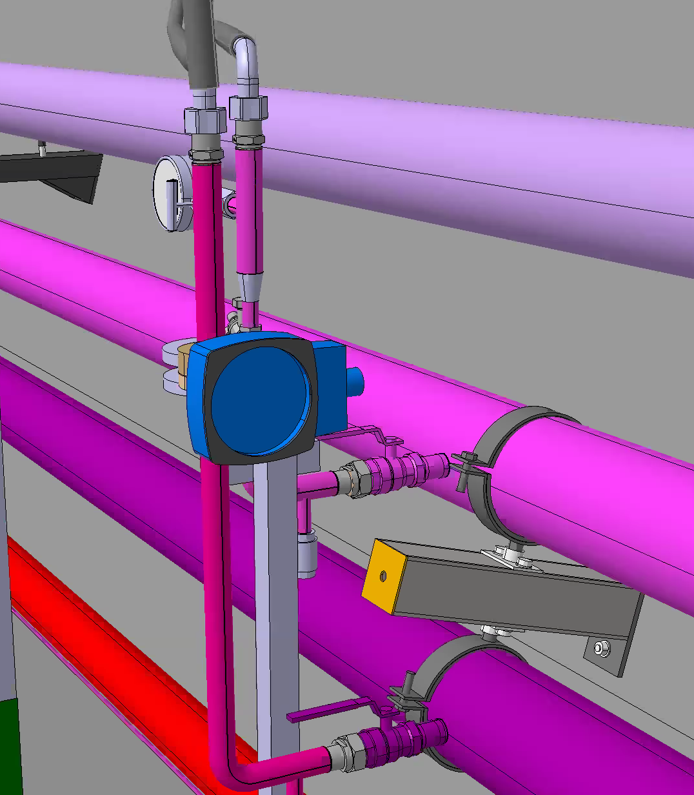
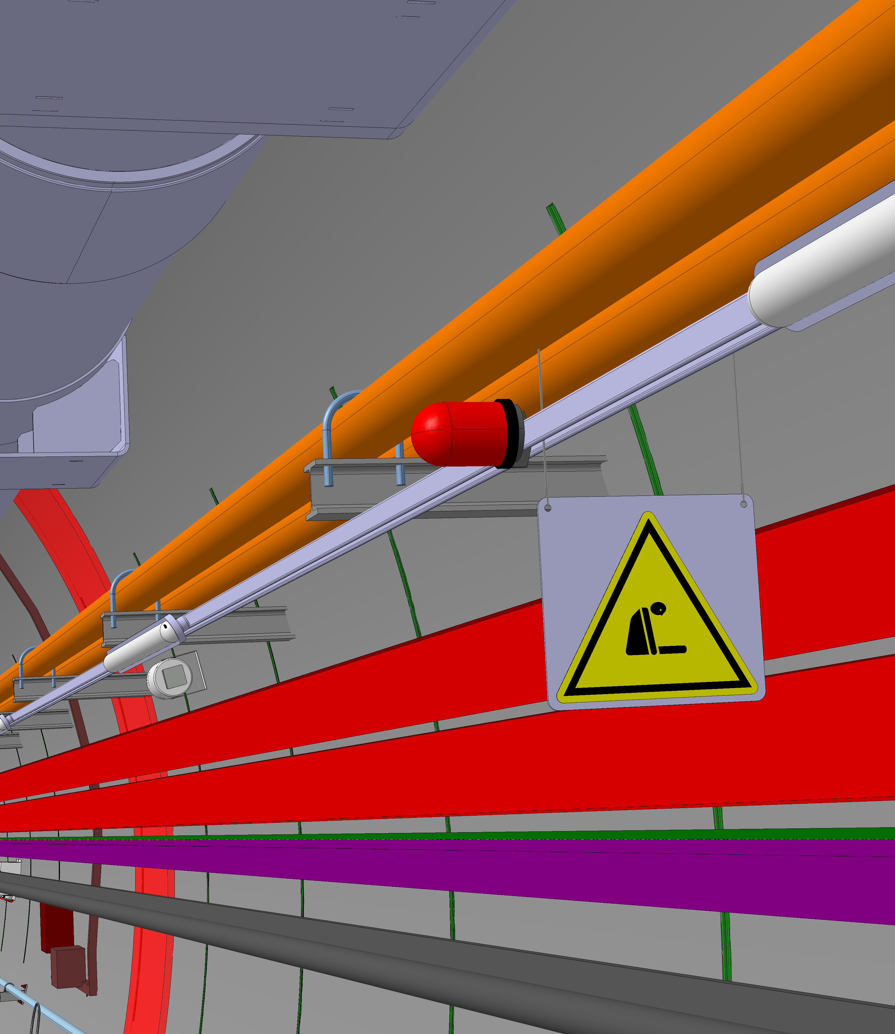
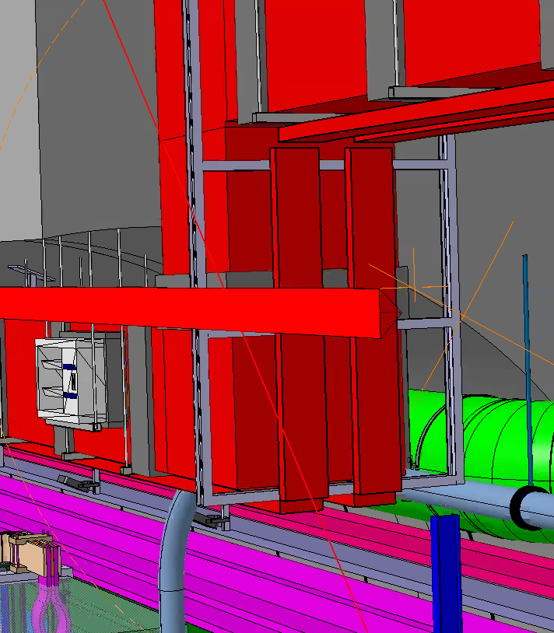
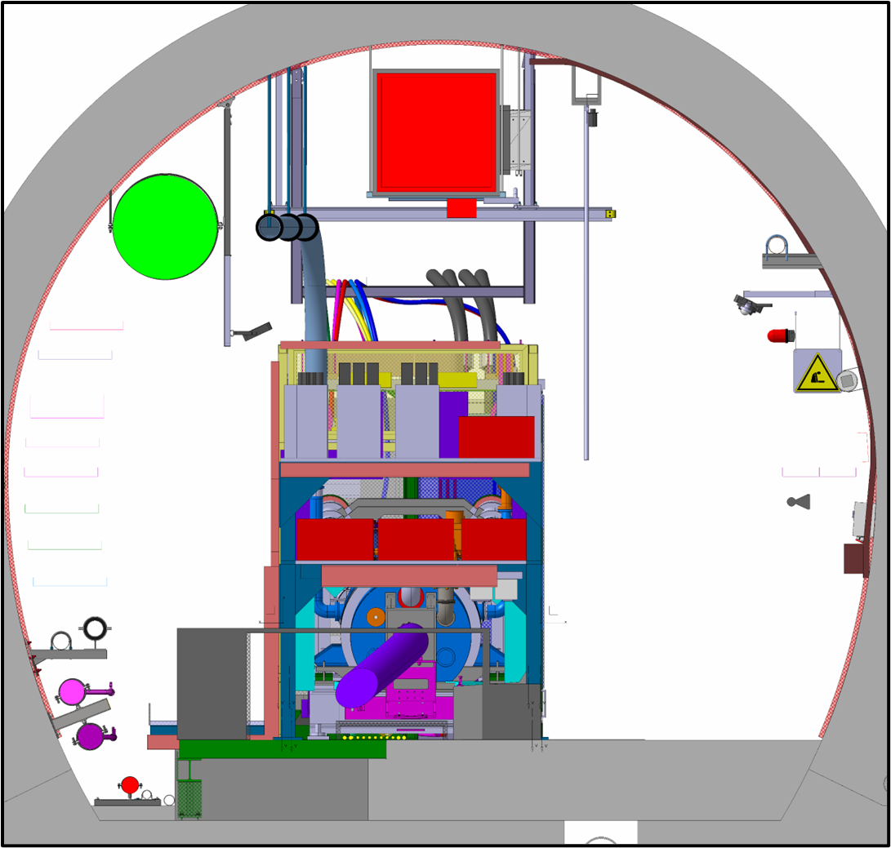
Pending ITEMs for UR15/UR55 Integration Approval
HL-LHC - UR15/UR55 - Weekly integration review for installation, EDMS 2796441
ITEM | Facility | Description | Actions Pending | Responsible | Deadline
79 | UR15 UR55 | Flexibles for Power Converters. | Integration | EN-CV | 31/03/2025
89 | UR15 UR55 | Installation Sequence and Transport Volumes for SC Link, DFHX and DFHM (discussion offline and outcome to be added later). | Global discussion on actions taken. Several actions ongoing. | WP6A, EN-EL, EN-ACE, SCE | Completed
91 | UR15 UR55 | Integration of EN-AA equipment. ASDs, Loudspeakers. | Final position integration | EN-AA | 07/04/2025
92 | UR15 UR55 | Integration of new fire-resistant cable tray below the smoke extraction duct. | Final integration check | EN-EL, EN-AA | 31/03/2025
94 | UR15 UR55 | Integration of ODH systems and electrical service boxes | Final integration check | EN-EL, EN-AA, WP15 | 31/03/2025
79
91
92
94

Slide 7
Pending ITEMs for UL13/UL17, UL53/UL57 Integration Approval
HL-LHC - UL13/UL17, UL53/UL57 - Weekly integration review for installation, EDMS 3018054
ITEM | Facility | Description | Actions Pending | Responsible | Deadline
60 | UL13/UL17, UL53/UL57 | Integration around cores area. | Converge on final integration at cores area. | WP9, EN-EL, EN-CV, WP6A | 28/04/2025
XX | UL13/UL17, UL53/UL57 | Integration of QXL short branch. | Final integration check. | WP9, ALL | 28/04/2025

Slide 8
Conclusions & Next Steps
HL New Infrastructure complete integration approval by
  Surface — 30/03/2025 (SD17/57) 14/04/2025
  Underground — 28/04/2025 (ULs)
Completing integration will ensure a smooth an ongoing installation process.
We are in the final stages of integration—last efforts are crucial.
We must free up resources to fully focus on the integration of the LHC tunnel.
Thank you all for your hard work and dedication in this final stretch!

Slide 9
Thanks!

Slide 10
Extra slides

Slide 11
Additional Material
Integration Review for Installation – SharePoint Link
HL-LHC Installation Discrepancies – SharePoint Link
HL-LHC Integration Reference Models for Underground and Surface Buildings – SharePoint Link

