Slide 1
Contribution example:
CMA-ES for IDDEFIX
Bernardo Abreu Figueiredo

Slide 2
Context
I gave presentation at CAP on CMA-ES for FCC Momentum Acceptance Optimization
Elena and I thought it could be useful to have it in IDDEFIX
We sat together coding for 2 hours and then merged the changes using Github in less than 5 min

Slide 3
What is the Contribution About?
Added new evolutionary algorithm solver CMA-ES to IDDEFIX
  CMA-ES: Covariance Matrix Adaptation - Evolution Strategy¹
  Implemented in Pymoo library²
New option besides DE (Differential Evolution) added by Malthe
Focus of this presentation more on workflow than on algorithm
  For an introduction to CMA-ES, see presentation in CAP section meeting of 7th March (starting from Slide 12)
¹ Hansen, Nikolaus. "The CMA evolution strategy: A tutorial." arXiv preprint arXiv:1604.00772 (2016).
² https://pymoo.org/

Slide 4
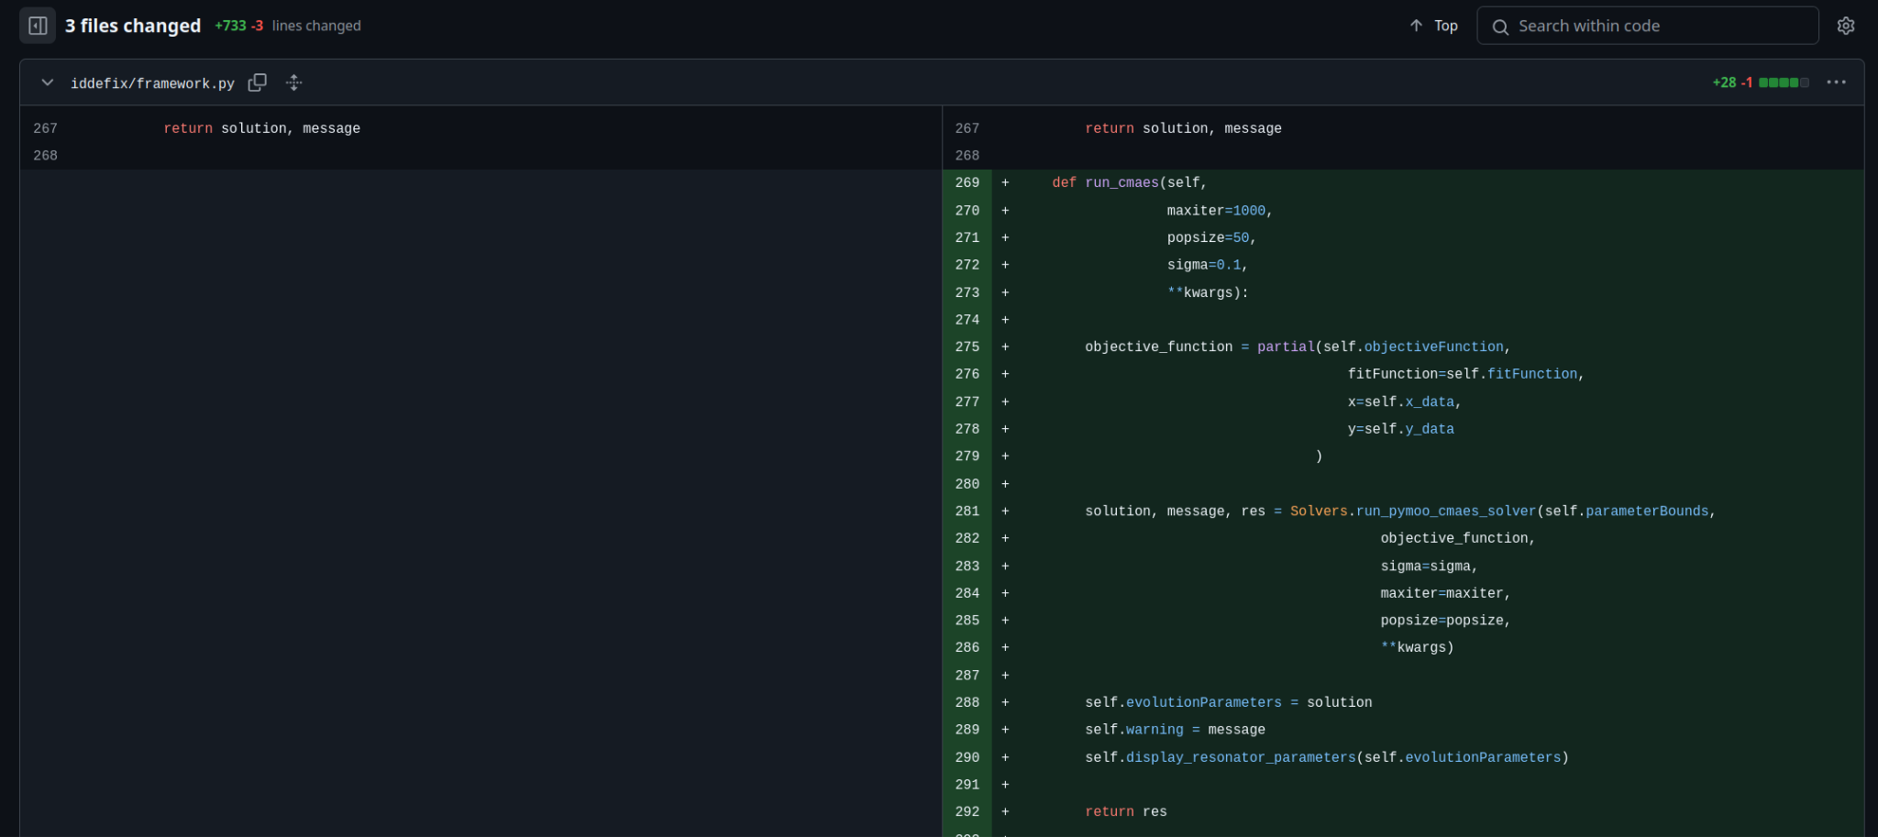
Changes in solver.py & framework.py
Code is written in a modular way → only needed to modify solver.py and framework.py and write one example proving the functionality of CMA-ES
Didn’t need to understand the rest of the package

Slide 5
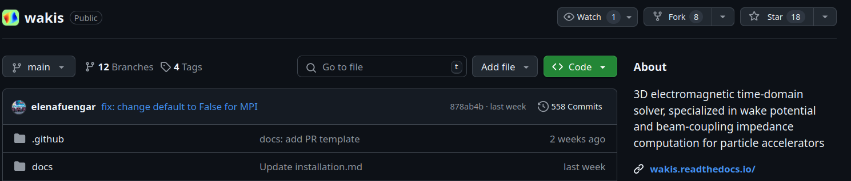
How to Contribute to a Project on Github?
Create a Fork of the repository you want to contribute to

Slide 6
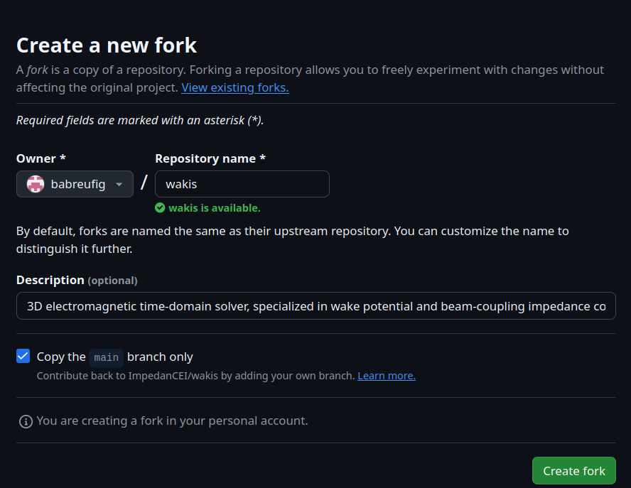
How to Contribute to a Project on Github?
Create a Fork of the repository you want to contribute to

Slide 7
How to Contribute to a Project on Github?
2. Create a new branch (Optional)
git switch -c [branch-name] in the terminal
or in the IDE of your choice (VS Code, Pycharm, etc. have git integration)
3. Make your changes, add them to the staging area (git add [files]), commit (git commit) and push them (git push) to the repository
4. Open a pull request to merge the changes into the main repository

Slide 8
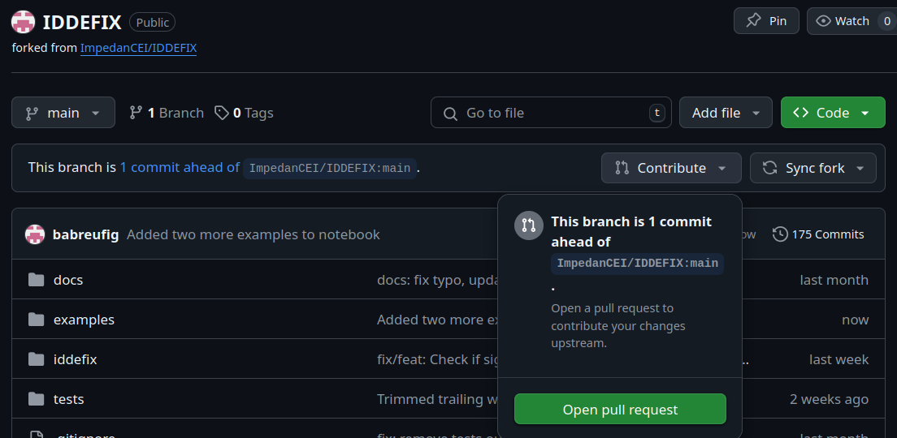
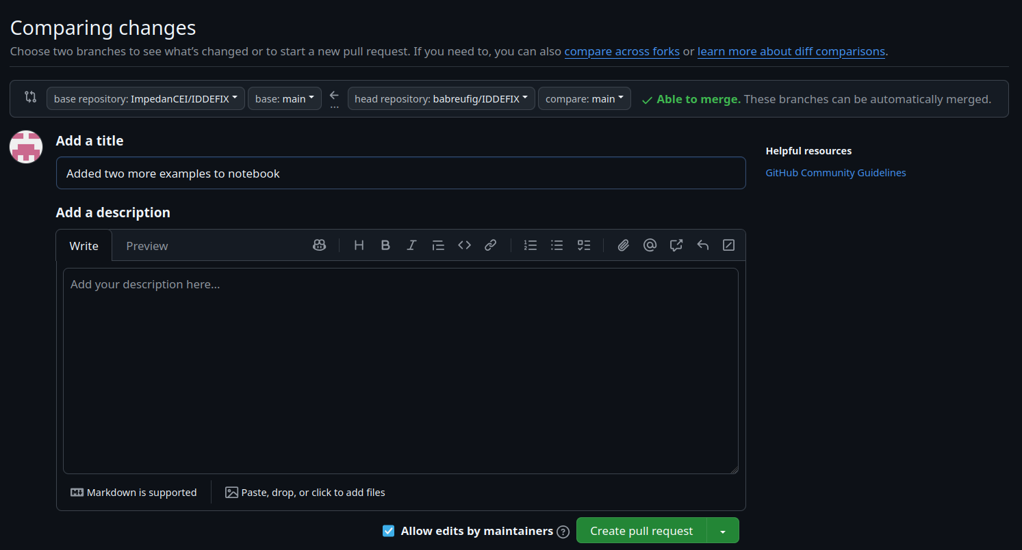
How to Contribute to a Project on Github?
4. Open a pull request to merge the changes into the main repository
5. Someone else reviews the request and approves/requests changes

Slide 9
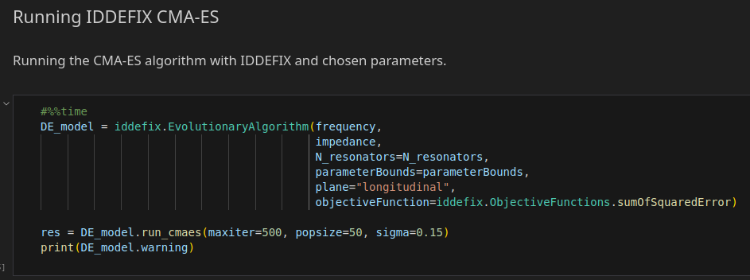
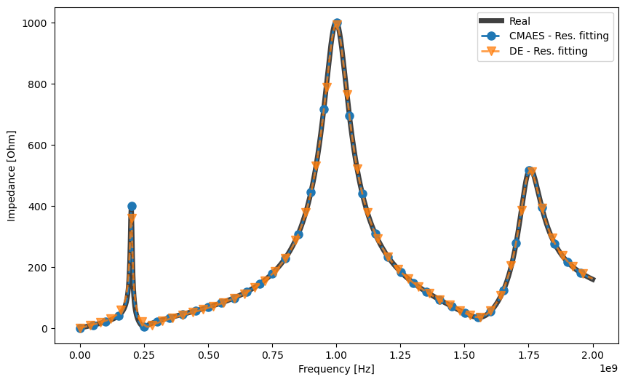
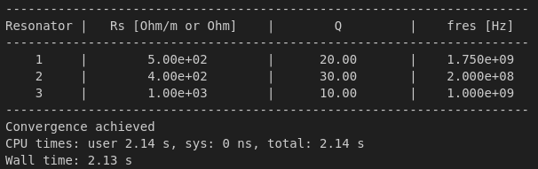
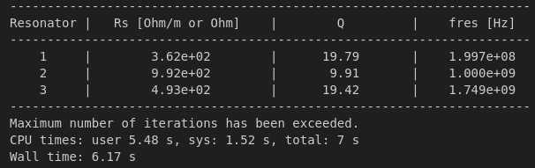
Why use CMA-ES for IDDEFIX?
Depending on use case, CMA-ES can be faster/yield more precise results
Added a jupyter notebook with examples using CMA-ES
CMA-ES
DE

Slide 10
Conclusion
Added a new solver to IDDEFIX
  Can achieve results faster and precise, better trade-off than DE
Git is a powerful tool for collaborative versioning of software projects
  Contributing to existing projects is simple with Git pull requests
  Changes are transparent through commits
  History is available and one can see what changes were introduced

