Slide 1

IDDEFIX case study
L. Sito
Many thanks to: E. de La Fuente, S. Joly, C. Zannini

Slide 2
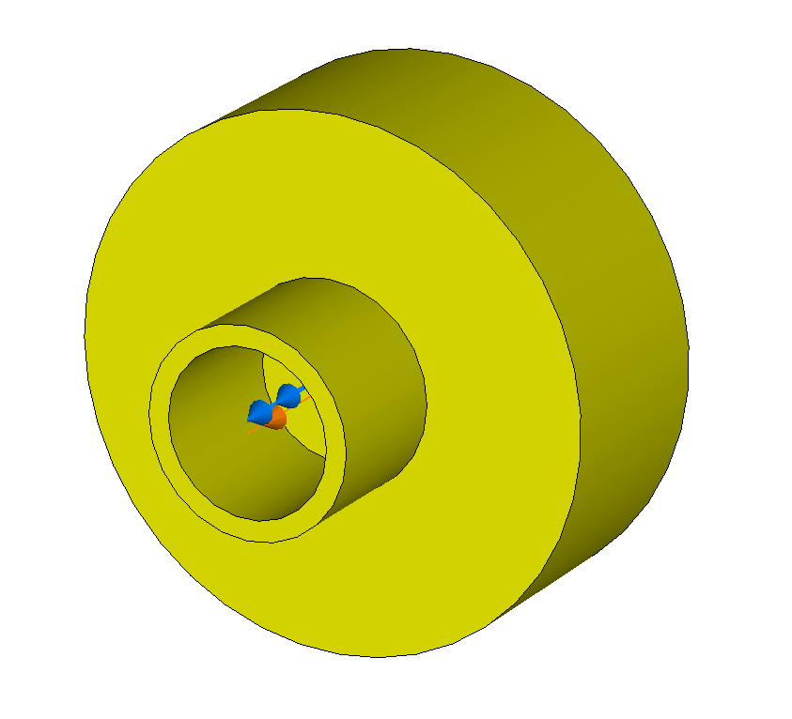
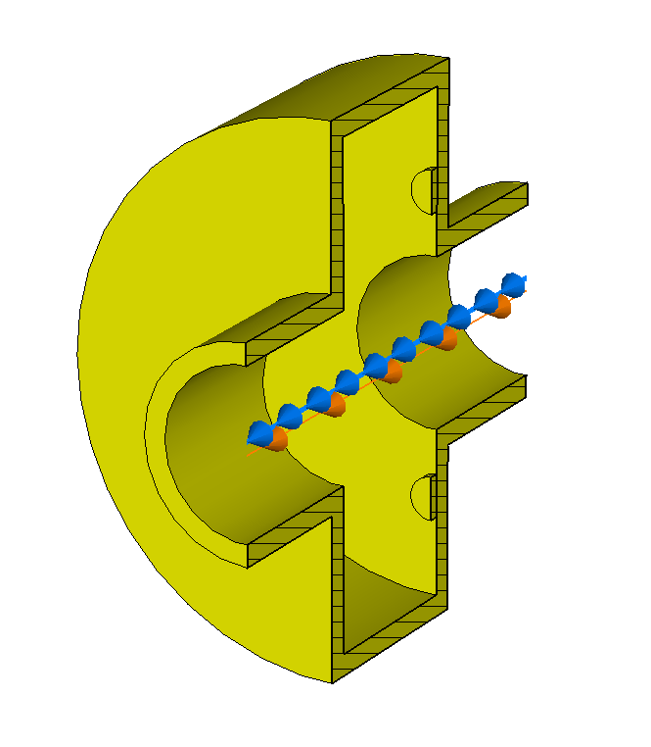
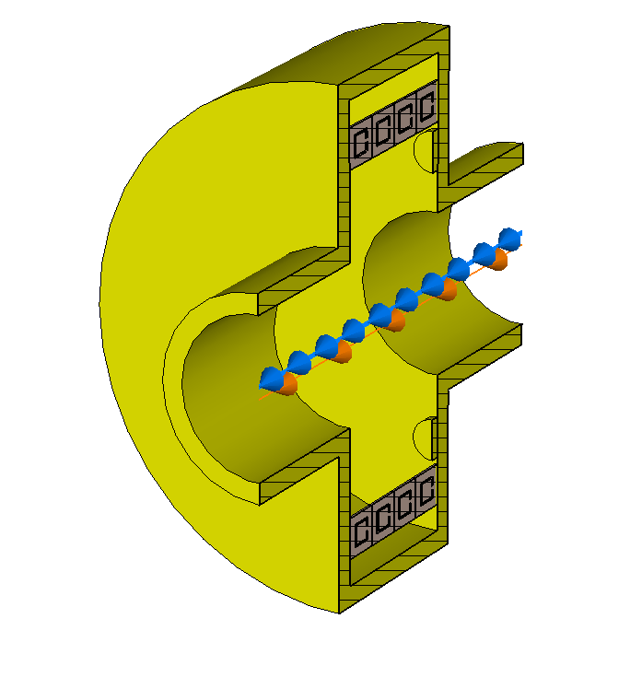
Introduction:
Main goal: show a practical case study where the use of IDDEFIX is extremely helpful!
Simulations of a test structure:
E.g. Study of Metamaterial insertions
Simple to design
Simple analytically
Not easy to simulate properly with Wakefield Solvers:
  Very high Q factor of resonant modes → Long Wavelength
  With MTM insertions → High number of mesh cells
Perfect for R&D
Also getting Q-factor from fitting (also of multiple overlapping modes!)
IDDEFIX allows to:
Simulate a non-fully decayed wake
“Reconstruct” the impedance

Slide 3
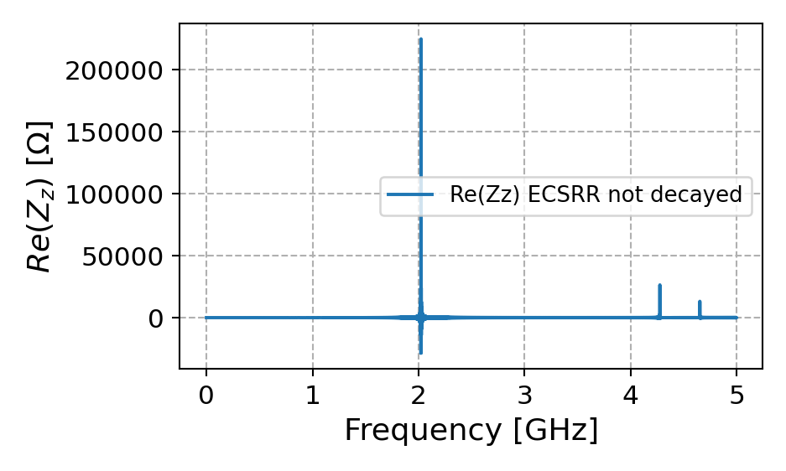
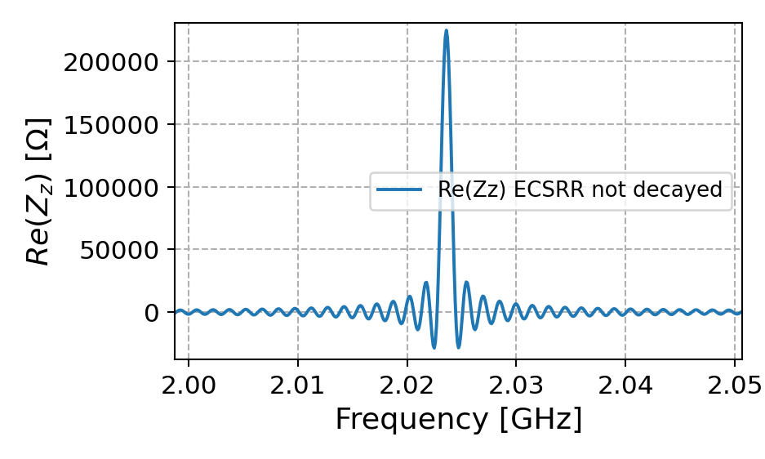

Example:
Workflow for a Pillbox Cavity
Aluminum Pillbox with Tuners
$$f_{0}\left(TM010\right)=2.02 GHz$$
$$f_{0}\left(TM110\right)=3.00 GHz$$
For a proper simulation:
Bl = 20 mm → We also want to see some other HOMs
#Meshcells = 1.7e6 → We need to resolve the tuners correctly
For the TM010, with a Q of 8000, one would need a WL = 2000m
(Estimated time: 30 to 40 hrs (if not unstable!))
Let’s do a simulation with WL = 200 m (8073 s ( = 2 h, 14 m, 33 s ))

Slide 4

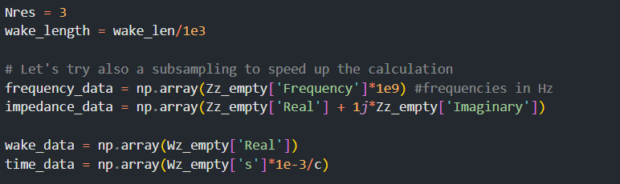
Example:
Workflow for a Pillbox Cavity
Let’s do a simulation with WL = 200 m (8073 s ( = 2 h, 14 m, 33 s ))
Let’s go into the post processing:

Slide 5
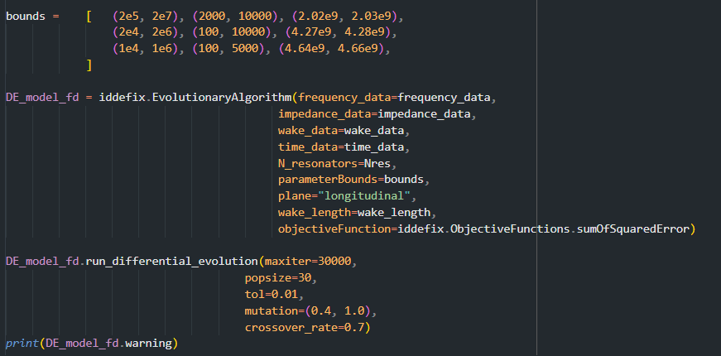
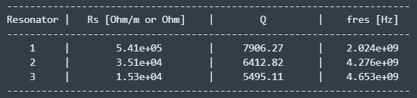
Example:
Workflow for a Pillbox Cavity
More post-processing:

Slide 6
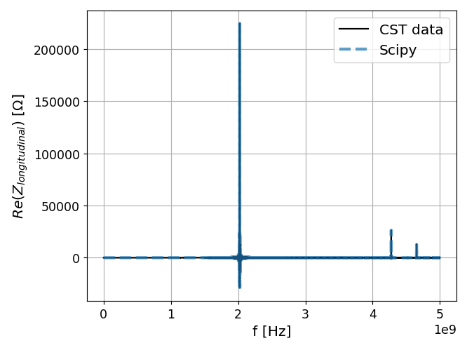
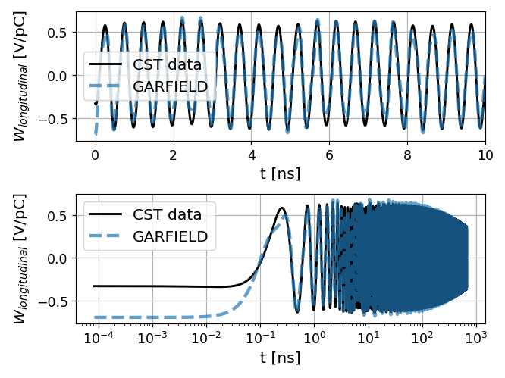
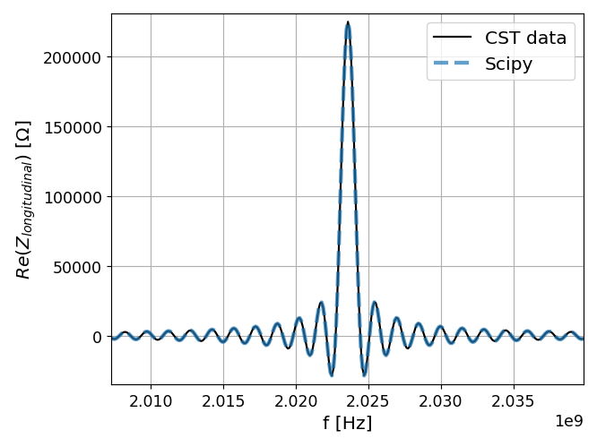
Example:
Workflow for a Pillbox Cavity

Slide 7
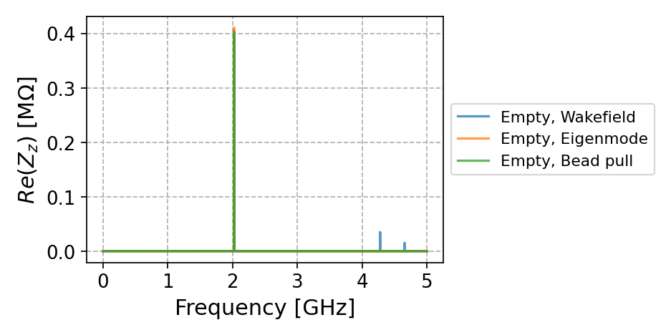
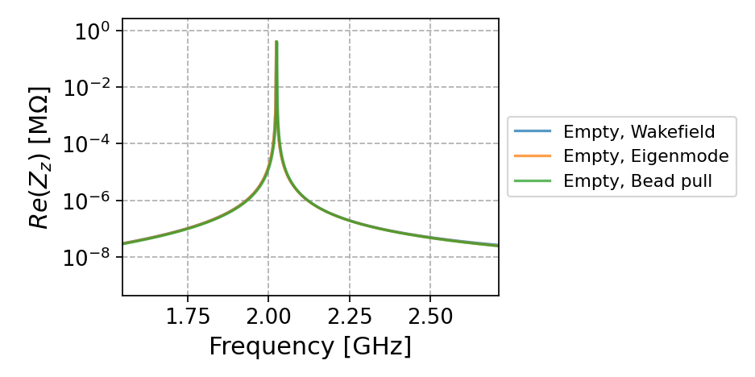
Example:
Workflow for a Pillbox Cavity
For more complex structures, with more resonances and lossy materials the EM solver is not the best choice
Why don’t you use EM solver?
Why don’t you use a lower conductivity metal and then rescale?
If we introduce in the structure lossy materials, then the rescaling process is not easy to perform

Slide 8
Thanks!

