Slide 1
BGC Regular Meeting
BGC Integration v4
L.Margerison 28.03.2025

Slide 2
Previous steps/conclusions
Investigate DN40 Gate Valve between 3rd skimmer and main chamber
  If possible, what can the max diameter of the optical port be? – Mocked up in CAD to evaluate integration
Rearrange turbo molecular pumps on injection chamber so they do not clash with other systems/beam line – Initial changes made to avoid clashes with beamline and optical system
Detail optical assembly of the 2 systems – Spoke with Danielle about possibilities and space needed – possibility for optimisation and changes and should fit within available space – can be looked at along the line
From findings from issues with v3 BGC at 1st turbomolecular pump – make updates to v4 (bigger pump etc) – Input TMP 700 into model

Slide 3
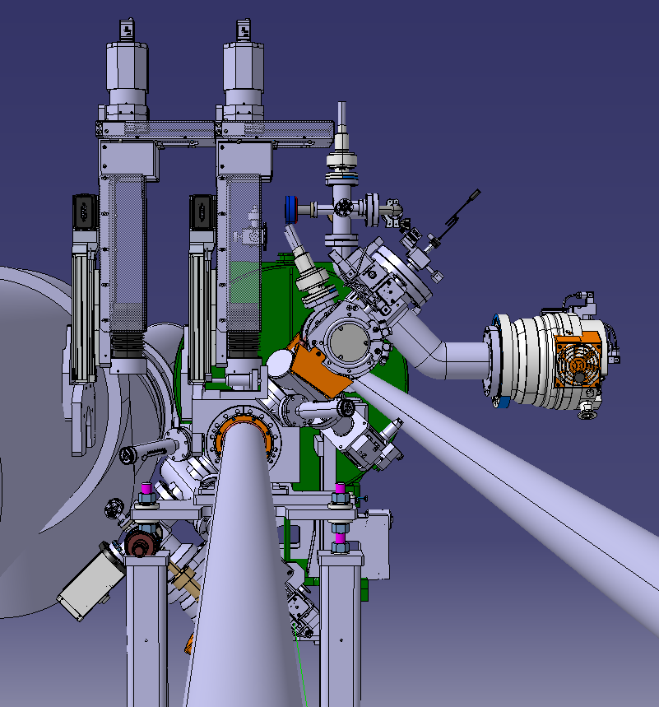
Work done
Injection Chamber
  HiPace 700 added
  Initial work to avoid conflicts
    1st pump with beamline and
    Xmas tree and gauges with optical assembly
  DN40 All Metal Gate valve
Gas Dump Chamber
  DN40 All Metal Gate valve to see space gained

Slide 4




Lens angle
α = 8 degrees for current system
Will calculate potential new max angle when using DN40 gate valve

Slide 5
Next steps
Alter Gas Dumb Assembly so TMP sits vertically
Optimise 1st injection chamber pump pipe connection/positioning
Calculate potential max lens size (opening angle?)
Relocate penning gauge on main chamber to avoid clash with injection chamber
Start work on support structure

