Slide 1
DAMSA – Preliminary AP0 Scoping and FLUKA Activation Analysis
Jonathan Williams
DAMSA Bi-weekly Meeting
1 April 2025

Slide 2
DAMSA @ AP0
Discussion from Jae’s Fermilab visit
  AP0 is potentially available for use by DAMSA
    Some facility modifications/cleanup required – fixturing/servicing?
  Some questions remain about specific beam parameters
TSD tasks
  Evaluate present state of AP0, what needs to be cleaned out/fixed to make room for DAMSA
  Procedural feasibility for handling/access to experiment rig
    Radiological considerations, EDEP (FLUKA)
    ROM scoping of thermals, activation, etc.
  Conceptual hardware design and ROM cost estimates
*This slide deck

Slide 3
Fixtures/Modifications at AP0
Shielding Modules
  Steel shielding elements, T-shaped
  Hang experiment platform from base of module
Alignment upstairs, before install into target chase
  Stack concrete blocks for a servicing stand?
  Radiation shielding for access?
Cable routing
  Up to 5k data cables, plus power
  Route through module, labyrinth
  Need to get cables through upper concrete shield as well…
Working towards conceptual cost estimates

Slide 4
AP0 Conceptual Layout
Elevation View – slice along beam axis *not to scale
Concrete Shielding Blocks
Floor Level in AP0
Steel Shielding Modules
8-GeV protons from Recycler
To proton dump

Slide 5
Elevation View – On-axis
Concrete block stacks form shielded service area
Allows for initial setup and cable routing (before irradiation),
potential diagnosis of issues mid-run,
and decommissioning at the end of the run
Handling equipment on service cell floor (e.g., lift table, or cask to store used experiment rig)
Data acquisition system above shielding
Custom concrete blocks with passthrough pipes for data
Or channel in blocks, etc.
*Exploring if pre-existing AP0 stand could be modified to support assembly/decommissioning with some extra shielding (need access to building)– this would be cheaper
Labyrinth passage in steel module for power and data cables

Slide 6
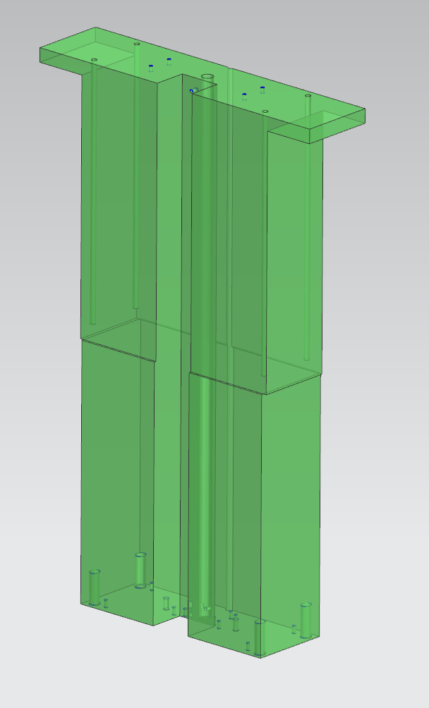
Cable Bundle Sizing
~5k cables max
Assume 20-gauge wire (0.032” diameter)
  Sub-bundles of 20 cables, ~0.18” diameter
  250 sub-bundles gives 5k cables in the full bundle
  ~3.5” diameter
Provide 2x 5”x6” labyrinth channels to accommodate signal lines, power, vacuum, etc.
  Estimate from prior test module design for target testing – see figure

Slide 7
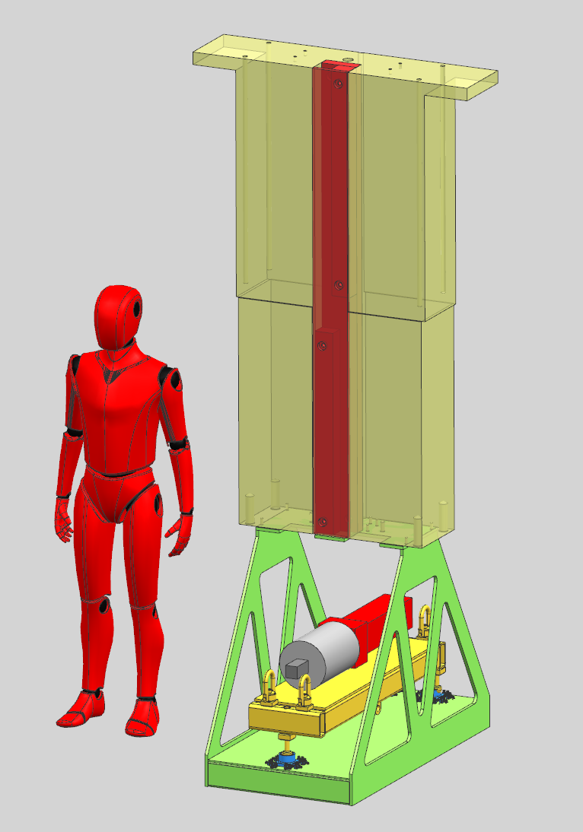
Conceptual AP0 Module and Experiment Platform
Reuse an existing design for an AP0 module for estimation purposes
Three-point stand to adjust elevation
Kinematic mounts with adjustment screws to fine tune position and angle w.r.t beam
  Ball feet on three-point stand seat into cups to locate
2 channels for instrumentation and commodities
This assembly can be constructed on a stand in AP0
  measure to confirm positions of components, then lower into beamline
Additional upstream instrumentation likely required on Fermilab side to measure beam position
  Not covered in this estimate

Slide 8
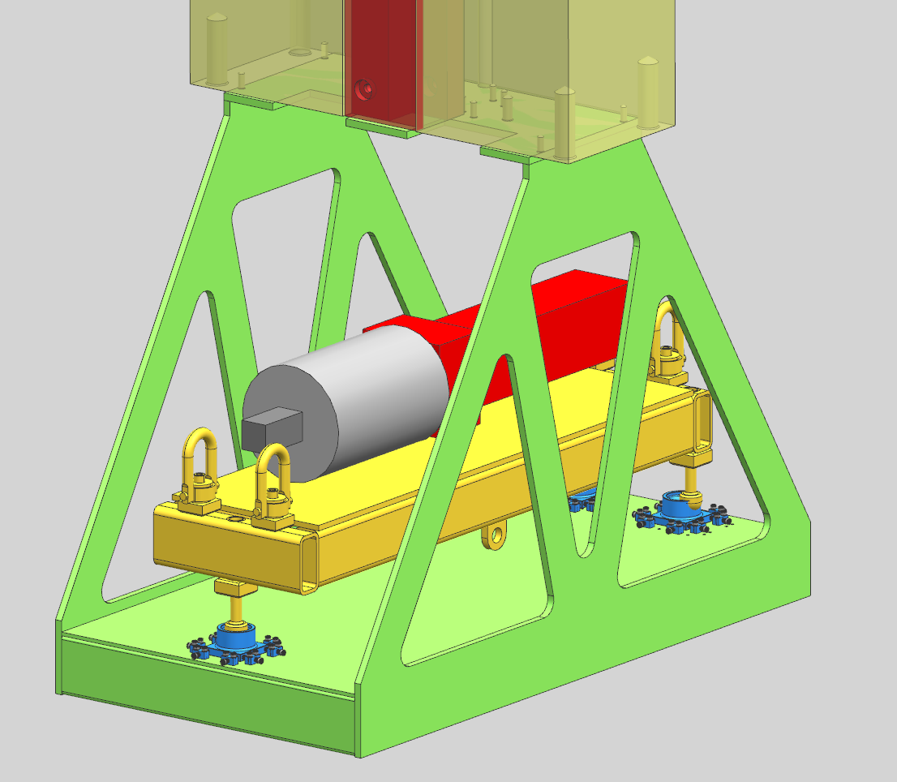
Conceptual AP0 Module and Experiment Platform
Rough non-binding estimates for hardware and labor:
  ~140k$ for module, platform, and shielding
  ~0.3 FTE design labor for the above
  Does not include:
    Instrumentation hardware or support
    Beamline modifications
    Experiment hardware (DAMSA itself) and instrument lines
    Basically anything not shown in the CAD
Should discuss schedule with Kevin more and get quotes for concept parts

Slide 9
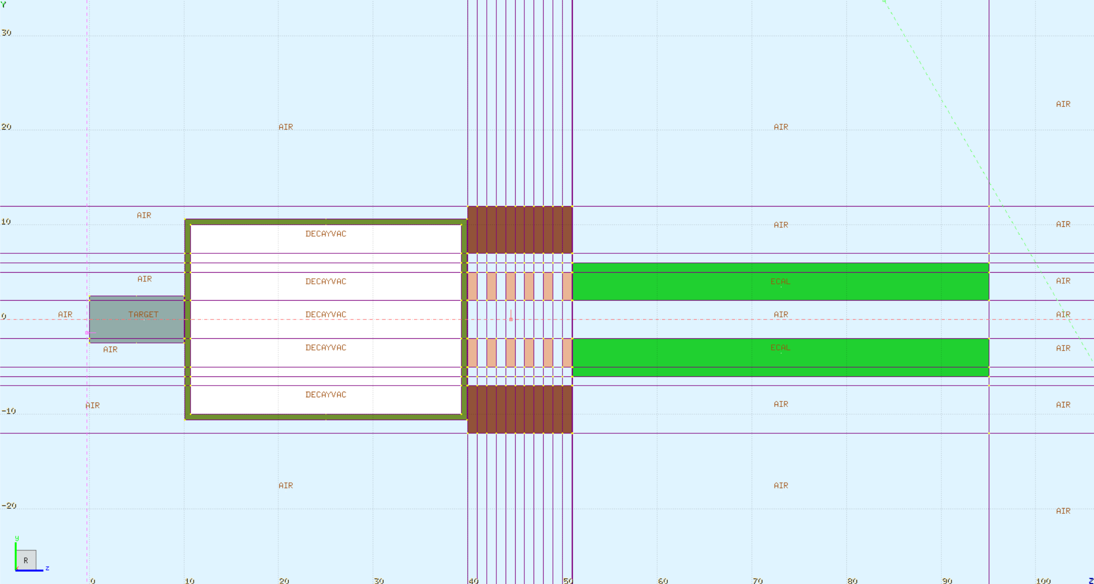
FLUKA Simualtion
8-GeV beam, 1 mm sigma
  10^16 POT over 90 days
  1.286e9 p/s
1.6M histories
  Good statistical uncertainties
Beam particles, EDEP, Prompt and Residual Dose rates
  Secondary particles can be scored in future runs
FLUKA geometry view at right
  Assumed: W target, SS vacuum vessel, Si tracker, CsI ECAL, Fe magnet

Slide 10
Results
Prompt dose is high enough that shielding thickness above the experiment is likely important
  May rule out running in a beamline tunnel vs in an existing target facility
  With adequate ceiling room, could stack shield blocks… but where?
  Need to consult with rad safety/modeling for appropriate limits
Residual dose is initially high but decays down fairly quickly
  Handling possible with some shielding like described earlier
  Disposal/decommissioning nontrivial but practical

Slide 11
Next Steps
More thought on servicing station in AP0 (stacked concrete blocks), can scope with a prelim shielding design
  Refine cost estimates, see if existing module stand can be reused
  Coordinate access to AP0 to examine (rad-controlled area)
Dimensions of AP0 chase/shielding
  More detailed FLUKA analysis for AP0-specific dose maps
  Hand off to Radiation Modeling group if possible
Continue refining cost estimates and scope of facility renovations required

Slide 12
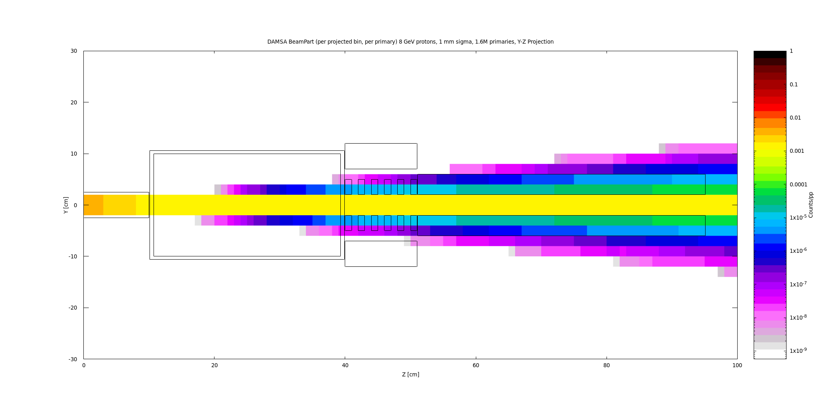
BeamPart

Slide 13
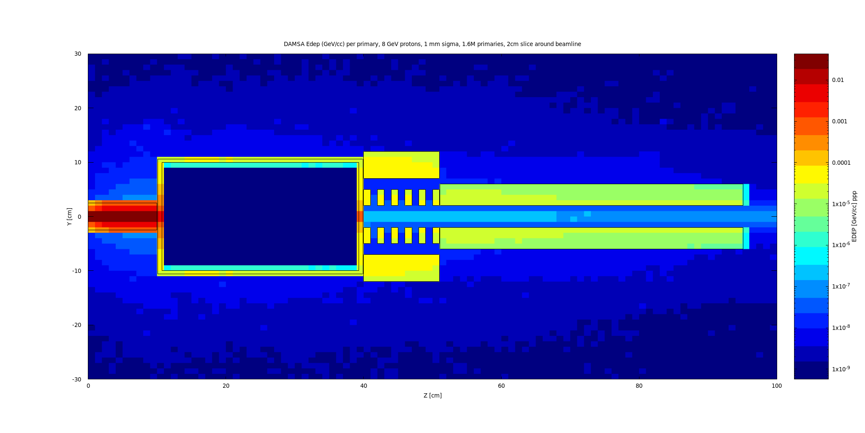
EDEP (GeV/cc-pr)

Slide 14
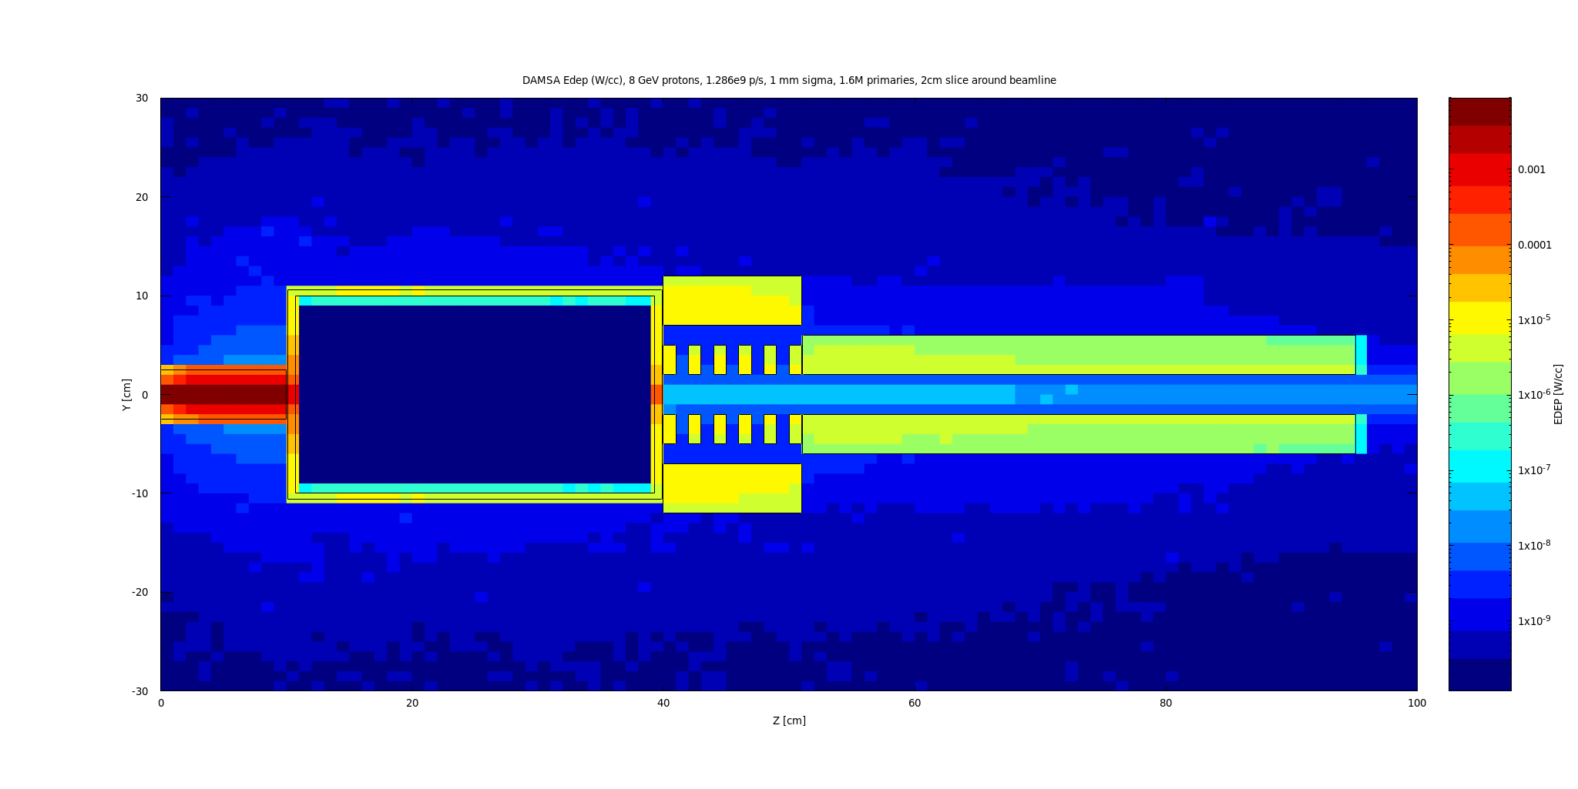
EDEP (W/cc) @ 1.286e9 pr/s (90-day run)

Slide 15
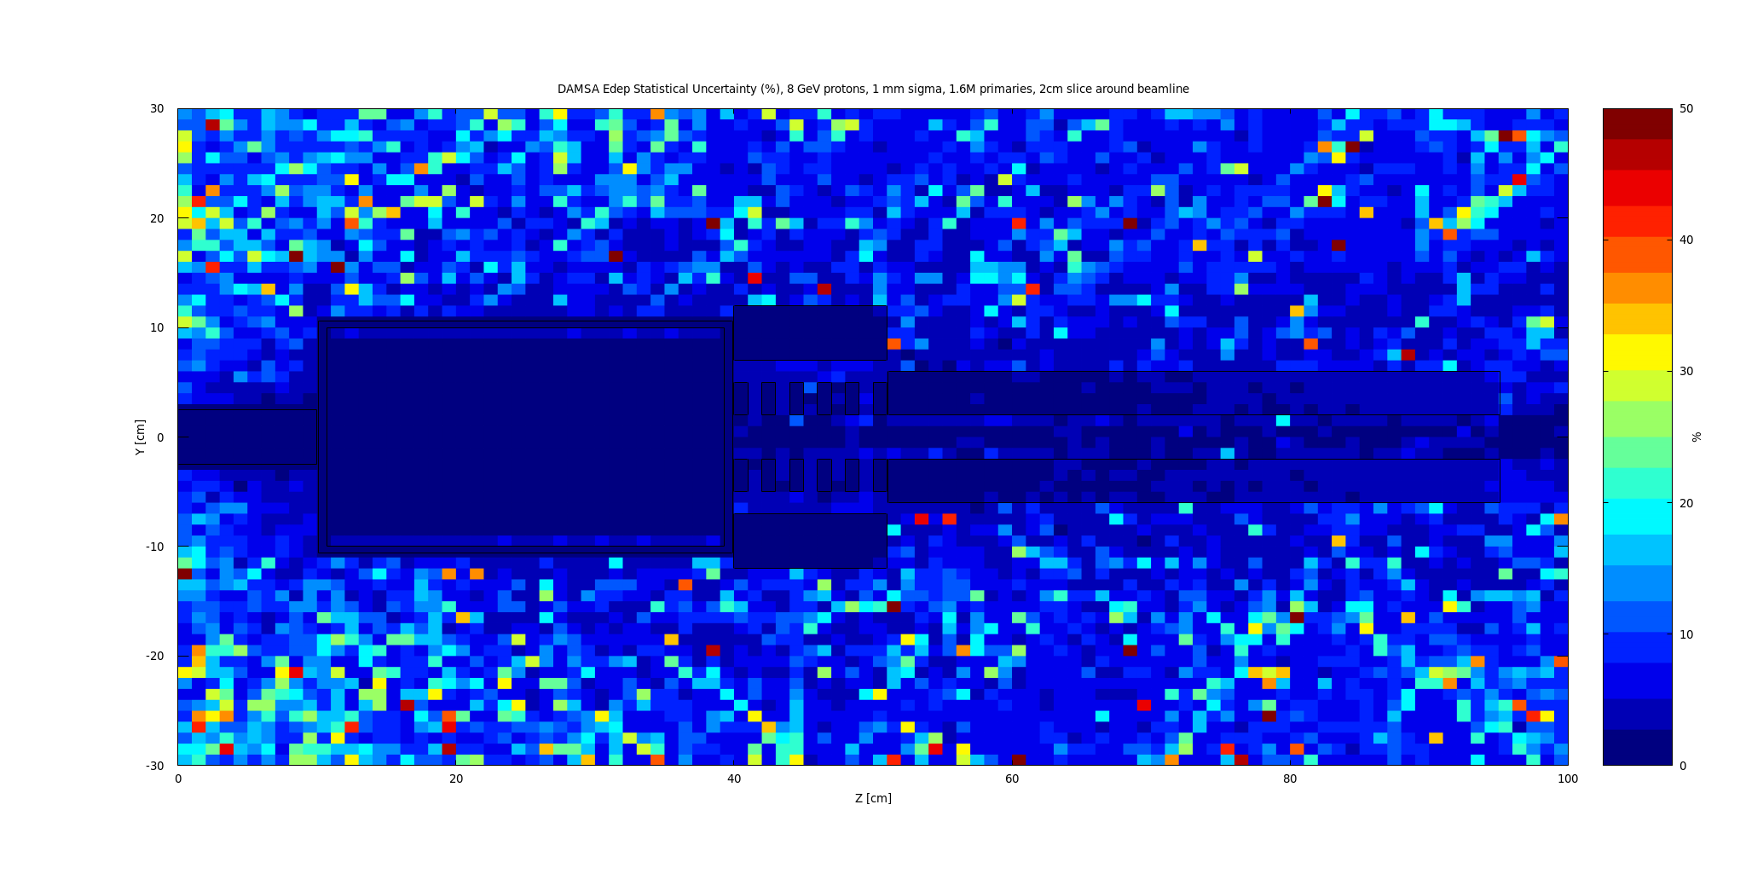
EDEP Statistical Uncertainty (%)

Slide 16
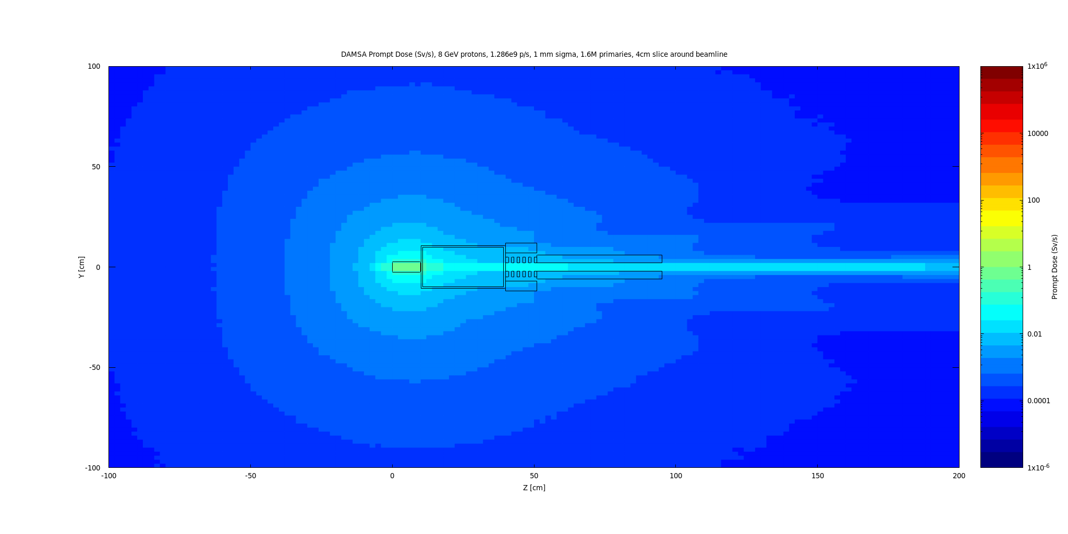
Prompt Dose Rate (Sv/s)

Slide 17
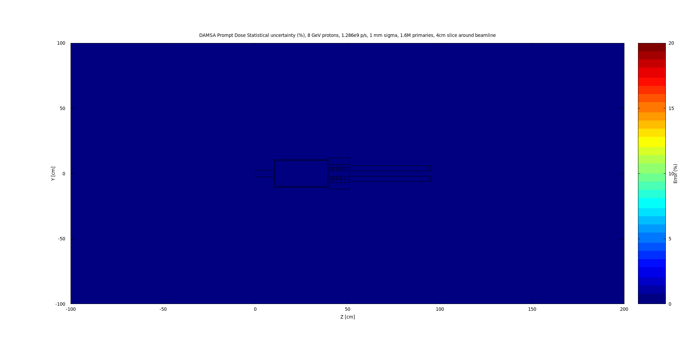
Prompt Dose Rate - Statistical Uncertainty (%)

Slide 18
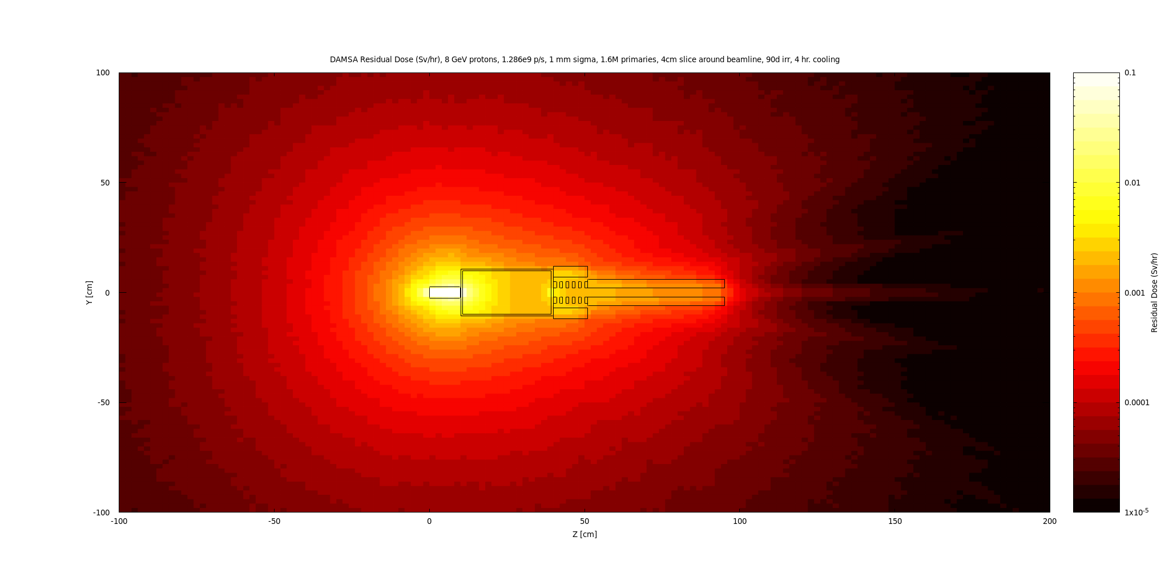
Residual Dose Rate – 90d irr., 4 hr. cooling
1 mSv/hr
Hi Rad zone

Slide 19
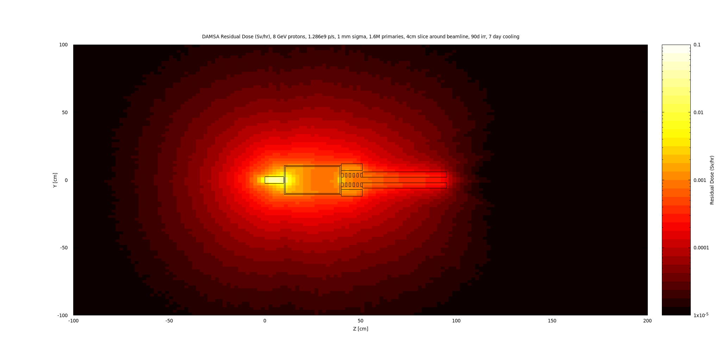
Residual Dose Rate – 90d irr., 7 days cooling

Slide 20
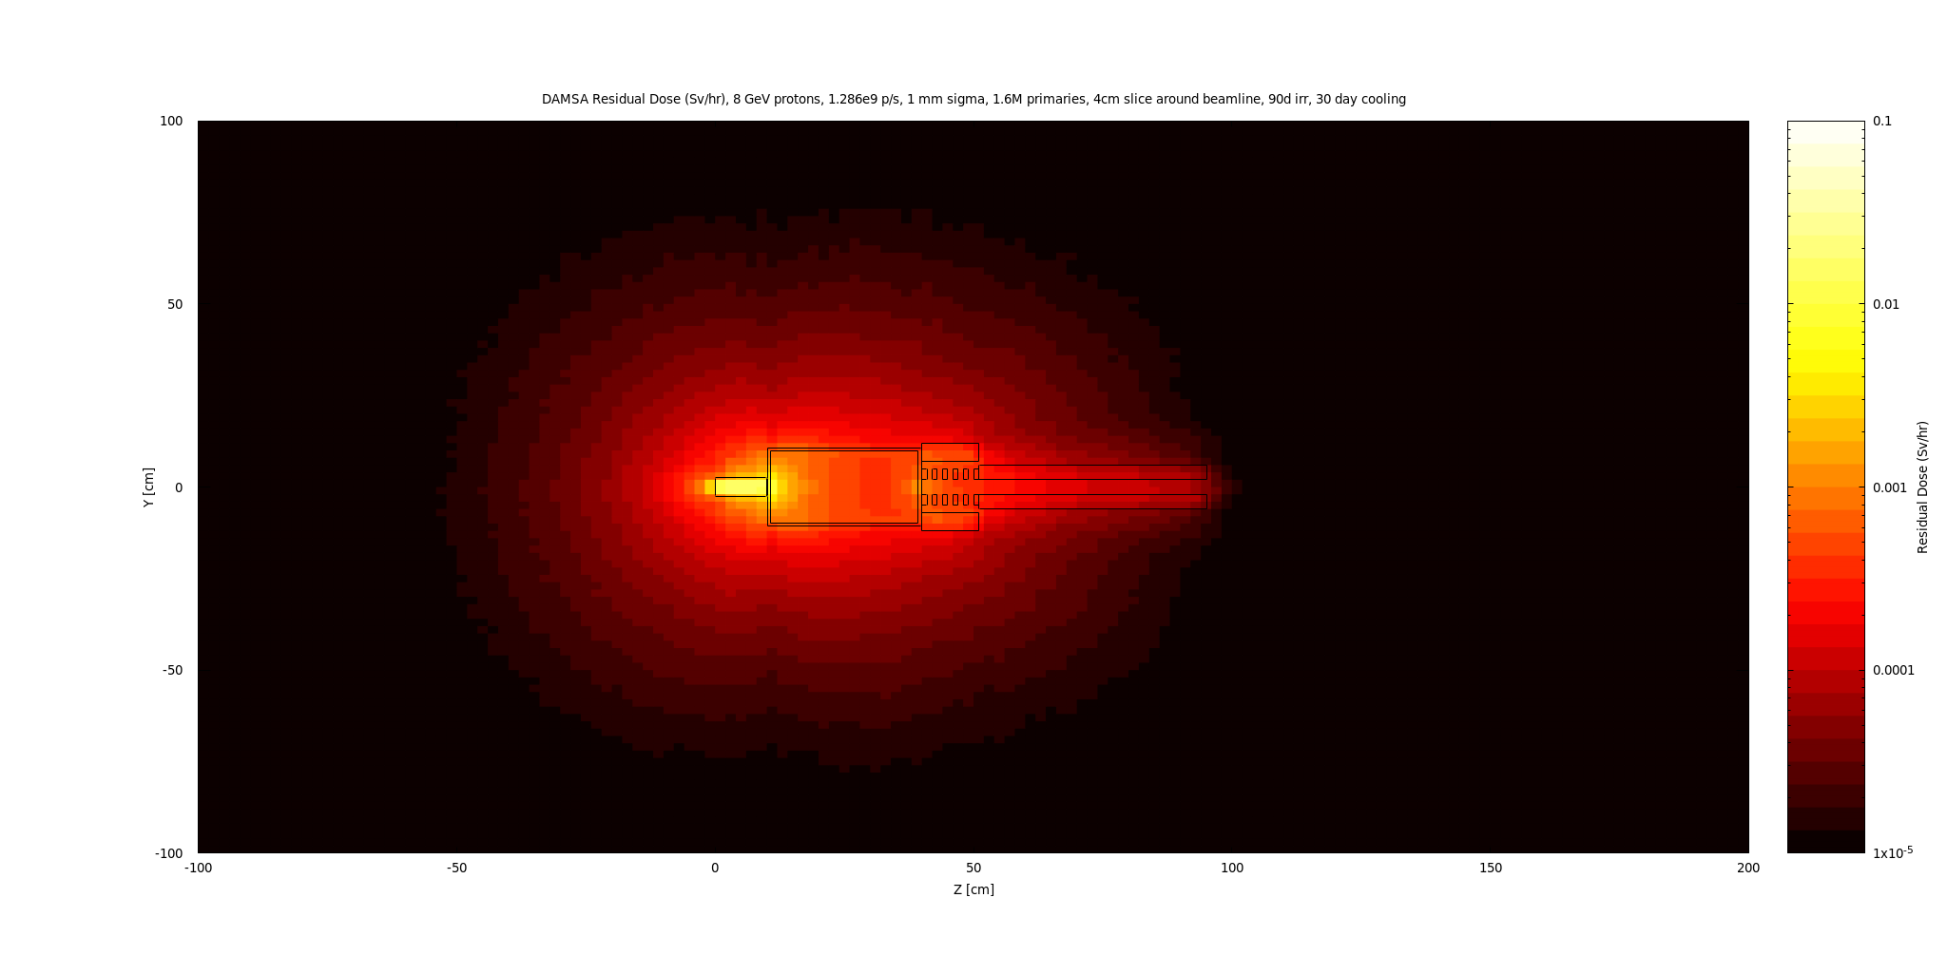
Residual Dose Rate – 90d irr., 30 days cooling

Slide 21
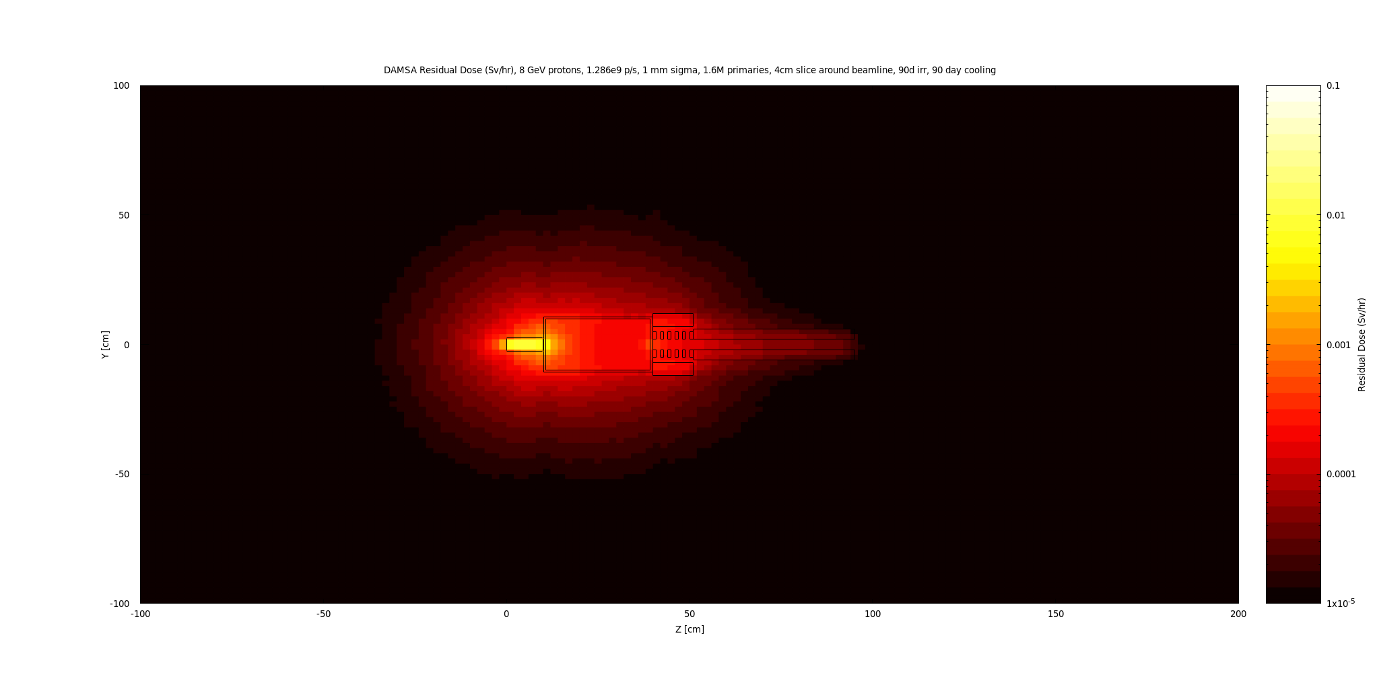
Residual Dose Rate – 90d irr., 90 days cooling

Slide 22
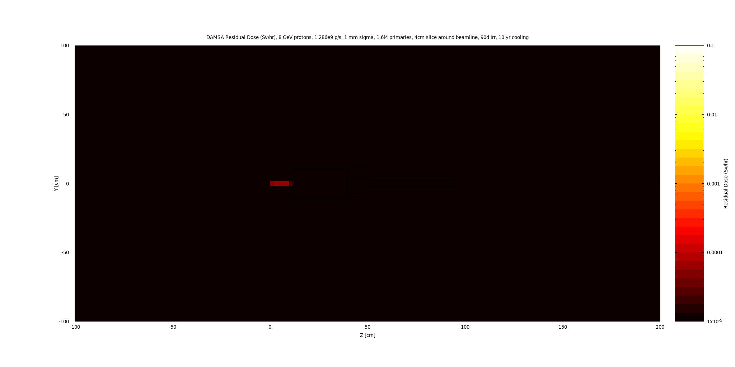
Residual Dose Rate – 90d irr., 10 years cooling

Slide 23
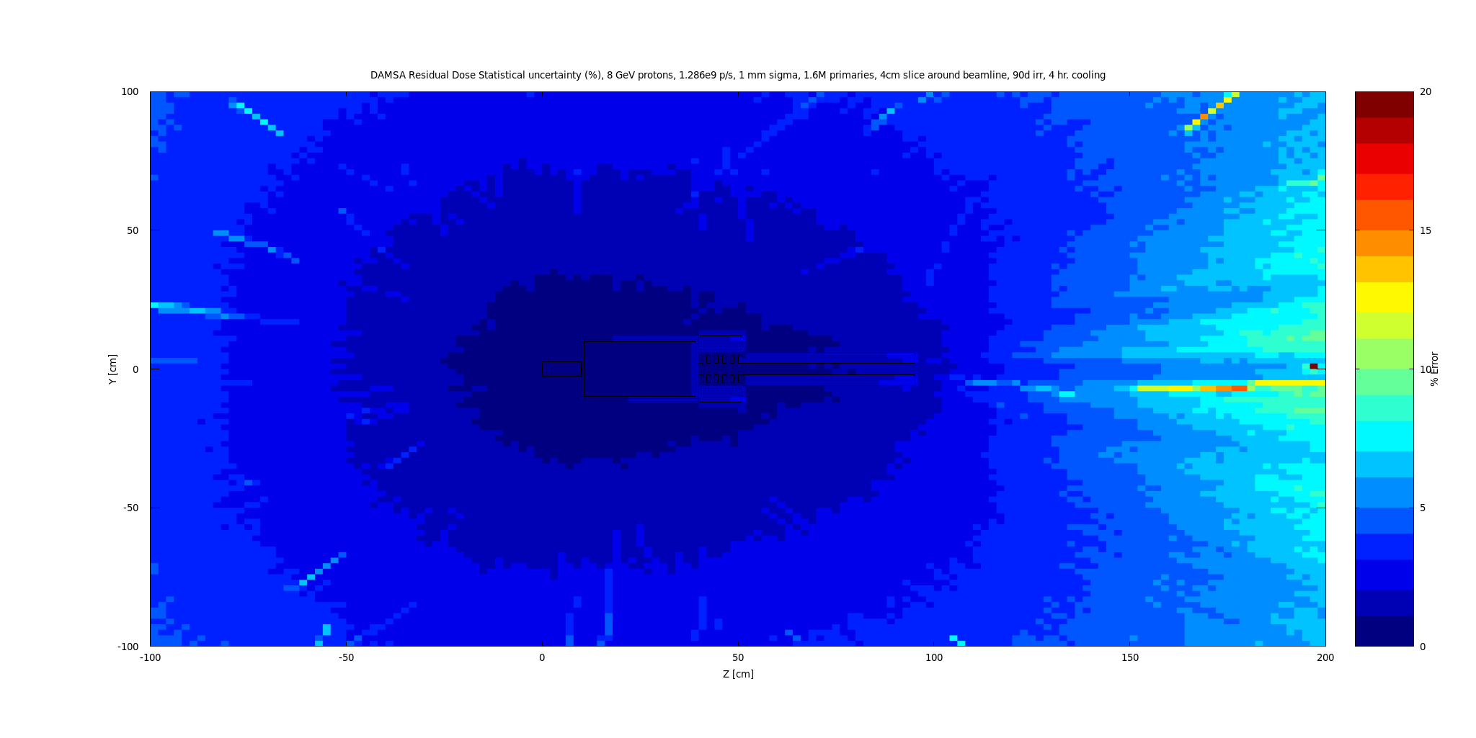
Residual Dose Rate – Statistical Uncertainty – 90d irr., 4 hr. cooling
1 mSv/hr
Hi Rad zone

Slide 24
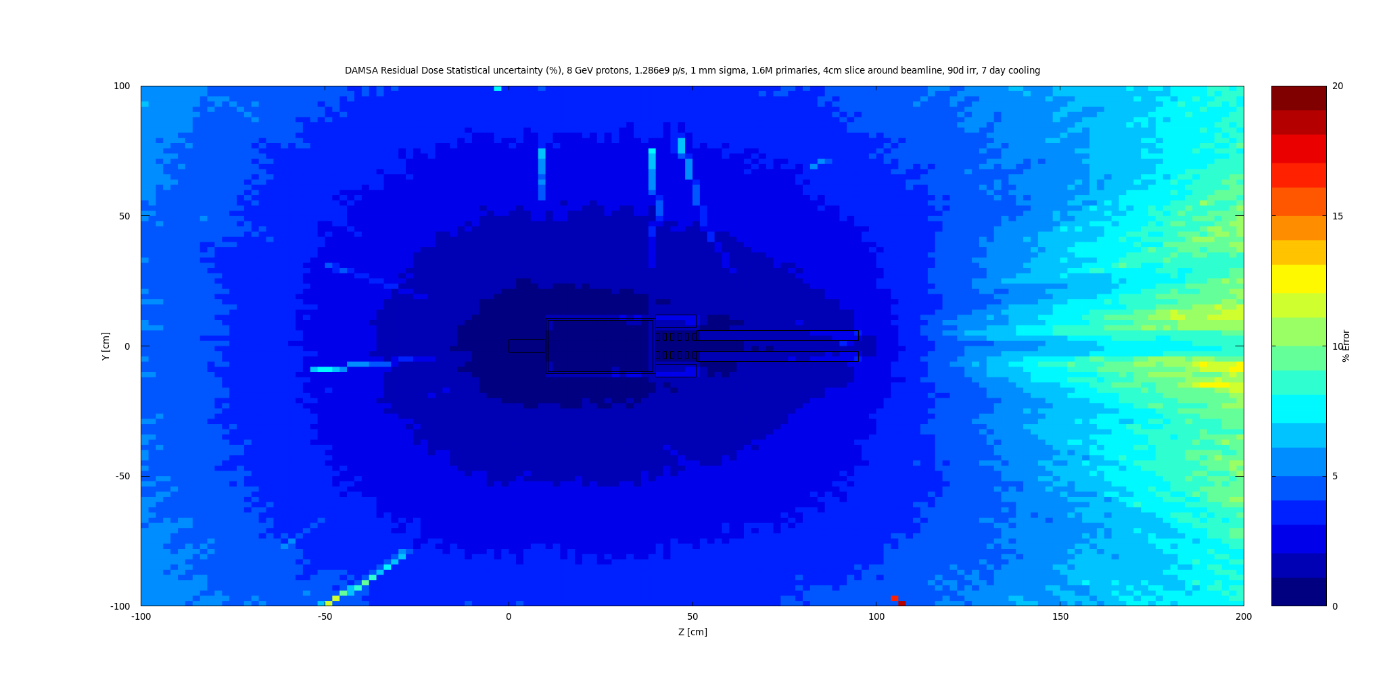
Residual Dose Rate – Statistical Uncertainty – 90d irr., 7 days cooling

Slide 25
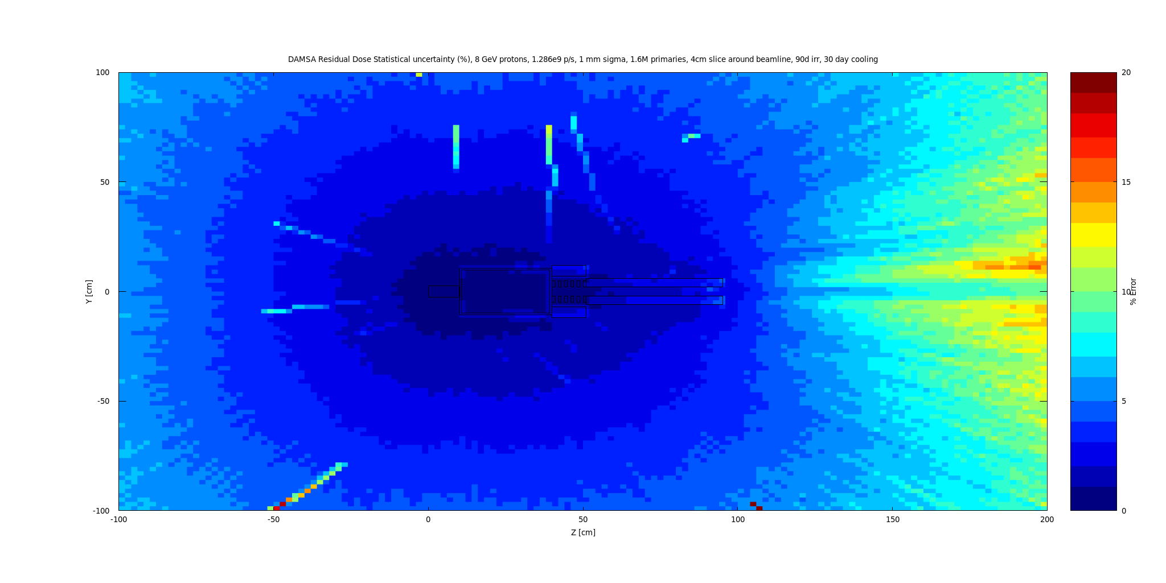
Residual Dose Rate – Statistical Uncertainty – 90d irr., 30 days cooling

Slide 26
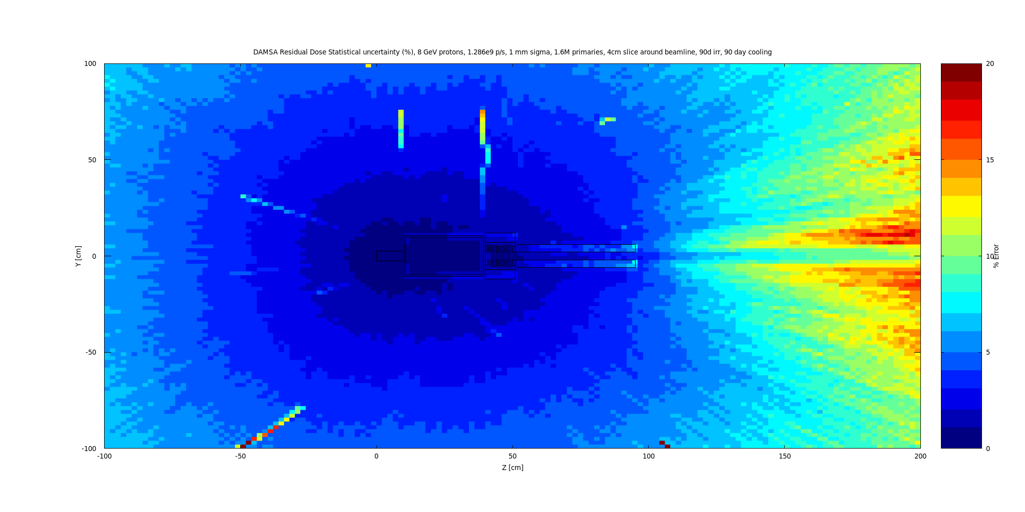
Residual Dose Rate – Statistical Uncertainty – 90d irr., 90 days cooling

Slide 27
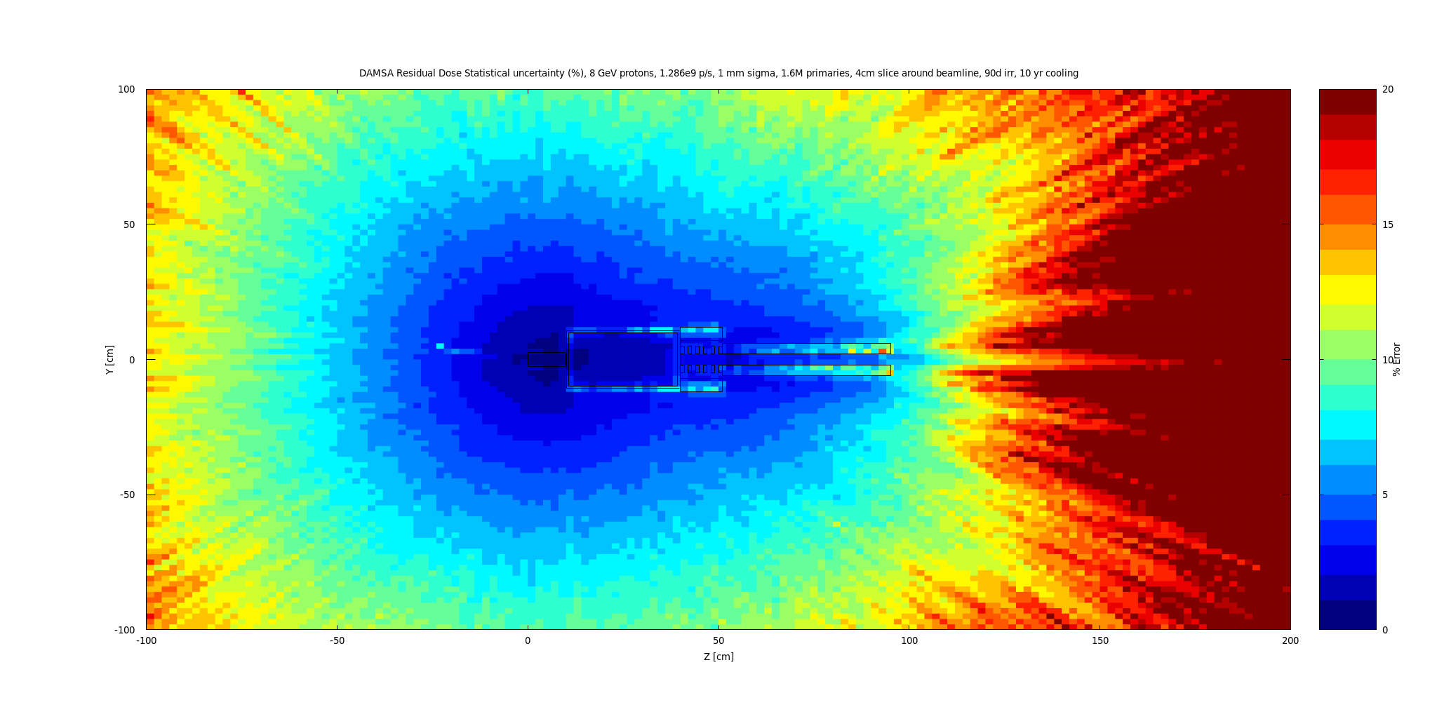
Residual Dose Rate – Statistical Uncertainty – 90d irr., 10 years cooling

Slide 28
Questions

Slide 29
Old FLUKA Simulation

Slide 30
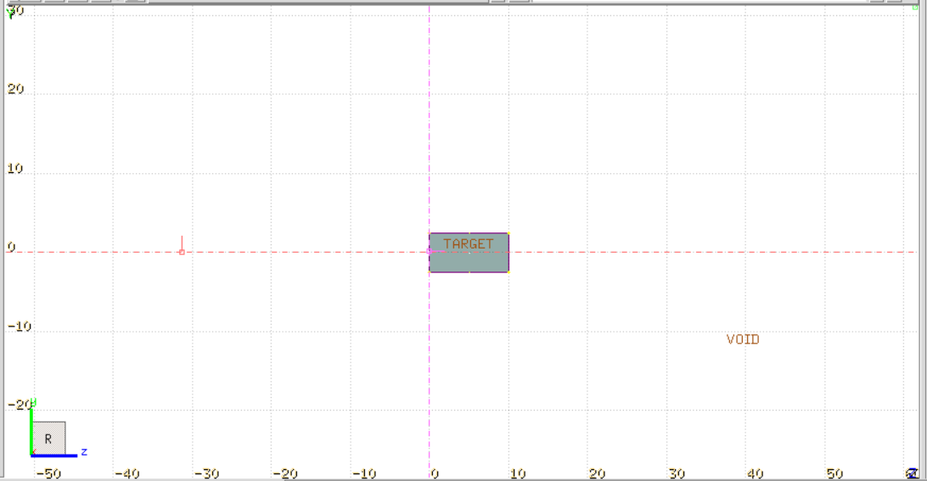
Old FLUKA Simulation Parameters
2.5 cm x 2.5 cm x 10 cm Tungsten target
8 GeV beam, 3mm sigma (assumed size, may change)
10^16 POT over 100 days (1.157e9 p/s)
  Rate may change? This is for rough scoping
800k primaries simulated – good uncertainties
Score secondary particles, energy deposition, activation and residual dose
FLUKA geometry view at right
Beam

Slide 31
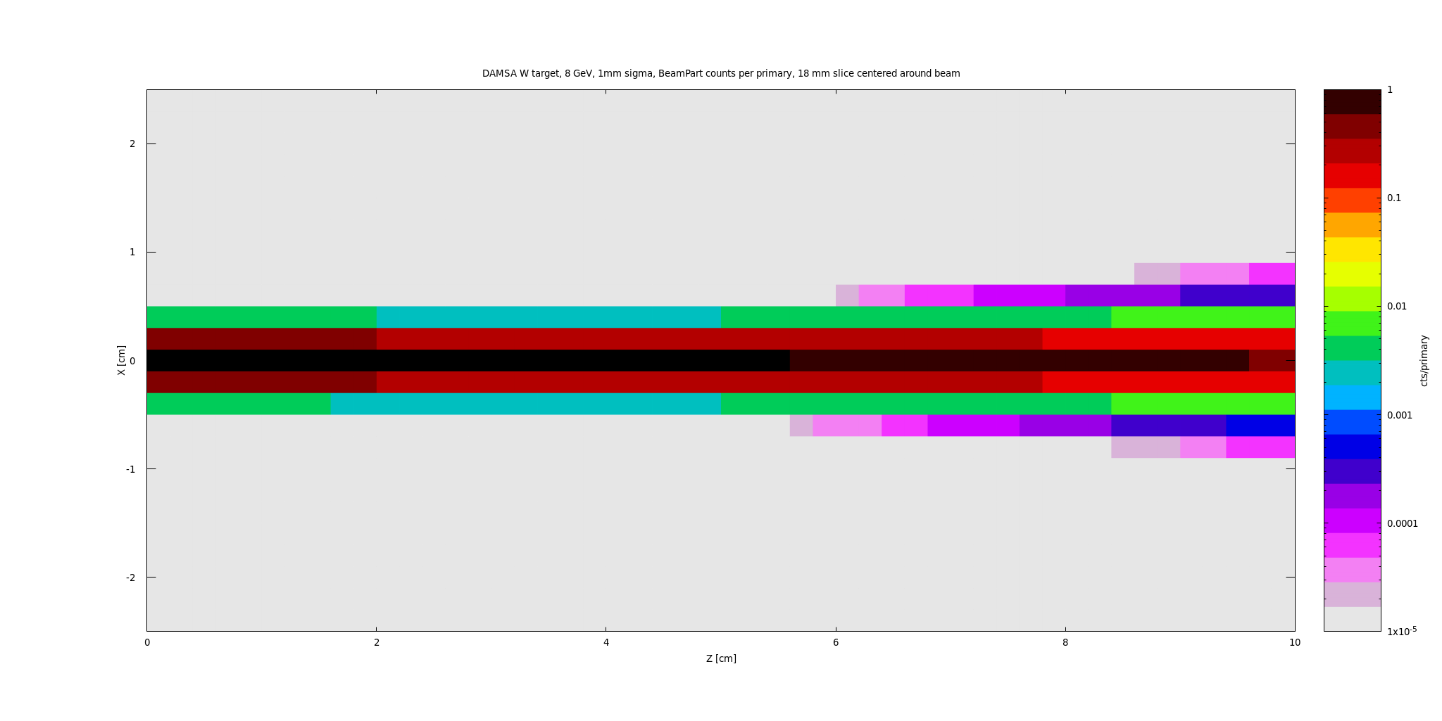
Beam Particles

Slide 32
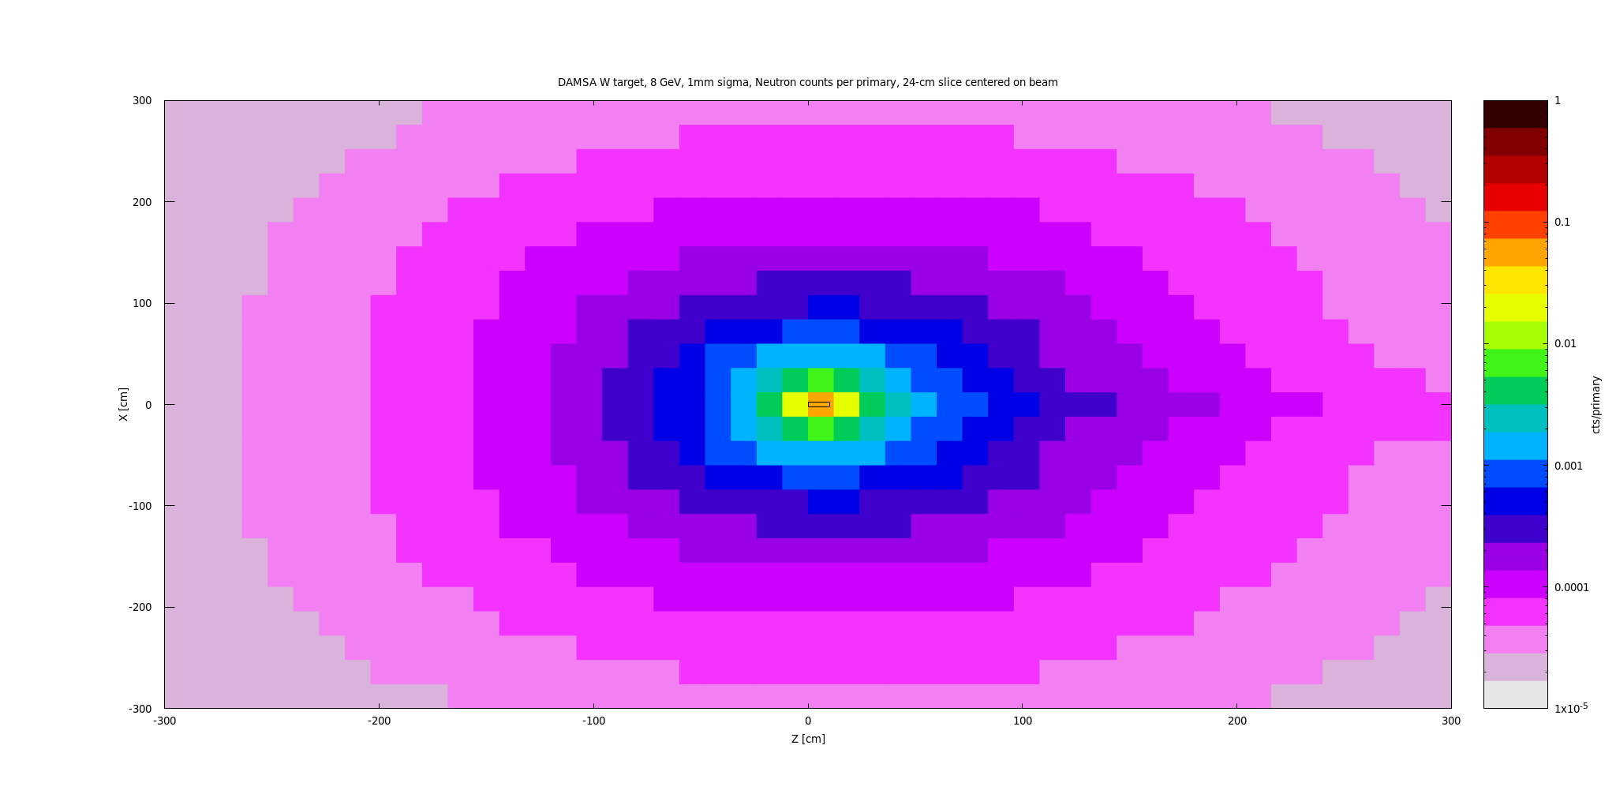
Target only - Neutrons

Slide 33
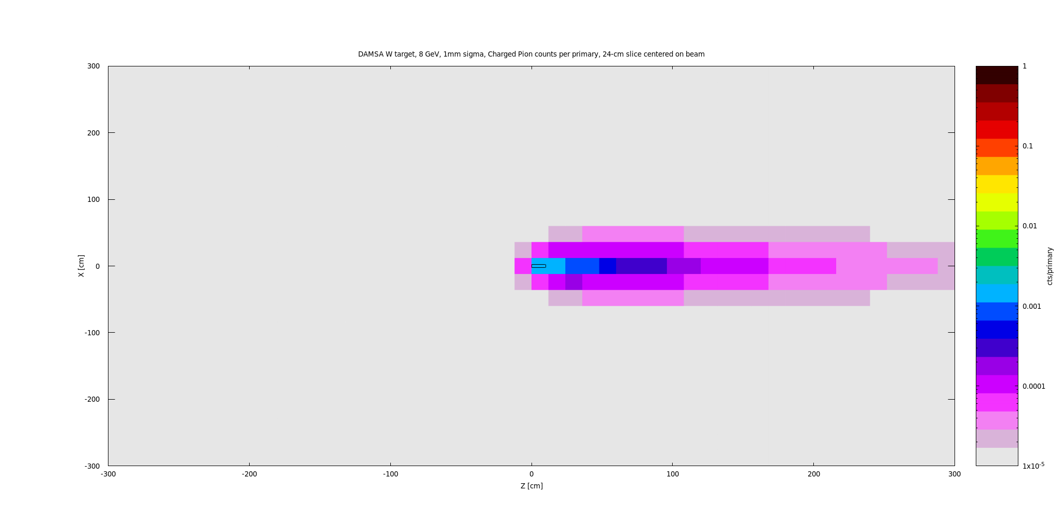
Target only - Charged Pions

Slide 34
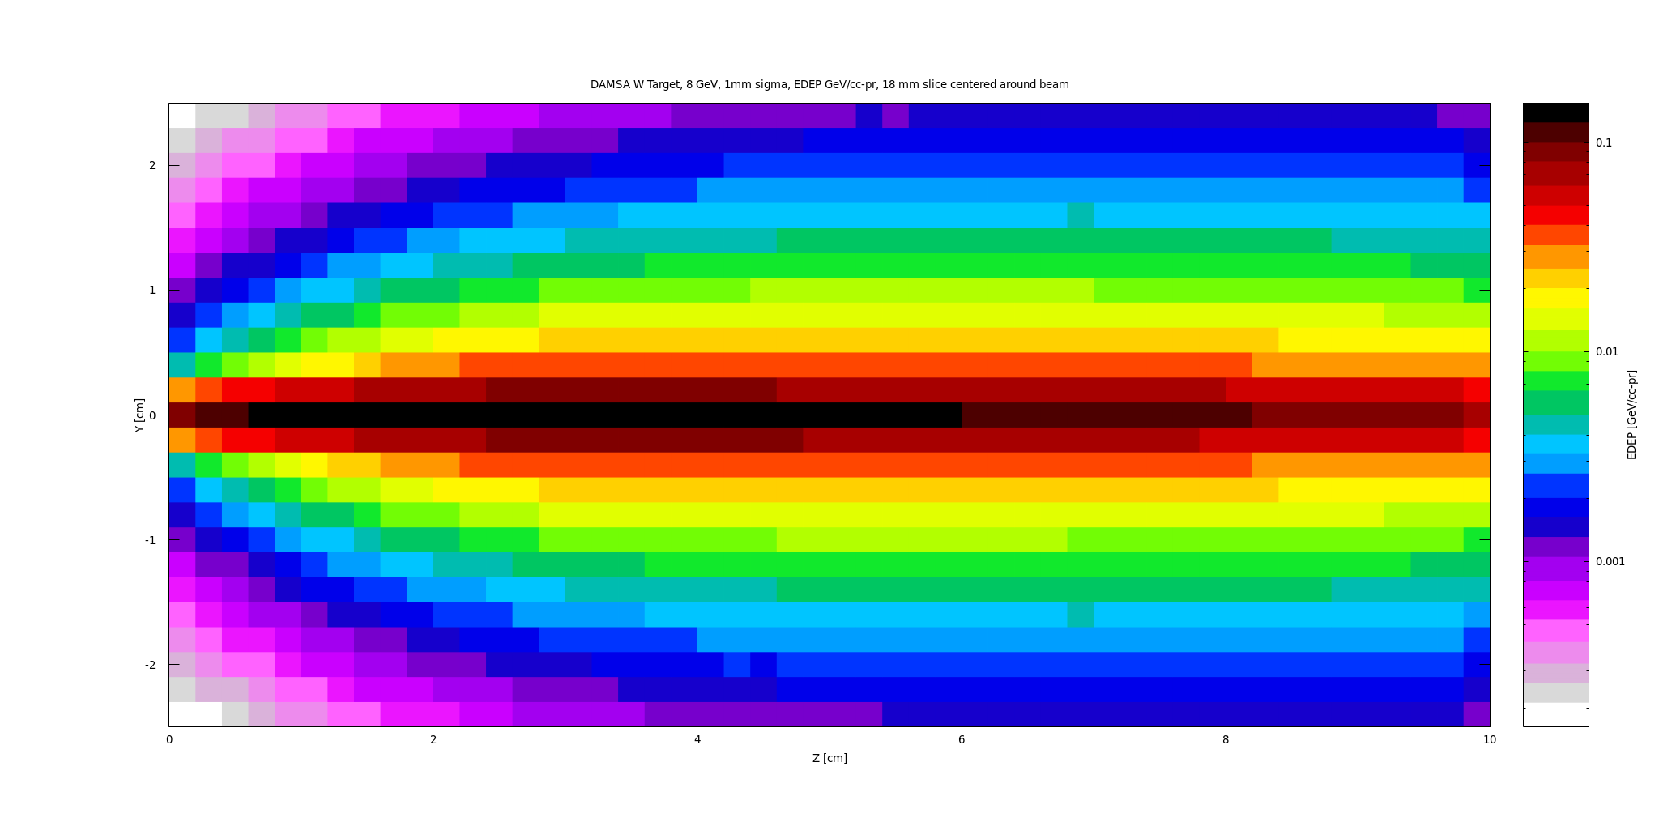
Target only - EDEP – GeV/cc-pr

Slide 35
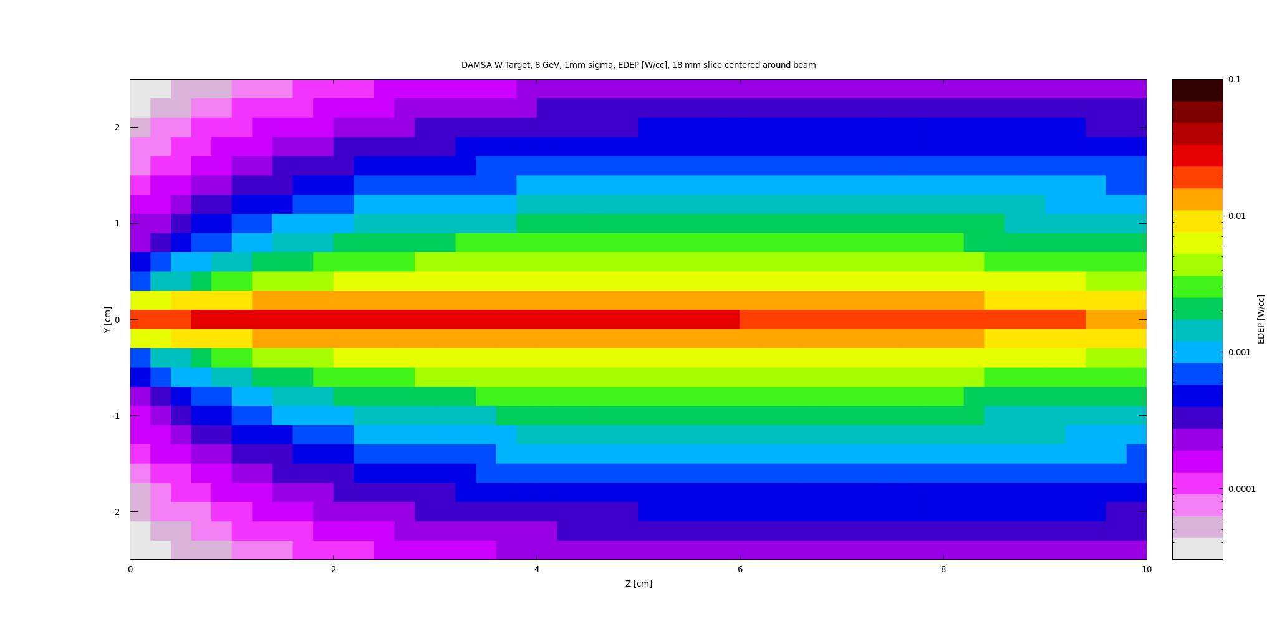
EDEP – W/cc

Slide 36
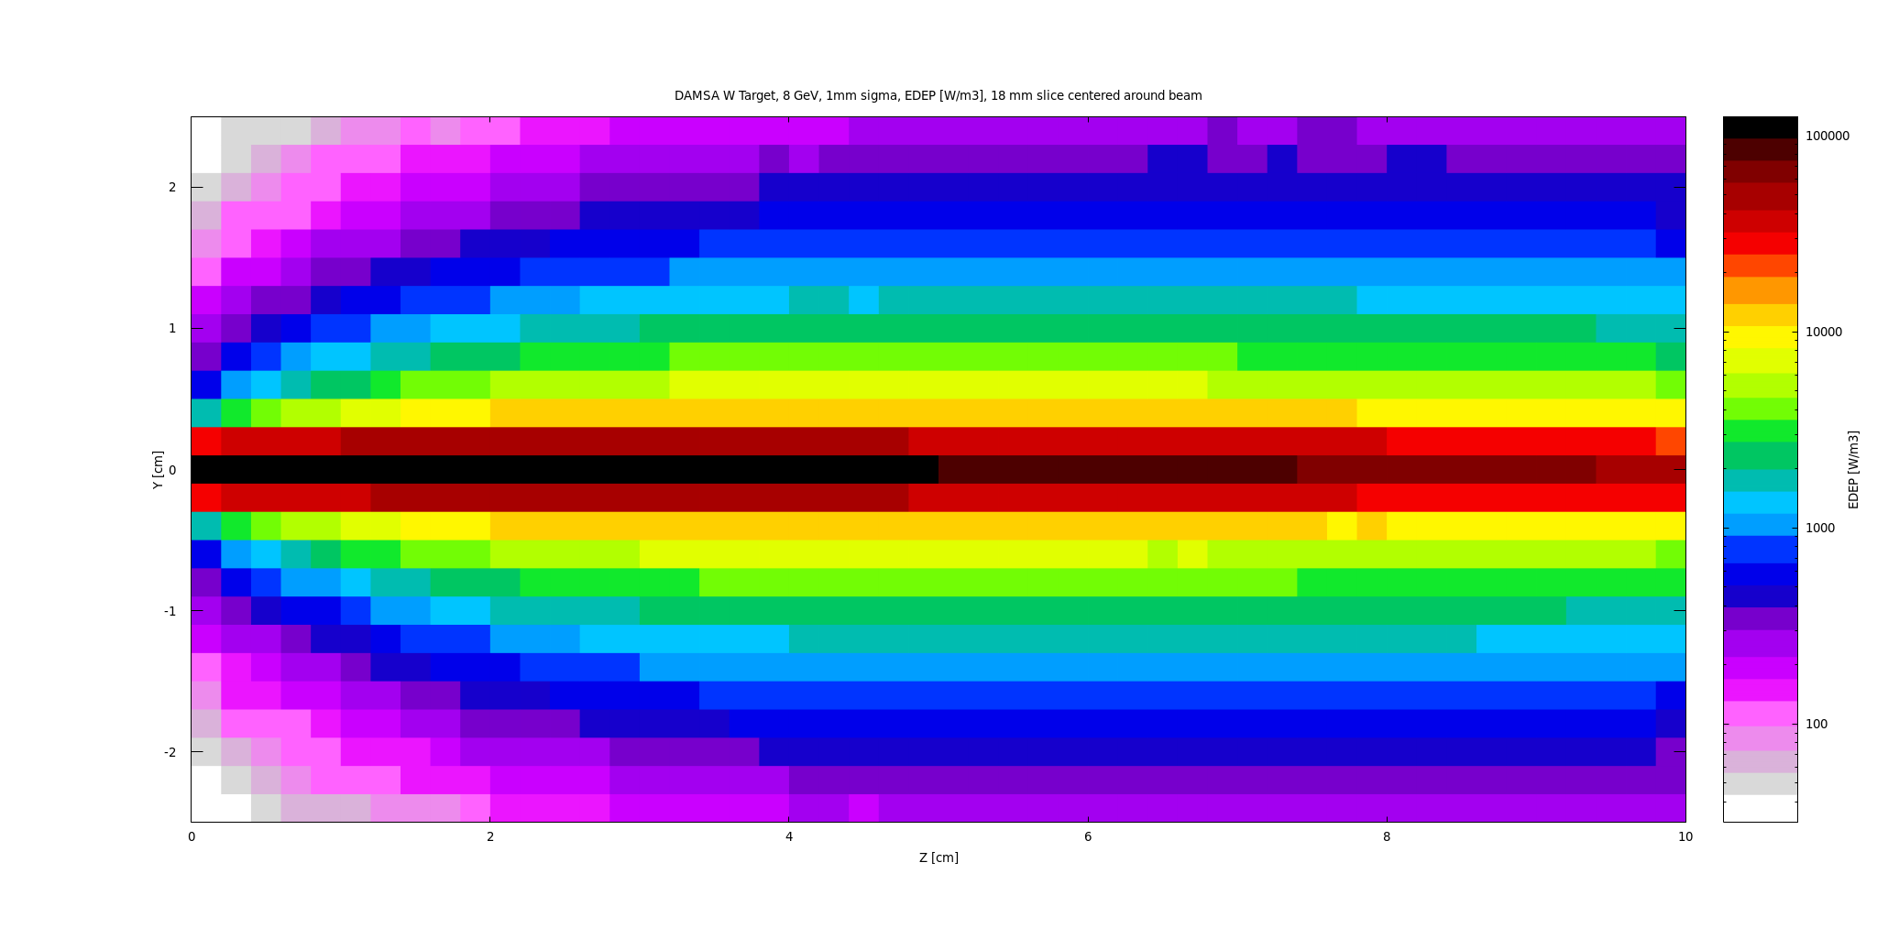
EDEP – W/m^3

Slide 37
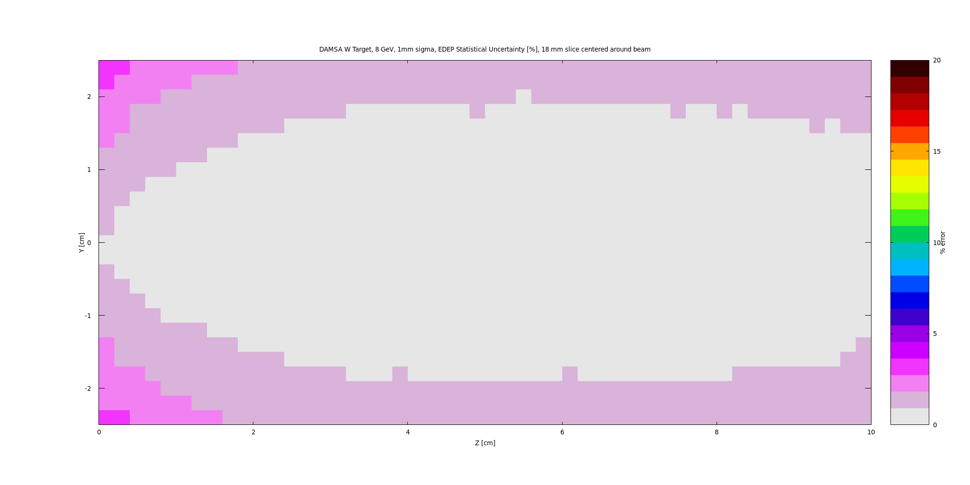
EDEP Statistical Uncertainty

Slide 38
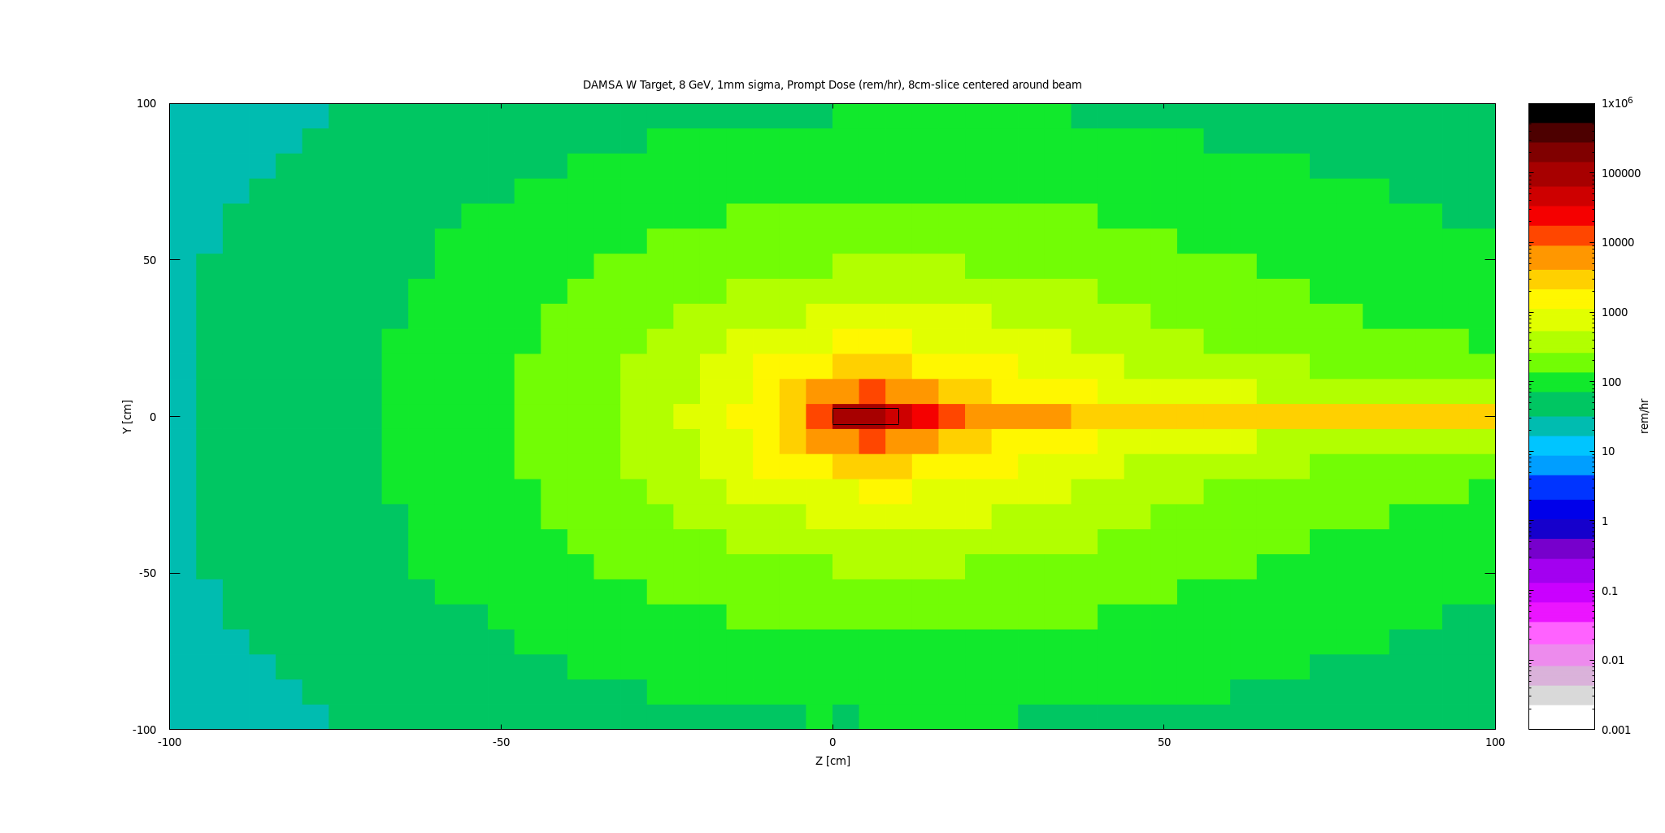
Prompt Dose (1.1574e9 p/s)
Unclear if tunnel roof shielding is rated for continuous radiation fields like this (re: skyshine) – may be strong argument for using AP0 station vs g-2, transfer lines, etc.
*Ask rad safety

Slide 39
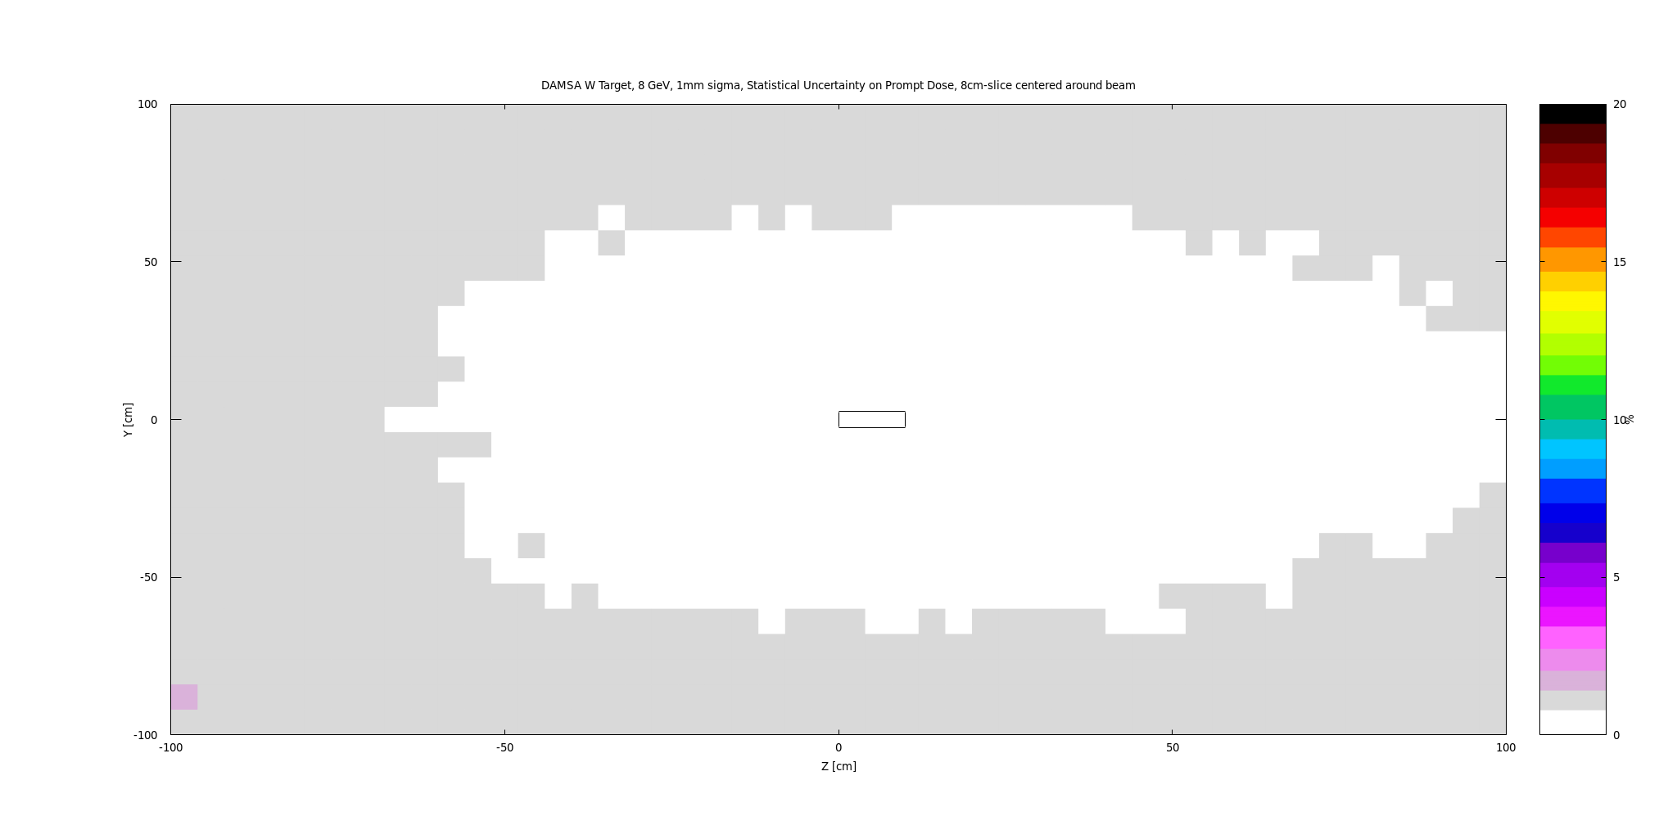
Prompt Dose Statistical Uncertainty

Slide 40
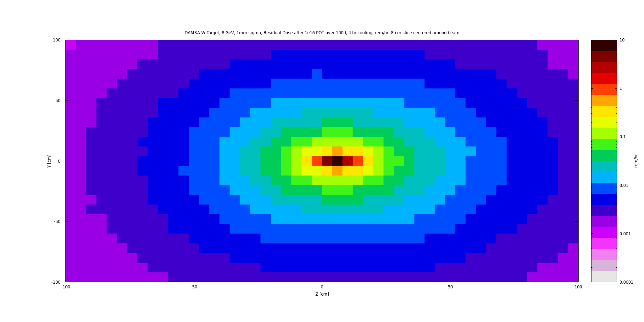
Residual Dose – 100d irr, 4 hr cooling

Slide 41
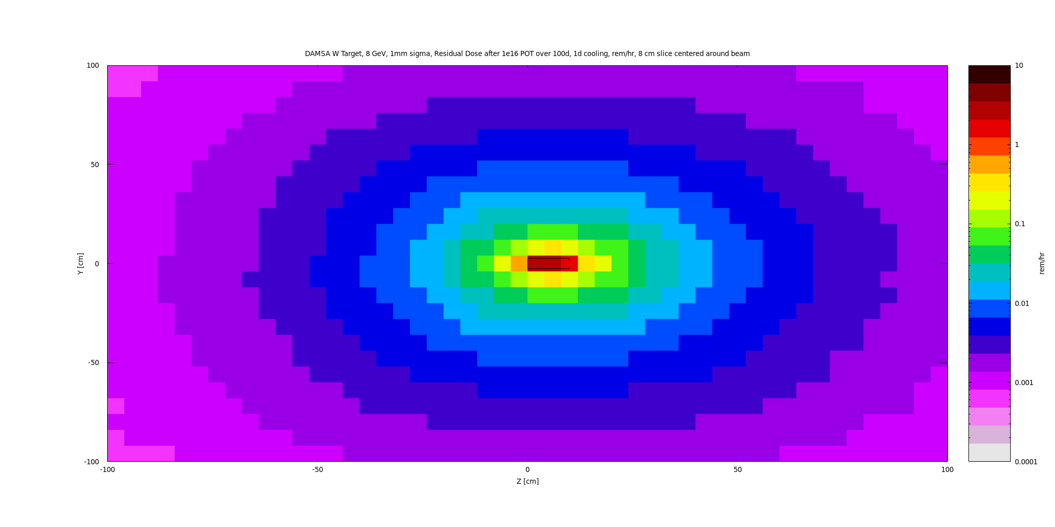
Residual Dose – 100d irr, 1d cooling

Slide 42
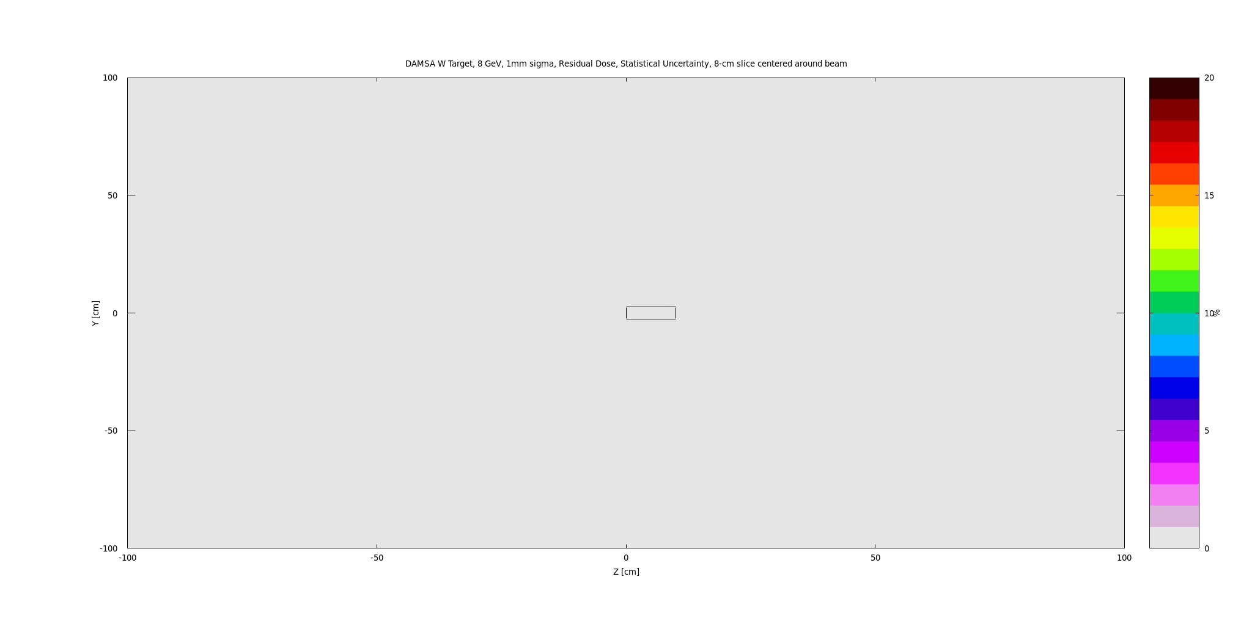
Residual Dose Statistical uncertainty

