Slide 2
Refrigeration Cycles and Respective Diagrams
T. Koettig on behalf of the CERN Cryolab

Slide 3
Content
Cryogenic fluids
Phase diagrams in 3D
Projected diagrams in 2D
T-s vs. log(p)-h diagram
Thermodynamic cycles as application Isentropic, Isenthalpic, HEX
Refrigeration cycles

Slide 4
Cryogenic fluids

Slide 5
Cryogenic Fluids
THERMOPHYSICAL PROPERTIES
Fluid | ³He | ⁴He | N₂ | Ar | H₂ | O₂ | Kr | Ne | Xe | Air
Boiling temperature 1.013 bar (K) | 3.19 | 4.2 | 77.3 | 87.3 | 20.3 | 90.2 | 119.8 | 27.1 | 165.1 | 78.8
Latent heat (evaporation at T_{b}) kJ/kg | ~7 15.87 @ 1.65 K | 20.91 | 199.1 | 163.2 | 448 | 213.1 | 107.7 | 87.2 | 95.6 | 205.2
Pressure to solidify bara or T_{tr} in K | 34.4 | 25.4 | 63.15 | 83.81 | 13.8 | 54.36 | 114.9 | 24.56 | 161.4 | -
Density of liquid (at T_{b}) – kg/m³ | 58.9 | 124.8 | 804 | 1400 | 71 | 1140 | 2413 | 1204 | 2942 | 874

Slide 6
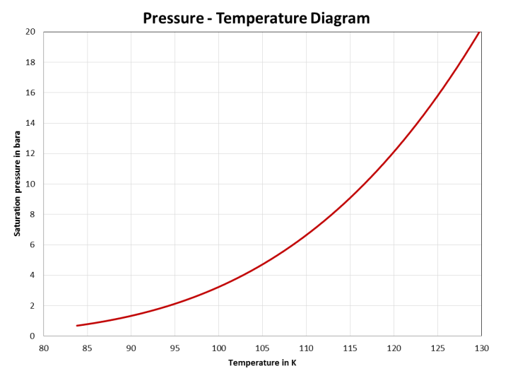
p-T diagram - Overview of vapor pressures
Liquid
Vapor
From: Haefer, Kryovakuumtechnik

Slide 7
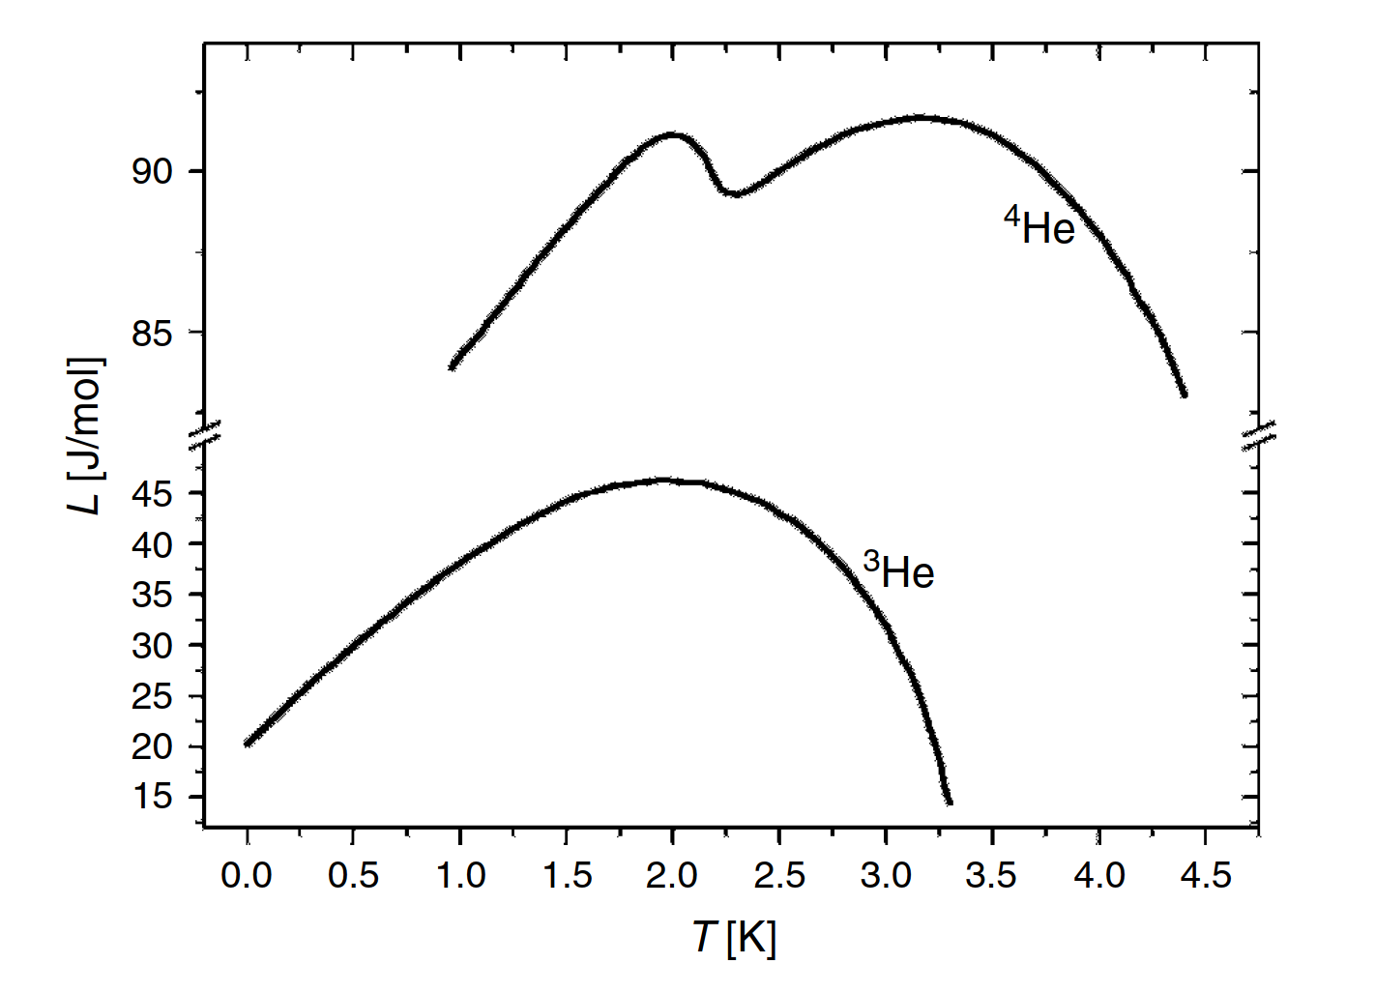
Latent Heat of Evaporation ³He and ⁴He
Source: Ventura, The Art of Cryogenics, Fig. 2.5

Slide 8
p - v - T diagram

Slide 9
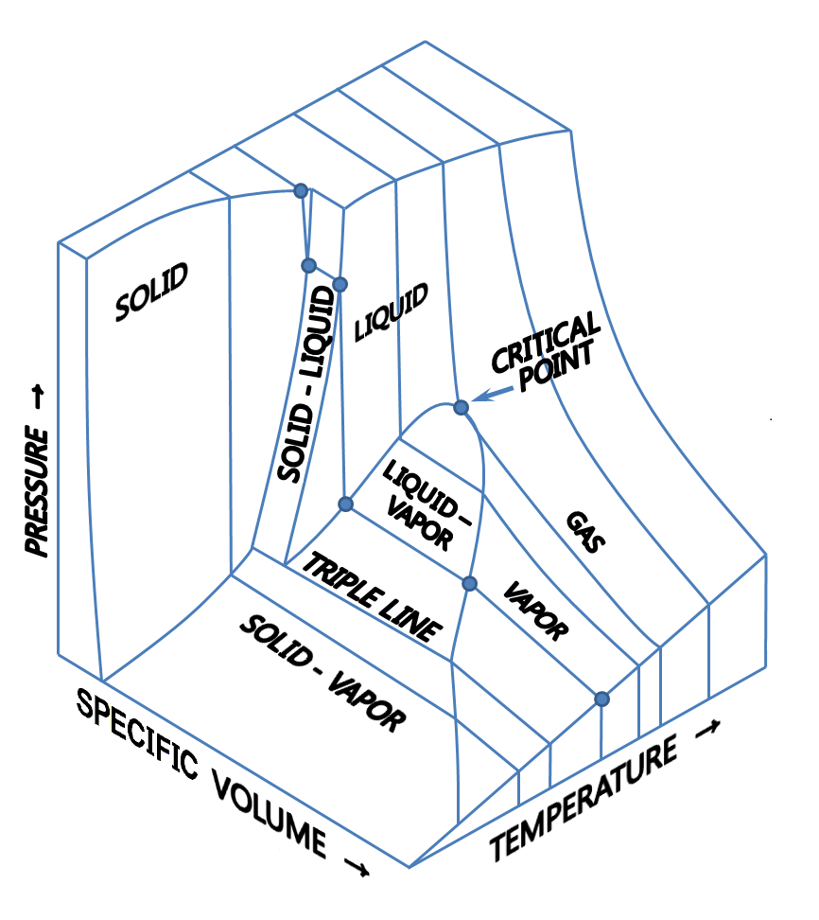
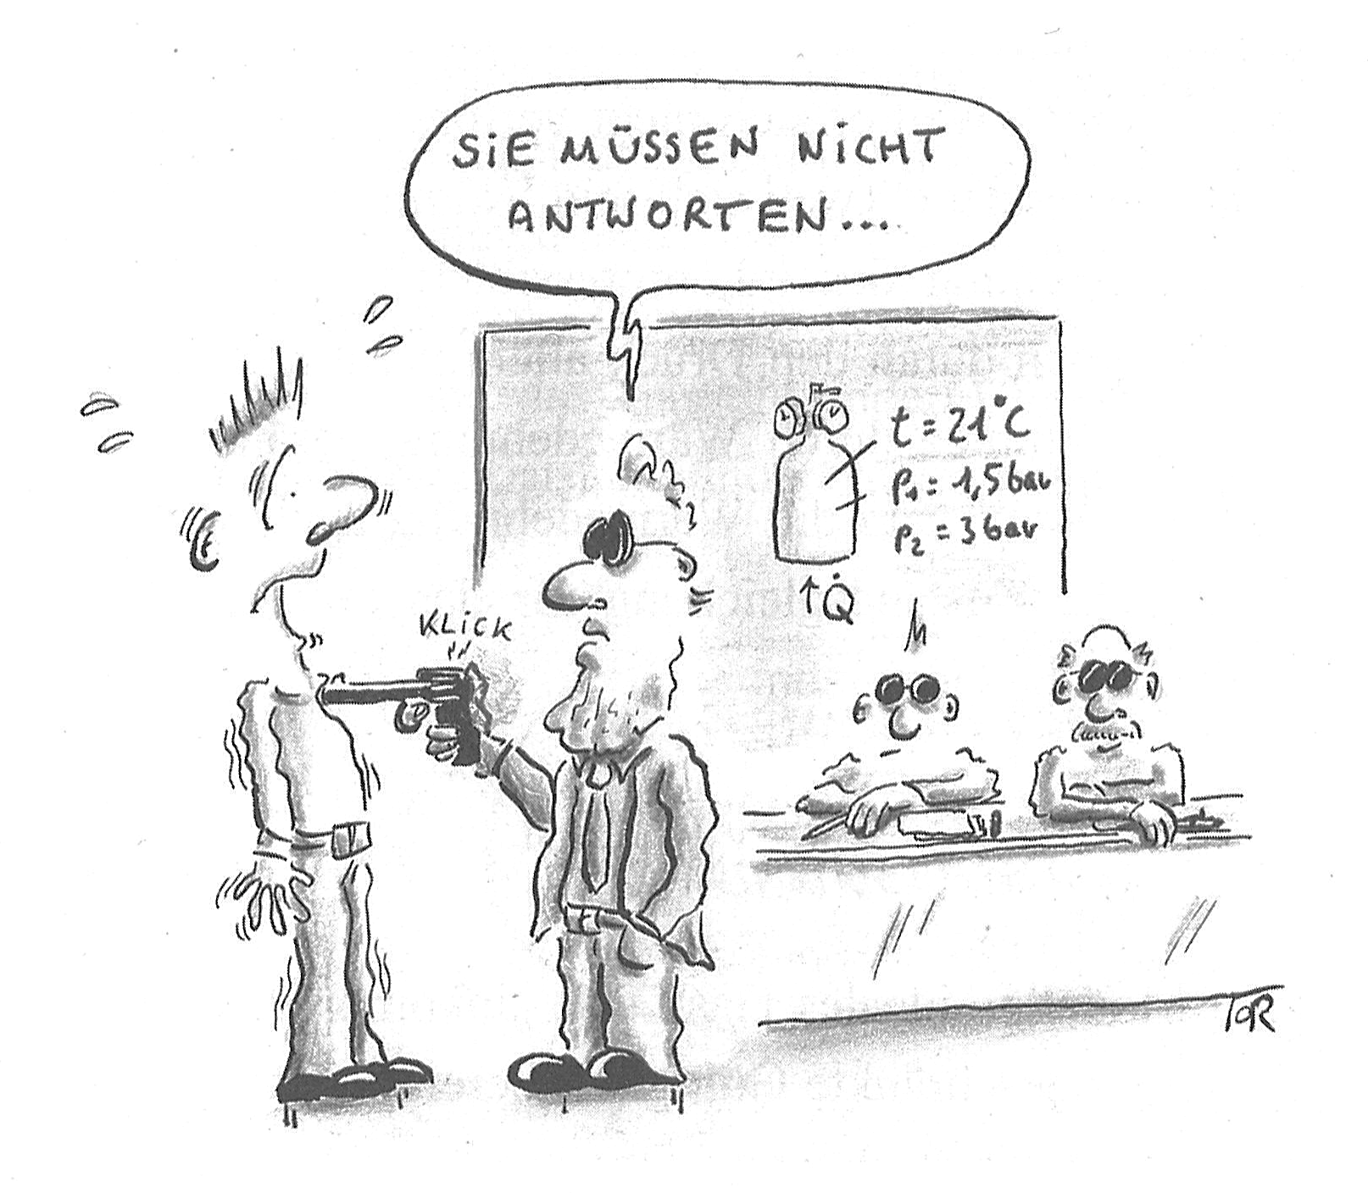
Phase diagrams
The Ideal Gas law
You don’t need
to answer….
T₁=294 K
p₁=1 bar
p₂=3 bar
Adapted from: Labuhn, Keine Panik vor Thermodynamik, 2011.

Slide 10
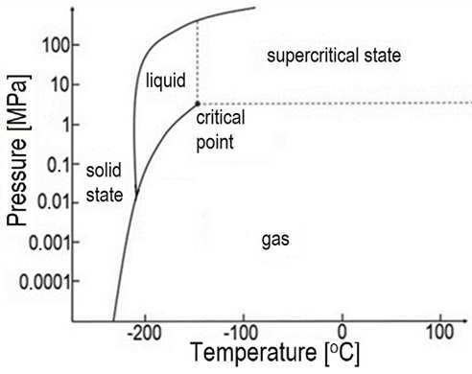
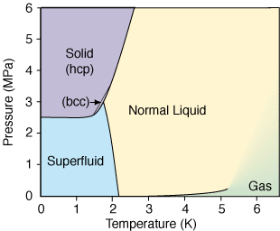
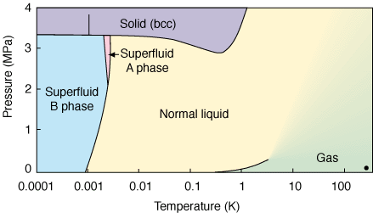
p-T diagrams
Nitrogen
⁴He
Source: http://ltl.tkk.fi/research/theory/helium.html
³He
https://www.researchgate.net/figure/The-temperature-pressure-phase-diagram-for-nitrogen_fig1_315888614
Phase diagrams for N₂, ⁴He and ³He
Helium isotopes show no triple point
Superfluid phases at low temperature
³He first binds two atoms weakly to have a bosonic character => ~ 2 mK

Slide 11
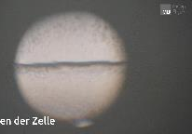
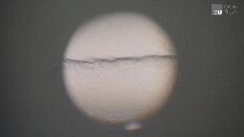
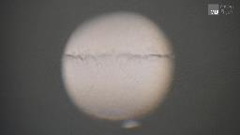
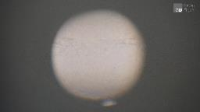
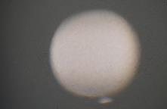
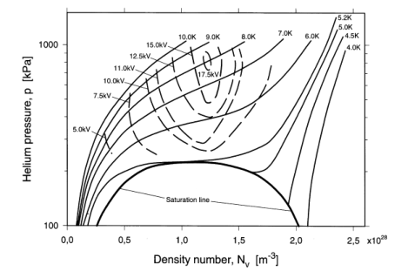
Critical point transition => opalescence e.g. SF₆
Heating a cell with two-phase SF₆ from 45 °C => rising p and T => supercritical fluid
Source: https://expvorl.physik.uni-muenchen.de/versuche_waermelehre/ideale_und_reale_gase/kritische_opaleszenz/index.html
Example LHC beam screen heating with 3 bar 4.6 K to 20 K
Start in subcooled (pressurized liquid) to vapor
Still large density change even without classical evaporation
Different diagrams like T-s or p-h are more suited to demonstrate the process
From: Gerhold, Properties of cryogenic insulants, Cryogenics Vol. 38, pp. 1063

Slide 12
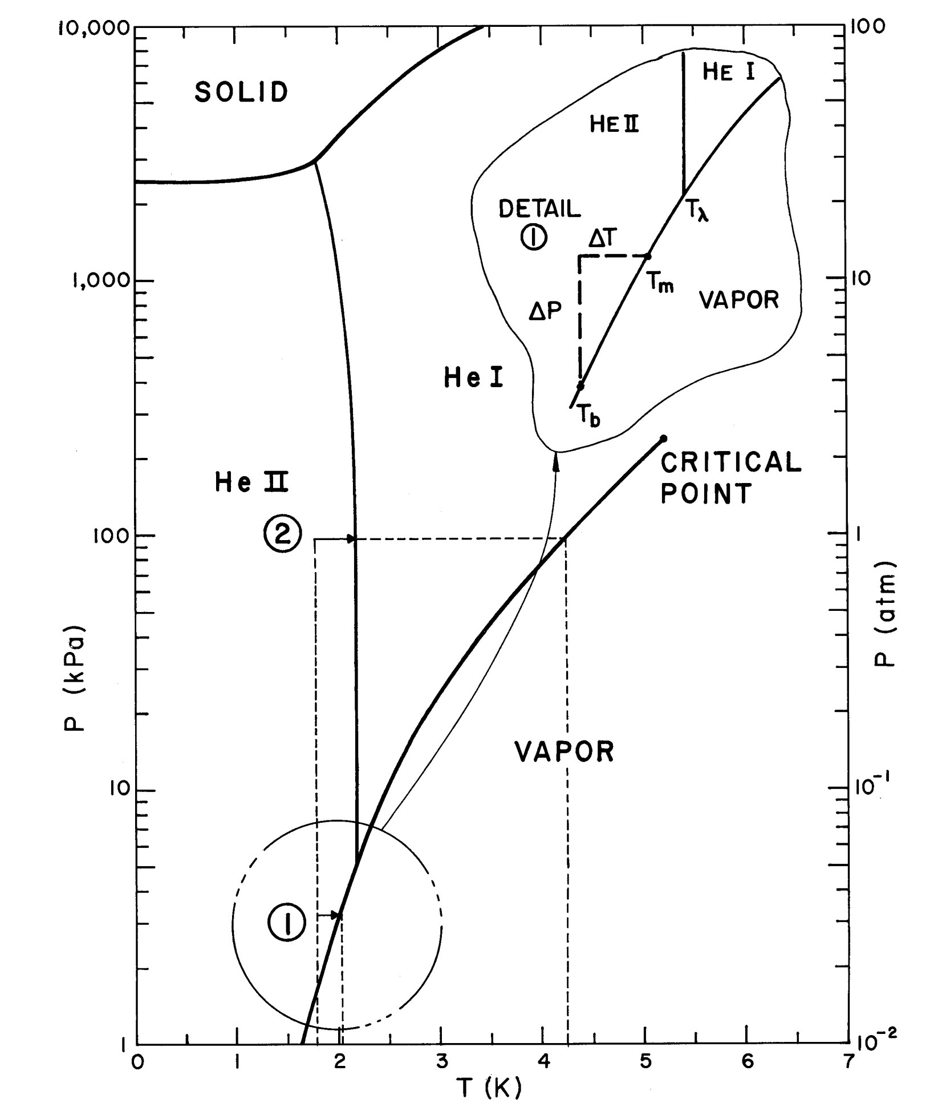
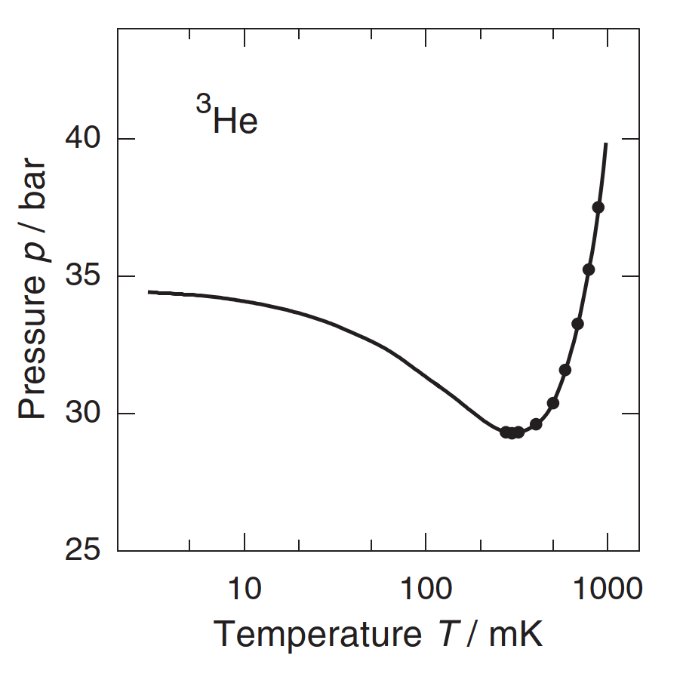
Helium p-T diagrams - effects
⁴He phase diagram
subcooling in a saturated bath
³He phase diagram
Pomeranchuk cooling
From: Van Sciver, Helium Cryogenics.
From: Enss, Low-Temperature Physics.

Slide 13
Thermodynamic cycles

Slide 14

In the restaurant
with entropy?
From: Labuhn, Keine Panik vor Thermodynamik, 2011.

Slide 15
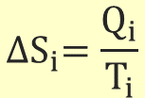
Thermodynamics of cryogenic refrigeration
First principle [Joule]
Second principle [Clausius]
(= for reversible process)
Hence,
which can be written in different ways:
introducing entropy S as
$${∆S}_{i}=\frac{Q_{i}}{T_{i}}$$
Carnot factor
From: P. Lebrun, CAS

Slide 16

Thermodynamics of cryogenic refrigeration
Graph for T_{warm} = 300 K
Carnot effectiveness:
$$\frac{T_{warm}−T_{cold}}{T_{cold}}$$
He II 1.8 K - e_{c}=166
He 4.5 K - e_{c}=65.7
H₂ 20 K - e_{c}=14
N₂ 77 K e_{c}=2.9
2
5
10
300

Slide 17
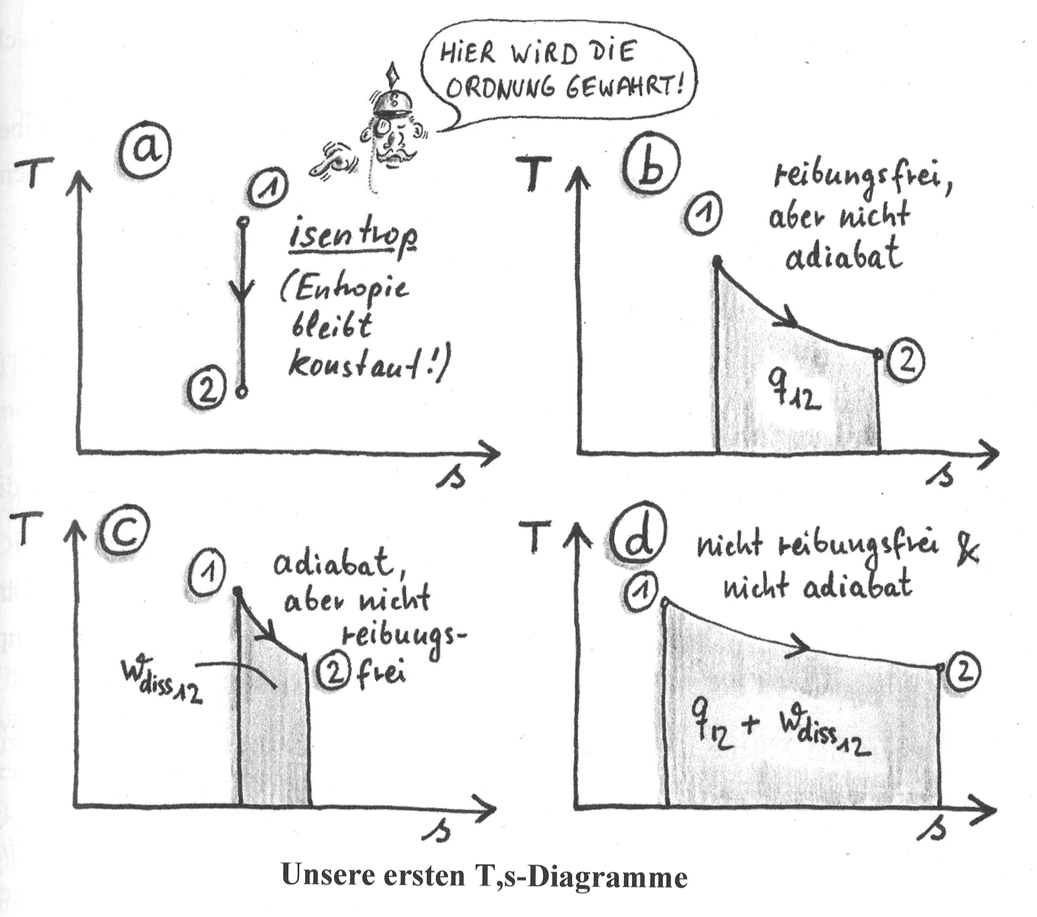
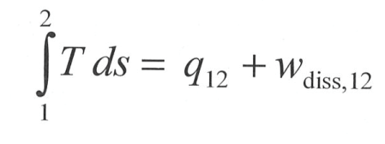
Our first T-s diagrams
Here, the state of order is preserved
e
Frictionless, but not adiabatic
Isentropic
(Entropy is constant!)
Ideal
Ideal gas piston
Adiabatic, but not
frictionless
Not adiabatic, nor frictionless
From: Labuhn, Keine Panik vor Thermodynamik, 2011.
e
J-T nozzle
Reality
e

Slide 18
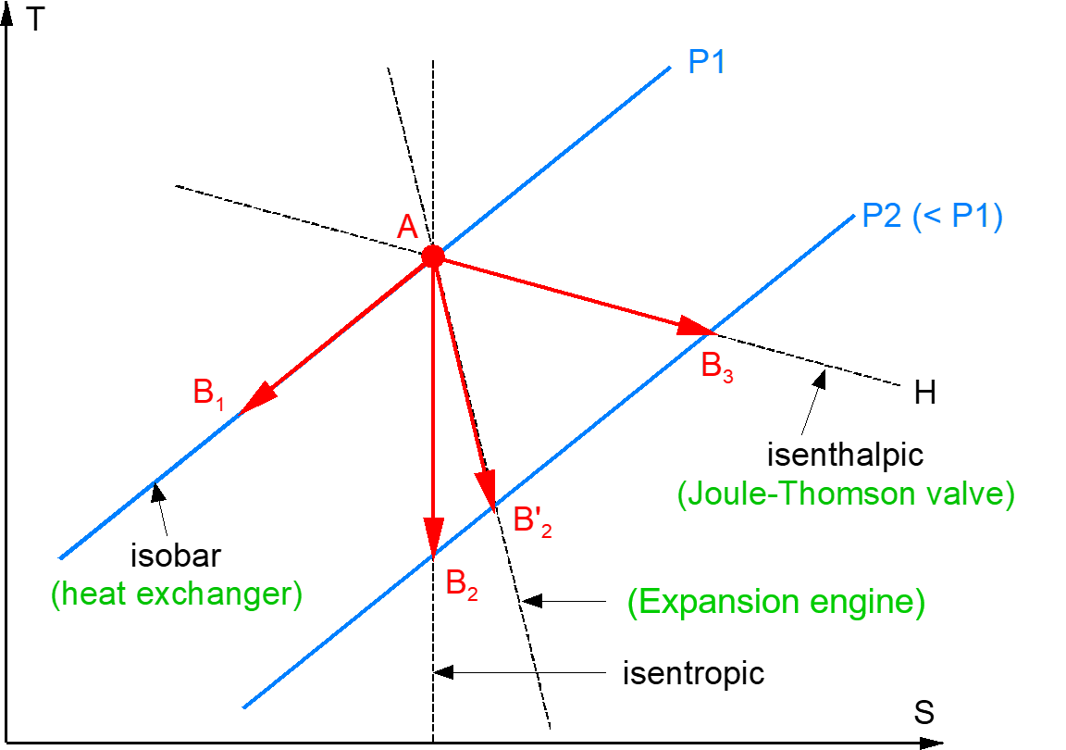
T-s vs. p-h diagram
p₁
p₂ < p₁

Slide 19
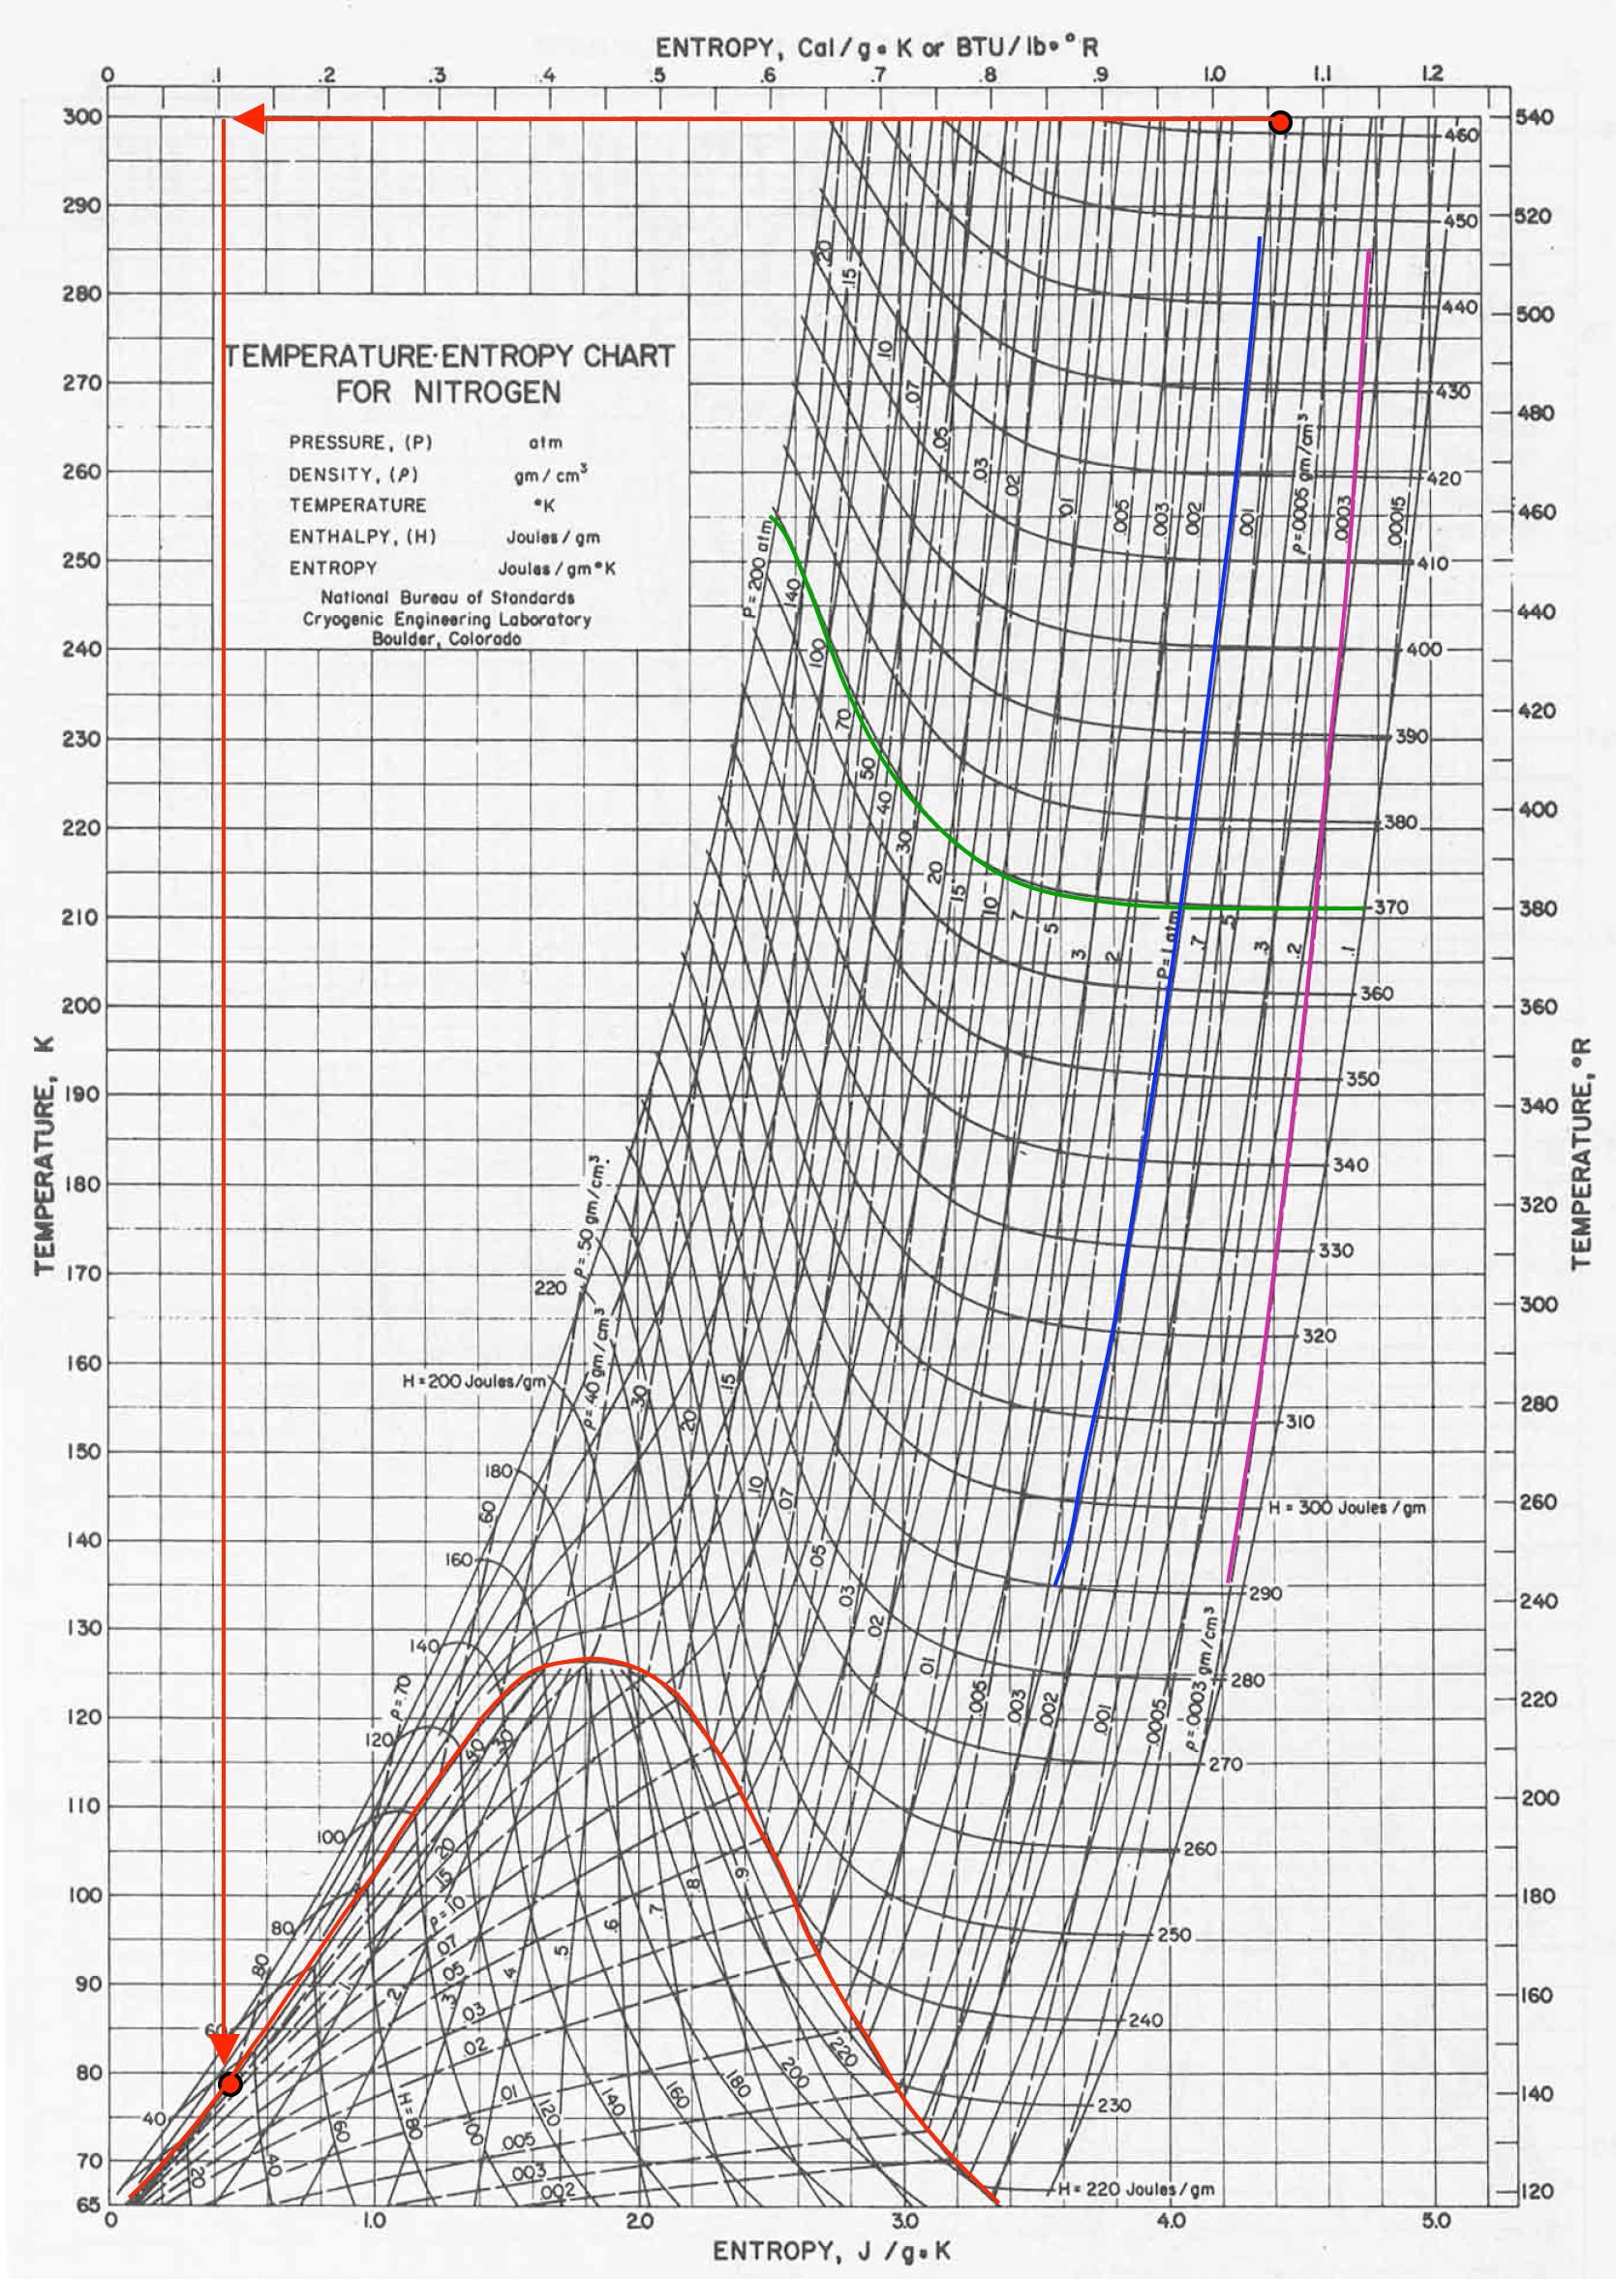
T-s diagram for nitrogen and lines of constant property
Check T-s diagram, lines of constant:
pressure, enthalpy, density and the vapor dome
Useful for refrigeration cycles with close to isentropic processes
  Turbine expansion,
  Heat exchange at const. pressure
Check the enthalpy curves in the T-s diagram for J-T expansion
From: USPAS, University of Wisconsin, Madison

Slide 20
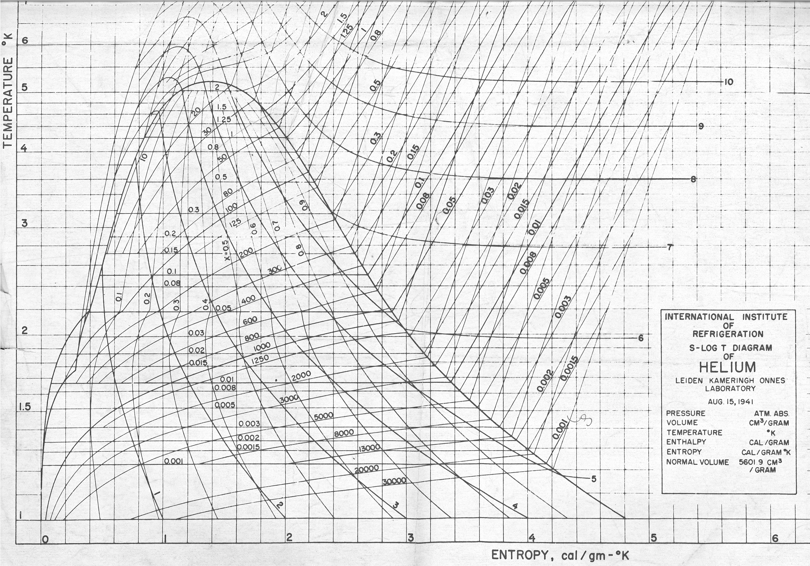
T-s diagram for helium and lines of constant property

Slide 21
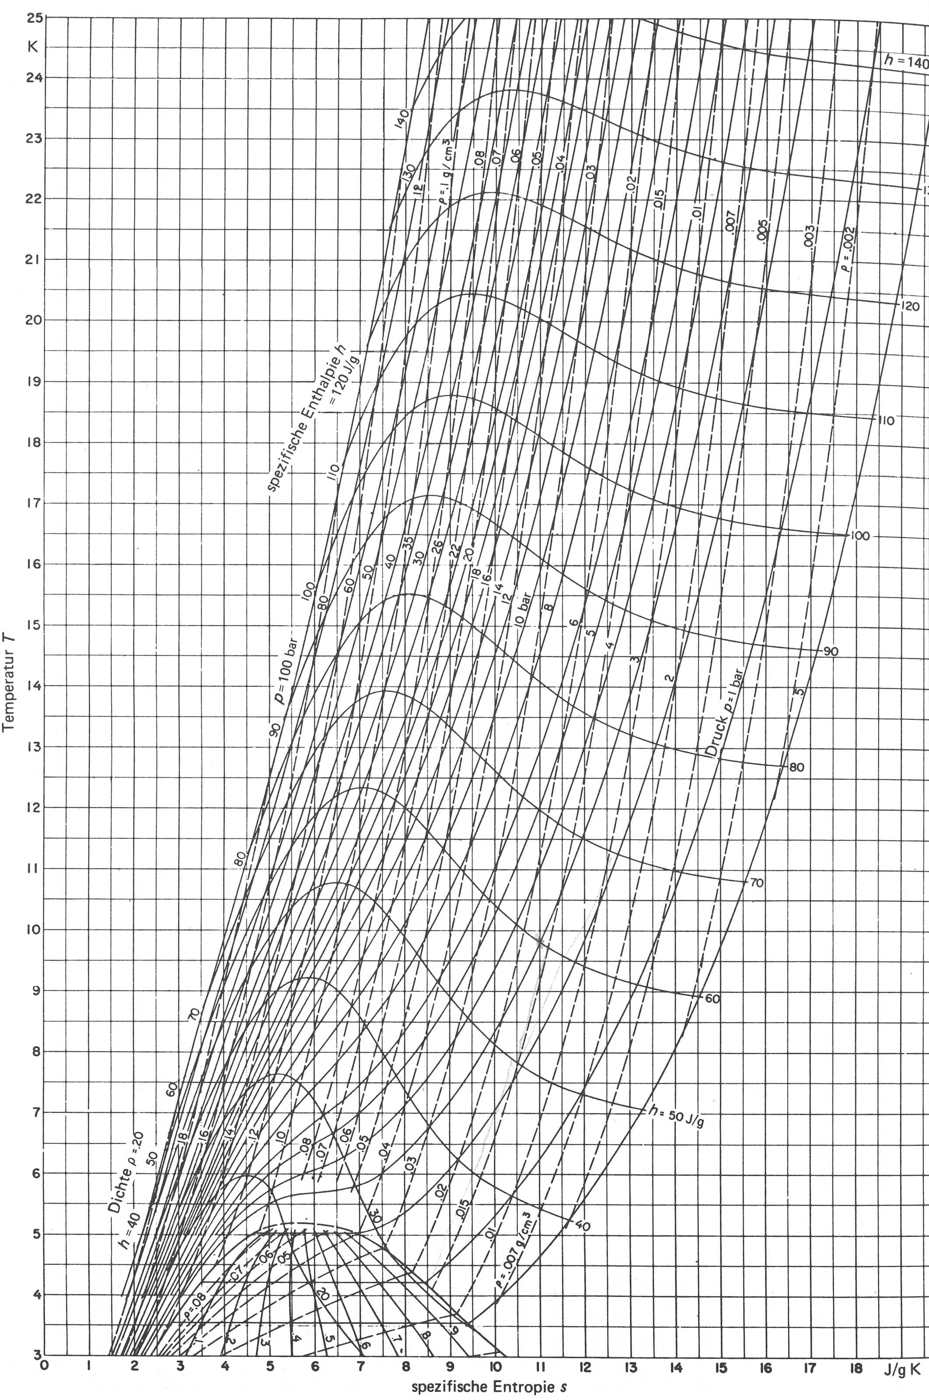

T-s diagram for helium
$$μ_{JT}={\left\{\frac{δT}{δp}\right\}}_{H}$$
Cryogen | Max. inversion temperature [K]
Helium | 43
Hydrogen | 202
Neon | 260
Air | 603
Nitrogen | 623
Argon | 723
Source: Refprop®
Air can be cooled down and liquefied by J-T expansion from room temperature,
Helium and hydrogen need precooling down to below the inversion temperature by heat exchange or work-extracting expansion (e.g. in turbines).
Published by: International Institute of Refrigeration

Slide 22
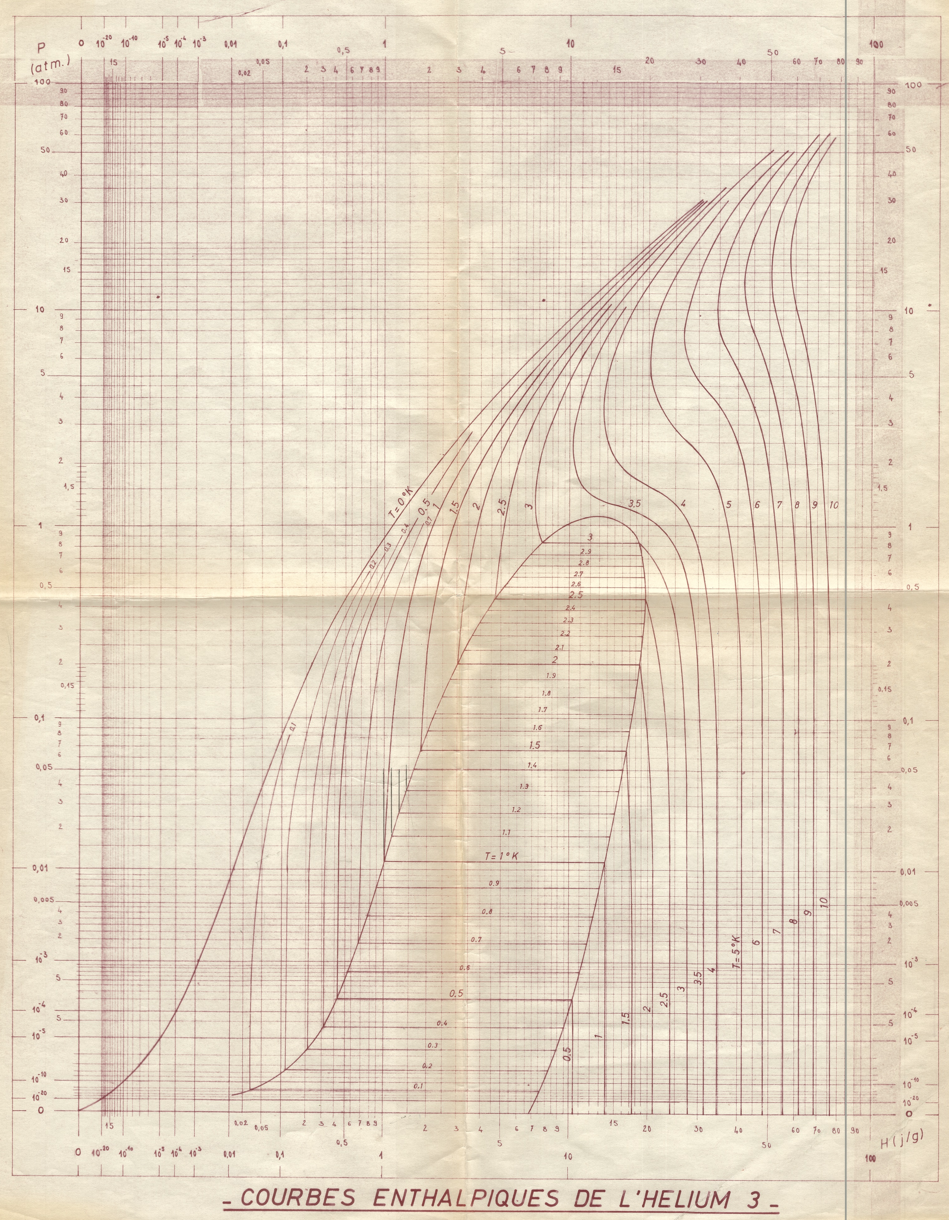
p-h diagram for ³He
Advantages:
Isenthalpic easy to spot
Subcooled liquid region large
Heating the 2-phase region => dh
Q = m * dh
.
.

Slide 23
Refrigeration cycles

Slide 24
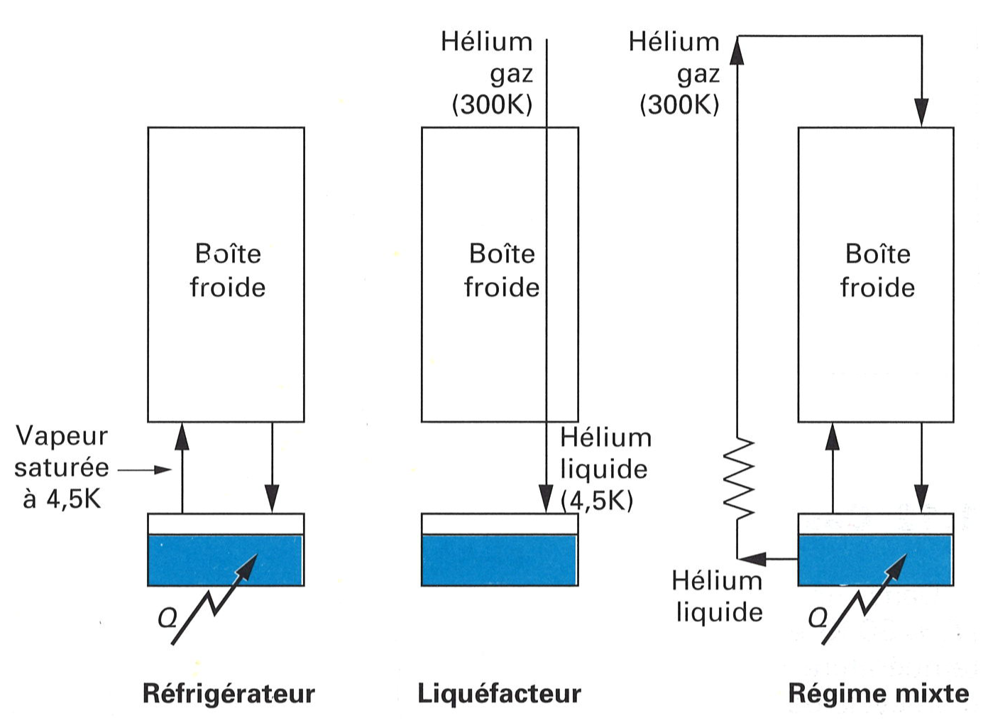
Open and closed circuits
Unbalanced heat exchanger by liquid extraction
He gas 300 K
He gas 300 K
Balanced heat exchanger due to equal mass flow
Unbalanced heat exchanger by e.g. current lead cooling, flow return at ambient temp.
Cold Box
Cold Box
Cold Box
He sat. vapor
@ 4.5 K
He liquid 4.5 K
He liquid
Refrigerator
Liquefier
Mixed mode
Adapted from: Cryogenie ses Applications en Supraconductivite, Institut International du Froid.

Slide 25
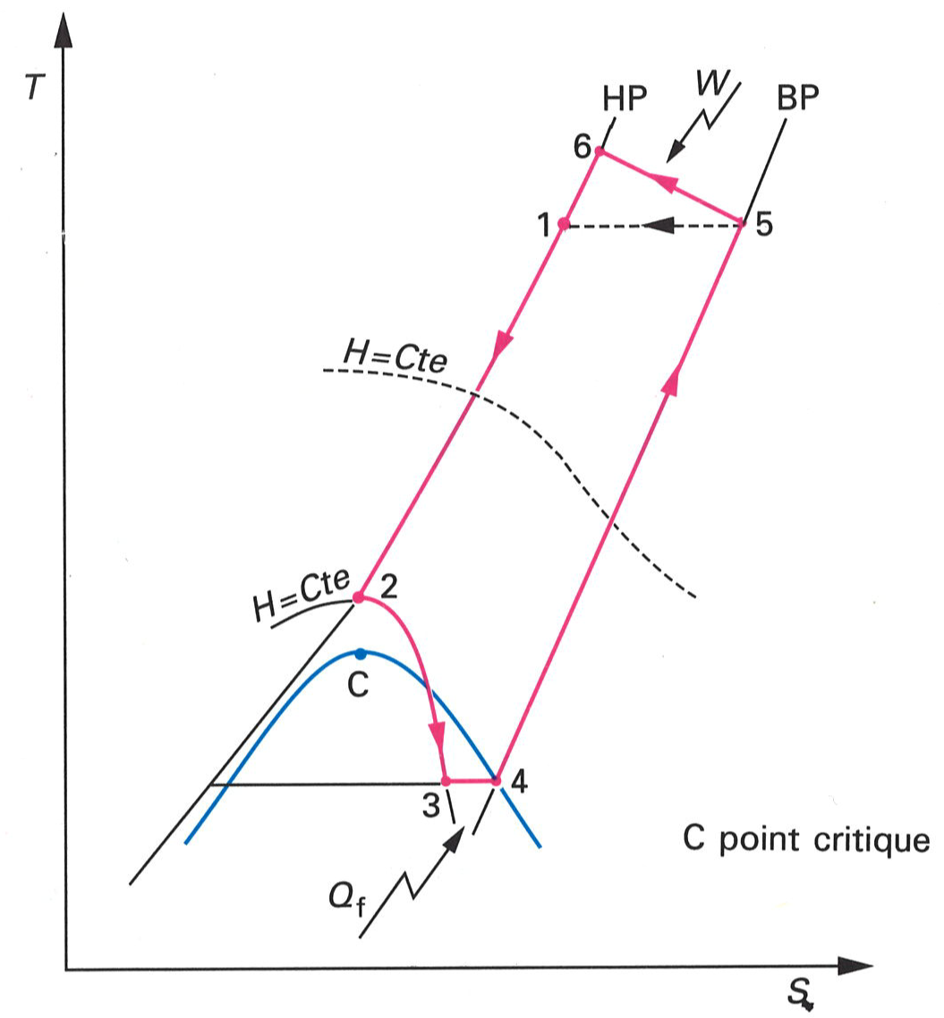
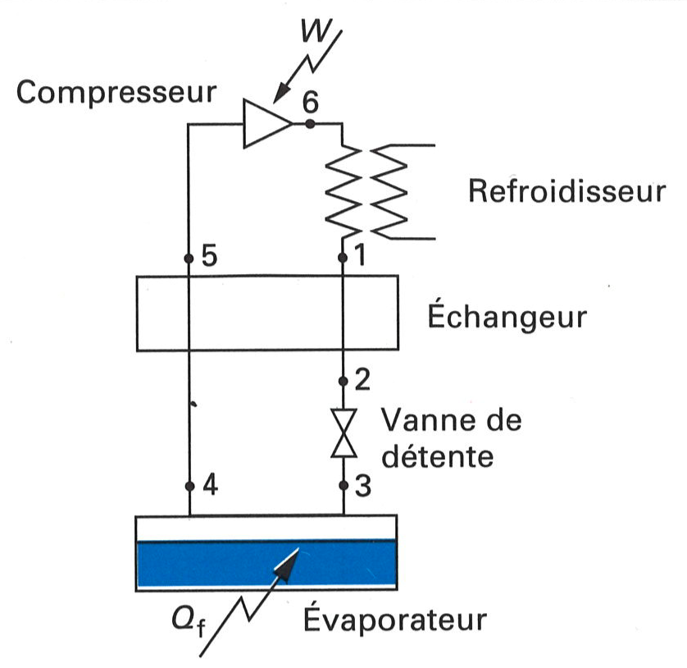
Joule-Thomson refrigerator
HP
LP
Compressor
Cooler
HEX
Expansion valve
C - critical point
Evaporator
Adapted from: Cryogenie, ses Applications en Supraconductivite, Institut International du Froid.

Slide 26
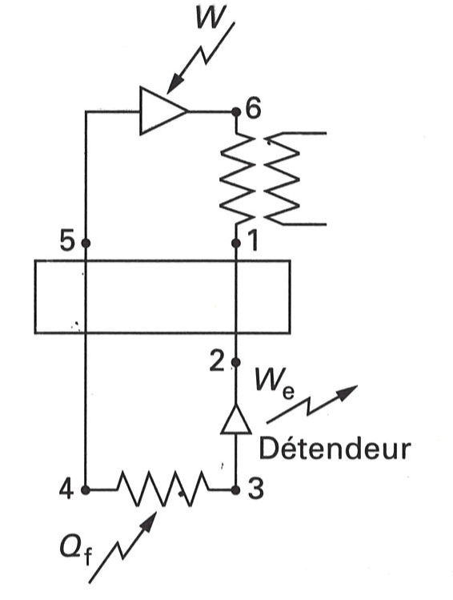
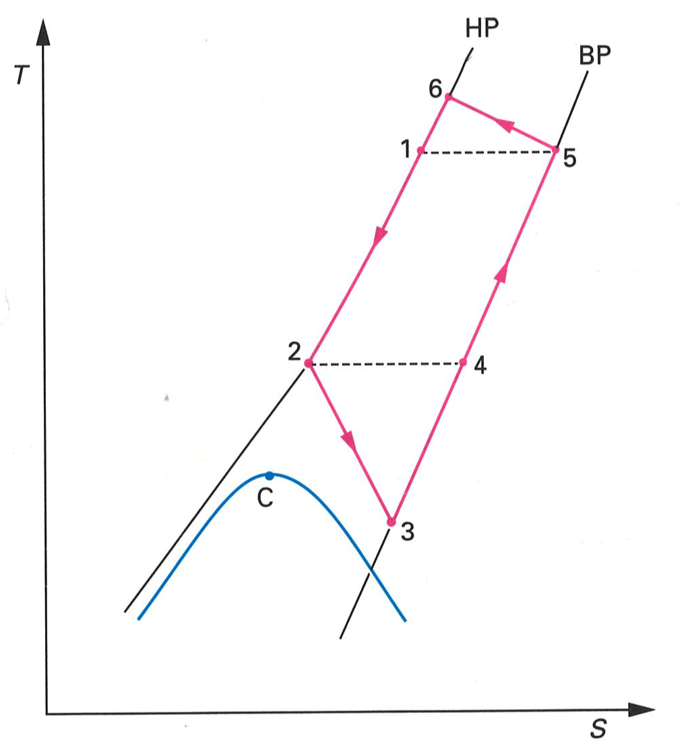
Brayton cycle refrigerator
HP
LP
Compressor
Cooler
HEX
Expansion turbine
C - critical point
Adapted from: Cryogenie, ses Applications en Supraconductivite, Institut International du Froid.

Slide 27
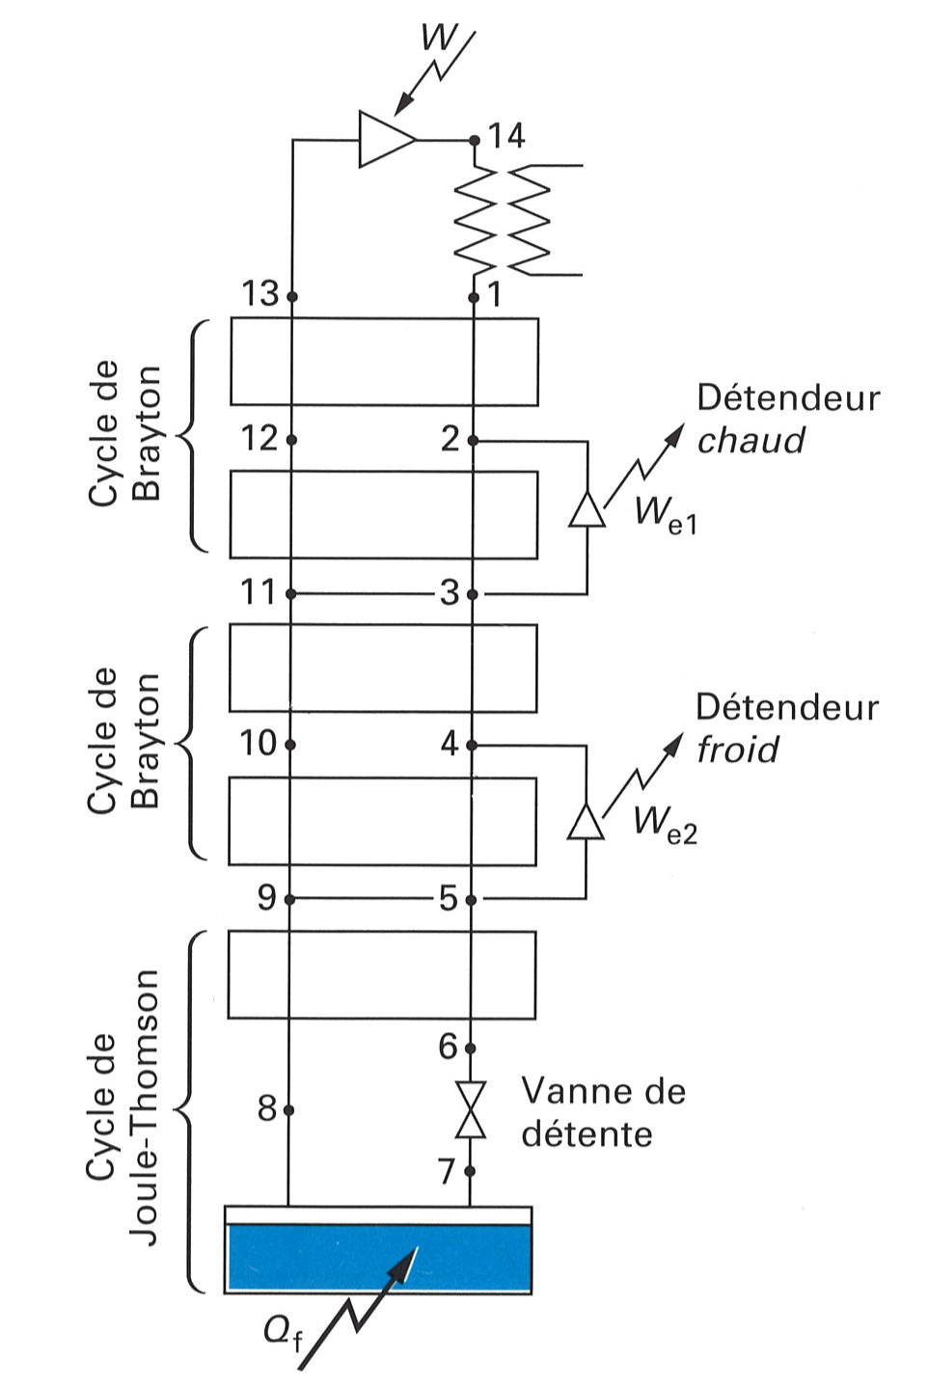
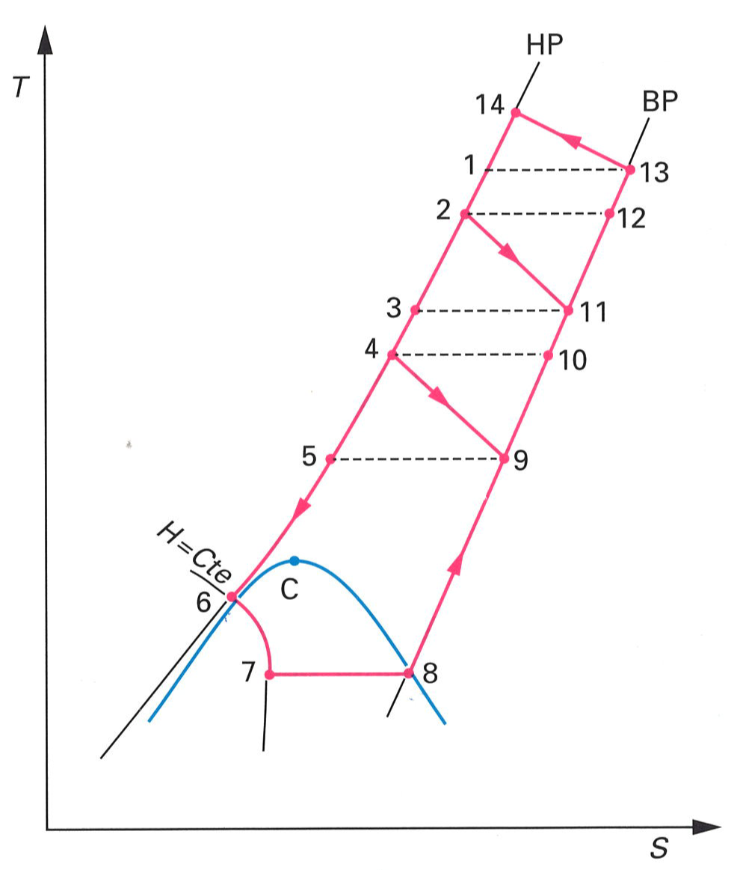
Claude cycle refrigerator
Compressor
HP
Cooler
LP
Brayton cycle
HEX
Expansion turbine “warm”
Expansion turbine “cold”
Brayton cycle
C - critical point
J-T cycle
Expansion valve
Adapted from: Cryogenie, ses Applications en Supraconductivite, Institut International du Froid.

Slide 28
Process cycle & T-s diagram of LHC 18 kW @ 4.5 K cryoplant
T
s

Slide 29
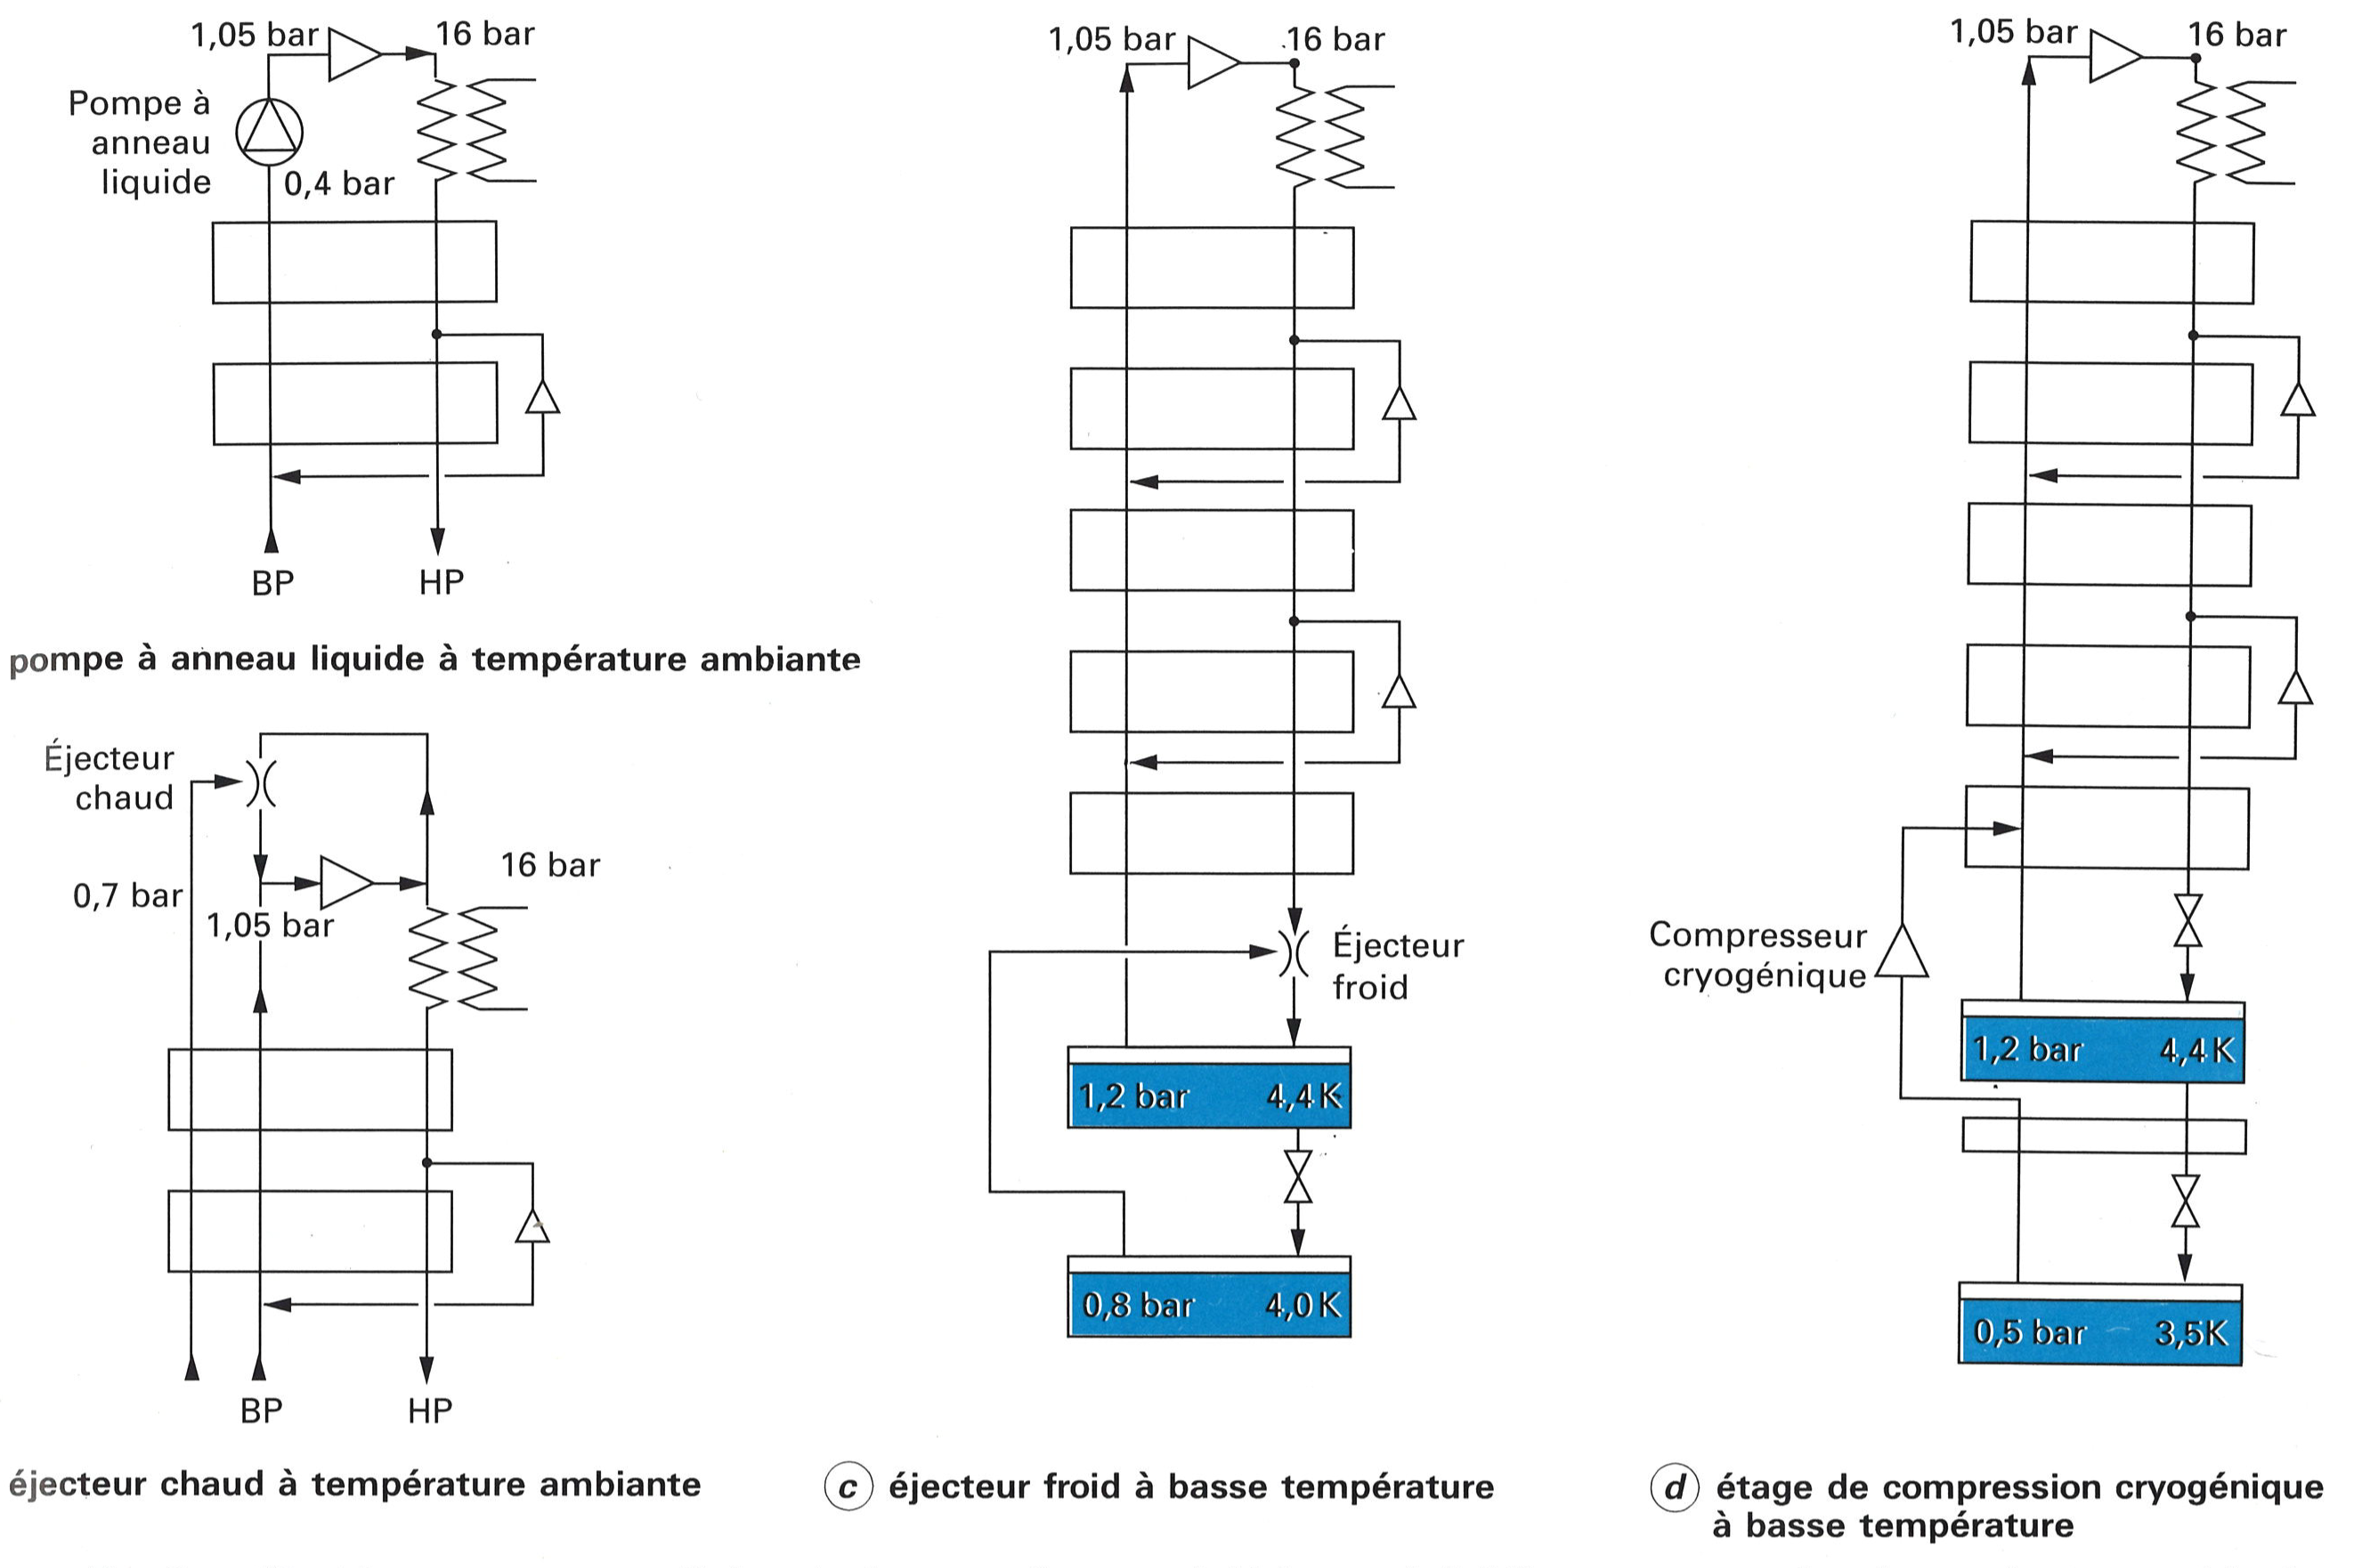
Cycles for operation below T=4.4 K
Pump
LP
HP
Ambient temperature pump
Ejector
warm
Ejector cold
Cold
compressor
LP*
LP
HP
Ambient temperature ejector
Ejector at low temperature
Cold compressor stage
Adapted from: Cryogenie ses Applications en Supraconductivite, Institut International du Froid.

Slide 30
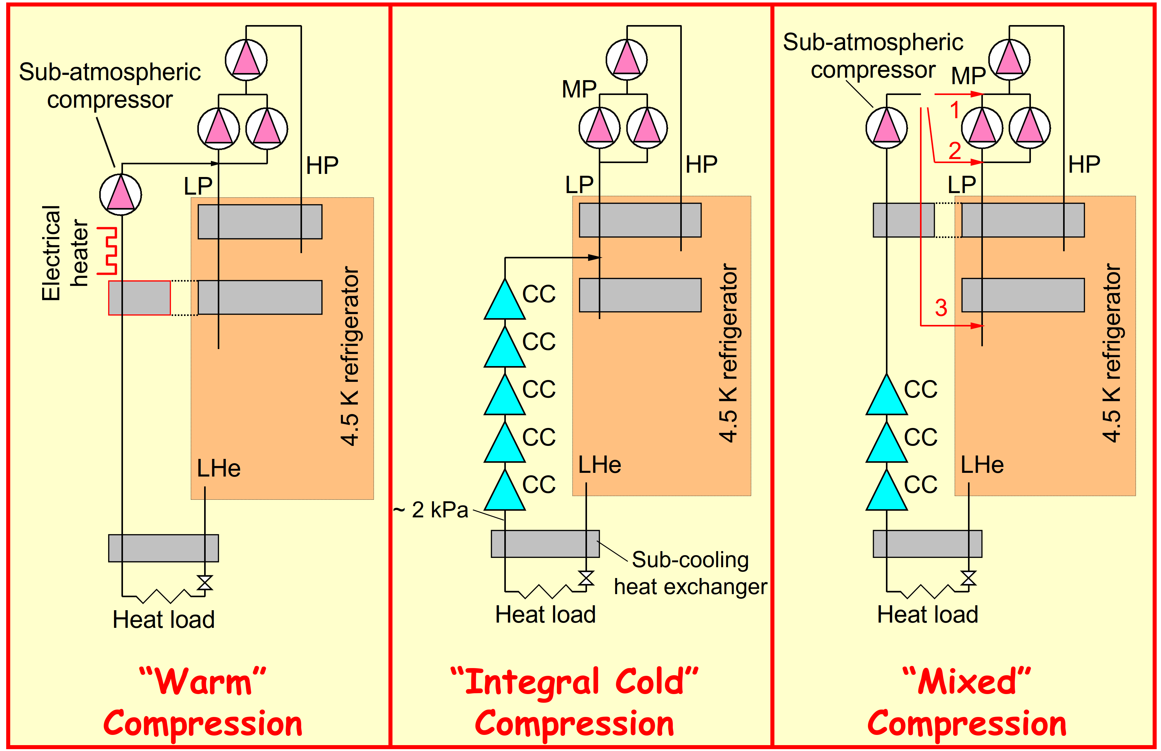
Cycles for operation below T=4.4 K
From: P. Lebrun, The Technology of Superfluid Helium, European Course of Cryogenics, 2019.

Slide 31
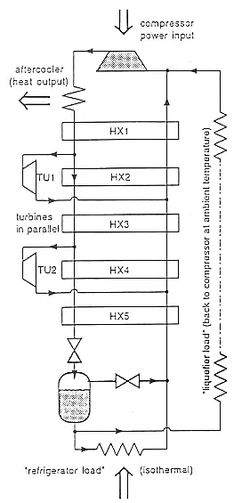
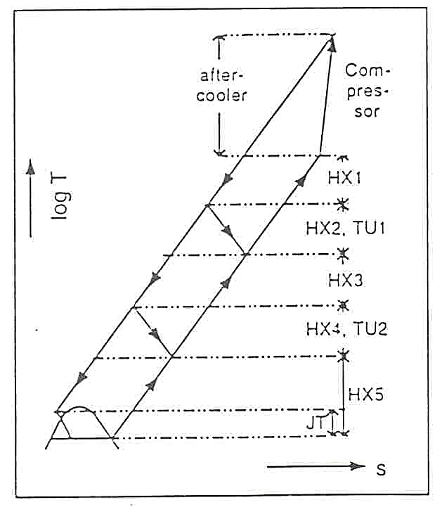
Two-stage Claude cycle

Slide 32

Once the Entropy had appeared to him
I have seen it.
How the hell did
it look like ??!!
From: Labuhn, Keine Panik vor Thermodynamik, 2011.

Slide 33
Refrigerator Liquefier

Slide 34
Refrigerator Liquefier
For refrigerators/liquefiers with the same efficiency:

Slide 35
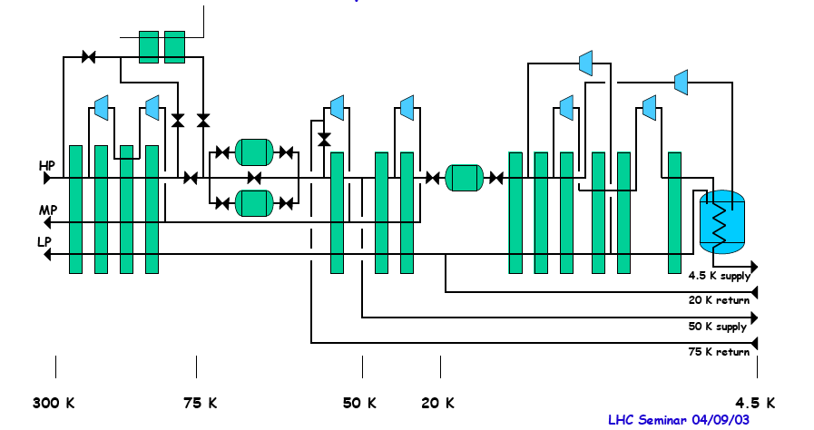
Process diagram, LHC refrigerator 18 kW @ 4.5 K
LN2 (cool-down)
Adsorbers (remove impurities)
Turbines
Heat exchangers

Slide 36
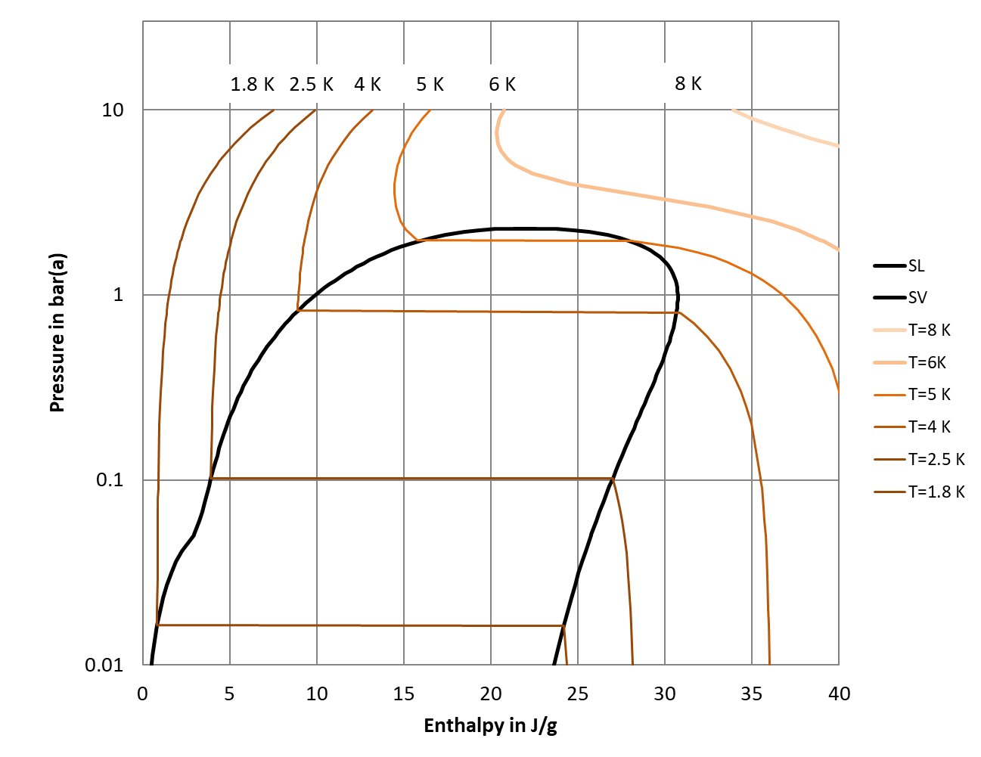
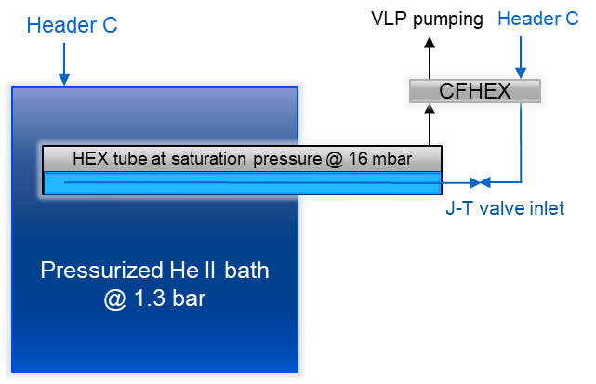
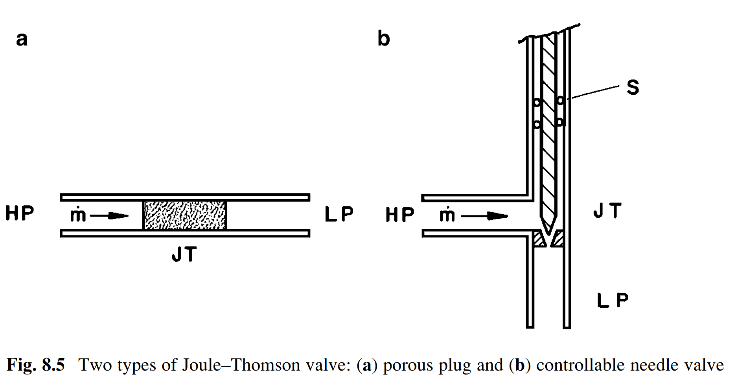




p-h diagram for helium (good for Joule-Thomson stages)
$${Δh}_{HP}$$
J-T circuit with precooling:
$${Δh}_{LP}={Δh}_{HP}+\dot{Q}res$$
J-T
$$\dot{Q}$$
$${Δh}_{LP}$$
From: Van Sciver. Helium Cryogenics.

Slide 37
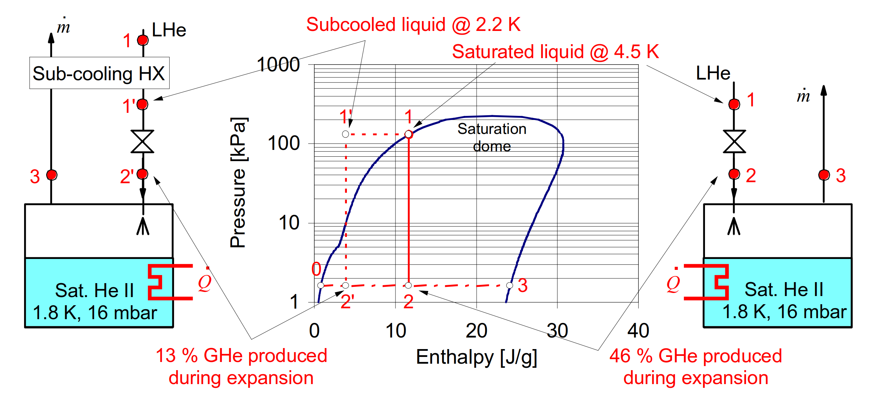
The effectiveness of J-T expansion
Source: Ph. Lebrun, Cooling with Superfluid Helium

Slide 38
Summary
Phase diagrams and how to chose the best for your process
Thermodynamic cycles: the reference is Carnot
Isentropic and isenthalpic expansion
Refrigeration cycles Brayton + J-T = Claude
Large scale applications

