Slide 2
Pressure Drop and Heat Transfer in Two-phase flow N₂ and CO₂
T. Koettig on behalf of the Cryolab team

Slide 3
Content
Motivation: Thermal shield cooling e.g. of large scale liquid Argon detectors N₂ or detector Inner Triplet cooling CO₂
Two-phase flow pressure drop
Test stand geometry and features
Pressure drop: measurement results in horizontal, vertical up- and downward orientation N₂
Verification of the test set-up by starting in subcooled liquid
Pressure drop and heat transfer on CO₂ in horizontal orientation
Summary

Slide 4


Thermal Shield Cooling of Large Scale Liquid Argon Detectors
neutrino $ν$
polyurethane foam insulation
neutrino $ν$
thermal shield
19.6 m
+
+
+
+
+
+
+
-
-
-
-
-
-
-
+
+
+
+
+
+
+
e⁻
+
liquid argon
liquid argon
γ
3.9 m
T_{sat} = 87 K
p_{sat} = 1 bar
T_{sat} = 87 K
p_{sat} = 1 bar
3.9 m
photomultipliers
3.6 m
3.6 m

Slide 5
Thermal Shield Cooling of Large Scale Liquid Argon Detectors
Constraints for the detector cooling thermal shield:
  Outer heat flux of 20 W/m² - foam insulated vessels
  Temperature gradient along shield panel dT< 500 mK
  High purity aluminum 1050A
  Boiling nitrogen as coolant at 87 K
2 g/s
boiling nitrogen
472 mm
10 mm
4 mm
42 panels
Fig.: Dimensions of one Al1050A cooling panel
Fig.: Arrangement of the cooling panels around the detector

Slide 6
Thermal Shield Cooling of Large Scale Liquid Argon Detectors
2.8 bar
∆p
∆T
1 bar
87 K
Fig.: p-T diagram with vapour pressure curves of Ar and N₂

Slide 7
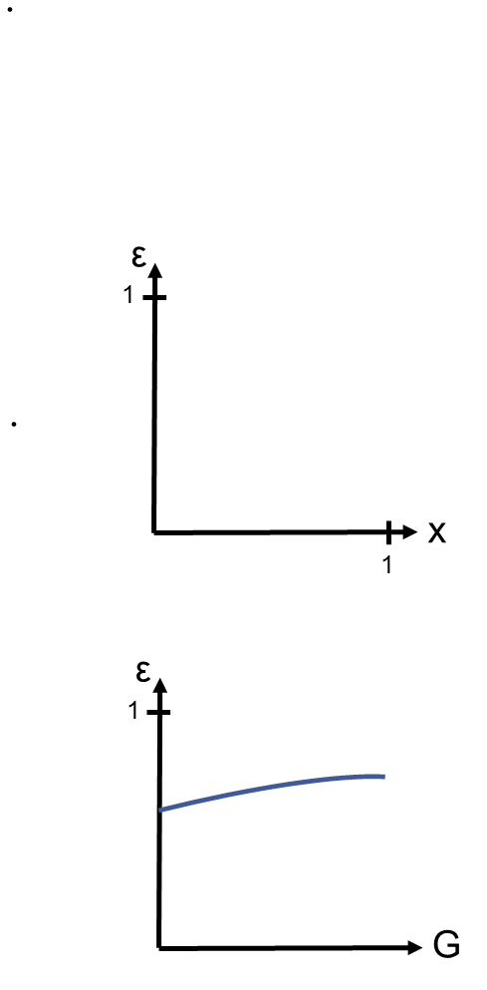

Two-phase Flow Pressure Drop
Void fraction:
Void fraction versus vapor quality
x↑ ➔ ε↑
0
Source: VDI Heat Atlas
Void fraction versus mass velocity
G↑ ➔ ε↑
in kg/(m²s)

Slide 8
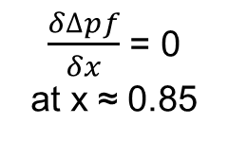
Two-phase Flow Pressure Drop
Void fraction:
Frictional pressure drop:
Void fraction versus vapor quality
Frict. press. drop versus vapor quality
x↑ ➔ ε↑
∆p_{f}
$\frac{δ∆pf}{δx}$ = 0
at x ≈ 0.85
0
Source: VDI Heat Atlas
Void fraction versus mass velocity
x
0.85
1
G↑ ➔ ε↑
Slip ratio S introduced
in kg/(m²s)

Slide 9
Two-phase Flow Pressure Drop
Void fraction:
Frictional pressure drop:
Void fraction versus vapor quality
Frict. press. drop versus vapor quality
∆p_{f}
x↑ ➔ ε↑
max. at x ≈ 0.6-0.85
0
x
0
0.6-0.75
1
Void fraction versus mass velocity
G↑ ➔ ε↑
in kg/(m²s)

Slide 10

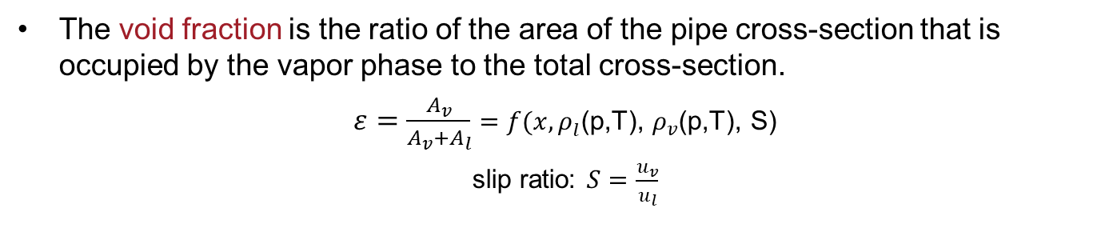
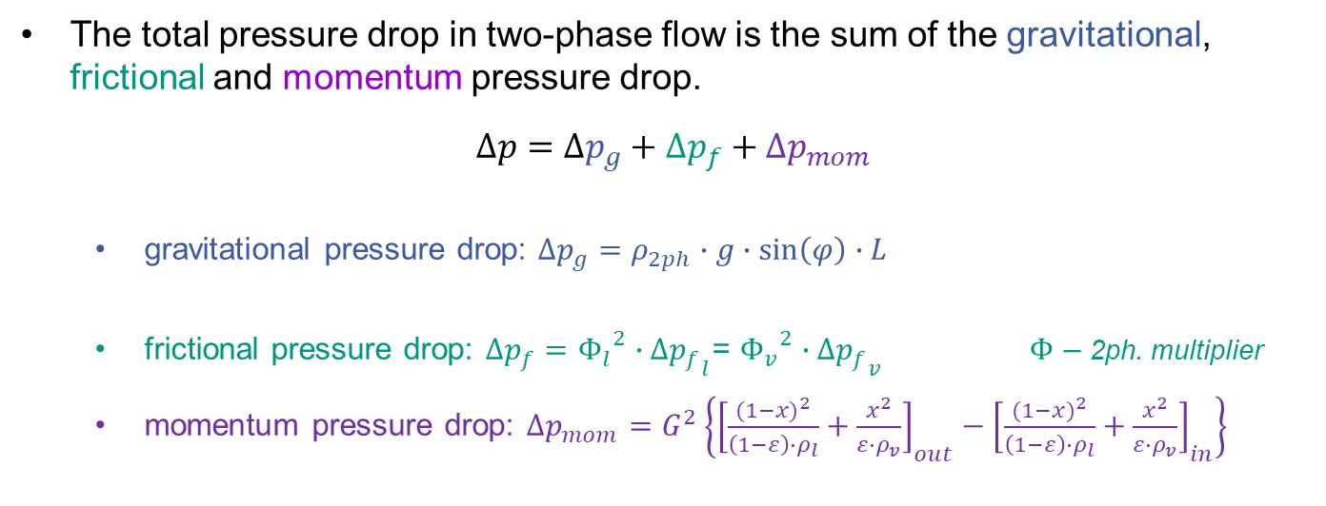
Two-phase flow pressure drop
The total pressure drop in two-phase flow is the sum of the gravitational, frictional and momentum pressure drop.
$$∆p=∆p_{g}+∆p_{f}+∆p_{mom}$$
  gravitational pressure drop: $∆p_{g}=ρ_{2ph}∙g∙\sin\left(φ\right)∙L$
  frictional pressure drop: $∆p_{f}={Φ_{l}}^{2}{∙∆p_{f}}_{l}$= ${Φ_{v}}^{2}{∙∆p_{f}}_{v}$ $Φ$ – 2ph. multiplier
  momentum pressure drop: $∆p_{mom}=G^{2}\left\{{\left[\frac{{(1−x)}^{2}}{\left(1−ε\right)∙ρ_{l}}+\frac{x^{2}}{ε∙ρ_{v}}\right]}_{out}−{\left[\frac{{(1−x)}^{2}}{\left(1−ε\right)∙ρ_{l}}+\frac{x^{2}}{ε∙ρ_{v}}\right]}_{in}\right\}$
$ρ_{2ph}={(1−ε)∙ρ}_{l}$+${ε∙ρ}_{v}$
The void fraction is the ratio of the area of the pipe cross-section that is occupied by the vapor phase to the total cross-section.
$ε=\frac{A_{v}}{A_{v}+A_{l}}=f(x,ρ_{l}$(p,T), $ρ_{v}$(p,T), S)
slip ratio: $S=\frac{u_{v}}{u_{l}}$
Source: H. Kirsch, Cooling Circuit Design for the Large-scale Liquid Argon Detectors in the ICARUS Experiment, CERN-THESIS-2016-438

Slide 11
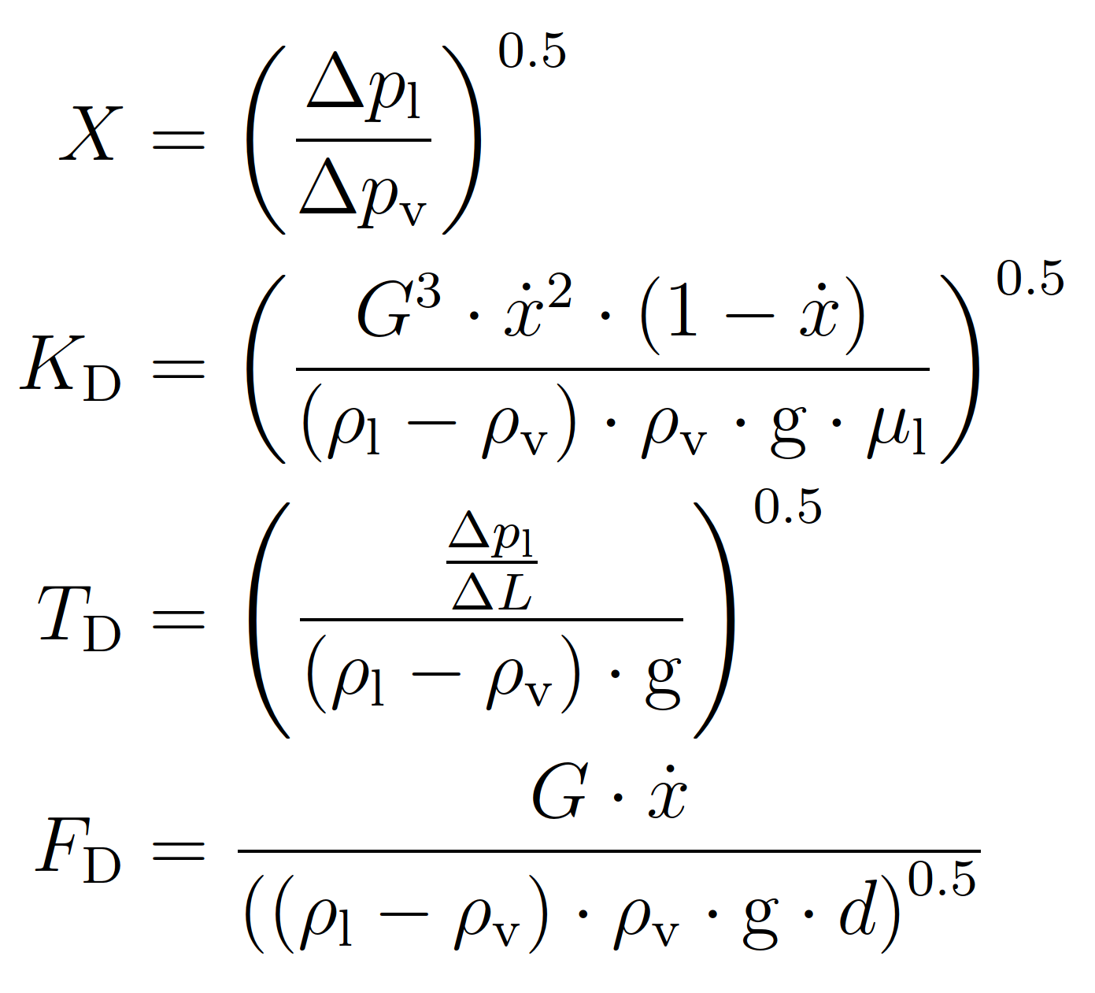
Flow pattern map I
Fig.: Flow pattern for horizontal flow
VDI Heat Atlas
Fig.: Flow pattern map according to Taitel and Dukler, VDI Heat Atlas
Source: H. Kirsch, Cooling Circuit Design for the Large-scale Liquid Argon Detectors in the ICARUS Experiment, CERN-THESIS-2016-438

Slide 12
Flow pattern map II
Fig.: Flow pattern for vertical flow
VDI Heat Atlas
Fig.: Flow pattern map according to Hewitt and Roberts, VDI Heat Atlas

Slide 13
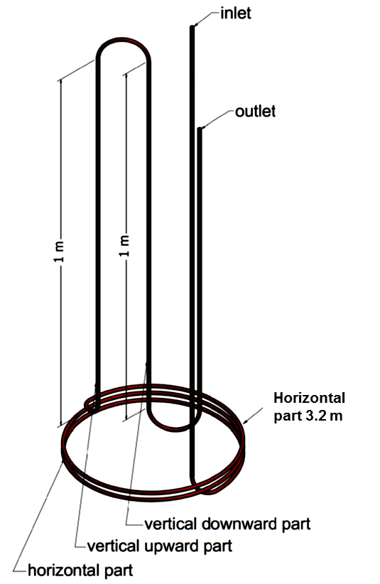
Experimental Set-up
LN₂
1 bar
TT
PT
PT
TT
FT
EH 1
EH 2
EH 3
2
3
4
5
6
Sample
Precooler
Joule-Thomson expansion
Cryostat with thermal shield
p
1
LN₂ Dewar
4 bar
EH 1
1
EH 2
3
4
2
Test
5
6
h

Slide 14
Experimental Set-up
LN₂
1 bar
TT
PT
PT
TT
FT
EH 1
EH 2
EH 3
2
3
4
5
6
Sample
Precooler
Joule-Thomson expansion
Cryostat with thermal shield
p
1
LN₂ Dewar
4 bar
EH 1
Test conditions
Pressure (bar abs.) | 2.8
Internal diameter (mm) | 6.0
Mass flow (g/s) | 0.6 – 2.0
Mass velocity (kg/m²s) | 22 - 72
1
EH 2
3
4
2
Test
5
6
h

Slide 15
PID (Mass flow control at inlet, pressure control at outlet!)

Slide 16
Results – Horizontal Orientation
Source: H. Kirsch, Cooling Circuit Design for the Large-scale Liquid Argon Detectors in the ICARUS Experiment, CERN-THESIS-2016-438

Slide 17
Results – Horizontal Orientation
Source: H. Kirsch, Cooling Circuit Design for the Large-scale Liquid Argon Detectors in the ICARUS Experiment, CERN-THESIS-2016-438

Slide 18
Results – Horizontal Orientation
Source: H. Kirsch, Cooling Circuit Design for the Large-scale Liquid Argon Detectors in the ICARUS Experiment, CERN-THESIS-2016-438

Slide 19
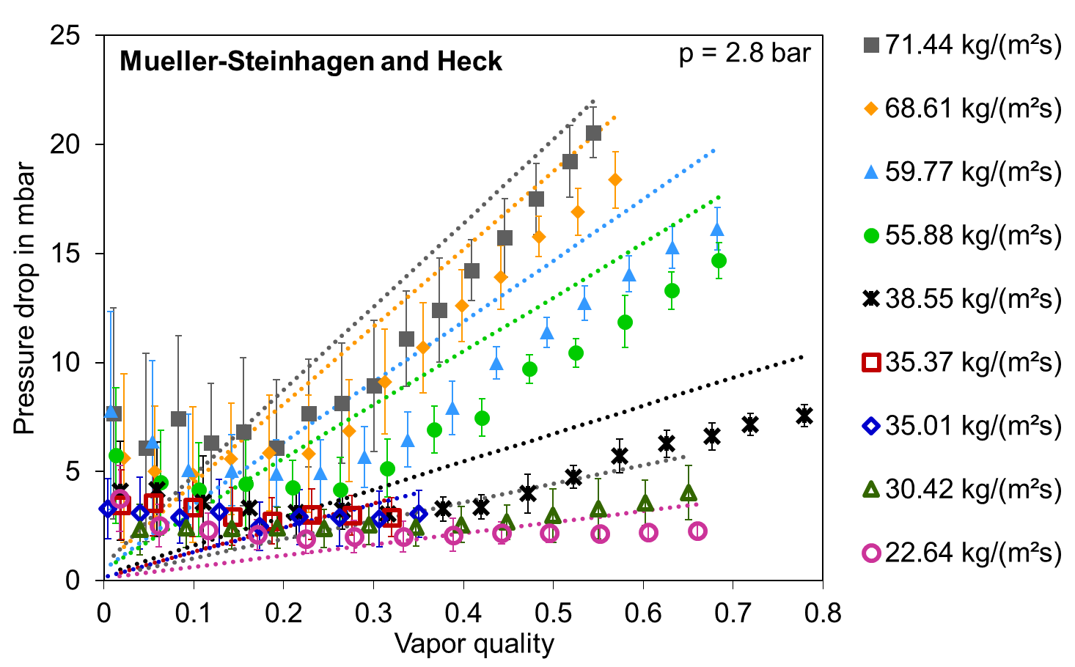
Results – Horizontal Orientation
Source: H. Kirsch, Cooling Circuit Design for the Large-scale Liquid Argon Detectors in the ICARUS Experiment, CERN-THESIS-2016-438

Slide 20
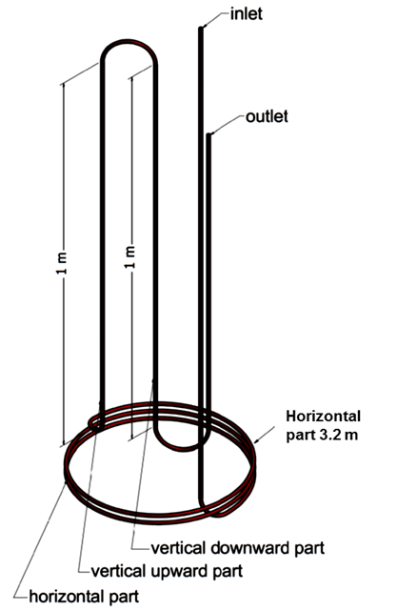
Vertical Upward Orientation

Slide 21
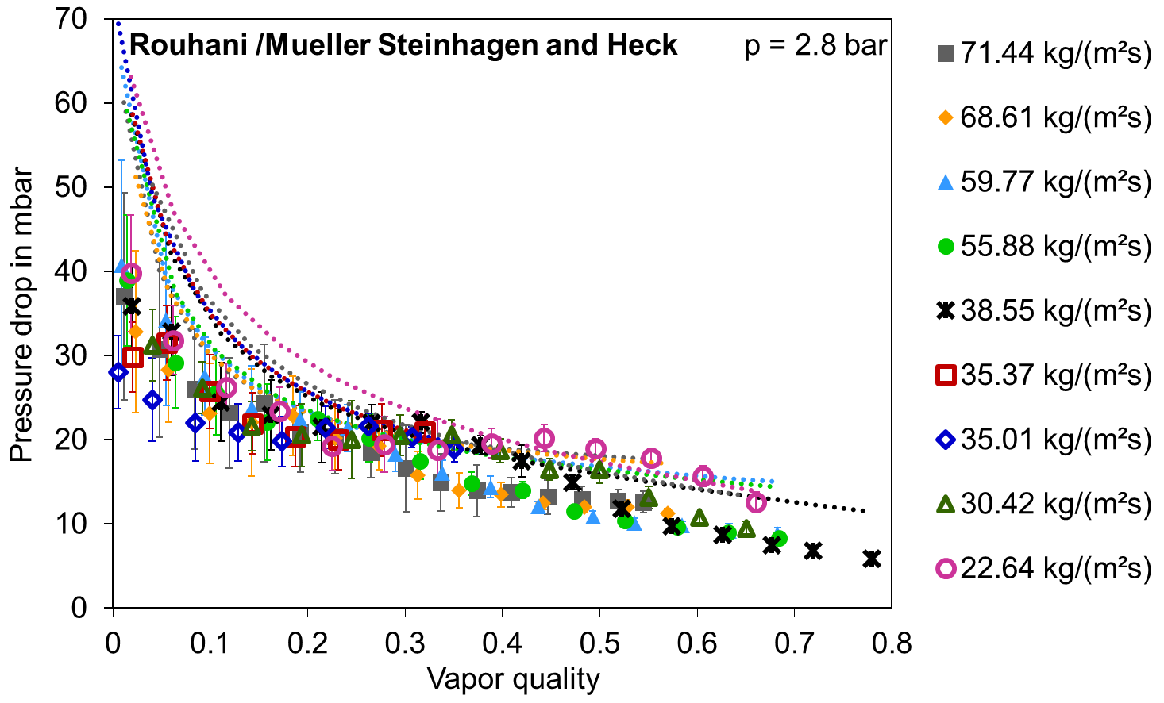
Results – Vertical Upward Orientation
Flow is always in chaotic regime
Source: H. Kirsch, Cooling Circuit Design for the Large-scale Liquid Argon Detectors in the ICARUS Experiment, CERN-THESIS-2016-438

Slide 22
Vertical Downward Orientation

Slide 23
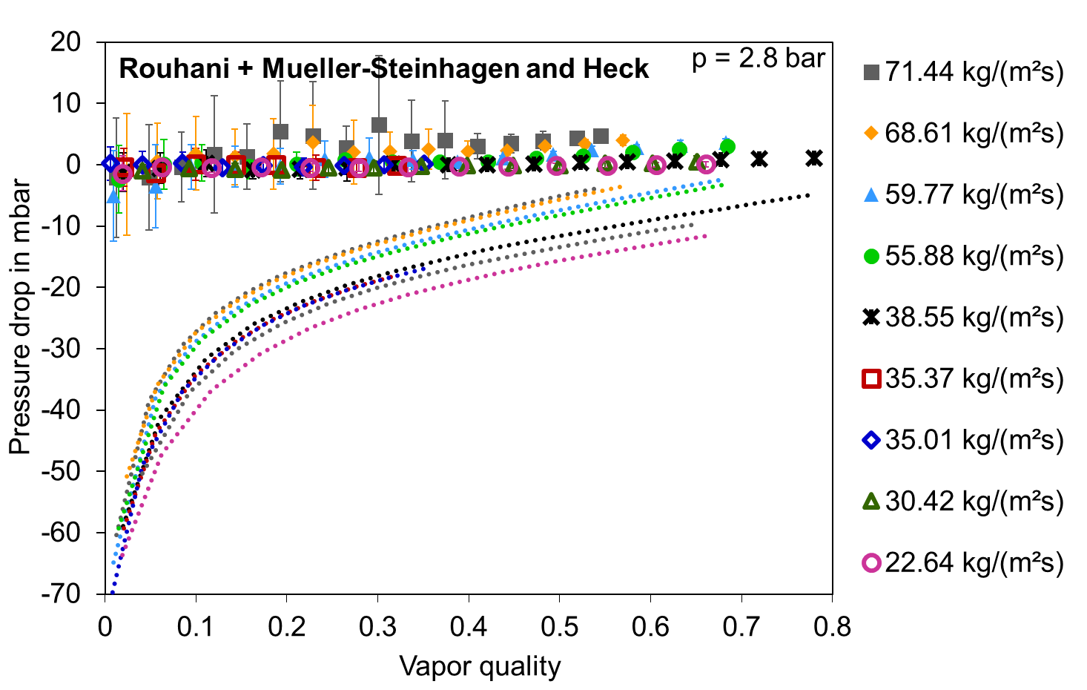
Results – Vertical Downward Orientation
Source: H. Kirsch, Cooling Circuit Design for the Large-scale Liquid Argon Detectors in the ICARUS Experiment, CERN-THESIS-2016-438

Slide 24
Verification of the set-up
Enter the two-phase range from the liquid phase (subcooled)
Monitor the change in pressure drop
Monitor the temperature behaviour single phase to saturation conditions

Slide 25
Experimental Set-up
LN₂
1 bar
TT
PT
PT
TT
FT
EH 1
EH 2
EH 3
2
3
4
5
6
Sample
Precooler
Joule-Thomson expansion
p
Cryostat with thermal shield
1
LN₂ Dewar
4 bar
EH 1
Test conditions
Pressure (bar abs.) | 2.8
Internal diameter (mm) | 6.0
Mass flow (g/s) | 1.44
Mass velocity (kg/m²s) | 51
1
3
4
2
5
6
Test
EH 2
h

Slide 26
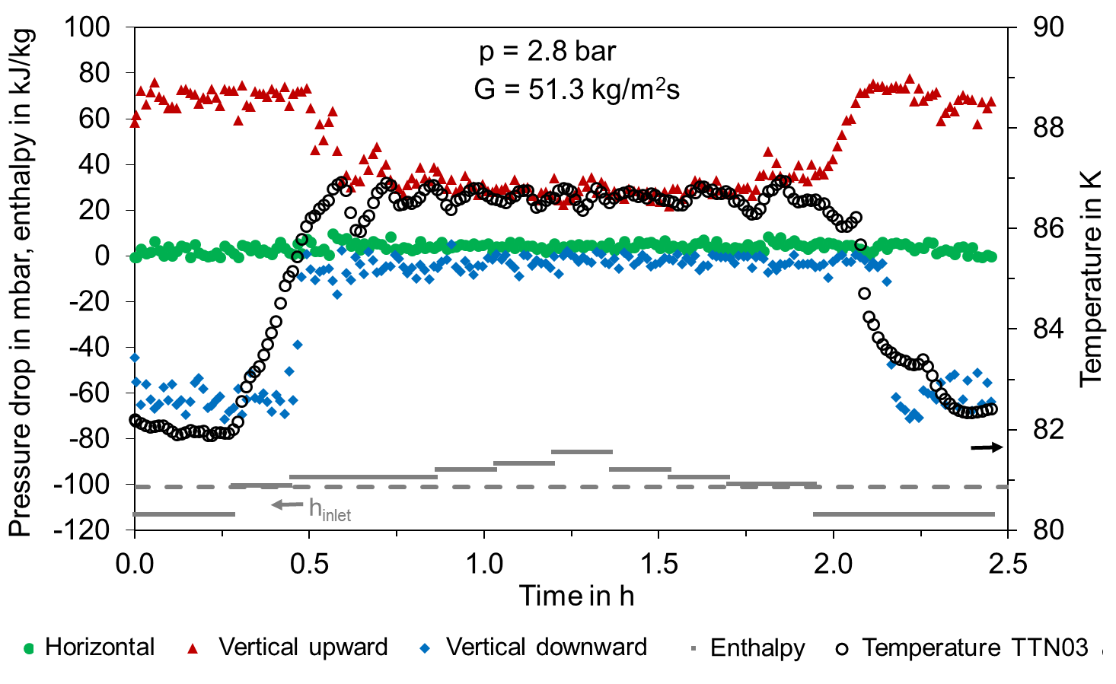
Results – Verification Test
Temperature inlet

Slide 27
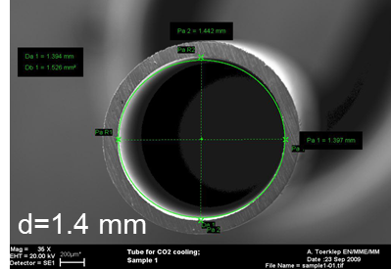
CO₂ two-phase flow in mini channels
Pressure drop and heat transfer study in a horizontal mini-channel as a function of:
  vapor quality
  mass flux
  heat flux
  p_{sat} and T_{sat}

Slide 28
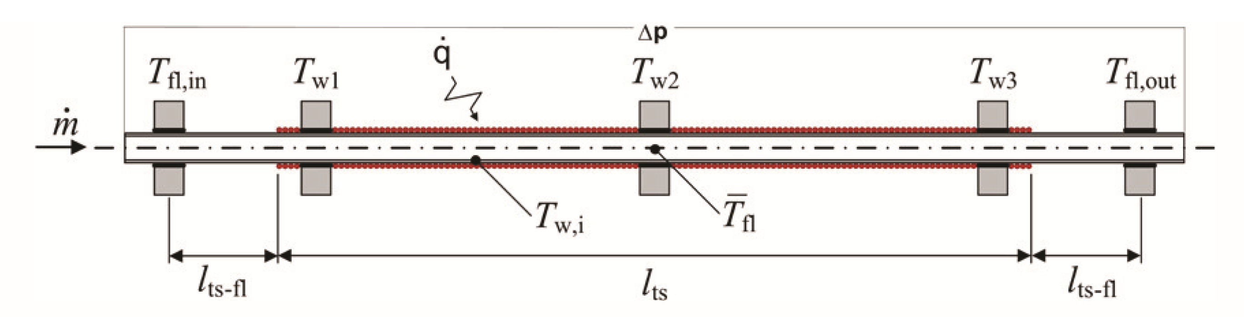
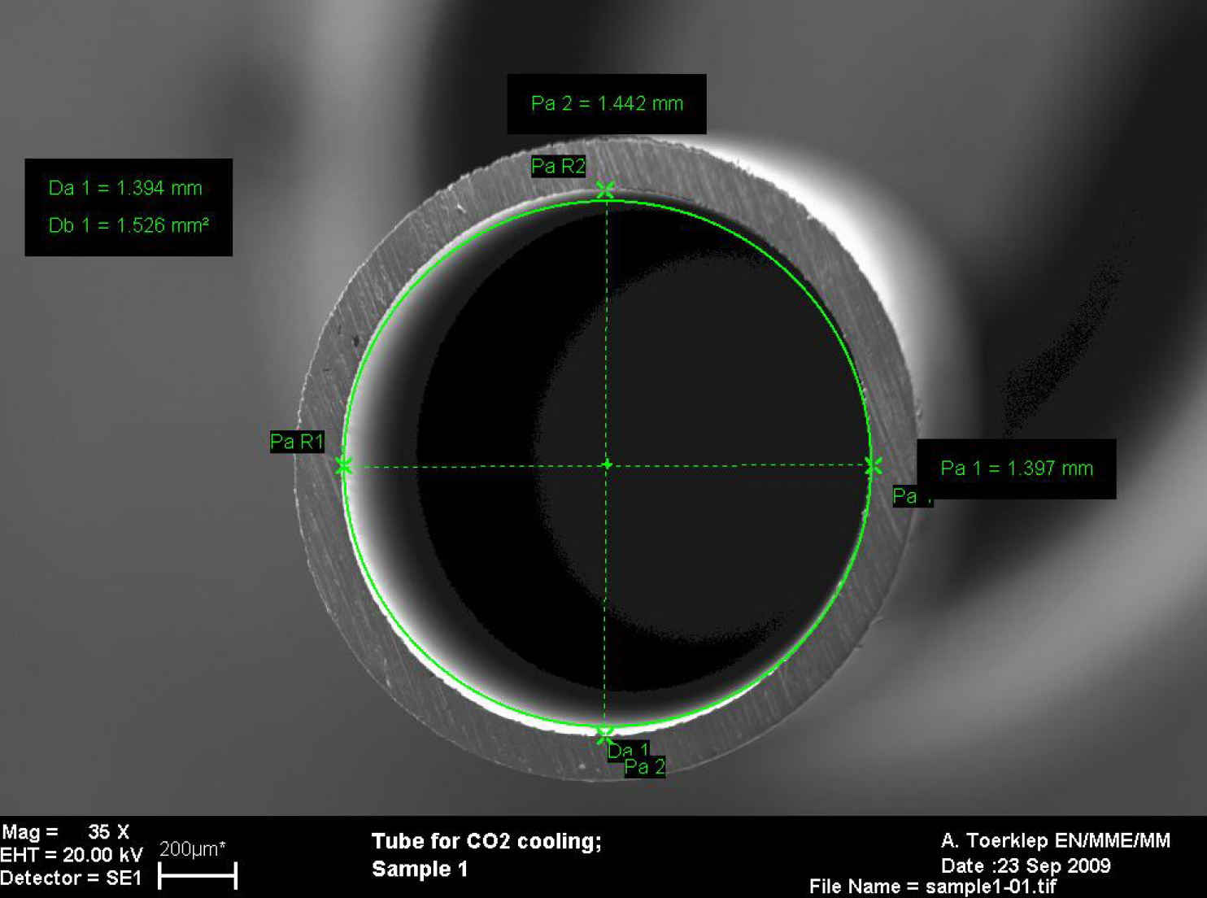
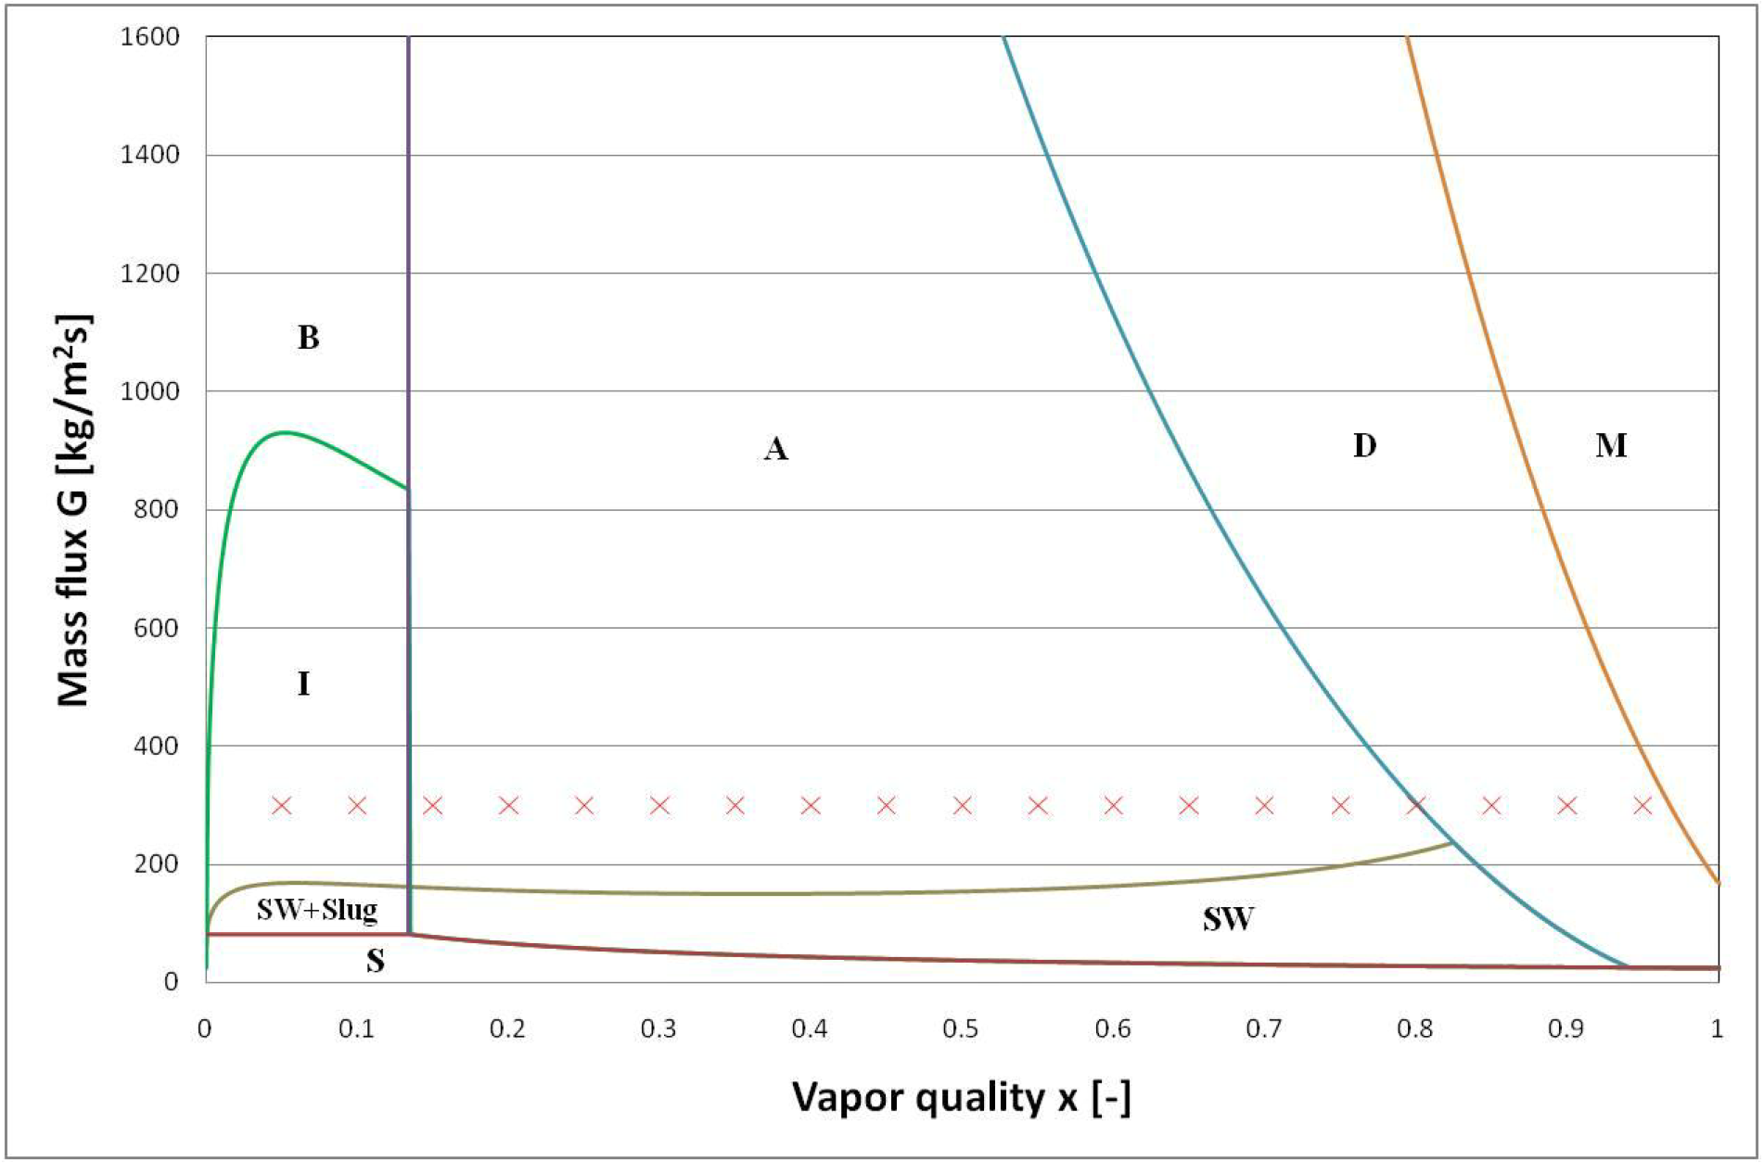
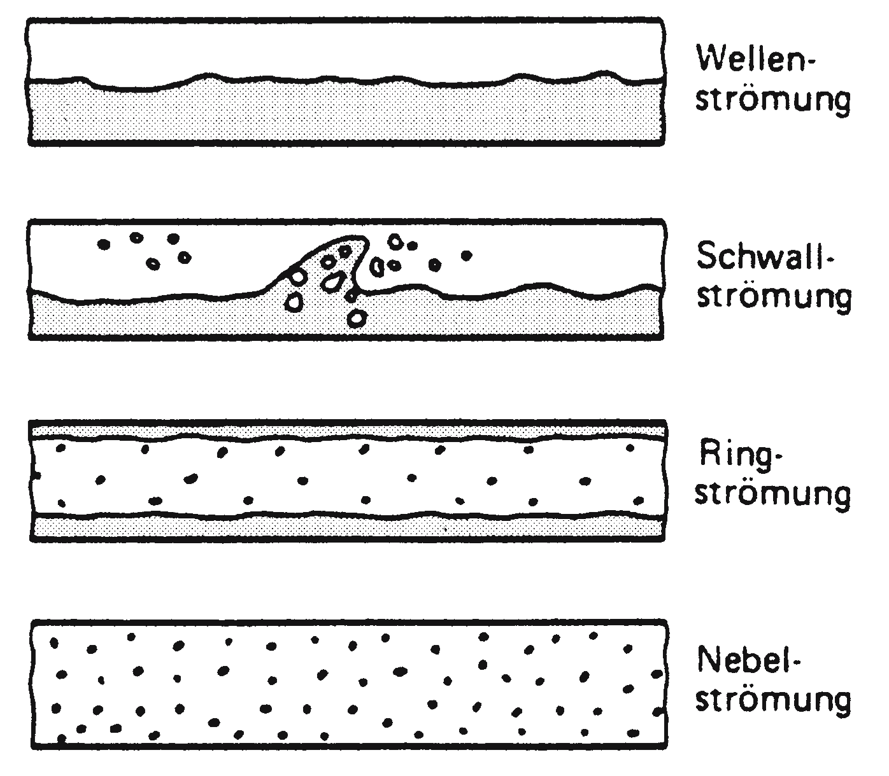
CO₂ two-phase flow pressure drop
d=1.4 mm
S => SW
Intermitt.
Annular
Dry-out
Mist
From: VDI Waermeatlas Hbb4, 2006

Slide 29
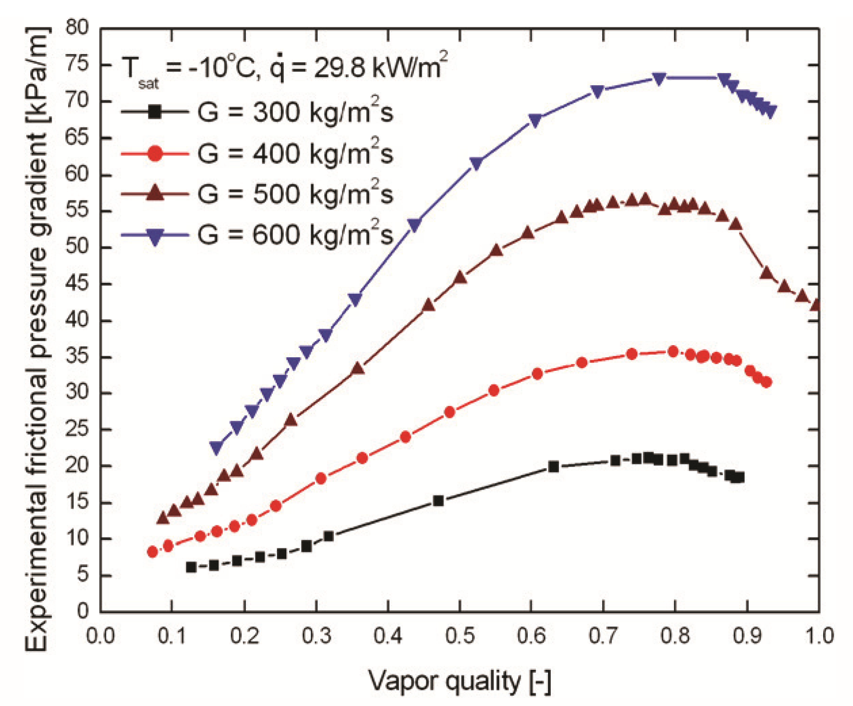
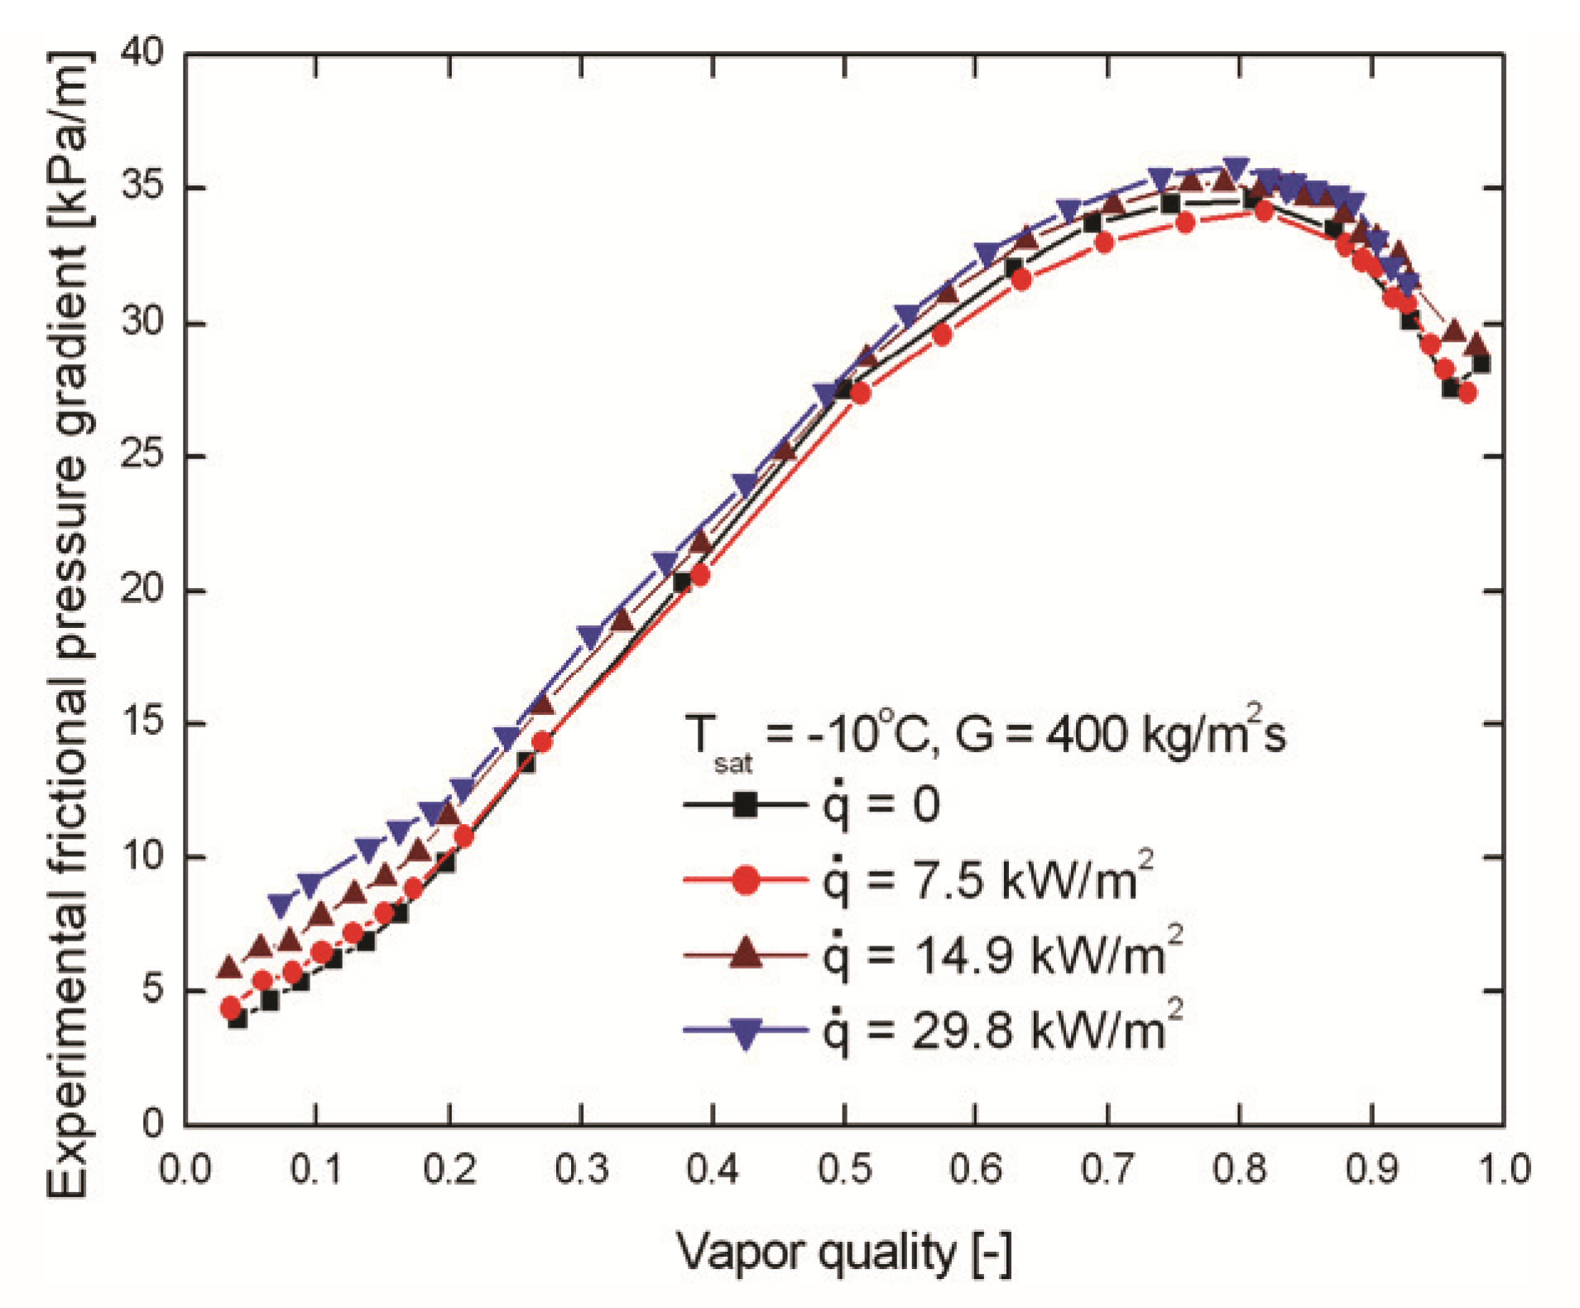


CO₂ two-phase flow - Pressure drop
$$Δp \text{= }\text{fct}\text{.}(G)$$
$$Δp≠\text{fct}\text{.}(\dot{q})$$

Slide 30
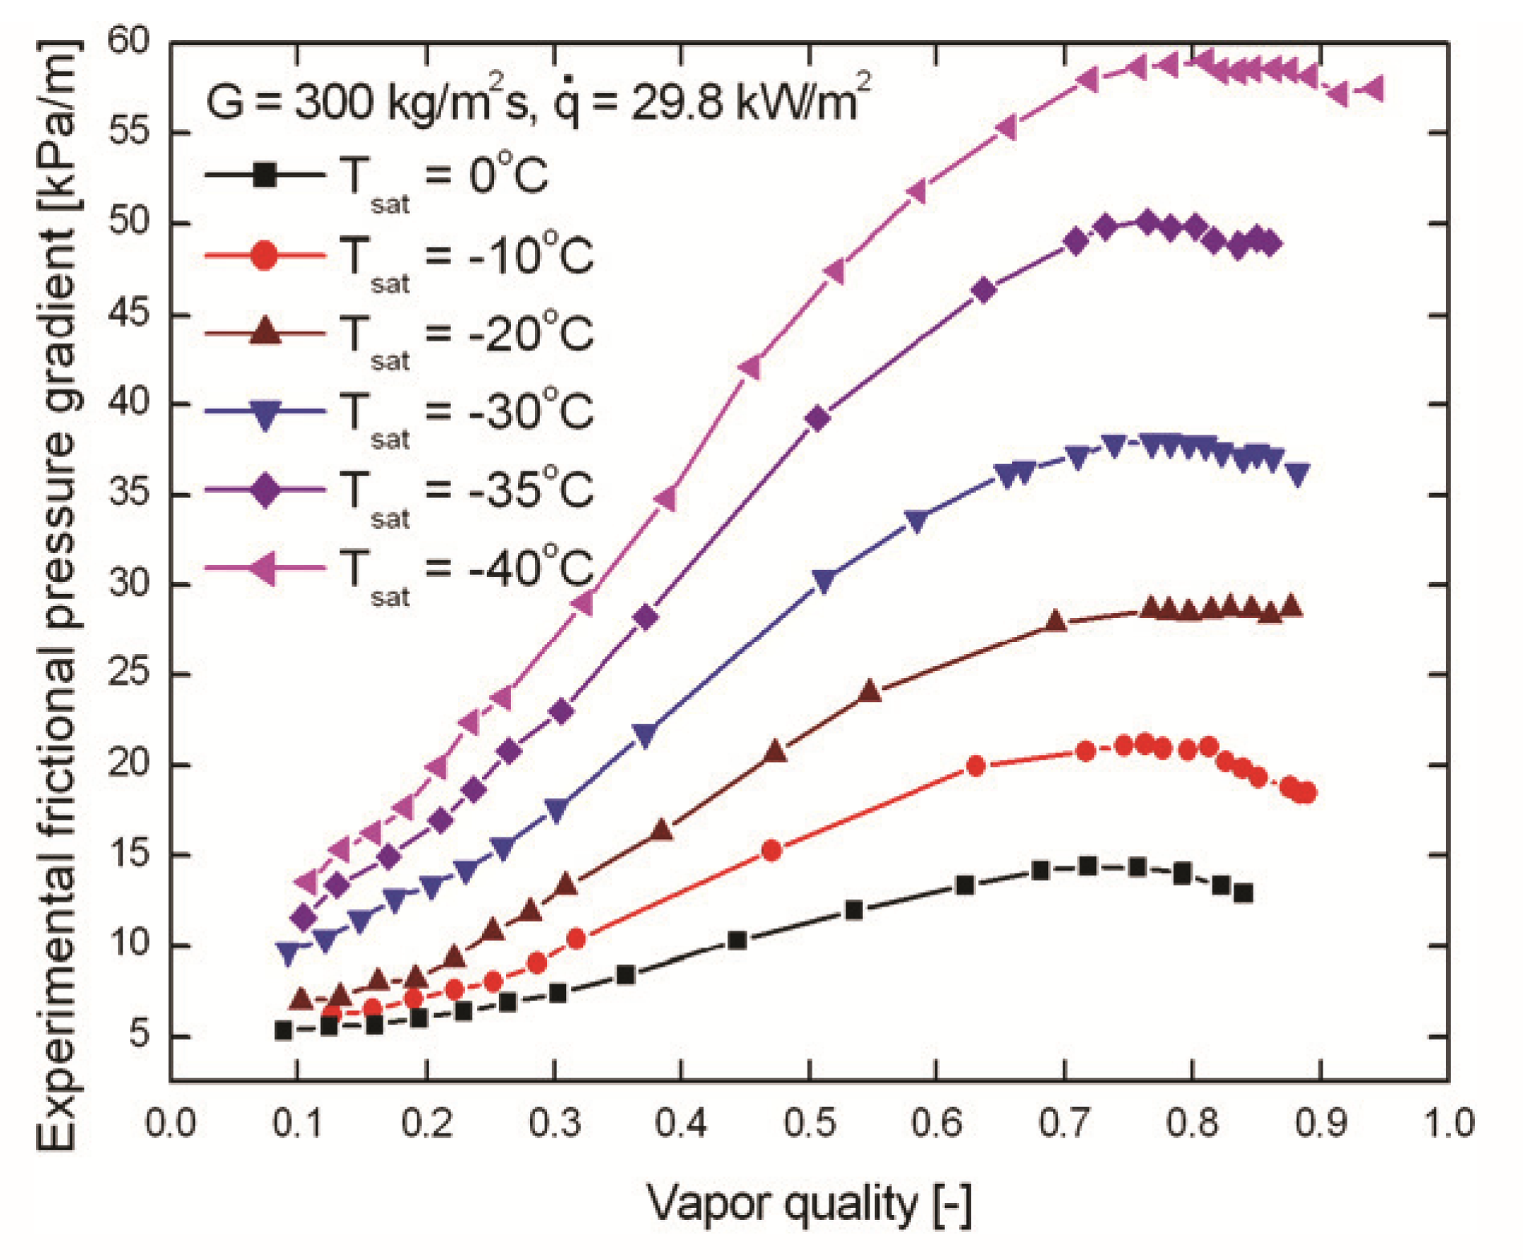
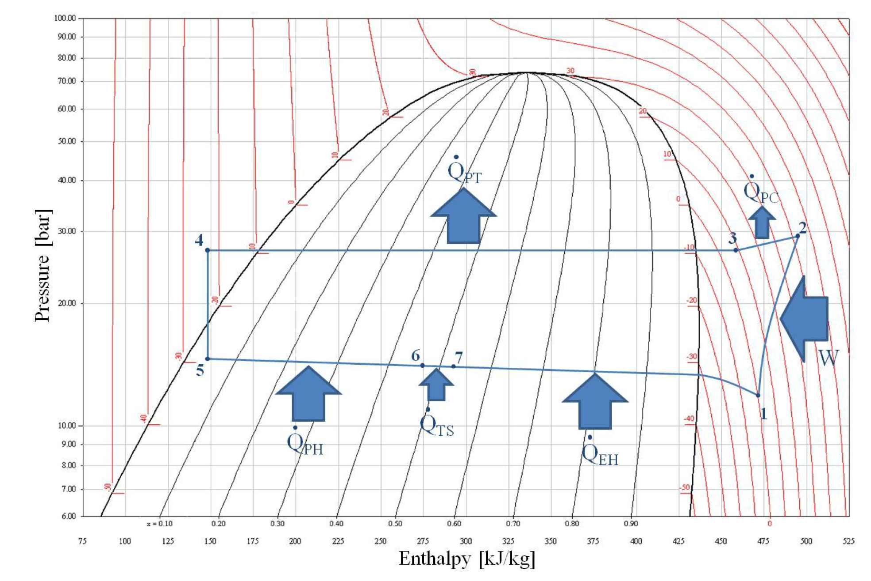

CO₂ two-phase flow - Pressure drop
$$Δp\text{ = }\text{fct}\text{.}\left(Tsat\right)⇒ fct. (p_{sat})$$
Pressure drop and or heating two-phase flow is cooling!
100
10
From: D. Helmer, Investigation of Heat Transfer and Pressure Drop Phenomena of CO₂ in Two Phase Flow

Slide 31
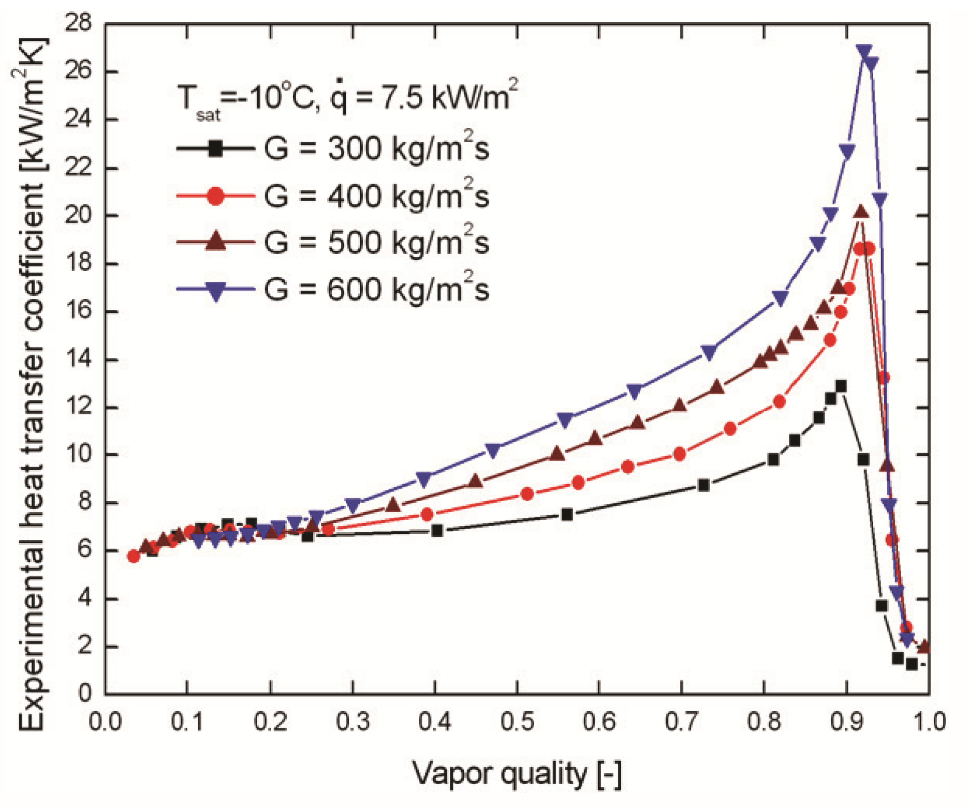
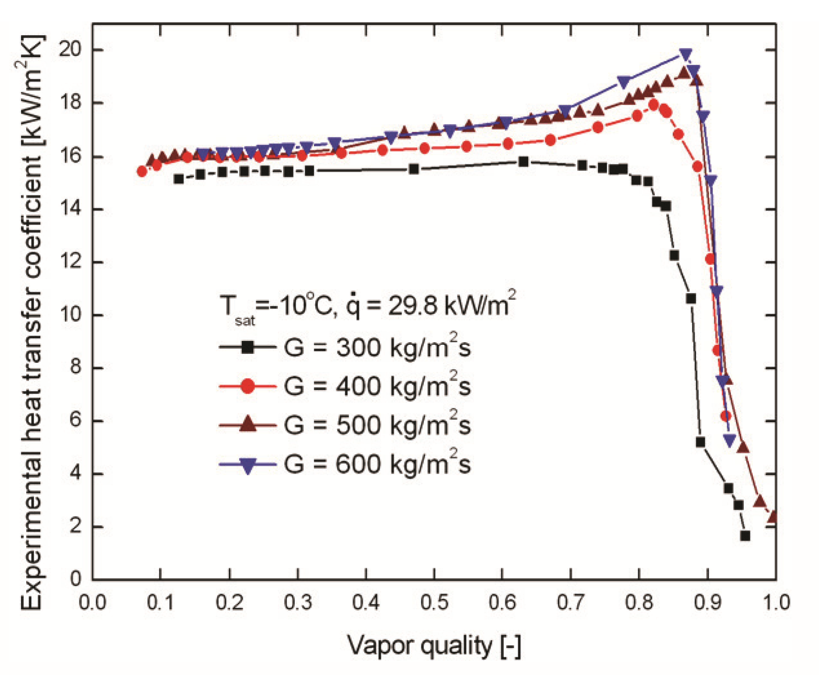
CO₂ two-phase flow - Heat transfer (heat and mass flux dep.)
Mass flux dep. at low heat flux
Mass flux dep. at high heat flux
d=1.4 mm

Slide 32
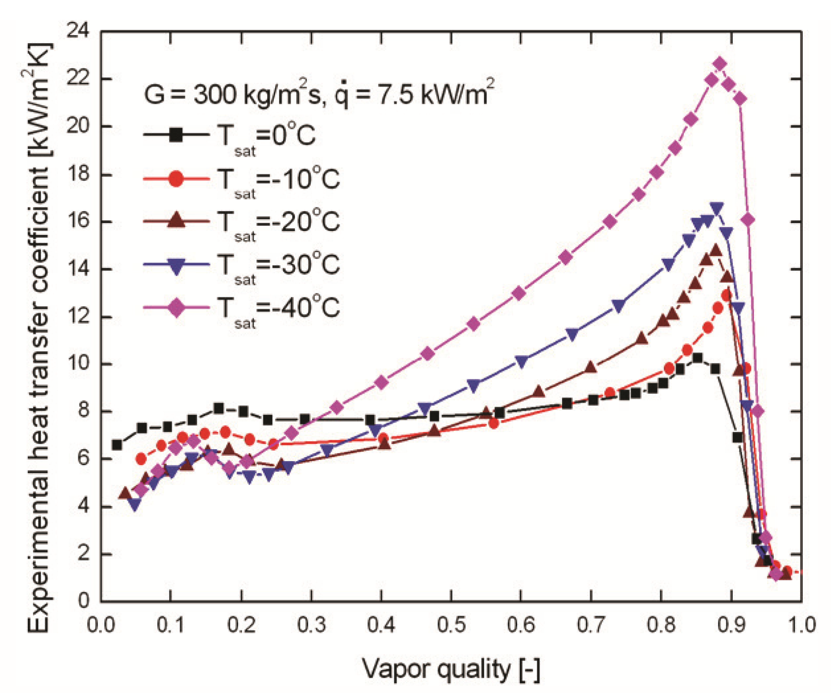
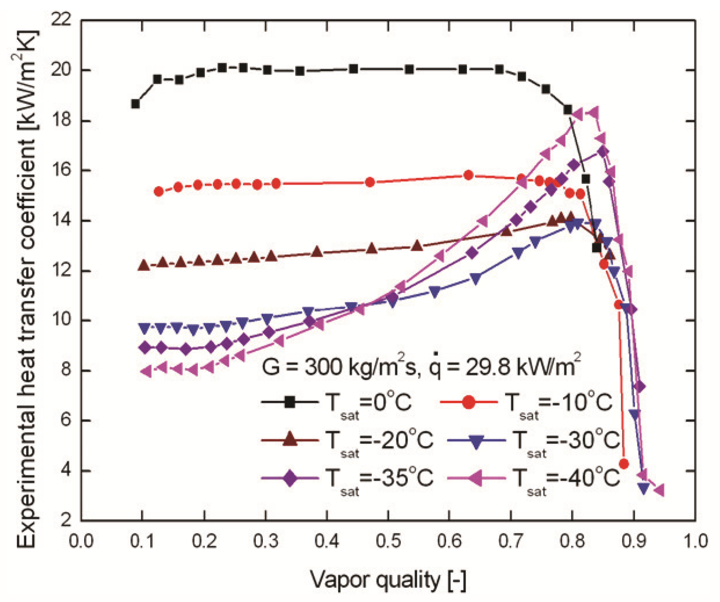
CO₂ two-phase flow - Heat transfer (temperature dependency)
Temperature dep. at low heat flux
Temperature dep. at high heat flux
d=1.4 mm

Slide 33
Summary
Two phase flow is special, remember the cooling effect by Δp(G) or Δp(q)!
Pressure drop at x~0.7-0.85 can be much higher than in gas or liquid phase
Deviation in vertical upward orientation of the models for small vapor quality
Models fail to predict pressure drop for vertical downward direction
First bubbles create buoyancy effect that overcomes gravitational influence
Consider the dry out and the sudden decrease in heat transfer for x>~ 0.7
Design for sufficient flow speed to avoid phase separation => syphons/instabilities
Parallel channels => tuning of the inlet restriction to 100 % pressure drop of the heated section

