Slide 1
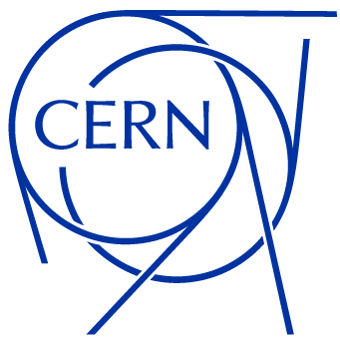
Status update
April 2025
Antonio Cristiano
EP-ESE-BE
BRATOL Meeting

Slide 2
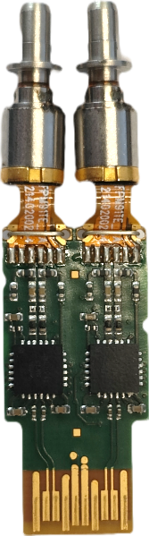
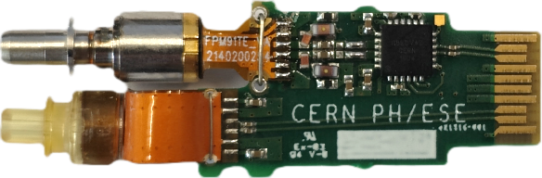
CWDM Links
1271
1291
BPM LINK
QSFP
1311
1331
BLM LINK
BiDi SFP
1271

Slide 3
CWDM Links
Front-End modules
Optical multiplexers
Back-End TRx
1271
1291
BPM LINK
QSFP
1311
1331
BLM LINK
BiDi SFP
1271

Slide 4
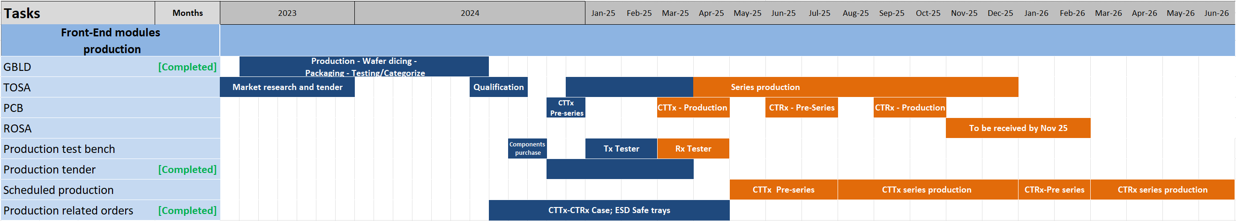

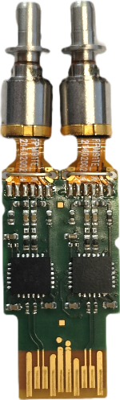

Front-end Modules Production Timeline
ROSA
TOSA
GBLD

Slide 5
Front-end Modules Production Timeline
GBLD
  50 Wafers were produced, packaged and tested to cover quantity requirement for both links.
ROSA
TOSA
GBLD

Slide 6
Front-end Modules Production Timeline
GBLD
  50 Wafers were produced, packaged and tested to cover quantity requirement for both links.
TOSA
  Samples were qualified through functional tests, neutron and gamma irradiation tests and temperature tests.
  3rd Lot received and qualified.
ROSA
TOSA
GBLD

Slide 7
TOSA Lot 3 acceptance
Static tests results
Dynamic tests results

Slide 8
Front-end Modules Production Timeline
GBLD
  50 Wafers were produced, packaged and tested to cover quantity requirement for both links.
TOSA
  Samples were qualified through functional tests, neutron and gamma irradiation tests and temperature tests.
  3rd Lot received and qualified.
PCB
  CTTx PCB pre-series qualified for the project.
  CTTx PCB production expected by 23 April.
  CTRx PCB pre-series production by June 2025
ROSA
TOSA
GBLD

Slide 9
Front-end Modules Production Timeline
GBLD
  50 Wafers were produced, packaged and tested to cover quantity requirement for both links.
TOSA
  Samples were qualified through functional tests, neutron and gamma irradiation tests and temperature tests.
  3rd Lot received and qualified.
PCB
  CTTx PCB pre-series qualified for the project.
  CTTx PCB production expected by 23 April.
  CTRx PCB pre-series production by June 2025
ROSA
  Required by November 2025 to continue modules production.
ROSA
TOSA
GBLD

Slide 10
Front-end Modules Production Timeline
GBLD
  50 Wafers were produced, packaged and tested to cover quantity requirement for both links.
TOSA
  Samples were qualified through functional tests, neutron and gamma irradiation tests and temperature tests.
  3rd Lot received and qualified.
PCB
  CTTx PCB pre-series qualified for the project.
  CTTx PCB production expected by 23 April.
  CTRx PCB pre-series production by June 2025
ROSA
  Required by November 2025 to continue modules production.
Production test bench
  CTTx Tester completed.
ROSA
TOSA
GBLD

Slide 11
Front-end Modules Production Timeline
Single Tx channel measurement routine
(From BRATOL Meeting 7/3/25)
GBLD
  50 Wafers were produced, packaged and tested to cover quantity requirement for both links.
TOSA
  Samples were qualified through functional tests, neutron and gamma irradiation tests and temperature tests.
  3rd Lot received and qualified.
PCB
  CTTx PCB pre-series qualified for the project.
  CTTx PCB production expected by 23 April.
  CTRx PCB pre-series production by June 2025
ROSA
  Required by November 2025 to continue modules production.
Production test bench
  CTTx Tester completed.
Wavelength Check
OMA Measurement
Functional test
Connection check
LI Curve
ROSA
TOSA
GBLD

Slide 12
Front-end Modules Production Timeline
GBLD
  50 Wafers were produced, packaged and tested to cover quantity requirement for both links.
TOSA
  Samples were qualified through functional tests, neutron and gamma irradiation tests and temperature tests.
  3rd Lot received and qualified.
PCB
  CTTx PCB pre-series qualified for the project.
  CTTx PCB production expected by 23 April.
  CTRx PCB pre-series production by June 2025
ROSA
  Required by November 2025 to continue modules production.
Production test bench
  CTTx Tester completed.
  Firmware design of Rx Tester completed, benchmark with reference instruments ongoing.
ROSA
TOSA
GBLD

Slide 13
Production tender outcome
Company | Total price 4004 CTTx -3500 CTRx | Price/module
ROMPAL Ingenieros | 71600 CHF | 9.55 CHF

Slide 14
Production tender outcome
Summary ROMPAL meeting
Agreed on contract performance shown below.
  Delivery of the assembly material by 19th of May.
  Delivery of CTTx pre-series by 30th of June.
Company | Total price 4004 CTTx -3500 CTRx | Price/module
ROMPAL Ingenieros | 71600 CHF | 9.55 CHF

Slide 15
Production tender outcome
Summary ROMPAL meeting
Agreed on contract performance shown below.
  Delivery of the assembly material by 19th of May.
  Delivery of CTTx pre-series by 30th of June.
ROMPAL is open to a faster production, willing to increase quantities per batch. TOSA/ROSA availability being the current limit of production.
Company | Total price 4004 CTTx -3500 CTRx | Price/module
ROMPAL Ingenieros | 71600 CHF | 9.55 CHF

Slide 16
Production tender outcome
Summary ROMPAL meeting
Agreed on contract performance shown below.
  Delivery of the assembly material by 19th of May.
  Delivery of CTTx pre-series by 30th of June.
ROMPAL is open to a faster production, willing to increase quantities per batch. TOSA/ROSA availability being the current limit of production.
Production will be handled by the same staff involved in the previous VTRx production.
Company | Total price 4004 CTTx -3500 CTRx | Price/module
ROMPAL Ingenieros | 71600 CHF | 9.55 CHF

Slide 17
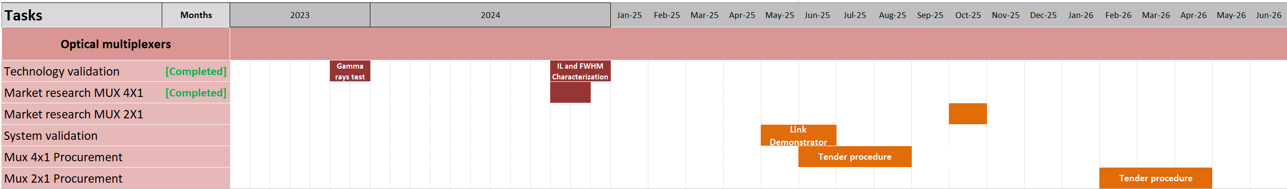
Optical Multiplexers Timeline

Slide 18
Optical Multiplexers Timeline
MUX Specifications
Technology validation
  TFF technology qualified for the project being insensitive to TID and temperature fluctuations.
  Commercially available 4x1 MUX with low IL, to account for radiation damage in TOSAs, and large enough FWHM, to account for wavelength shifts.
FWHM(T) > 15 nm
IL < 1.4 dB

Slide 19
Optical Multiplexers Timeline
MUX Specifications
Technology validation
  TFF technology qualified for the project being insensitive to TID and temperature fluctuations.
  Commercially available 4x1 MUX with low IL, to account for radiation damage in TOSAs, and large enough FWHM, to account for wavelength shifts.
Market research
  Prices of suitable 4X1 MUX in the range 67-32 CHF.
  Market research 2x1 MUX awaiting for link design choice.
FWHM(T) > 15 nm
IL < 1.4 dB

Slide 20
Optical Multiplexers Timeline
Technology validation
  TFF technology qualified for the project being insensitive to TID and temperature fluctuations.
  Commercially available 4x1 MUX with low IL, to account for radiation damage in TOSAs, and large enough FWHM, to account for wavelength shifts.
Market research
  Prices of suitable 4X1 MUX in the range 67-32 CHF.
  Market research 2x1 MUX awaiting for link design choice.
System validation
  Link demonstrator required. Ready in June.
MUX 4X1 Procurement
  Procurement to be started in June following system validation.
BiDi SFP Procurement
  Procurement to be started in February 2026 following system validation.

Slide 21
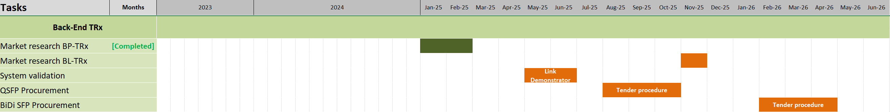
Back-End TRx Timeline
Market research BP-TRx
  Commercially available QSFP and SFP+ to overcome radiation degradation of TOSAs and increase total power budget.
  QSFP preferred choice being a more compact solution with higher power budget than one MUX 4X1 and four SFP+.
  EdgeOptic is registering on CERN’s SupplierDB. Purchase of QSFP and SFP+ samples will follow.
Market research BL-TRx
  Market research BL-TRx awaiting for link design choice.
QSFP Specification
Rx Sensitivity < -13.7 dBm

Slide 22
Back-End TRx Timeline
Market research BP-TRx
  Commercially available QSFP and SFP+ to overcome radiation degradation of TOSAs and increase total power budget.
  QSFP preferred choice being a more compact solution with higher power budget than one MUX 4X1 and four SFP+.
  EdgeOptic is registering on CERN’s SupplierDB. Purchase of QSFP and SFP+ samples will follow.
Market research BL-TRx
  Market research BL-TRx awaiting for link design choice.
System validation
  Link demonstrator required. Ready in June.
QSFP Procurement
  Procurement to be started by August 2025.
BiDi SFP Procurement
  Procurement to be started by February 2026.
QSFP Specification
Rx Sensitivity < -13.7 dBm

Slide 23
Summary and next steps
Front-End modules production:
  Receiver tester being benchmarked against reference instruments.
  CTTx PCB intended for production expected at CERN by 23rd April.
  Lot qualification to be completed by 5th of May.
  Assembly and testing material to be shipped out within 12th -16th May.
Optical multiplexers:
  TFF Technology qualified.
  MUX 4X1 Procurement to be started in June.
  MUX 2X1 : Link design choice expected by end-of-the year.
BPM Back-End TRx:
  QSFP preferred choice.
  Samples of QSFP and SFP+ from EdgeOptic being purchased.
BLM Back-End TRx:
  Link design choice expected by end-of-the year.

