Slide 1
EMD213/A80 Earth Fault
22.03.2025
E. Freddi, J. Leppilahti · EN-EL
26.03.2025
EDMS 3281948

Slide 2
Fault context

Slide 3
Fault context
Overview
On the 22.03.2025 @ 03:23:37.723 an earth fault struck the cable termination on EMT213/A80, fed from EMD213/A80.
The feeder EMD213/A80 tripped to clear the fault, but the North Area stable loop head feeders in BE9 EMD404/E9 and EMD405/E9 also tripped at the same time, de-energizing the whole loop.
Other unselective trips occurred on EMD408/E9 and EMD213/A81 which were external to the earth fault current path.
The voltage perturbation also caused overvoltage protections on the LHC stable filters in SE4 and SE8 to trip.

Slide 4
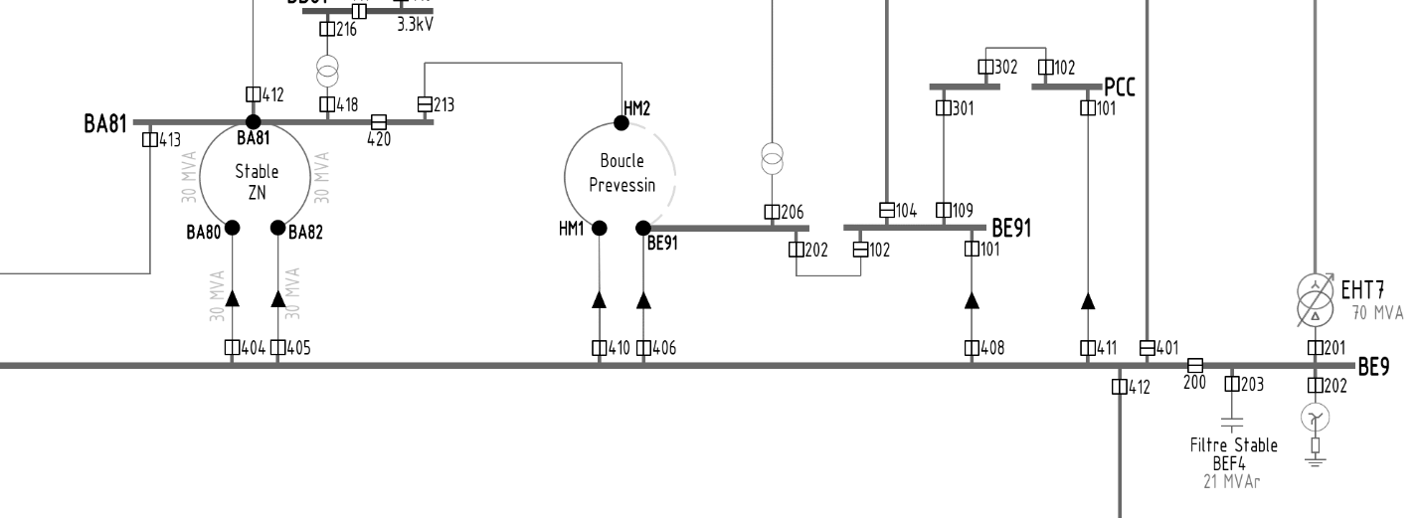
Fault context
Configuration before fault
HM2 powered from BA81 instead of BE9 in preparation of the worksite for HM0

Slide 5
Fault context
Current path – SLD – General HV SLD
Correct trip
Unwanted trip

Slide 6
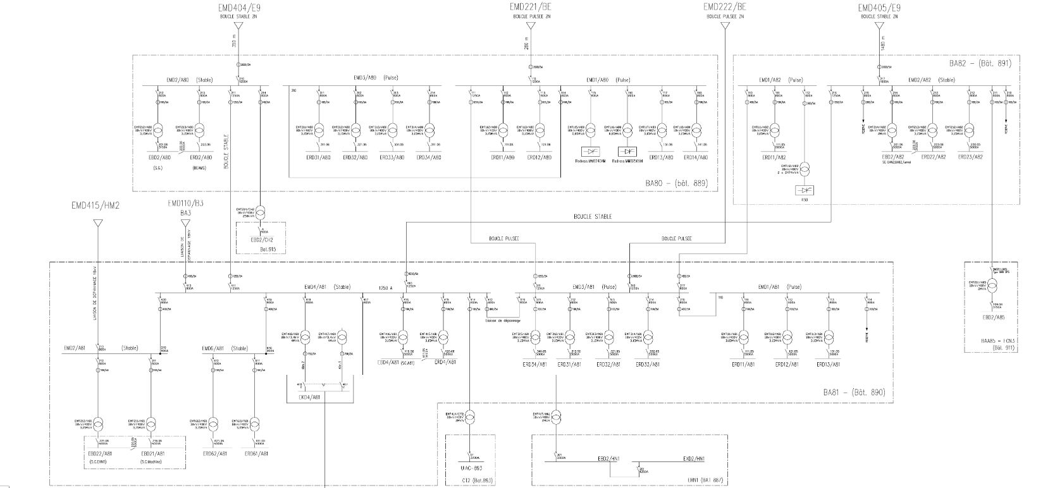
Fault context
Current path – SLD – North Area
Correct trip
Unwanted trip

Slide 7
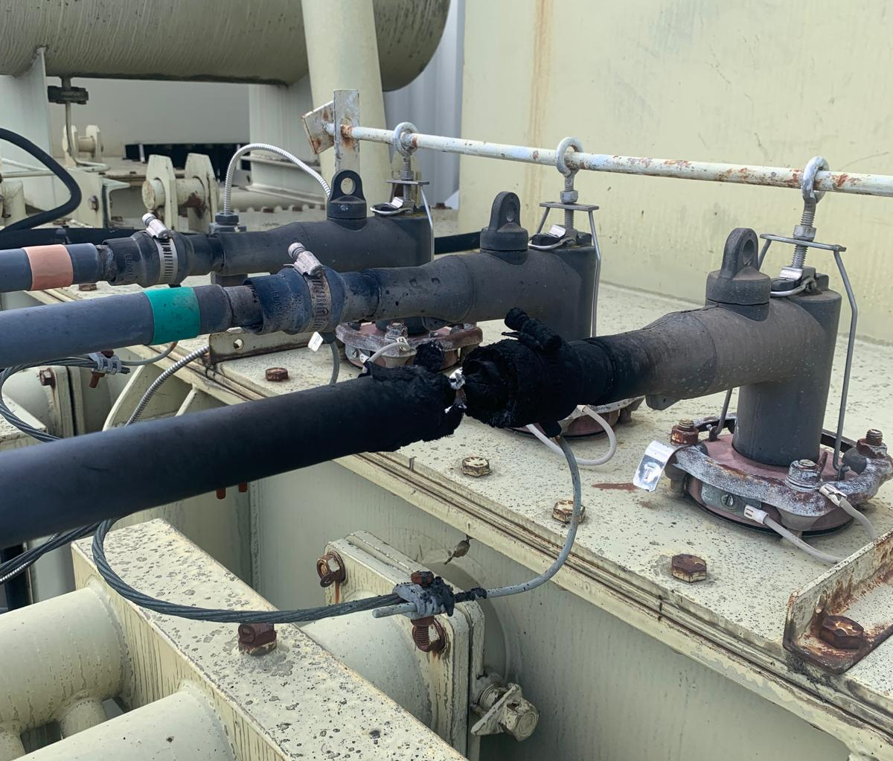
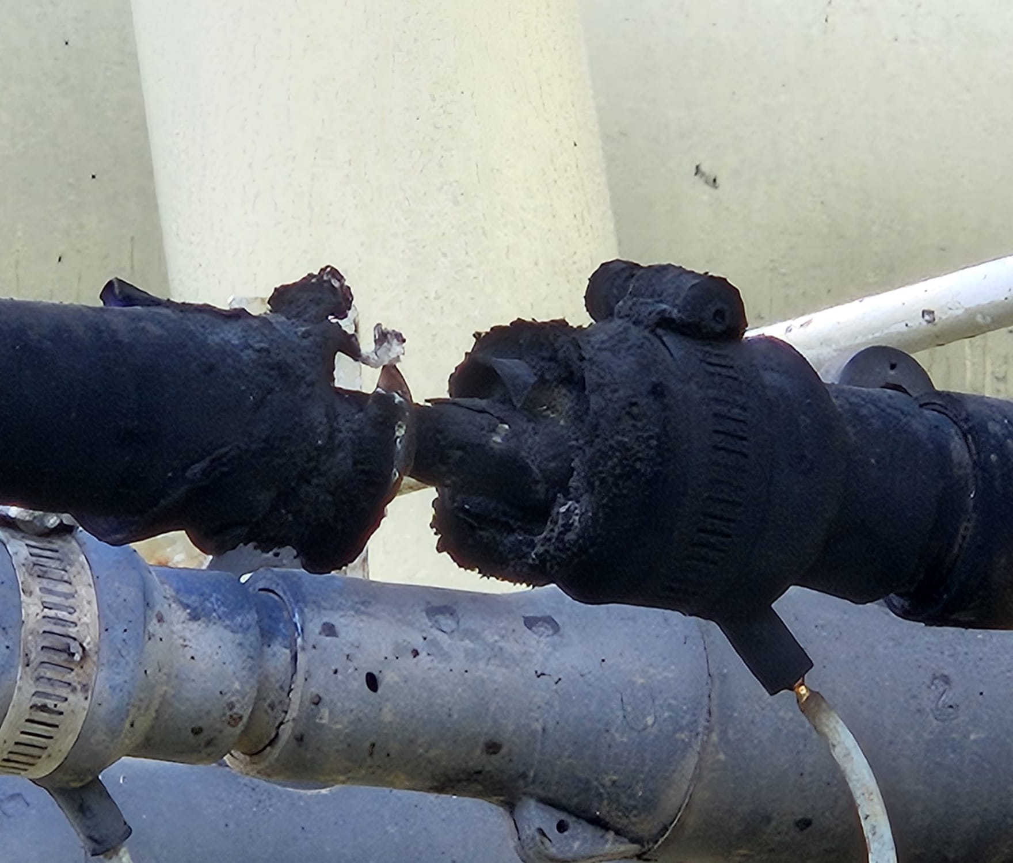
Fault context
Pictures

Slide 8
Fault context
Events sequence 1/2
Earth fault, loss of North Area stable loop, LHC stable filters trip.
The initial assessment by the stand-by team highlights earth faults trips on EMD404/E9, EMD405/E9, EMD408/E9 and EMD213/A81 as well as overvoltage trip on EMD104/4E.
  Indeed, no fault signals are sent from EMD213/A80 – the actual faulted feeder – only the “CB open” status is recorded in PSEN.
EMD213/A81 is considered to be the root cause of the failure, but no signs of faults are found on the cable terminations.
The North Area stable loop is re-energized, HM1 and HM2 resupplied from BE9. Stand-by intervention is called in.

Slide 9
Fault context
Events sequence 2/2
On Monday 24th of March several in-depth inspections are carried out on the EMD213/A81 and EMD415/HM2 cubicles, as well as VLF and insulation tests on the BA81-HM2 cable. All the tests are successful, no failures found.
On Tuesday 25th of March, following the release of the preliminary version of this fault report, the real fault is found on EMT213/A80.
EMT213/A80 is energized despite the EMD213/A80 breaker status indicates “open”: the circuit breaker is stuck in closed position, intervention requires the de-energisation of the whole EMD2/A80 busbars.

Slide 10
Fault analysis

Slide 11
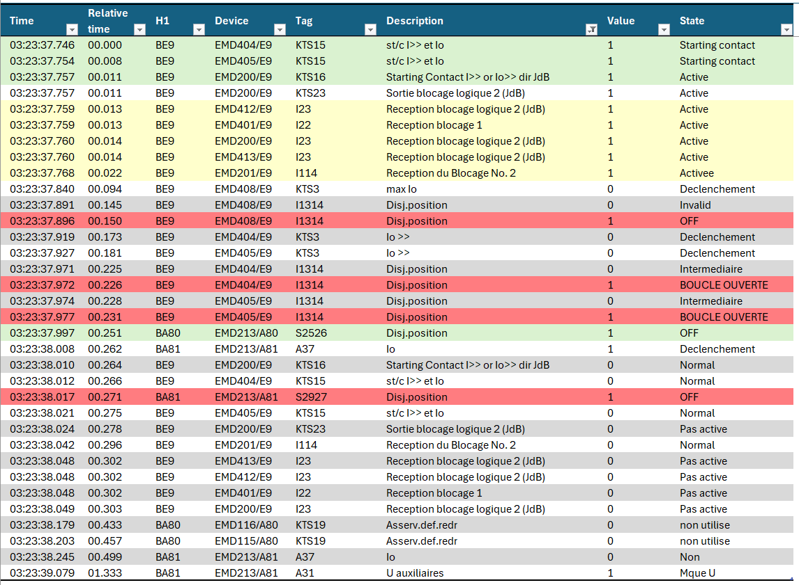


Fault analysis
PSEN events list
Starting contacts
All blockings received
EMD404/E9,
EMD405/E9,
EMD408/E9
CBs open
EMD213/A80 CB open
EMD213/A81 CB open

Slide 12
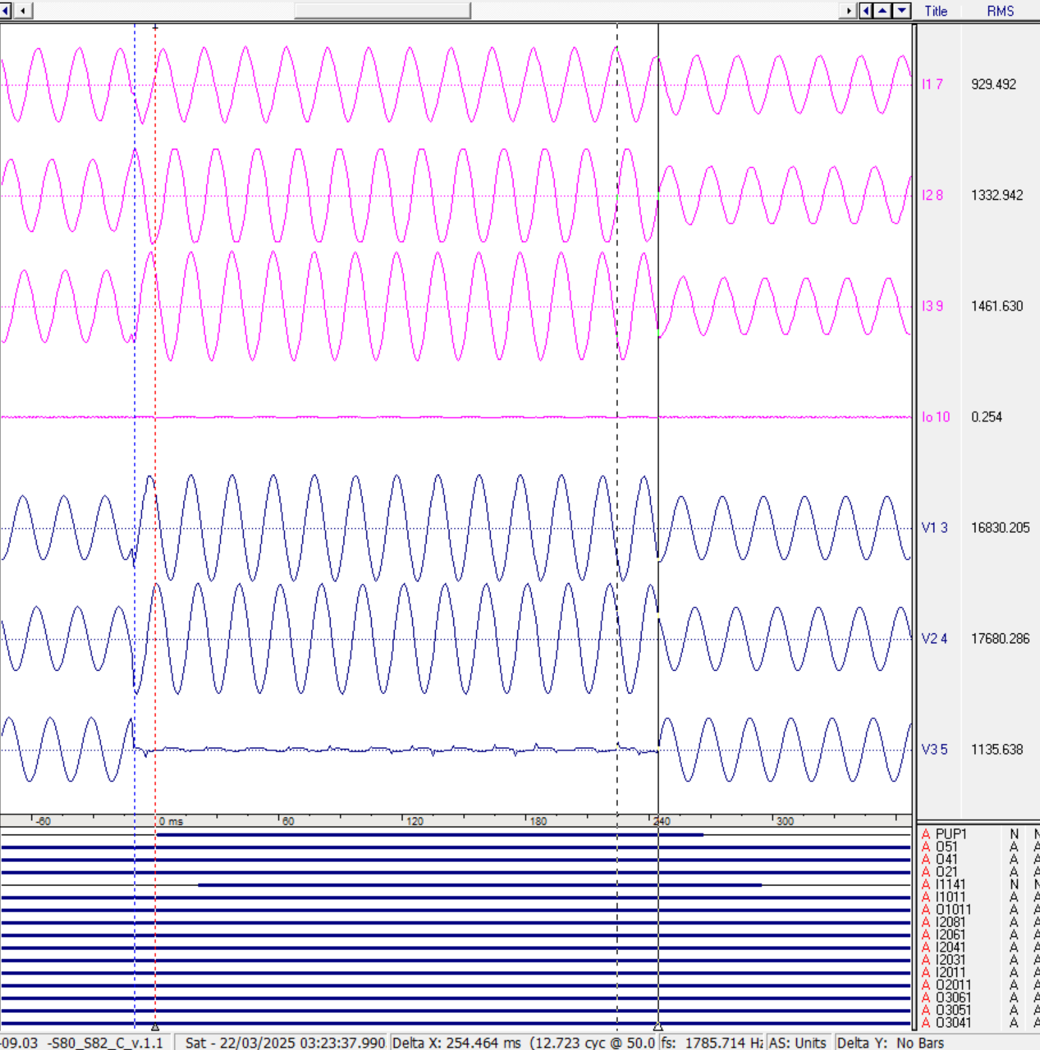
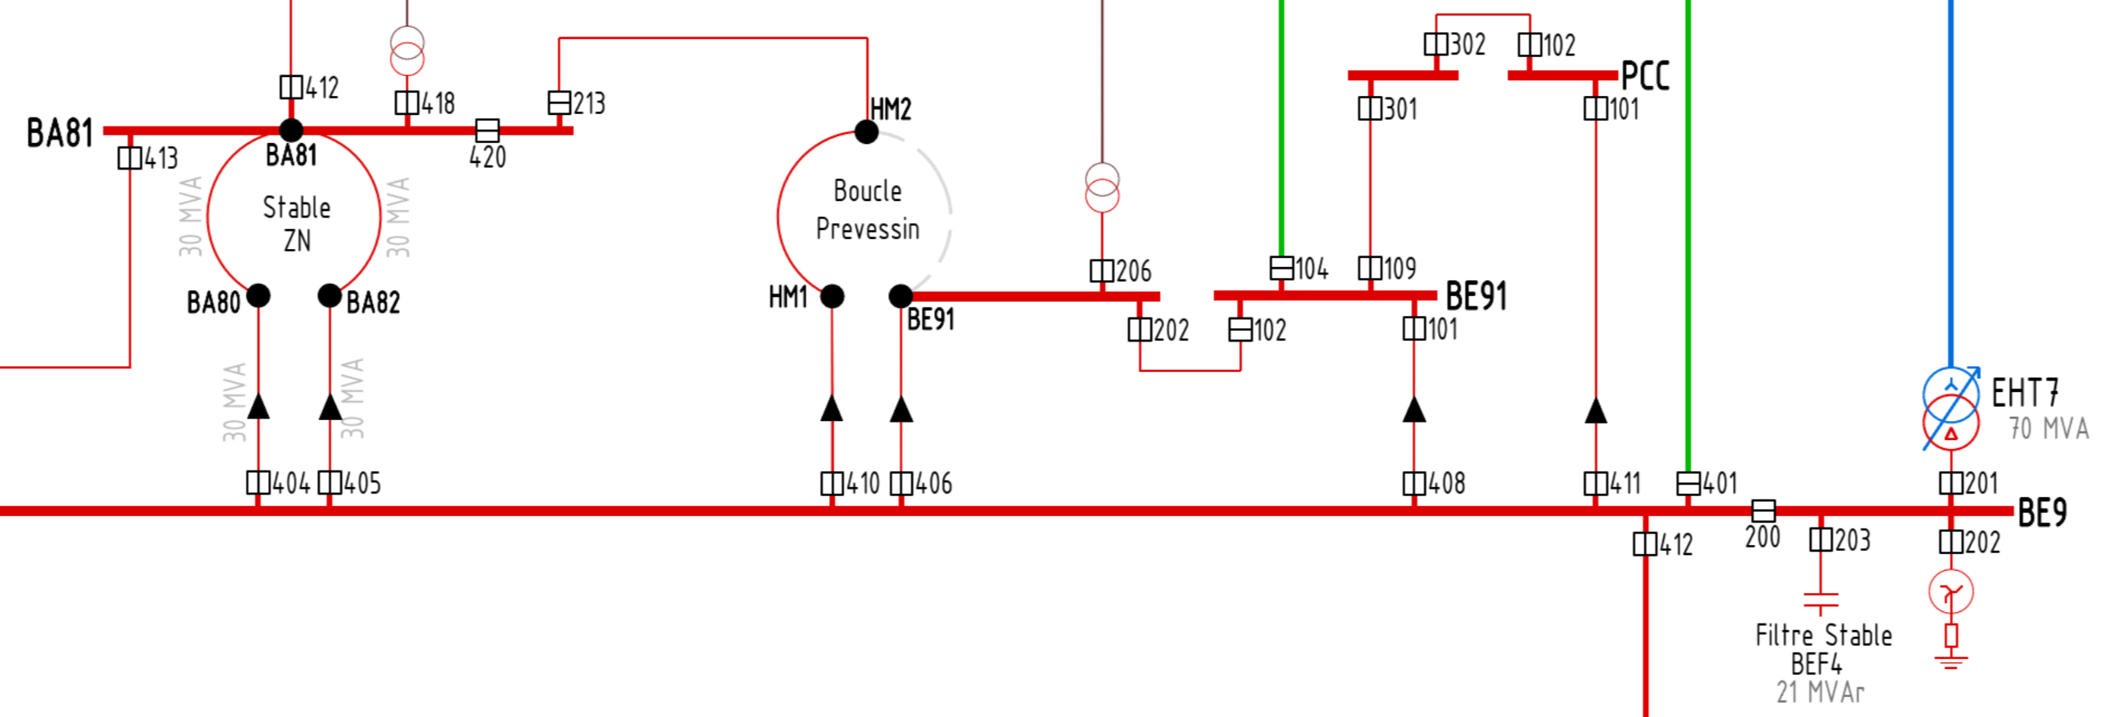
Fault analysis
Disturbance recording – EMH201/E9
Earth faults are not detected by the 66/18 kV transformer incomer because the earthing transformer is located downstream of the current measurement point.
This disturbance recording is useful to show the faulted phase and to measure precisely the fault duration.
Fault on phase 3
Total fault duration: 255 ms

Slide 13
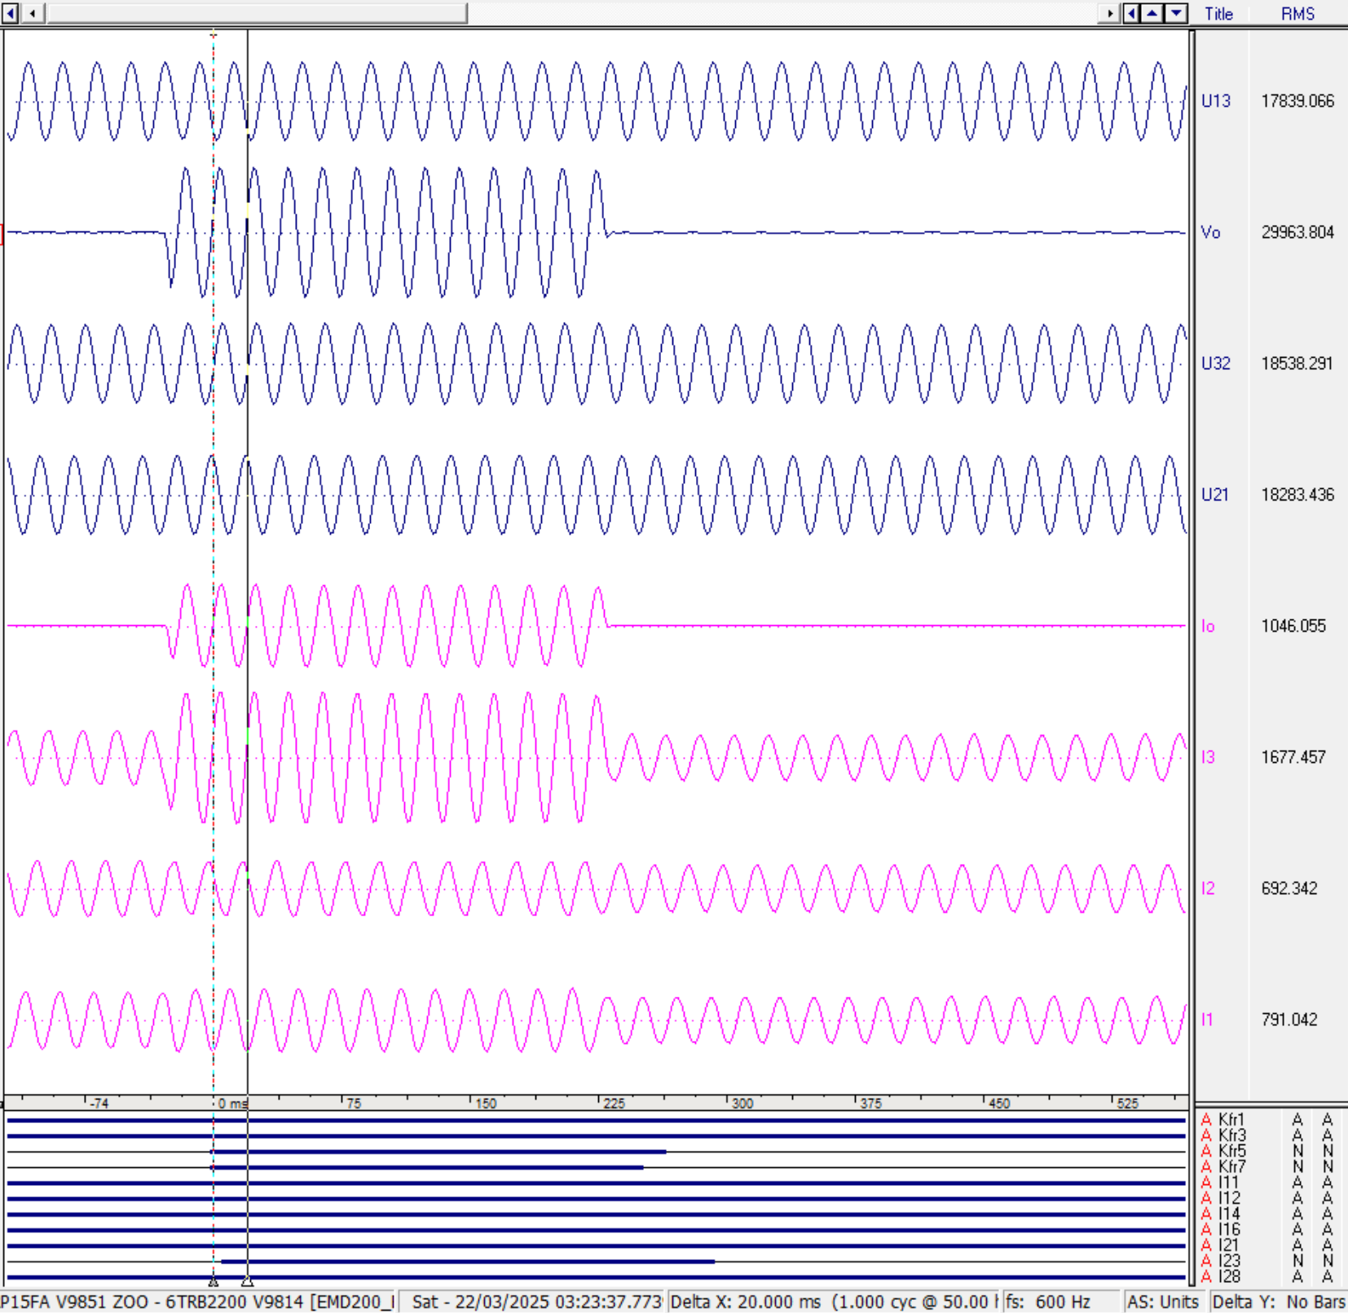
Fault analysis
Disturbance recording – EMH200/E9
The coupling between EMD2/E9 and EMD4/E9 can see the total earth fault current before it is positioned after the BPN.
No OPG are available on the earth fault current path after this point, the protection relays are not OPG capable.
Earth fault current 1046 A

Slide 14
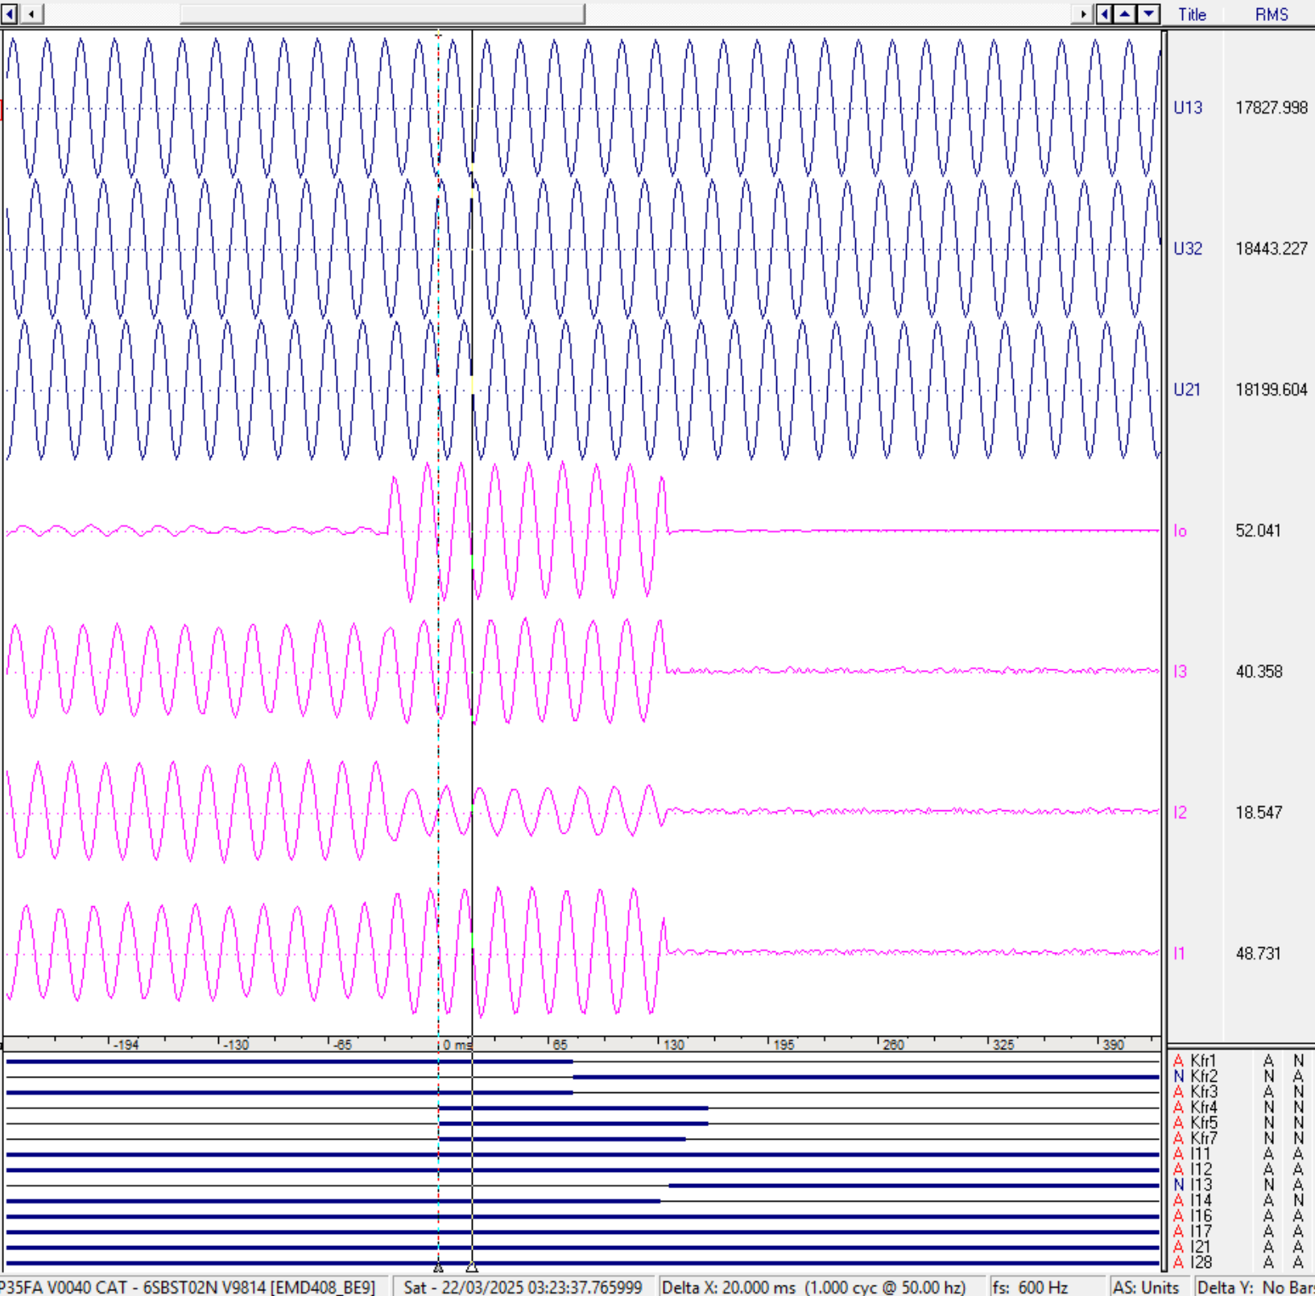
Fault analysis
Disturbance recording – EMH408/E9
The feeder of the PCC loop detected a circulating zero-sequence current above the set threshold of 50 A and tripped accordingly.
Relay asserts and CB opens in 166 ms
Zero-sequence current measured: 52 A

Slide 15
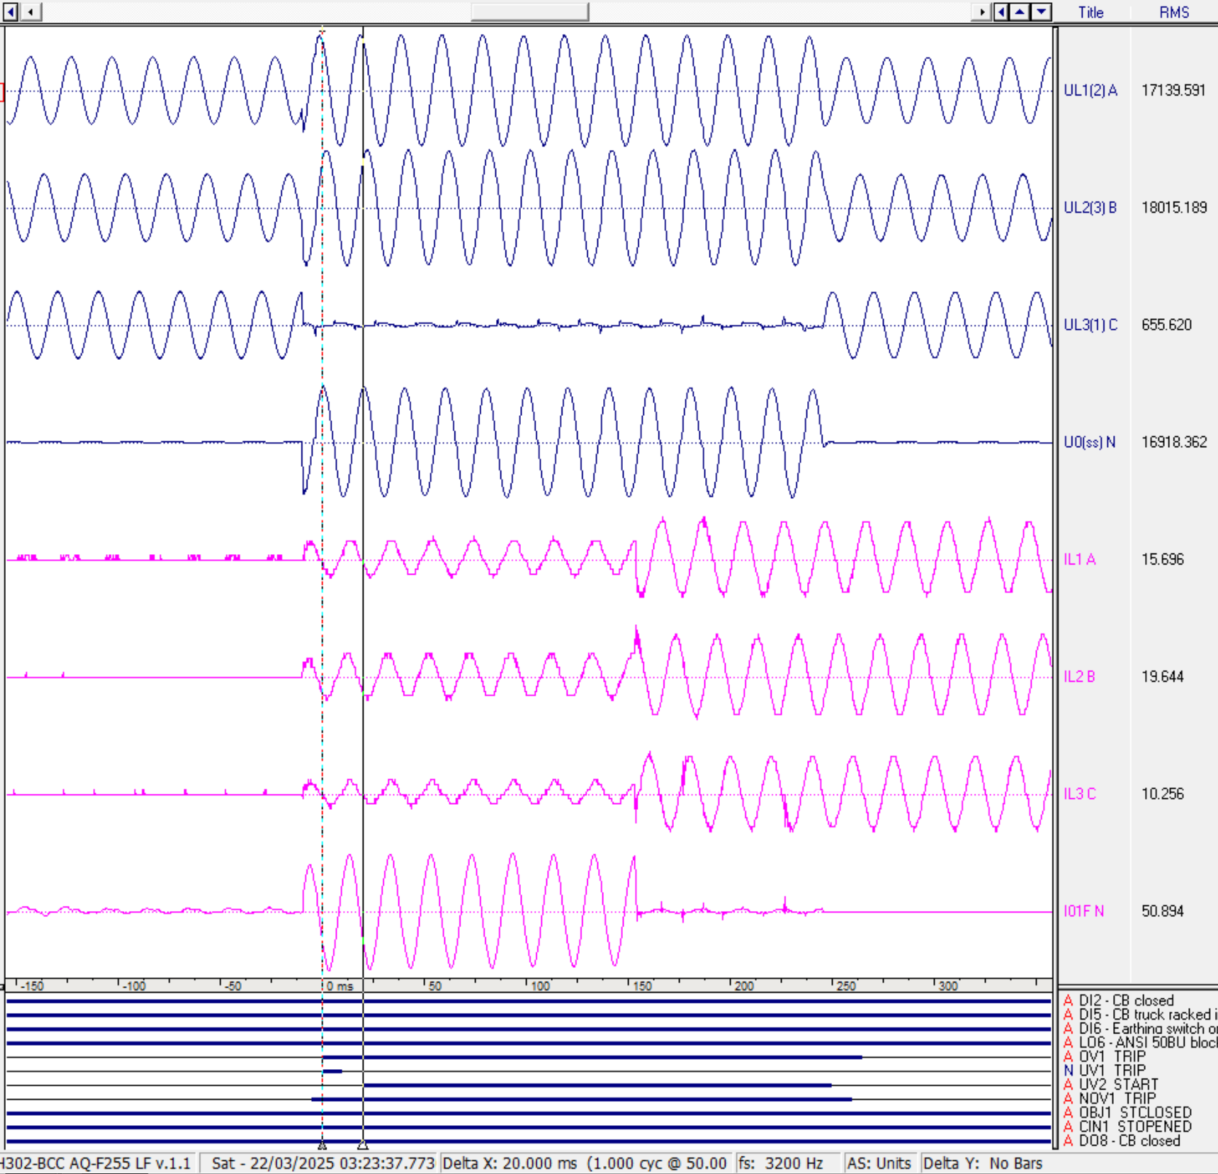
Fault analysis
Disturbance recording – EMH302/BCC
The presence of the zero-sequence looping current is clear when examining the PCC coupling, which is unloaded before the fault inception and then sees a homopolar set of currents (almost all in phase) flowing while EMD408/9E remains closed.
Before the fault (V0 rise) no current in the coupling
With the loop open, the coupling resupply EMD3/BCC and EMD1/E91 from EMD1/BCC
As soon as EMD408/9E opens the loop, the I0 current cannot circulate anymore

Slide 16
Fault analysis
Protection system issues – North Area Loop
The protection in North Area relies on old static relays type “CEE”. The selectivity is uniquely time-based, but the settings have not been reviewed since long time.
In the specific situation, both EMD213/A80 and the loop head EMD404-405/E9 were set to trip in 200 ms, which is the reason why the three breakers opened at the same time.

Slide 17
Fault analysis
Protection system issues – EMD408/E9 trip
The EMD408/E9 tripped upon detecting an earth fault of ~50 A.
After the analysis of the OPG available in BE91 and PCC, the root cause of the “earth fault current” detected by the protection relay is the zero-sequence induction from the actual faulty circuit. This behavior is natural, it occurred also in the North Area pulsed loop (~8 A circulating current), but the small impedance of the short PCC loop enabled the induced current to reach the setting threshold of EMH408/E9.
EMH408/E9 is not currently set according to the protection plan because no consolidation was done on the specific link since the protection plan enforcement.
The settings according to the protection plan should have been 200 A which is calibrated exactly to cope with these kind of mutual induction scenarios.

Slide 18
Fault analysis
Protection system issues – EMD213/A81 trip
The EMD213/A81 tripped upon detecting an earth fault (setting value of 100 A exceeded)
Secondary injection tests on the protection relay have been successful.
After inspection of the residual CT circuit, it was found that the execution of the HV cable shield wiring through the CT was correct, but the shields star point was touching the cubicle wall causing the screen current not to be cancelled through the core balance CT.
If the shield current path does not go back through the core balance CT, the CT will measure stray currents flowing through the shield, during earth faults, which is why the relay picked up and tripped on the external earth fault.

Slide 19
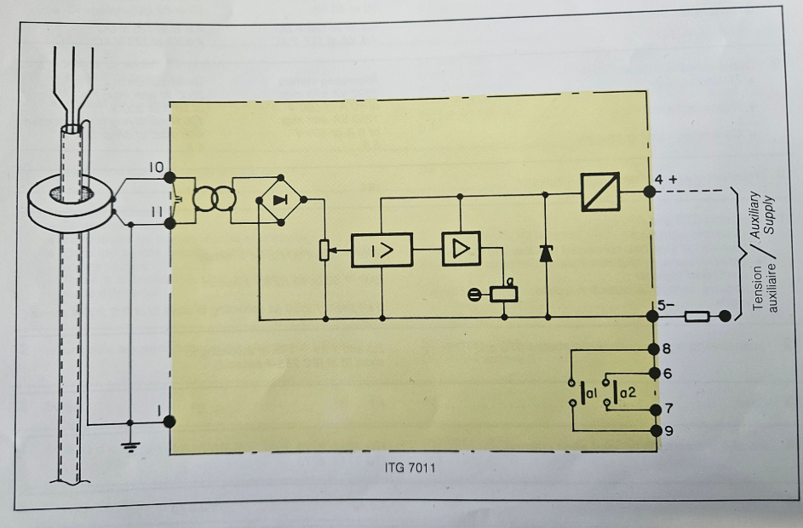
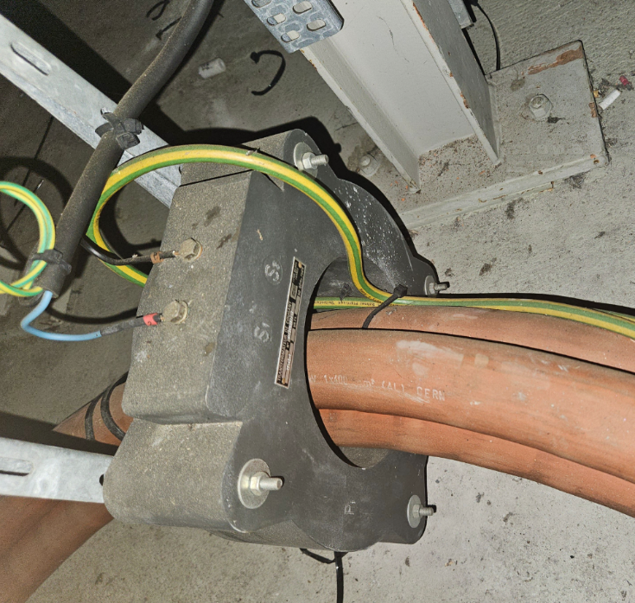
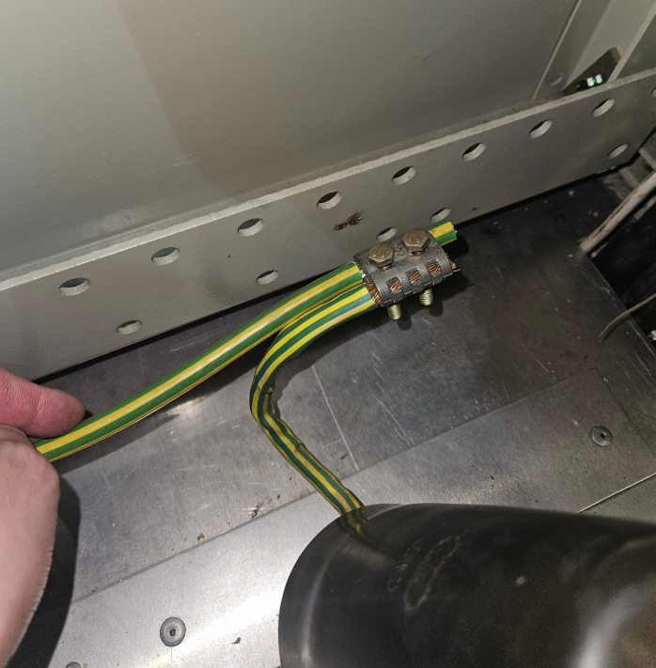
Fault analysis
Protection system issues – EMD213/A81 trip

Slide 20
Fault analysis
Protection system issues – LHC Stable Filters
The harmonic filters have an overvoltage protection set to 110% @ 200 ms which picked up on the √3 overvoltage on the healthy phases during the fault and tripped because the fault was cleared in 255 ms.
This in the intended behavior by design (EDMS 1322037) and alternatives are current limited by the installed capabilities of the protection relays used for the harmonic filter protection in LHC.

Slide 21
Corrective actions

Slide 22
Corrective actions
Overview
The implementation of the settings guidelines as per protection plan will solve the poor selectivity issues seen during the fault.
As a reminder, since the protection plan has been established, the application of its guidelines has not been done systematically on the entire network due to resource and schedule limits. It is agreed, instead, that its provisions are applied to the portions of the network under consolidation as these progress.
The consolidation of North Area is upcoming, while the other corrective actions in BE9 can be implemented quickly thanks to the second supply of PCC.
As a short-term measure, the increase of the loop trip time to 300 ms will greatly reduce the risk of losing the whole loop in case of terminal earth faults.

Slide 23
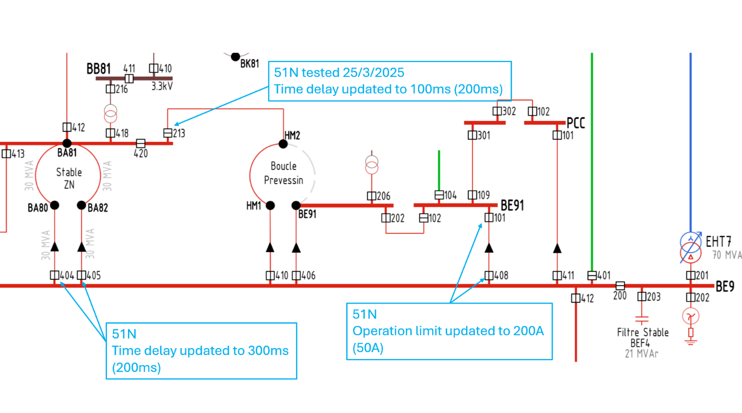
Corrective actions
Overview

Slide 24
Corrective actions
LHC harmonic filters overvoltage protection
The overvoltage settings have been agreed with SY-EPC and they aims at preserving the capacitors lifespan and limit the damage in case of overvoltages, as explained in EDMS 1322037.
With the LHC FIR consolidation project, the protections of the LHC harmonic filters will also be updated, allowing for a more targeted overvoltage protection (e.g. using IDMT curves).
Discussion to be held jointly with SY-EPC to evolve the protection plan before the commissioning of the new protection relays in LHC.

Slide 25
Conclusions

Slide 26
Conclusions
Summary and lessons learned
The protection system unselective reaction is due to the age of the installation as no protection studies or protection coordination reviews have been carried out in recent times. Partial consolidation of the zone (BA80) is already planned and ongoing, but the event highlighted the obsolescence of the equipment with HV breaker failing to open with very dangerous situations resulting from it. These risks were already evaluated by EN-EL (EDMS 2748988) and will remains high until full consolidation in LS4.
The application of the protection plan guidelines during the upcoming (LS3) CEE relays preventive maintenance plan will improve the protection reaction in future events, but will not solve the underlying issue impacting the overall availability and safety of North Area.
The BE9-BE91 link has been already updated and will not be subject to the same phenomena in the future.

Slide 27
Conclusions
Summary and lessons learned
The trip of the LHC stable filters highlights a critical issue in the overvoltage settings policy for harmonic filters, which cannot cope with the nominal maximum trip time on earth fault of 900 ms (ultimate trip of the BPN). The overvoltage protection requirements for harmonic filters shall evolve accordingly – this requires a joint review with SY-EPC.
To improve the stand-by duty awareness of the network status following complex events, a dedicated screen or PSEN function to easily display all the breakers that changed status (from closed to open and vice versa) during a defined interval could greatly help to speed up the fault finding in future occasions.
Such a screen would act as starting point for further analysis and events filtering in PSEN using the already available tools.

