Slide 1
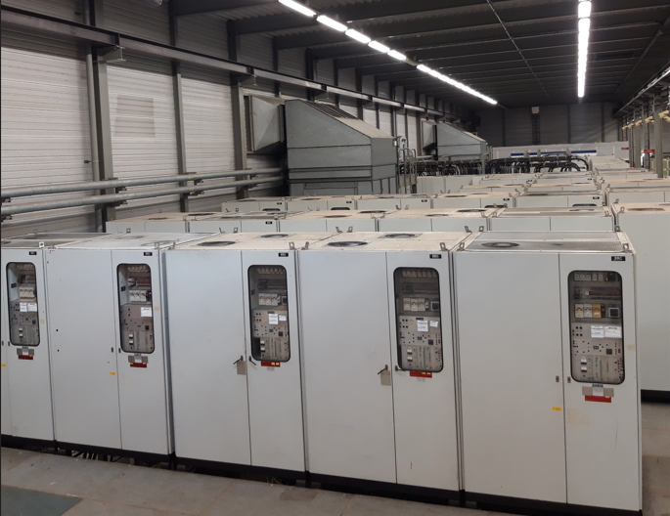
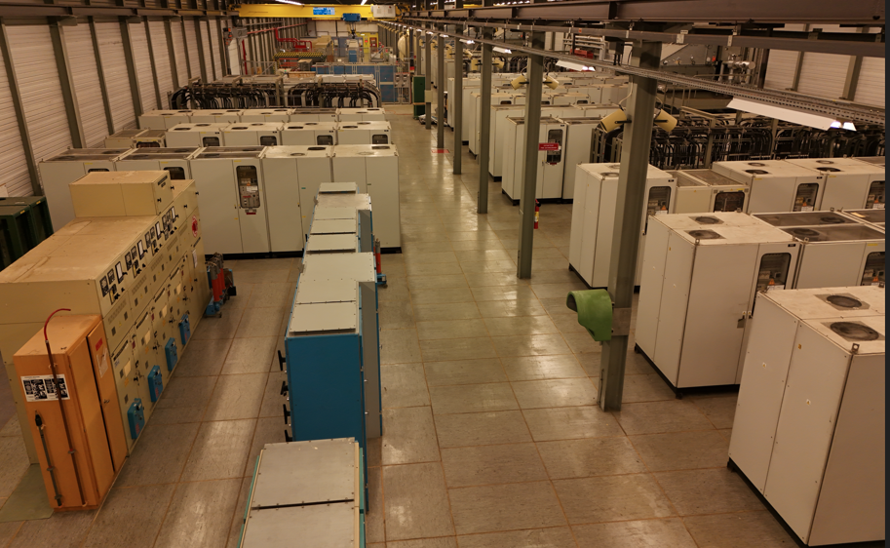
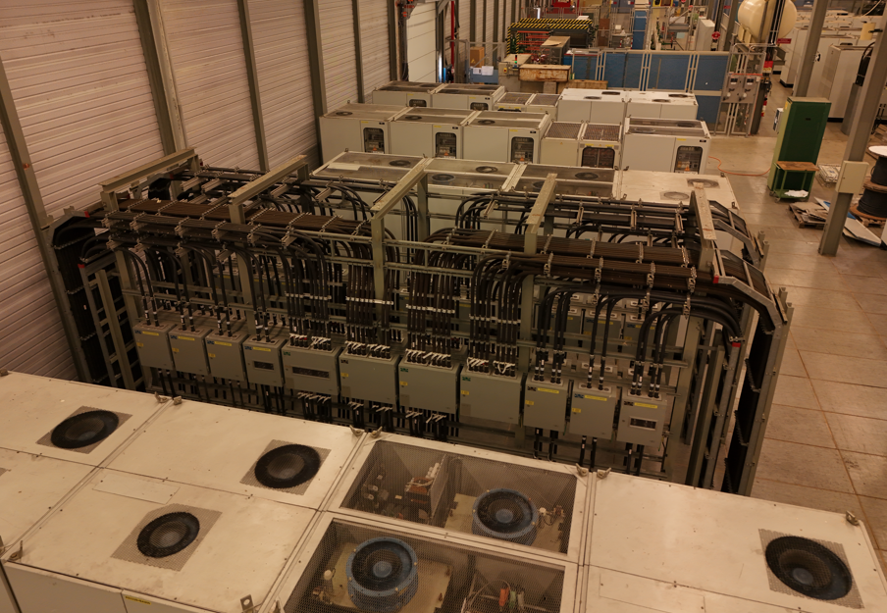
NORTH AREA POWER CONVERTERS
IST 2025
Xavier GENILLON SY-EPC

Slide 2
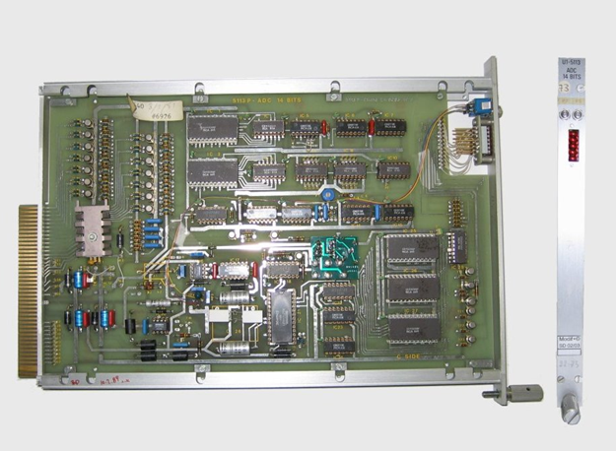
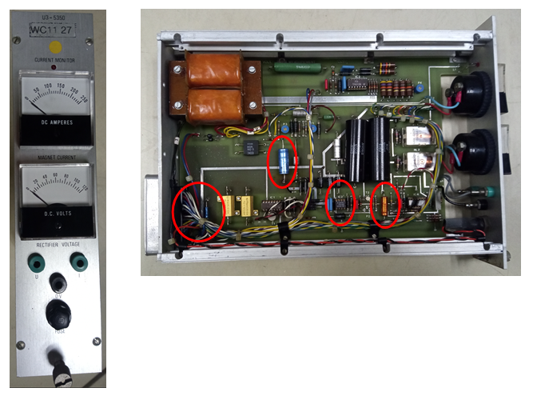
Maintenance YETS24-25
ADC cards:
Modification of 385 cards
Changement of all the electrolytic capacitors
→ 1540 capacitors
Current/Voltage measurement card:
Modification of 107 cards
Changement of all the electrolytic capacitors
→ 428 capacitors

Slide 3
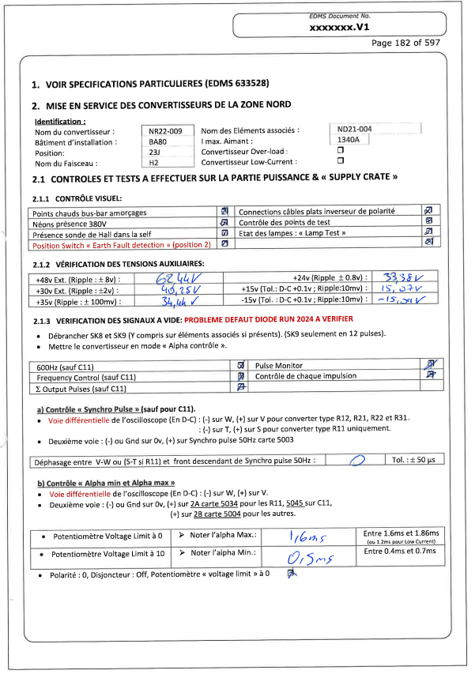
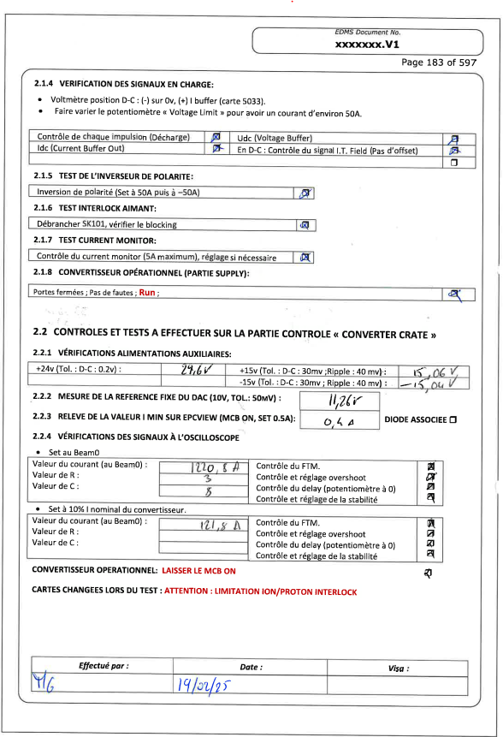
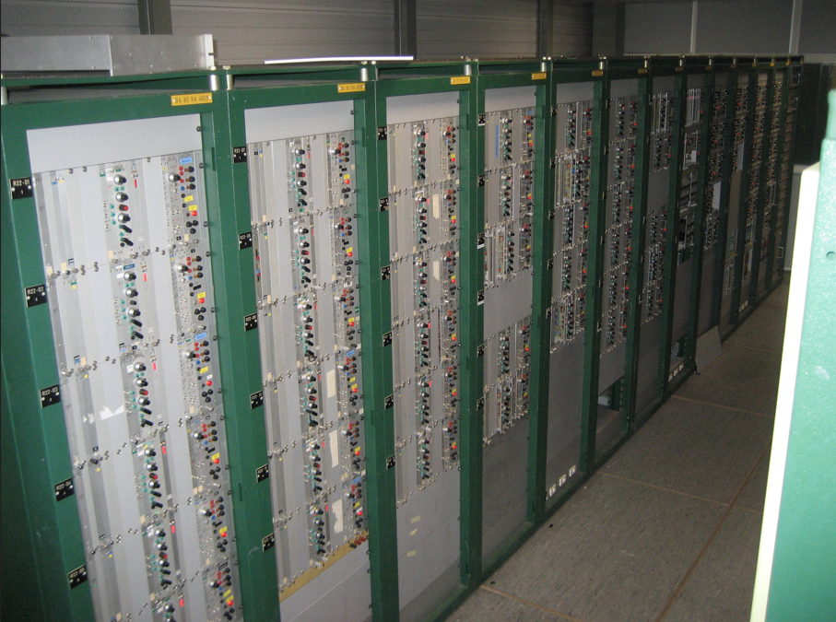
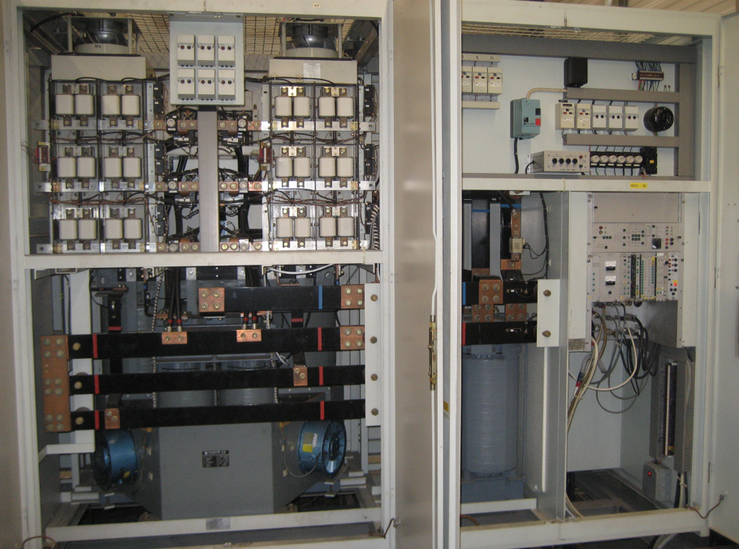
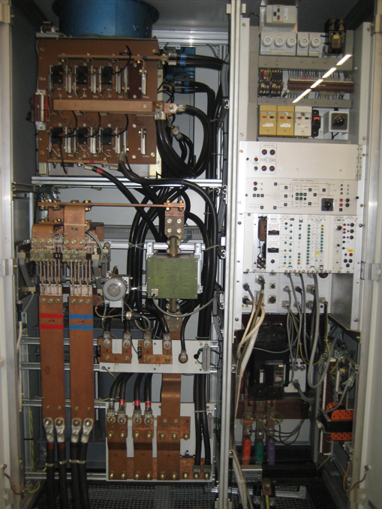
Startup 2025
From the 17th of February to the 14th of March: One month of test
269 power converters and 7 Spectrometers tested
All the power and control parts were checked with procedures
10 people involved on the duration of the tests
51 power converters required repair
  15 Main Circuit Breakers were changed
  39 electronic cards were changed

