Slide 1
NA magnet commissioning & IST status
TE-MSC
Philip Schwarz
01.04.2025

Slide 2
Inspections performed
Audio-visual patrol
  Pulsing magnets (if possible) to check coil shimming
  Visual inspection to search for leaks / other problems
Heat-run (whole NA)
  Operation of magnets in D-C at their maximum RMS current
  Verification that sufficient cooling is available for the magnets
Polarity inspection (whole NA)
  Verification of polarity of all installed magnets
  During the hardware commissioning week with the respective beamline physicists

Slide 3
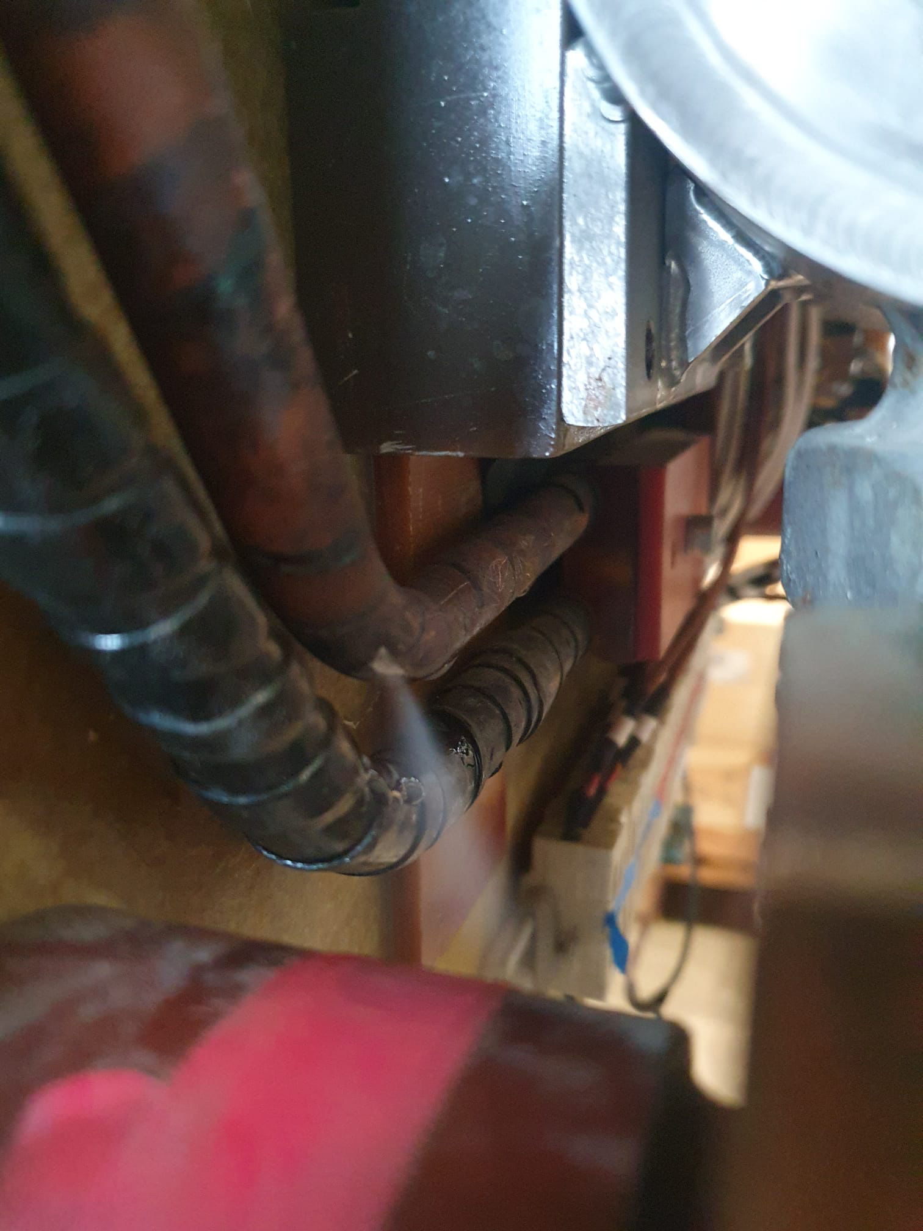
Inspection results
Coil shimming
  15 magnets found with moving coils (15x QNL, 1x MBN, 1x QTS)
  All temporarily repairable on-site
Leaks
  Several leaks found on Walther connectors, which have been repaired
  Three leaks on filters
  LSX.X0220134 showed a leak on a coil and had to be replaced
  QTS.X0410397, QNL.241100 and QNL.X0420371 all showed leaks on brazing / conductors and were repaired by brazing or parts exchange
Emergency stops
  12 emergency stops were found pressed stopping power converter tests
  Please try to remember to remove the emergency stop if you use it during your works
QTS.X0410397 leak

