Slide 1

ECR/Documents for Information and Approval
Giulia Romagnoli and Natalya Kahn for BE-EA, 2025-04-01
EA Documents - Agile Board - CERN Central Jira

Slide 2
LIST OF DOCUMENTS for Info
FOR INFORMATION EATM
Summary | Reporter | EA Projects | EDMS number | EDMS Status
Consolidation of XCET Cherenkov Detectors in NACONS Project | Giulia Romagnoli | North Area, NACONS | 2802361 - SPSX-B-WD-0004 | Released
Consolidation of XCET Cherenkov Detectors in NACONS Project | Giulia Romagnoli | North Area, NA-CONS | 2802361 - SPSX-B-WD-0004 | Released
First steps of a consolidation and upgrade program for the CEDAR detectors_WP 3.1.2.7 | Miguel Santos | North Area, NA-CONS | 2742855 - SPSX-B-WD-0002 | Released
North Area Consolidation Project Phase-1 Cost, Schedule and Scope Review: Summary, Findings and Recommendations | Yacine Kadi | North Area, NA-CONS | 3245180 - SPSX-PM-MR-0009 | Under Approval
Magnetic Measurement of MCA Magnet PXMBXHCCWP-01000085 | Thomas Zickler | North Area, NA-CONS | 3285415 - SPSX-M-EP-0008 | Engineering check
Magnetic Measurement of SPQSL__8WP-B2000004 | Thomas Zickler | North Area, NA-CONS | 3245649 - SPSX-M-EP-0007 | Under Approval
Magnetic Measurement of SPMTN__HWP-00000002 | Philip Schwarz | North Area, NA-CONS | 3179284 - SPSX-M-EP-0006 | Under Approval
Magnetic Measurement of QTA MAGNET SPQTA__8WP-00000023 | Thomas Zickler | North Area, NA-CONS | 3031777 - SPSX-M-EP-0004 | Under Approval
Magnetic Measurement of QNL MAGNET SPQWL__8WP-00000061 | Thomas Zickler | North Area, NA-CONS | 3031775 - SPSX-M-EP-0005 | Under Approval
Magnetic Measurement of MBN SPMBNH_HWP-B2000084 | Thomas Zickler | North Area, NA-CONS | 2934224 - SPSX-M-EP-0003 | Under Approval
Magnetic Measurement of QTL MAGNET SPQTL__8WP-00000042 | Thomas Zickler | North Area, NA-CONS | 2917457 - SPSX-M-EP-0002 | Under Approval
Magnetic Measurement of QNL MAGNET SPQNL__8WP-00000140 | Thomas Zickler | North Area, NA-CONS | 2915165 - SPSX-M-EP-0001 | Under Approval

Slide 3
LIST OF DOCUMENTS for Info
FOR INFORMATION EATM
Summary | Reporter | EA Projects | EDMS number | EDMS Status
NCR - Removal of Cable Tray Supports for Pipe Passage | Iliasse Derrag | North Area, NA-CONS | 3253647 - SPSX-H-QN-0001 | Under Approval
NCR - BA81 False Floor Cable Tray | Iliasse Derrag | North Area, NA-CONS | 3245165 - SPSX-E-QN-0001 | Released
NCR BA81 Extension | Mehdi Lamrani | North Area, NA-CONS | 3181653 - SPSX-SF-QN-0001 | Released
HI-ECN3 - BDF Target Complex Integrated Service Cell | Jean-Louis Grenard | North Area, HI-ECN3 | 3203029 - SPSX-PM-MEMO-0004 | Under Approval
HI-ECN3 - BDF Target Complex Integrated Service Cell | Jean-Louis Grenard | North Area, HI-ECN3 | 3203029 - SPSX-PM-MEMO-0004 | Under Approval
Space Management of B185 for HI-ECN3 Project and SHiP Experiment | Richard Jaconsson | North Area, HI-ECN3 | 3245155 - SPSX-PM-MEMO-0006 | Released
BDF/SHiP Magnetized Hadron Stopper | Jean-Louis Grenard | North Area, HI-ECN3 | 3233771 - SPSX-T-SPC-0004 | Engineering check
Consolidation of the SPS TT20 Target Collimator Splitter Version C (TCSC) | Matthew Fraser | North Area, HI-ECN3 | 3235125 - SPSX-T-SPC-0005 | Under Approval
P42 Transfer Line Dump for the High Intensity ECN3 Facility | Aleksandr Gorn | North Area, HI-ECN3 | 3049242 - SPS-XT-SPC-0001 | Under Approval
ODH Risk Assessment EHN1 Gallery | Havin Ozcanli | North Area | 1728885 - SPSX-S-RPT-0003 | Released
Finite Element Analysis for the MTN vacuum chamber | Angelo Petrellese | North Area | 3199579 | Engineering check
Finite Element Analysis for the MCB vacuum chamber in F61 | Angelo Petrellese | East Area | 3162570 | Released
AMBER TPC - Middle Flange Handling Jig Calculation Note | Miguel Santos | North Area | 3264674 | Engineering check

Slide 4
LIST OF DOCUMENTS for Info
FOR INFORMATION EATM
Summary | Reporter | EA Projects | EDMS number | EDMS Status
MBSA Magnet - Functional Specification | Philip Schwarz | North Area | 3238175 - SPSX-M-SPC-0004 | Under Approval
Assembly Procedure for Fast FISC | Eva Kamenicka | North Area | 3178861 | Released
Seismic Risk Assessment of a Shielding Block Configuration in EHN1 - PPE144 Bridge Shielding Modification | Marco Andreini | North Area | 3212641 - SPSX-K-SSR-0002 | Released
XCIO.X0220450 System Safety Assessment | Naini Mandal | North Area | 3133860 - SPSX-T-RPT-0003 | Released
Safety File Compliance Before Operation | Sebastien Evrard | East Area | 2610351 - PSZ-S-SR-0014 | Released
Risk assessment for the Individual System Tests of East Area power converters at the end of the YETS | Stephane Reignier | East Area | 3170222 - PSZ-RP-SYP-0001 | Released
Functional Specification for the Power Converters for the AD Electron Cooler | Yves Thurel | AD | 3140648 - AD-LNT-SPC-0004 | Under Approval
Seismic Risk Assessment of the GBAR Shielding Block Configuration | Marco Andreini | AD | 3263138 - AD-K-SR-0001 | Under Approval
Procedure to Follow in the Event of a Broken Beryllium Window on the HiRadMat Dump | Nicola Solieri | HiRadMat | 3136124 - HRM-T-SYP-0001 | Under Approval

Slide 5
LIST OF DOC for FUTURE APPROVAL
ECR INFO/FUTURE APPROVAL EATM
Summary | Reporter | EA Projects | EDMS number | EDMS Status
Production/Installation of the Horizontal Beamline Section in TELMAX (AD/ELENA) | Francois Butin | AD | 3284097 - AD-LJ-EC-0027 | Engineering check
Shortening of Vacuum Chamber in IRRAD Zone 1 for the HEARTS Run | Federico Ravotti | East Area | 3267946 - PSZ-V-EC-0002 | Engineering check
MDX Magnet Installation for User Set-Up in T10 | Maarten Van Dijk | East Area | 3212841 - PSZ-M-EC-0002 | In Work
GIF++ extension | Martin Jaekel | North Area | 3223563 - SPSX-J-EC-0011 | Engineering check
Installation of a New Hydrogen Buffer outside EHN1 for the NA61/SHINE Experiment | Bartosz Maksiak | North Area | 3197663 – SPSX-J-EC-0009 | In Work
Small Modifications to the Instrumentation in PPE134 | Nikos Charitonidis | North Area | 3252972 - SPSX-L-EC-0011 | In Work
Displacement of Beam Instrumention from H4 to H2 Beamline for Neutrino Platform Operation in 2025 | Nikos Charitonidis | North Area | 3252924 - SPSX-B-EC-0017 | Engineering check
User Requirements for XTAX Absorbers in North Area Beamlines | Miguel Santos | North Area | 2747997 – SPSX-T-ES-0003 | Under Approval

Slide 6
LIST OF DOCs for APPROVAL
ECR APPROVAL EATM
Summary | Reporter | EA Projects | EDMS number | EDMS Status
Creation of New Lorry and Personnel Doors in Building 911 | Jean-Louis Grenard | North Area, HI-ECN3 | 3173295 – SPSX-J-EC-0008 | Under Approval
New Trench on the Edge of the Budker Road Extension | Ixone Angulo Vaquero | North Area, HI-ECN3 | 3252302 – SPSX-J-EC-0012 | Under Approval
GIF++ Metallic Platform for Gas Area Extension | Sylvain Girod | North Area | 3214920 - SPSX-J-EC-0010 | Under Approval
Removal of XCIO on P42 Beamline in TCC2 | Giulia Romagnoli | North Area | 3236070 – SPSX-T-EC-0006 | Under Approval
TT66 Vacuum Chambers Modifications around BPM.660517 | Anthony Harrison | HiRadMat | 3253941 - HRM-V-EC-0004 | Under Approval
Asset Replacement Request – FTA.TAR9065 | Edouard Grenier-Boley | AD | 3244126 – SPSX-TARAD-ARR-0003 | Under Approval

Slide 7
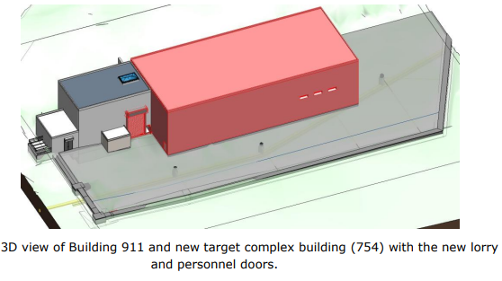
ECR for Approval
SPSX-J-EC-0008
Version 0.2
Creation of New Lorry and Personnel Doors in Building 911
This document describes new doors which are needed for the new target complex building (754) and for internal connection with Building 911 in order for radioactive equipment not to pass outside.
By Jean-Louis Grenard
This ECR list changes and additions to equipment belonging to:
EN-HE
  Crinoline ladder (ladder, overhead crane end-stops)
EN-CV
  The electrical distribution box (P-UICC-00103) and its associated ancillary
  The small ventilation fan on the north face (P-UAUV-00046)
  The second heating station (P-UAVC-00194)
EN-AA
  One branch of the air sampling pipe of the fire detection SFASD-01487
  Local modification of the second branch
  The junction box YSVIC-01411BJ of the external camera YSVIC-01411
  Integration into the SUSI system
IT-CS
  Two ethernet sockets (0412/01 and 0412/02)
  One WIFI access point (U911-R-PRZ-BARI4-1)
EN-EL
  EN-HE Crane power supply (239126A)
  EN-CV heating power supply (239131A)
  EN-EL socket outlet (239124A)
SCE
  New doors

Slide 8
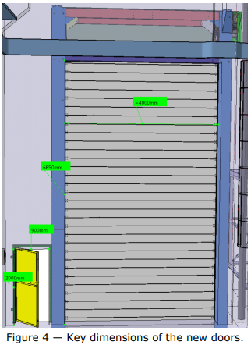
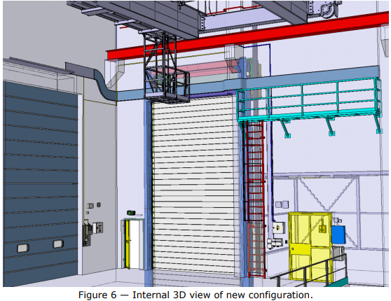
ECR for Approval
SPSX-J-EC-0008
Version 0.2
Creation of New Lorry and Personnel Doors in Building 911
By Jean-Louis Grenard

Slide 9
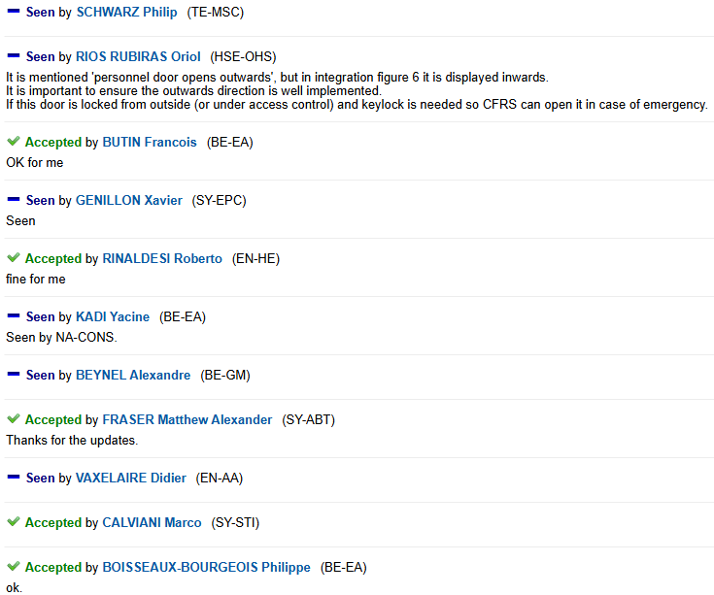
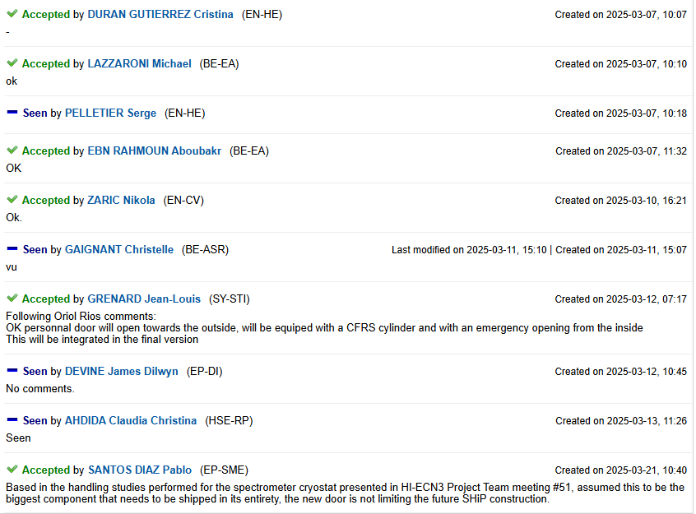
ECR for Approval
SPSX-J-EC-0008
Version 0.2
Creation of New Lorry and Personnel Doors in Building 911
By Jean-Louis Grenard
Seeking approval from EATM

Slide 10
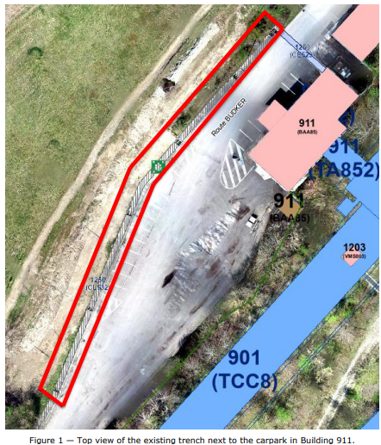
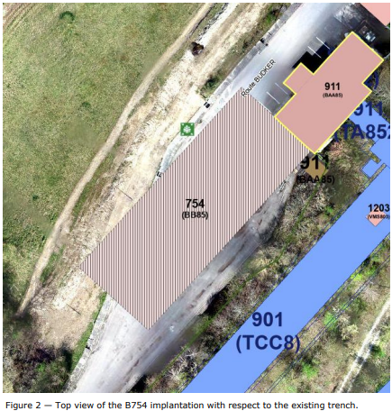
ECR for Approval
SPSX-J-EC-0012
Version 0.1
New Trench on the Edge of the Budker Road Extension
By Ixone Angulo Vaquero
A new trench must be created to allow services to be rerouted in light of the extension of the route Budker and the construction of Building 754.

Slide 11
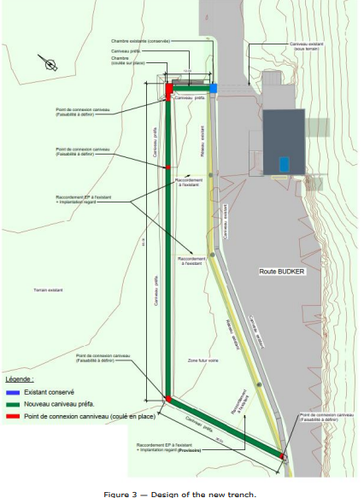
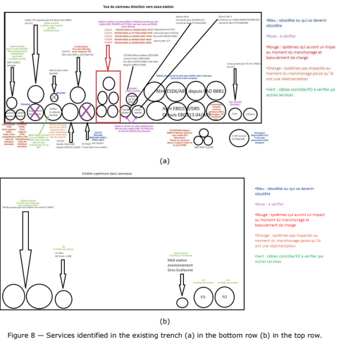
ECR for Approval
SPSX-J-EC-0012
Version 0.1
New Trench on the Edge of the Budker Road Extension
By Ixone Angulo Vaquero
Activities to be done by SCE:
Construction of the trench
Activities to be done by EN-EL
Rerouting existing equipment
Installing new secured network cables
Installing new reserve connection to Building 918

Slide 12
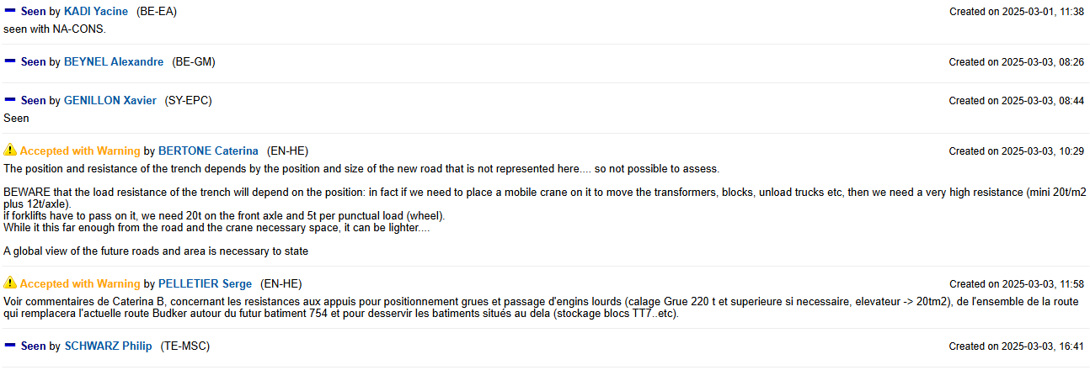
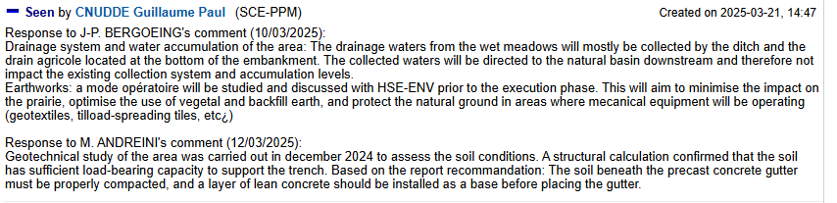
ECR for Approval
SPSX-J-EC-0012
Version 0.1
New Trench on the Edge of the Budker Road Extension
By Ixone Angulo Vaquero
Seeking approval from EATM

Slide 13
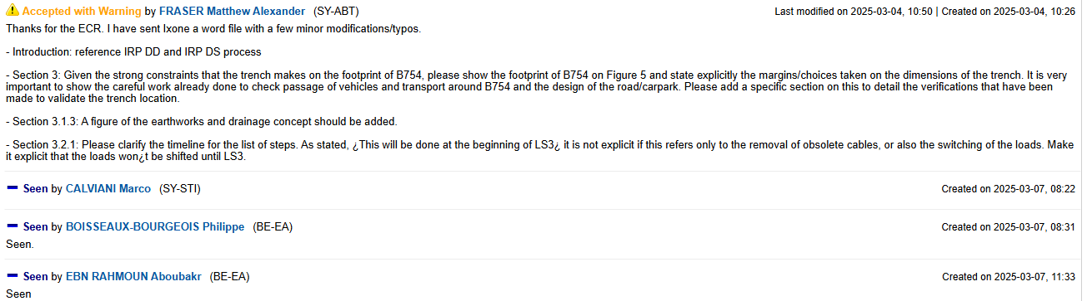
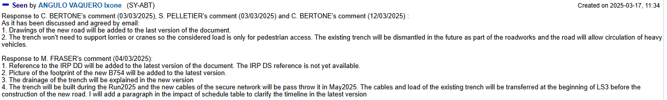
ECR for Approval
SPSX-J-EC-0012
Version 0.1
New Trench on the Edge of the Budker Road Extension
By Ixone Angulo Vaquero
Seeking approval from EATM

Slide 14
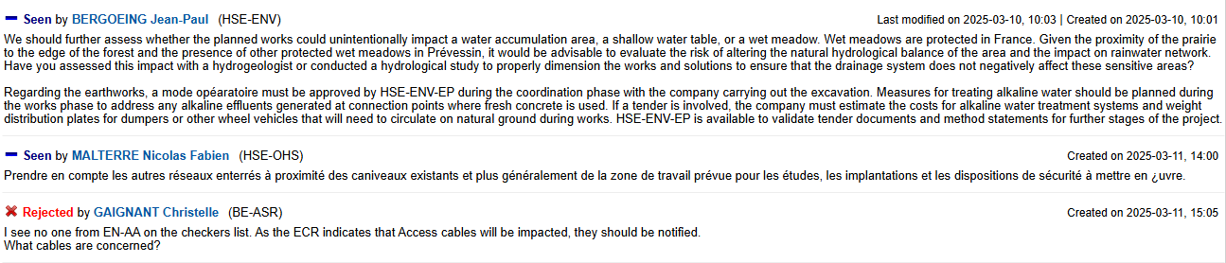


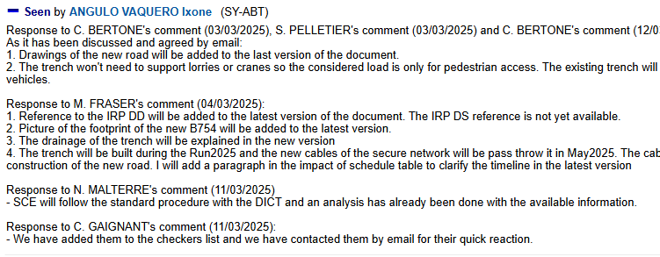
ECR for Approval
SPSX-J-EC-0012
Version 0.1
New Trench on the Edge of the Budker Road Extension
By Ixone Angulo Vaquero
Seeking approval from EATM

Slide 15
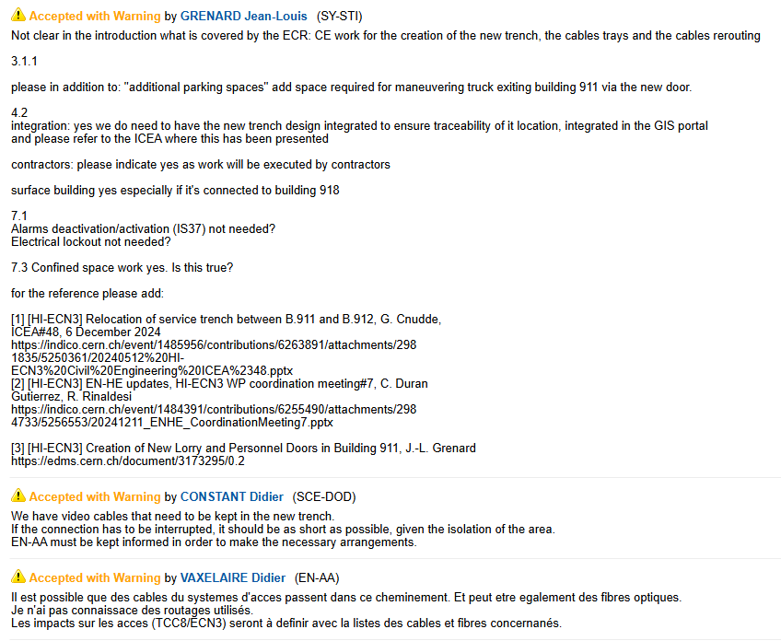
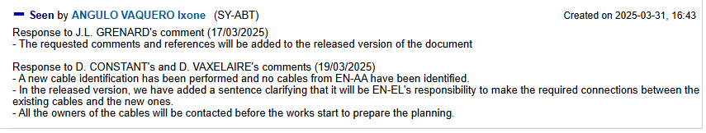
ECR for Approval
SPSX-J-EC-0012
Version 0.1
New Trench on the Edge of the Budker Road Extension
By Ixone Angulo Vaquero
Seeking approval from EATM

Slide 16
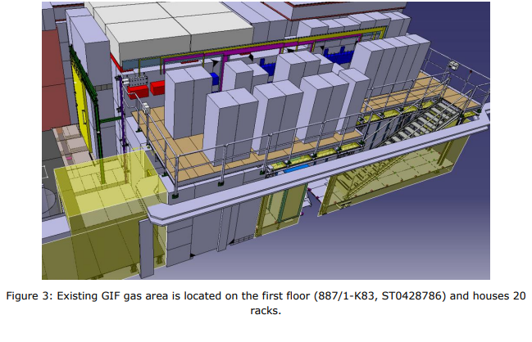
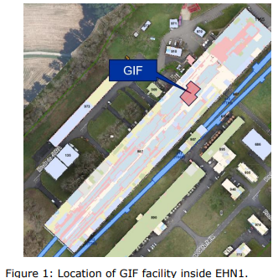
ECR for Approval
SPSX-J-EC-0010
Version 0.2
GIF++ Metallic Platform for Gas Area Extension
By Sylvain Girod
This document describes the proposed extension of the GIF++ gas balcony to allow the installation of additional gas mixer racks to cope with increased diversity needs.

Slide 17
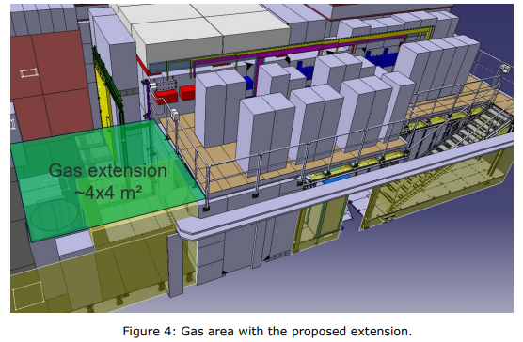
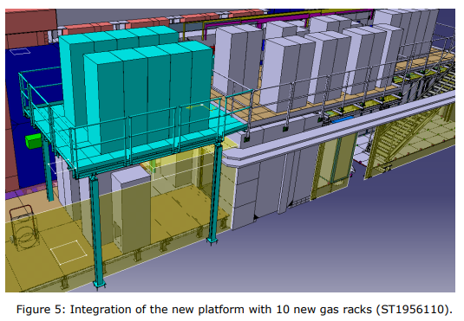
ECR for Approval
SPSX-J-EC-0010
Version 0.2
GIF++ Metallic Platform for Gas Area Extension
By Sylvain Girod
The changes involve:
Metallic frame (steel S235 profile HEB140 with an anti-corrosion zinc coating (hot-dip galvanizing) finishing.
A wooden false floor. On the lower part of steel profile, a second layer made of steel profile planking will be installed.
This will create a new surface of 4x4 m² with a general load capacity of 250 kg/m²
Design and installation: SCE-SAM
Integration: BE-EA

Slide 18
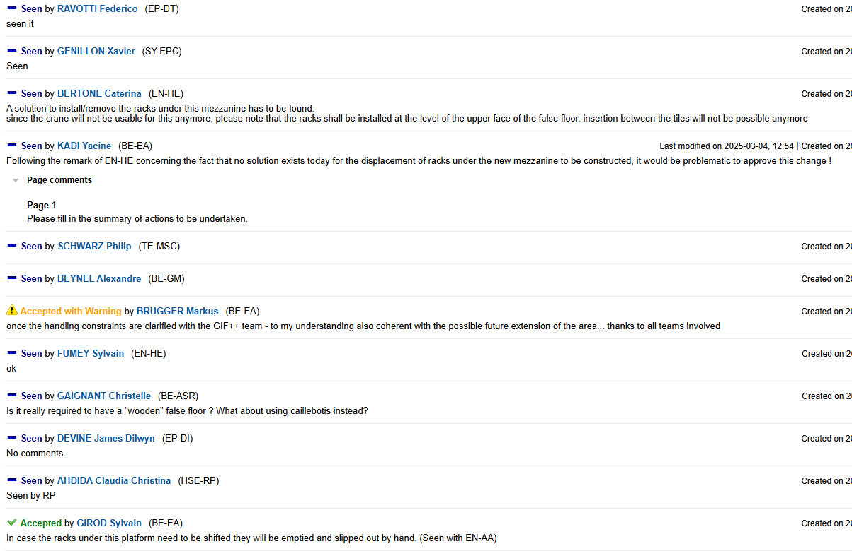
ECR for Approval
SPSX-J-EC-0010
Version 0.2
GIF++ Metallic Platform for Gas Area Extension
By Sylvain Girod

Slide 19
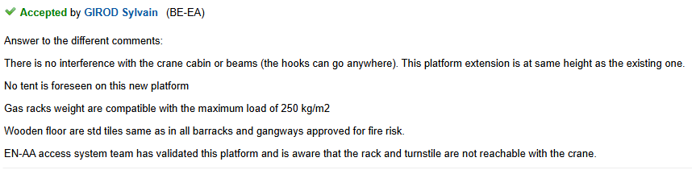
ECR for Approval
SPSX-J-EC-0010
Version 0.1
GIF++ Metallic Platform for Gas Area Extension
By Sylvain Girod
Seeking approval from EATM

Slide 20
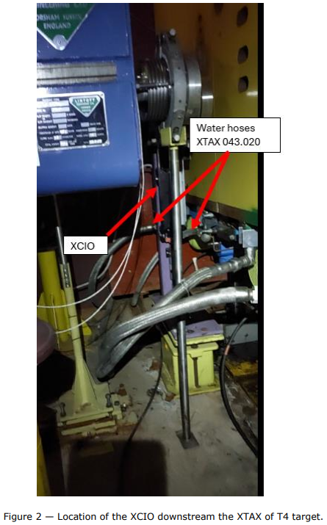
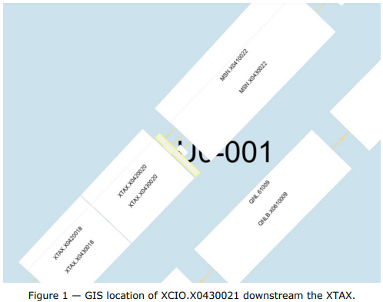
ECR for Approval
SPSX-T-EC-0006
Version 0.1
Removal of XCIO on P42 Beamline in TCC2
By Giulia Romagnoli
This document describes the removal of XCIO.X0430021.
The XCIO (converter IN/OUT) in position XCIO.X0430021 on P42 beamline in TCC2 was removed to reduce the dose during an XTAX maintenance operation during the YETS24- 25

Slide 21
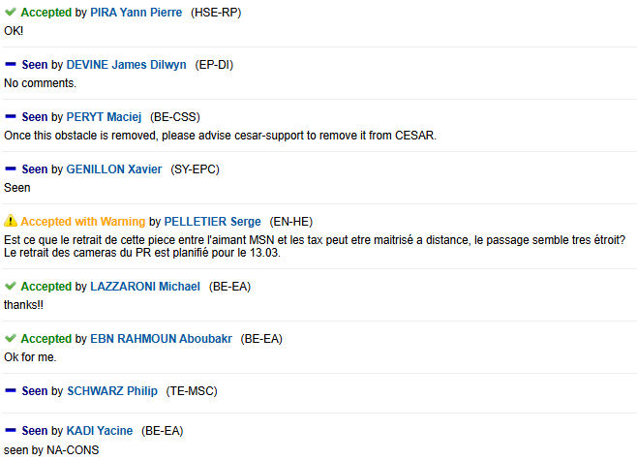
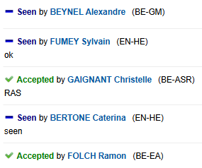
ECR for Approval
SPSX-T-EC-0006
Version 0.1
Removal of XCIO on P42 Beamline in TCC2
By Giulia Romagnoli
Seeking approval from EATM

Slide 22
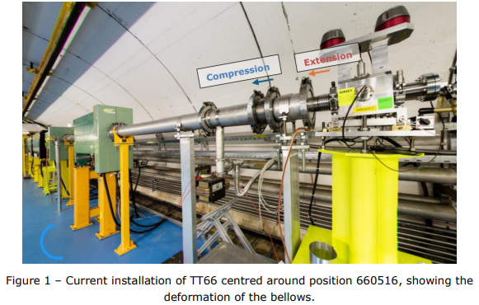
ECR for Approval
HRM-V-EC-0004
Version 0.2
TT66 Vacuum Chambers Modifications around BPM.660517
This document describes the modifications required around position 66516 of TT66 to reduce distortion due to vacuum forces.
By Anthony Harrison
During an alignment check in March 2025, it was found that the longitudinal position could not be corrected to better than 14 mm upstream and with an axial rotation offsetting the exit by 2 mm.
The original installation of the vacuum chambers and support is not adequate to withstand the vacuum forces as a cause of the change in aperture to the neighbouring BPM.660517 from Ø156 mm to Ø80 mm. The support at position 660516 is obsolete.
Changes include:
Remove the obsolete support which was used for BCTFI.660516.
Rotate the vacuum support 90°, re-drilling the floor for 3 x M12 threaded inserts to fix the vacuum support in place.
Remove vacuum chamber VCAB.660516 and bellows chamber VBBA.660516, replacing with a vacuum drift chamber VCAB.660516 [L=350 mm]

Slide 23
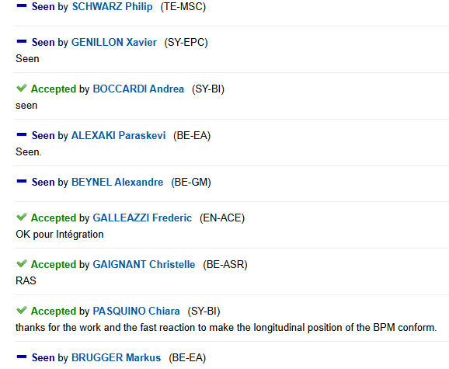
ECR for Approval
HRM-V-EC-0004
Version 0.1
TT66 Vacuum Chambers Modifications around BPM.660517
By Anthony Harrison
Seeking approval from EATM

Slide 24
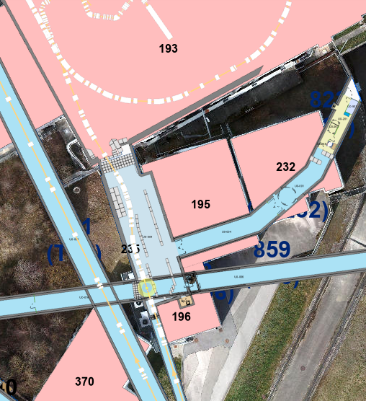
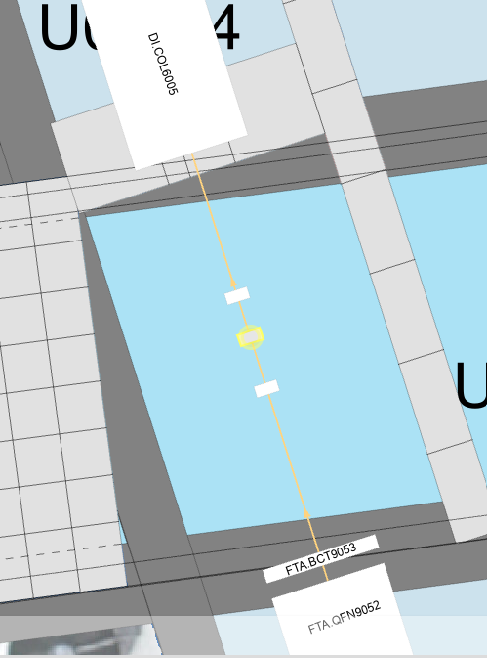
ECR for Approval
AD-TARAD-ARR-0003
Version 0.1
Asset Replacement Request - FTA.TAR9065
By Edouard Grenier-Boley
This document describes routing replacement of the AD target system.
The target exchange procedure has been rehearsed during LS2, YETS 21/22 and EYETS23-24 (ARR: EDMS 3000228). More detail on the intervention procedure is available in EDMS 3024759.
The target exchange will be supervised by RP and STI. An RP survey will be carried out before the target exchange proceeds.
The old target will be placed in a shielded box and moved to the shielded bunker in surface building 232 immediately after the target exchange.

Slide 25
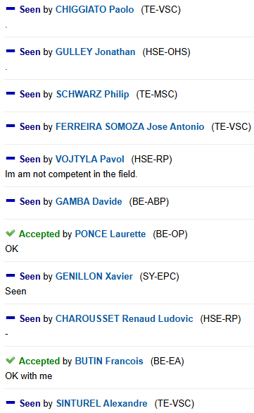
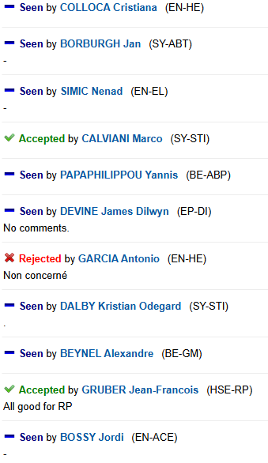
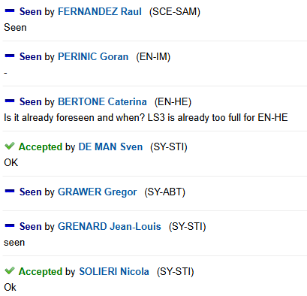
ECR for Approval
AD-TARAD-ARR-0003
Version 0.1
Asset Replacement Request - FTA.TAR9065
By Edouard Grenier-Boley
Seeking approval from EATM

Slide 26
Thank you!

