Slide 1
North Area BIDs
Controls Status
Author: Jérôme Lendaro
Date: 1/04/2025

Slide 2
North Area BIDs Controls Status
All BIDs and associated control systems have been inspected and tested during the YETS in collaboration with BE/EA and SY/STI.
During the tests, the functionality of the control systems was fully validated from the middleware level (FESA).
All BIDs are fully operational (still one issue ongoing with a collimator in M2 occurred yesterday)
  Primary targets and associated devices (TBIU, TBID,…)
  Collimators and converters XCSH/V , XCHV, XCBV and XCON
  Several collimators were exchanged for preventive or corrective maintenance -> all calibrated and tested prior to installation and commissioned when in place
  Preventive exchange of 8 collimator potentiometers in TCC2 -> all motorized axes have been calibrated and tested
  XTAX and cooling monitoring system
  Ion splitter XSPL
  Beam stoppers XTDV :4 new tables
  Micro-collimators in H8
  Magnetic collimators XCMH/V : The board used for the potentiometer's connection have been replaced on all XCM
  Absorbers XABS

Slide 3
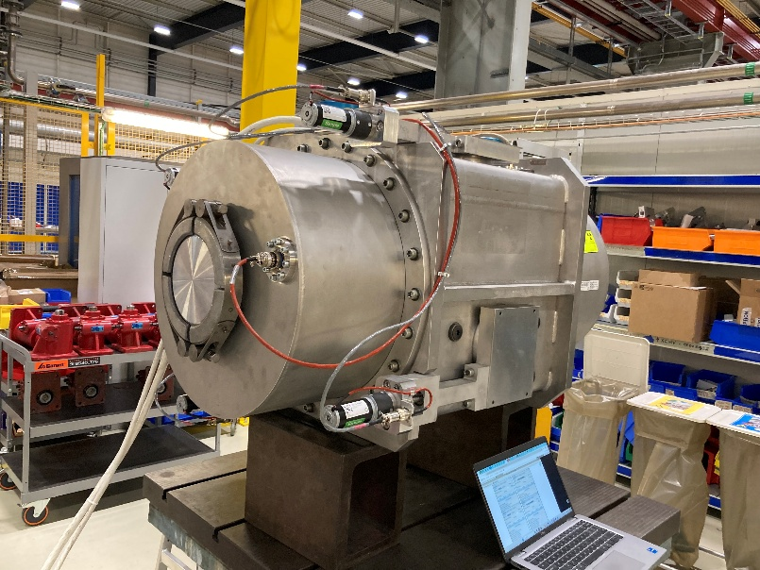
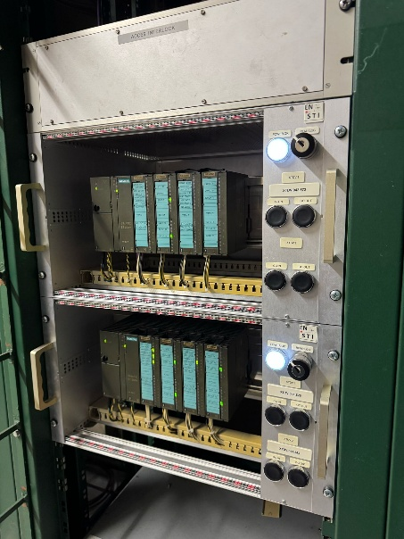
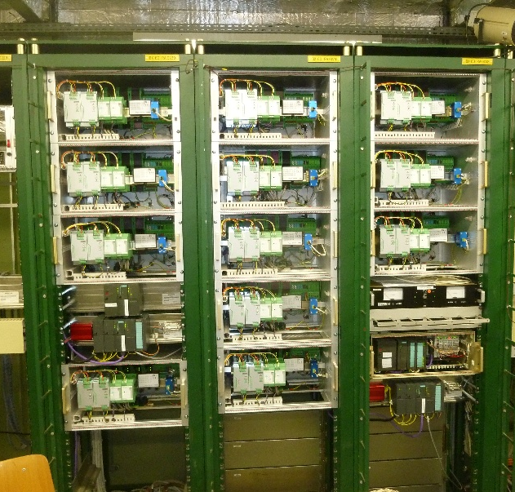
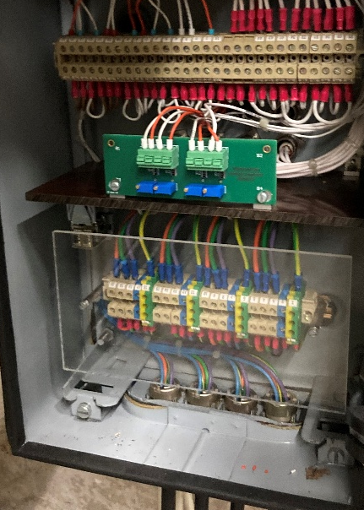
North Area BIDs Controls Status
The YETS activities for BE/CEM in the North Area were completed without any major issues. However, several issues occurred during the hardware commissioning period, particularly with the T09 and M2 collimators and the T10 beam stopper.
The large number of devices and the large scope of activities presented significant challenges, demanding efficient coordination of all interventions and considerable effort to ensure timely completion.
During HWC and operation period our “BIDs monitoring tool” help us to proactively detect some issue from the devices
A big thank you to all the teams and individuals involved in the coordination, including the STI and EA teams, the radioprotection group, and the access system team, for their dedication, professionalism, and outstanding collaboration.
XCHV collimator acceptance test
XTDV control system
New XCMH/V pot board
Collimator control system

