Slide 1
Vacuum SBA status
YETS 2024-2025
01 April 2024
Philippe BOISSEAUX-BOURGEOIS

Slide 2
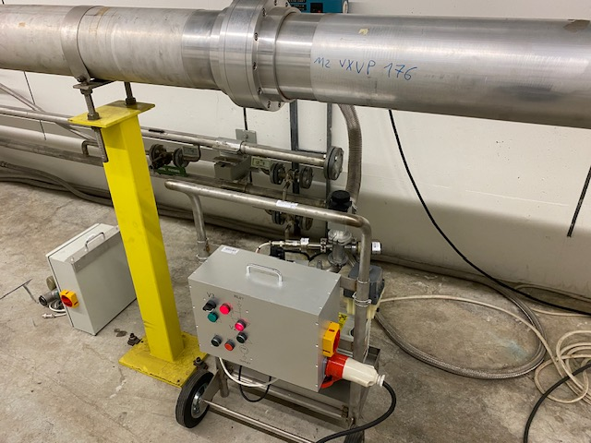
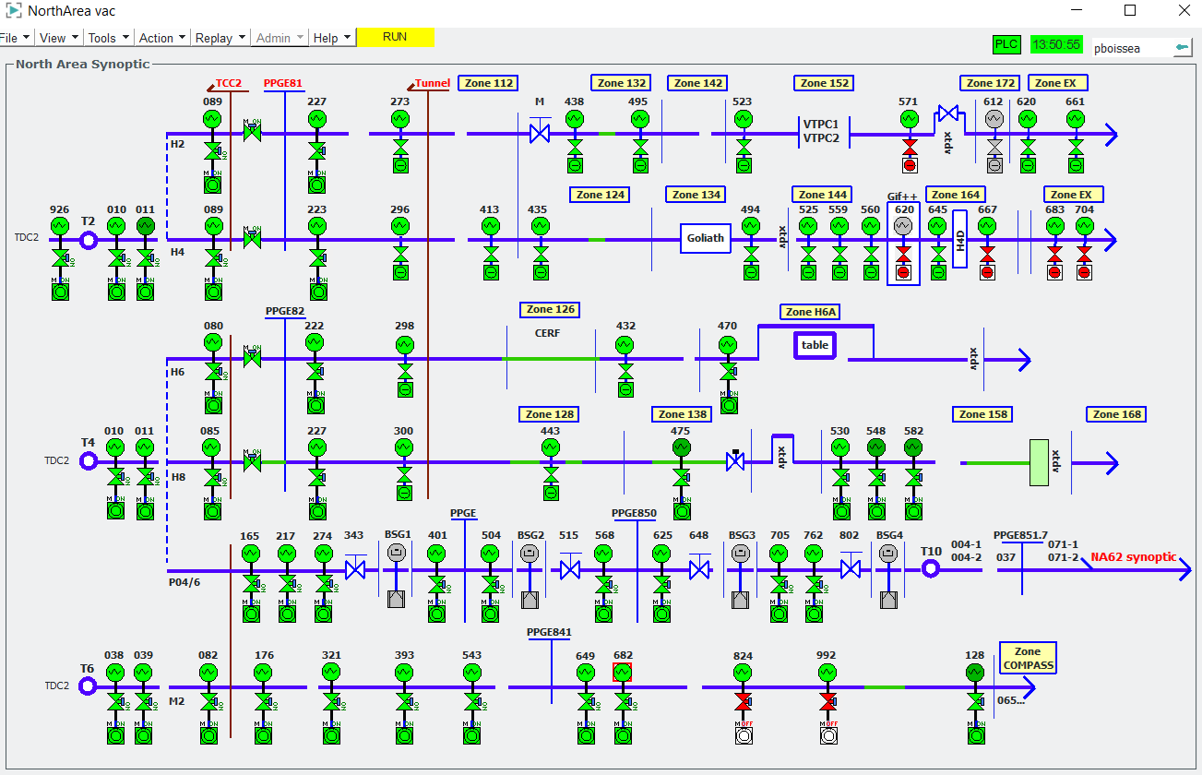
Vacuum SBA status – North Area
Maintenance of pumping group almost finished 100%
Oil replacement of the pump
Verification of the vacuum level of the pump
Verification of the devices on pumping group (electrovalves, manuel valve, gauge)
NA-CONS scheduled finished 100%
34 pumping groups consolidated (HARDWARE ➔ electrical box, electrovalve V2 and V3, gauges)
12 pumping groups consolidated (SOFTWARE ➔ PLC replacement)
01/04/2025

Slide 3
Vacuum SBA status – North Area
Vacuum status in the beam lines H2, H4, H6 and H8 (before EHN1)
TCC2, TT81 and TT82:
All ok
Vacuum level between 3x10-2 and 1x10-3 mbar.
01/04/2025

Slide 4
Vacuum SBA status – North Area
Vacuum status in the beam lines P42
TCC2 :
All ok
TT83 and TT85 :
All ok
One new pumping unit added at position 625.
Vacuum level between 2x10-2 and 10-3 mbar.
01/04/2025

Slide 5
Vacuum SBA status – North Area
Vacuum status in the beam lines M2
TCC2 :
All ok
TT83 :
All ok
TT84 :
Sector 5 open for :
collimators XCHV.065.013 and 54 exchange.
vacuum configuration modification for users.
(Vacuum test are already ok)
Vacuum level between 3.5x10-2 and 1x10-3 mbar.
01/04/2025

Slide 6
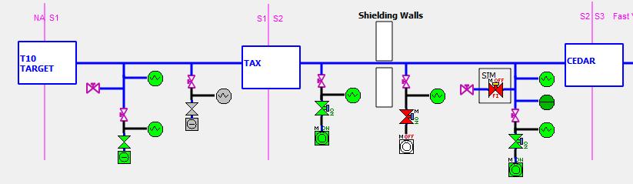
Vacuum SBA status – North Area
Vacuum status in the beam line K12
TCC8 and TCC8 (ECN3) side :
Maintenance done but one issue on pump discovered (thermal protection triggered)
➔ the pump will be replaced this Thursday.
Vacuum level already ok with redundancy.
01/04/2025

Slide 7
Vacuum maintenance SBA status
Vacuum status in the beam lines in EHN1
Vacuum ok except :
2 vacuum configuration will be finished tomorrow.
H4 VLE not under vacuum (not used in 2025)
01/04/2025

Slide 8
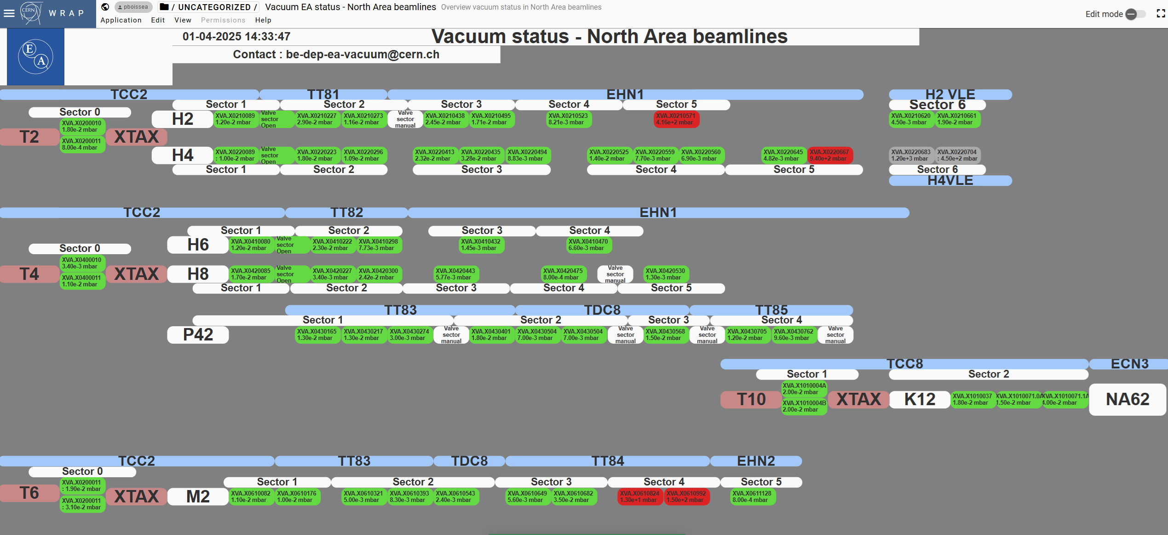
Vacuum maintenance SBA status
WRAP Dashboard
https://wrap.cern.ch/app/131986
01/04/2025

