Slide 1


Slide 2
ISAAC Engineering Design and Schedule
J. García Matos, C. Martins, F. Toral (CIEMAT)
J.C. Pérez, E. Todesco (CERN)

Slide 3
Outline
Introduction
Manufacturing
  Strategy
  Design
  Assembly sequence
Status and schedule

Slide 4
Outline
Introduction
Manufacturing
  Strategy
  Design
  Assembly sequence
Status and schedule

Slide 5
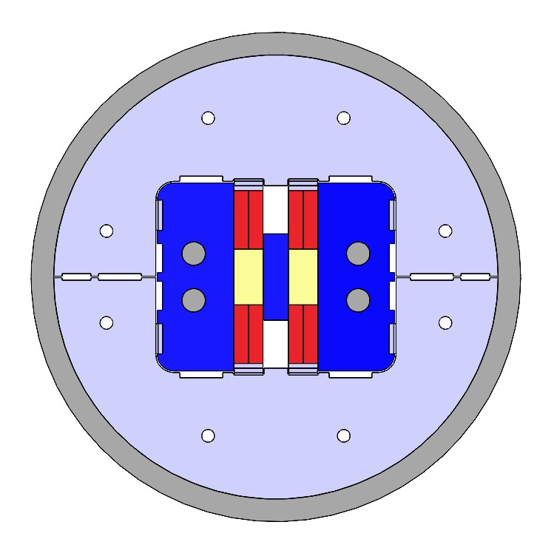
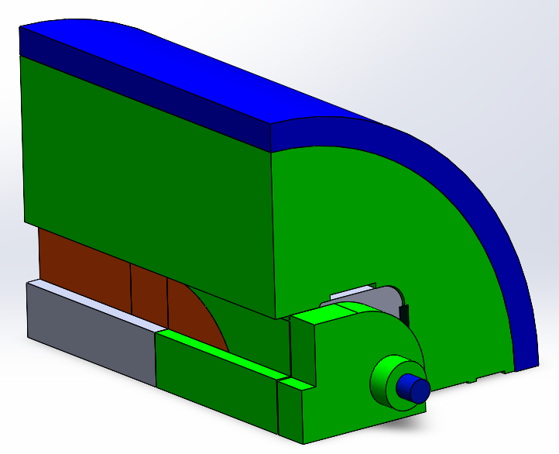
Introduction
ISAAC: Investigating Superconducting Assembly to Address Common coil mechanics
Main goal: Learn for the 14 T demonstrator (DAISY) with existing coils, mostly on mechanics.
Existing RMC coils made at CERN with MQXF strand.
Horizontally-split yoke to hold large horizontal EM forces.
Assembly with bladder and keys with a low preload concept:
  Slight horizontal preload just to keep contact between parts at room temperature
  Coil vertical preload (0.2 mm interference with yoke) to reduce vertical and shear stress (avoid cable detaching from pole).
Axial support with four stainless steel rods.

Slide 6
Outline
Introduction
Manufacturing
  Strategy
  Design
  Assembly sequence
Status and schedule

Slide 7
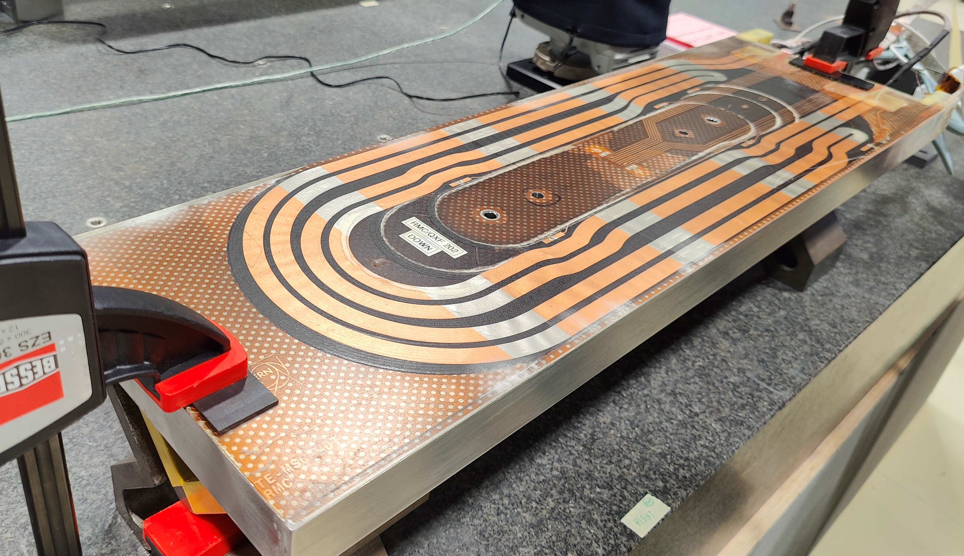
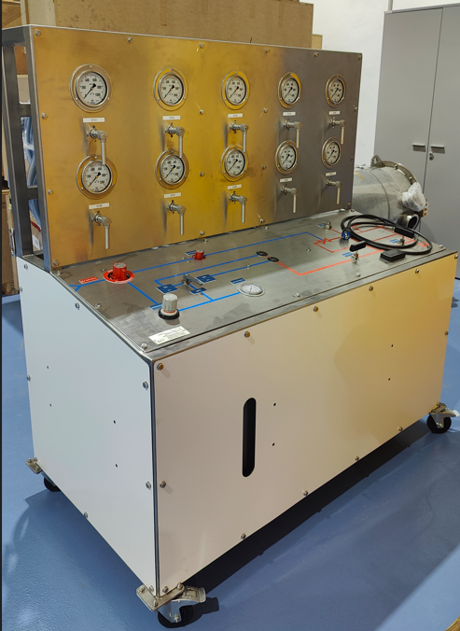
Manufacturing strategy
RMC coils made at CERN.
Manufacturing documents prepared by CIEMAT:
  ISAAC Components drawings.
  ISAAC Assembly tooling drawings.
  Instrumentation requirements.
  Purchasing specifications.
Procurement of magnets and tooling components done by CERN.
ISAAC assembly will be done at CERN:
  To avoid shipping the RMC coils to CIEMAT and then back to CERN for cold tests.
  CIEMAT first magnet assembly with bladder and keys (CIEMAT personnel training using CIEMAT B&K hydraulic system and tooling).
ISAAC instrumentation will be done at CERN.
ISAAC powering tests will be done at CERN.

Slide 8
Outline
Introduction
Manufacturing
  Strategy
  Design
  Assembly sequence
Status and schedule

Slide 9
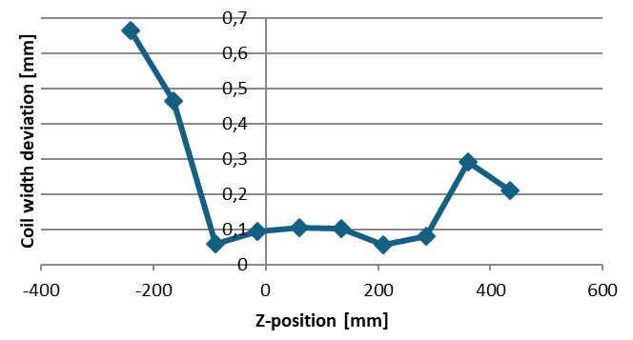
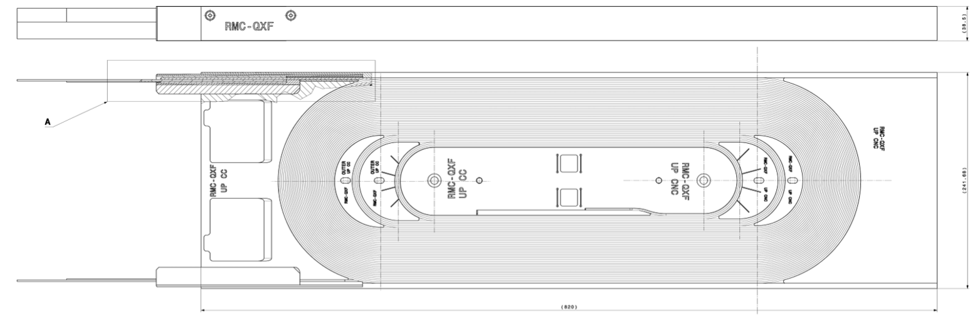
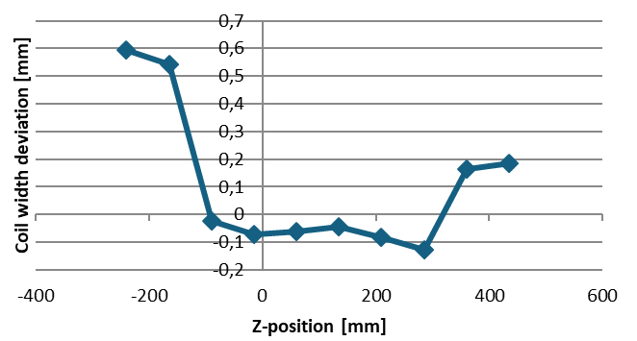
Manufacturing design: RMC dimensions
Real RMC coil dimensions considered for ISAAC magnet (RMC-QXF #201 & #202):
  Width shimming to assure uniform vertical preload (measured along coil length each 75mm, deviations btw. +0.1mm and +0.7mm).
Courtesy G. Hernando (CERN)
  Winding coil length over nominal (9.85mm in #201, 11.24mm in #202 at each coil head). Non-connection EndShoe shortened to reduce total length to nominal, 820mm (819.5mm in #201, 819.8mm in #202).
  Shimming to match both coil dimensions and ensure alignment in the assembly.
#201 Width deviation
Thickness
#202 Width deviation
Width
Length

Slide 10
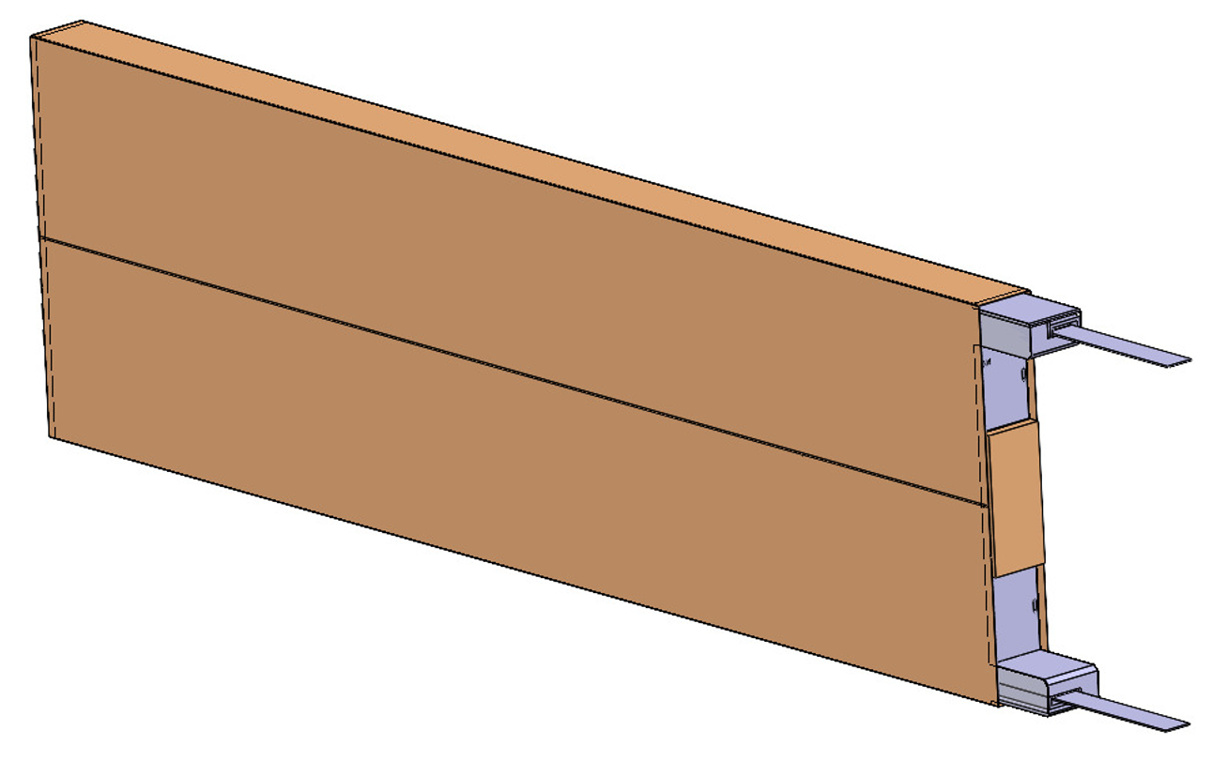
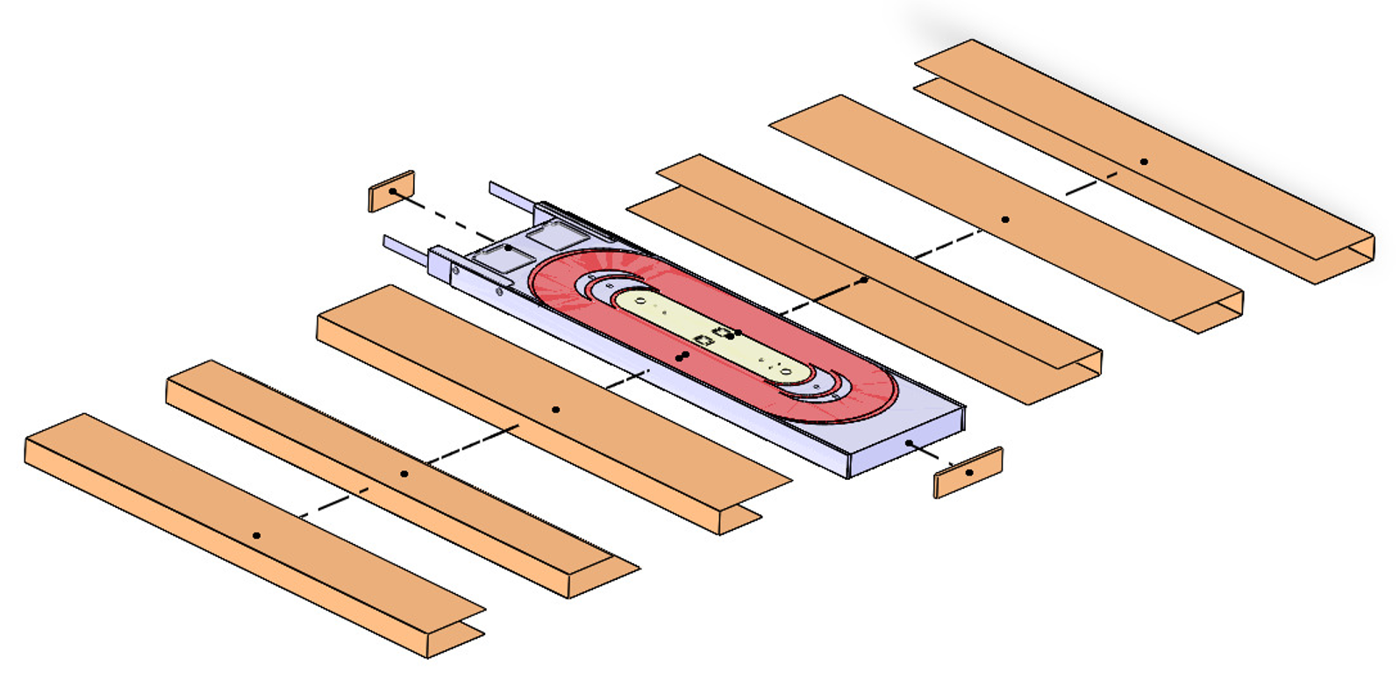
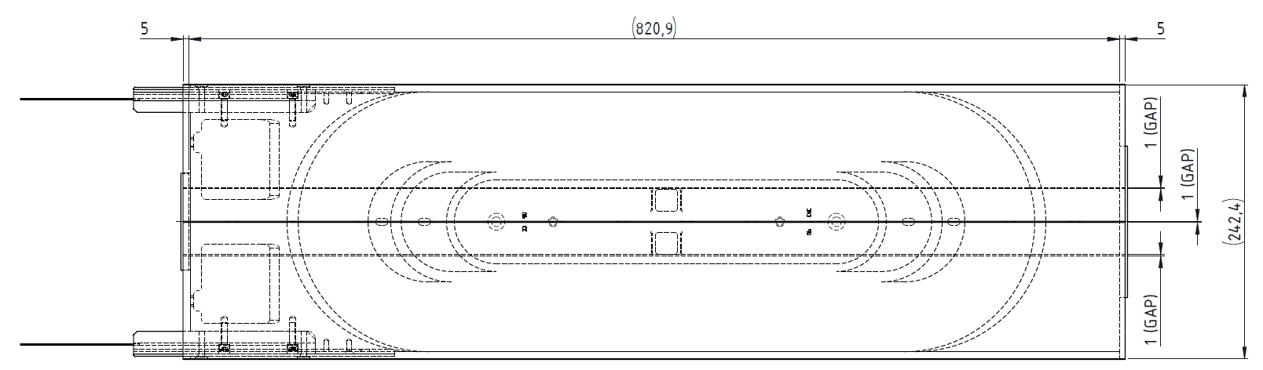
Manufacturing design: coil insulation
Three Polyimide layers (each 0.125mm thick) around each coil.
G11 insulation plates at each coil end.

Slide 11
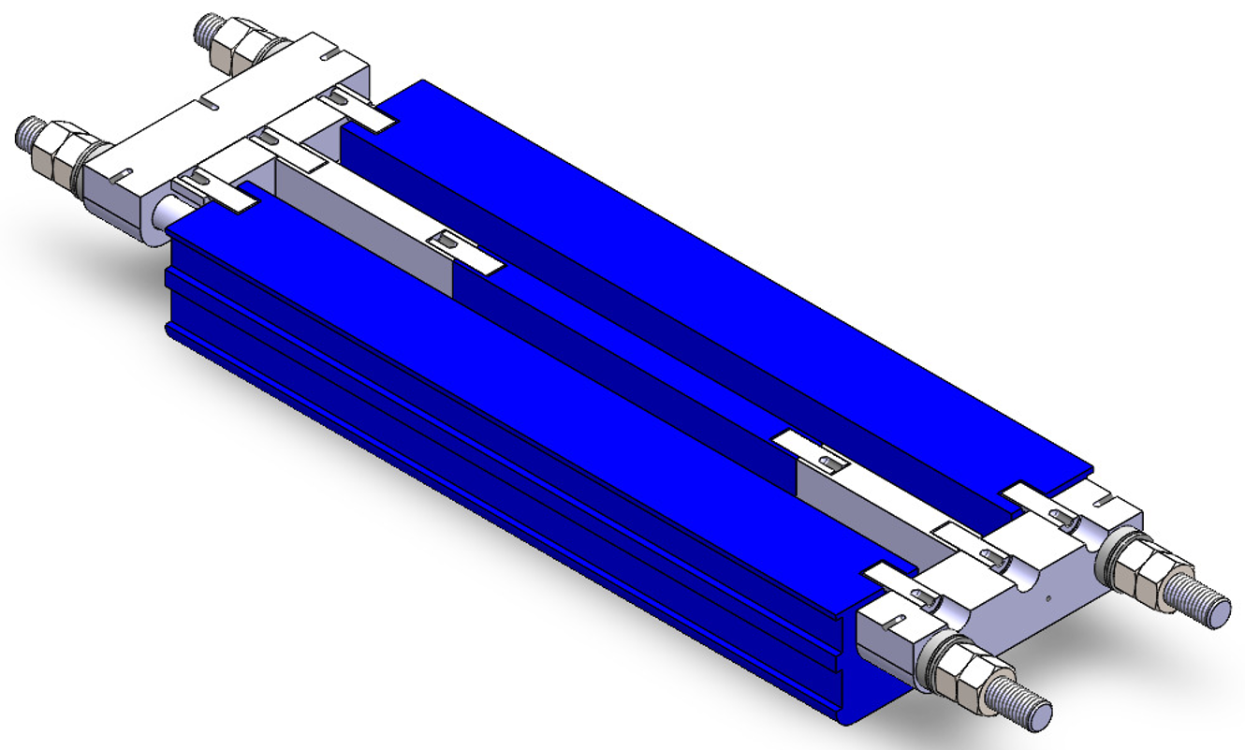
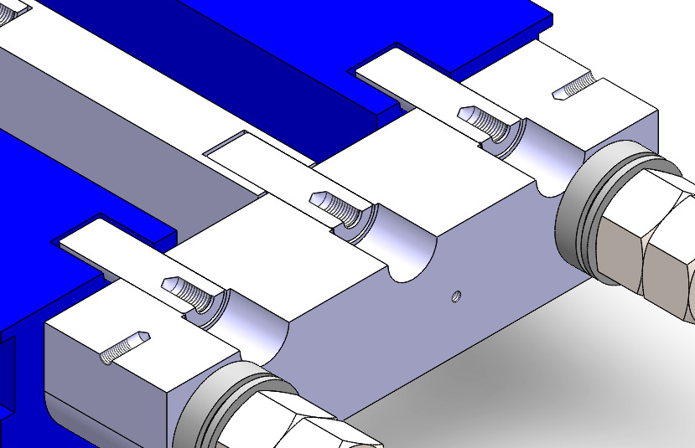
Manufacturing design: spacer
Off-centering EM forces on the iron space.
Central spacer made of iron. End spacers made of stainless steel, aligned to central spacer with pins.
Spacer Pins
End spacer aligned to EndPlate with a central pin
Pads horizontally aligned to EndPlate with pins (horizontal slot in Pad)

Slide 12
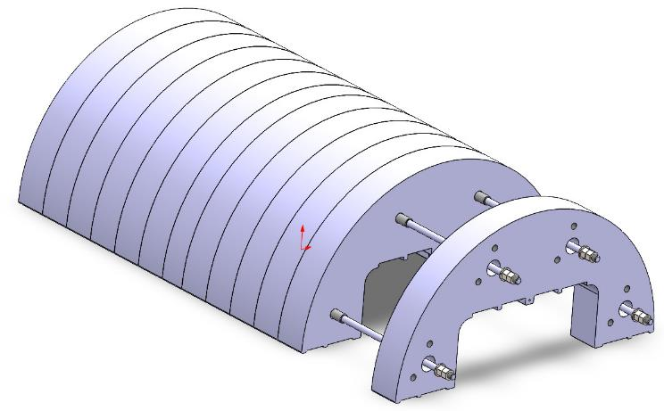
Manufacturing design: Yoke
Stainless steel yoke (mechanical support structure) sliced into 64mm and 54mm thickness parts.
Yoke assembly stacked with (four) positioning tubes and tightening rods to machine precision surfaces as one.
Precision positioning tubes
Tightening rods

Slide 13
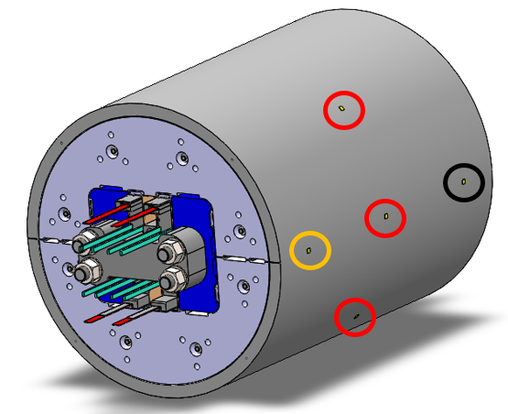
Manufacturing design: Shell
Aluminium shell. Outer Ø: 650 mm. Thickness: 30 mm.
Instrumented with 10 bidirectional gauges (axial and azimuthal).
6x gauges centered with coils (0°, 45°, 135°, 180°, 225° & 315°)
2x gauges in connection side (0° & 180°), 210mm from coil center.
2x gauges in non-connection side (0° & 180°) , 210mm from coil center.
2D Ansys simulation

Slide 14
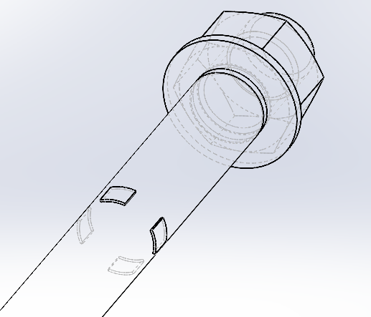
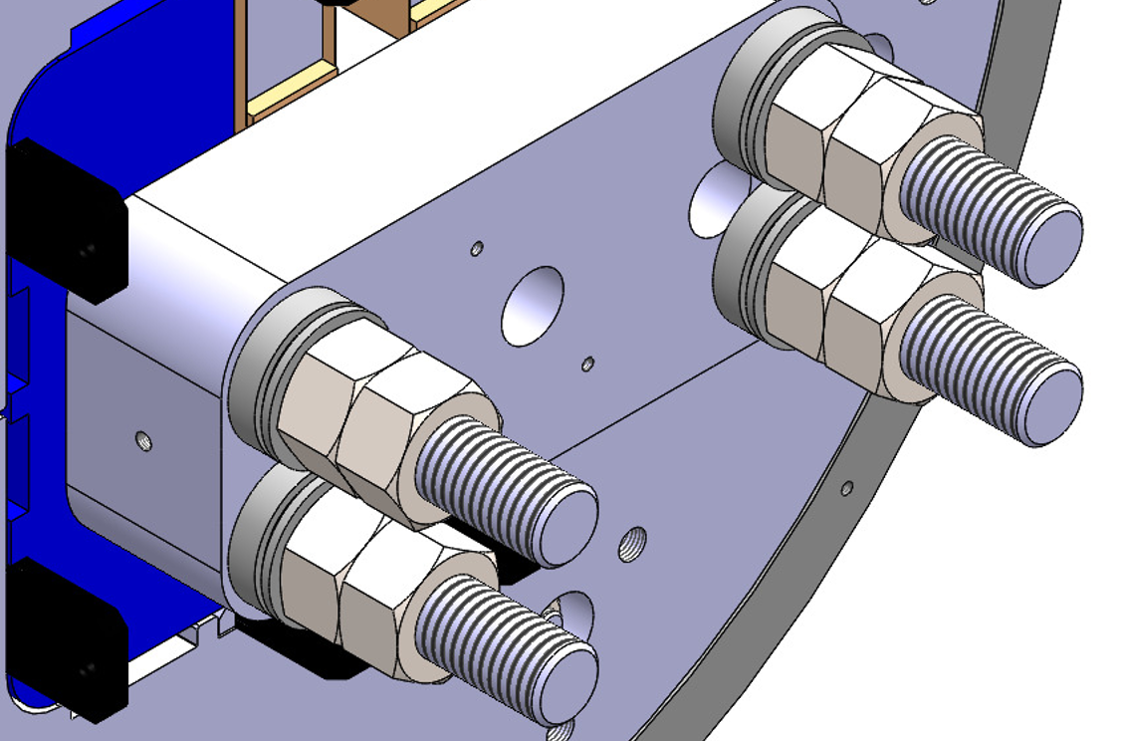
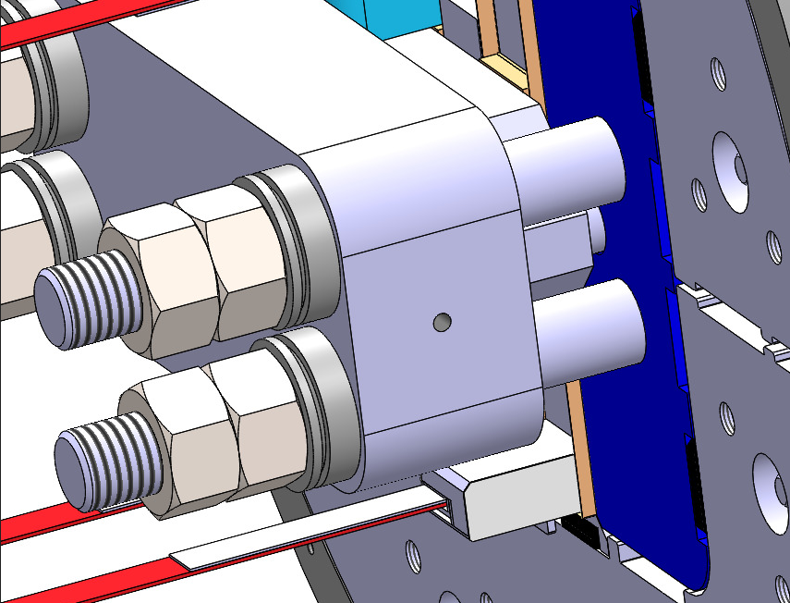
Manufacturing design: Main Rods
Four stainless steel rods.
Each rod instrumented with 4 bidirectional gauges (connection side):
  (2x) axial
  (2x) bending
At each rod end: One Spherical washer and two nuts
Gauges
CS spacer
Rod gauges location

Slide 15
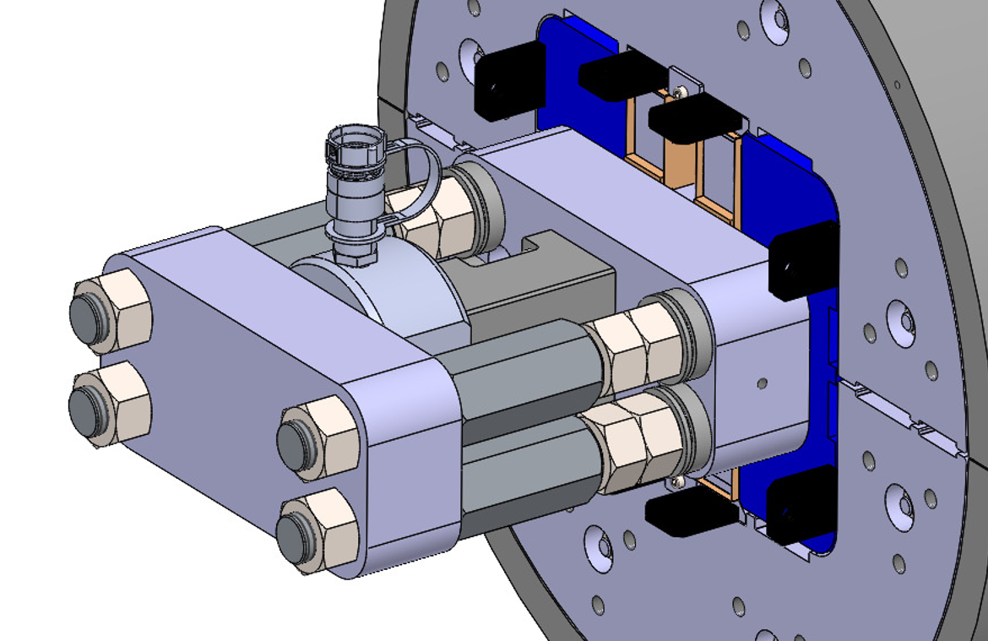
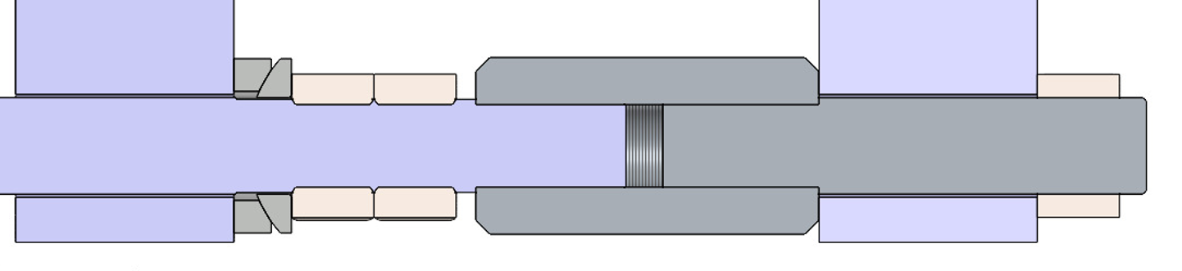
Manufacturing design: Axial loading system
Axial loading system to preload the rods, to be assembled in non-connection side.
Hydraulic cylinder
Main Rod
Axial clamp

Slide 16
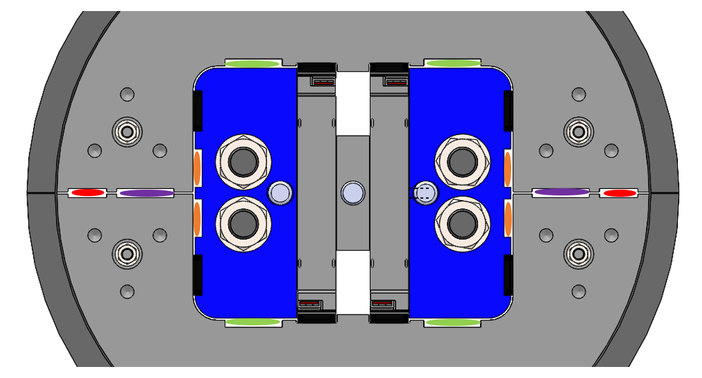
Manufacturing design: Bladders and Keys
Horizontal opening with four 37 mm width bladders (btw yokes and pads).
Vertical opening with two 56 mm width bladders (btw yokes in midplane).
Vertical preload with four 38 mm keys (over & below each coil).
Horizontal preload with four 40 mm keys (btw yokes and pads).
Four additional 56 mm slots for bladders or keys (btw yokes and pads).
Two additional 37 mm slots for bladders or keys (btw yokes in midplane).

Slide 17
Outline
Introduction
Manufacturing
  Strategy
  Design
  Assembly sequence
Status and schedule

Slide 18
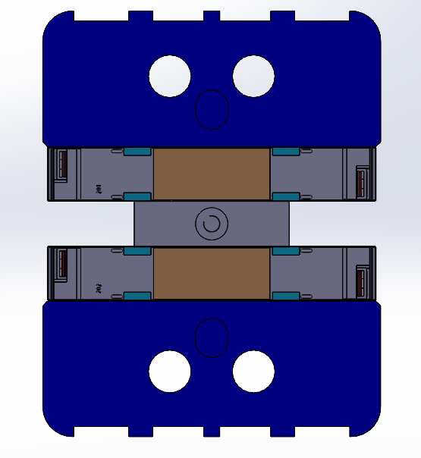
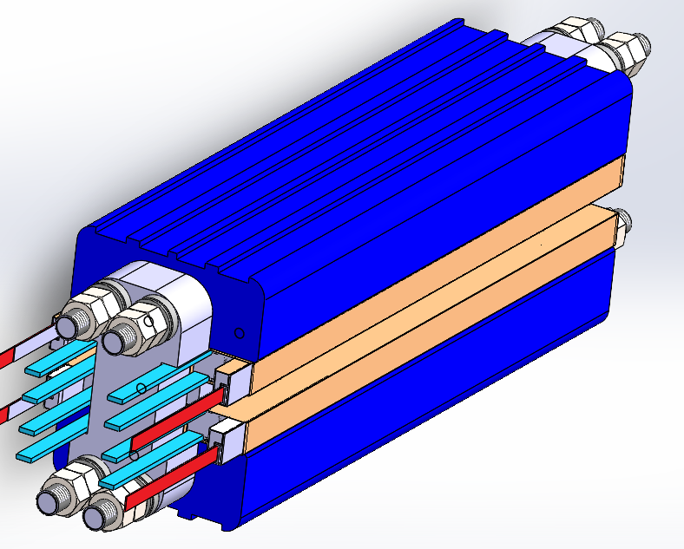
Assembly sequence: Coil Pack assembly
Coil Pack assembly in horizontal position.
Components handling with vacuum cups.
Coil Pack assembly closing at both ends with EndPlates and Rods.
Total weight: 350kg approx.

Slide 19

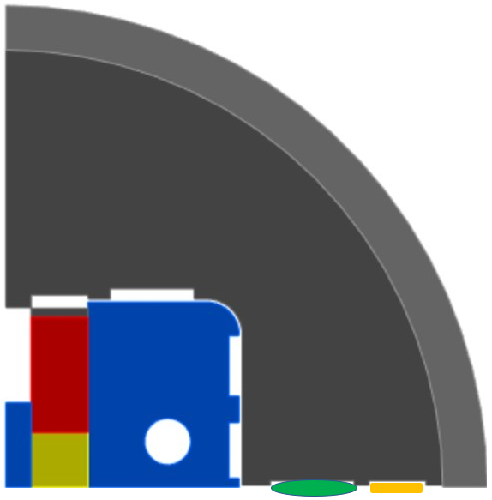
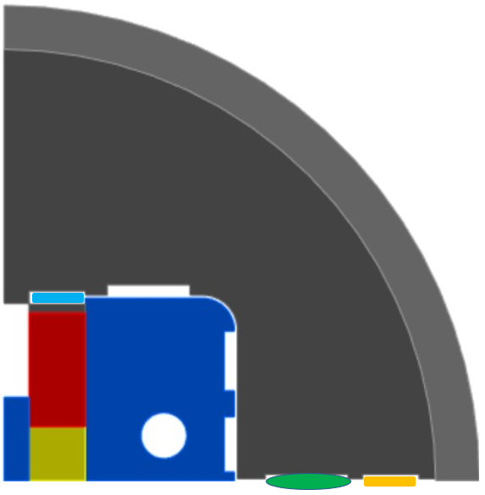
Assembly sequence: Coil Pack in Yoke-Shell (I)
Assembly in vertical position:
Vertical bladder (40MPa) -> Yoke moves 0.57mm up and 0.09mm left.
Alignment of Yoke parts with Shell gauges position. Gauge btw. Yoke parts (Yokes + Shell block).
Coil Pack insertion (Horizontal gap 1.9mm & Vertical gap: 2.6mm approx.).
Vertical gauges (key with nominal gap) to center vertically the Coil Pack wrt. Yokes.
1)
2)
3)
Values per quadrant

Slide 20
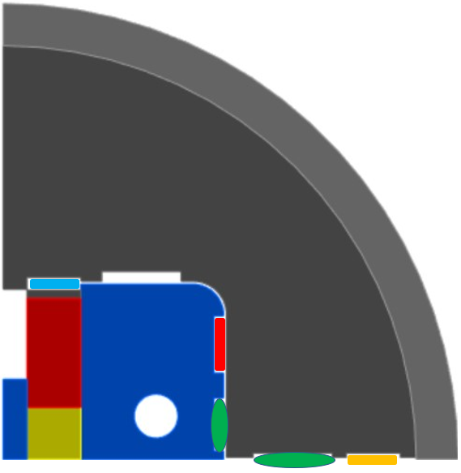
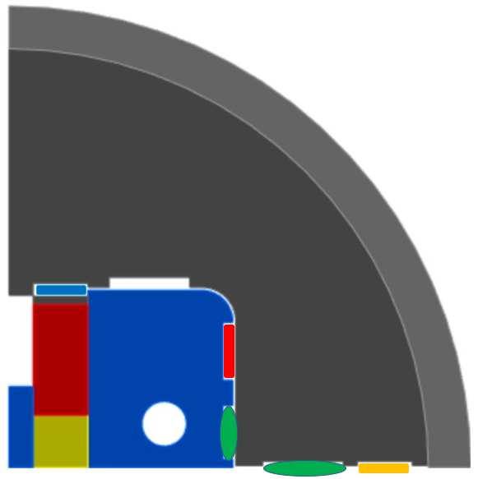
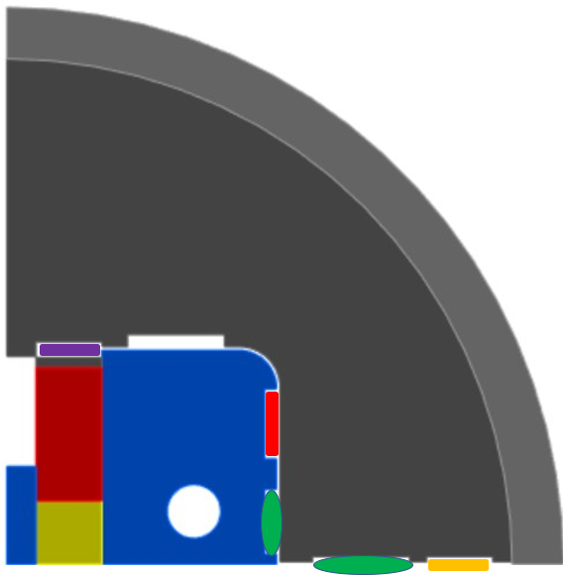
Assembly sequence: Coil Pack in Yoke-Shell (II)
Horizontal bladder (50MPa) -> Yoke moves 0.25mm to the right and 0.23mm down. Pad moves 0.02mm to the left. Horizontal gauges (key with nominal gap) to center horizontally the Coil Pack wrt. Yokes.
0.1mm interference Vertical keys insertion.
0.2mm interference Vertical keys insertion.
Horizontal & Vertical bladders removal (in horizontal position, using bladder extraction system).
Horizontal key gap: +0.16mm from nominal
Vertical key gap: +0.24mm from nominal
4)
5)
6)
Values per quadrant

Slide 21
Outline
Introduction
Manufacturing
  Strategy
  Design
  Assembly sequence
Status and schedule

Slide 22
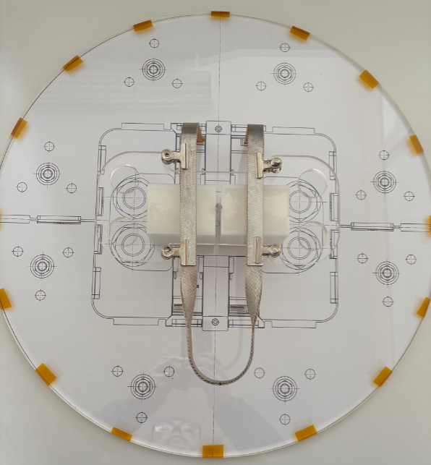
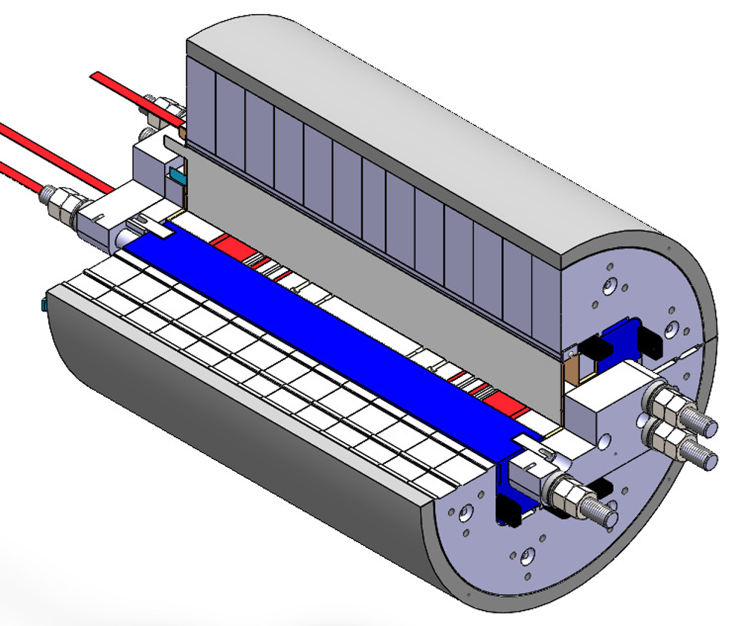
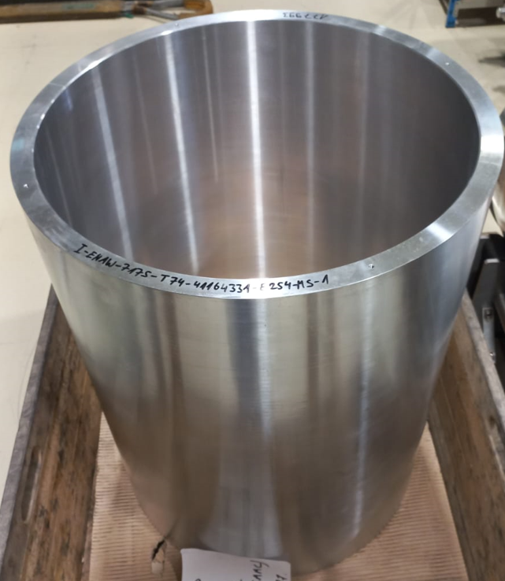
Status and schedule
Engineering (manufacturing) 3D design almost finished:
  Connection Plate: Coil leads very close (54mm), splice solved. Support being designed.
  Tuning design for Ø34 (M33) stainless steel rods.
Manufacturing magnet components drawings under final revision.
Axial loading system already designed. Drawings under final revision.
Bladder extraction system design is in progress.
Detailed calculations in final phase.
Shell already manufactured.
Courtesy J.C. Pérez (CERN)
Schedule (end dates)
  Manufacturing drawings: Mid-April 2025
  Detailed calculations: Mid-April 2025
  Manufacturing: July 2025
  Assembly: September 2025
  Power test: October 2025

Slide 23
Thanks for your attention

Slide 24
Extra slides

Slide 25

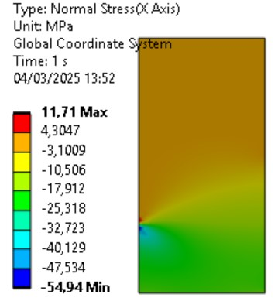
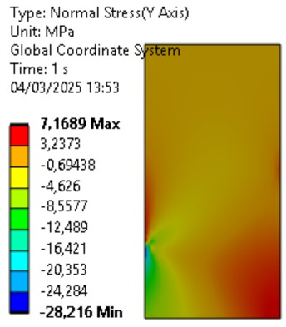
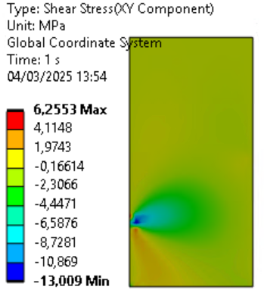
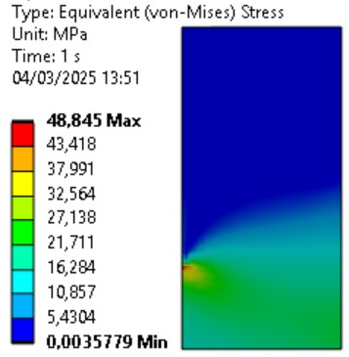
3.
Cable stress with vertical and horizontal bladders

Slide 26

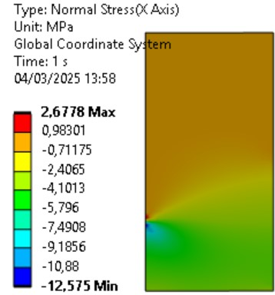
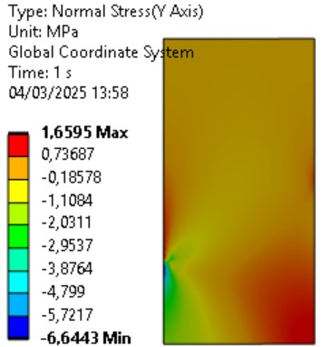
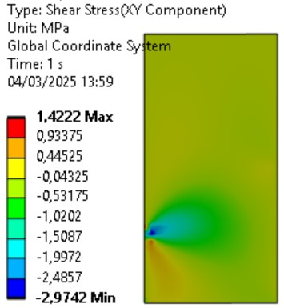
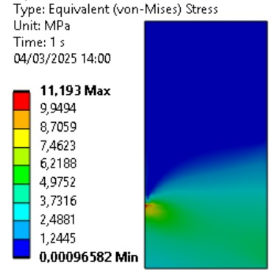
5.
Cable stress with vertical and horizontal keys, and vertical bladders

Slide 27

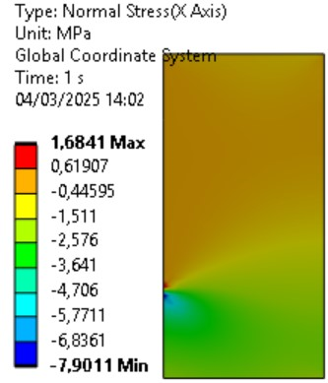
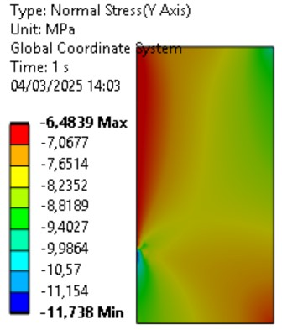
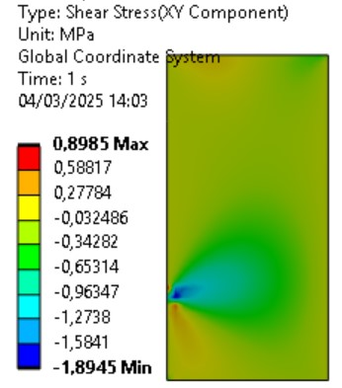
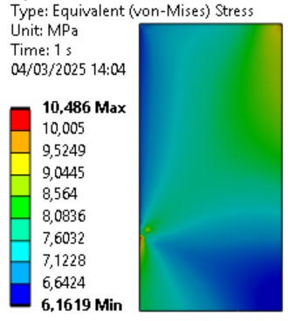
6.
Cable stress with vertical and horizontal keys

