Slide 1


AUP Update
Leonardo Ristori
Manuele Narduzzi
Global Crab Cavity Coordination Meeting – 4th April 2025

Slide 2
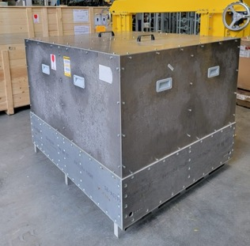
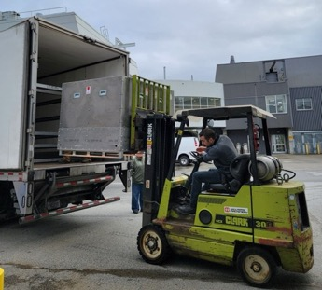
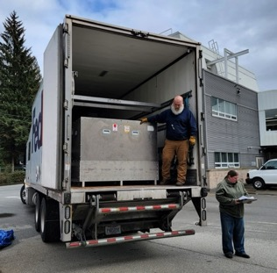

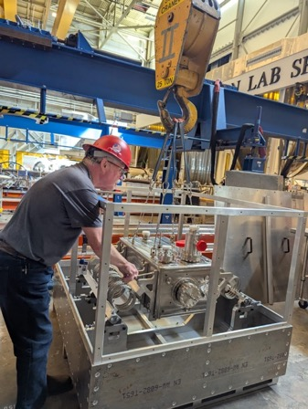
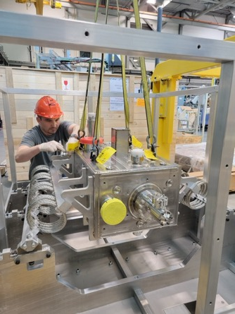
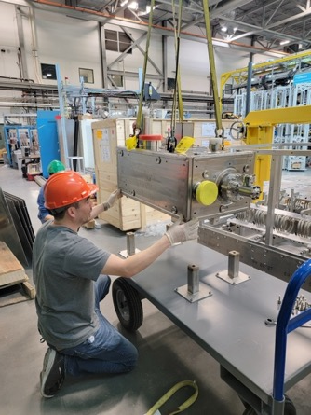
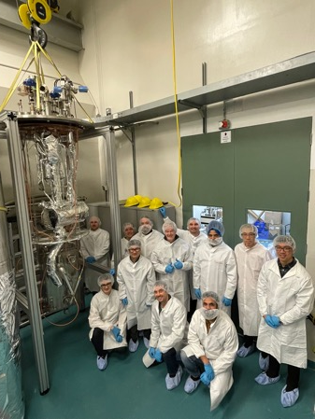

First Dressed Cavity Arrived Safely at TRIUMF
Loading operations at JLAB (2/21/25)
Receiving at TRIUMF (2/26/25)
Test at TRIUMF (3/17/25)

Slide 3
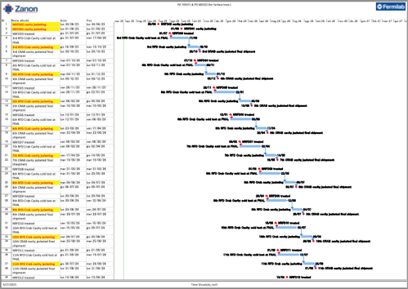
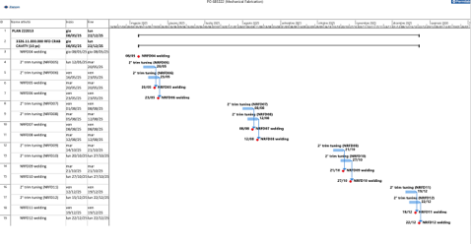
Production Restart at Zanon
RFDs production at ZRI paused since Oct 2024. We realized there was a gap between the plans at Zanon and the requirements of HL-LHC in terms of documentation prior to manufacturing and UT/metrology inspections.
Two Change-Orders (c/o) were needed to modify individual contracts for Bare and Jacketed to add work at Zanon per the above.
  New schedules received from Zanon for both contracts (right).
  After lengthy negotiations, resulting in advancements up to 9 months, we have reached an agreement on dates for both contracts.
  Bare Cavity c/o: Approved.
  Jacket Cavity c/o: In hand at Zanon for minor tweaks, approval likely early next week.
Zanon informed us that they have started fabrication of Ti-SST brazed joints for the production helium tanks.

Slide 4

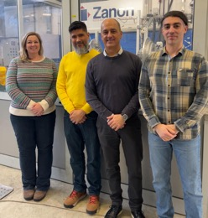
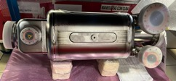
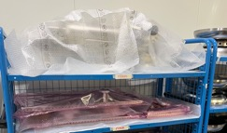
Vendor Visits
AUP & CERN reps visited ZRI Feb 24th-28th.
  Reviewed all details of HPR procedures of ZRI/JLAB and CERN.
  Finalized CMM plans for Jacketed and Bare cavities.
  Agreed on plans for UT C-Scan at CERN of all NEW joints made at Zanon.
  Discussed issue with CBAM EU regulation (Carbon Border Adjustment Mechanism) negotiated that JLAB can ship all the vacuum test hardware to Zanon in one shipment and avoid additional limitations starting in 2026 (kits expected to arrive at Zanon in time for first preparations in ~June).
AUP Representatives at Zanon Feb. 2024
Next visit planned for April 15th-17th to officialize restart of production:
  Verify quality of completed NRFD03
  Confirm that trim-tuning targets are achieved for NRFD04-06

Slide 5
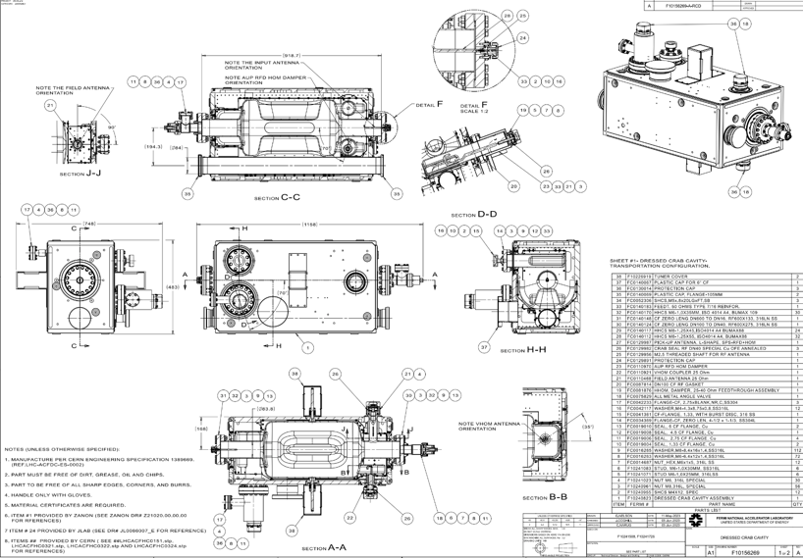
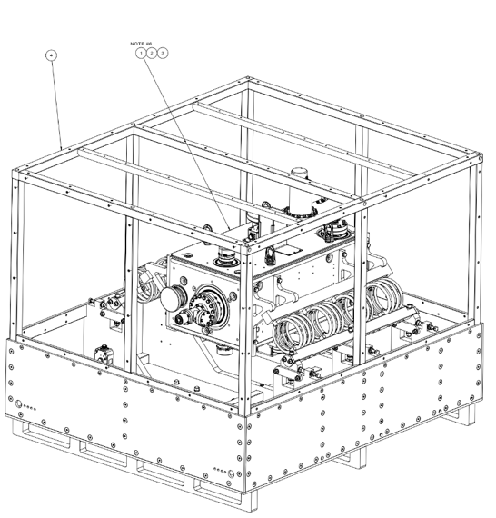
Interfaces: Last Pending Items
AUP “as delivered” drawings provided recently, waiting for CERN feedback in EDMS.
These define all details of final preparations at JLAB for dressed tests and ultimate delivery configuration to TRIUMF.
No surprises expected considering the recent hand-off JLAB-TRIUMF went very smoothly.

Slide 6
Recent Advancements on Documentation

Slide 7
AUP Series Bare RFD status
(before HL-LHC SC 10/2024)
  RRR300 Nb and NbTi material certificates →Nb tubes certs pending approval
  QA - Documentation Prior To Manufacturing Status
    2397280 v3.1 Welding Book → approved Mar 2023
    2479595 v5 Test Plan PQR → approved Nov 2021
    2910273 v4 Brazing Test Plan → approved Feb 2024
    3067420 v3 AUP RFD Bare Cavity: Welding Book for Brazed Joints NbSS → draft for discussion Jul 2024
  QA – MIP and Procedures
    2069490 v6 Manufacturing Inspection Plan – MIP (Pre-Series) → approved Sep 2021
    2069492 v4 Cleaning and Etching Procedure → approved Sep 2021
    2069496 v1.2 Identification, Marking and Traceability Procedure → approved Sep 2021
    2069497 v3 Procedure for Radiographic Examination of Welds → approved Sep 2022
    2080831 v4 Leak Test Procedure → approved Sep 2022
    2080833 v3 RF measurements & Trimming Procedure → draft for discussion (Oct 2024)
    2080834 v1.1 Dimensional Control Procedure → approved Feb 2022
    2100569 v2.2 Visual Testing → approved Sep 2021
    2630567 v3 Grinding Procedure → approved Sep 2021
    2901969 v1.1 High and Low Temperature Heat Treatment → approved Jul 2023
    2901971 v2 BCP → approved Jul 2023
    2901972 v1.2 Assembly in cleanroom → approved Jul 2023
    2901976 v2 Manufacturing Inspection Plan – Processing → approved Jul 2023
    3060320 v3 MIP: RFD bare cavity inspection and testing at JLAB → approved May 2024
    3185384 v2.1 Manufacturing Inspection Plan - MIP (Base Series) → created Nov 2024
  NCRs
    3153562 v1.1 NCR Excessive material removal from BCP at ZRI → open Sep 2024
    3172667 v0.3 NCR: RF Measurements at cold NRFD01/02 → open Oct 2024
    3190827 v2 NCR NRFD01/02 Brazed Joints Nb/SS qualifications → open Jul 2024
    3213819 NCR Final metrology control NRFD02 → open Dec 2024

Slide 8
AUP Series Bare RFD
Mar. ‘25 status
  RRR300 Nb and NbTi material certificates →all approved
  QA - Documentation Prior To Manufacturing Status
    2397280 v3.1 Welding Book → approved Mar 2023
    2479595 v5 Test Plan PQR → approved Nov 2021
    2910273 v4 Brazing Test Plan → approved Feb 2024
    3067420 v3 AUP RFD Bare Cavity: Welding Book for Brazed Joints NbSS → approved Jan 2025
  QA – MIP and Procedures
    2069490 v6 Manufacturing Inspection Plan – MIP (Pre-Series) → approved Sep 2021
    2069492 v4 Cleaning and Etching Procedure → approved Sep 2021
    2069496 v1.2 Identification, Marking and Traceability Procedure → approved Sep 2021
    2069497 v3 Procedure for Radiographic Examination of Welds → approved Sep 2022
    2080831 v4 Leak Test Procedure → approved Sep 2022
    2080833 v3 RF measurements & Trimming Procedure → draft for discussion (Oct 2024)
    2080834 v1.1 Dimensional Control Procedure → approved Feb 2022
    2100569 v2.2 Visual Testing → approved Sep 2021
    2630567 v3 Grinding Procedure → approved Sep 2021
    2901969 v1.1 High and Low Temperature Heat Treatment → approved Jul 2023
    2901971 v2 BCP → approved Jul 2023
    2901972 v1.2 Assembly in cleanroom → approved Jul 2023
    2901976 v2 Manufacturing Inspection Plan – Processing → approved Jul 2023
    3060320 v3 MIP: RFD bare cavity inspection and testing at JLAB → approved May 2024
    3185384 v2.1 Manufacturing Inspection Plan - MIP (Base Series) → approved Feb 2025
  NCRs
    3153562 v1.1 NCR Excessive material removal from BCP at ZRI → closed Jan 2025
    3172667 v0.3 NCR: RF Measurements at cold NRFD01/02 → closed Jan 2025
    3190827 v2 NCR NRFD01/02 Brazed Joints Nb/SS qualifications → closed Jan 2025
    3213819 NCR Final metrology control NRFD02 → closed Jan 2025

Slide 9
AUP Series Jacketed RFD status
(before HL-LHC SC 10/2024)
  Material certificates → All draft for discussion
  QA - Documentation Prior To Manufacturing Status
    2885616 v3 Welding Book He Tanks → created Apr 2021
  QA – MIP and Procedures
    2782942v2.1 AUP RFD He Tanks: Leak Testing procedure → created Sep 2022
    2782946v4.1 AUP RFD He Tanks: Manufacturing and Inspection Plan → created Apr 2024
    3135910v2.1 AUP RFD He Tanks: Visual Inspection Procedure → created Jul 2024
    3135911v2.1 AUP RFD He Tanks: Radiographic Testing Procedure → created Jul 2024
    3138880v.3 AUP RFD Series He Tanks: assembly procedure → created Jul 2024
    3138881v.2.1 AUP RFD He Tanks: Pressure Test procedure → created Jul 2024
    3154346v.2 AUP RFD Series He Tanks: shipping procedure → created Aug 2024
    3214775v.1 AUP RFD He Tanks: Cleaning Procedure → Not available in Oct 2024
  NCRs
    3181073v.0.7 NCR for lack of UT "C" scan reports for brazed joint → Not available in Oct 2024
    3207758 v.2 NCR - NRFD01/02 Qualification of Brazed joints Ti/SS at ZRI → Not available in Oct 2024

Slide 10
AUP Series Jacketed RFD
Mar. ‘25 Status
  Material certificates → All approved
  QA - Documentation Prior To Manufacturing Status
    2885616 v3 Welding Book He Tanks → approved Dec 2024
  QA – MIP and Procedures
    2782942v2.1 AUP RFD He Tanks: Leak Testing procedure → approved Nov 2024
    2782946v4.1 AUP RFD He Tanks: Manufacturing and Inspection Plan → approved Feb 2025
    3135910v2.1 AUP RFD He Tanks: Visual Inspection Procedure → approved Dec 2024
    3135911v2.1 AUP RFD He Tanks: Radiographic Testing Procedure → approved Jan 2025
    3138880v.3 AUP RFD Series He Tanks: assembly procedure → approved Oct 2024
    3138881v.2.1 AUP RFD He Tanks: Pressure Test procedure → approved Nov 2024
    3154346v.2 AUP RFD Series He Tanks: shipping procedure → approved Nov 2024
    3214775v.1 AUP RFD He Tanks: Cleaning Procedure → draft for discussion (Jan 2025)
  NCRs
    3181073v.1 NCR for lack of UT "C" scan reports for brazed joint → closed (Feb 2025)
    3207758 v.2 NCR - NRFD01/02 Qualification of Brazed joints Ti/SS at ZRI → WP4 evaluation (Dec 2024) – Might be approved already

Slide 11
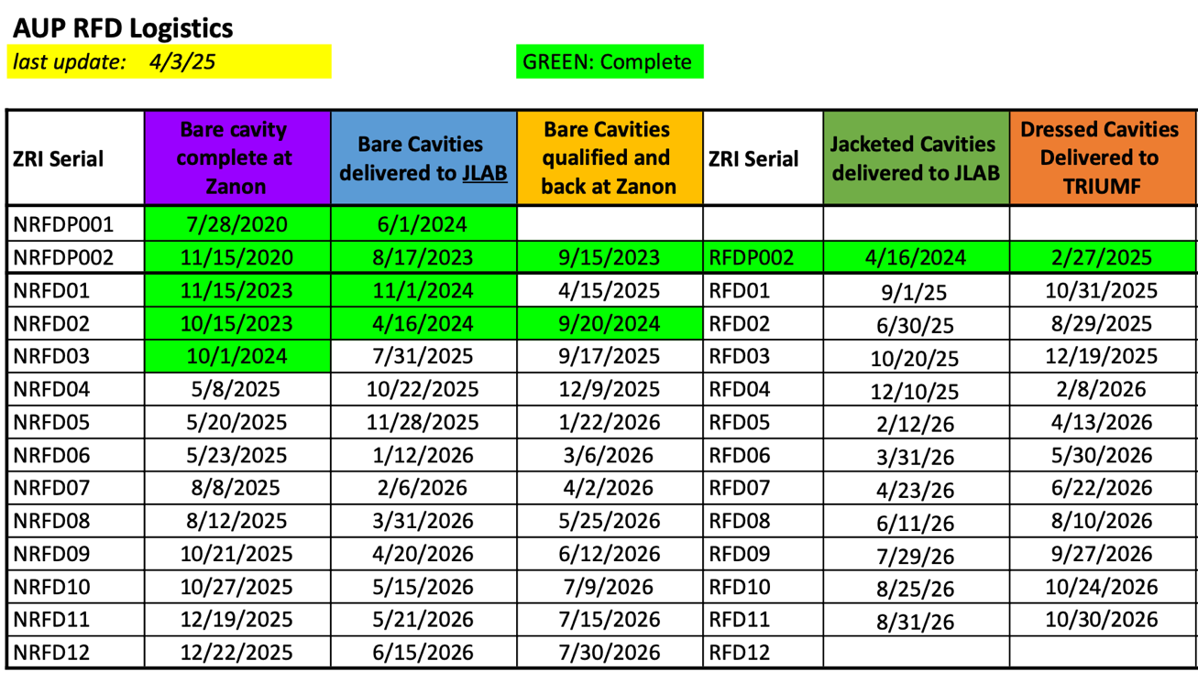
Logistic Dates and Deliveries to TRIUMF
Contractual
Contractual

