Slide 1

Report for WP1
Coordination and Communication
R. Losito, CERN

Slide 2
Outline
Objectives of the Workpackage and their relevance to provide scientific or industrial breakthrough
the expected potential scientific, technological, economic, competitive and social impact, and plans for using and disseminating results
Workplan and degree of execution.
how resources were planned and used in relation to the achieved progress, and if their use respects the principles of economy, efficiency and effectiveness
the management procedures and methods
the beneficiaries’ contributions and their integration within the project
Work performed by third parties (associates and not).

Slide 3
Objectives of the WP
WP1 will coordinate both the scientific and administrative tasks of MuCol. All participants will participate to the decision making through the Collaboration Board. The objectives of WP1 are:
  Provide scientific coordination of the work
  Setup and ensure a quality assurance process for peer review of all the results
  Provide technical coordination
  Ensure compliance with requirements from EU rules for the project (financial reporting, notification of the achievement of milestones and deliverables etc…)
  Organisation of Collaboration meetings and workshops, harmonization of events across the workpackages
  Editing of common reports, ensuring the respect of deadlines for deliverables and milestones
  Coordination of Communication and Dissemination activities.
  Monitoring of gender dimension issues

Slide 4
Objectives of the WP
WP1 will coordinate both the scientific and administrative tasks of MuCol. All participants will participate to the decision making through the Collaboration Board. The objectives of WP1 are:
  Provide scientific coordination of the work
    Performed throughout the project, the Project Leader of MuCol is also Study Leader of the Internation Muon Collider Collaboration, ensuring an overall scientific coherence
  Setup and ensure a quality assurance process for peer review of all the results
    The guidelines are described on the MuCol Website
  Provide technical coordination
    The WP1 leader is also the technical coordinator of the Project. It has impact particularly in the connection between the physics WP, the machine design WPs (3-4-5) and the hardware WPs (6-7-8). Both for the scientific and the technical WPs most of the work is performed by direct contact with WP leaders, or during the Executive Committee meetings.

Slide 5
Objectives of the WP
WP1 will coordinate both the scientific and administrative tasks of MuCol. All participants will participate to the decision making through the Collaboration Board. The objectives of WP1 are:
  Ensure compliance with requirements from EU rules for the project (financial reporting, notification of the achievement of milestones and deliverables etc…)
    The project leader and the technical coordinator have the support of the CERN EU office and of the CERN Finance and Administrative Process services for any follow-up and question.
  Organisation of Collaboration meetings and workshops, harmonization of events across the workpackages
    Performed with the help of the Muon Collider Secretariat.
  Editing of common reports, ensuring the respect of deadlines for deliverables and milestones
    Performed in collaboration with the Muon Collider Secretariat.

Slide 6
Objectives of the WP
WP1 will coordinate both the scientific and administrative tasks of MuCol. All participants will participate to the decision making through the Collaboration Board. The objectives of WP1 are:
  Coordination of Communication and Dissemination activities.
    Performed by the Communication and Dissemination Officer, with the support of the IMCC Publications and Speakers Committee and the Muon Collider Secretariat.
  Monitoring of gender dimension issues
    The Gender Advisor has regular contacts with WP leaders and also directly with PIs and ESRs in the project. No particular issue has been raised specific to MuCol. Also the project and the Gender Advisor have organised presentation and small workshops such as the one at the last annual meeting : https://indico.desy.de/event/45968/timetable/#20250516.detailed

Slide 7
Plans for using and disseminating results
The main goal stated in the proposal concerned the preparation of a coherent and as detailed as possible input for the European Strategy of particle physics update.
For various reasons the process was anticipated by one year, but despite that we managed to present a complete description of the entire Muon Collider Complex, compatible with technologies available today or reasonably anticipated to be ready and demonstrated within the next 10 years.
The MuCol Project leader was invited to give a talk on the Muon Collider at the Open Symposium of the ESPPU in Venice:
  https://agenda.infn.it/event/44943/timetable/#20250624.detailed
In this context, a vibrant R&D programme was proposed to prove that all the requirements can be met by the available hardware at the time of the construction (due to start during the second half of 2030s).
It has been proposed therefore to fund sufficiently the studies in order to be ready for a decision for construction around 2035.

Slide 8
The expected potential scientific, technological, economic, competitive and social impact
MuCol is driving the effort of the IMCC collaboration to set common goals for the performance of the Muon Collider complex.
Instrumental for that are the annual reviews of parameters performed under the coordination of MuCol:
  https://zenodo.org/records/15110101
  https://zenodo.org/records/13970100
The approval of MuCol had an extraordinary impact on the association of additional institutes to the efforts of the IMCC. As a result we have today many more institutes participating to scientific discussions and scientific studies.
It has given a boost to the European effort towards a complete design of the machine. This contributed to convince the US P5 Committee to also give a positive recommendation to increase the US resources for studies on the Muon Collider. They recently formed a US Muon Collider Collaboration to match the European effort and join the IMCC
There is an important potential for impact on the high temperature superconductors magnets (see presentation of WP78) and for new concepts of detectors, of machine simulations etc…, although at different level of economic interest and of cost of investment to reach a suitable TRL. Details in presentation of specific WPs.

Slide 9
Workplan and degree of execution
All milestones and deliverables of WP1 were delivered in time, or within the short delay (max three months) agreed with EU PO.
We have discussed already during the annual meeting the process to perform the next review of the parameters, whose submission is foreseen by end of October 2025.
We anticipated the establishment of a scenario for hosting the Muon Collider at CERN, as a necessary input to the ESPPU. A potential siting layout has been found, and in the next two years we will follow-up to understand whether there is any showstopper in the implementation of such scenario.

Slide 10
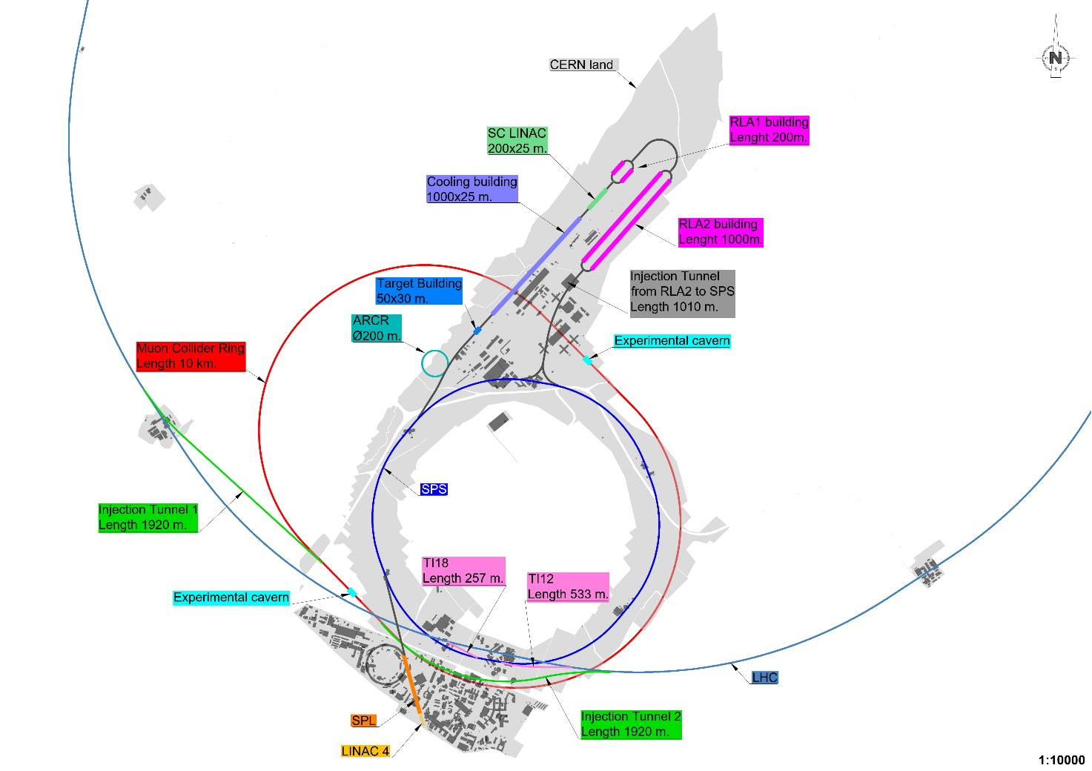

Slide 11
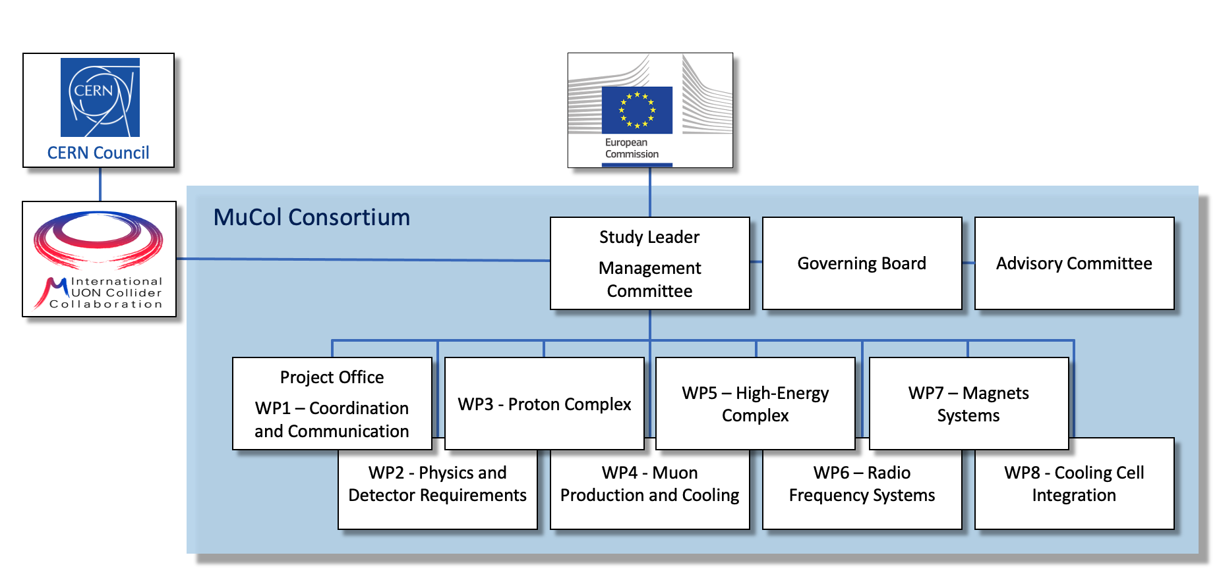
the management procedures and methods
WP1 organises the meetings of the Management Committee, of the Governing board, and of the Advisory committee, plus specific meetings for the CERN siting option. Specific meetings are organized as necessary.

Slide 12
the beneficiaries’ contributions and their integration within the project
All Institutes participated to the activities of WP1:
  participation to management meetings
  editing of the reports
  Organisation of conferences and workshops
  Communication and Dissemination

