Slide 1

Report for WP4:
Muon Production and Cooling
Chris Rogers on behalf of WP4

Slide 2
Outline
WP4 is studying muon production for the muon collider
Important to estimate potential flux and emittance of muon beams
Three Tasks:
  Cooling System Development
  Target System Development
  Code development

Slide 3
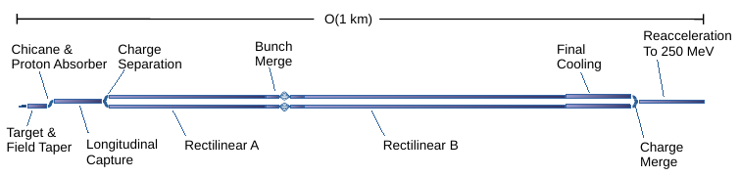
Objectives of the WP
Cooling System Development
  Improvement to lattice designs
  Study of cooling test stand
Target System Development
  Assessment of pion yield
  Target lifetime
  Magnet irradiation studies
Code Development
  Integration of cooling cell design into BDSIM

Slide 4
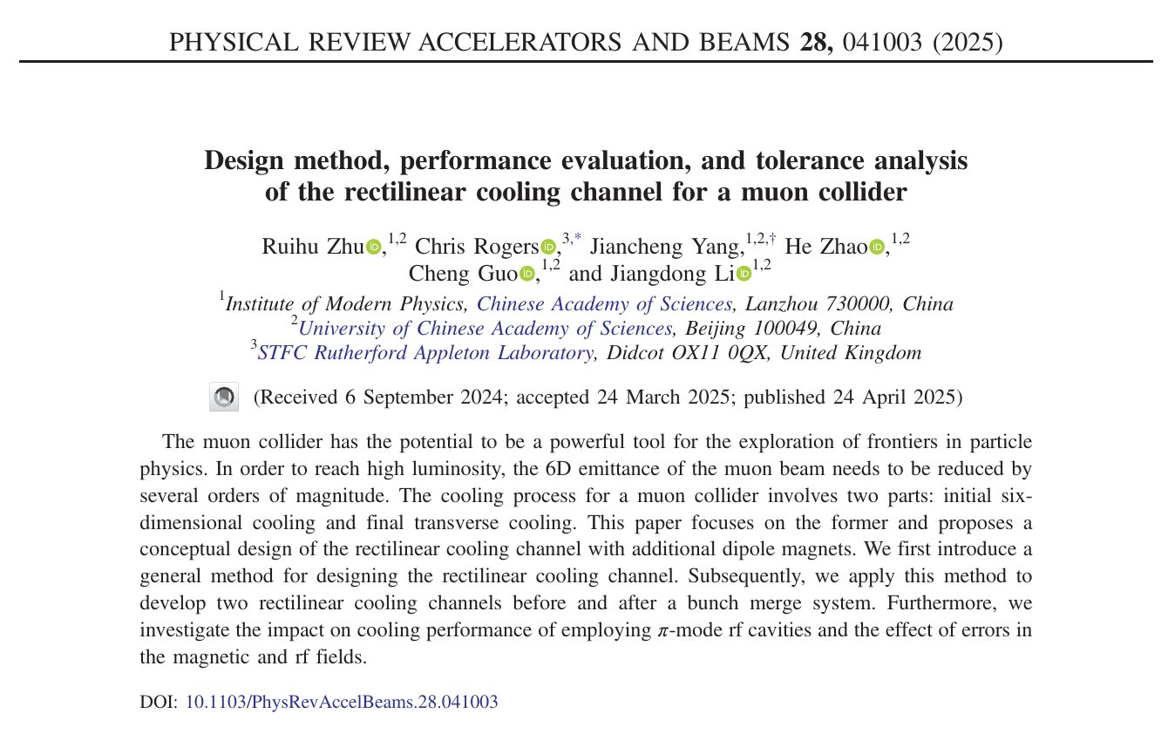
Plans for using and disseminating results
Several dissemination activities undertaken by the WP:
  CERN Accelerator School lectures every 2 years as part of Advanced Graduate Lectures
  Journal publications
  Regular conference publications

Slide 5
the expected potential scientific, technological, economic, competitive and social impact
Scientific impact
  Advanced beam physics
  Increased activity in Bright Muon Beams programmes in Europe and beyond
Other impacts
  Training several PhD students within the WP
  Lectures for new accelerator scientists
  Improved functionality in widely used beam simulation code BDSIM as compared to US and other competitors

Slide 6
Workplan and degree of execution
Completed Deliverable D4.1
Baseline 2 MW target well-established
Investigating options for target that can survive with higher proton power
Cooling system achieved performance beyond targets
First studies of a cooling demonstrator

Slide 7
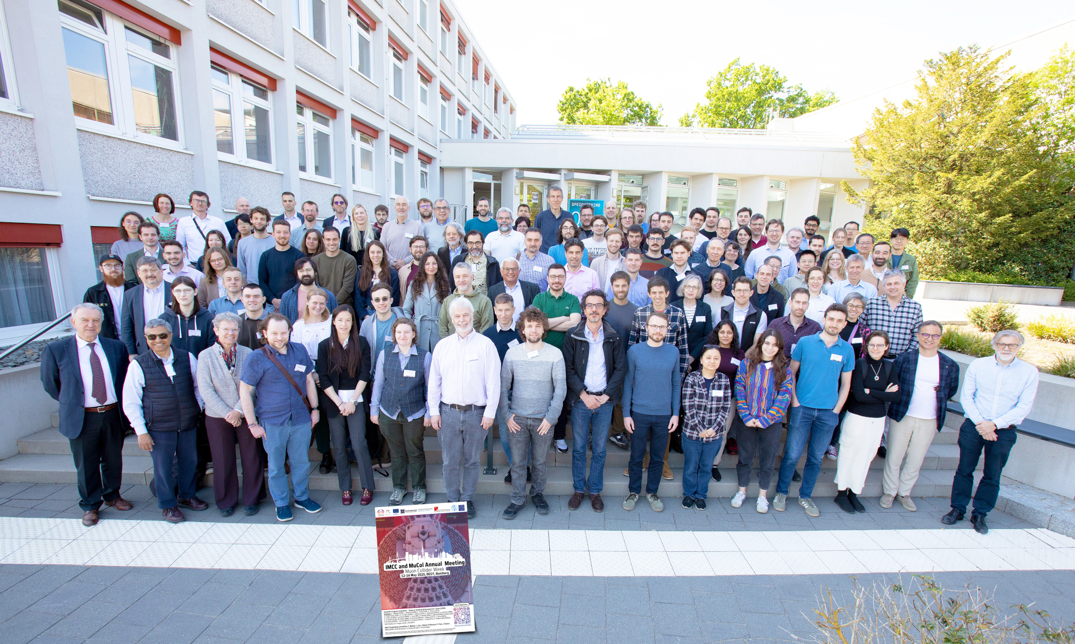
Management procedures and methods
Monitor progress in fortnightly WP meetings
Regular face-to-face meetings
  IMCC Annual Meetings
  Demonstrator Workshop
  Cooling Cell Workshop
  Ad-hoc discussions
Formal documentation of lattices
  MuCol deliverables
  Conference proceedings
  Journal papers
Lattice files managed through github
  Appropriate release and pre-release procedure

Slide 8
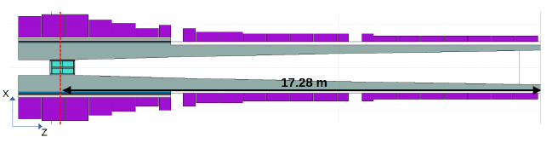
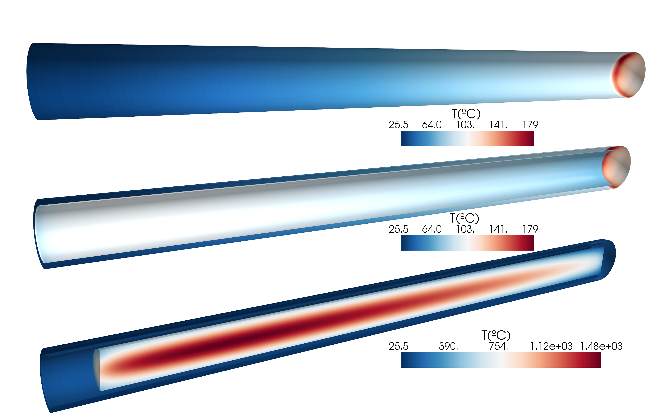
Beneficiaries’ contributions - Target
High power targetry (CERN)
  Development of (baseline) graphite target
  @ 2 MW: passively cooled graphite rod
  @ 4 MW: actively cooled graphite rod
Assessment of radiation load on target
Assessment of radiation load on surrounding materials

Slide 9
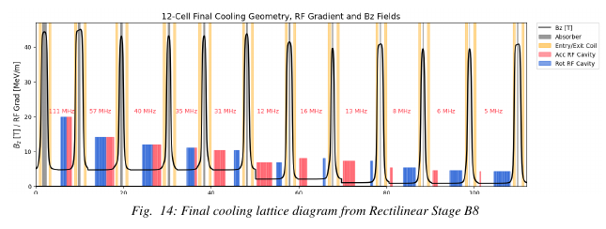
Beneficiaries’ contributions - Cooling
Final cooling lattice design (CERN)
  “RB8” lattice preliminary design
Cooling demonstrator
  Site identification
  Study on civil engineering, radiological feasibility, proton beam handling

Slide 10
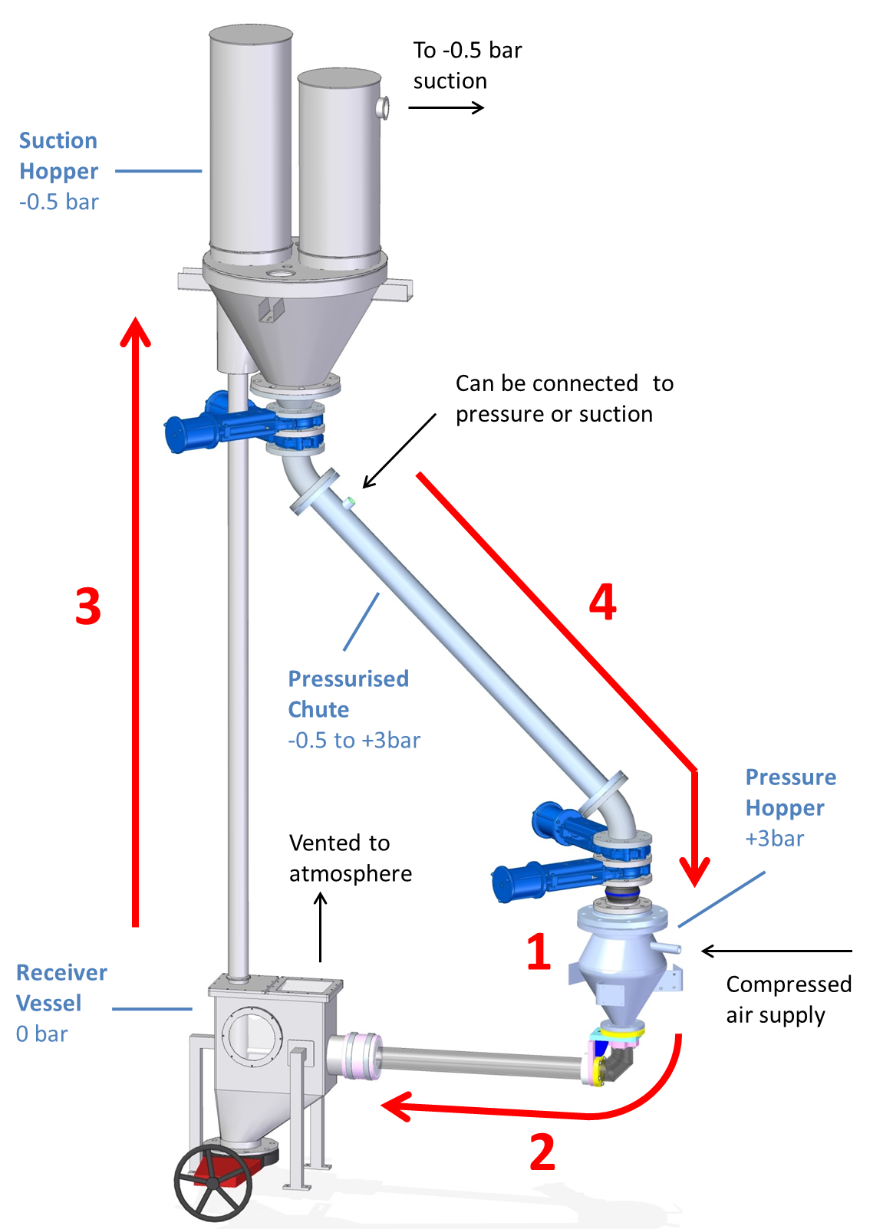
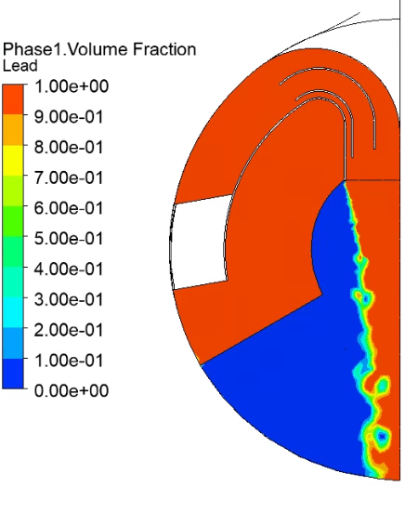
Third Parties’ Contributions - Target
High power target alternatives
  Fluidised Tungsten target (UKRI, Warwick)
    Assessment of radiation load
    Thermal management of tungsten
  Liquid lead target (ENEA, CERN)
    Numerical calculation of lead behaviour on beam impact

Slide 11
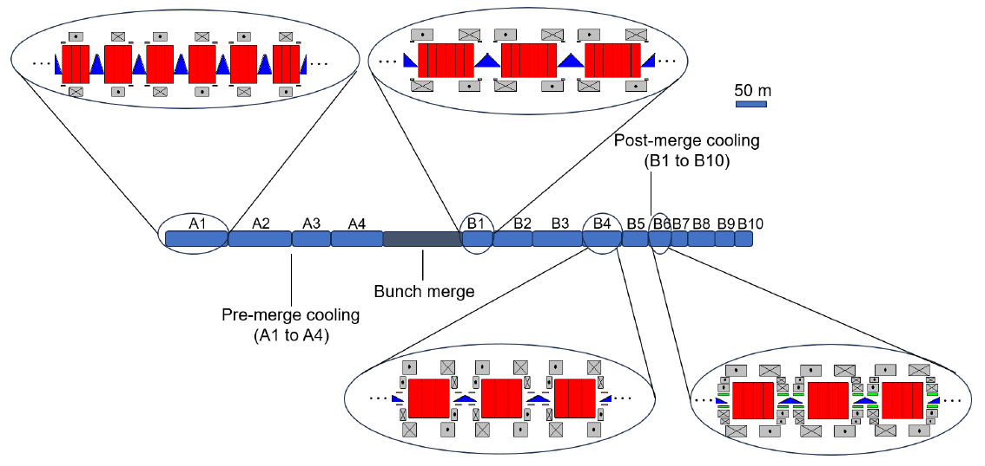
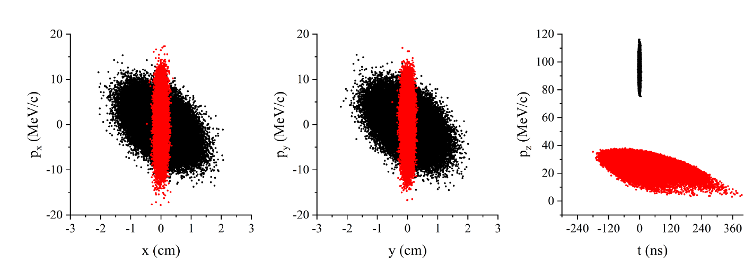
Third Parties’ Contributions - Cooling
Muon capture dynamics (UKRI)
Rectilinear cooling channel design (IMP, UKRI)
Final cooling channel design (IMP)
  “RB10” lattice

Slide 12
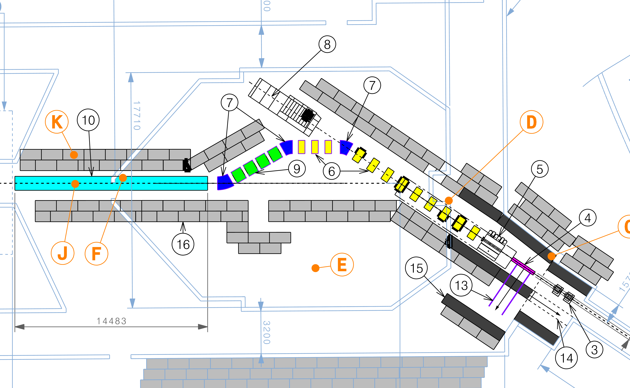
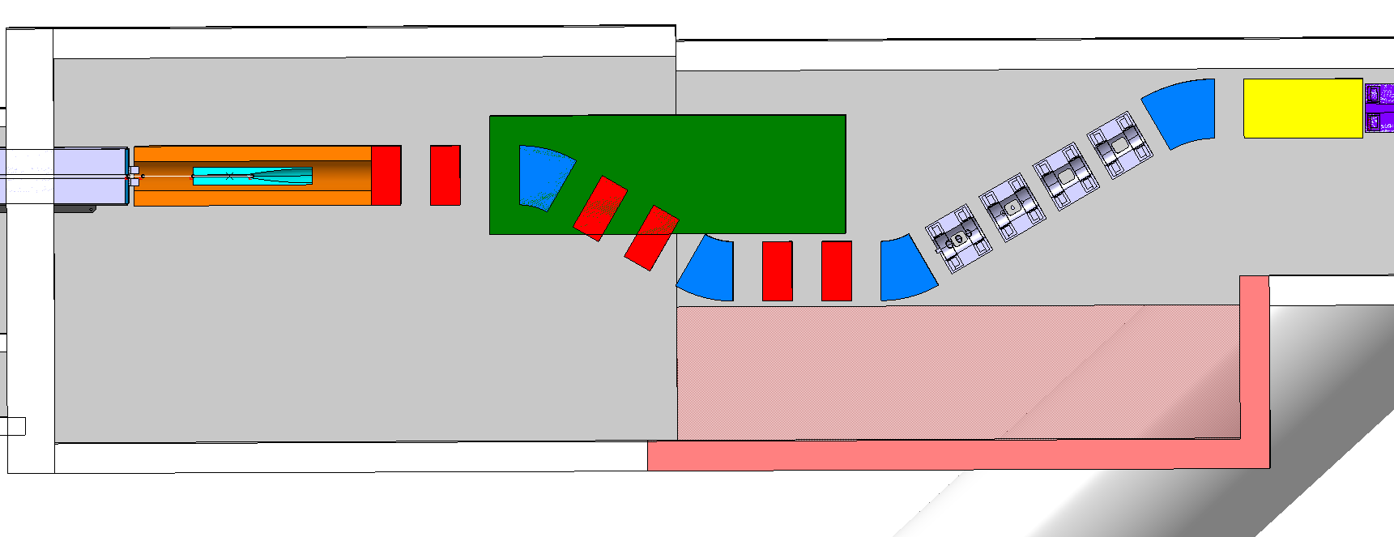
Third Parties’ Contributions – Cooling Demonstrator
Demonstrator experimental design (UKRI, IMPERIAL)
  Studying two possible sites at CERN
  Also some exploration of synergies

Slide 13
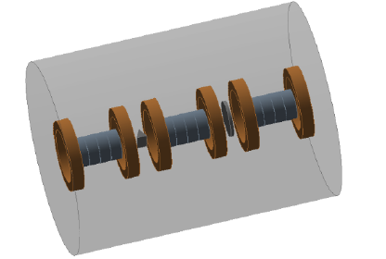
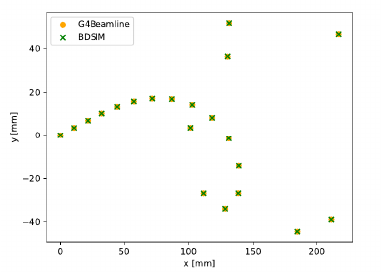
Third Parties’ Contributions – Code Development
BDSIM Code Development
  Build European capability for cooling cell simulation
  Successfully delivered cooling cell simulation
  Fully validated against US codes
  D4.1
Further development will improve the code
  Improved UI

Slide 14
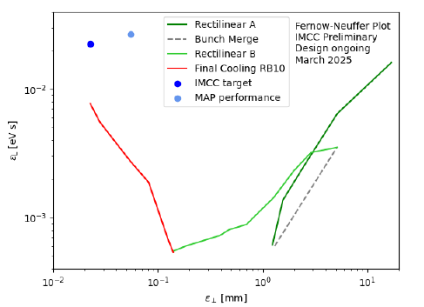
Conclusion
Excellent progress made so far in MuCol design for WP4
Target
  Secure target design @ 2 MW
  Studying target design @ 4 MW
Cooling
  Exceeding desired parameters
  Delivered D4.1 on time

