Slide 1

Report for WP6
Radio Frequency Systems
Dario Giove, INFN -LASA

Slide 2
Outline
Objectives of the Workpackage and their relevance to provide scientific or industrial breakthrough
the expected potential scientific, technological, economic, competitive and social impact, and plans for using and disseminating results
Workplan and degree of execution.
how resources were planned and used in relation to the achieved progress, and if their use respects the principles of economy, efficiency and effectiveness
the management procedures and methods
the beneficiaries’ contributions and their integration within the project

Slide 3
Objectives of the WP
Objectives
This WP is devoted to assess crucial feasibility issues and technological challenges of the RF systems. The study will concentrate on the two most challenging sections, the Muon Cooling Complex (MCC), and the muon acceleration stage of the High Energy Complex (HEC), for which a baseline concept of most critical RF components will be outlined.
Scientific and industrial relevance
Study the capability of different elements, alloys and surface treatments to achieve high electric fields values in presence of significant magnetic fields;
Design and propose a new multicell RF structure able to fit the strict requirements of a compact cooling channel;
Develop a new generation of high power RF tubes and modulators.

Slide 4
Plans for using and disseminating results
The results obtained in the specific WP 6 have been published in different formats
Reports to different meetings of the related WPs of the collaboration
Reports to International Conference and Specific Workshops
Invited Talks to International Conference
Specific contribution to the INFN document for the 2026 European Strategy for Particle Physics Upgrade
Contribution to the European Strategy for Particle Physics Upgrade collaboration submission
The muon collider https://indico.cern.ch/event/1439855/contributions/6461618/

Slide 5
Plans for using and disseminating results
Seminar and presentations
25 devoted events related to:
RF Systems for Acceleration to High Energy Physics (task 6.1): 14 events
RF Systems for Muon Cooling Complex and Demonstrator (task 6.2): 6 events
High gradient RF in Strong Magnetic Fields (task 6.3): 5 events

Slide 6
Workplan and degree of execution
The WP6 has been organized in 4 different subtasks:
Task 6.1: Baseline concept of the RF system for acceleration to the High Energy Complex (University of Rostock)
Task 6.2: Baseline concept of the RF system for the Muon Cooling Complex (MCC) (INFN and CEA)
Task 6.3:Breakdown mitigation studies for cavities of the muon cooling cells (CEA)
Task 6.4: Baseline concept of high efficiency and high-power RF sources for the muon collider (University of Lancaster)

Slide 7
Workplan and degree of execution
Task 6.1
A preliminary design concept for the SRF cavities for acceleration in the Rapid Cycling Synchrotrons (RCS) of the HEC of the muon collider.
RF system is separated into multiple stations
  Reduction of effective synchrotron tune
  Challenging for installation → distribution of hardware
RF parameters and requirements differ significantly in the RCS
  First RCS: high current, large peak power requirement, lower CW power
  Last RCS: lower current, lower peak power, larger CW power
Challenging tunings mechanisms and the effects of strong transient beam loading are now under investigation.

Slide 8
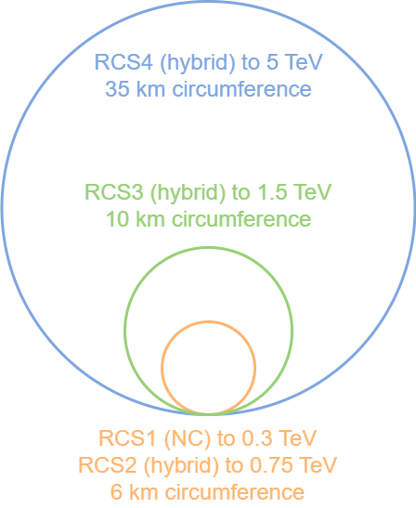

Workplan and degree of execution
Very different beam parameters in RCSs
Shorter bunches
Higher RF frequency usable
Assuming $1.3 GHz$ TESLA as baseline
 | RCS1 | RCS2 | RCS3 | RCS4
Beam current [mA] | 43 | 39 | 20 | 5
Acceleration time [ms] | 0.34 | 1.1 | 2.4 | 6.4
Energy gain per turn [GeV] | 15 | 8 | 11 | 64
Bunch length [mm] | 9 … 6 | 9 … 7 | 7 … 6 | 4 … 3

Slide 9
Workplan and degree of execution
Task 6.2
A conceptual design of the RF systems for the MCC, based on a consistent set of parameters for all RF cavities and associated systems to be integrated into the cooling channels, has been layed out.
An experimental setup has been developed to study the effects of high magnetic fields on the achievement of remarkable RF gradients (of the order of 30 MV/m).
A proposal has been designed for an advanced full scale test facility of a RF high frequency cavity operating in a 7 T magnetic field.

Slide 10
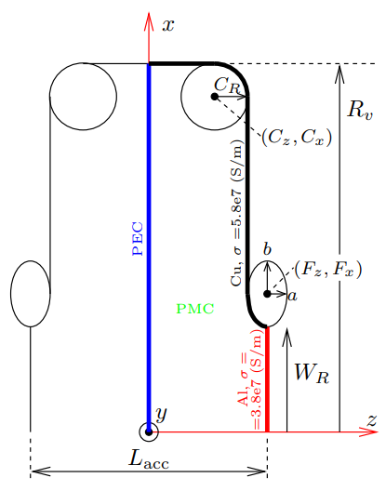
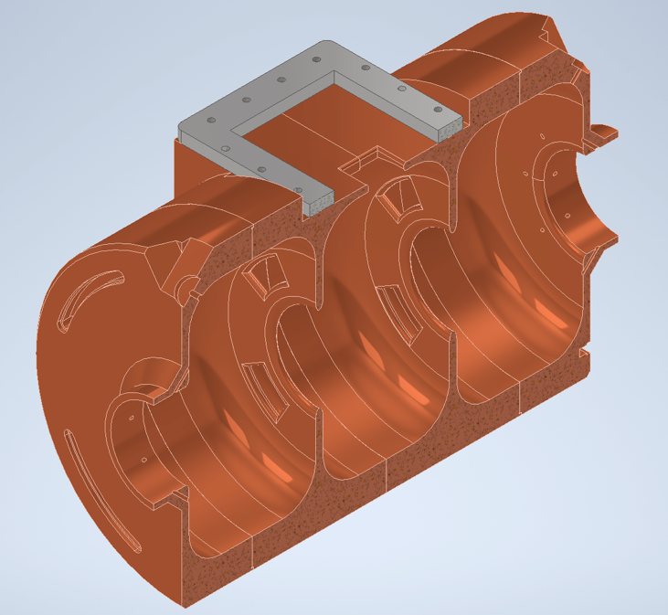
Workplan and degree of execution
Task 6.2

Slide 11
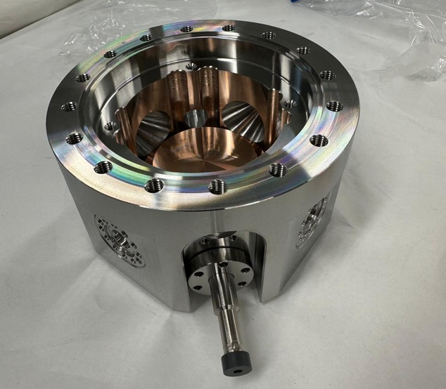
Workplan and degree of execution
Task 6.2

Slide 12
Workplan and degree of execution
Task 6.3
A study to enhance the present comprehension of the intrinsic concepts that influence the break down rate of RF cavities submitted to strong magnetic fields has been established and the first simulations are in progress.

Slide 13
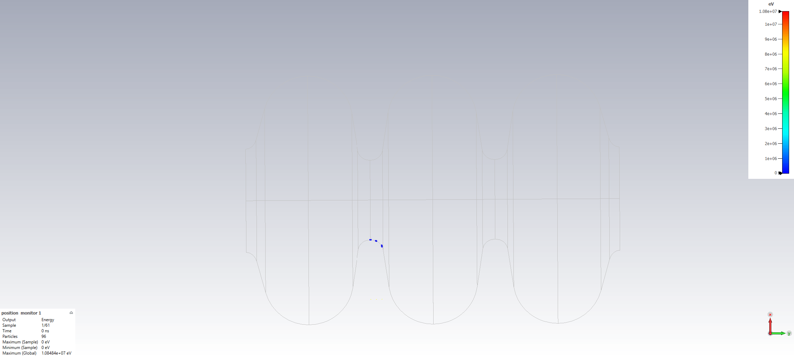
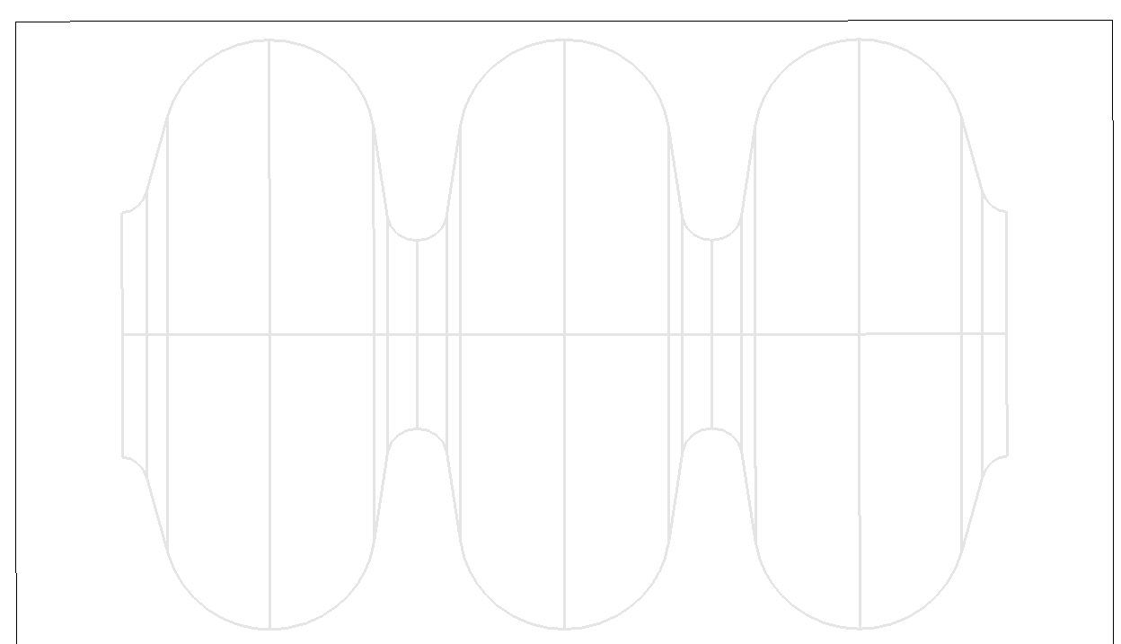
Workplan and degree of execution
Task 6.3
Electron max energy is 10 MeV (velocity close to c)
With DC magnetic field (superimposed)
Result is the same from B = 1 T
The electrons follow exactly the DC field lines.
Here, most electrons hit the facing iris, and some electron fly up to the window…

Slide 14
Workplan and degree of execution
Task 6.4
A baseline concept for the RF sources needed for the muon collider that will require higher RF power than is currently possible with commercially available sources has been started and the results are encouraging in terms of peak power and efficiency.
A 24MW 704MHz Klystron is viable, this will substantially reduce the number of required Klystrons for the Muon Collider.
Viable design is proposed with wide bandwidth in KlyC (CERN specific code) at ~82% Efficiency.
In the near future full scale PIC simulations are in progress.

Slide 15
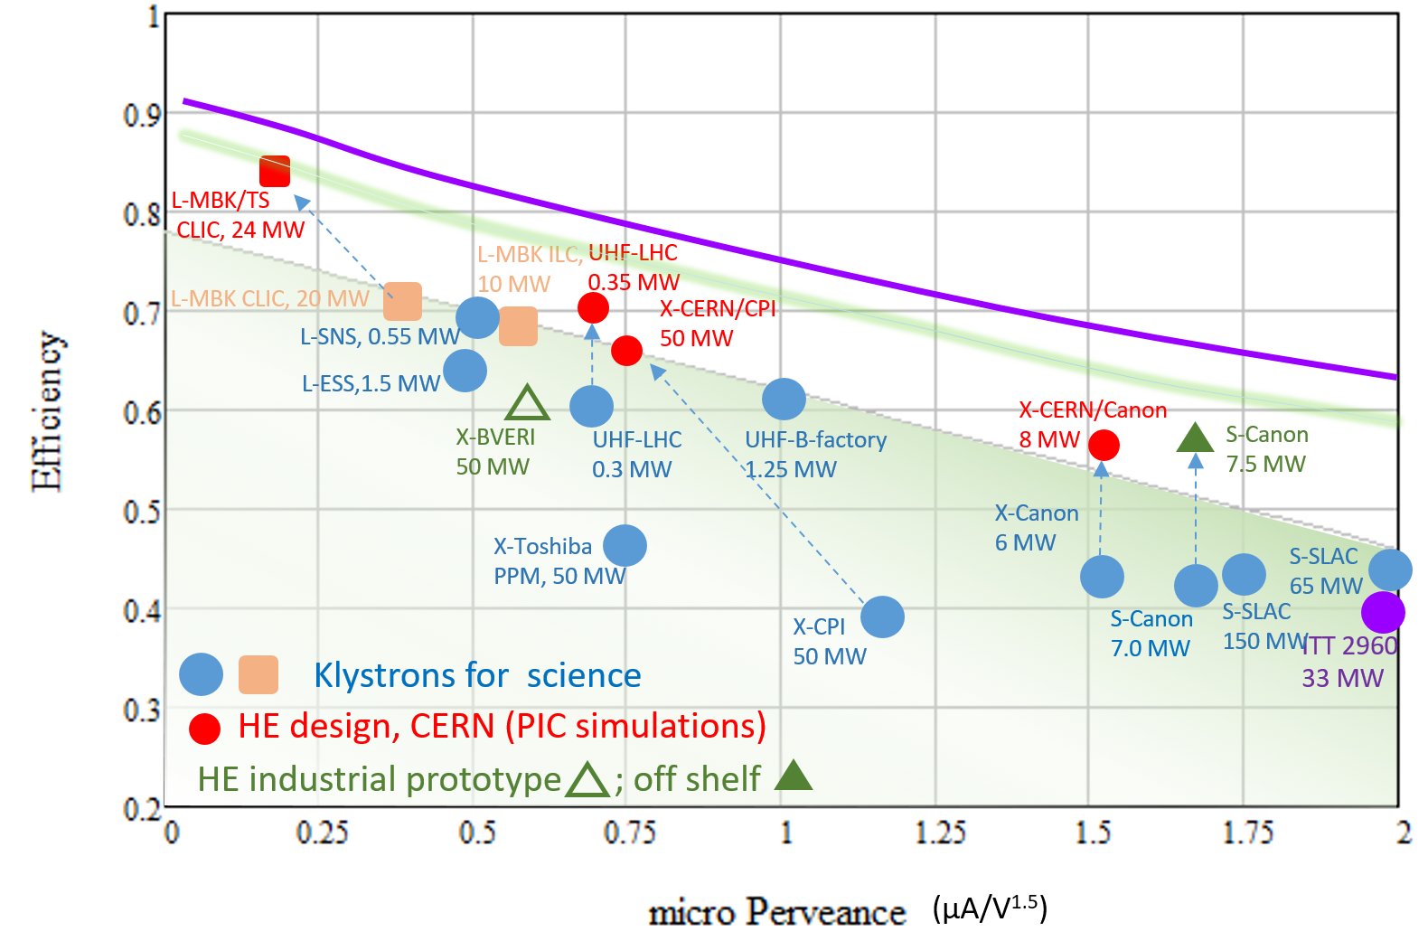
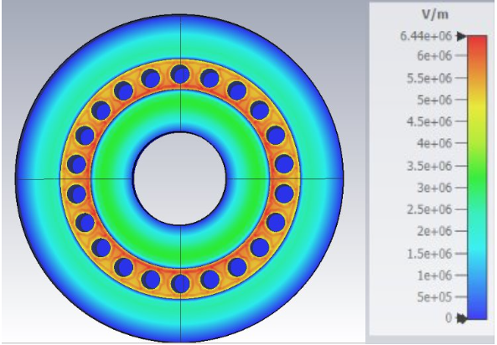
Workplan and degree of execution
Task 6.4
Fundamental_100_85_10
R/Q = 40.8095
Q = 19198
M = 0.783

Slide 16
Management procedures and methods
Management procedure:
General WP6 meetings at a regular timeline with agenda on CERN indico
Single tasks weekly meeting and continuous feedbacks within the collaboration
Dedicated meetings or workshops on specific elements (Cooling Channel Integration)

Slide 17
The beneficiaries’ contributions and their integration within the project
All Institutes participated to the activities of WP6:
  participation to management meetings
  editing of the reports
  Organisation of conferences and workshops
  Communication and Dissemination

