Slide 1
MQXFS4f… test plan discussion
2025.03.27
Slides compiled by F. Mangiarotti
Discussion by L. Fiscarelli, A. Haziot, S. Izquierdo Bermudez,
F. Mangiarotti, A. Milanese, G. Willering

Slide 2
Discussion points
Include a criteria to do a thermal cycle or not (“significantly different”)
  Outcome of the discussion: let’s always do a thermal cycle
Assign priority to the possible tests
  Outcome of the discussion: in two slides

Slide 3
“Significantly different” proposed criteria
I would define “significantly different” as checking at least two of the following conditions:
Ic (extracted from VI measurements) reduced by more than 50 A in any segment
Quench current at 4.5 K, 20 A/s reduced by at least 50 A
Quench current at 4.5 K reduced by at least 50 A for at least two high ramp rates (between 50 and 400 A)
Quench location at 4.5 K changed for at least two high ramp rates (between 50 and 400 A)
I leave this for reference, but we decided to always do the thermal cycle during the meeting

Slide 4
Tests priority
Priority | Test | Comment
1 | Training 1.9 K
2 | Training 4.5 K
3 | VI 4.5 K
4 | Magnetic measurements 1.9 K | Only in the first and last iterations
5 | Ramp rate 4.5 K
6 | Ramp rate 1.9 K | Only in the first and last iterations
 | Magnetic measurements 4.5 K | Not needed

Slide 5
MQXFS4

Slide 6
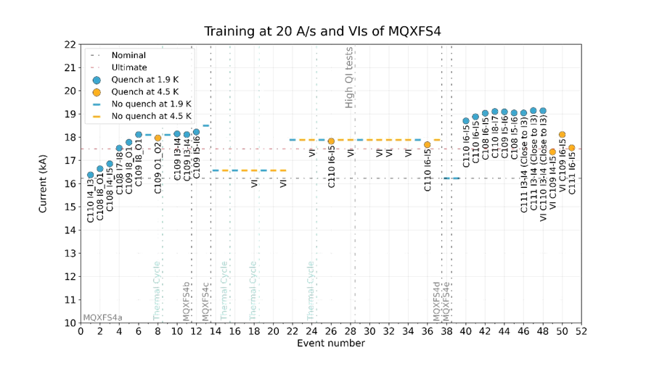

Slide 7
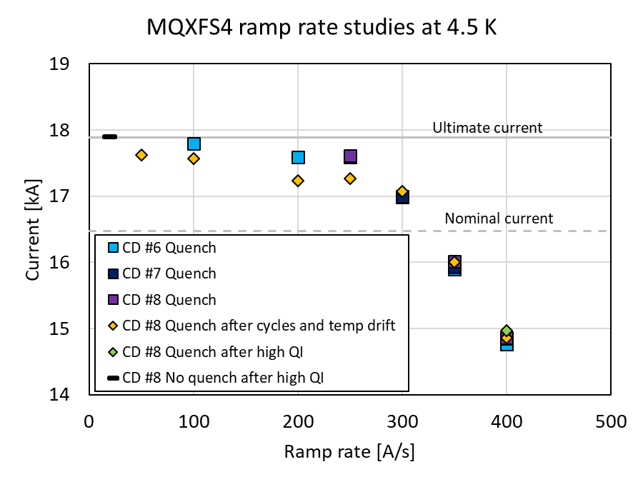

Slide 8
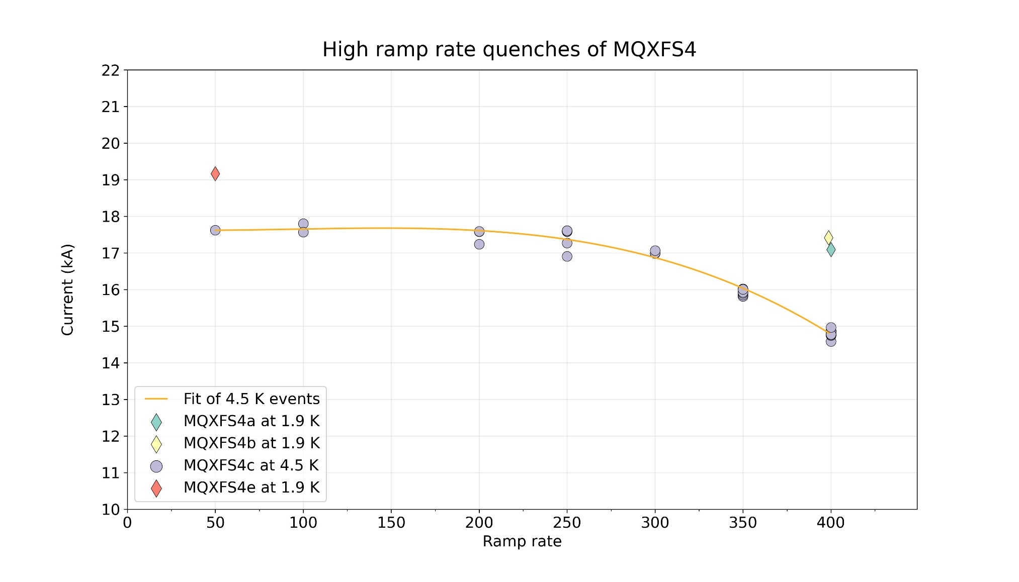

Slide 9
MQXFS7

Slide 10
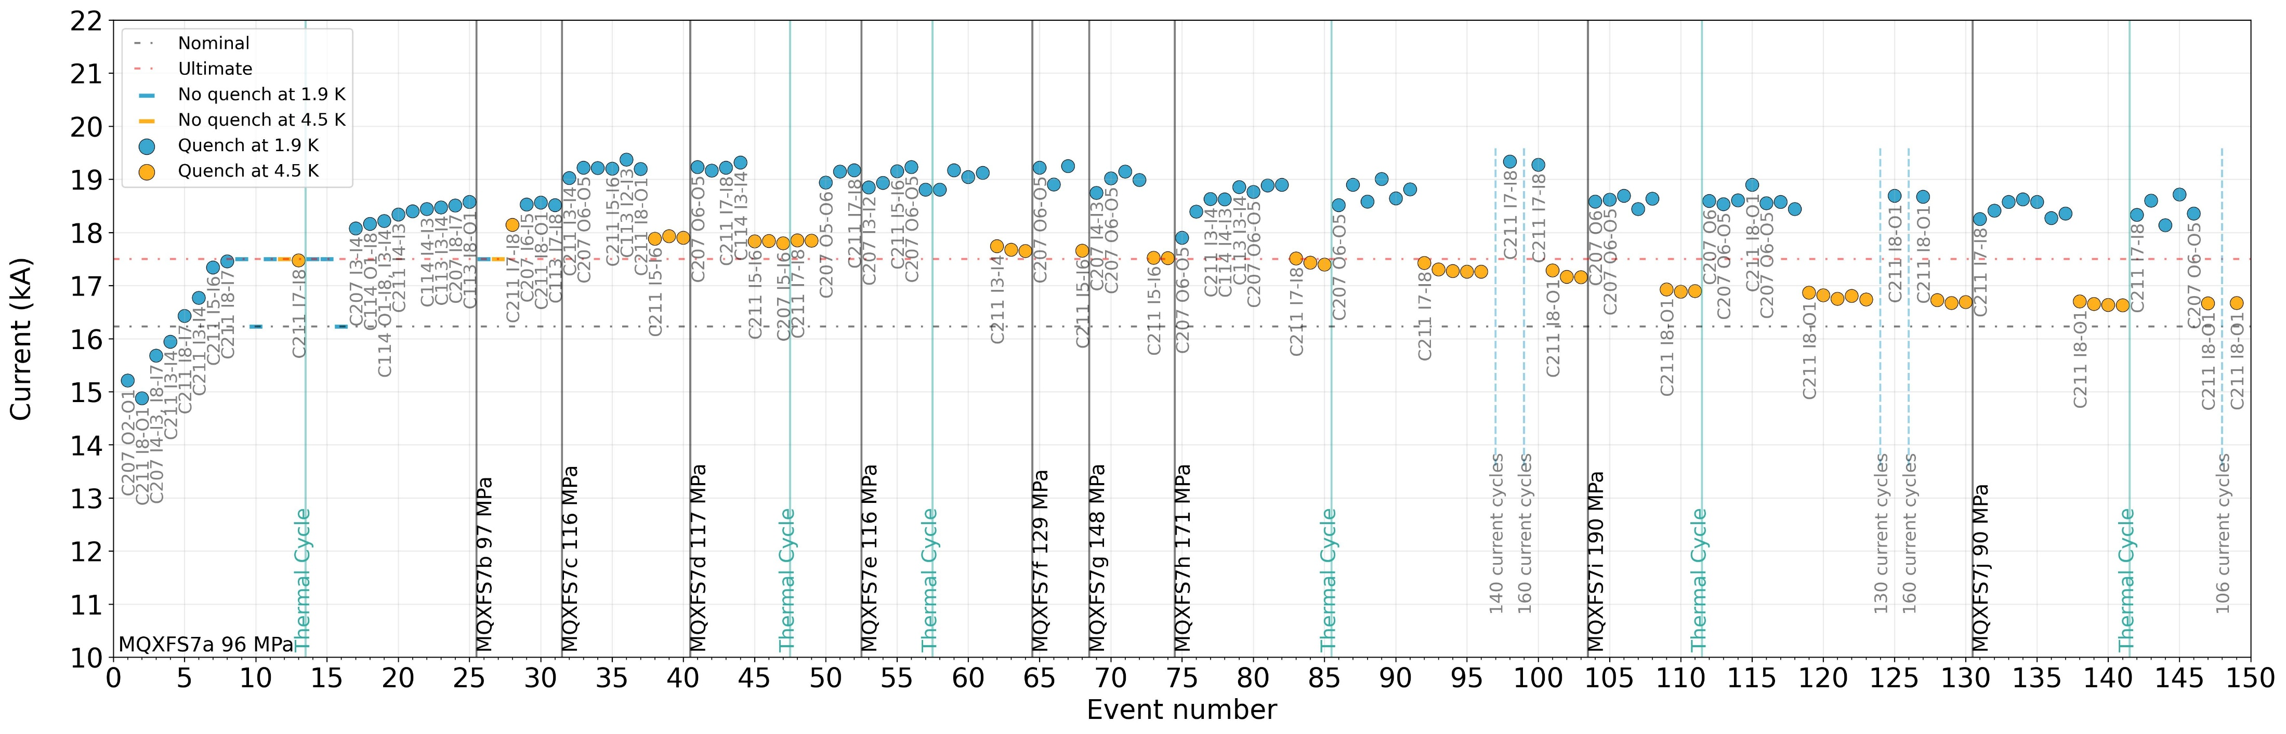
MQXFS7 quenches at 20 A/s

Slide 11
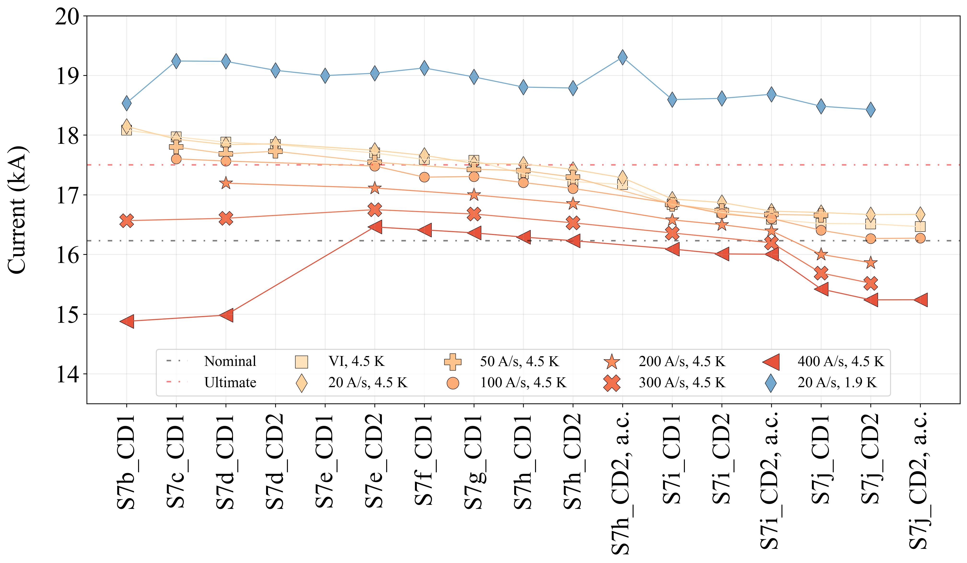

Slide 12
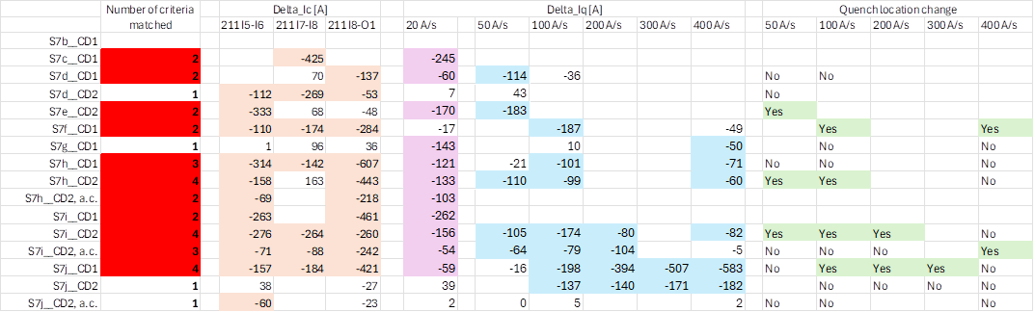
MQXFS7 -- “significantly different”

Slide 13
MQXFS8

Slide 14
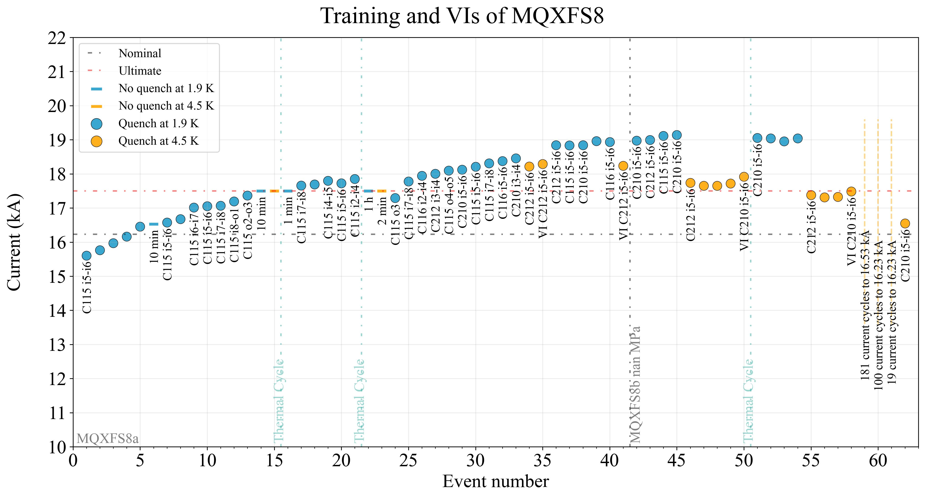

Slide 15
