Slide 1
First OMC measurements of 2025 with long capture in the SPS
Ewen H. McLean, Joschua W. Dilly, Panos Zisopoulos
31 March 2025

Slide 2
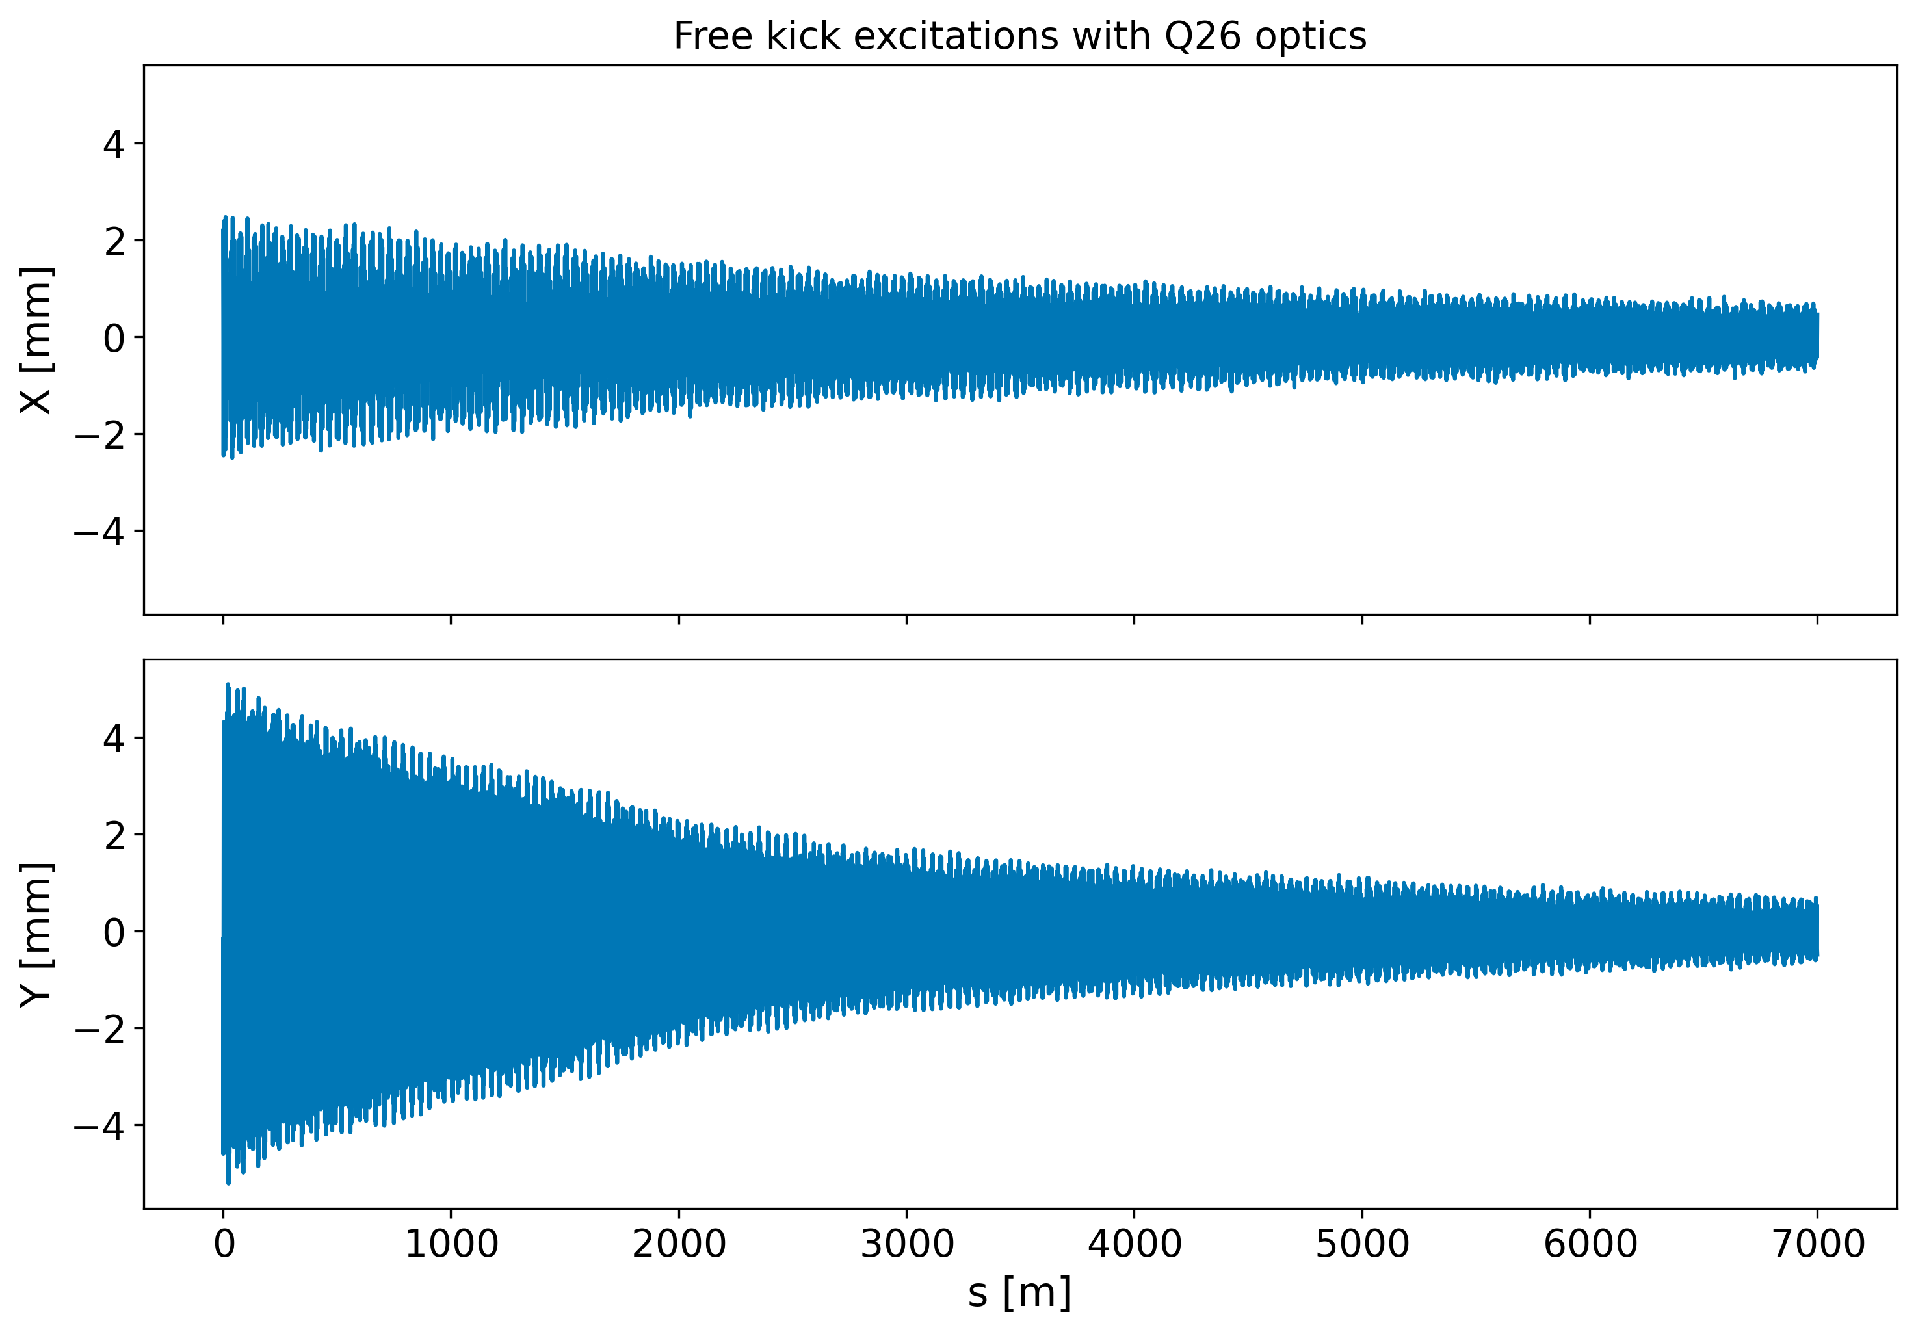
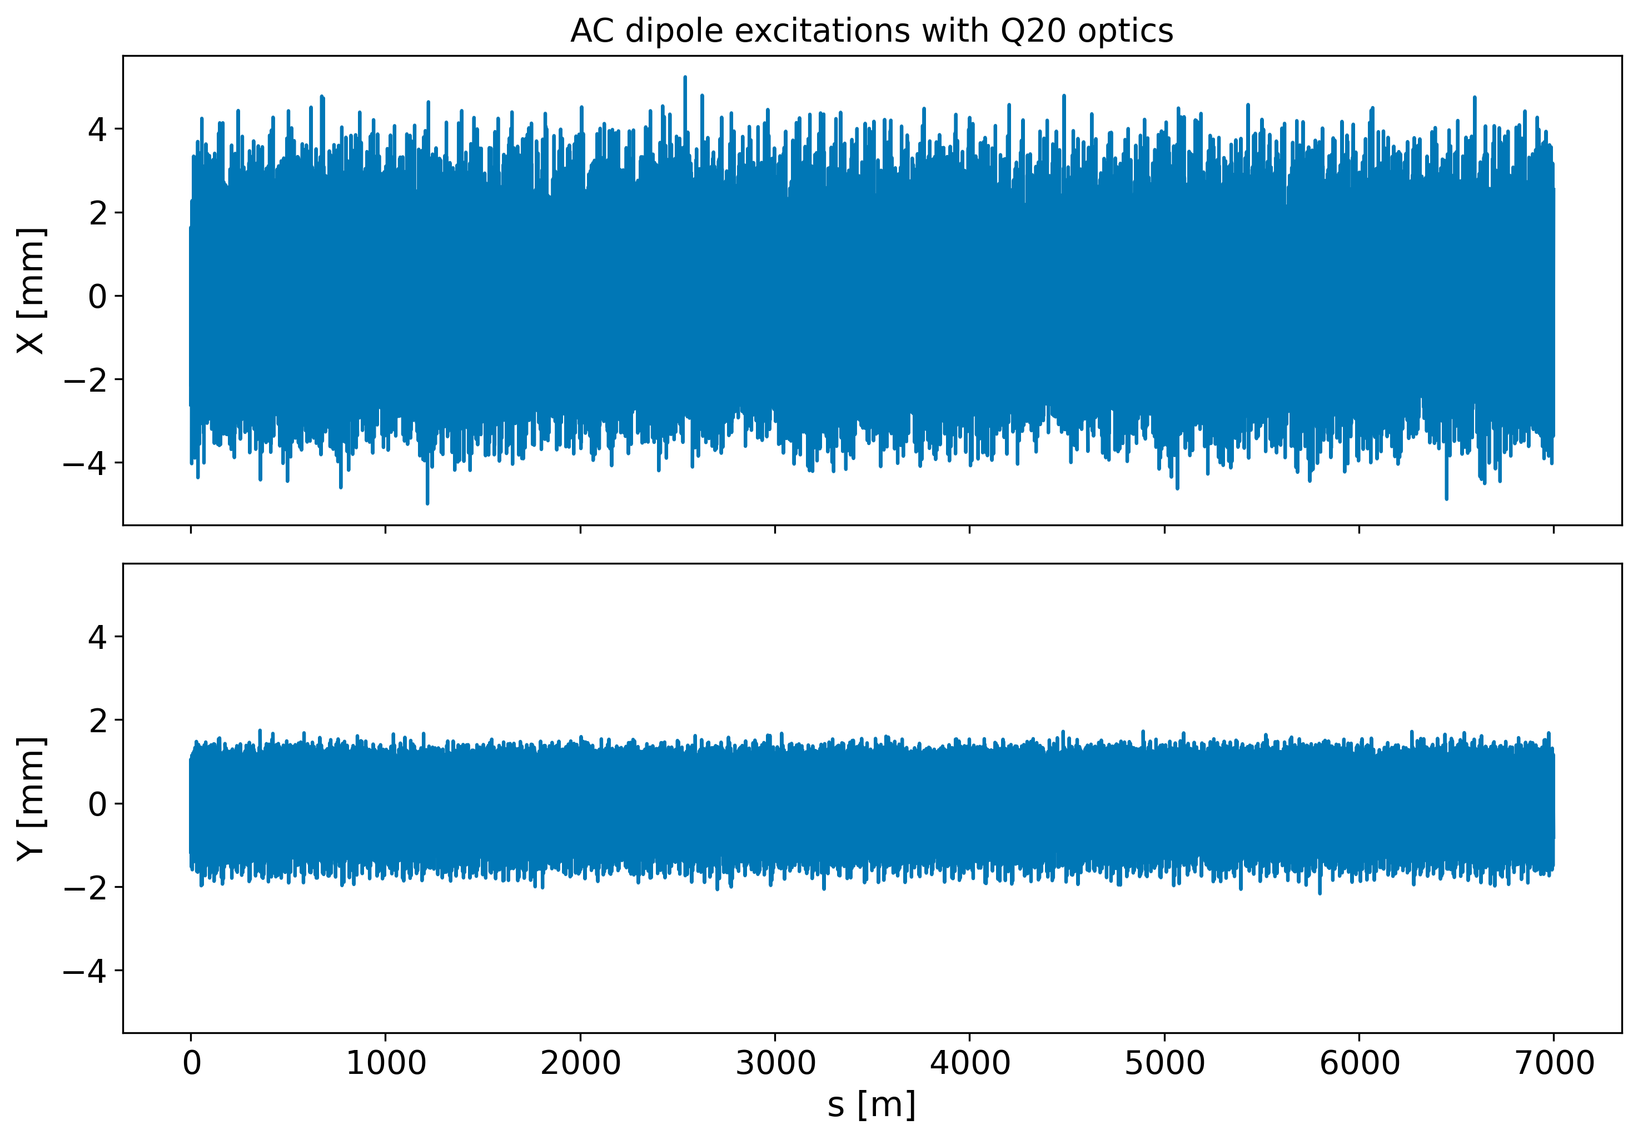
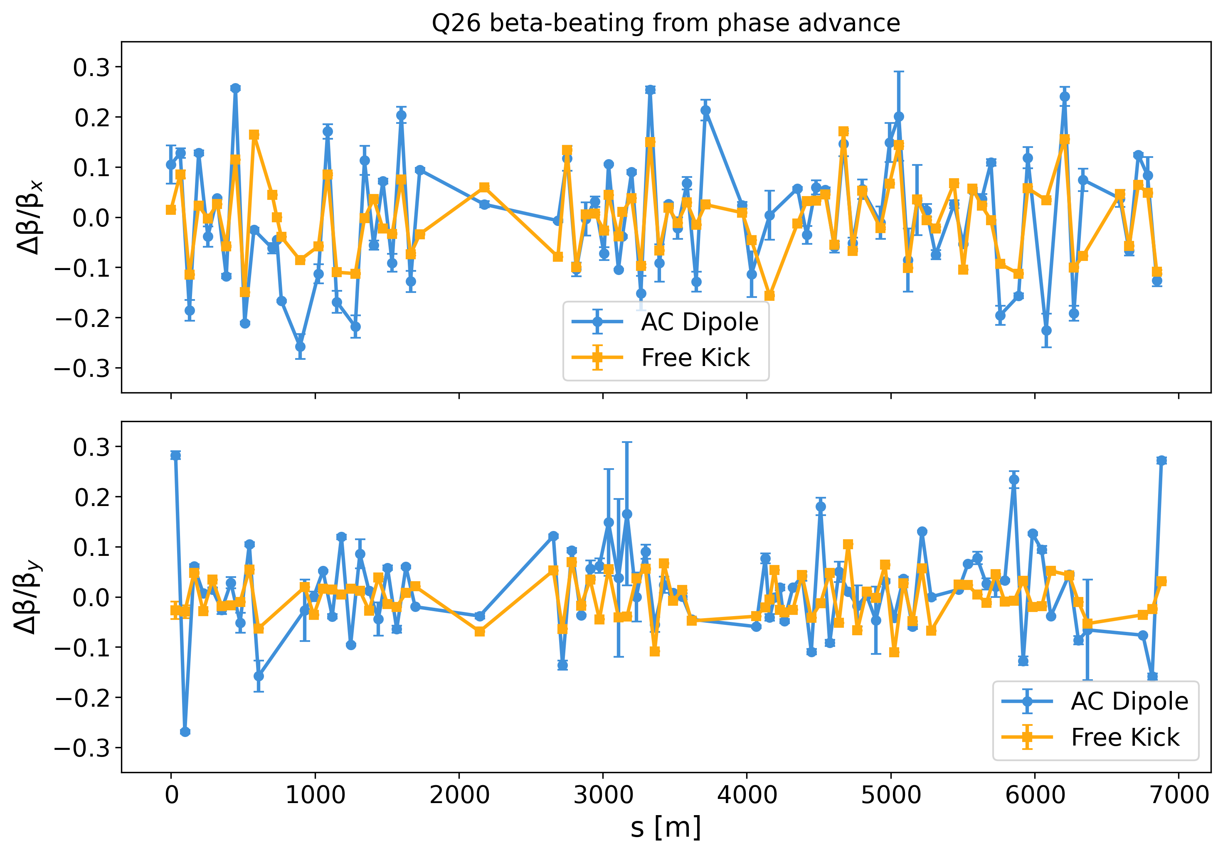
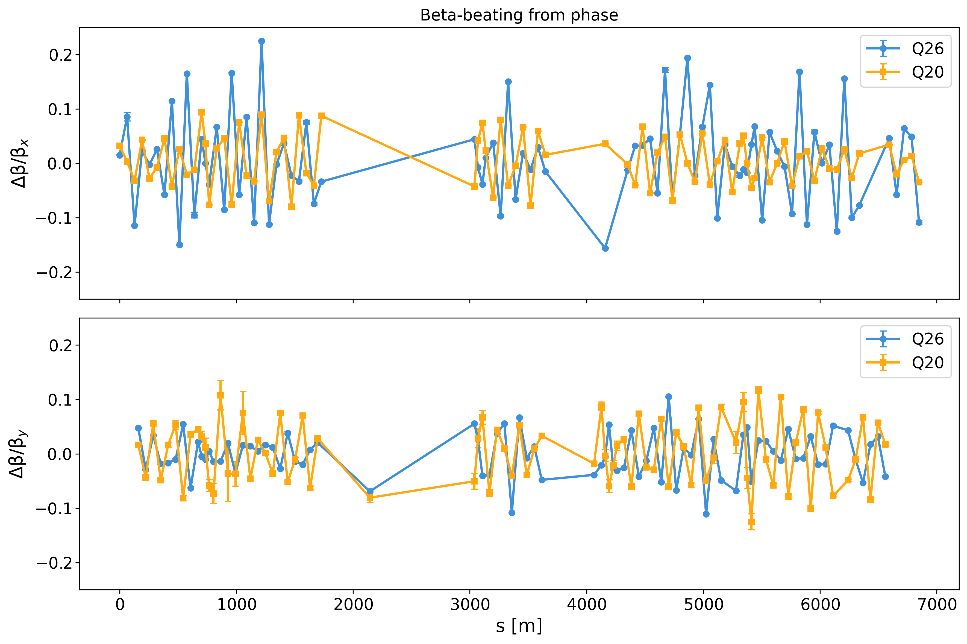
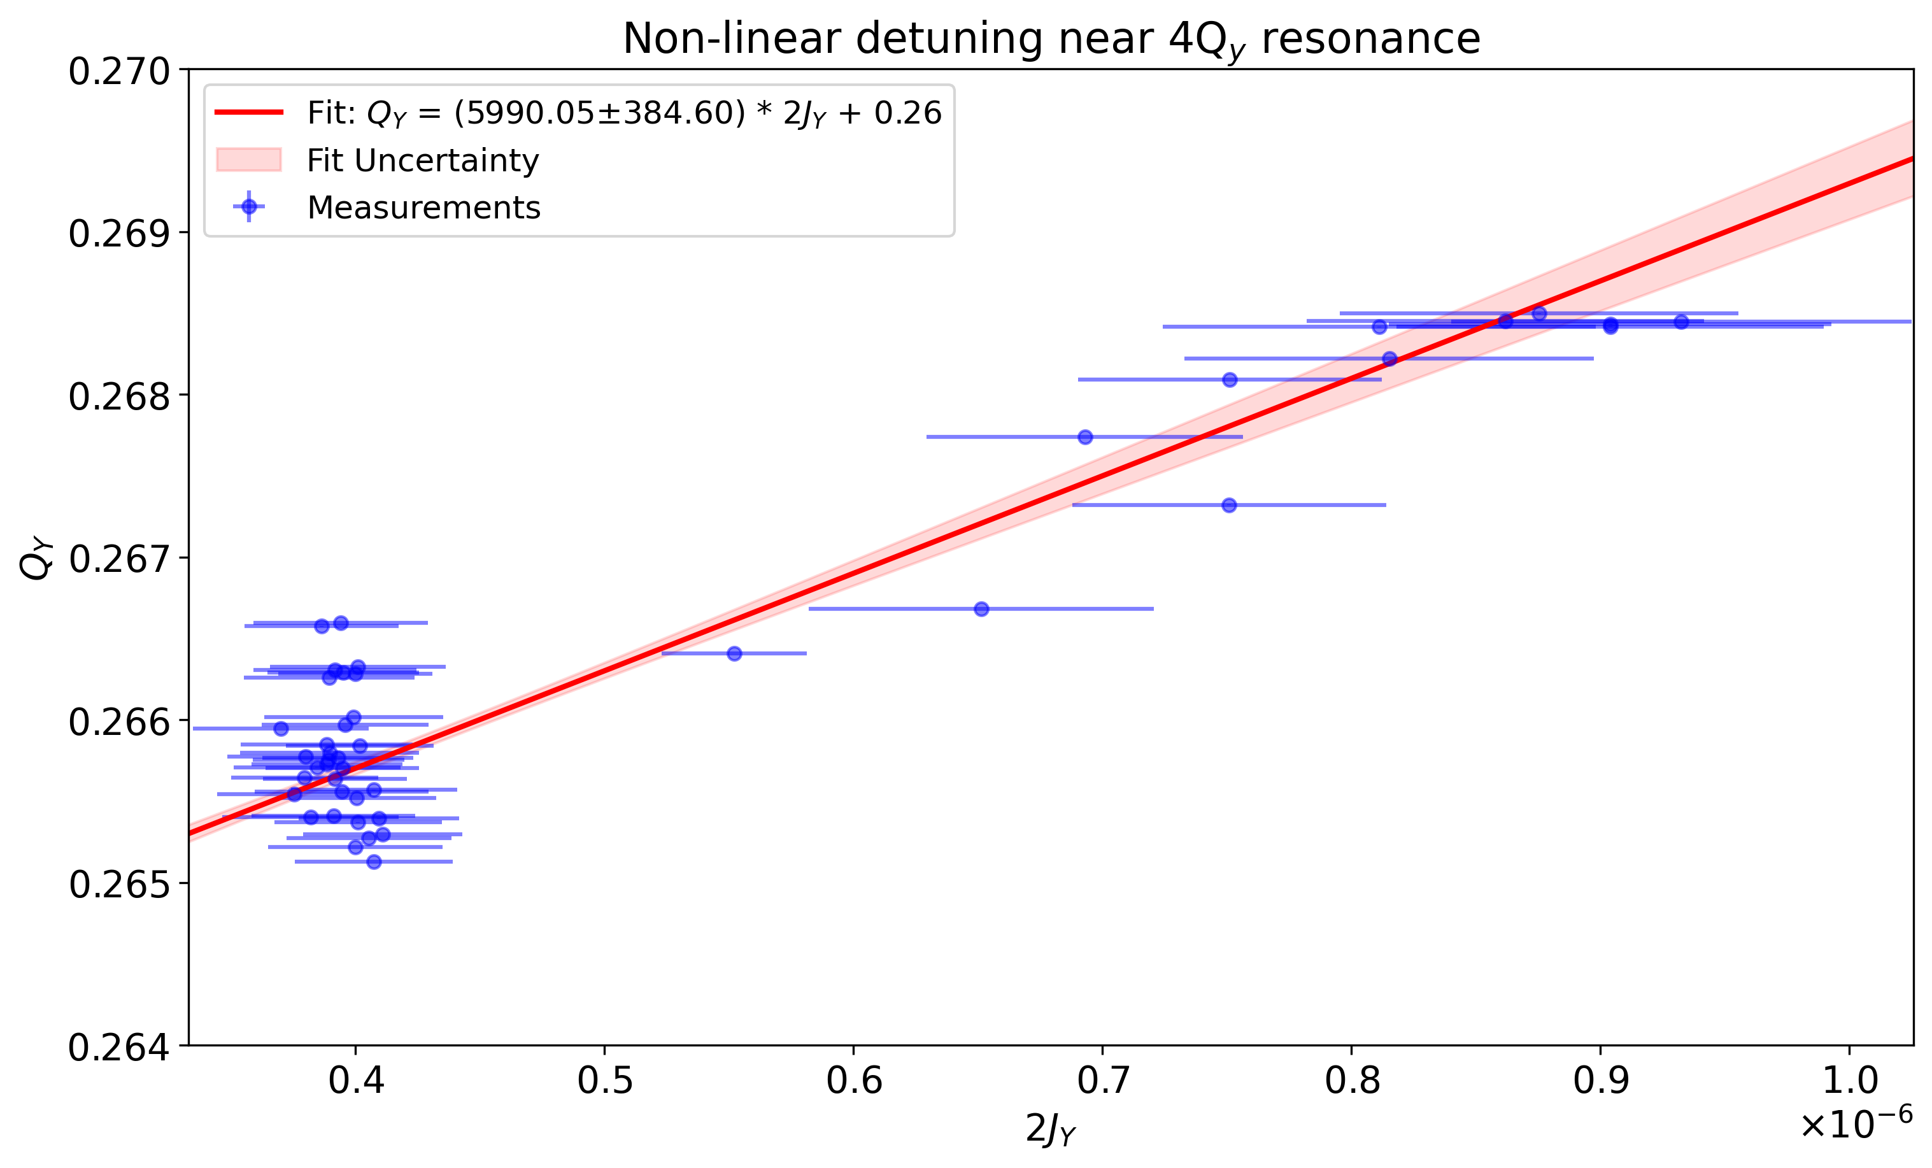
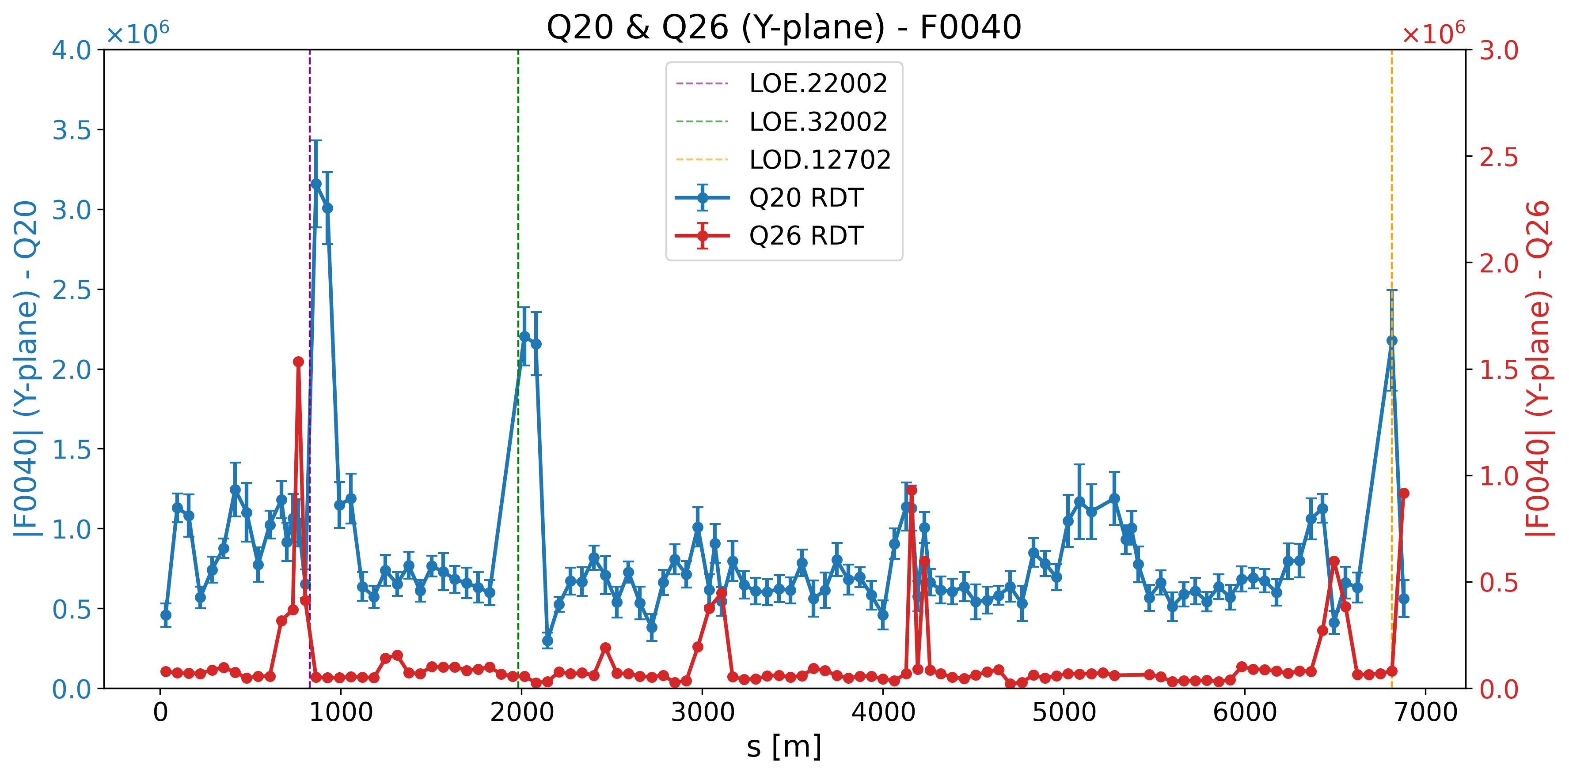
Recap 2024
Last year, OMC was first introduced in the SPS
BBQ was used in AC-dipole mode for the first time
MDs to measure optics & RDTs
Single kicks measurements with Q26 optics also effective
BPM acquisition then limited to 8,000 turns
The number of turns considered to be a limitation for analysis of AC-dipole excitations
E. McLean, Benchmarking of optics and magnetic models, JAP 2024
P. Zisopoulos, Optics & RDT measurements, MD Days 2025

Slide 3
Recap 2024
Last year, OMC was first introduced in the SPS
BBQ was used in AC-dipole mode for the first time
MDs to measure optics & RDTs
Single kicks measurements with Q26 optics also effective
BPM acquisition then limited to 8,000 turns
The number of turns considered to be a limitation for analysis of AC-dipole excitations
Some BPMs were identified as “bad” (synchronization issues, 1-turn offsets, NaNs etc.)
E. McLean, Benchmarking of optics and magnetic models, JAP 2024
P. Zisopoulos, Optics & RDT measurements, MD Days 2025

Slide 4
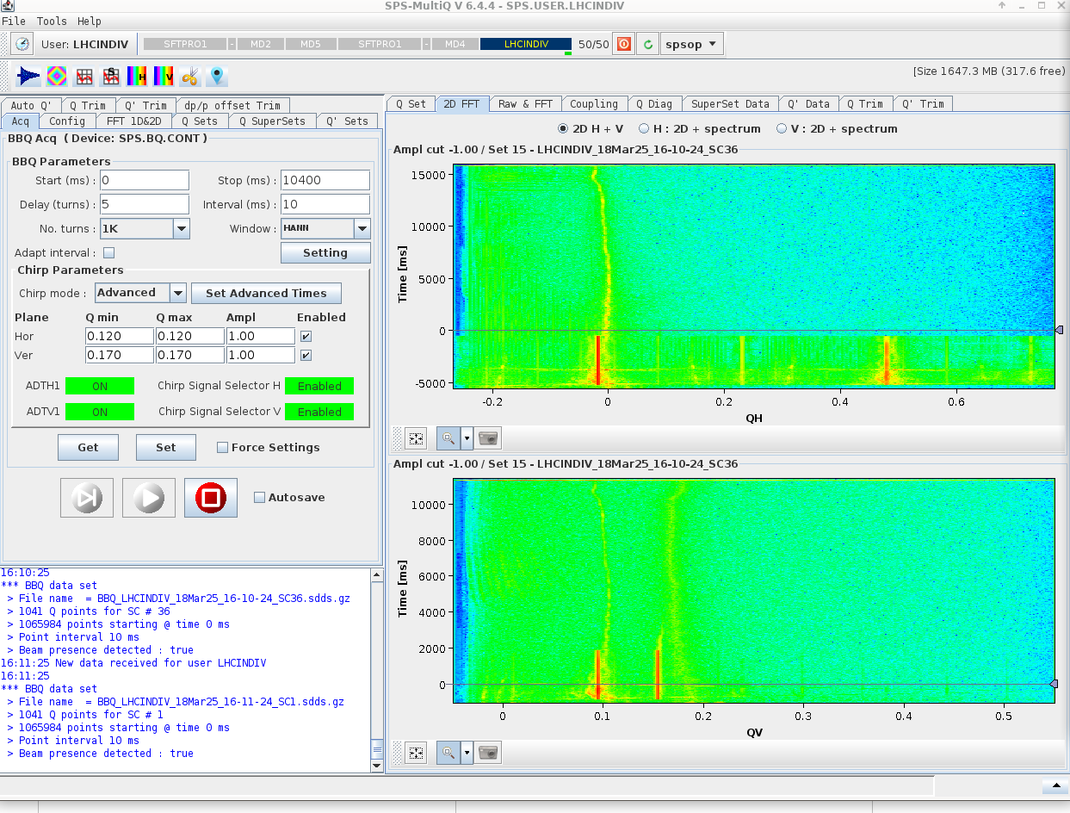
First Optics measurements in the SPS for 2025
During 2025 SPS beam commissioning, the new long capture acquisition mode became available
Can now record up to 64,000 turns at all 216 ALPS BPMs in the SPS
First set of optics measurements on first week of beam commissioning with LHCINDIV beam (Q20 optics)

Slide 5
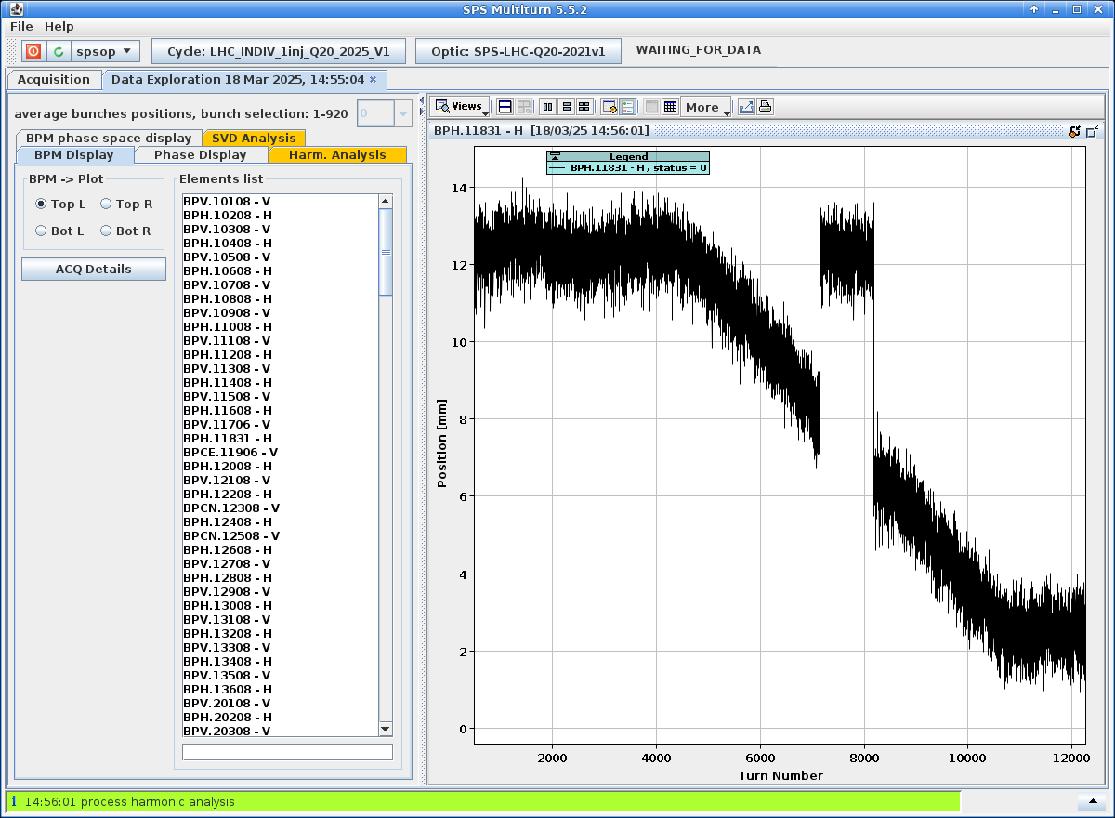
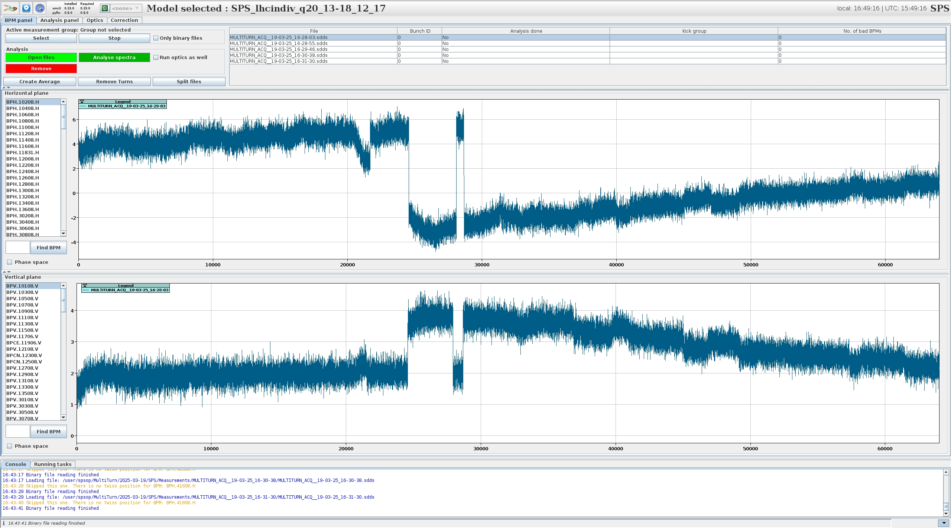
First Optics measurements in the SPS for 2025
During 2025 SPS beam commissioning, the new long capture acquisition mode became available
Can now record up to 64,000 turns at all 216 ALPS BPMs in the SPS
First set of optics measurements on first week of beam commissioning with LHCINDIV beam (Q20 optics)
Large beam position jumps observed at almost half the BPMs!

Slide 6
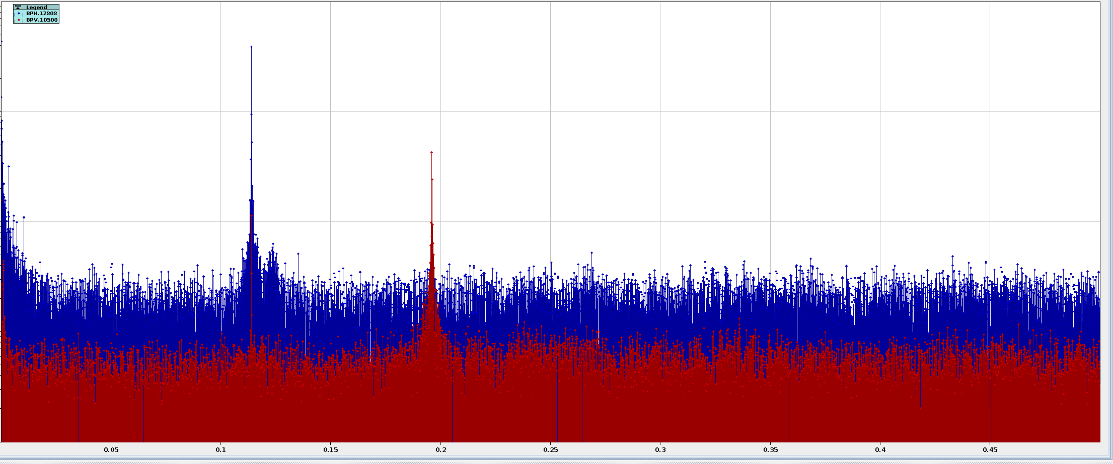
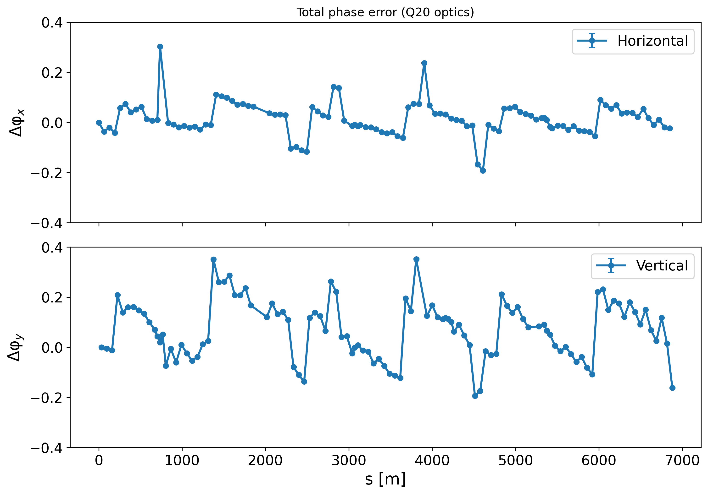
First Optics measurements in the SPS for 2025
AC-dipole excitation produced good frequency spectra (around 10 μm noise plateau in H, 1 μm in V)
First phase beating measurements revealed a strange saw-tooth pattern: Phase error being almost zero at the start of each sextant & building up until the end
Super-periodicity of SPS is 6!
Is there a weird quadrupole powering issue taking place?

Slide 7
First Optics measurements in the SPS for 2025
Data Buffer receives Batch A
Reading data
Processing data
Data buffer empties to receive Batch B
First BPM experts investigated:
Reading & processing the data is too slow compared to how fast the new data is coming in
Need 200 ms (~8500 turns) to handle all BPM data per sextant (around 40 channels)
But we receive data every ~ 90 ms (3,800 turns)
This explains why the first BPMs in each sextant look relatively OK
Data off-set is building-up until next sextant
Every 90 ms
Every 200 ms

Slide 8
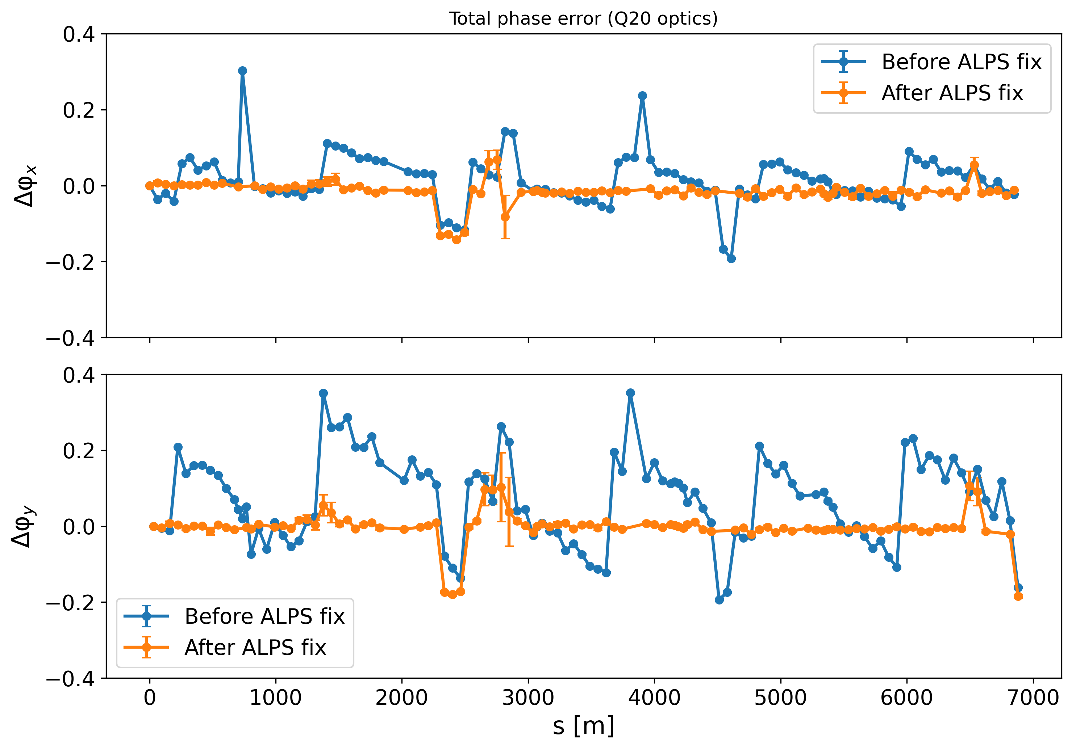
2025 First Optics Measurements
Issue was quickly resolved and Q20 measurements repeated with AWAKE & HiRadMat beam (single bunch - Q20 optics)
Results much more consistent to expectations this time

Slide 9
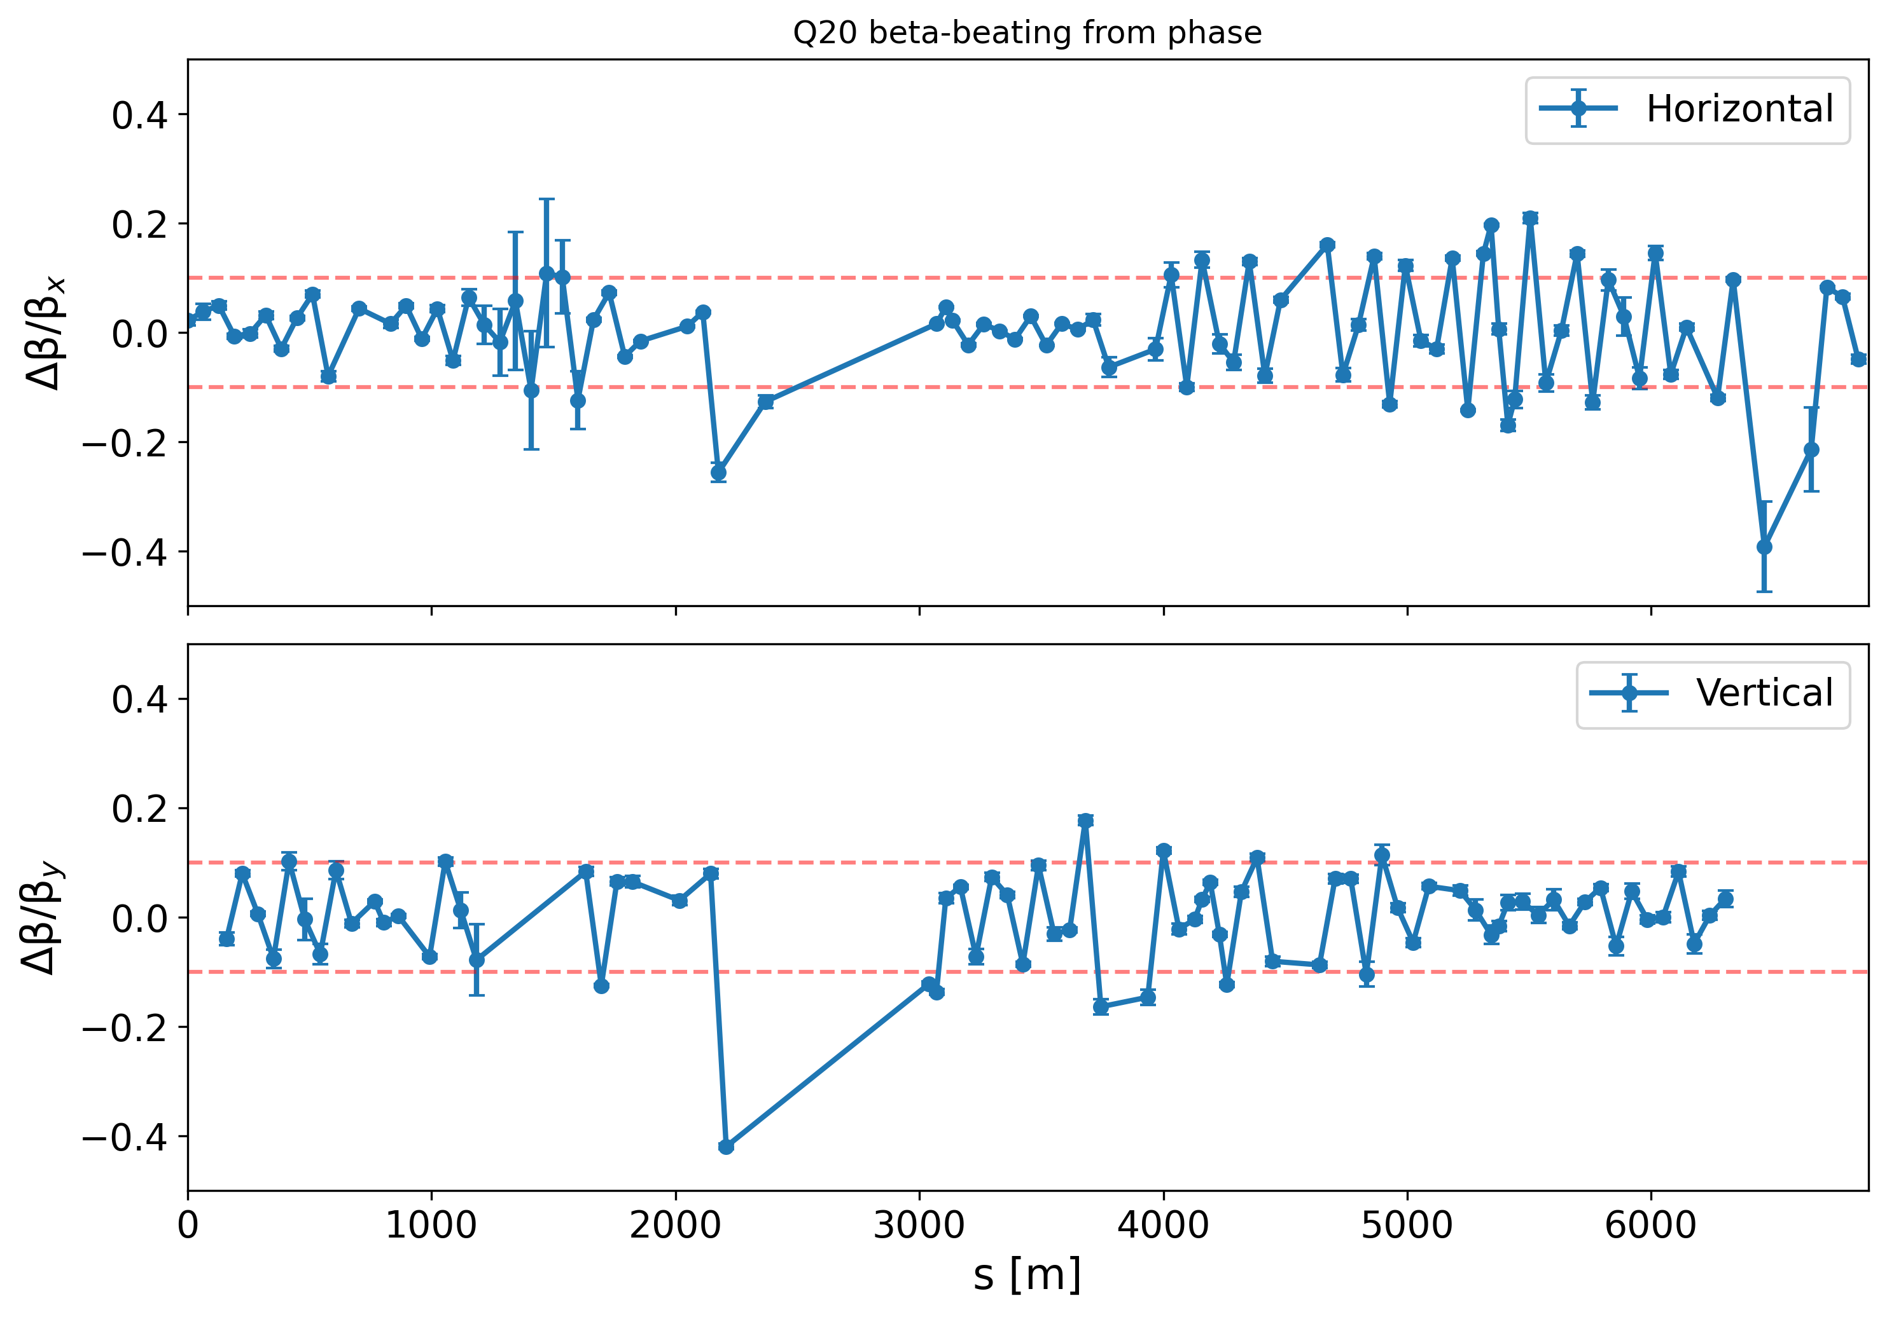
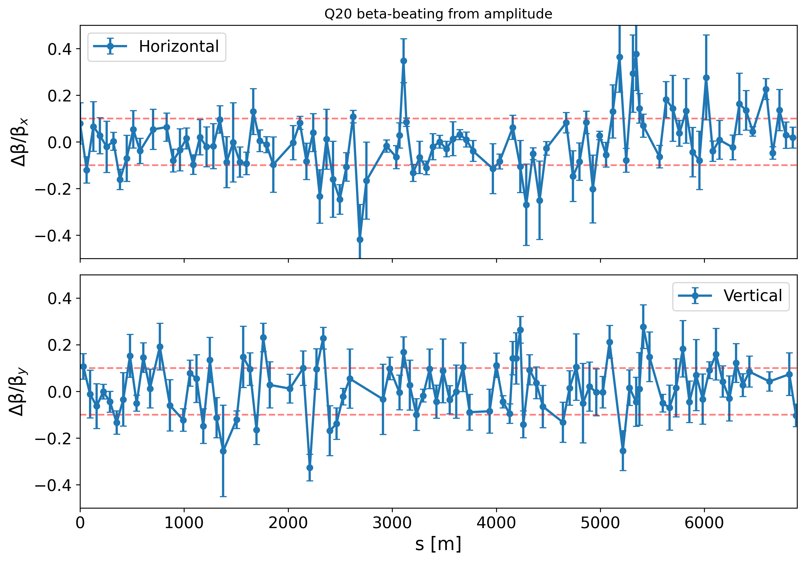
2025 First Optics Measurements
Issue was quickly resolved and Q20 measurements repeated with AWAKE & HiRadMat beam (single bunch - Q20 optics)
Results much more consistent to expectations this time
Beta-beating on par with last year’s measurements
Many BPMs provided very large errors due to sync. issues, NaN values …

Slide 10
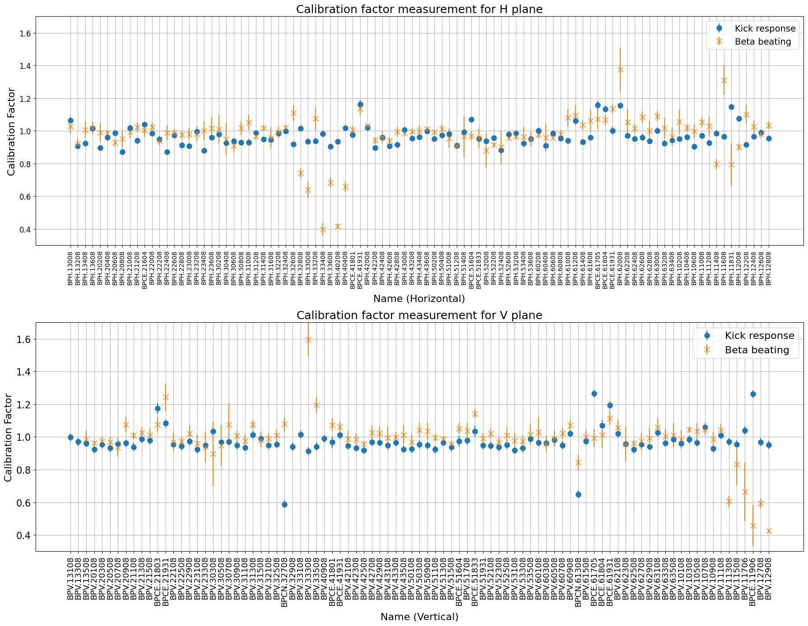
2025 First Optics Measurements
Good agreement of calibration factors between kick response & beta-beating measurements
Clear to spot regions were BPMs look problematic
It is known that BPMs from BPCE & BPCN families (directional couplers) are quite non-linear

Slide 11
2025 First Optics Measurements
LSS2 extraction
LSS4 extraction
LSS6 extraction
LSS1 injection
Good agreement of calibration factors between kick response & beta-beating measurements
Clear to spot regions were BPMs look problematic
It is known that BPMs from BPCE & BPCN families (directional couplers) are quite non-linear
Most unreliable BPMs are located around the SPS injection (LSS1) extraction regions (LSS2, LSS4, LSS6)

Slide 12
Conclusion
OMC commissioned in the SPS with new long capture mode & AC-Dipole
From OMC optics measurements discovered issue with data handling in the BPMs
After the issue was fixed, optics beating found to be much more consistent to previous year’s results
Plan to book MD time for more measurements also non-linear optics (chroma, detuning …)
Single kick excitation will be also investingated

Slide 13
Thank you for your attention

Slide 14
Extra

Slide 15
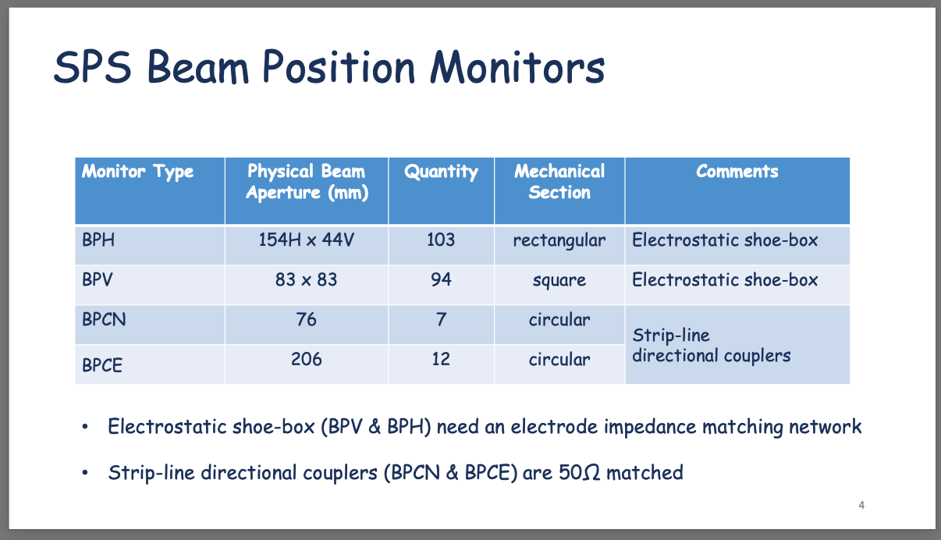

Slide 16
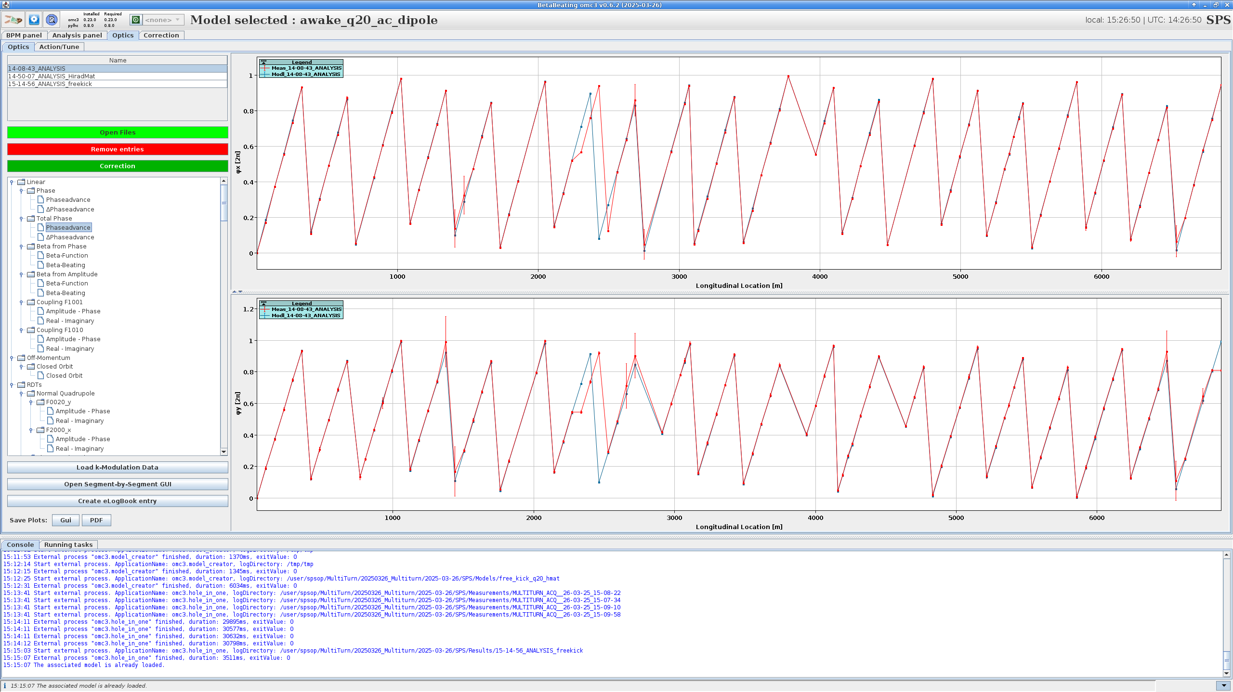
Total phase – Measurement with AWAKE 2025 cycle

