Slide 1
LHC arc BPM scaling
M. Krupa SY-BI-BP

Slide 2
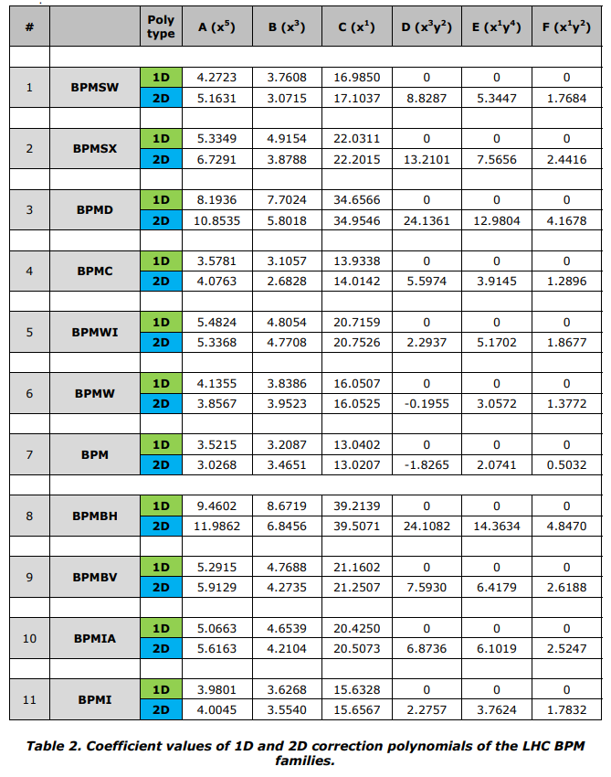
LHC BPM scaling
All LHC BPMs use polynomials for translating the raw normalized position in scale [-1,1] to physical position in mm
1D polynomials were used until 2014. 2D (cross-term) polynomials in use since 2014
Polynomials were derived from CST simulations (quasi-2D electrostatic and/or wakefield) and are defined in EDMS 1342295
Arc BPM

Slide 3
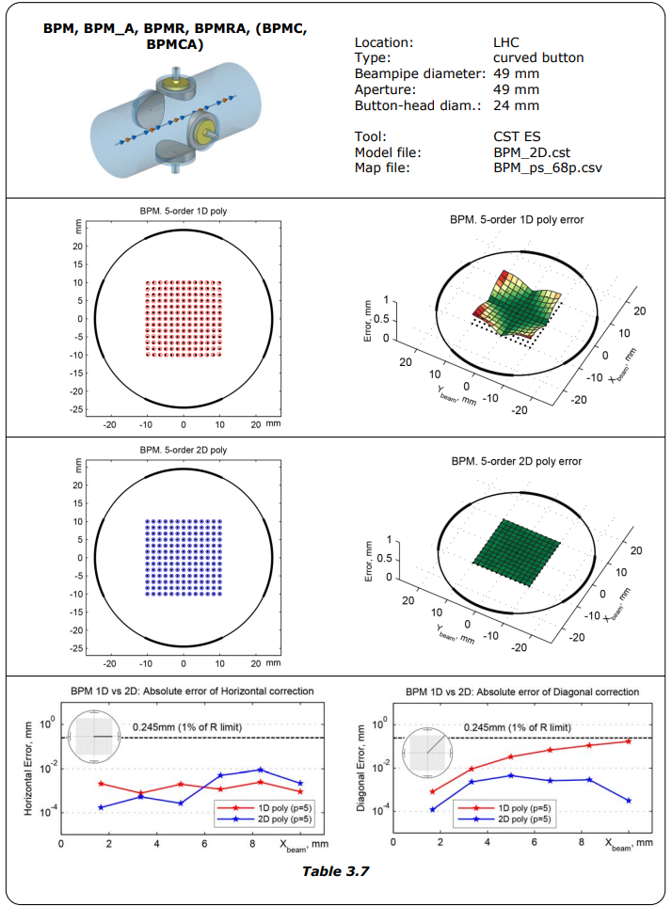
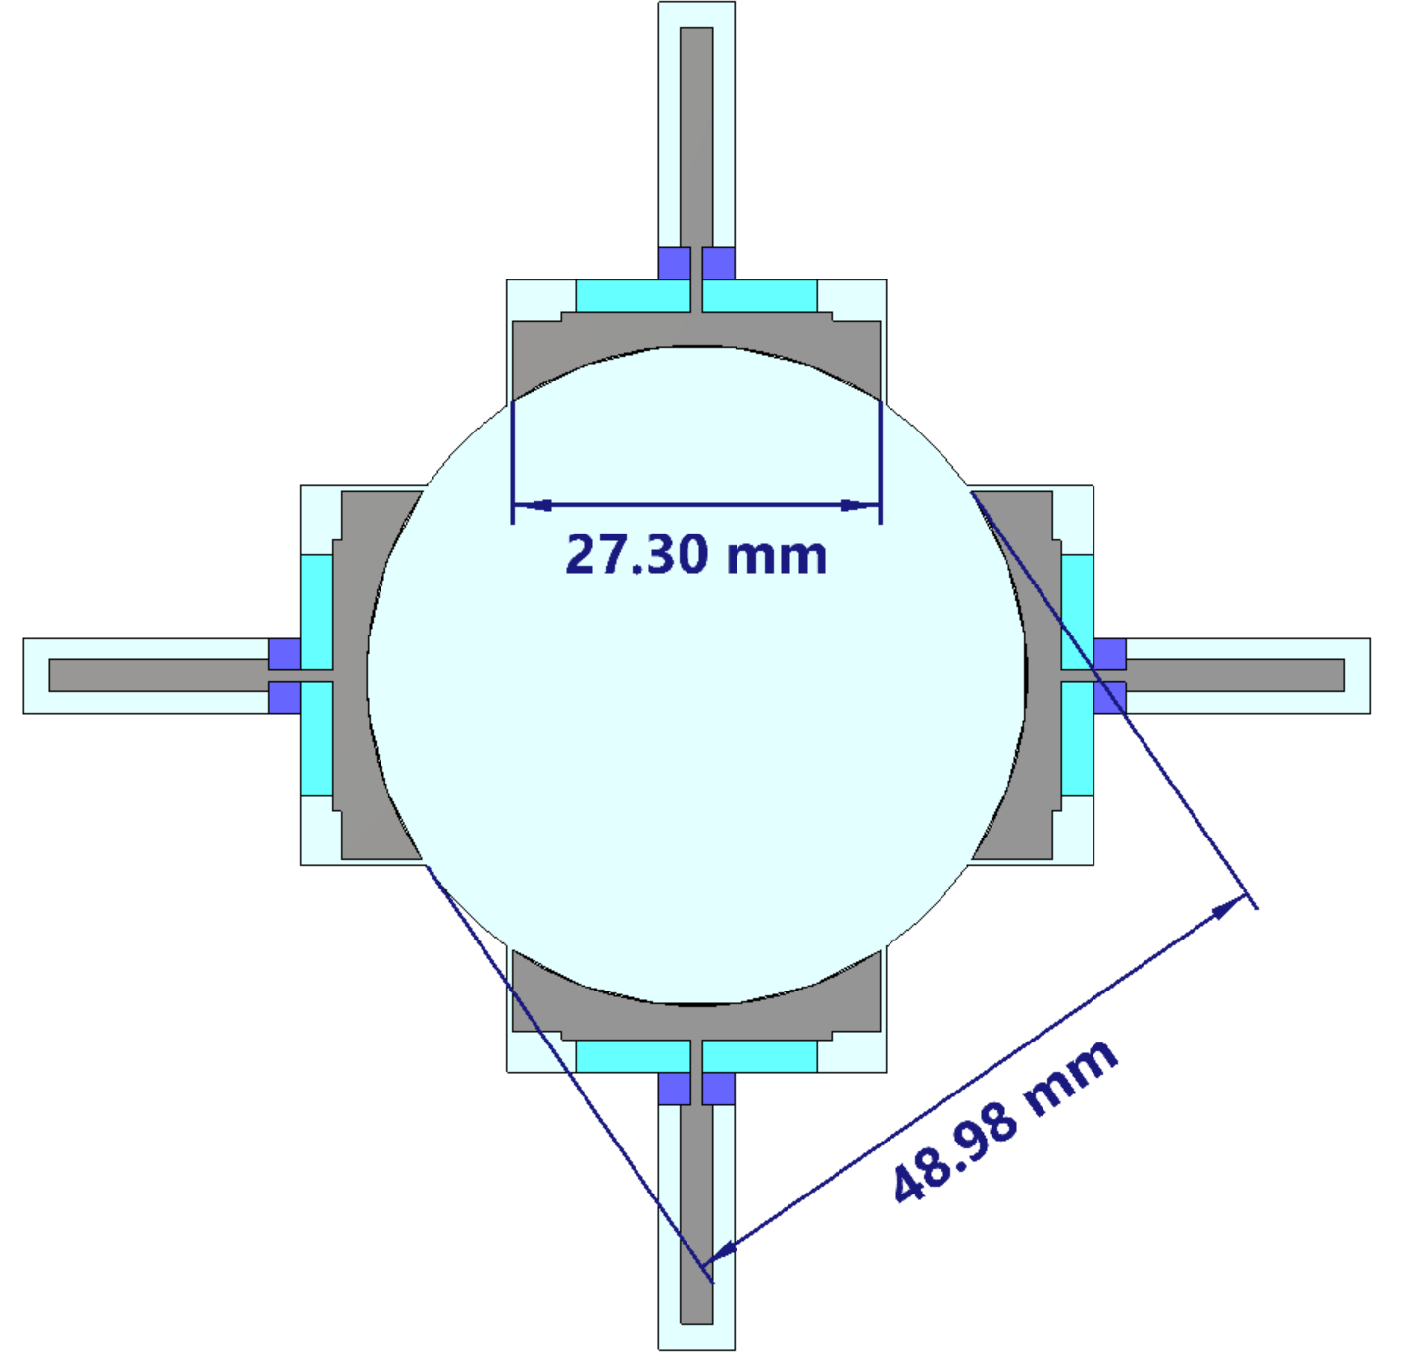
Model used in 2014 for arc BPM polynomial derivation
discrepancy
Discussed with the model creator (not at CERN anymore).
Reason for the discrepancy remains unknown.

Slide 4
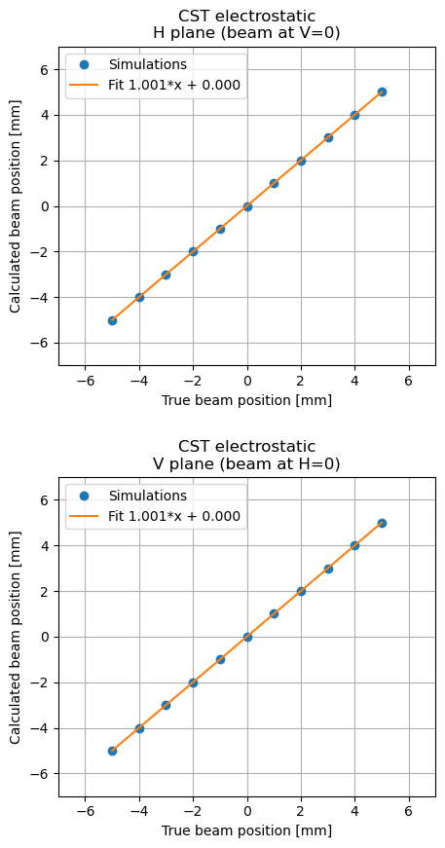
2014 model – polynomial accuracy
Very good agreement on the scale is found when the polynomial defined in EDMS is applied to the simulation data obtained with the 2014 model
The polynomial is doing exactly was it is supposed to do

Slide 5
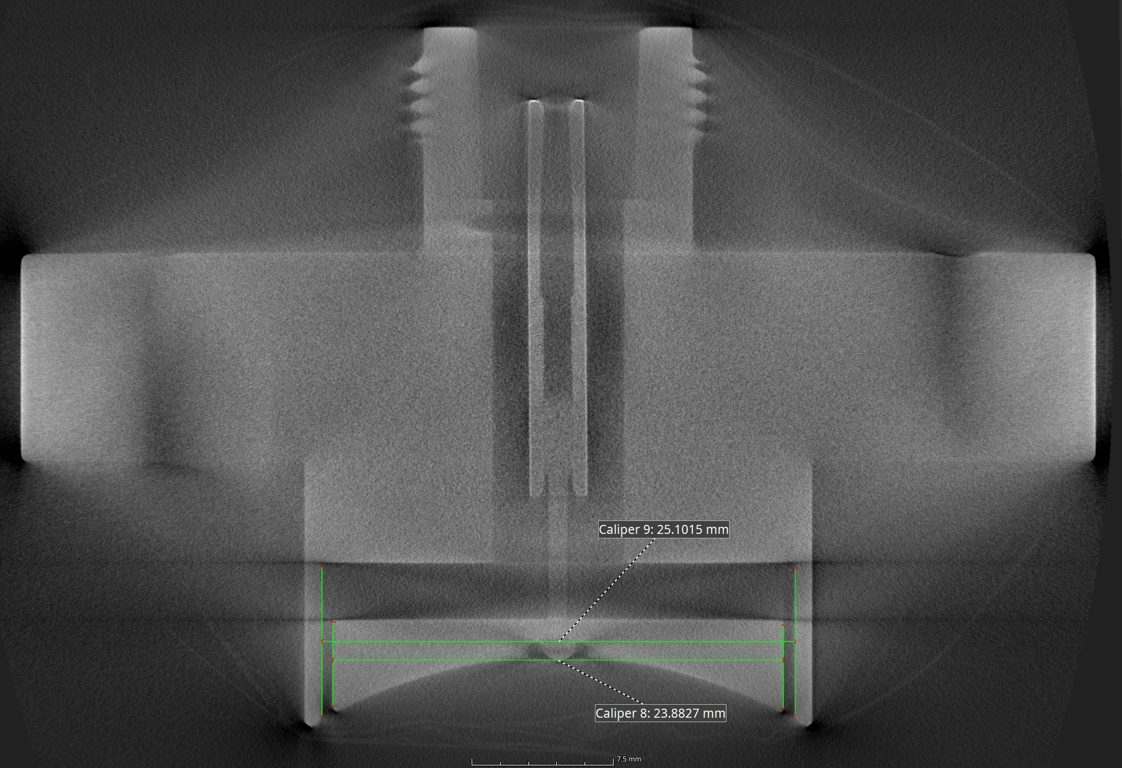
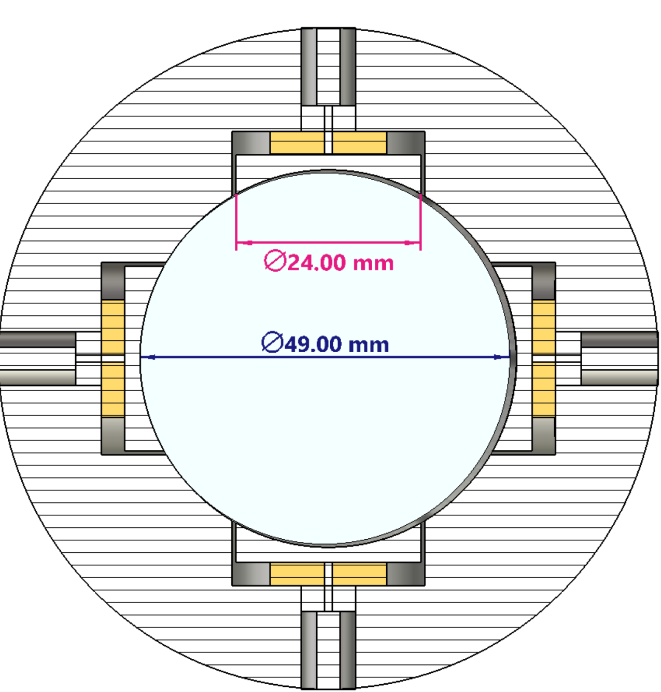
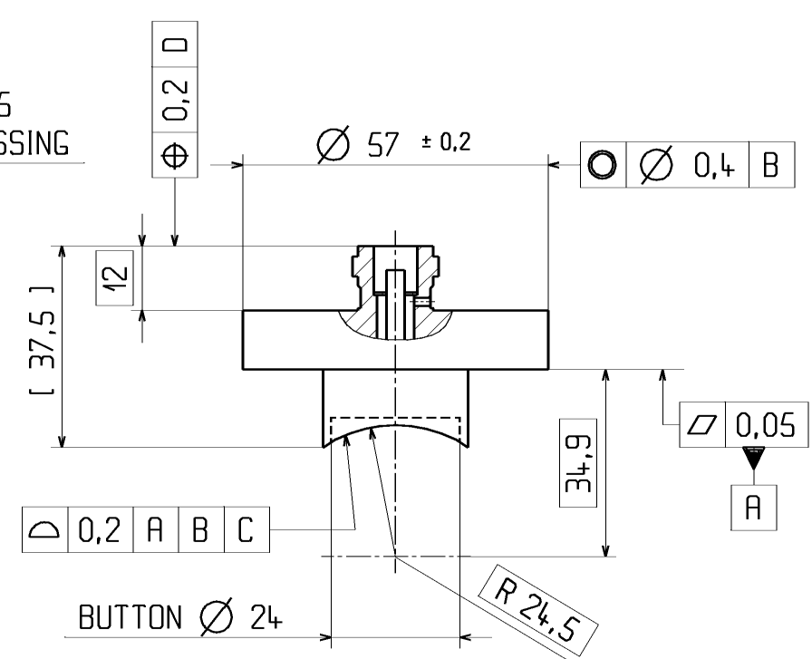
2025 arc BPM model
23.9 mm
from a CT scan of a spare electrode
(non metrology grade)
24 mm
defined in drawings

Slide 6
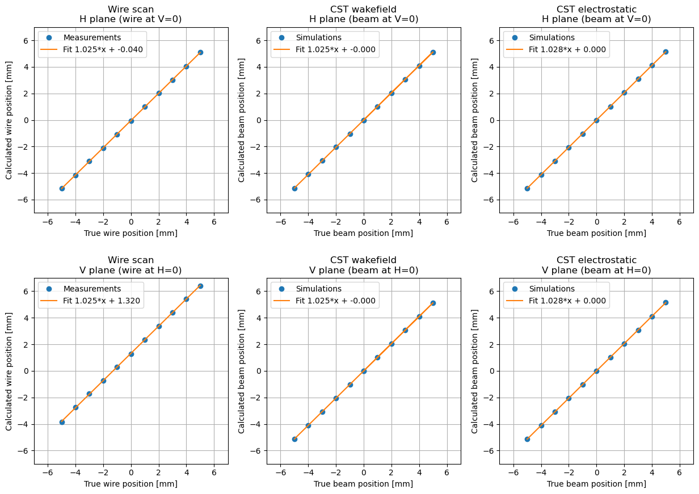
Real BPM and 2025 model vs 2014 polynomial
2.5-2.8% scale error found when applying the 2014 polynomial to:
  Real arc BPM measured on a stretched-wire test bench
  2025 model with wakefield solver
  2025 model with electrostatic solver

Slide 7
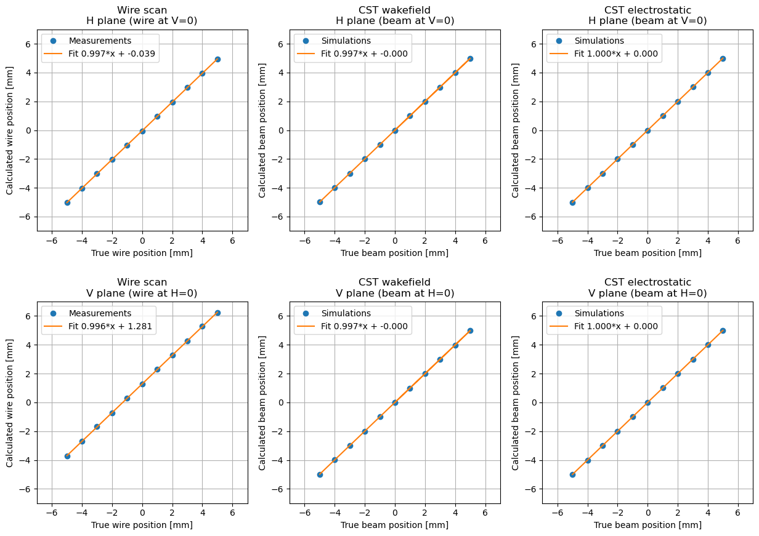
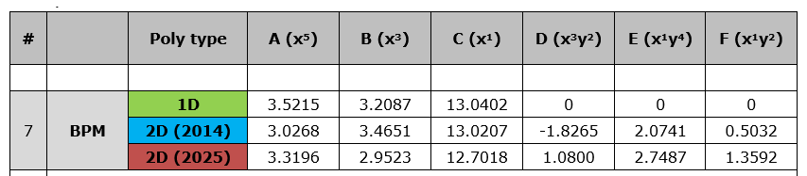
Polynomial derived from 2025 model
PRELIMINARY polynomial derived from the 2025 model with electrostatic solver
0.3% disagreement between the wakefield solver and electrostatic solver to be understood
  This might be the ultimate accuracy limit
  Similar discrepancy seen in other facilities

Slide 8
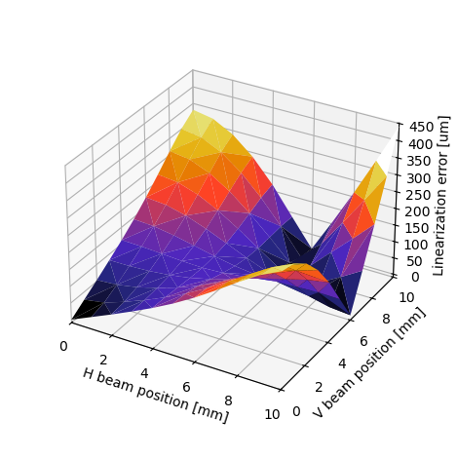
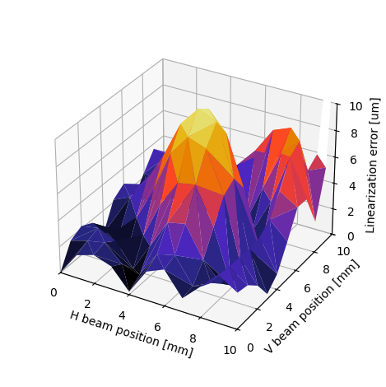
Linearization error – 2014 polynomial vs 2025 polynomial

Slide 9
Next steps?
Who decides if we deploy a new polynomial?
  How do we document and communicate the change?
Do we need to check all other BPM types?
  Any hint from OMC of a scale issue with other BPM types?

