Slide 1

Calorimeters – Upbringing & Care A brief review on my personal journey from clean to dirty physics and the things we are trying to measure with the coolest detectors in the world
Peter Loch
^{Department of Physics}
^{University of Arizona}
^{Tucson, Arizona, USA}

Slide 2



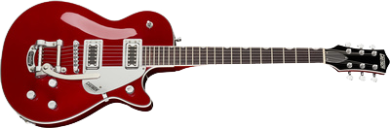
Next for me…. Looking for new experiment!
Expected final state components:
Not observed yet – needs clean up and calibration
Fine tuning and calibration (observed!)
Leadership & location
Research & Spokesperson (elected for life, already in place)
Location

Slide 3
Piling it up in the ATLAS (LAr) Calorimeters at the LHC What to do to keep it down?
Peter Loch
^{Department of Physics}
^{University of Arizona}
^{Tucson, Arizona, USA}

Slide 4
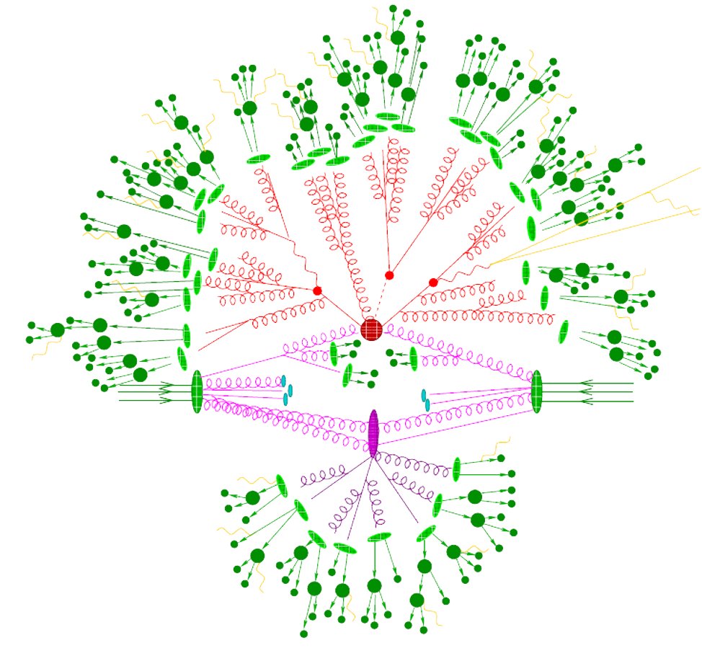
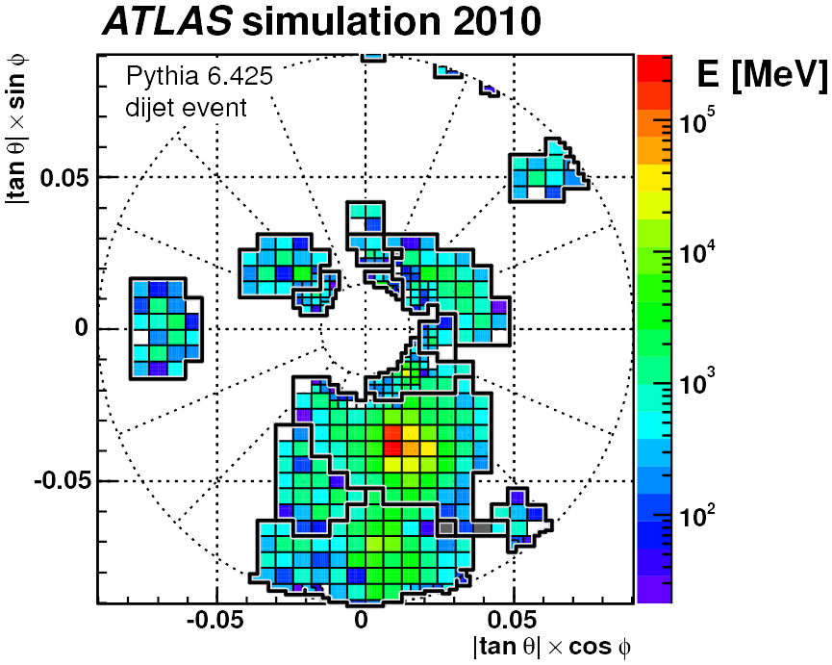
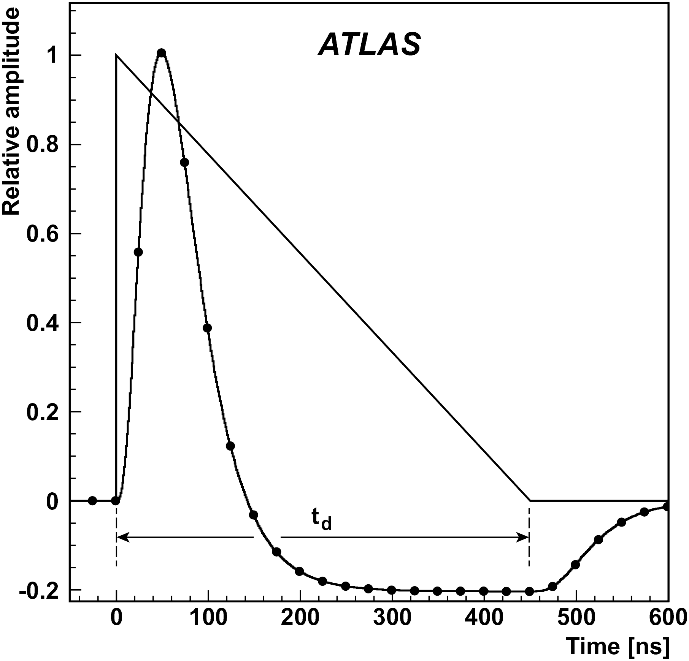


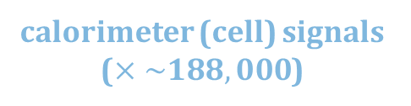
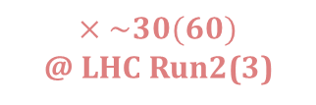
Calorimeter Signals in ATLAS
pile-up
Topo-clusters in FCal
$×\sim 30(60)$
@ LHC Run2(3)
particles
particles
hard scatter interaction
topological
cell clusters
(topo-clusters)
calorimeter (cell) signals ($×\sim 188,000$)
JetEtMiss

Slide 5
Calorimeter Signals in ATLAS in Simulations
Monte Carlo Generator
(e.g., Pythia for standard
jet final states)
Topo-clusters in FCal
pile-up
$×\sim 30(60)$
@ LHC Run2(3)
particles
particles
Detector Simulation
& signal modeling
hard scatter interaction
topological
cell clusters
(topo-clusters)
calorimeter (cell) signals ($×\sim 188,000$)
JetEtMiss

Slide 6

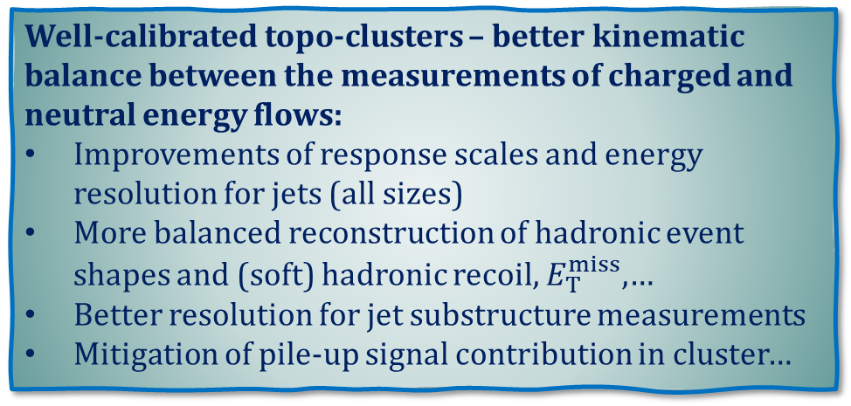
Calorimeter Signals in ATLAS in Analysis
Topo-clusters in FCal
remove noise/pile-up
reconstruct (neutral & composite) energy flow generated by particles emerging from the hard scatter interaction
Well-calibrated topo-clusters – better kinematic balance between the measurements of charged and neutral energy flows:
Improvements of response scales and energy resolution for jets (all sizes)
More balanced reconstruction of hadronic event shapes and (soft) hadronic recoil, $E_{T}^{miss}$,…
Better resolution for jet substructure measurements
Mitigation of pile-up signal contribution in cluster…
hard scatter interaction
JetEtMiss

Slide 7
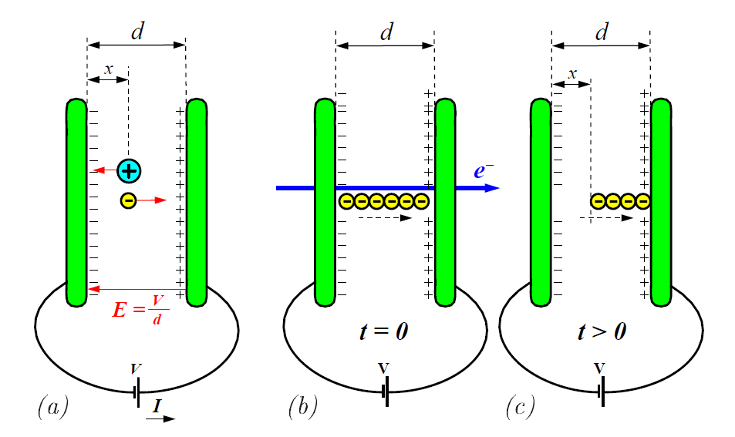
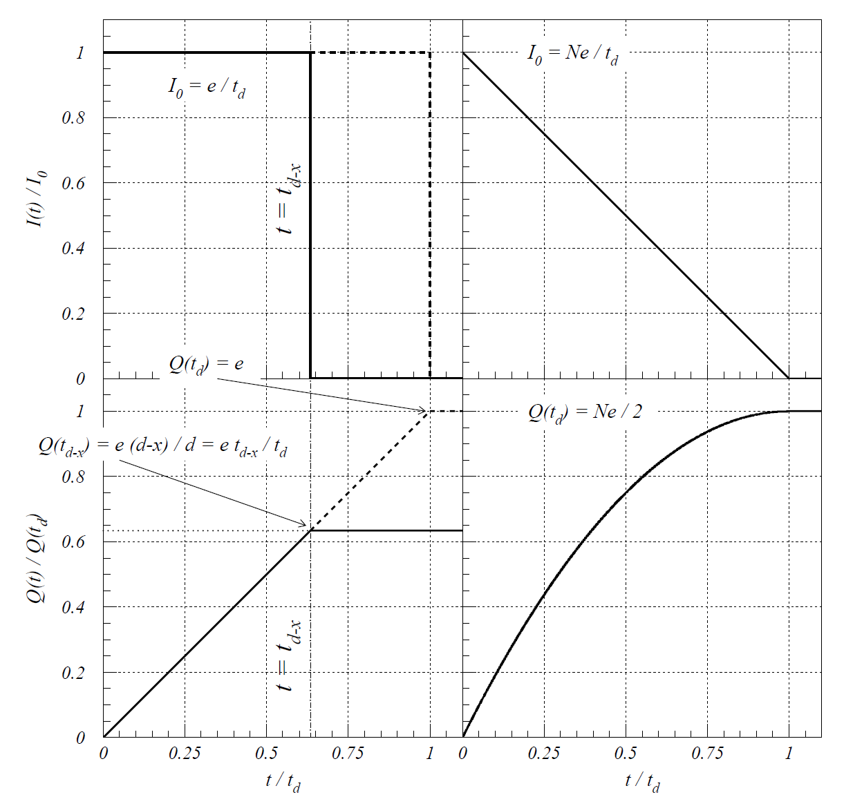
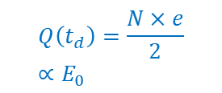
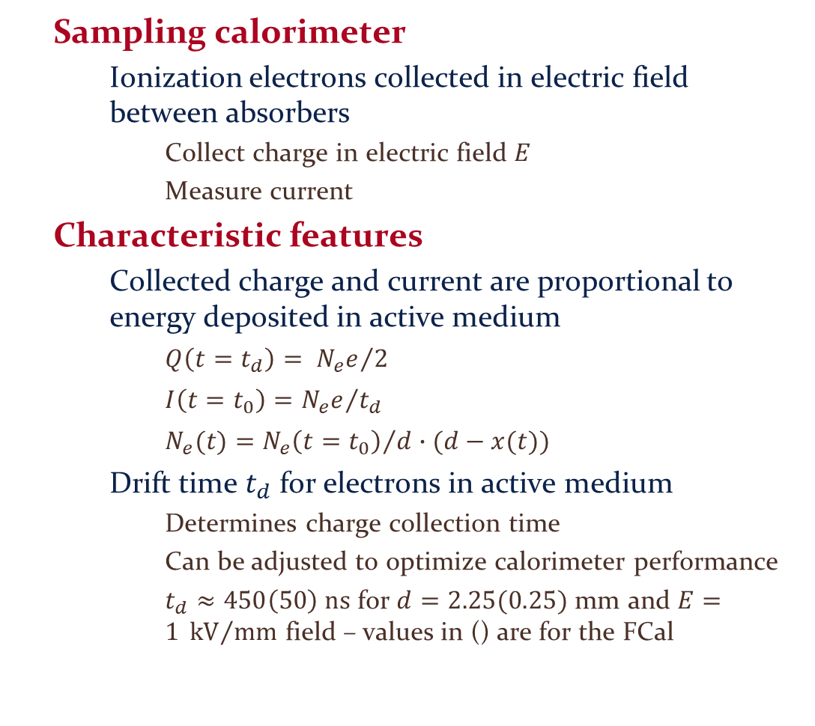
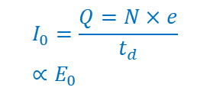
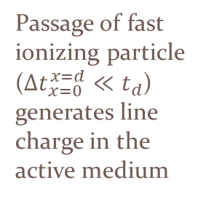
Signal Formation Example: ATLAS LAr Calorimeter
Sampling calorimeter
Ionization electrons collected in electric field between absorbers
Collect charge in electric field $E$
Measure current
Characteristic features
Collected charge and current are proportional to energy deposited in active medium
$Q\left(t=t_{d}\right)= {N_{e}e}/2$
$I\left(t=t_{0}\right)={N_{e}e}/{t_{d}}$
$N_{e}(t)={N_{e}\left(t=t_{0}\right)}/d∙(d−x(t))$
Drift time $t_{d}$ for electrons in active medium
Determines charge collection time
Can be adjusted to optimize calorimeter performance
$t_{d}≈450\left(50\right) ns$ for $d=2.25(0.25)$ mm and $E=1 {kV}/{mm}$ field – values in () are for the FCal
(A)
(B)
(C)
Passage of fast ionizing particle (${Δt}_{x=0}^{x=d}≪t_{d}$) generates line charge in the active medium
$$I_{0}=\frac{Q=N×e}{t_{d}}∝E_{0}$$
(A)
current I(t)
(B), (C)
$$Q\left(t_{d}\right)=\frac{N×e}{2}∝E_{0}$$
collected charge Q(t)
(A)
(B), (C)
point charge injection
line charge injection

Slide 8
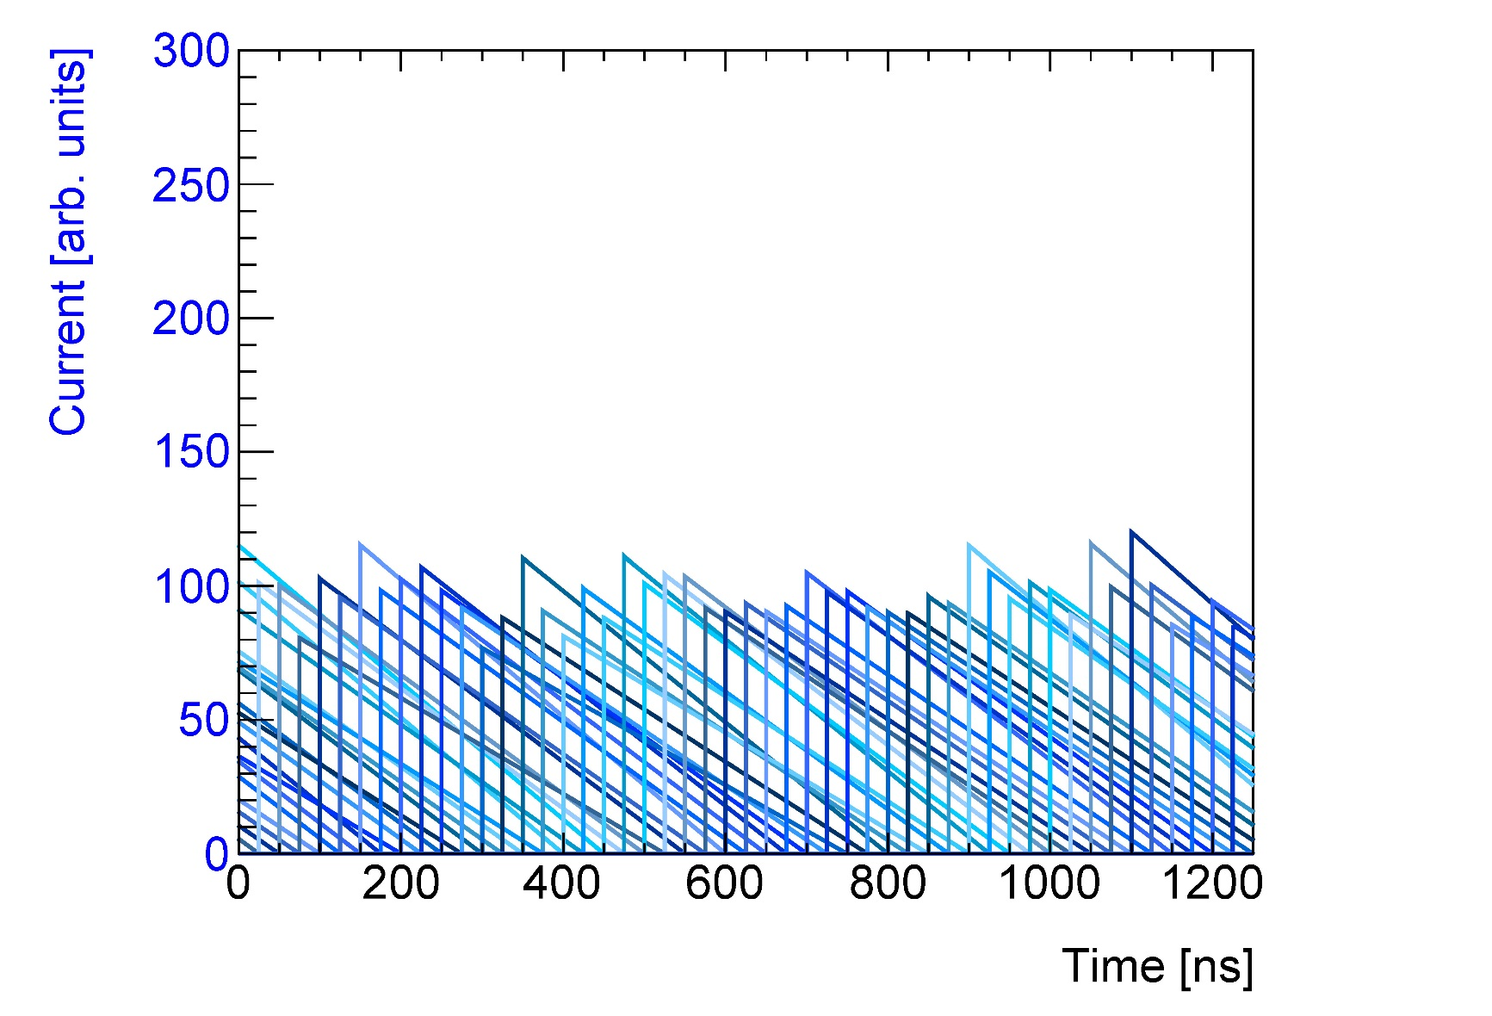
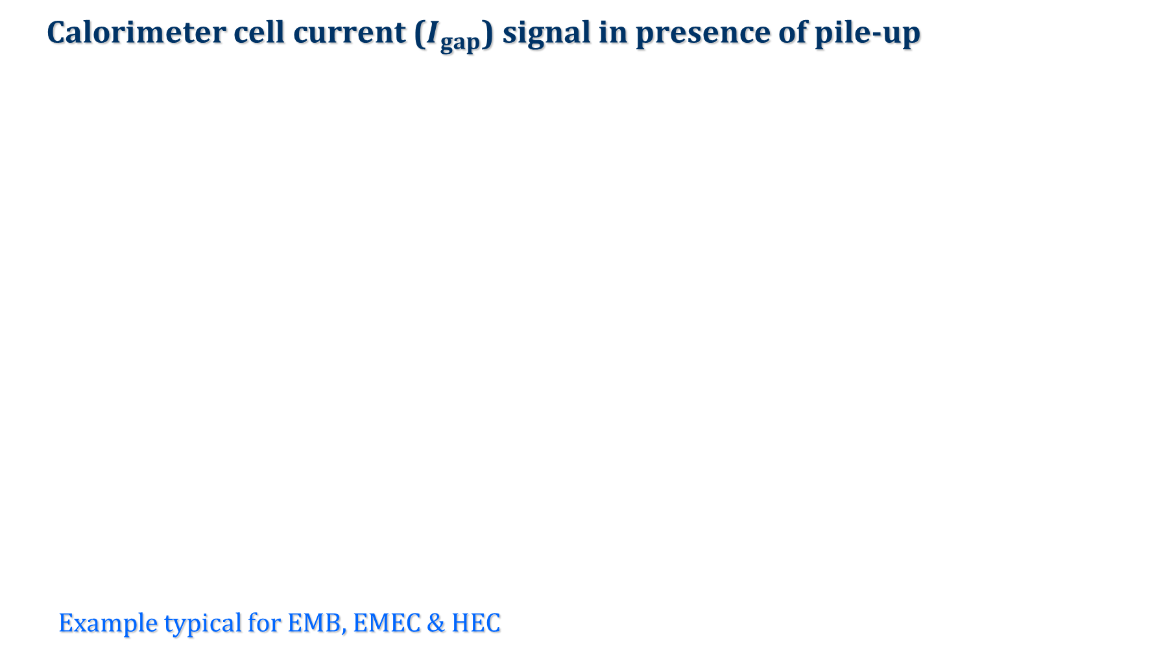


Charge Collection in Pile-up
Calorimeter cell current ($I_{gap}$) signal in presence of pile-up
Example typical for EMB, EMEC & HEC
$$I_{gap} [pA]$$
$$t [ns]$$

Slide 9
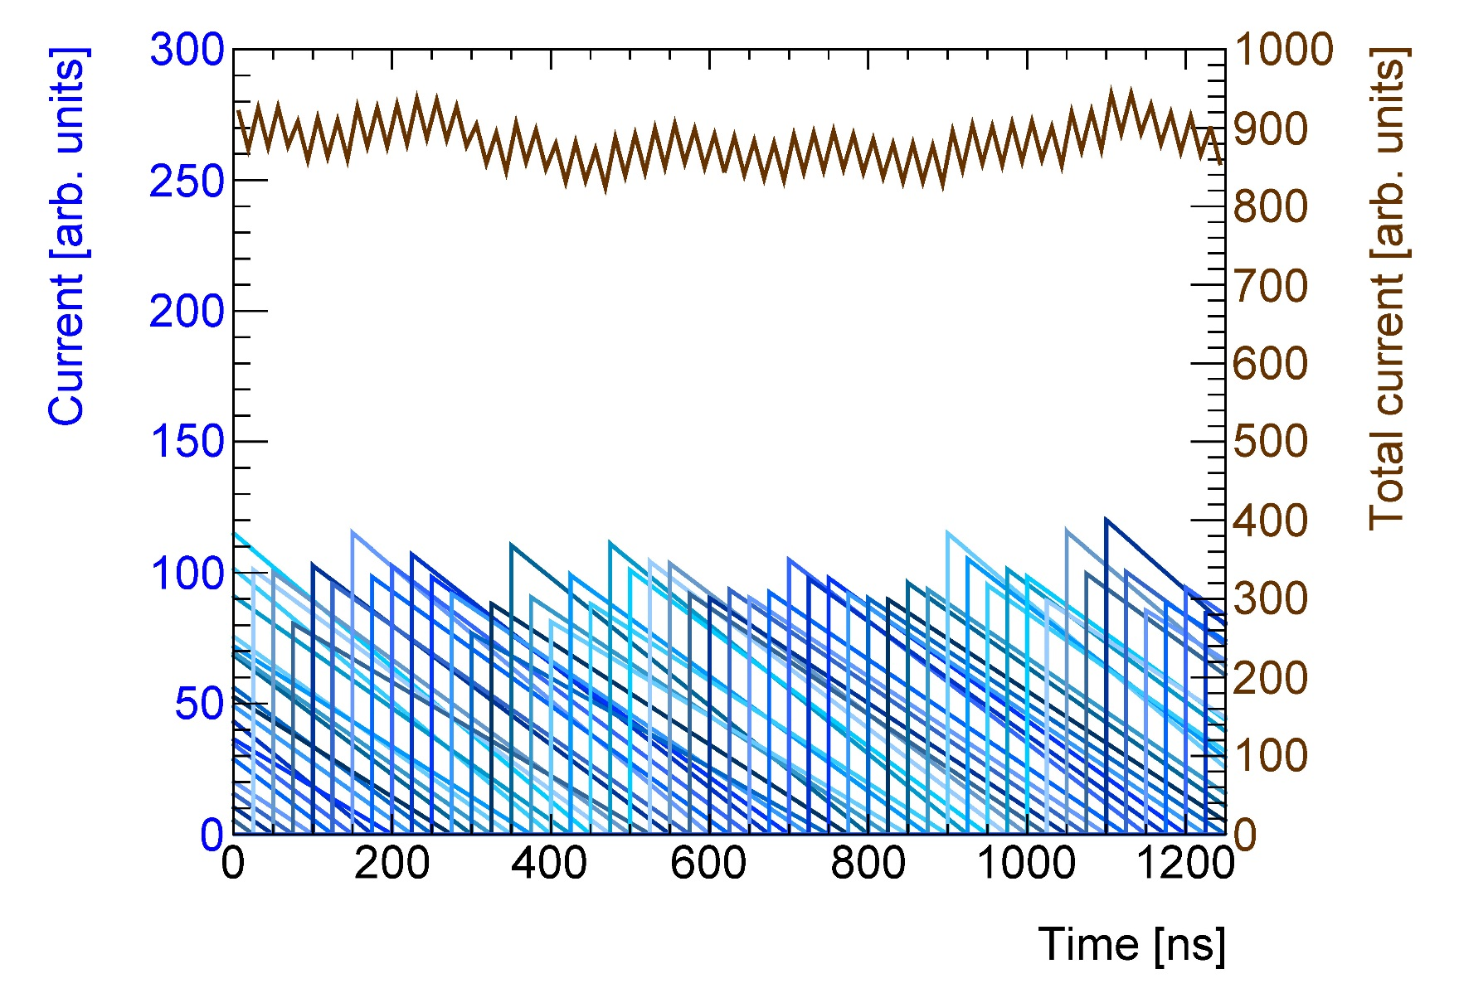

Charge Collection in Pile-up
Calorimeter cell current ($I_{gap}$) signal in presence of pile-up
Example typical for EMB, EMEC & HEC
$$I_{gap} [pA]$$
High frequency oscillations – initial current (peak) fluctuations every 25 ns
Low frequency oscillations – variations in previous current amplitude contributions
Total current $[nA]$
$$t [ns]$$

Slide 10
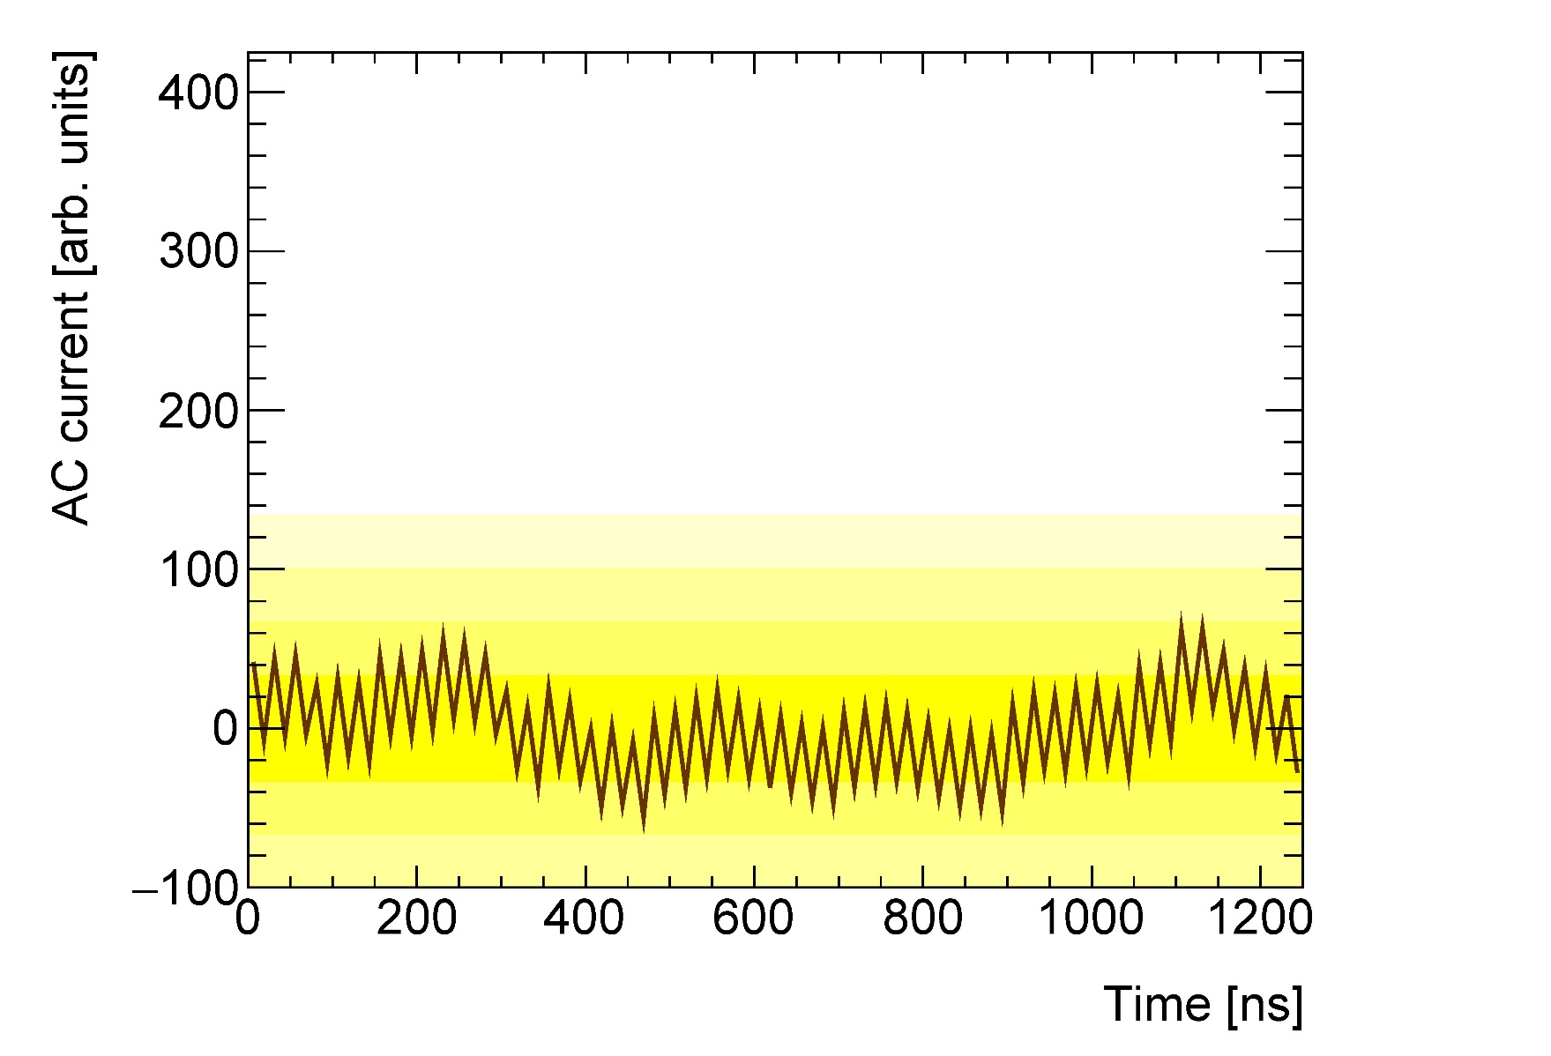






Charge Collection in Pile-up
Current at pre-amplifier input (no hard scatter signal)
(ignoring pulse shape modifications by transmission line etc.)
Example typical for EMB, EMEC & HEC
AC-coupled signal extraction to amplifier – no base line
$$+4σ_{noise}$$
$$+3σ_{noise}$$
$$+2σ_{noise}$$
$$+1σ_{noise}$$
$$−1σ_{noise}$$
$$−2σ_{noise}$$
$$t [ns]$$

Slide 11
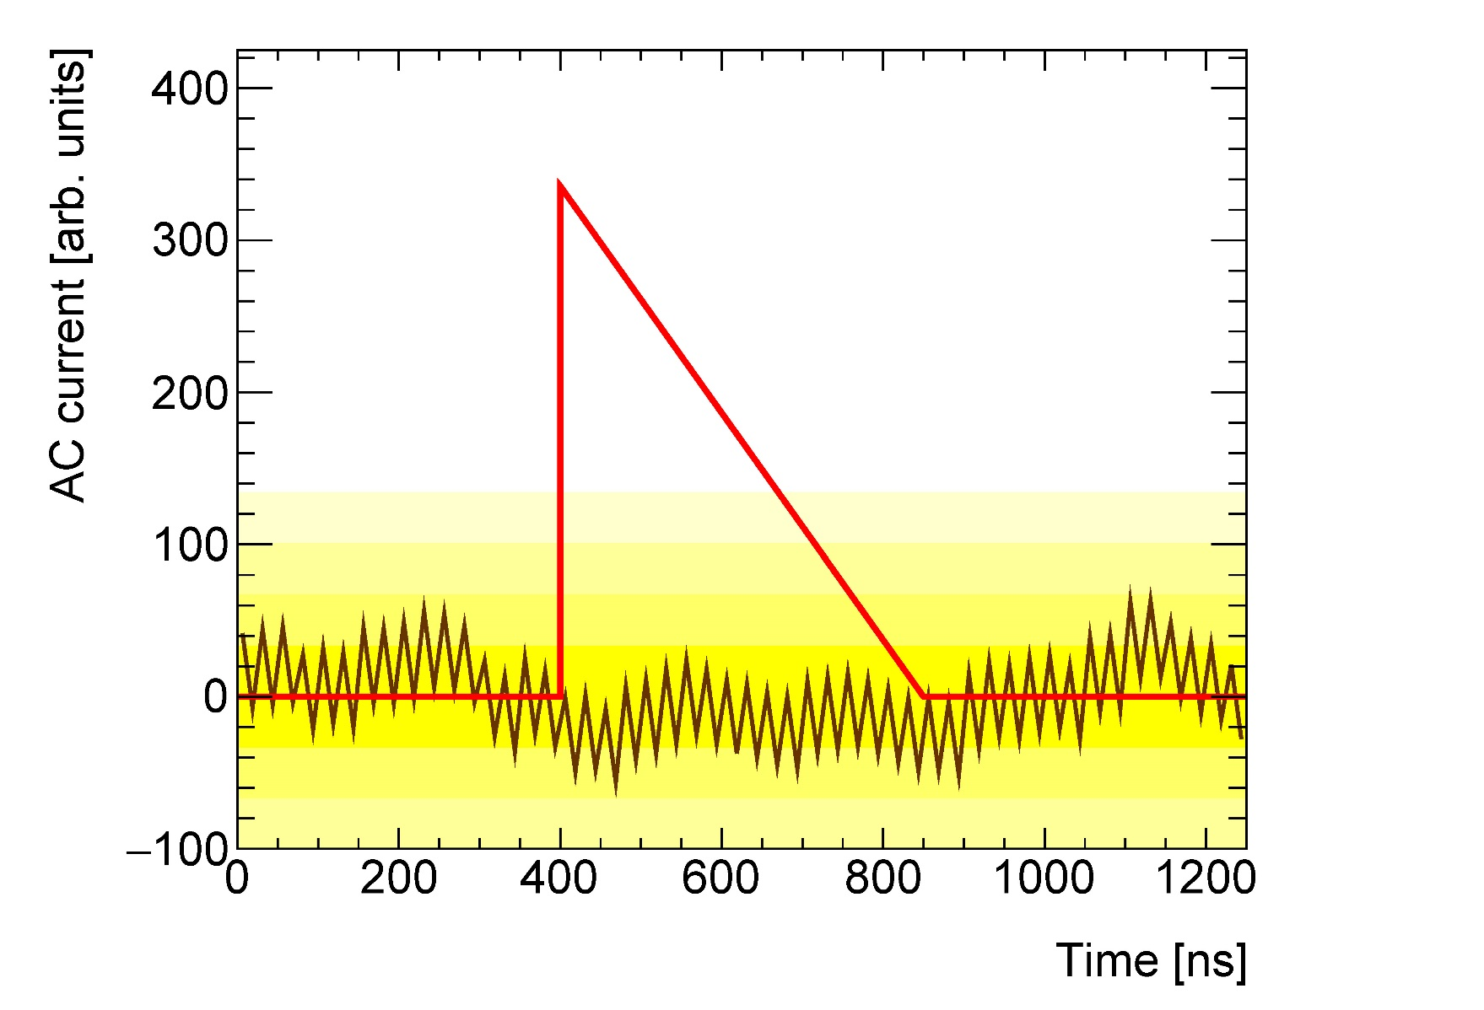


Charge Collection in Pile-up
Large amplitude hard scatter cell signal
Example typical for EMB, EMEC & HEC
True particle signal – triggers readout
$$+4σ_{noise}$$
$$+3σ_{noise}$$
$$+2σ_{noise}$$
$$+1σ_{noise}$$
$$−1σ_{noise}$$
$$−2σ_{noise}$$
$$t [ns]$$
$$t_{0}$$
$$t_{0}+t_{drift}$$

Slide 12
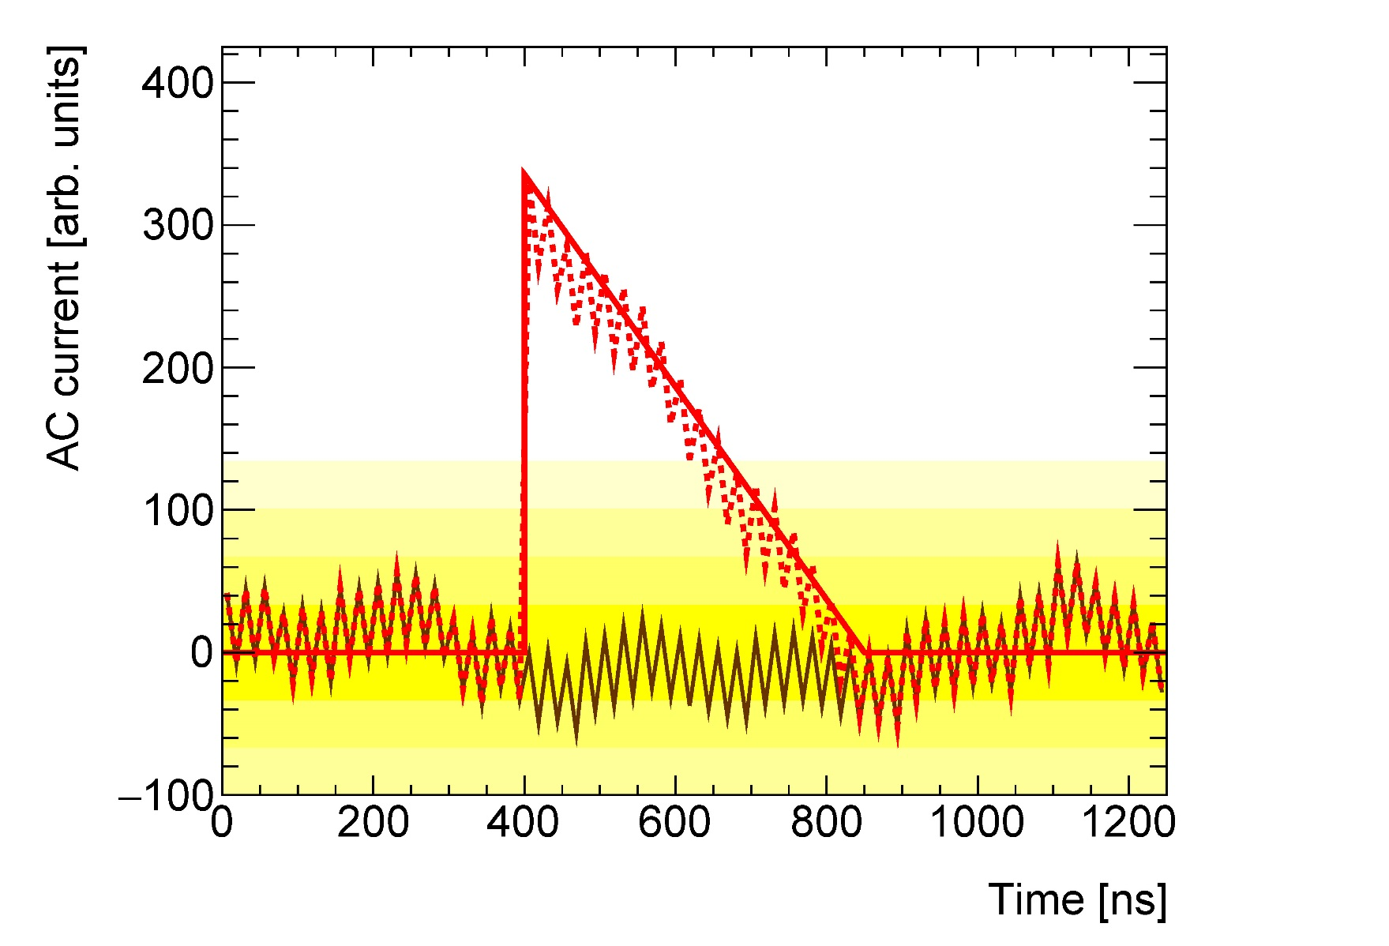
Charge Collection in Pile-up
Large amplitude hard scatter cell signal
Example typical for EMB, EMEC & HEC
Received particle signal – includes pile-up
$$+4σ_{noise}$$
$$+3σ_{noise}$$
$$+2σ_{noise}$$
$$+1σ_{noise}$$
$$−1σ_{noise}$$
$$−2σ_{noise}$$
$$t [ns]$$
$$t_{0}$$
$$t_{0}+t_{drift}$$

Slide 13
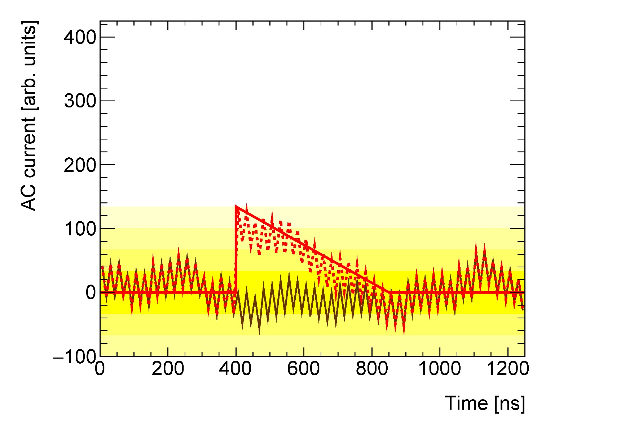
Charge Collection in Pile-up
Medium amplitude hard scatter cell signal
Example typical for EMB, EMEC & HEC
Received particle signal – includes pile-up
$$+4σ_{noise}$$
$$+3σ_{noise}$$
$$+2σ_{noise}$$
$$+1σ_{noise}$$
$$−1σ_{noise}$$
$$−2σ_{noise}$$
$$t [ns]$$
$$t_{0}$$
$$t_{0}+t_{drift}$$

Slide 14
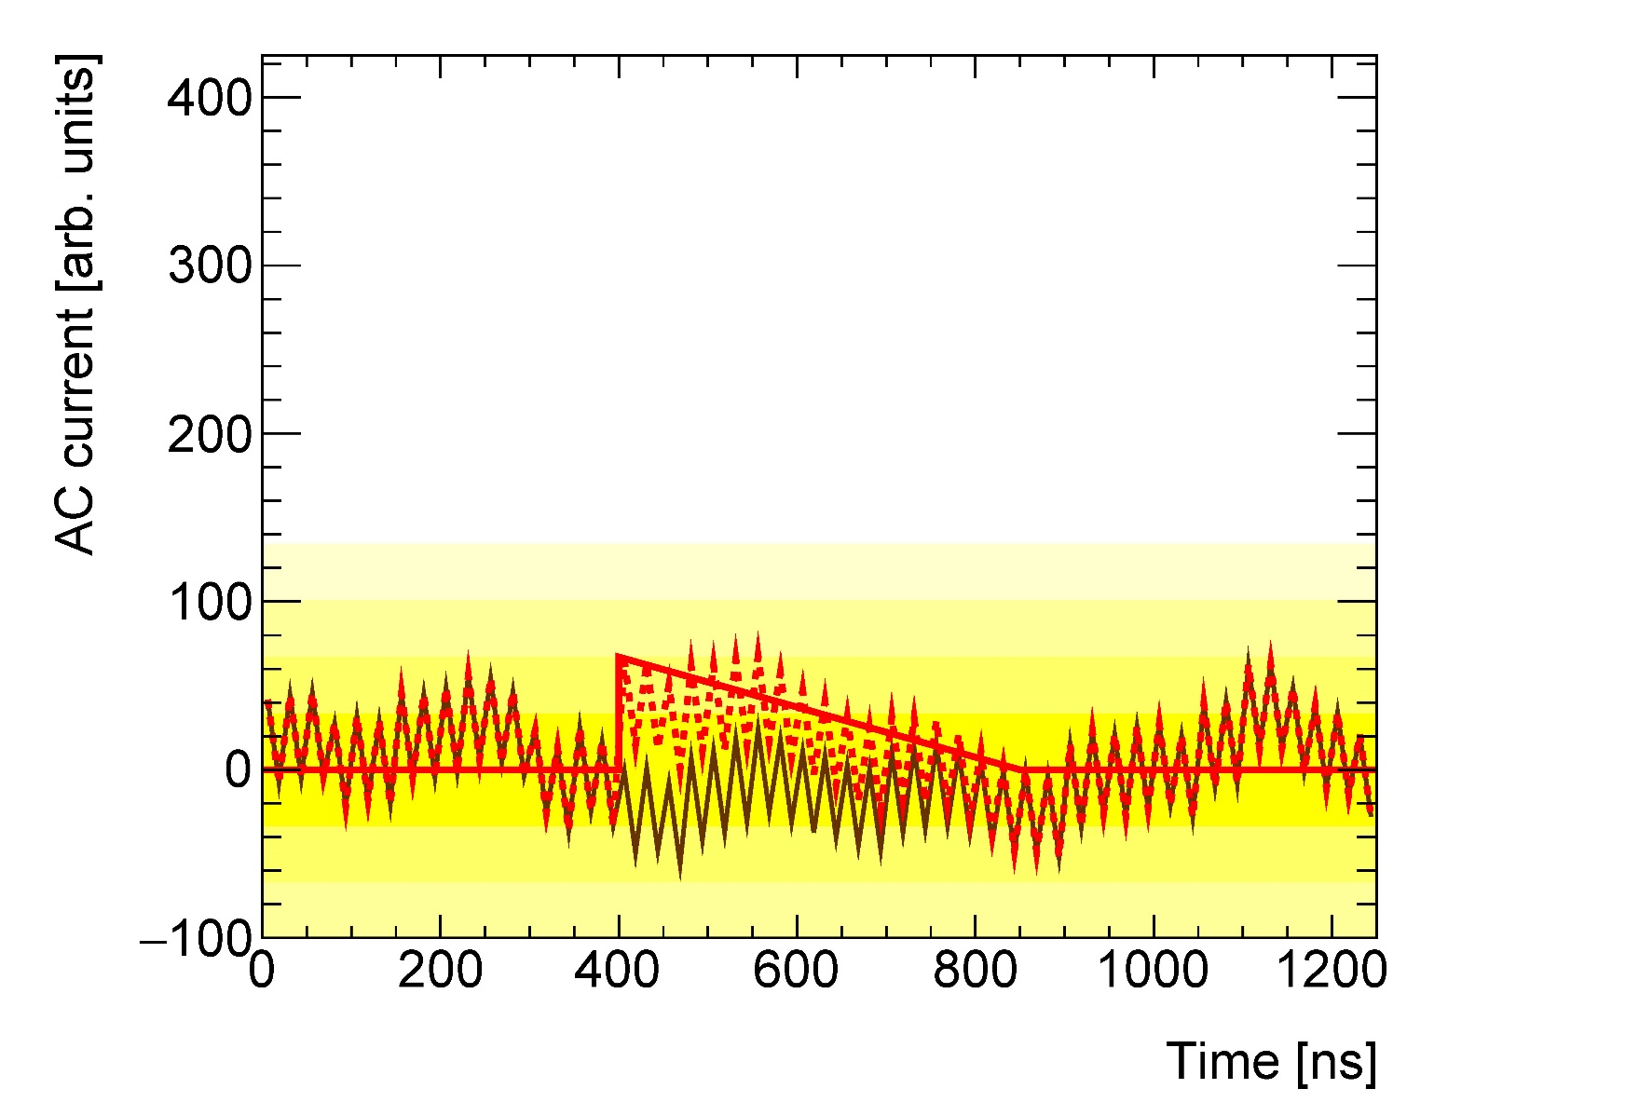
Charge Collection in Pile-up
Small amplitude hard scatter cell signal
Example typical for EMB, EMEC & HEC
Received particle signal – includes pile-up
$$+4σ_{noise}$$
$$+3σ_{noise}$$
$$+2σ_{noise}$$
$$+1σ_{noise}$$
$$−1σ_{noise}$$
$$−2σ_{noise}$$
$$t [ns]$$
$$t_{0}$$
$$t_{0}+t_{drift}$$

Slide 15
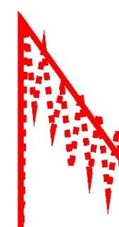
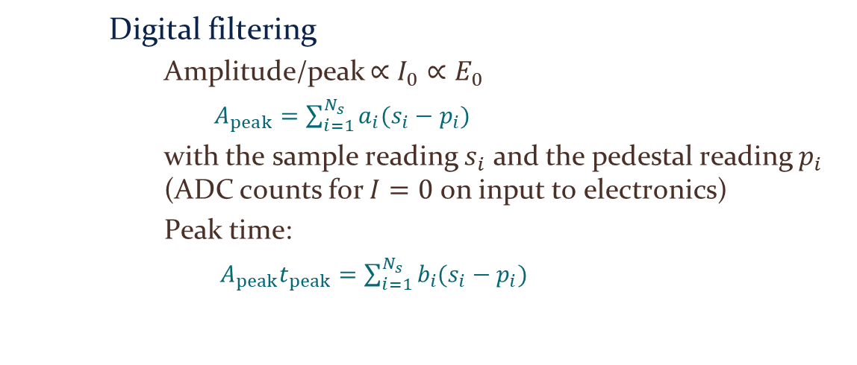
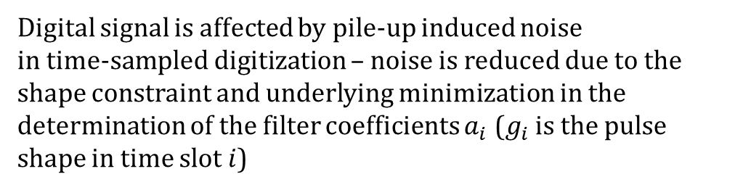
Charge Collection in Pile-up
Digitization
Example typical for EMB, EMEC & HEC
Digital signal is affected by pile-up induced noise
in time-sampled digitization – noise is reduced due to the shape constraint and underlying minimization in the determination of the filter coefficients $a_{i}$ ($g_{i}$ is the pulse shape in time slot $i$)
Digital filtering
Amplitude/peak $∝I_{0}∝E_{0}$
$A_{peak}=\sum_{i=1}^{N_{s}}{a_{i}(s_{i}−p_{i})}$
with the sample reading $s_{i}$ and the pedestal reading $p_{i}$ (ADC counts for $I=0$ on input to electronics)
Peak time:
$A_{peak}t_{peak}=\sum_{i=1}^{N_{s}}{b_{i}(s_{i}−p_{i})}$

Slide 16


Signal Shaping
$$t_{BX}$$
reading out (digitize) 4-5 samples sufficient!
$$τ$$

Slide 17
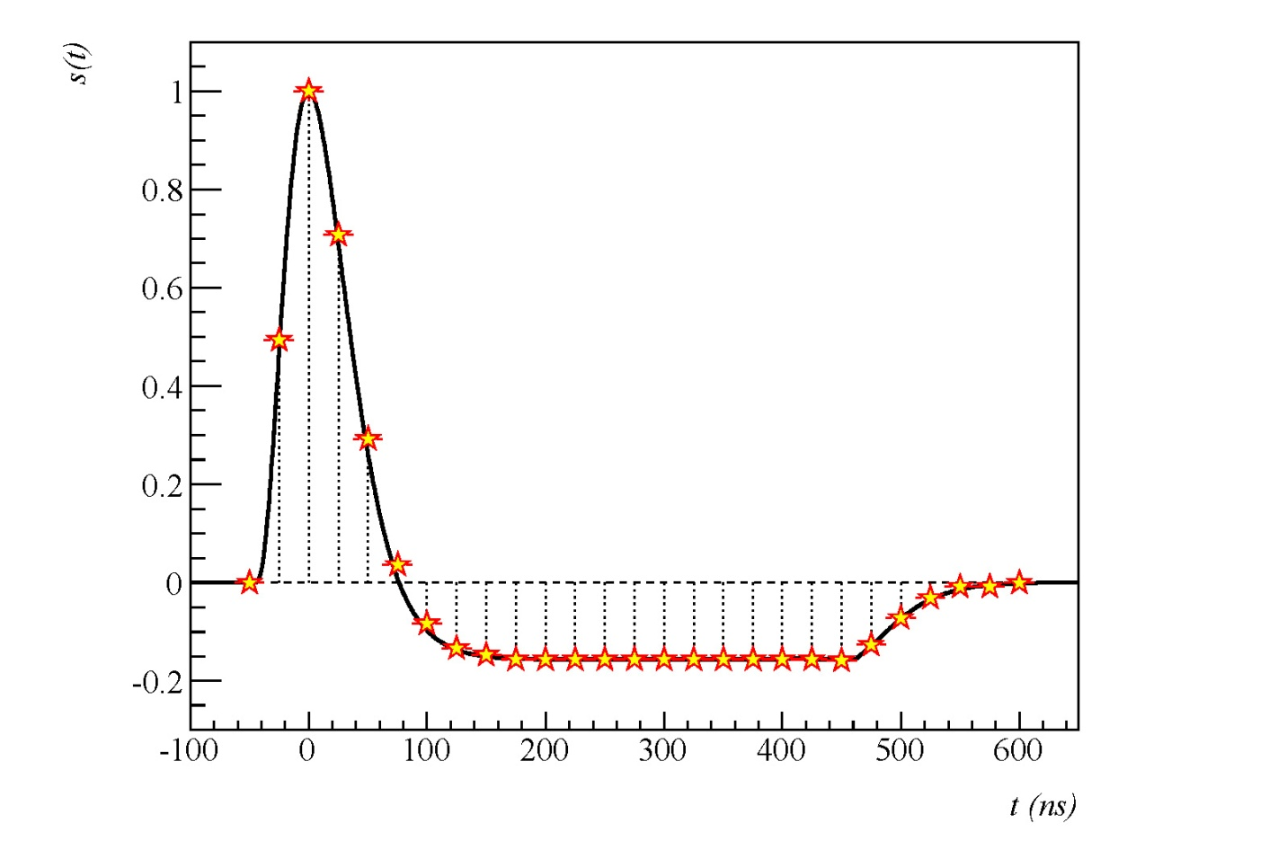
Pile-up Suppression in ATLAS
General strategies
Build calorimeter with relatively fast signal collection
E.g., ATLAS tile, CMS crystal & tile
Only sensitive to small time window around triggered signal
Convert slow pulse to net-zero area bi-polar pulse
E.g, ATLAS liquid argon
Measures initial current rather than total charge
Signals from pile-up history suppress in-time pile-up contribution due to pulse shape
Exercise
Pile-up suppression in various LHC bunch crossing timing
following bunch crossings
past bunch crossings

Slide 18
Pile-up Suppression in ATLAS
following bunch crossings
past bunch crossings

Slide 19
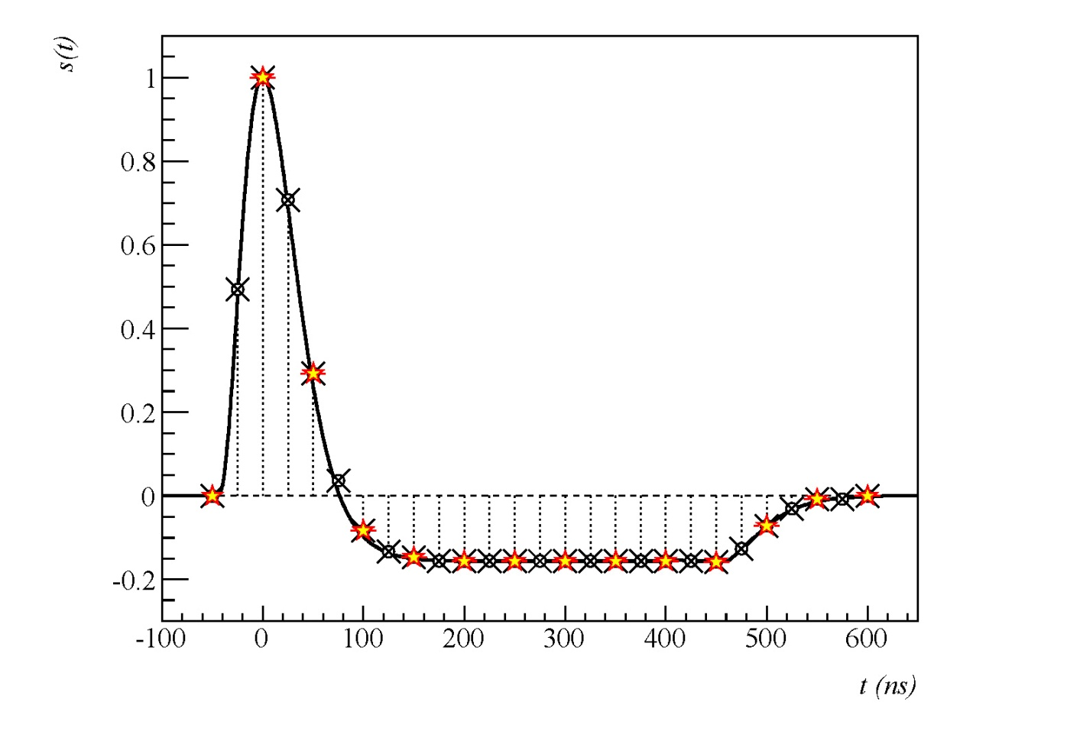
Pile-up Suppression in ATLAS
following bunch crossings
past bunch crossings

Slide 20
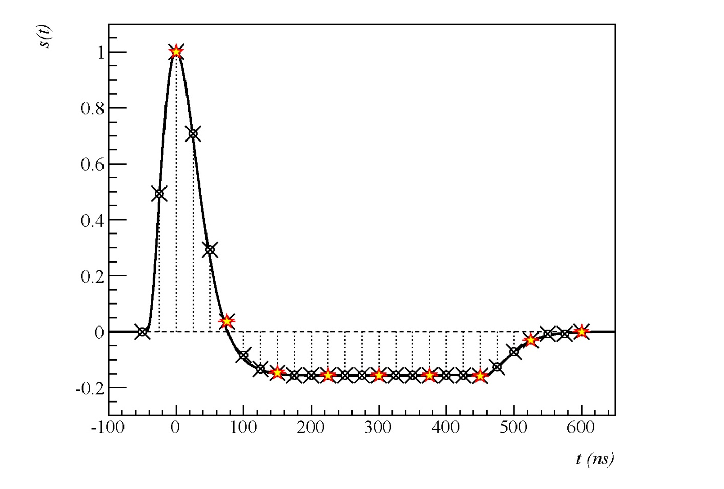
Pile-up Suppression in ATLAS
following bunch crossings
past bunch crossings

Slide 21
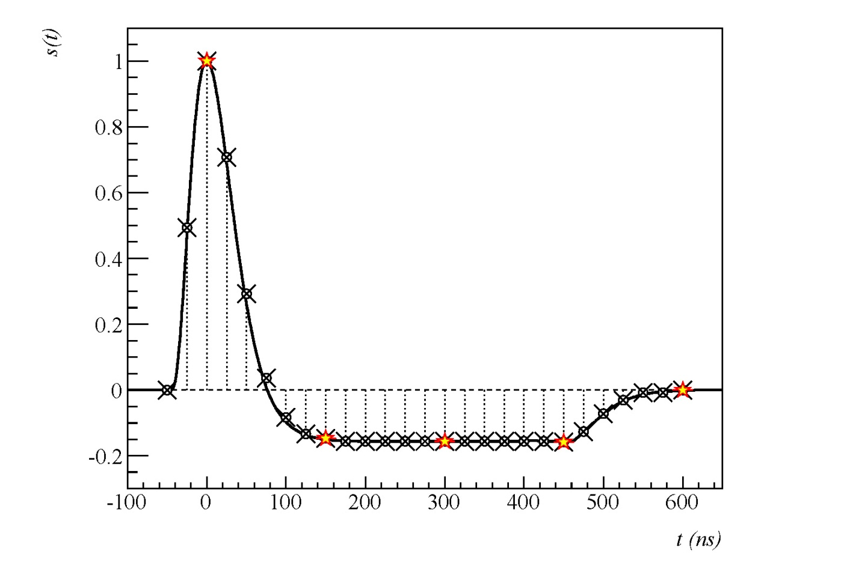
Pile-up Suppression in ATLAS
following bunch crossings
past bunch crossings

Slide 22
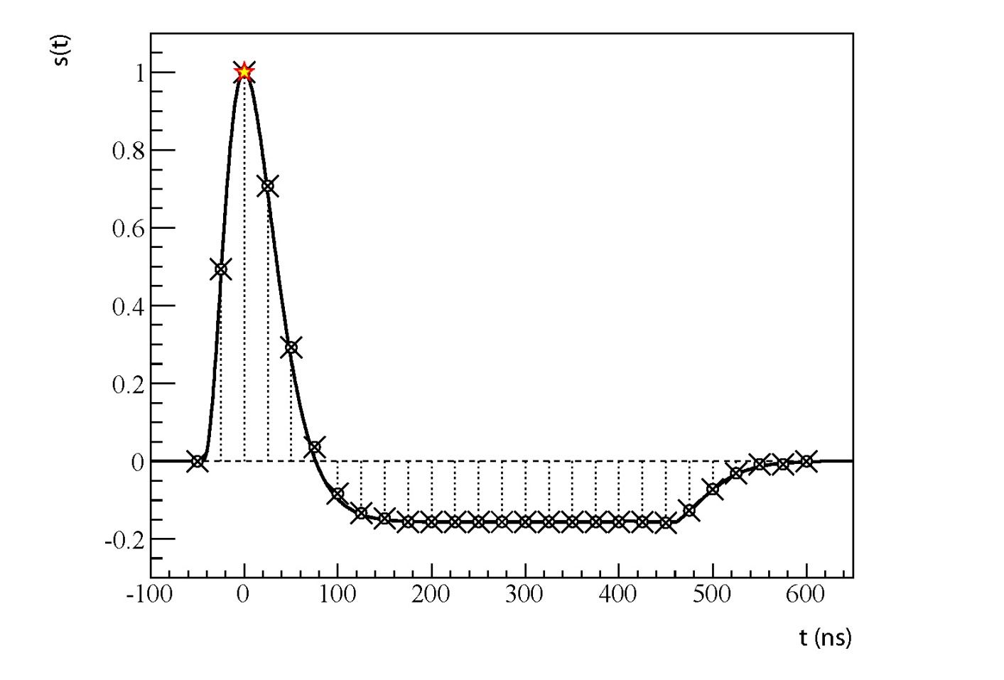
Pile-up Suppression in ATLAS
following bunch crossings
past bunch crossings

Slide 23
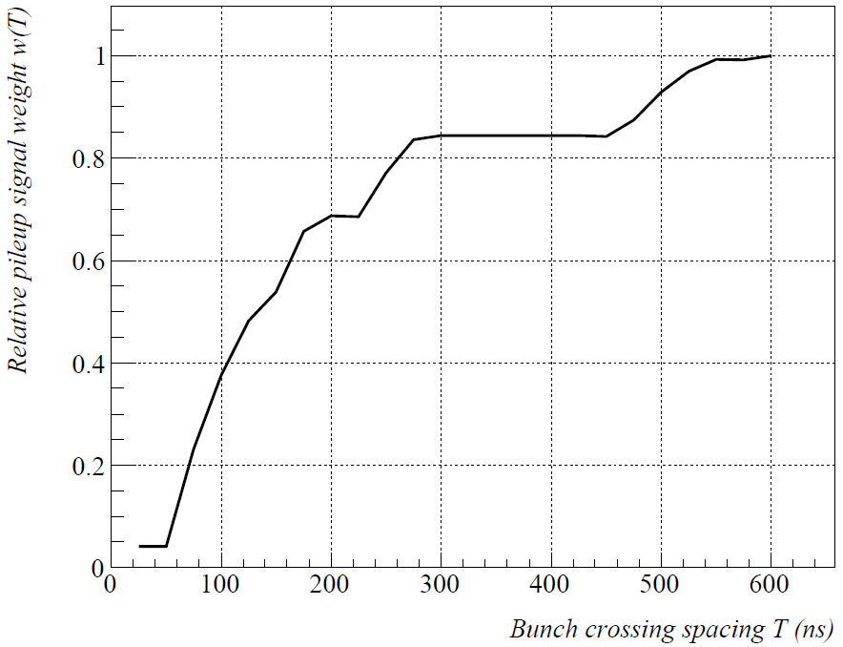
Pile-up Suppression in ATLAS
increasing pile-up effect on signal
decreasing pile-up history

Slide 24
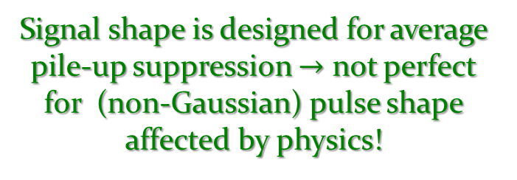
Pile-up Suppression in ATLAS
Online pile-up suppression
Compensate in-time pile-up by weighted signals in the pile-up history
Can only suppress average in-time pile-up contribution in any given calorimeter cell
Residual in-time pile-up effects still to be addressed offline
Non-gaussian fluctuations in signal from minimum bias events in a given cell
Distortion of pile-up history
LHC bunch structure and super-structure makes pile-up history dependent on phase with respect to bunch gaps
Works better in high lumi/high bunch crossing scenario
Better cancellation with more stable average energy & finer integration of pulse shape
physics & coherent noise from particle showers
Signal shape is designed for average pile-up suppression $→$ not perfect for (non-Gaussian) pulse shape affected by physics!

Slide 25
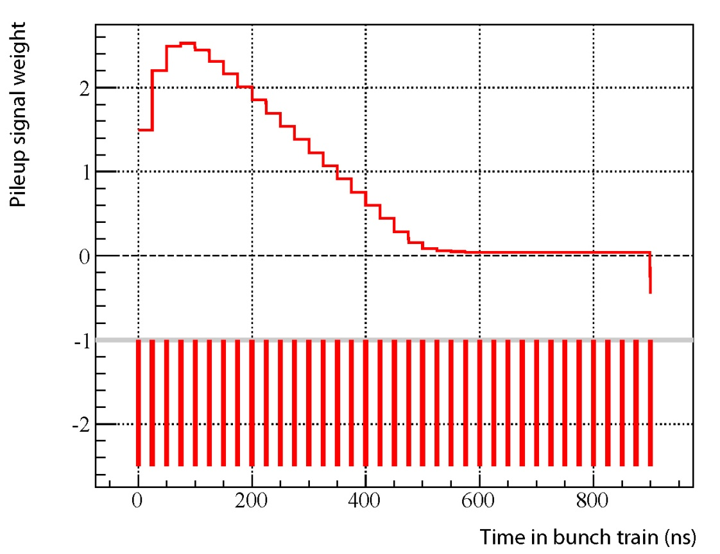
Pile-up Suppression in ATLAS
Online pile-up suppression
Compensate in-time pile-up by weighted signals in the pile-up history
Can only suppress average in-time pile-up contribution in any given calorimeter cell
Residual in-time pile-up effects still to be addressed offline
Non-gaussian fluctuations in signal from minimum bias events in a given cell
Distortion of pile-up history
LHC bunch structure and super-structure makes pile-up history dependent on phase with respect to bunch gaps
Works better in high lumi/high bunch crossing scenario
Better cancellation with more stable average energy & finer integration of pulse shape
in-time + next
over-compensation due to lack of next bunch-crossing w/collisions

Slide 26
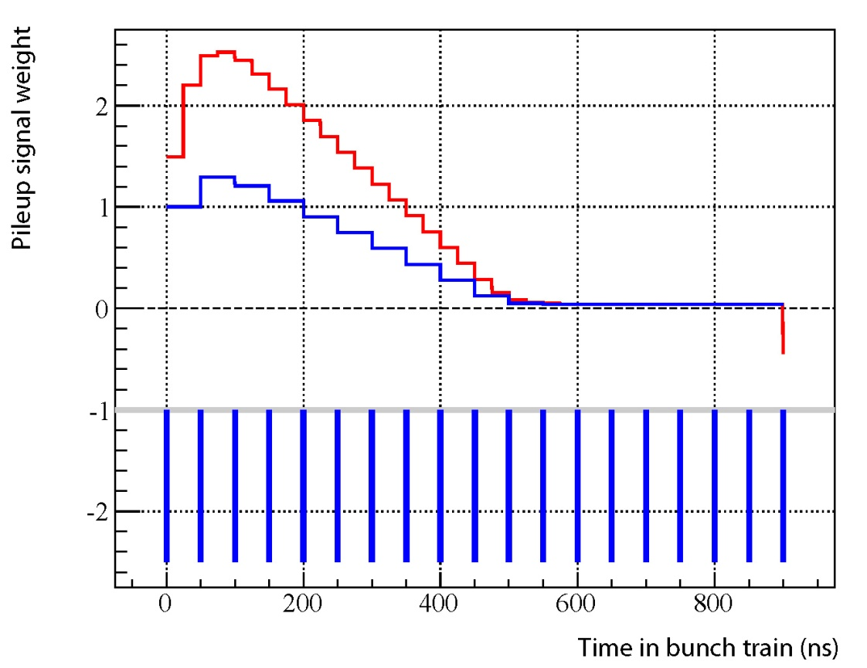
Pile-up Suppression in ATLAS
Online pile-up suppression
Compensate in-time pile-up by weighted signals in the pile-up history
Can only suppress average in-time pile-up contribution in any given calorimeter cell
Residual in-time pile-up effects still to be addressed offline
Non-gaussian fluctuations in signal from minimum bias events in a given cell
Distortion of pile-up history
LHC bunch structure and super-structure makes pile-up history dependent on phase with respect to bunch gaps
Works better in high lumi/high bunch crossing scenario
Better cancellation with more stable average energy & finer integration of pulse shape
in-time only

Slide 27
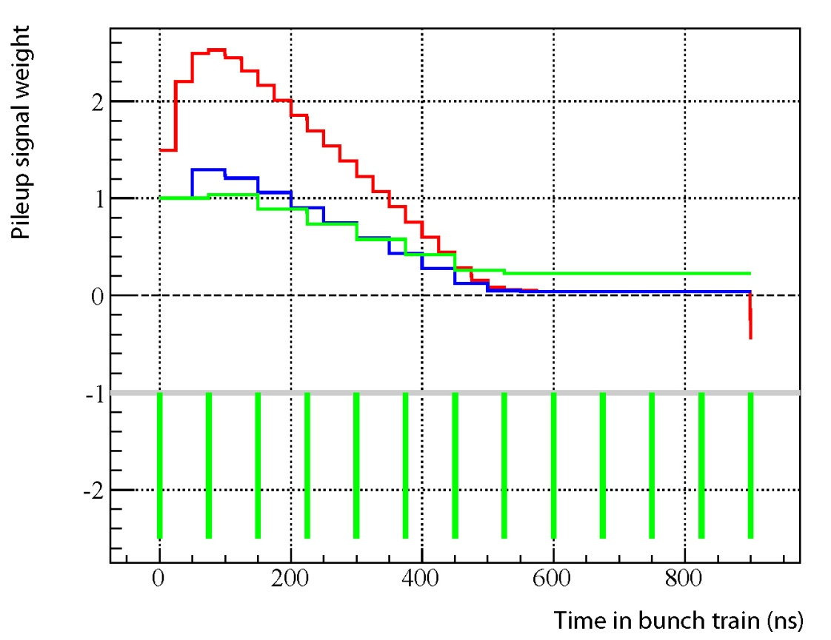
Pile-up Suppression in ATLAS
Online pile-up suppression
Compensate in-time pile-up by weighted signals in the pile-up history
Can only suppress average in-time pile-up contribution in any given calorimeter cell
Residual in-time pile-up effects still to be addressed offline
Non-gaussian fluctuations in signal from minimum bias events in a given cell
Distortion of pile-up history
LHC bunch structure and super-structure makes pile-up history dependent on phase with respect to bunch gaps
Works better in high lumi/high bunch crossing scenario
Better cancellation with more stable average energy & finer integration of pulse shape
in-time only

Slide 28
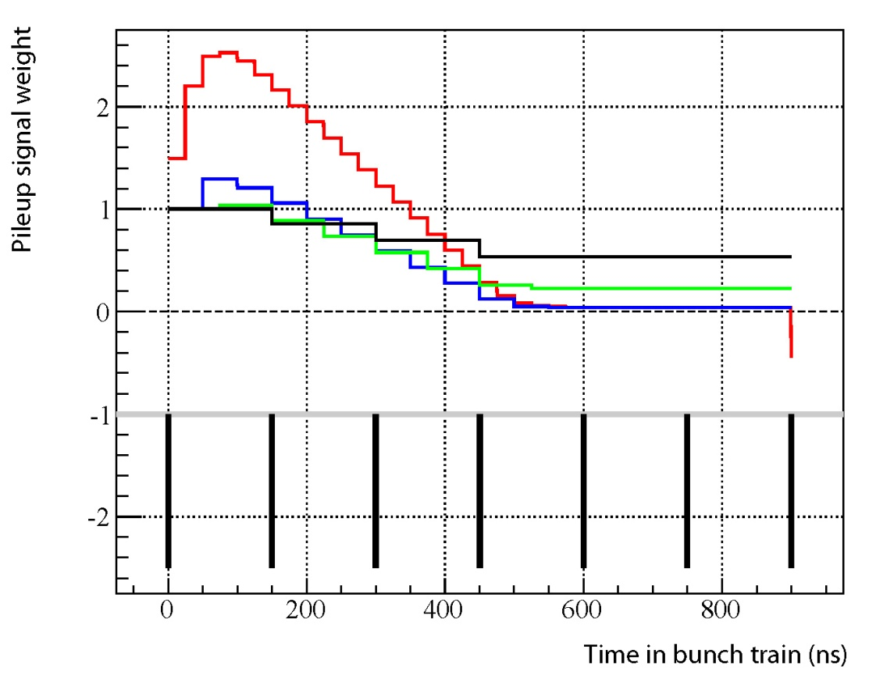
Pile-up Suppression in ATLAS
Online pile-up suppression
Compensate in-time pile-up by weighted signals in the pile-up history
Can only suppress average in-time pile-up contribution in any given calorimeter cell
Residual in-time pile-up effects still to be addressed offline
Non-gaussian fluctuations in signal from minimum bias events in a given cell
Distortion of pile-up history
LHC bunch structure and super-structure makes pile-up history dependent on phase with respect to bunch gaps
Works better in high lumi/high bunch crossing scenario
Better cancellation with more stable average energy & finer integration of pulse shape
in-time only

Slide 29

WElcome to the machine !

Slide 30

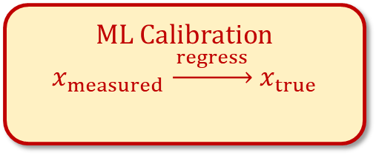
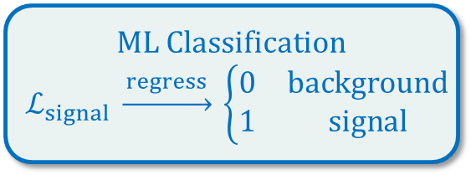
ML for Hadronic Final State Reconstruction
ML Classification
$$ℒ_{signal} \underset{→}{ regress } \left\{\begin{matrix}0 & background \\ 1 & signal\end{matrix}\right.$$
Inner detector
(tracks)
ML Calibration
$$x_{measured} \underset{→}{ regress } x_{true}$$
Signal likelihood
(detector truth)
deposited energy
(detector truth)
Energy
Mass
Calorimeter
(topo-clusters)
particle energy
(physics truth)
origin tagging
(physics truth)
TrackCaloCluster
(TCC)
ParticleFlow
(PFlow)
particle jet mass
(physics truth)
Quark-gluon jet tagging –
Chin.Phys.C 48 2, 023001 (2024)
UnifiedFlowObjects
(UFO)
Large-$R$ jets –
Mach.Learn.: Sci.Technol. 5 035051 (2024)
Jets
JetEtMiss

Slide 31
ML for Hadronic Final State Reconstruction
cluster-level
pile-up
suppression,
pile-up signal
mitigation,
signal origin
tagging …
ML Classification
$$ℒ_{signal} \underset{→}{ regress } \left\{\begin{matrix}0 & background \\ 1 & signal\end{matrix}\right.$$
Inner detector
(tracks)
ML Calibration
$$x_{measured} \underset{→}{ regress } x_{true}$$
Signal likelihood
(detector truth)
deposited energy
(detector truth)
Energy
Mass
Calorimeter
(topo-clusters)
particle energy
(physics truth)
pile-up jet tagging,
q/g tagging,
W/Z/H tagging,
top tagging,
scale factor
calibration …
origin tagging
(physics truth)
TrackCaloCluster
(TCC)
ParticleFlow
(PFlow)
particle jet mass
(physics truth)
UnifiedFlowObjects
(UFO)
Jets
JetEtMiss

Slide 32
ML for Hadronic Final State Reconstruction
ML Classification
$$ℒ_{signal} \underset{→}{ regress } \left\{\begin{matrix}0 & background \\ 1 & signal\end{matrix}\right.$$
Inner detector
(tracks)
ML Calibration
$$x_{measured} \underset{→}{ regress } x_{true}$$
Signal likelihood
(detector truth)
deposited energy
(detector truth)
Energy
Mass
Calorimeter
(topo-clusters)
particle energy
(physics truth)
origin tagging
(physics truth)
TrackCaloCluster
(TCC)
ParticleFlow
(PFlow)
particle jet mass
(physics truth)
UnifiedFlowObjects
(UFO)
Soft hadronic recoil, missing transverse momentum
JetEtMiss

Slide 33
Pile-up and Topo-clusters
The good…
Topological cell signal clustering removes a lot of signals not arising from the hard scatter final state – applies a first step pile-up (noise) suppression…
Produce context for local calibration possibly applying further pile-up mitigation
… the bad …
Topo-clustering is guided by cell signal significance – enhances probability of large pile-up signal contributions/spikes (direct from in-time and indirect from noise) to the final state signal
… and looked-at solutions!
Local calibrations attempts to remove pile-up signal contributions in clusters that contain true signal
Cluster classification can help to remove pure pile-up generated topo-clusters

Slide 34
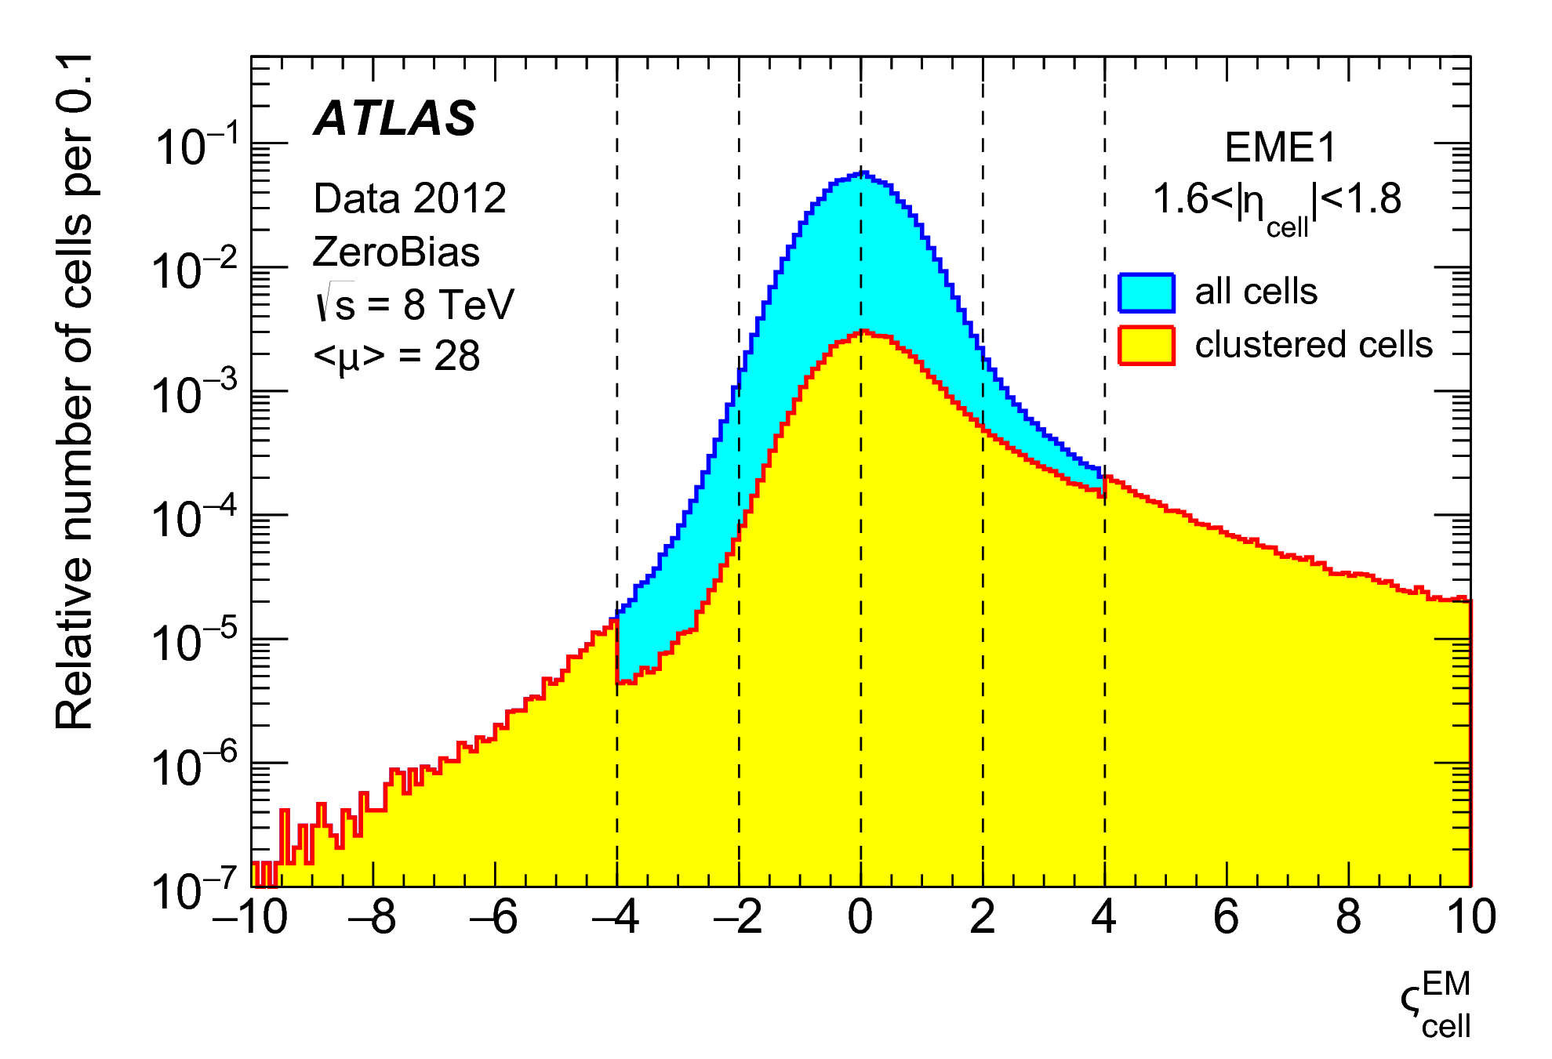
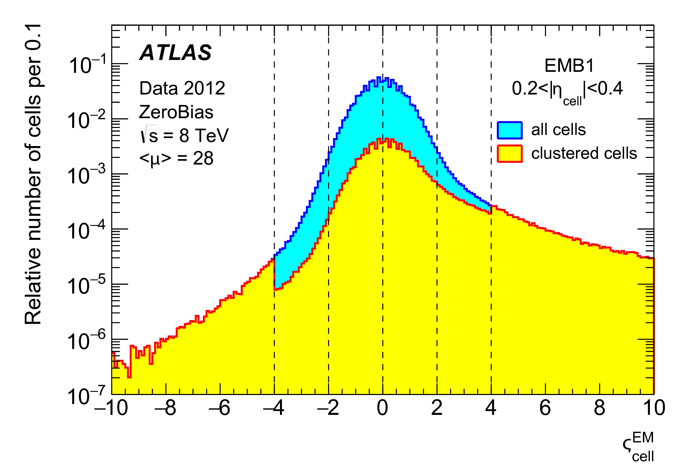
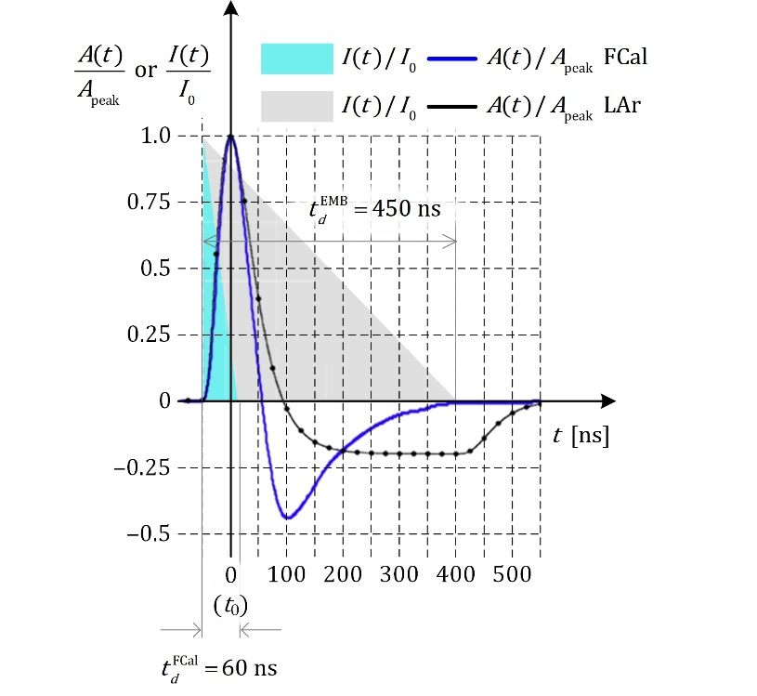

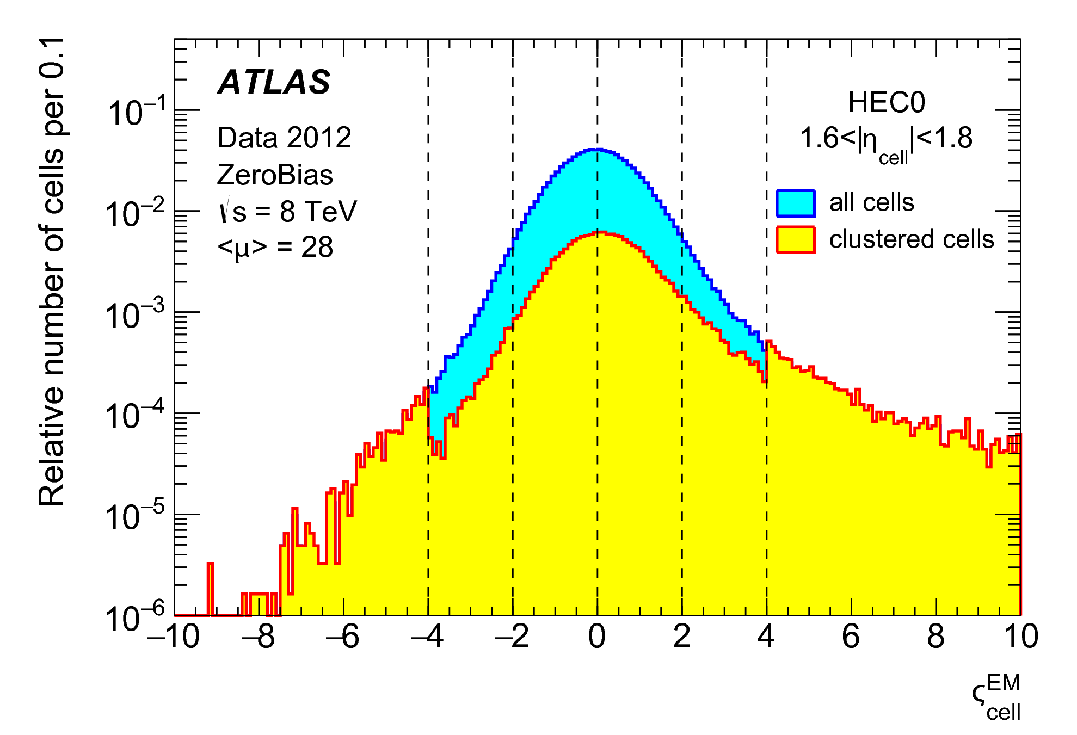
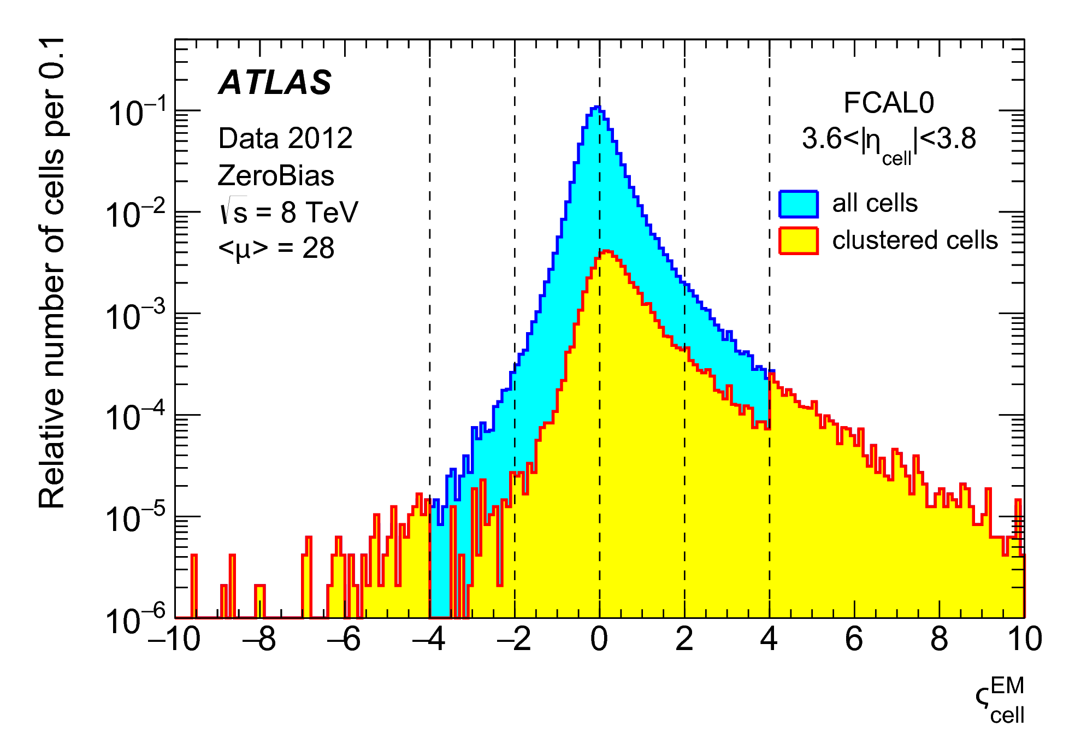




Signal Significance for Clustered Cells in ZeroBias Data
Tails in cell significance introduced by physics – with contributions from in-time minimum bias collisions and correlations in out-of-time pile-up signal remnants
$t_{d}≈450$ ns
$t_{d}≈450$ ns
2012 data with pile-up!
$t_{d}≈430$ ns
$t_{d}≈60$ ns
Variations in tails partly due to differences in drift time (LAr gap sizes) leading to different pulse shapes

Slide 35
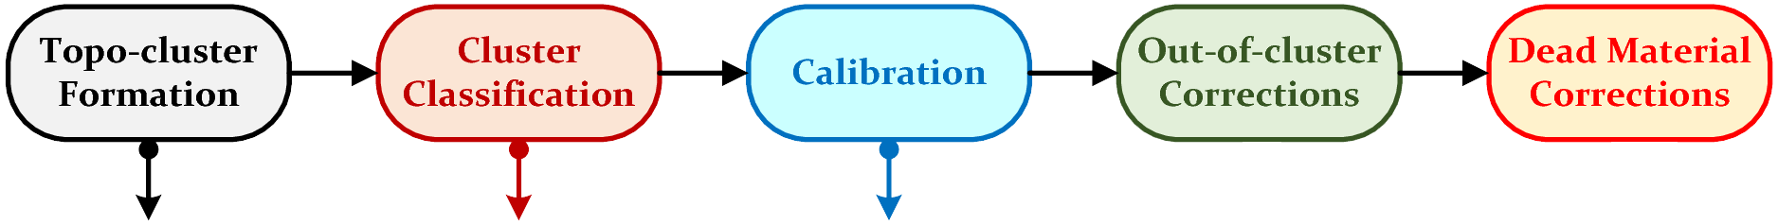
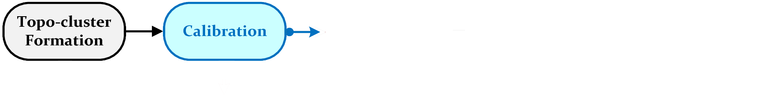

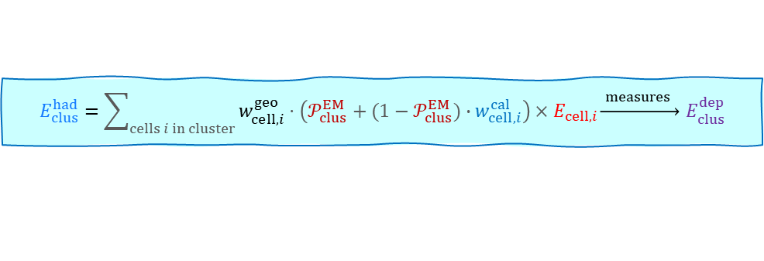




Building a Multi-dimensional Calibration Model
Moving to the machine – tasks & challenges
Collect the feature set (inputs)
Need to be relevant to describe the calibration target (expressiveness)
Need to be well modeled for MC-based approach – well comparable to data
Need to reflect environmental contributions
Configuring the network for supervised training
Defining the calibration target – here representation of (detector) truth from MC simulations
Reference: LCW hadronic calibration
Measures true energy at topo-cluster location
Machine-learning based approach
Regression fits to learn response $ℛ_{clus}^{ML}(𝒳_{clus})$
EM-likelihood
hadronic calibration
outside energy losses
$$E_{clus}^{had}=\sum_{cells i in cluster}{w_{cell,i}^{geo}⋅\left(𝒫_{clus}^{EM}+(1−𝒫_{clus}^{EM})∙w_{cell,i}^{cal}\right)×E_{cell,i}}\underset{→}{ measures } E_{clus}^{dep}$$
energy deposited in cluster (from MC)
$E_{clus}^{dep}$ only includes energy deposits from particles emerging from the hard scatter interaction
no in-time or out-of-time pile-up contribution
represents the visible detector truth viewed through topo-clustering
perfect topo-cluster calibration should remove/reduce stochastic (pile-up) contribution to signal and thus improve resolution
energy deposited in cluster (from MC)
$$E_{clus}^{ML}=C_{clus}^{ML}\left(𝒳_{clus}\right)⋅E_{clus}^{EM}\underset{→}{ measures } E_{clus}^{dep}$$
$$\hat{=}E_{clus}^{had}$$
basic cluster signal at EM scale
$$ℛ_{clus}^{ML}\left(𝒳_{clus}\right)\underset{→}{learns}ℛ_{clus}^{EM}=\frac{E_{clus}^{EM}}{E_{clus}^{dep}}\underset{→}{ yields }{ C}_{clus}^{ML}\left(𝒳_{clus}\right)=\frac{1}{ℛ_{clus}^{ML}\left(𝒳_{clus}\right)}$$
JetEtMiss

Slide 36








Testing the Trained Models: Resolution
MC16d multi-jets w. pile-up
Signal linearity
Measures calibration performance
Median signal linearity compares energies reconstructed at various scales $κ=${EM, LCW had, BNN, DNN}
Spread around central value
${IQR}_{f=68\%}$ measures width of narrowest range of distribution containing 68% of the integral
Base for relative resolution measure
X
${\left\langle Δ_{E}^{κ}\right\rangle }_{med}={\left\langle {\left(E_{clus}^{κ}−E_{clus}^{dep}\right)}/{E_{clus}^{dep}}\right\rangle }_{med}$
$$E_{clus}^{dep}$$
BNN learns transition to ionizations well!
$${{IQR}_{f=68\%}}/{\left(2×{\left\langle {E_{clus}^{BNN(DNN)}}/{E_{clus}^{dep}}\right\rangle }_{med}\right)}$$
Feature/network input
Evaluation scale from truth, not a feature
X
JetEtMiss

Slide 37






Testing the Trained Models: Pile-up Mitigation
MC16d multi-jets w. pile-up
Signal linearity
Measures calibration performance
Median signal linearity compares energies reconstructed at various scales $κ=${EM, LCW had, BNN, DNN}
Spread around central value
${IQR}_{f=68\%}$ measures width of narrowest range of distribution containing 68% of the integral
Base for relative resolution measure
${\left\langle Δ_{E}^{κ}\right\rangle }_{med}={\left\langle {\left(E_{clus}^{κ}−E_{clus}^{dep}\right)}/{E_{clus}^{dep}}\right\rangle }_{med}$
$$μ$$
$$N_{PV}$$
Strong indication of pile-up mitigation of cluster signals by ML calibrations!!
$${{IQR}_{f=68\%}}/{\left(2×{\left\langle {E_{clus}^{BNN(DNN)}}/{E_{clus}^{dep}}\right\rangle }_{med}\right)}$$
Feature/network input
Evaluation scale from truth, not a feature
X
$$t_{clus}$$
JetEtMiss

Slide 38










Pile-up Topo-cluster Tagging in Jets
MC16d multi-jets w. pile-up
Recent studies (see Jad Sardain’s talk)
Same MC as for DNN/BNN calibration training
Score signal likelihood $0≤𝒮_{clus}^{HS}≤1$ for clusters in a Anti-$k_{t}$ $R=0.4$ EMTopo jets
GATNet – graph neural network (GNN)
EdgeConv – GNN with edges
DNN – dense neural network
Attenuation Function $w_{clus}(𝒮_{clus}^{HS})$
GATNet
$$E_{jet}^{ML}=\sum_{i∈ jet }{𝒲_{clus,i}(𝒮_{clus,i}^{ML})E_{clus,i}^{EM}}$$
with $ML∈\left\{DNN,EdgeConv,GATNet\right\}$
$$ℒ=0$$
(pile-up)
$$𝒲_{clus}(𝒮_{clus,}^{ML})$$
$$ℒ=1$$
(HS signal)
$$𝒮_{clus}^{HS}$$
$$𝒮_{clus}^{HS}$$
JetEtMiss

Slide 39





Pile-up Topo-cluster Tagging in Jets
MC16d multi-jets w. pile-up
Performance estimates:
⇾Target:
$${\sum_{i∈ jet|ℒ_{i}=1 }{E_{clus,i}^{EM}}}/{E_{jet}^{true}}$$
⇾ Learned scores:
$${E_{jet}^{ML}}/{E_{jet}^{true}}, ML ∈\left\{DNN,EdgeConv,GATNet\right\}$$
⇾ Detector truth:
$${\sum_{i∈ jet }{E_{clus,i}^{dep}}}/{E_{jet}^{true}}$$
⇾ Reference:
Constituent scale signal after jet-area-based pile-up correction ${E_{jet}^{area}}/{E_{jet}^{true}}$
First observations:
Machine learns signal label well
$E_{jet}^{JES}≈E_{jet}^{true}≳50$ GeV, below still a large fraction of pile-up signal removed from jet
Significant resolution improvements for $E_{jet}^{true}≲50$ GeV, above no effect from pile-up on resolution
Next steps
Improve labeling (DigiTruth), use of ML-calibrated topo-cluster
JetEtMiss

Slide 40


Additional Material
Click here!
https://indico.cern.ch/event/1366444/attachments/2781618/4879898/Atlas.02.06.2024%20-%20Additional%20material.pdf

