Slide 1
CERN Scientific Information Service
An introduction
Alexander Kohls
1 July 2025

Slide 2
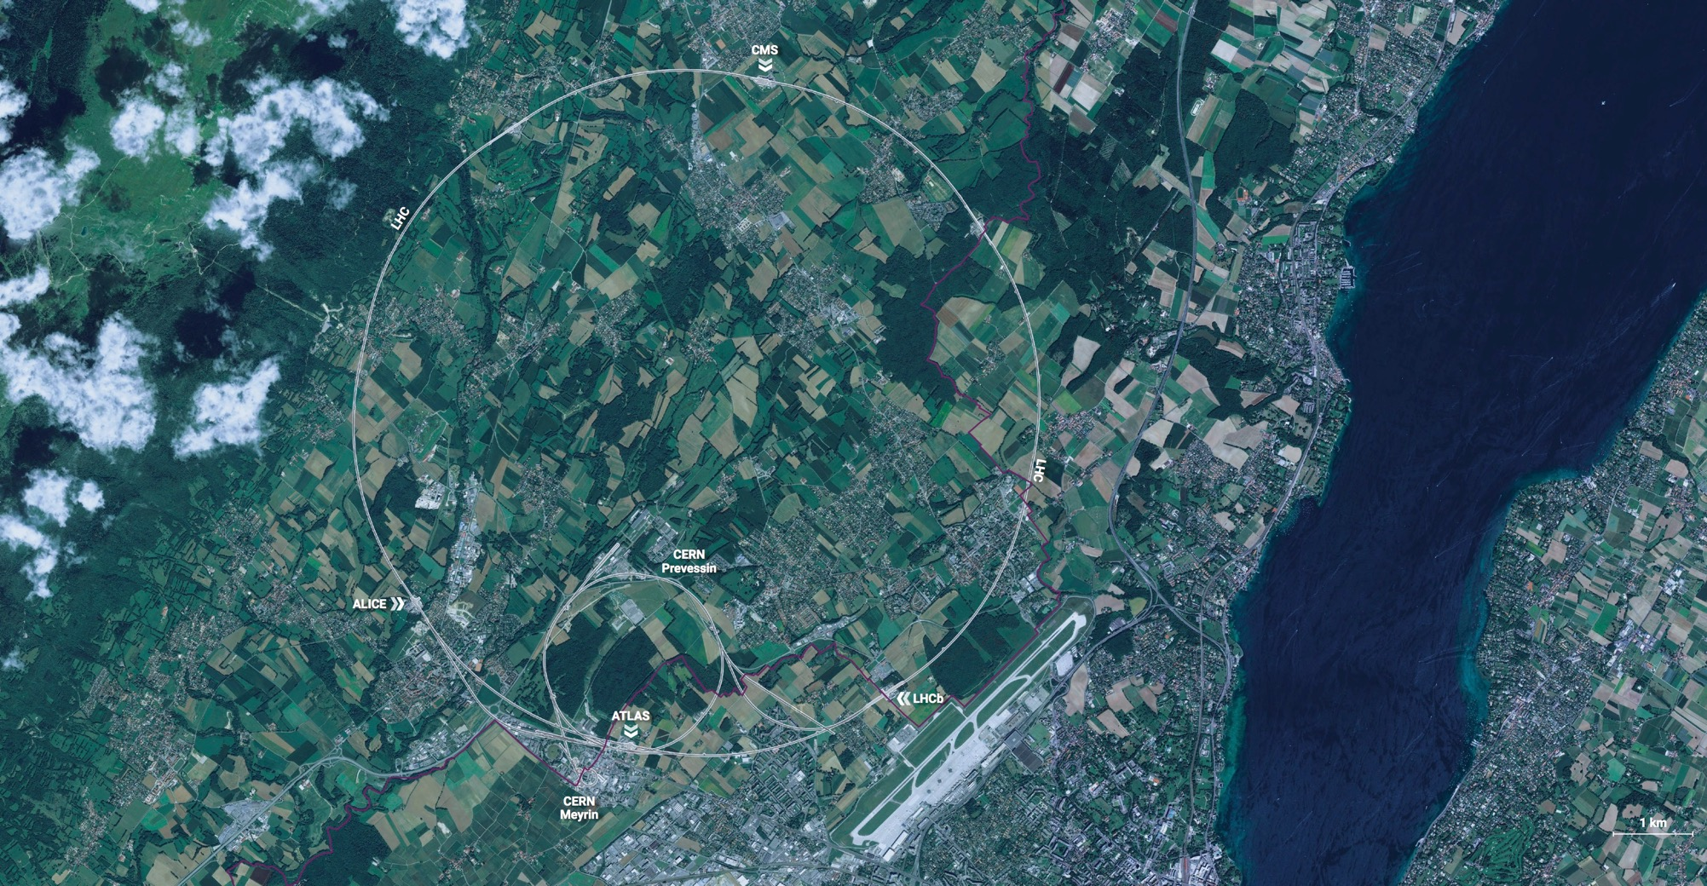
CERN - the world’s biggest laboratory for particle physics.
International Organization
established in 1954 -
“Science for Peace”.
Immunity of jurisdiction
and execution.
Notes:
This slide addresses two questions:
“Where are we?”
Use the map to indicate the location of CERN, headquartered in Geneva, straddling the Franco-Swiss border
“What is CERN?”
CERN is one of the world’s leading laboratories for particle physics
CERN’s vision (long-term goal) is to understand the fundamental particles and laws of the Universe (This is the Vision statement that features in CERN’s communication strategy)
Thus, CERN is first and foremost a research laboratory

Slide 3
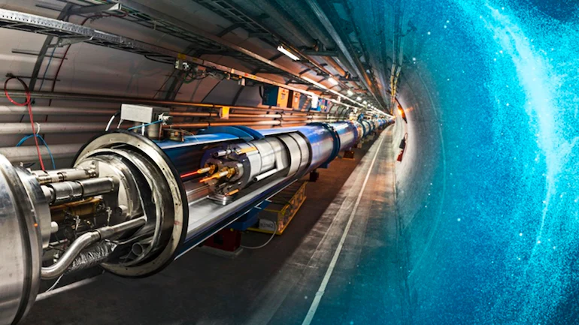
  CERN’s Mission
  Perform world-class research in fundamental physics
  Provide a unique range of particle accelerator facilities that enable research at the forefront of human knowledge, in an environmentally responsible and sustainable way.
  Unite people from all over the world to push the frontiers of science and technology for the benefit of all.
  Train new generations of physicists, engineers and technicians, and engage all citizens in research and in the values of science.

Slide 4
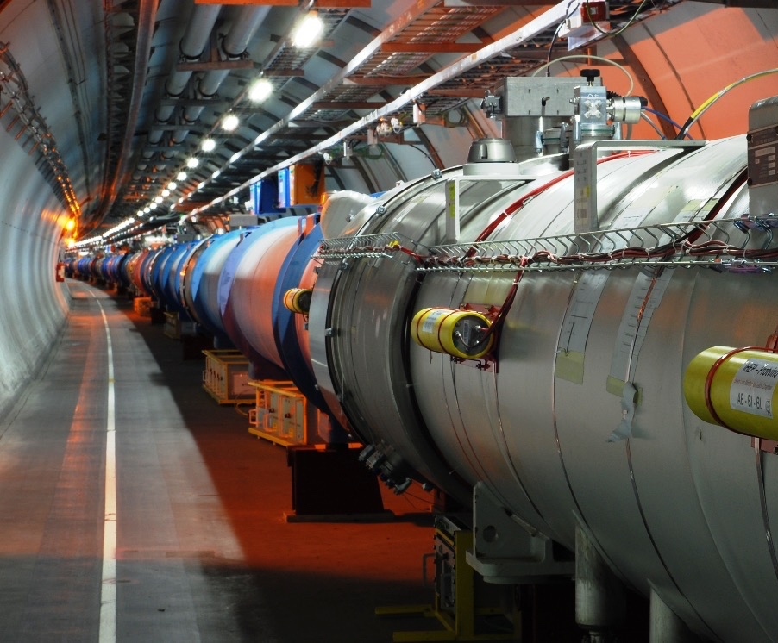
CERN‘s flagship:
The Large Hadron Collider
  Ca. 100m underground
  27 km circumference
  Coldest known place in the universe
  (Magnets cooled down to -271°C)
  Hottest place in the solar system
  (Collision temperature 100‘000x hotter than the sun)
  1 billion+ particle collisions per second
  Detectors collect 1PB/sec of data
Alexander Kohls | SIS Intro

Slide 5

In 1954 CERN started with 12 Member States
Today CERN has 25 Member States and is still growing
Geographical & cultural diversity
110 nationalities,
from 77 countries
25 Member States
2 Associate Member States in the pre-stage to membership
8 Associate Member States
~ 2’600 Staff members
~ 2‘000 contractors’ employees
~ 13‘000 physicists /users
Yearly budget ~ 1‘400 MCHF
Notes:
The speaker can highlight CERN’s second mission as stated when it was established: to foster peaceful collaborations between nations that had recently been at war.
This slide will have information on the country of the visiting delegation:
Location on the world map
Date of accession (if Member State or Associate Member State)
For information:
Member States – Austria, Belgium, Bulgaria, Czech Republic, Denmark, Finland, France, Germany, Greece, Hungary, Israel, Italy, Netherlands, Norway, Poland, Portugal, Romania, Slovak Republic, Spain, Sweden, Switzerland, United Kingdom
Associate Member States in the pre-stage to membership – Cyprus, Serbia, Slovenia
Associate Member States – India, Lithuania, Pakistan, Turkey, Ukraine
Observers – USA, Russia, Japan, (EU, JINR, UNESCO)

Slide 6
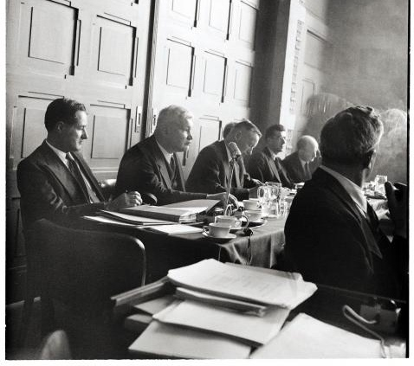

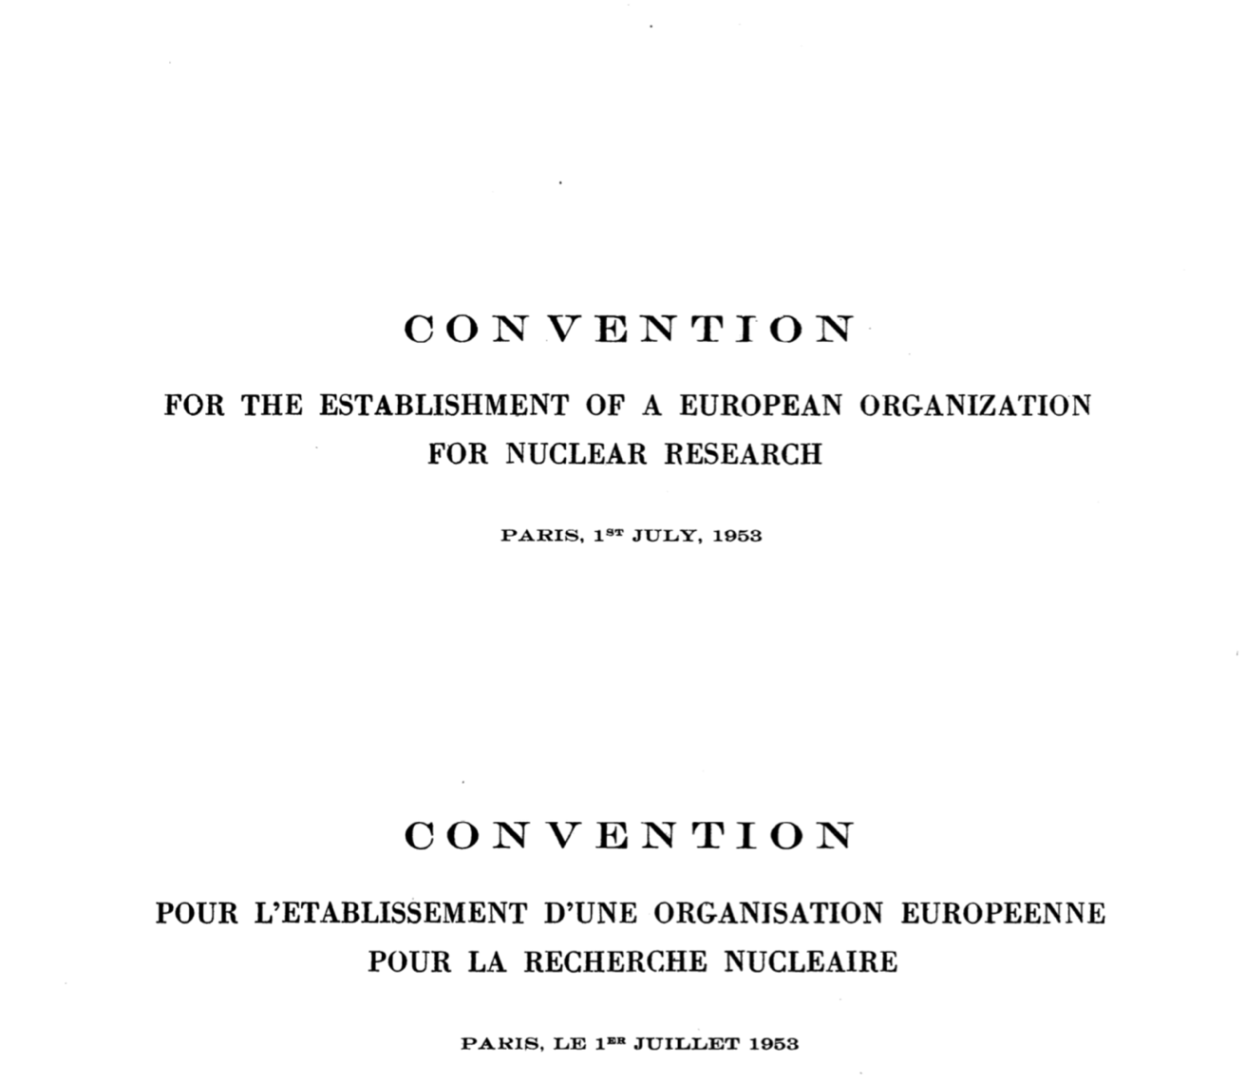
CERN was built for openness of information.

Slide 7
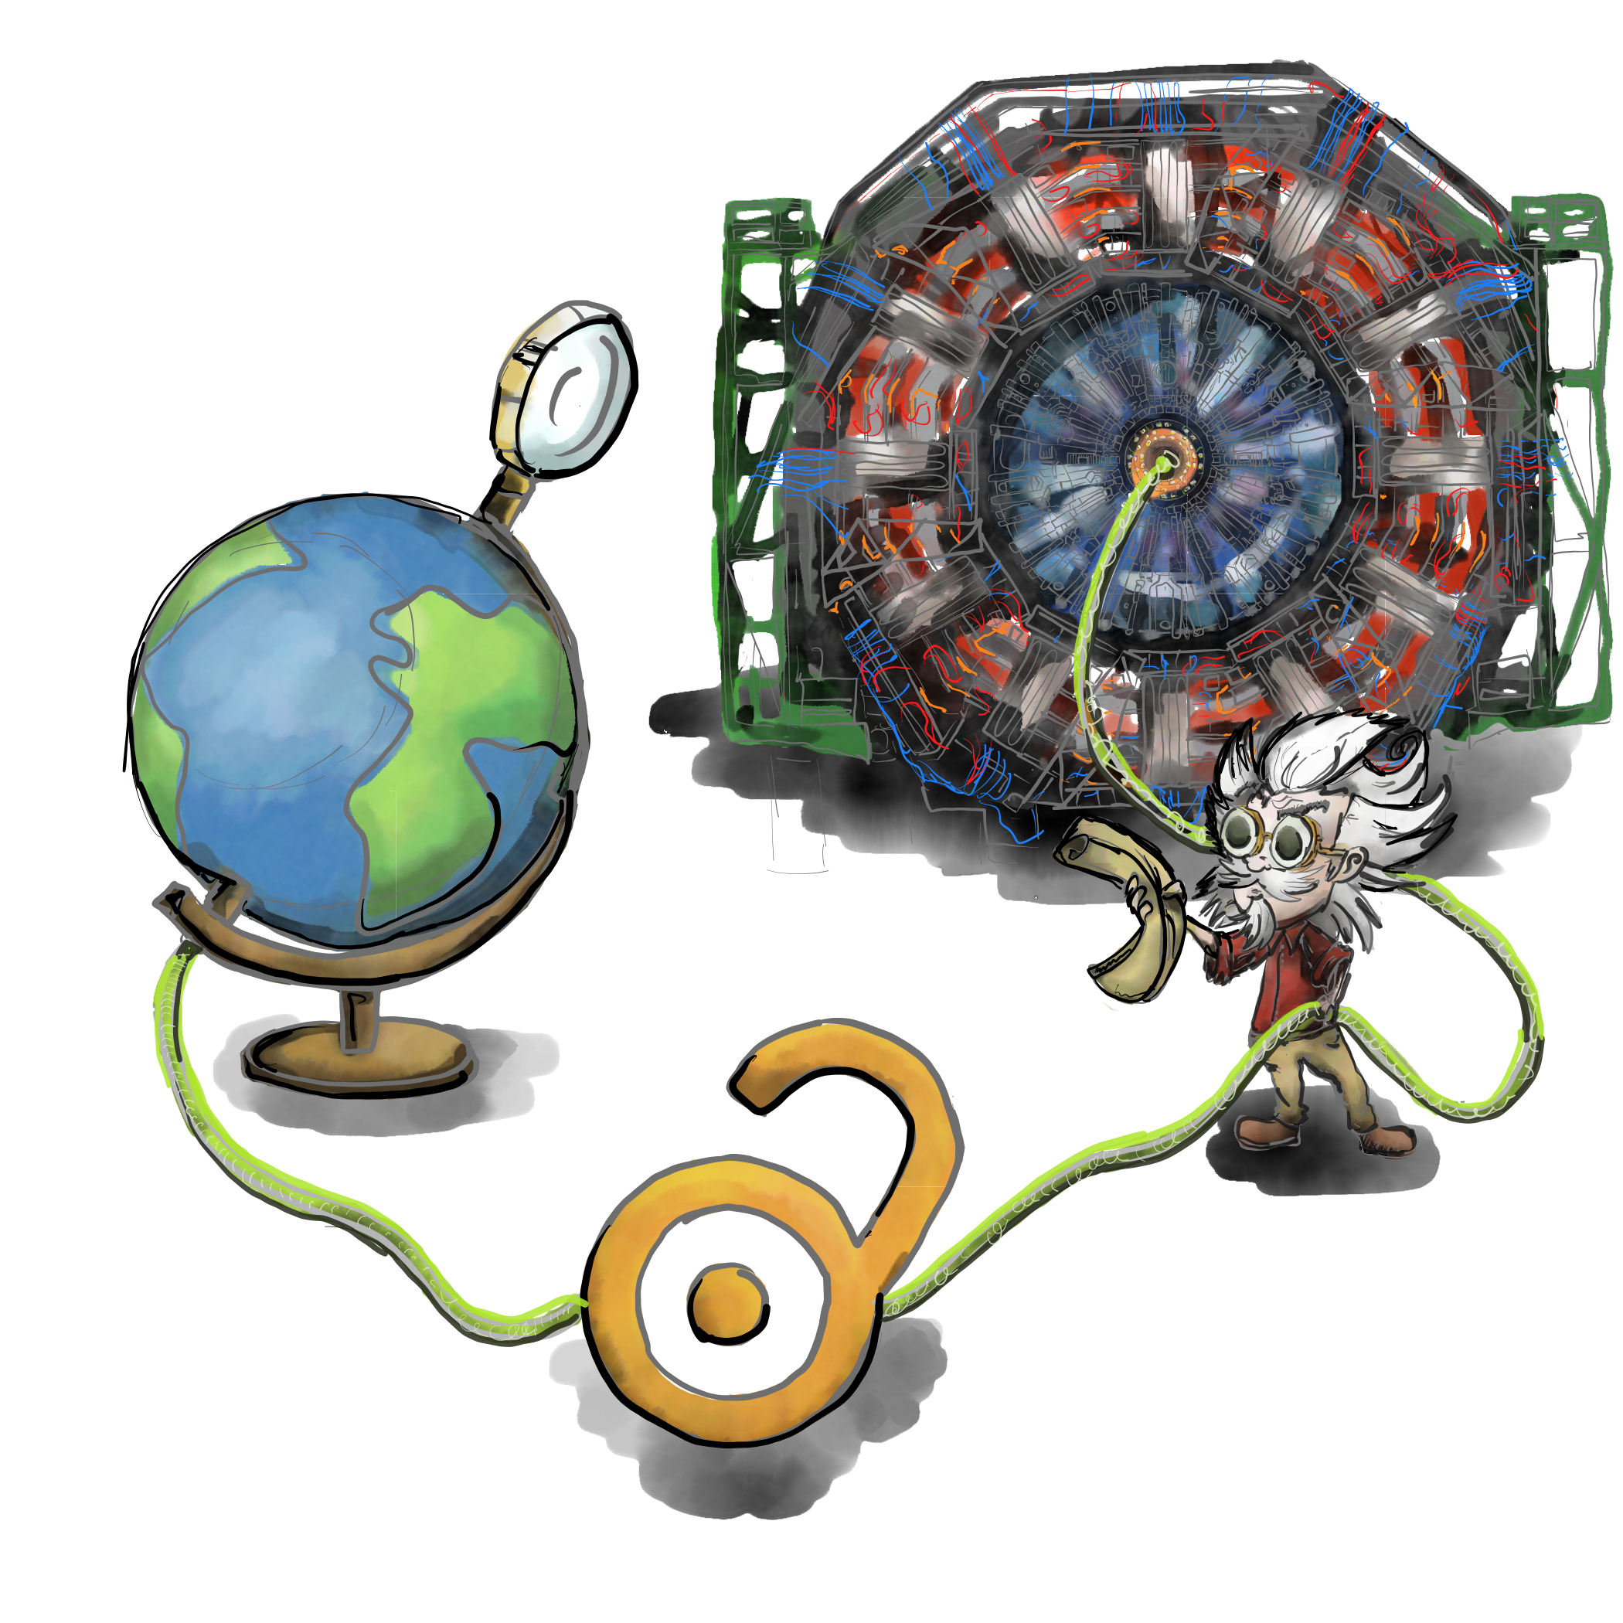

“…and the results of its experimental and theoretical work shall be published or otherwise made generally available”
CERN Founding Convention (1953)
Illustration by Stephanie van de Sandt

Slide 8
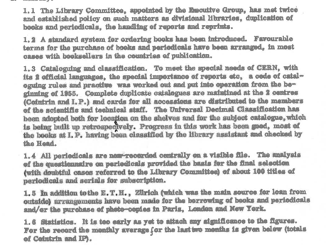
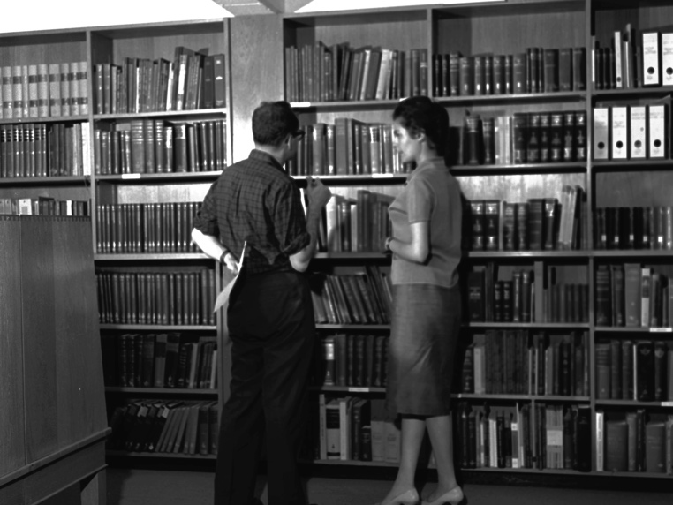
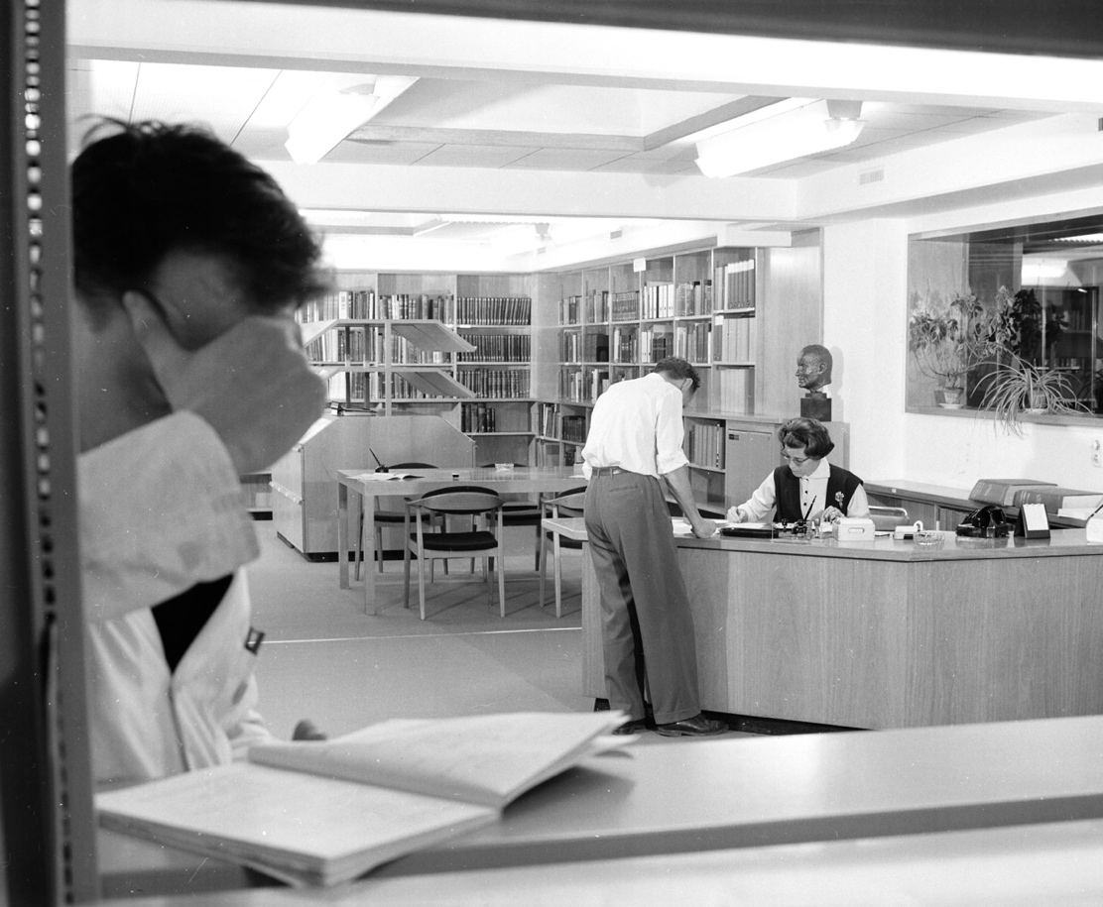
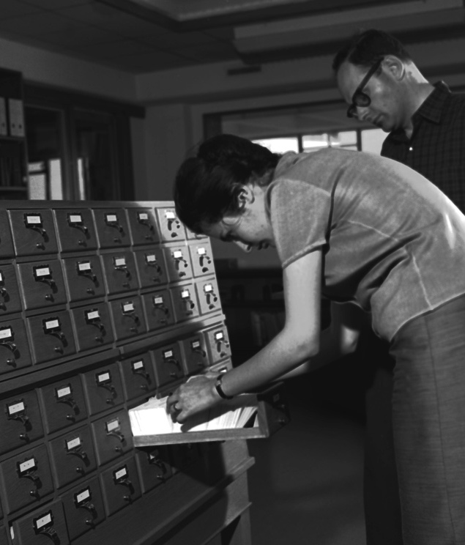

The Scientific Information Service (SIS) has existed throughout these 70 years but its role has evolved over time.

Slide 9

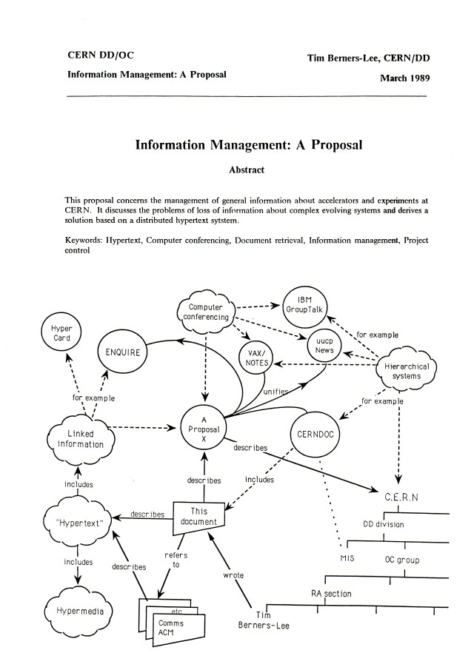







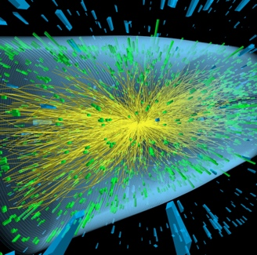
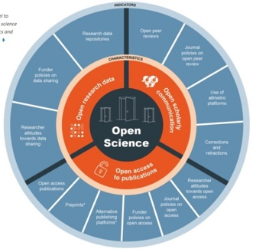
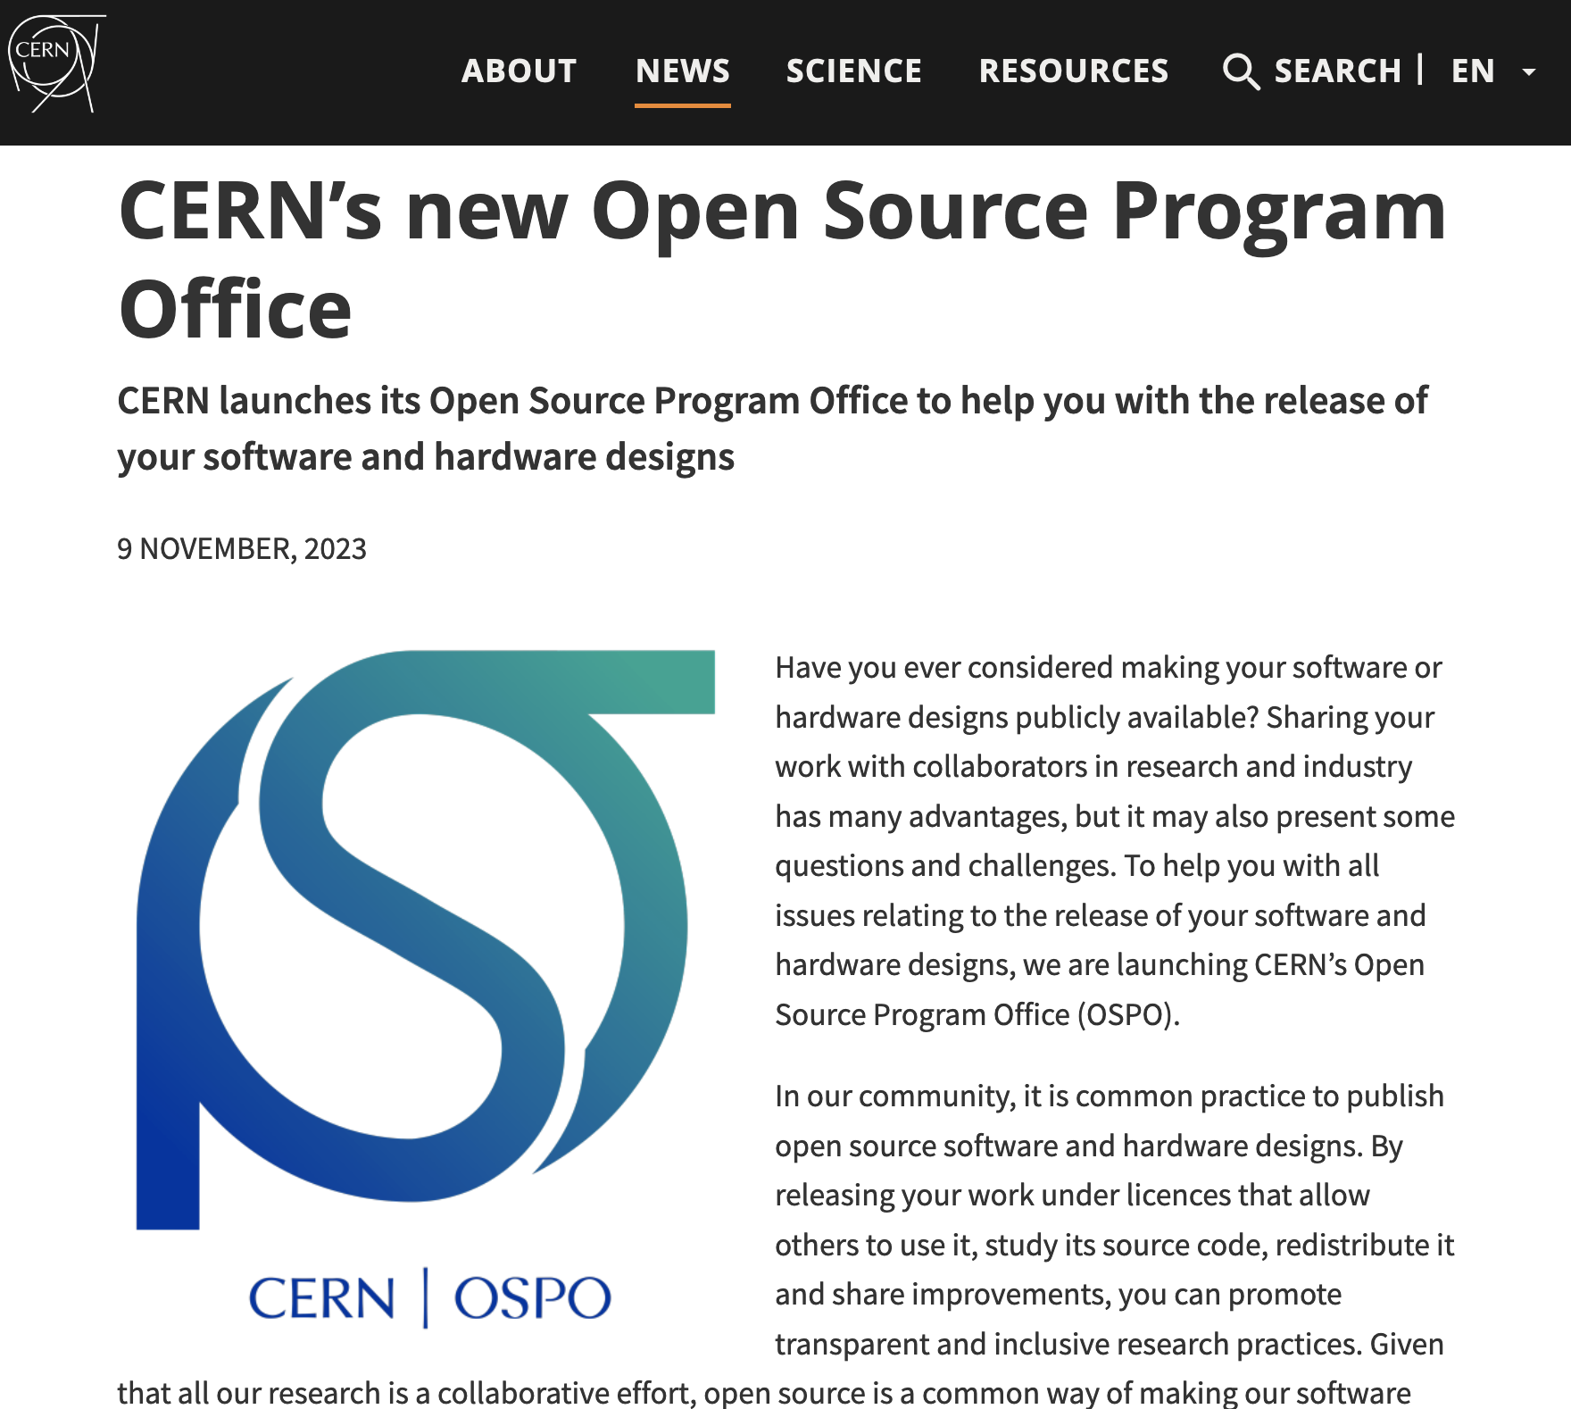


Our role has evolved over the years
Some open science milestones since 1989
Open Data Policy
CERN/NASA OS Summit
Article/Data
linking
SCOAP3: 90% OA
WWW
OA Policy
Accelerating the Adoption of Open Science
1989
1991
2011
2014
2018
2020
2022
2023
OSPO
Open Hardware License V1.0
Launch Open Data Portal
Reuse and Reproducability Framework
Open Science Policy

Slide 10








CERN Scientific Information Service activities today
Manage, preserving and disseminate knowledge
Preserve, safeguard and exploit the historic knowledge and heritage of CERN
Provide access to all required scientific literature to the CERN community
and openly disseminate the organisational research products
Enable accessibility, preservation, reuse and reproducibility of HEP research
Promote and enable best practices on open and collaborative science in
particle physics and beyond
CERN OSPO
10

Slide 11
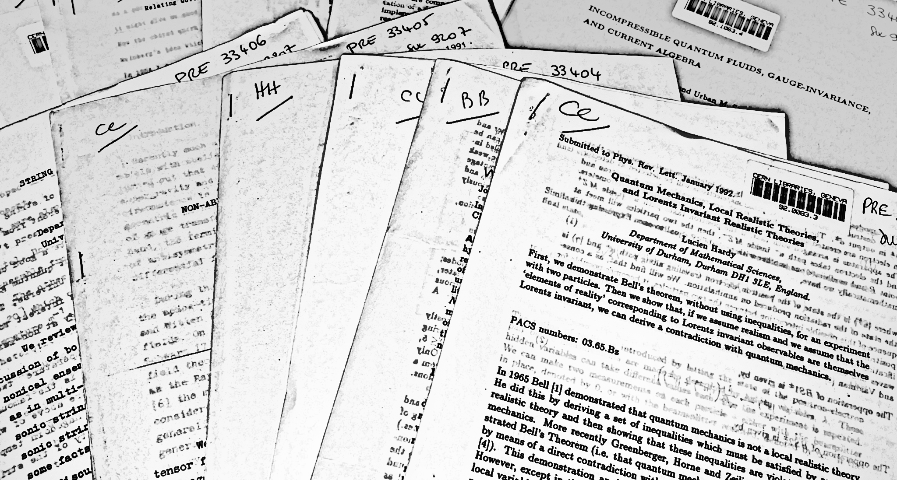
Preprints used to be distributed on paper.

Slide 12
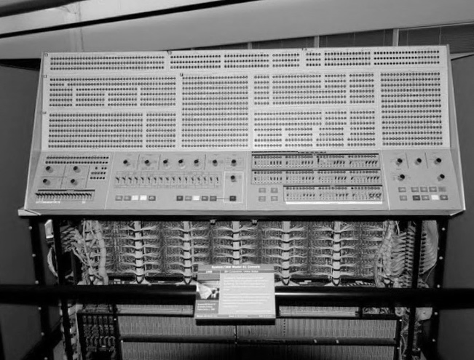
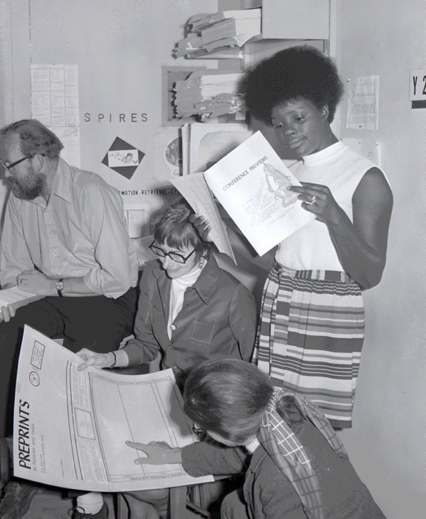
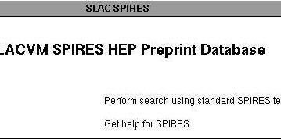
The first electronic preprint catalogue was established at SLAC.
1969

Slide 13
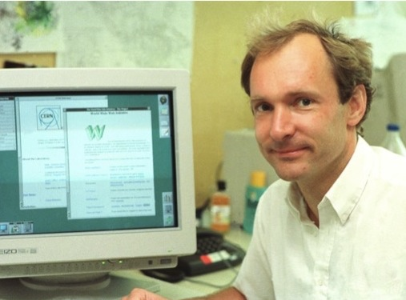
The WWW changed everything
1989

Slide 14
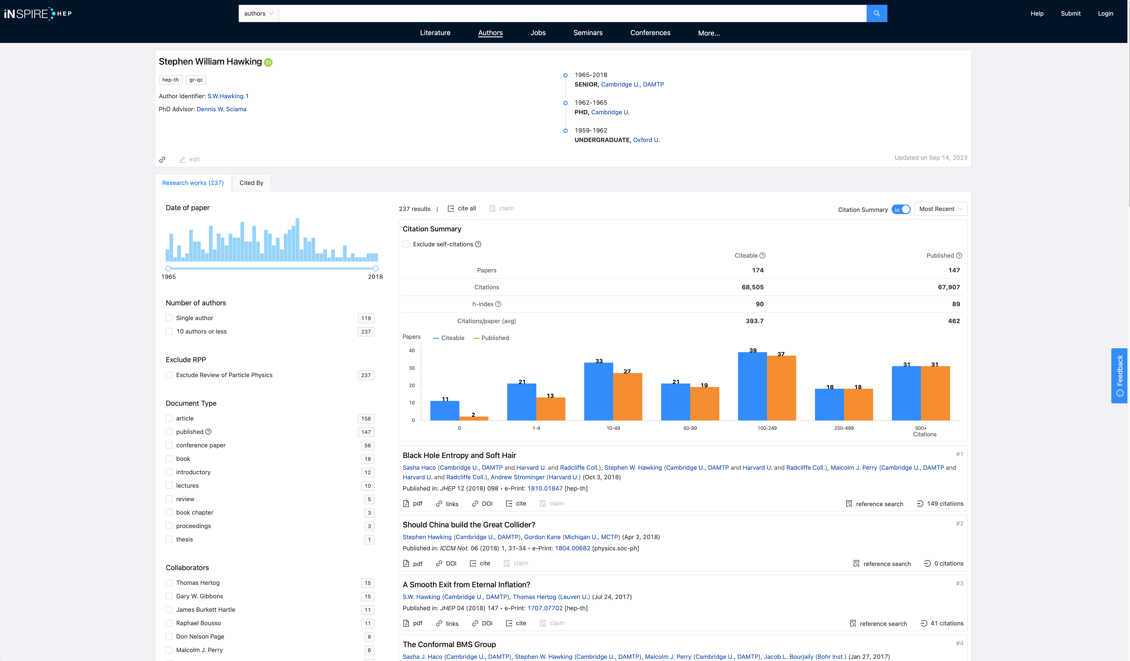
The preprint catalogues SPIRES has evolved into INSPIREhep
a global knowledge hub for particle physics, hosted by CERN.

Slide 15

INSPIREhep in a nutshell
The “Google” for particle physics
Main information platform for HEP and related fields (e.g. nuclear physics)
1.7 M curated papers
100k author profiles*
More than papers:
  Research datasets
  Seminars
25k daily visits from researchers worldwide
Collaboration of various HEP labs (> 15 FTE)
  Technical hosting and development at CERN
  Joint responsibility for data selection and curation
  Jobs
  Conferences

Slide 16
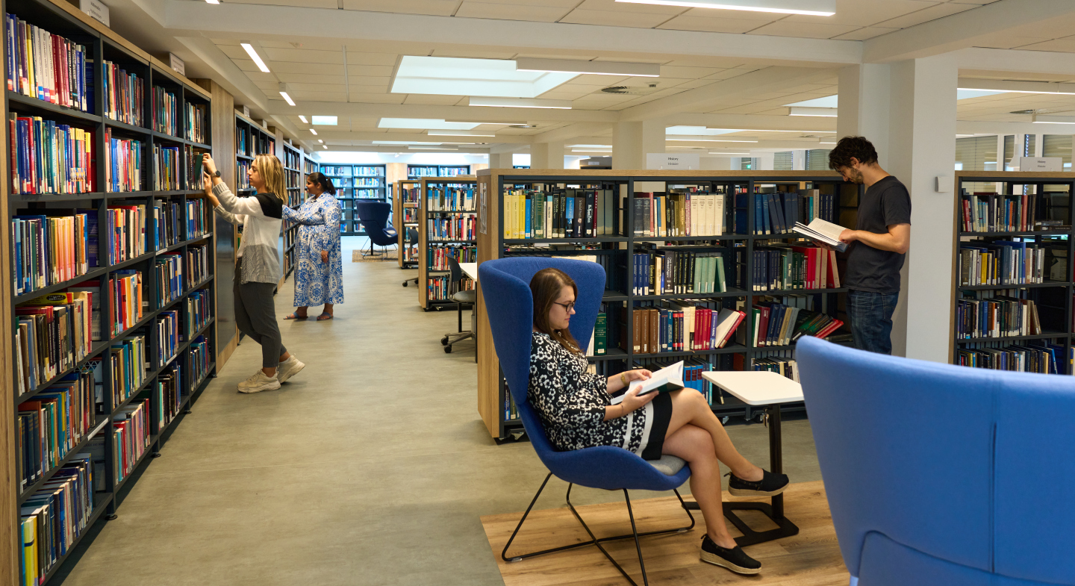
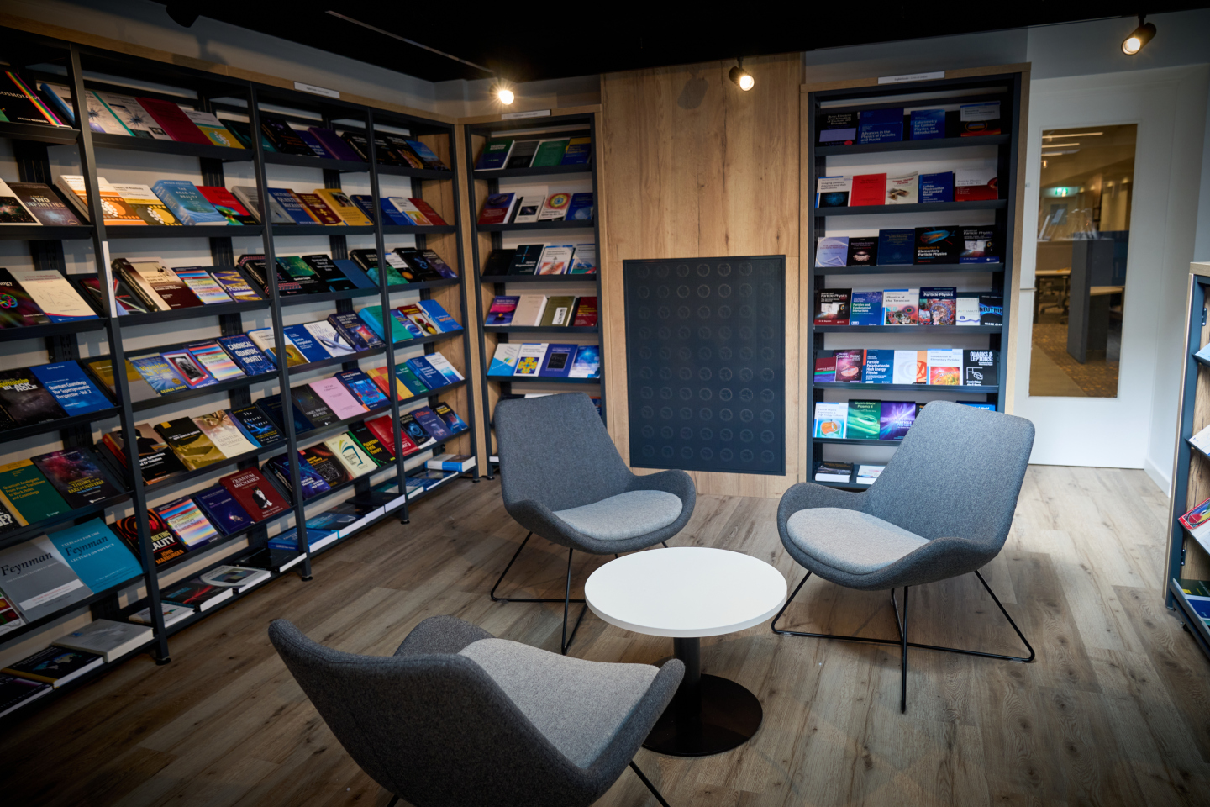
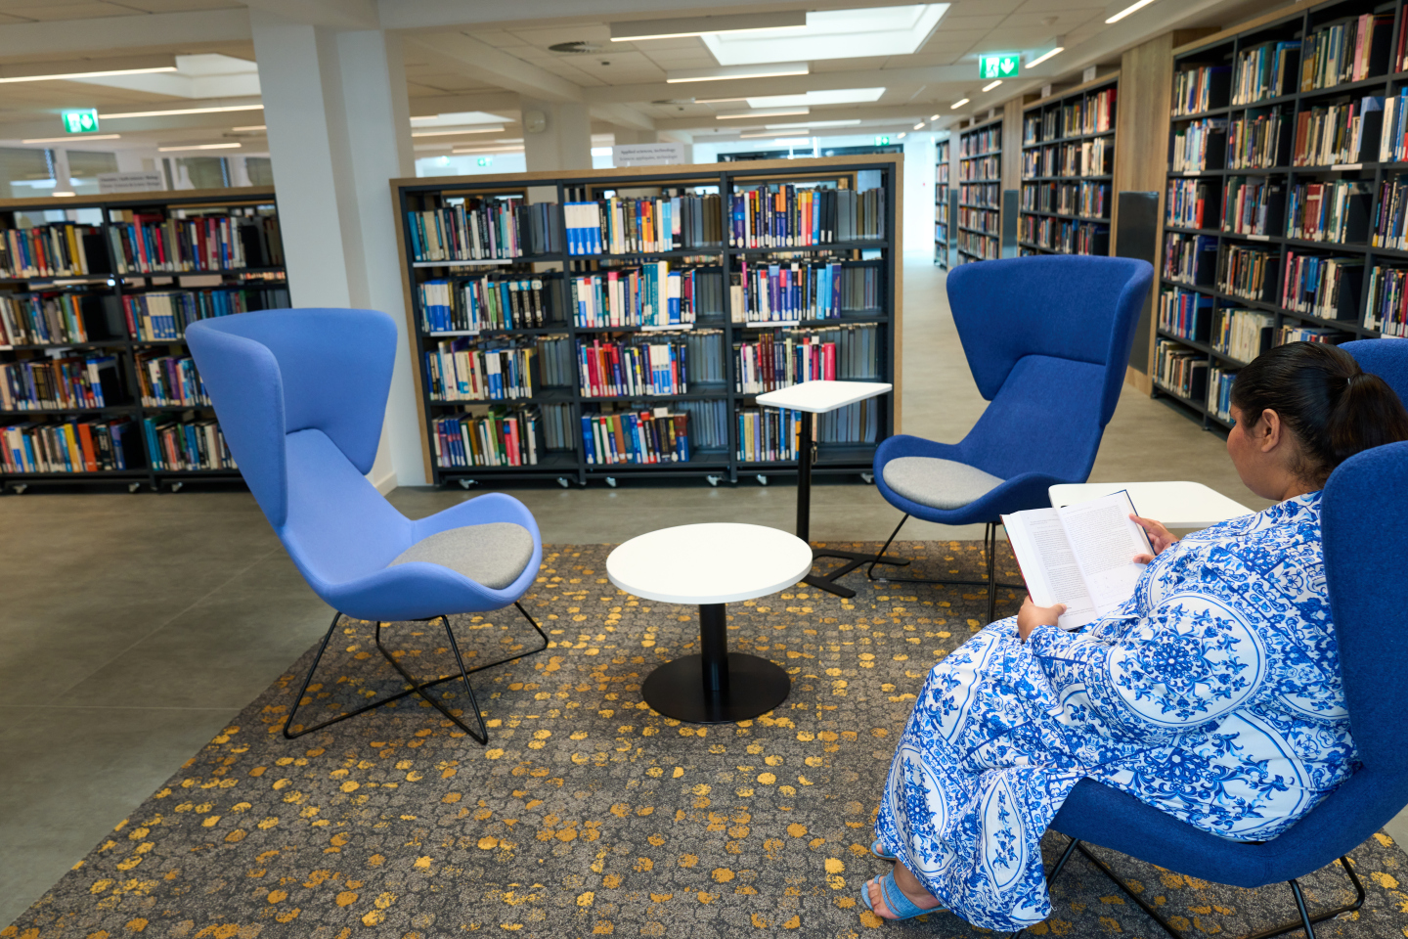
The Library is still there – but looks a bit different now.

Slide 17
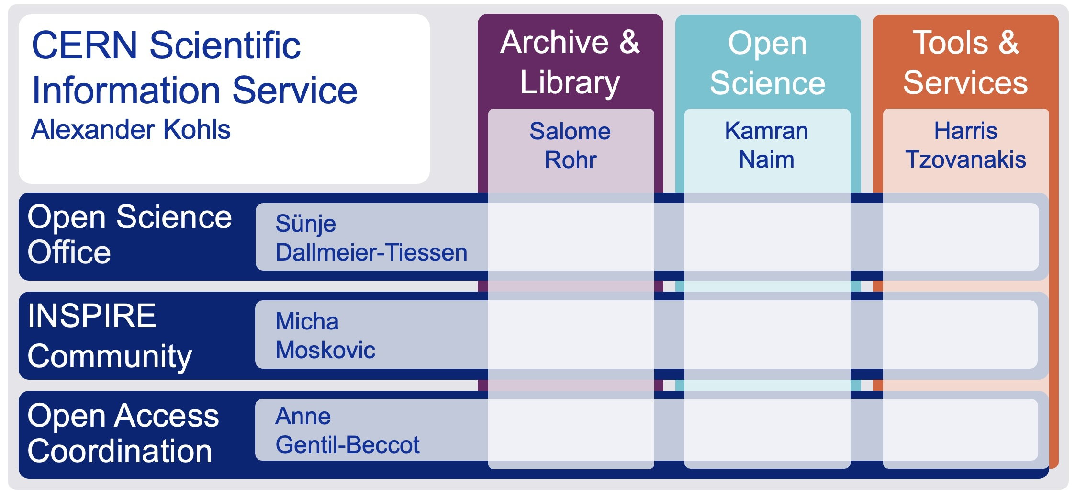
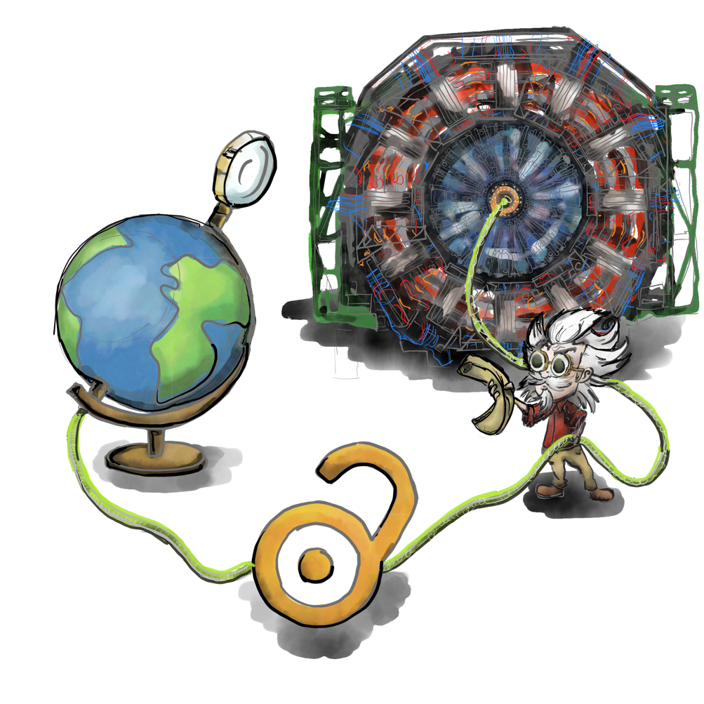
The CERN Scientific Information Service 2024
Connecting the CERN Community with global research
The CERN Scientific Information Service aims at efficiently managing, preserving and disseminating scientific information to make it openly accessible and reusable to CERN and the worldwide High-Energy Physics community.
Le Service d’Information Scientifique du CERN a pour mission de gérer, conserver et diffuser efficacement l’information scientifique afin de la rendre accessible et utilisable pour le CERN et pour la communauté mondiale de la physique des hautes énergies.

Slide 18
CERN OSPO

