Slide 1
CERN Archives & Library section
Presentation
Lydia Pieper & Salomé Rohr
July 2025

Slide 2
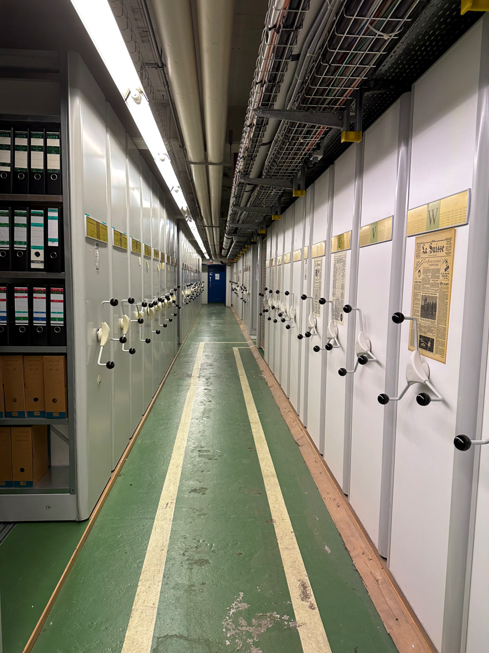
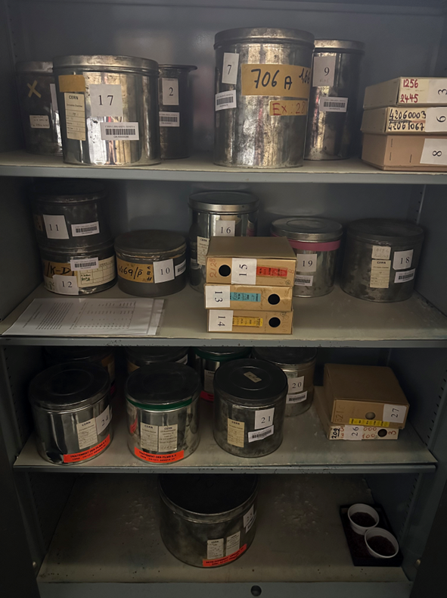
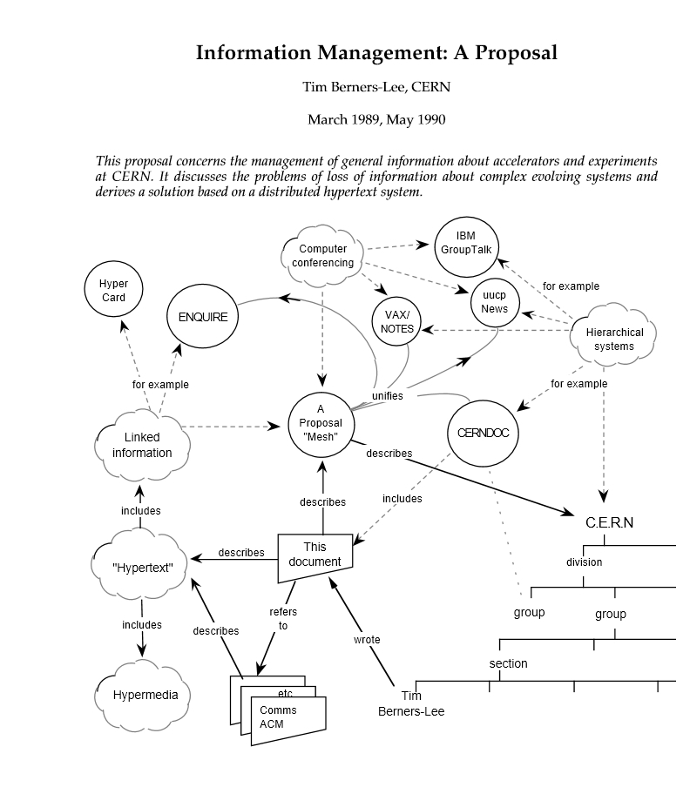
CERN Archives
The Archives holds over 2 linear kilometres (or 16’000 document boxes) of original historical documents, photographs, film reels, audio recordings, and objects. CDS contains 38,000 archival bibliographic records and some digitized documents.
You can request access to documents by emailing archive.enquiries@cern.ch
https://scientific-info.cern/archives
Notes:
The CERN Archives was originally conceived as a support for writing the history of CERN, as part of CERN’s 25th Anniversary celebrations. The projects were launched in April 1979 by the Committee of Council, and in November the DG requested division leaders to make source material available to the CERN Historical Archives and to appoint Divisional Records Officers to ensure ongoing collection of historical records.

Slide 3
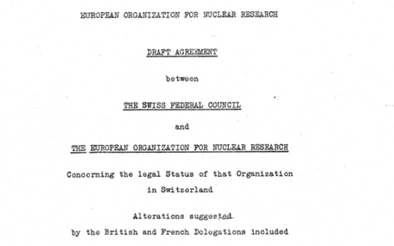
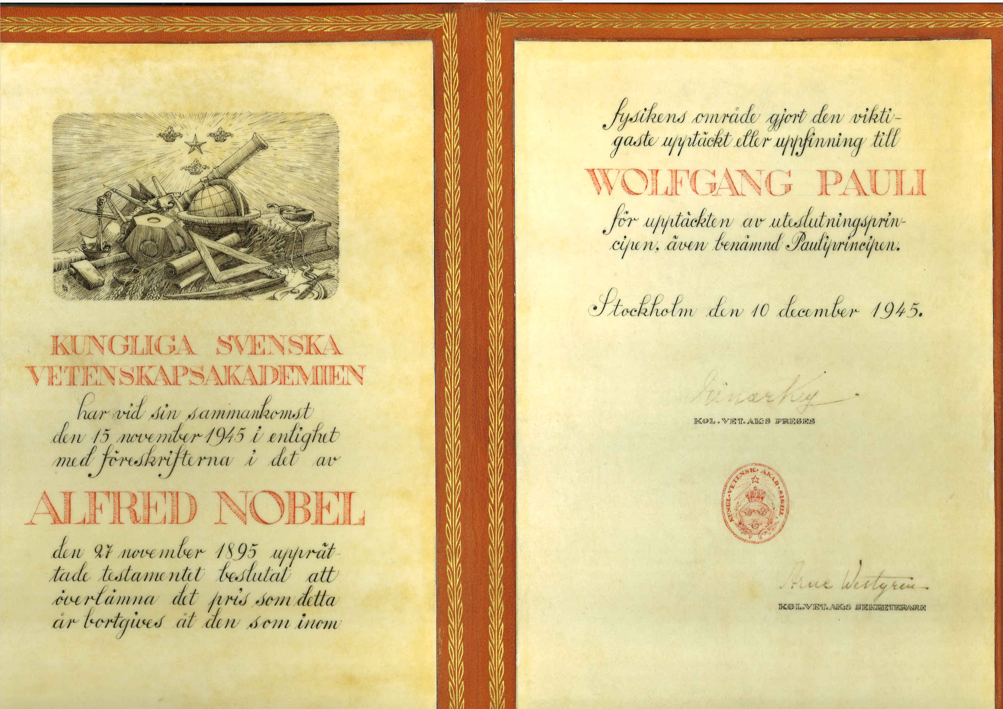
CERN Archives
We also have custody of the Wolfgang Pauli records, a private collection of scientific books, correspondence, and manuscripts from the Austrian Nobel Prize winner.
Our materials document all aspects of CERN’s history, including the CERN Council, administration & management, the experiments, theoretical and experi-mental physics, and technology, including a collection related to the creation of the World Wide Web.

Slide 4
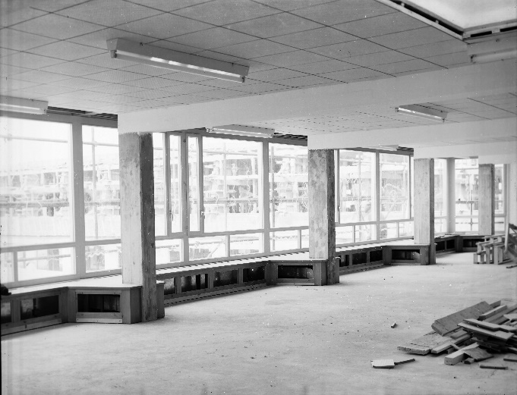
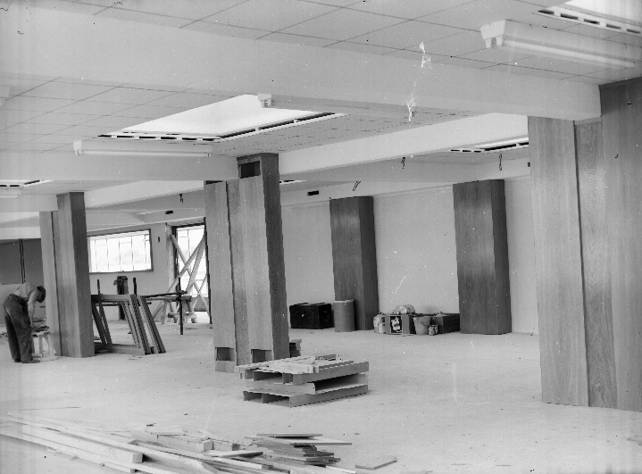
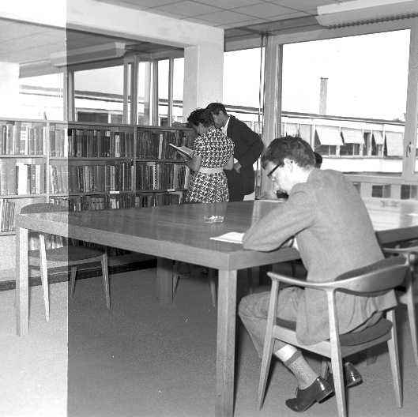
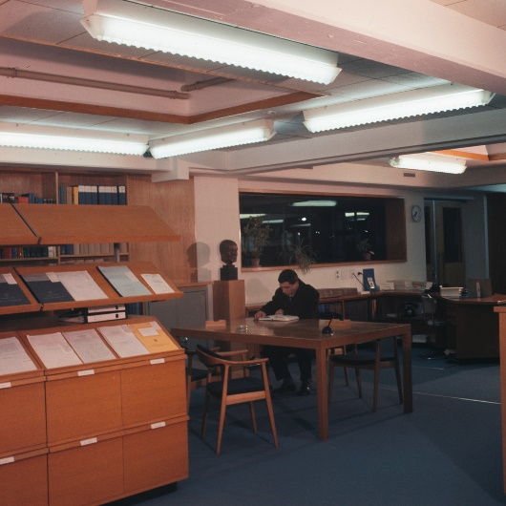
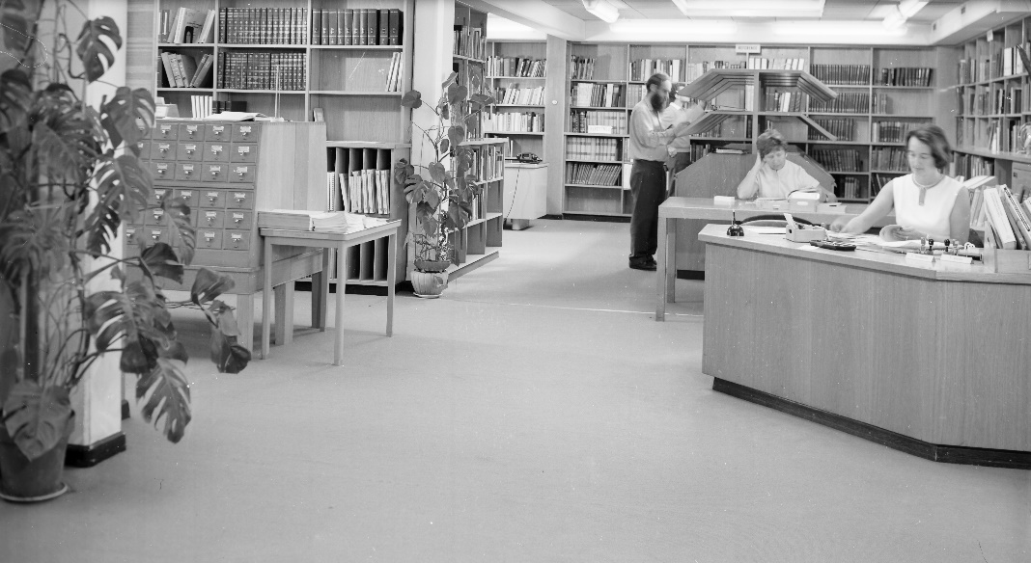
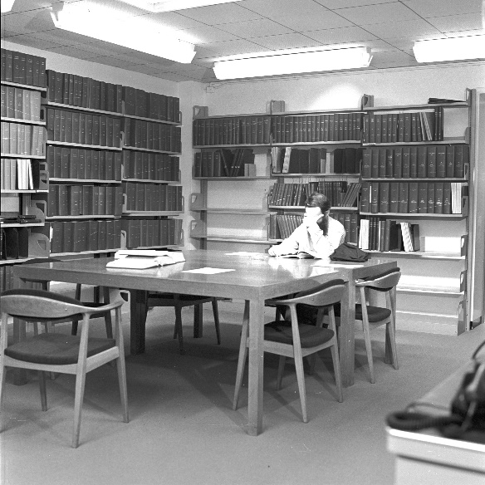
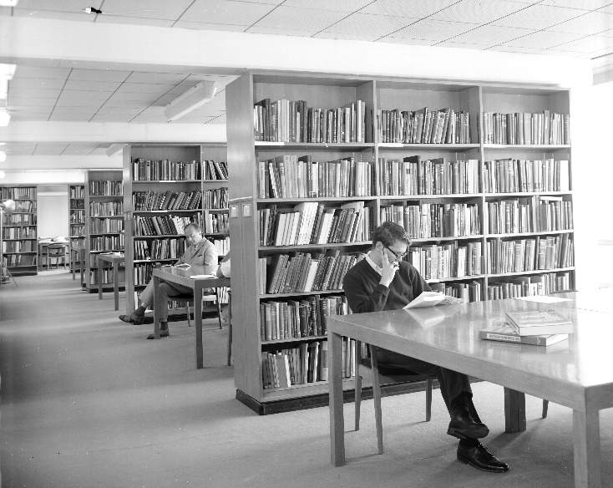
Historical views of the Library
1957 - Construction
1962
1964
1968

Slide 5
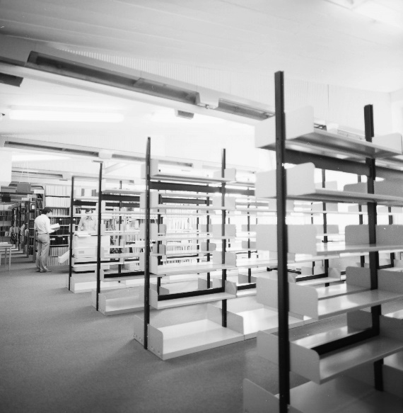
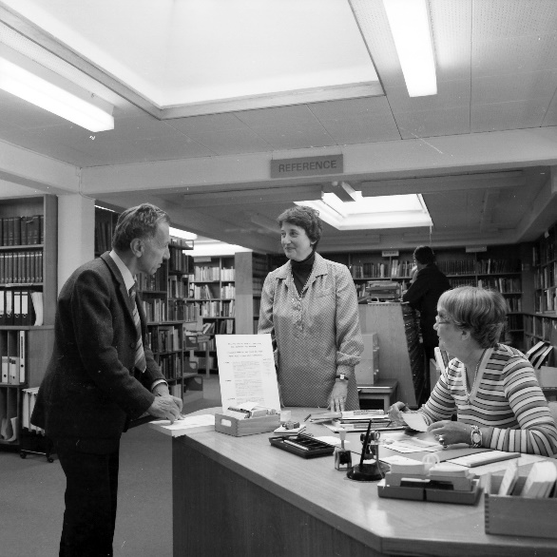
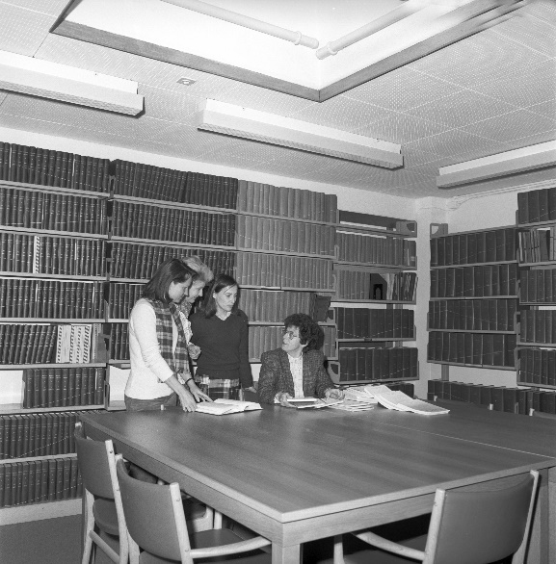
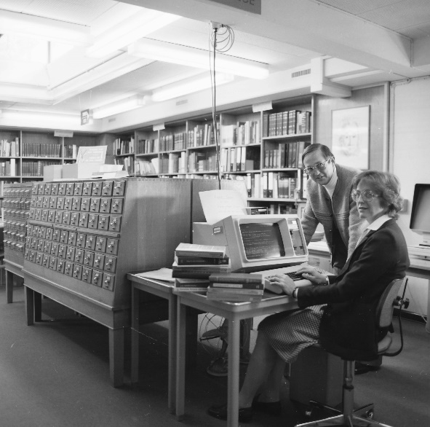
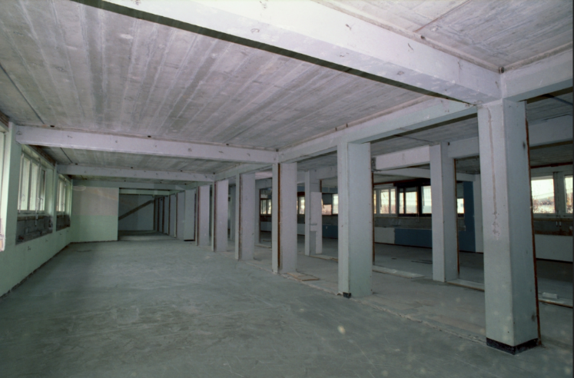
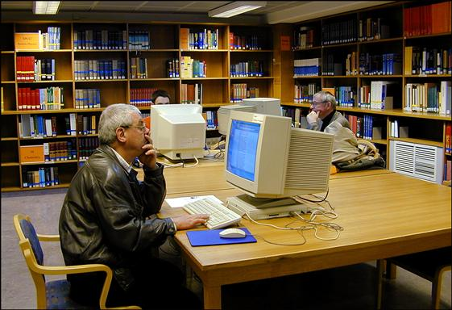
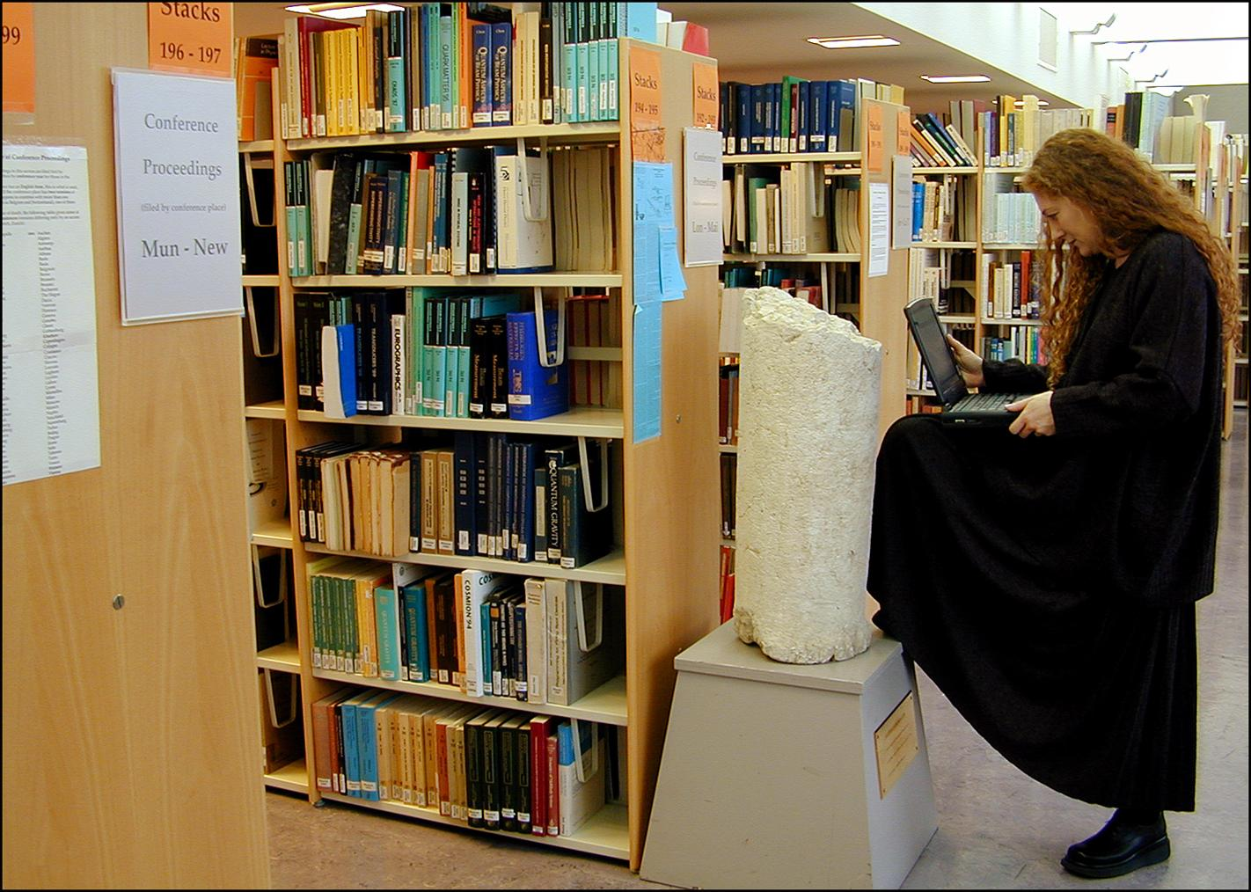
Historical views of the Library
1979 - Extension of the Central Library into building 3
1981
1983
1996 - Expansion of the Library to the ground-floor of building 52
2001

Slide 6
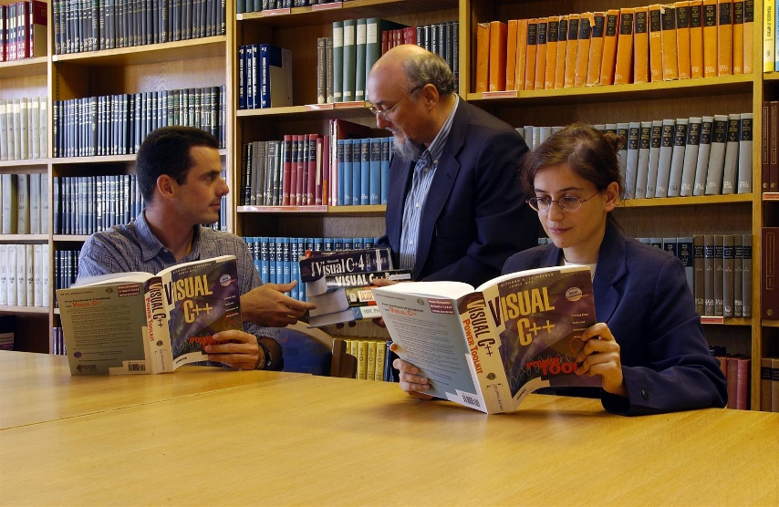
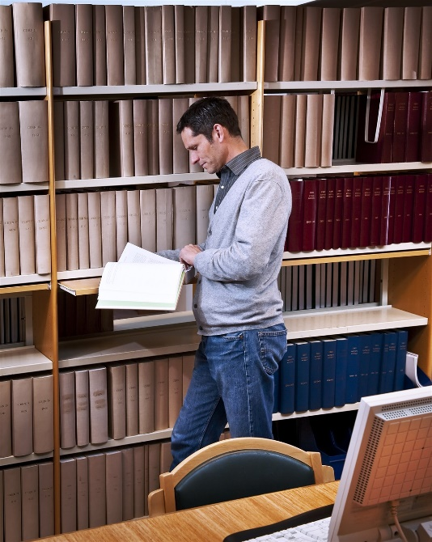
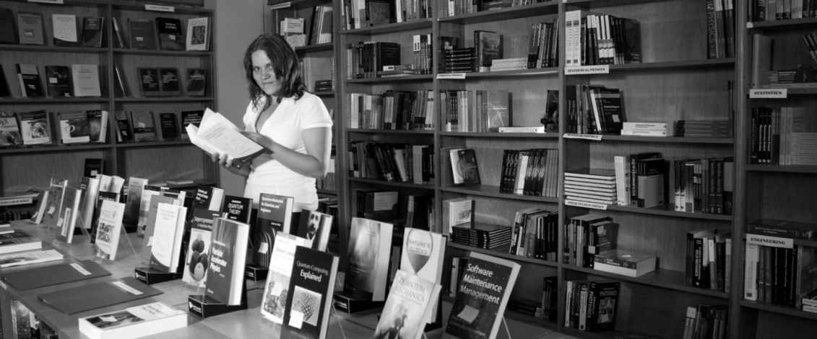
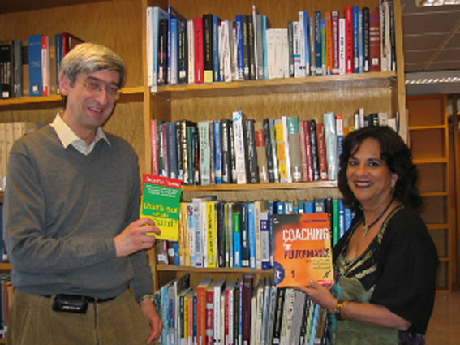
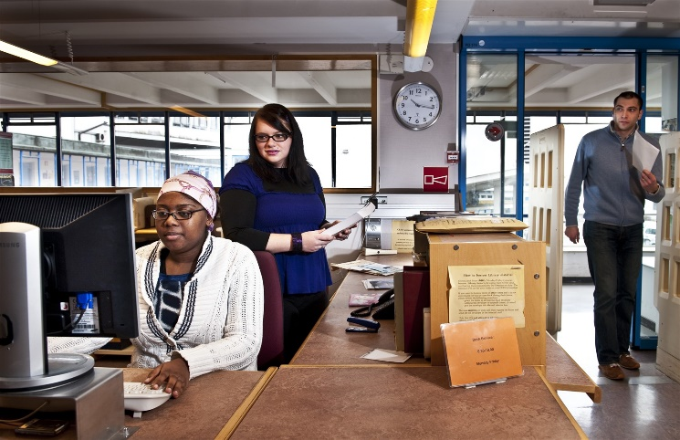
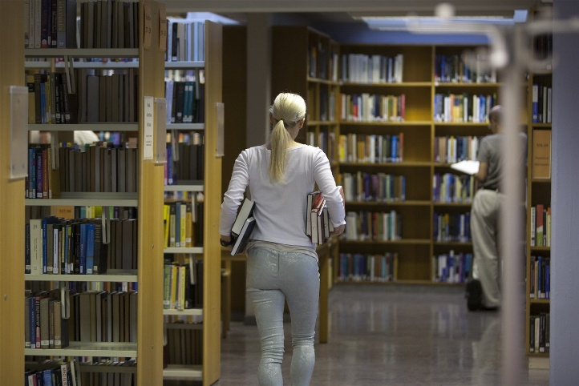
Historical views of the Library
2003
2008
2009
2012

Slide 7
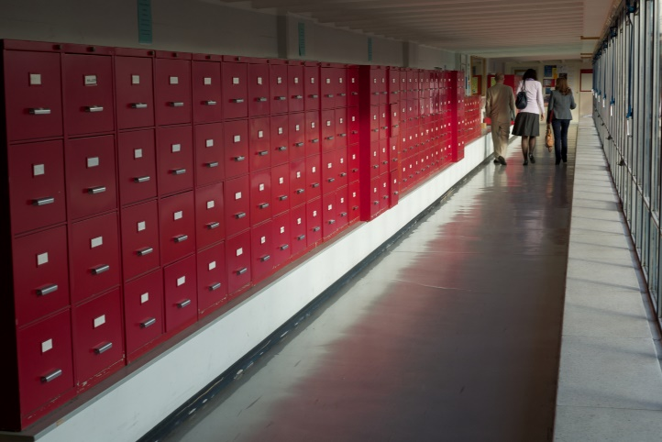
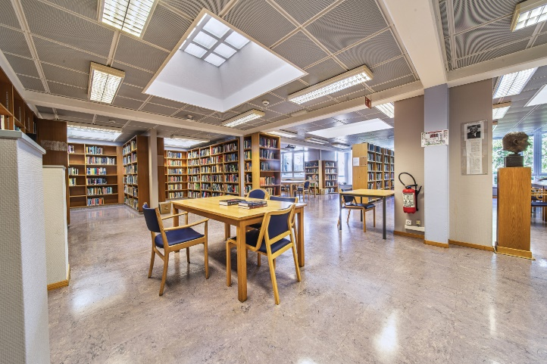
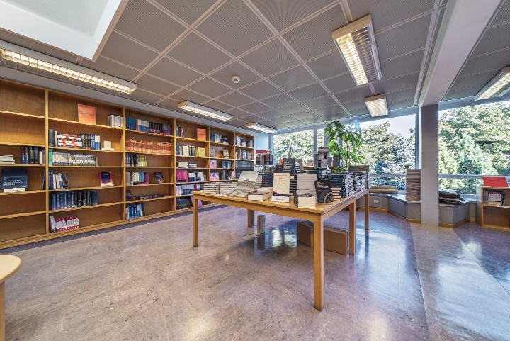
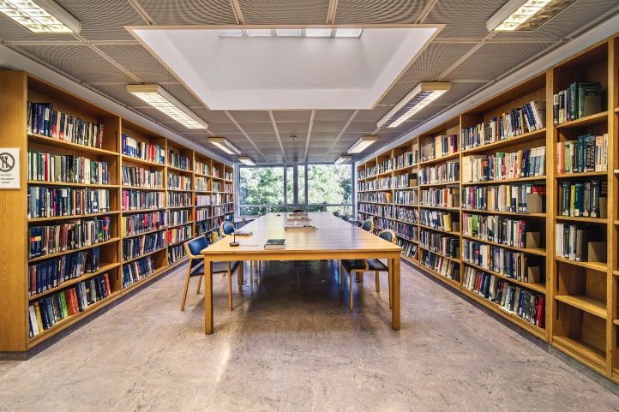
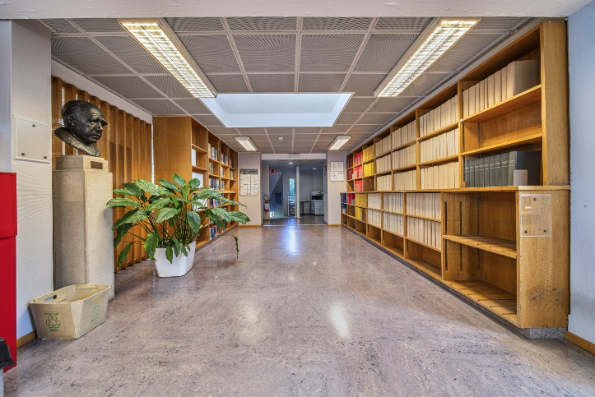
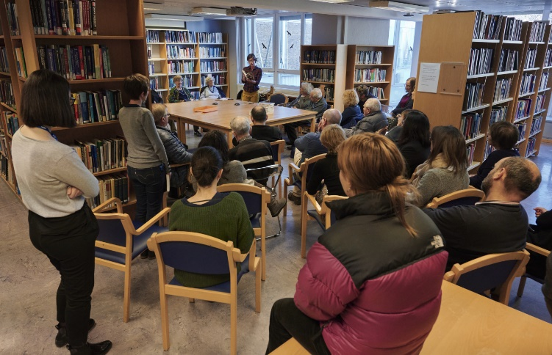
Historical views of the Library
2019
2020

Slide 8

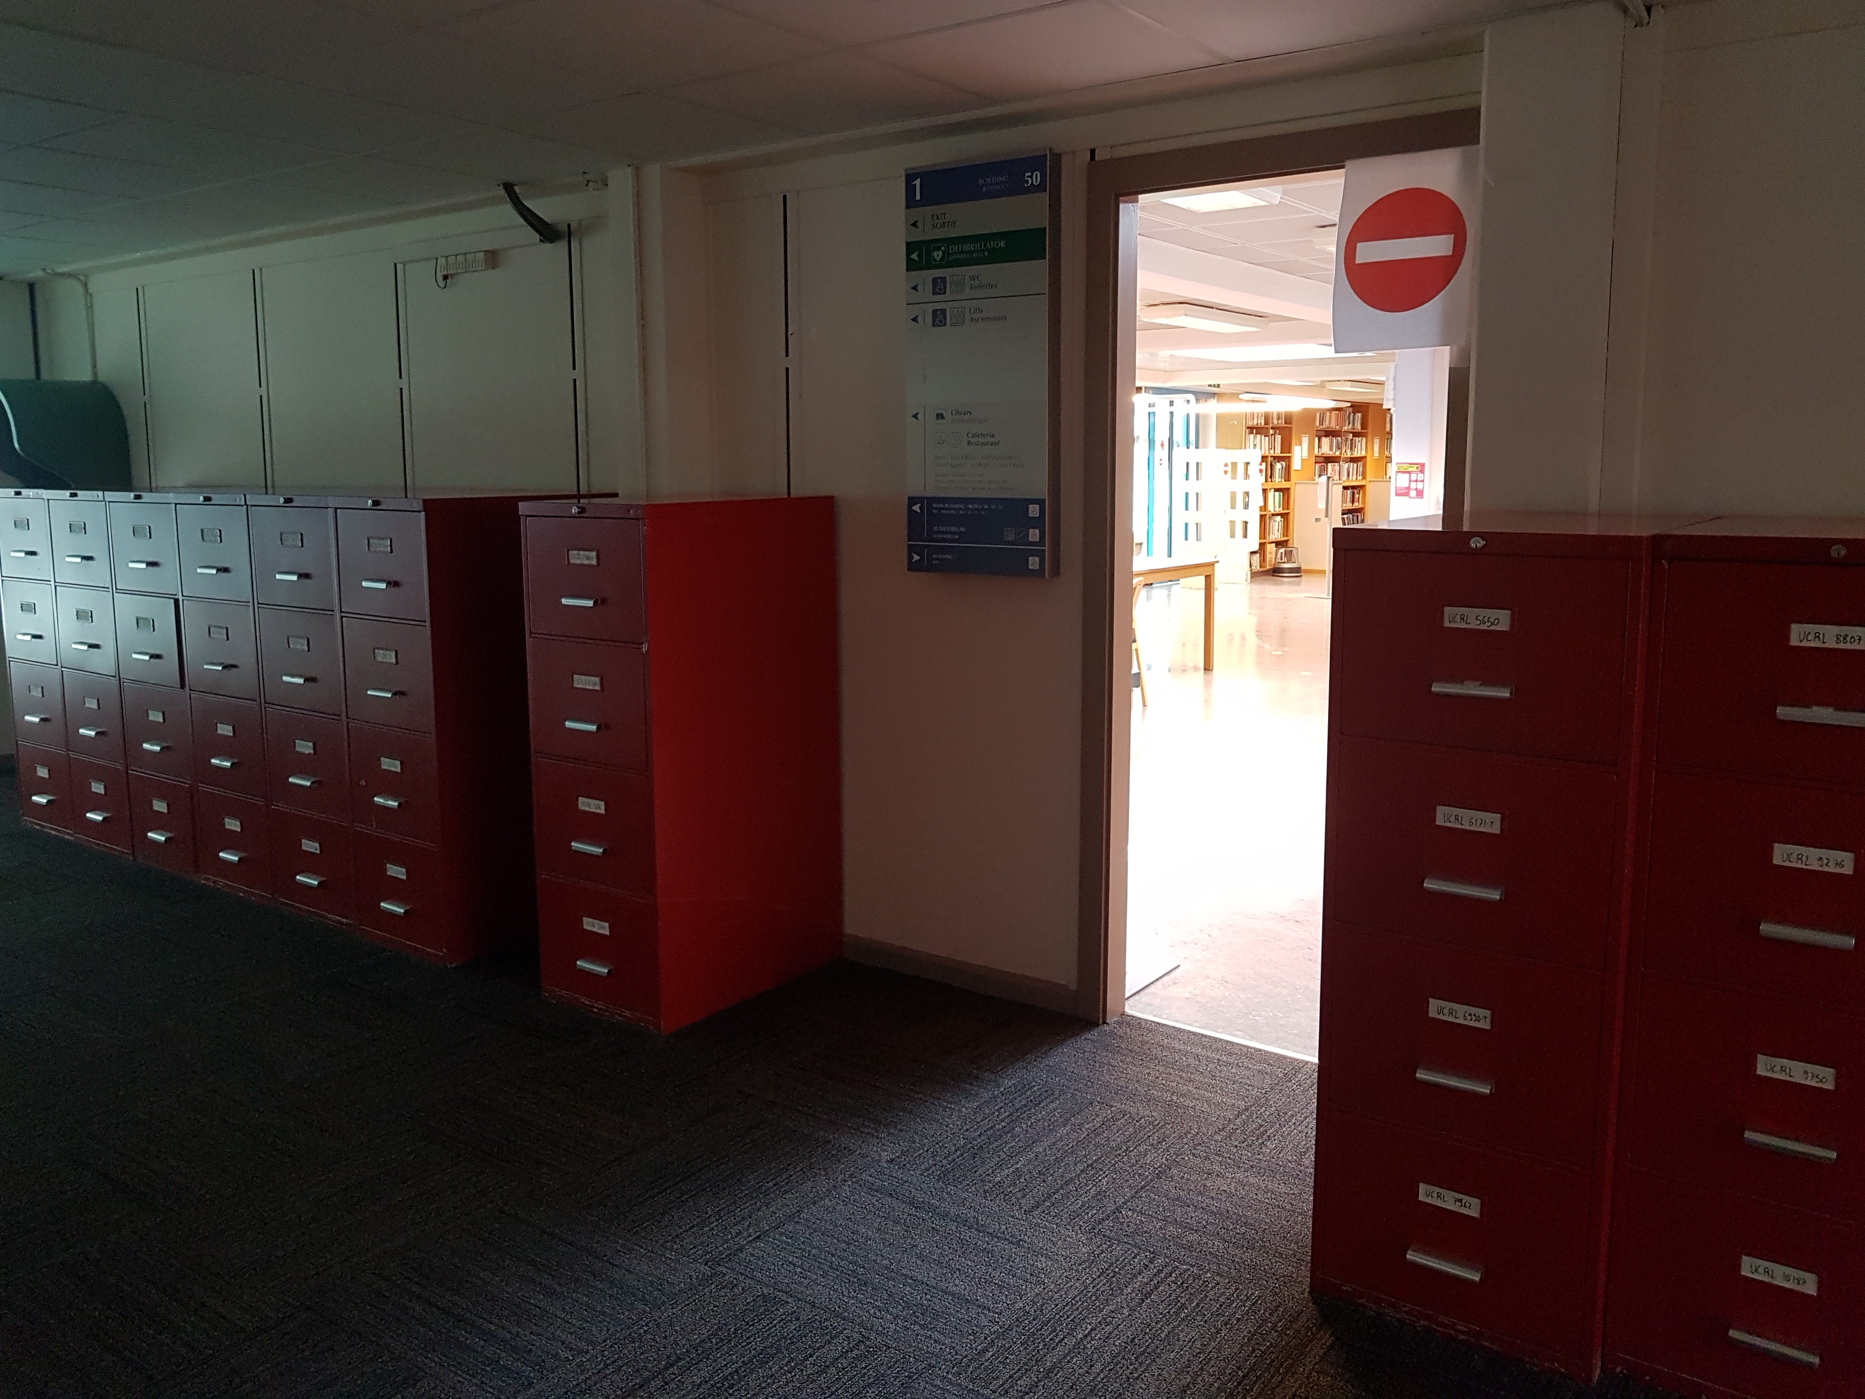
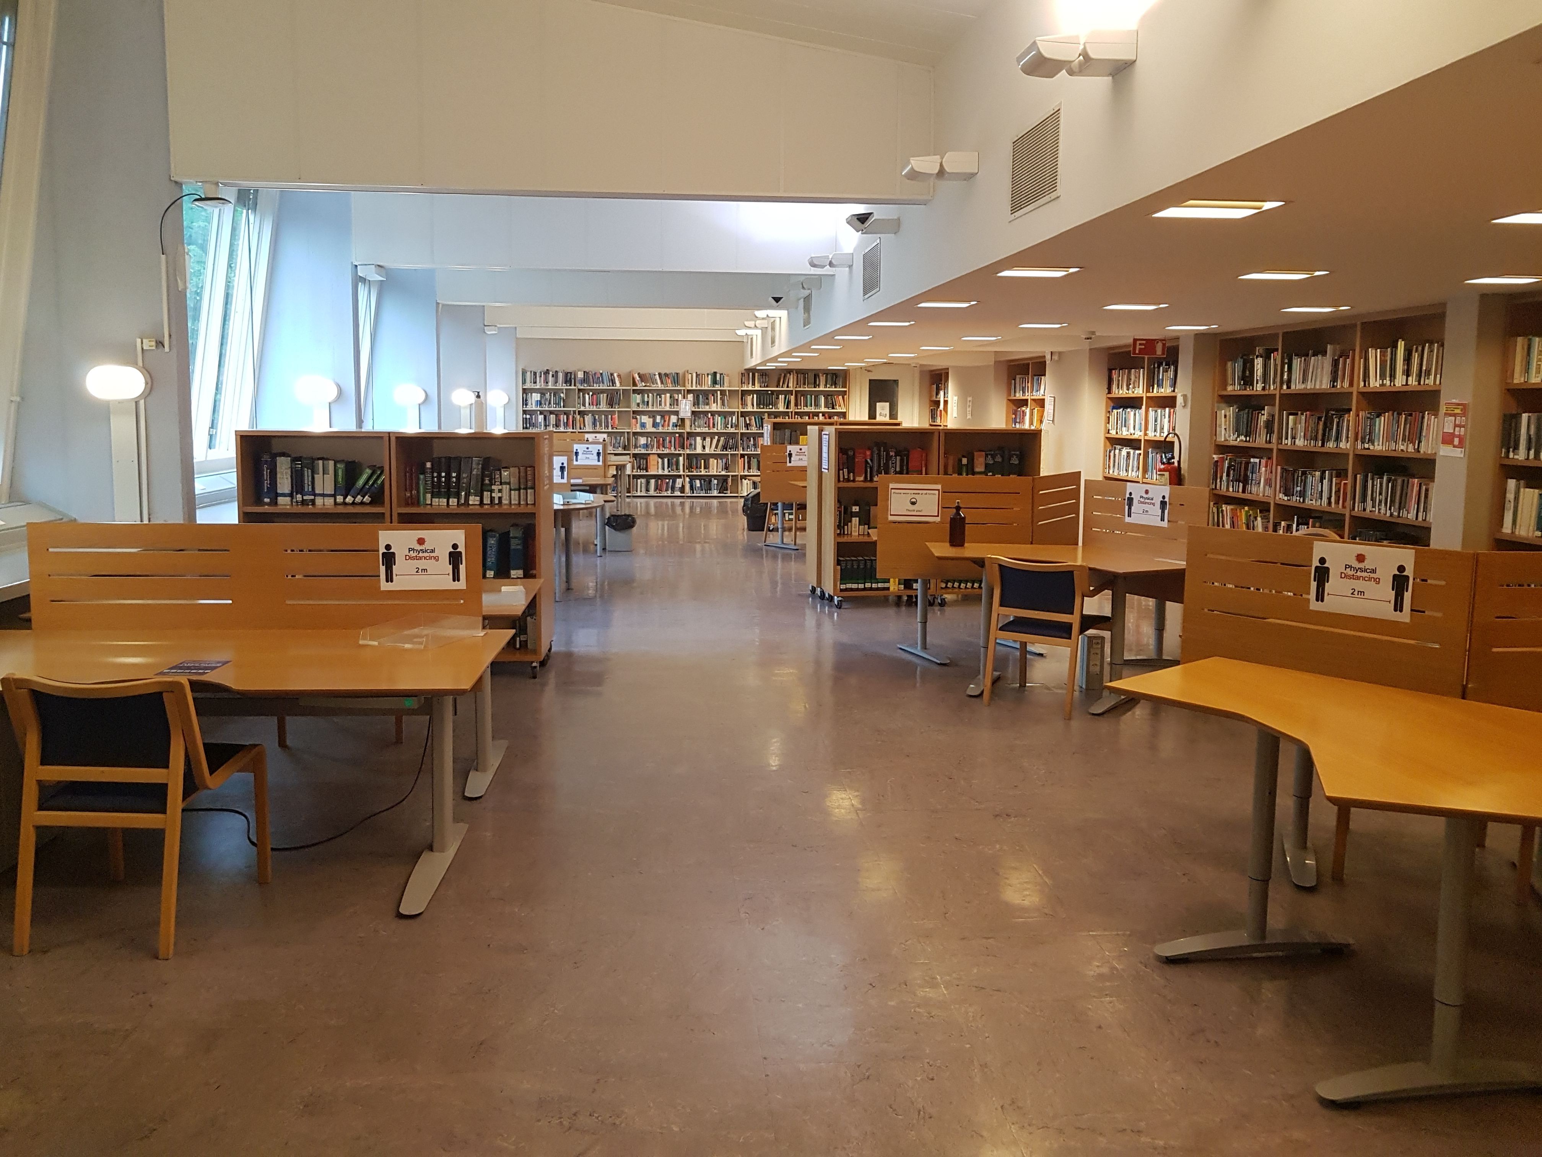
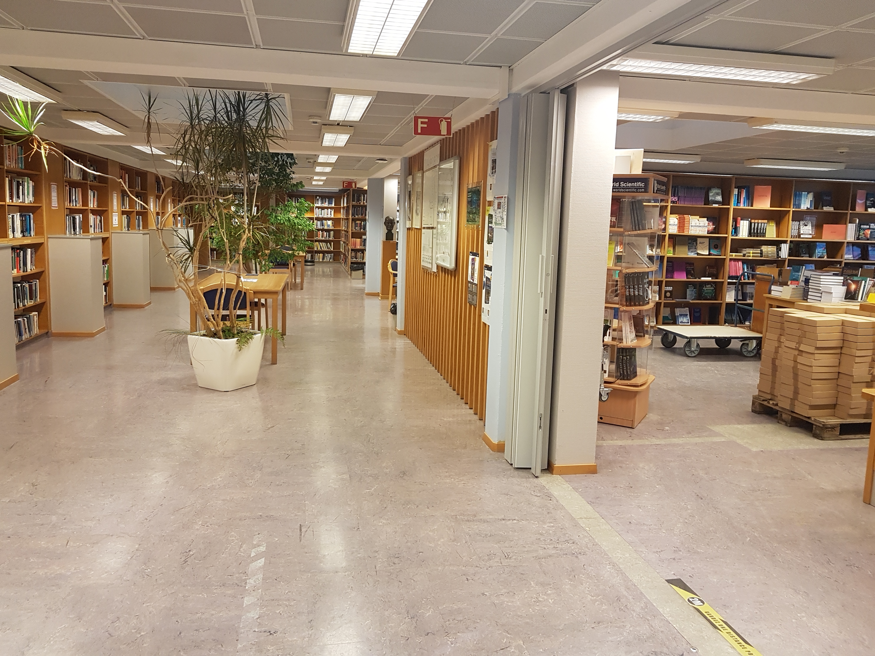
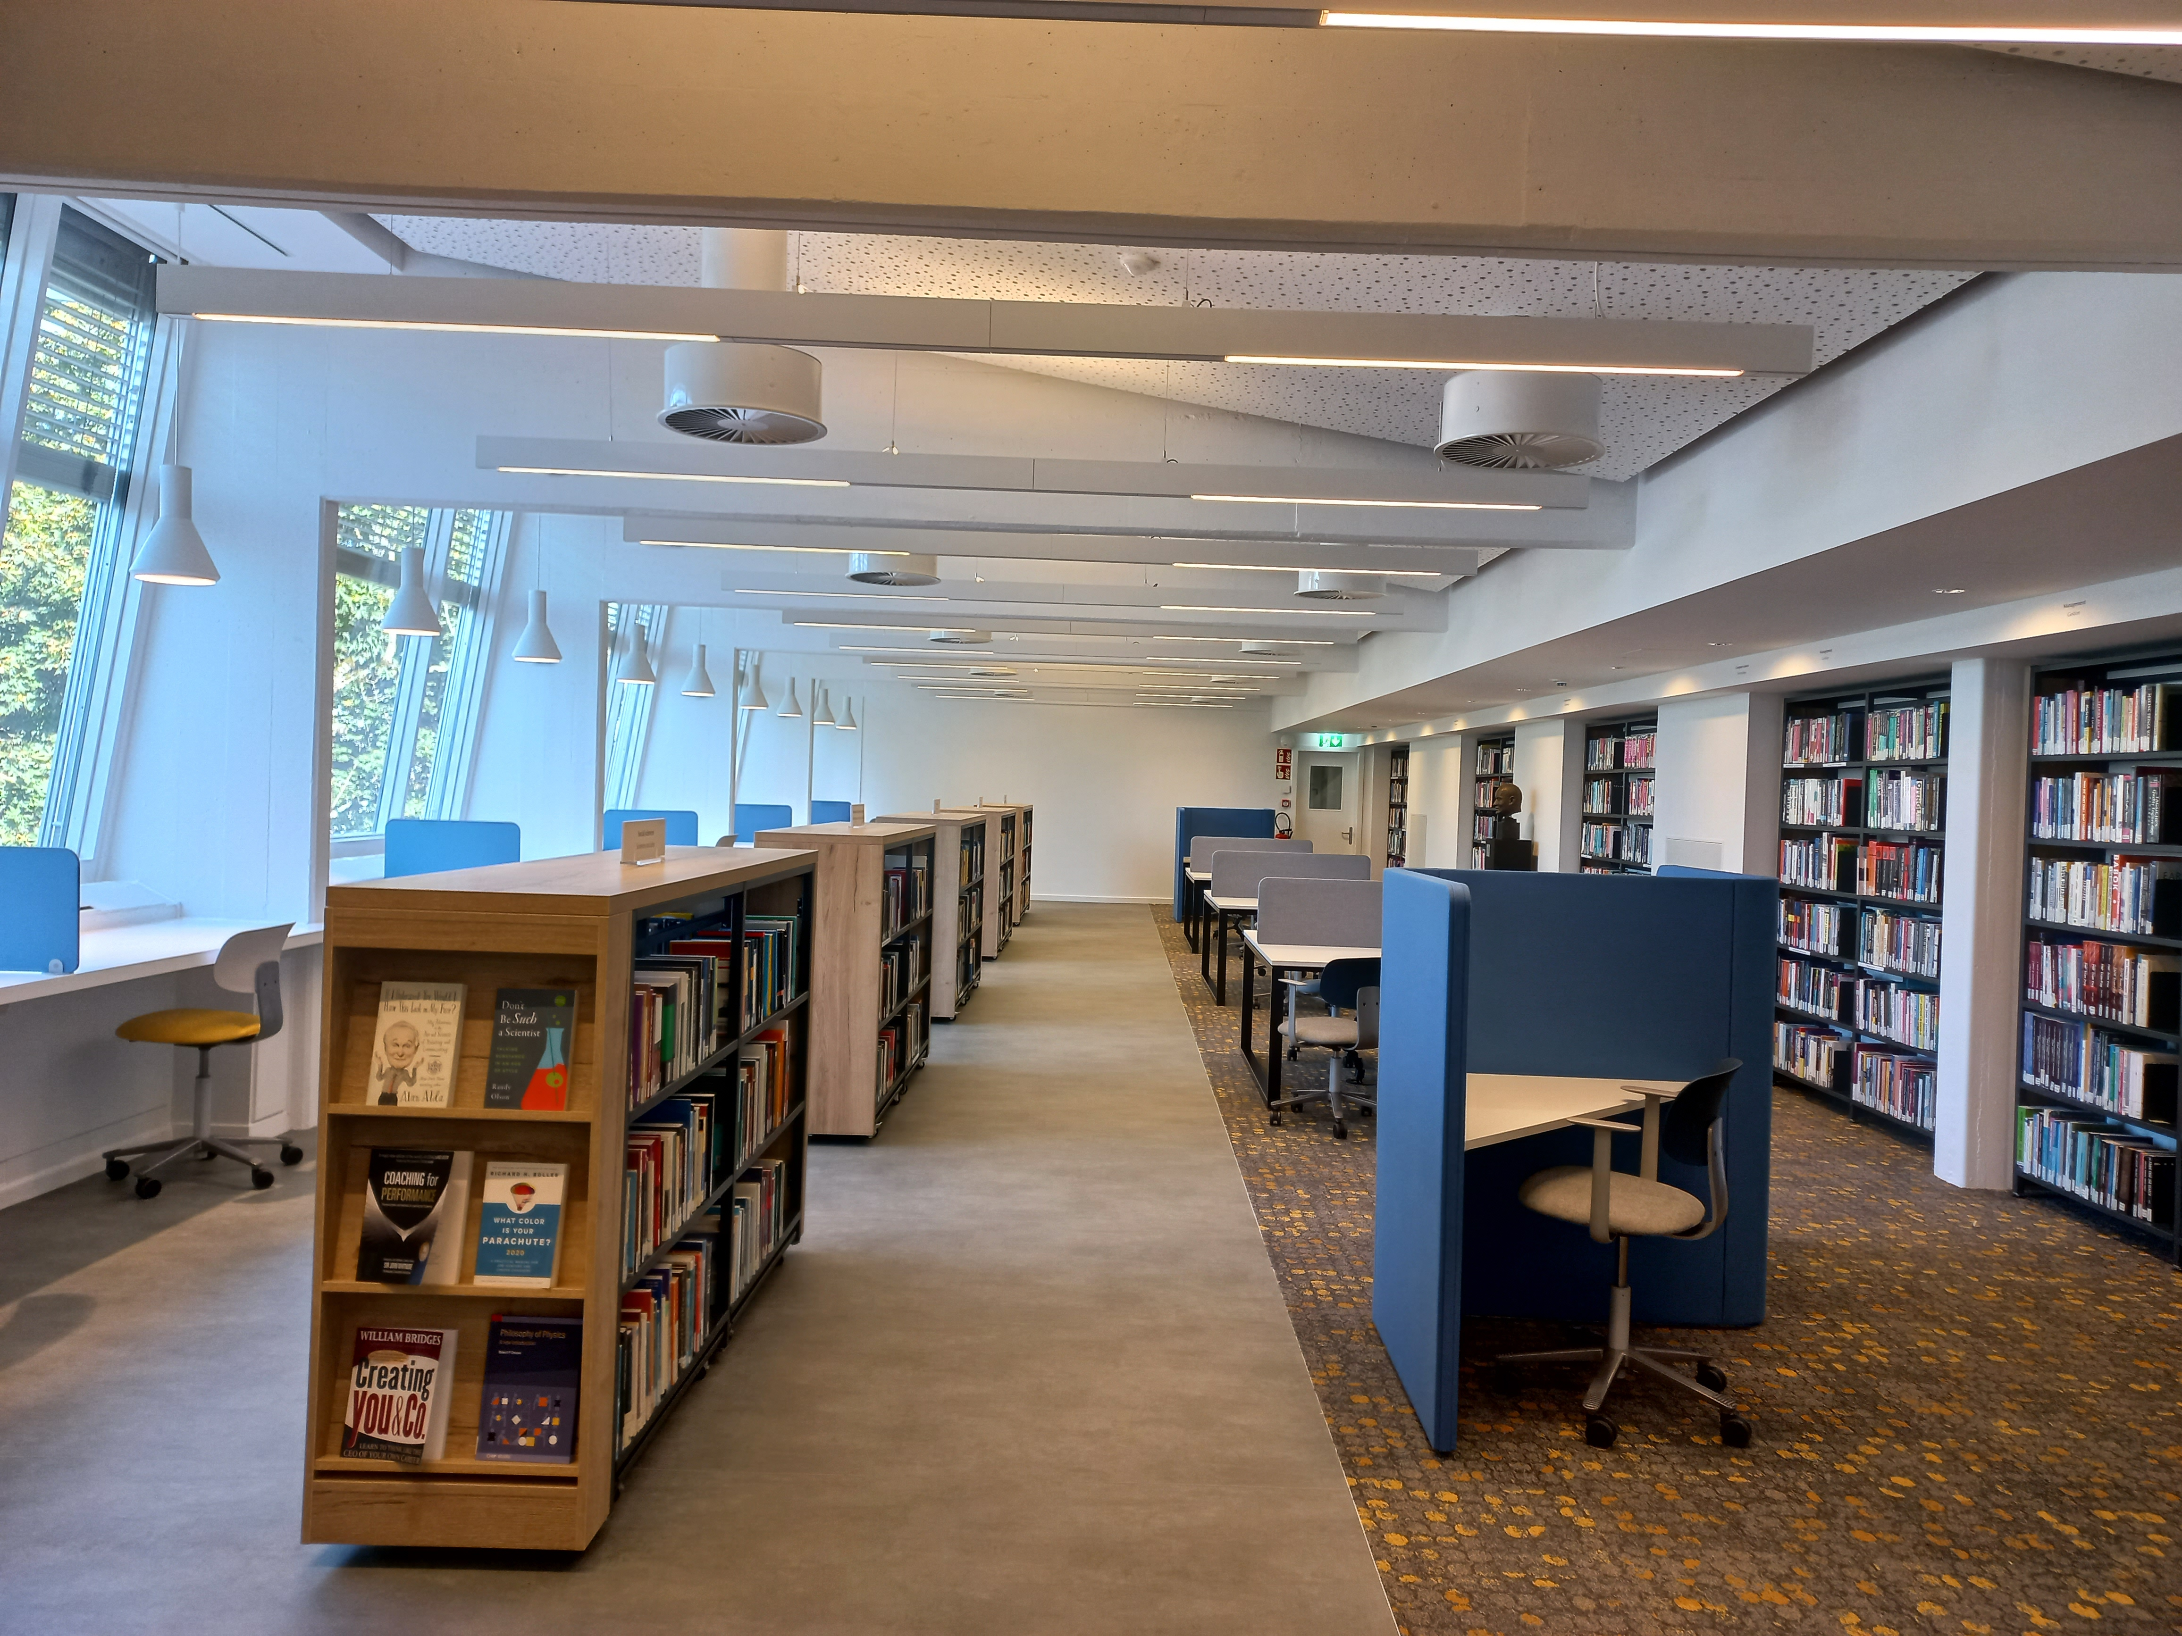
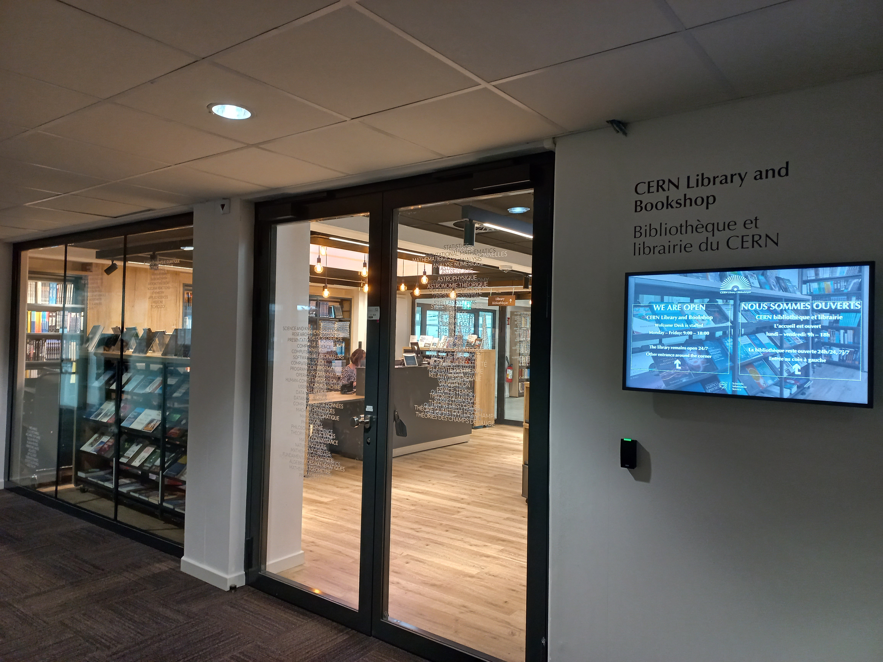
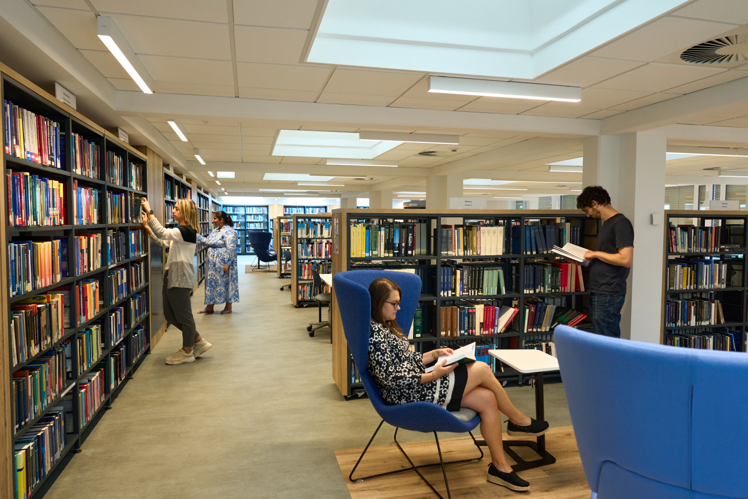
Library facilities – renovated in 2023!

Slide 9
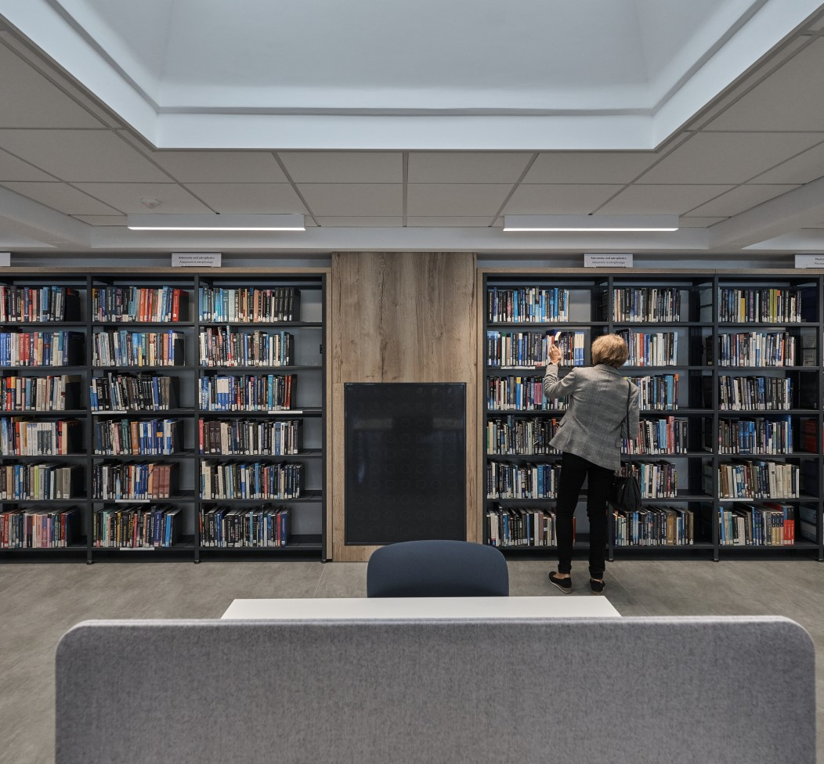
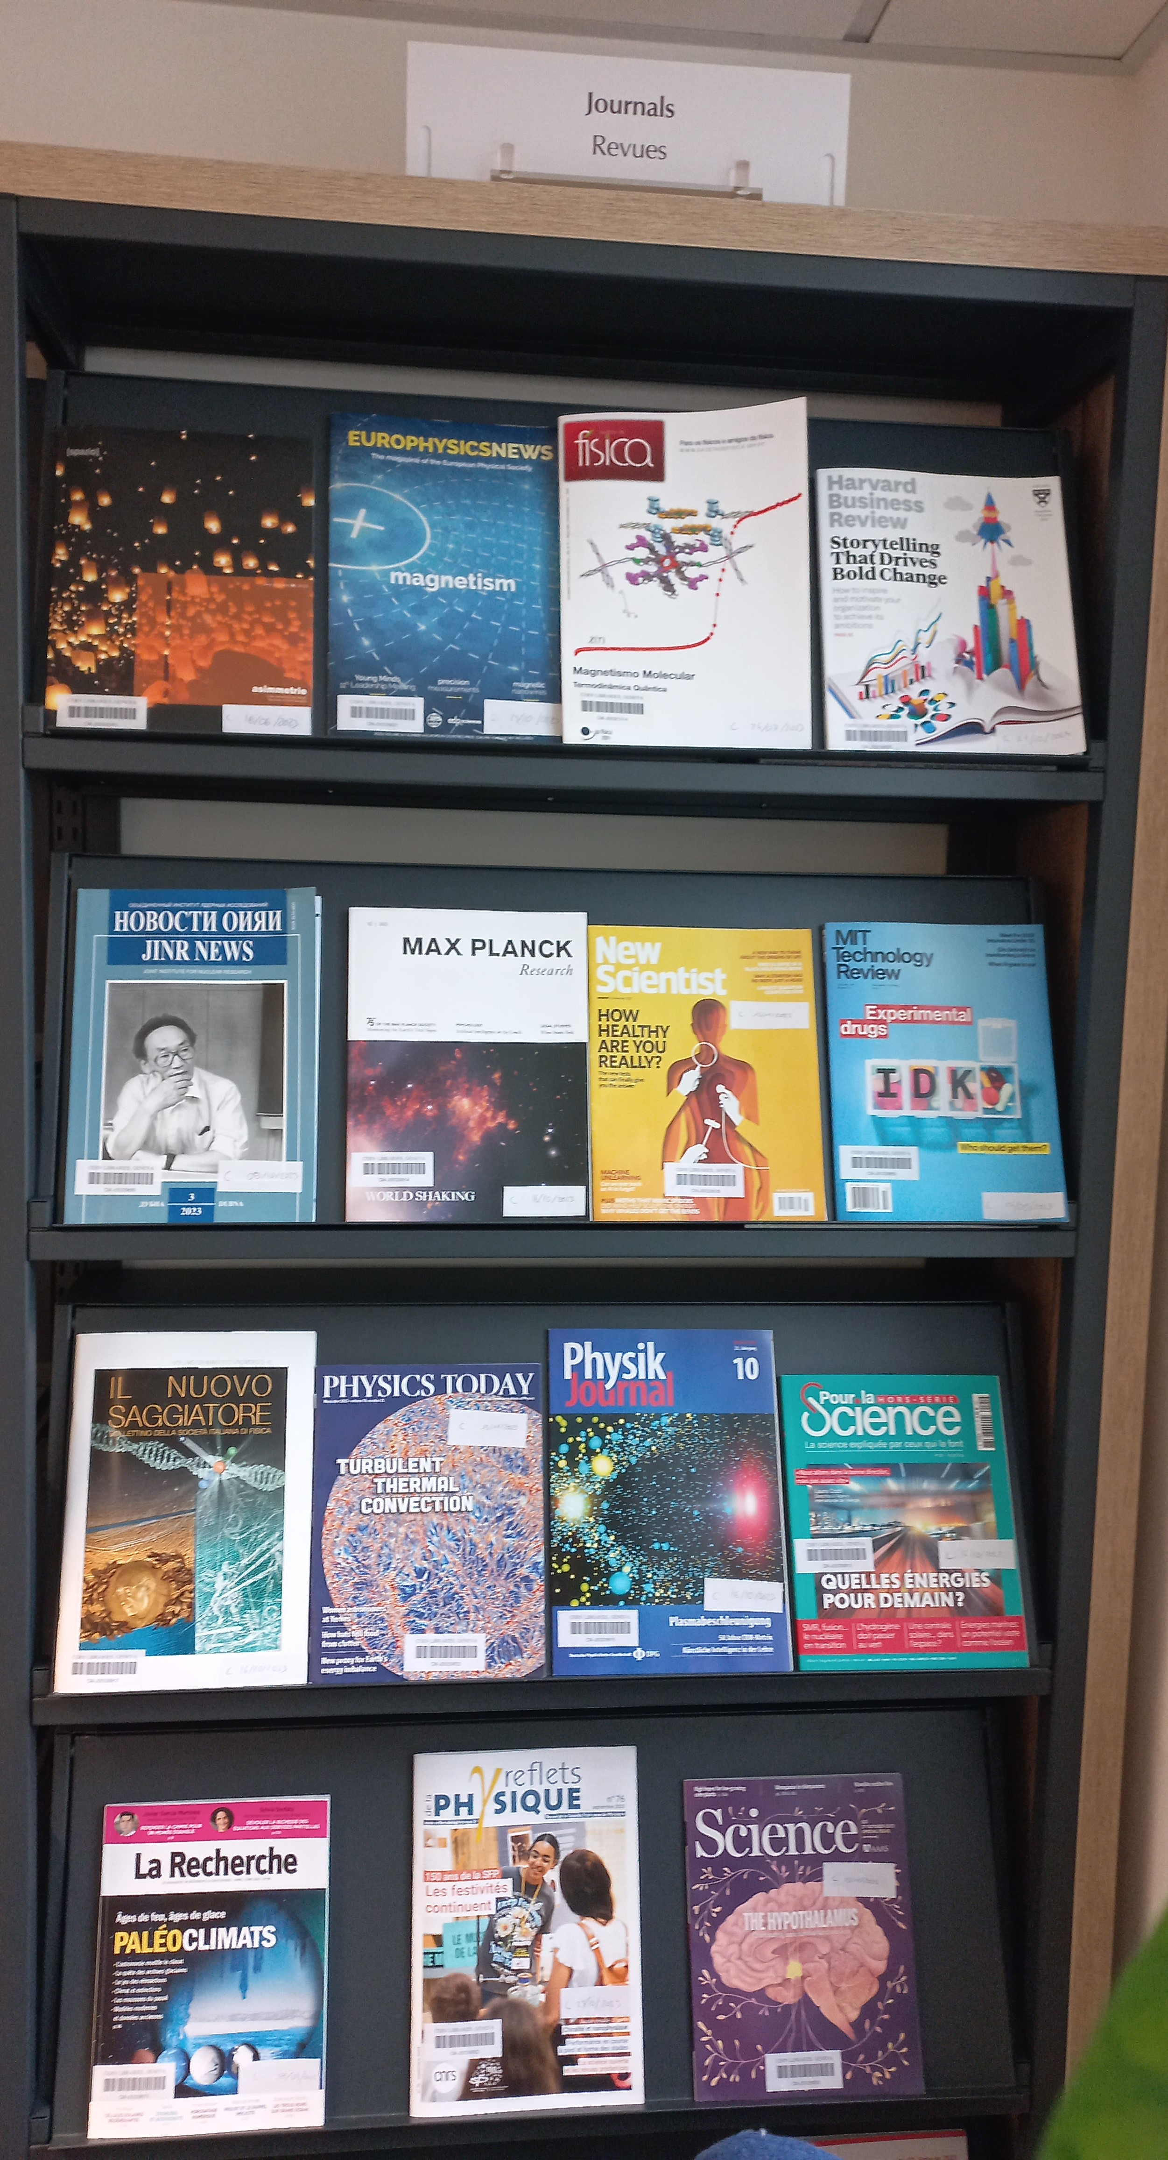
CERN Library collection
16’000 paper books freely available, 40’000 paper books in total
More than 110’000 e-books
20’000 proceedings
45’000 standards
2’300 journals

Slide 10
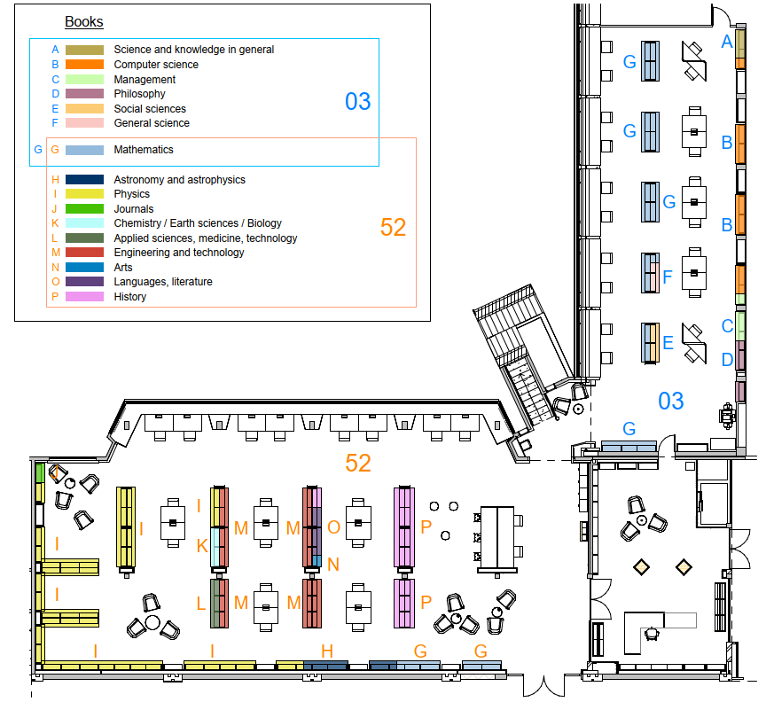
CERN Library catalogue:
Which subjects are covered?
Physics and Mathematics are our biggest subject groups, but we also offer books in other fields:
Applied Sciences
Arts
Astronomy
Chemistry & Biology
Computer Science
Engineering
General Science
History
Languages
Management
Philosophy
Social Sciences
etc.

Slide 11
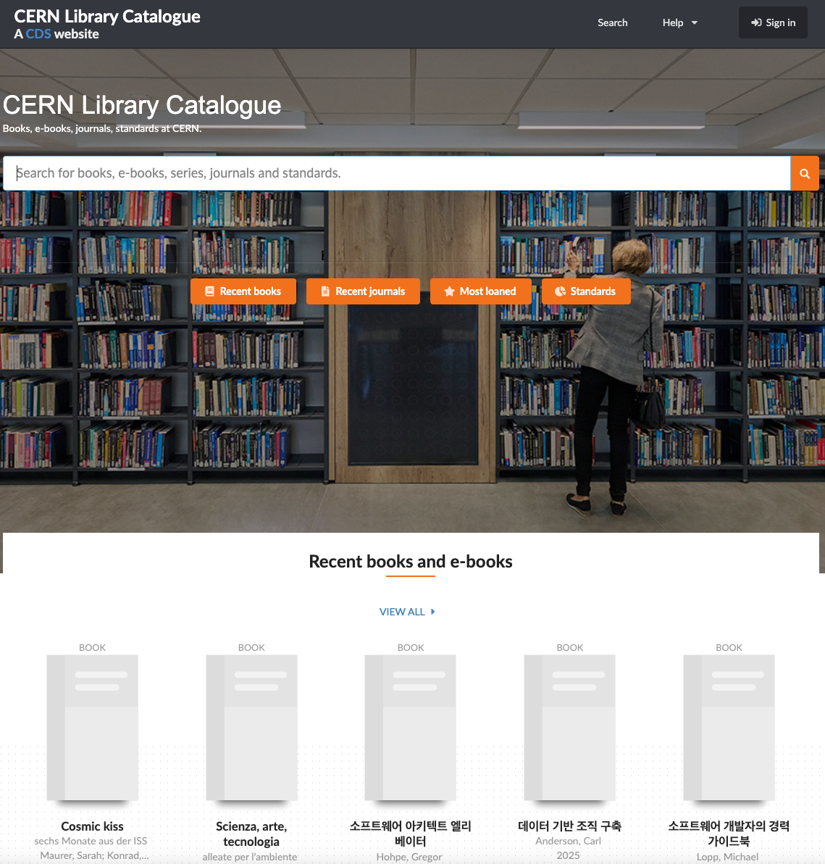
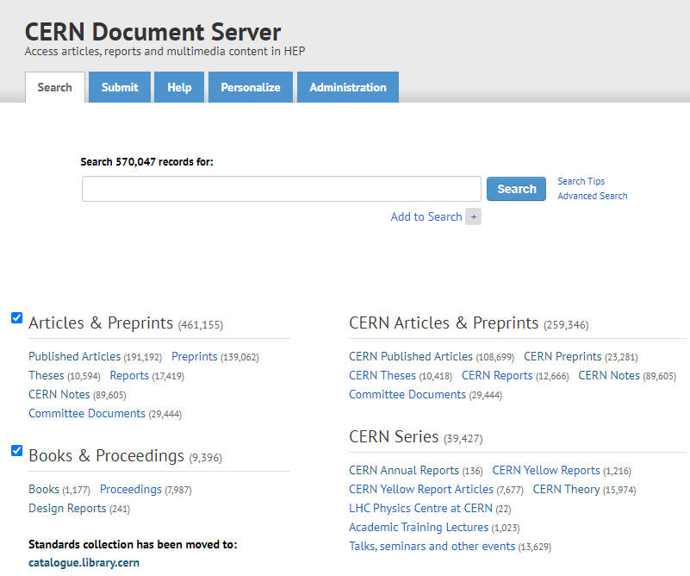
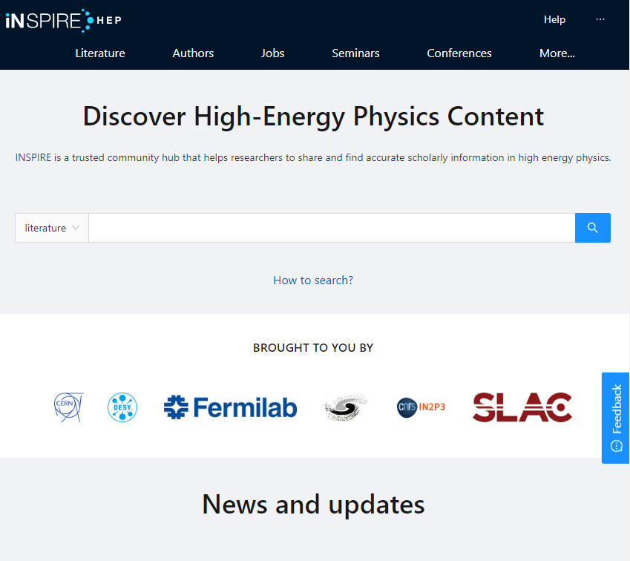
Where to find information?
Library catalogue: https://catalogue.library.cern/
Books, proceedings, journals, standards, in all fields of relevance to the Organisation
CERN Document Server (CDS):
http://cds.cern.ch/
CERN institutional repository which stores documents written by CERN authors and collaborations: CERN articles, reports, Yellow Reports, theses, photos, lectures, Archive collections… and much more!
INSPIRE:
https://inspirehep.net/​
High energy physics (HEP) content: interlinked database on literature, conferences, institutions, seminars, researchers, experiments, job

Slide 12
Online resources external to the Library catalogue
Beside e-books and e-journals available in the catalogue, CERN SIS provides a wide range of online resources in various disciplines:
Dictionaries and reference books (e.g. Oxford English Dictionary, Oxford References, Grand Robert)
Online databases (e.g. Total Materia, Nucleonica)
Scientific writing references (e.g. Chicago Manual of Style, Oxford Style guide)
Online trainings and videos (O’Reilly learning platform)
Online standards (SNV Connect): more than 45’000 standards accessible for CERN
All resources available here: https://sis.web.cern.ch/search-and-read/online-resources

Slide 13
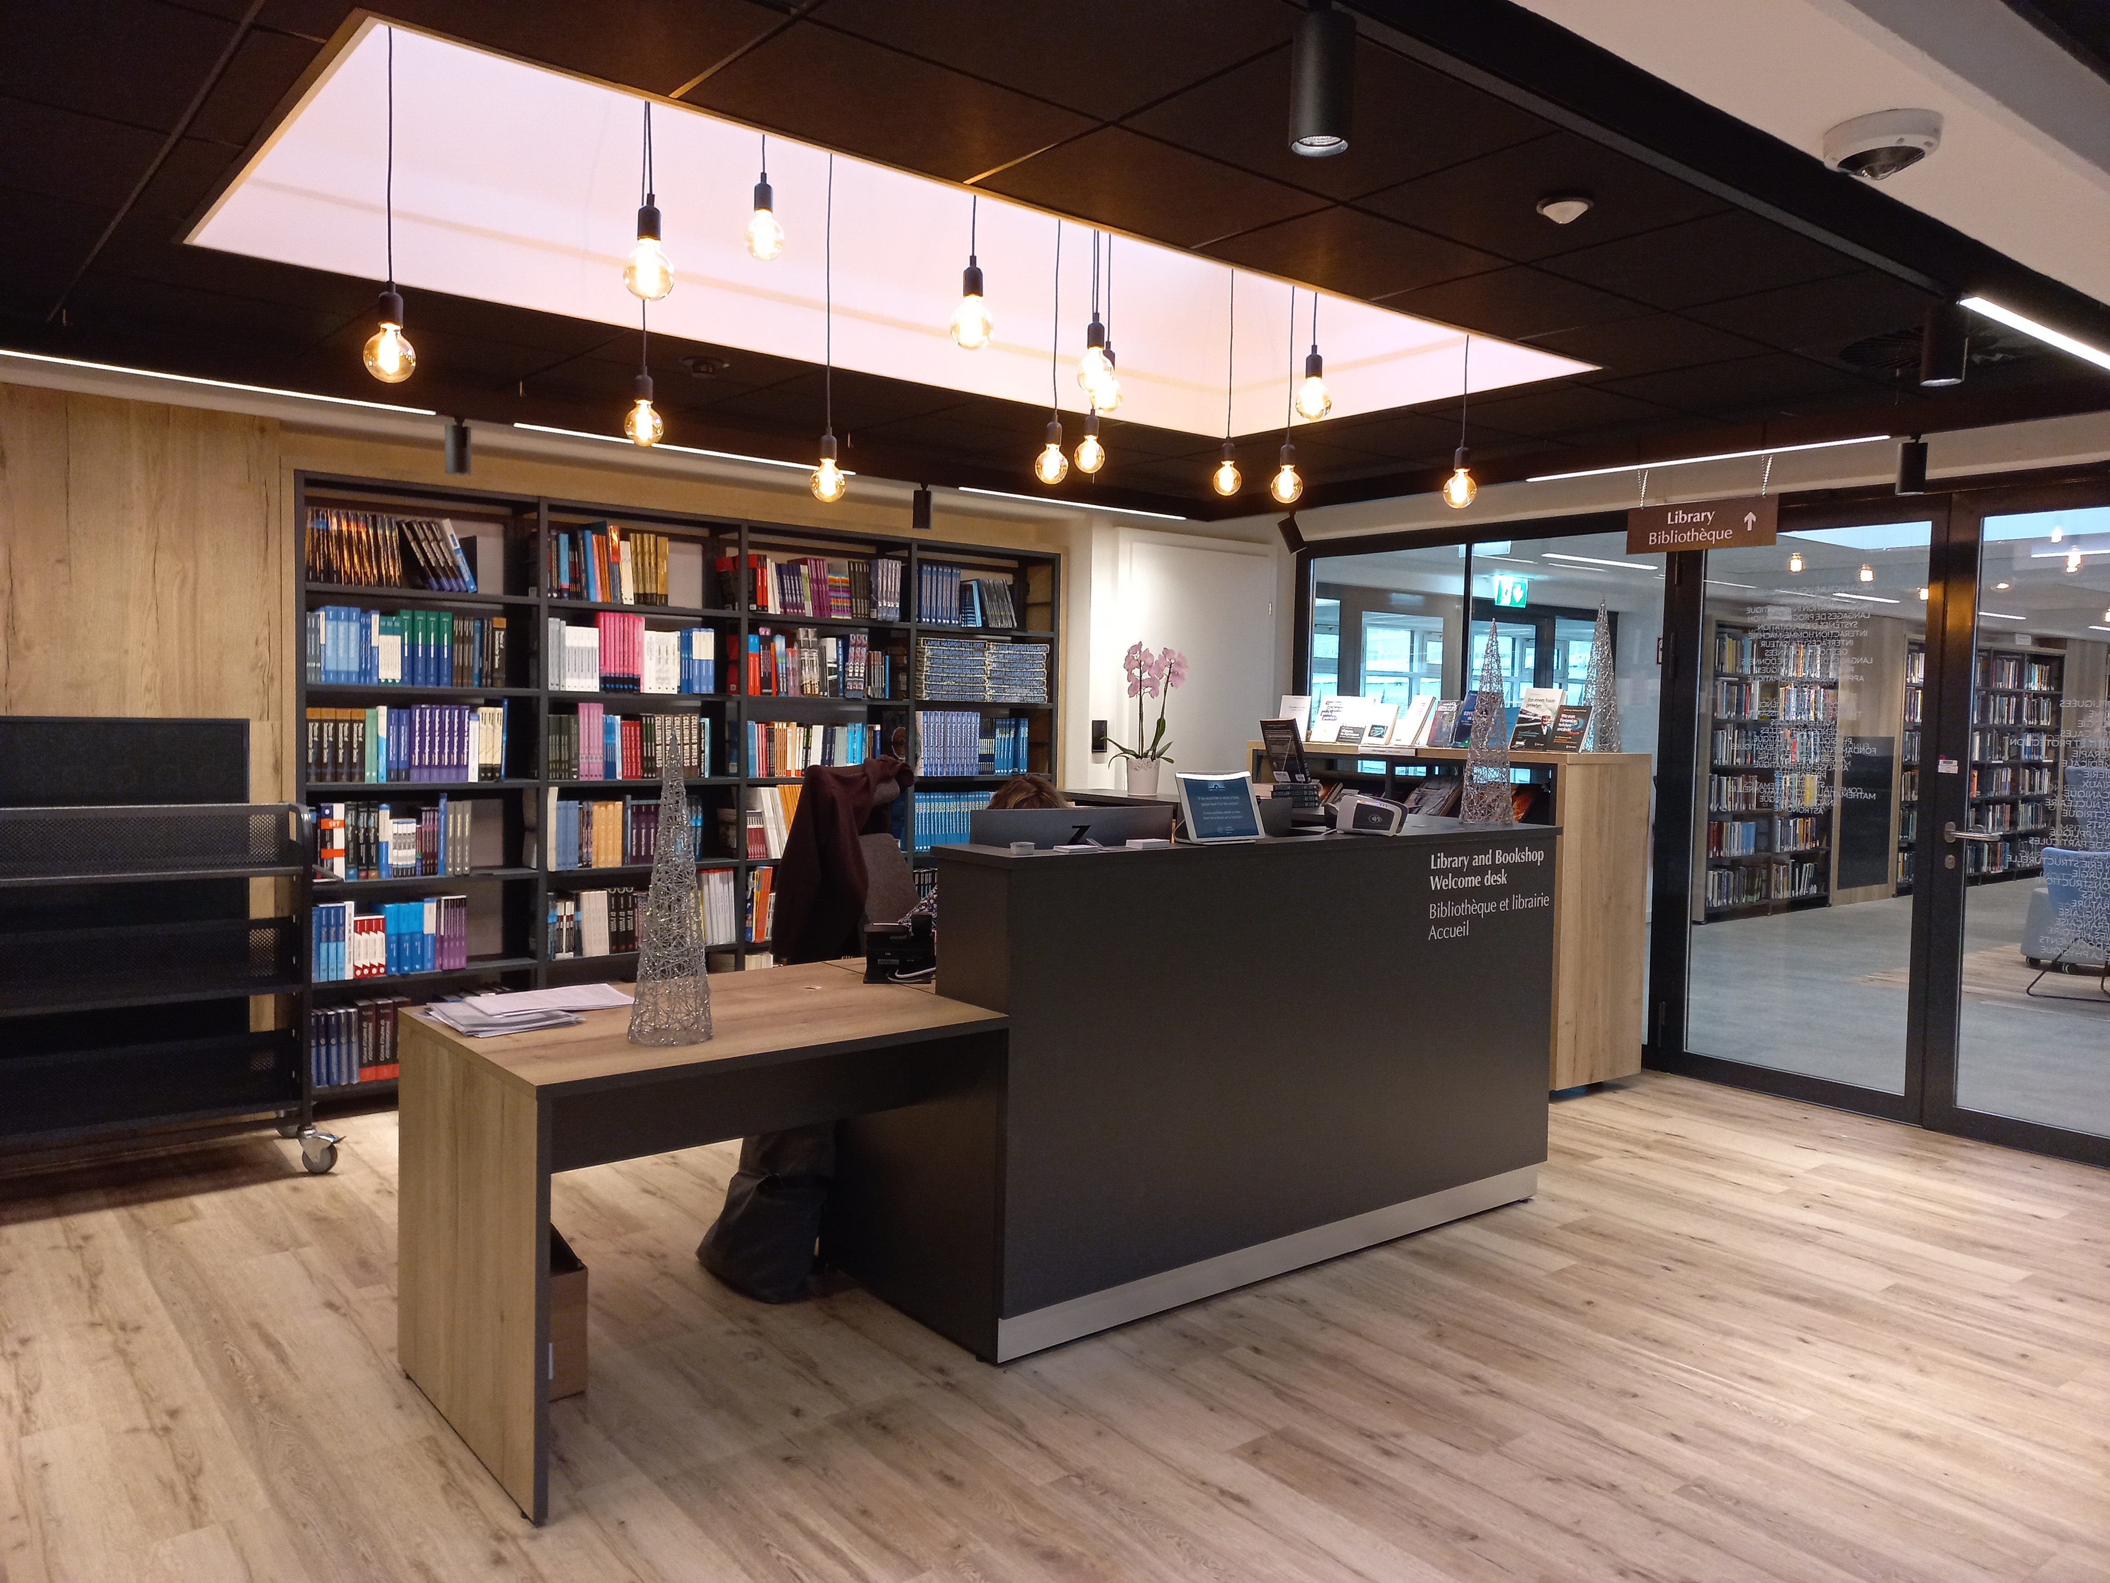
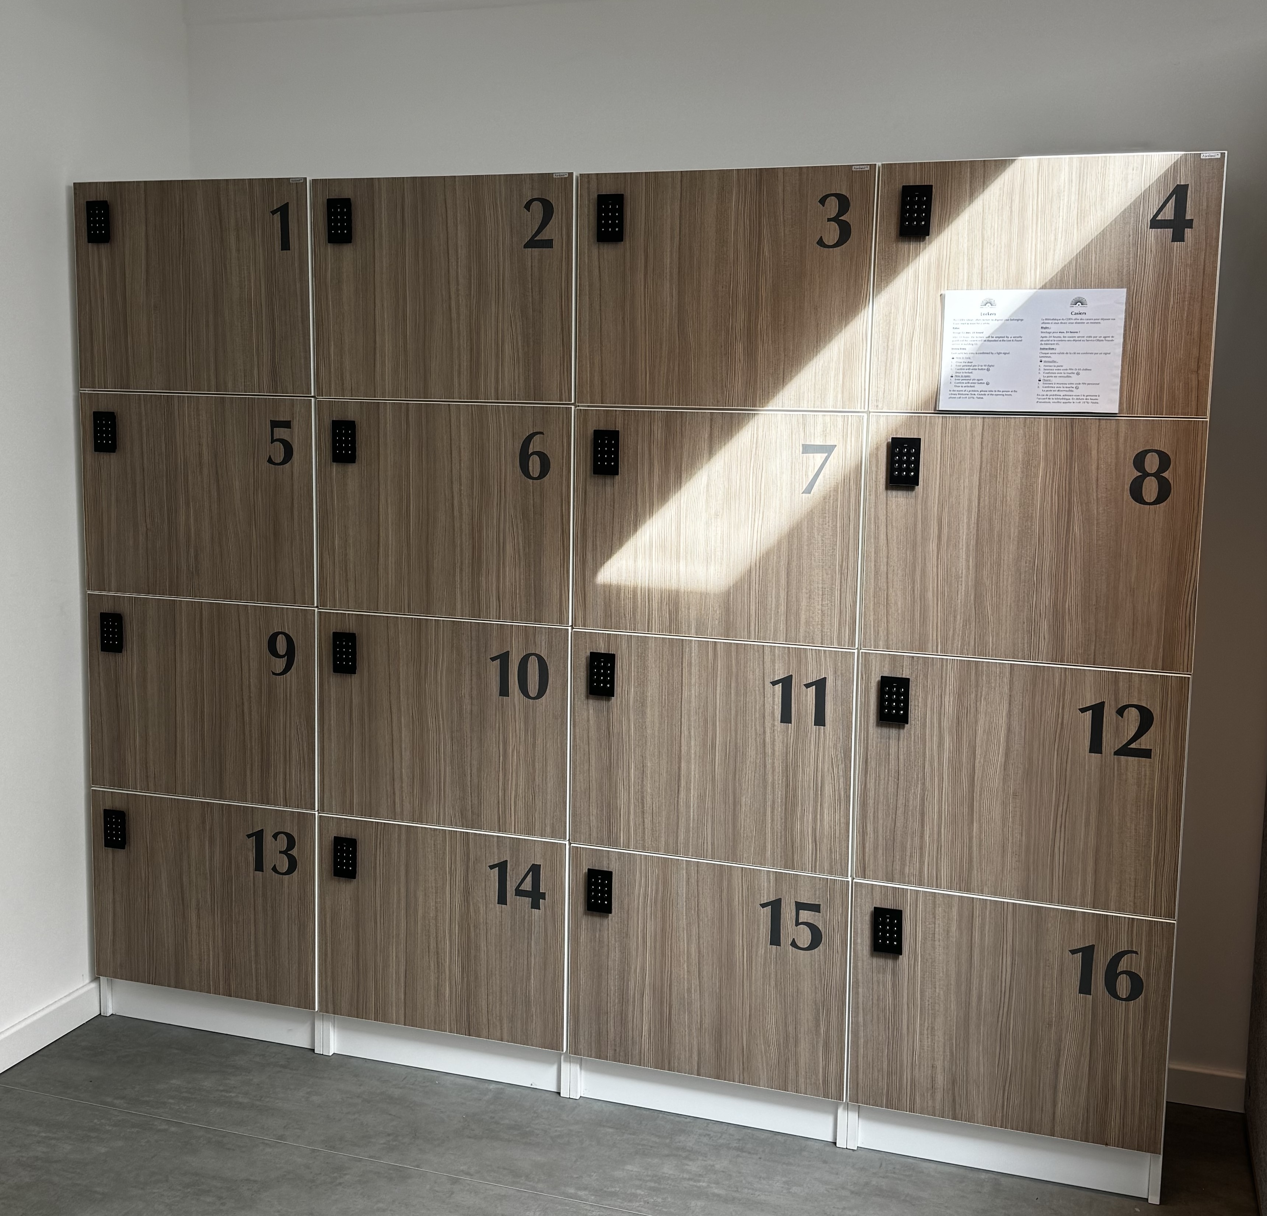
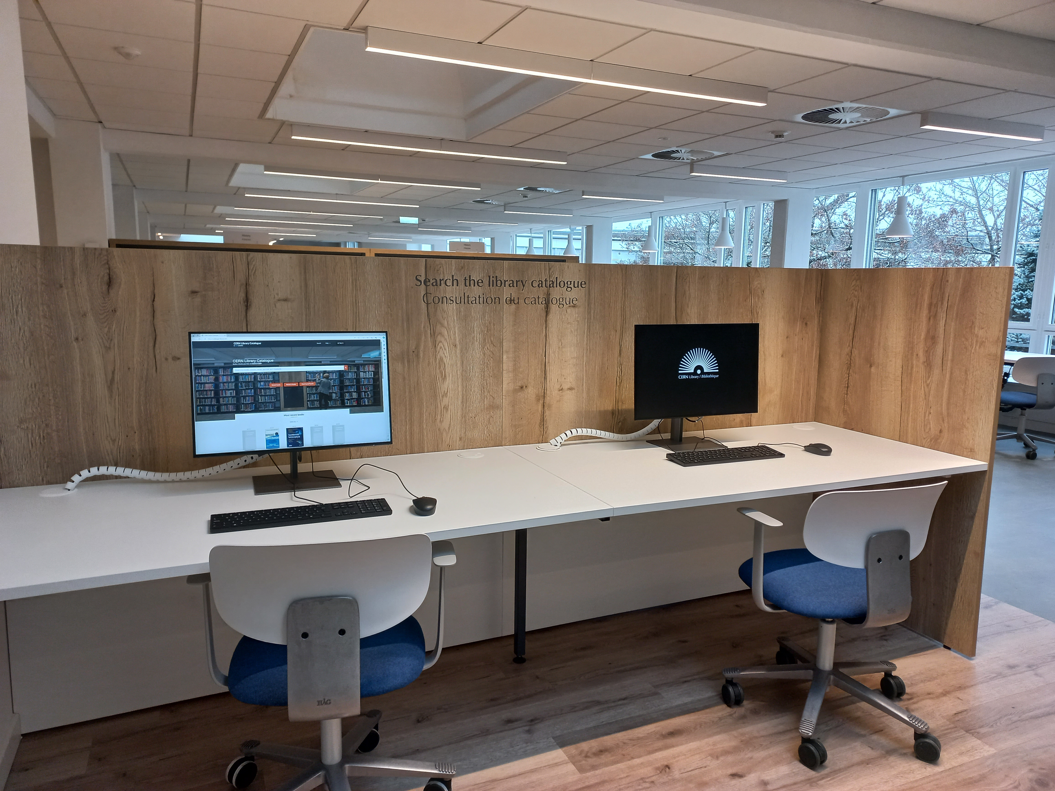
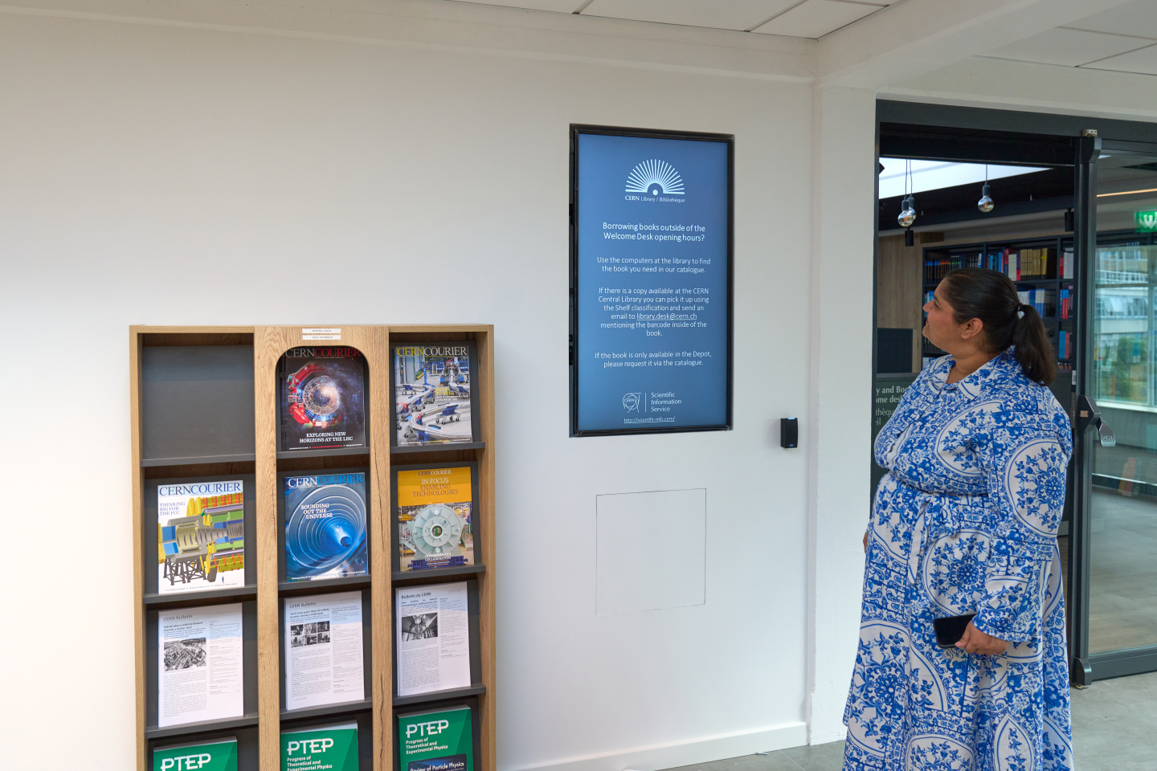
Library facilities
Public PCs to search the
library catalogue; four screens for connecting laptops
The library is open 24/7! Desk is open from Monday-Friday 9:00 – 18:00
Library lockers and a water fountain
Recent CERN publications display
Location: Building 52/1-052

Slide 14
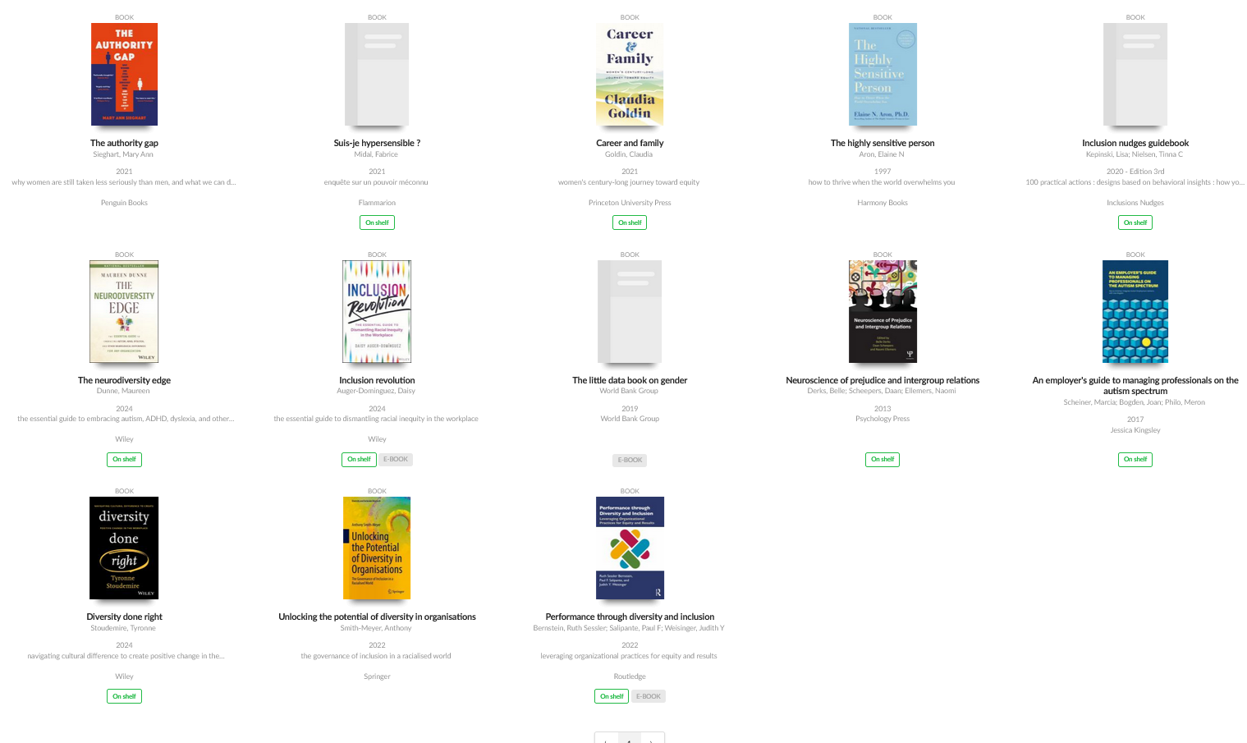
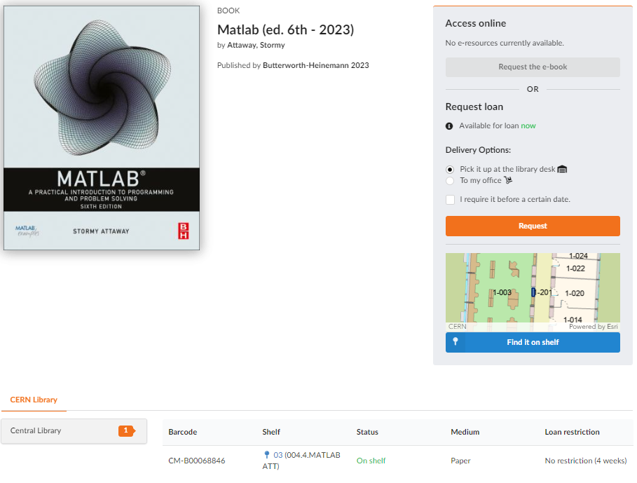

The library is becoming more accessible (1)
Reading corner with books about Diversity & Inclusion: selection made with Diversity & Inclusion Office and dedicated tag
Location of the book on the shelf in the catalogue. Implemented with MapCERN

Slide 15
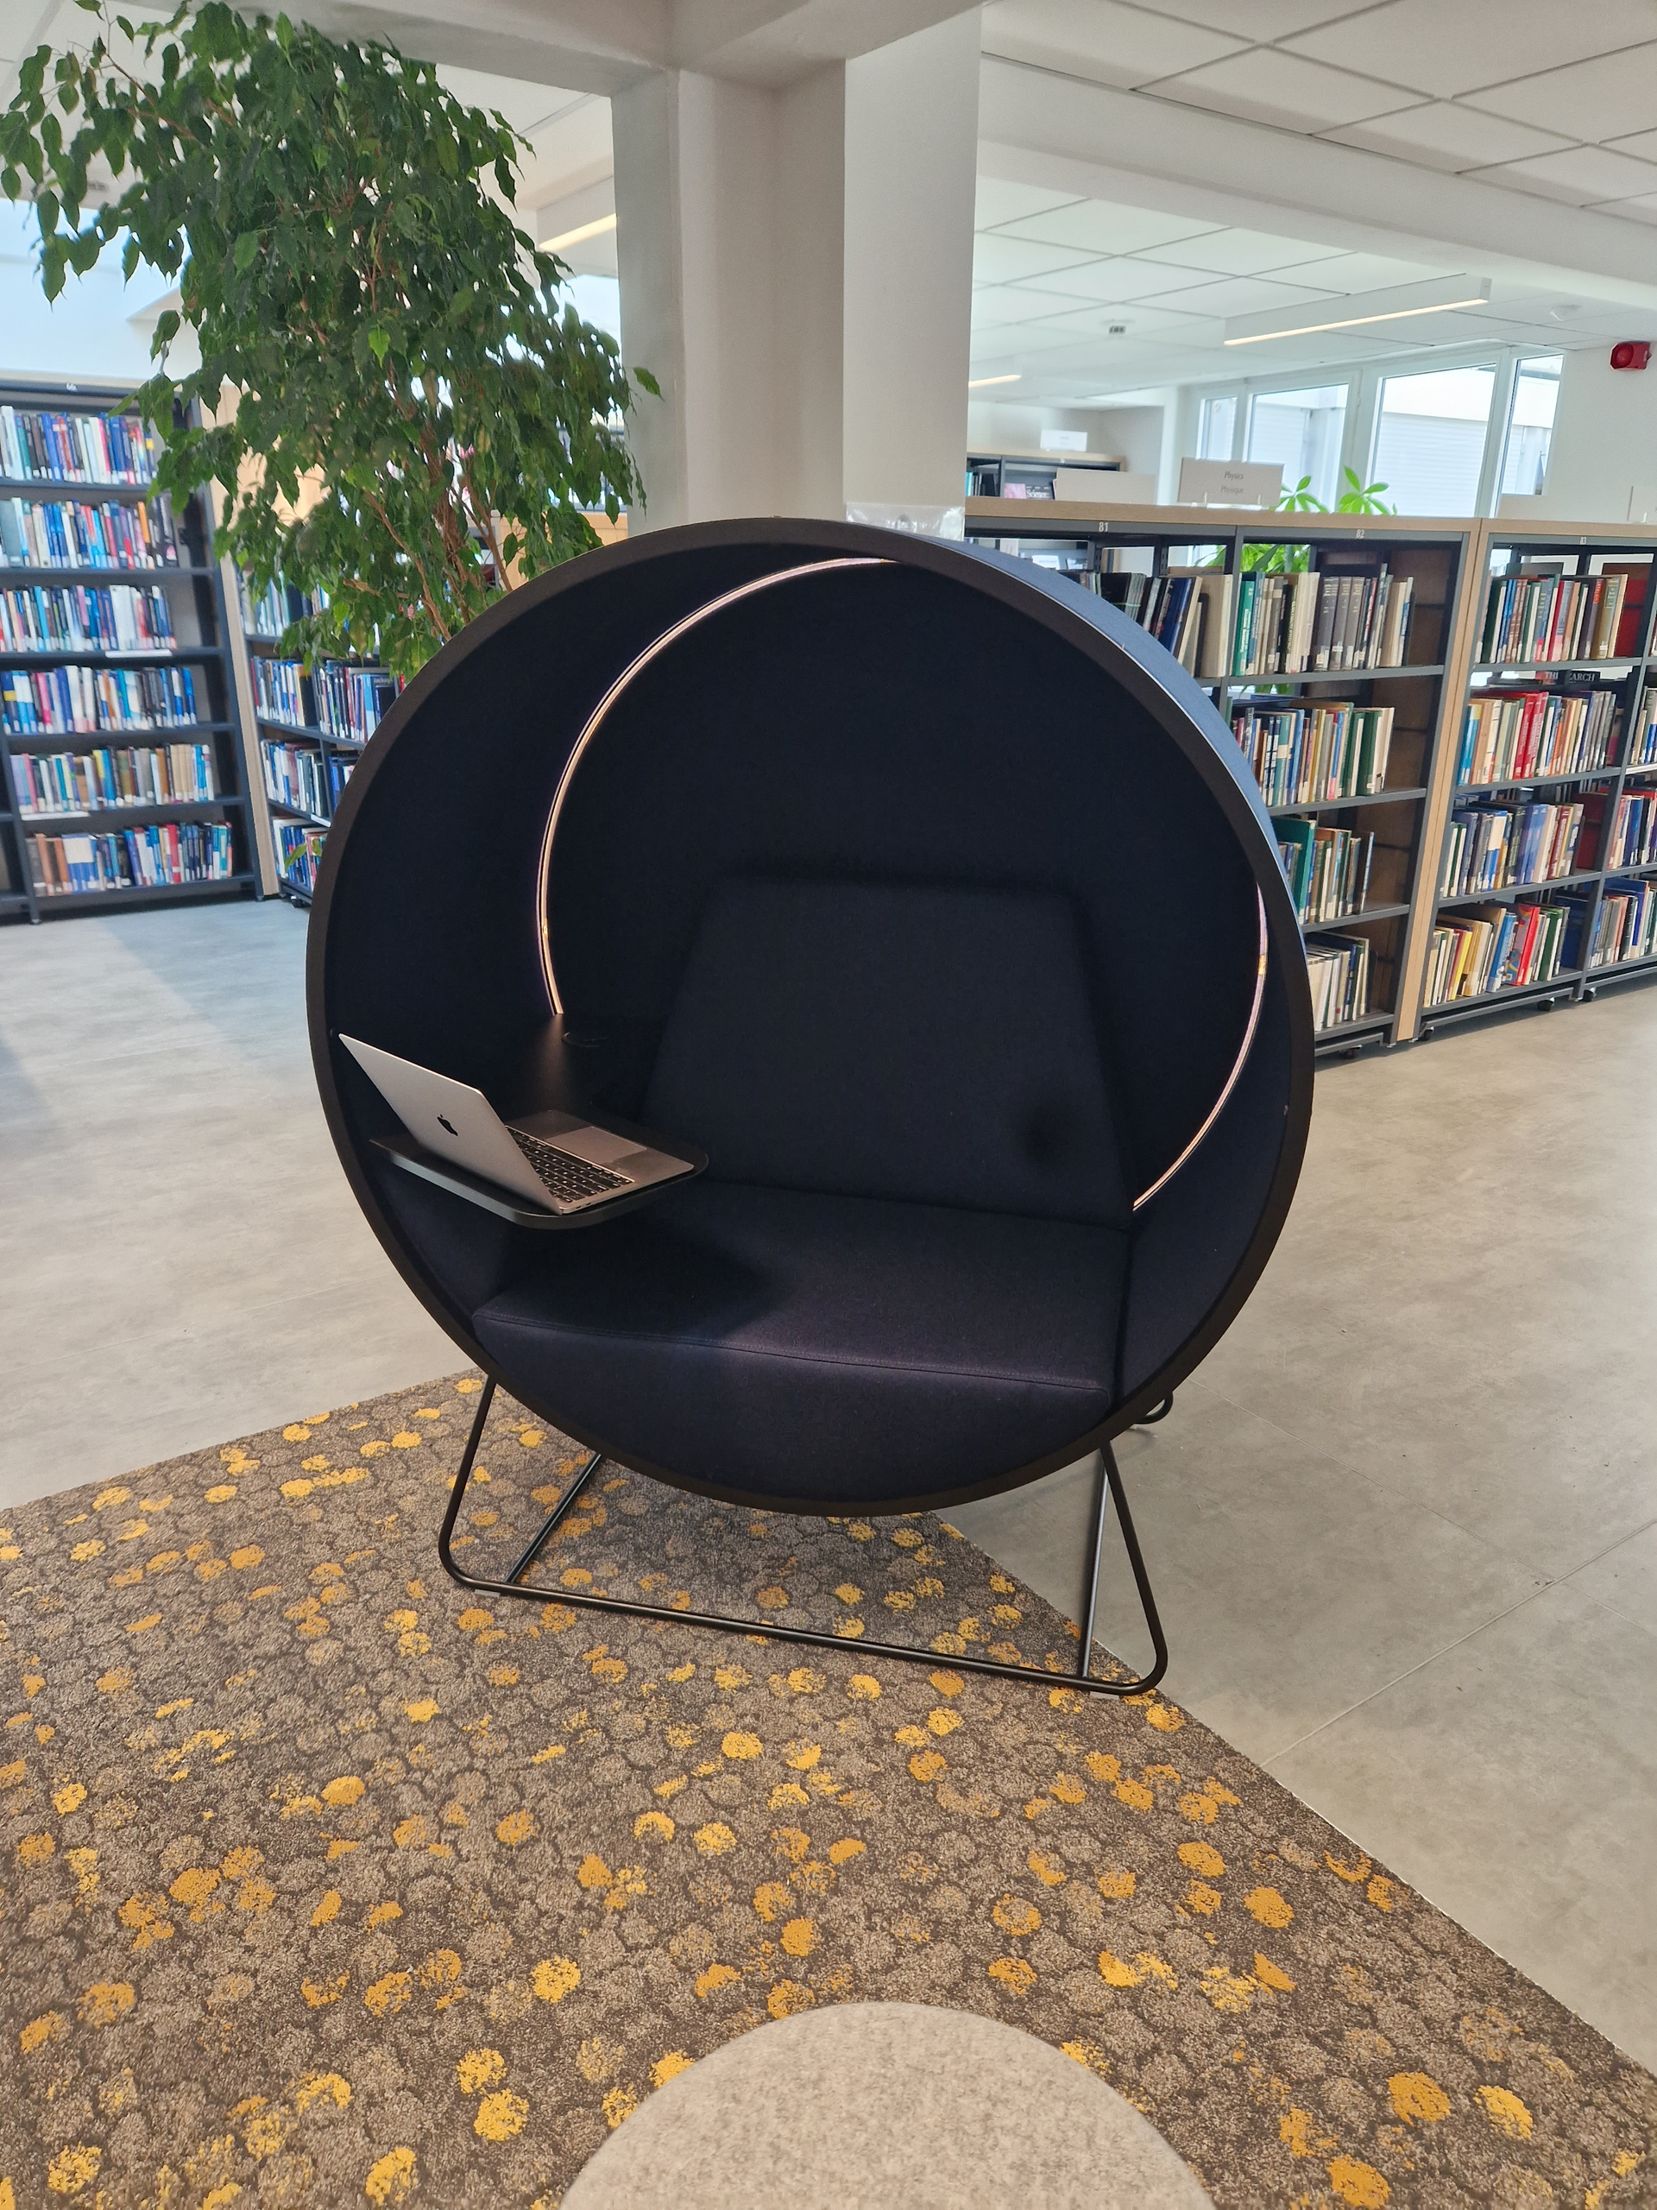



The library is becoming more accessible (2)
“Kuppel” chair: reduces surrounding noise and soft light.
Ear plug dispenser, noise cancelling headphones and magnifying glasses can be borrowed
Better visible signs in the library
Audiobooks and videos are available since July in the catalogue

Slide 16


The library is becoming more accessible (3)
We have automatic doors since October to access the library!
They can be opened manually or by pushing a button.
Notes:
Next steps:
Accessibility of SIS Drupal website, ok → accessibility of CERN Library Catalogue to be done

Slide 17


New: Island SOLO booth
Island SOLO is an acoustic booth for calls and video conferences without being disturbed or disturbing others.
It is located next to the lockers in the CERN Library.

Slide 18

New: Test phase for self-checkout
Scan the QR code
Login with CERN SSO
Scan the barcode inside the book
Register the loan

Slide 19


CERN Bookshop – part of the CERN Library!
Bookshop catalogue
We offer not only physics and mathematics books but also popular science, children’s books, CERN photo books, as well as books in different languages (English, French, Italian, German)
Location and opening hours are the same as the Library Welcome Desk:
Monday-Friday: 09:00 – 18:00
Payment: cash/card or CERN budget code

Slide 20
Thanks for your attention!
Any questions?

