Slide 1
DRD6-RADiCAL Beam Test Planning - for Sept. 2025, H6
Needs from CERN
  Beam Electrons
    E = 5, 10, 15, 25, 50, 75, 100, 125, 150 GeV
    Spot 2 x 2 cm²
    Flux 10k per spill
  DESY Table
  Beam Chamber for (x,y)
  One week of running
  Access to counting room prior and during run
  Possible crane access to table placement
  Not needed: no cryo, no gases
RADiCAL will provide
  RADiCAL module for testing various scintillator and waveshifter combinations.
  Trigger and DAQ
  MCP for timing reference
  Scintillation Counters for trigger
  Pb glass 2x2 array for downstream energy measurement of beam albedo, and hadron and muon ID.
Contact Persons:
J. Wetzel, A. Mestvirishvili, R. Ruchti
Groups:
USA - Caltech, Coe, Iowa, Notre Dame, Virginia
Turkiye - Istanbul, Istanbul Cerrahpasa, Yildiz Technical
*Note for Reference:
Talk by James Wetzel summarizing RADiCAL beam test, from October 2024, attached to the Indico.

Slide 2
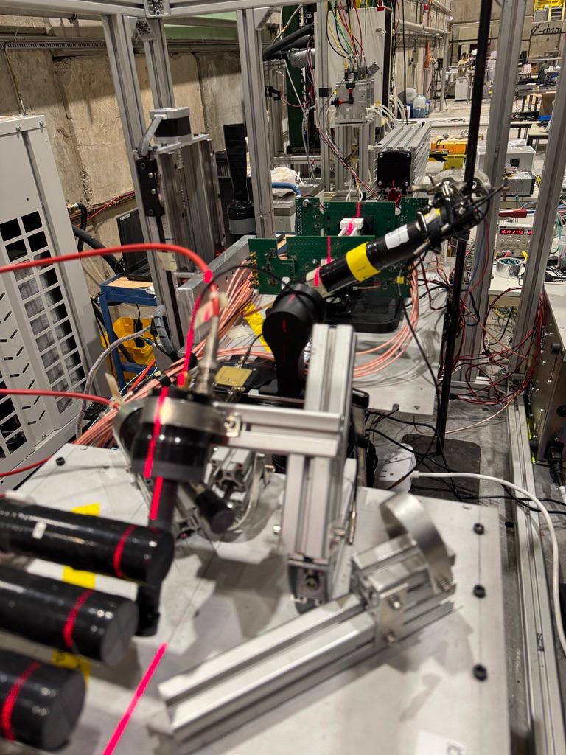
RADiCAL Setup in H6
2-9 October 2024
6 Pb Glass Backing Cal.
5 RADiCAL Module
4 Scint Ctr
3 MCP Timing Ref
2 Scint Ctr
1 Scint Ctr

Slide 3
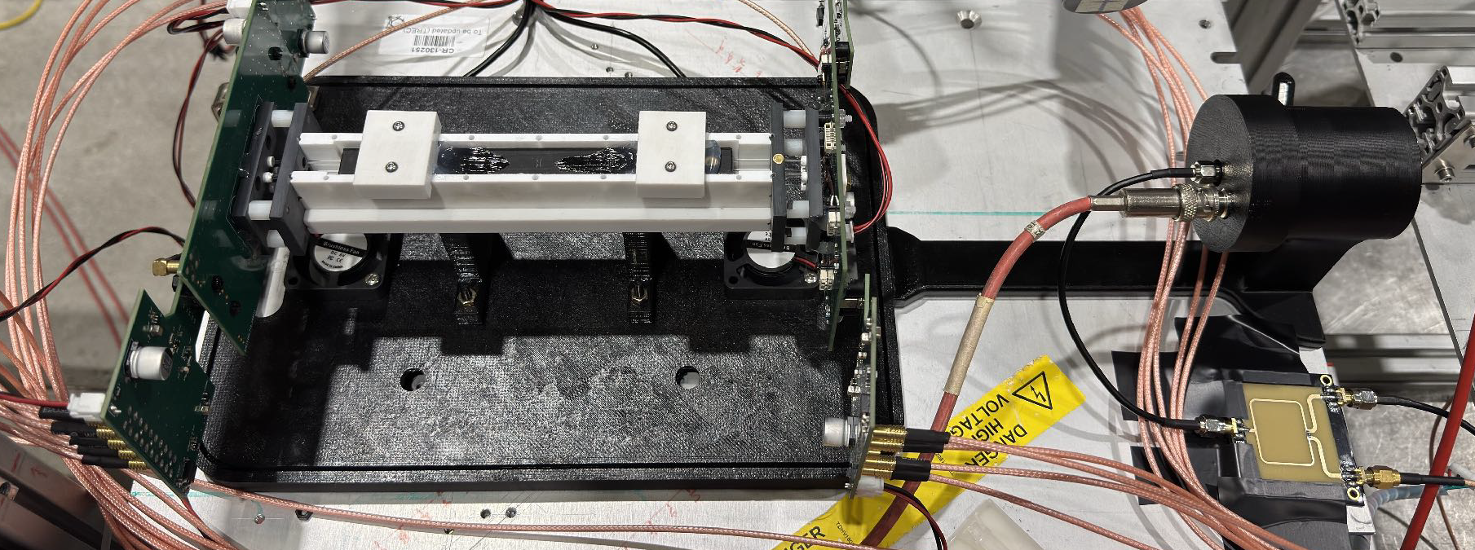
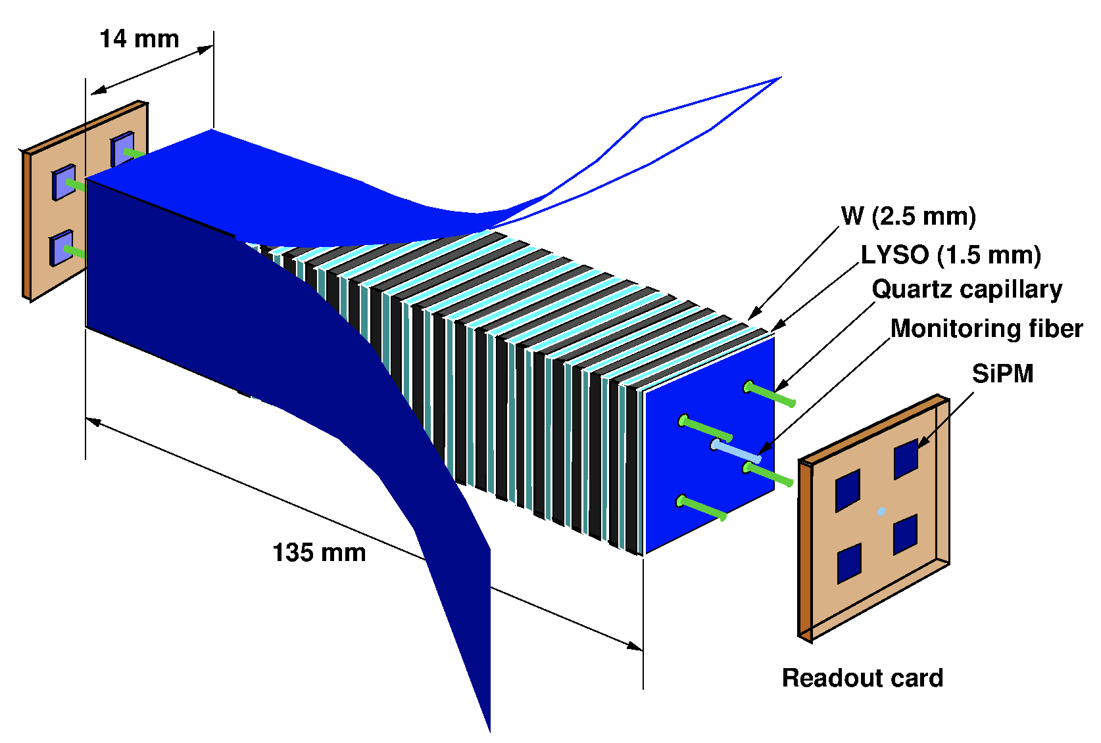
RADiCAL Module
MCP for timing reference
Beam

