Slide 1
WP1
Monica D’Onofrio, Cristiano Sebastiani, Joseph Carmignani
University of Liverpool

Slide 2
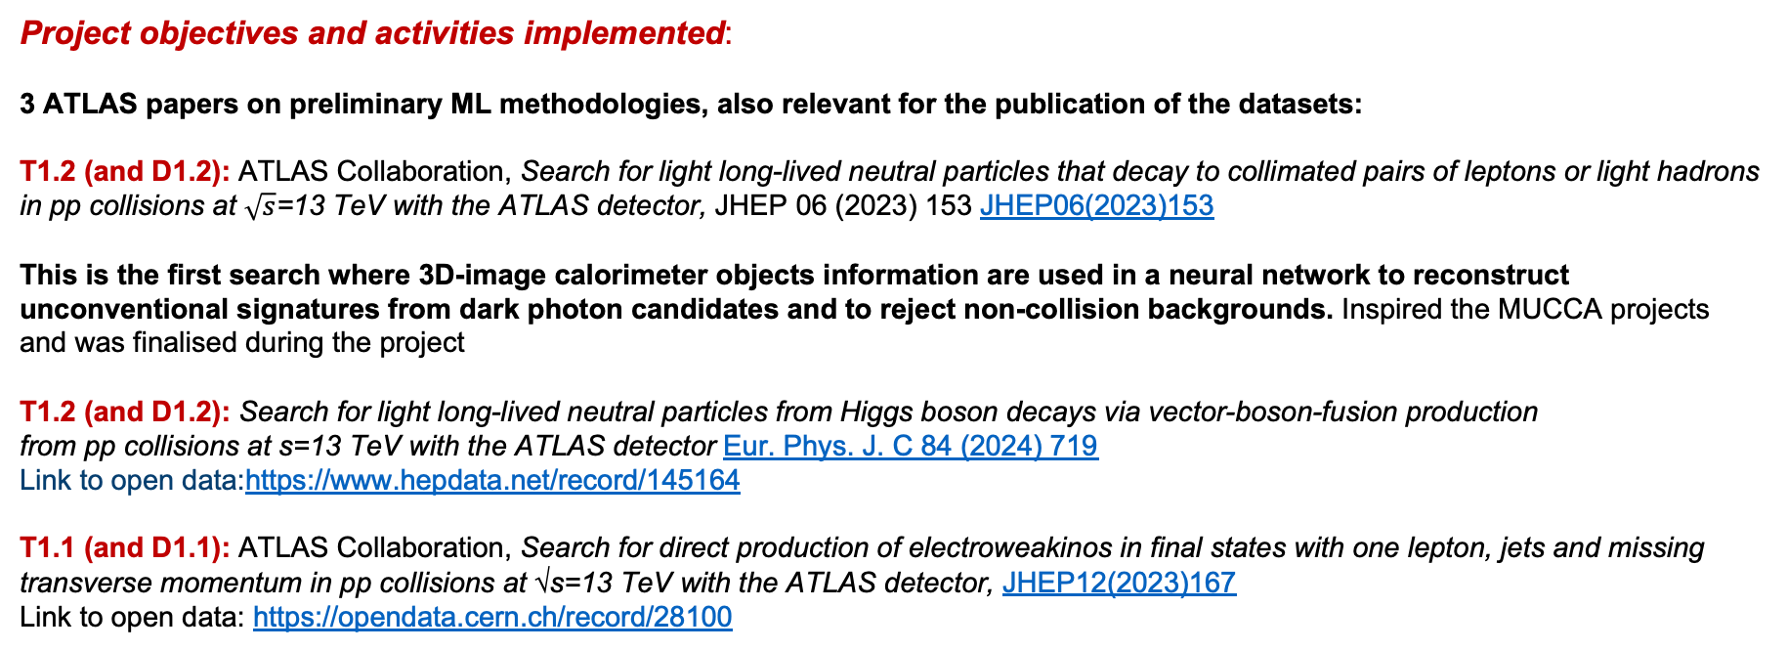
WP1: Searches for new physics at the ATLAS experiment
DARK PHOTON: light long-lived particles belonging to a new hidden sector not yet discovered because too feebly interacting with ordinary matter.
SUSY: search for dark matter candidates resulting from the decay of new particles predicted by Supersymmetry.
Project objectives and activities implemented:
3 ATLAS papers on preliminary ML methodologies, also relevant for the publication of the datasets:
T1.2 (and D1.2): ATLAS Collaboration, Search for light long-lived neutral particles that decay to collimated pairs of leptons or light hadrons in pp collisions at $\sqrt{s}$=13 TeV with the ATLAS detector, JHEP 06 (2023) 153 JHEP06(2023)153
This is the first search where 3D-image calorimeter objects information are used in a neural network to reconstruct unconventional signatures from dark photon candidates and to reject non-collision backgrounds. Inspired the MUCCA projects and was finalised during the project
T1.2 (and D1.2): Search for light long-lived neutral particles from Higgs boson decays via vector-boson-fusion production from pp collisions at s=13 TeV with the ATLAS detector Eur. Phys. J. C 84 (2024) 719
Link to open data:https://www.hepdata.net/record/145164
T1.1 (and D1.1): ATLAS Collaboration, Search for direct production of electroweakinos in final states with one lepton, jets and missing transverse momentum in pp collisions at √s=13 TeV with the ATLAS detector, JHEP12(2023)167
Link to open data: https://opendata.cern.ch/record/28100

Slide 3
Project objectives and activities implemented (cont.d):
Explainability papers:
WIRN (DA for anomaly detection) – T1.1 and T1.3 (and D1.3): A. Verdone, M. D’Onofrio, et. al. Enhancing High-Energy Particle Physics Collision Analysis through Graph Data Attribution Techniques, June 2024, https://arxiv.org/abs/2407.14859
MoE (design and interpretable architecture) – T1.1 and T.1.3 (and D1.3): Mixture-of-Experts Graph Transformers for Interpretable Particle Collision Detection
https://arxiv.org/abs/2501.03432 - answering questions from referees
Additional studies and tests made by Donatella: https://bristle-sleet-bfa.notion.site/Additional-Test-for-MoE-Graph-Transformer-19dcb86031e4802ca275d8fc85050304
T1.2 and T1.3 (and D1.3): paper in preparation (see later for status) – initial work done using TracIn and saliency maps, presented at EUCaiF 2024 by Joe Carmignani: Integrating Explainable AI in Modern High-Energy Physics
https://indico.nikhef.nl/event/4875/contributions/20273/

Slide 4
Project objectives and activities implemented (cont.d):
Further outcomes of T1.3 (from T1.1):
FCC-hh di-Higgs studies: feasibility studies for di-Higgs in the bbtautau channel using GNN initially developed for SUSY https://repository.cern/records/p8y5f-23w42
Additional studies done by Donatella and Sam on MoE applied to the diHiggs case (see later)
Plan: paper using baseline GNN with MoE in appendix (results are slightly worse – dependence on statistics of the samples?)
Further outcomes of T1.3 (from T1.2):
Axion-like particle analysis at ATLAS in Run 3: use GNN as from Dark Photon jets in the analysis for ALPs from Higgs decay
Expected publication end of 2025. Work with MDO and Cristiano Sebastiani, results are still internal
TauJetGraph – for reconstruction of hadronic taus as alternative to the currently in-development GNTau algorithm
Documenting the progress internally to ATLAS – Joe Carmignani qualification task to become ATLAS author; pub note in preparation for end of 2025 with contributions from 2 Liverpool students co-supervised by the UK PI (MDO)
Report on results, i.e. in Institute of Physics conference by PhD student: https://indico.global/event/5646/contributions/122117/
Knowledge developed in MUCCA utilised now for healthcare related project (ML predicting eye disease progression)

Slide 5
Transnational collaboration
Work closely done with WP7 members
Impact on global policy: AI for Particle Physics in the UK – https://cds.cern.ch/record/2927605
Enabling AI in HEP experiment and theory: software/tools, operations, wider engagement and skills capacity
(We should make sure to also cite this from Stefano: https://arxiv.org/abs/2503.14192 Strategic White Paper on AI Infrastructure for Particle, Nuclear, and Astroparticle Physics: Insights from JENA and EuCAIF)
BSc and MPHYS projects: 2 in 2024 (Lennox Wood, Sam Valentine) and 3 in 2025 (one on T1.1 – Naveen Baghran, one on T1.2 and one – Lennox Wood, on diHiggs in ATLAS studying regression methods, Alice Cartridge);
Summer studentships: 2 students – same from BSc and MPHYS in 2024. Also relevant for introducing AI to other academics and postdocs in Liverpool (Academics: Dr Rompotis, Prof Gwilliam; Dr Degens, Dr Anders)
Beyond MUCCA collaboration : Submission of a project to STFC (Small Awards Astronomy): ASTRID Asteroid Structural Threat Risk Identification for planetary Defense. → O1. Bridge the gap between astrophysical evolution models and spacecraft gravity inverse models to better understand long-term asteroid evolution; O2. Develop physics-informed machine learning models for gravity predictions. O3. Optimise mission design and improve explainability of gravity inversion techniques, ensuring reliable asteroid density estimation.
Simone Scardapane as one of the project collaborators. Other collaborators from ESA. Awaiting for results
Significant events and results (See objectives)
Also – From Graph Neural Networks to explainable AI” School, University of Liverpool, September 2023 (~35 participants) .
Seminars to undergraduate students in Liverpool
Talk last year from Joe Carmignani directly relevant for the project. Cristiano reporting in CHIST-ERA meeting + talks in next slides
Monica presenting to UG students dedicated seminars + Seminar in TorVergata 17.12.2024
preparing an article for the public on AI for PP in Liverpool (to be published in early June); enhancing connections with NVIDIA and IBM; boosting collaboration with Institute of Life Science in Liverpool.
Technology readiness level (TRL) - From 3 to 4

Slide 6
 | Titolo presentazione | Nome conferenza | Luogo e data | Tipo (conferenza, workshop, …) | Nazionale/ Internazionale | Su invito | Orale o poster | Plenaria/ Parallela
1 | Triggering long-lived particles: challenges and perspective for the HL-LHC at ATLAS and CMS | WIFAI 2024 | Bologna, 12-15 Nov 2024 | Workshop | Nazionale | Si | Orale | Plenaria
2 | Recent results on LLPs from displaced vertices in ATLAS | LHCP2024 | Boston, 3-8 Giu 2024 | Conferenza | Internazionale | No | Orale | Parallela
3 | Multi-disciplinary Use Cases for Convergent new Approaches to AI explainability | CHIST-ERA projects seminar | Helsinki, 16-18 Apr 2024 | Congresso | Internazionale | No | Orale | Parallela
4 | Exotic decays of the Higgs bosons | Higgs2022 | Pisa, 7-11 Nov 2022 | Conferenza | Internazionale | No | Orale | Parallela
5 | Searches for exotic physics with unconventional signatures at ATLAS and CMS | MoriondQCD2021 | Moriond@Home, 27 Mar- 3 Apr 2021 | Conferenza | Internazionale | No | Orale | Parallela
Cristiano’s Seminars
Seminar at Lawrence Berkeley National Laboratory (LBNL), Berkeley, California
Title: “Searches for exotics physic with long-lived particles at ATLAS”
18 aprile 2023 - https://rpm.physics.lbl.gov/event/speaker-cristiano-sebastiani-title-search-for-exotic-physics-with-long-lived-particles-at-atlas/
Seminar at Imperial College, Londra, Inghilterra
Title: “Searches for exotic physics with long-lived particles at ATLAS”
7 giugno 2023 - http://www.hep.ph.ic.ac.uk/seminars/special/seminars_past.html
Seminario a University of Edinburgh, Edinburgh, Scozia
Title: “Searches for exotic physics with long-lived particles at ATLAS”
17 marzo 2023 - https://www.ph.ed.ac.uk/particle-physics-experiment/seminars/archive

Slide 7
Public github tools from WP7 members (Donatella Genovese and Alessio Devoto)
these for example have been used by students and postdocs for further studies
Dataset Susy: PIP package to manipulate high energy collision events via graphs and Pytorch Geometric https://github.com/alessiodevoto/sparticles
Dataset diHiggs: https://github.com/DonatellaGenovese/diHiggsDataset
Dataset Darkphoton: https://github.com/alessiodevoto/darkphoton/tree/main (README to be added)
Mixture of experts: https://github.com/DonatellaGenovese/Mixture-of-Expert-Graph-Transformer

Slide 8
Status of DPJ paper
Reminder: issues in having anything meaningful from a xAI perspective – also Joe left and this was unfinished
Cristiano and Alessio now working on it
  Lev and Marco updated the workflow to make it more efficient
  Tested on topological deep learning models, also trying to exploit new features → not really groundbreaking …
  Hence, decided to use MoE also on this use-case with addition on doing some sampling on routing during inference. On the routers one can see how the experts choices are distributed
  Studying the history, one hopes to obtain an estimate on the uncertainty on the outputs – in practice do N runs of inference, record assignements of expert for each sample and calculate the frequency of assignments on the N run as a probability, in such a way we get, for each sample, the empirical probability that it is assigned to that expert.

Slide 9
Some details on new analysis – di Higgs
Reminder of the FCC-hh
Current nominal c.o.m.: 84 TeV

Slide 10
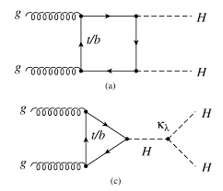
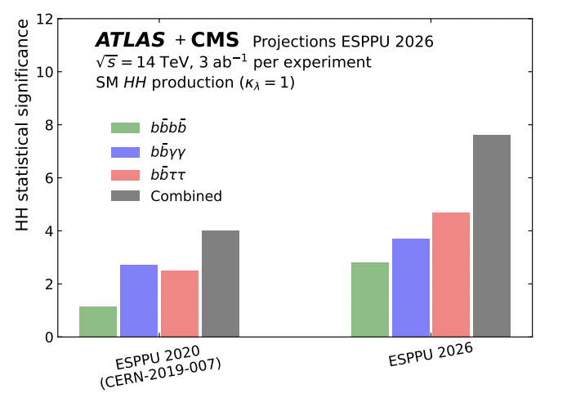
Di-Higgs studies at the FCC-hh
Measurements of HH production, sensitive to modifications to BEH potential and therefore crucial for our understanding of EWSB, remains one of the main targets of the LHC, the HL-LHC and the FCC.
  New feasibility studies HL-LHC → reach 7σ, uncertainties on k_{λ} below +/-30%
  At FCC-hh, more precise measurements will be possible!
HL-LHC
Briefing book from previous ES updated in this study

Slide 11
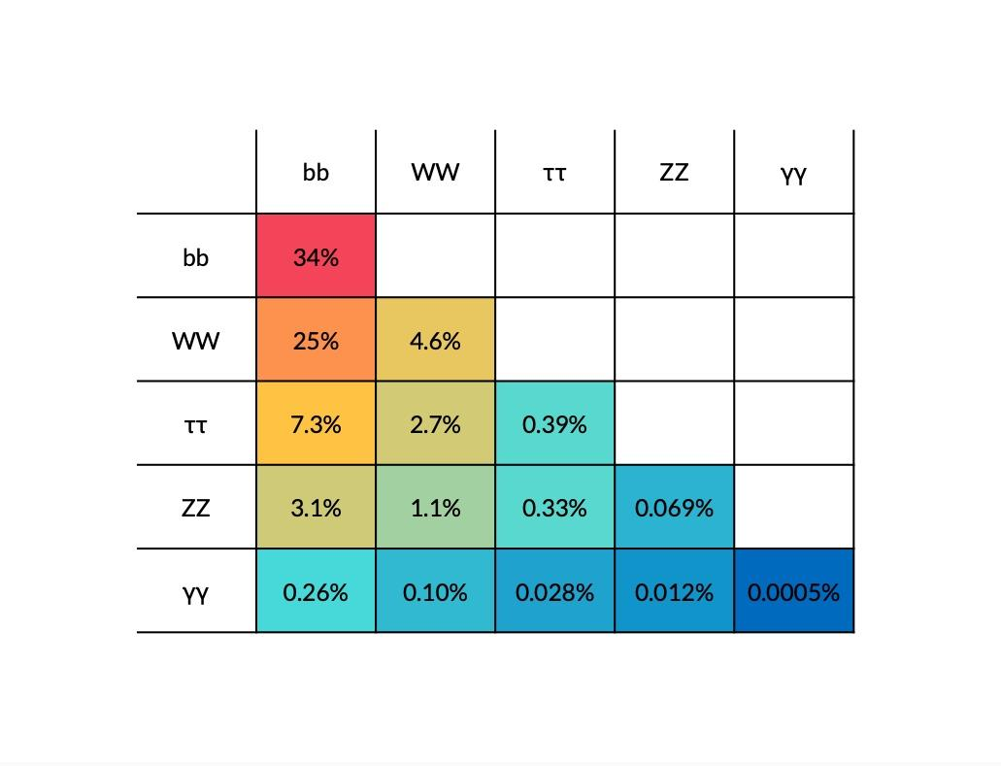
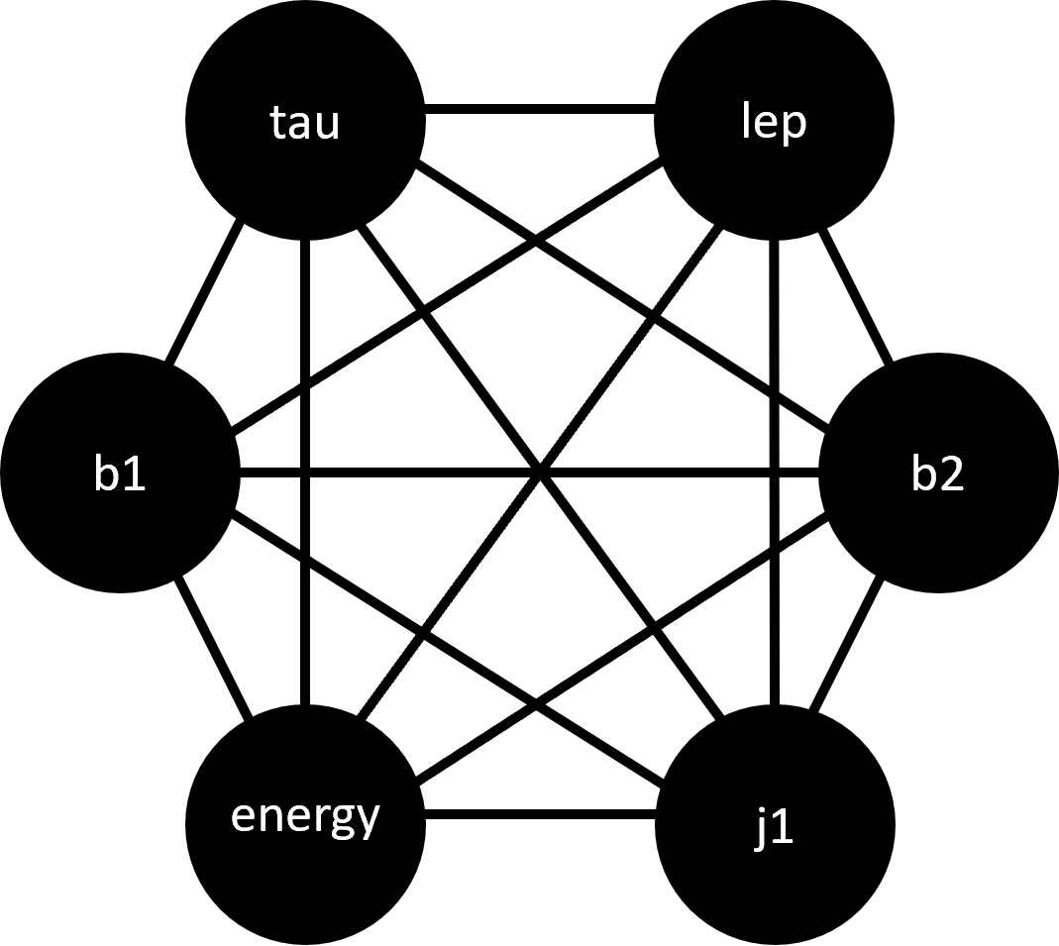
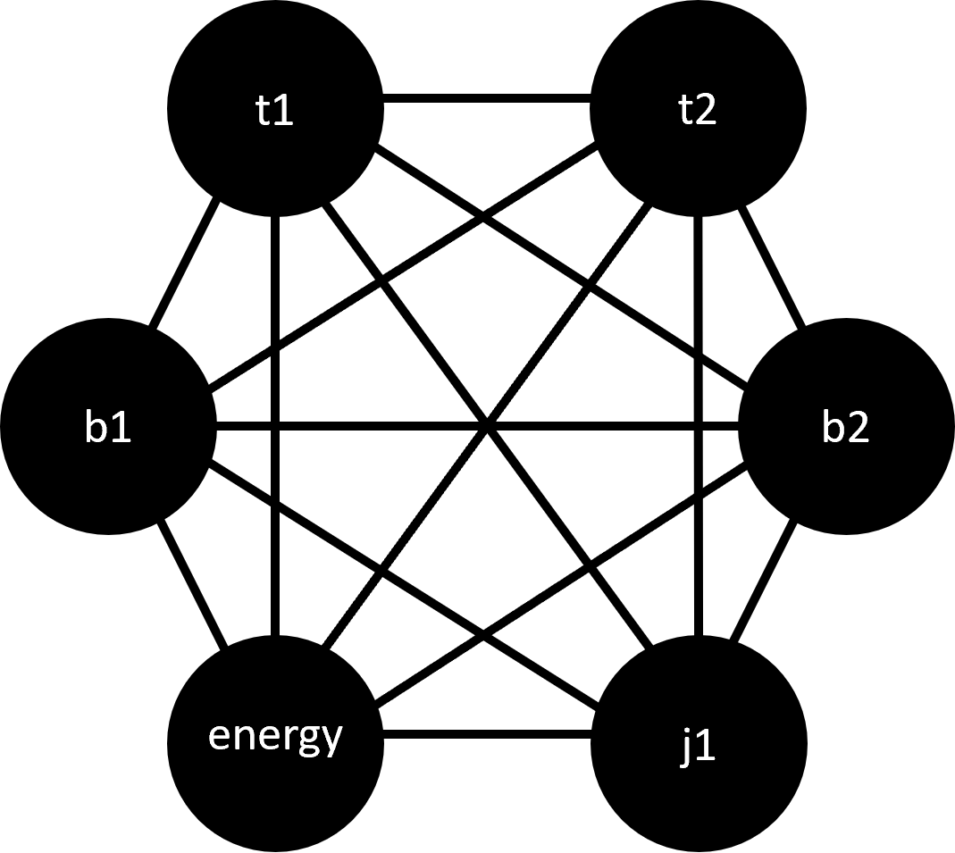
Di-Higgs studies at the FCC-hh
Monica D’Onofrio, Carl Gwilliam, Jordy Degens, Cristiano Sebastiani, Lennox Wood (MPhys), Sam Valentine (fMPhys)
Consider bbττ channel
  Good compromise between signal yield and background rejection
  Two set of studies depending on tau decays
    Οne tau decaying leptonically and one hadronically (lephad)
    Both taus decaying hadronically (hadhad)
Use Graph Neural Network architecture to attempt better significance.
  GNN pipelines originally from Alessio Devoto and Donatella Genovese
  Fully connected graphs used with kinematic features.
  Systematic evaluation of performance based on relevant metrics (S vs B separation, AUC, significance).
  See back-up for details on architecture
tauH,tauL
tauH,tauH

Slide 12

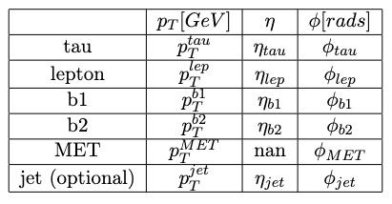
Graph Neural Network architecture
Graphs are “created” from individual particle physics events.
Each node contains information for the features of that object, , 𝜂, 𝜙 etc.
  Objects include b-jets, tau objects, as well as Missing ET and a possible extra jet in the event
Information is passed between nodes through layers of the NN:
  Fully-connected graph, including particle momenta and relevant kinematic correlations as features (mbb.mtautau,dRbb,…)
Different GNN models tested (GCN, GAT)
  GAT best performing
Other hyperparameters tested.
  Optimisation of performance done
Of course, separate GNN for had-lep and had-had
More info see: link
tauH,tauL
tauH,tauH

Slide 13
Analysis
Graphs are “created” from individual selected events.
  Each node contains information for the features of that object
Objects include b-jets, tau objects, as well as Missing ET and a possible extra jet in the event
Information is passed between nodes through layers of the NN:
  Fully-connected graph, including particle momenta and relevant kinematic correlations as features (mbb, mtautau, dRbb,…)
Two separate GNN for lep-had and had-had
  Top pair events (dominant) used to evaluate the SM background
Example distribution for lep-had channel

Slide 14
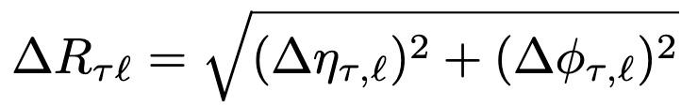

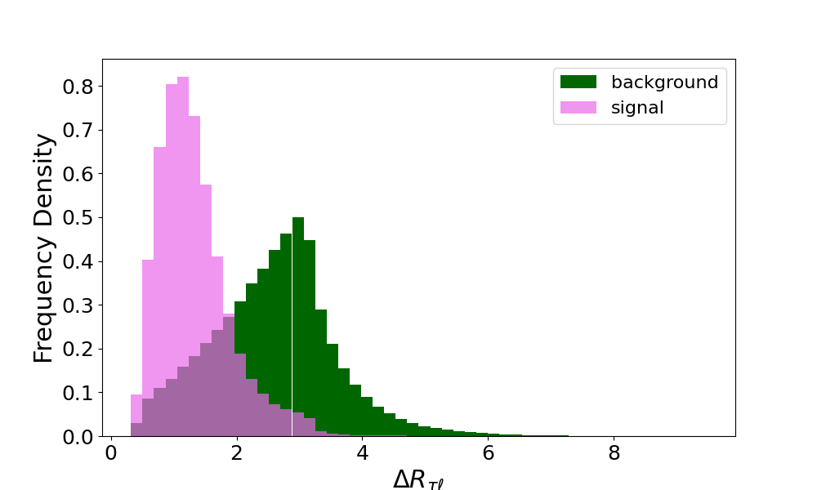
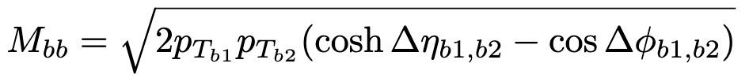
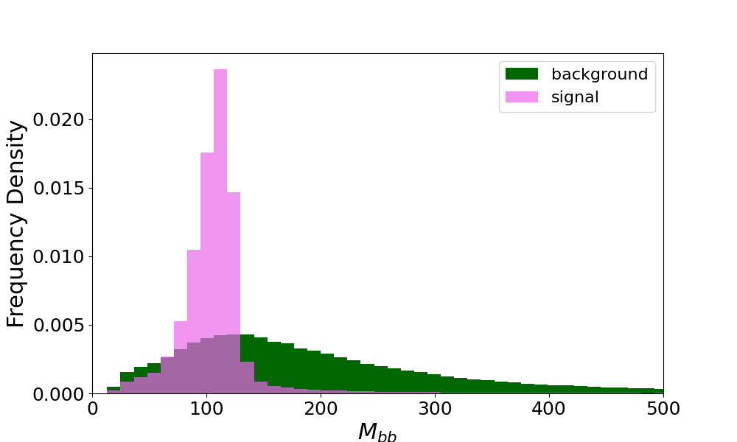
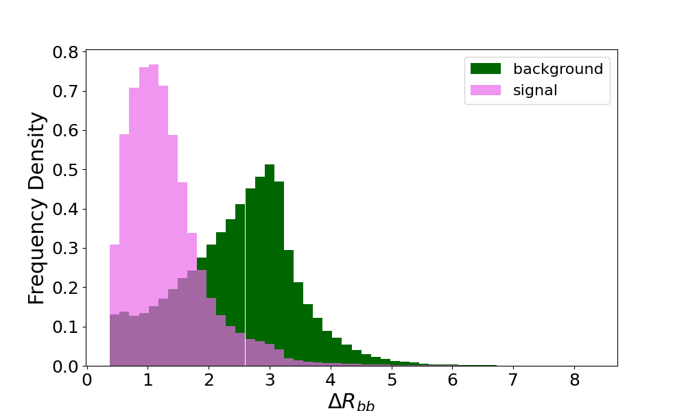
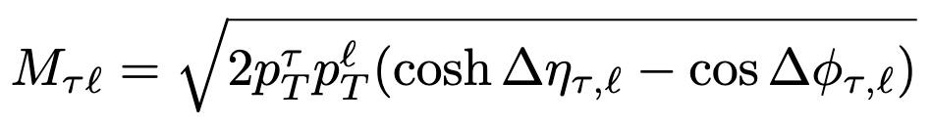
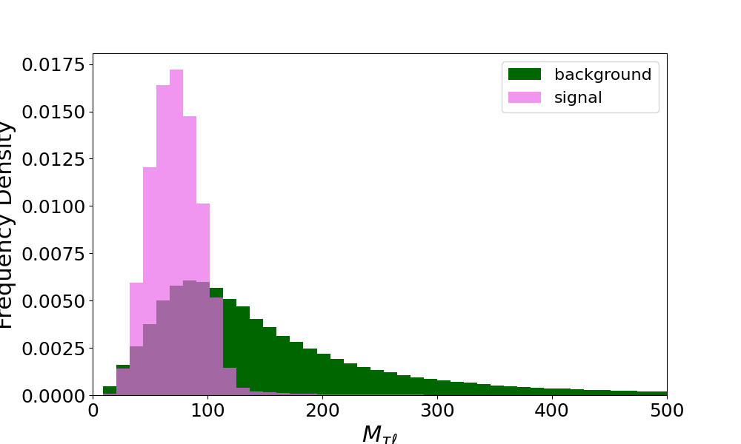
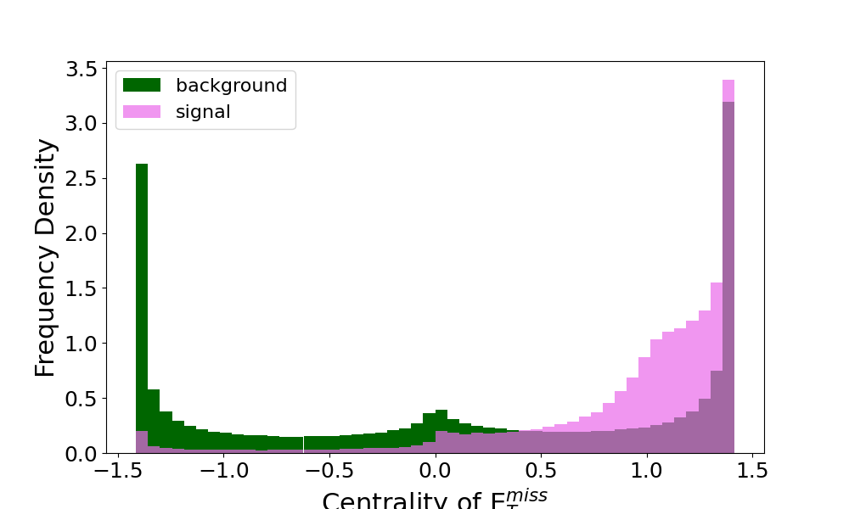
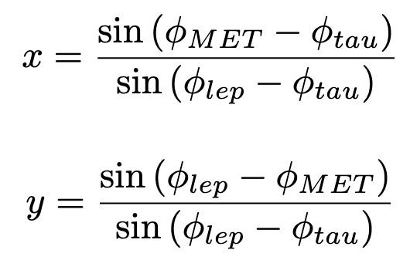
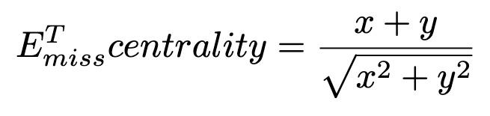
Features
Relational features added to give extra discriminating power.
Variables normalised to improve performance.
lep-had:
where l = tau_lep or tau_had depending on channel
Without complex features, poor performance. Increase at each correlation included (AUC: 0.6 → 0.99)

Slide 15
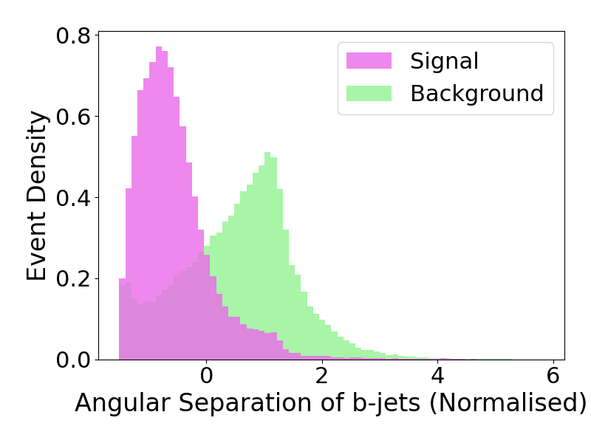
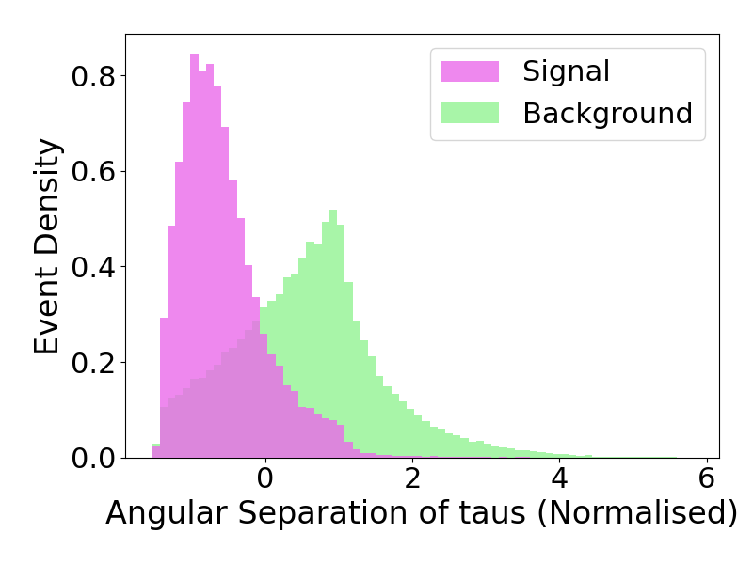
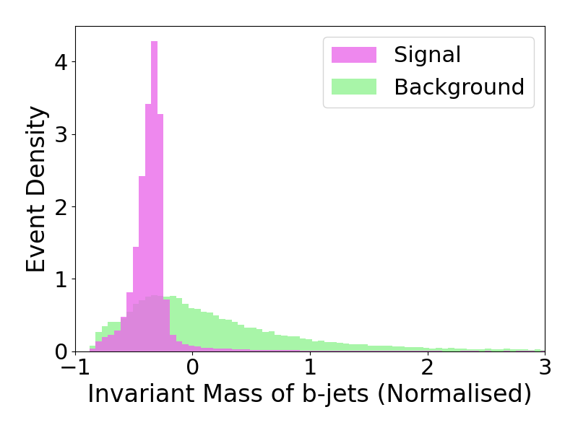
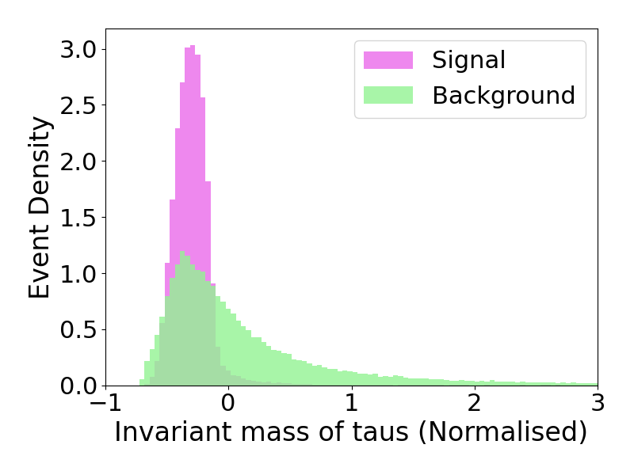
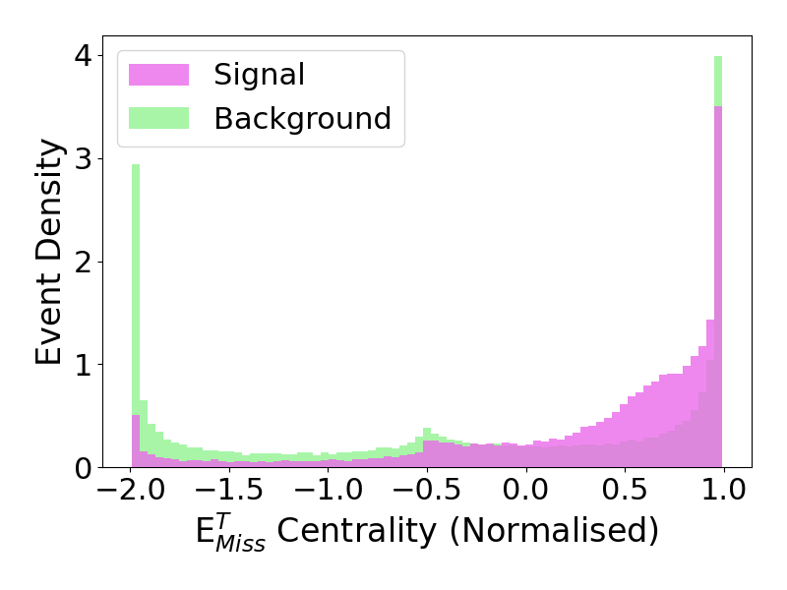
Features
Relational features added to give extra discriminating power.
Variables later “normalised” to improve performance.
had-had:
where l = tau_lep or tau_had depending on channel
Without complex features, poor performance. Increase at each correlation included (AUC: 0.6 → 0.98)

Slide 16
Results
Good separation signal-bkg significance to be calculated for score (s) above a given thresholds > 0.99X in the following
Best sensitivity achieved with had-had channel → diverse hypotheses made for score threshold and systematic uncertainties
Examples of m_HH distribution signal and bkg (depending on score value)

Slide 17
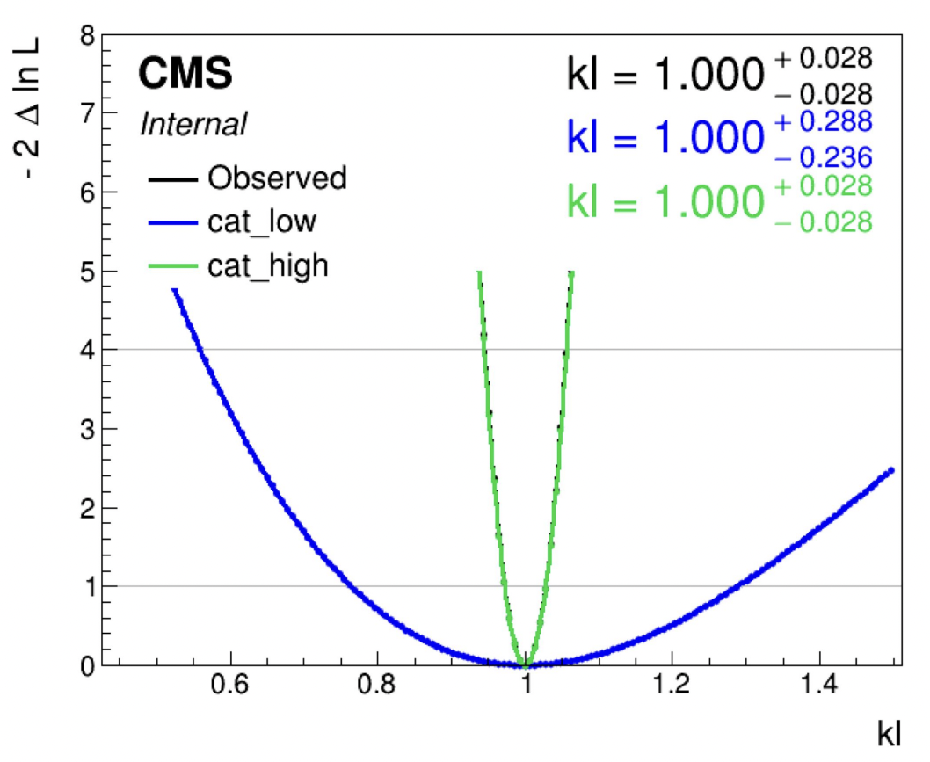
Results (2)
Translating this in terms of k_lambda constraints → final results in progress
Preliminary results show precision below 3%
Future progress:
ΔR show that residual discriminating power is possibly achievable i.e. using separate Δφ, Δη
*** Use Graph transformers (Mixture-of-Expert) as done with another dataset
FCC-hh
Results have been published in preliminary form for the ES 2026 submission and have contributed to inform the FCC-hh physics submission

Slide 18
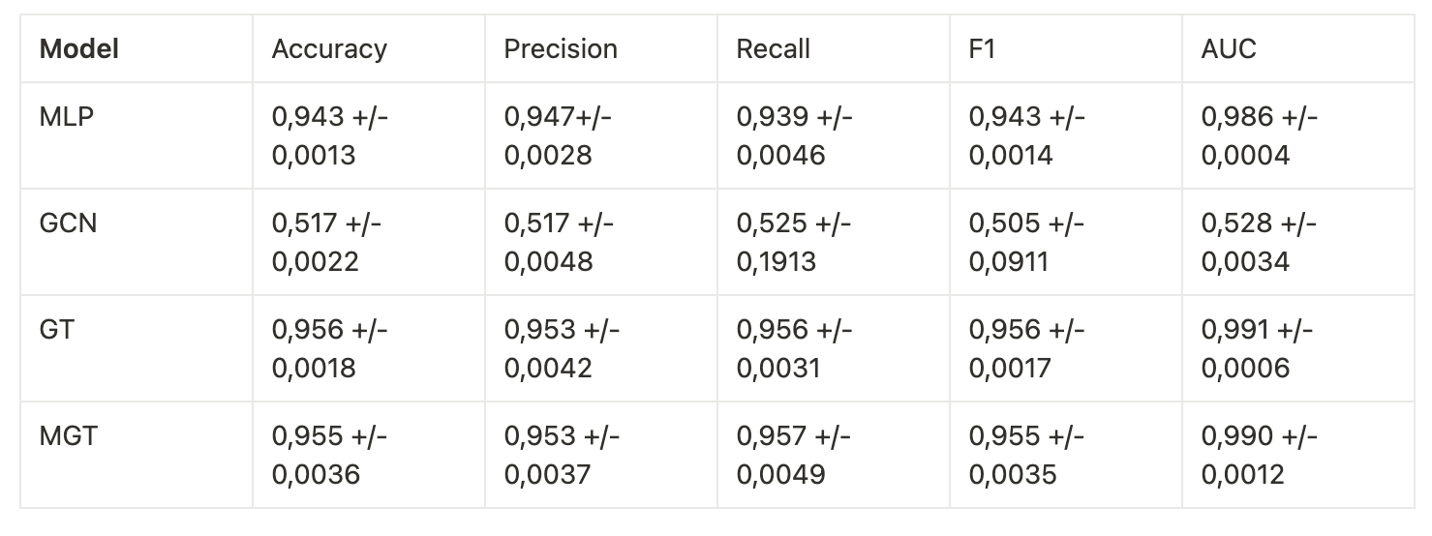
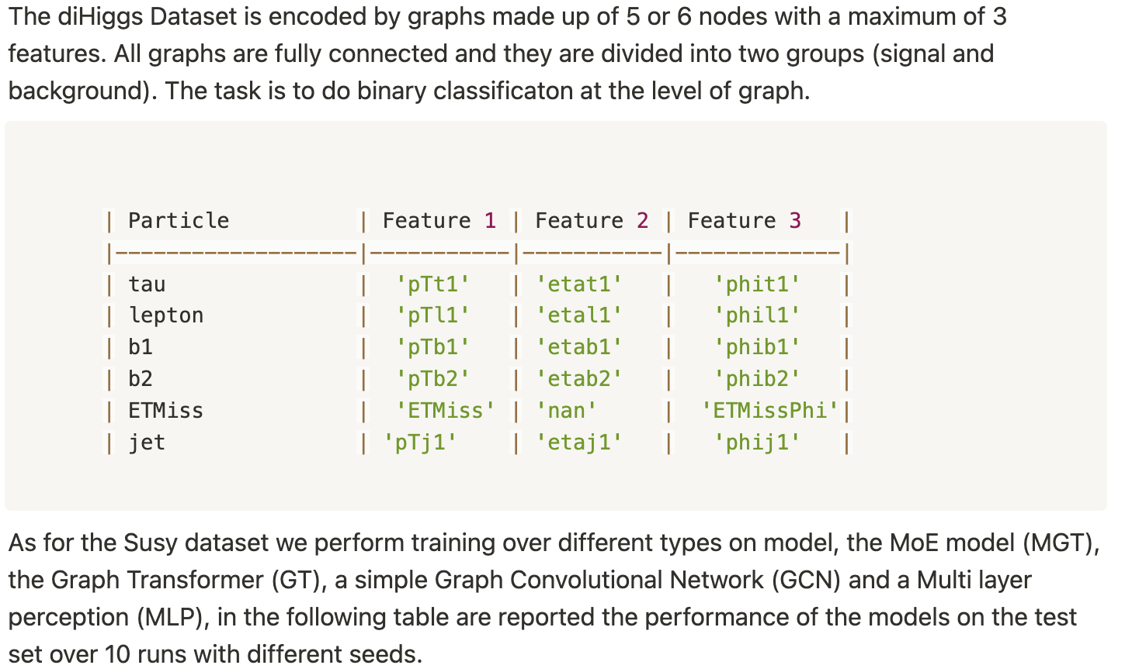
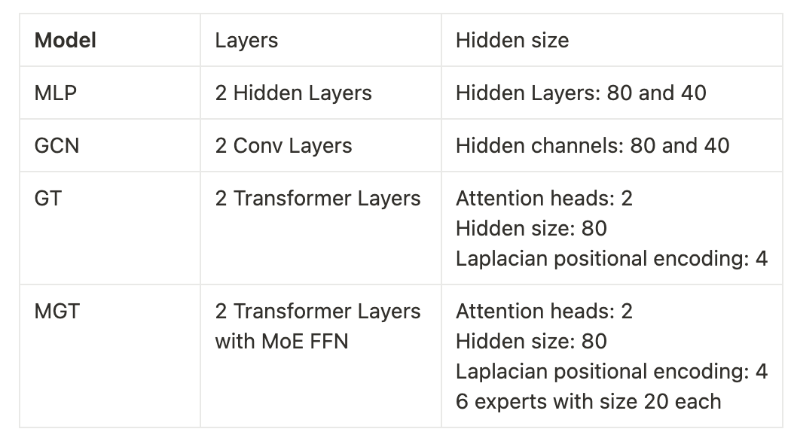
MoE
https://bristle-sleet-bfa.notion.site/Additional-Test-for-MoE-Graph-Transformer-19dcb86031e4802ca275d8fc85050304

Slide 19
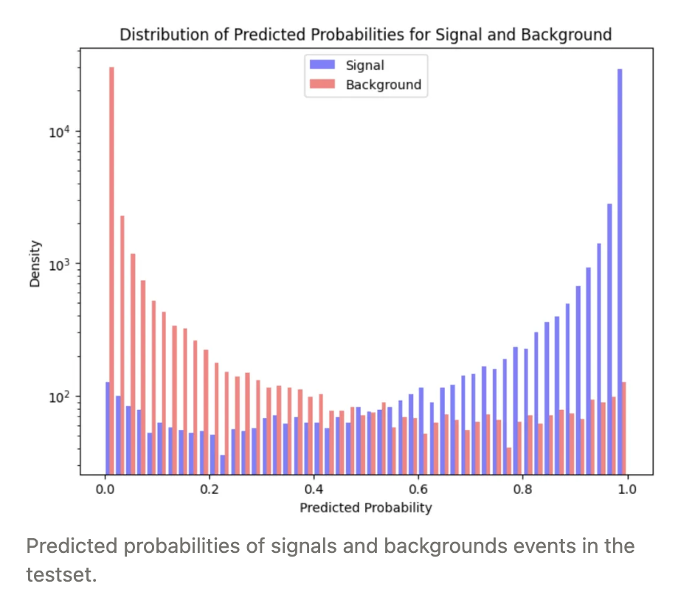
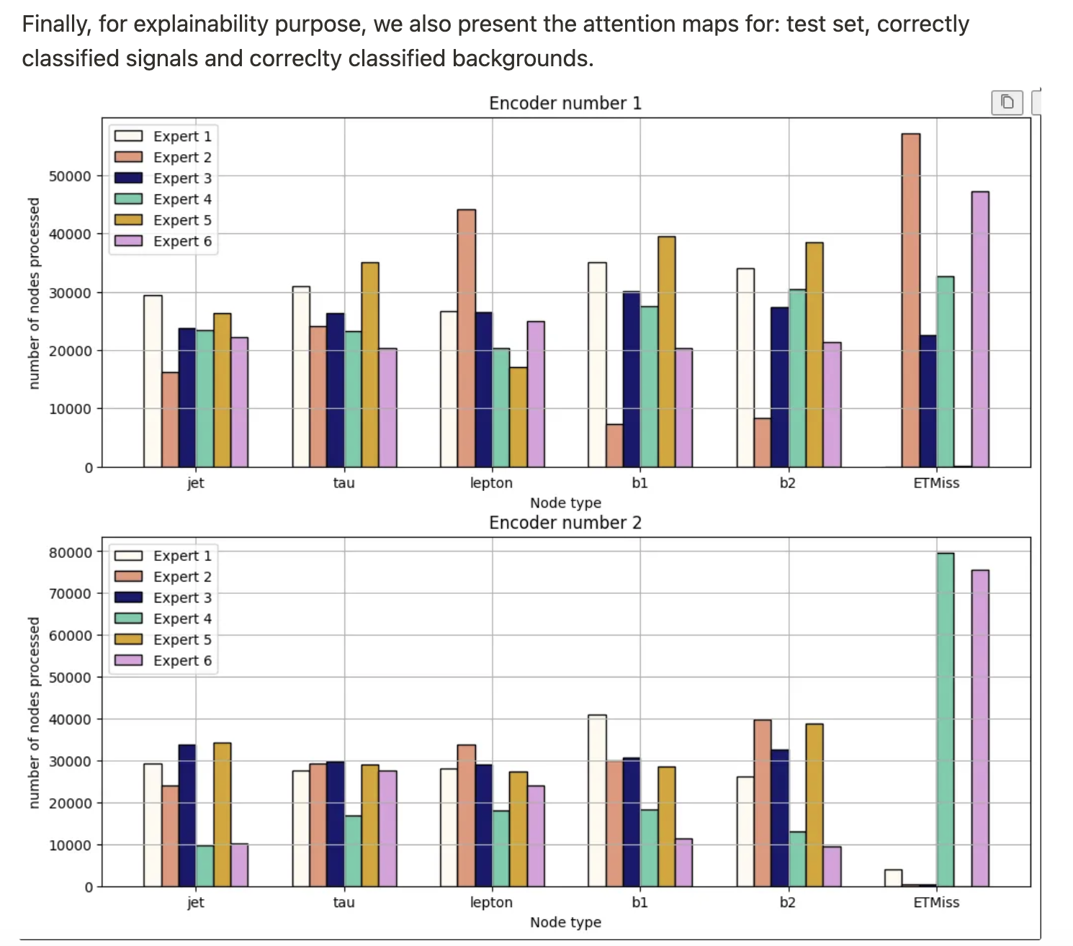
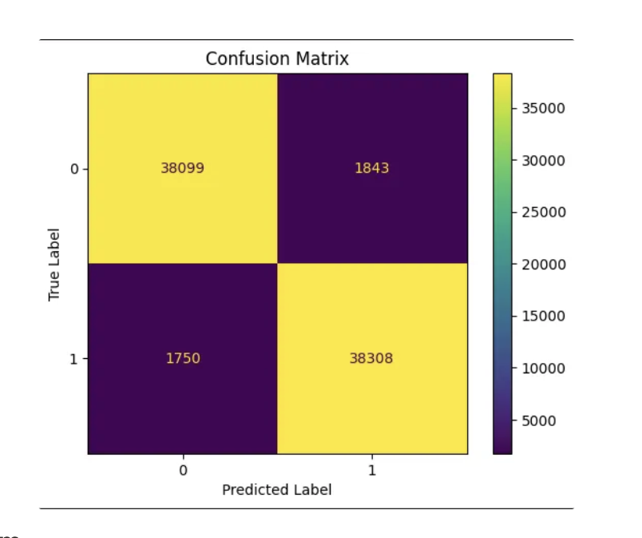
To be compared with what we got with the GAT model using all complex variables
Lep-had studied
Similar to physics observations made for SUSY

Slide 20
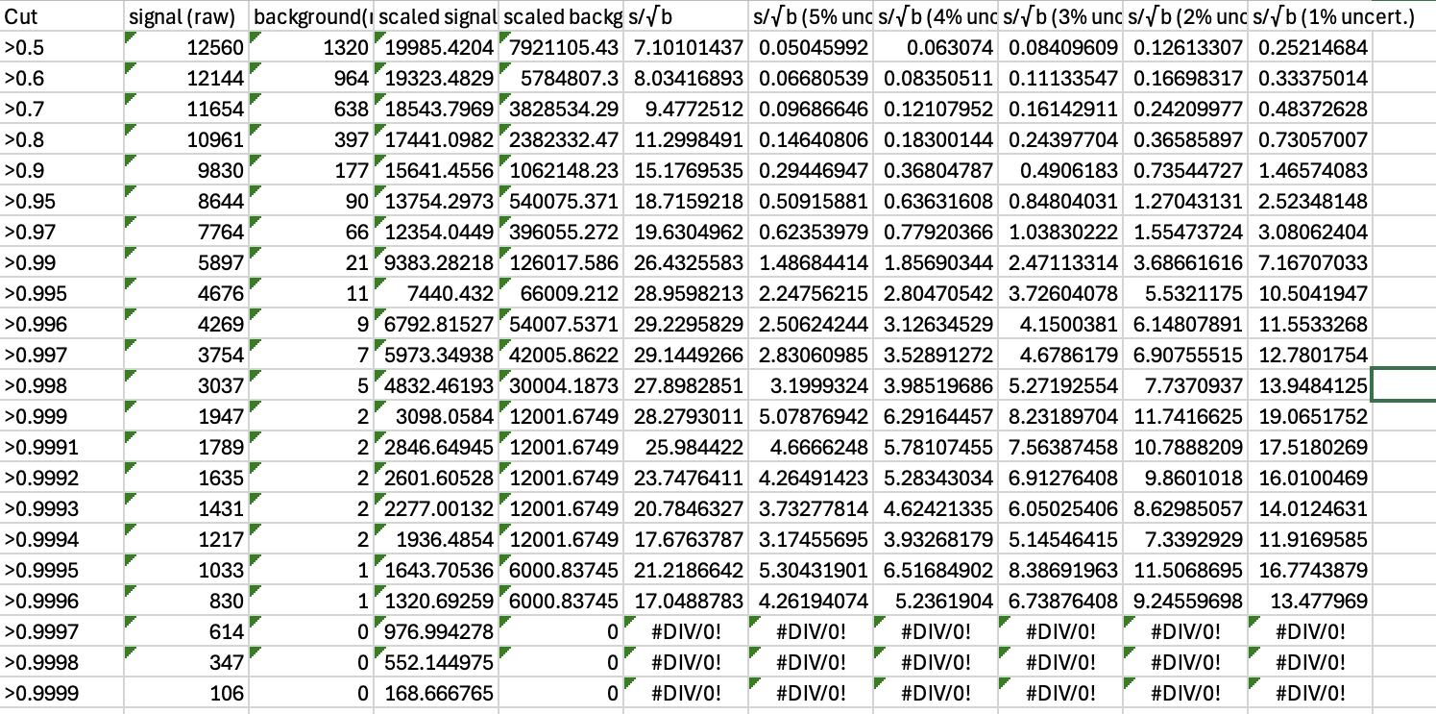
MoE
From Sam – studies of the significance for had-had, the most sensitive channel
Overall results are slightly worst than using directly all complex variables
Can we learn something more? Is it due to MC samples low stats limitations?

