Slide 1

Roberto Prieto García PhD. 4th meeting CERN-US
CERN, 28th March 2025

Slide 2
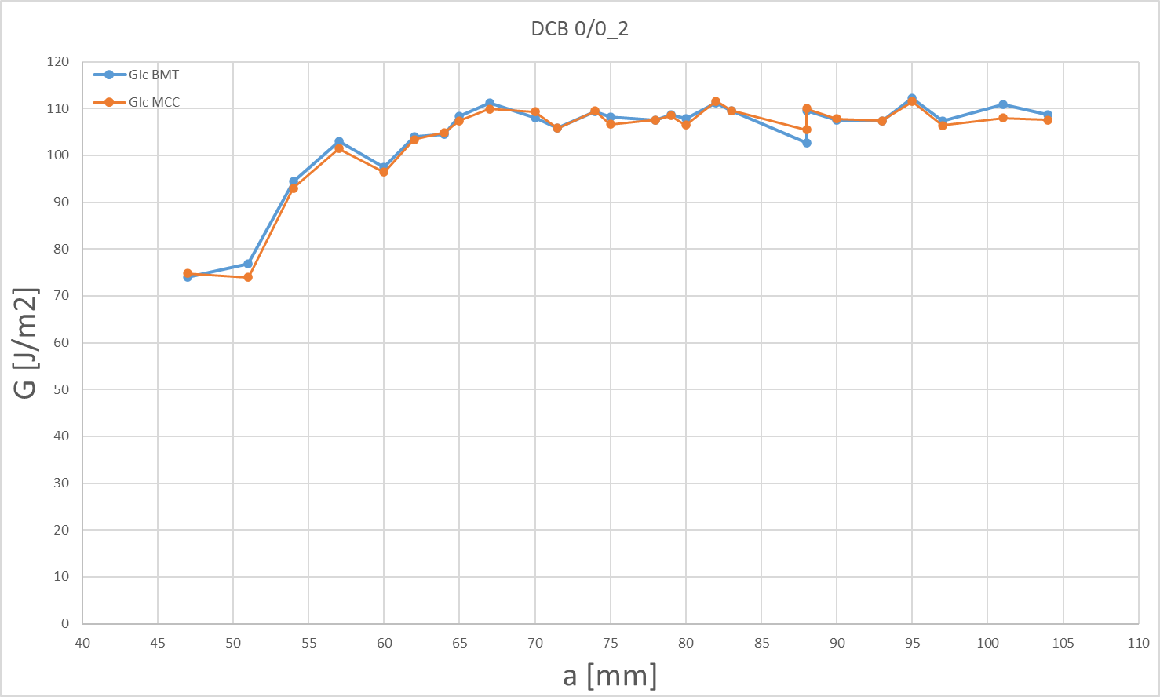
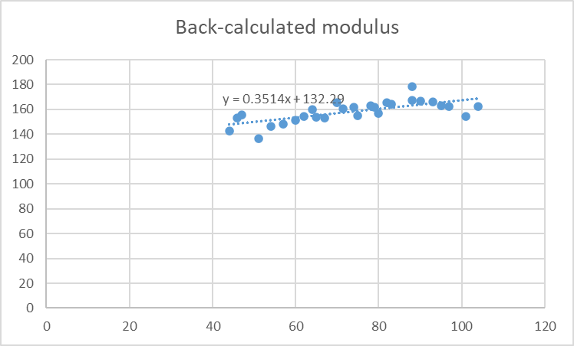

DCB Results
GIc for 0/0 interface before thermal treatment. Values found in literature point to GIc$≈$60 [J/m²]
Flexural modulus (back-calculated modulus) expected to be around 200 GPa according to TDS.
28/03/2025

Slide 3
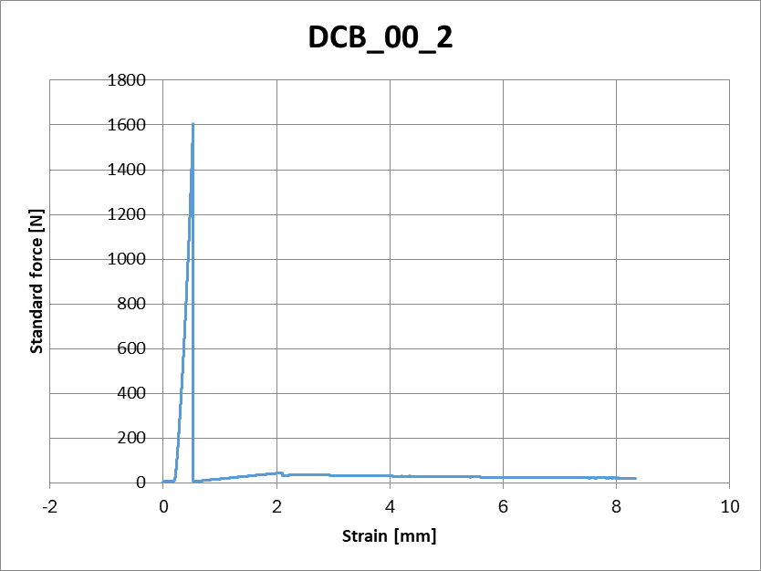
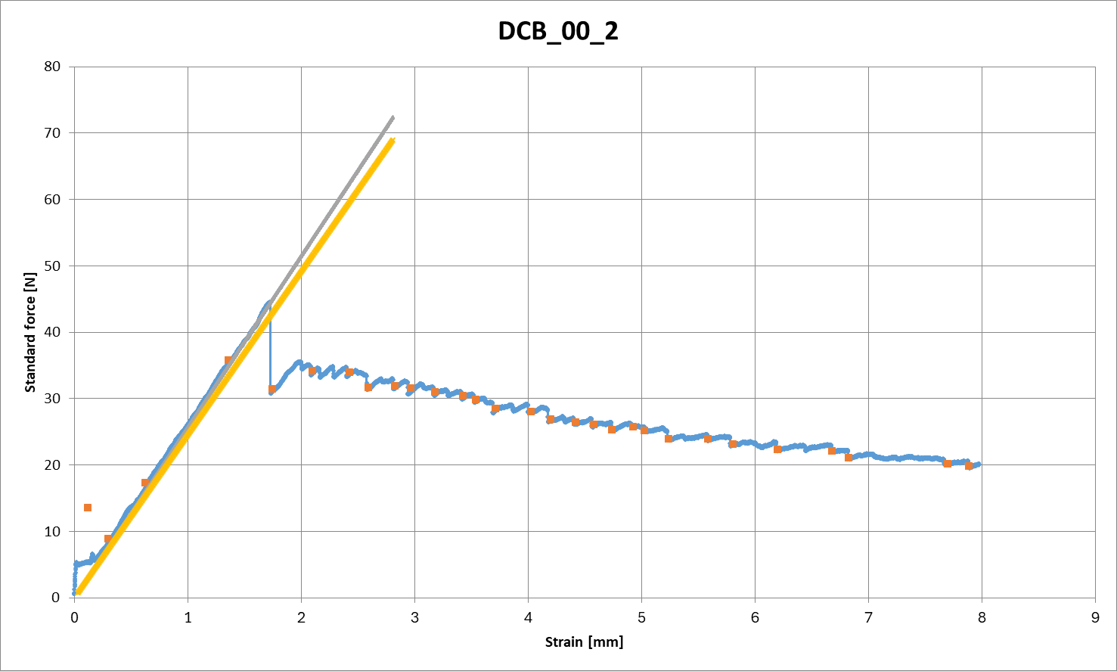
DCB Results. Nonconformities.
Precrack does not open until very high forces $\left(O\right)\sim {10}^{3}\text{N} \text{are} \text{reached}\text{.}$
Presence of high stiffness at the beginning of the test.
28/03/2025

Slide 4
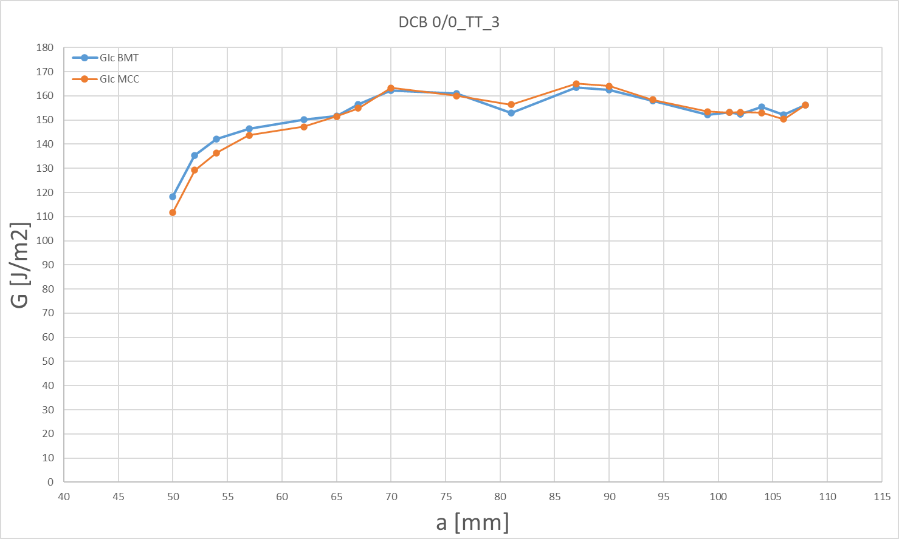
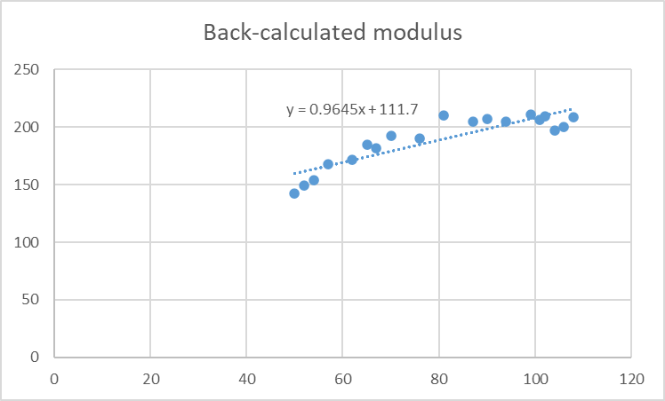
DCB Results
GIc for 0/0 interface after thermal treatment. There is an increment of GIc ($↑\sim 50\%$), instead of a decrease $(↓\sim 50\%)$ as presented on previous studies.
Flexural modulus (back-calculated modulus) expected to be around 200 GPa according to TDS.
28/03/2025

Slide 5
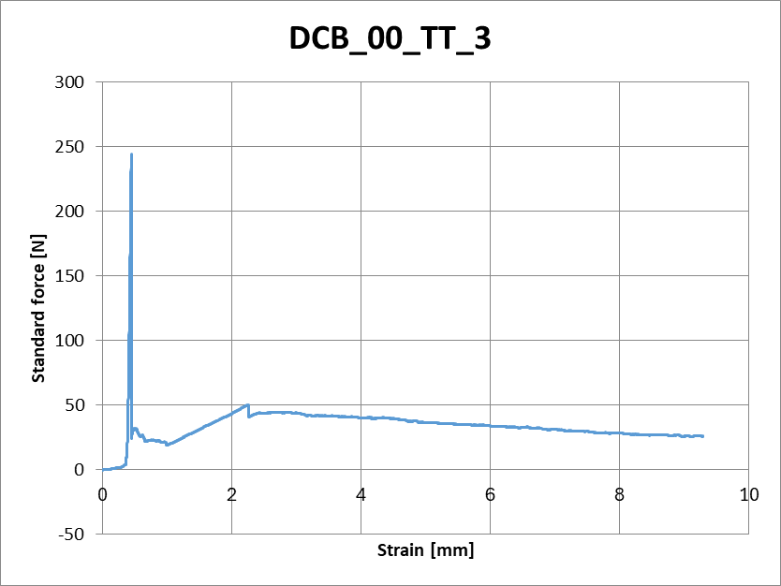
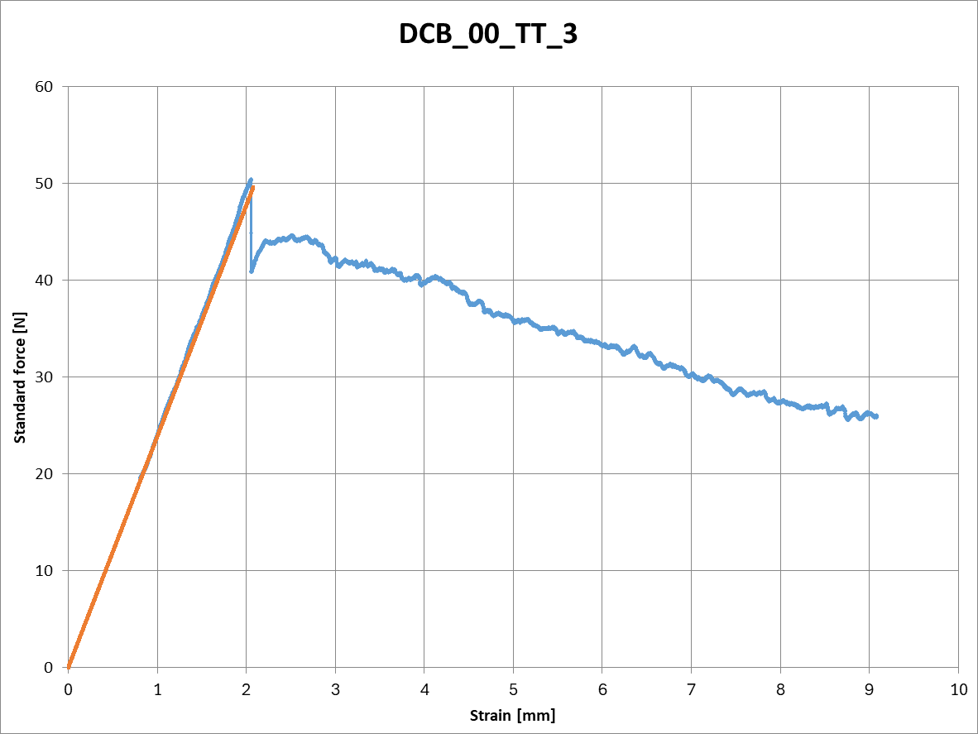
DCB Results. Nonconformities.
Precrack does not open until very high forces $\left(O\right)\sim {10}^{2}\text{N} \text{are} \text{reached}\text{.}$
No presence of high stiffness at the beginning of the test.
28/03/2025

Slide 6
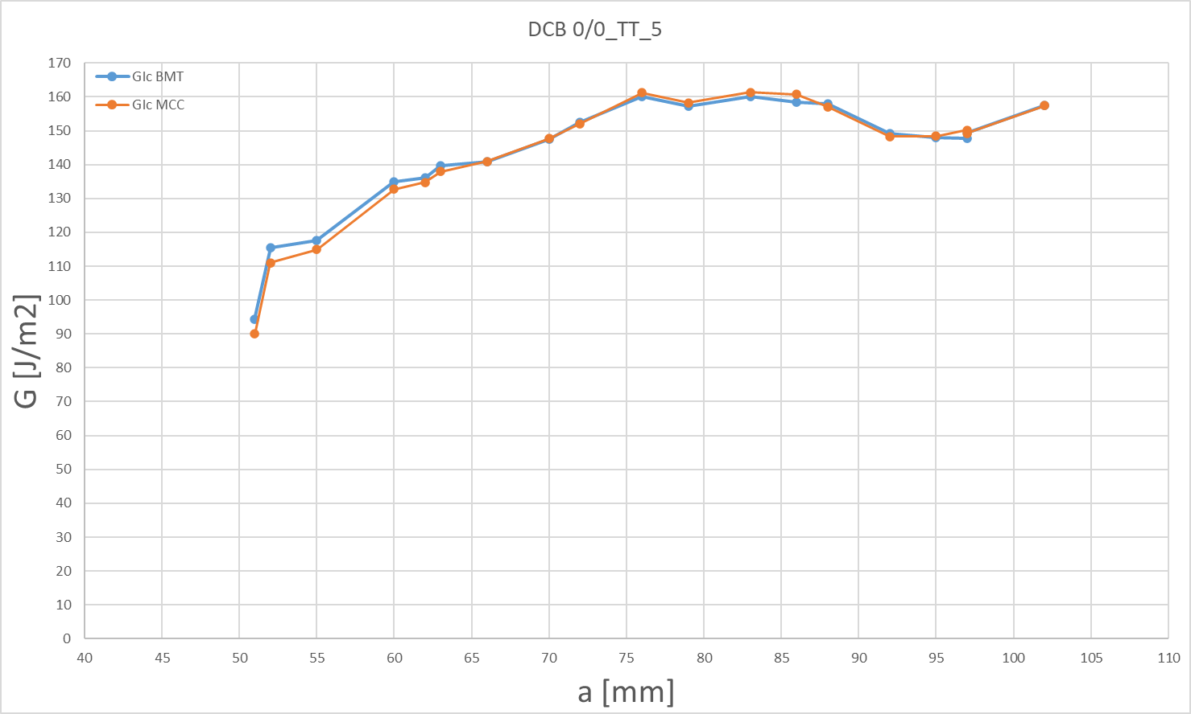
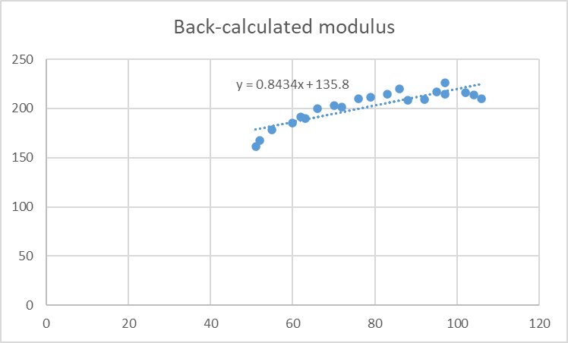
DCB Results
GIc for 0/0 interface after thermal treatment. There is an increment of GIc ($↑\sim 50\%$), instead of a decrease $(↓\sim 50\%)$ as presented on previous studies.
Flexural modulus (back-calculated modulus) expected to be around 200 GPa according to TDS.
28/03/2025

Slide 7
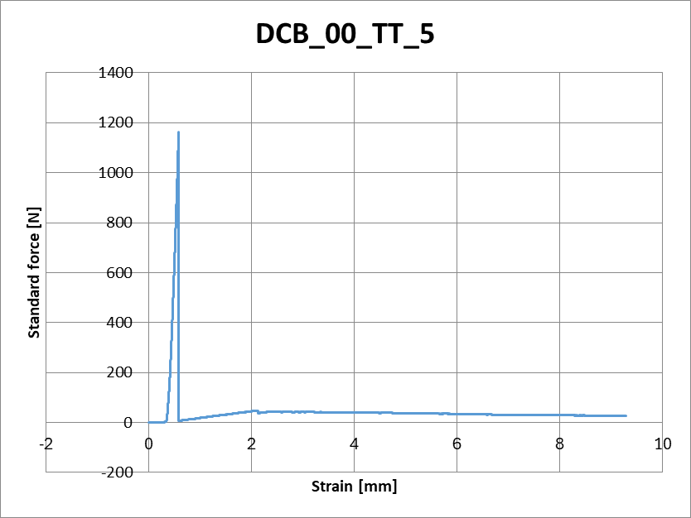
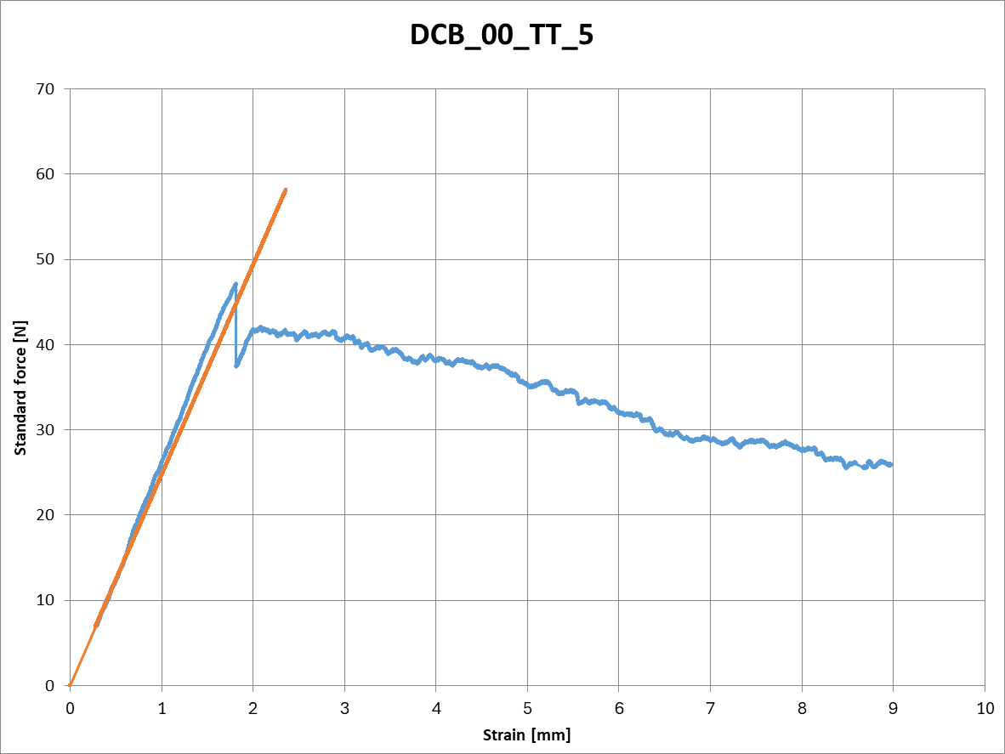
DCB Results. Nonconformities.
Precrack does not open until very high forces $\left(O\right)\sim {10}^{3}\text{N} \text{are} \text{reached}\text{.}$
No presence of high stiffness at the beginning of the test.
28/03/2025

