Slide 1
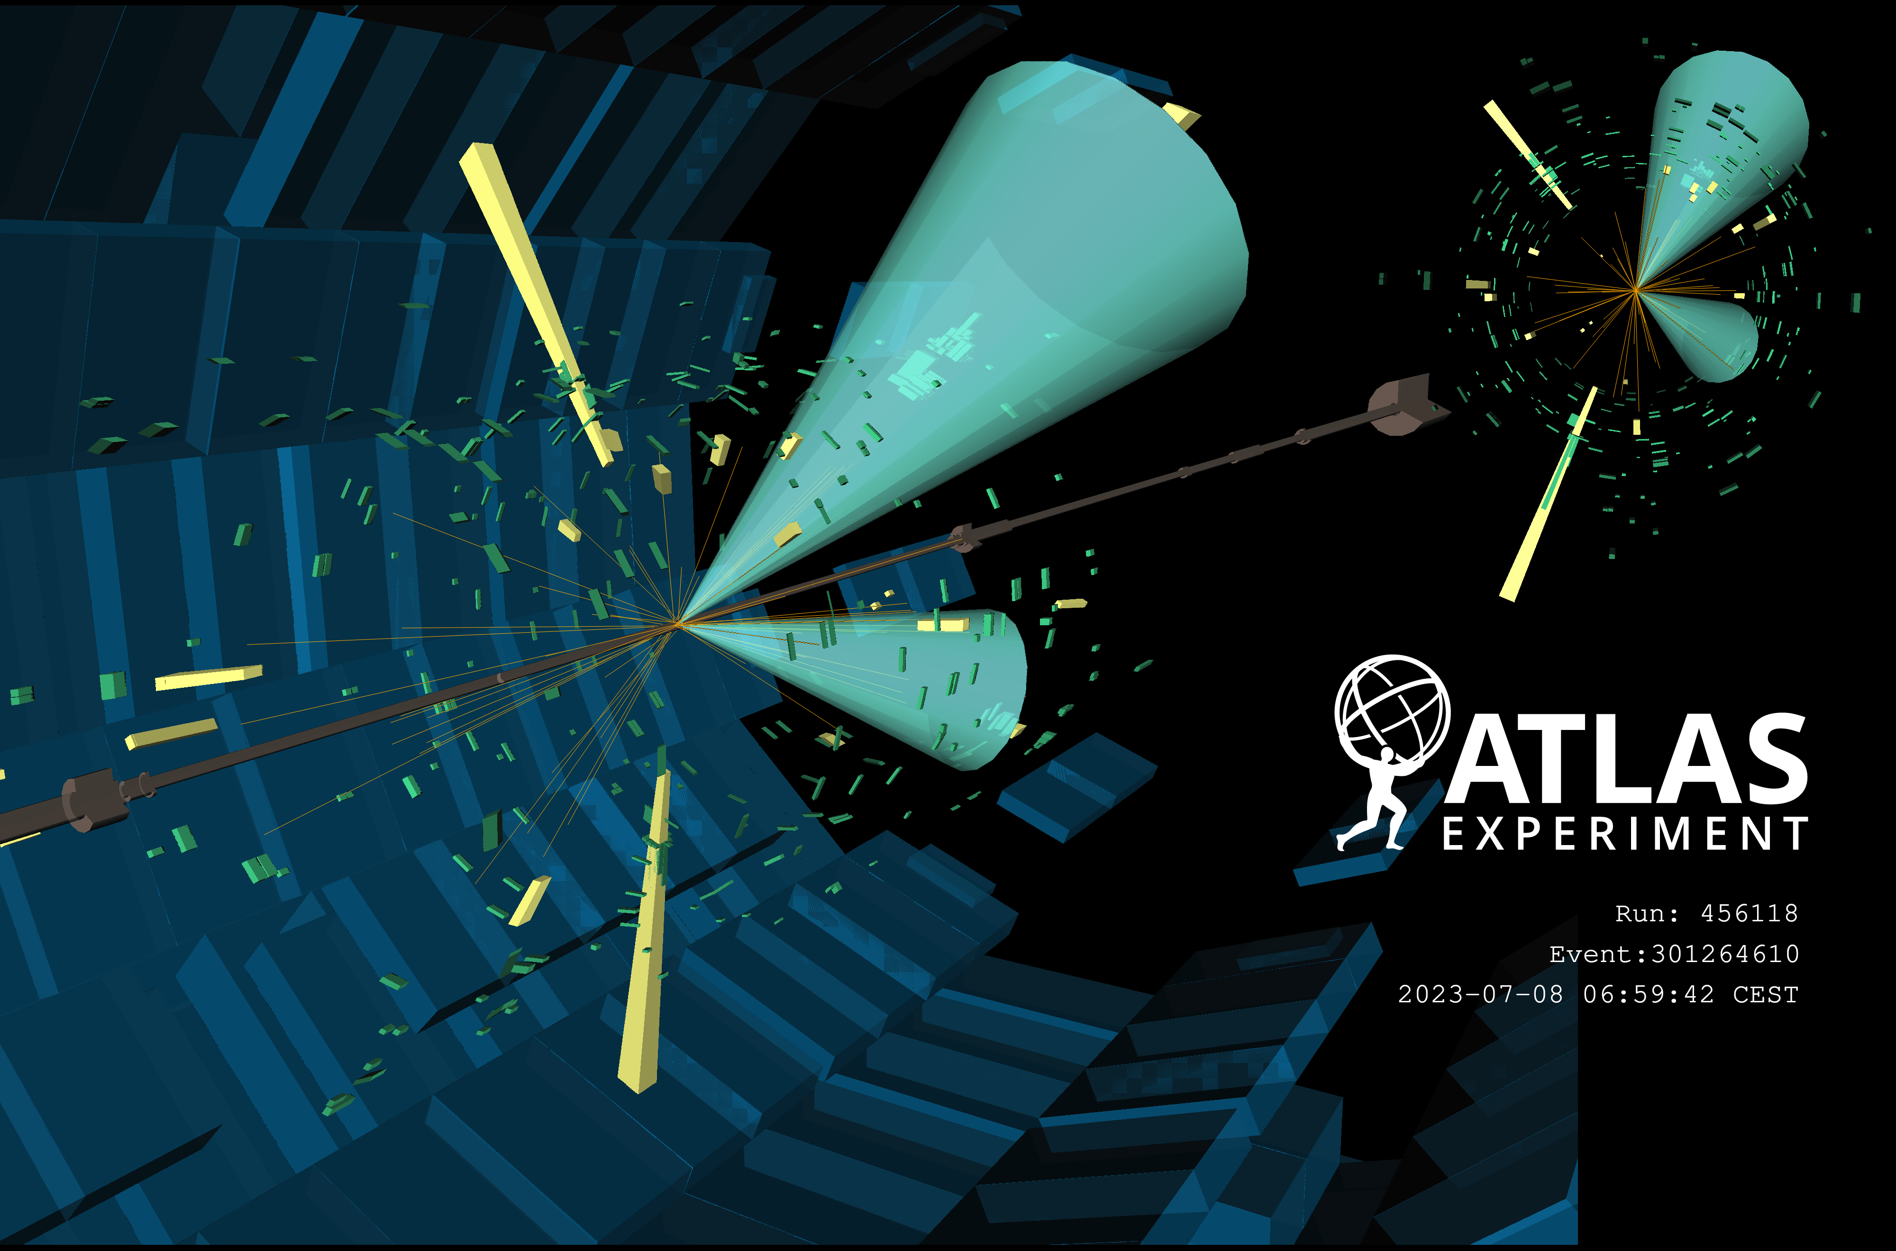
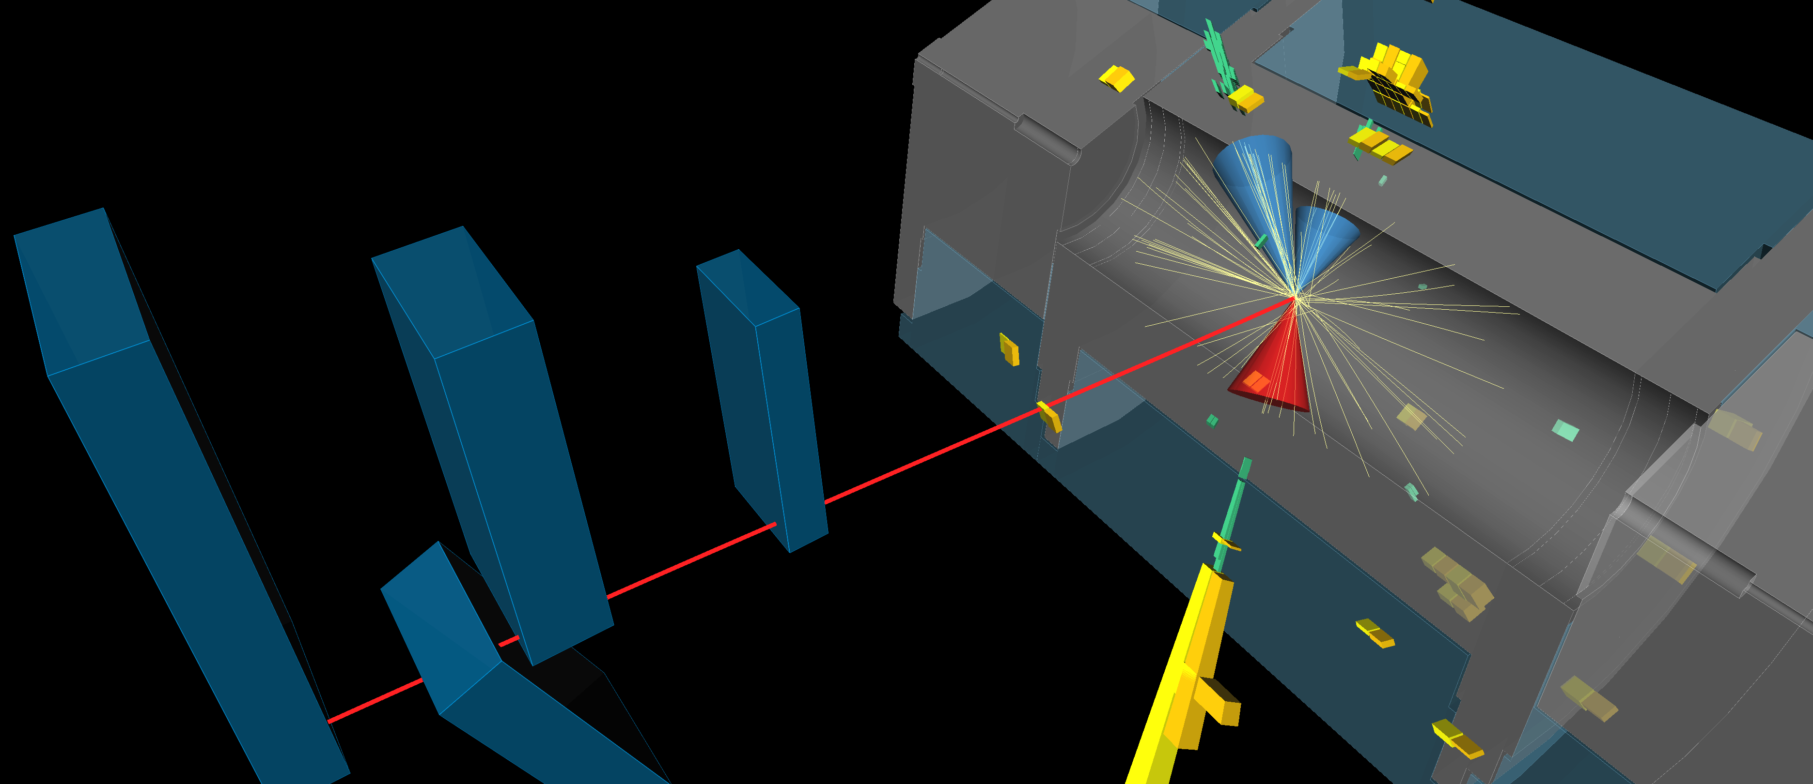
Non-Resonant Higgs Boson Pair Production and Self-Coupling Measurements with the ATLAS Experiment
Higgs 2025, Brown University
27 – 31 October 2025
Alexandra Sidley, on behalf of the ATLAS Collaboration

Slide 2
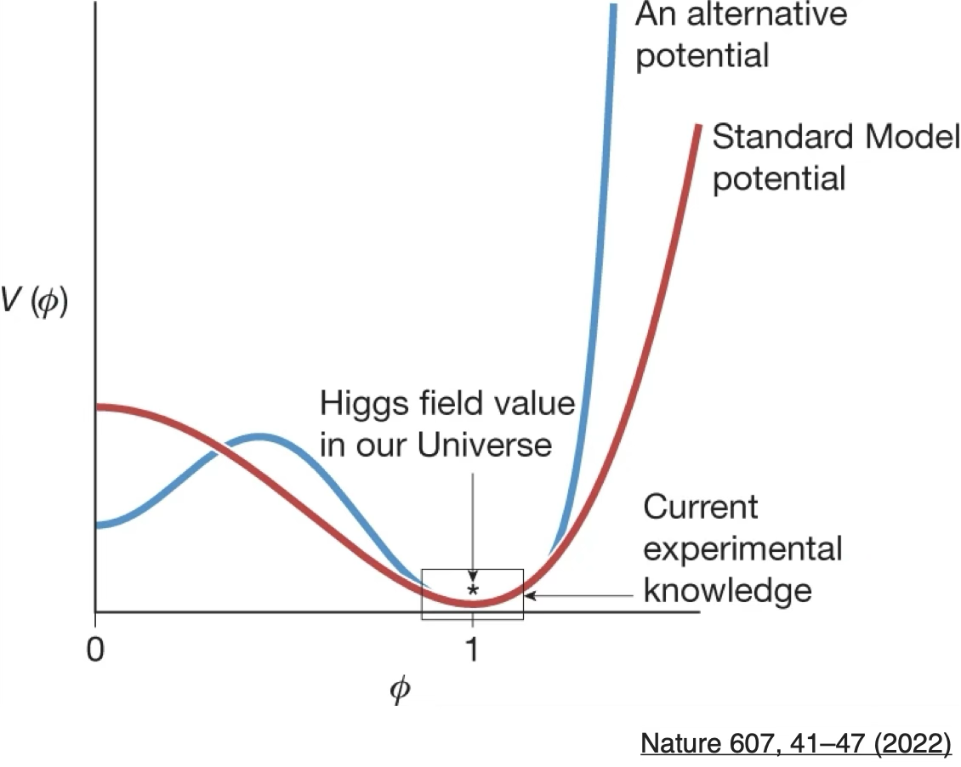
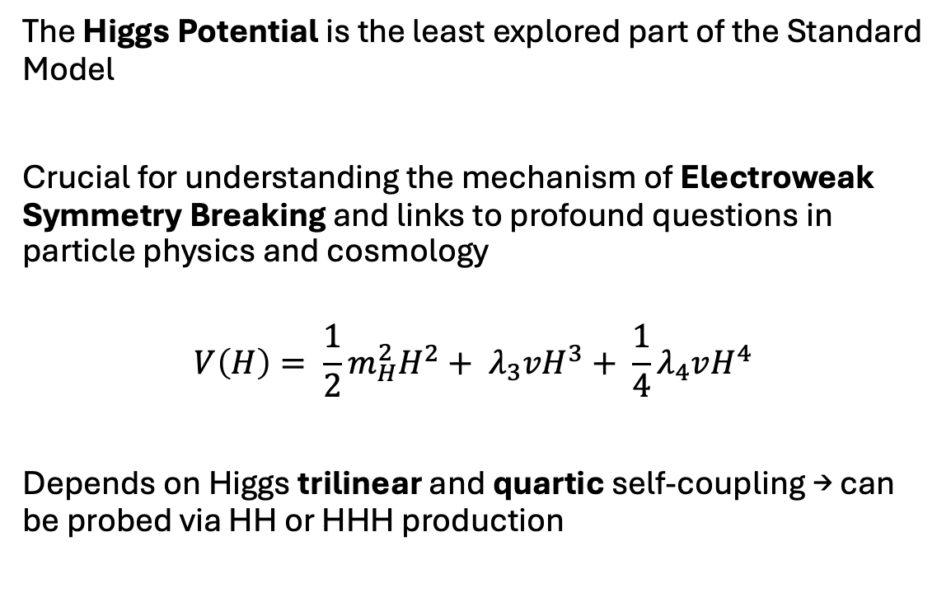
Why are we interested in Higgs pair-production?
The Higgs Potential is the least explored part of the Standard Model
Crucial for understanding the mechanism of Electroweak Symmetry Breaking and links to profound questions in particle physics and cosmology
$$V\left(H\right)= \frac{1}{2}m_{H}^{2}H^{2}+ λ_{3}vH^{3}+ \frac{1}{4}λ_{4}vH^{4}$$
Depends on Higgs trilinear and quartic self-coupling → can be probed via HH or HHH production
Notes:
forefront current / future hep. reason Higgs potential. newest least explored. EWSB. links questions. exp knowledge, alt. written depend on lambdas. probe at LHC

Slide 3
What will be covered in this talk
ATLAS Run 2 legacy non-resonant HH combination (140 fb⁻¹)
Individual Run 2 channels
HH→bbbb
HH→bbττ
HH→bb𝛾𝛾
HH→bbℓℓ (+MET)
HH→multilepton
Run 2 + partial Run 3 HH→bb𝛾𝛾 (308 fb⁻¹)
Notes:
comb incl 5. each. 2nd half more bby

Slide 4
What will not be covered in this talk
HH resonant results [see Jackson Barr’s talk]
Triple-Higgs [see Matthew Klein’s talk]
High-Luminosity LHC projections [see Daniela Bortoletto’s talk]

Slide 5
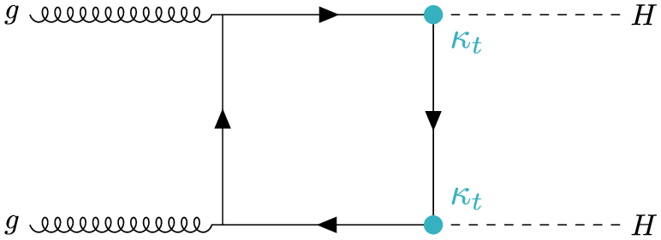
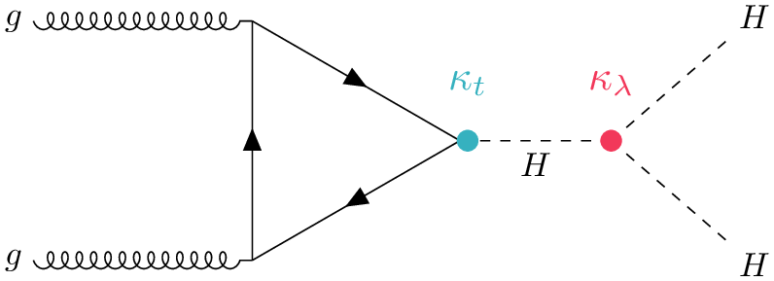
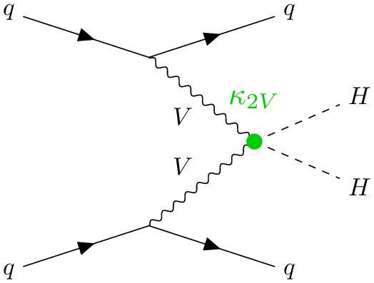
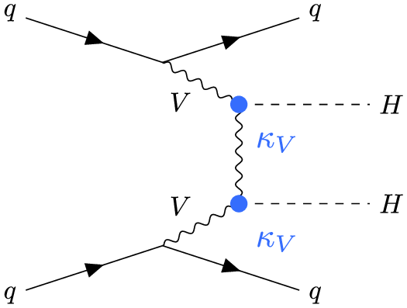
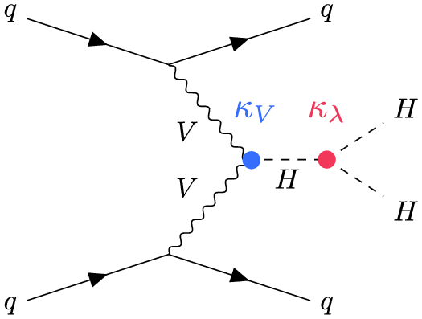
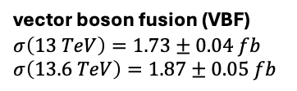
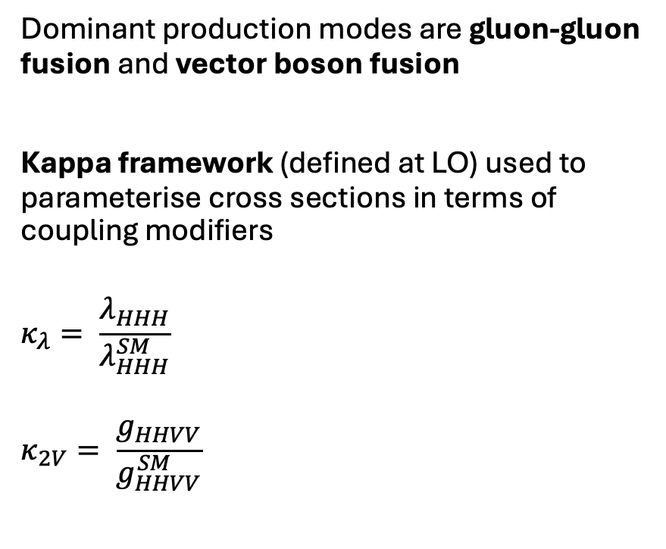

HH production in ATLAS
Dominant production modes are gluon-gluon fusion and vector boson fusion
Kappa framework (defined at LO) used to parameterise cross sections in terms of coupling modifiers
$$κ_{λ}= \frac{λ_{HHH}}{λ_{HHH}^{SM}}$$
$$κ_{2V}= \frac{g_{HHVV}}{g_{HHVV}^{SM}}$$
gluon-gluon fusion (ggF)
$$σ\left(13 TeV\right)={31.1}_{−7.2}^{+2.1} fb$$
$$σ\left(13.6 TeV\right)={34.1}_{−7.2}^{+2.2} fb$$
vector boson fusion (VBF)
$$σ\left(13 TeV\right)=1.73±0.04 fb$$
$$σ\left(13.6 TeV\right)=1.87±0.05 fb$$
Notes:
how? dominant modes. k FW param CS modifiers deviation. Both kl (=). VBF k2v. SM=1

Slide 6
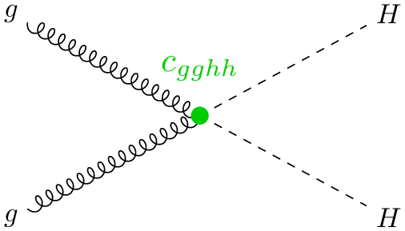
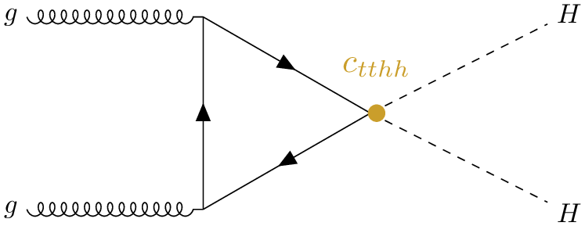
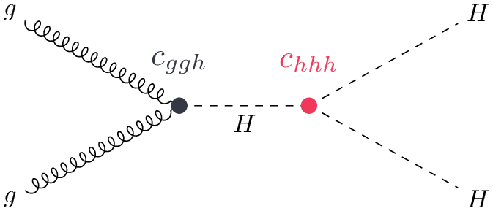
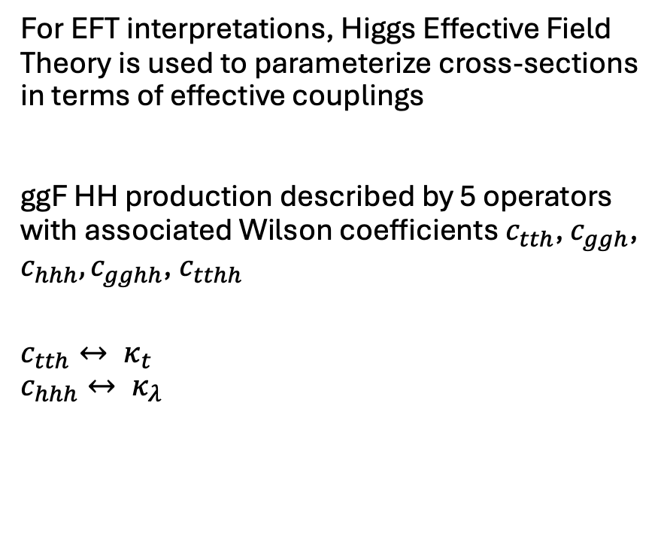
HH production in ATLAS
For EFT interpretations, Higgs Effective Field Theory is used to parameterize cross-sections in terms of effective couplings
ggF HH production described by 5 operators with associated Wilson coefficients $c_{tth}$, $c_{ggh}$, $c_{hhh},c_{gghh}$, $c_{tthh}$
$$c_{tth}↔ κ_{t}$$
$$c_{hhh}↔ κ_{λ}$$
Notes:
how? dominant modes. k FW param CS modifiers deviation. Both kl (=). VBF k2v. SM=1

Slide 7
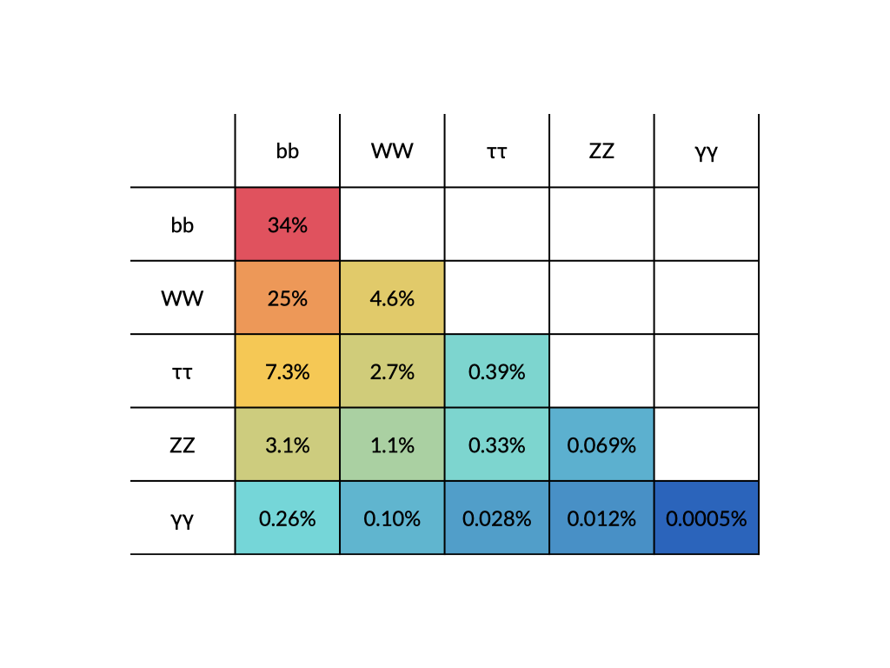
HH decay modes in ATLAS
HH→bbbb
HH→bbbb
Golden channels
HH→bbℓℓ+MET
HH→bbℓℓ+MET
HH→bbττ
HH→bbττ
HH→multileptons
HH→multileptons
HH→bb𝛾𝛾
HH→bb𝛾𝛾
Notes:
how? table. BF decrease clean final state and resolution. channels – golden. last 2 bbll + MET. remaining multileptons channel. orthogonal

Slide 8
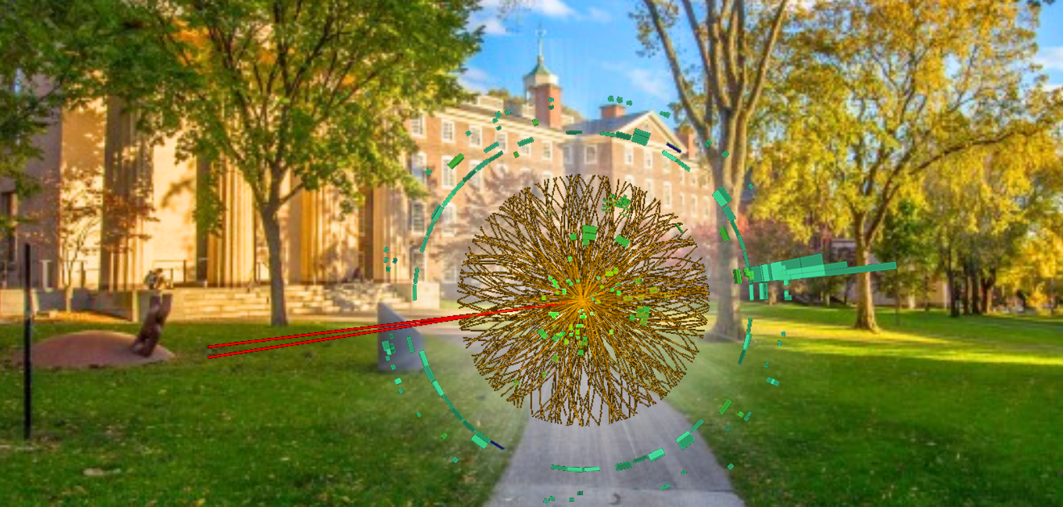
Recent HH results
Phys. Lett. B 858 (2024) 139007
Phys. Rev. Lett. 133 (2024) 101801
JHEP 02 (2024) 037
JHEP 01 (2024) 066
Full Run 2
Boosted VBF HH→bbbb
Full Run 2
HH→bbℓℓ+MET
Run 2 legacy
HH→ bb𝛾𝛾
Run 2 HH Combination
2024
2025
Present
Run 2 Resolved
HH→bbbb
Run 2 legacy
HH→ bbττ
Full Run 2
HH→multileptons
Run 2 + partial Run 3
HH→ bb𝛾𝛾
Phys. Rev. D 108 (2023) 052003
Phys. Rev. D 110 (2024) 032012
JHEP 08 (2024) 164
arXiv:2507.03495
Notes:
2 years, leading comb june. first run 3. links. intro comb

Slide 9
Run 2 HH Combination
Phys. Rev. Lett. 133 (2024) 101801, ATLAS Briefing

Slide 10
Run 2 HH Combination: channels
HH→bb𝛾𝛾
Small BR but clean final state
BDT used to separate signal from background and categorise events
Unbinned maximum likelihood fit to m_{𝛾𝛾}
HH→bbℓℓ+ MET
Targets HH→2b + 2l + neutrinos
DNN used to separate signal from background
MVA outputs used as statistical discriminants
HH→multilepton
Multiple final states with different numbers of leptons and τ_{had}, diphotons
BDT score or m_{𝛾𝛾} as fit variable
HH→bbbb
Largest BR, but challenging due to large QCD multijet background
Multi b-jet triggers used to select events
Boosted and resolved topologies
HH→bbττ
Reasonably large BR and manageable backgrounds compared to bbbb
τ_{had}τ_{had} and τ_{lep}τ_{had} channels
BDTs to separate VBF from ggF, signal from background
Notes:
5 channeld. stat combined overall muHH kll. describe then result. 95%

Slide 11
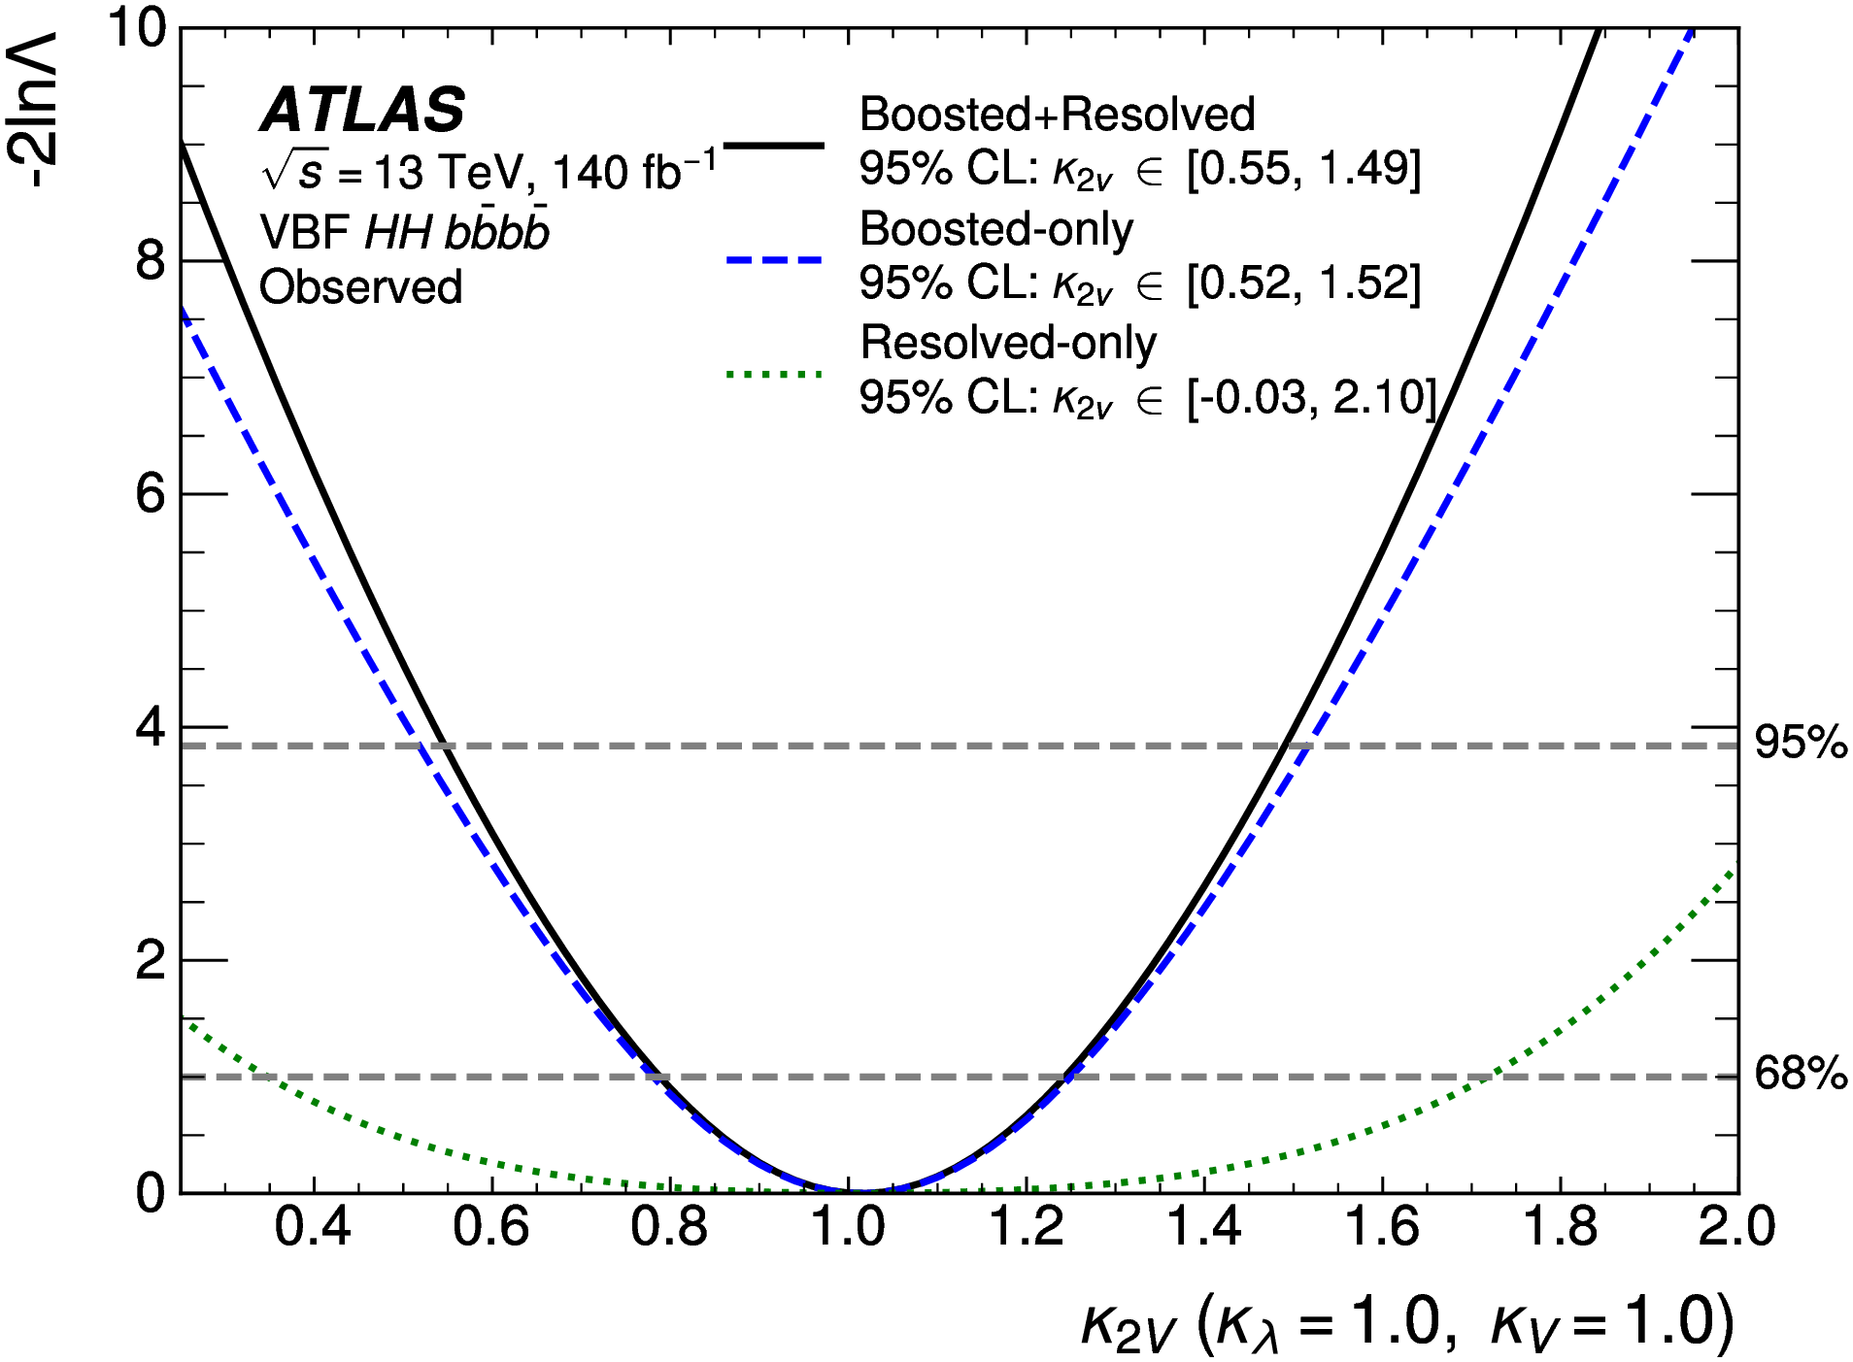





Run 2 HH Combination: channels
HH→bbbb
Largest BR, but challenging due to large QCD multijet background
Boosted and resolved topologies
VBF boosted channel very sensitive to VVHH coupling
$$b\overline{b}$$
$$b$$
$$\overline{b}$$
$$b\overline{b}$$
$$b$$
$$\overline{b}$$
Phys. Lett. B 858 (2024) 139007, Phys. Rev. D 108 (2023) 052003
Notes:
large br, challenging. > boosted + resolved. boosted vbf quartic >

Slide 12

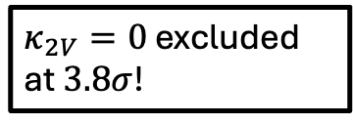




Run 2 HH Combination: channels
HH→bbbb
Largest BR, but challenging due to large QCD multijet background
Boosted and resolved topologies
VBF boosted channel very sensitive to VVHH coupling
$κ_{2V}=0$ excluded at $3.8σ$!
$$b\overline{b}$$
$$b$$
$$\overline{b}$$
$$b\overline{b}$$
$$b$$
$$\overline{b}$$
Notes:
scan, sensitivity driven boosted. comb tightest limits. 0 excl

Slide 13
Run 2 HH Combination: channels
HH→bb𝛾𝛾
Small BR but clean final state
BDT used to separate signal from background and categorise events
Unbinned maximum likelihood fit to m_{𝛾𝛾}
HH→bbℓℓ
Targets HH→2b + 2l + neutrinos
DNN used to separate signal from background
MVA outputs used as statistical discriminants
HH→multilepton
Multiple final states with different numbers of leptons and τ_{had}, diphotons
BDT score or m_{𝛾𝛾} as fit variable
HH→bbbb
Largest BR, but challenging due to large QCD multijet background
Multi b-jet triggers used to select events
Boosted and resolved topologies
HH→bbττ
Reasonably large BR and manageable backgrounds compared to bbbb
τ_{had}τ_{had} and τ_{lep}τ_{had} channels
BDTs to separate VBF from ggF, signal from background
Notes:
Moving on to bbtt

Slide 14
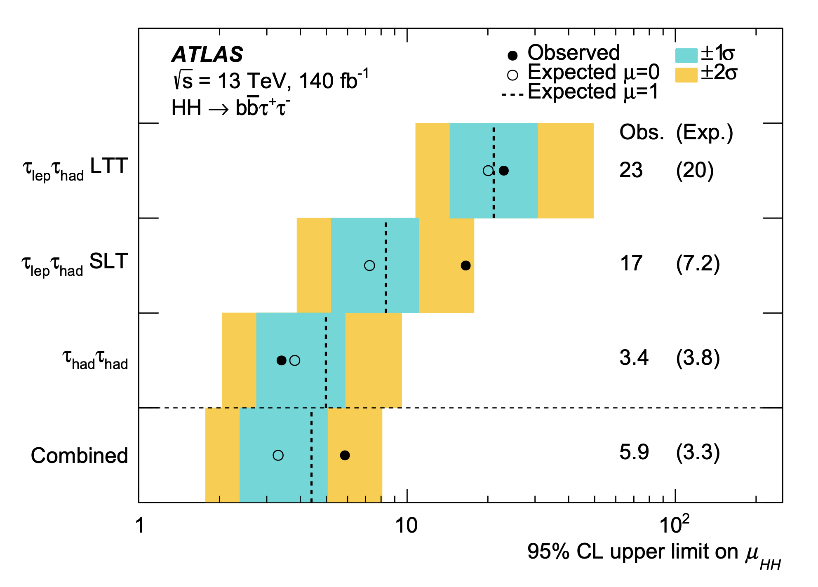
Run 2 HH Combination: channels
HH→bbττ
Reasonably large BR and manageable backgrounds compared to bbbb
τ_{had}τ_{had} and τ_{lep}τ_{had} channels
BDTs to separate VBF from ggF and signal from background
Phys. Rev. D 110 (2024) 032012
Notes:
large br manageable nkg. SRs thadhad tlephad. BDTsfor VBF ggF events, S B

Slide 15
Run 2 HH Combination: channels
Best expected (observed) upper limit of μ_{HH} < 3.3 (5.9)
HH→bbττ
Reasonably large BR and manageable backgrounds compared to bbbb
τ_{had}τ_{had} and τ_{lep}τ_{had} channels
BDTs to separate VBF from ggF and signal from background
Phys. Rev. D 110 (2024) 032012
Notes:
upper limit plot separate + comb. best mu_HH sens with 3.3. obs excess 5.9

Slide 16
Run 2 HH Combination: channels
HH→bb𝛾𝛾
Small BR but clean final state
BDT used to separate signal from background and categorise events
Unbinned maximum likelihood fit to m_{𝛾𝛾}
HH→bbℓℓ+ MET
Targets HH→2b + 2l + neutrinos
DNN used to separate signal from background
MVA outputs used as statistical discriminants
HH→multilepton
Multiple final states with different numbers of leptons and τ_{had}, diphotons
BDT score or m_{𝛾𝛾} as fit variable
HH→bbbb
Largest BR, but challenging due to large QCD multijet background
Multi b-jet triggers used to select events
Boosted and resolved topologies
HH→bbττ
Reasonably large BR and manageable backgrounds compared to bbbb
τ_{had}τ_{had} and τ_{lep}τ_{had} channels
BDTs to separate VBF from ggF, signal from background
Notes:
Moving onto the run 2 legacy bbyy channel.

Slide 17
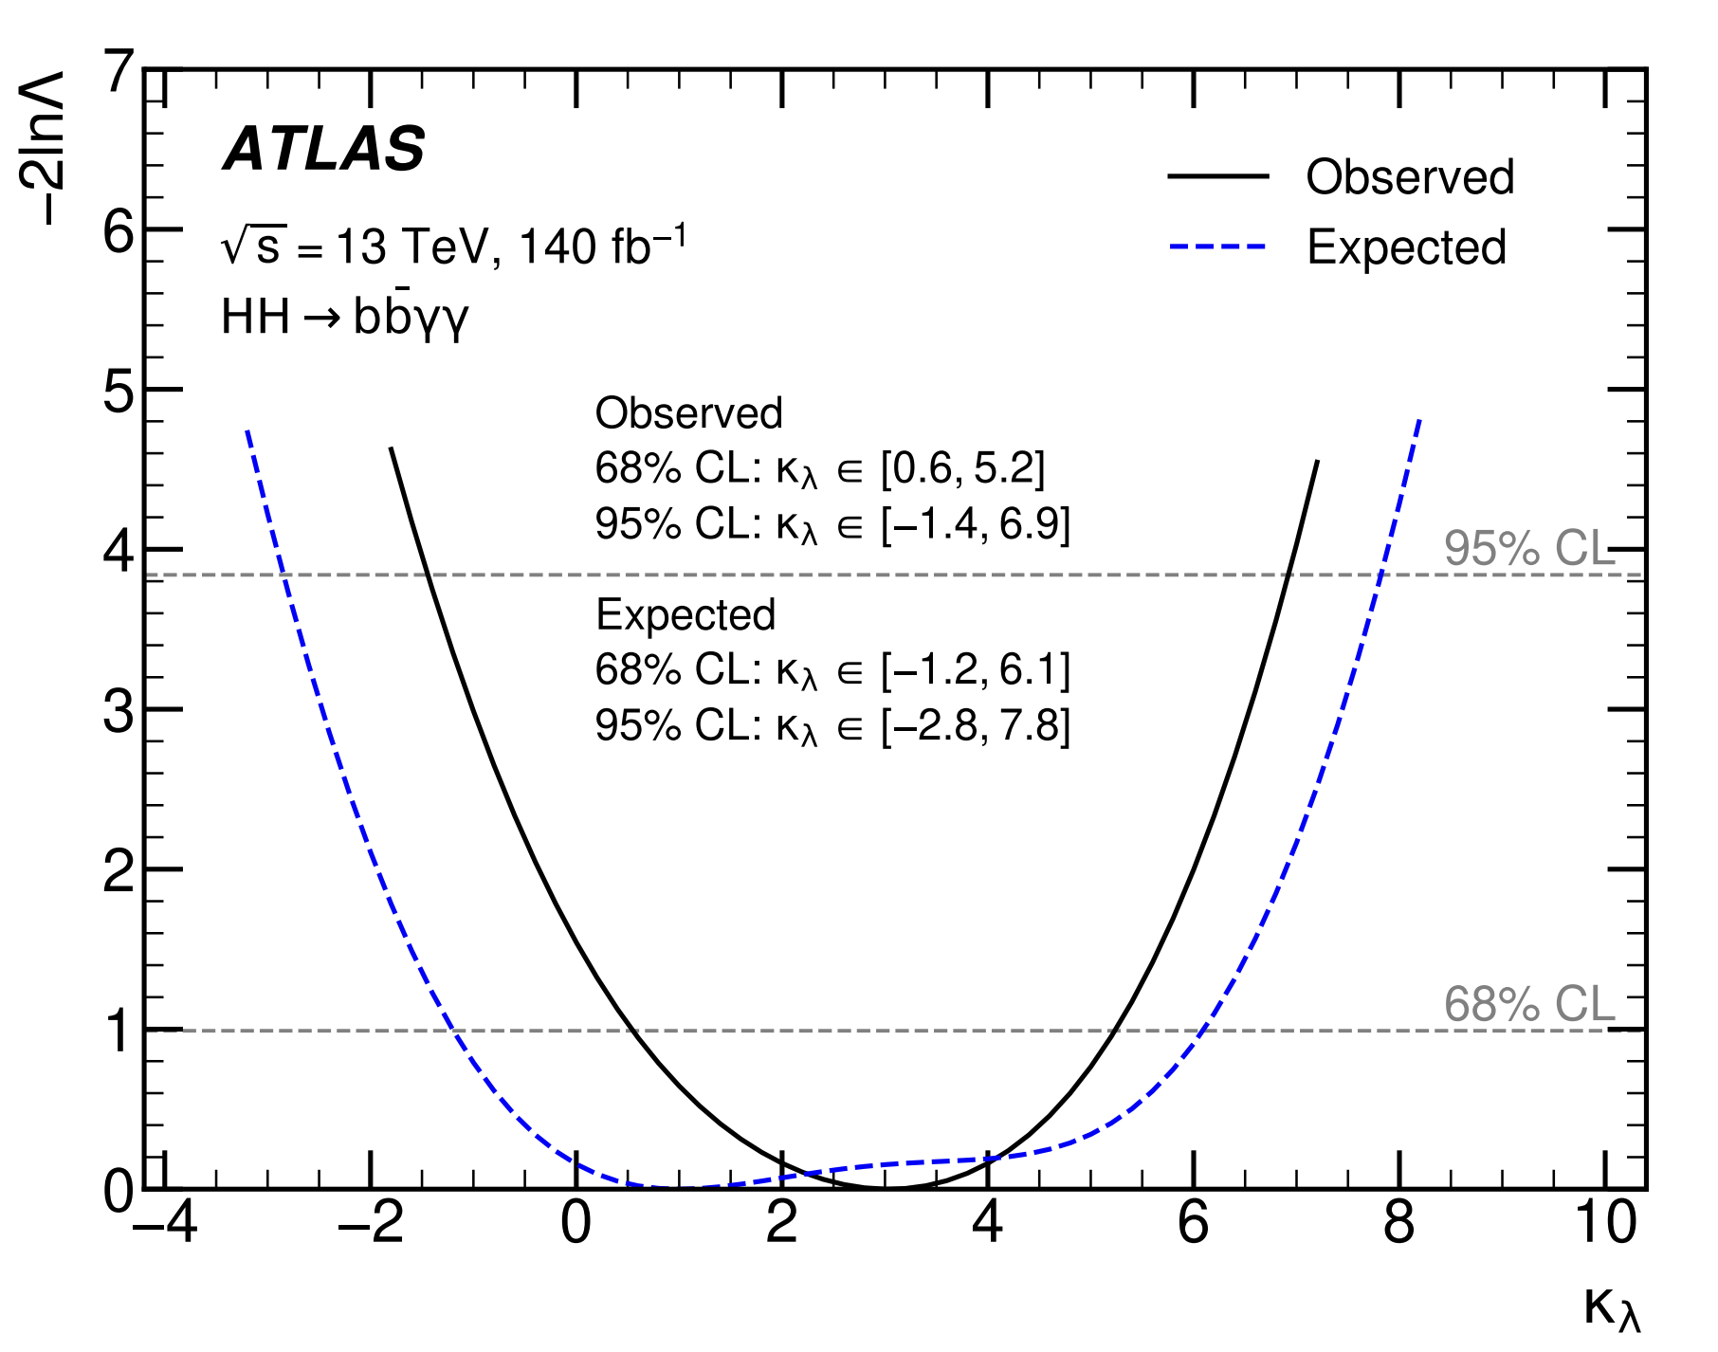
Run 2 HH Combination: channels
HH→bb𝛾𝛾
Small BR but clean final state
BDT used to separate signal from background and categorise events
Unbinned maximum likelihood fit to m_{𝛾𝛾}
JHEP 01 (2024) 066
Notes:
small br compensated. BDTs. unbinned ML myy

Slide 18
Run 2 HH Combination: channels
Best expected (observed) 95% CL
𝜅_{𝜆} ϵ [-2.8, 7.8] ([-1.4, 6.9])
HH→bb𝛾𝛾
Small BR but clean final state
BDT used to separate signal from background and categorise events
Unbinned maximum likelihood fit to m_{𝛾𝛾}
JHEP 01 (2024) 066
Notes:
kl scan. most sensitive. obs limit

Slide 19
Run 2 HH Combination: channels
HH→bb𝛾𝛾
Small BR but clean final state
BDT used to separate signal from background and categorise events
Unbinned maximum likelihood fit to m_{𝛾𝛾}
HH→bbℓℓ+ MET
Targets HH→2b + 2l + neutrinos
DNN used to separate signal from background
MVA outputs used as statistical discriminants
HH→multilepton
Multiple final states with different numbers of leptons and τ_{had}, diphotons
BDT score or m_{𝛾𝛾} as fit variable
HH→bbbb
Largest BR, but challenging due to large QCD multijet background
Multi b-jet triggers used to select events
Boosted and resolved topologies
HH→bbττ
Reasonably large BR and manageable backgrounds compared to bbbb
τ_{had}τ_{had} and τ_{lep}τ_{had} channels
BDTs to separate VBF from ggF, signal from background
Notes:
last 2 comb diff final states. not competitive with goldem, but complementary and add. feat broad range

Slide 20
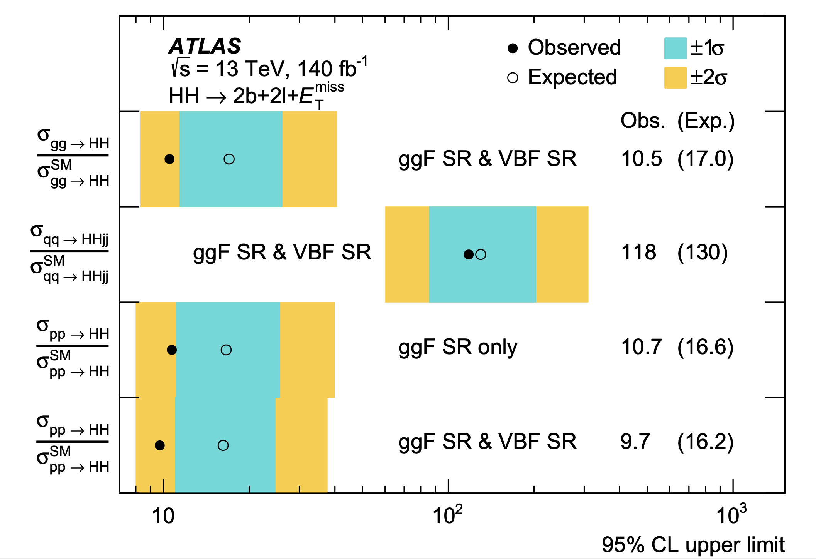
Run 2 HH Combination: channels
HH→bbℓℓ+MET
Targets HH→2b + 2l + neutrinos
DNN and BDT used to separate VBF from ggF and signal from background
MVA outputs used as statistical discriminants
JHEP 02 (2024) 037
Notes:
2b, 2OC l, neutrinos MET. DNN BDT ggF and VBF signal respectively, SB. MVA disc

Slide 21
Run 2 HH Combination: channels
Expected (observed) 95% CL upper limit μ_{HH} < 16.2 (9.7)
HH→bbℓℓ
Targets HH→2b + 2l + neutrinos
DNN and BDT used to separate signal from background
MVA outputs used as statistical discriminants
JHEP 02 (2024) 037
Notes:
mu_HH ggF VBF comb. obs exp.

Slide 22
Run 2 HH Combination: channels
HH→bb𝛾𝛾
Small BR but clean final state
BDT used to separate signal from background and categorise events
Unbinned maximum likelihood fit to m_{𝛾𝛾}
HH→bbℓℓ+ MET
Targets HH→2b + 2l + neutrinos
DNN used to separate signal from background
MVA outputs used as statistical discriminants
HH→multilepton
Multiple final states with different numbers of leptons and τ_{had}, diphotons
BDT score or m_{𝛾𝛾} as fit variable
HH→bbbb
Largest BR, but challenging due to large QCD multijet background
Multi b-jet triggers used to select events
Boosted and resolved topologies
HH→bbττ
Reasonably large BR and manageable backgrounds compared to bbbb
τ_{had}τ_{had} and τ_{lep}τ_{had} channels
BDTs to separate VBF from ggF, signal from background

Slide 23
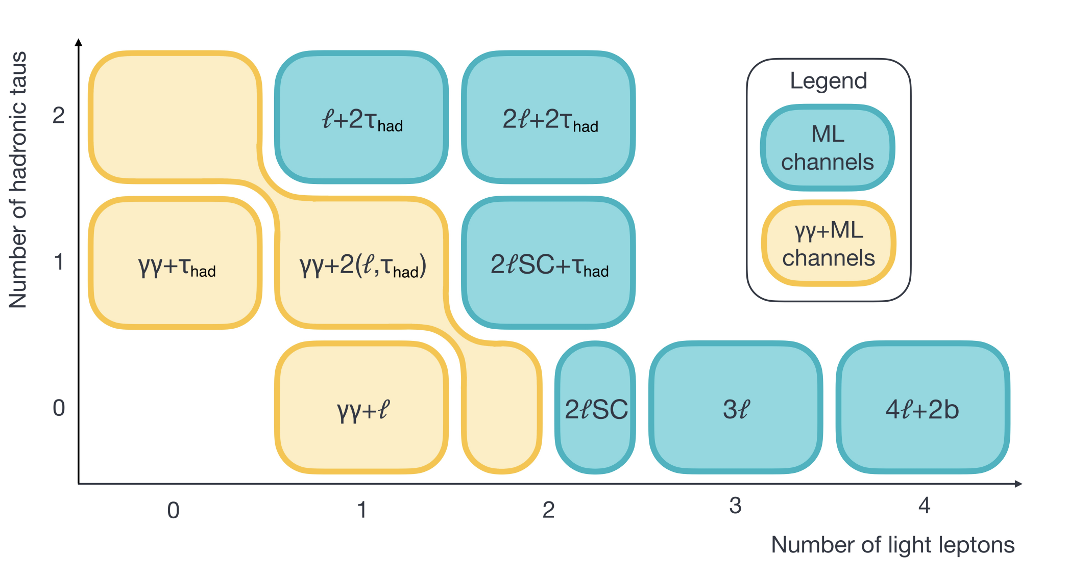
Run 2 HH Combination: channels
HH→multilepton
Multiple final states with different numbers of leptons and τ_{had}, diphotons
BDTs used to separate signal from background
BDT score or m_{𝛾𝛾} as fit variable
JHEP 08 (2024) 164
Notes:
remaining decay modes, orthoganlity

Slide 24
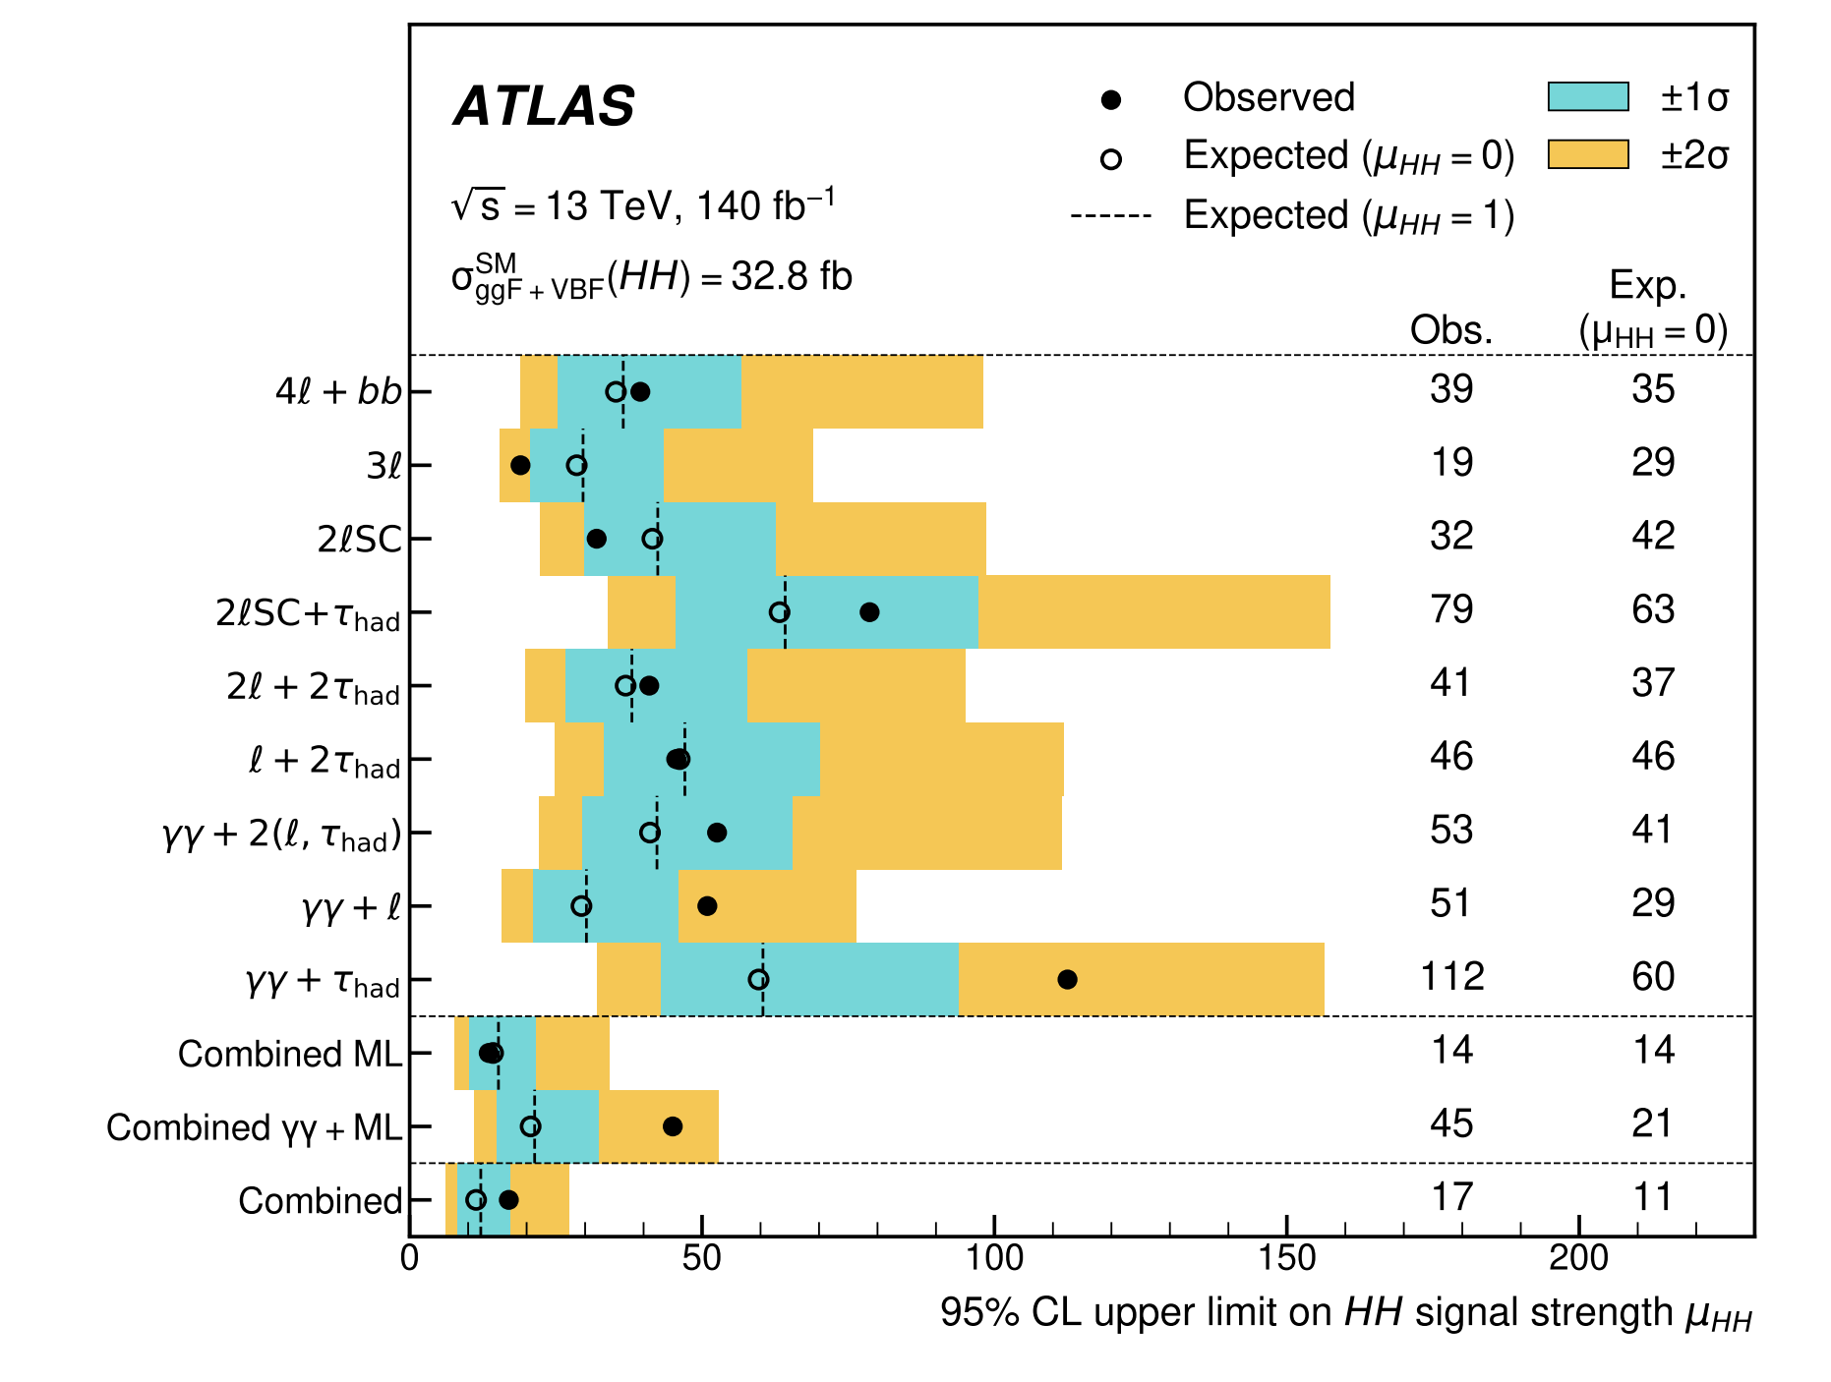
Run 2 HH Combination: channels
Expected (observed) 95% CL upper limit μ_{HH} < 11 (17)
HH→multilepton
Multiple final states with different numbers of leptons and τ_{had}, diphotons
BDTs used to separate signal from background
BDT score or m_{𝛾𝛾} as fit variable
JHEP 08 (2024) 164
Notes:
incl diff ll thad yy. full set axes SC. BDTs. statistical discriminant . first time many, some 100. comb brings obs mu 17.

Slide 25
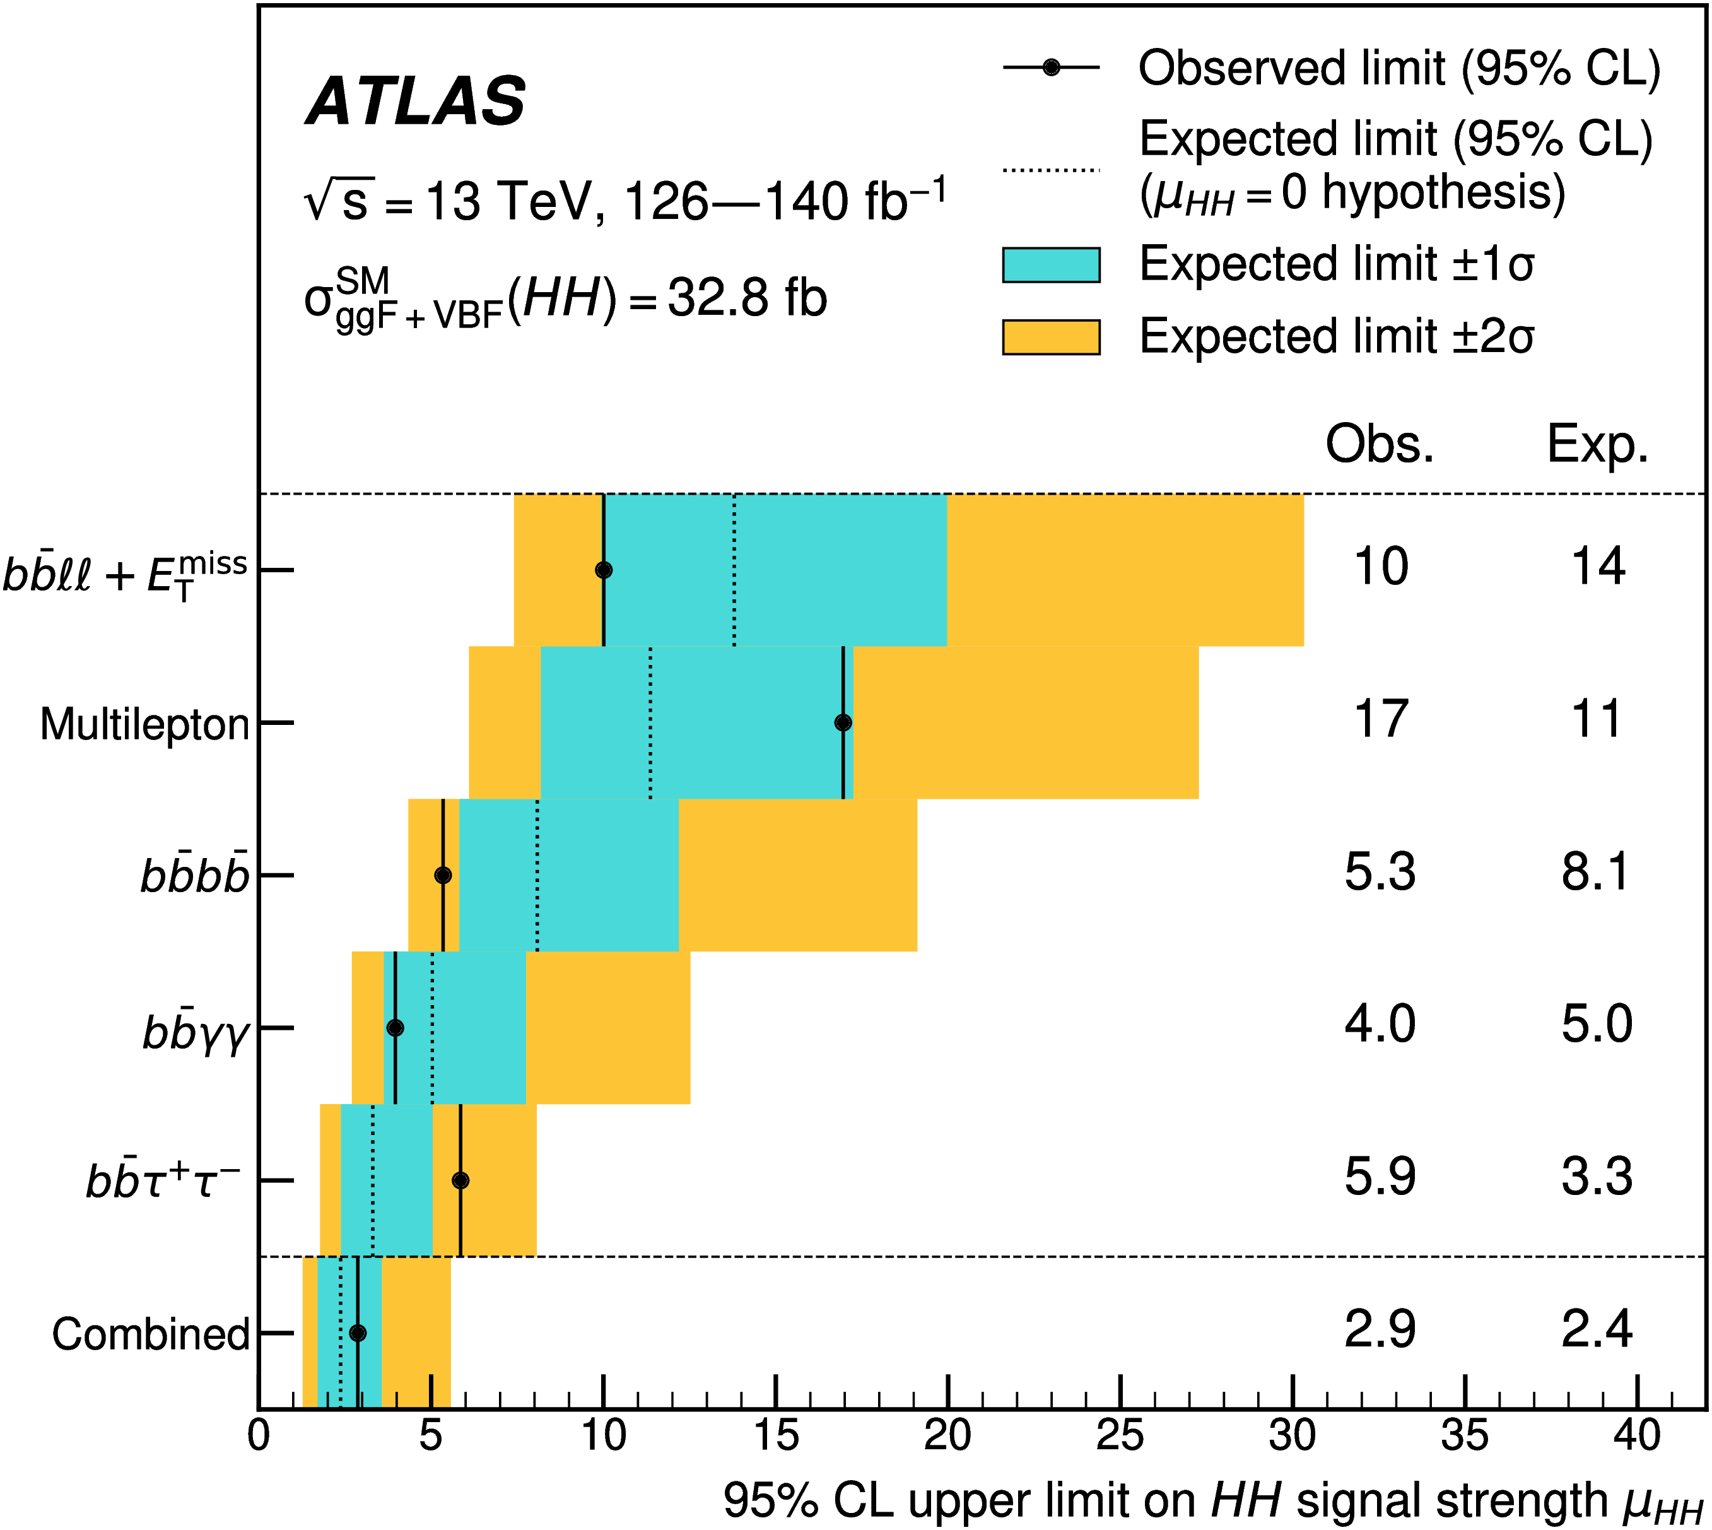
HH Combination results
Observed 95% CL upper limit on HH signal strength: μ_{HH} < 2.9
Observed upper limit on ggF and VBF HH cross section: σ_{ggF+VBF}(HH) < 86 fb
Strongest limit to date
HH→bb𝛾𝛾 has the best observed limit
HH→bbττ has the best expected limit
Phys. Rev. Lett. 133 (2024) 101801
Notes:
5 quite diff, plot, contr obs lim 2.9. CS lim. strongest. indiv channels.

Slide 26
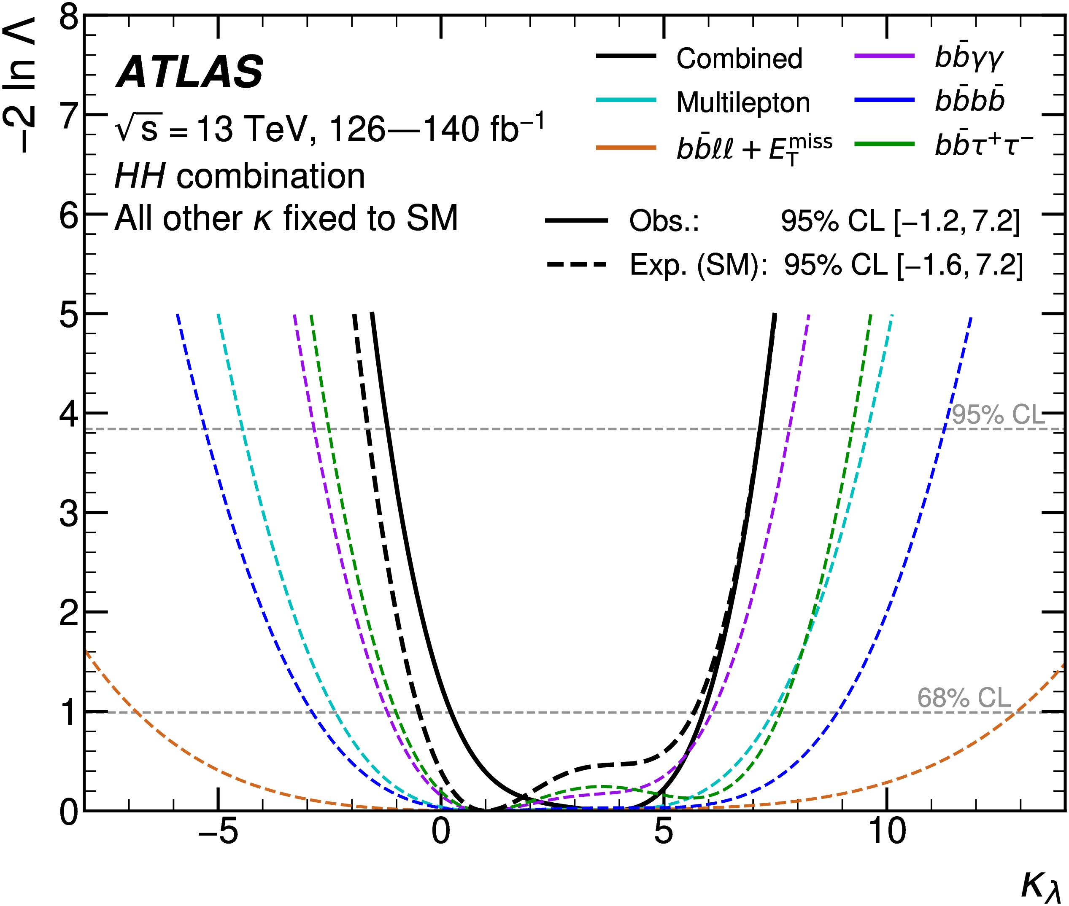
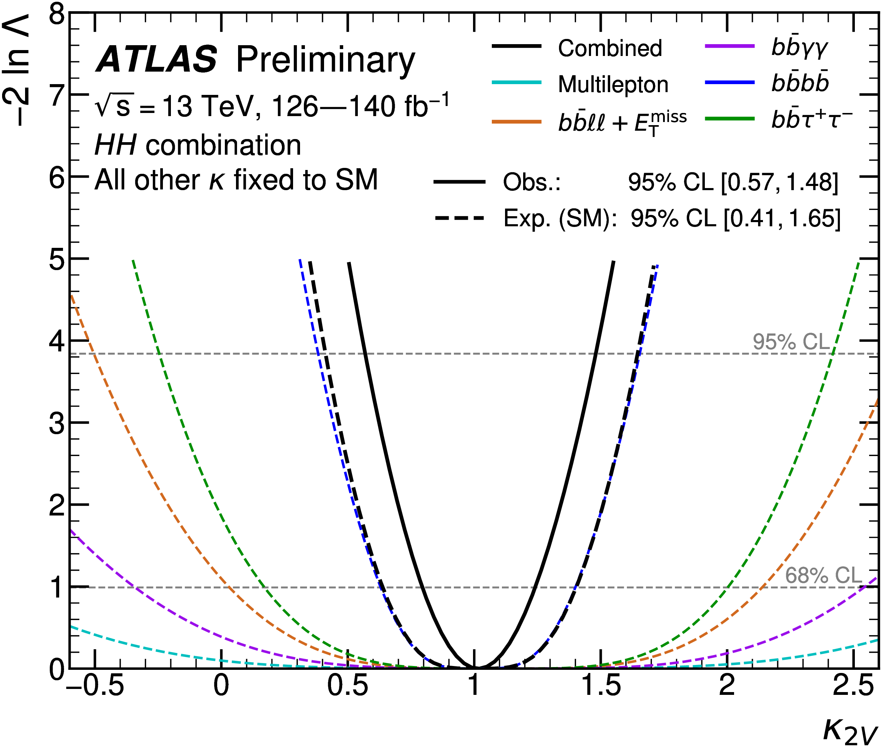
HH Combination results
Observed 95% CI on κ_{λ} ϵ [-1.2, 7.2]
HH→bb𝛾𝛾 has the tightest interval and best upper limit
HH→bbττ has the best lower limit
Observed 95% CI on κ_{2V} ϵ [0.57, 1.48]
HH→bbbb has the best limits, driven by the boosted VBF channel
Phys. Rev. Lett. 133 (2024) 101801
Notes:
continuing couplings. scans. kl constr. indiv. k2v constr. sensitivity from 4b, best due to boosted vbf.

Slide 27
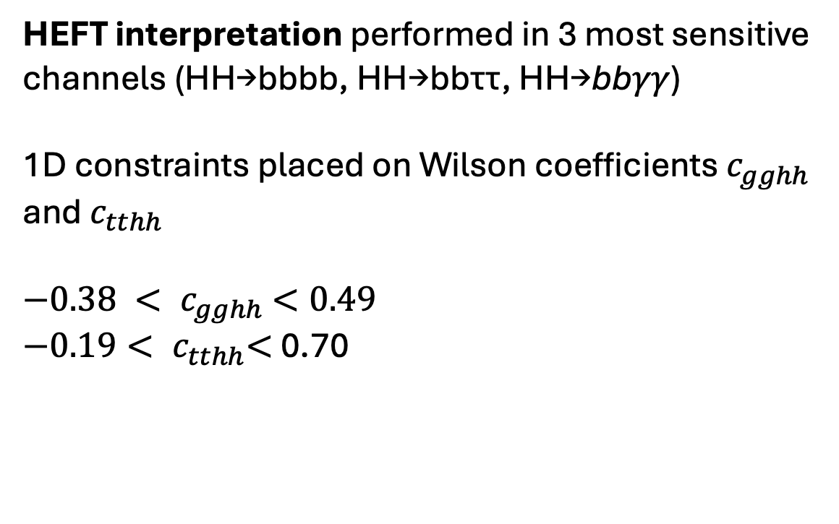
HH Combination results
HEFT interpretation performed in 3 most sensitive channels (HH→bbbb, HH→bbττ, HH→bb𝛾𝛾)
1D constraints placed on Wilson coefficients $c_{gghh}$ and $c_{tthh}$
${−0.38 < c}_{gghh} <0.49$
${−0.19< c}_{tthh}<$ 0.70
Phys. Rev. Lett. 133 (2024) 101801
Notes:
continuing couplings. scans. kl constr. indiv. k2v constr. sensitivity from 4b, best due to boosted vbf.

Slide 28
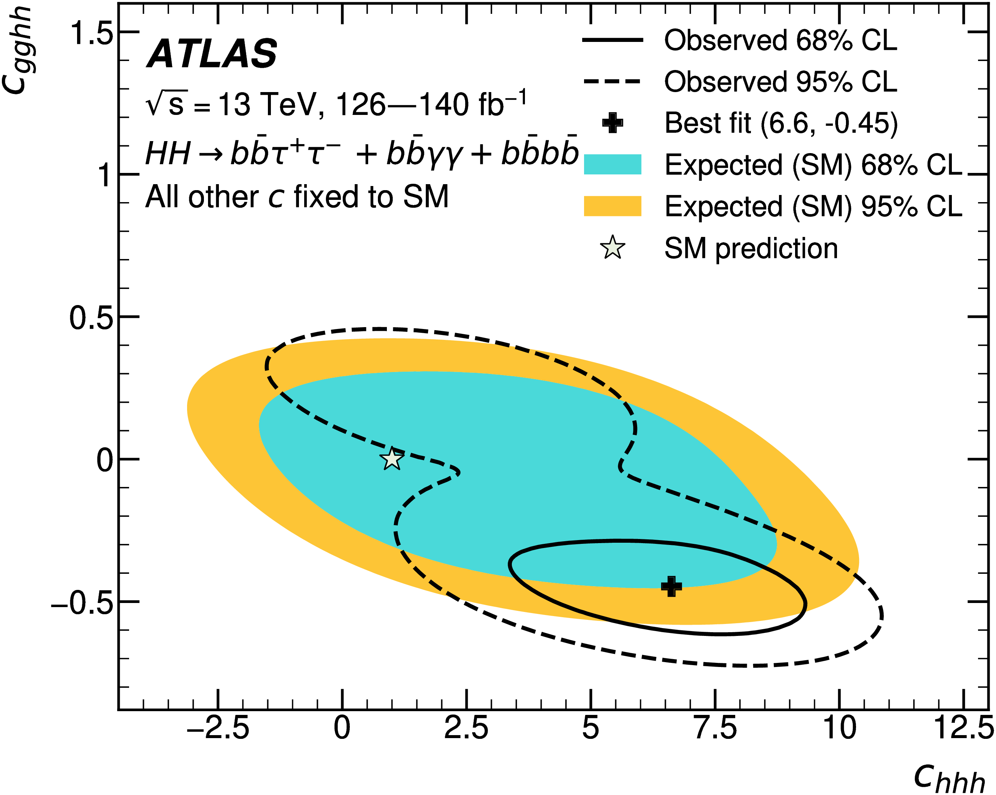
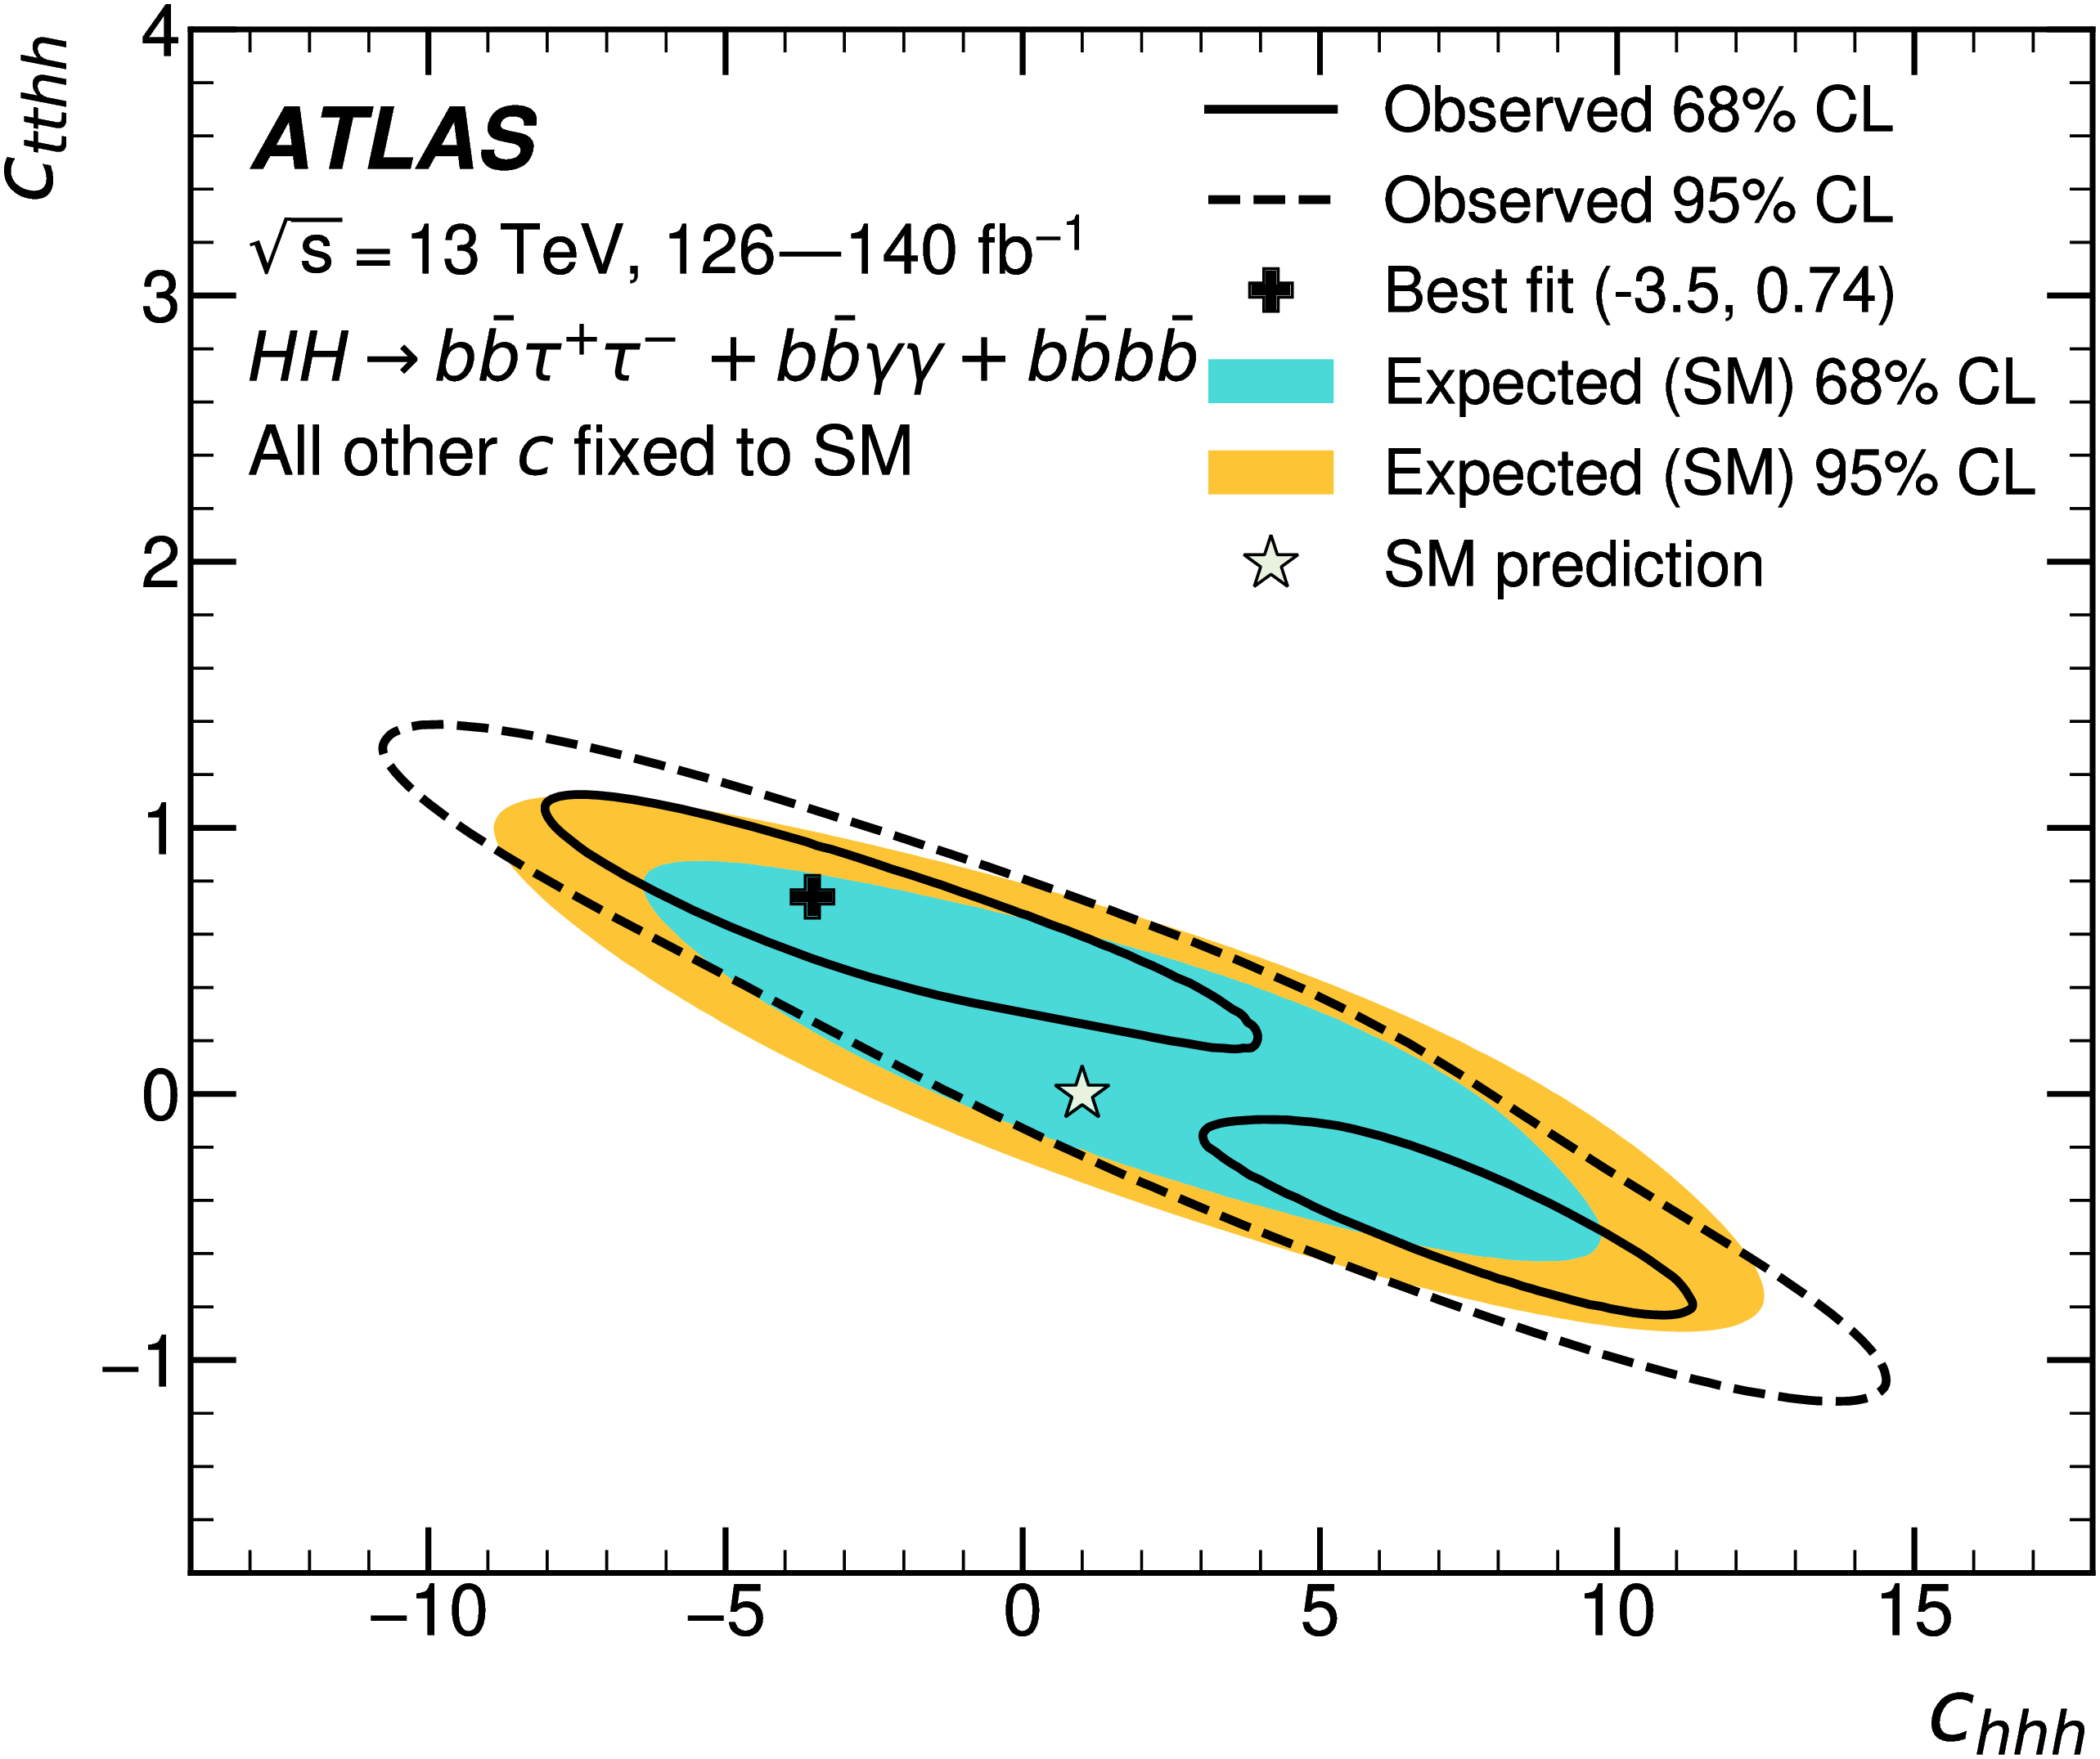
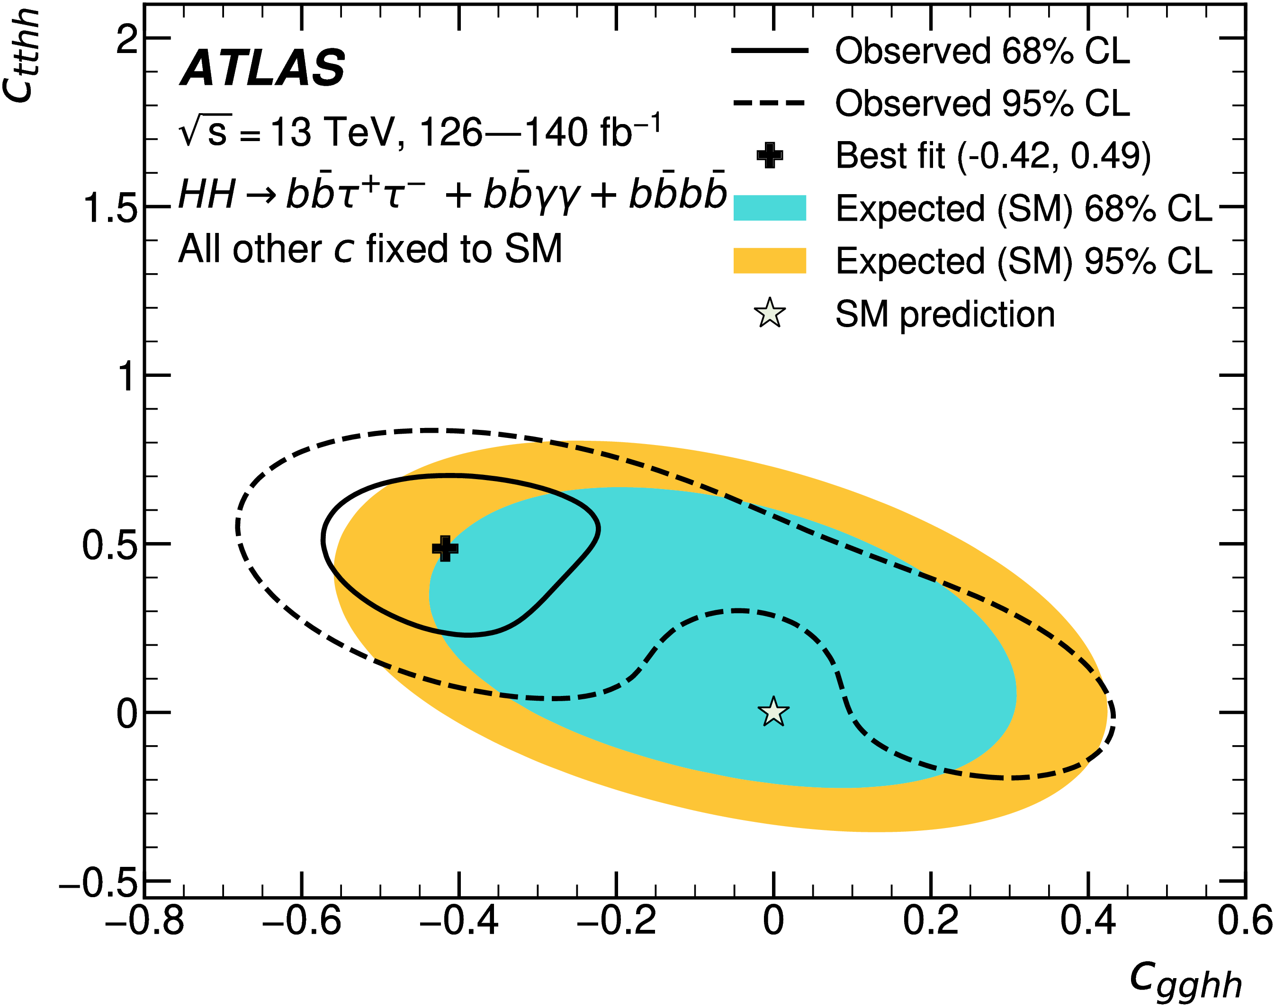

HH Combination results
2D likelihood scans performed for $(c_{gghh}$, $c_{tthh}$),$(c_{gghh}$, $c_{hhh}$), $(c_{tthh}$, $c_{hhh}$), fixing the 3rd coefficient to its SM value

Slide 29
Run 2 + partial Run 3 HH → bbγγ
Phys. Rev. Lett. 133 (2024) 101801, ATLAS Briefing
See also Punit’s dedicated talk
Notes:
Now I will show our newest non-resonant HH result: Run 2 and partial Run 3 HH -> bbyy analysis. I will give a broader overview of the strategy and results, but I encourage you to see Punit’s dedicated talk later today for more details on this analysis.

Slide 30
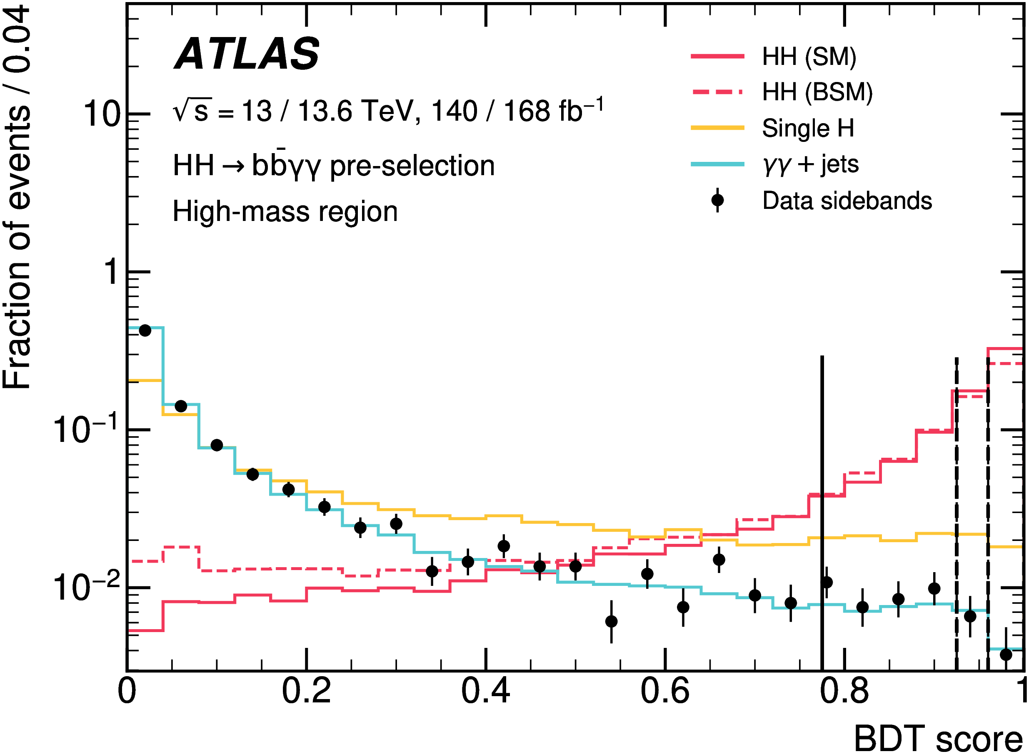
Run 2 + partial Run 3 HH → bbγγ
First ATLAS result using 308 fb⁻¹ of data!
Asymmetric di-photon trigger with (sub)leading photon p_{T} > 35 (25) GeV
H→γγ selection, H→bb selection (GN2 85% WP) and ttH veto
BDT trained in high (m*_{bbγγ} > 350 GeV) and low (m*_{bbγγ} ≤ 350 GeV) four-body invariant mass regions to separate signal from Single Higgs and γγ+jets background
$$m_{bbγγ}^{∗}= {m_{bbγγ} −(m}_{bb}−125 GeV) −(m_{γγ} −125 GeV)$$
arXiv:2507.03495
Notes:
funn run 2, 2022-2024. 1st 308! asymmetric yy trigger pt thresholds. presell hyy hbb thh. >2 bjets 85%. bdt trained HM, LM, 350 threshold SB. plot score SM,BSM signal and singleH, yyjets bkg. lines category

Slide 31
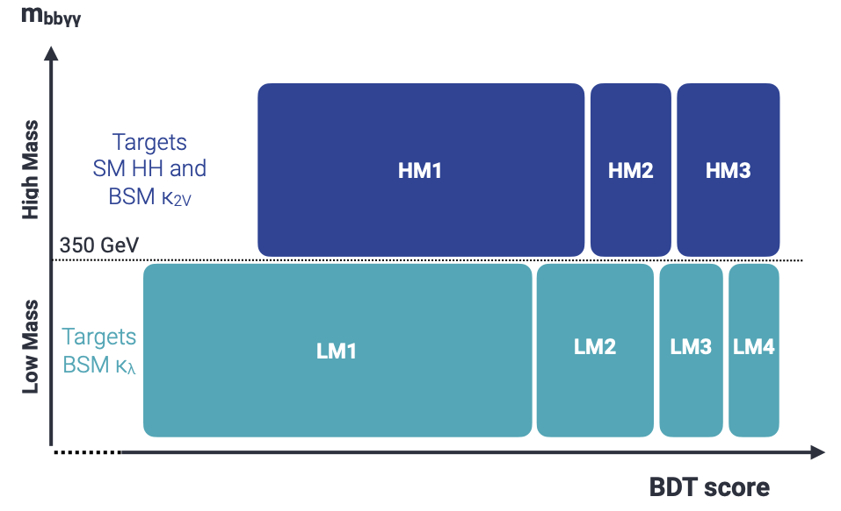
Run 2 + partial Run 3 HH → bbγγ
BDT score used to define categories that maximise benchmark signal counting significance
11 γγ+jets events required in each category → Run-2 and Run-3 correlated to allow for tighter BDT score cuts
Background shapes also correlated, background normalization decorrelated
Data events categorised in 14 regions
Image by K Leney
arXiv:2507.03495
Notes:
boundaries max sig. sufficient events to constrain -, 11 yy+jets per cat run 2 run 3. corr tight cuts, sig purity. shapes corr, norm not. schematic cat. 3 HM, SM HH; 4 LM BSM HH. cat applied to data separately - 14

Slide 32
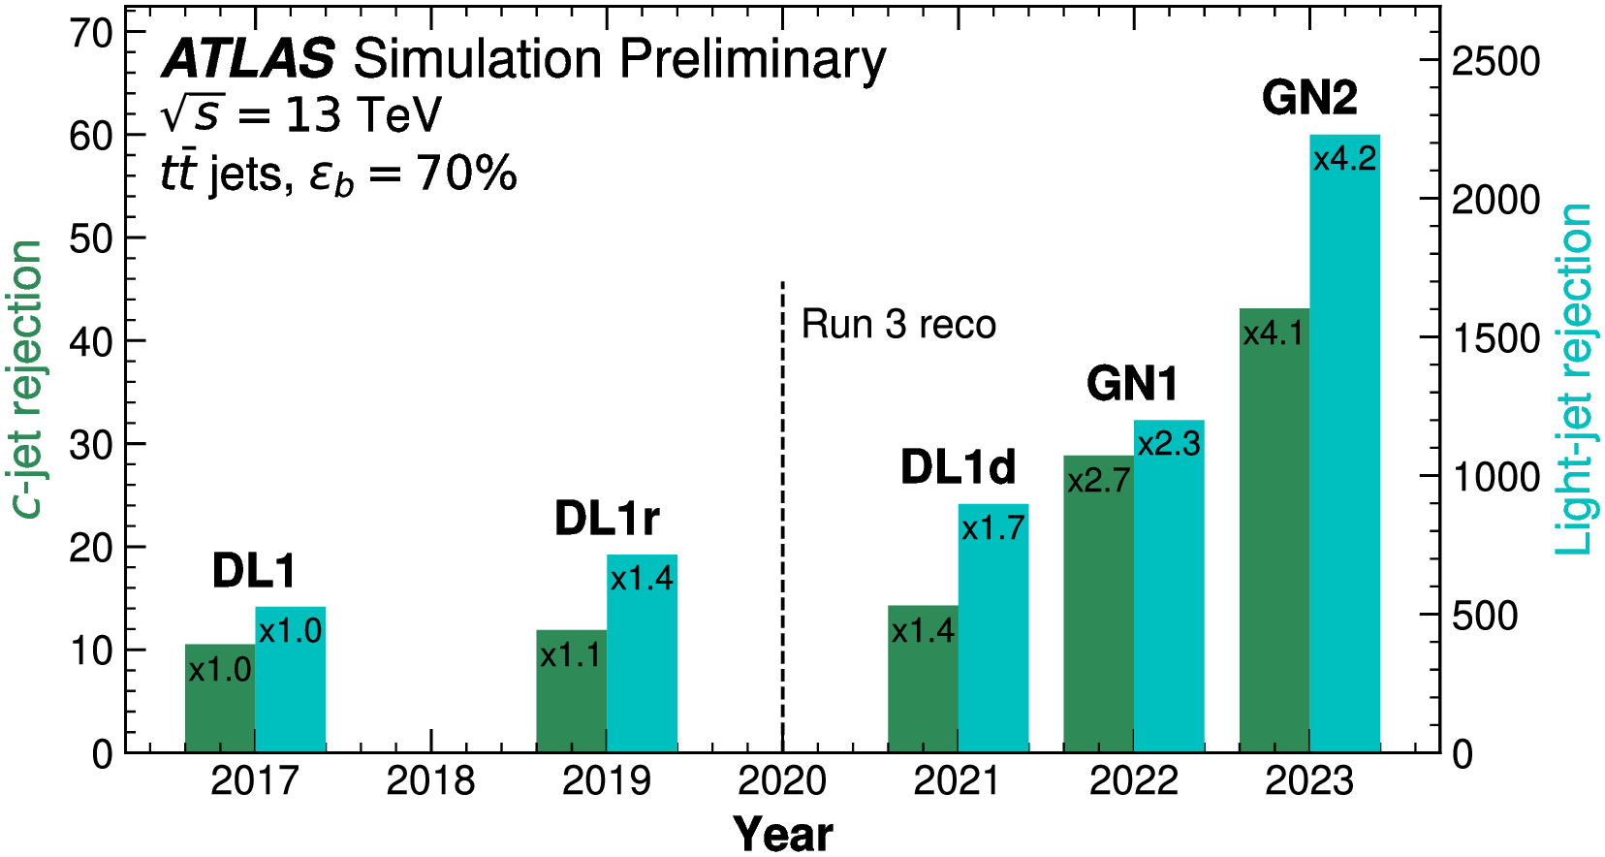
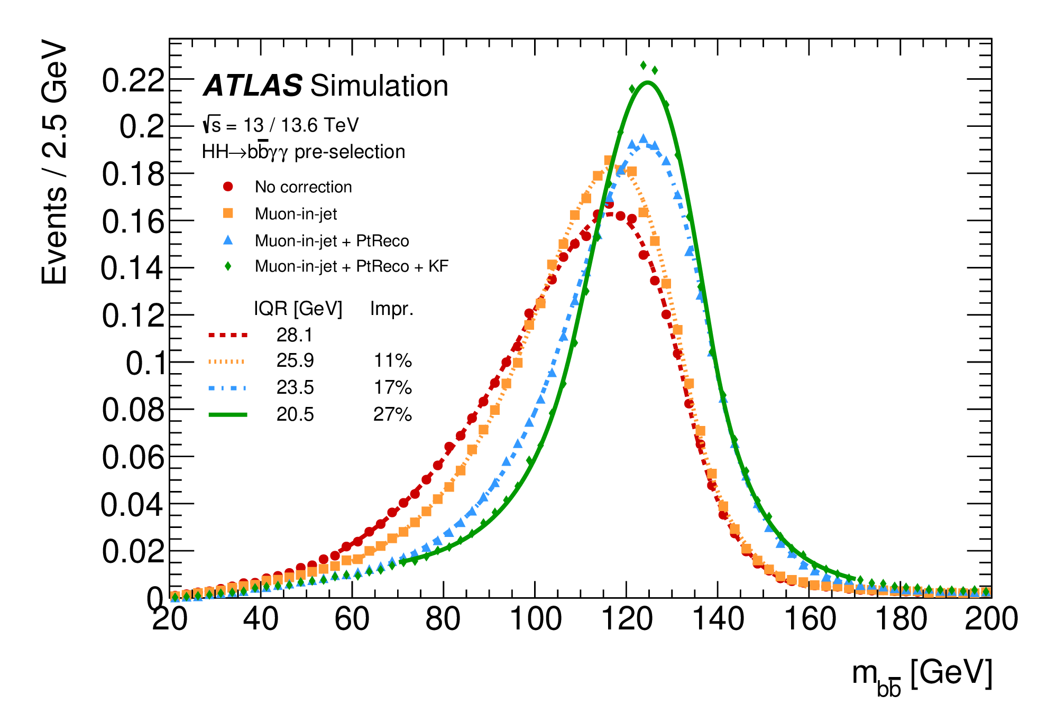
Run 2 + partial Run 3 HH → bbγγ
ATLAS-FTAG-2023-01
Main improvements over Run 2 legacy
More data! 140 fb⁻¹ → 308 fb⁻¹ (50%)
New GNN-based tagger GN2 (20%)
Correlation between Run 2 and Run 3 events in BDT and category optimization (10%)
Kinematic Fit to improve m_{bb} resolution (5%)
arXiv:2507.03495
Notes:
several improvements. addition run3 alone. aside data, tools analysis. GN2, around 3x bkg rejection than DL1r, legacy. plot remarkable. use allows tighter WP, 20%. corr strategy 10%. KF momentum balance, correct p4 event improve mbb. mbb for no corr standard KF. 5%

Slide 33
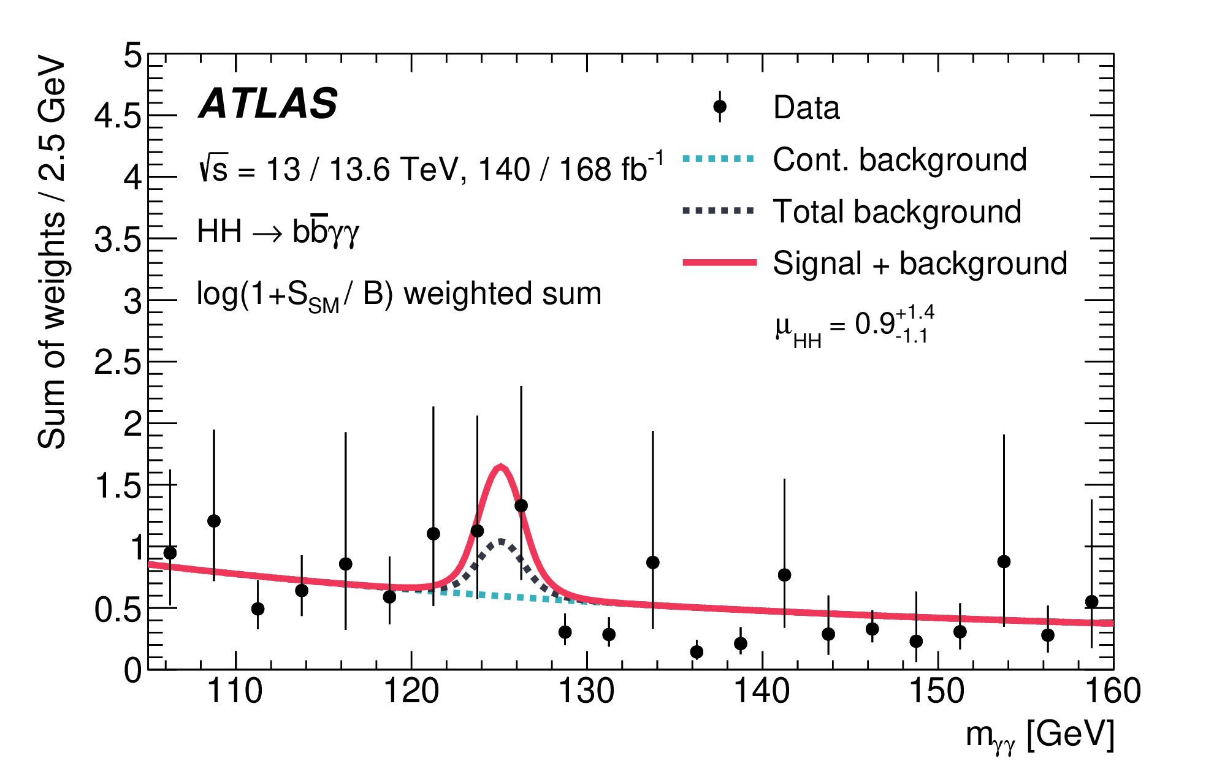
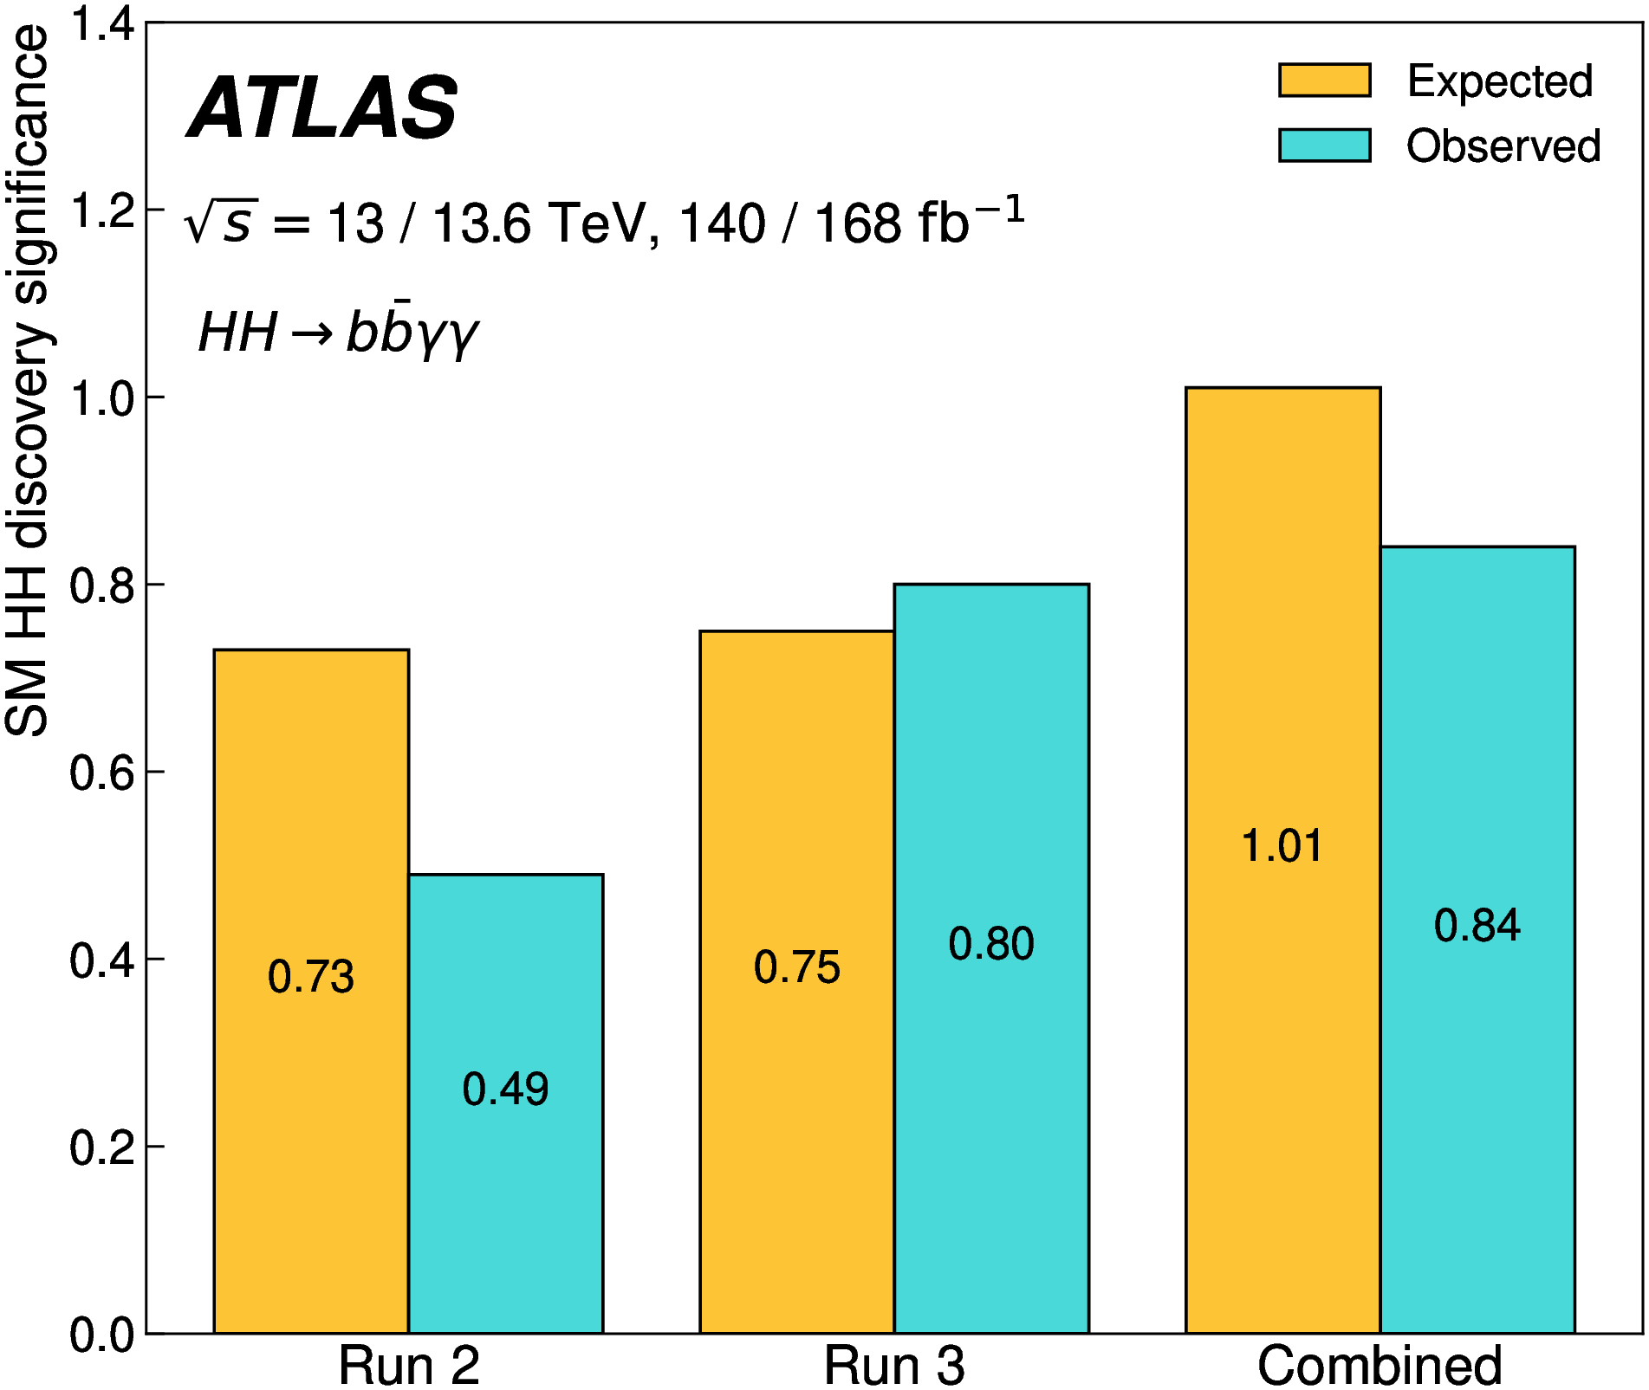
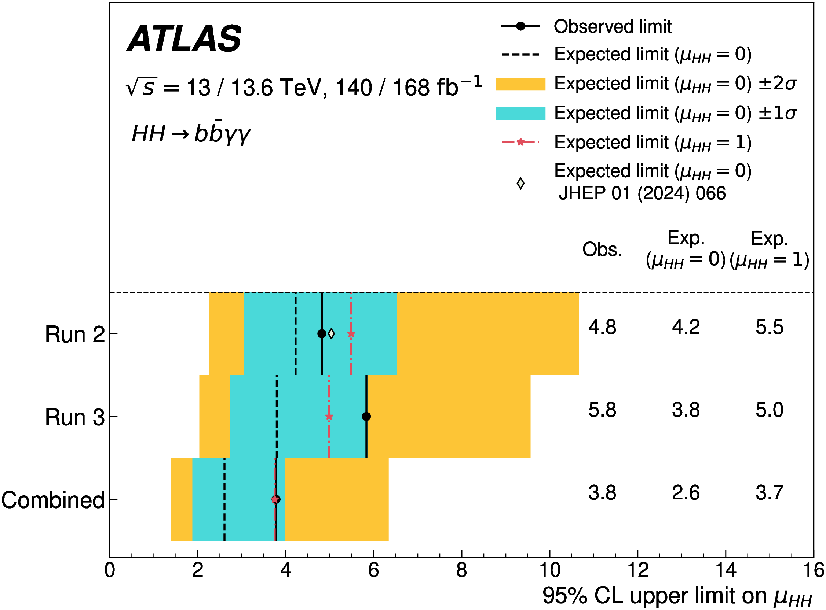
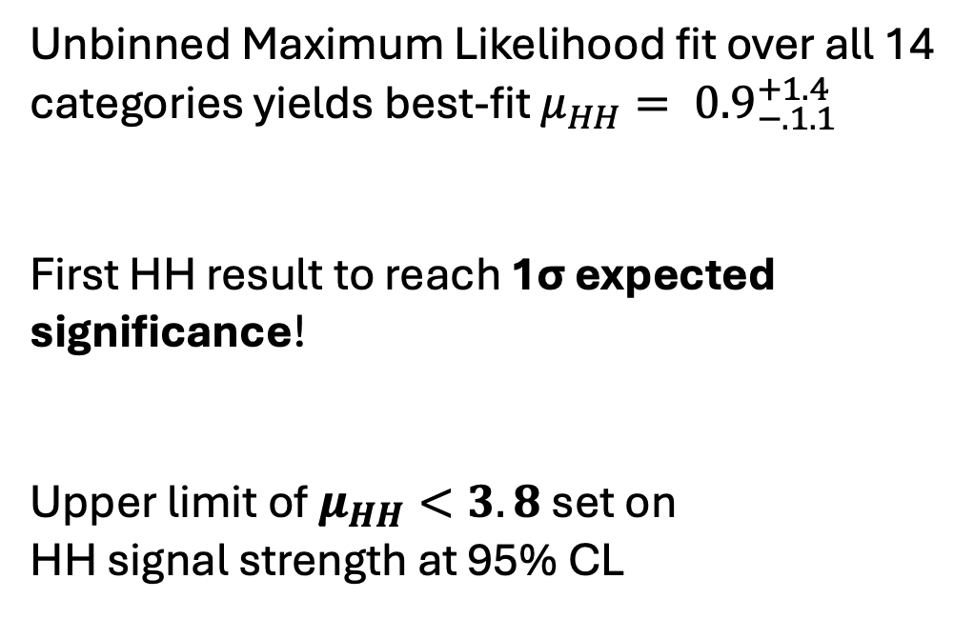
Run 2 + partial Run 3 HH → bbγγ
arXiv:2507.03495
Unbinned Maximum Likelihood fit over all 14 categories yields best-fit $μ_{HH}= {0.9}_{−.1.1}^{+1.4}$
First HH result to reach 1σ expected significance!
Upper limit of $μ_{HH}<3.8$ set on
HH signal strength at 95% CL
Notes:
results exrtacted unbinned ML fit over cat (plot). best fit compatible SM. corresponds exp sig 1sig, first HH. obs upper limit 3.8. plots

Slide 34
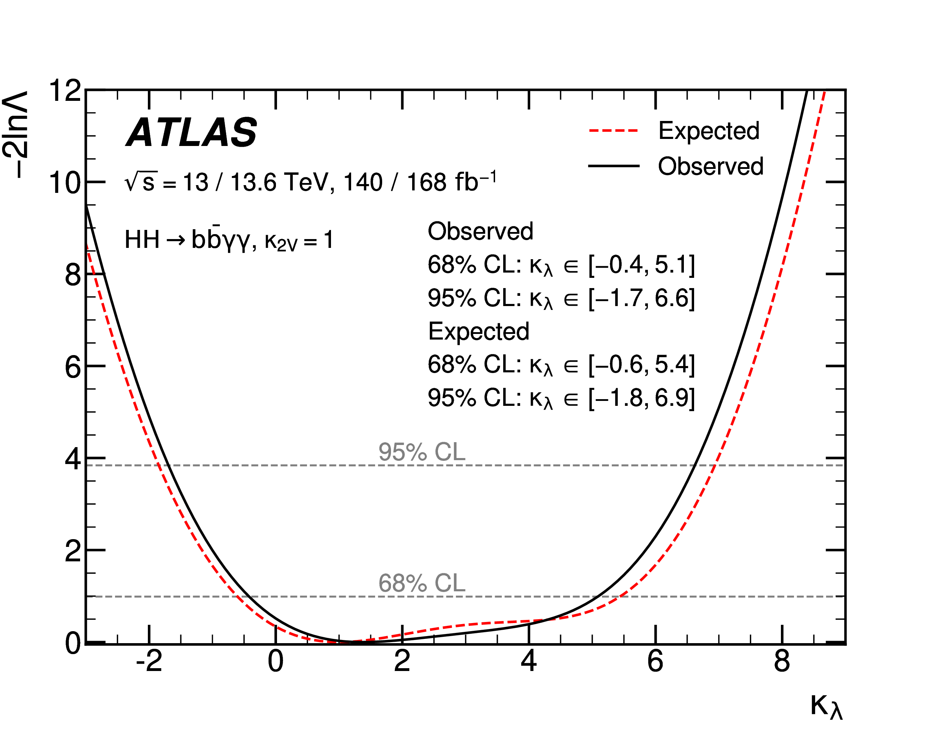
Run 2 + partial Run 3 HH → bbγγ
Limits set on Higgs self-coupling at the 95% confidence level:
κ_{λ} ϵ [-1.7, 6.6]
Limits competitive with the Run 2 legacy HH combination (κ_{λ} ϵ [-1.2, 7.2])
arXiv:2507.03495
Notes:
plot obs limits set. competitive with full comb. remarkable single channel

Slide 35
Summary and outlook
The last 2 years brought major progress in non-resonant searches for HH production in ATLAS
Combining several complementary channels has given us the tightest limits to date on the HH cross-section and self-coupling
Our first result with Run-3 data (HH→bbγγ) already rivals the entire Run-2 combination in sensitivity to the Higgs trilinear self-coupling → stay tuned for further Run-3 results and combinations…
The future of HH looks promising – see HL-LHC and Future Colliders talks
Notes:
major progress non res HH prod. wide program of indiv searches tightest. first run3 rivals comb. bodes well, stay tuned. many things to look forward to in future of HH, and I encourage you to attend HL-LHC, FC

Slide 36
Backup

Slide 37
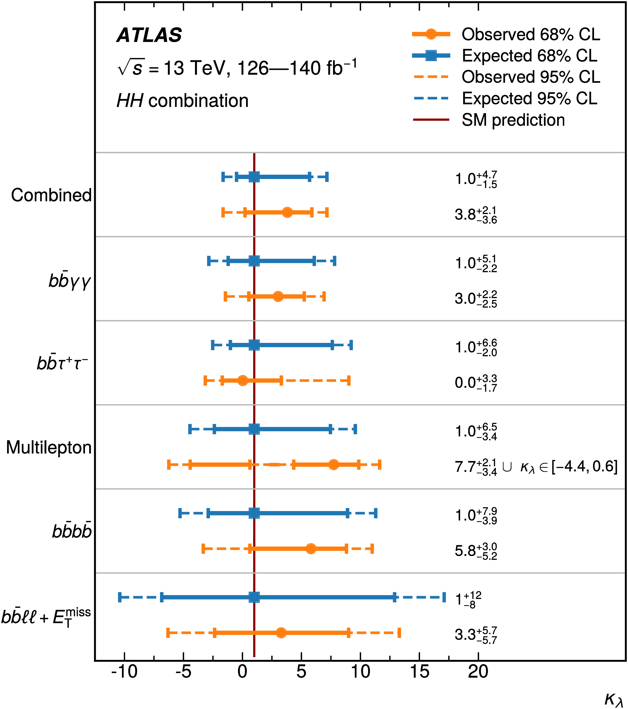
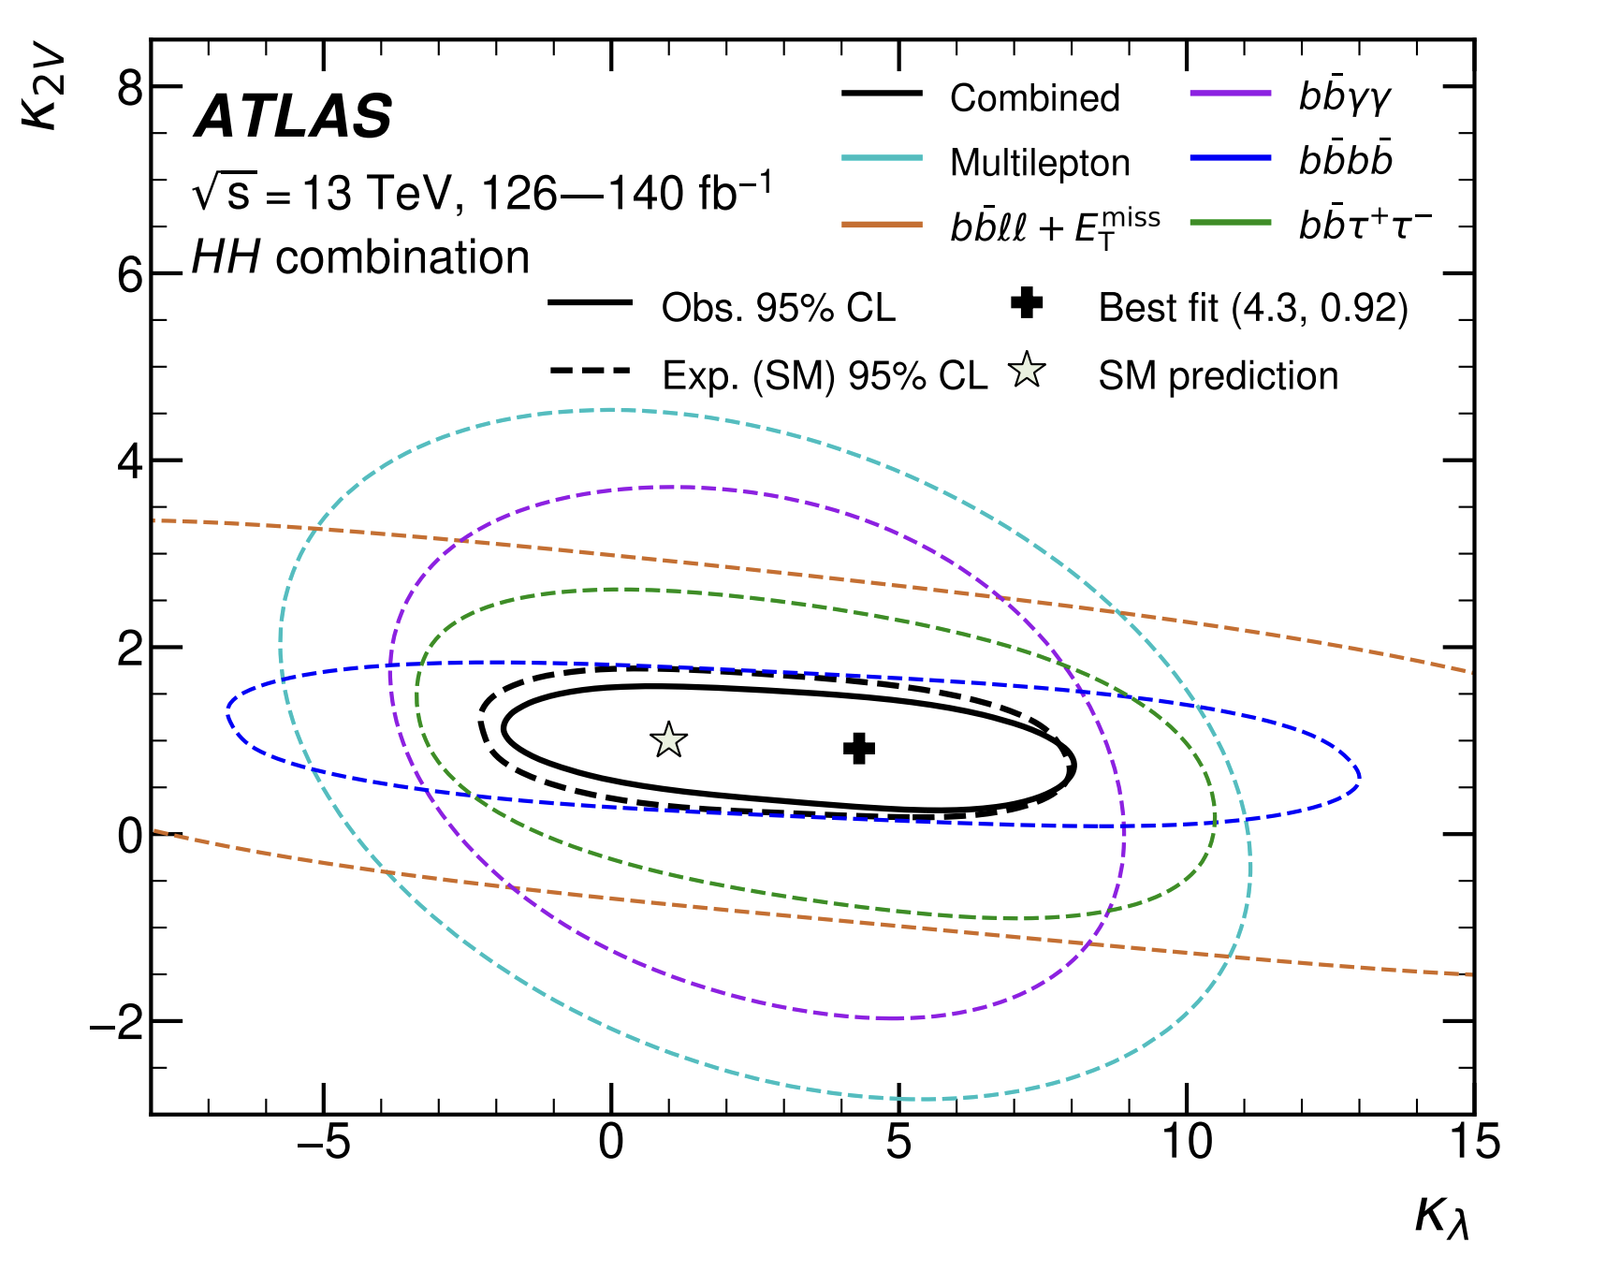
Run 2 HH combination

Slide 38
Run 2 HH combination

Slide 39
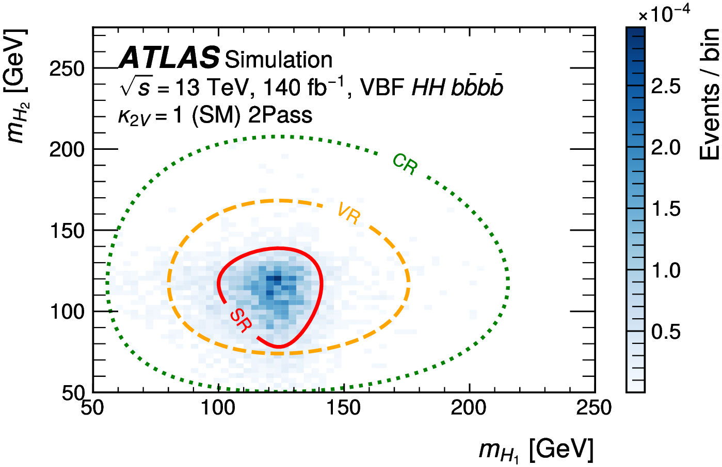
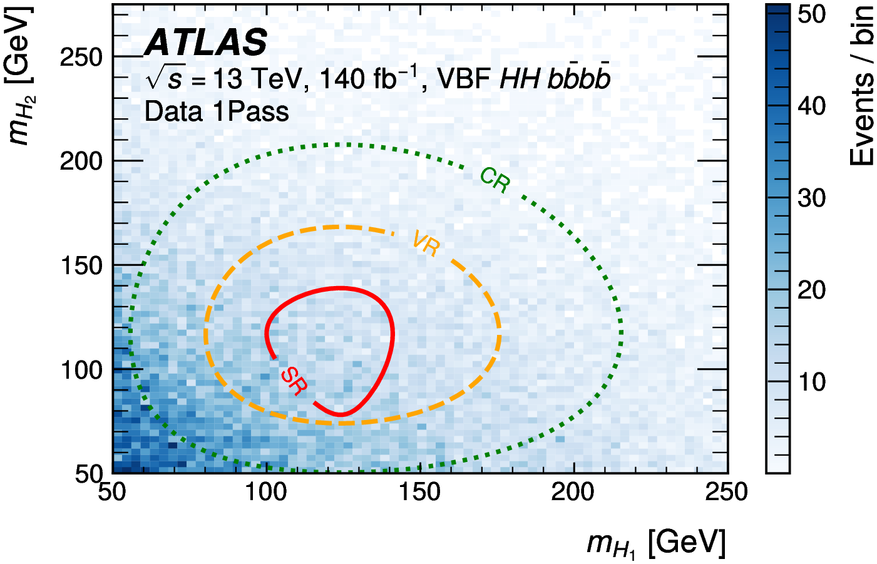
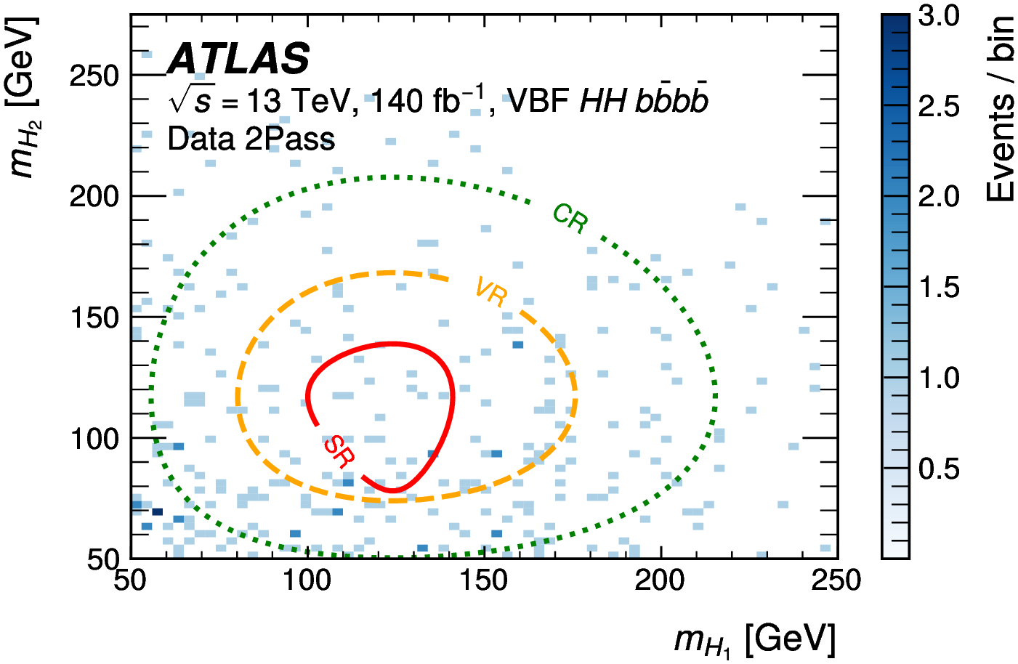
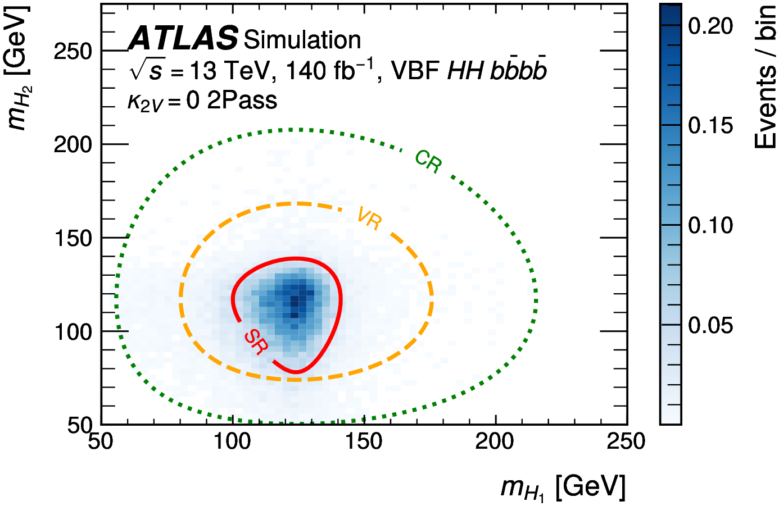
Run 2 HH→bbbb
1Pass: Events with 1 Higgs boson candidate passing 60% WP
2Pass: Events with 2 Higgs boson candidates passing 60% WP

Slide 40
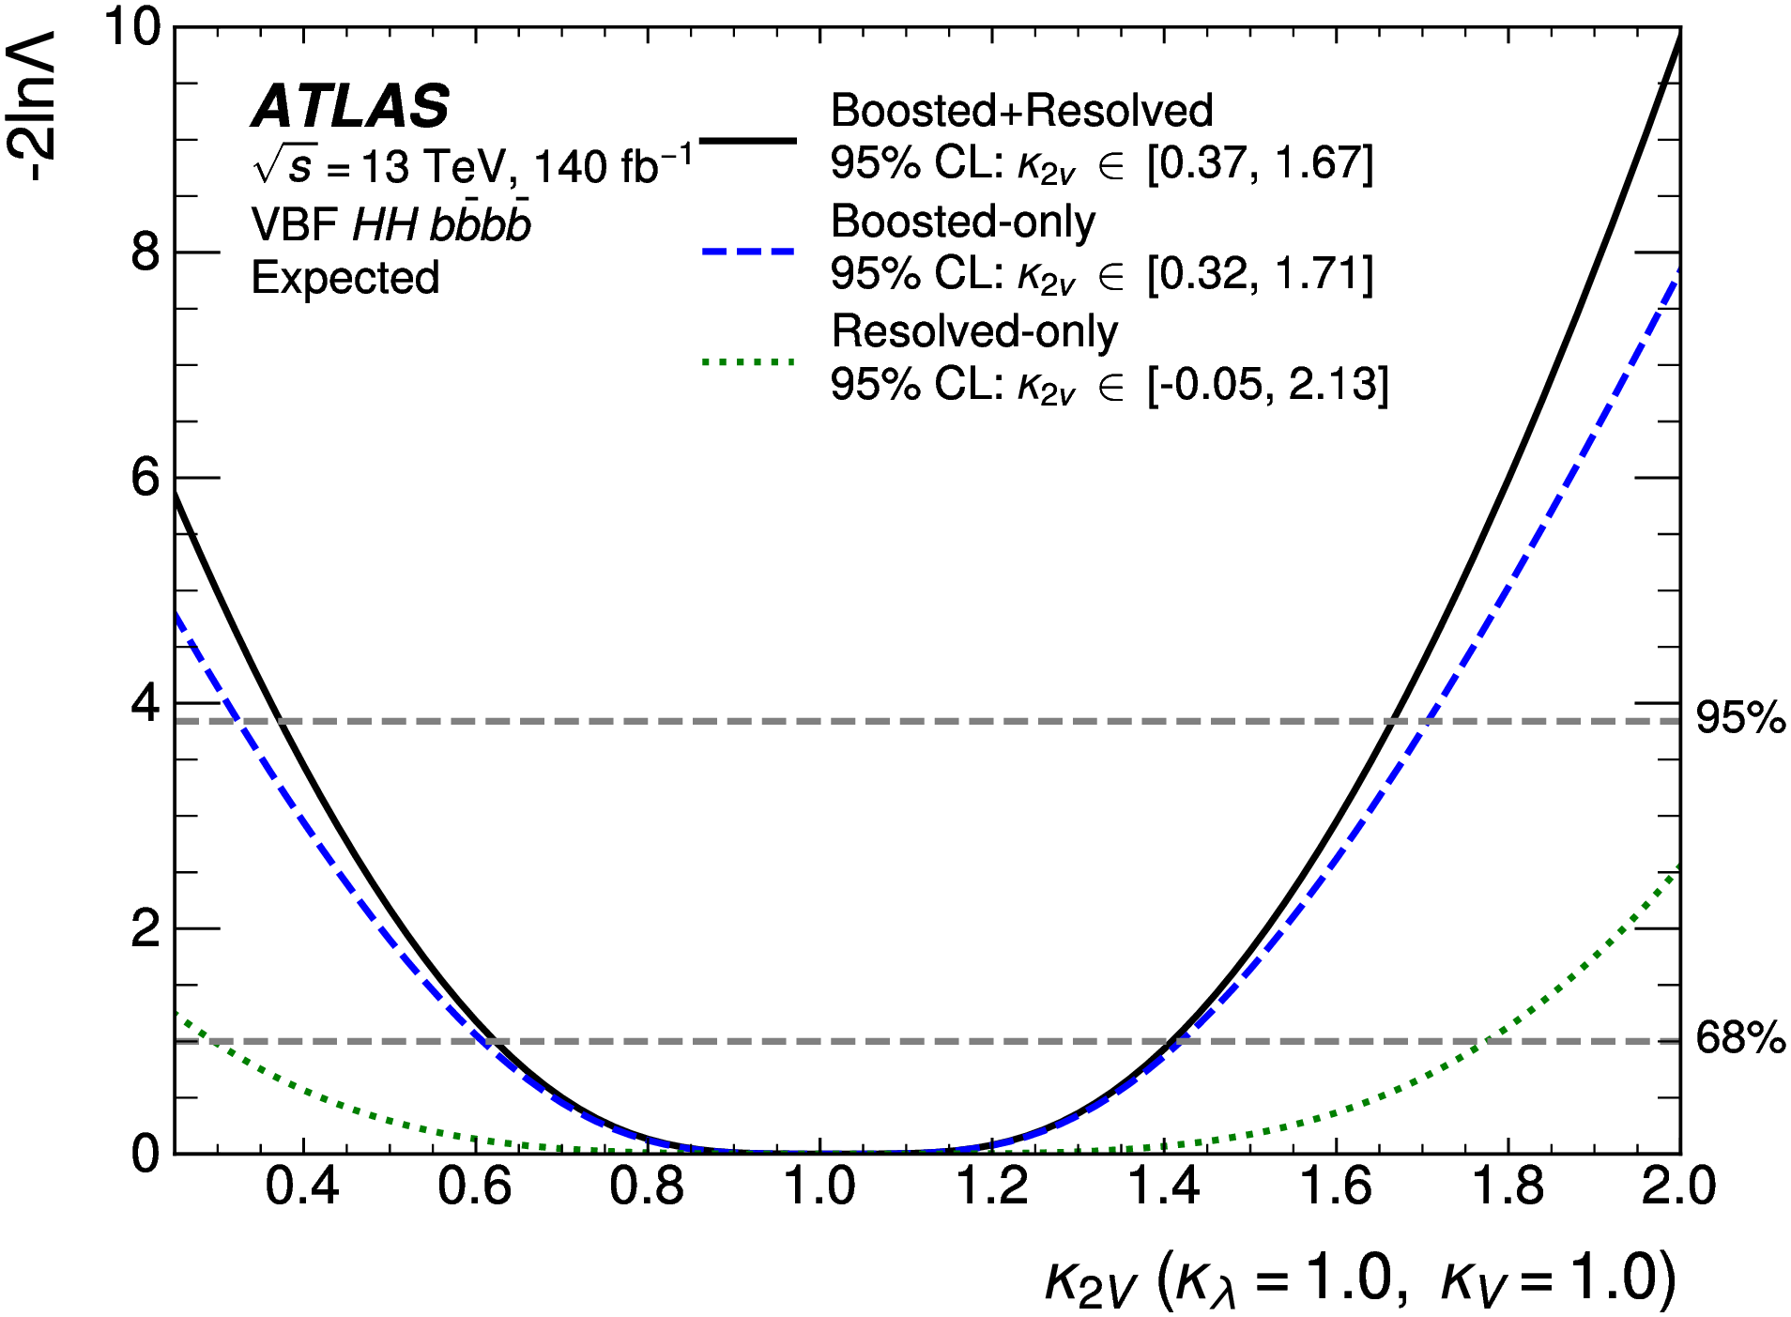
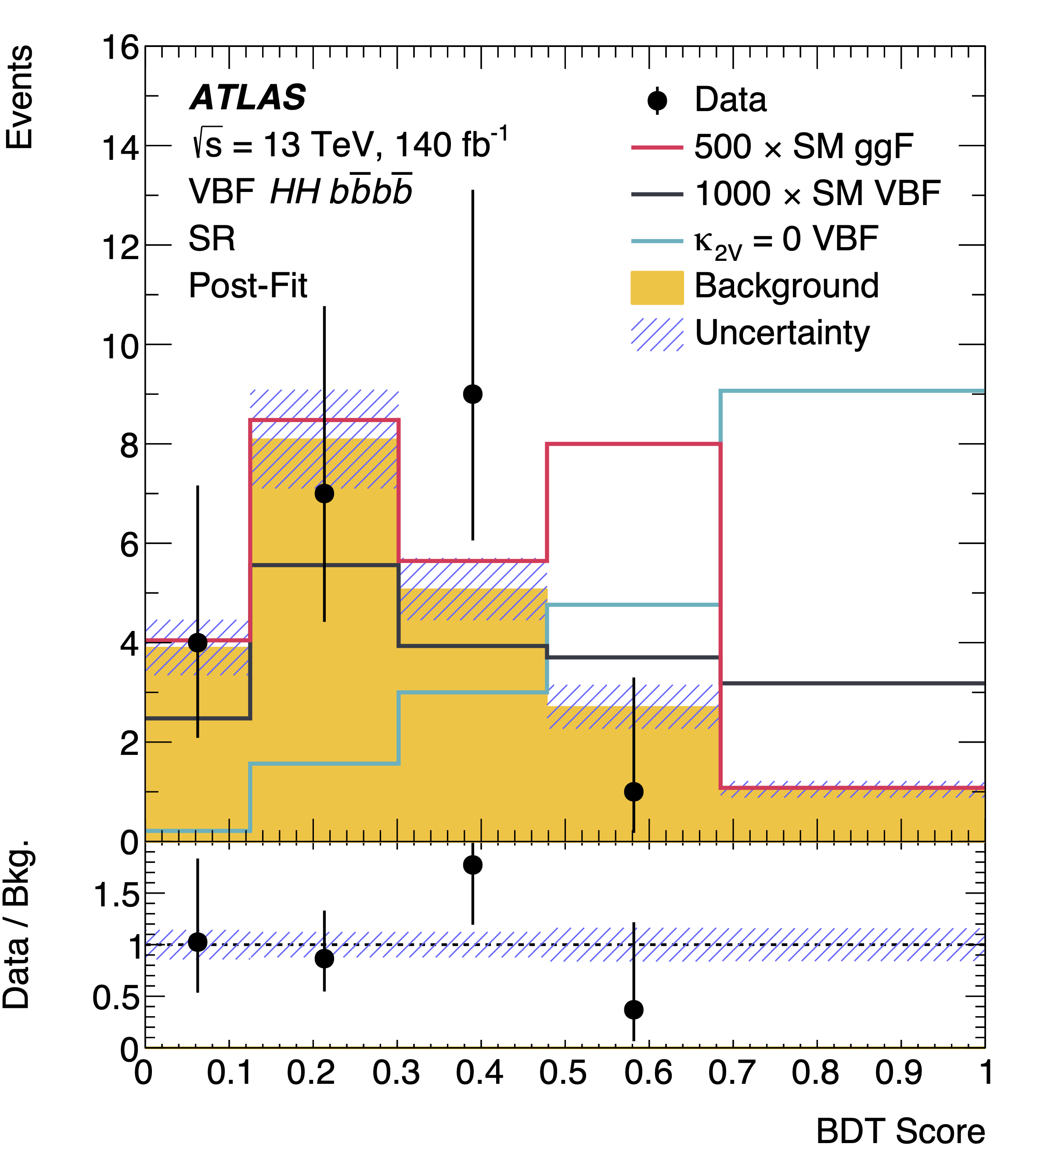
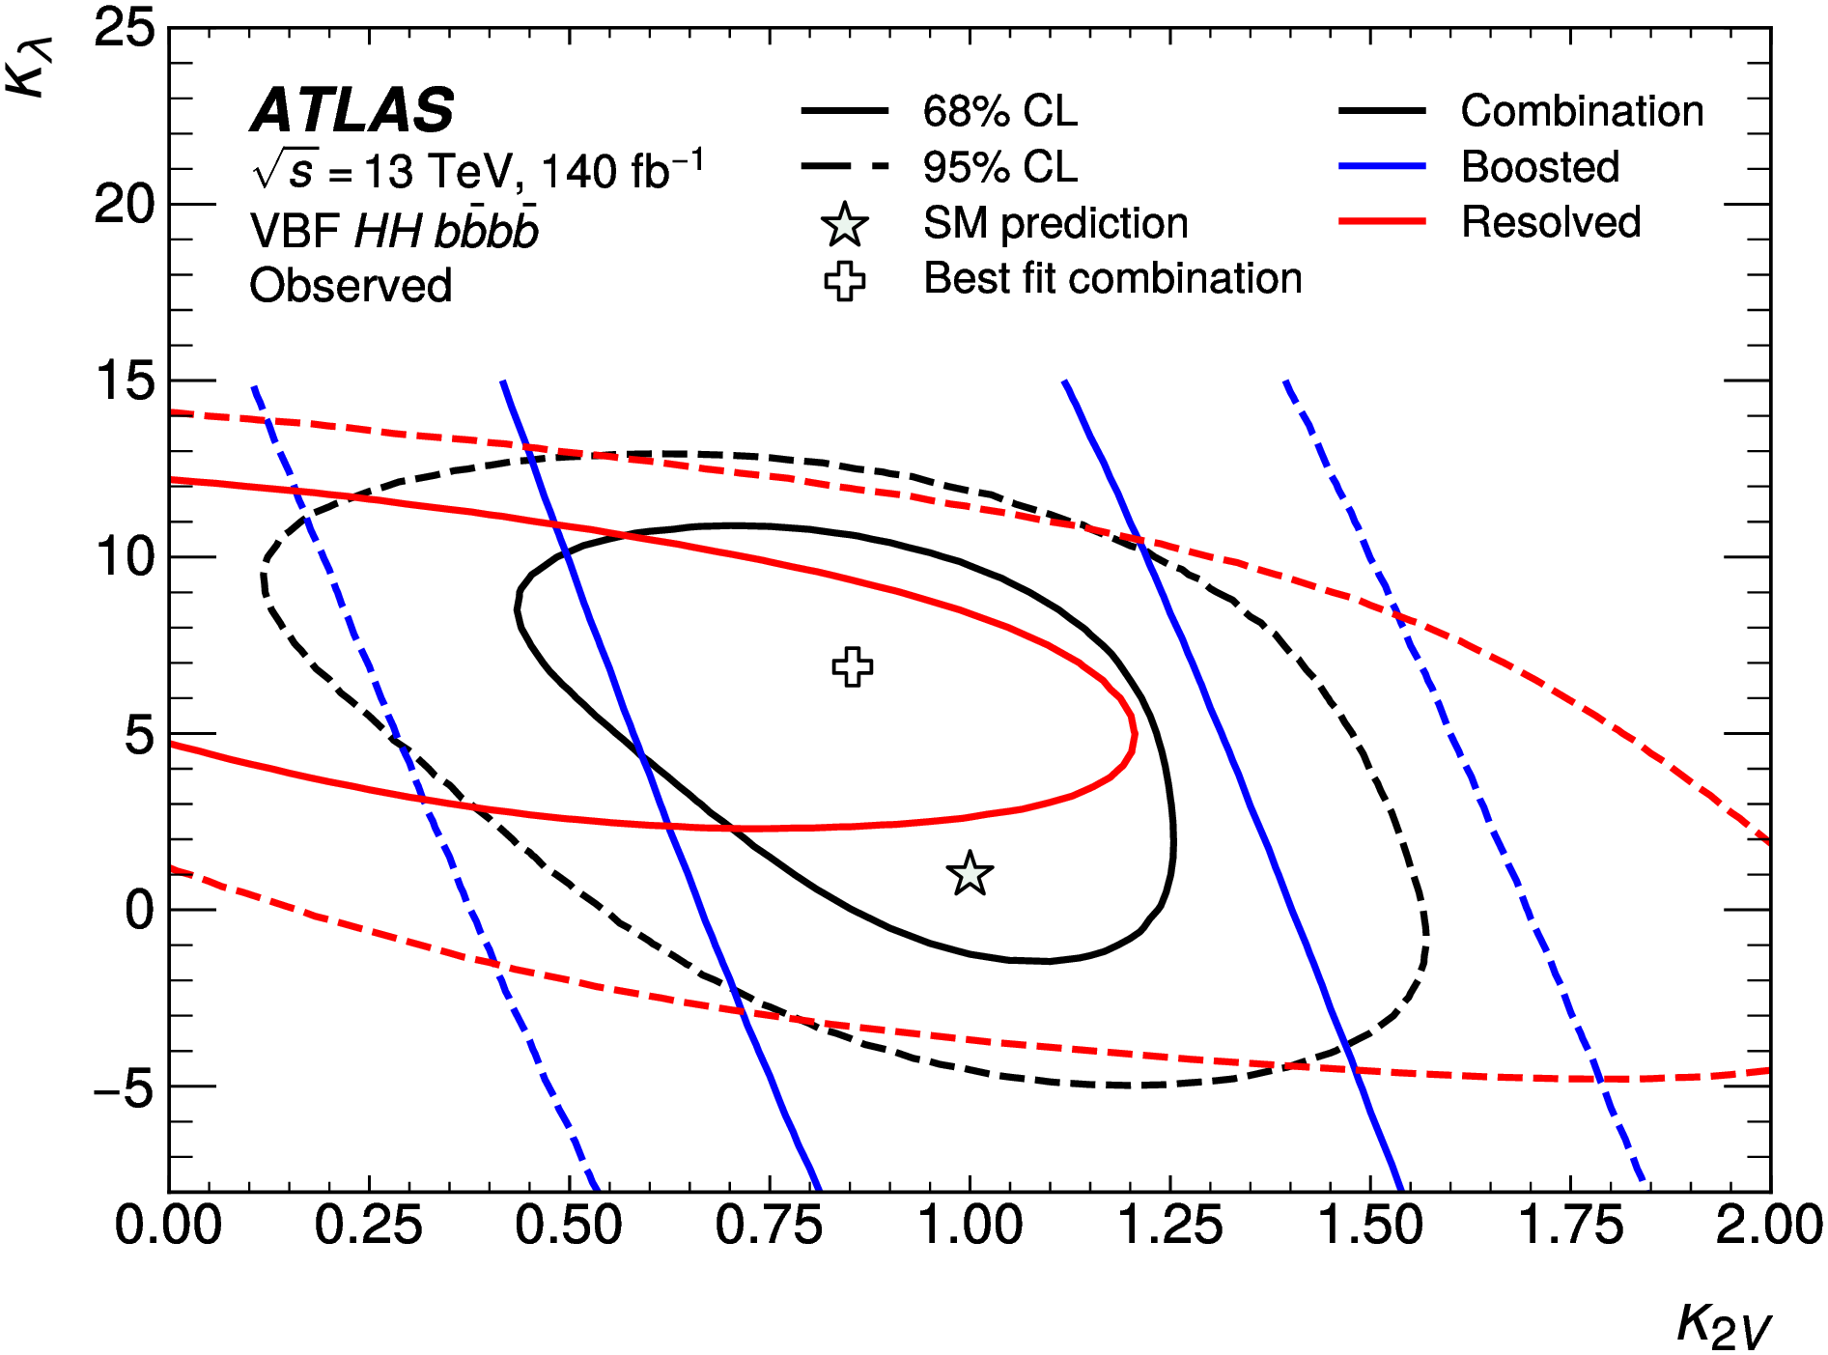

Run 2 HH→bbbb

Slide 41

Run 2 HH→bbττ

Slide 42









Run 2 HH→bbττ

Slide 43



Run 2 HH→bbττ

Slide 44







Run 2 HH→bbγγ

Slide 45


Run 2 HH→bbγγ

Slide 46


Run 2 HH→bbγγ

Slide 47


Run 2 HH→bbll + MET

Slide 48


Run 2 HH→bbll + MET

Slide 49


Run 2 HH→multilepton

Slide 50


Run 2 HH→multilepton

Slide 51


Run 2 + partial Run 3 HH→ bbγγ

Slide 52

Run 2 + partial Run 3 HH→ bbγγ

Slide 53


Run 2 + partial Run 3 HH→ bbγγ

Slide 54


Run 2 + partial Run 3 HH→ bbγγ

Slide 55

Run 2 + partial Run 3 HH→ bbγγ

