Slide 1
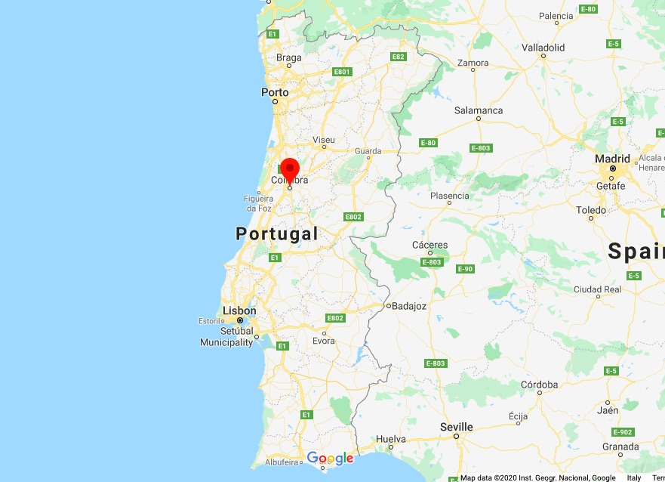
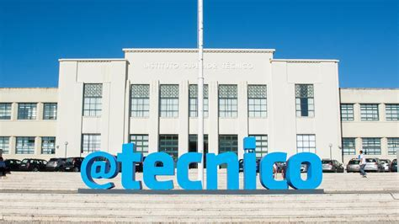
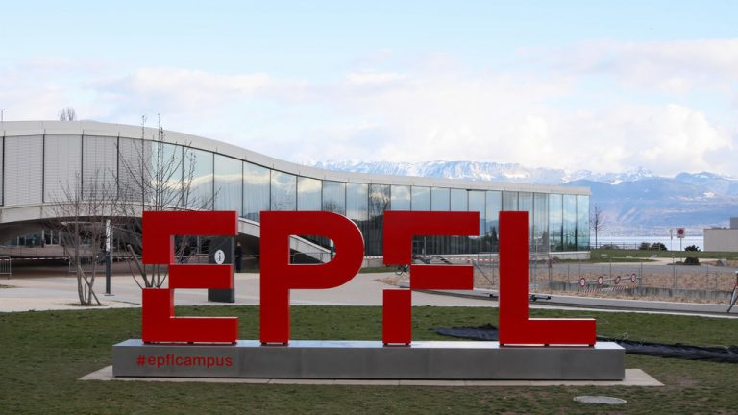

Miguel Afonso
24 years old;
Born in Coimbra, Portugal;
Moved to Lisbon at 18y to study in Instituto Superior Técnico;
At 22y went on an Erasmus+ program to EPFL in Lausanne;

Slide 2
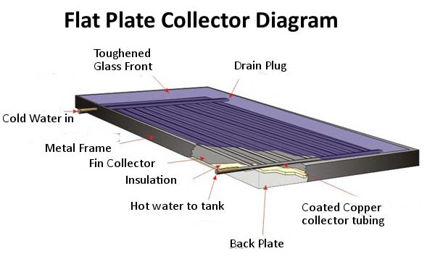
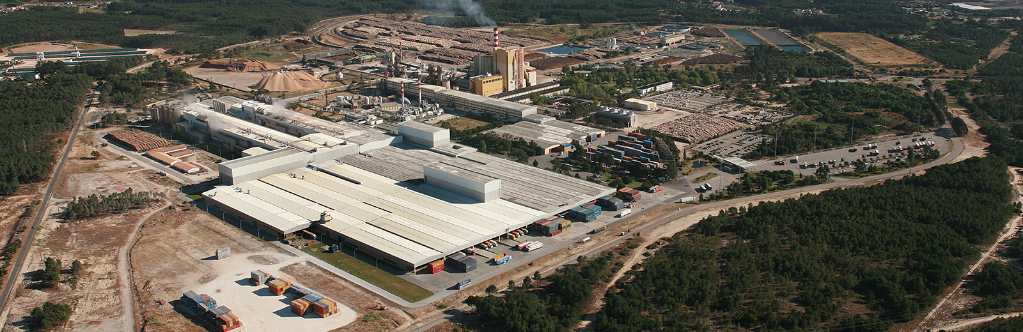
Academic Background
Mechanical Engineering not my first choice!;
Bachelor’s in Mechanical Engineering;
Minor’s in Technologies and Space Science;
Master’s in Mechanical Engineering (Energies field);
Currently developing my Master Thesis about the investigation of hybrid nanofluids in a FPSC;
9 months internship at The Navigator Company where I worked at the maintenance strategies and optimization in the pulp and paper production;
Flat Plate Solar Collector
The Navigator Company, Figueira da Foz, Portugal

Slide 3

Since 1st of April, 2025...
Got the opportunity to do a 1 year internship at CERN, where I will be in the EP-DT-FS gas systems team, working in the maintenance of the gas gystems and efficient stock managment.
Looking forward to meet and work with everyone!

