Slide 1
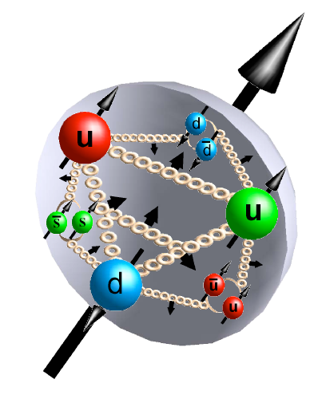
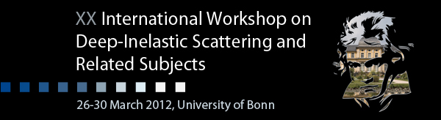



Bonn, March 27th, 2012
Helicity PDFs at an EIC
a quantitative appraisal
Marco Stratmann
marco@bnl.gov
work done in collaboration with E. Aschenauer, R. Sassot

Slide 2


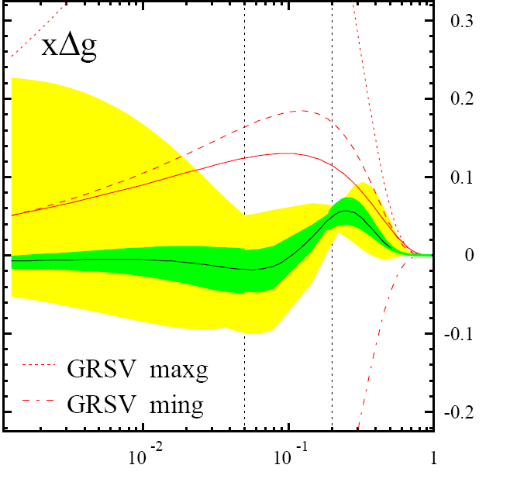
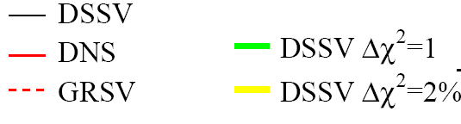
helicity structure - open questions
--> W. Vogelsang’s talk earlier today
significant experimental and theoretical progress in past 25+ years, yet many unknows …
Δg(x,Q²)
DSSV global fit
de Florian, Sassot,
MS, Vogelsang
found to be small at 0.05 < x < 0.2 [RHIC, COMPASS, HERMES]
can hide one
unit of here
RHIC can slightly extend x range & reduce uncertainties
[500 GeV running & particle correlations]
yet, full 1st moment [proton spin sum]
will remain to have significant uncertainties
from unmeasured small x region
DIS
&
pp
RHIC
pp
x

Slide 3
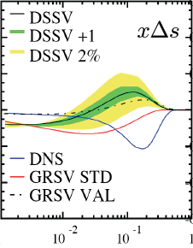

helicity structure - open questions
--> W. Vogelsang’s talk earlier today
significant experimental and theoretical progress in past 25+ years, yet many unknows …
Δg(x,Q²)
DSSV global fit
de Florian, Sassot,
MS, Vogelsang
found to be small at 0.05 < x < 0.2 [RHIC, COMPASS, HERMES]
can hide one
unit of here
RHIC can slightly extend x range & reduce uncertainties
[500 GeV running & particle correlations]
yet, full 1st moment [proton spin sum]
will remain to have significant uncertainties
from unmeasured small x region
DIS
&
pp
RHIC
pp
Δq’s (x,Q²)
x
known: quarks contribute much less to proton spin
than expected from quark models
yet, large uncertainties in ΔΣ from unmeasured small x
surprisingly small/positive Δs from SIDIS: large SU(3) breaking?
_
_
flavor separation not well known, e.g., Δu - Δd
x

Slide 4
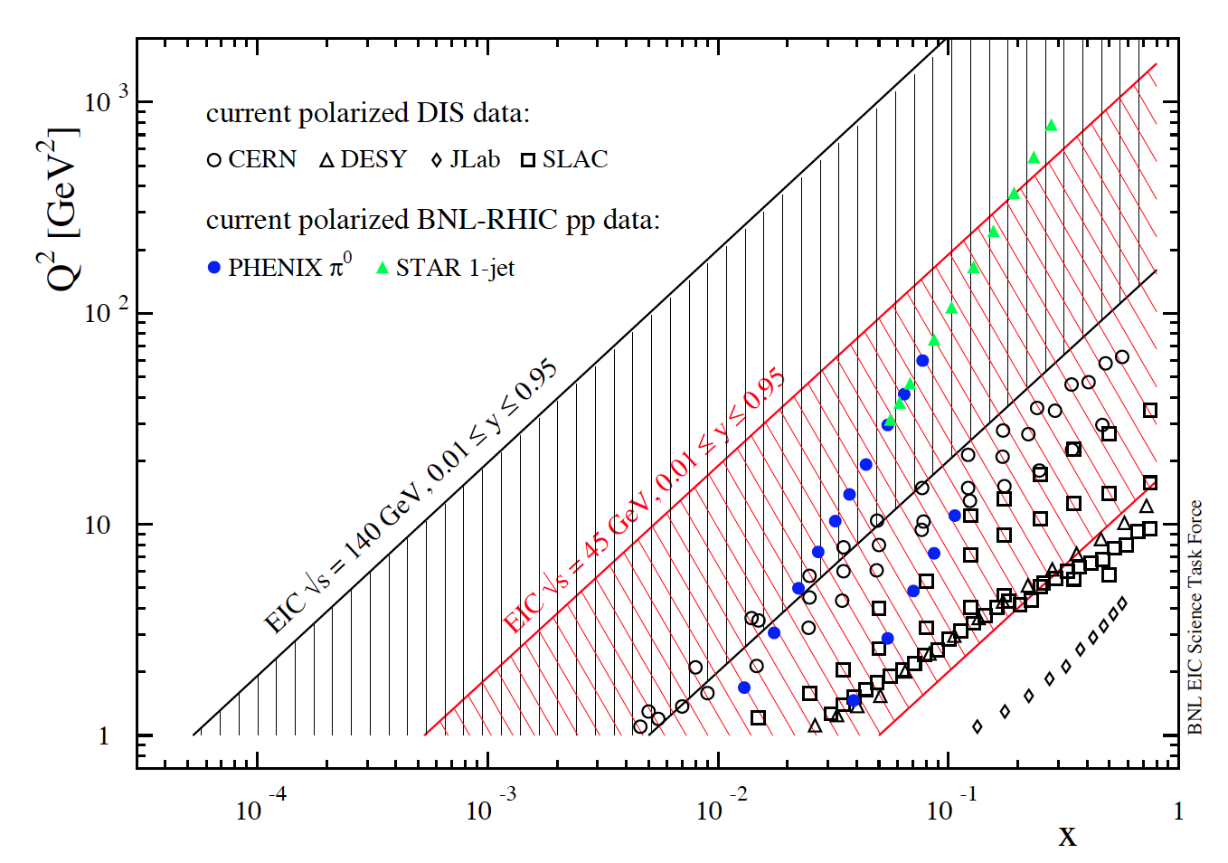
present vs EIC kinematic coverage
EIC might be realized in stages: 5 x 100 – 5 x 250 GeV [eRHIC stage-1] to 20(30) x 250 GeV [eRHIC]
5 x 100 GeV eRHIC stage-1
20 x 250 GeV eRHIC

Slide 5
present vs EIC kinematic coverage
EIC might be realized in stages: 5 x 100 – 5 x 250 GeV [eRHIC stage-1] to 20(30) x 250 GeV [eRHIC]
5 x 100 GeV eRHIC stage-1
20 x 250 GeV eRHIC
lowest x so far 4.6 x10⁻³
COMPASS

Slide 6
present vs EIC kinematic coverage
EIC might be realized in stages: 5 x 100 – 5 x 250 GeV [eRHIC stage-1] to 20(30) x 250 GeV [eRHIC]
RHIC pp data
constraining Δg(x)
in approx. 0.05 < x <0.2
data plotted at x_{T}=2p_{T}/√S
5 x 100 GeV eRHIC stage-1
20 x 250 GeV eRHIC
lowest x so far 4.6 x10⁻³
COMPASS

Slide 7
present vs EIC kinematic coverage
EIC might be realized in stages: 5 x 100 – 5 x 250 GeV [eRHIC stage-1] to 20(30) x 250 GeV [eRHIC]
EIC extends x coverage
by up to 2 decades
(at Q²=1 GeV²)

Slide 8
present vs EIC kinematic coverage
EIC might be realized in stages: 5 x 100 – 5 x 250 GeV [eRHIC stage-1] to 20(30) x 250 GeV [eRHIC]
likewise for Q²
EIC extends x coverage
by up to 2 decades
(at Q²=1 GeV²)

Slide 9
present vs EIC kinematic coverage
EIC might be realized in stages: 5 x 100 – 5 x 250 GeV [eRHIC stage-1] to 20(30) x 250 GeV [eRHIC]
Q²_{min}
can also play with
Q²_{min} cut in fits
(in particular with 20 x 250 GeV)

Slide 10
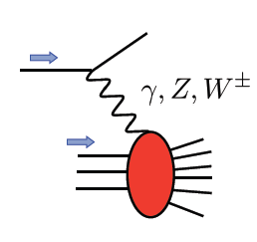
present vs EIC kinematic coverage
EIC might be realized in stages: 5 x 100 – 5 x 250 GeV [eRHIC stage-1] to 20(30) x 250 GeV [eRHIC]
novel electroweak probes
(never been measured before)
unprecedented opportunities in DIS, SIDIS, … with polarized beams

Slide 11
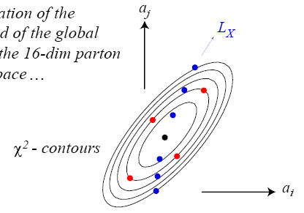
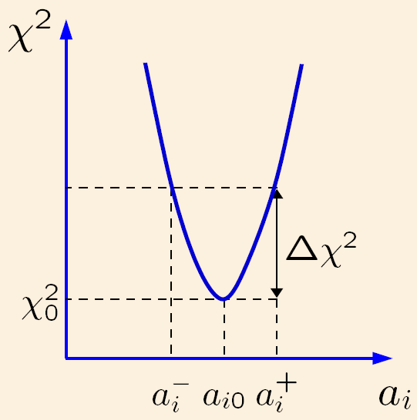
global fits with EIC data & quantifying their impact
follow closely DSSV/DSSV+ framework [same flexible functional form with possible nodes, Q0, α_{s}]
to facilitate comparison of fits with & without EIC mock data
use robust Lagrange multiplier method to
estimate PDF uncertainties
same Δχ²=9 as in DSSV to quantify impact of EIC data
track how fit deteriorates under
certain enforced conditions
explores the full parameter space
standard Hessian method works also well
once EIC data are included (but not with current data)
uncertainty estimates with both methods very similar
explores vicinity of χ² minimum
in quadratic approximation
cartoons taken from CTEQ
all fits performed at NLO accuracy

Slide 12
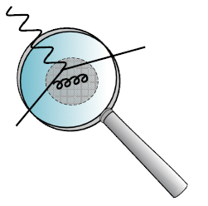
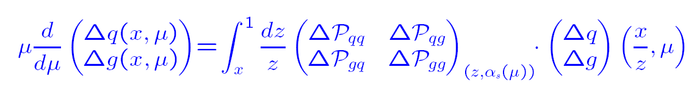
global fits with EIC data & quantifying their impact
follow closely DSSV/DSSV+ framework [same flexible functional form with possible nodes, Q0, α_{s}]
to facilitate comparison of fits with & without EIC mock data
use robust Lagrange multiplier method to
estimate PDF uncertainties
same Δχ²=9 as in DSSV to quantify impact of EIC data
track how fit deteriorates under
certain enforced conditions
explores the full parameter space
standard Hessian method works also well
once EIC data are included (but not with current data)
uncertainty estimates with both methods very similar
explores vicinity of χ² minimum
in quadratic approximation
cartoons taken from CTEQ
all fits performed at NLO accuracy
for discussions later on, recall:
for a PDF at x = x₀ DGLAP evolution only cares about x values larger than x₀
a priori not known down to which value of Q²_{min} DGLAP evolution applies
expect 1-2 GeV² range (HERA) but might be different for helicity PDFs
important to play with Q²_{min} to map out region where DGLAP works [needs an EIC to do that]

Slide 13
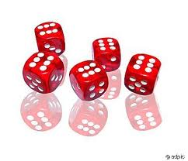
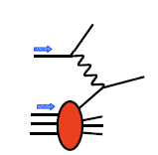
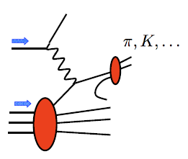
preparation of DIS and SIDIS mock data
PEPSI MC to generate σ⁺⁺ and σ⁺⁻ with LO GRSV PDFs
DIS
SIDIS
inclusive final-state
identified charged pions and kaons
assume modest 10 fb⁻¹ for each energy, 70% beam polarizations
Q² > 1 GeV² , 0.01 < y < 0.95 , invariant mass W² > 10 GeV²
depolarization factor of virtual photon D(y,Q²) > 0.1 (cuts on small y)
scattered lepton: 1º < θ_{elec} < 179º and p_{elec} > 0.5 GeV
hadron: p_{hadr} > 1 GeV, 0.2 < z < 0.9,
1⁰ < θ_{hadr} < 179º
use rel. uncertainties of data to generate mock data by randomizing around DSSV+ by 1-σ
SIDIS: incl. typical 5% (10%) uncertainty for pion (kaon) frag. fcts (from DSS analysis)

Slide 14
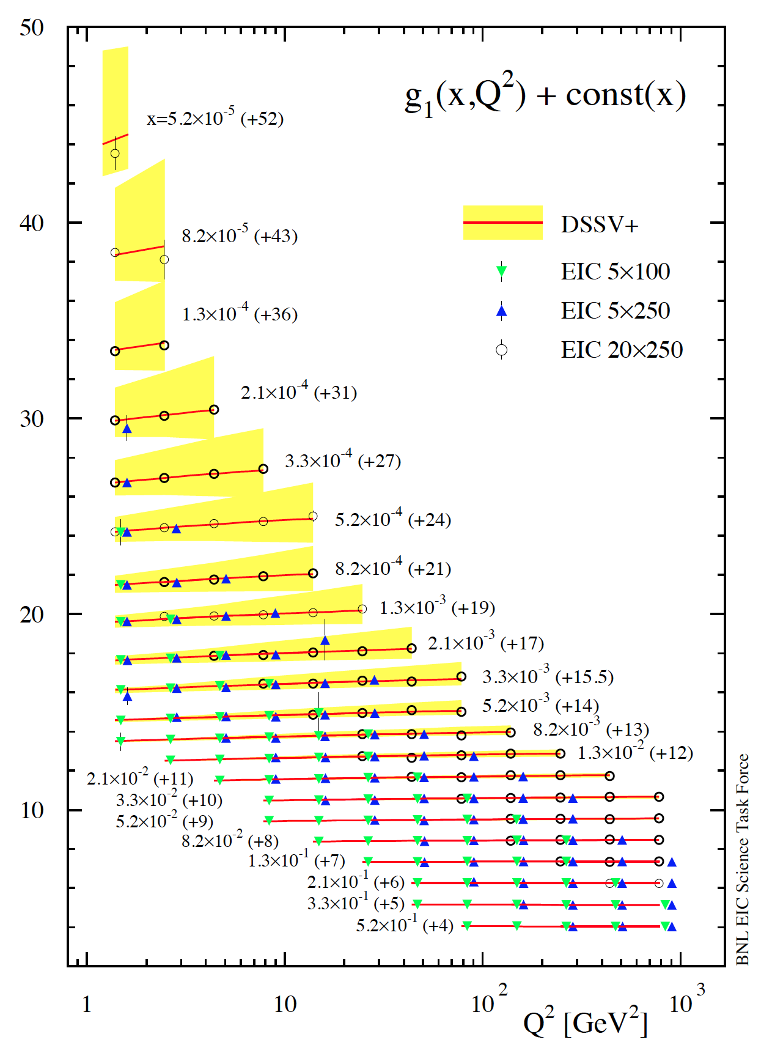
example: projected DIS data for g₁^{p}
3 sets of [eRHIC] energy settings studied:
E_{e}×E_{p} [GeV] | √s [GeV] | x_{min} for y_{max} = 0.95 and Q² = 1 GeV² Q² = 2 GeV²
5 x 100 | 44.7 | 5.3 x 10⁻⁴ 1.1 x 10⁻³
5 x 250 | 70.7 | 2.1 x 10⁻⁴ 4.2 x 10⁻⁴
20 x 250 | 141.4 | 5.3 x 10⁻⁵ 1.1 x 10⁻⁴
4 [5] bins/decade in Q² [x] (spaced logarithmically)
bands reflect current uncertainties on g₁^{p}
DSSV+ estimate

Slide 15
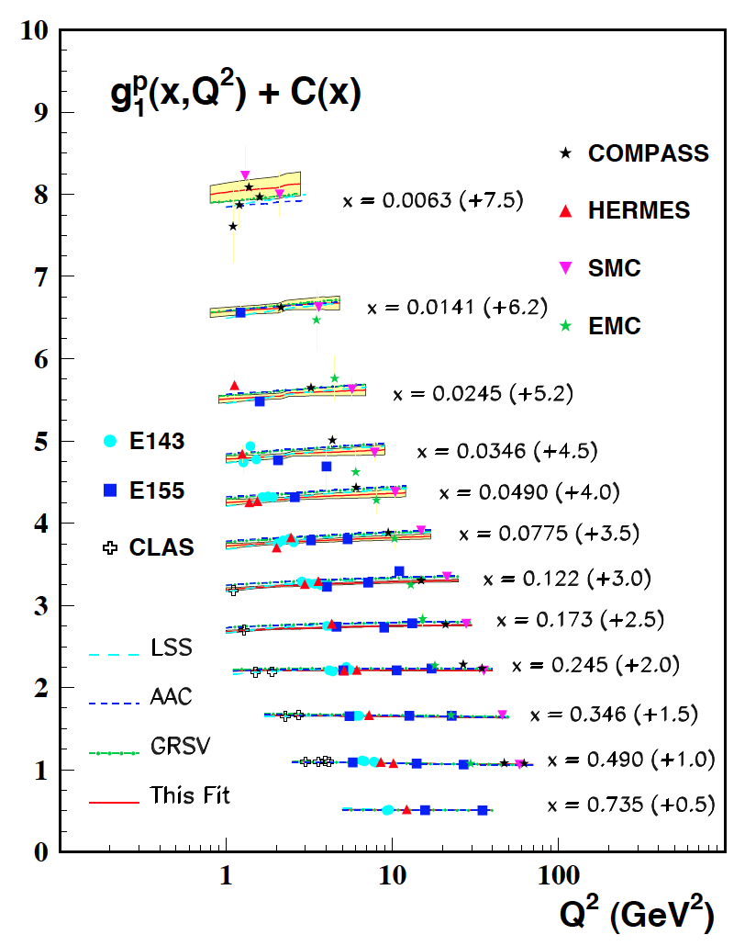
example: projected DIS data for g₁^{p}
3 sets of [eRHIC] energy settings studied:
E_{e}×E_{p} [GeV] | √s [GeV] | x_{min} for y_{max} = 0.95 and Q² = 1 GeV² Q² = 2 GeV²
5 x 100 | 44.7 | 5.3 x 10⁻⁴ 1.1 x 10⁻³
5 x 250 | 70.7 | 2.1 x 10⁻⁴ 4.2 x 10⁻⁴
20 x 250 | 141.4 | 5.3 x 10⁻⁵ 1.1 x 10⁻⁴
5 x 250 starts here
4 [5] bins/decade in Q² [x] (spaced logarithmically)
5 x 100 starts here
bands reflect current uncertainties on g₁^{p}
DSSV+ estimate
COMPASS data
start here
taken from
Blumlein,
Bottcher

Slide 16
example: projected DIS data for g₁^{p}
3 sets of [eRHIC] energy settings studied:
E_{e}×E_{p} [GeV] | √s [GeV] | x_{min} for y_{max} = 0.95 and Q² = 1 GeV² Q² = 2 GeV²
5 x 100 | 44.7 | 5.3 x 10⁻⁴ 1.1 x 10⁻³
5 x 250 | 70.7 | 2.1 x 10⁻⁴ 4.2 x 10⁻⁴
20 x 250 | 141.4 | 5.3 x 10⁻⁵ 1.1 x 10⁻⁴
5 x 250 starts here
4 [5] bins/decade in Q² [x] (spaced logarithmically)
5 x 100 starts here
bands reflect current uncertainties on g₁^{p}
DSSV+ estimate
similar data sets generated
for SIDIS with identified
charged pions and kaons

Slide 17
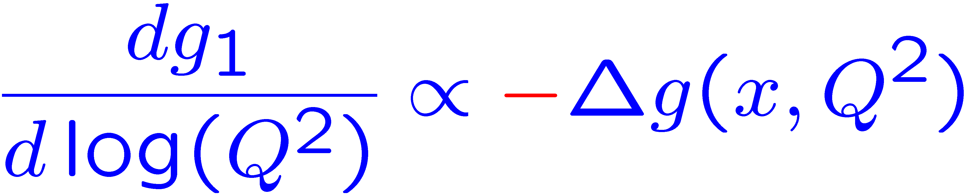
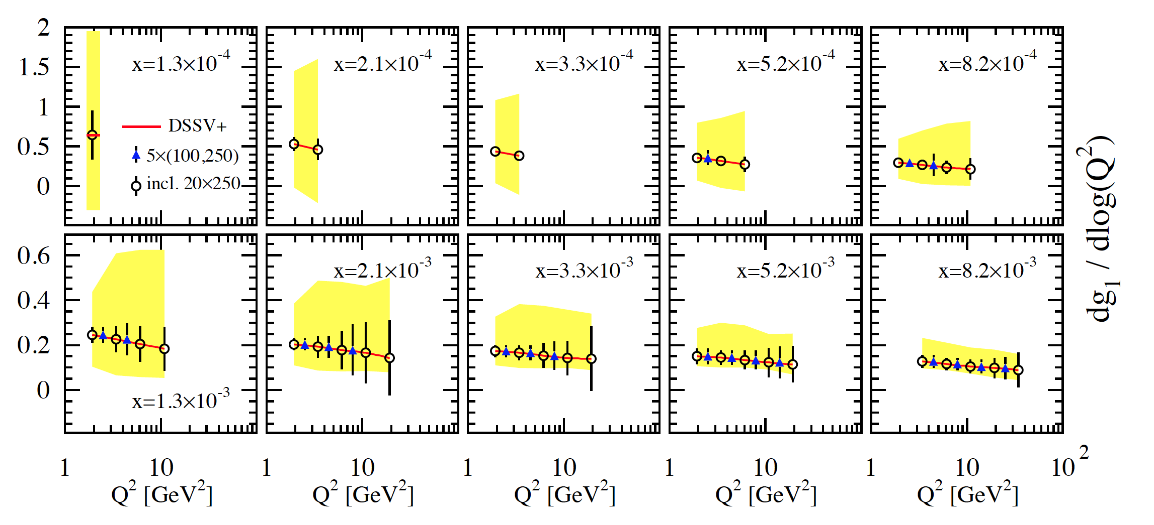
scaling violations at small x
rough small-x approximation to Q²-evolution:
spread in Δg(x,Q²) translates into
spread of scaling violations for g₁(x,Q²)
need x-bins with a least two Q² values to compute derivative (limits x reach somewhat)

Slide 18
scaling violations at small x
rough small-x approximation to Q²-evolution:
spread in Δg(x,Q²) translates into
spread of scaling violations for g₁(x,Q²)
need x-bins with a least two Q² values to compute derivative (limits x reach somewhat)
smallest x bins require 20 x 250 GeV
5 x 250 starts here
error bars for moderate 10fb⁻¹ per c.m.s. energy; bands parameterize current DSSV+ uncertainties

Slide 19
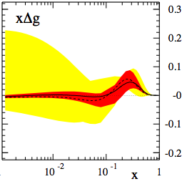

impact of EIC data on helicity PDFs
DIS scaling violations mainly determine Δg at small x ( SIDIS scaling violations add to this)
Q² = 10 GeV²

Slide 20
impact of EIC data on helicity PDFs
DIS scaling violations mainly determine Δg at small x ( SIDIS scaling violations add to this)
Q² = 10 GeV²
dramatic reduction of uncertainties:
“before”
“after”

Slide 21
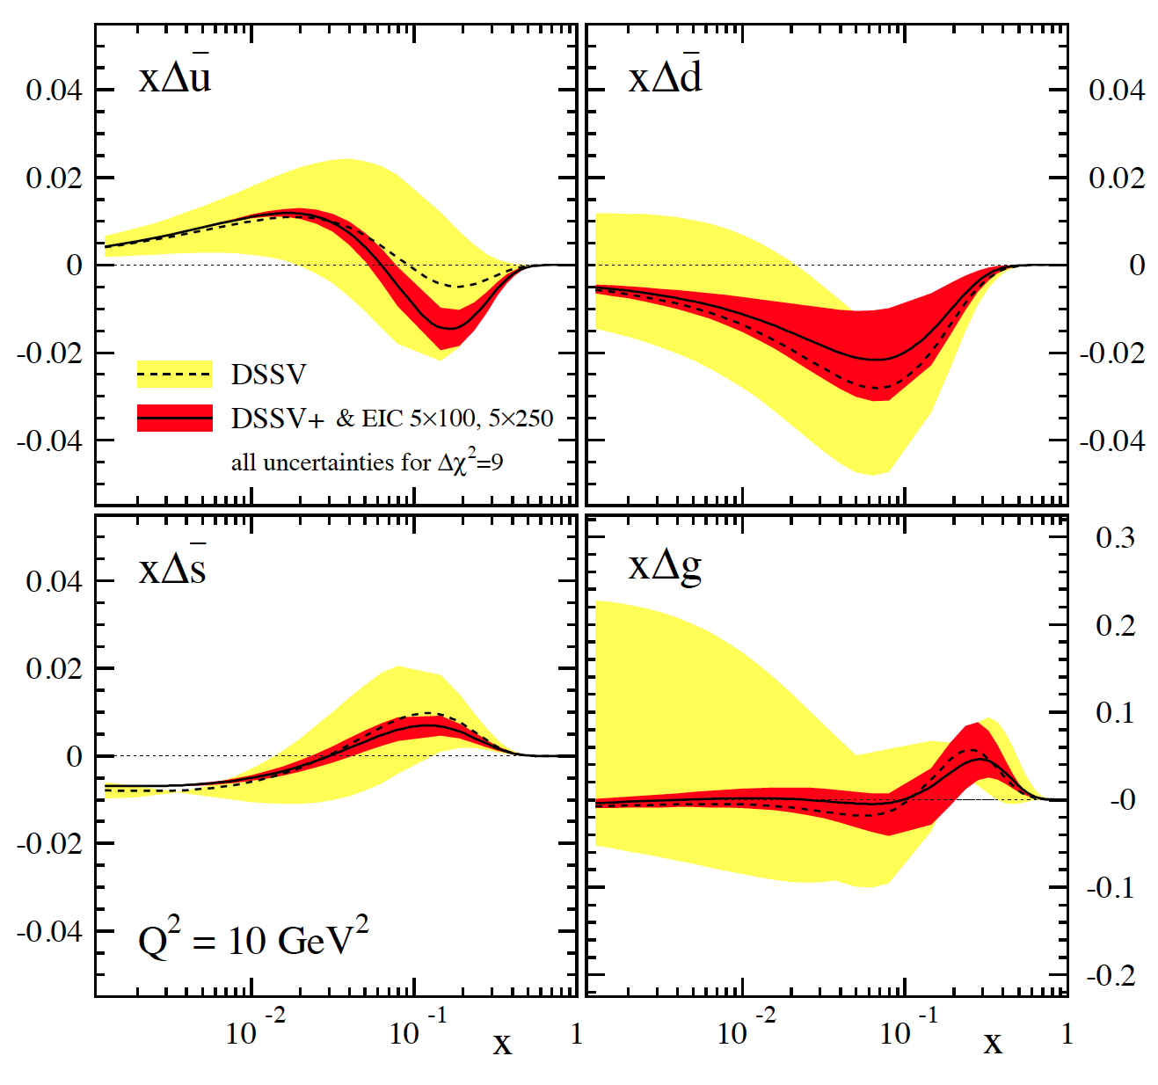
impact of EIC data on helicity PDFs
DIS scaling violations mainly determine Δg at small x ( SIDIS scaling violations add to this)
in addition, SIDIS data provide detailed flavor separation of quark sea

Slide 22
impact of EIC data on helicity PDFs
DIS scaling violations mainly determine Δg at small x ( SIDIS scaling violations add to this)
in addition, SIDIS data provide detailed flavor separation of quark sea
includes only “stage-1 data”
[even then Q²_{min} can be 2-3 GeV²]
can be pushed to x=10⁻⁴ with
20 x 250 GeV data
[still one can play with Q²_{min} ]
uncertainties determined with
both Lagrange mult. & Hessian

Slide 23
impact of EIC data on helicity PDFs
DIS scaling violations mainly determine Δg at small x ( SIDIS scaling violations add to this)
in addition, SIDIS data provide detailed flavor separation of quark sea
includes only “stage-1 data”
[even then Q²_{min} can be 2-3 GeV²]
can be pushed to x=10⁻⁴ with
20 x 250 GeV data
[still one can play with Q²_{min} ]
uncertainties determined with
both Lagrange mult. & Hessian
“issues”:
(SI)DIS @ EIC limited by
systematic uncertainties
need to control rel. lumi, polarimetry,
detector performance, … very well
QED radiative corrections
need to “unfold” true x,Q²
well known problem (HERA)
BNL-LDRD project to sharpen tools
-> H. Spiesberger’s talk tomorrow

Slide 24
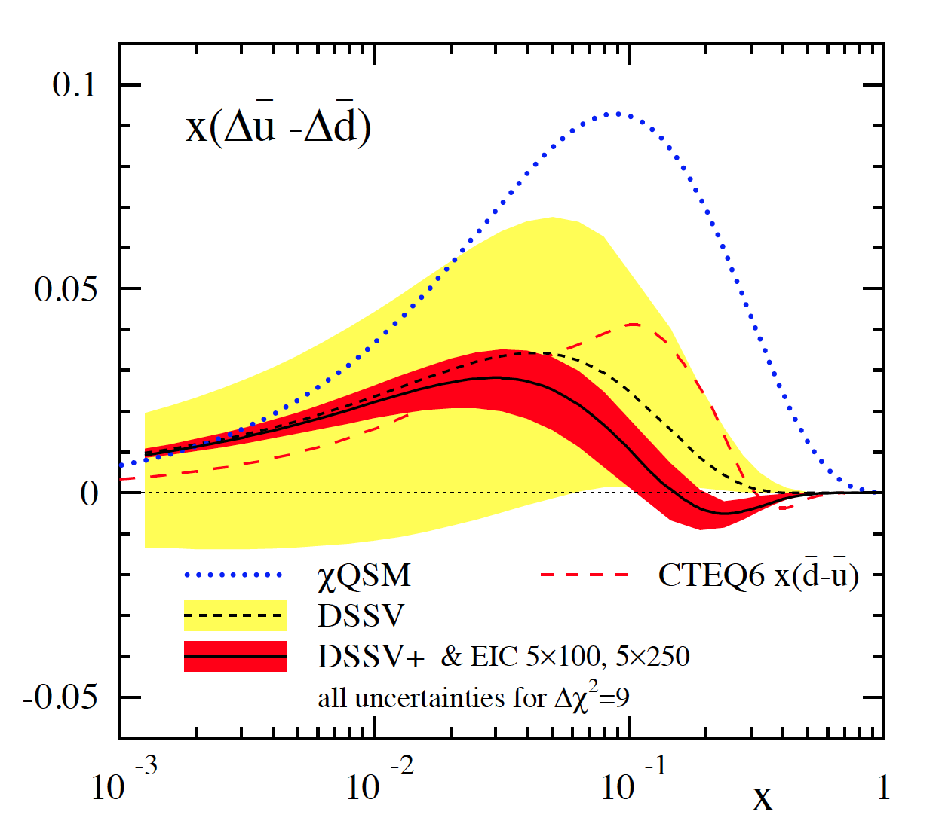
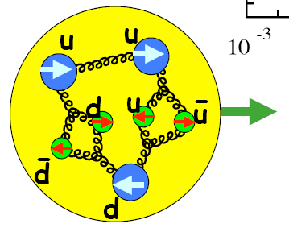
probing a possible asymmetry in the polarized sea
current SIDIS data not sensitive to (known to be sizable for unpol. PDFs)
many models predict sizable asymmetry [large N_{C} , chiral quark soliton, meson cloud, Pauli blocking]
Thomas, Signal, Cao; Holtmann, Speth, Fassler;
Diakonov, Polyakov, Weiss; Schafer, Fries; Kumano;
Wakamatsu; Gluck, Reya; Bourrely, Soffer, …
can be easily studied at an EIC
with stage-1 data
main effect expected to be at not too small x

Slide 25
probing a possible asymmetry in the polarized sea
current SIDIS data not sensitive to (known to be sizable for unpol. PDFs)
many models predict sizable asymmetry [large N_{C} , chiral quark soliton, meson cloud, Pauli blocking]
Thomas, Signal, Cao; Holtmann, Speth, Fassler;
Diakonov, Polyakov, Weiss; Schafer, Fries; Kumano;
Wakamatsu; Gluck, Reya; Bourrely, Soffer, …
can be easily studied at an EIC
with stage-1 data
main effect expected to be at not too small x
can try to look into a possible
with K^{+/-} SIDIS data
needs improved frag. fcts. first

Slide 26

impact of EIC data in terms of χ² profiles
dramatic improvements for [truncated] first moments
best visualized by χ² profiles obtained with Lagrange multipliers

Slide 27
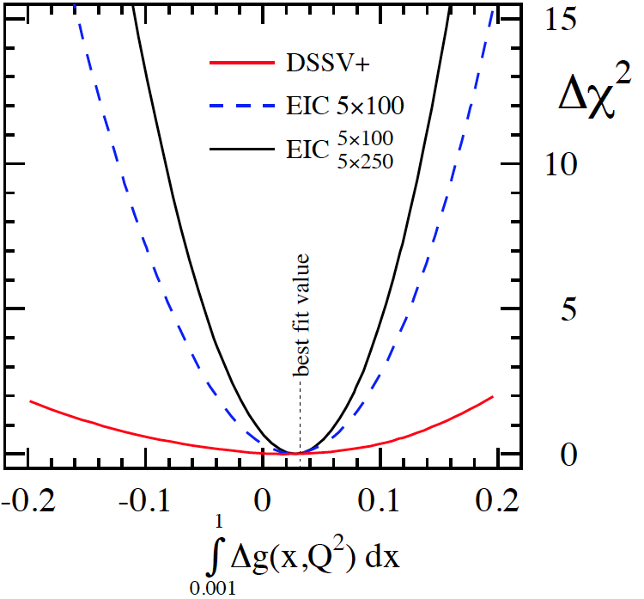
impact of EIC data in terms of χ² profiles
dramatic improvements for [truncated] first moments
best visualized by χ² profiles obtained with Lagrange multipliers
example: Δg in x-range 0.001-1 without/with stage-1 eRHIC data
not well constrained by current data
profile not parabolic
27

Slide 28
impact of EIC data in terms of χ² profiles
dramatic improvements for [truncated] first moments
best visualized by χ² profiles obtained with Lagrange multipliers
example: Δg in x-range 0.001-1 without/with stage-1 eRHIC data
not well constrained by current data
profile not parabolic
EIC DIS data [eRHIC stage-1]
lead to significant improvement
profile parabolic; Hessian method also works
28

Slide 29
impact of EIC data in terms of χ² profiles
dramatic improvements for [truncated] first moments
best visualized by χ² profiles obtained with Lagrange multipliers
example: Δg in x-range 0.001-1 without/with stage-1 eRHIC data
read off uncertainties for given Δχ²
Δχ² =1 usually not leading to a faithful error
take conservative Δχ² = 9 as in DSSV analysis
appropriate tolerance Δχ² can be
further refined once data are available
29

Slide 30
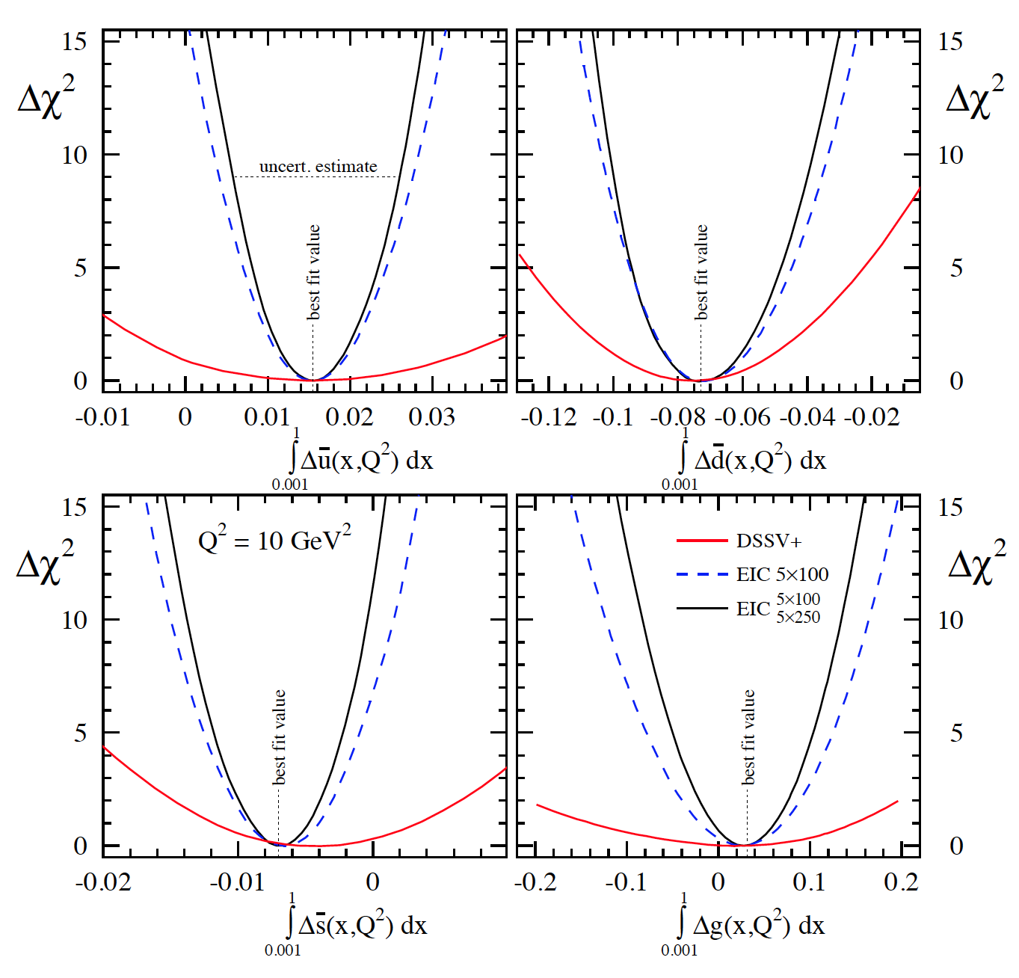
impact of EIC data in terms of χ² profiles
dramatic improvements for [truncated] first moments
best visualized by χ² profiles obtained with Lagrange multipliers
similar improvements for all quark flavors with stage-1 eRHIC SIDIS data
5 x 250 GeV data allow to
study Q²_{min} dependence
of 0.001-1 moments
30

Slide 31
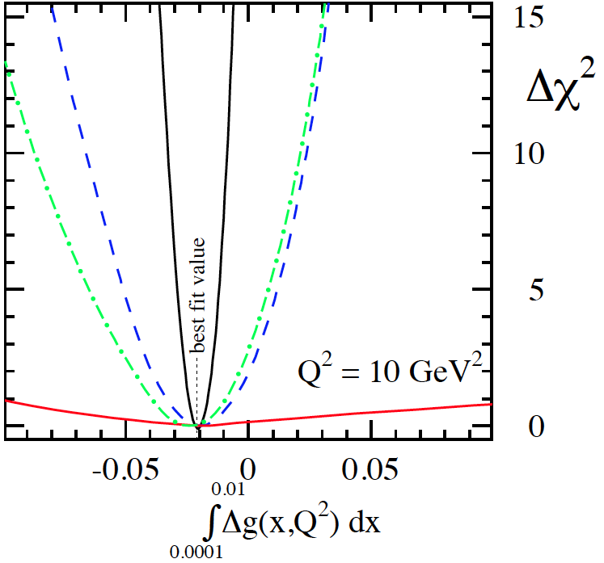
impact of EIC data (cont’d)
further improvements with 20 x 250 GeV data at smaller x
example: Δg in x-range 0.0001-0.01 without/with eRHIC data
20 x 250
data
stage-1
data

Slide 32
impact of EIC data (cont’d)
further improvements with 20 x 250 GeV data at smaller x
example: Δg in x-range 0.0001-0.01 without/with eRHIC data
20 x 250
data
stage-1
data
somewhat less dramatic
for quark sea
impact varies with quark flavor

Slide 33
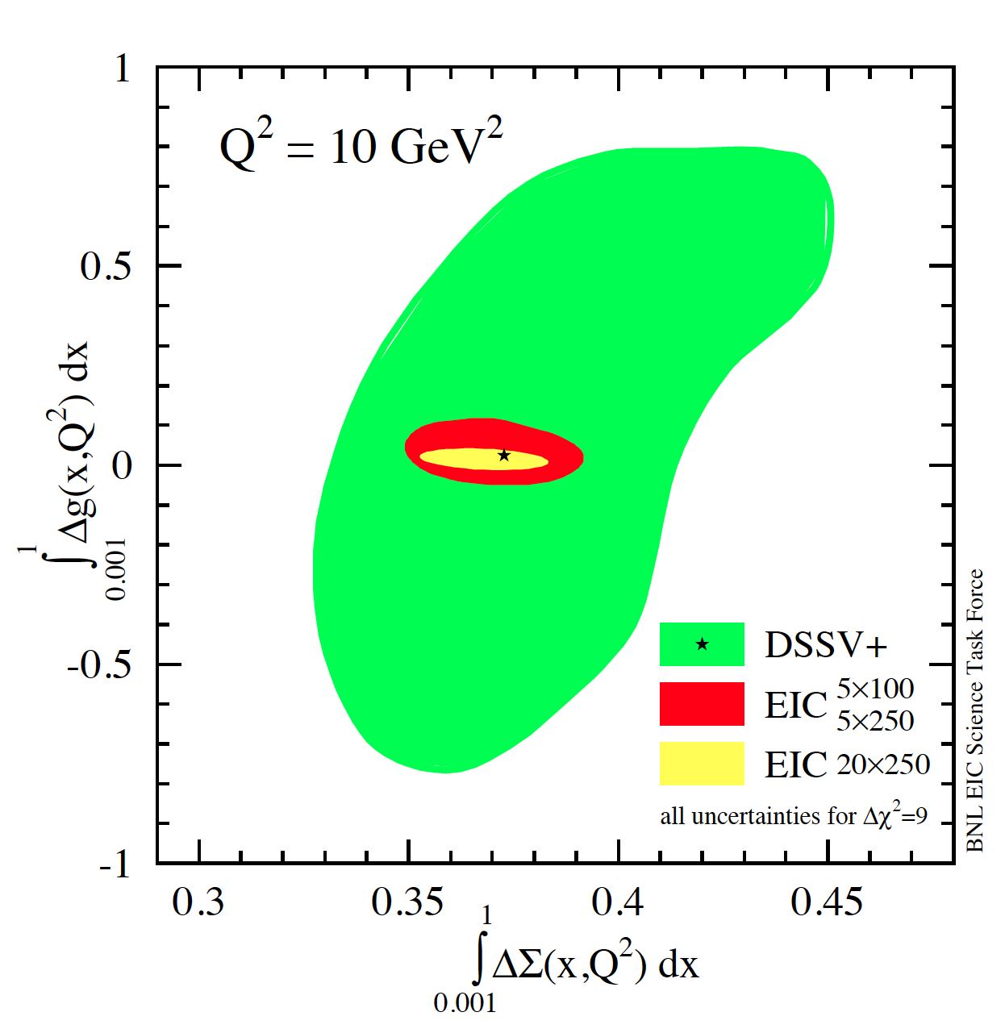
progress towards spin sum rule
combined correlated uncertainties for ΔΣ and Δg
results obtained with two
Lagrange multipliers
Hessian method consistent
current data
similar improvement
for 0.0001-1 moments
needs 20 x 250 GeV data
w/ EIC data
can expect approx. 5-10%
uncertainties on ΔΣ and Δg
but need to control systematics

Slide 34
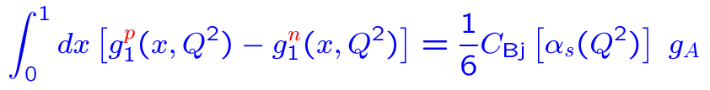
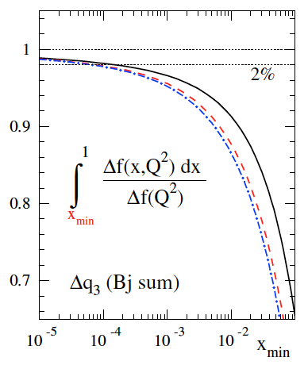
other opportunities in polarized (SI)DIS at an EIC
aim for high precision polarized experiments [progress in polarimetry, detectors, …]
-> should be able to measure polarized cross sections rather than spin asymmetries
studies presented here are based on lepton – proton collisions – what about neutrons?
main objective would be fundamental Bjorken sum rule
C_{Bj} known up to O(α_{s}⁴)
Kodaira; Gorishny, Larin; Larin, Vermaseren; Baikov, Chetyrkin, Kühn, ...
theoretically interesting, non-trivial relation to Adler fct. in e⁺e⁻ “Crewther relation”
experimental challenge: effective neutron beam (³He), very precise polarimetry, …
expect to need data down to 10⁻⁴
to determine relevant non-singlet
combination Δq₃ to about 1-2 %
“running integral”
for Bjorken sum

Slide 35
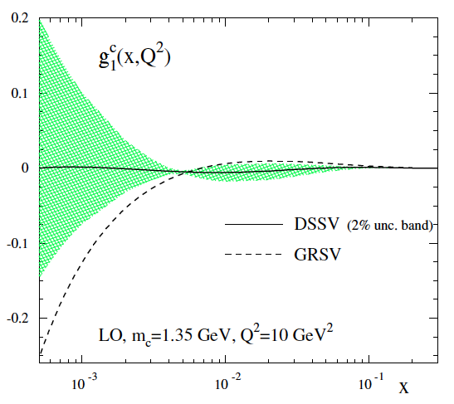
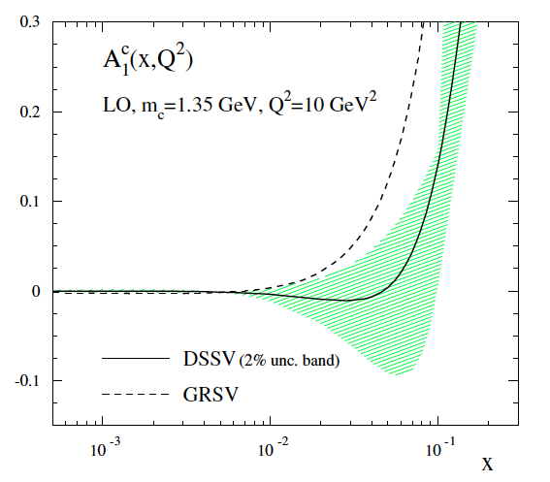
other opportunities at an EIC (cont’d)
can watch out for possible “surprises” at small x
some expectations that non-linear effects might set in earlier than in unpol. DIS
method: onset of tensions in global fits by varying Q²_{min}
Bartels, Ermolaev, Ryskin;
Ermolaev, Greco, Troyan
can systematically study charm contribution to g₁
irrelevant so far (<< 1%) in fixed target data
relevance at EIC strongly depends on size of Δg
charm not massless for EIC kinematics; need to compute relevant NLO corrections [in progress]
some expectations (LO estimates)
DSSV: very small (1-2% of g₁^{uds})
g₁^{charm}
A₁^{charm}
DSSV: ≈ 2x10⁻⁵
GRSV: 10-15% of g₁^{uds}
GRSV: ≈ 2x10⁻³

Slide 36

other opportunities at an EIC (cont’d)
high Q²: access to novel electroweak structure functions [thanks to 100-1000 x HERA lumi]
probes combinations of PDFs different from photon exchange -> flavor separation from DIS
contains e-w propagators
and couplings
Wray; Derman; Weber, MS, Vogelsang;
Anselmino, Gambino, Kalinowski; de Florian, Sassot;
Blumlein, Kochelev; Forte, Mangano, Ridolfi; …
most promising: CC structure fcts
requires a positron beam
not necessarily polarized
studies by Deshpande, Kumar,
Ringer, Riordan, Taneja, Vogelsang
de Florian, Sassot; MS, Vogelsang, Weber;
van Neerven, Zijlstra; Moch, Vermaseren, Vogt
NLO QCD corrections all available
can be easily put into global QCD analyses
kinematically limited to medium-to-large x region
novel Bj-type sum rules
can extract (anti-)strangeness from CC charm production
MS, Vogelsang, Weber
e.g.
NLO: Kretzer, MS

Slide 37
take away message
many unique opportunities to study helicity PDFs
at a high-energy polarized lepton-nucleon collider
access to small x to reliably determine Δg and ΔΣ
flavor separation in broad x, Q² range to study (a)symmetry of quark sea
access to novel electroweak probes at high Q²
effective neutron beam: study of Bjorken sum rule

