Slide 1
Muon Background Acceptance of SHiP
by Florian Stummer

Slide 2
Recap
Initial Muon Background Findings
  Muon background from vacuum rest-gas and BDF instrumentation may fill the entire experimental cavern.
  Production angle of muons from proton-Ti foil interactions
Potential issue:
  SHiP is not optimised to handle off-axis muons
  Question: How much of the off-axis muon flux falls within SHiP’s acceptance?
Production angle vs Momentum
µ / proton / 1 GeV/c / mrad
100m Vacuum
Foil 10m upstream
Foil 30m upstream
Production Angle | Muon Momentum
10 mrad | Any
50 mrad | p < 50 GeV/c
100 mrad | p < 20 GeV/c
µ / proton / 1x1cm²
µ / proton / 1x1cm²
µ / proton / 1x1cm²

Slide 3
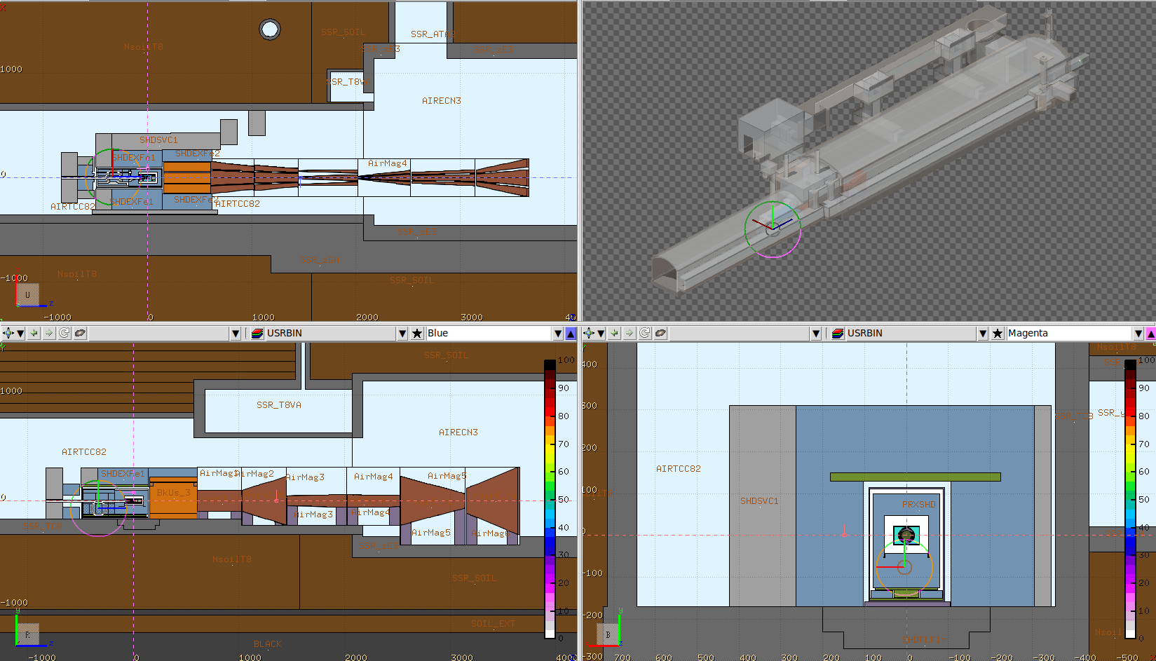
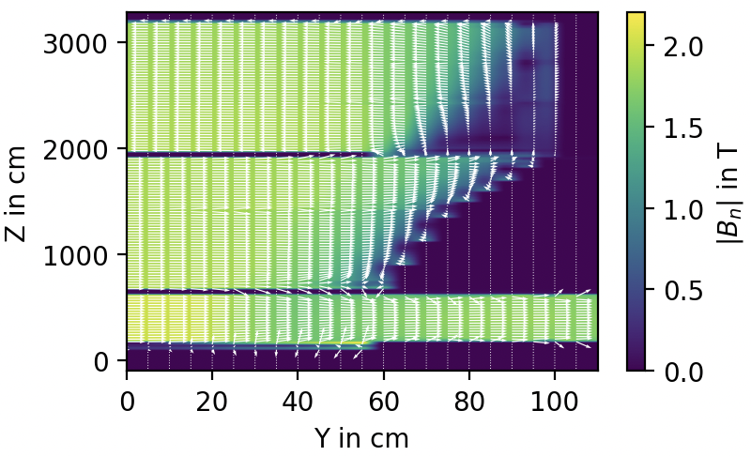
How can we evaluate SHiP’s off-axis muon acceptance?
MC-simulation of muons through BDF and SHiP’s muon shield
What we can learn from this simulation:
  Is a 10 GeV momentum cut-off for muons due to the material’s stopping power suitable?
  Do we capture a specific muon component with the magnetic field of the muon shield?
  Are there any muons that SHiP might be particularly sensitive to?
Muon Grid Distribution
over 2x2 m² upstream of BDF
Radial angle of 0-10 mrad
(outward / correlated to position)
Relevant Mass of BDF,
Hadron Stopper, Muon Shield
and RP-Shielding
Magnetic field of the Muon Shield

Slide 4
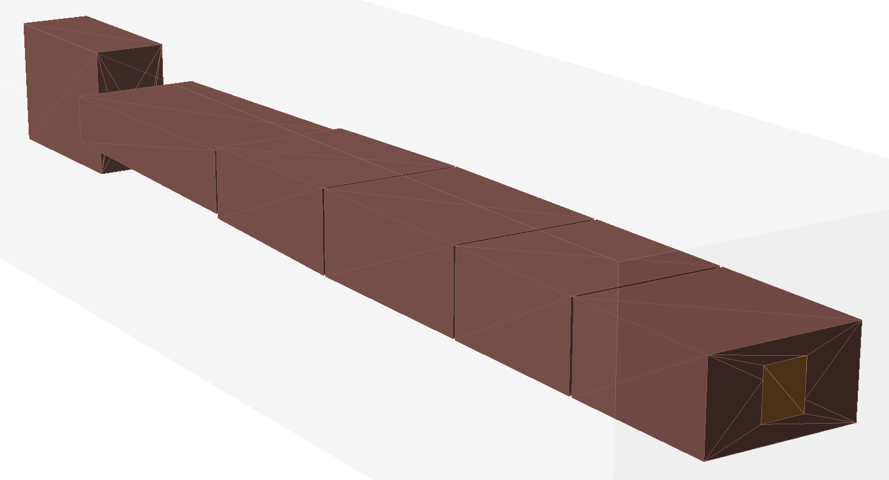
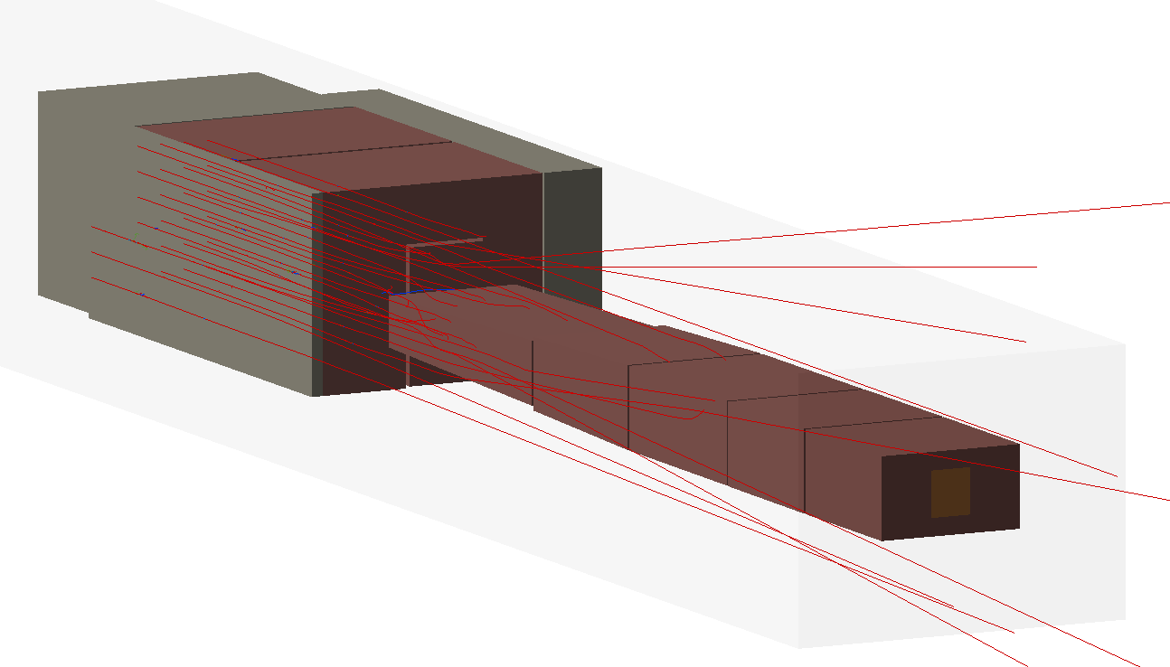
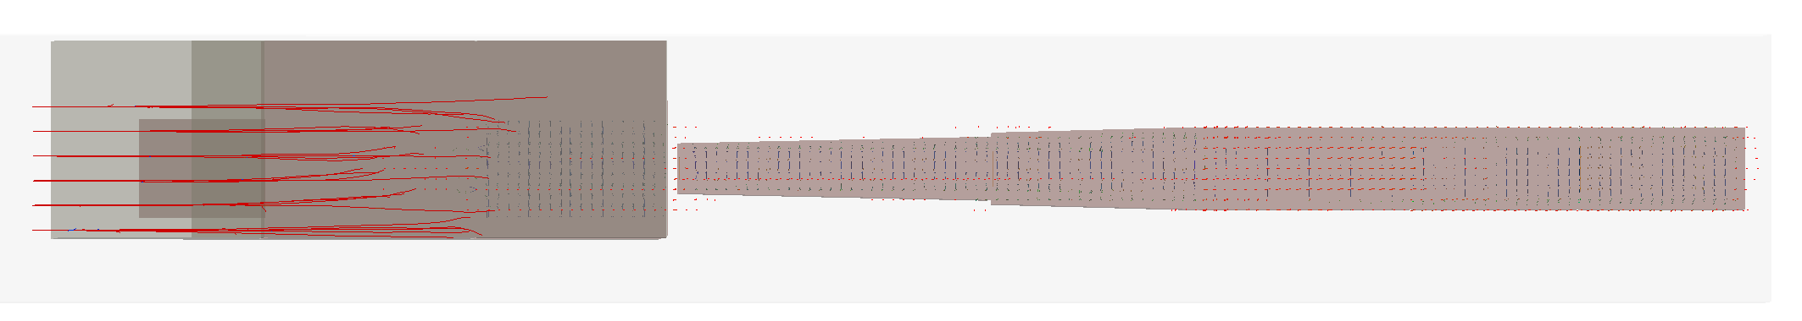
Simulation model
Big thanks to Guglielmo Frisella who provided me with field map and muon shield specs!
Muon Shield
3D view
Side view
Model assembled with information from FLUKA model,
Guglielmo’s Muon Shield baseline and technical drawing.
(BDF = simplified geometry, but with roughly the right mass)

Slide 5
Simulation model
Simulation Specifics:
  Kinetic Energy Cut-Off: 0.1 GeV
  Physics List: g4FTFP_BERT (incl. stopping power and multiple scattering)
  All secondaries stopped → Initial muons only

Slide 6
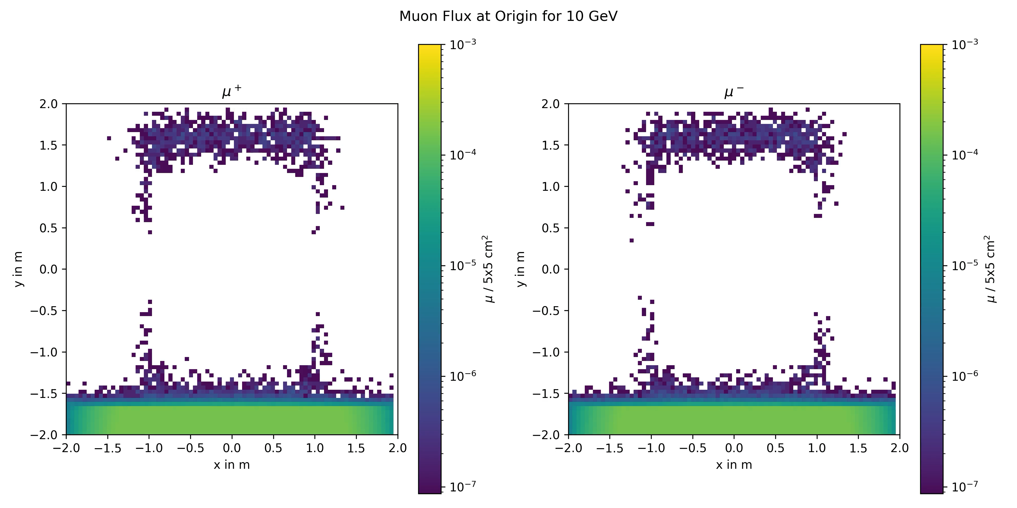
Muon acceptance with magnetic fields OFF
Initial position of muons which enter the first STRAW detector (s location before BDF)
Learnings:
Experimental Hall should be included in future runs
p < 10 GeV/c killed
p < 50 GeV/c killed in central 3m x 1m

Slide 7
Muon acceptance with magnetic fields OFF
Considering the vacuum-induced background (just as an example)
Muon Flux
Muon Momenta along x

Slide 8
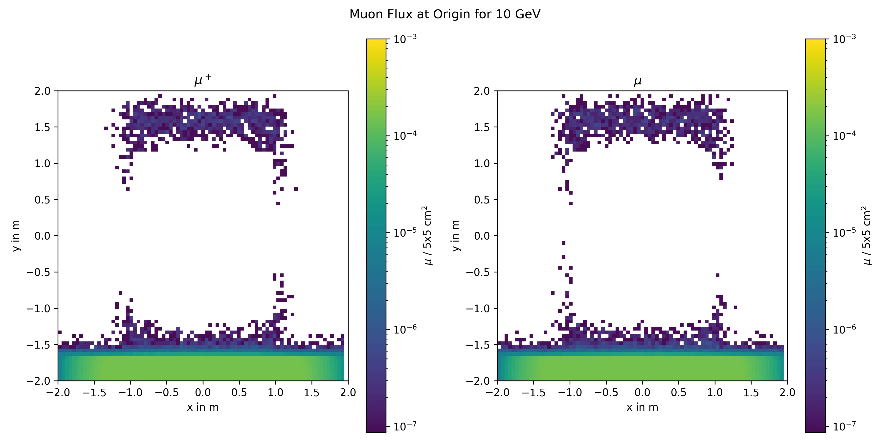
Muon acceptance with magnetic fields ON
Initial position of muons which enter the first STRAW detector (s location before BDF)
Learnings:
Beam centre remains muon free up to 350 GeV
Magnetic fields help cleaning 2m x 2m area in the centre (specific locations left out)
Capturing triangles close to the beam axis in horizontal (side is charge dependent)

Slide 9
Conclusion
What we can learn from this simulation:
  Is a 10 GeV momentum cut-off for muons due to the material’s stopping power suitable?
  Yes.
  In central 3m x 1m area even muons up to 50 GeV are killed passively
  (depending on the mass of the muon shield of course)
  Do we capture a specific muon component with the magnetic field of the muon shield?
  Are there any muons that SHiP might be particularly sensitive to?
  Yes, muons off-axis can be captured. If SHiP is sensitive to this component will be decided by the rate
  of these muons (more realistic simulation of the rate to come soon)
Next Steps:
  Add Experimental Hall
  Investigate the regions close to the beam axis to find out what mechanism catches these muons
  Once the beam optics for P42 is ready, evaluate what the real distribution before BDF might be.
  Once the muon shield design is finalised redo this study and propose solutions of mitigating muons in the sensitive regions already upstream.
  Benchmarking the P42 model with real measurements will be necessary! We need to find a suitable detector for measuring muon rates upstream of BDF asap. Ideally, we also find a detector for tracking the muons (before LS3 if possible).

