Slide 1



Cooling Cell Integration
Recap and plan
Lucio Rossi Univ. of Milan & INFN-Milan-LASA
Roberto Losito, CERN
WP8

Slide 2
Concentrating on Lattice operation
(not yet on cell end/start or standalone test
LATTICE OPERATION
SINGLE CELL
ONE CELL
absober
RF cavity
Solenoid and dipole
FORCE
FORCE

Slide 3
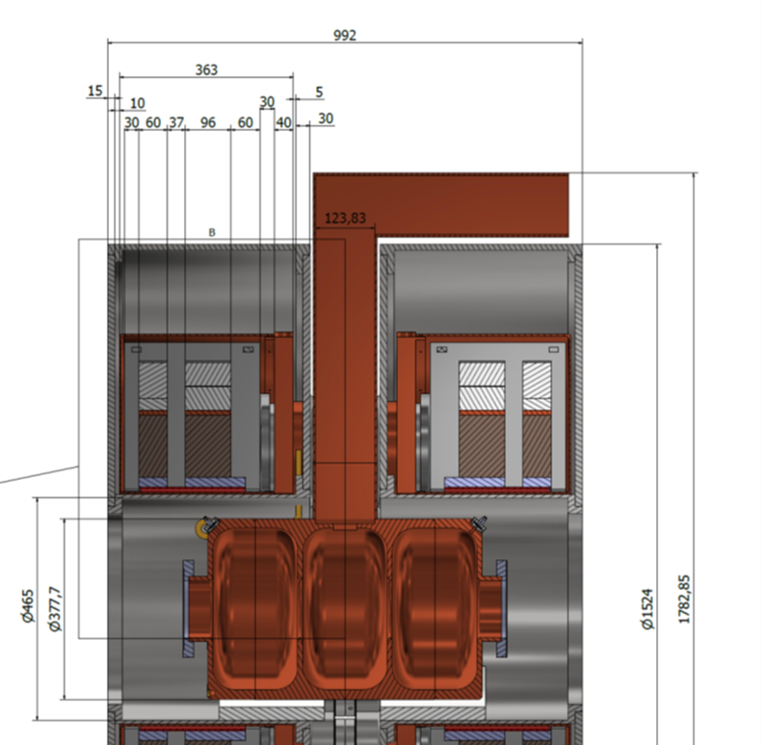
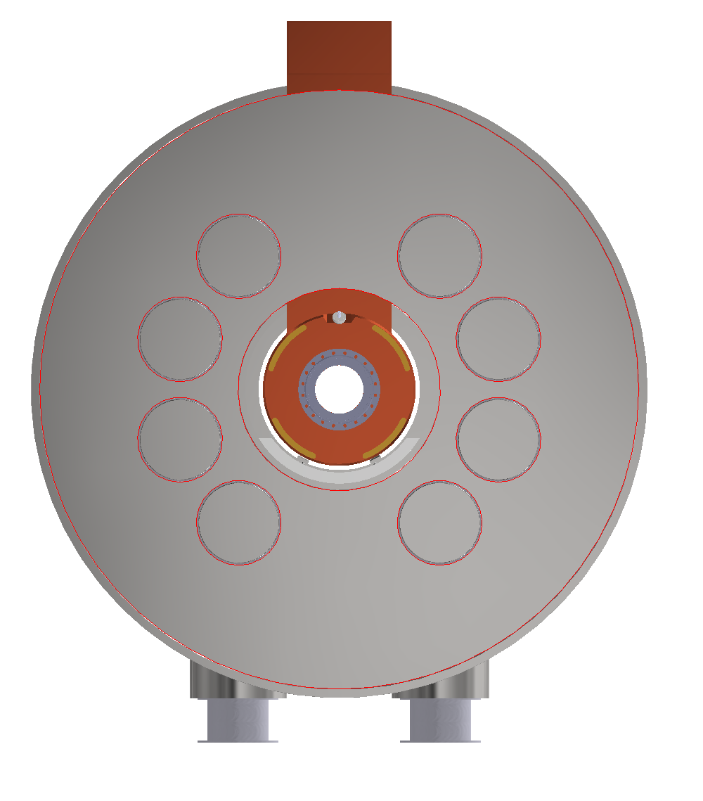
S5-like demo cell
Integration V0.1
992 mm
Where to gain more: space removed with an intercell cryostat
Solution 2 : single cell cryostat → no good for thermal
And huge forces between intracell coils
Traces of the 8 support rods

Slide 4
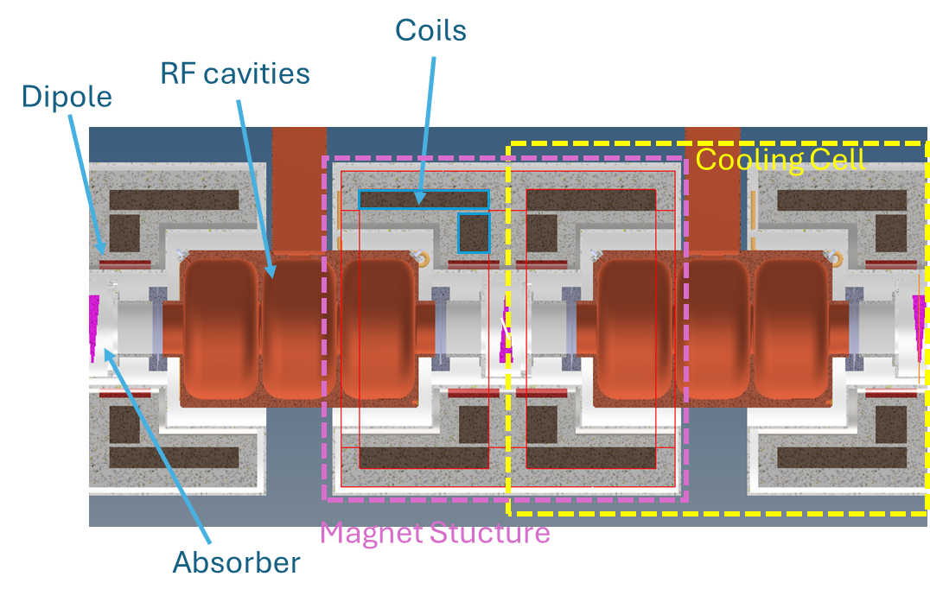
The magnet crystat would be simply slided over the RF structure from both sides of RF coupler
Solution pursued for lattice operation
Intercell cryostat
Plus
RF structure fully assembled independently on the rest
Makes easy assembly and access to RF for maintenance
The coils of a cell can be pushed as near the cell border as wanted
Minus
The forces between coils of the same cell needs to be reacted though RT gap
This generates enormous heat load at 20 K since gap is short and forces enormous (>> than the RFMFTF)
A single cell is not representative of the whole. For a single cell one needs to build also adjacent magnets (and forces are not balanced on aside coils)

Slide 5
Summary Table
Configuration considered to study the mechanics of the coil assembly
“11MN-20mm gap” configuration provides highest margins, low magnetic energy density and forces, with 9 km increase of the total HTS length .
Lattice operation
 | J_eng Coil1/Coil2 (A/mm^2) | B2/B1 (%) | Focus. Strength per cell length (T^2*m/m) | Axial Force on Coil1/Coil2 (MN) | Net Axial Force (MN) | Net Torque applied on centroid of forces (MN*m) | Peak Hoop Stress on Coil1/Coil2 (MPa) | Peak Positive Radial Stress on Coil1/Coil2 (MPa) | Peak Von Mises Stress on SS spacers (MPa) | Total Magnetic Energy Density in cell (MJ/m^3) | Total HTS length (full cell) (km) | Coil Current Coil1/2 (A)
Option 17MN-10mm gap | 421.5 209.1 | 14.7 | 24.7 | +6.7 +10.4 | +17.1 | -0.597 | +294 +397 | +1.96 +14.5 | +499 +465 | 159.4 | 66 | 795 394
Option 18MN-10mm gap | 322.9 209.1 | 14.5 | 24.6 | +8.0 +10.3 | +18.3 | -0.652 | +230 +358 | +0.91 +14.1 | +390 +459 | 130.0 | 85.6 | 609 394
Option 11MN – 20mm gap “min. vol.” | 380.3 263.9 | 14.7 | 24.4 | +0.4 +11.0 | +11.4 | -0.540 | +260 +349 | +3.45 +8.97 | +377 +460 | 155.3 | 62.8 | 717.4 497.2
Option 11MN – 20mm gap | 328.3 263.9 | 14.8 | 23.7 | +0.7 +10.8 | +11.5 | -0.562 | +222 +344 | +2.95 +8.84 | +323 +454 | 136.2 | 71.6 | 619.4 497.9
This is under integration

Slide 6
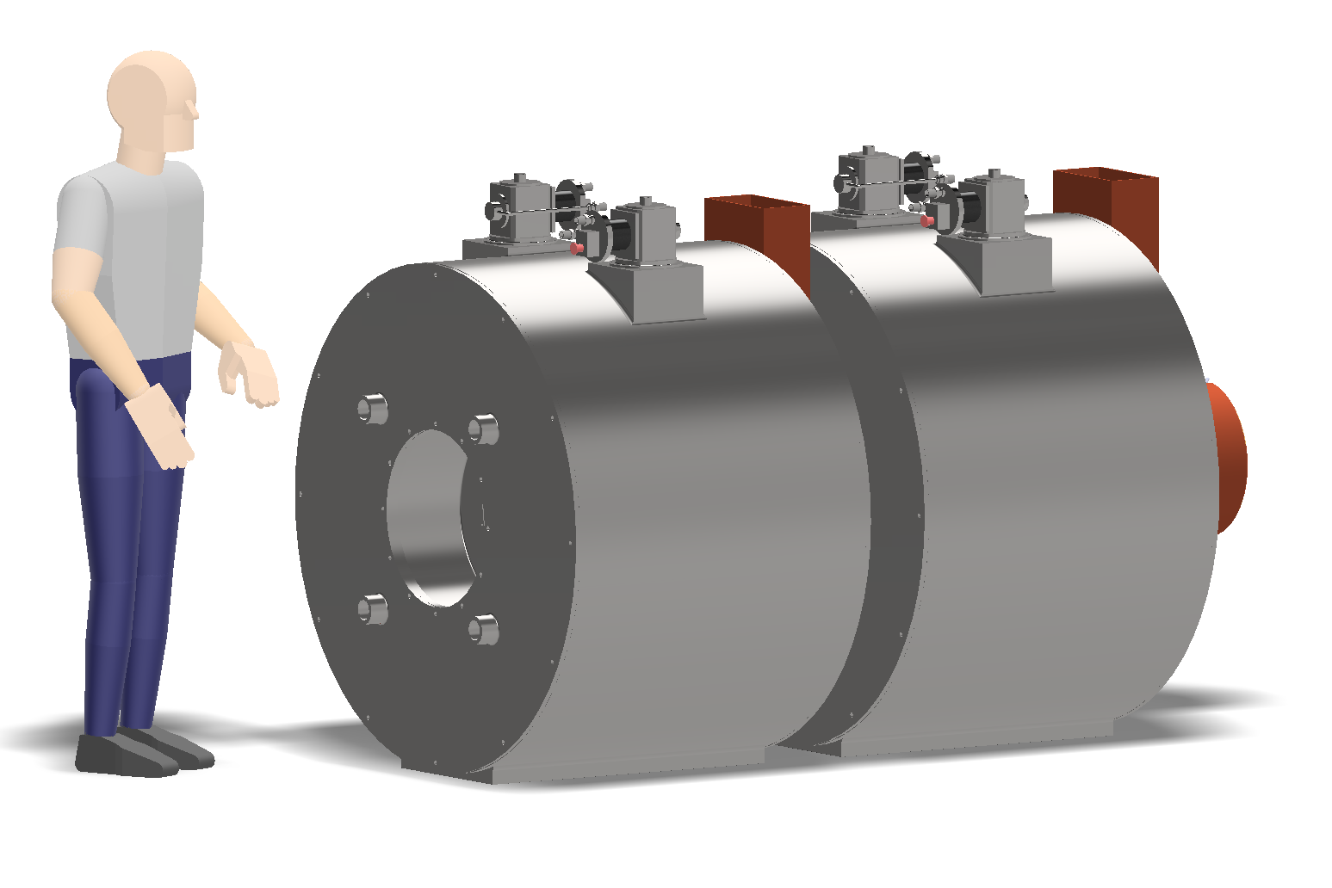
Status of integration in January, see progress in M Castoldi presentation

Slide 7
Plan
Finish the integration of the selected configuration
Review on 6 May !
Decision on the optimal magnetic field configuration, acceptable a baseline of the MC CC.
Integrate with more details and finish by July/September: First demo cell!
Study end/start and standalone : March 2026.

