Slide 1



B5 Cooling Cell Demonstrator Integration
Vacuum & Assembly
Lucio Rossi – Marco Statera – Giuseppe Scarantino – Mattia Castoldi WP8 & WP7

Slide 2
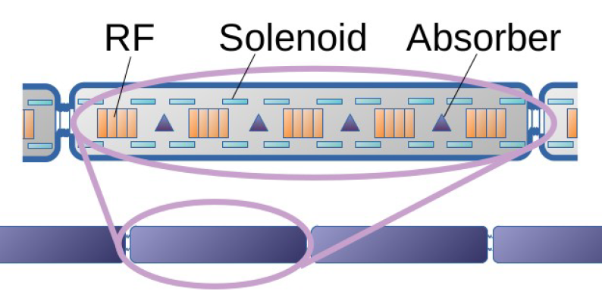
Muon Collider - 6D cooling magnets
6D Cooling solenoids
Field: 4 T … 14 T
Bore: 90 mm … 600 mm
Length: 500 mm (x 17)
Radiation heat: TBD
Radiation dose: TBD
2 km of 6D cooling
2432 solenoids
TASK 7.2

Slide 3
6D Cooling Cell: Operating Mode (I)
LATTICE OPERATION
(nominal, beam operation)
SINGLE CELL
ONE CELL
absober
Dipole
RF cavity
Solenoid
FORCE
FORCE
Periodic cell array: magnets with alternated polarity.
Magnet design considering lattice operation
Test of each cell at full field is mandatory.
A magnet design fulfilling both operative conditions looks challenging!

Slide 4
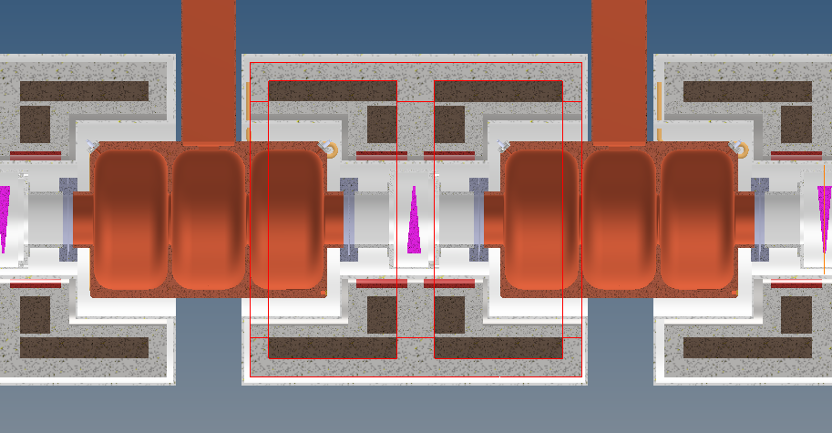
B5-DEMO Cell: Updated Layout
“inter-cell cryostat”
Coils
RF cavities
Dipole
Cooling Cell
Magnet Stucture
Absorber

Slide 5
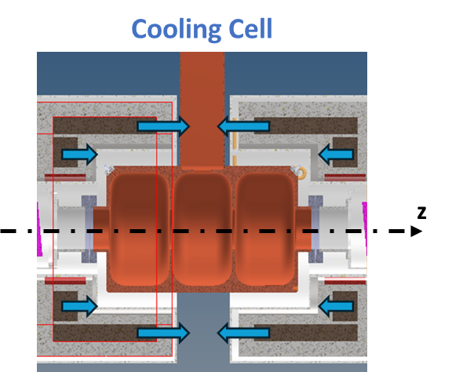
Solution pursued for lattice operation
“Inter-cell cryostat”
The magnet cryostat would simply slide over the RF structure from both sides of RF coupler
Plus
RF structure fully assembled independently on the rest
Makes easy assembly and access to RF for maintenance
The coils of a cell can be pushed as near the cell border as wanted
Minus
The forces between coils of the same cell needs to be reacted though RT gap
This generates enormous heat load at 20 K since gap is short and forces enormous (>> than the RFMFTF)
A single cell is not representative of the whole. For a single cell one needs to build also adjacent magnets (and forces are not balanced on aside coils)
20 K
300 K
20 K

Slide 6
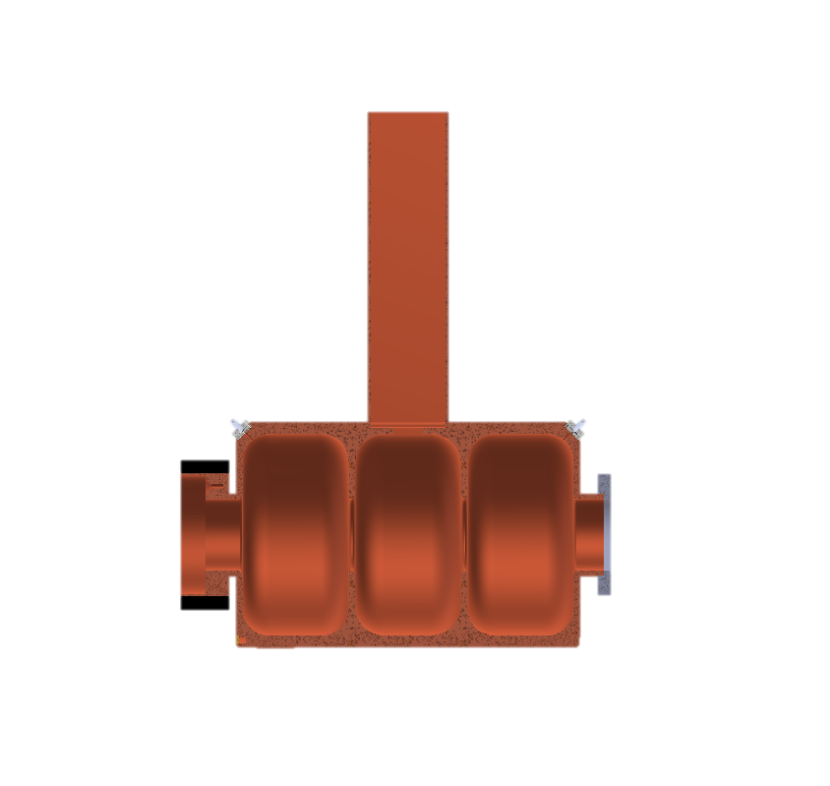
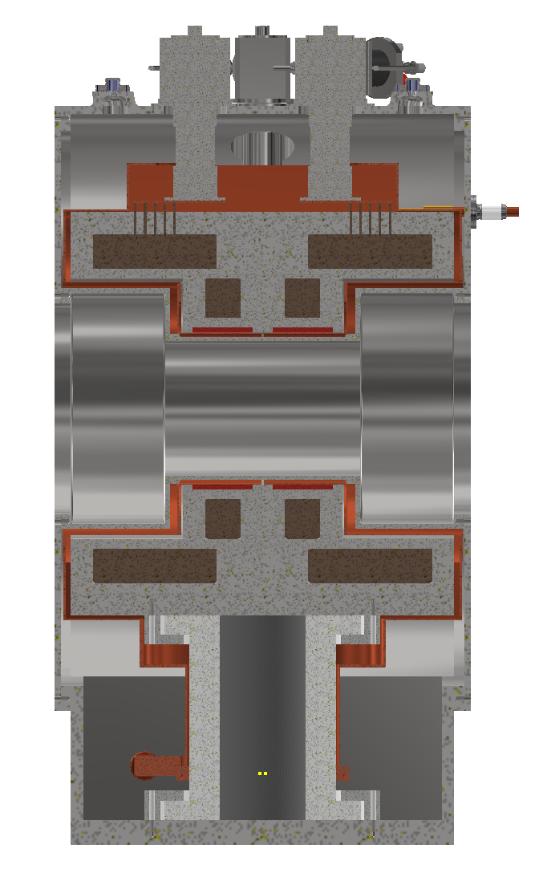
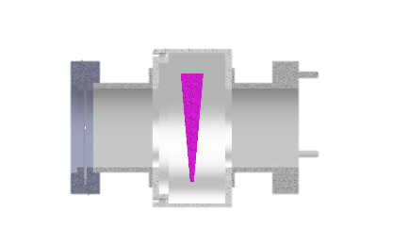
Cooling Cell Integration

Slide 7
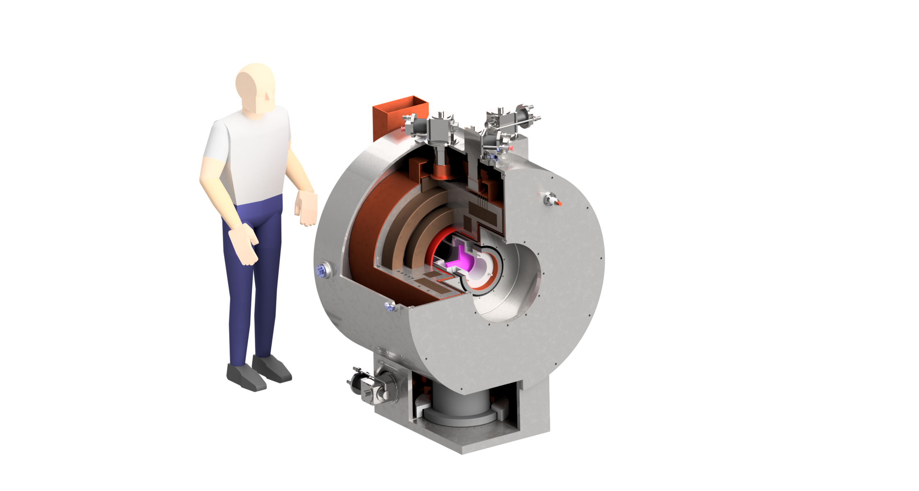
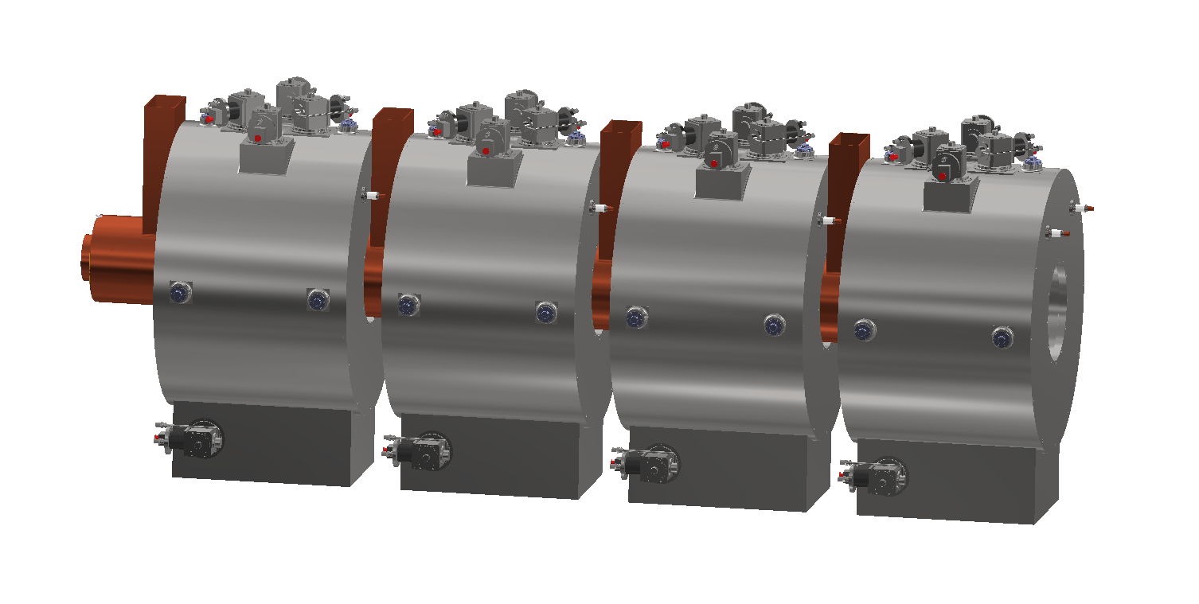
Cooling Cell Integration
Shell
X4
Absorber
Foot

Slide 8
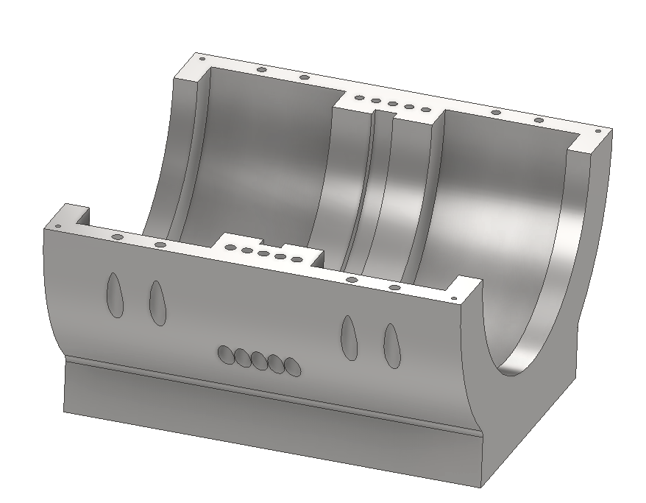
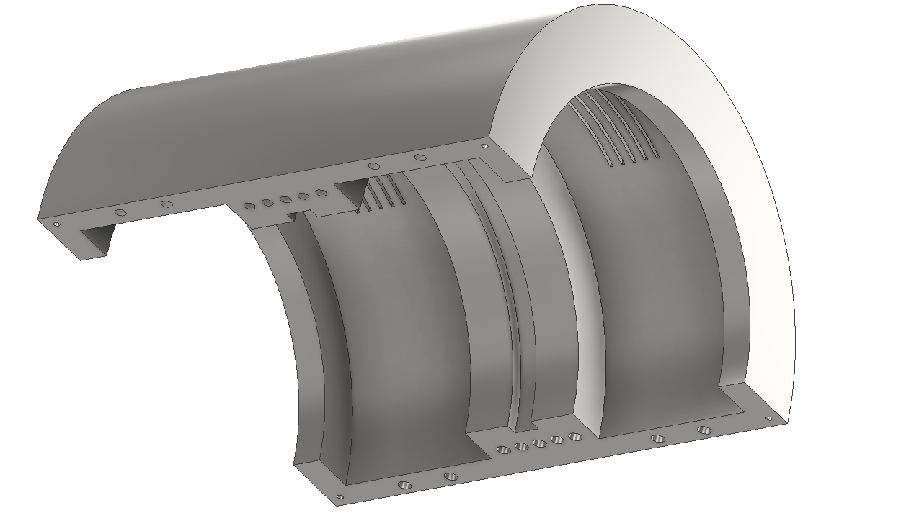
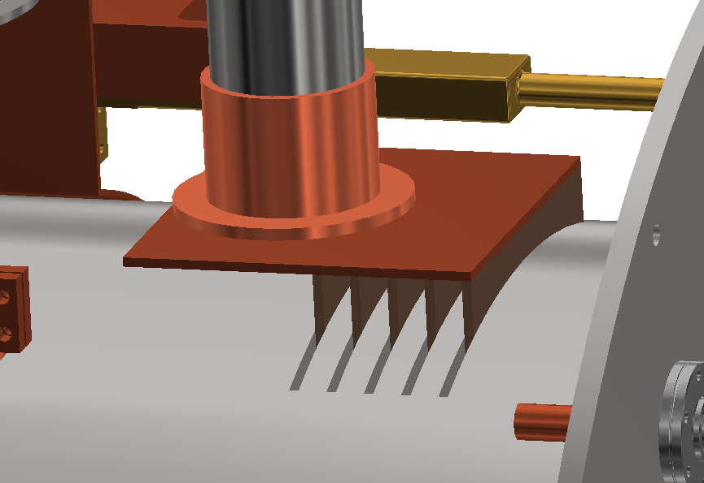
Magnets Supports: Half-Shell
Single milled SS element for acceptable tolerances: 420 x 780 x 800 (mm)
Bottom
Top
Bolted joints
pins
pins
Conduction cooling ways
pins
pins
Bolted joints
Bolted joints tightly holds the two half-shells together, four pins on the edges for optimal alignment.

Slide 9
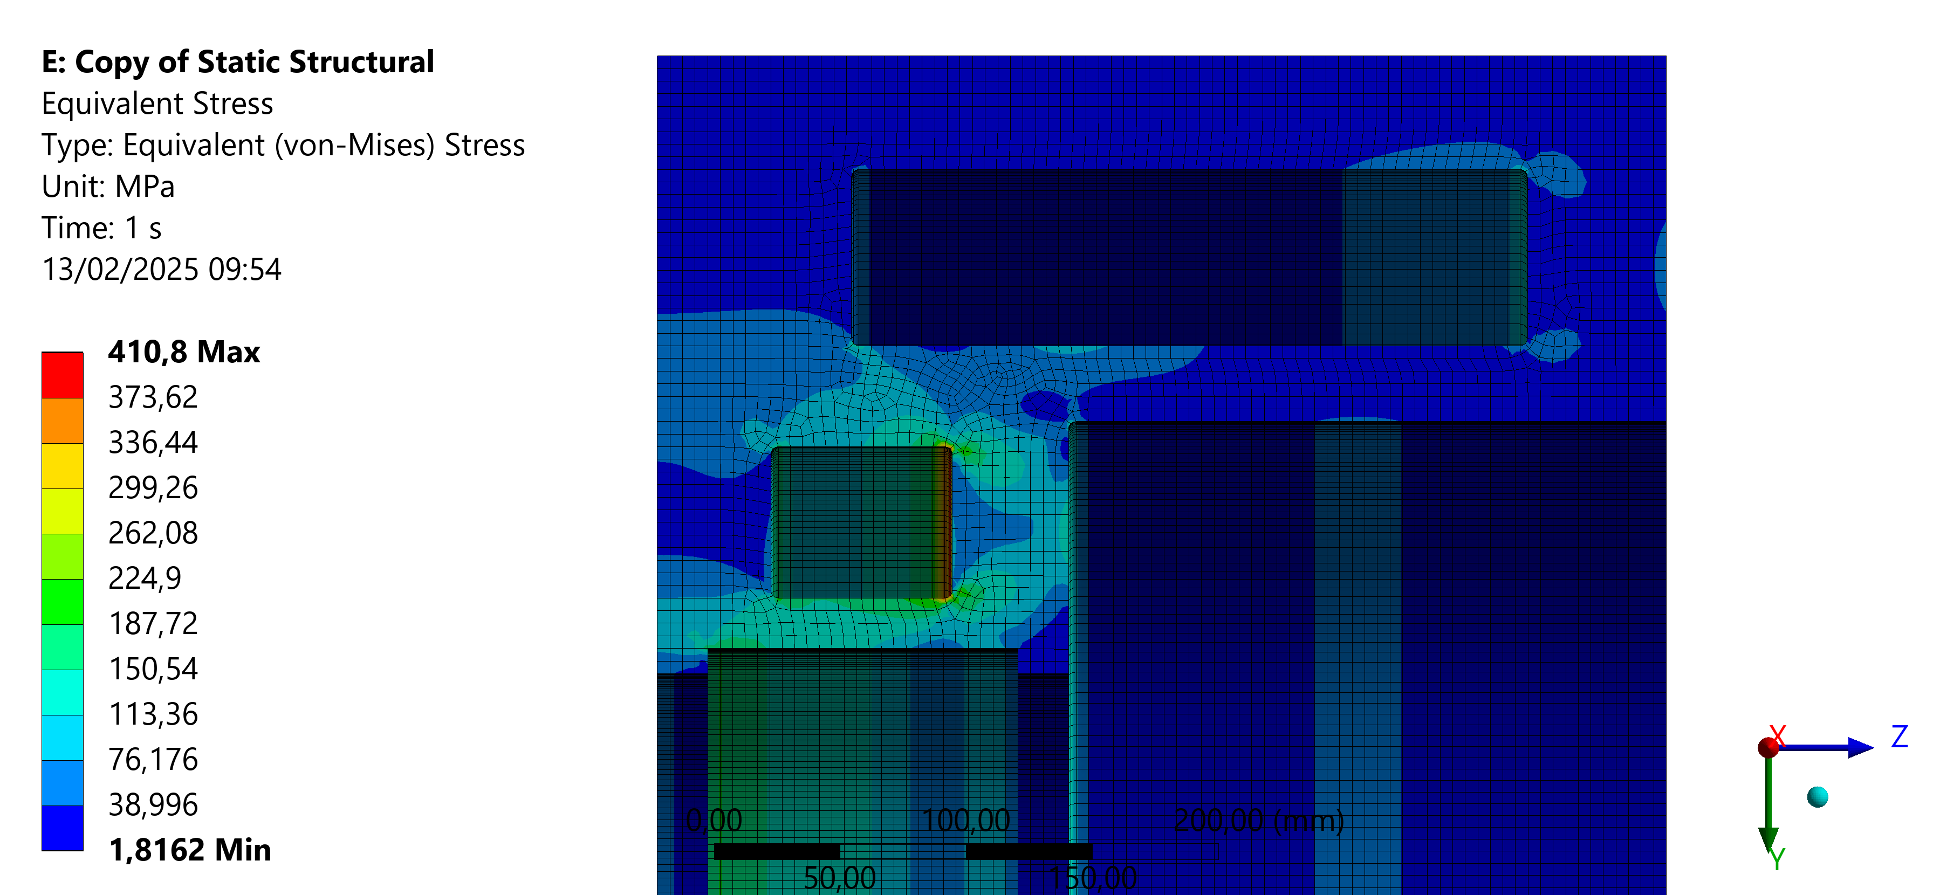
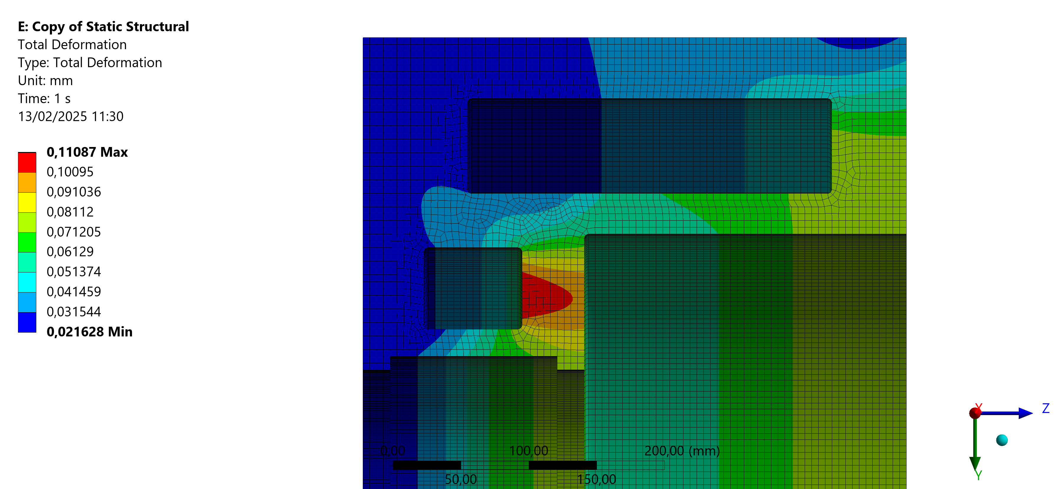
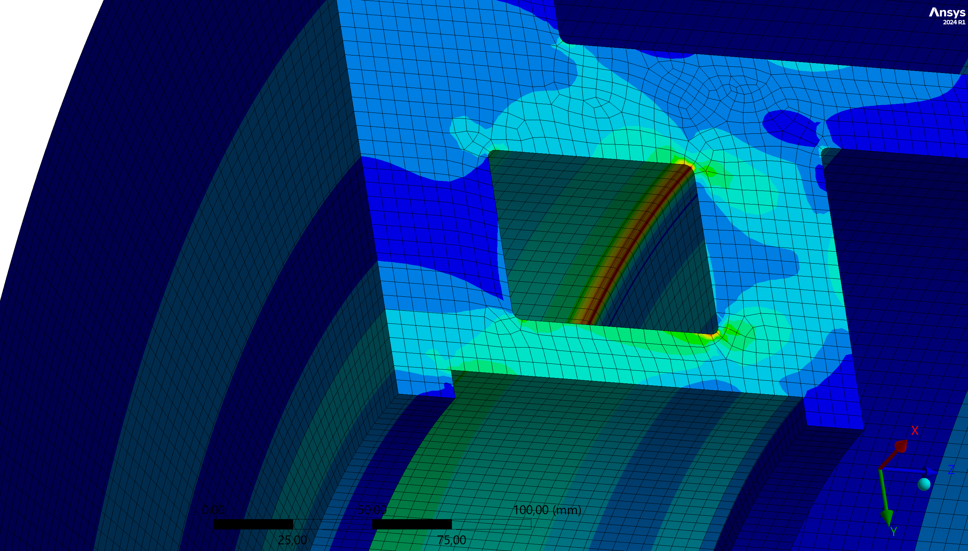
Mechanical Analysis
Coil Support Structure
Von Mises Stress
Total Deformation
Mechanical analysis of the coil support structure in lattice operation:
MECHANICALY APPROVED

Slide 10
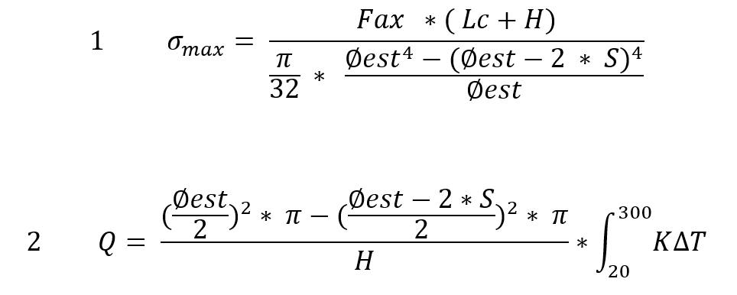
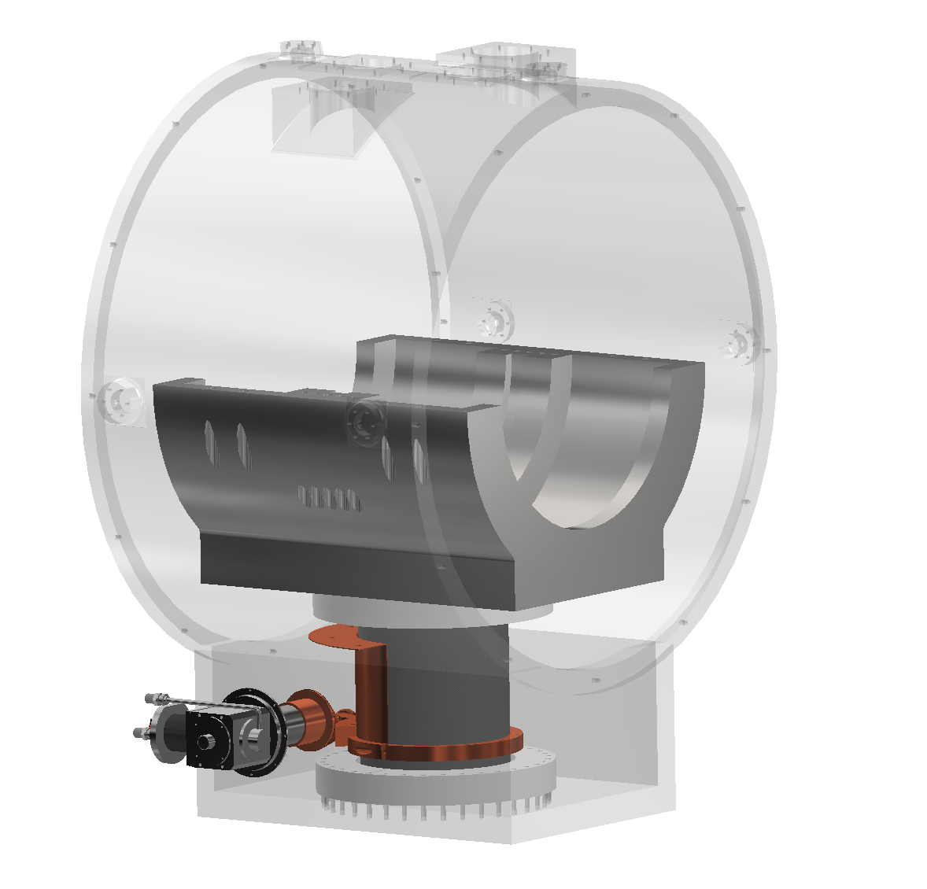
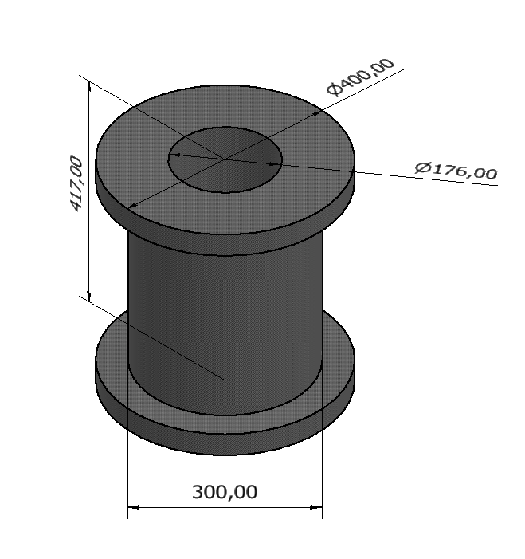
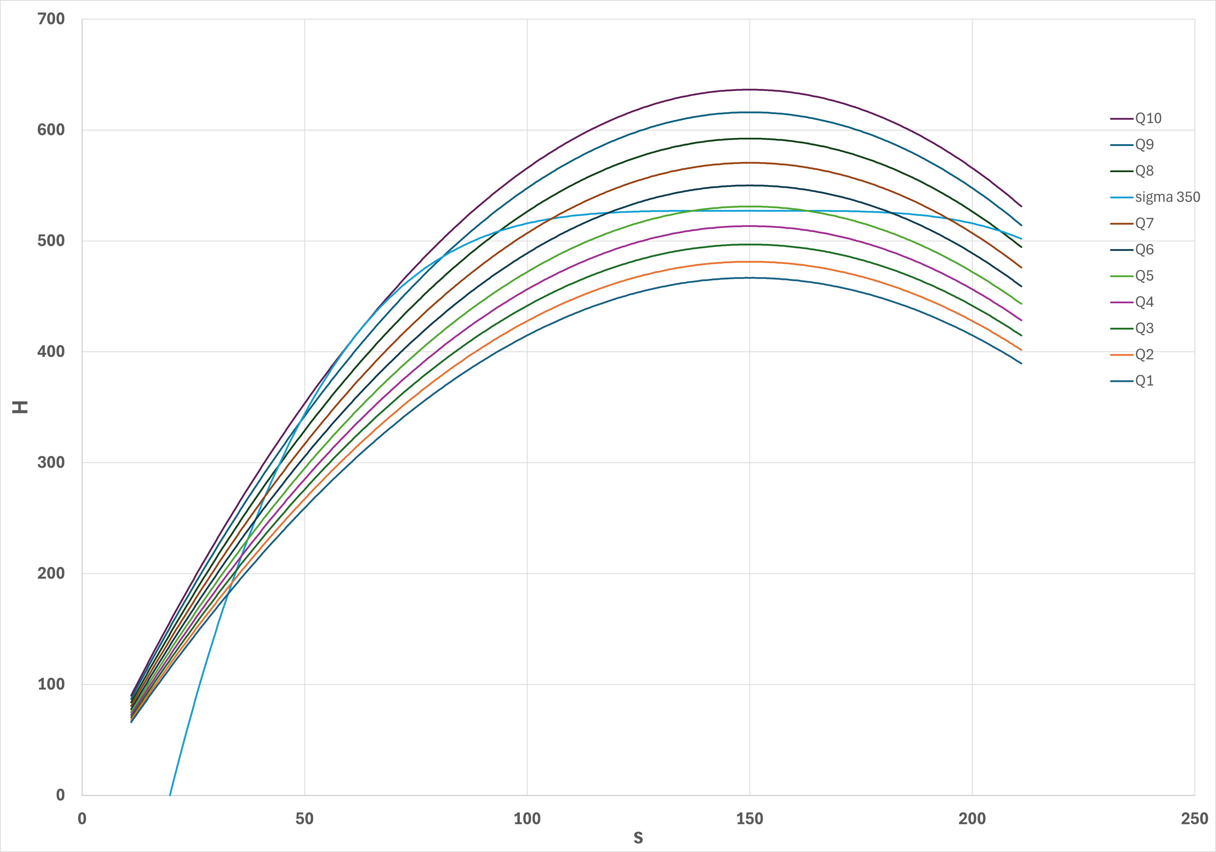
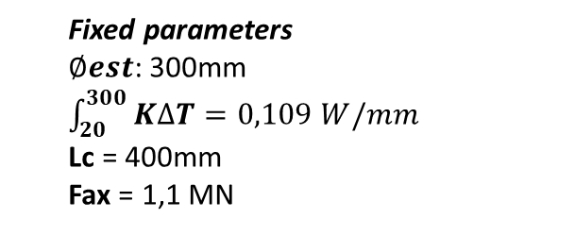
Foot (GFRE) optimization
Fixed parameters
$∅est$: 300mm $\int_{20}^{300}{K∆T=0,109 W/mm}$
Lc = 400mm
Fax = 1,1 MN
Dimensions
Plots H(s)
Main forces
Heat leak
point of tangency
S = 62mm
H = 417mm
1,57 W @ 20K
&
86,52 W @ 60K

Slide 11
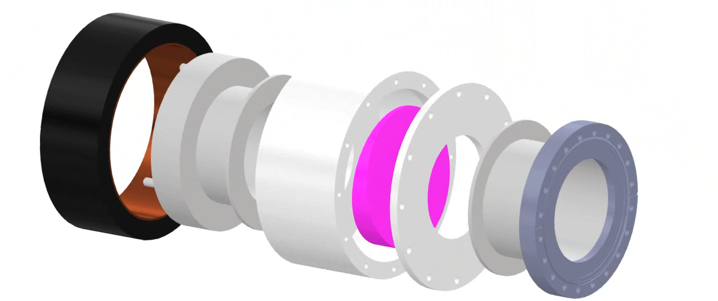
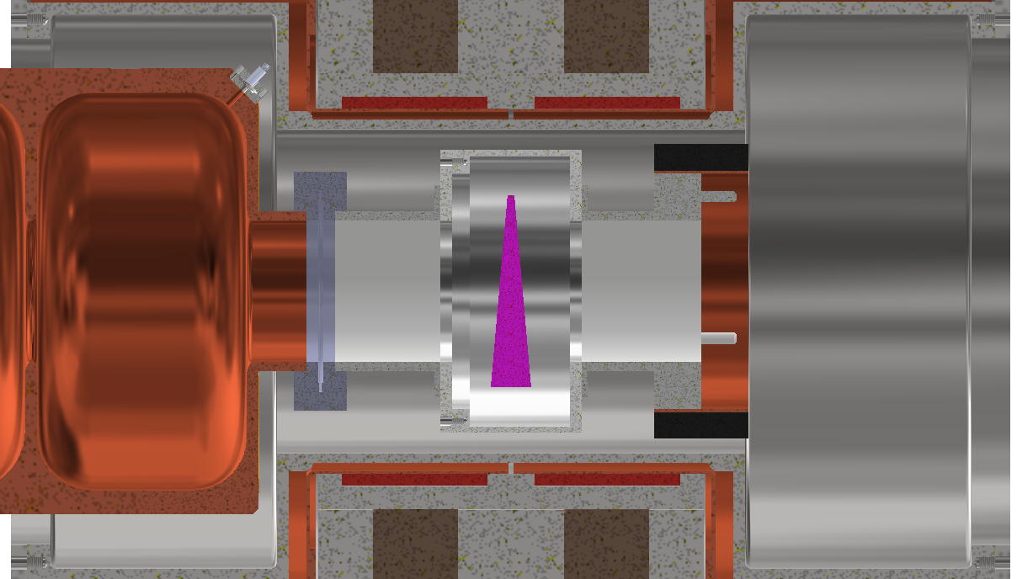
Absorber
SMA ring cuopling
LiH Absorber
Beam
CF Flange
Copper gasket
Due to space constraints, we have to use special connections (SMA connections are illustrated), but other solutions will be evaluated.

