Slide 1
S5-like DEMO Cell
Coil Search Scheme Update
Optimization Tool
New Configurations
Giuseppe Scarantino
11/04/2025

Slide 2
Lattice / Single Cell Operation
LATTICE OPERATION
(nominal, beam operation)
SINGLE CELL
ONE CELL
absober
Dipole
RF cavity
Solenoid
FORCE
FORCE
Test of each cell at full field is mandatory.
A magnet design fulfilling both operative conditions looks challenging!
Periodic cell array: magnets with alternated polarity.
In this presentation: results for lattice conditions.

Slide 3
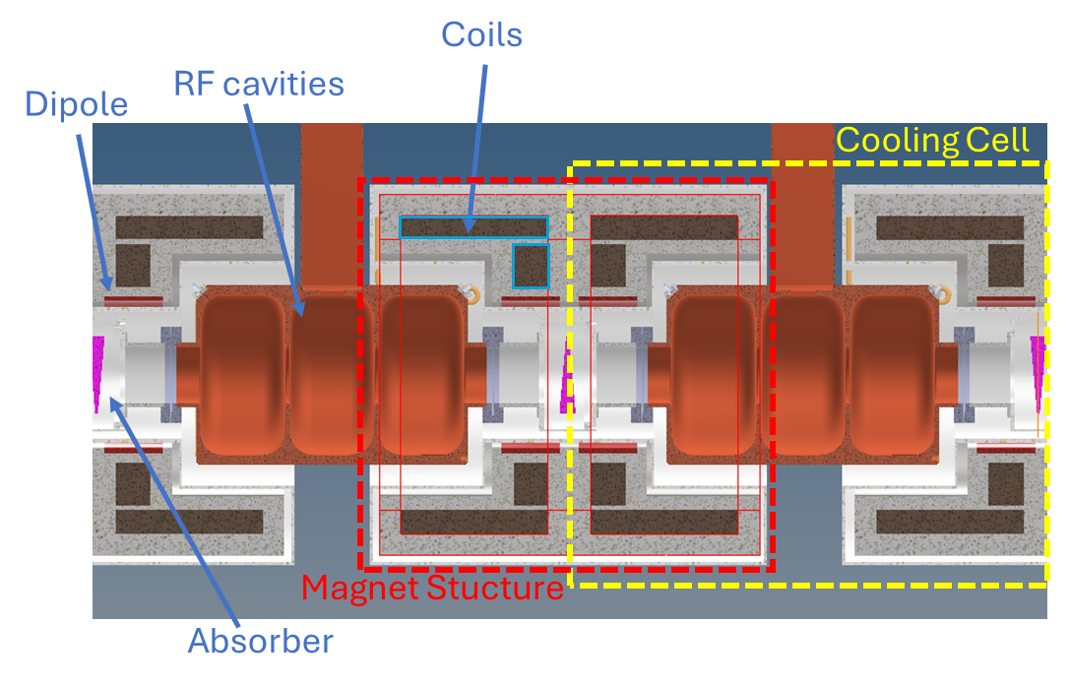
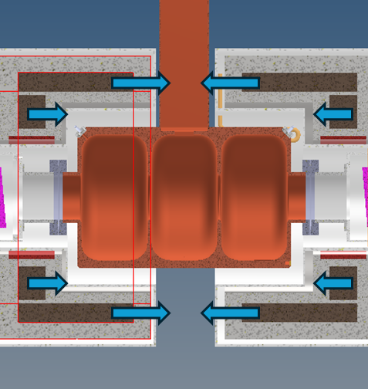
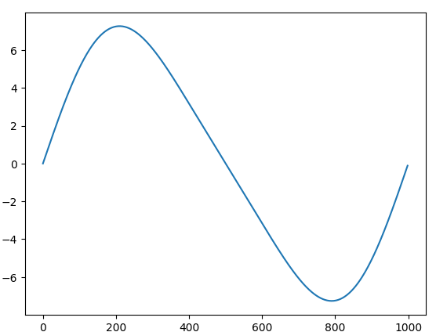
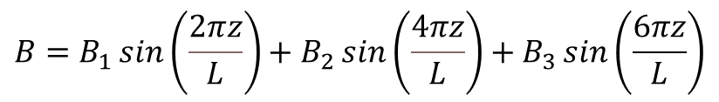
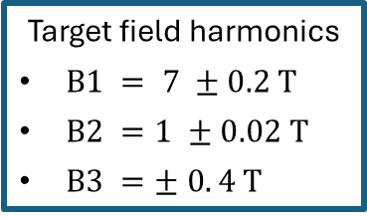
Updated Cell Layout: “inter-cell cryostat”
Cooling Cell
Axial forces on coils
(lattice operation)
z
Target field on axis for a 1 m cell
Target field harmonics
$B1 = 7 ±0.2 T$
$B2 =1 ±0.02 T$
$B3 =± 0. 4 T$
$$B=B_{1}\sin\left(\frac{2πz}{L}\right)+B_{2}\sin\left(\frac{4πz}{L}\right)+B_{3}\sin\left(\frac{6πz}{L}\right)$$

Slide 4
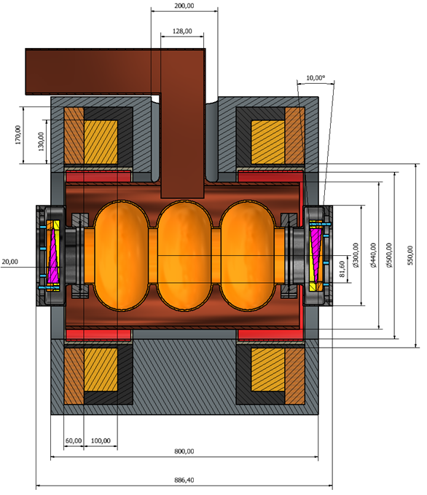
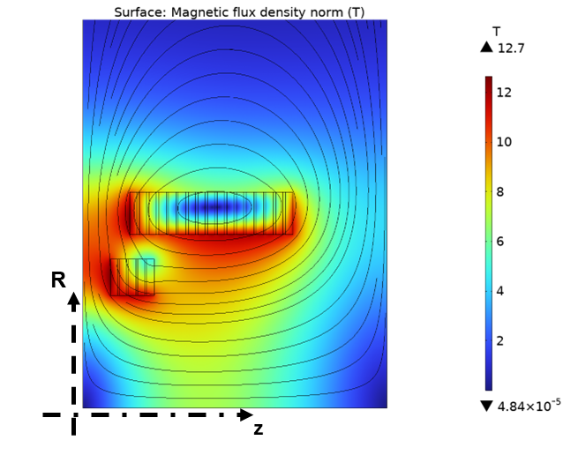
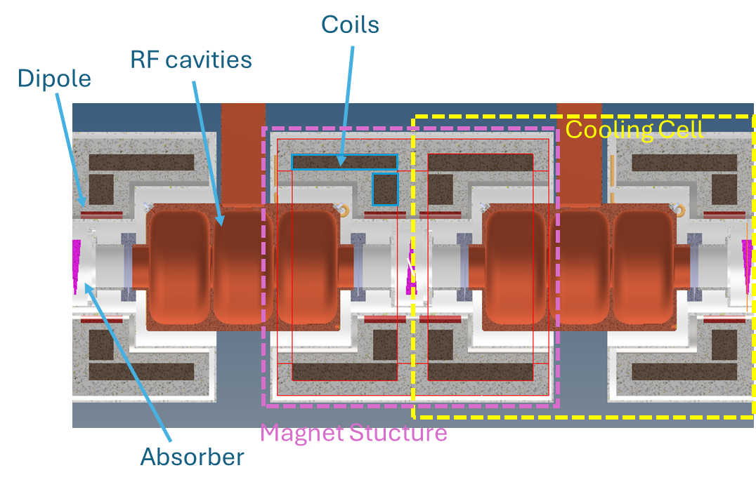
Magnet configuration nomenclature
“B5-DEMO MAG X.Y”
Cell layout numbering:
Numbering of magnet configurations studied for cell integration
Magnet configuration #3
0.8 m cell (layout #1)
1 m cell (layout #2)

Slide 5
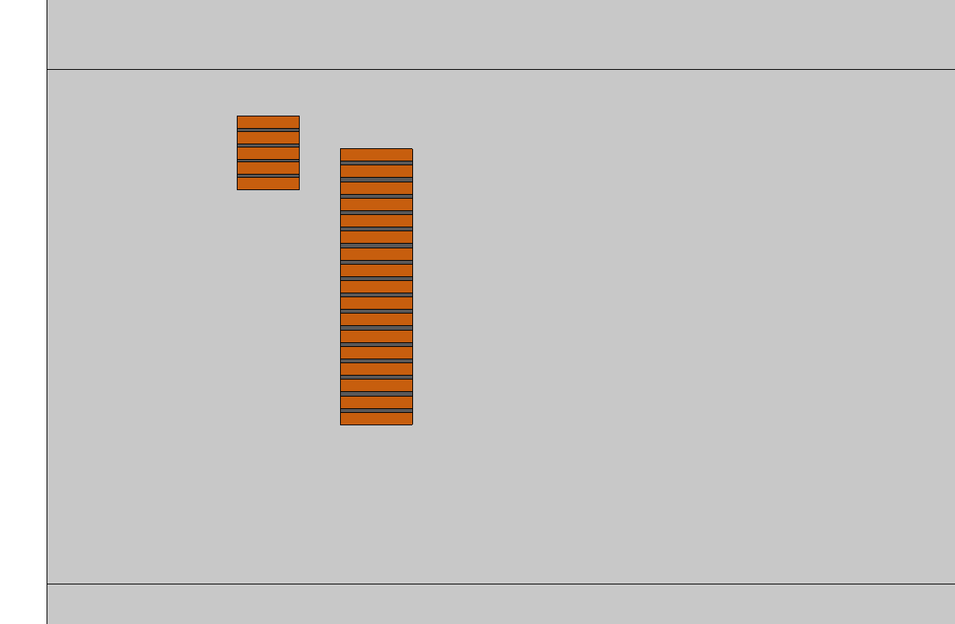

B5-DEMO MAG 2.3 configuration
Engineering current density:
Coil 1: 328.43 A/mm^2,
N. turns = 445
Coil 2: 300.00 A/mm^2,
N. turns = 382
Conductor Section
SS tape: $26 μm$
Coil 1
268 mm
N. pancakes: 17
HTS
77 mm
70 mm
HTS
72 mm
Metal-Insulated Coil
SS spacer
Conductor section:
2 X HTS tape (12mm x 0.0656mm)
1 X SS tape (12mm x 0.026mm)
45 mm
60 mm
Coil 2
N. pancakes: 5
R = 285 mm
Coil 2
40 mm
Spacers:
Coil 1: 4 mm SS spacers
Coil 2: 3 mm SS spacers
R = 185 mm
R
Baseline magnet configuration currently
considered for integration.
z
z = 0mm at cell boundary

Slide 6
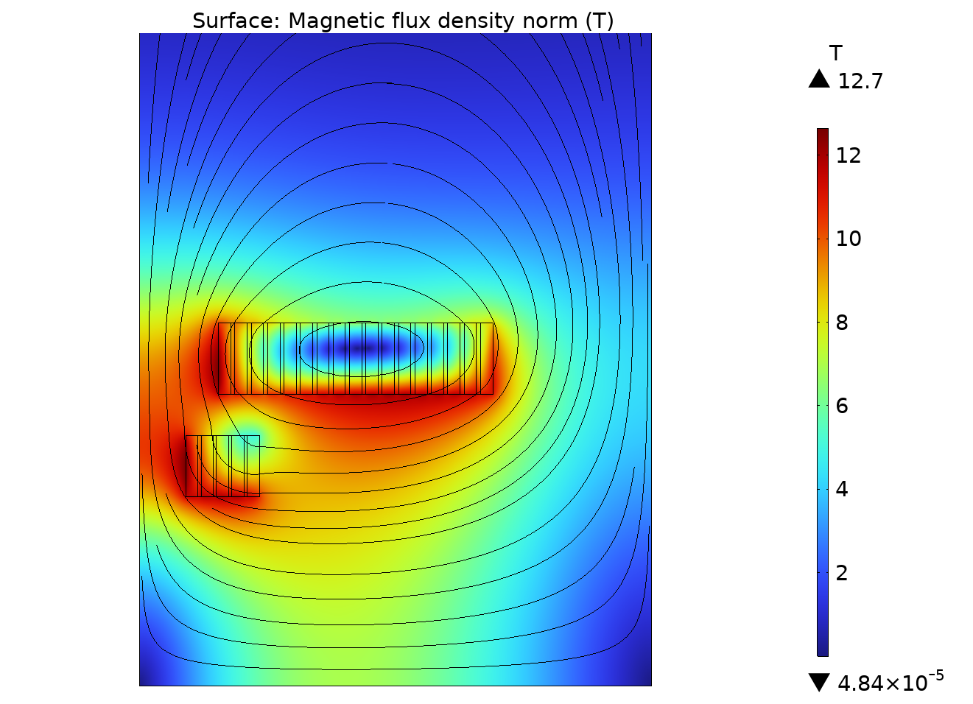
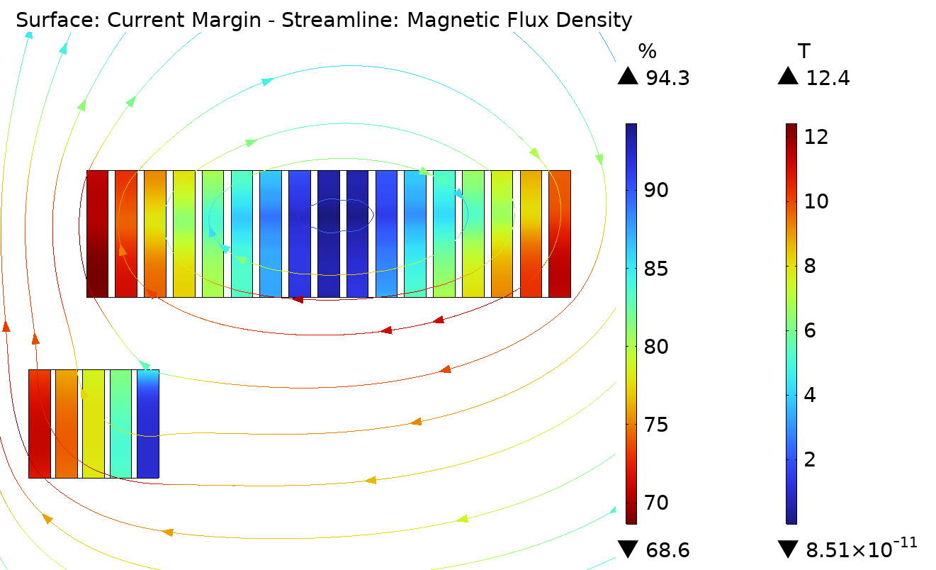
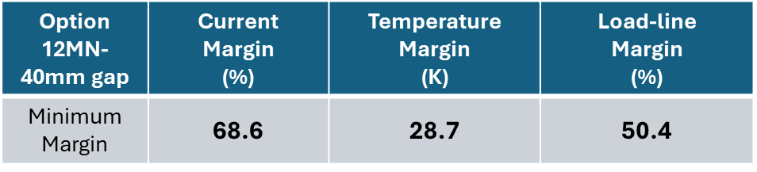


B5-DEMO MAG 2.3: EM analysis results
$$\left|B\right|$$
$$Ic\left(T,B,θ\right)$$
angular dependence considered
$$4.12 MN$$
Mag. Energy Density (lattice)
140.4 MJ/m3
Total Mag. Energy - full cell
12.2 MJ
R
$$Ic margin=\left(1−\frac{I}{I_{c}}\right) \%$$
$$8.25 MN$$
z
 | Coil 1 | Coil 2
Total Radial Resistance [mΩ] | 30.6 | 12.0
Coil Inductance (lattice op.) [H] | 29.2 | 3.39
Characteristic Time [s] | 954 | 282.6
Power dissipated @ charging [W] (ramp rate: 0.1 A/s) | 278 | 9.58
Margins exceedingly high: non-optimal conductor usage with the selected winding layout (2x 12mm HTS tape + SS tape) considering the coil protection limit (maximum stored magnetic energy density < 150 MJ/m^3).

Slide 7
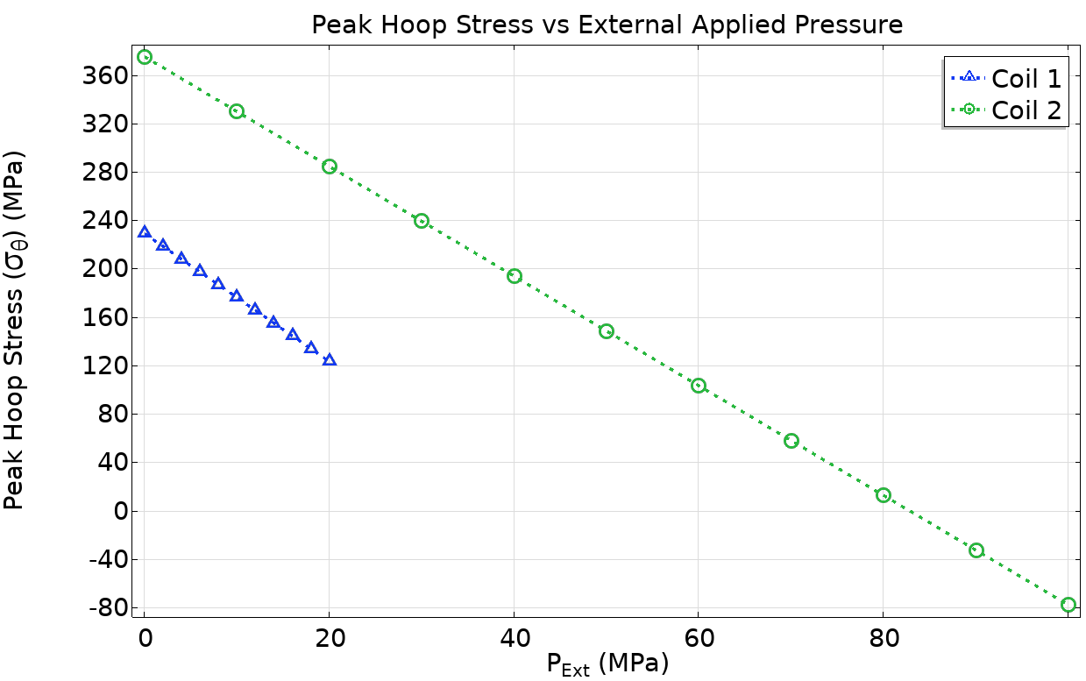
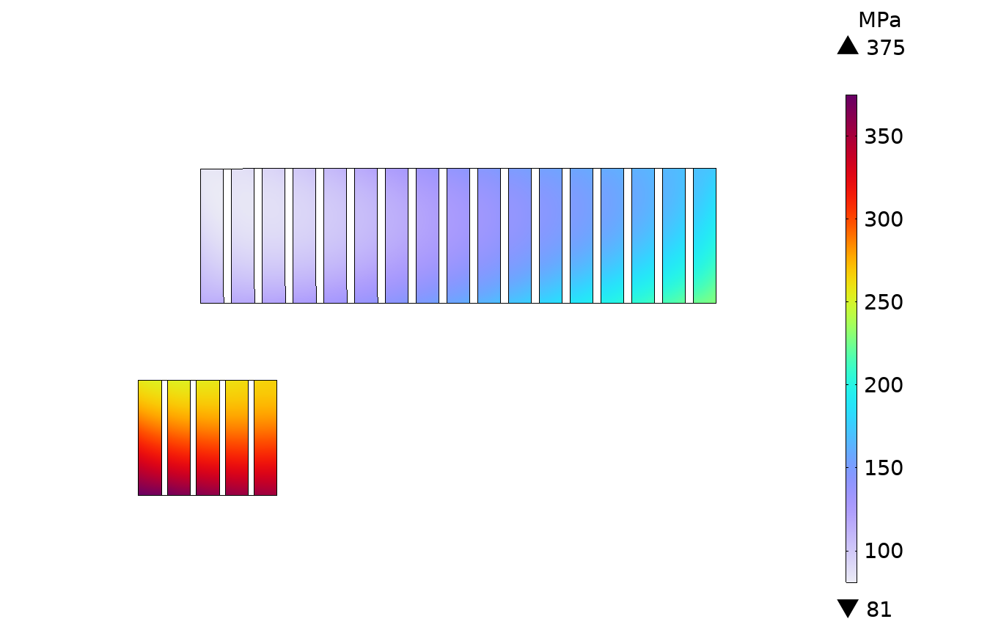
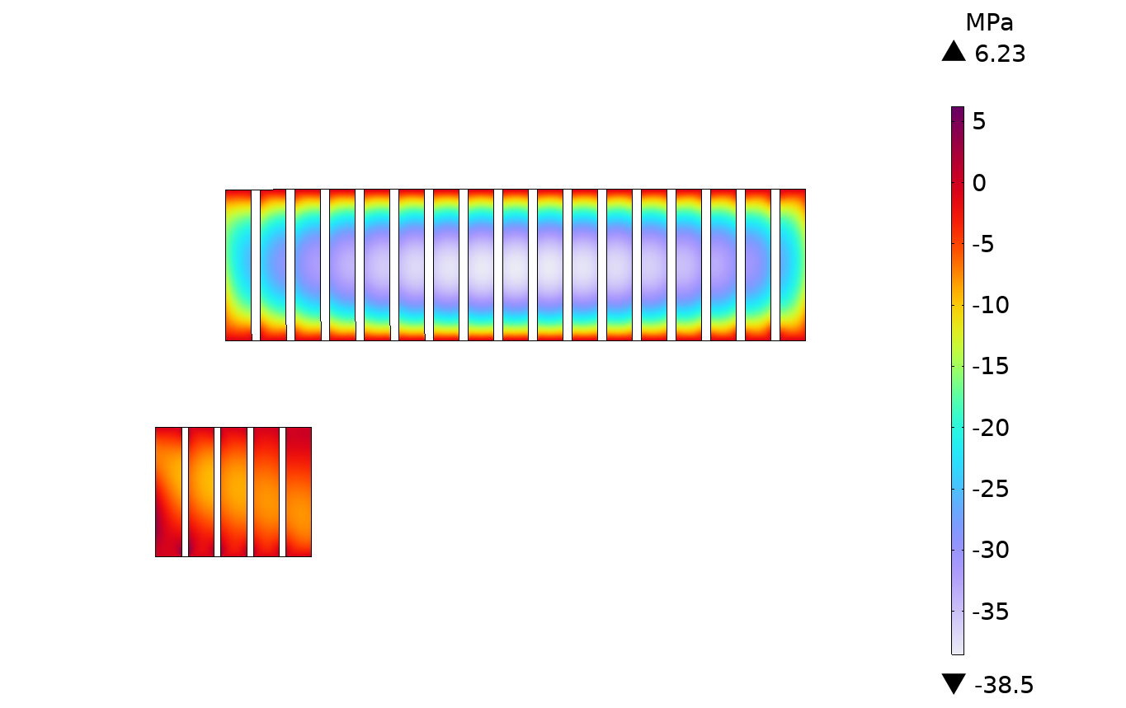
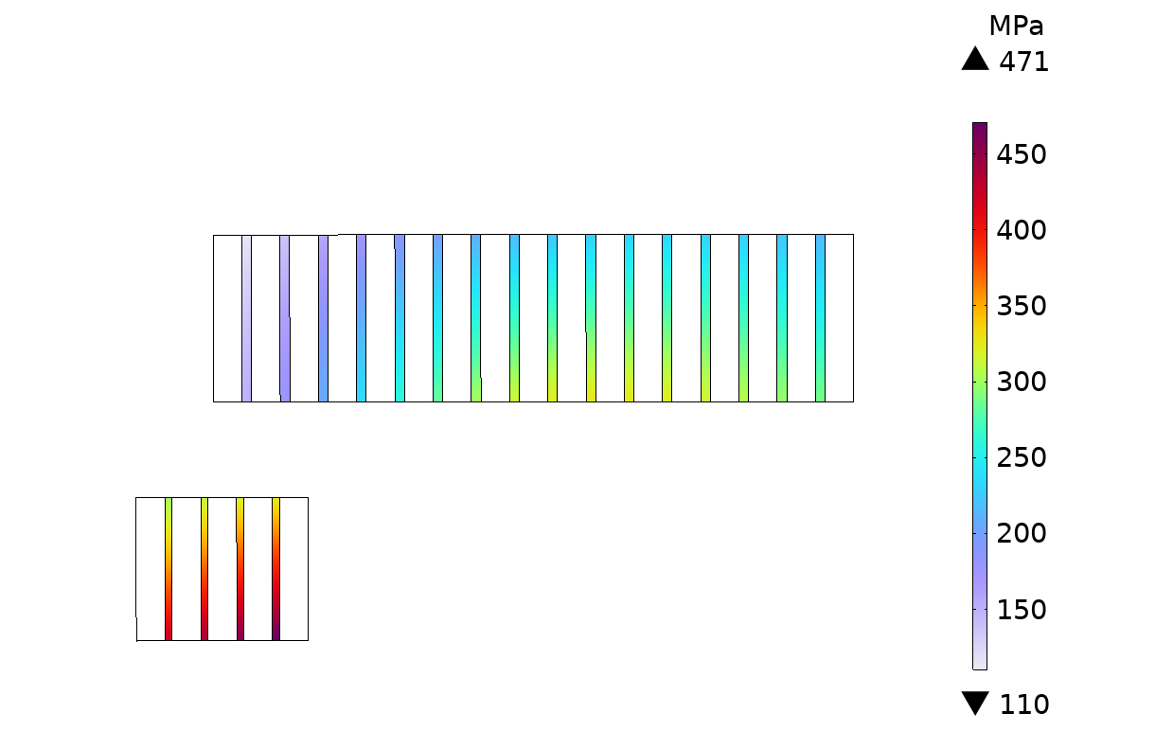
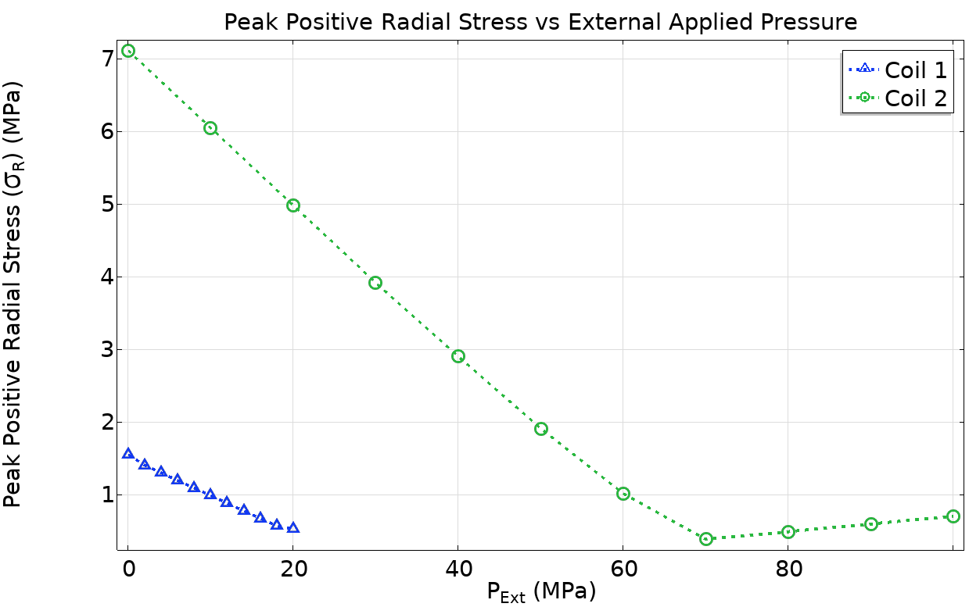
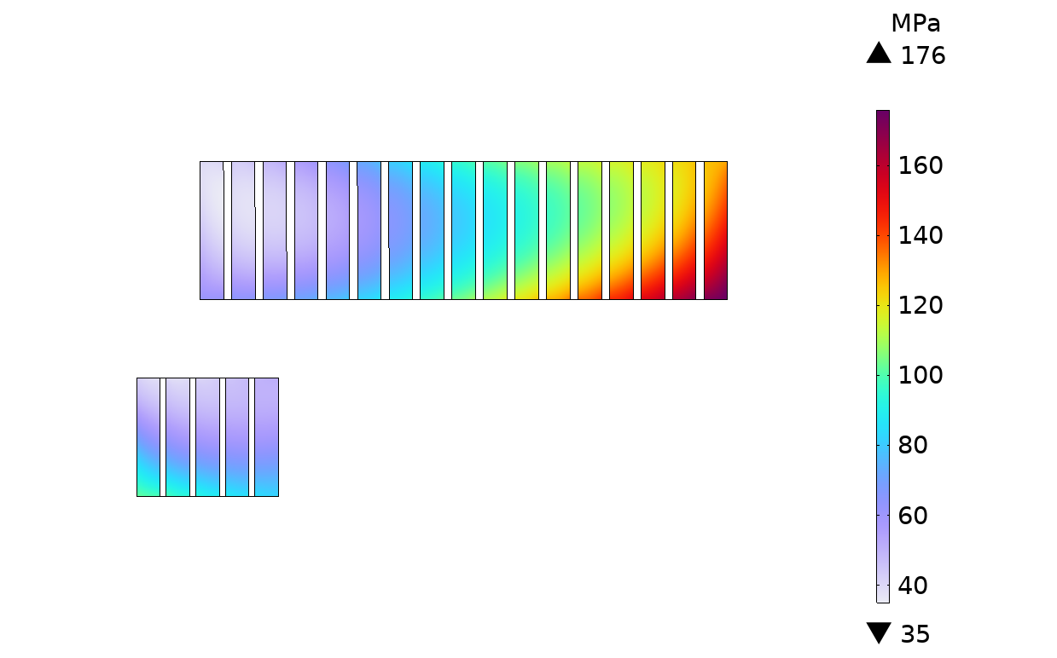
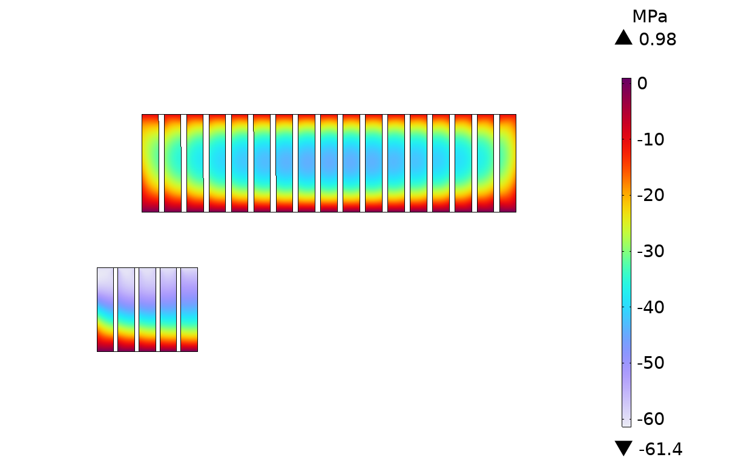
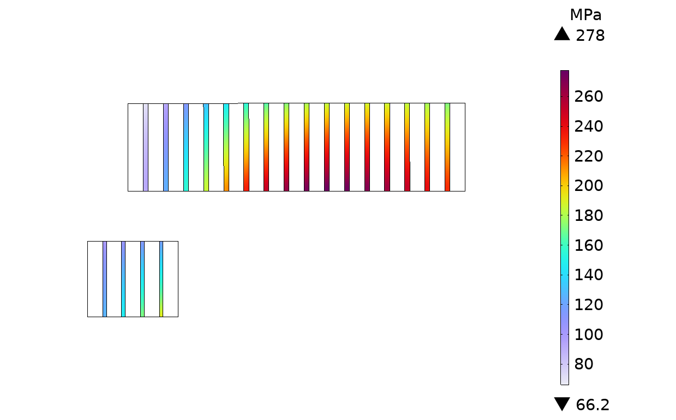
B5-DEMO MAG 2.3: Mechanical analysis results
Free radial expansion
Coil Hoop Stress
Coil Radial Stress
Von Mises Stress SS spacers
Minimum ext. pressure:
Radial stress < 1MPa,
Hoop stress > 0 in operation
Radial precompression
Radial pressure applied on the external coil boundary:
10 MPa on Coil1
60MPa on Coil2
Coil Hoop Stress
Coil Radial Stress
Von Mises Stress SS spacers

Slide 8
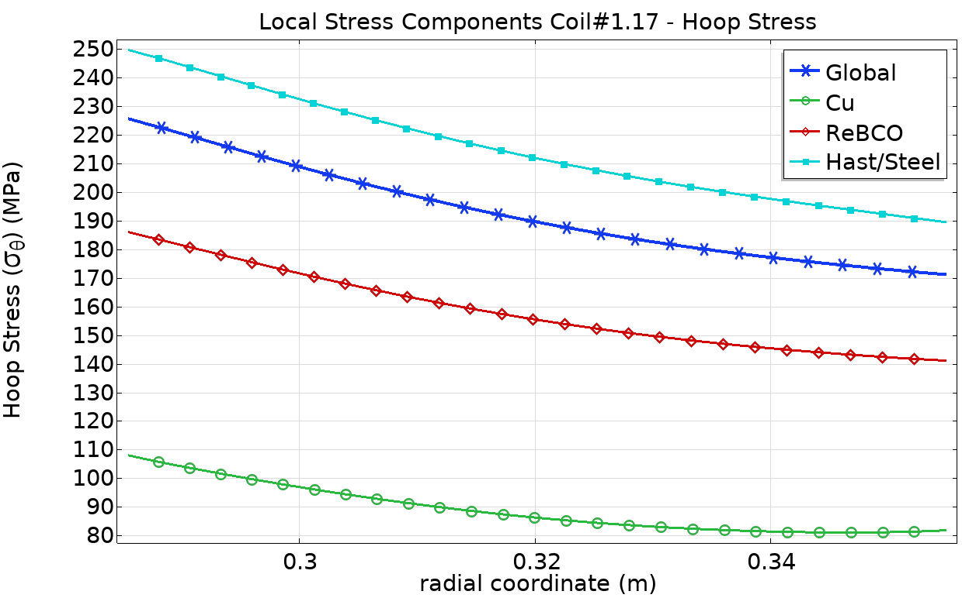

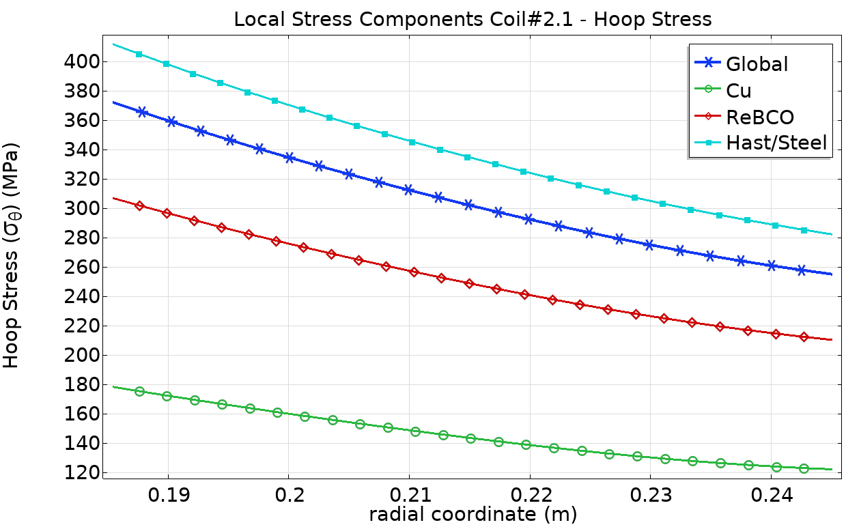
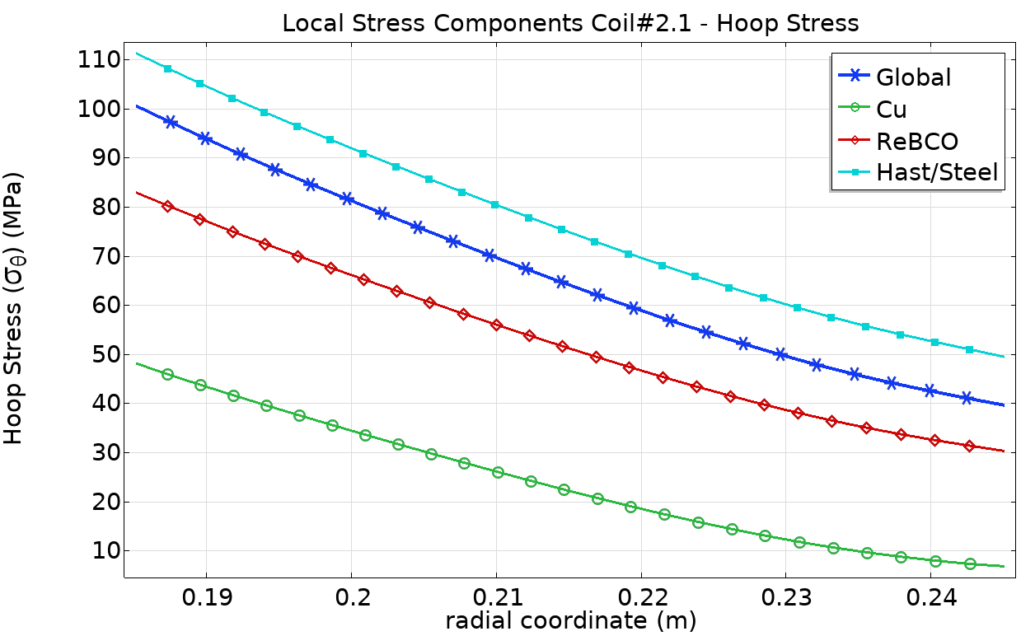
B5-DEMO MAG 2.3: Local Stress Components
Coil#1.17
Coil#1.17
Coil#2.1
Evaluate the local stress components on the most loaded coils.
Free radial expansion
Pre-compression
Coil#2.1

Slide 9
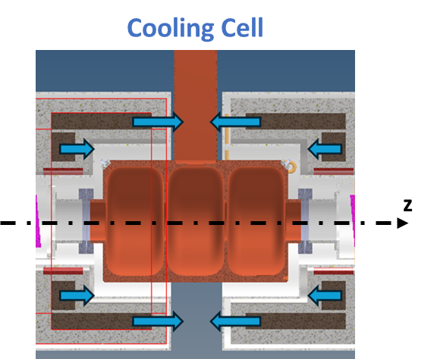
B5-DEMO MAG 2.3 :
Magnets Main Parameters
B5-DEMO MAG 2.3
J_eng Coil1/Coil2 (A/mm^2) | 328.6 / 299.8
B2/B1 (%) | 14.9
Focusing strength per cell length (T^2*m/m) | 24.0
Axial Force on Coil1/Coil2 (MN) | +4.12 / +8.25
Net Axial Force (MN) | +12.4
Net Torque applied on centroid of forces (MN*m) | -0.558
Peak Hoop Stress on Coil1/Coil2 (MPa) | +231 / +374
Peak Positive Radial Stress on Coil1/Coil2 (MPa) | +1.77 / +9.48
Peak Von Mises Stress on SS spacers (MPa) | +353 / +508
Magnetic Energy Density Coil1/Coil2 (MJ/m^3) | 148.7 / 92.92
Total HTS length (full cell) (km) | 71.2
Coil Current Coil1/2 (A) | 620.0 / 565.4
Note: peak stress values referred to radially unconstrained coils.

Slide 10
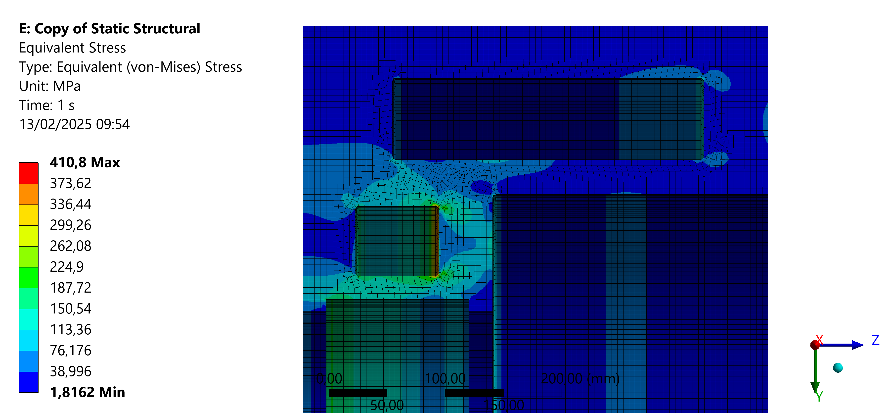
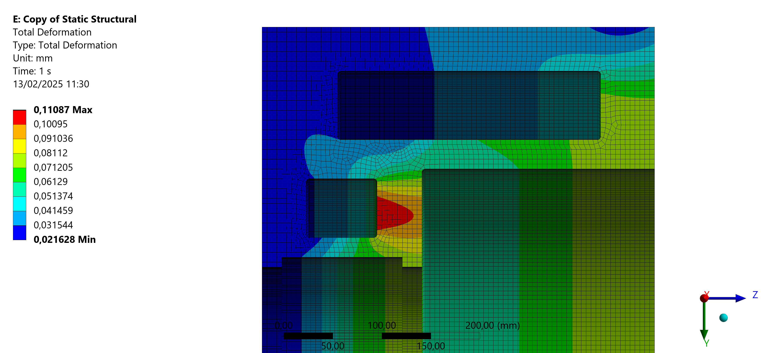
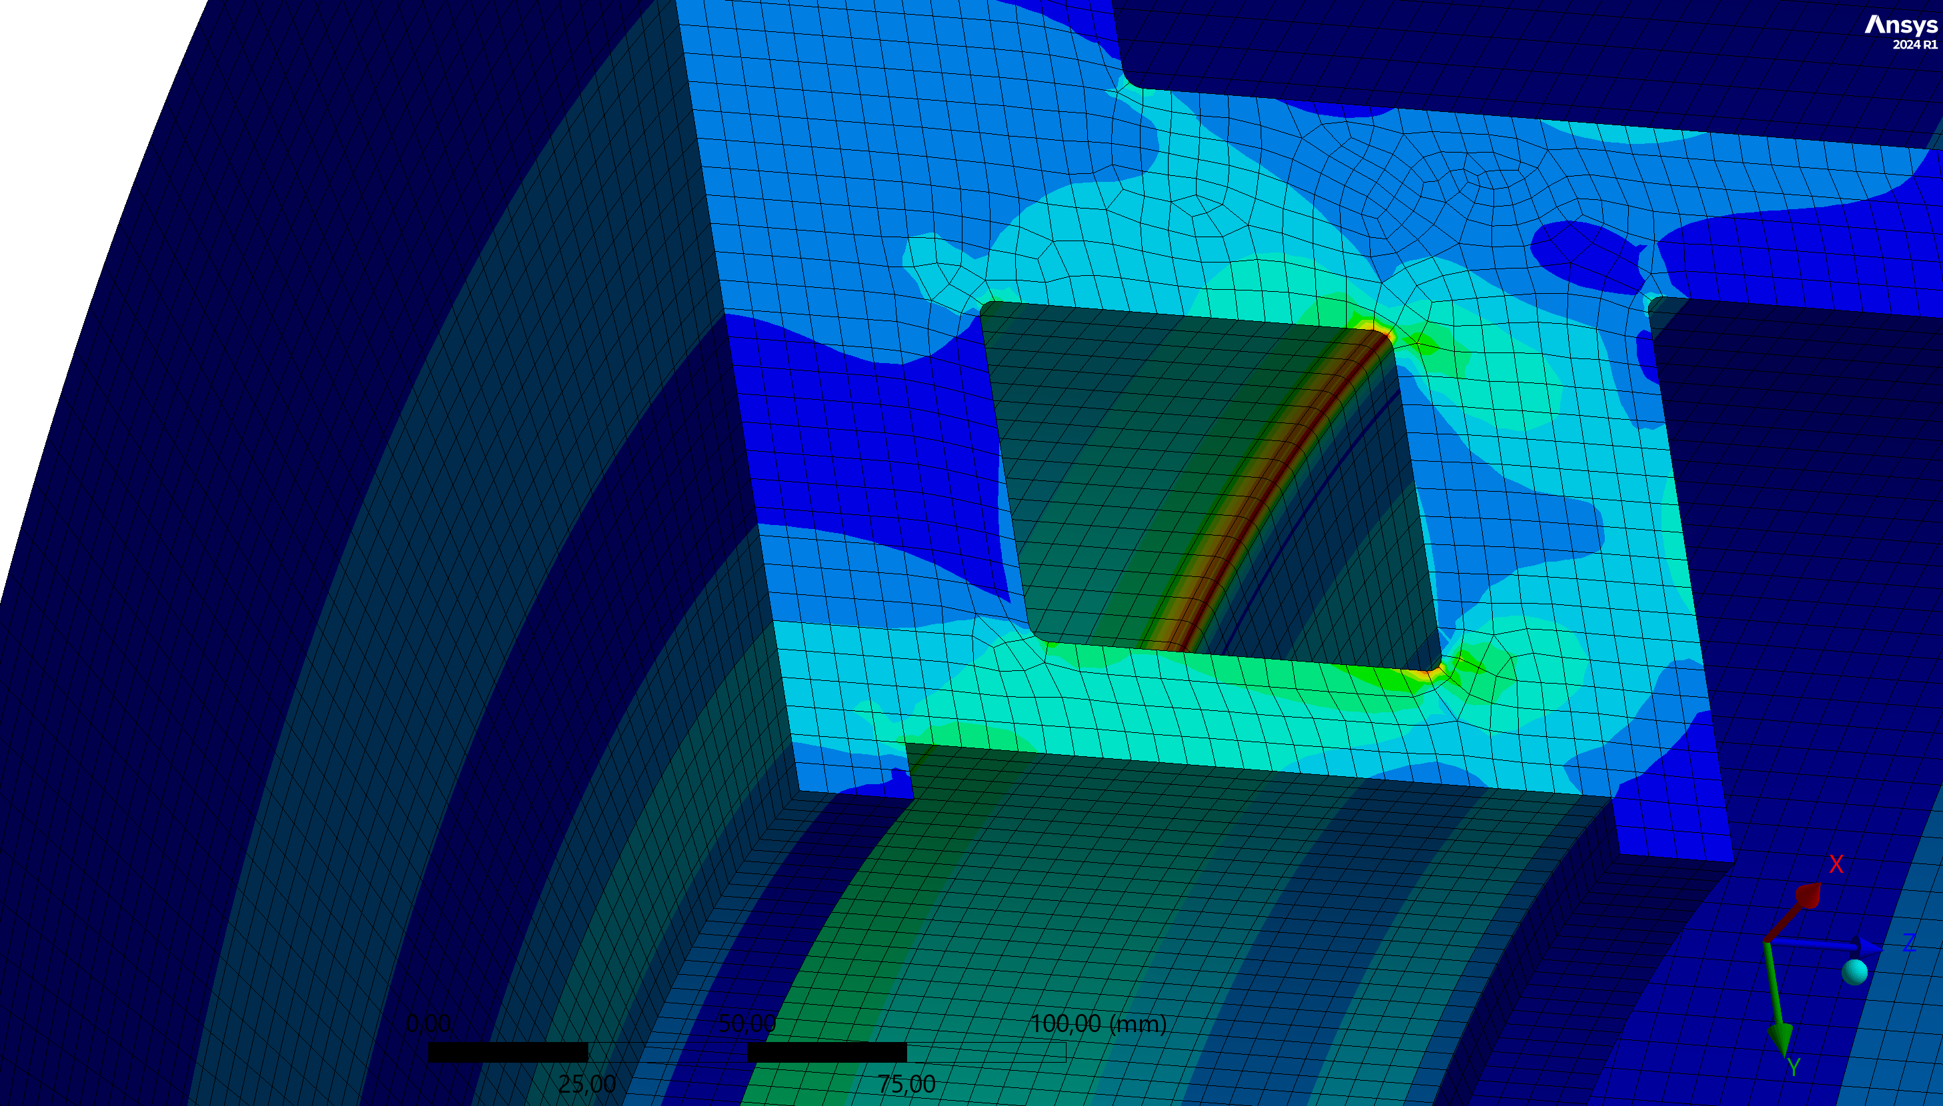
B5-DEMO MAG 2.3: Coil Support Structure
Von Mises Stress
Total Deformation
Mechanical analysis of the coil support structure in lattice operation

Slide 11
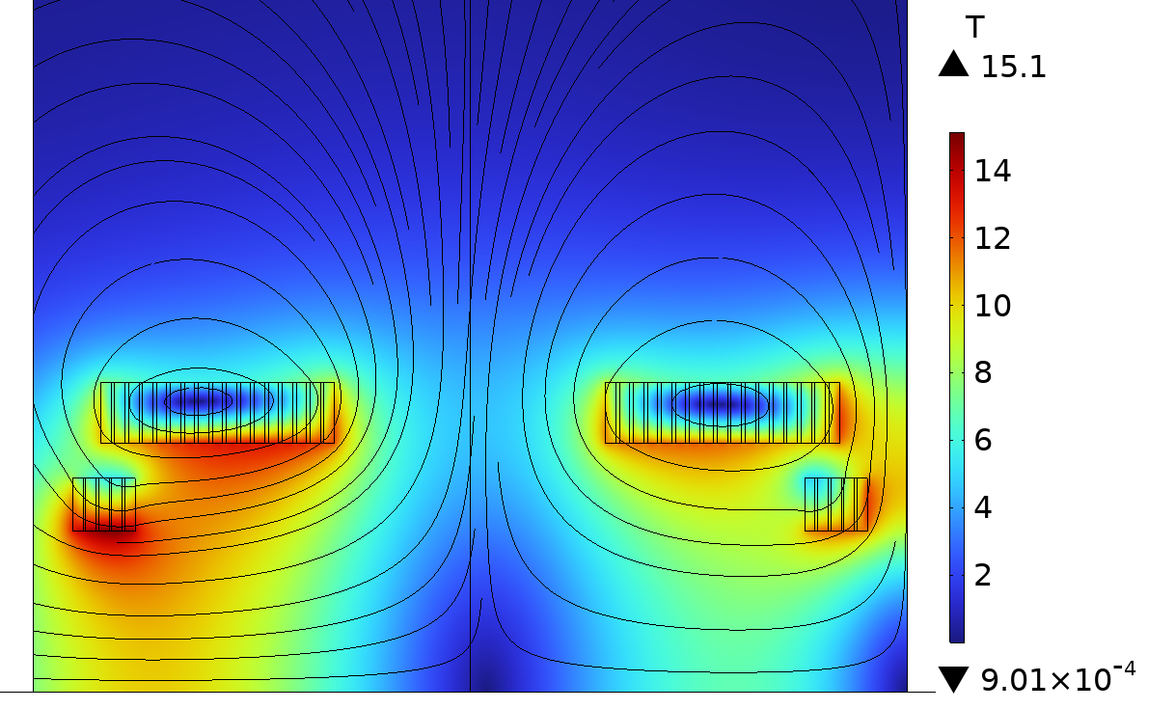
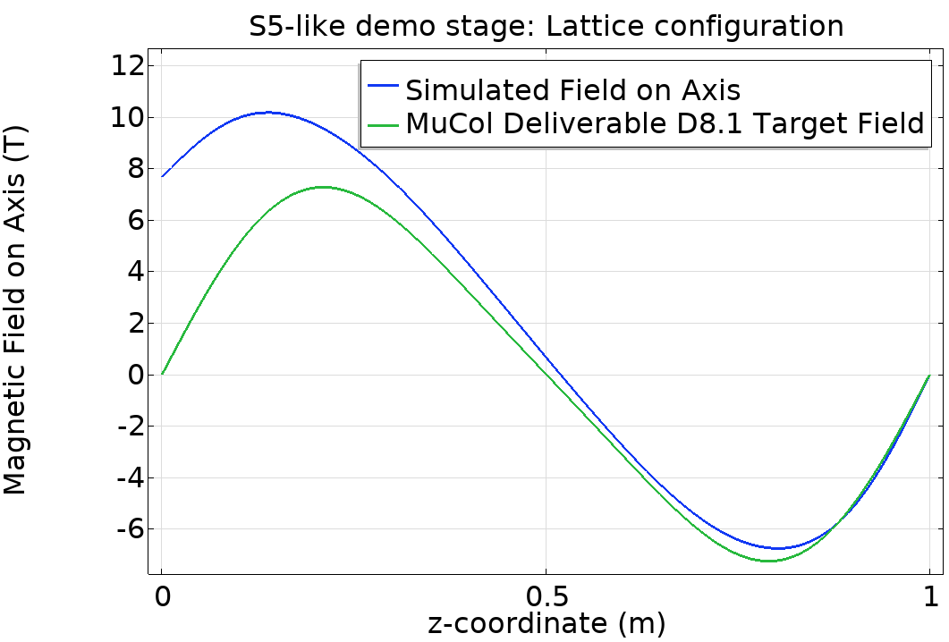
First Stage Evaluation:
EM Analysis Results at full current
Peak Field >> Target
Begin of Cell
6D lattice
R
z

Slide 12
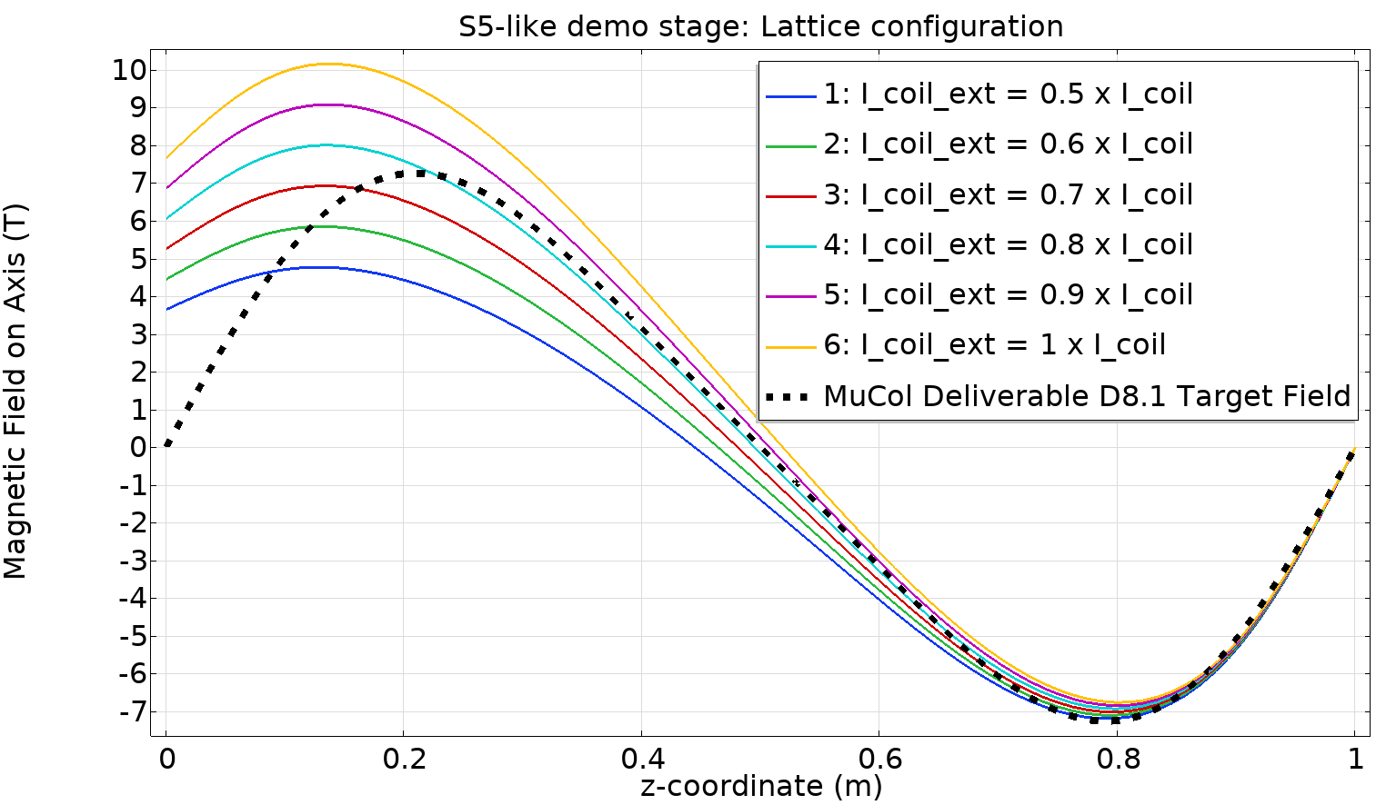
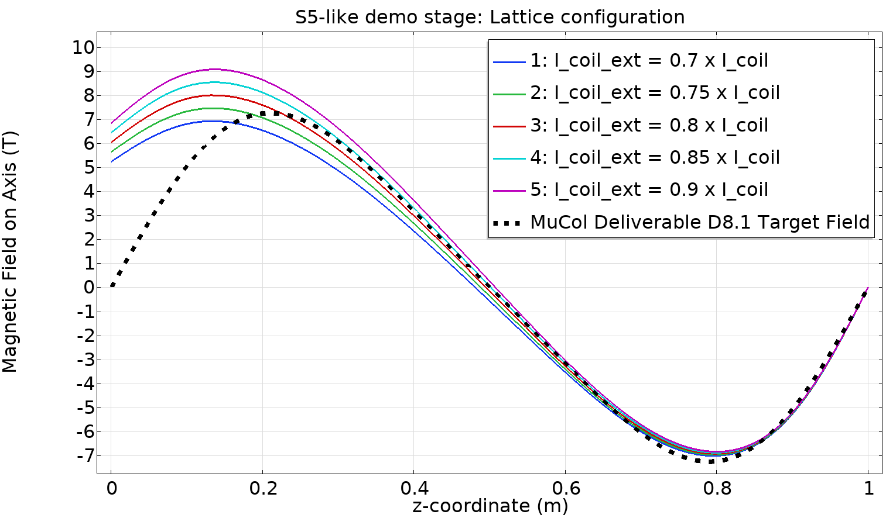
First stage evaluation: reduced current on external coils
~ Target Peak Field
Parametric sweep of the currents in Coil#1, Coil#2 facing the “beginning of cell” side.
0.1 x I_coil steps: 0.5 – 1.0 range
Parametric sweep of the currents in Coil#1, Coil#2 facing the “beginning of cell” side.
0.05 x I_coil steps: 0.7 – 0.9 range

Slide 13
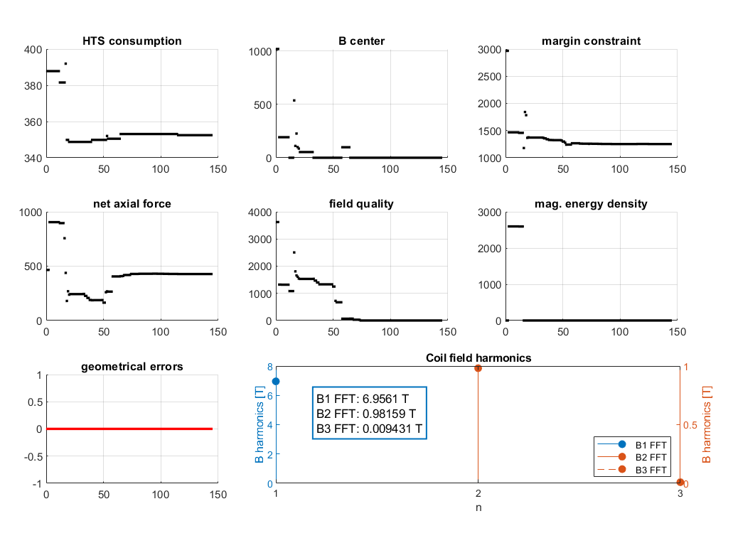
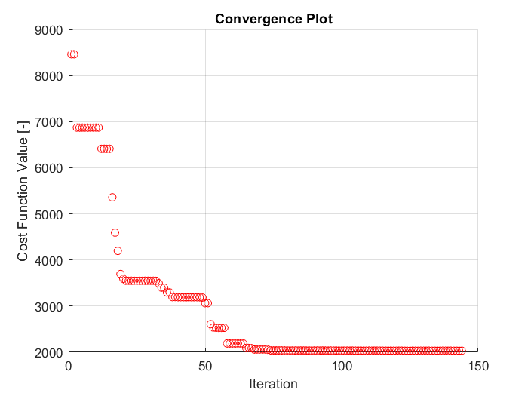
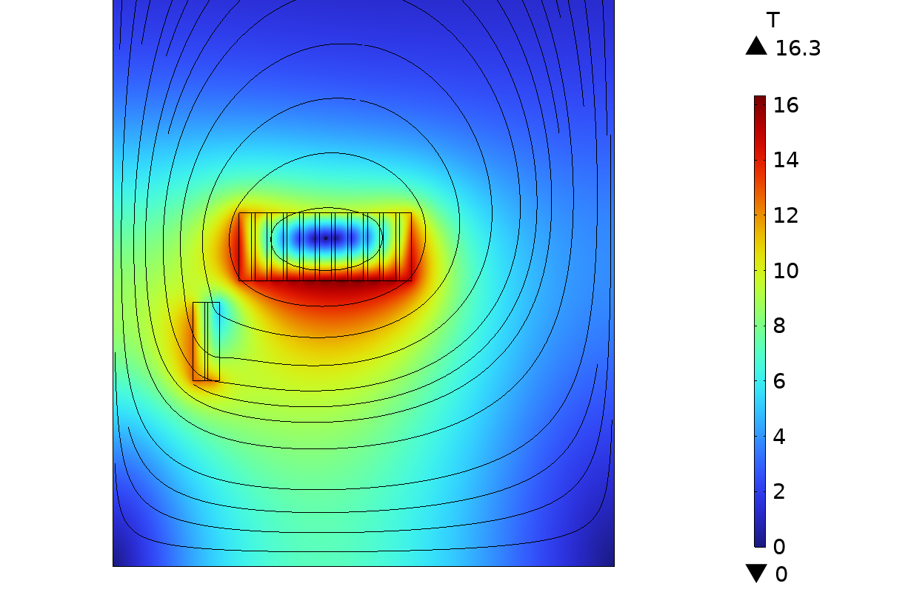
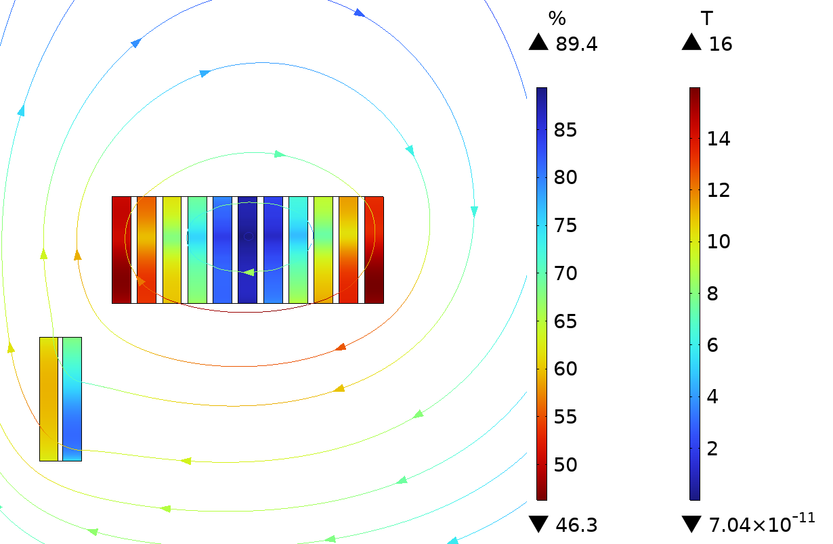
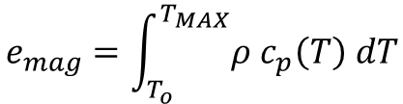
Coil Search Scheme Update: Optimization Tool
Cost Function parameters
Coil configuration search via optimization methods (gradient-based / genetic algorithms).
Conflict between different optimization targets → objective weighting.
Re-evaluate the 150 MJ/m^3 limit for magnet protection: consider thermal stability during charging/discharge transients.
As a first approximation, we are considering the enthalpy increase to reach the limit temperature of 200 K.
In case of quench, assuming the energy of the magnet is dissipated uniformly in the entire volume, we get:
However, this hypothesis may lead to non-conservative results for NI-coils.
$$e_{mag}=\int_{T_{o}}^{T_{MAX}}{ρ c_{p}\left(T\right) dT}$$
Ongoing discussion on better criteria to use

Slide 14

Optimization Tool: Cost Function Definition
Optimization with patternsearch(), Matlab built-in function. Cost function is:
$$J= J_{HTS}+J_{f.q.}+J_{B}+J_{margin}+J_{Fz}+ J_{Emag}+ J_{geo}$$
Higher weight has been given to the field harmonic constraints and peak field on axis. For the iterations with the 150MJ/m3 limit, to find solutions within this energy density value a higher cost has been used for $J_{Emag}$.
High cost on the polynomial definition of geometrical constraints, to be sure that no solutions outside the space available are considered.
Geometrical Constraints
Cost of tape consumption
Cost on mag. energy density
Field harmonics constraints
B peak on axis constraint
Cost on margins
Cost on Axial Forces

Slide 15
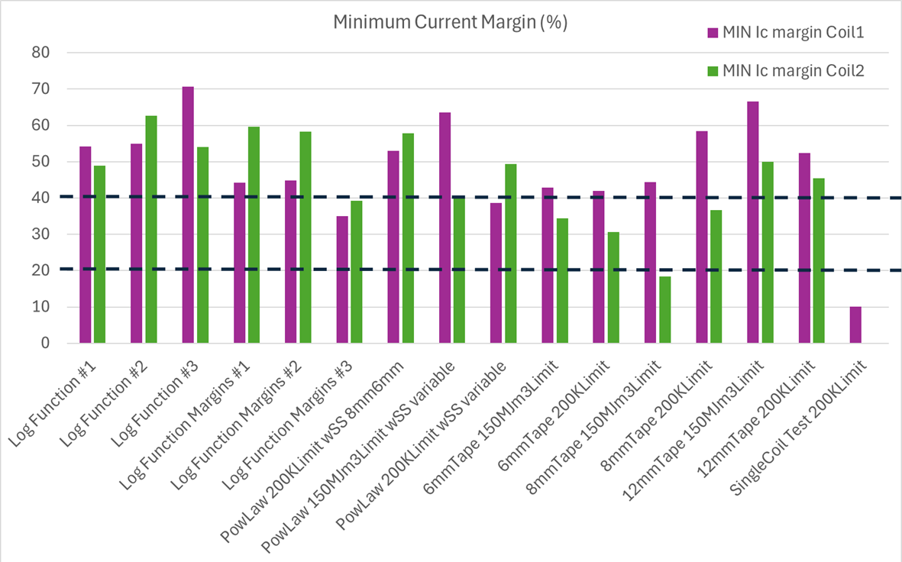
Coil Search Scheme: Results Comparison (I)

Slide 16
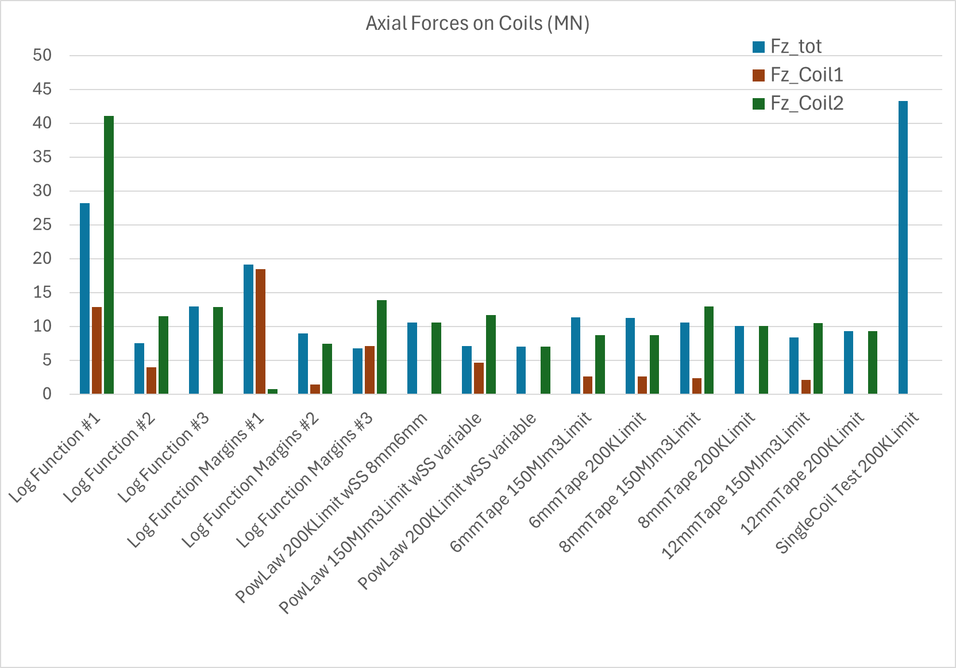
Coil Search Scheme: Results Comparison (II)

Slide 17
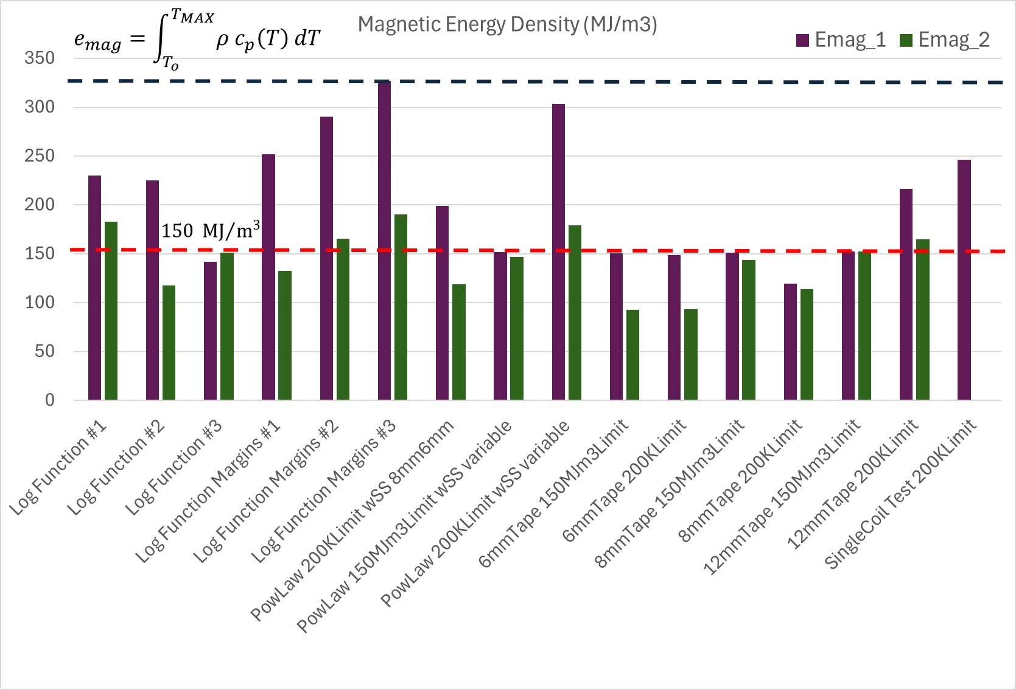
Coil Search Scheme: Results Comparison (III)

Slide 18
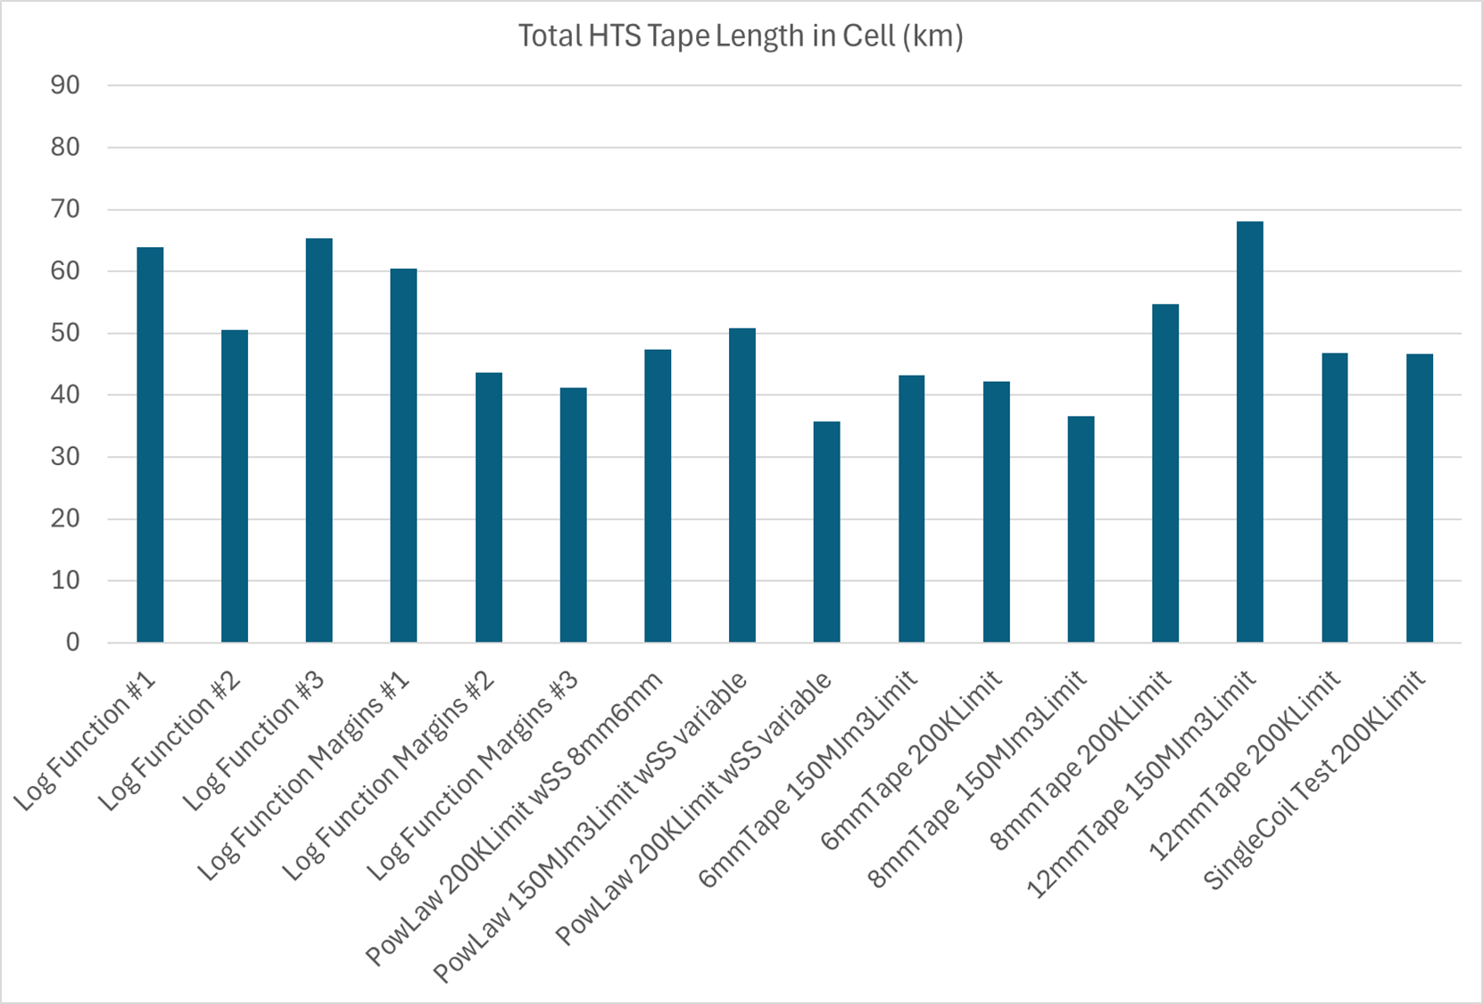
Coil Search Scheme: Results Comparison (IV)
Results in equivalent 12 mm tape length

Slide 19

Summary Table: Margins
B5-DEMO MAG 2.4
 | Current Margin (%) | Temperature Margin (K) | Load-line Margin (%)
12 mm tape 150 MJ/m³ Limit | 40.4 | 13.2 | 19.6
12 mm tape 200K Limit | 38.7 | 12.8 | 20.4
8 mm tape 200K Limit | 37.1 | 12.4 | 19.0
6 mm tape 150 MJ/m³ Limit | 34.6 | 11.5 | 18.3
6 mm tape 200K Limit | 31.1 | 10.0 | 14.8
12MN-40mm gap Option | 68.6 | 27.2 | 48.6
Conductor Section
SS tape: $26 μm$
Target minimum temperature margin > 10K
HTS
HTS

Slide 20
Configuration Comparison: Summary Table
B5-DEMO MAG 2.4
 | Coil Current Coil1/Coil2 (A) | SS spacer width Coil1/Coil2 (mm) | Axial Force on Coil1/Coil2 (MN) | Net Axial Force (MN) | Net Torque applied on centroid of forces (MN*m) | Peak Hoop Stress on Coil1/Coil2 (MPa) | Peak Positive Radial Stress Coil1/Coil2 (MPa) | Peak Von Mises Stress on SS spacers (MPa) | Magnetic Energy Density Coil1/Coil2 (MJ/m^3) | Total HTS tape length (full cell) (km)
12 mm tape 150 MJ/m³ Limit | 761.2 1193 | 7.9 13.7 | -4.61 11.7 | 7.09 | -0.319 | 207 435 | 3.50 9.51 | 560 | 151.7 147.0 | 50.9
12 mm tape 200K Limit | 1132 957.8 | 4.7 2.0 | -0.010 7.13 | 7.12 | -0.202 | 391 573 | 9.96 12.2 | 749 | 303.1 179.3 | 35.7
8 mm tape 200K Limit | 582.8 828.3 | 12.5 13.1 | 0.069 10.1 | 10.2 | -0.768 | 170 380 | 2.26 8.37 | 525 | 119.4 113.8 | 54.7
6 mm tape 150 MJ/m³ Limit | 566.5 669.6 | 11.3 14.8 | 2.66 8.72 | 11.4 | -0.347 | 208 332 | 3.65 7.37 | 454 | 150.5 92.99 | 43.4
6 mm tape 200K Limit | 575.7 707.6 | 11.7 15.7 | 2.61 8.73 | 11.3 | -0.371 | 205 321 | 3.56 6.96 | 453 | 148.4 93.47 | 42.2
12MN-40mm gap Option | 620.0 565.4 | 4.00 3.00 | +4.12 +8.25 | +12.4 | -0.558 | +231 +374 | +1.77 +9.48 | +353 +508 | 148.7 92.92 | 71.2

Slide 21
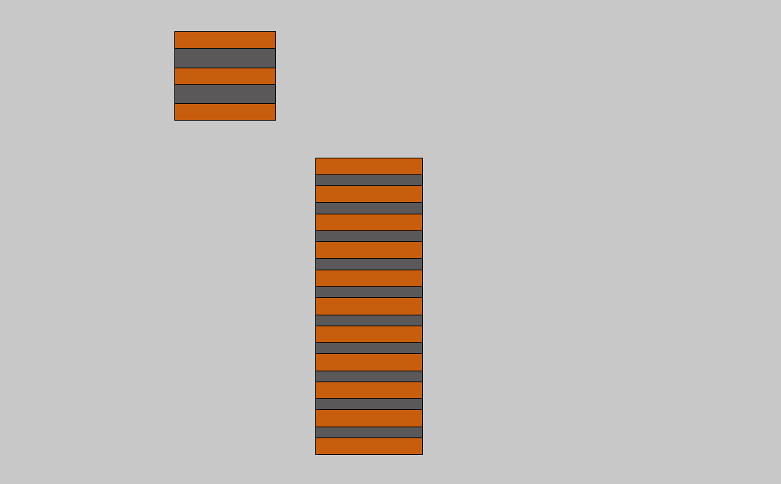
New B5-DEMO MAG 2.4 configuration
Engineering current density:
Coil 1: 403.51 A/mm^2,
N. turns = 485
Coil 2: 632.31 A/mm^2,
N. turns = 456
Conductor Section
N. pancakes: 11
SS tape: $26 μm$
Coil 1
211 mm
HTS
146.25 mm
76.19 mm
HTS
12 mm
N. pancakes: 3
7.9 mm
56.422 mm
63.4 mm
Coil 2
Conductor section:
2 X HTS tape (12mm x 0.0656mm)
1 X SS tape (12mm x 0.026mm)
71.67 mm
R = 285 mm
R
13.7 mm
12 mm
R = 185 mm
Spacers:
Coil 1: 7.9 mm SS spacers
Coil 2: 13.7 mm SS spacers
z
z = 0mm at cell boundary

Slide 22
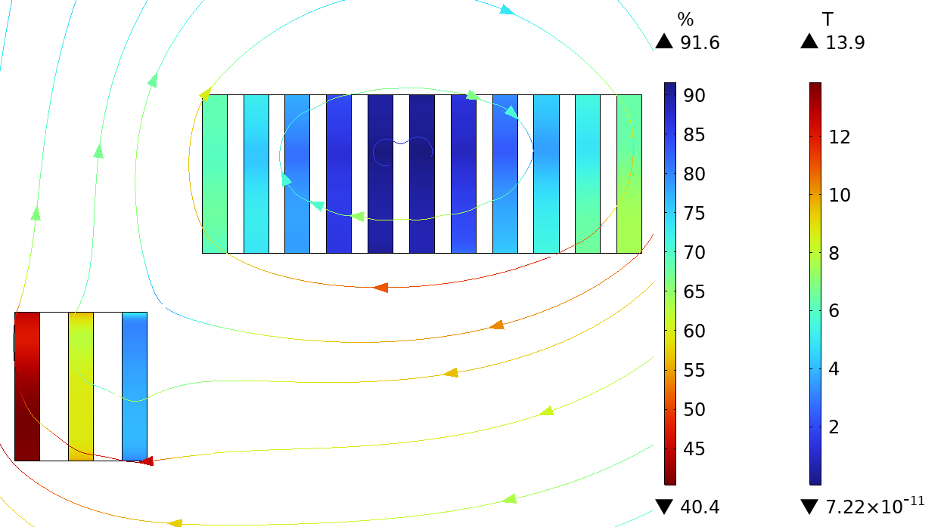

B5-DEMO MAG 2.4: EM analysis results
$$Ic margin=\left(1−\frac{I}{I_{c}}\right) \%$$
 | Current Margin (%) | Temperature Margin (K) | Load-line Margin (%)
12 mm tape 150 MJ/m³ Limit | 40.4 | 13.2 | 19.6

Slide 23
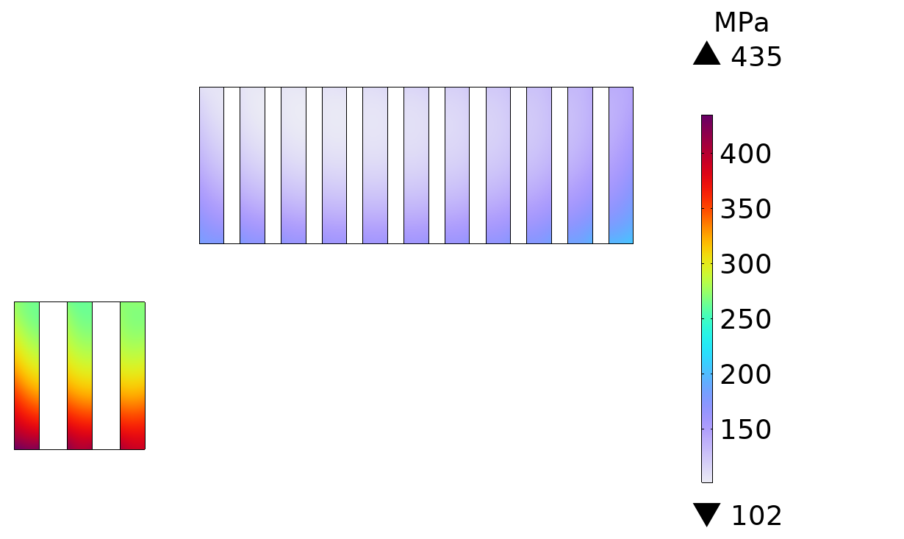
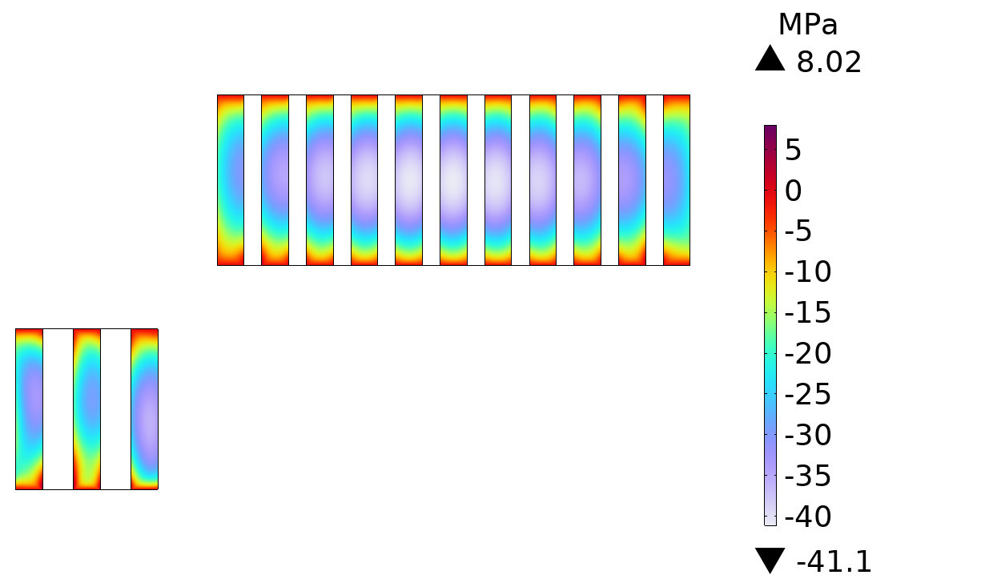
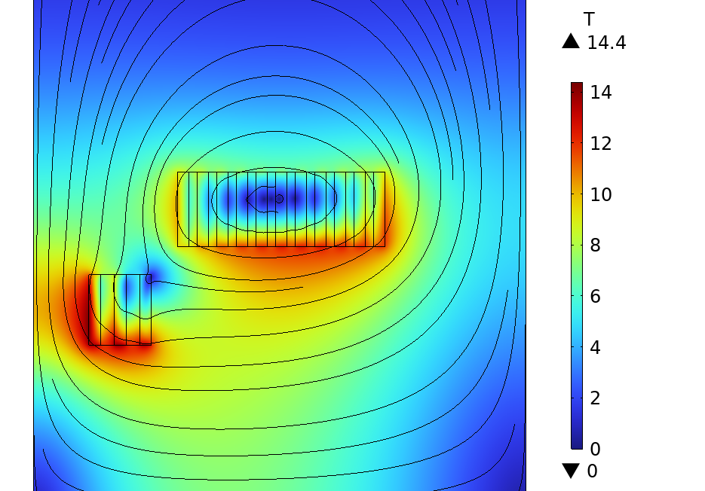
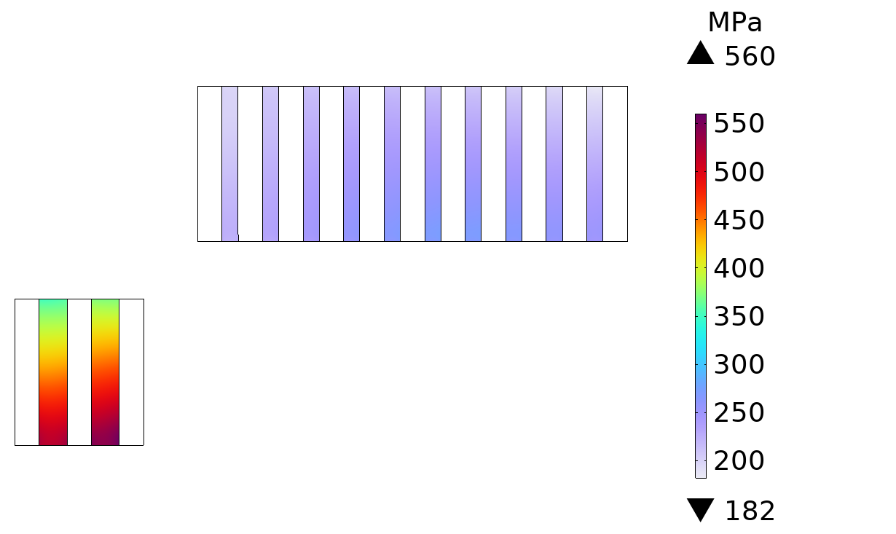


B5-DEMO MAG 2.4: Mechanical analysis results
$$4.61 MN$$
Coil Hoop Stress
Coil Radial Stress
$$11.7 MN$$
Free radial expansion
Von Mises Stress SS spacers

Slide 24
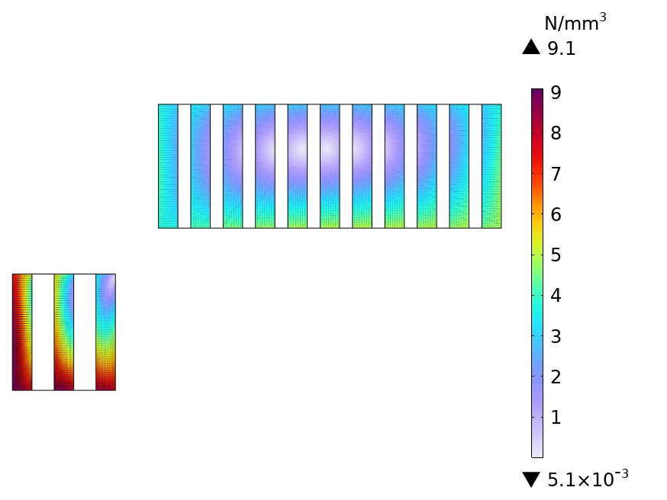
Lorentz force distribution on the coil pancakes
Coil 1.1
Coil 1.11
Coil 2.1
Coil 2.3
5.55 MN
-6.28 MN
R
7.16 MN
z

Slide 25
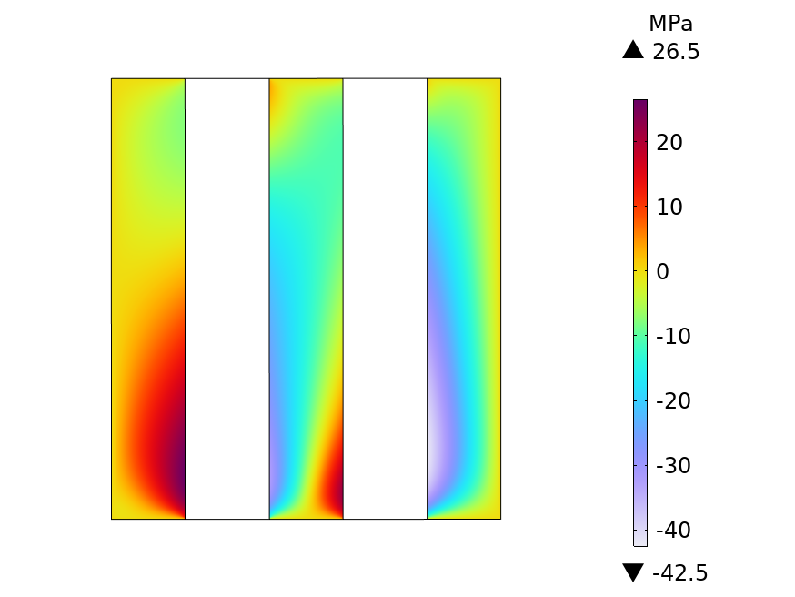
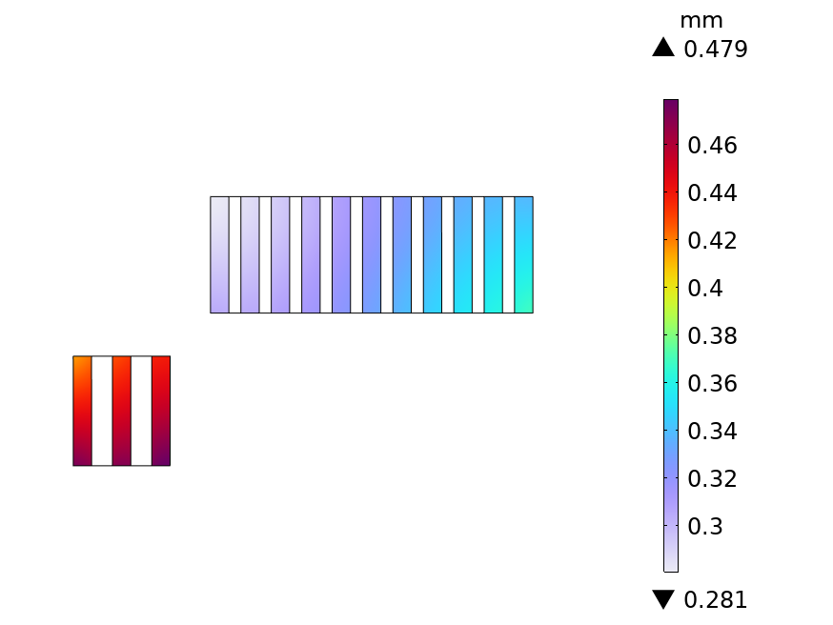

Note: Coil + Spacers model - contact stabilization & friction
Shear Stress, Coil 2
Zoom on radial displacement magnitude
+ deformation
Radial Displacement Magnitude
Shear Stress on Coil Boundary
Pressure applied on Coil Boundary
Radial displacement values differs from the stabilized models and rigid SS spacers approximation.
Bonded contact hypothesis non verified !!
Model inter-turn contact to evaluate the single turn mechanical behavior

Slide 26
B5-DEMO MAG 2.4 :
Magnets Main Parameters
B5-DEMO MAG 2.4
J_eng Coil1/Coil2 (A/mm^2) | 403.5 / 632.3
B2/B1 (%) | 14.3
Focusing strength per cell length (T^2*m/m) | 25.9
Axial Force on Coil1/Coil2 (MN) | -4.61 / +11.7
Net Axial Force (MN) | +7.09
Net Torque applied on centroid of forces (MN*m) | -0.319
Peak Hoop Stress on Coil1/Coil2 (MPa) | +207 / +435
Peak Positive Radial Stress on Coil1/Coil2 (MPa) | +3.50 / +9.51
Peak Von Mises Stress on SS spacers (MPa) | +273 / +560
Magnetic Energy Density Coil1/Coil2 (MJ/m^3) | 151.7 / 147.0
Total HTS length (full cell) (km) | 50.9
Coil Current Coil1/2 (A) | 761.2 / 1193
Note: peak stress values referred to radially unconstrained coils.

Slide 27



B5-DEMO MAG 2.4: Coil Support Structure
Displacement Magnitude
Von Mises Stress
NOTE: Strong axial forces with opposed directions!!!
Peak Von Mises Stress: 648 MPa
4.61 MN
11.7 MN

Slide 28


Rough estimate of dipole dimensions
Data to be checked with more detailed analyses.
same polarity on both dipoles: consider a single dipole magnet across the absorber wedge.
saddle coil option
Dipole dimensions:
Inner radius: 140 mm
Radial thickness: 15 mm
Axial length: 236 mm (maximum length available for the inter-cell layout).
Number of turns: 30
Current: 629.6 A
Dipole z center position at the center of the absorber wedge.

Slide 29
Backup

Slide 30

Gradient-based Optimization

Slide 31

Coil Search Scheme: Results Comparison (IV)
Results NOT normalized in terms of equivalent 12 mm tape

