Slide 1
Progress update
Presented by : Manal Karmoude
Presented on : 28/03/2025

Slide 2
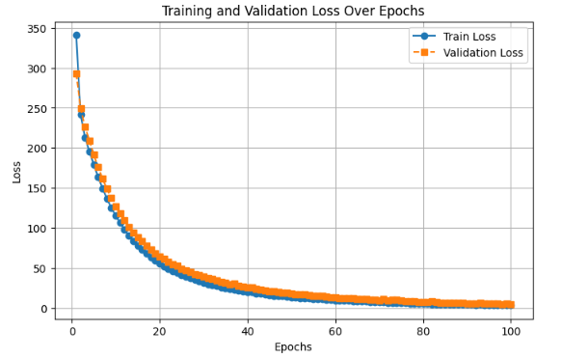
CNN-LSTM : Training and Validation Loss Over Epochs
1

Slide 3
Weather Data Collection
- I collected weather data from Open-Meteo for 6 selected stations. These stations were chosen based on the minimal number of missing values to ensure data quality.
- I then merged our original dataset with the weather data. The selected features include:
temperature_2m, surface_pressure, wind_gusts_10m, wind_speed_100m, wind_direction_100m, relative_humidity_2m, wind_direction_10m, wind_speed_10m, cloud_cover, cloud_cover_high, cloud_cover_mid, cloud_cover_low, weathercode, rain, precipitation.
2

Slide 4
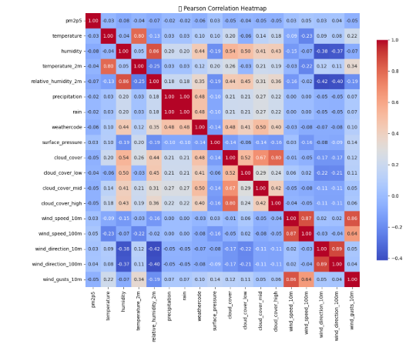
Feature Correlation with PM2.5
3

Slide 5
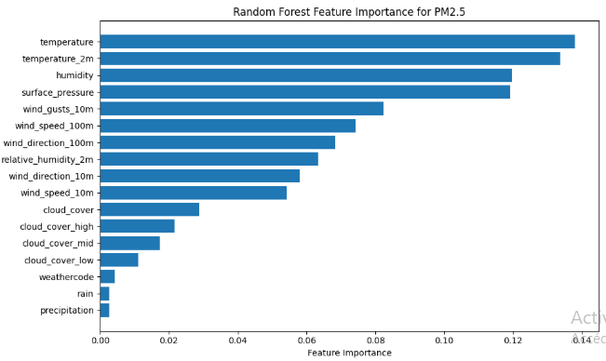
Random Forest Feature Importance for PM2.5
4

Slide 6
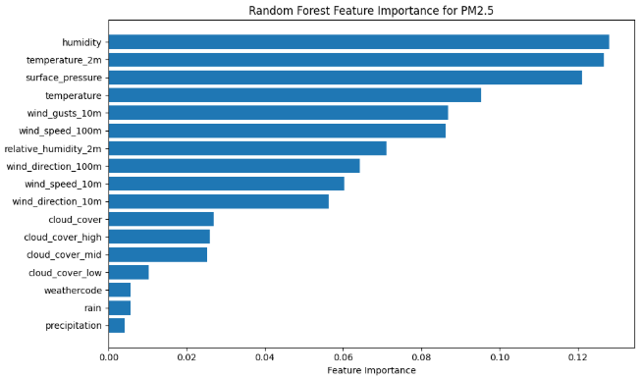
Random Forest Feature Importance for PM2.5 for another station
5

Slide 7
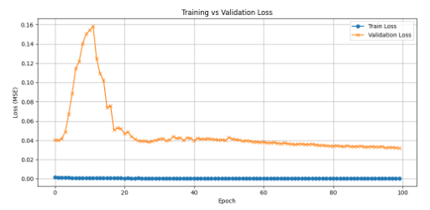
Model Training Performance : ConvLSTM : New Architecture
- This model is less complex than CNN-LSTM
6

Slide 8
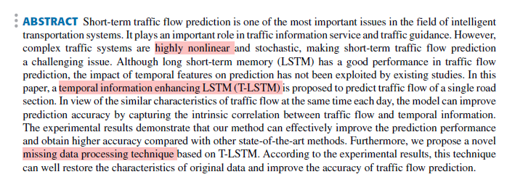
T-LSTM: A Long Short-Term Memory Neural Network
- they proposed a new model called T-LSTM that enhances the traditional LSTM by adding temporal information.
- the model can handle gaps in the data without needing interpolation, which is very useful in our case because we have too much missing values.
7

