Slide 1
Intra-Domain
Transfer Learning for Air Quality Forecasting
From PM2.5 to PM4.0

Slide 2
Background & Challenges
Air Quality Monitoring Challenges:
  Limited labeled data for some pollutants
  Complex spatio-temporal dependencies
Transfer Learning in Air Quality :
  Leverage learned representations from one pollutant to another
  Our previous work: Fine-tuned a model on PM2.5 data
Objective :
  Fine-tune the PM2.5 model to predict PM4.0 (intra-domain transfer)

Slide 3
Methodology Overview
Model Architecture:
GNN-LSTM hybrid (AdvancedTemporalGraphNetwork)
Captures spatial (GraphSAGE) and temporal (LSTM + attention) features
Training Process:
Pre-train and fine-tune on PM2.5
Further fine-tune on PM4.0 data (intra-domain transfer)
Data Preparation:
Time-series sequences (sequence length = 10)
Graph: single-node (univariate forecasting)

Slide 4
Intra-Domain Transfer Learning
Transfer Setup:
Start with PM2.5 fine-tuned model
Further fine-tune for PM4.0 prediction
Rationale:
PM2.5 and PM4.0 share similar emission sources and dynamics
Intra-domain transfer leverages shared spatio-temporal patterns

Slide 5
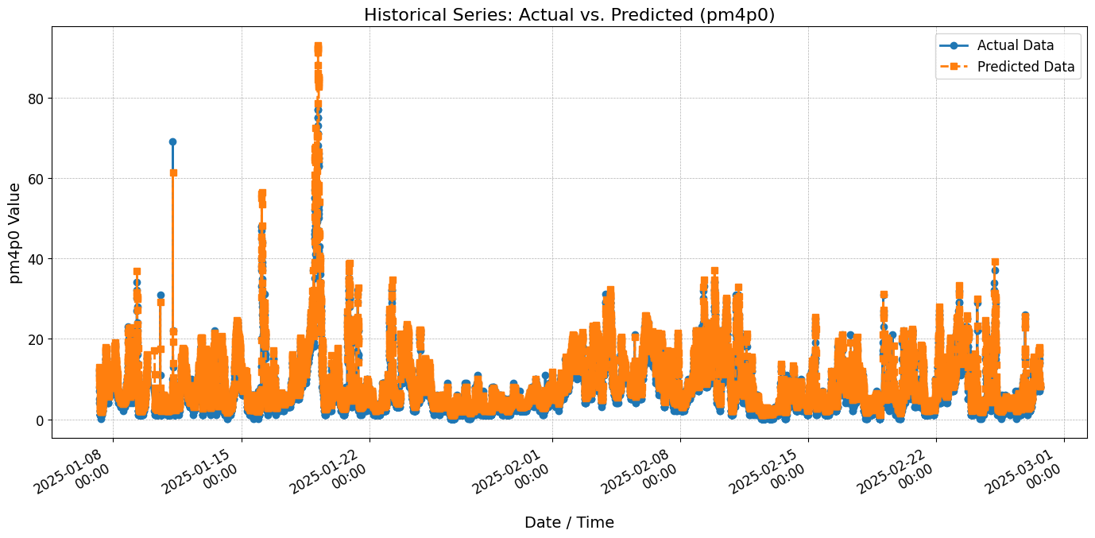
Result

