Slide 1






EXO-24-030: WH SUEP
Reinterpretation
04/01/2025
Zeynep Demiragli, Carlos Erice Cid, Gianfranco de Castro, Ryleigh Resendiz

Slide 2
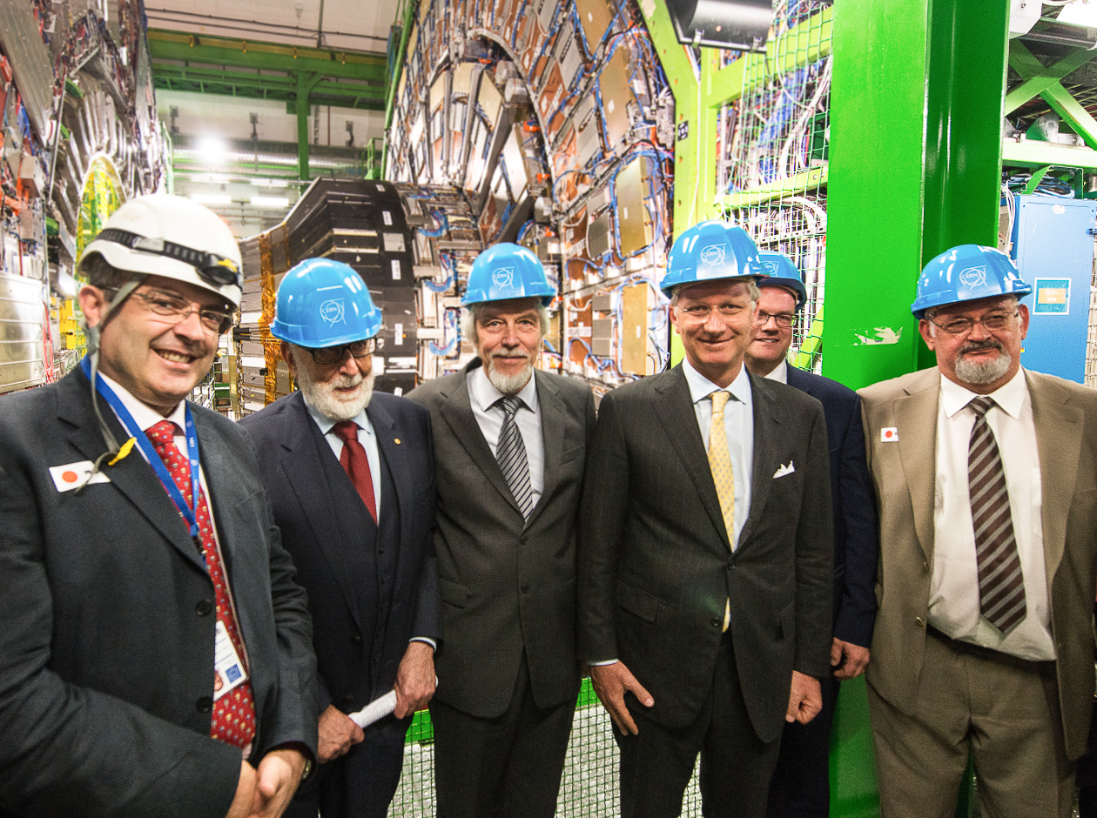


HAPPY BIRTHDAY TIZIANO

Slide 3
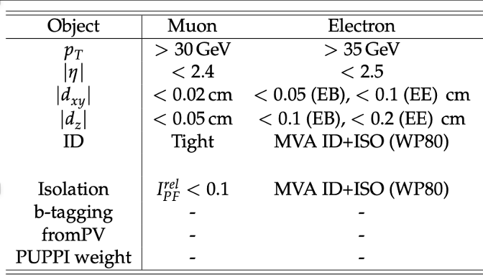
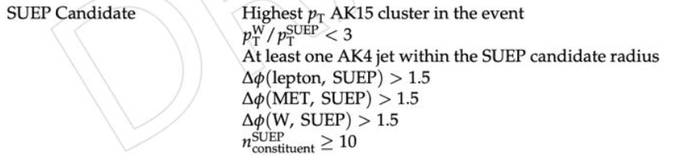
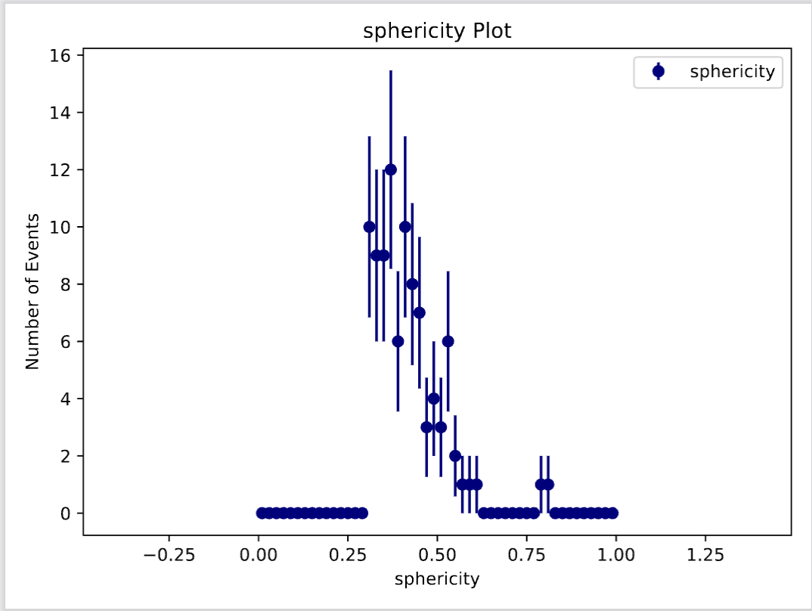
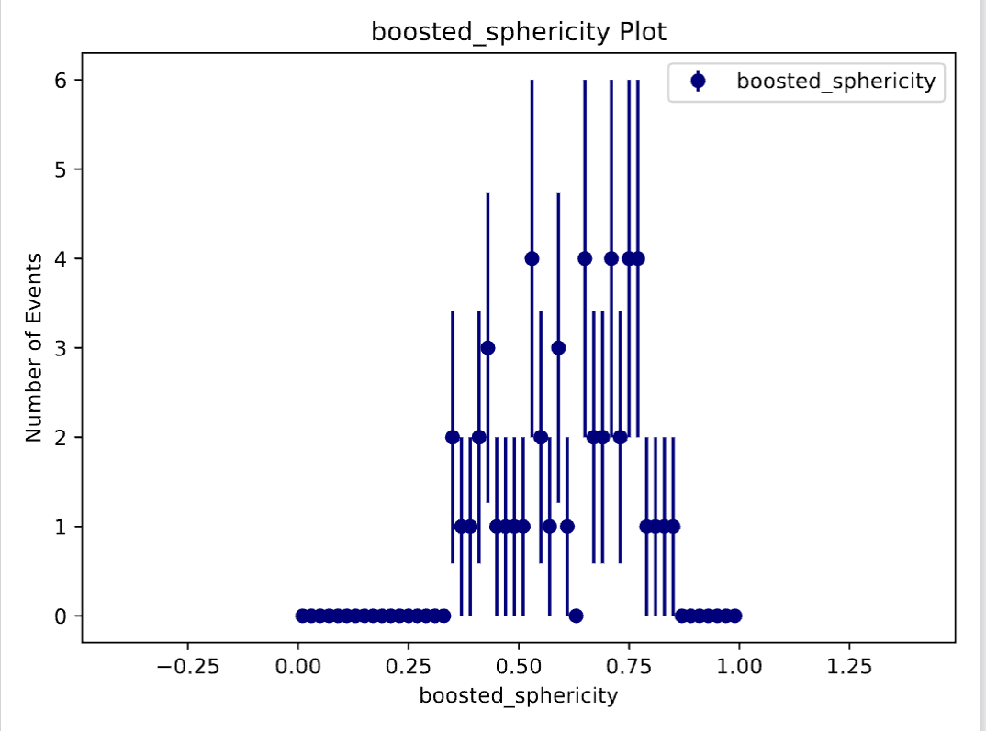
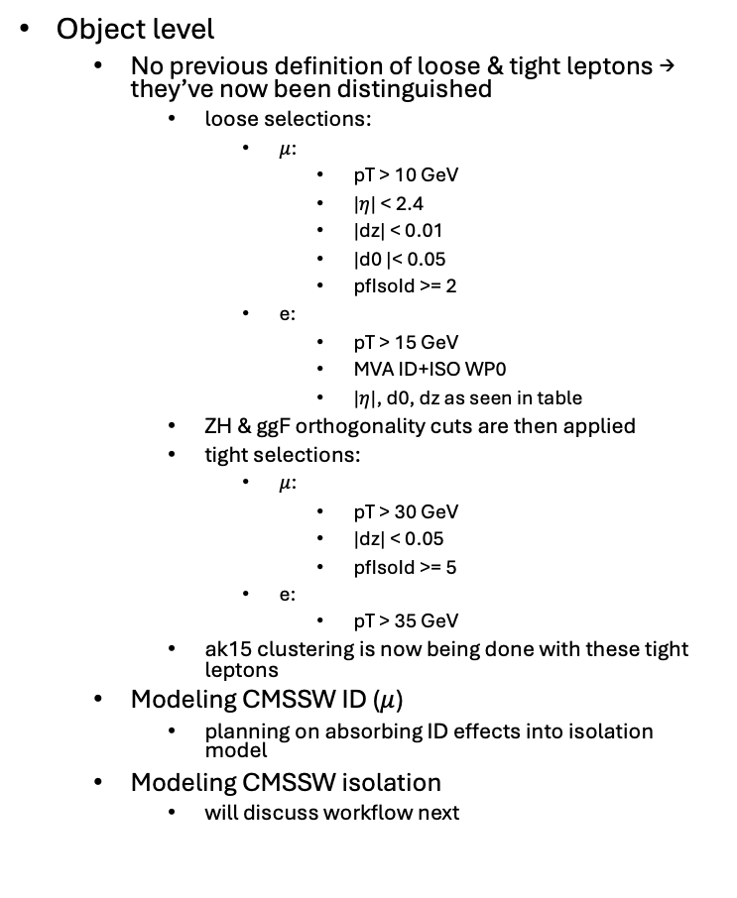
Added cuts & precisions
Object level
  No previous definition of loose & tight leptons → they’ve now been distinguished
    loose selections:
      $μ$:
        pT > 10 GeV
        |$η$| < 2.4
        |dz| < 0.01
        |d0 |< 0.05
        pfIsoId >= 2
      e:
        pT > 15 GeV
        MVA ID+ISO WP0
        |$η$|, d0, dz as seen in table
    ZH & ggF orthogonality cuts are then applied
    tight selections:
      $μ$:
        pT > 30 GeV
        |dz| < 0.05
        pfIsoId >= 5
      e:
        pT > 35 GeV
    ak15 clustering is now being done with these tight leptons
  Modeling CMSSW ID ($μ$)
    planning on absorbing ID effects into isolation model
  Modeling CMSSW isolation
    will discuss workflow next
Event level
  only keeping events with exactly one lepton*
  all cuts on the suep candidate have been added
  sphericity now boosted
    const boosted to cluster frame
  still missing: b-tagging
    currently: b-tag veto
    proposed plan: apply ZH mis-id rates

Slide 4
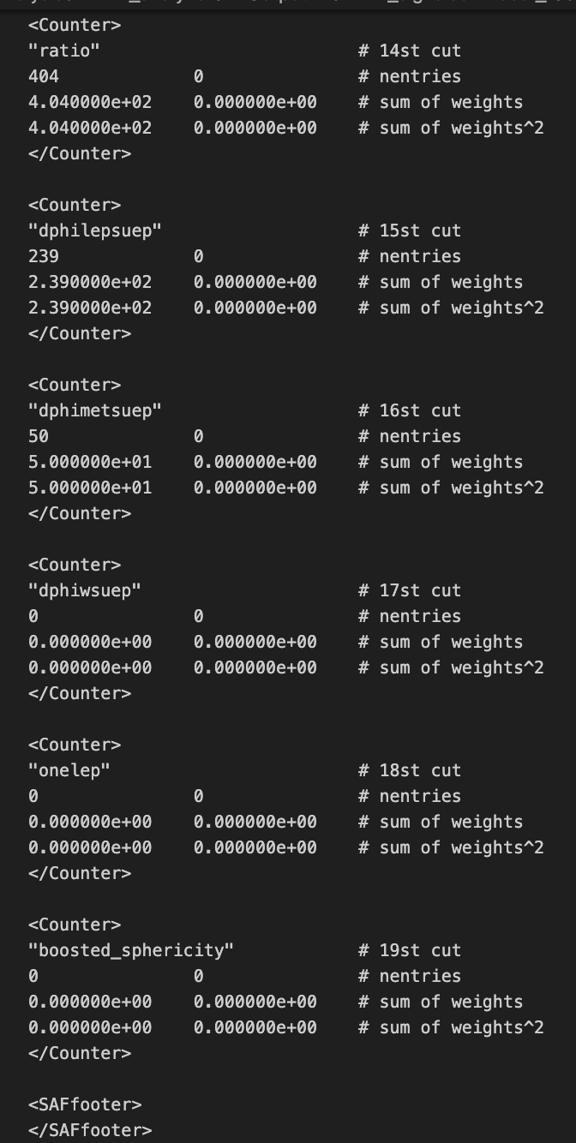

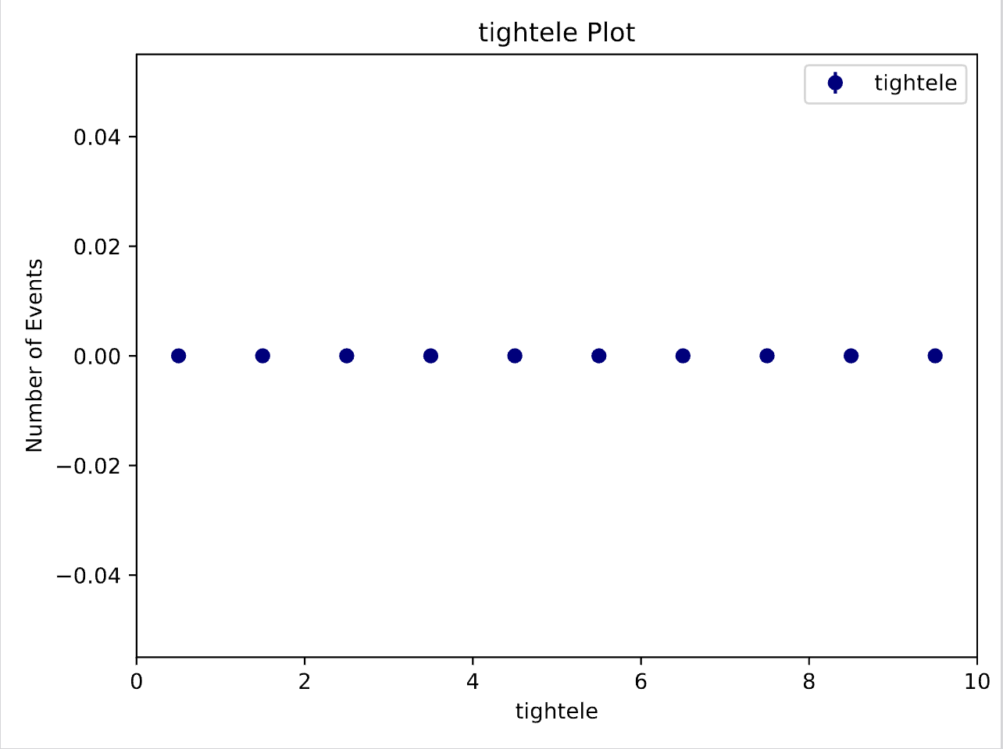
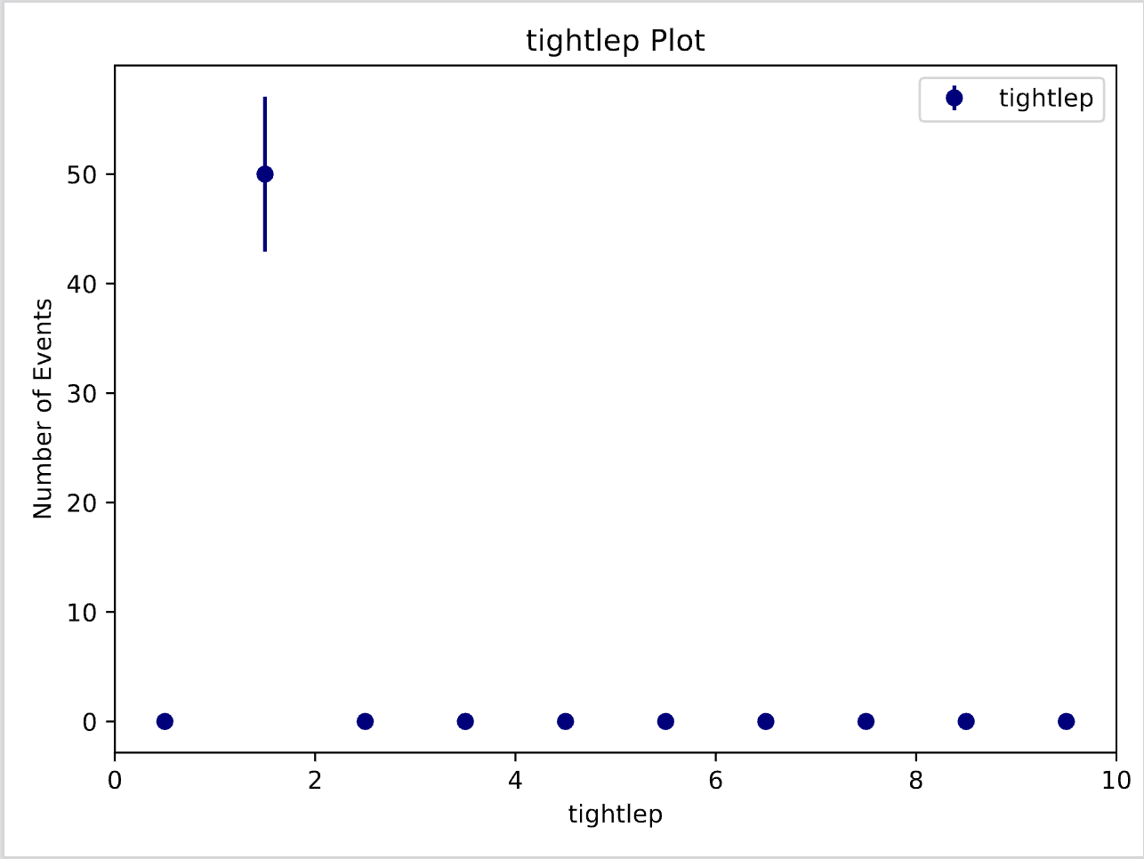
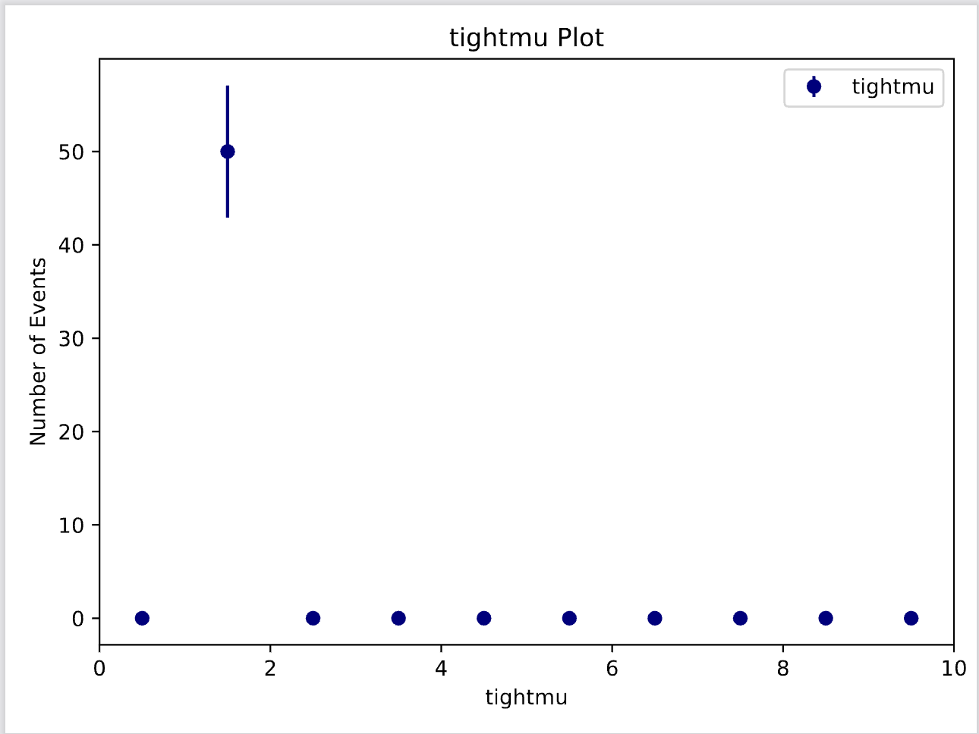
Everything broke. Again.
Spent weeks debugging iso function
Everything worked → added 1 lep cut & now broken
Somehow have ~no electrons in events

Slide 5
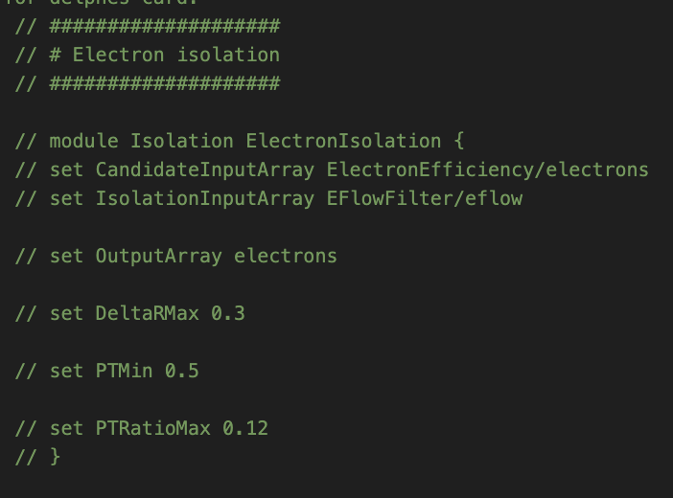
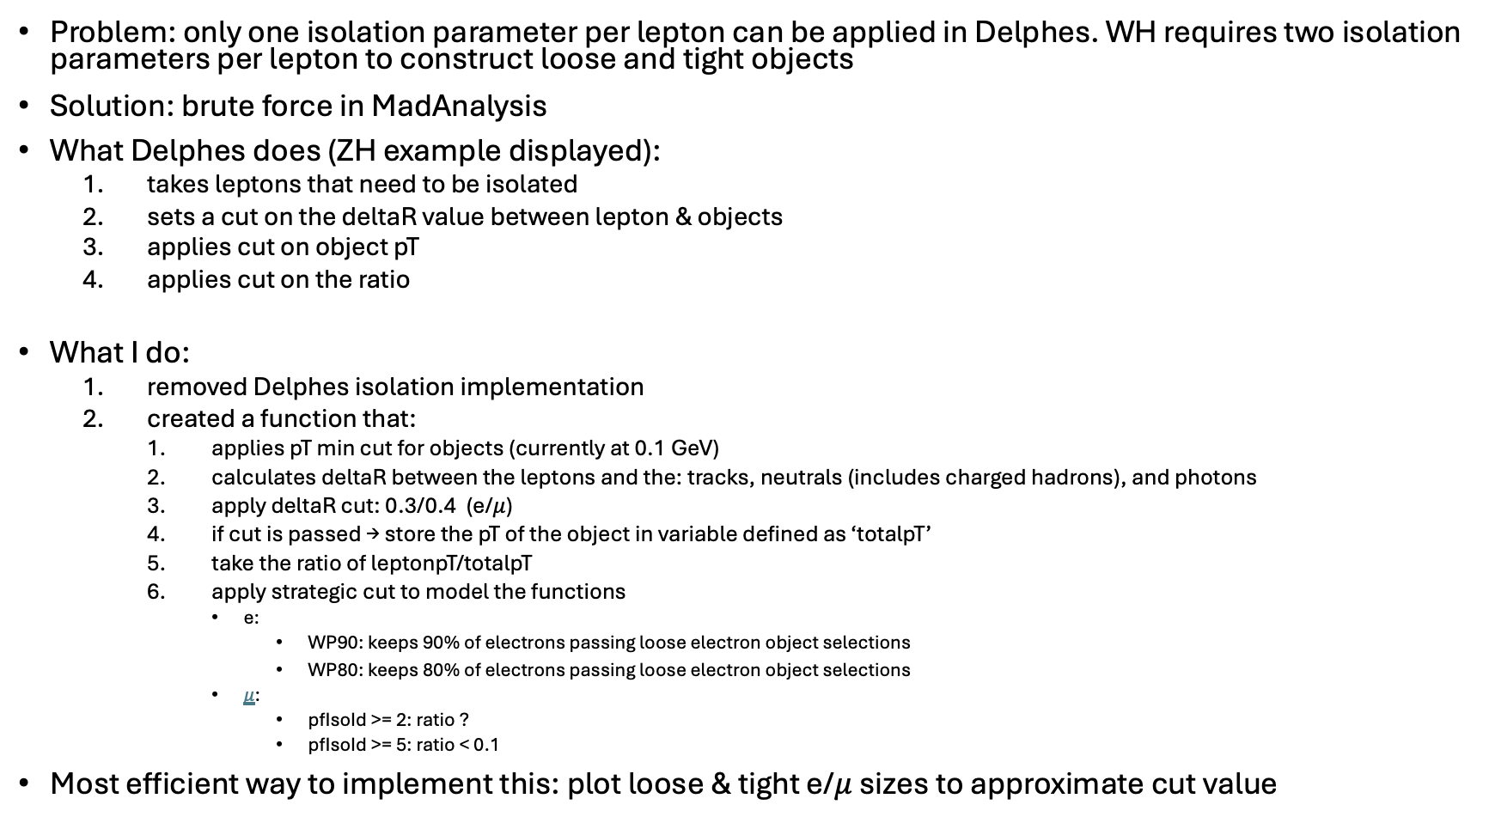
Modeling CMSSW Isolation
Problem: only one isolation parameter per lepton can be applied in Delphes. WH requires two isolation parameters per lepton to construct loose and tight objects
Solution: brute force in MadAnalysis
What Delphes does (ZH example displayed):
  takes leptons that need to be isolated
  sets a cut on the deltaR value between lepton & objects
  applies cut on object pT
  applies cut on the ratio
What I do:
  removed Delphes isolation implementation
  created a function that:
    applies pT min cut for objects (currently at 0.1 GeV)
    calculates deltaR between the leptons and the: tracks, neutrals (includes charged hadrons), and photons
    apply deltaR cut: 0.3/0.4 (e/$μ$)
    if cut is passed → store the pT of the object in variable defined as ‘totalpT’
    take the ratio of leptonpT/totalpT
    apply strategic cut to model the functions
      e:
        WP90: keeps 90% of electrons passing loose electron object selections
        WP80: keeps 80% of electrons passing loose electron object selections
      $μ$:
        pfIsoId >= 2: ratio ?
        pfIsoId >= 5: ratio < 0.1
Most efficient way to implement this: plot loose & tight e/$μ$ sizes to approximate cut value

Slide 6
What’s currently working
Debugging & looking at CMSSW cutflows on HepData
Working on plotting CMSSW histos from Luca’s pickl files
  generated HEPMC samples at mD=T=3
  will be plotting same signal point in CMSSW for most direct comparison
Cleaning up analyzer script
  messy, unorganized
Getting wheels turning on b-tagging implementation
  saved for last

