Slide 1
HGCal progress report: understanding FE electronics
Jackson Lake

Slide 2
First of all…
Happy 38th birthday to Tiziano!
Tanti auguri!

Slide 3
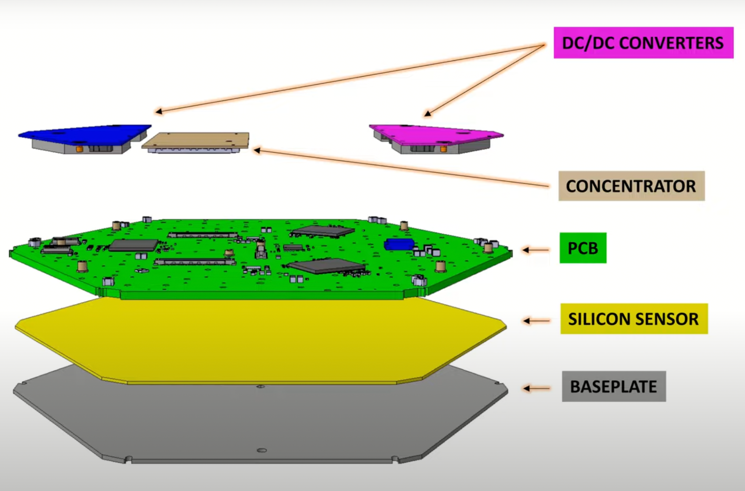
Progress and Work Updates
Last week: DAQ BE + discussion with supervisors
This week: TPG BE (in progress), Hexaboard and Module Testing training (CMS P5), Friday electrical testing shift

Slide 4
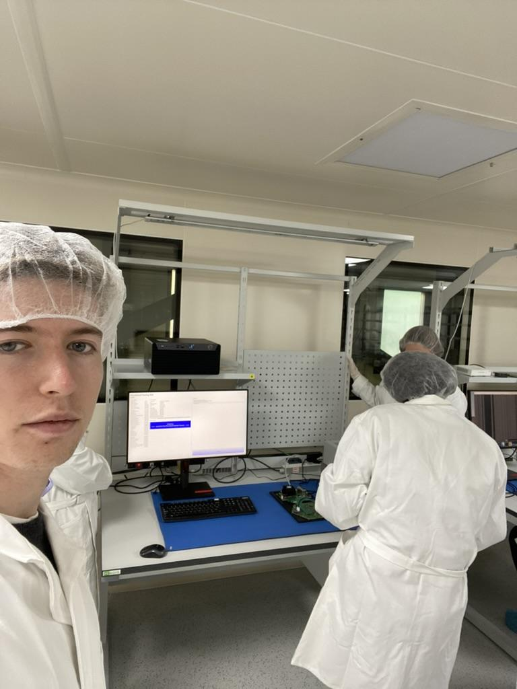

Slide 5
Data Acquisition Back End (DAQ BE)
Main function: data aggregation → conserve the number of links used to bring data to the central DAQ
Divided between the two endcaps; further split into three parts, each servicing 120˚ φ sector of an endcap.
DAQ boards and DTH boards
  DAQ: implement HGCAL DAQ BE algorithms; DTH: data aggregation from multiple DAQ boards, hubs for the distribution of timing and control
Notes:
DTH boards data aggregation from DAQ boards = (DAQ800)
DTH boards distribution of timing and control to DAQ boards = (DTH400)

Slide 6
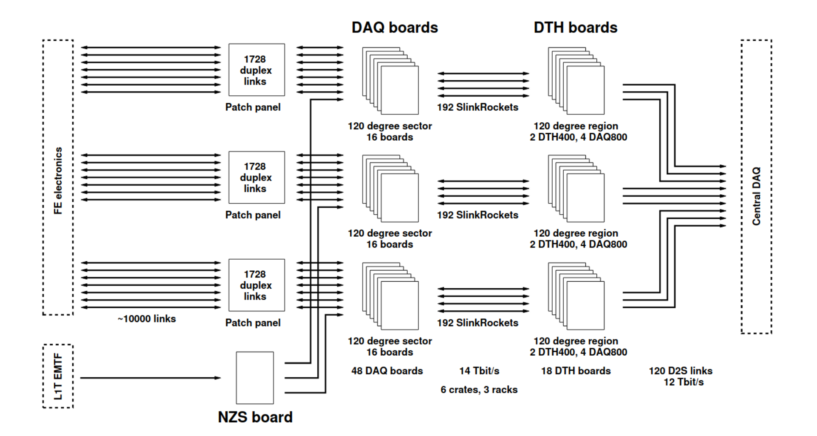
Notes:
Structure of the DAQ BE system for one endcap. At the time the block diagram was drawn it was taken as a worst case scenario that there will be 10000 links (50% of them dark) routed between the FE and the DAQ BE and that a stage of patch panels will also be needed. Since then matters have improved and the BE may not even need any patch panels. Regardless, the DAQ BE is prepared to connect to as many as 5184 FE lpGBT links.

Slide 7
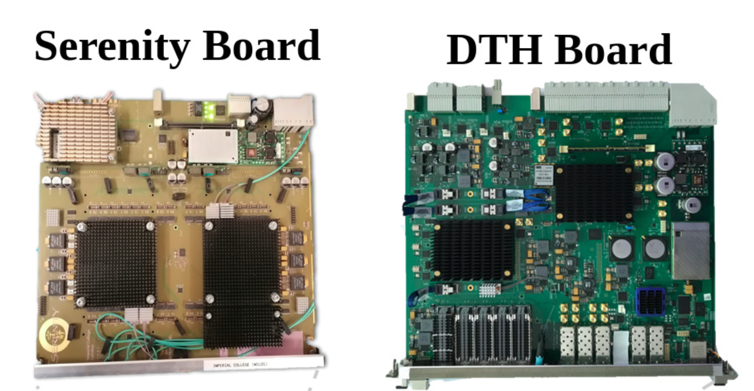
Notes:
Each DAQ BE board will be a Serenity board with a single VU13P FPGA having ten pairs of 12 channel bi-directional modules. Nine pairs of these modules are used to implement the interface with 9 × 12 = 108 DAQ lpGBTs in the FE. Hence, 5184/108 = 48 boards are needed per endcap (16 per sector).

Slide 8
DAQ BE
Of the 10 pairs of 12 channel bi-directional modules of the FPGA, 9 are used to interface with the FE DAQ lpGBTs. (16 boards needed per sector)
Remaining module pair on a board interfaces with DTH board via 12 SLinkRocket 25 Gbit/s streams. (To be specific: DAQ800)
DTH board: further aggregates data → sends higher data rate over smaller number of links
  12 Tbit/s across 120 D2S 100 Gbit/s links toward cDAQ (per endcap)*
  Fluctuations around average bandwidth to DAQ BE boards (~160 Gbit/s) and DTH boards (300) are handled by buffering in the boards.
Notes:
Interesting subpoint:
The information throughput of a human being is about 10 bits/s. In comparison, our sensory systems gather data at bits/s.
* = distinction is made: the “total average usable DAQ data rate” does not count idles which are sent around 80% of the time.
Example of buffering: de-randomization of L1A rate.

Slide 9
DAQ BE: fast and slow control
Timing, Fast Control: DTH400 boards implement the TCDS2 system, sending clock reference and fast commands to DAQ BE boards
Slow Control firmware block (via CPU link) transforms commands into streams of 2-bit IC or EC lpGBT fields → reaches a particular FE ASIC in this way
Uses prioritization logic to manage overlapping fast commands.

Slide 10
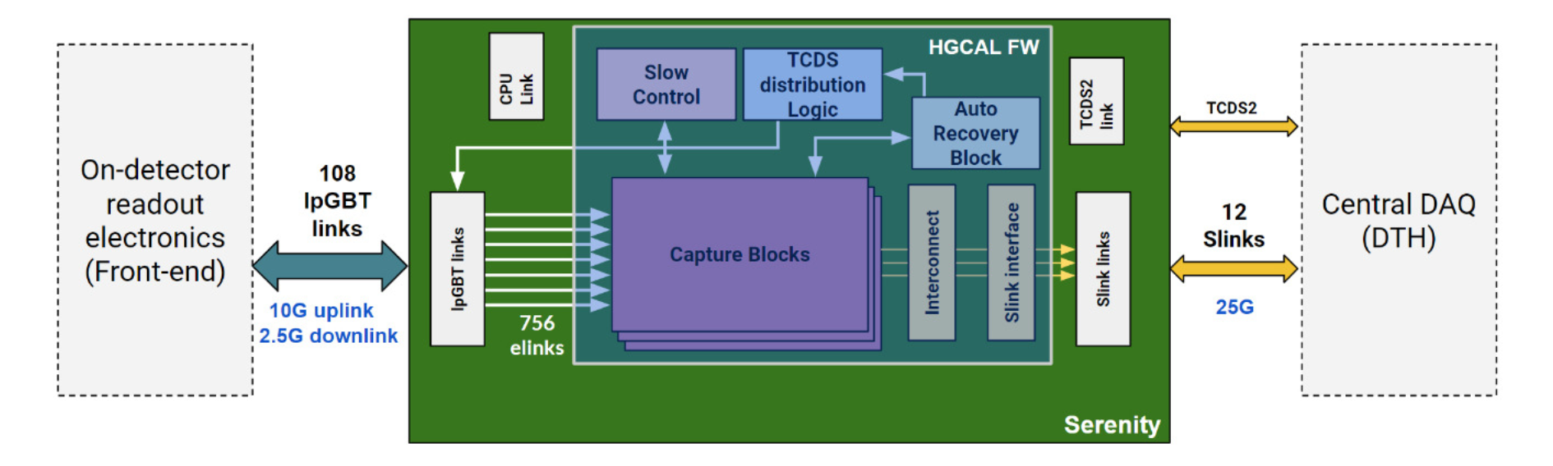
VU13P FPGA
Capture block: assembles data from ECON-D packets (up to 12), buffers, event builder, event buffer
Readout blocks: aggregation of event packets, sends SLink packets
Notes:
Event builder aggregates ECON-D packets into “event packets”
Event packets in the event buffer have metadata compared with BE L1A record and timing

