Slide 1
April 1 Status Report
Dongha Simon Lim

Slide 2
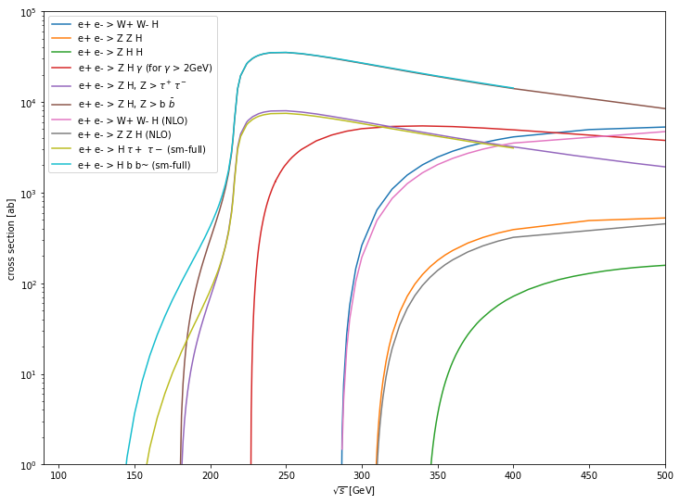
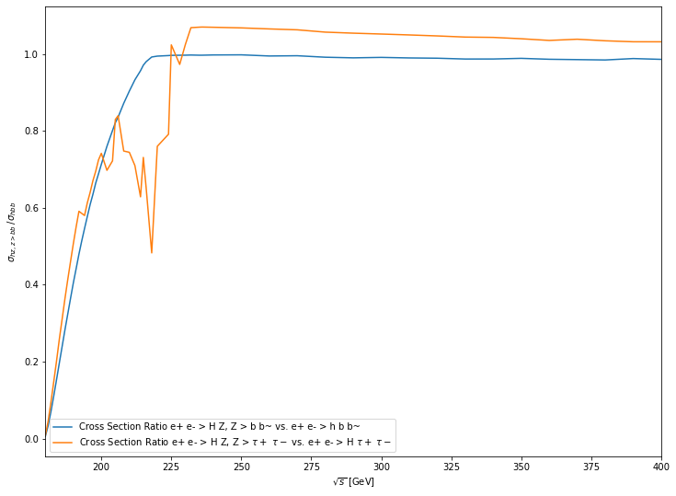
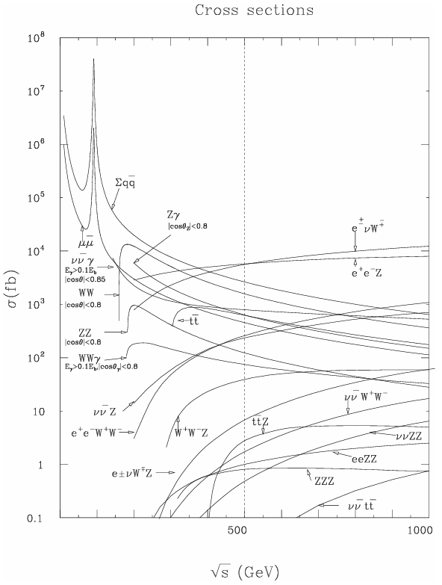

Last time…
e+ e- > H 𝛕+ 𝛕- / H b ̅b vs.
e+ e- > H Z where Z > 𝛕+ 𝛕- / H b ̅b

Slide 3

Turns out…
I messed up the arrays.
first array was miss a value at around 190 GeV…
and the second was missing a value at around 230 GeV

Slide 4
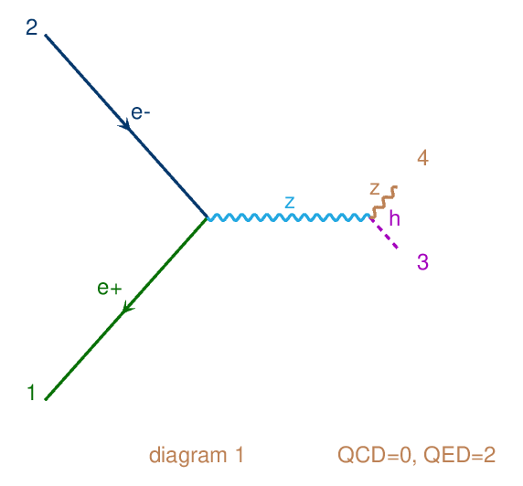
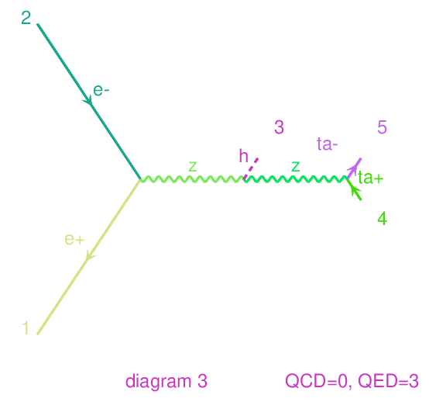
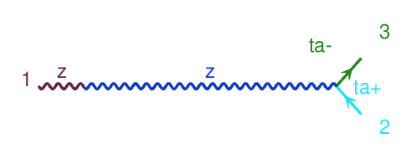
But it didn’t matter (I think)!

Slide 5
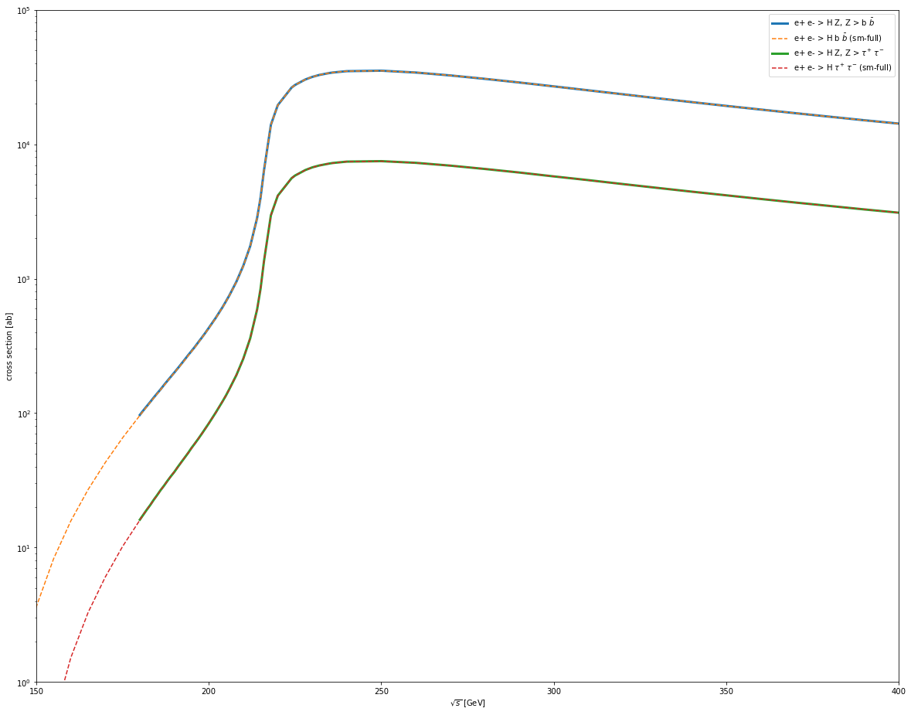

Slide 6
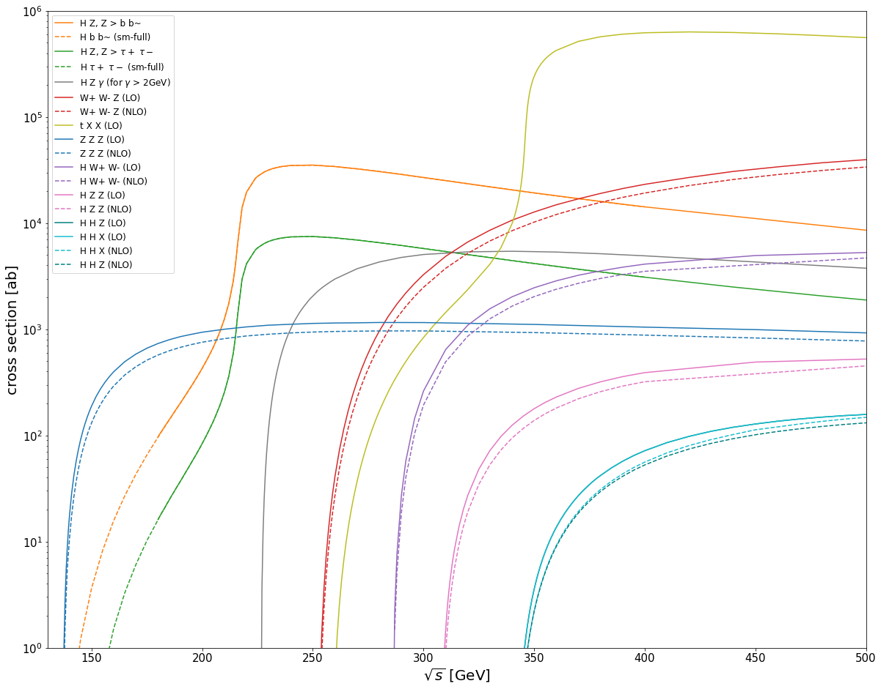

As for the extra processes
Issue with my code:
zzz_lo_e - 2*zzz_lo_e
zzz_nlo_e - 2*zzz_nlo_e
When I should’ve had
zzz_lo_e = 2*zzz_lo_e
zzz_nlo_e = 2*zzz_nlo_e

Slide 7
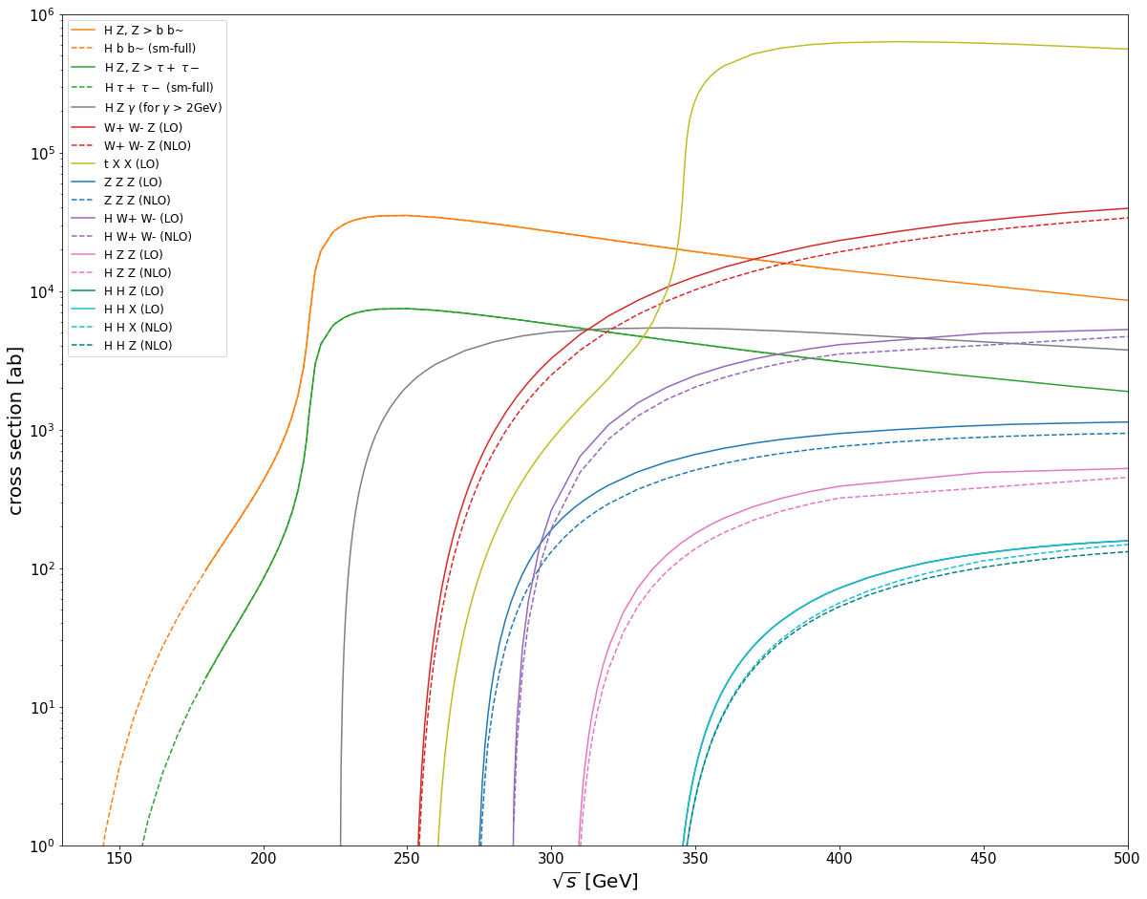

Slide 8
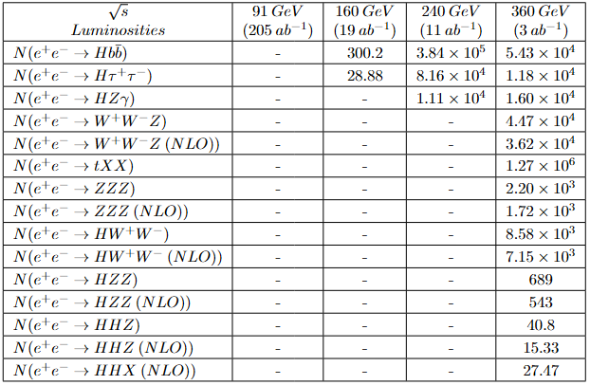

N = L_{int}*𝝈*(𝛜)
New paper regarding the updated L_{int} to drop this week.
I’m still trying to catch up on the physics…

Slide 9

Soon

Slide 10
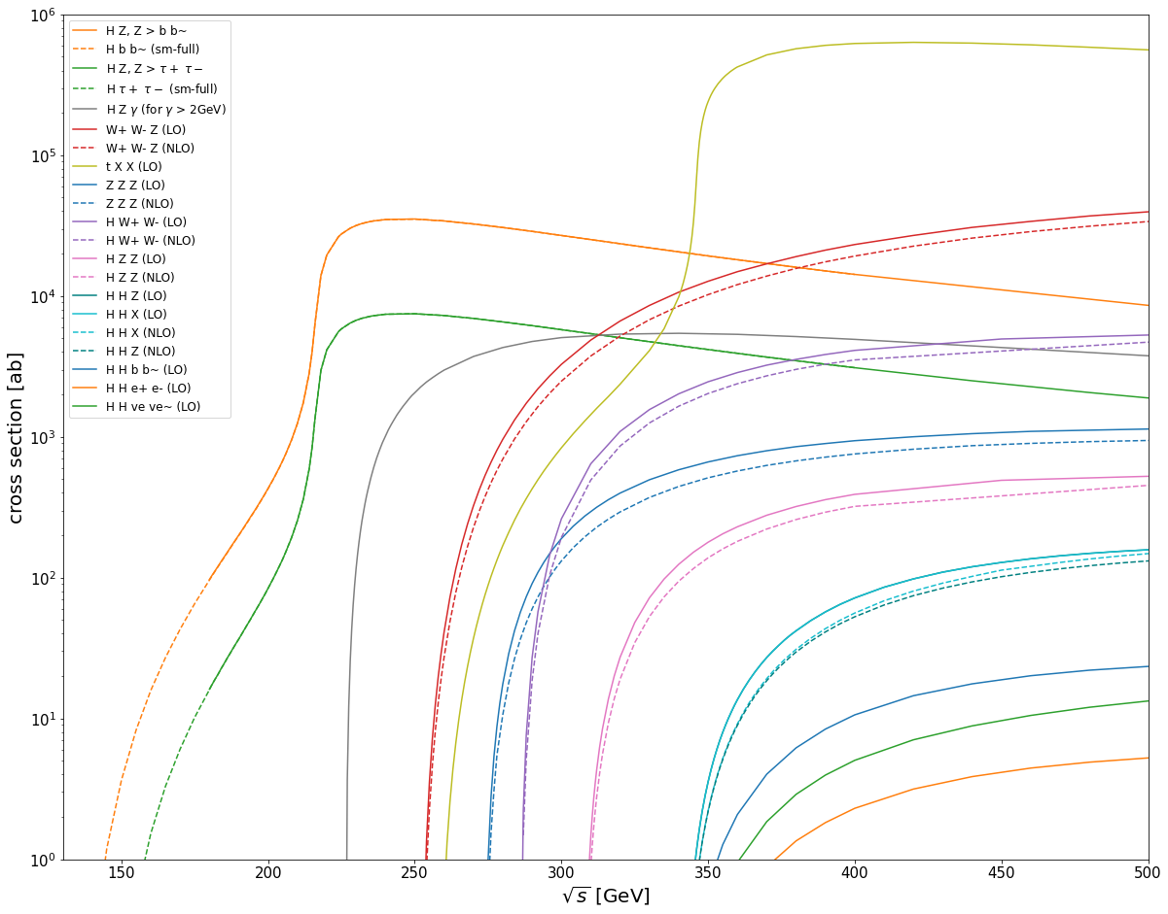

Slide 11
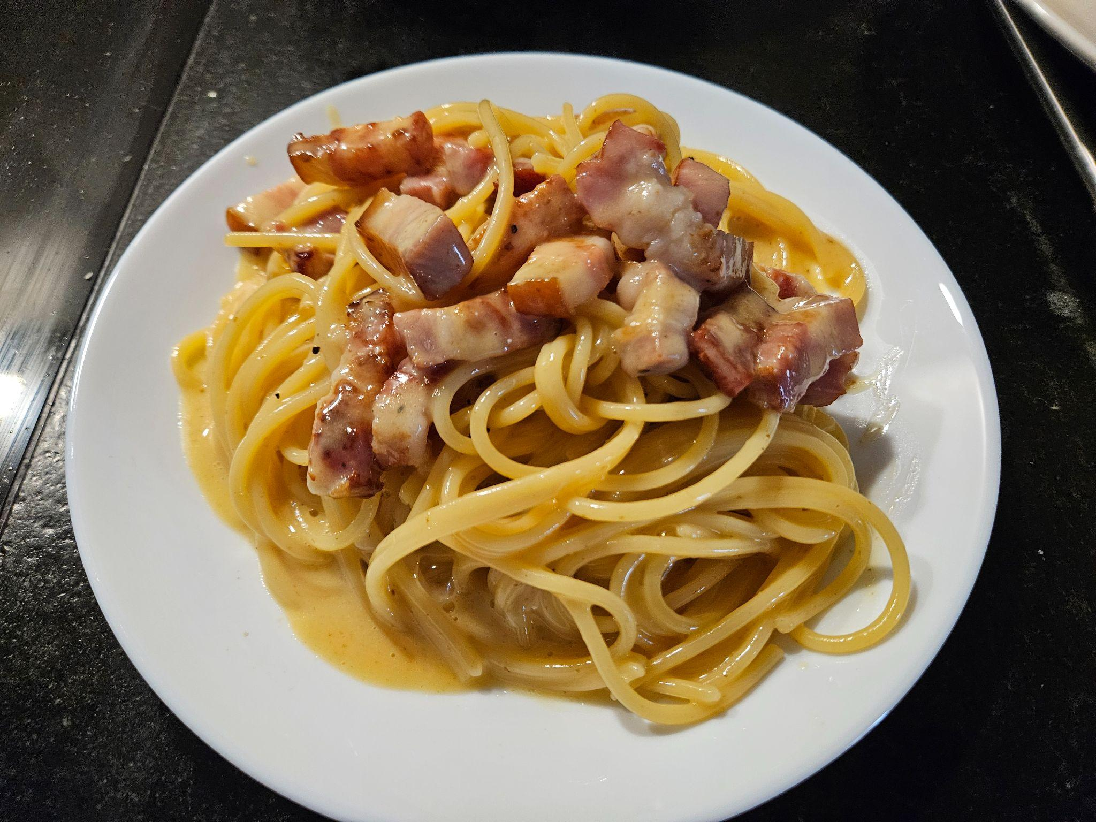
HAPPY BIRTHDAY TIZIANO!!

