Slide 1
Public Event Advisory Board – 26 June 2025
Quantum! season
Communications campaign

Slide 2
  CERN proposes events for everyone
  CERN is a place for artistic enquiry
  Science Gateway is a physical encounter between researchers and children, visitors and physicists, tourists and scientists, all driven by curiosity and the thirst for knowledge
  Come to Science Gateway to get informed, engaged, entertained
  Explore a new scientific theme every year
Key narratives & messages
Tourist attraction - Scientific and cultural place to visit
CERN is a place to communicate around science
Public events are a platform for CERN researchers to communicate with non-researchers and promote their work to a broader audience
Education - Discover a scientific theme
Science - Value the scientific work of CERN community

Slide 3
Target audiences & channels
Local communities
Voisins website / Local magazines, websites / Geneva tourism office
General public
Visit.cern / Newsletter / Screens in GW / Social media / TPG
Teachers and students
TSP channels
Media (as a vector)
Press briefing / Press release
CERN community
Bulletin / Screens in R1,2 / Posters at CERN / Experiments channels
Scientific community
Alumni channels / UNIGE
Industry
KT, OQI, Ideasquare channels
Donors
CERN & Society Foundation channels

Slide 4
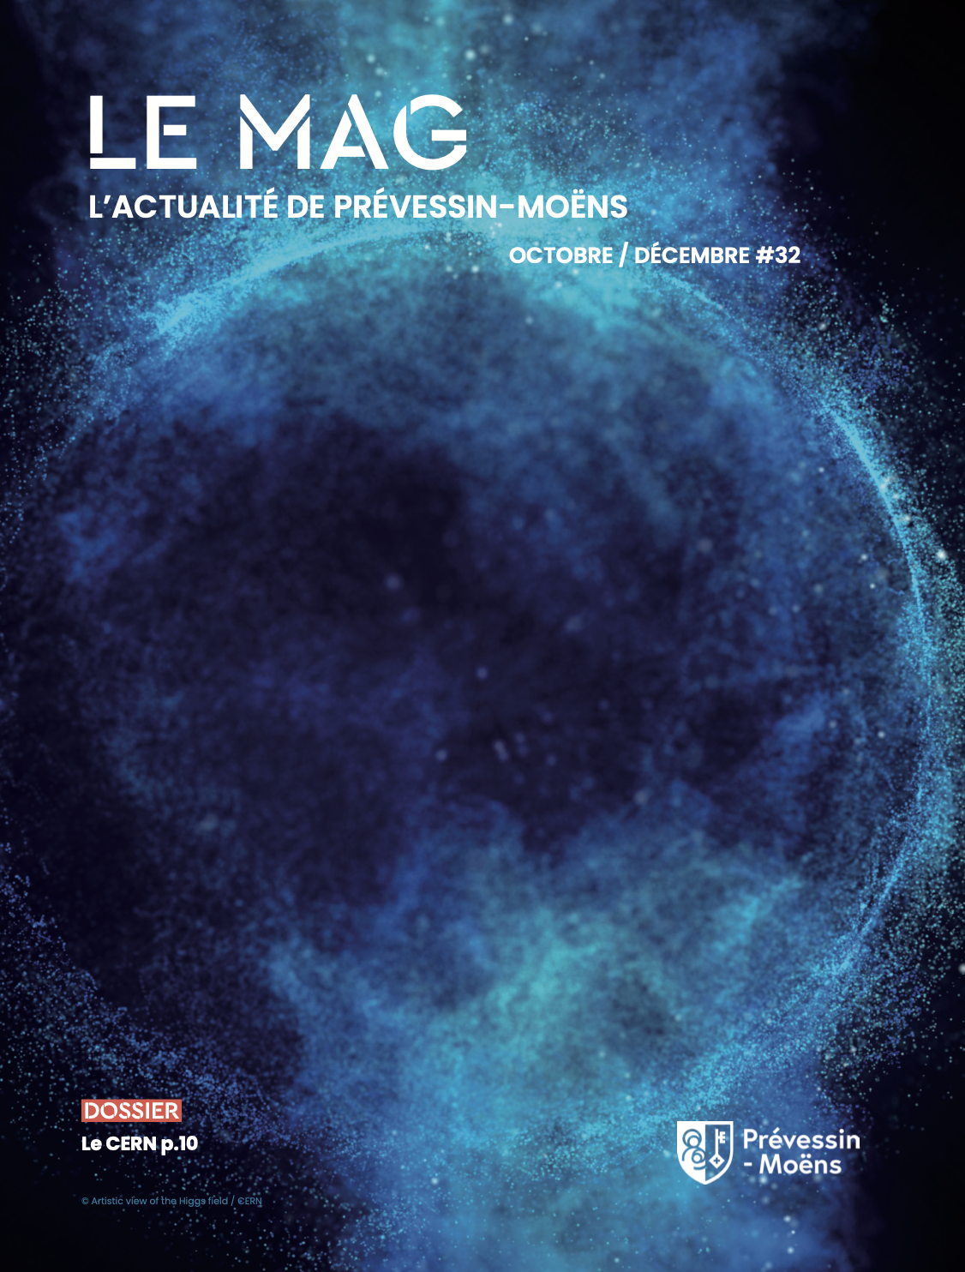
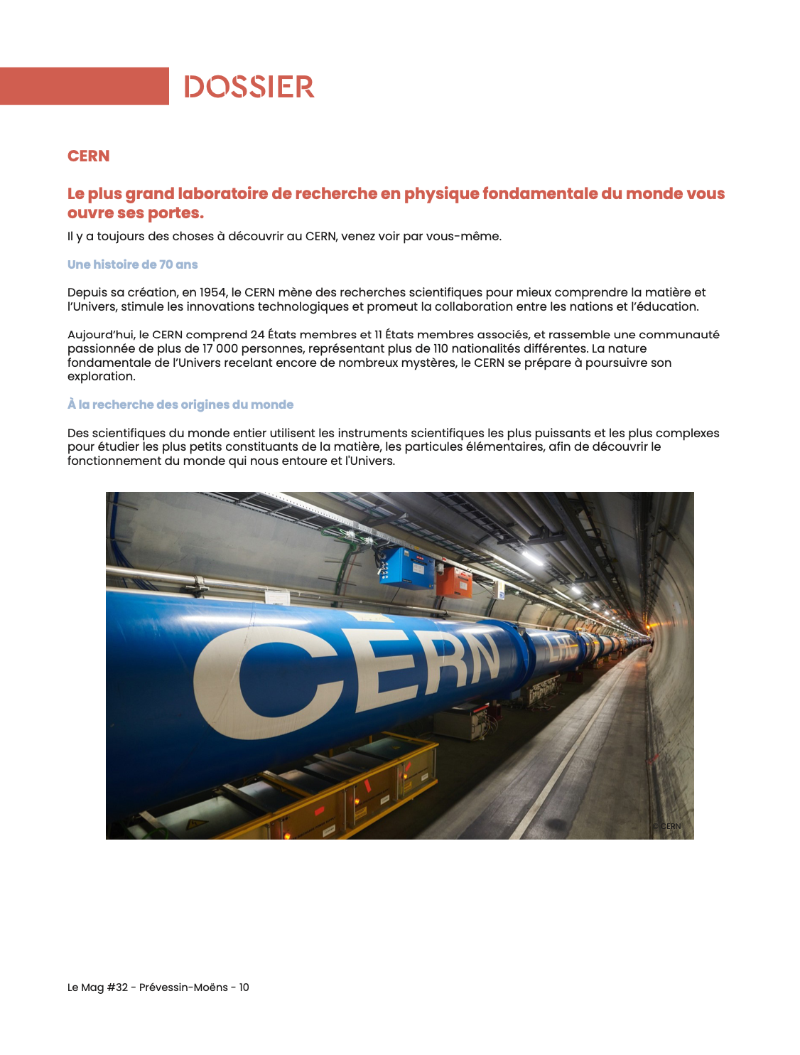
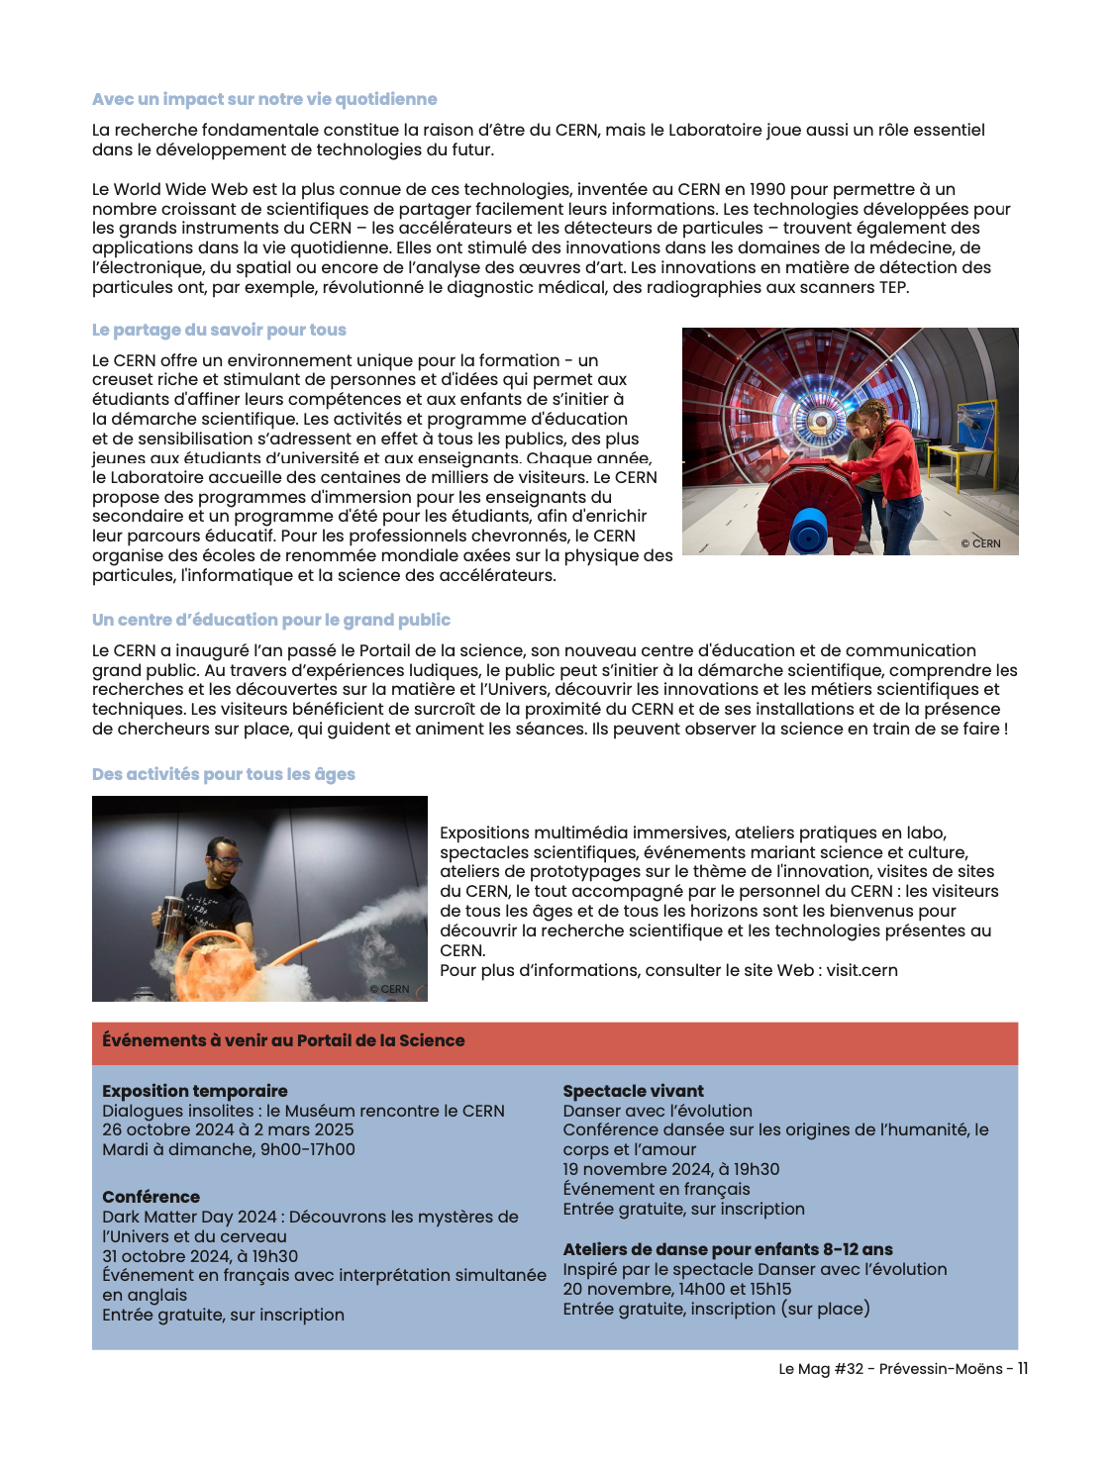
Free publication - local magazine
Featured article on the Science Gateway in the free municipal magazine of Prévessin-Moens (edition: October-December 2024)
Half a page dedicated to CERN public events in each edition
Distributed to more than 9000 habitants

Slide 5
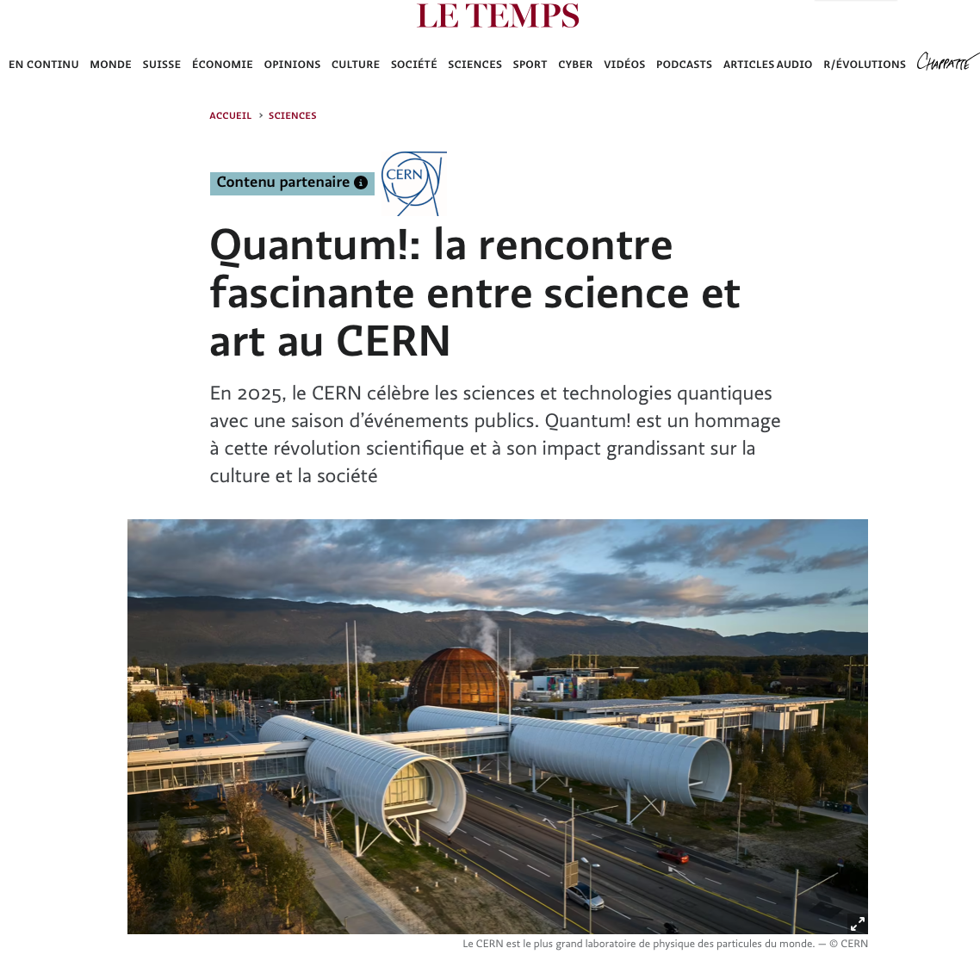
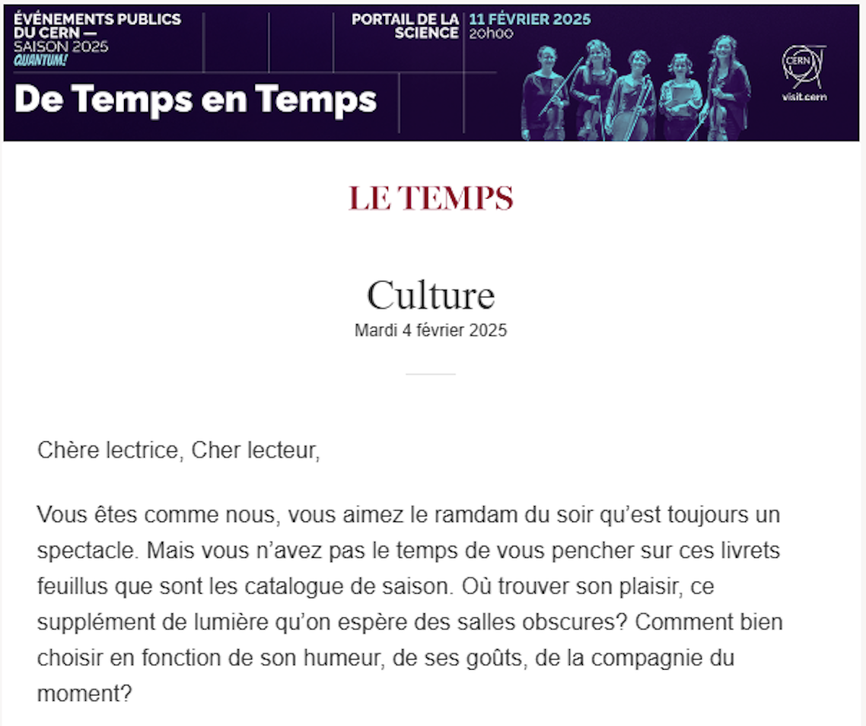
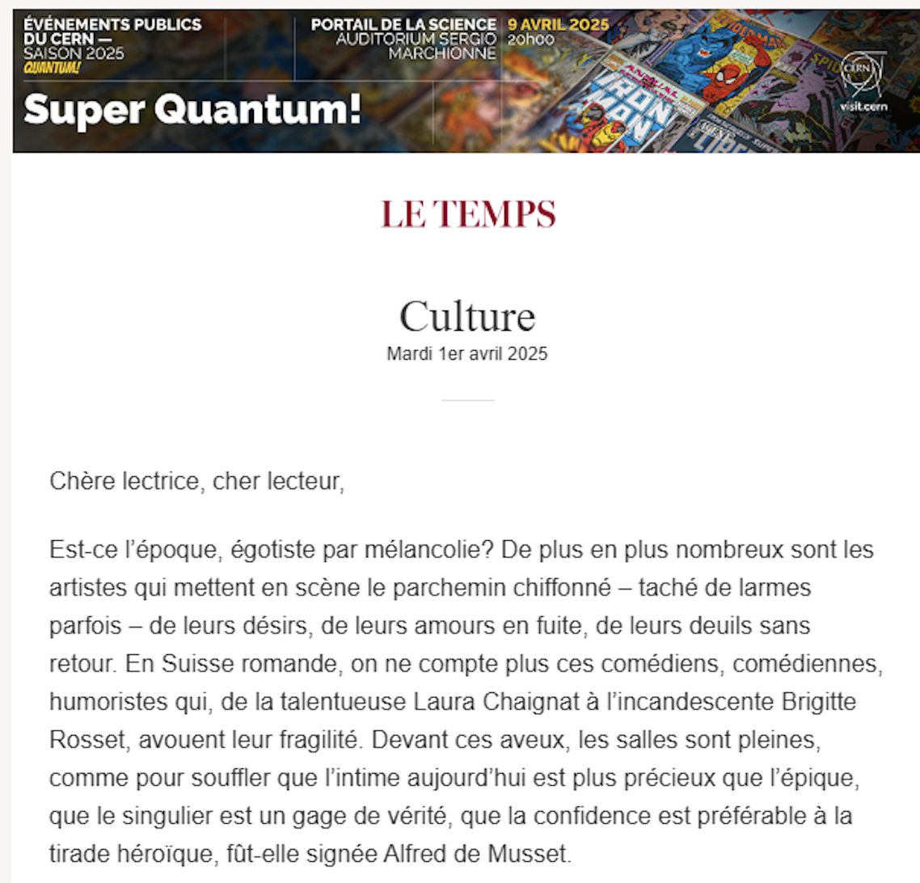
Paid campaign - Le Temps online
Dedicated article introducing the Quantum Season in January
Promotional banners in the digital Culture newsletter for all events
More than 30 000 impressions

Slide 6
Paid campaign - Le Temps online
Results

Slide 7
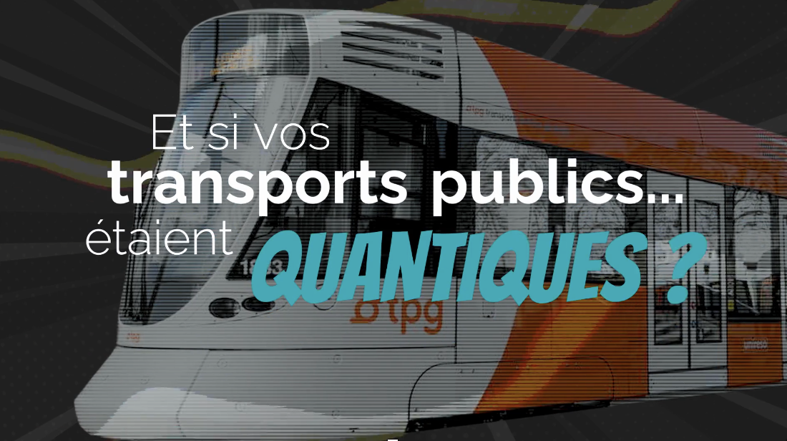
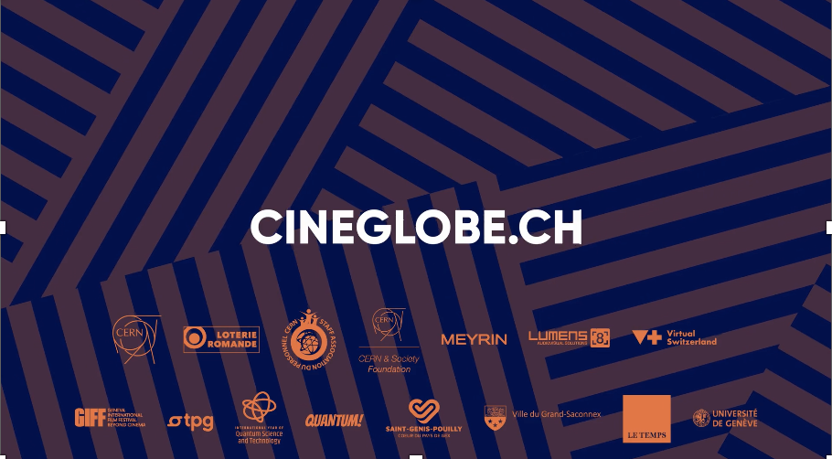
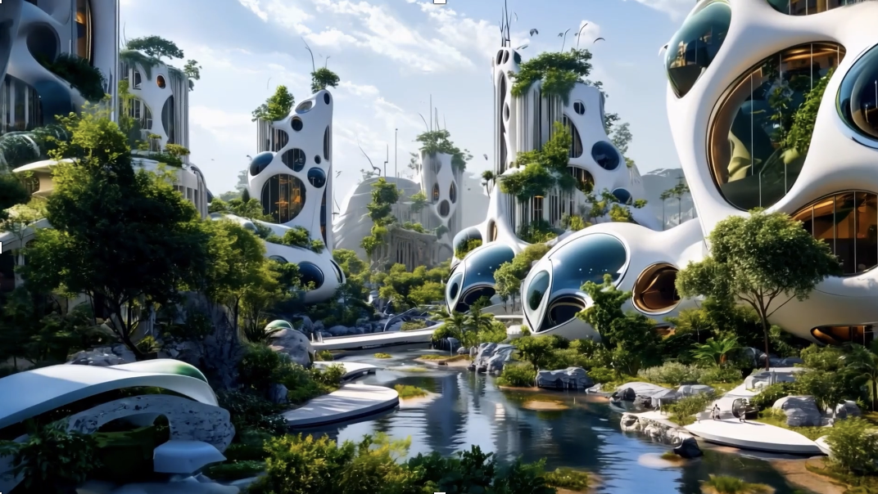
Free advertising on TPG
Projected in more than 1500 screens and 600 000 people per day
Trailer promoting the Quantum! season
Individual trailers for each event

Slide 8
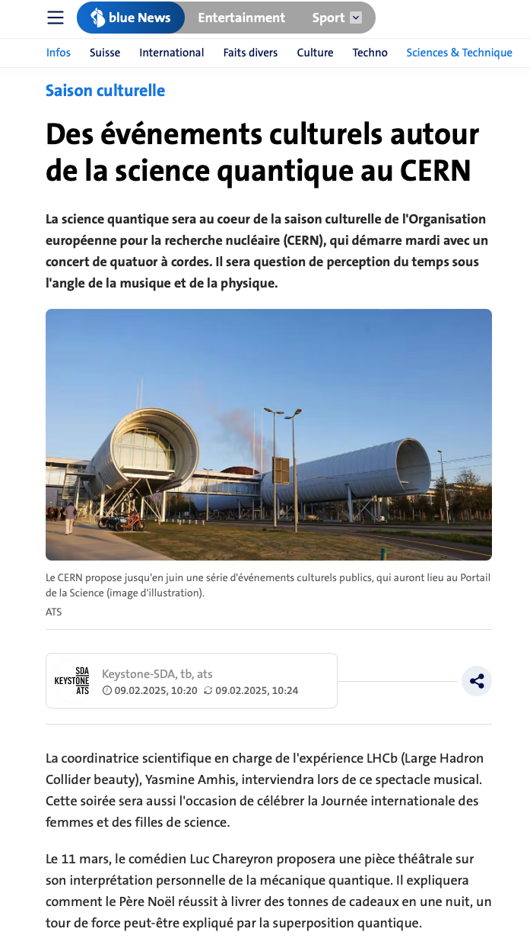
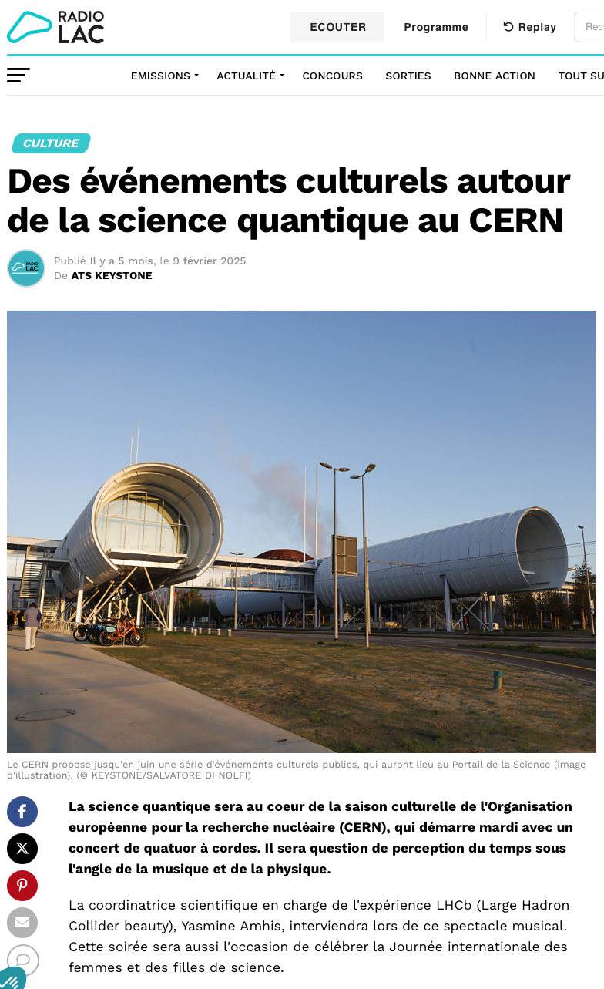
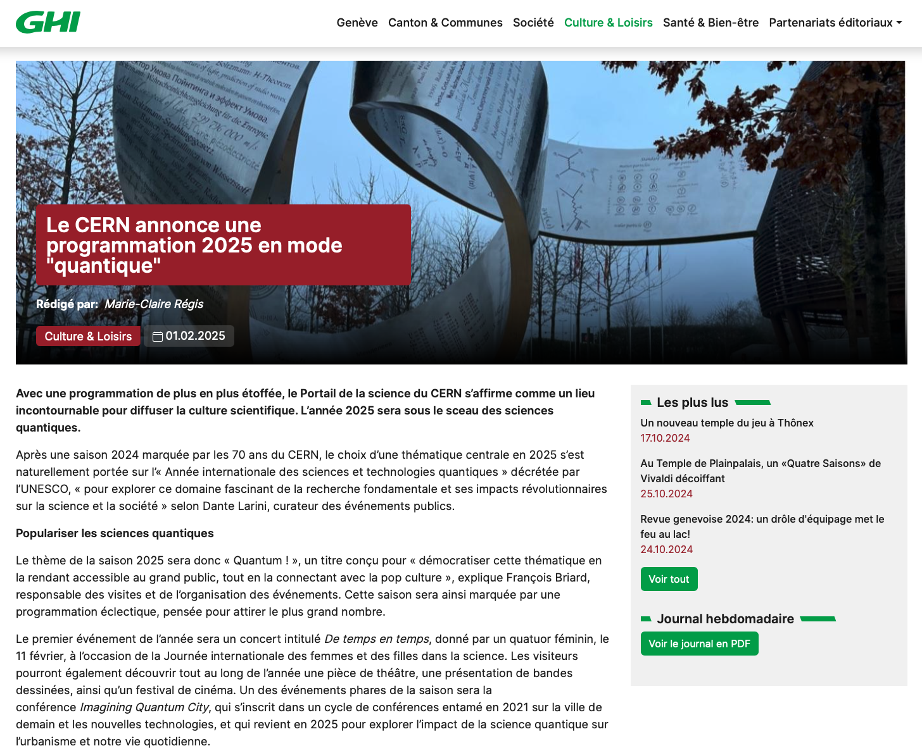
Presence in local media

Slide 9
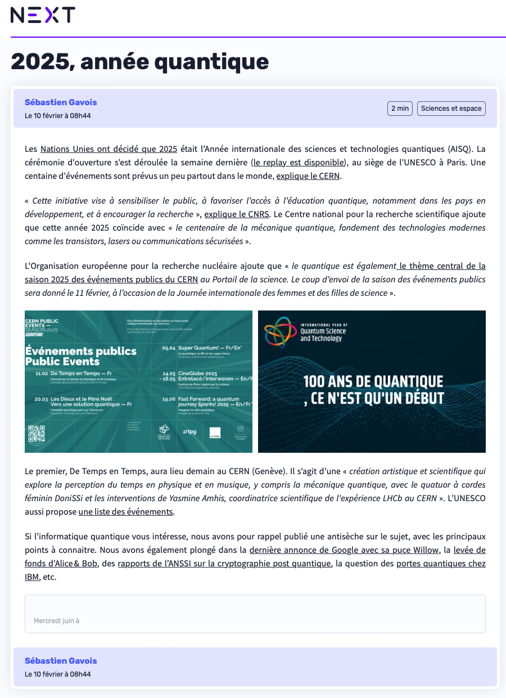
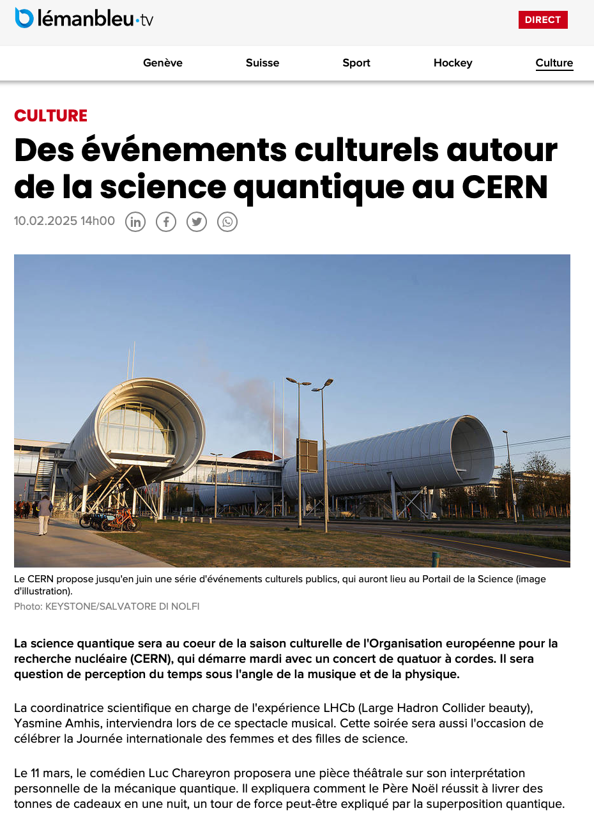
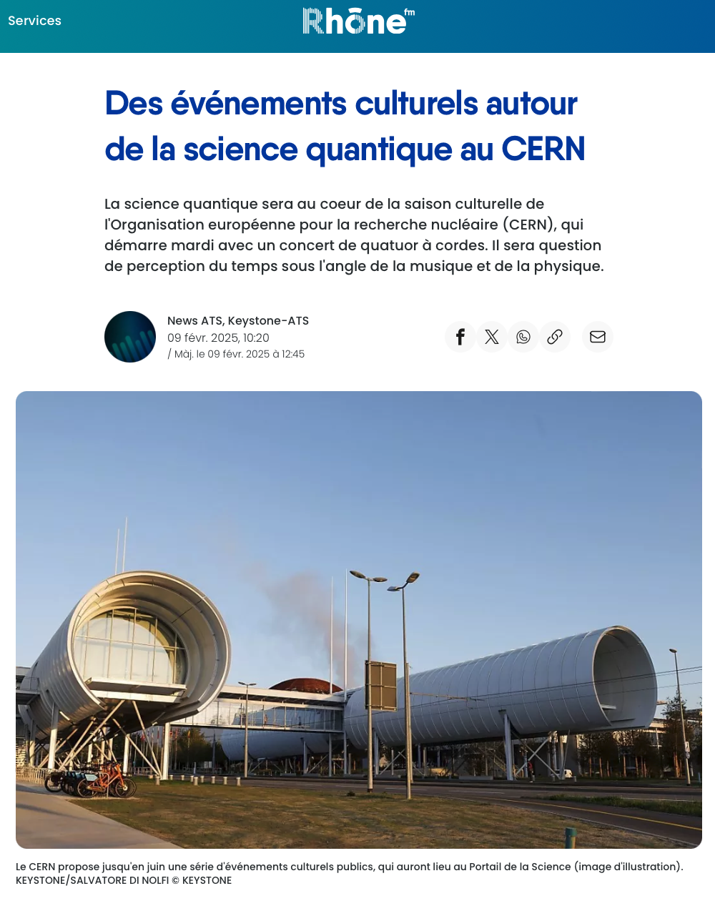
Presence in local media

Slide 10
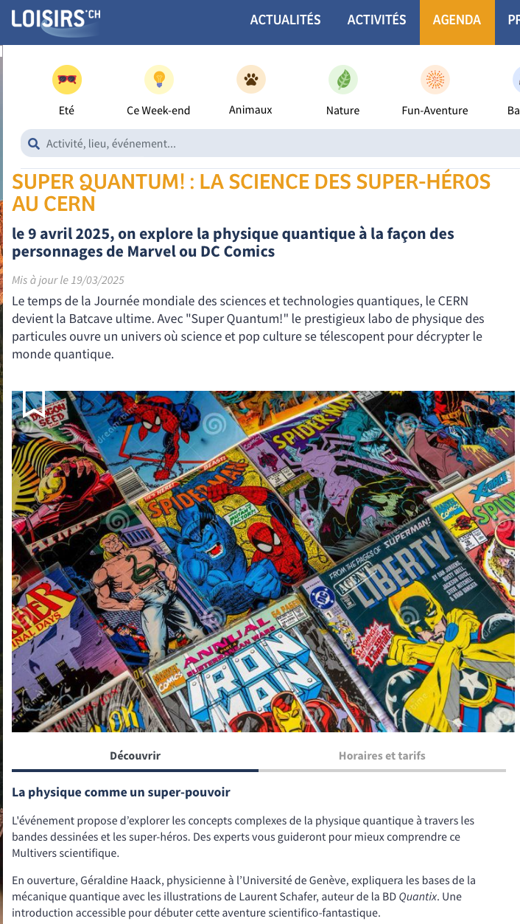
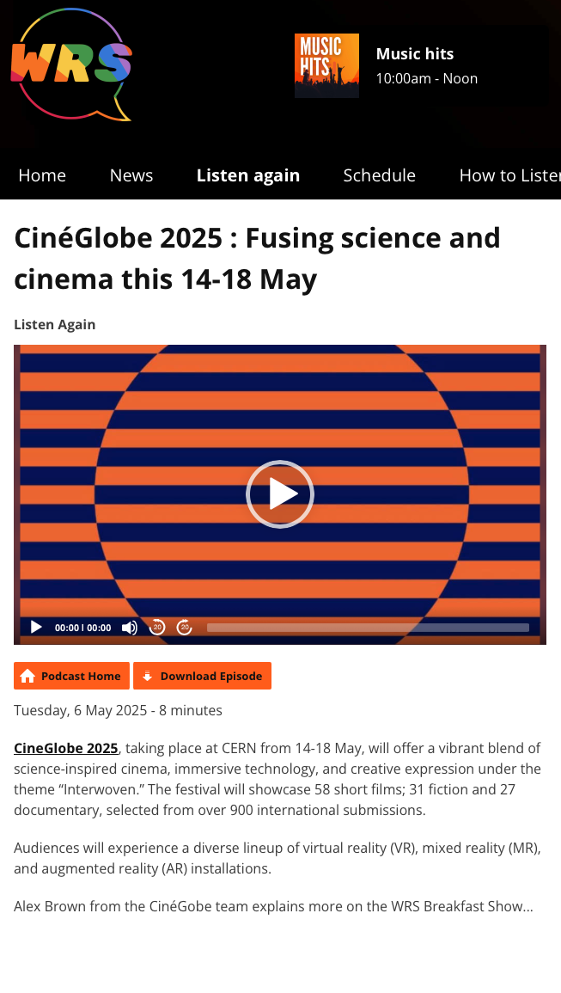
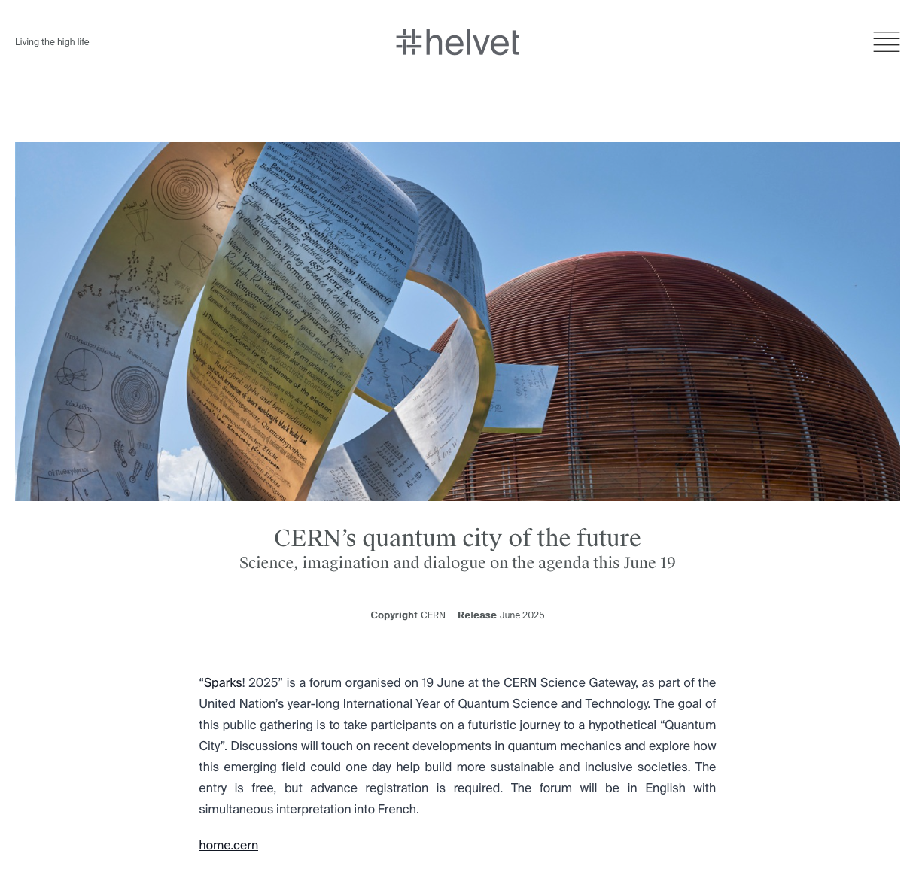
Presence in local media

Slide 11
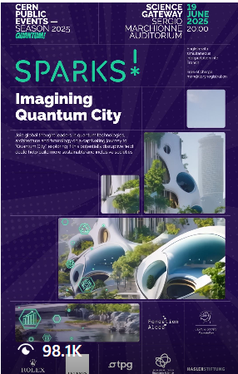
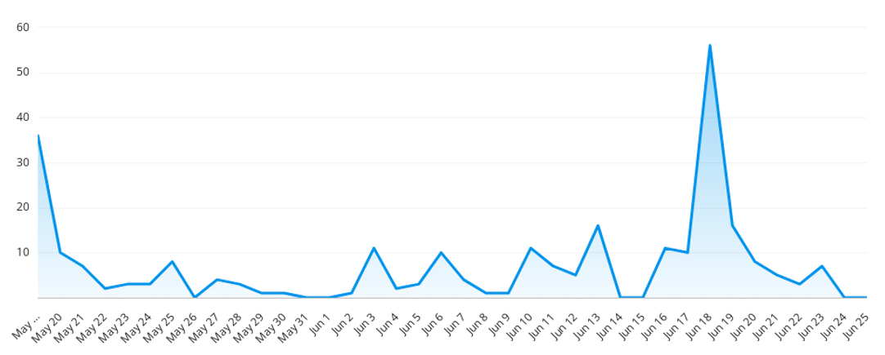
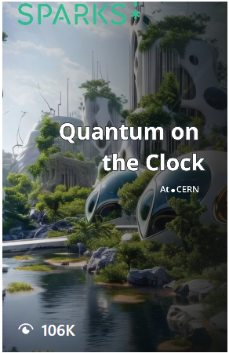
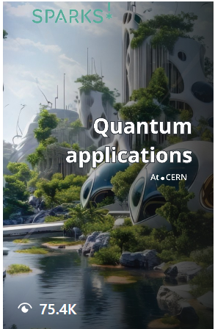
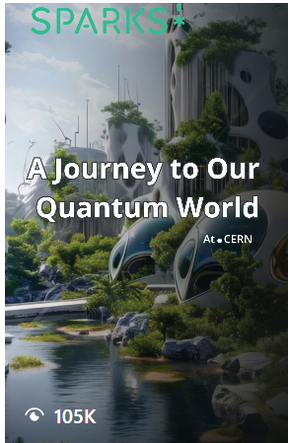
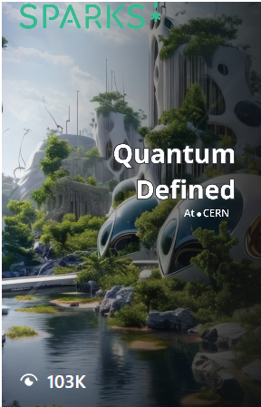
Social media coverage
Promotion across CERN’s social media platforms, before and after the events
Four videos, one story and one official trailer shared
Campaign Timeline: 19 May - 19 June
Hashtags used: #CERNSparks #Quantum Cities
5.16 million Total Impressions
37.8 million Reach
231 Total Mentions (74% higher than previous period)
22.8k Total Engagements (52% higher than previous period)
1181 Link clicks (to Indico page + Livestream) *Mostly from Linkedin post
713469 video views across all platforms
Top countries: US, Switzerland and UK
Most engaging posts
Most engaged audience: Instagram
*stats are subject to change overtime (Analysis covered 19 May - 24 June)
Tyra Kaddu-Mulindwa | CERN Digital Communications Team

Slide 12
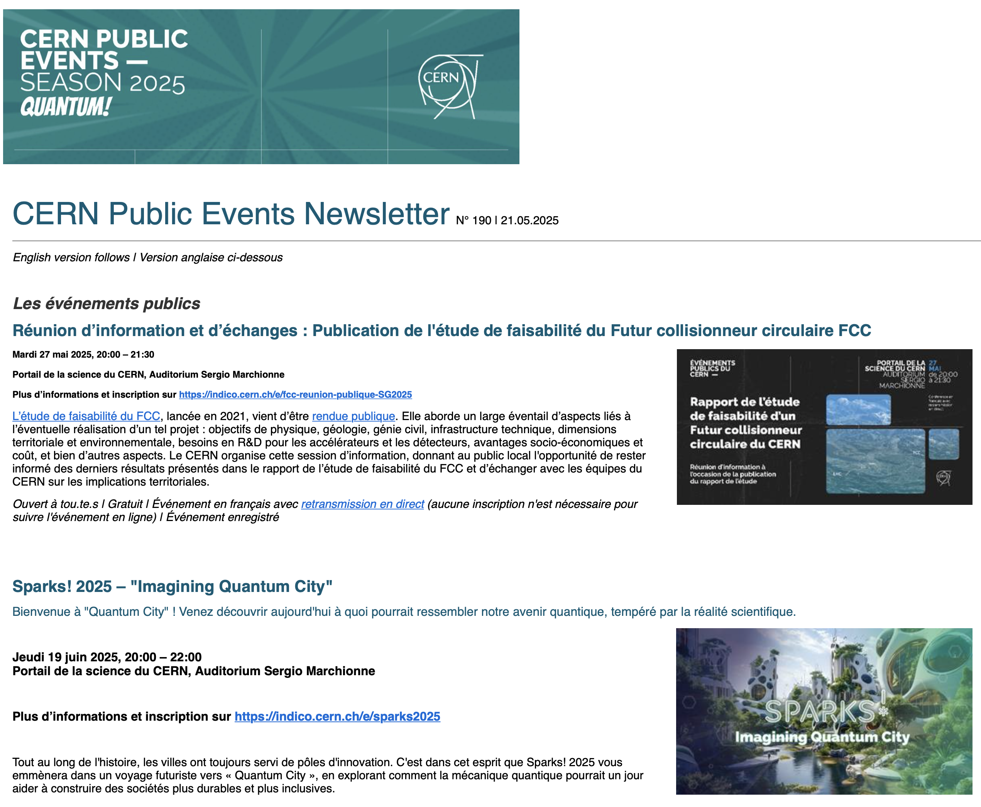
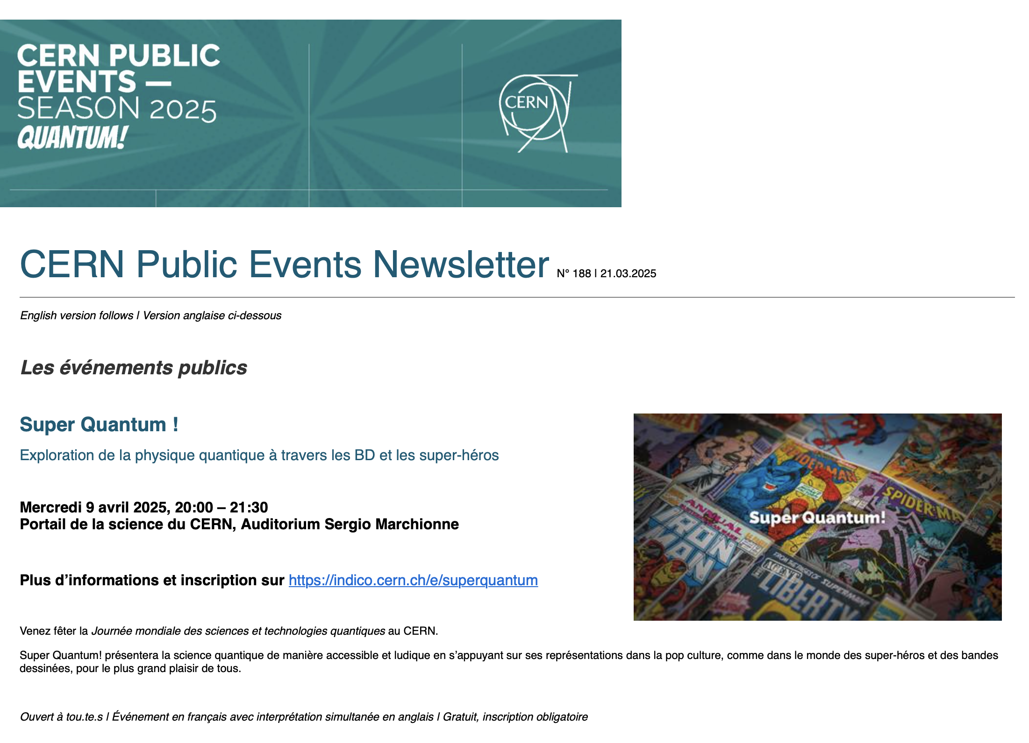
Newsletter
More than 13 000 subscribers
La newsletter et le site visit.cern sont les principaux canaux de communication pour les événements publics.

Slide 13
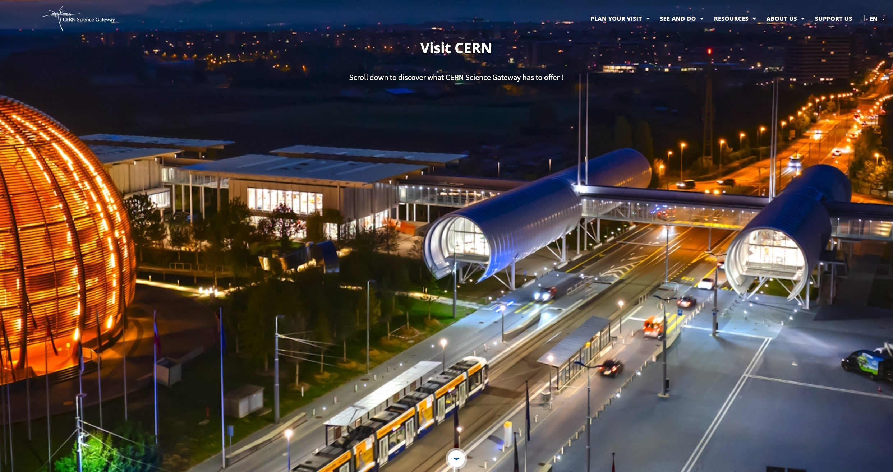

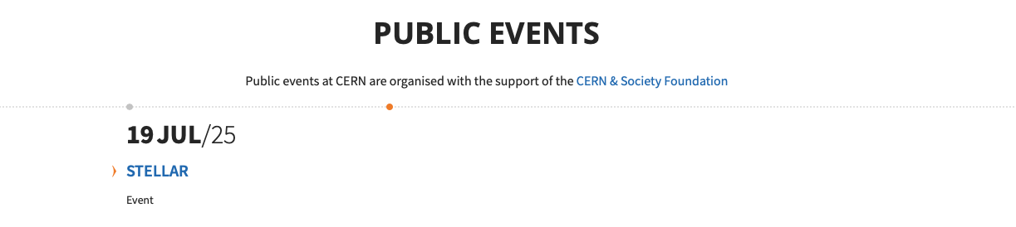
Visit.cern
More than 360 000 unique visitors since January
Public events consistently featured on the homepage of visit.cern
Highlights and Public Events sections

Slide 14
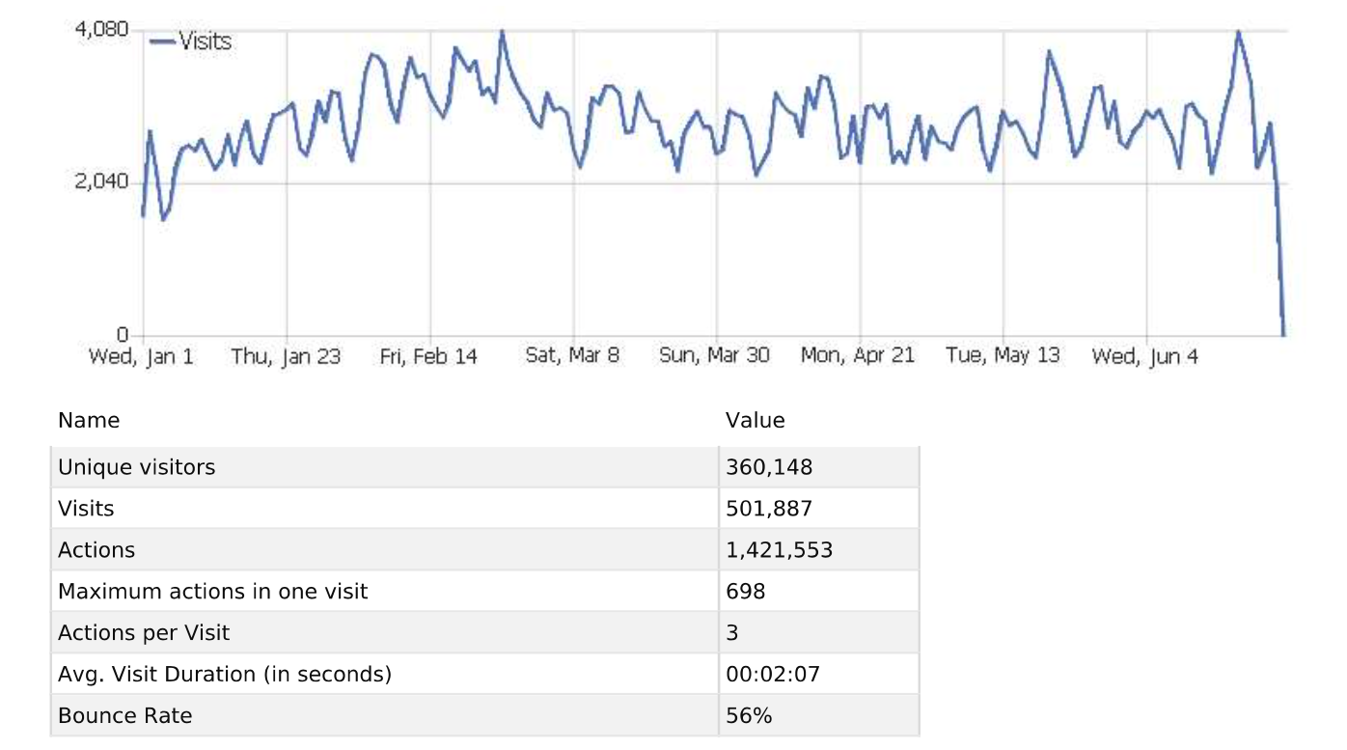
Visit.cern
Results

Slide 15
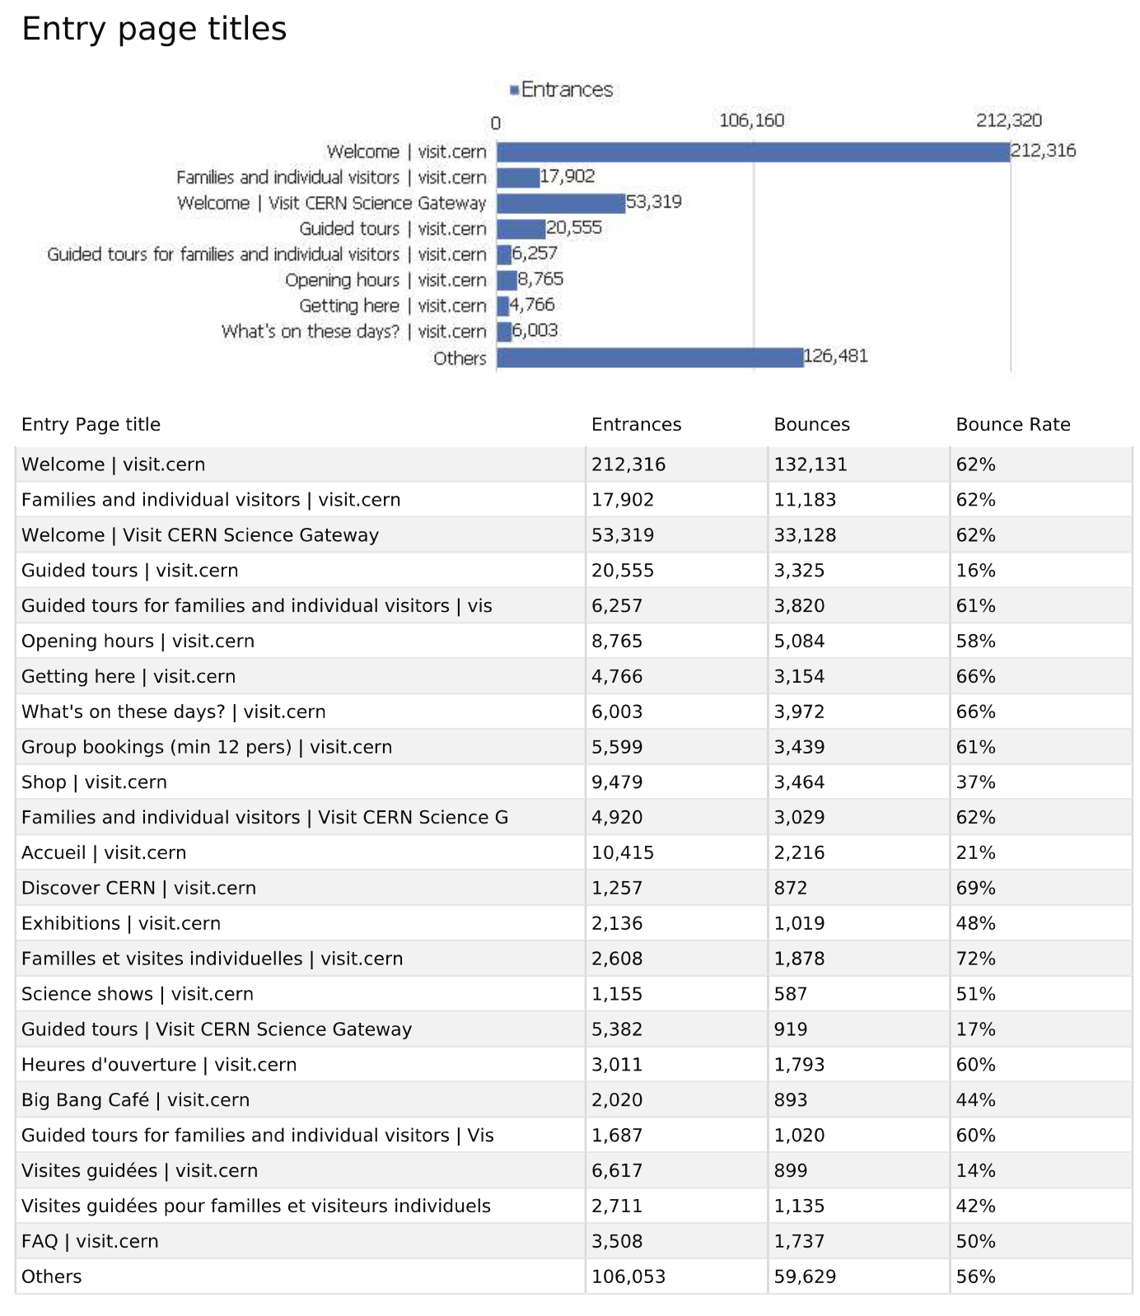
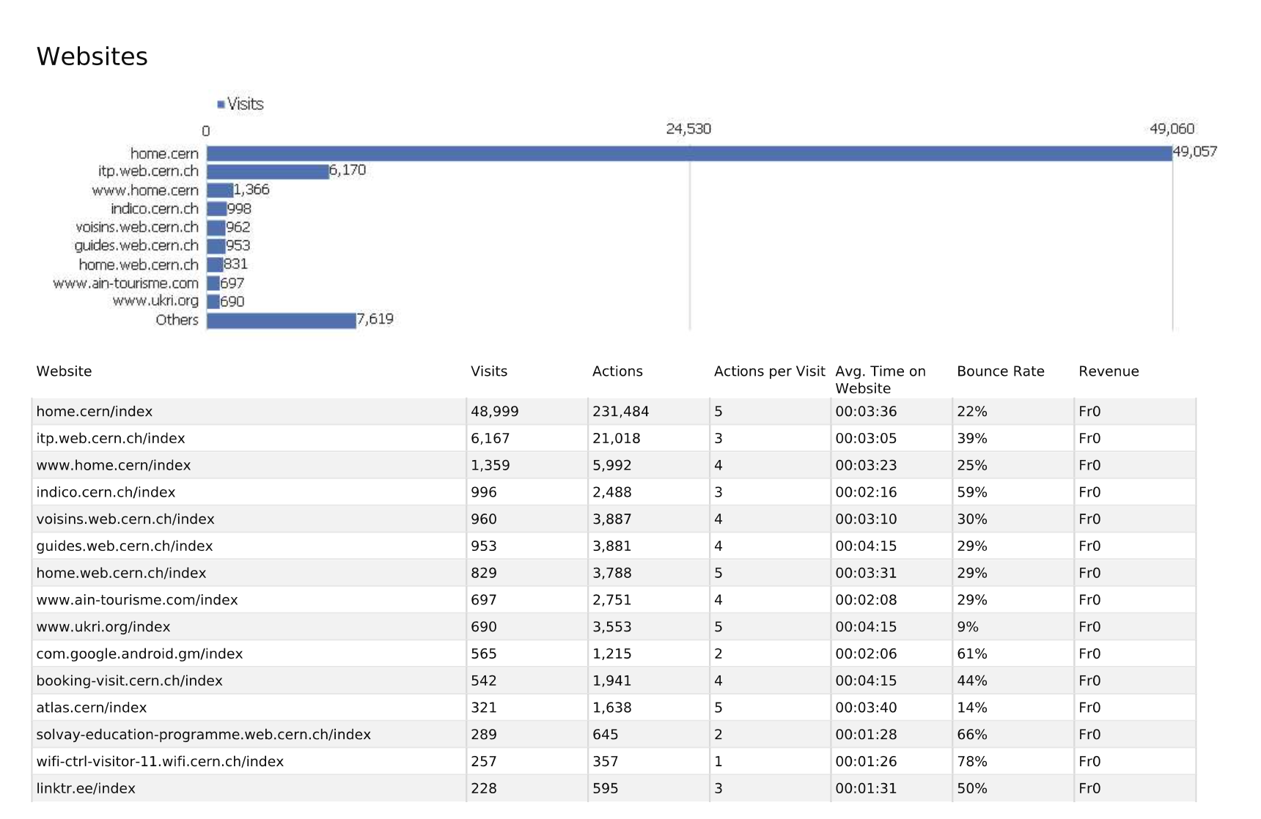
Visit.cern
Results

Slide 16
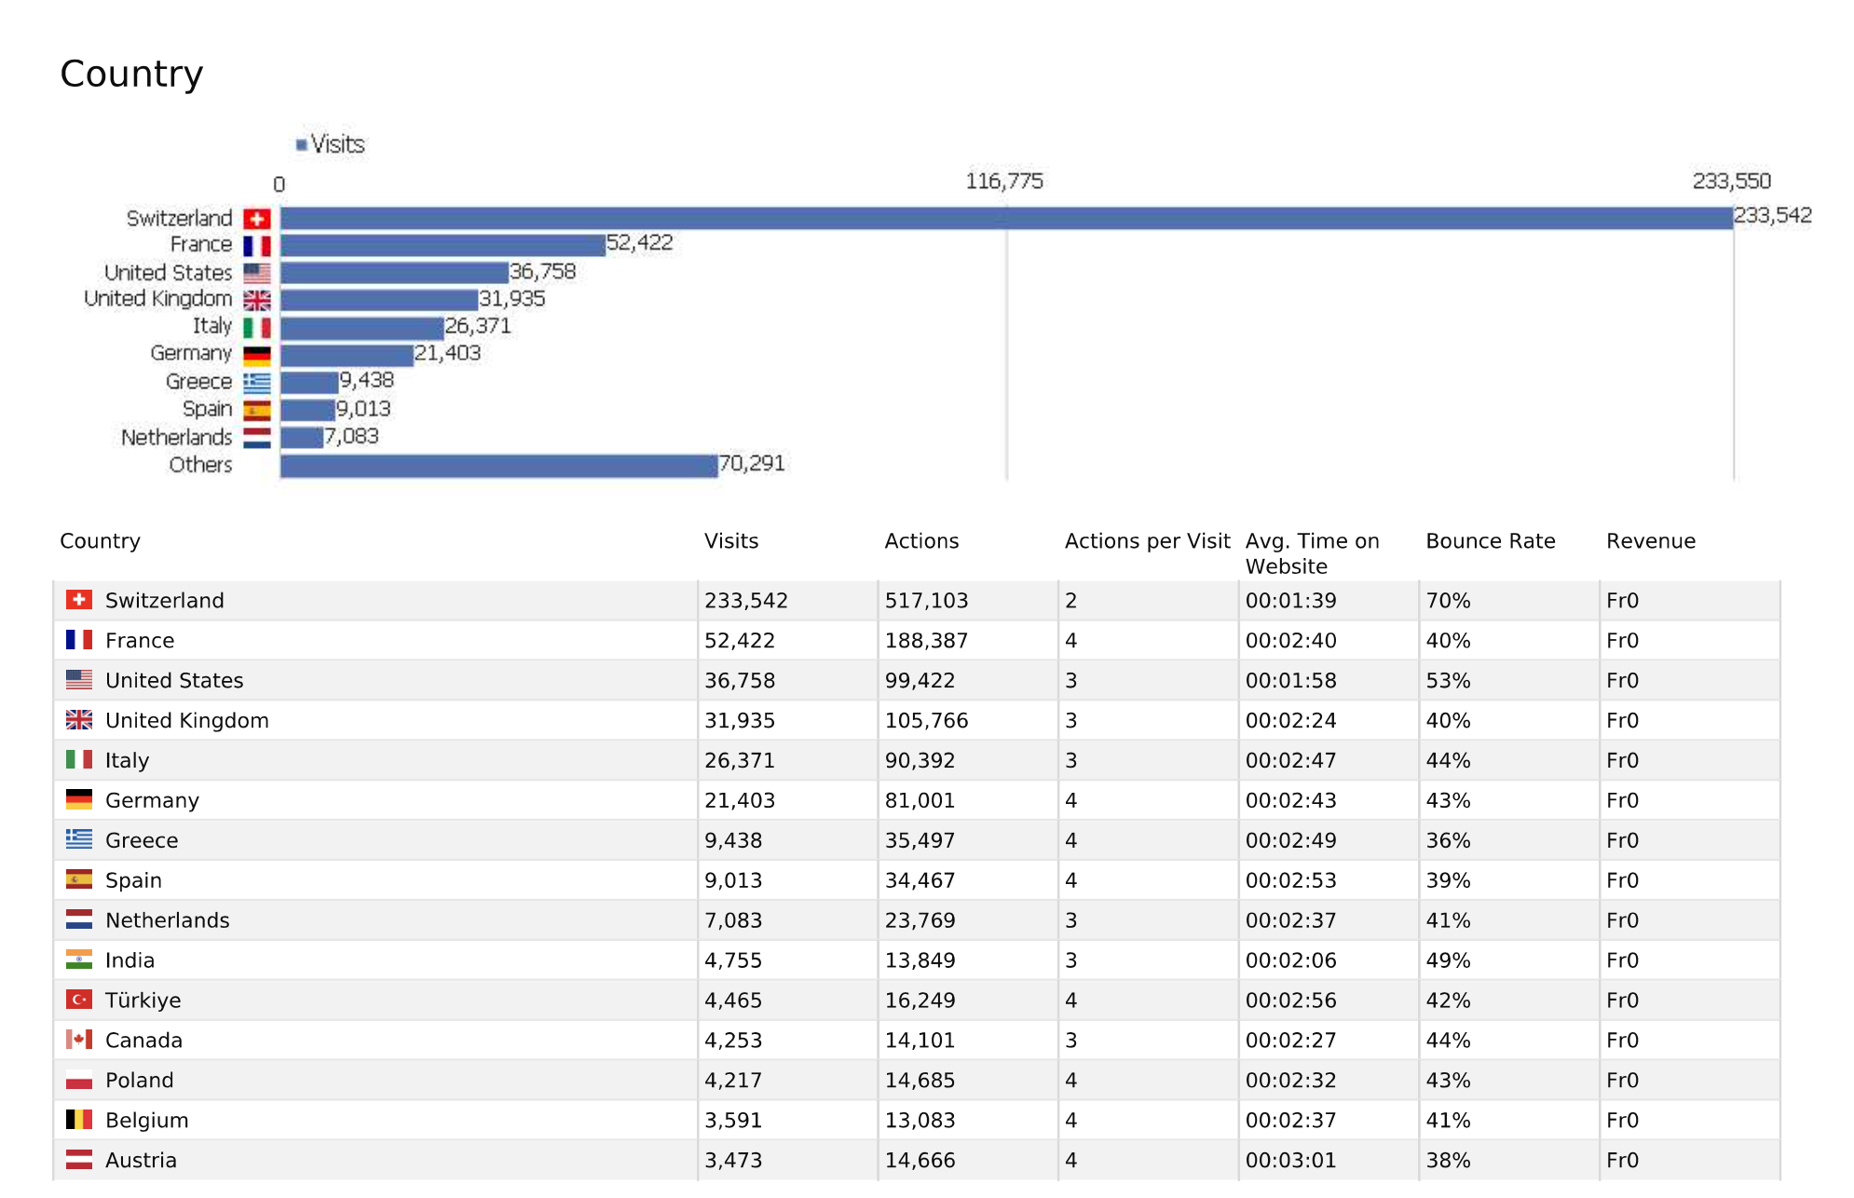
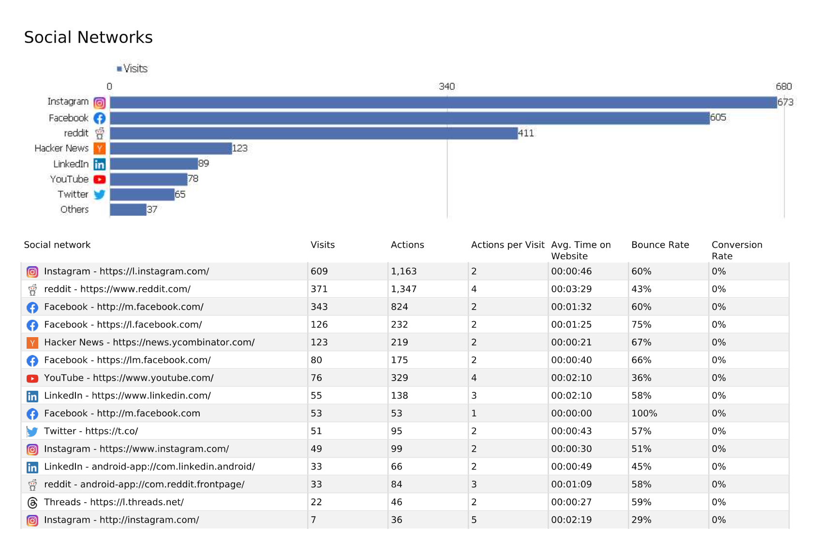
Visit.cern
Results

Slide 17
Any questions or comments?

Slide 18
Thank you!

