Slide 1
Public Event Advisory Board – 26 June 2025
Meeting Q2

Slide 2
Agenda
Review of 2025 season Quantum!
Upcoming events: STELLAR
Review of 2025 season Quantum!: communication campaign
2025-2026 season: discussion and target audience
Sparks! 2026
Other event proposals?

Slide 3
Members
Antonella Del Rosso
Barbara Solich
Chiara Mariotti
Enrique Rico Ortega
François Briard or Loraine Massarotti
Frederick Bordry
Louise Carvalho
Malika Meddahi
Manuela Cirilli
Mélissa Gaillard
Paola Catapano
Dante Larini (Chair)
Zoe Nikolaidou (Deputy Chair)

Slide 4
Refresh: Public Events Strategy Missions
1 Deliver a yearly season of event programming by following a key theme for CERN
2 Seek cohesion and diversity in the choice and format, including through the arts and pop culture, with the aim of offering a programme accessible to all.
3 Strengthen our audience from the region, further integrating with the local cultural, artistic, business, civil society and educational scene through partnerships to seek synergies and collaborations.
4 Apply principles of multidisciplinarity, diversity and inclusiveness in the event curation, designed to cater to a wide & varied audience.
5 Ensure a high quality, cost efficient and well organised event architecture, living up to high standards and seeking frequent feedback.
6 Position public events as a valuable platform for CERN experts to not only promote their research, but also connect the dots with existing or potential partners.
7 Bring cohesion throughout CERN regarding public events by engaging and collaborating with internal partners

Slide 5
1. Review of season 2025 Quantum!

Slide 6
Season 2025 assessment
Date | Event | Venue | Attendance | No-show rate | Rentabilité BBC | CERN recording views to date | Youtube views to date
05.Feb.25 | Art & Science Summit | SG A | 215 | 22% | \ | \ | 3800
11.Feb.25 | De temps en temps | SG A | 300 | 17% | Non | Not published | \
20.Mar.25 | Les dieux et le Père Noel | SG ABC | 470 | 11% | Oui | 579 | Info not available
09.Apr.25 | Ateliers Super Quantum | Lab A | 37 | 8% | \ | No recording | \
09.Apr.25 | Super Quantum | SG A | 210 | 42% | Non | 1554 | \
26.Apr.25 | Girls in ICT | Lab A | 96 | \ | \ | No recording | \
14.May.25 | CineGlobe - Total | SG A+BC+Globe+Piazza | 1100 | \ | Non | \ | \
14.May.25 | CineGlobe - Opening night | SG A | 220 | 34% | Non | Not published | \
16.May.25 | CineGlobe - Award | SG A | 92 | 37% | Non | Not published | \
17.May.25 | Nuit des Musées | SG ABC | 900 |  | Oui | \ | \
27.May.25 | Réunion FCC | SG A+Lower foyer | 170 | 35% | Non | 539 | 430
19.Jun.25 | Sparks! | SG ABC | 420 | 41% | Oui | Not published | 3600
Total |  |  | Attendance | No-show
 |  |  | 3918 | 27%

Slide 7
2. Upcoming events: STELLAR

Slide 8



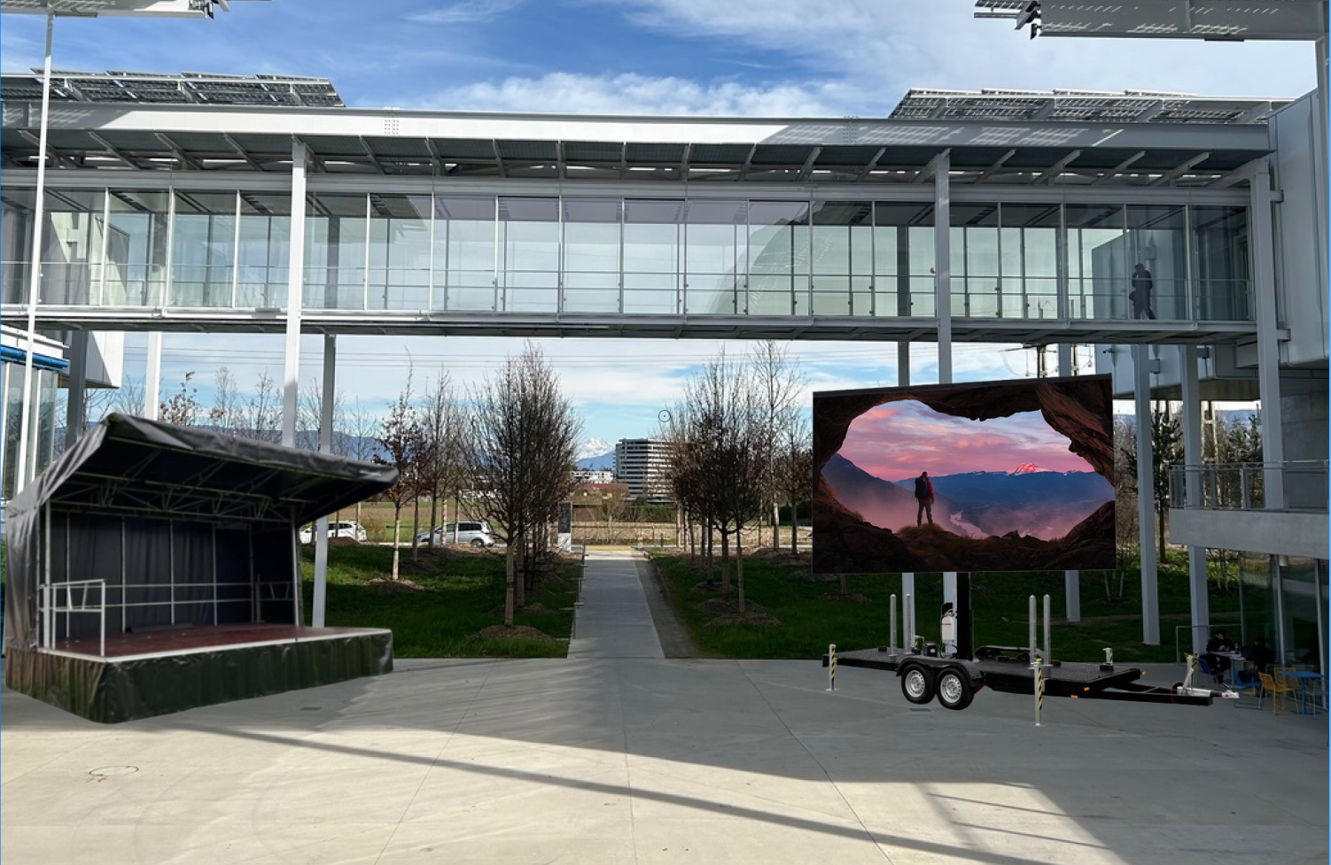

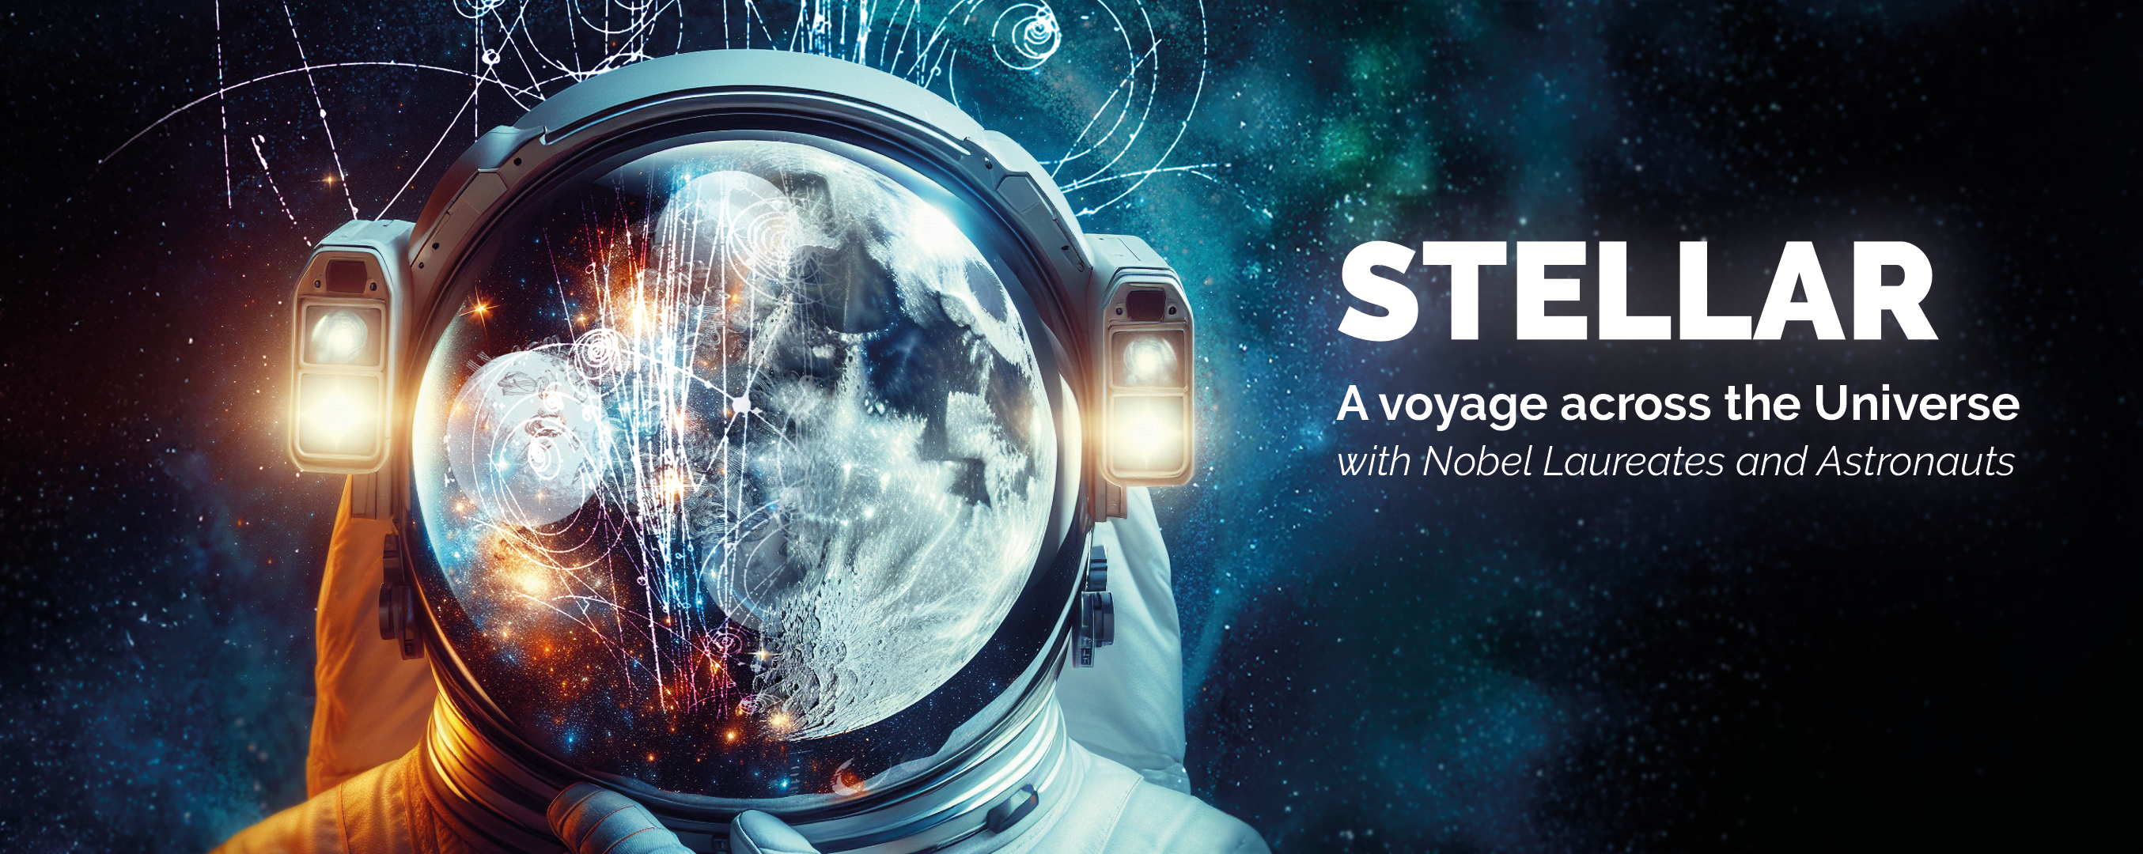
STELLAR: A voyage across the Universe with Nobel Laureates and Astronauts Saturday 19 July – 16h to midnight, Science Gateway
A joint event of the IUPAP, the University of Geneva and CERN, in the context of the International Cosmic Ray Conference 2025
Conferences in the Auditorium and live music on the SG Piazza
Speakers confirmed:
  CERN
  Opening remarks by Fabiola Gianotti TBC
  Clara Nellist
  Nobels:
  Michel Mayor
  Sam Ting
  Takaaki Kajita
  Barry Barish
  Astronauts:
  Paolo Nespoli
  Matthias Maurer
  Meganne Christian
  Luca Parmitano (remote)
  Chris Cassidy
  Astrophysicists
  Teresa Montaruli (UNIGE)
  Patrizia Caraveo (INAF)

Slide 9
3. Review of season 2025 Quantum!
Communications campaign

Slide 10
  CERN proposes events for everyone
  CERN is a place for artistic enquiry
  Science Gateway is a physical encounter between researchers and children, visitors and physicists, tourists and scientists, all driven by curiosity and the thirst for knowledge
  Come to Science Gateway to get informed, engaged, entertained
  Explore a new scientific theme every year
Key narratives & messages
Tourist attraction - Scientific and cultural place to visit
CERN is a place to communicate around science
Public events are a platform for CERN researchers to communicate with non-researchers and promote their work to a broader audience
Education - Discover a scientific theme
Science - Value the scientific work of CERN community

Slide 11
Target audiences & channels
Local communities
Voisins website / Local magazines, websites / Geneva tourism office
General public
Visit.cern / Newsletter / Screens in GW / Social media / TPG
Teachers and students
TSP channels
Media (as a vector)
Press briefing / Press release
CERN community
Bulletin / Screens in R1,2 / Posters at CERN / Experiments channels
Scientific community
Alumni channels / UNIGE
Industry
KT, OQI, Ideasquare channels
Donors
CERN & Society Foundation channels

Slide 12
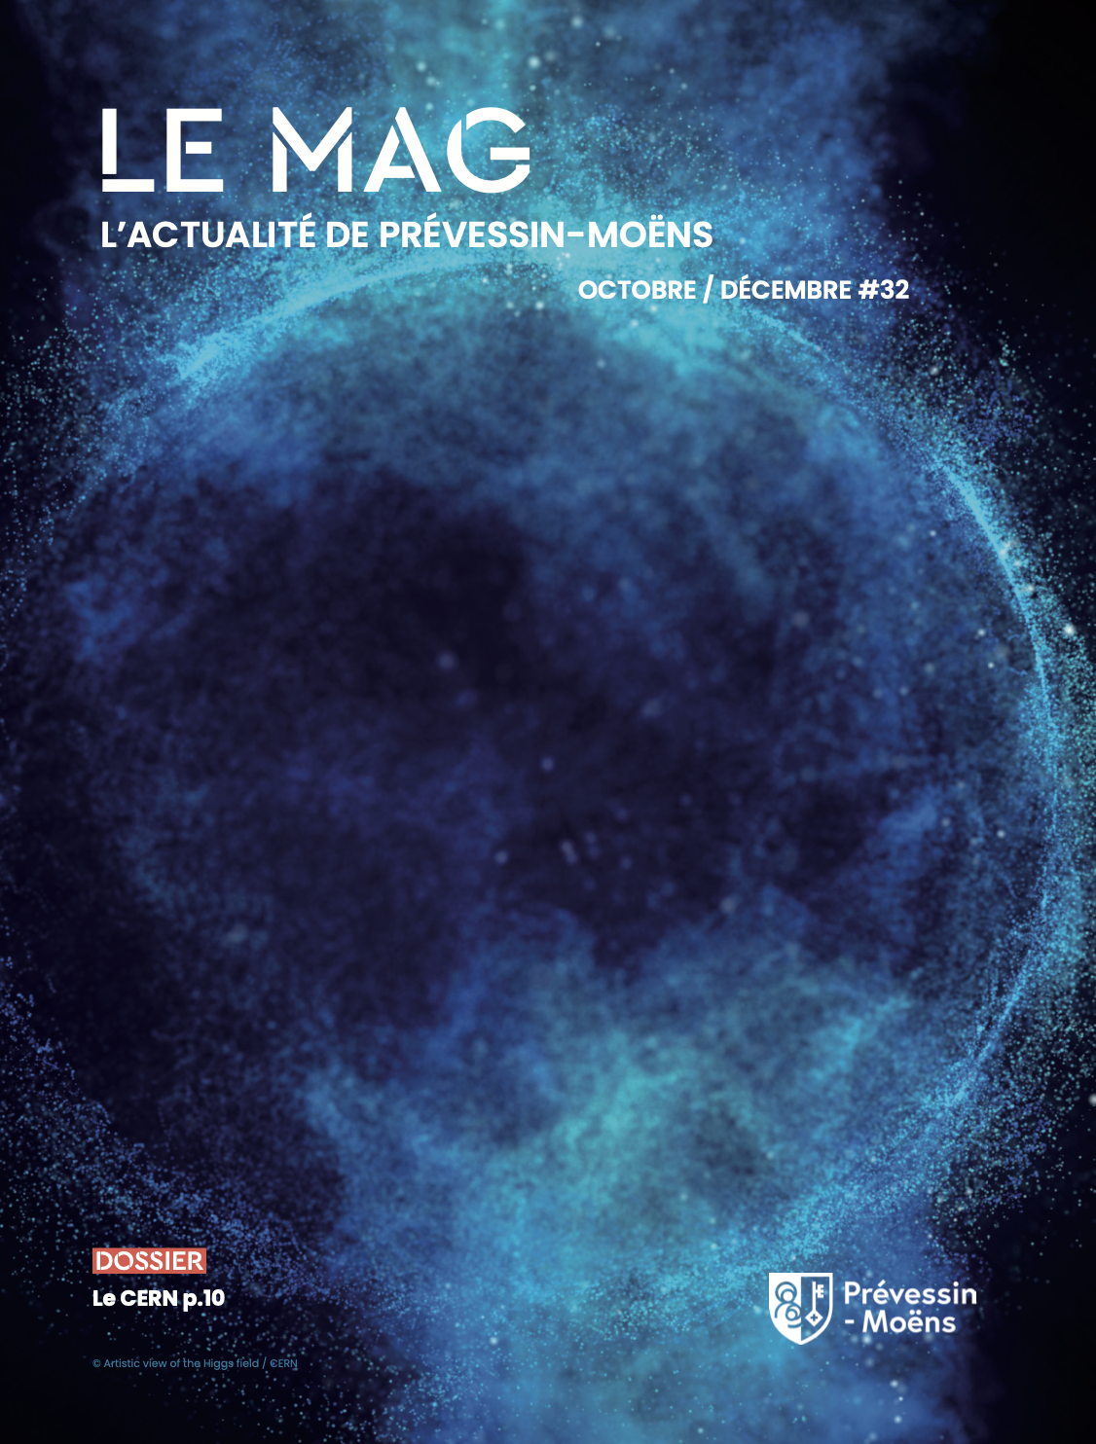
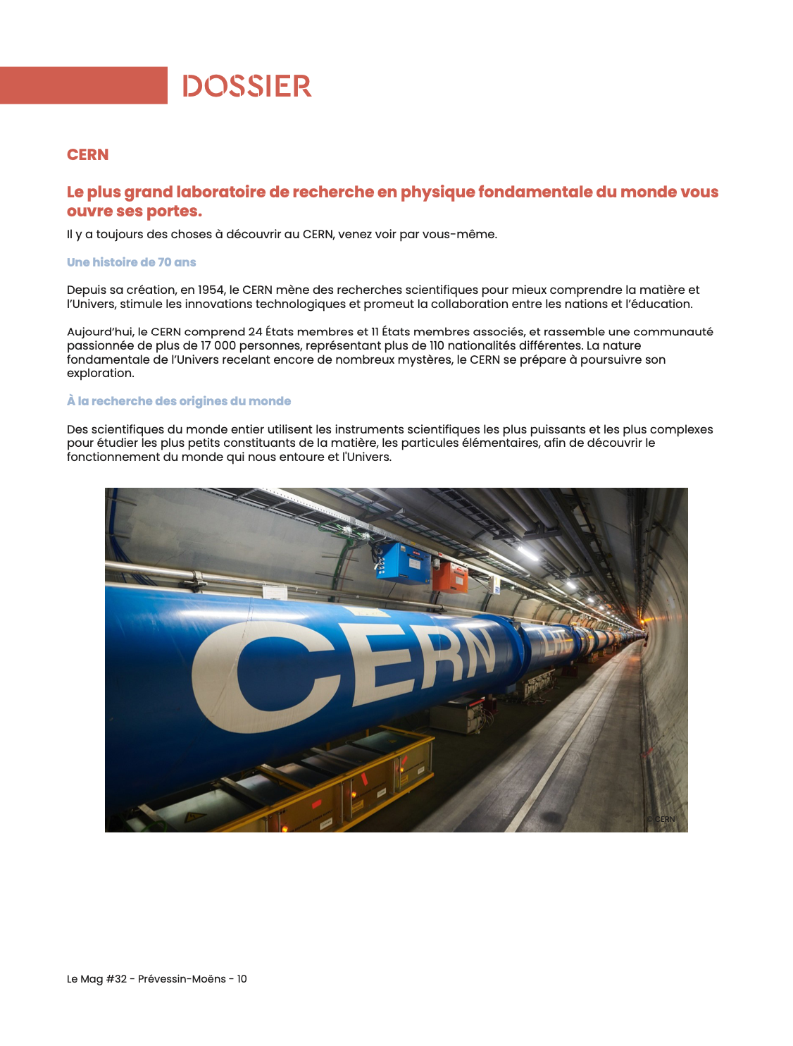
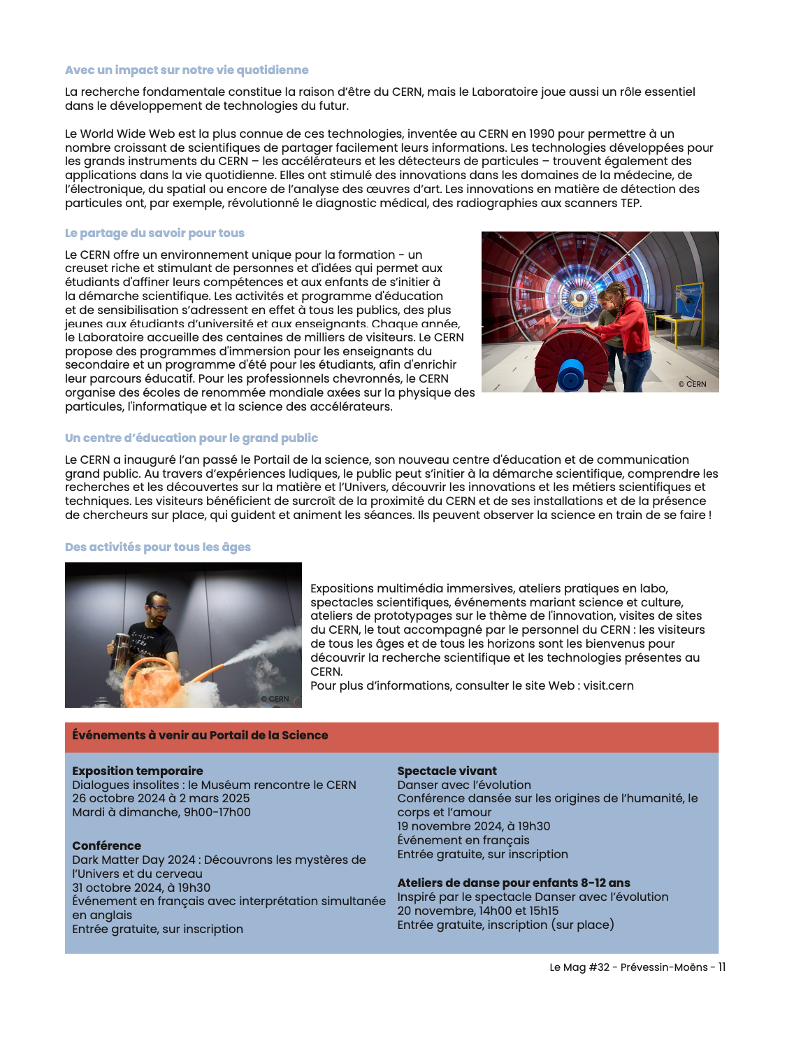
Free publication - local magazine
Featured article on the Science Gateway in the free municipal magazine of Prévessin-Moens (edition: October-December 2024)
Half a page dedicated to CERN public events in each edition
Distributed to more than 9000 habitants

Slide 13
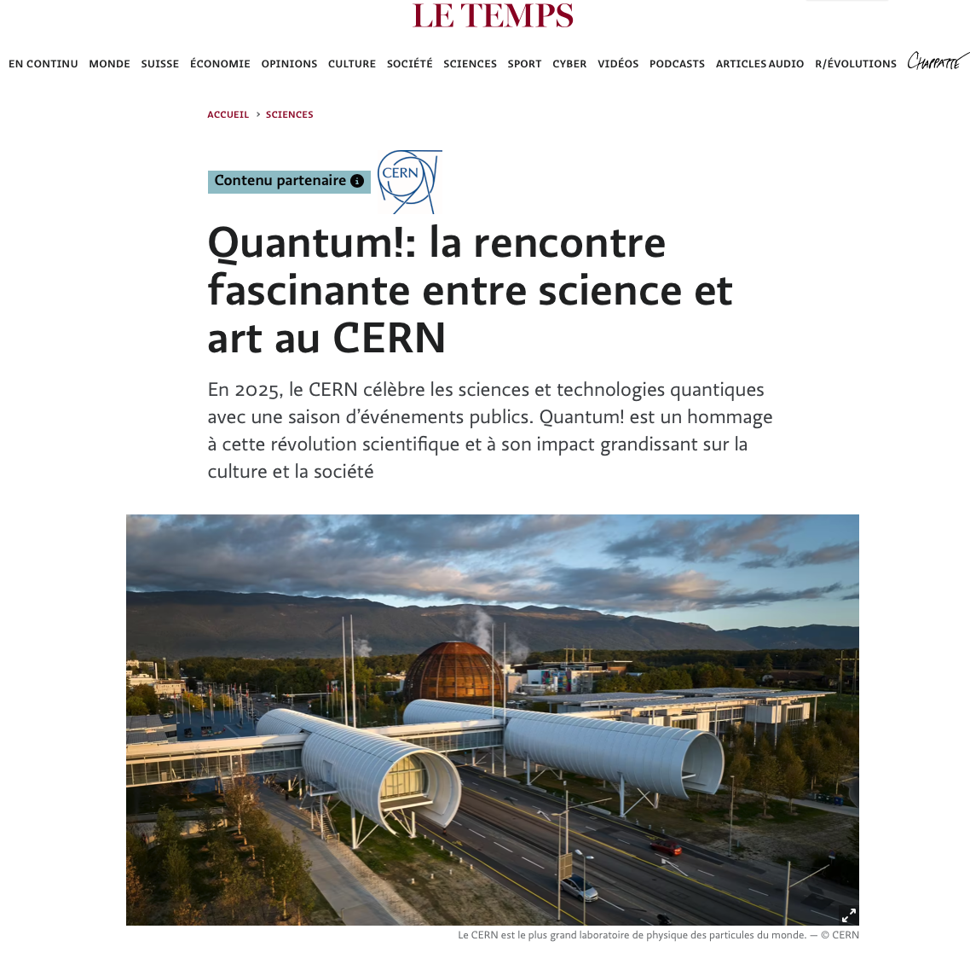
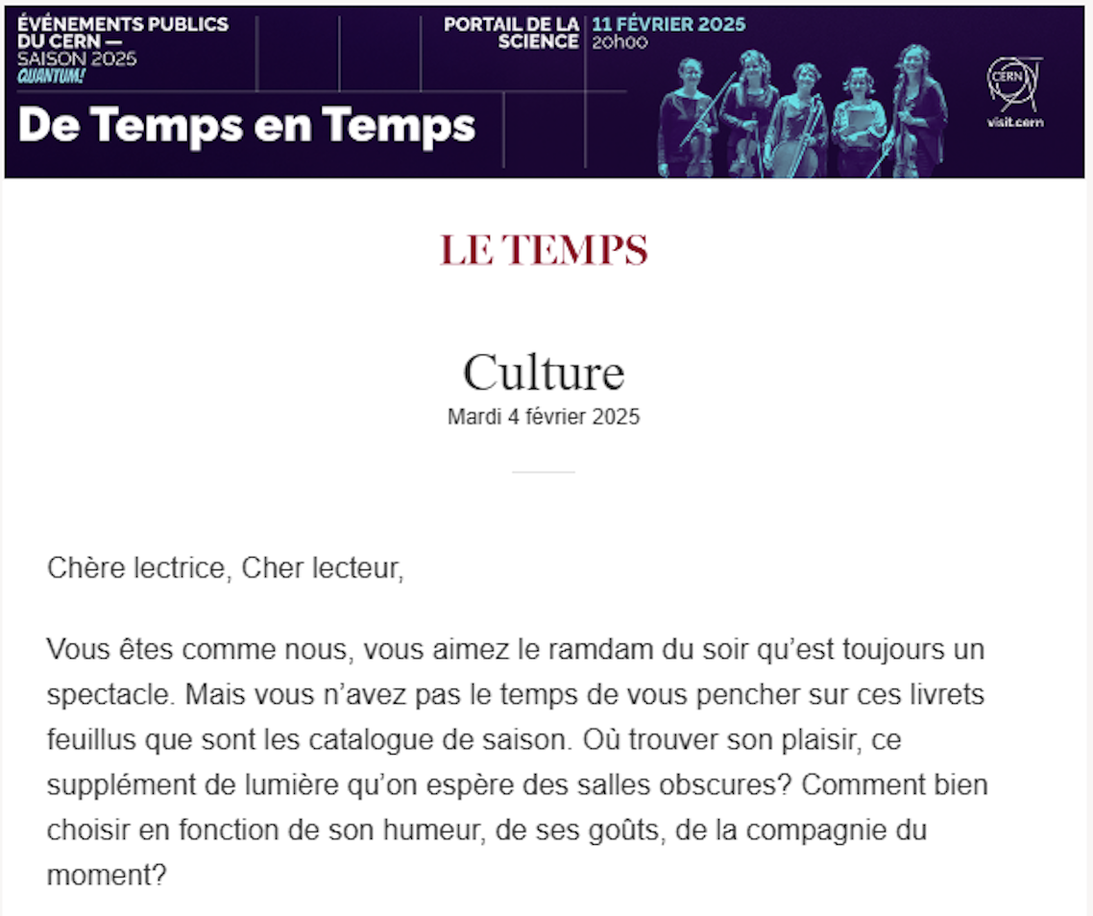
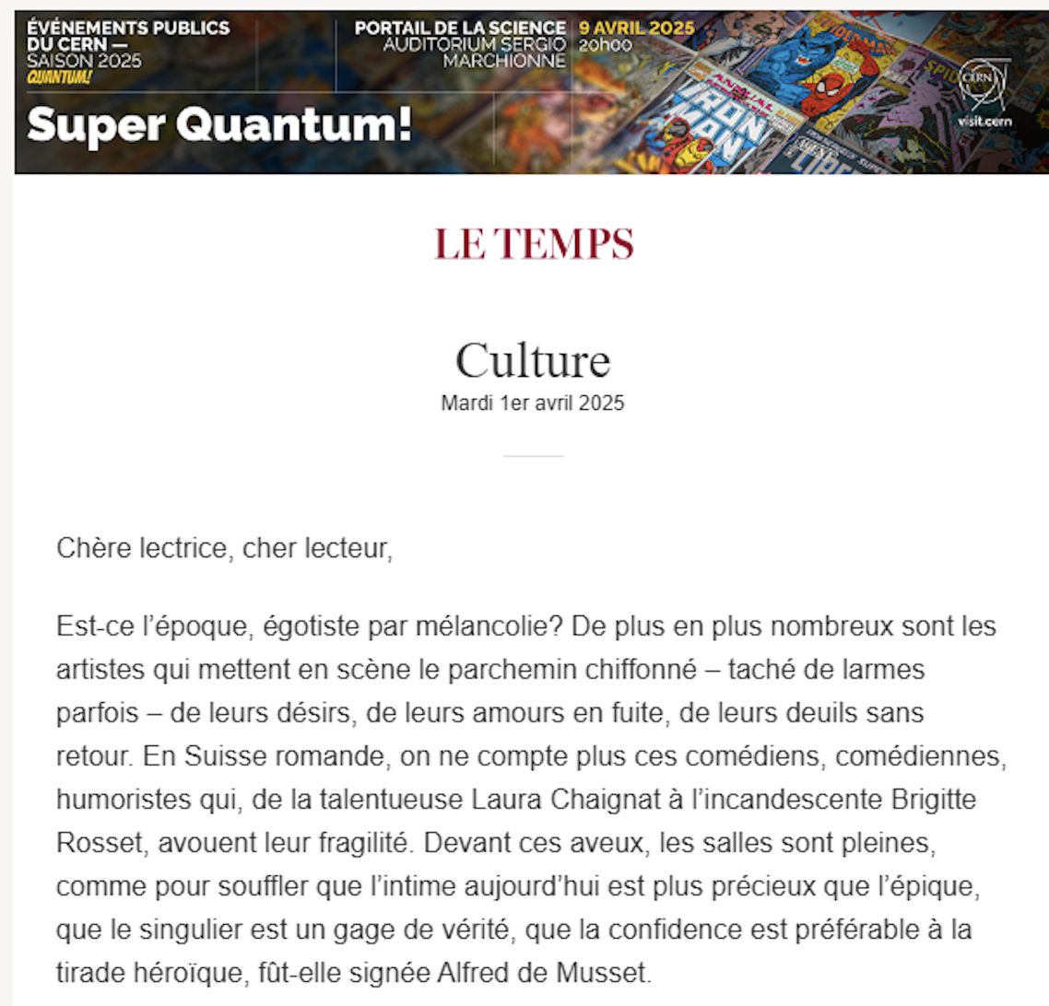
Paid campaign - Le Temps online
Dedicated article introducing the Quantum Season in January
Promotional banners in the digital Culture newsletter for all events
More than 30 000 impressions

Slide 14
Paid campaign - Le Temps online
Results

Slide 15


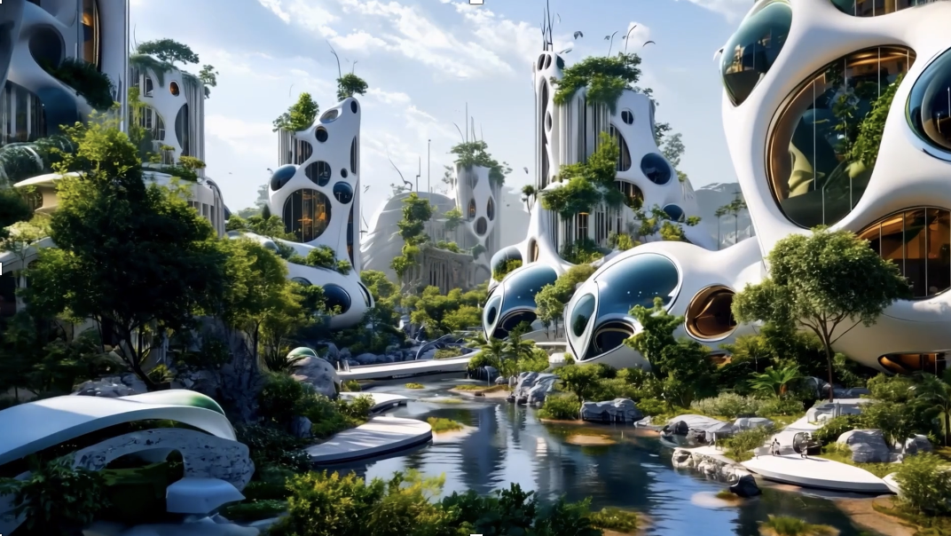
Free advertising on TPG
Projected in more than 1500 screens and 600 000 people per day
Trailer promoting the Quantum! season
Individual trailers for each event

Slide 16
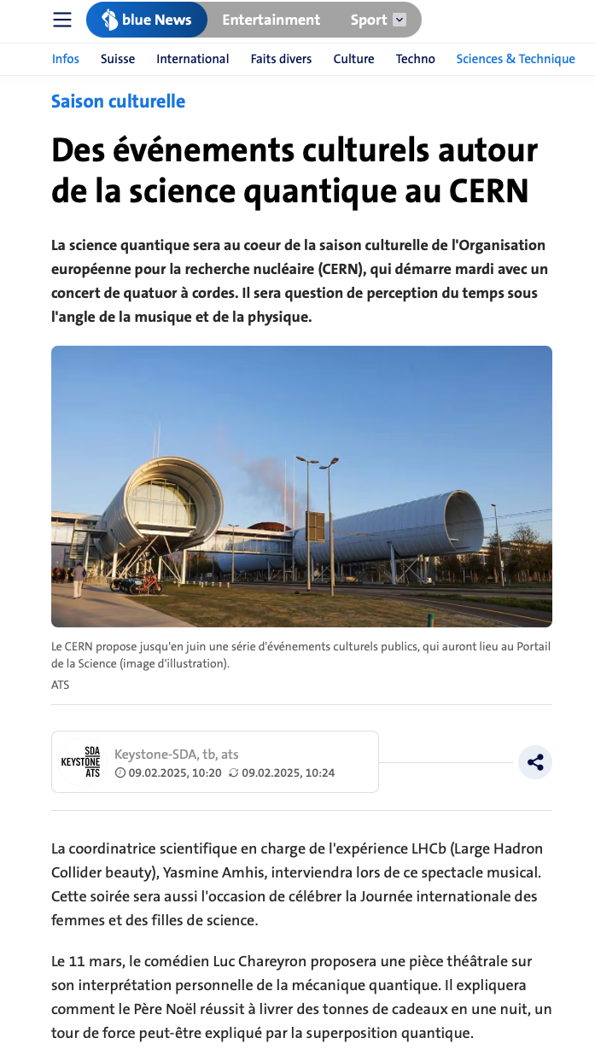
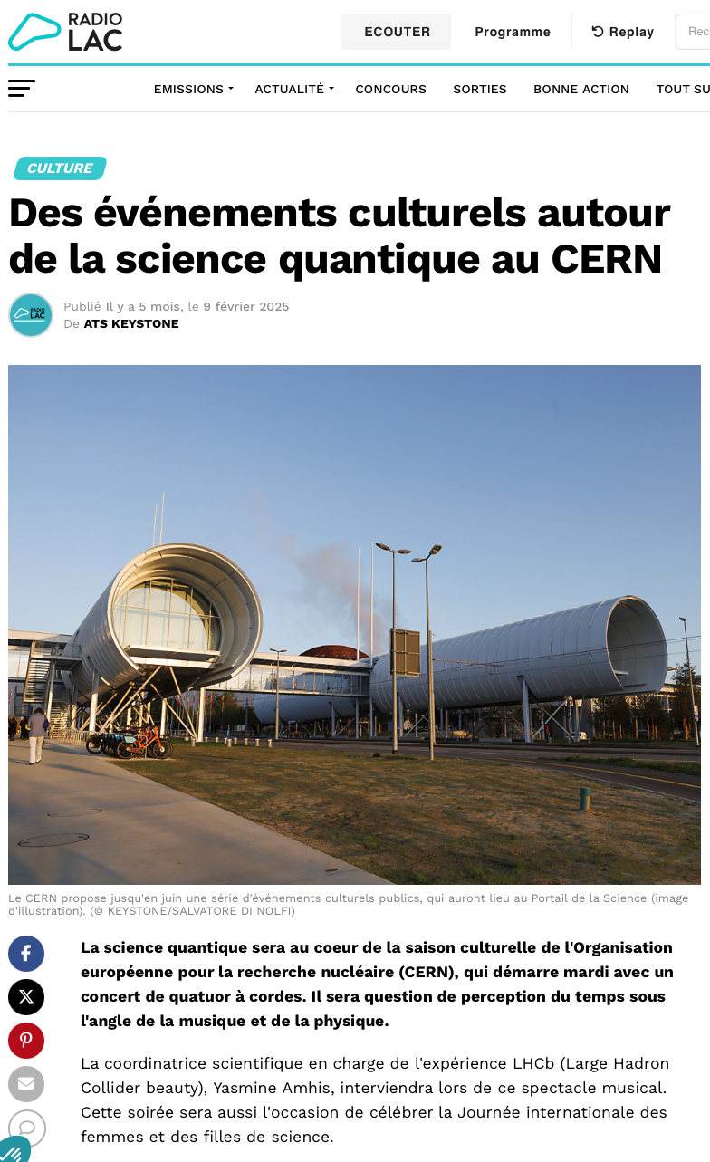
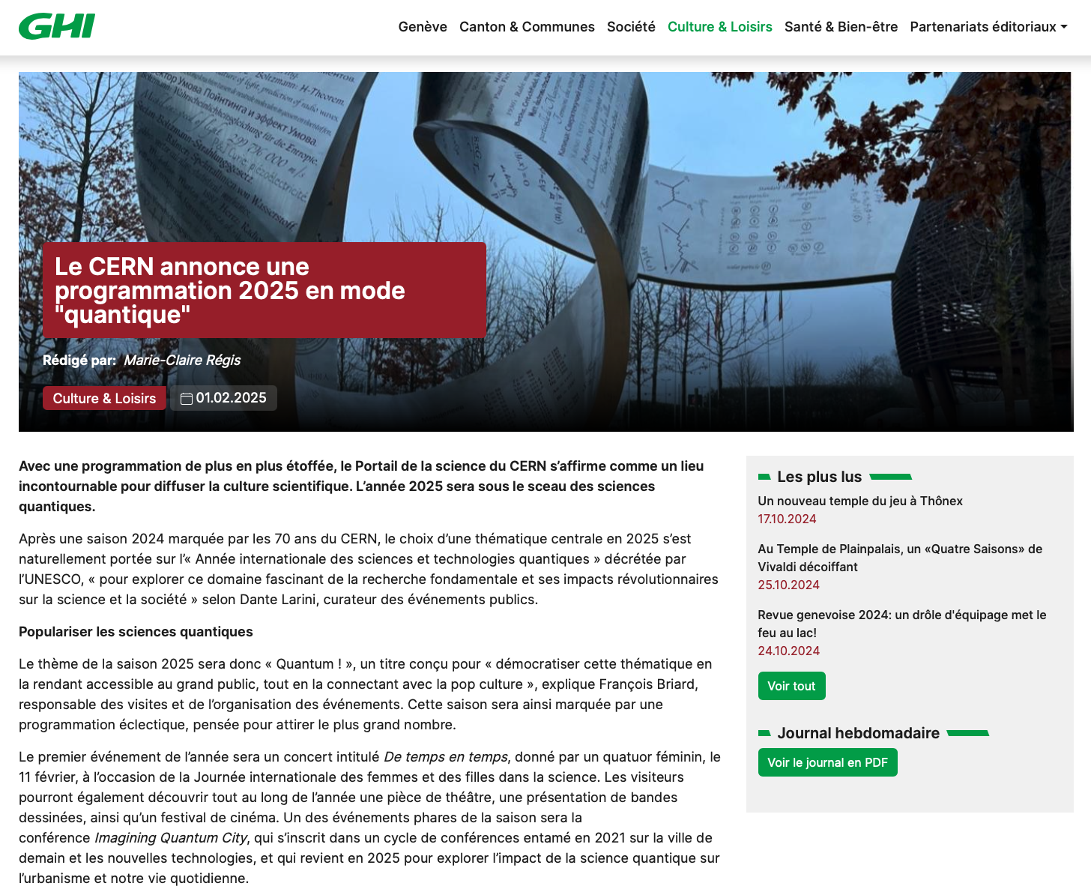
Presence in local media

Slide 17
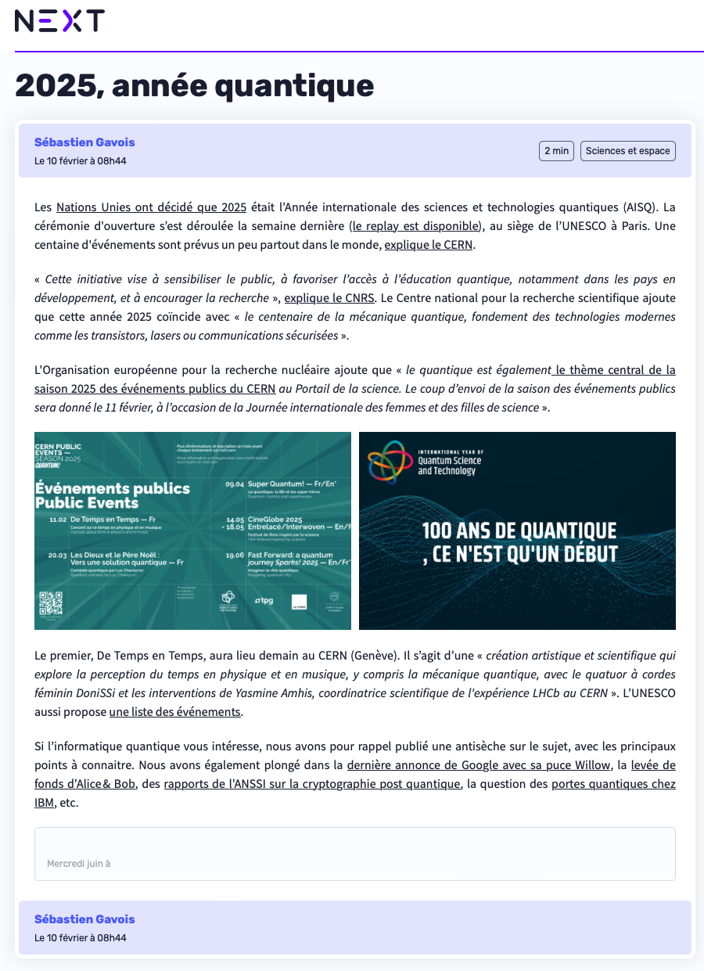
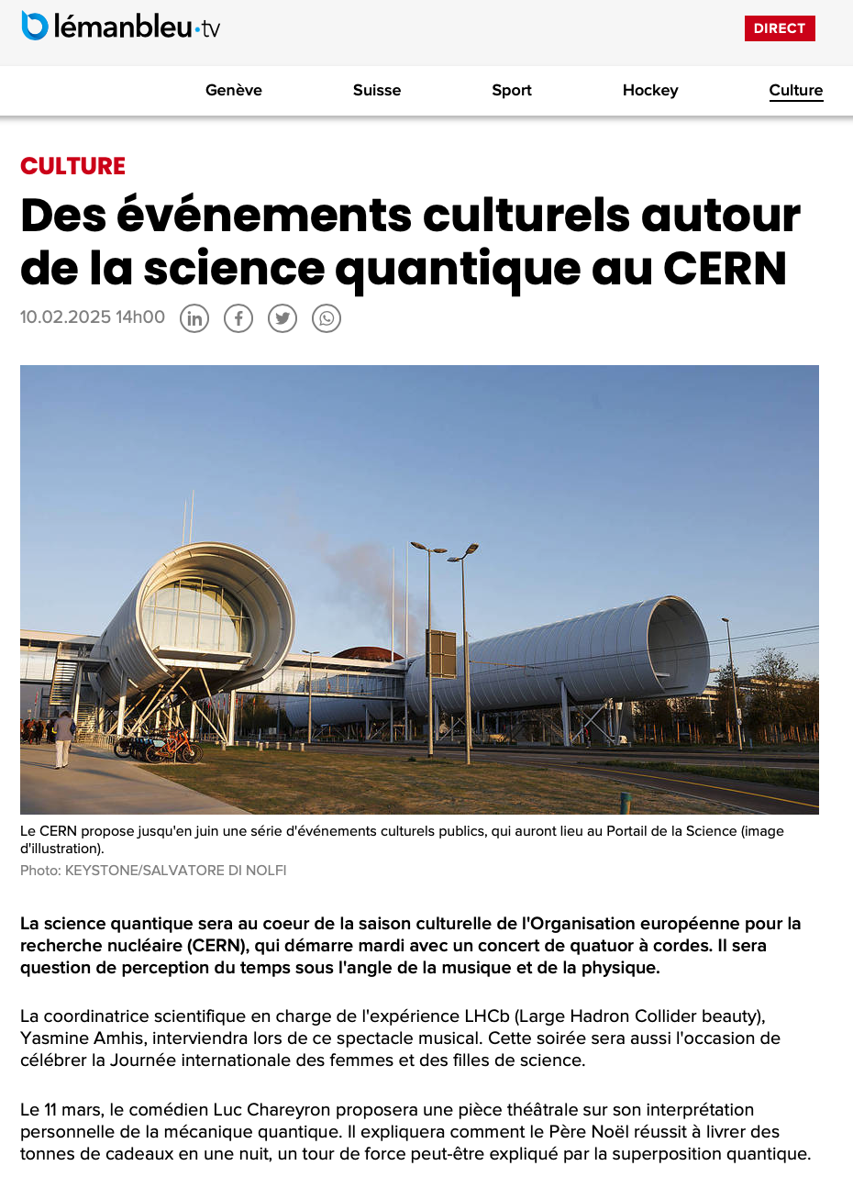
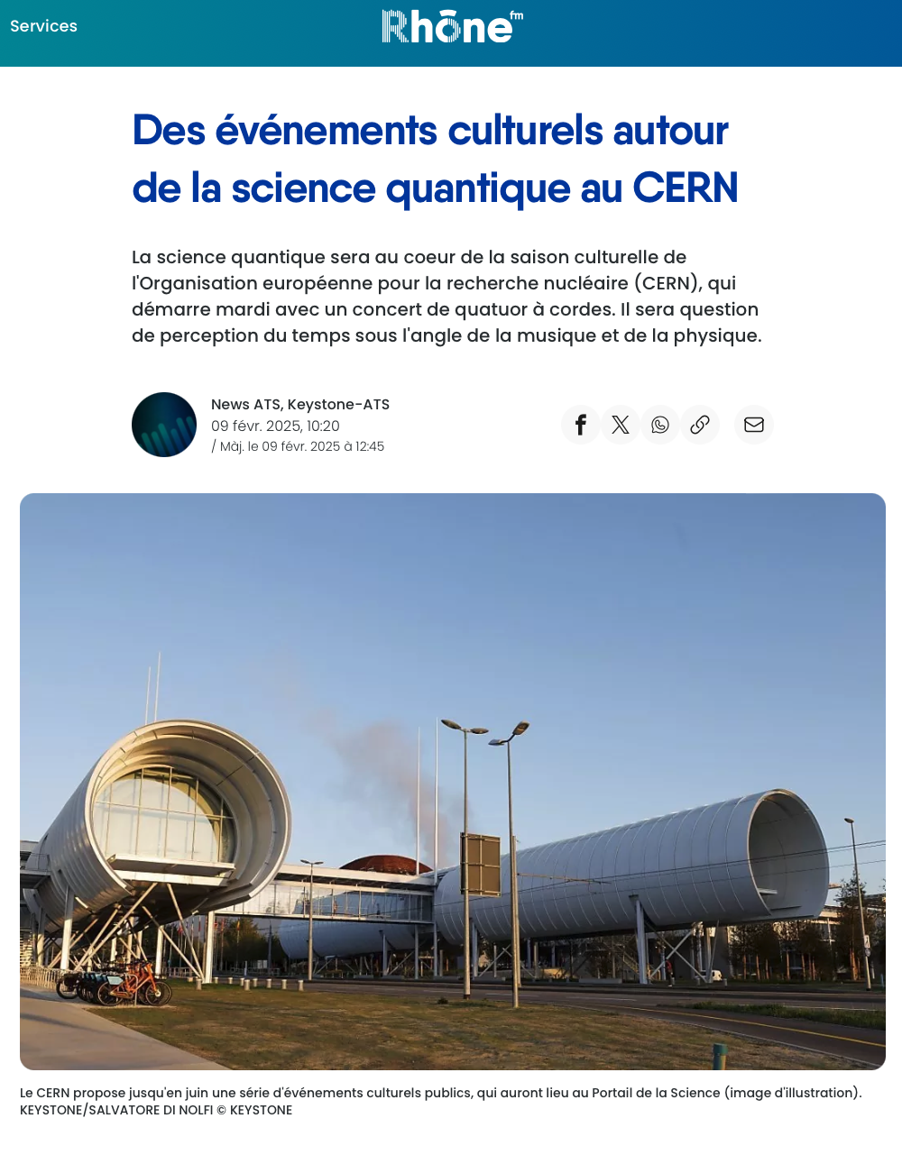
Presence in local media

Slide 18
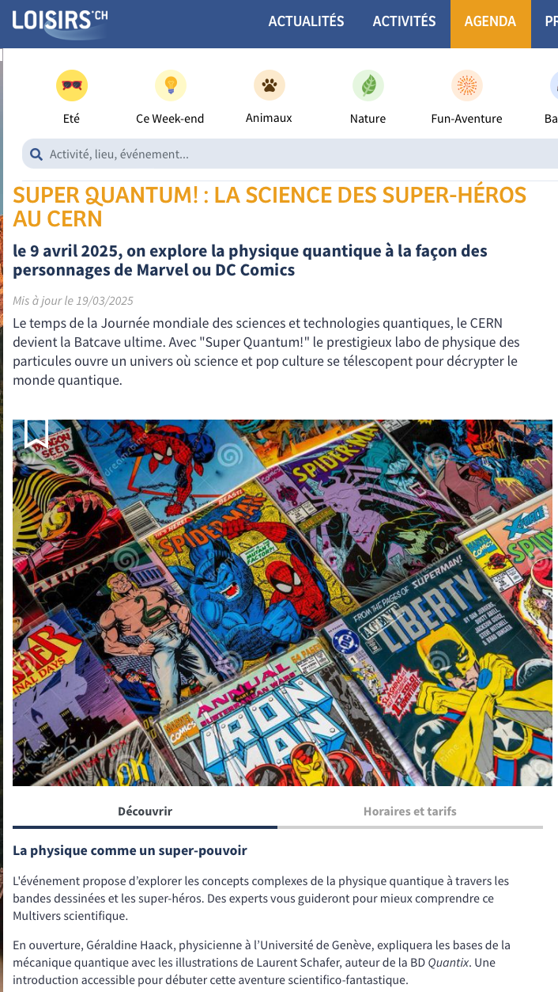
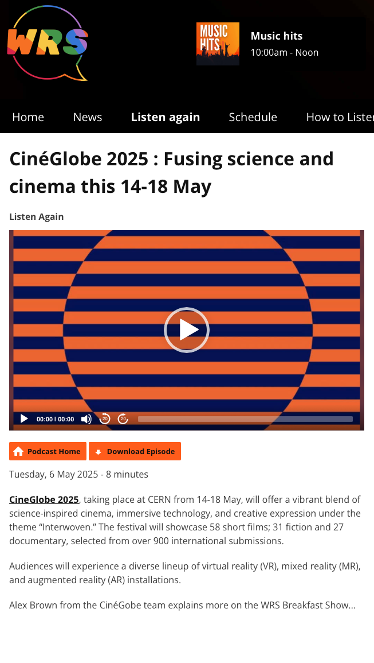
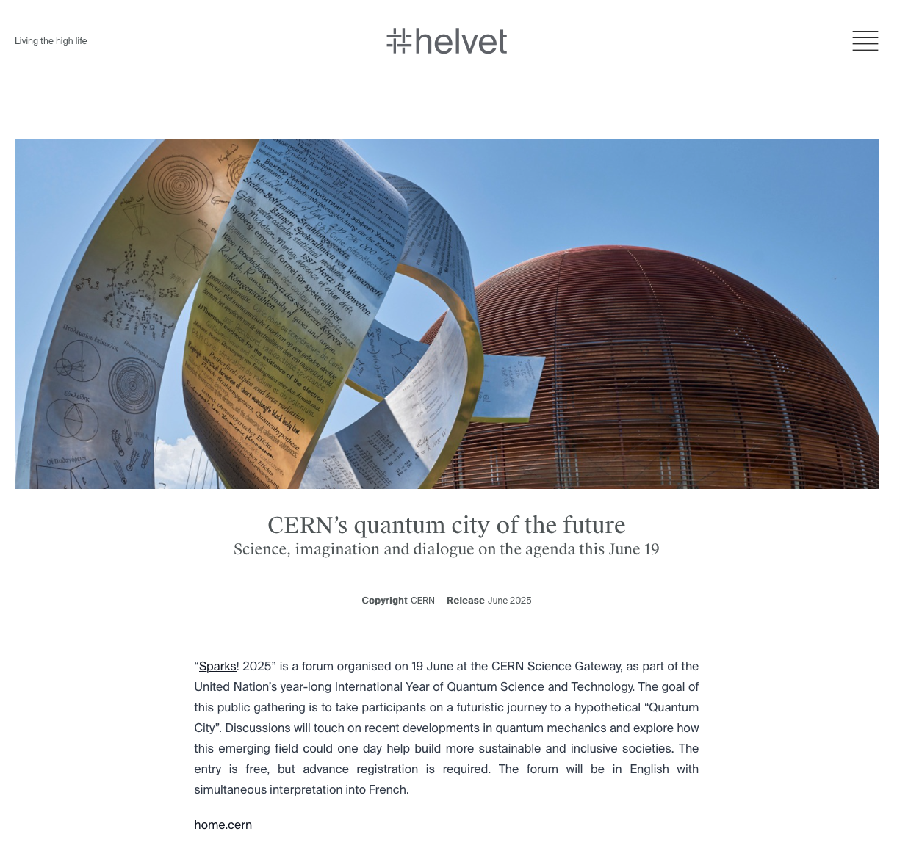
Presence in local media

Slide 19
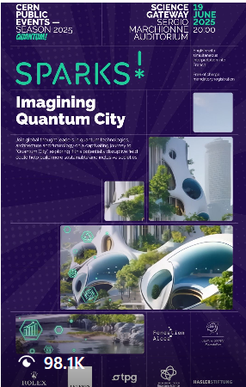
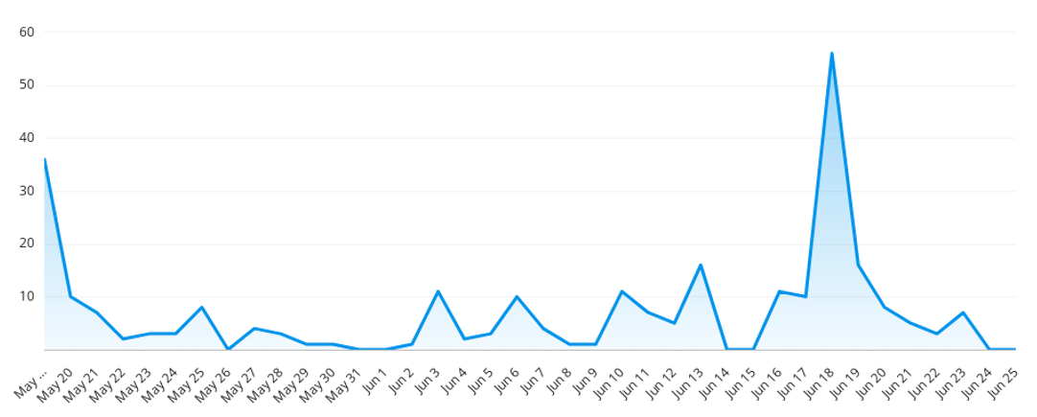
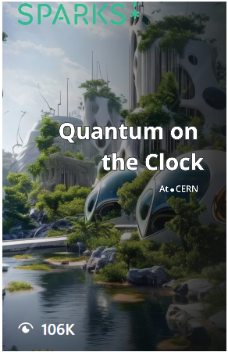
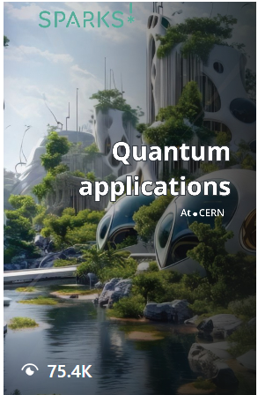
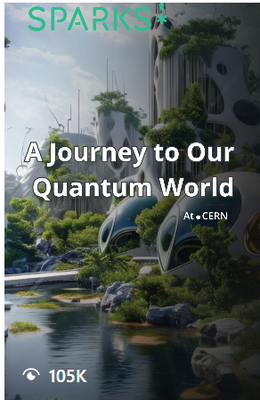
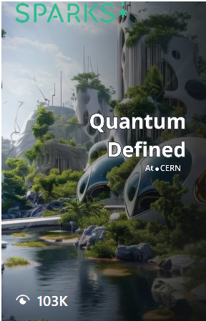
Social media coverage
Promotion across CERN’s social media platforms, before and after the events
Four videos, one story and one official trailer shared
Campaign Timeline: 19 May - 19 June
Hashtags used: #CERNSparks #Quantum Cities
5.16 million Total Impressions
37.8 million Reach
231 Total Mentions (74% higher than previous period)
22.8k Total Engagements (52% higher than previous period)
1181 Link clicks (to Indico page + Livestream) *Mostly from Linkedin post
713469 video views across all platforms
Top countries: US, Switzerland and UK
Most engaging posts
Most engaged audience: Instagram
*stats are subject to change overtime (Analysis covered 19 May - 24 June)
Tyra Kaddu-Mulindwa | CERN Digital Communications Team

Slide 20
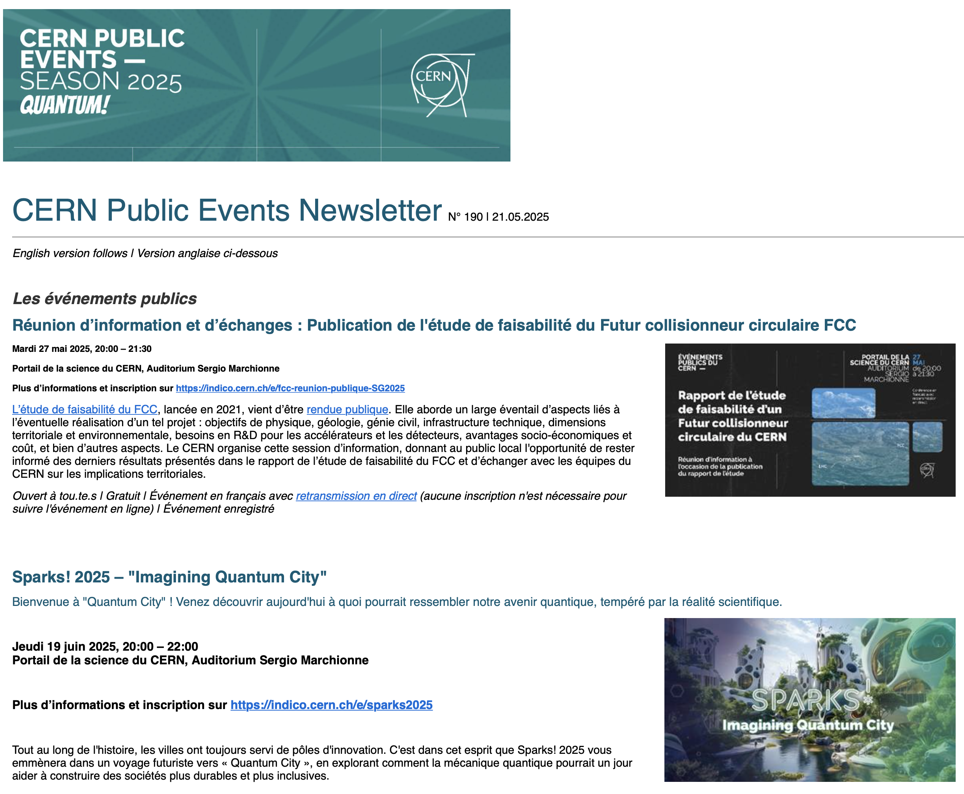
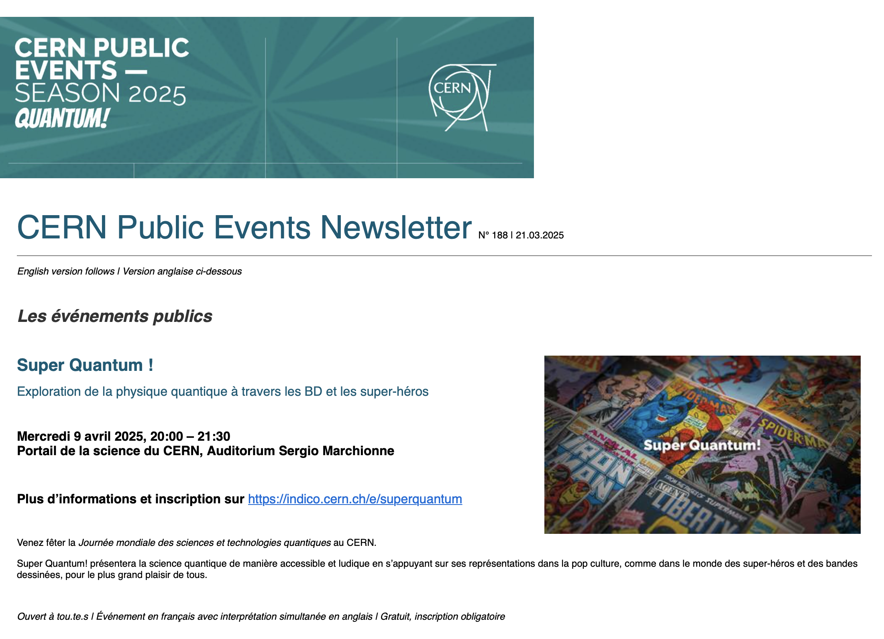
Newsletter
More than 13 000 subscribers
La newsletter et le site visit.cern sont les principaux canaux de communication pour les événements publics.

Slide 21
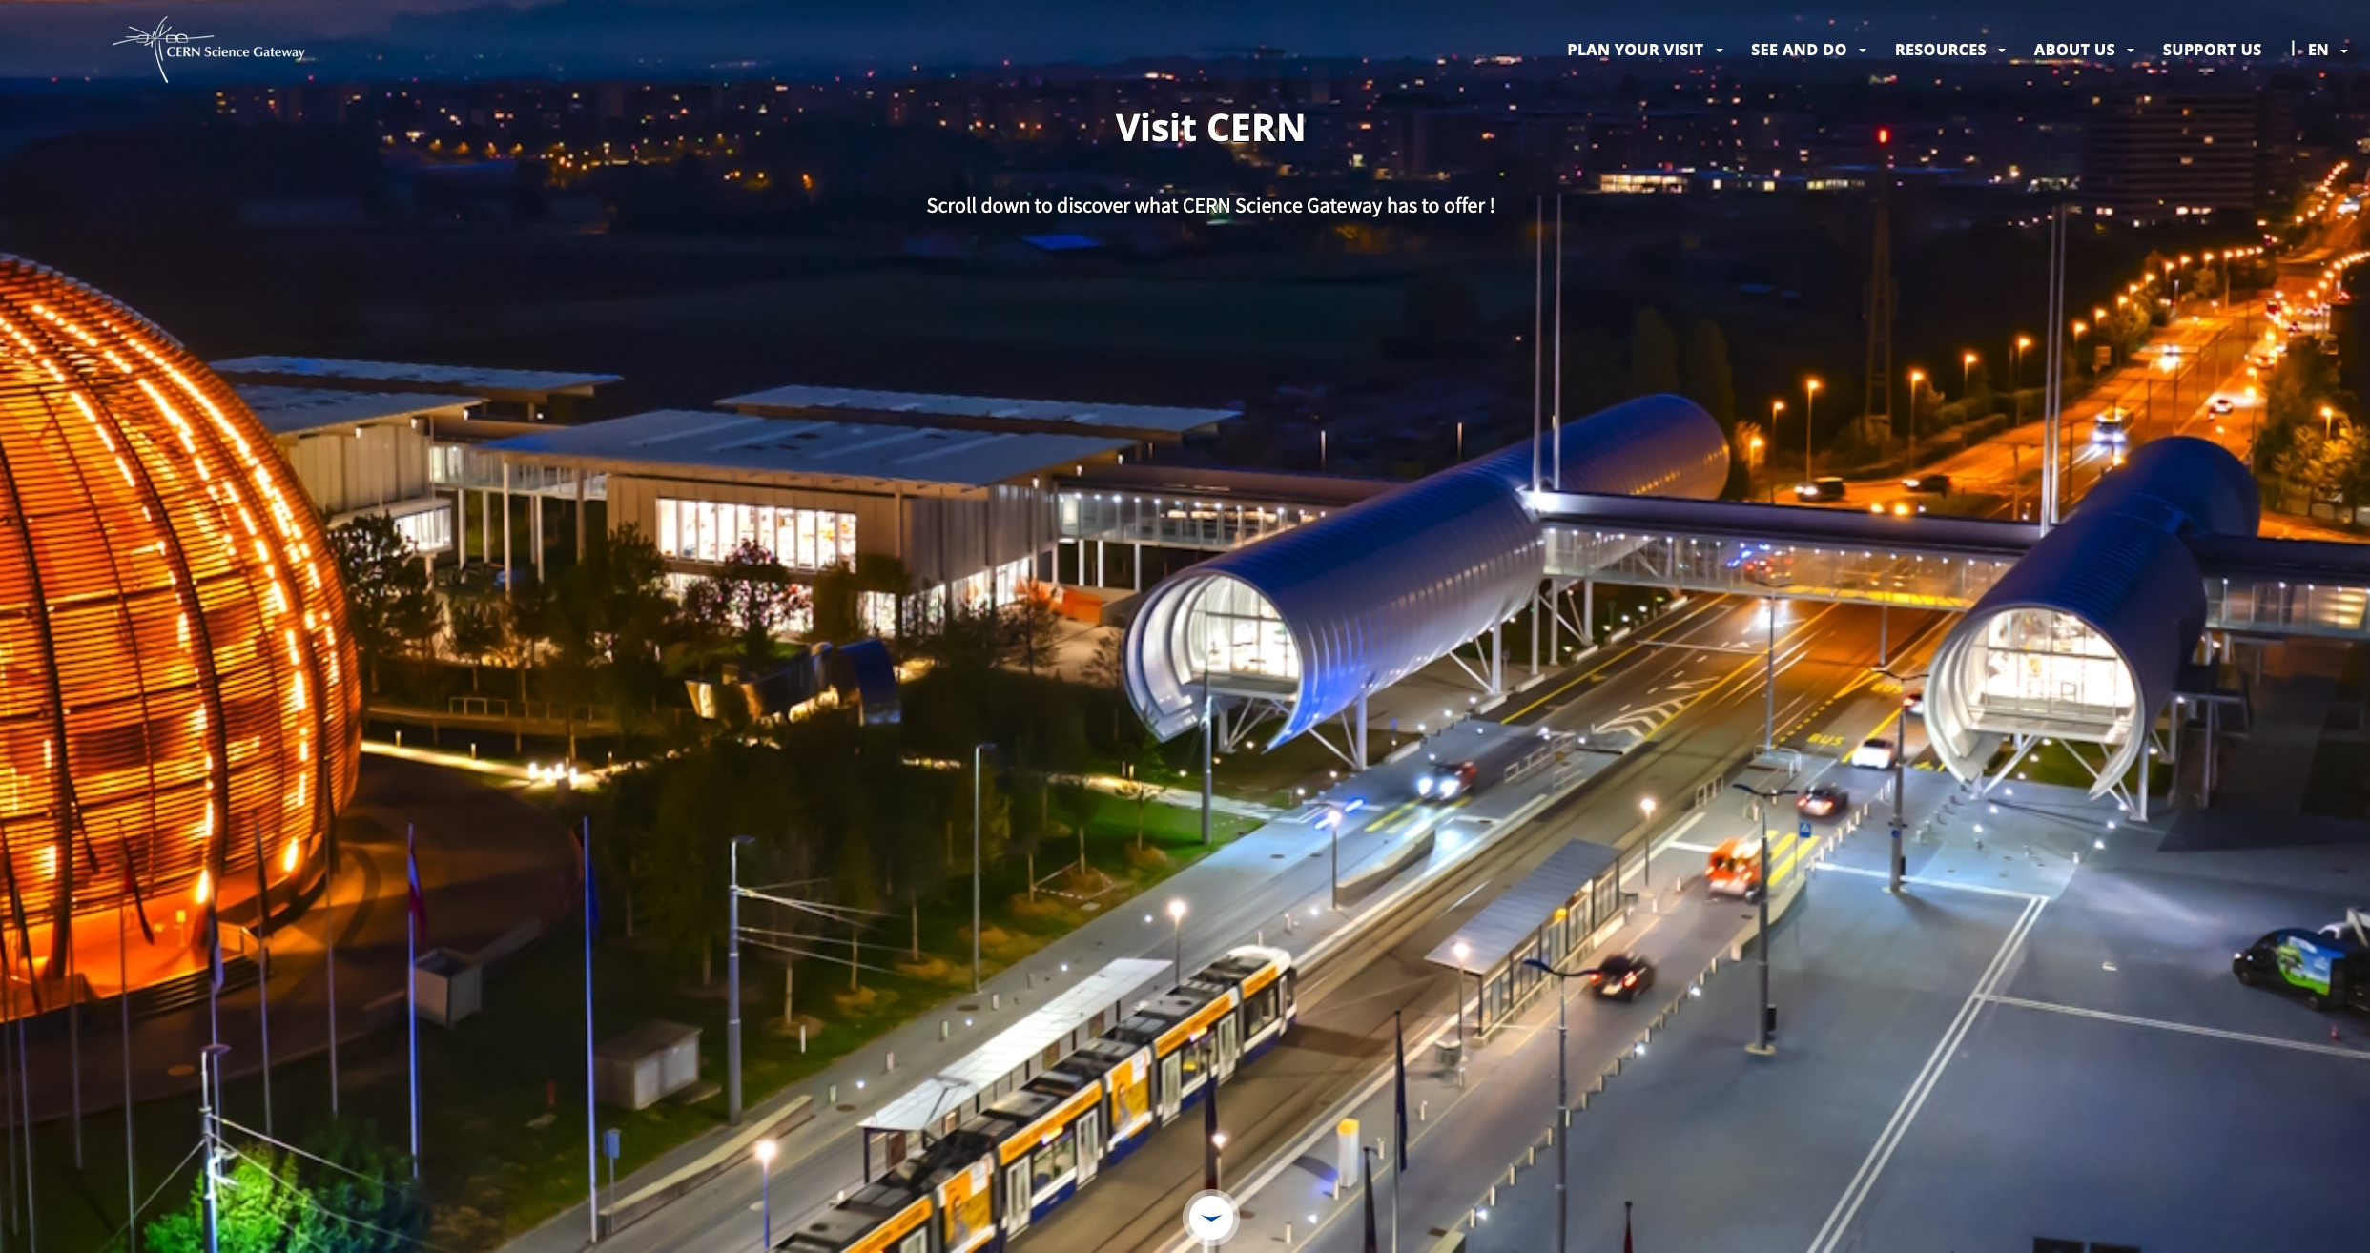

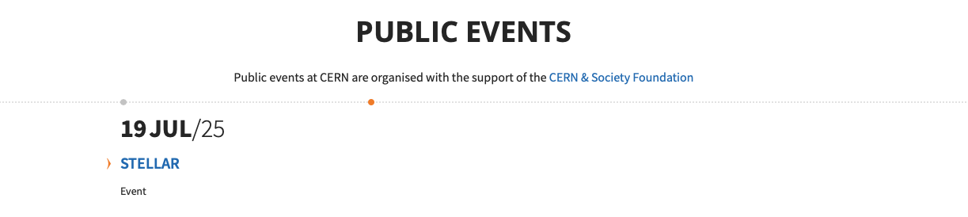
Visit.cern
More than 360 000 unique visitors since January
Public events consistently featured on the homepage of visit.cern
Highlights and Public Events sections

Slide 22
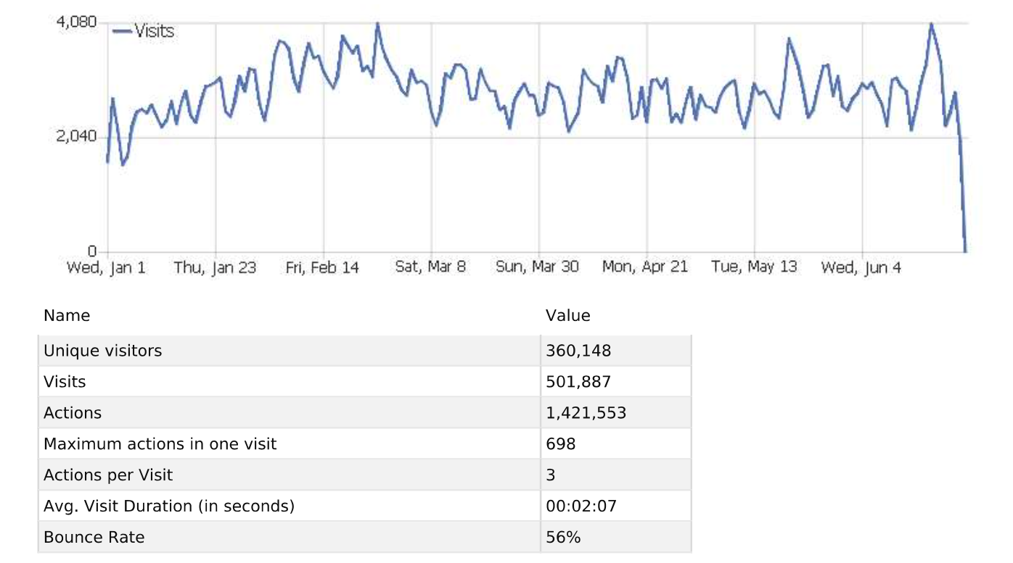
Visit.cern
Results

Slide 23
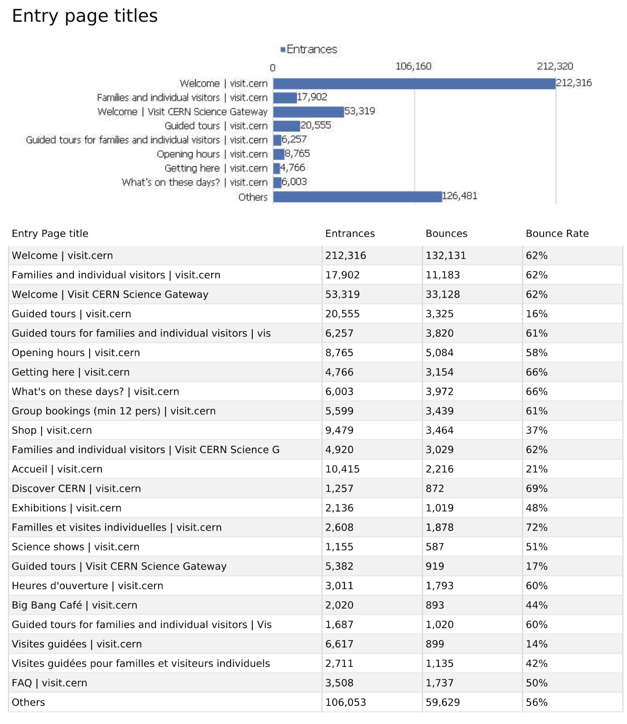
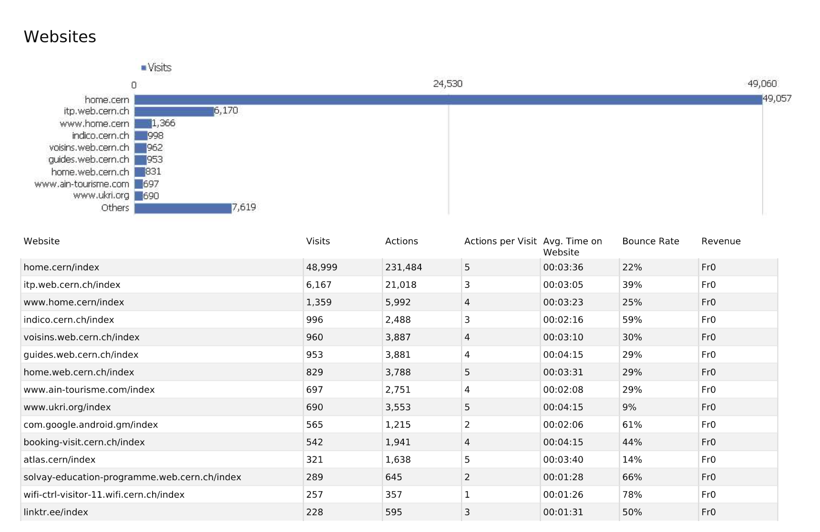
Visit.cern
Results

Slide 24
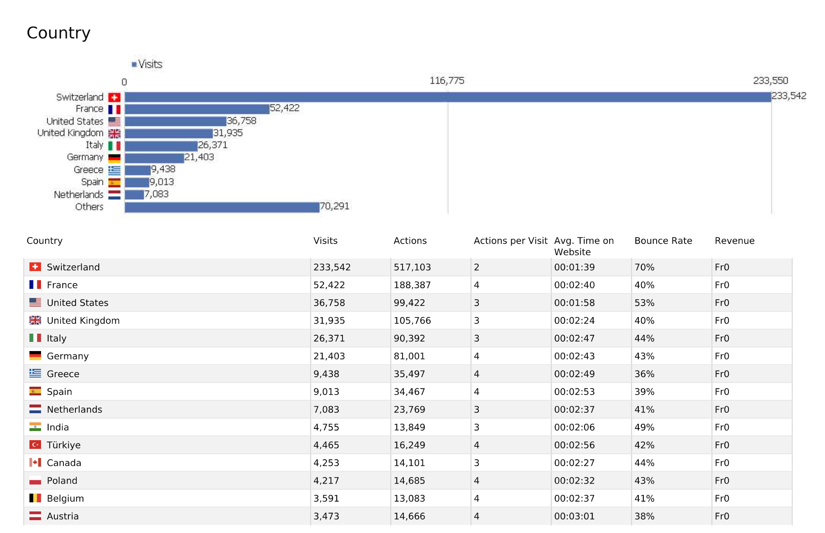
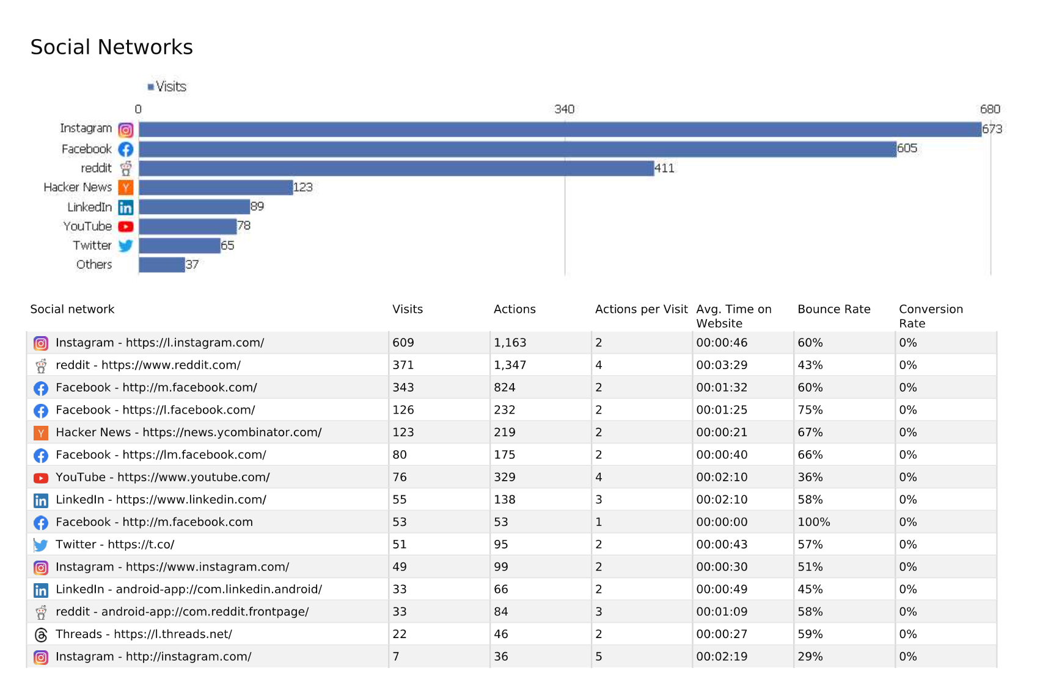
Visit.cern
Results

Slide 25
4. 2025-2026 Season discussion: target audience

Slide 26
Overview Season 25-26 part 1/4
Event | Description (in blue: involvement of youth) | Location | Date | Language | Type | Partnership | Status | Cost estimate | Lead | Target audiences (segmentation can evolve)
Première Film Cédric Klapish | Film about life at CERN by film director Cédric Klapisch, who produced the French movie “L'Auberge espagnole” | Science Gateway | 25 Septembre 2025 | Fr | Movie |  | Confirmed | CHF 1,000 | tbd | General Public Cinema enthousiasts Local Communities Local independent cinemas CERN Community CineGlobe community
Binôme | The concept of binôme is that a researcher (Yasmine Amhis, LHCb) becomes the object of study for a playwright,. Involvement of young actors and use of the theme in the screenplay, also representations and workshops for local high schools | Château Rouge Annemasse | 26-28 September 2025 | Fr | Theatre | Château Rouge | Confirmed | CHF 5,000 incl. March 2026 representation | Local Com | General Public Theatre enthousiasts Young audience and their families Local Communities Audience from Annemasse and wider Haute-Savoie
Partage ta Science | Modelled on the organisation of a scientific symposium, this evening will give students from the Pays de Gex and Geneva the opportunity to present seven final-year research works covering a variety of scientific fields. | Science Gateway | 03 October 2025 | Fr | Talk |  | Confirmed | CHF 2,000 | SG | Teachers and Students Local schools and students General Public Parents, families
Orbite CinéGlobe | Showcase of a movie with intervention of young researcher to explain physics phenomenon. Workshop and projection for kids in the morning | Théâtre Le Bordeaux, St Genis Pouilly | Sun 12 October 2025 | Fr | Movie | Théâtre Le Bordeaux | tbc | CHF 1,000 | Neal Hartman | General Public Cinema enthousiasts Local Communities Local independent cinemas CERN Community CineGlobe community

Slide 27
Overview Season 25-26 part 2/4
Event | Description (in blue: involvement of youth) | Location | Date | Language | Type | Partnership | Status | Cost estimate | Lead | Target Audience
Dark Matter Day | Programme for young kids | Science Gateway | Tue 28 October | Fr | Talk | Am stram gram | tbc | CHF 3,000 | Local Com | General Public Parents, families CERN community (families) Local astronomy clubs CERN Community CERN community (families)
Bob Wilson Talk | tbd | Science Gateway | 14-Nov | Eng | Talk |  | confirmed | ? | tbd | General Public (arts) Local art and Fashion scene Art schools (ex: HEAD) Greater Geneva theatres and their audiences (Grand Théatre) Arts @ CERN community
FameLab International Final | FameLab is a challenge for young scientists to explain a scientific concept in three minutes to a general audience. The international final will be held at CERN | Science Gateway | 25-Nov | Eng | Talk |  | Confirmed | CHF 4,000 | Paola Catapano & Local Com | Scientific Community Local Universities (UNIGE, HES, LAPP) Student communities and organisations Industry Innovation scene (FONGIT)

Slide 28
Overview Season 25-26 part 3/4
Event | Description (in blue: involvement of youth) | Location | Date | Language | Type | Partnership | Status | Cost estimate | Lead | Target Audience
Antigel (title tbc) | Music concert – more info tbd | Science Gateway | Thu 5 February 2026 | Fr | Concert | Antigel | tbc | tbd | Local Coms | Local communities General public (distant) Young adults Music fans Cultural scene of Geneva
Arts at CERN summit | tbc | Science Gateway | February | Fr | Performance |  | tbc |  | Arts @ CERN | General Public (arts) Local art and Fashion scene Art schools (ex: HEAD) Arts @ CERN community
Binôme | 2nd edition of the Binôme play (see above) but at Science Gateway | Science Gateway | Thu 5 March 2026 | Fr | Theatre | Château Rouge | Confirmed | CHF 1000 | Local Coms | General Public Theatre enthousiasts Local Communities Châteaux Rouge community Audience from Annemasse and wider Haute-Savoie
KV 265 Youth Piano concert | The KV 265 Science & Symphony project consists of live performances accompanied by high-definition science films. For this edition, the performance would partner with young pianists from the HEM of Geneva. | Science Gateway | Tue 31 mars 2026 | n/a | Concert | Haute Ecole de Musique Genève | Confirmed | CHF 6,000 | Local Coms | General Public Classical music enthousiasts Astronomy enthousiasts Local Community HEM Community Scientifc Community UNIGE, EPFL (astrophysics) Donors VIP (C&SF?)
Hunting the Higgs | Hunting the Higgs is a fun & interactive show that sees the audience proceed through all the steps of the scientific method to attempt to discover the Higgs Boson. For this performance, we would target a young audience | Science Gateway | Wed 22 April 2026 | Eng | Talk |  | tbc | CHF 4,000 | Local Coms | General Public Parents, families CERN Community families Scientific Community (UNIGE, LAPP), targeting families of researchers

Slide 29
Overview Season 25-26 part 4/4
Event | Description (in blue: involvement of youth) | Location | Date | Language | Type | Partnership | Status | Cost estimate | Lead | Target Audience
Sparks! (or other format) | Sparks! Young Explorers | Science Gateway | May | Eng | Talk |  | tbc | tbc | Local Coms | General Public Scientifc Community UNIGE, EPFL, HES-SO, LAPP Donors VIP (C&SF?)
Cineglobe | includes in Nuit du Musee. Coordination avec Radio | Science Gateway | 5-7 June | Fr/Eng | Movie | Cine Globe | tbc | external | Neal Hartman | General Public Cinema enthousiasts Local Communities Local independent cinemas CERN Community CineGlobe community
Georgian Dance Performance | The dancers are students of the Georgian Technical University, who collaborate with CMS. The idea is to inspire youth for science thanks to traditional folklore | Science Gateway | Thu 11 June 2026 | n/a | Dance | CMS | tbc | tbc | CMS (Chiara Mariotti | General Public Dance enthousiasts CERN Community CMS

Slide 30
5. Sparks! 2026

Slide 31
Sparks! 2026: Young Explorers (May 2026)
Position research on particle physics as an exploration, similar to exploring Space, Sea, Antarctic (or event sport): exploring the Fronters of humankind, and human performance.
Involve ”young explorer stars” in their field
  Sea: Violette Dorange (Vendee Globe at 23 years old)
  Particle physicist: Sabrina Gonzalez Pasterski and CERN
  …
Partnership with National Geographic? Rolex Perpetual?
Role of CERN?

Slide 32
6. Event suggestions / other items?

Slide 33
Thank you!

