Slide 1
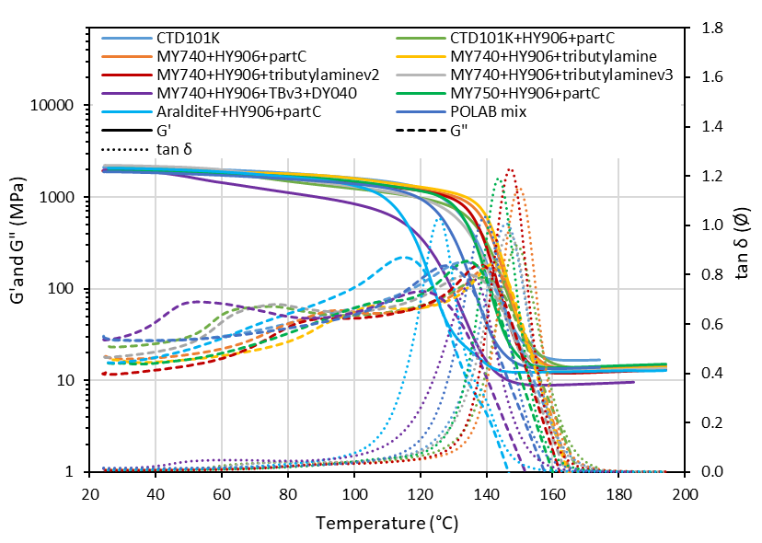
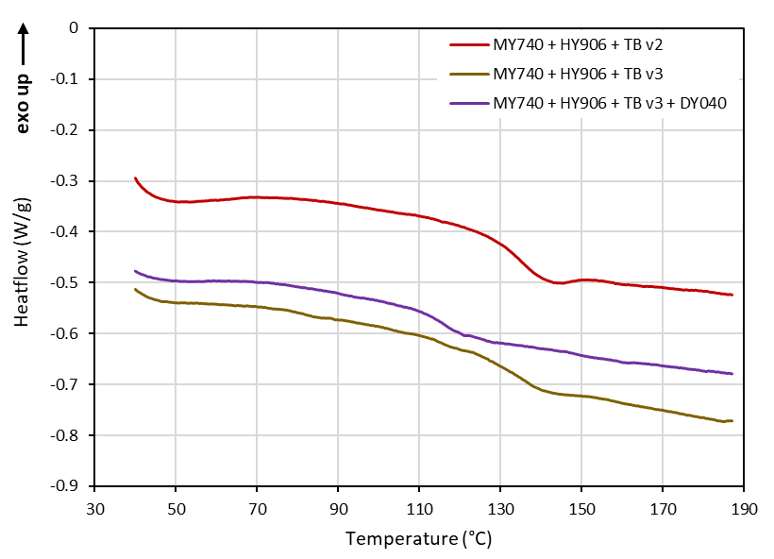
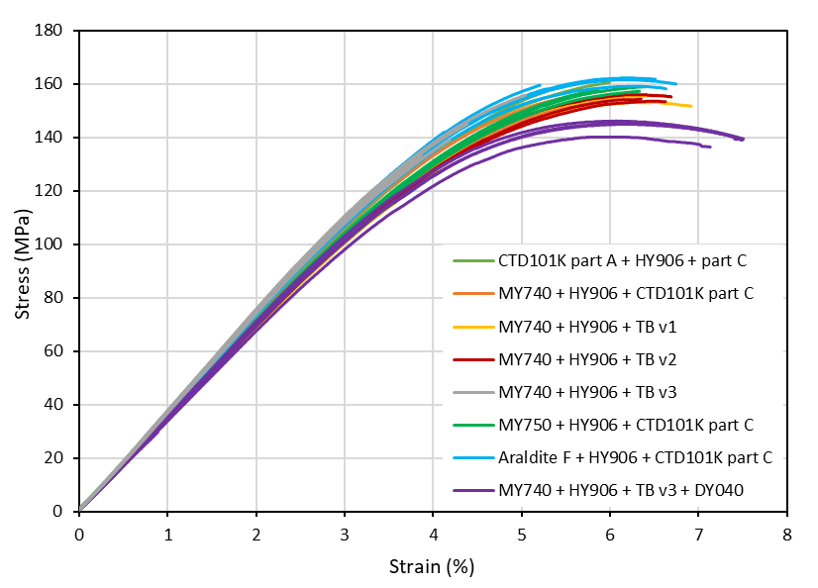
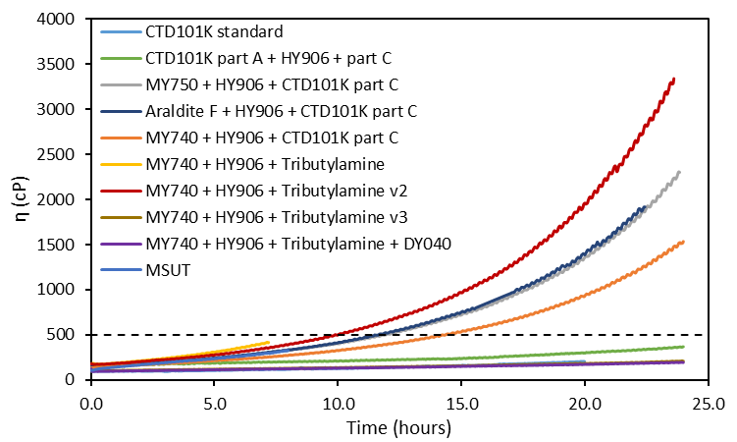
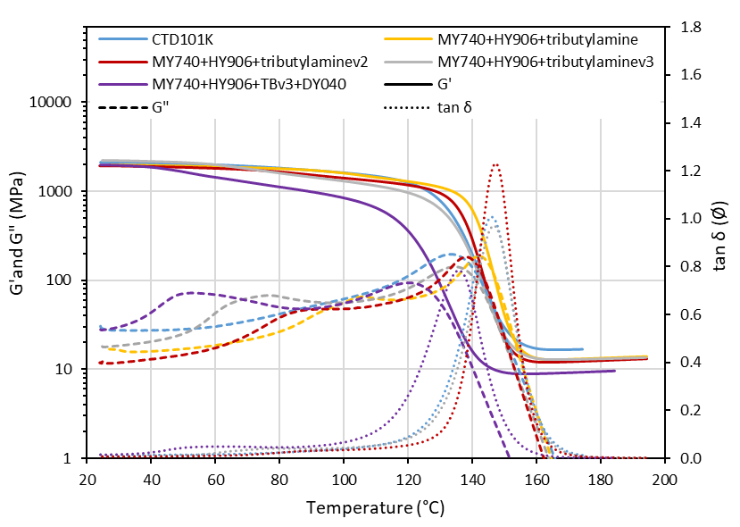
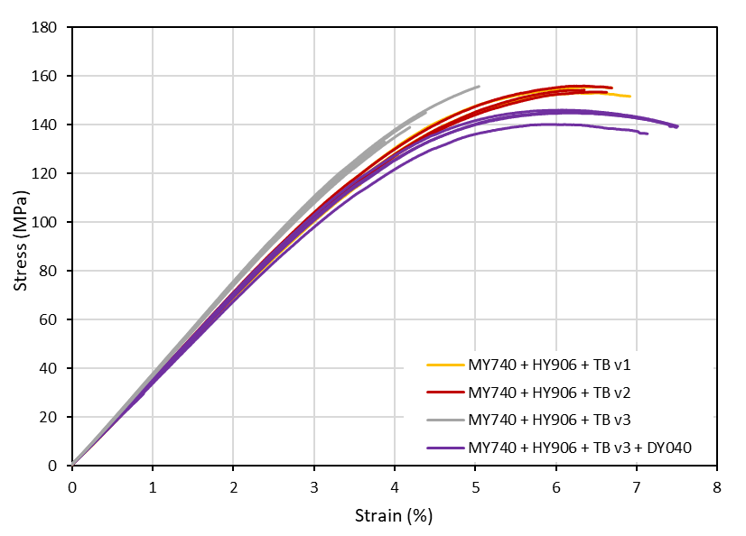
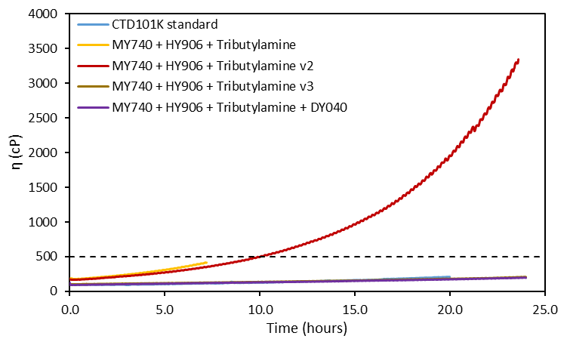
Formulation of epoxy impregnation systems
  Based on an analysis of the molecular structures of different epoxies in the POLAB, different formulations were made and viscosity, DSC, DMA and 3-point bending tests were carried out. This study highlights the possibility to modify the accelerator percentage to stick with the process requirements (e.g. mix process time) and the impact of a flexibilizer onto the properties
Viscosity curves of epoxy mixes
DSC curves of epoxies
DMA curves of epoxies
3-point bending curves of epoxies
  Conclusion:
  Change of accelerator % allows to tailor the process time, without modifying the end properties
  Flexibilizer increases strain at break and reduces the Tg
v1: 0.68, v2: 0.45, v3: 0.2 %w
DY040: 10 %w
Influence of accelerator percentage and flexibilizer compared to CTD 101K
[V. SCHENK]

Slide 2
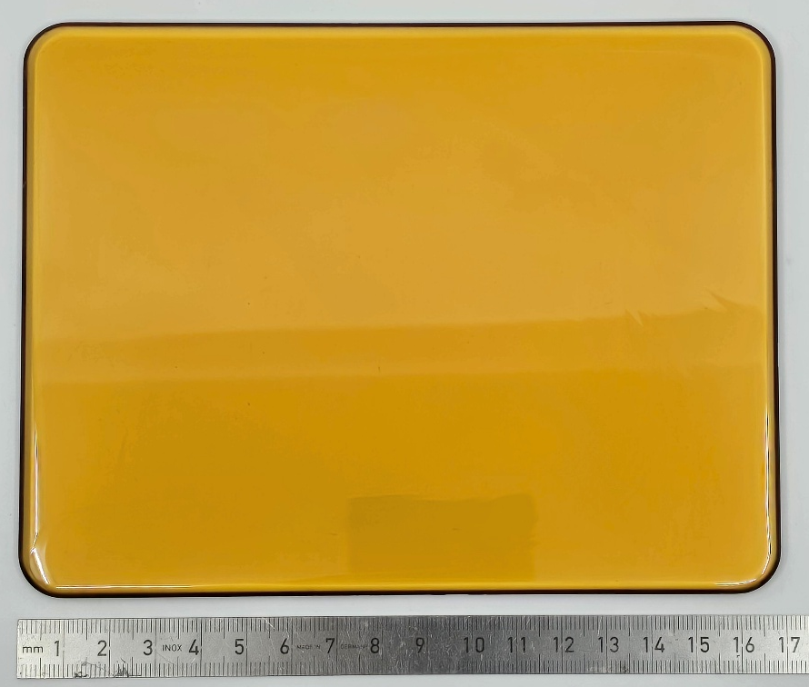
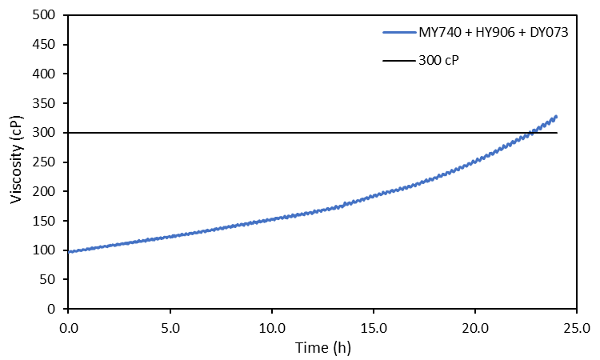
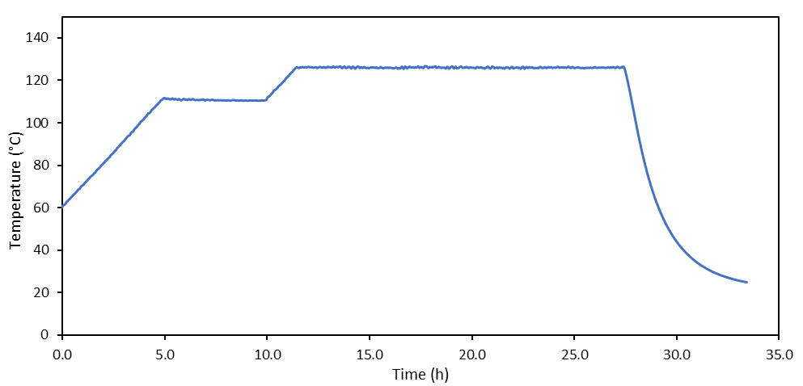
Mix MY740 + HY906 + DY073-1: viscosity + plate
5h at 110 °C + 16h at 125 °C (CTD101K standard curing)
EDMS 3284958
Viscosity at 60 °C of a mix MY740 + HY906 + DY073
  Next steps:
  Perform DSC, DMA and 3-point bending experiments on the mix MY740 + HY906 + DY073-1
  Study the same mix with 10 %w flexibilizer DY040
  Study the influence of DY073-1 accelerator content and curing cycle on the end properties?
  Write report on the mix formulation study
[V. SCHENK]

