Slide 1
Innsbruck university in DRD4 WG 4.5.2
(Development of a new type of detectors combining precise tracking and particle identification capabilities.)
Representative Anatoli Romaniouk
Senior Scientist in Innsbruck University, Innsbruck, Austria.
Also Adjunct Professor in Istinye University, Istanbul, Turkey
Group composition involved in the DTRD 4.5.2 project:
3 senior physicists:
                Serge Smirrnov (Millennium Institute for Subatomic Physics at High Energy Frontier (Chilie) and from summer 2025 in Istinye University.)
                Vladimir Tikhomirov (Istinye University)
                Yury Smornov (Istinye University)
                2 PhD students and 1 student (working locally in their institute).
Notes:
A diagram illustrating the sensors and structural elements in the barrel of the ID: the beryllium beam-pipe, the three cylindrical silicon-pixel layers, the four cylindrical double layers of barrel silicon-microstrip sensors (SCT) and 72 straw layers in the barrel transition radiation tracker modules within their support structure.

Slide 2
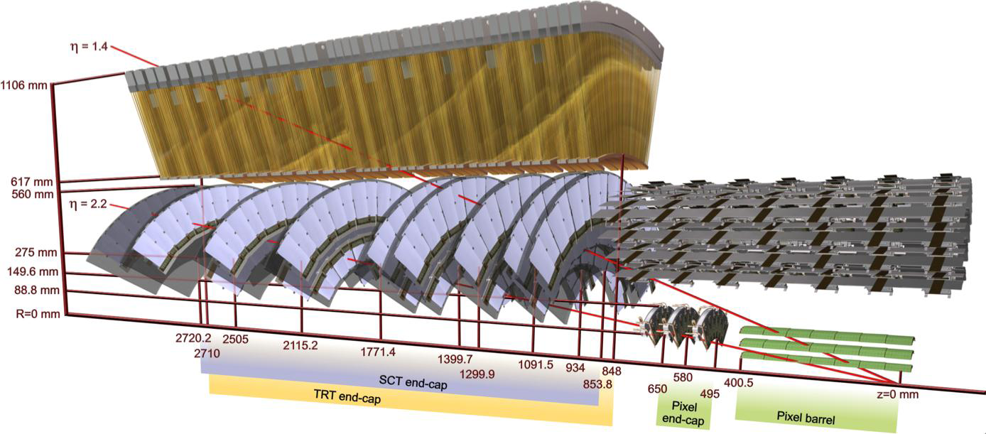
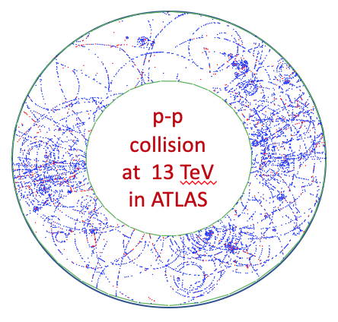
Related experience
The ATLAS TRT: Development, construction and operation
Barrel TRT
End-Cap TRT
Straw based transition radiation/tracker.
Contains ~340 000 channels.
Successfully running in the unprecedented radiation environment.
40 MHz counting rate
~10 C per 1 cm of wire integrated charge.
Operates up to 80% occupancy
Drift-time measurement accuracy 110-140 μm depending on occupancy.
Pion rejection power 50 at low occupancy and 7 at maximum occupancy
Contribution:
RD-6 project (1990-1993): Proposal for the development of the TRD/tracker
Development and studies of straws capable to sustain such radiation conditions.
Development and test beam studies of different types of TRD prototypes
ATLAS experiment (from 1994): TRT project
Straw ageing studies
Studies of the basic processes in the active gas and signal development in straw.
TRT prototypes development and tests.
FE electronics development and studies (physics aspects).
Responsibilities: TRT test beam coordinator, TRT commissioning coordinator, TRT run coordinator, TRT project leader, TRT operation coordinator.
Developed technology also used for construction of TRDs for AMS and HERA –B experiments.
Notes:
A diagram illustrating the sensors and structural elements in the barrel of the ID: the beryllium beam-pipe, the three cylindrical silicon-pixel layers, the four cylindrical double layers of barrel silicon-microstrip sensors (SCT) and 72 straw layers in the barrel transition radiation tracker modules within their support structure.

Slide 3
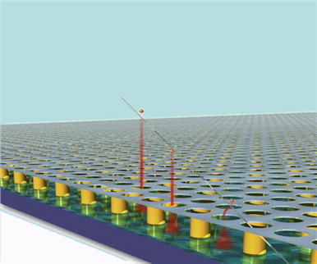
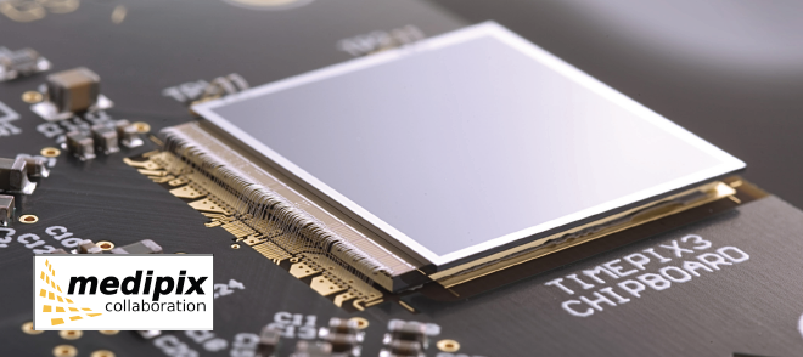
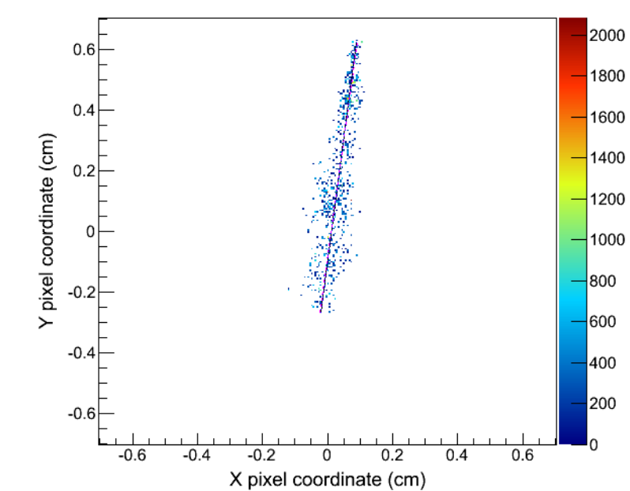
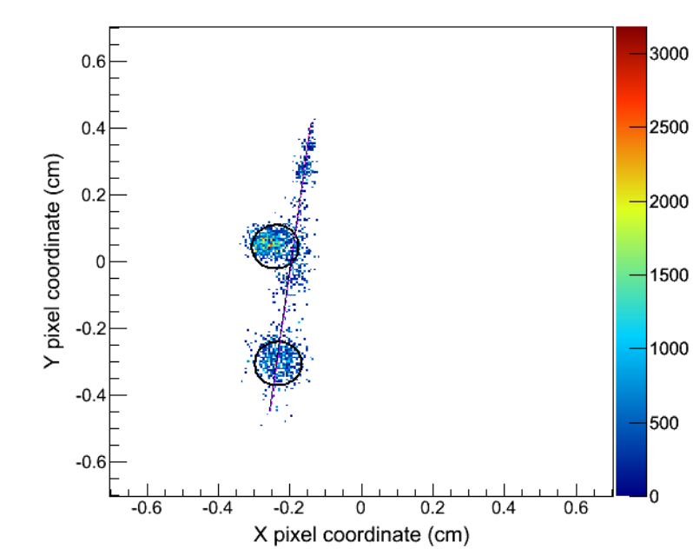
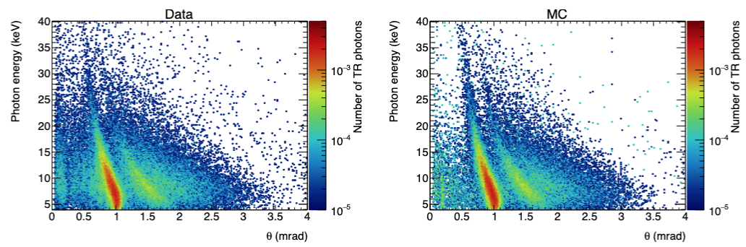

Related R&D activities
TRDs with vector tracking capabilities.
TRDs based on solid state detectors.
Timepix3 attached to Si or GaAs sensors
Ingrid on TimePix2 chip
Xe/CO₂ (80/20)
Angular distribution of TR photons
Θ $≠$ 1/γ
Pions
Electrons
TR
TR
NIM, A 706 (2013) 59–64
NIM, A 961 (2020) 163681

Slide 4
Presentations on DRD4 meetings:
Transition Radiation Detectors WG 4.5.B:
https://indico.cern.ch/event/1403486/contributions/6007280/attachments/2881499/5048376/TRD_20.06.24.pdf
High purity electron and hadron beams for PID studies at SPS:
https://indico.cern.ch/event/1456663/contributions/6187078/attachments/2954610/5194829/E_Pi_contamination.pdf
Most relevant publications
F Hartjes et al., Test beam studies of the GasPixel transition radiation detector prototype. Nucl. Instrum. Meth. A 706 (2013) 59–64
F. Dachs et al., Transition radiation measurements with a silicon and a gallium arsenide pixel sensor on a timepix3 chip, Nucl. Instrum. Meth. A, 958 (2020), 162037 DOI: https://doi.org/10.1016/j.nima.2019.03.092
J. Alozy et al., Studies of the spectral and angular distributions of transition radiation using a silicon pixel sensor on a Timepix3 chip, Nuclear Inst. and Methods in Physics Research, A 961 (2020) 163681, https://doi.org/10.1016/j.nima.2020.163681.
Transition radiation detectors for hadron separation in the forward direction of LHC experiments, Nuclear Inst. and Methods in Physics Research, A 1055 (2023) 168535, https://doi.org/10.1016/j.nima.2023.168535.

Slide 5
Plans in the framework of the DRD4 WG 4.5.2 project:
Analysis of the existing data.
MC model development.
  Standalone
  GEANT4 (does not describe yet well TR production)
New radiator developments and optimization.
Study of intrinsic coordinate resolution of detectors based on GaAs.
Study of the limits of e/pi separation with GaAs detectors.
Test beam studies with different sensors, Timepix chips and radiators.

