Slide 1
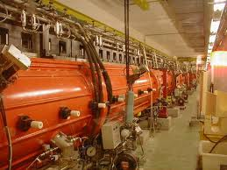
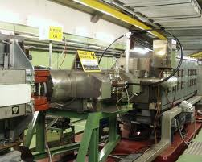
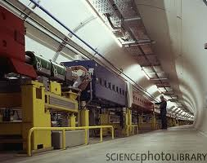
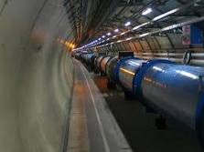
LHC, Status and Performance
LHCC 21th September
Paul Collier
On behalf of the whole LHC Team and international collaborators

Slide 2
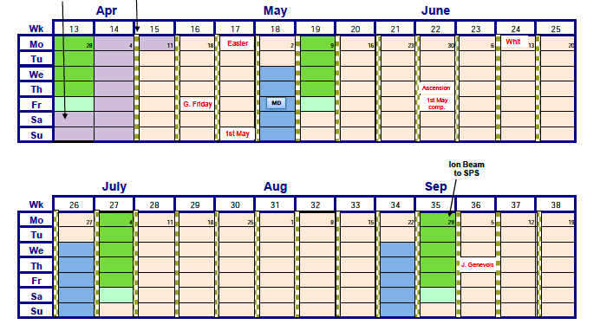
From one LHCC to the Next
May-June: Progressive increase in the number of bunches towards 1380/beam
29th June – 4th July: MD2 Block followed by TS
Mini-Chamonix Meeting to set strategy for remainder of 2011
10th July-23rd August: Luminosity Production
Pushing the parameters, ε down I_{b} up
24th – 29th August : MD3 Block followed by TS
New results and set up of β*=1m
4th September -> : Qualification of new operating conditions
Luminosity Production
June

Slide 3
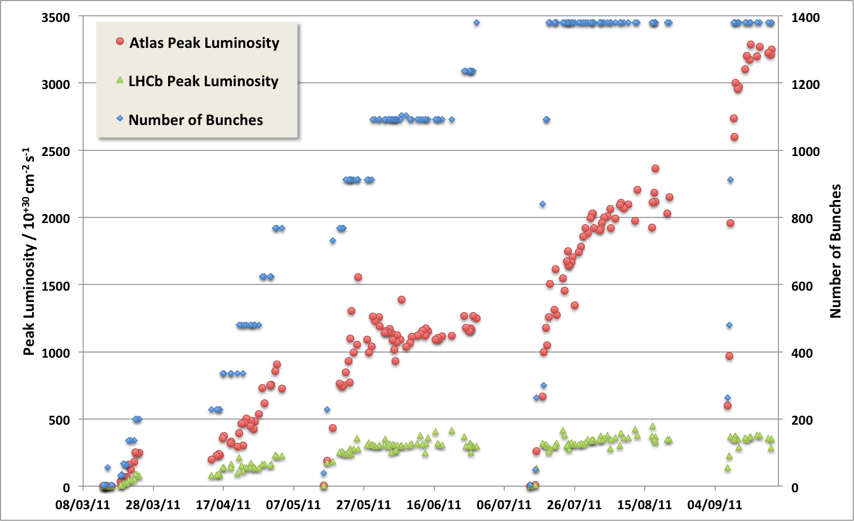
LHC Status : 2011 – so far …
Last LHCC
75 ns
50 ns
Intermediate energy run, technical stop, scrubbing
MD, technical stop
Mini-Chamonix
MD, technical stop
MD, technical stop
Emittance
reduction
Intensity Ramp Up
β* = 1m

Slide 4
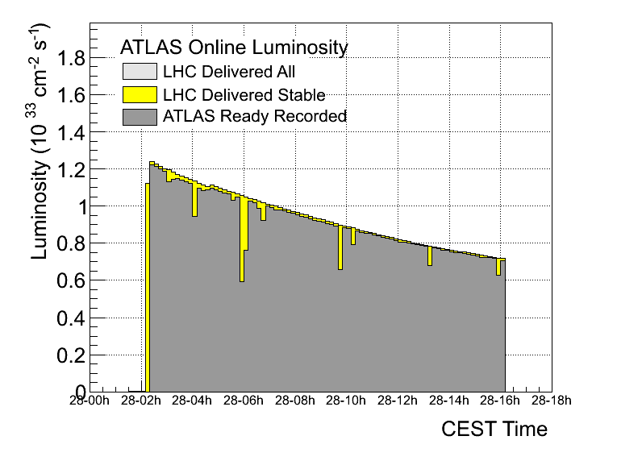
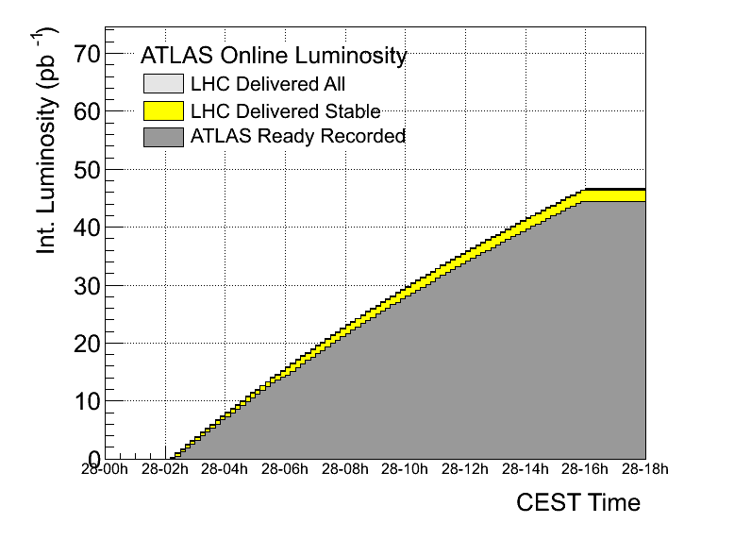
End June 2011 …
Reached 1380 (max possible with 50ns) on 28 June fill 1901
Complete MP and OP Qualification for ~100MJ/beam

Slide 5
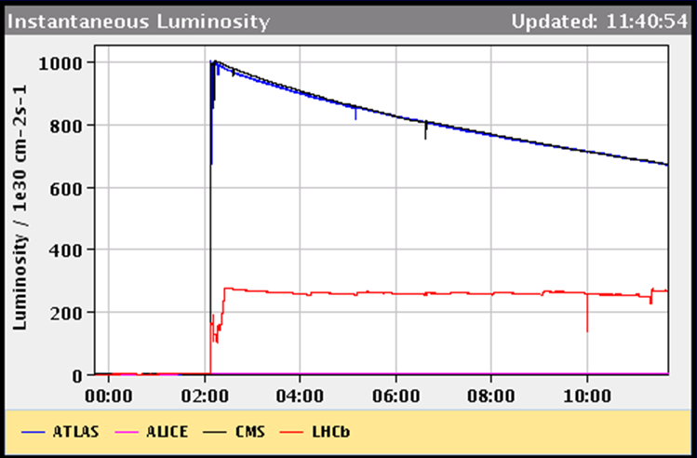
Luminosity Leveling via beam Separation
Introduced luminosity leveling for LHCb → can run at optimal μ and L_{max}
GPD luminosity falls-off exponentially
Luminosity of LHCb levelled continuously
LHCb design luminosity
Since end of May running at constant L ~ 3-3.5∙10³² cm⁻²s⁻¹ with μ ~ 1.5
LHCb now want maximum time in physics and not an increase in performance

Slide 6
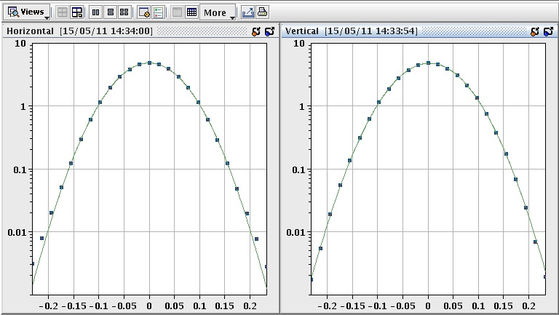
LHC Luminosity Calibration
absolute luminosity normalization
low, well understood backgrounds
precision optics for ATLAS-ALFA and TOTEM
VdM scan
IP1 H
IP1 V
precise measurement of the luminous region +
beam intensity --> absolute luminosity and
cross section calibration
currently ~ 3.5 % level

Slide 7
MD2 Block Studies
MD (in order of execution) | Time scheduled | Time used | Balance
ATS I | 02 h | 02h46 | + 0h46
Injection 25 ns | 06 h | 05h40 | - 0h20
RF setup high bunch int. | 06 h | 05h07 | - 0h53
Beam instr. (stopped late), followed by access | 08 h | 09h00 | + 1h00
Head-on beam-beam limit | 08 h | 03h17 | - 4h43
Inj. nom. emittances, UFO’s | 09 h | 09h50 | + 0h50
RF longitudinal stability, followed by access | 13 h | 10h21 | - 2h39
Long-range beam-beam limit | 08 h | 05h17 | - 2h43
Non-linear dynamics (started early, stopped late, 1b only) | 08 h | 10h31 | + 2h31
Collimation | 08 h | 04h28 | -3h32
ATS II (started early, stopped late) | 08 h | 10h51 | + 2h51
Beam distribution | 04 h | 01h45 | -2h15
Quench margin at injection | 08 h | 08h15 | +0h15
R2E | 08 h | 05h38 | -2h22
Very satisfied with second MD:
  Some ground-breaking results → path to very high LHC luminosity.
  Good balance: MD’s pushing the boundary and detailed studies.
  Almost all MD teams had the opportunity to obtain good results.
  Good availability, though not as good as first MD.
  We managed to hold reasonably to schedule, thanks to the excellent preparation and discipline of many colleagues involved.
Thanks to the injectors that provided the planned zoo of beams!
Results discussed and analyzed in a ‘mini-Chamonix’ meeting to set the strategy for the remainder of 2011

Slide 8
MD2 : A few Highlights
First injection of 25 ns bunch trains with up to 216 bunches.
Collision of (individual) bunches with twice nominal intensity and half emittance, demonstrating 8 times nominal bunch luminosity.
Injection and storage of even higher bunch intensities with nominal emittance.
Collision of 50 ns bunch trains with 4-5 sigma separation, demonstrating margin in long-range beam-beam effects.
First squeeze below 1.5 m, demonstrating β* = 0.3 m with pilot beam, flat machine, no collisions and ATS optics.
Many, many detailed studies that were needed to achieve the above results and will make it usable (RF, injection, collimation, quench margins, R2E, optics, …). The devil is in the details!

Slide 9
MD2 : In Numbers
High bunch intensity in LHC: N_{p} = 2.7×10¹¹ p/bunch
excellent beam lifetime γε ≈ 3.3 μm
Colliding beam @ 450 GeV: N_{p} = 2.3×10¹¹ p/bunch
twice nominal intensity, half nominal γε ≈ 1.7 μm
emittance, head-on & parallel separation OK
Long-range beam-beam for 50ns: α_{c}/2 = 48 μrad for τ ≈ 15 h
crossing angle can be more than halved
Short bunch spacing → 25ns: N_{bunch} = 216
24b trains, vacuum ~OK, heat load ~OK, N_{p} = 1.2×10¹¹ p/bunch
instabilities, better than 50ns at same stage γε ≈ 2.7 μm first batches
Injection: γε ≈ 3.5 μm OK for injection
Tune working point: Q_{x}/Q_{y} = 0.47/0.47
more space in tune diagram for BB footprint
ATS optics: β* = 0.3 m

Slide 10
Mid Year performance Review
“mini-Chamonix”
(July 15)
The workshop will examine the possible performance improvement options available during the rest of the LHC's 2011 proton run. It will also consider the experiments' requirements and potential limitations from hardware and beam related phenomena. The principle aim to arrive at a strategy for maximizing the delivered luminosity by the end of the year. The results from, and plans for, machine development will be considered where the knowledge gained might impact the above goal.

Slide 11

Discussion
Luminosity comparisons are wrt. 1380 bunch operation with:
  1.1E⁺¹¹ppb, emittance 2.7υm, β* = 1.5, Peak Luminosity = 1.2E⁺³³ cm⁻2 s⁻¹ in the GPD

Slide 12
Conclusion …
Continue with 50ns!
Operate with minimum emittance (2μm) from the injectors
Adiabatically increase the bunch intensity (max 1.55E⁺¹¹)
Reduce β* to 1m (LATER after next Technical Stop)
See how things go … and how the GPD cope with the (hopefully) increased pileup

Slide 13
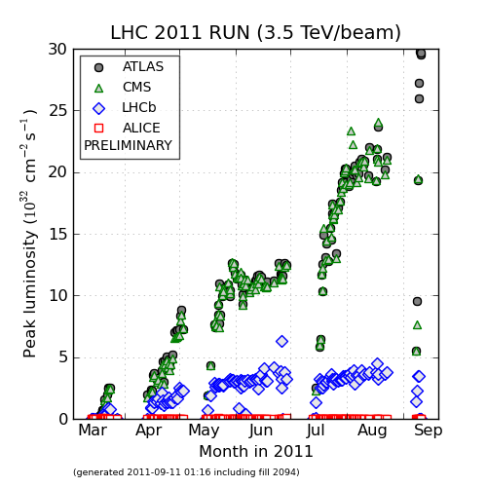
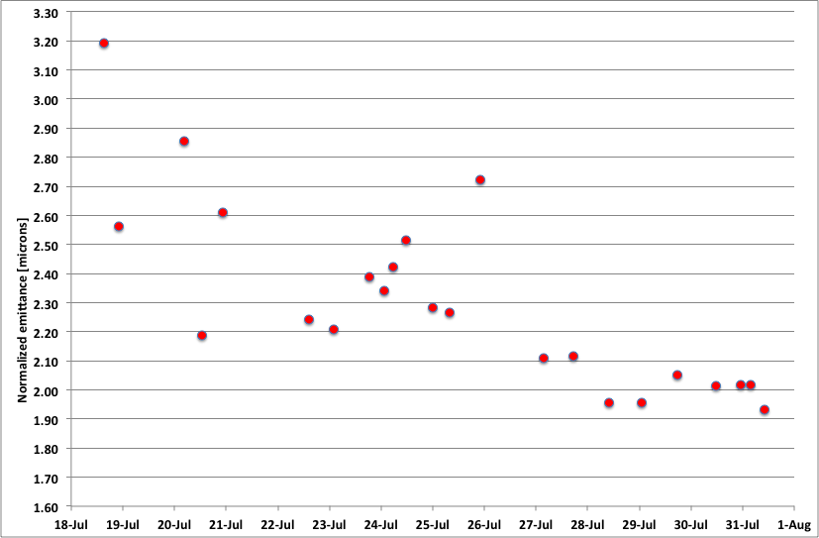
Post Mini-Chamonix Production Period
Emittances – start of fill – from luminosity
Factor of 2 from reduced emittance (and some pushing of bunch intensity)
This was possible because of the incredible performance of the injector complex! Routinely delivering beams well beyond the design parameters.

Slide 14
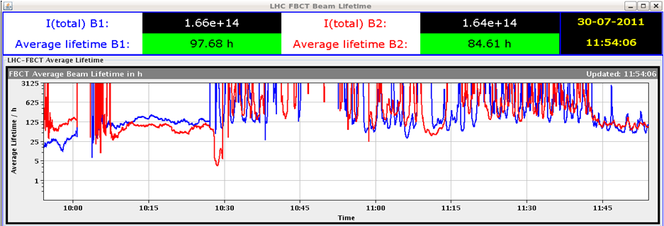
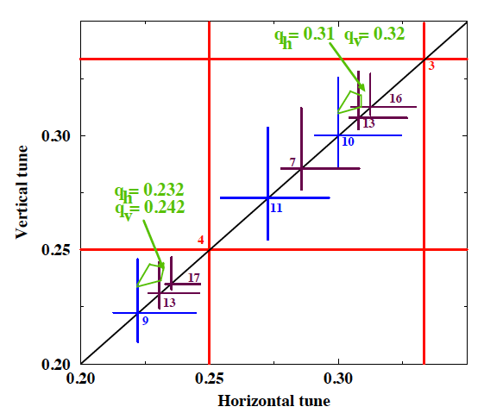
Beam-Beam Tuneshift
Design report
Now
After re-optimizing WP when going into collisions …
Increase both planes by 0.002
… No lifetime dip. Initial lifetimes in Physics ~25 hours … spot where we collided!
Tatiana Pieloni
(re-)learned about WP adjustment to optimize the lifetime (beam-beam pushes the tune down onto the 10th order resonance

Slide 15
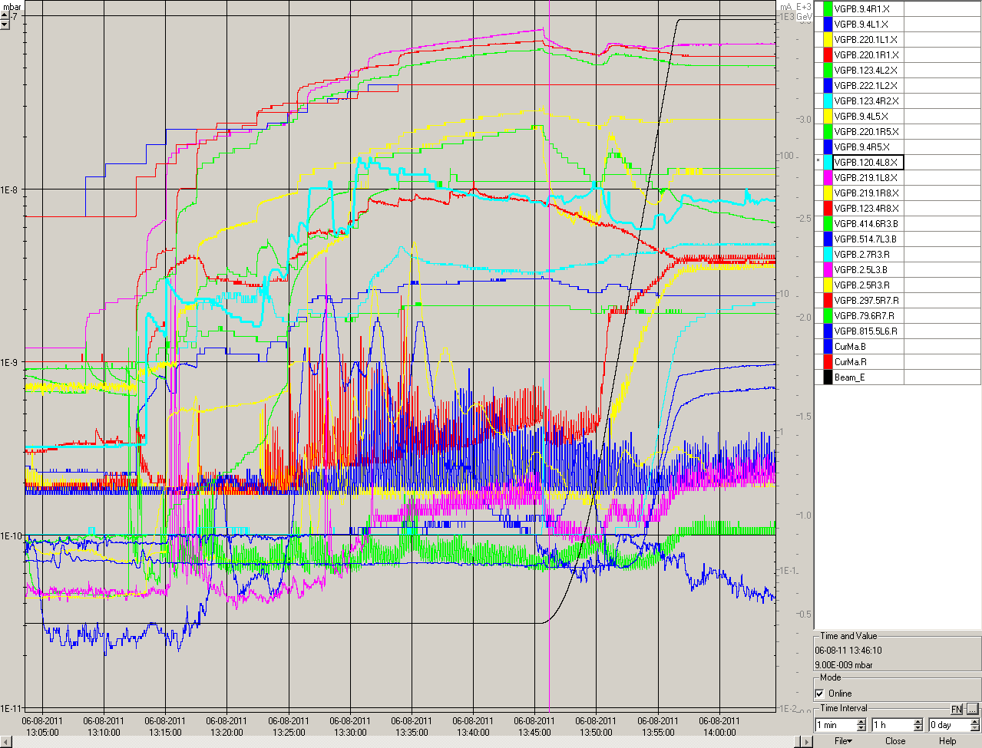
…but not all plain sailing
Vacuum activity when increasing the bunch population above~1.25E⁺¹¹ ppb
Very Sharp threshold.
Suspect e-cloud is back
Seems to indeed improve with time
But still issues, especially in the vacuum around the experiments

Slide 16
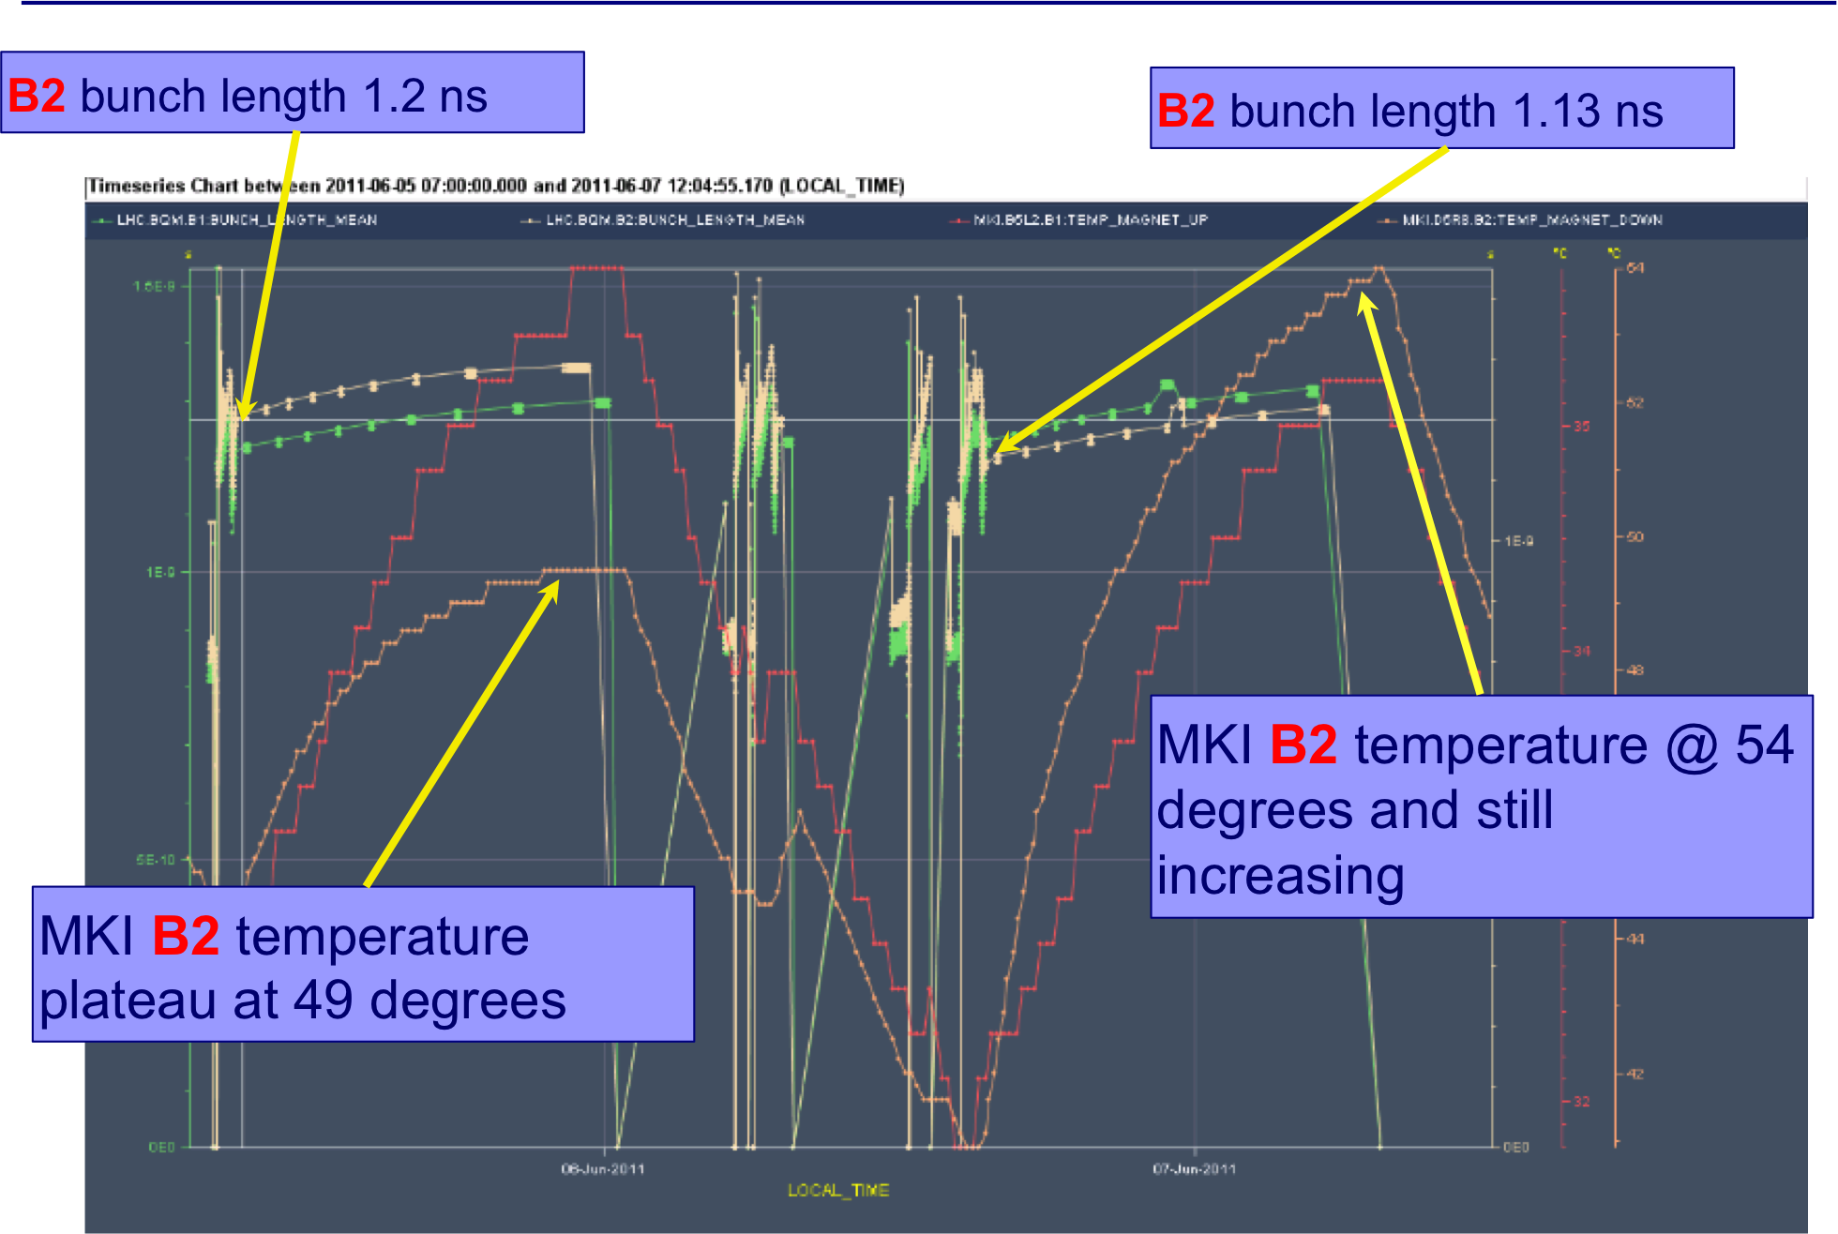
Beam Induced Heating : eg Injection Kickers
Beam induced heating has strong bunch length dependence ➔ Carefully controlled blow-up during the ramp

Slide 17
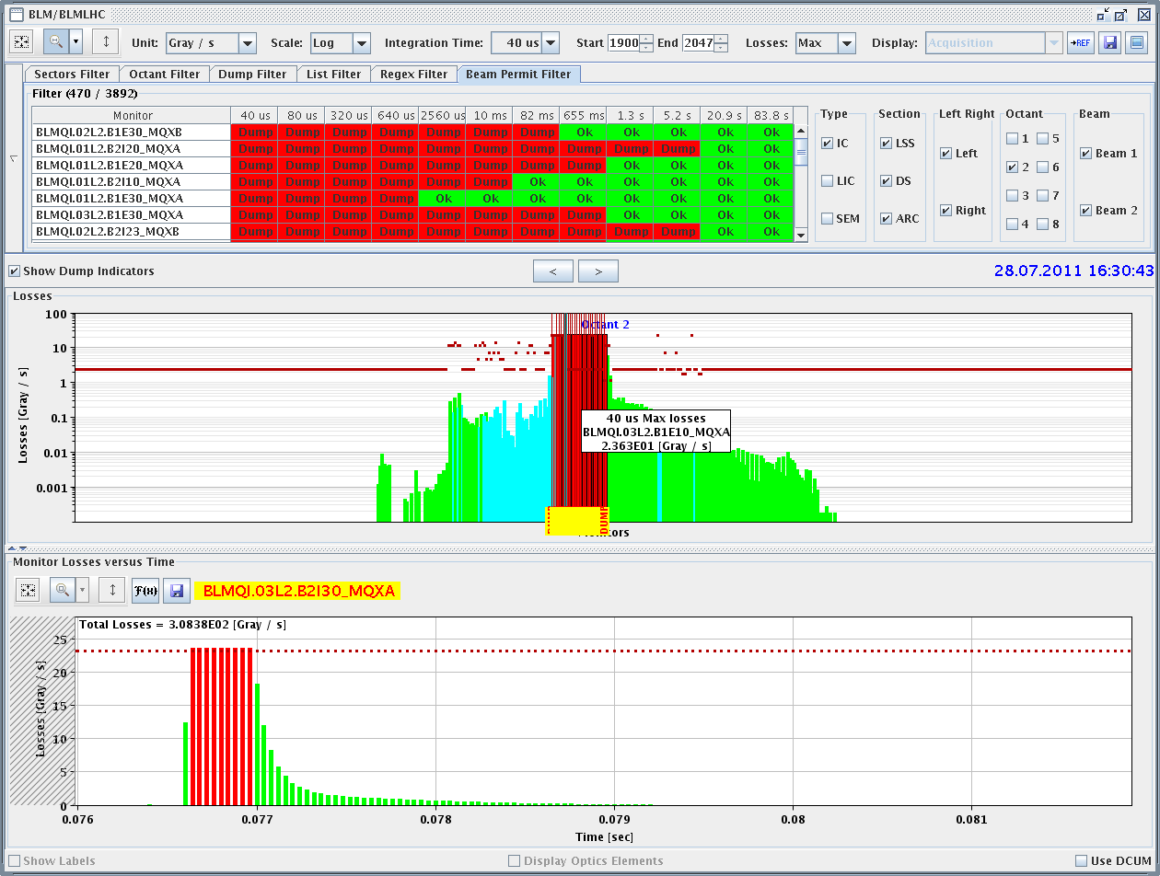
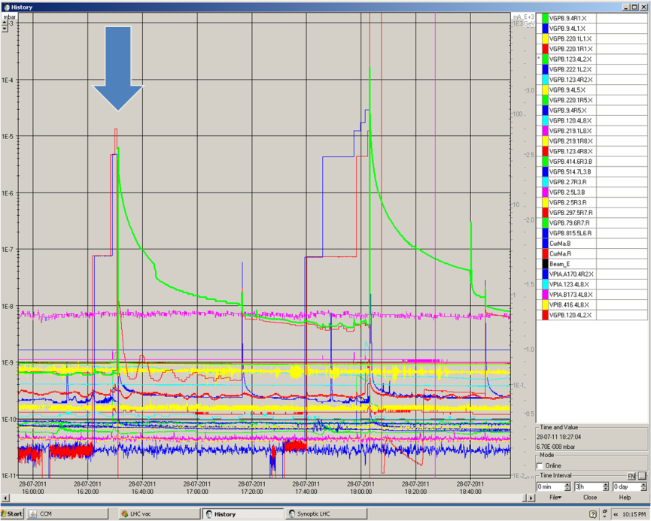
MKI ‘Misfire Events’ (not related to previous slide
16:30 Injected beam of 144b dumped on TDI in IR2.
  Main switch erratic on PFN C.
  Injected beam was not kicked, erratic was too late to prevent extraction.
  Circulating beam was not hit.
  Heavy losses in IR2, but NO quench.
  Vacuum spike, valves closed.
This kind of event is a known failure case.
The TDI is there to protect us from this …
… and it worked perfectly.

Slide 18
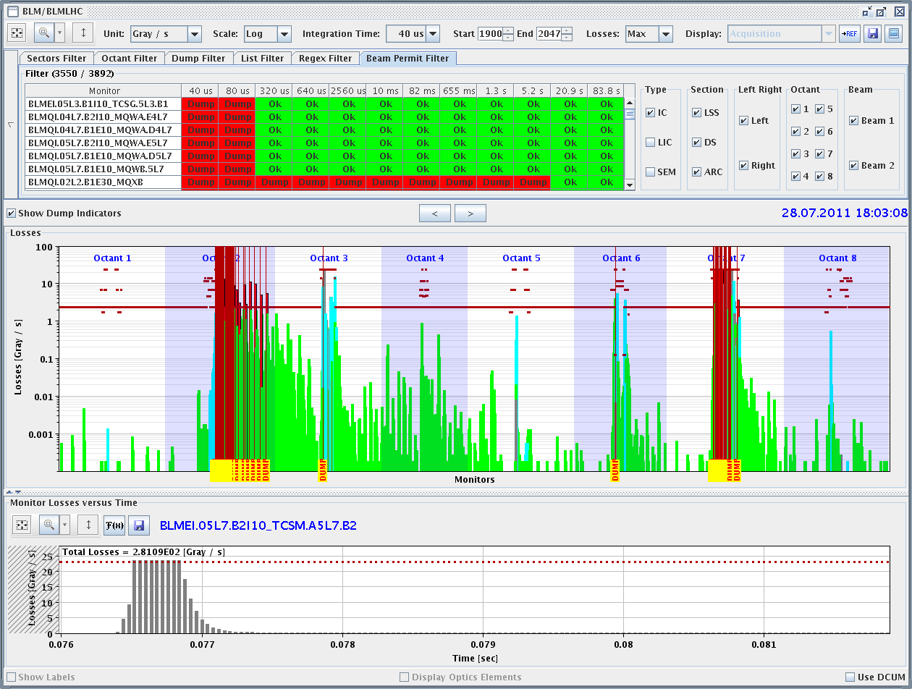
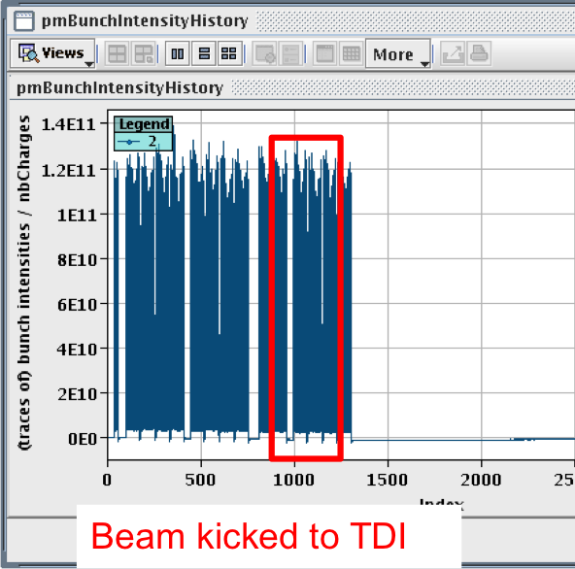
MKI2, event 2 … not so clean – but safe!
Erratic during resonant charging and before SPS extraction. SPS beam was not extracted.
Interlocks did NOT detect erratic of MS3 (at 33kV). PFNs discharged via the dump switch after 4ms (no further magnet current); THIS HAS NOW BEEN FIXED
The circulating beam which was swept over the aperture and protection elements (~17% of normal kick) for ~9µs. Bunches grazing on TDI quenched D1.L2, triplet L2 and D2.R2 and hit ALICE.
Never forget we are dealing with a dangerous beam, even at injection.
Machine Protection issues are the highest priority!

Slide 19
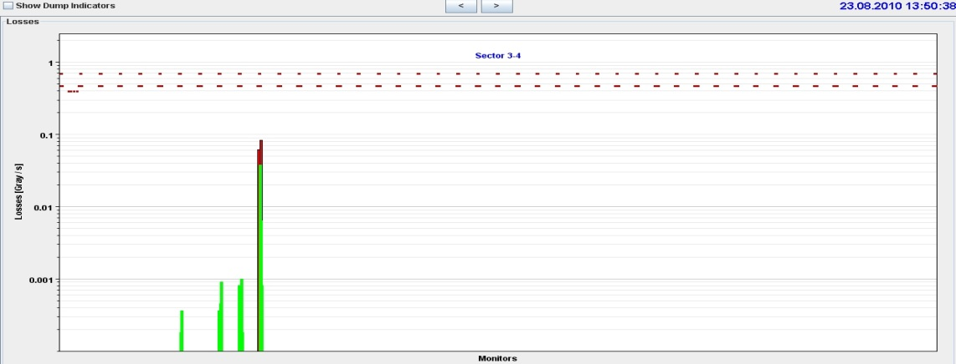
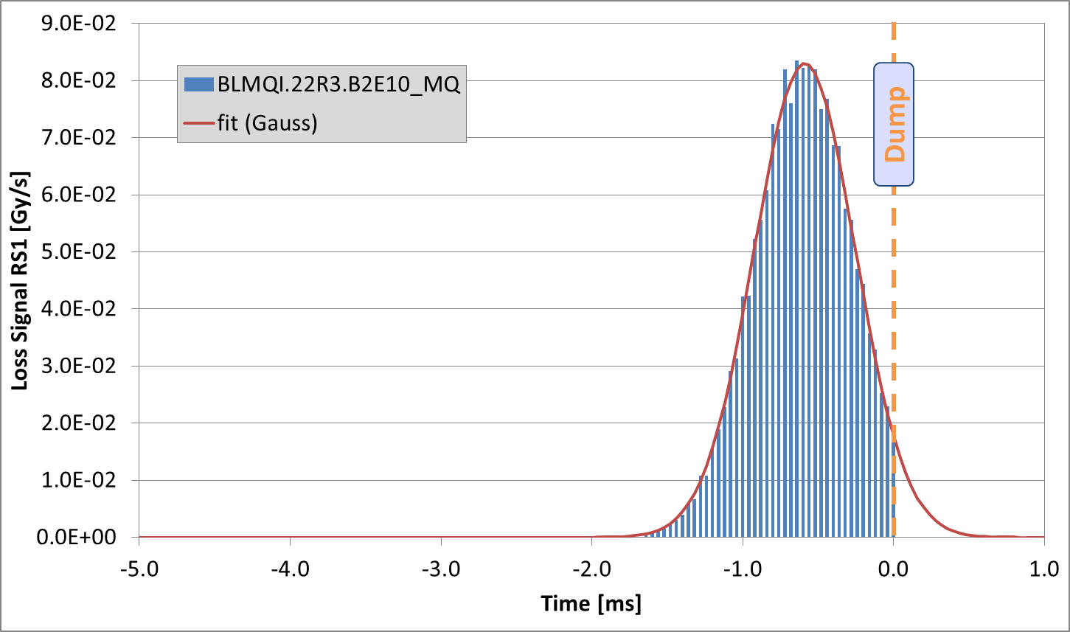
UFO’s Still around – but come and go …
Since July 2010 35 fast loss events led to a beam dump.
18 in 2010, 17 in 2011.
13 around MKIs.
6 dumps by experiments.
1 at 450 GeV.
Typical characteristics:
  Loss duration: ~10 turns
  Often unconventional loss locations (e.g. in the arc)
Over 10000 candidate UFOs below threshold detected.
On average ~6 UFOs/hour during stable beams in the arcs.
UFO Example:
Middle of Arc in Sector 34
Spatial and temporal loss profile of UFO
Micrometer sized macro-particles are (still) the most plausible explanation.

Slide 20
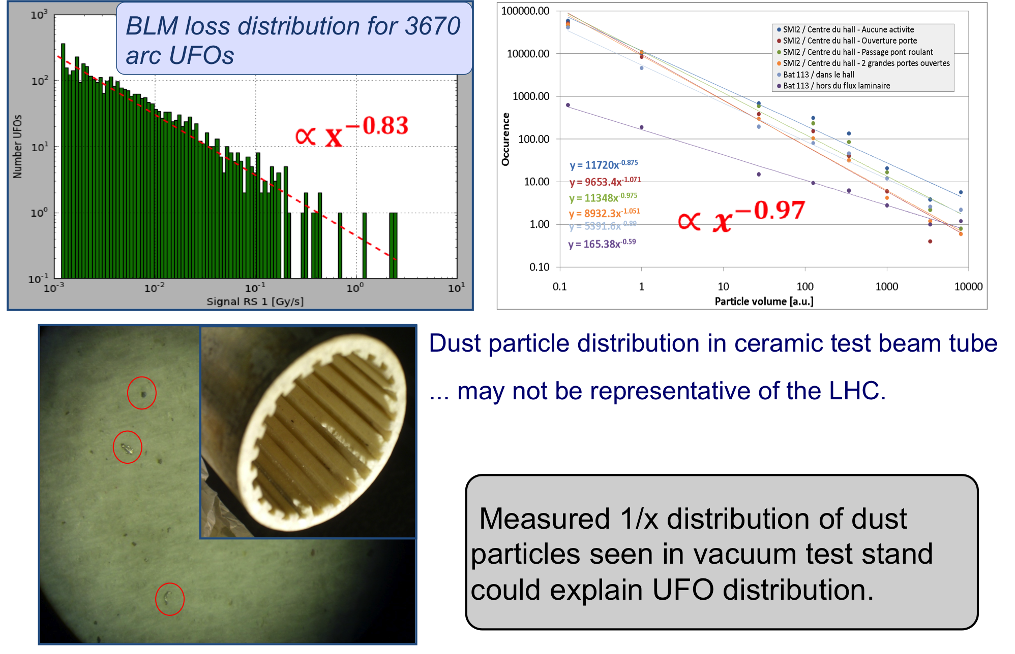
Are UFO’s Just Dust?

Slide 21
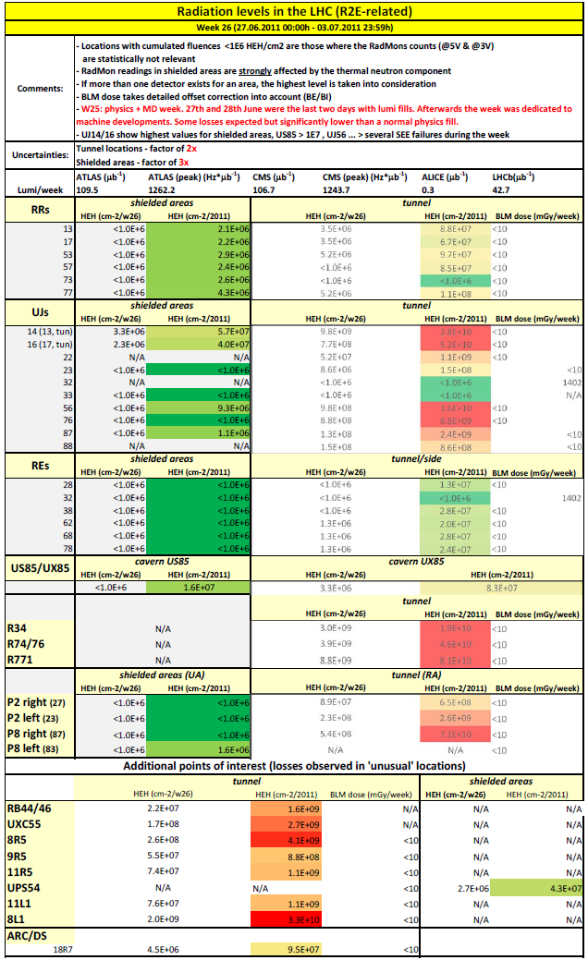
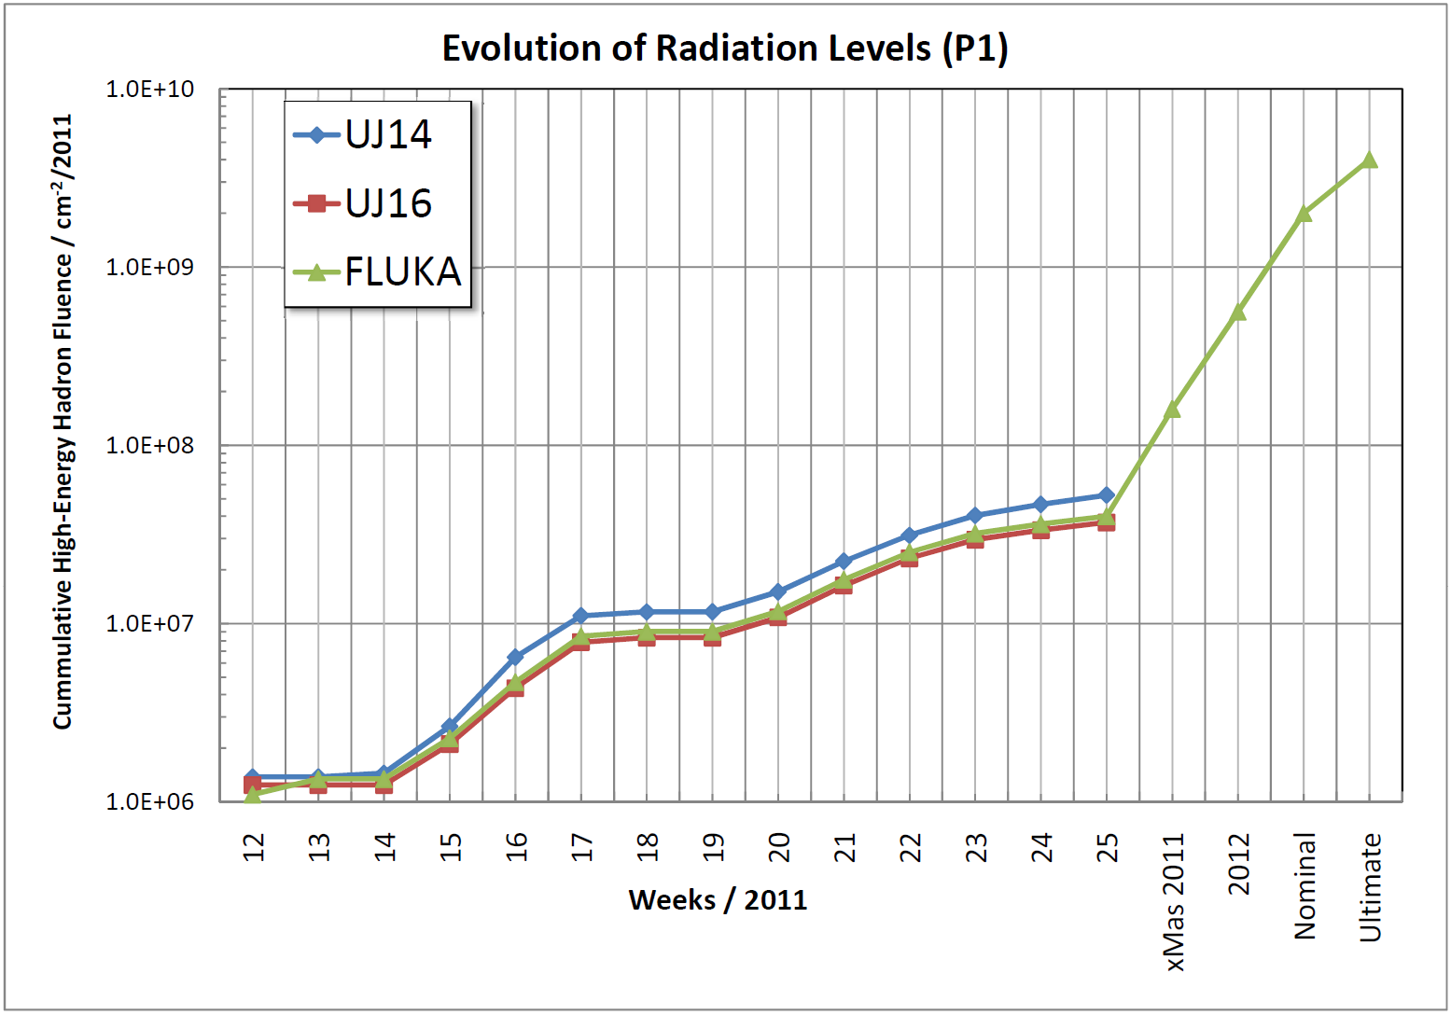
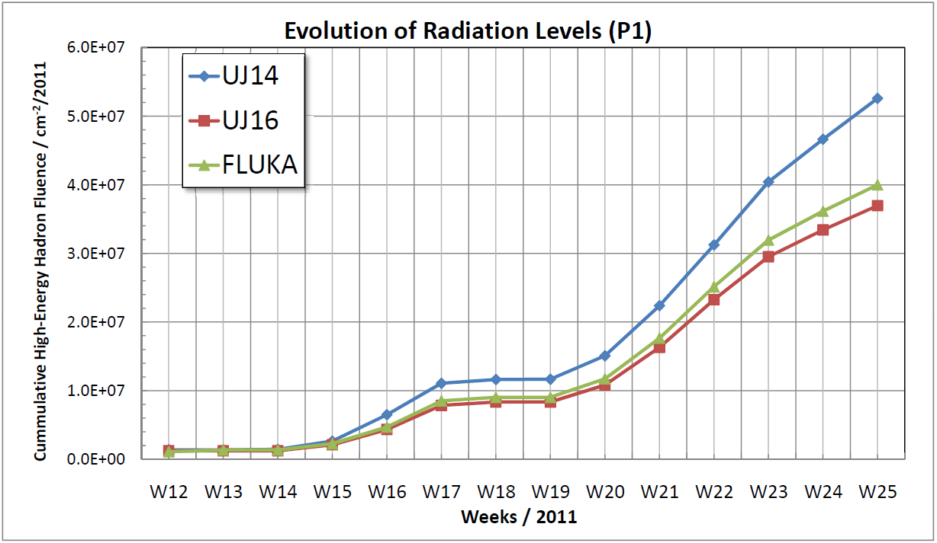
Radiation Levels around the LHC tunnel: Measured and Expected
R2E Team
Weekly Report
Detailed Analysis
Comparison & Extrapolation
x50

Slide 22
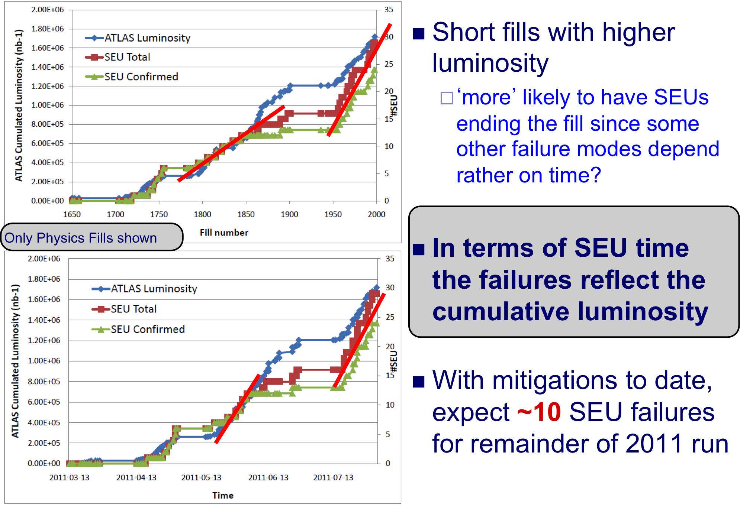
SEU’s : Failures and Correlations
Mitigation measures ‘on the fly’ (where possible) or stored up for the Christmas Technical Stop

Slide 23
Record Page by the end of August
 | 2010 | 2011 | Nominal
Energy [TeV] | 3.5 | 3.5 | 7
β* [m] (IP1,IP2,IP5,IP8) | 3.5, 3.5, 3.5, 3.5 | 1.5, 10, 1.5, 3.0 | 0.55, 10, 0.55, 10
Emittance [μm] (start of fill) | 2.0 – 3.5 | 1.5 – 2.2 | 3.75
Transverse beam size at IP1&5 [μm] | 60 | 28 | 16.7
Bunch population | 1.2×10¹¹ p | 1.35×10¹¹ p | 1.15×10¹¹ p
Number of bunches | 368 | 1380 | 2808
Number of collisions (IP1 & IP5) | 348 | 1318 | -
Stored energy [MJ] | 28 | 110 | 360
Peak luminosity [cm⁻²s⁻¹] | 2×10³² | 2.41×10³³ | 1×10³⁴
Max delivered luminosity (1 fill) [pb⁻¹] | 6.23 | 100.7 | -
Longest Stable Beams fill [hrs] | 12:09 | 25:59 | -

Slide 24
MD#3 Block: β* up (90m) and down (1m)
High Beta Optics
Basic cycle commissioned during previous MD periods
Some time given from Physics to commission and qualify conditions for Totem/ALFA data taking
23-24 September 90 m optics run
  Preparation and verification of the collimation functions
  Re-generation of functions for Transverse damper, RF longitudinal blow-up etc.
  New bunch scheme needed (5 bunches of 6E⁺¹⁰)
  TCT collimator alignment + Vertical Totem pots
  technical problem with Alfa movement
  Beam lost before any data taking
Status – Good for Totem data taking, work still needed for ALFA.
  Some time for this will have to come out of the remaining Physics time

Slide 25
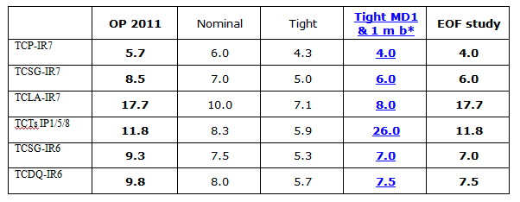
MD#3 Block: β* up (90m) and down (1m)
It was already hoped to move to β* = 1m after the technical stop and significant MD time was given over to prepare it (mini-Chamonix meeting)
To maintain the same margins for orbit, beta-beat etc. we would needed to reduce the crossing angle from ±120 to ±100 μrad … and move to tighter collimator settings
Tested and Works – but life gets a lot tougher as the collimators are very close to the beam
9.3
Long-range beam-beam separation from 12σ to 8σ (ε=2.5 μm).

Slide 26
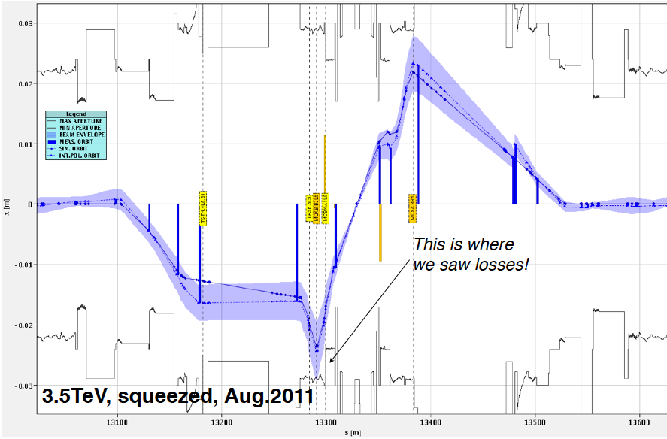
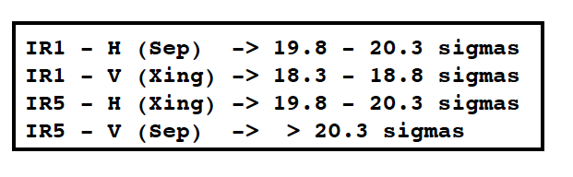
Triplet Aperture : At Last a ‘Hole’ we can exploit!
Measurement of the triplet aperture at 3.5TeV squeezed confirms it is larger than assumed: better alignment, orbit, beta-beat etc.
At Least 4σ bigger than assumed
S. Raedelli
Decision taken to exploit this margin to run at β*=1m with ±120mrad crossing angle and original (relaxed) collimator settings
Crash programme to develop a method of qualifying the operating conditions
Loss maps with TCT’s retracted by 2σ to ensure IT still protected.
Successfully achieved and Physics now with 1m β*

Slide 27
Back to Physics
Restart Blocks:
Confirmation of Aperture
Alice polarity inversion
Qualification of 1m β*
Intensity Ramp up
Completed very rapidly : In less than 5 days
Peak luminosity improvement in line with β* reduction: 50% more!
Peak Luminosity now stands at:
3.3x10⁺³³ cm⁻² s⁻¹
Now we just have to establish nice long fills to exploit this potential

Slide 28
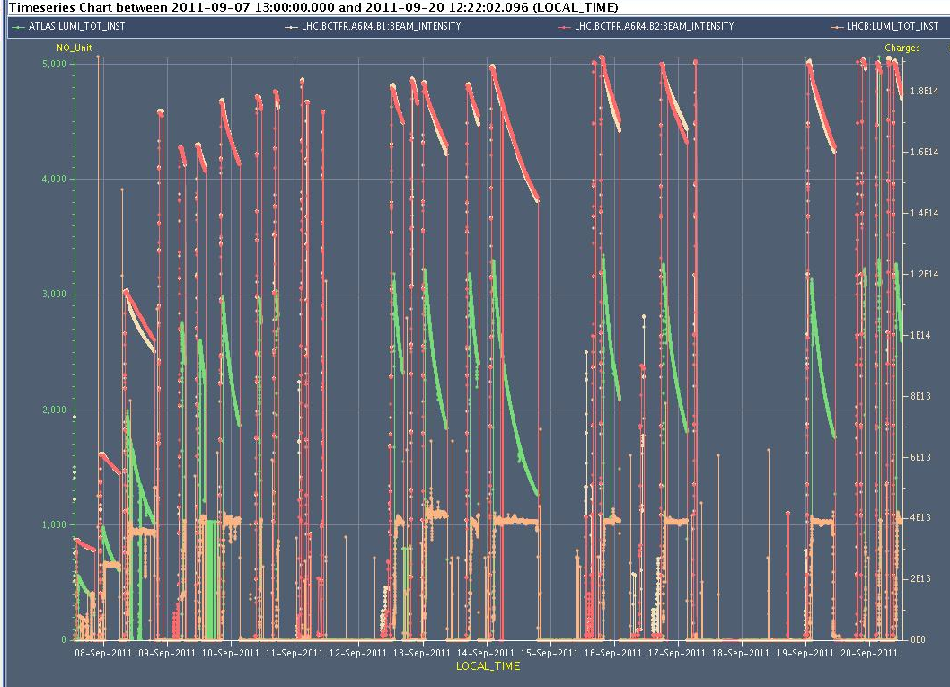
8th September Onwards ….

Slide 29
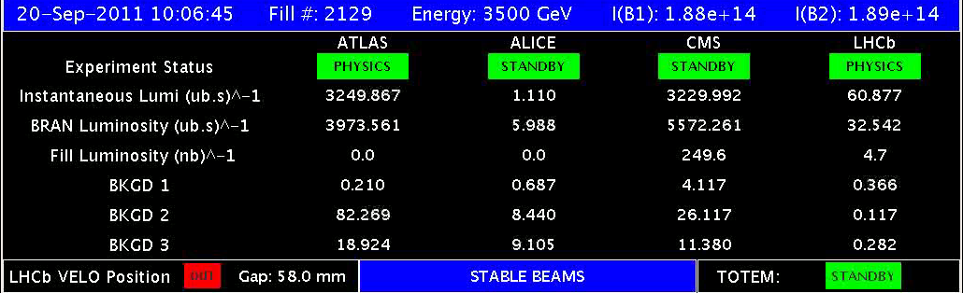
Latest Period
Excellent Peak Performance L_{pk} >3.2x10⁺³³ cm⁻² s⁻¹
Fill Length Very Variable (between 20mins and 16 hours!)
Some Technical issues causing downtime and a smattering of SEU’s
High and spiky vacuum conditions around Alice and LHCb have caused some background problems and even beam dumps.
  For some time Alice could not take data
In spite of the gaps we produced 610pb⁻¹ in 12 days = 50pb⁻1/day

Slide 30
(new) Record Page
 | 2010 | 2011 | Nominal
Energy [TeV] | 3.5 | 3.5 | 7
β* [m] (IP1,IP2,IP5,IP8) | 3.5, 3.5, 3.5, 3.5 | 1.5, 10, 1.5, 3.0 | 0.55, 10, 0.55, 10
Emittance [μm] (start of fill) | 2.0 – 3.5 | 1.5 – 2.2 | 3.75
Transverse beam size at IP1&5 [μm] | 60 | 28 | 16.7
Bunch population | 1.2×10¹¹ p | 1.35×10¹¹ p | 1.15×10¹¹ p
Number of bunches | 368 | 1380 | 2808
Number of collisions (IP1 & IP5) | 348 | 1318 | -
Stored energy [MJ] | 28 | 110 | 360
Peak luminosity [cm⁻²s⁻¹] | 2×10³² | 2.41×10³³ | 1×10³⁴
Max delivered luminosity (1 fill) [pb⁻¹] | 6.23 | 100.7 | -
Longest Stable Beams fill [hrs] | 12:09 | 25:59 | -
1.0, 10,1.0,3.0
23
1.4x10⁺¹¹ p
3.3x10⁺³³
116

Slide 31
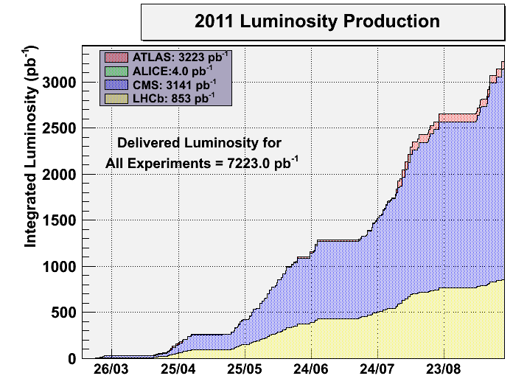
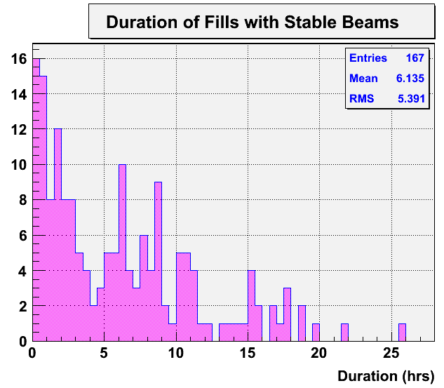
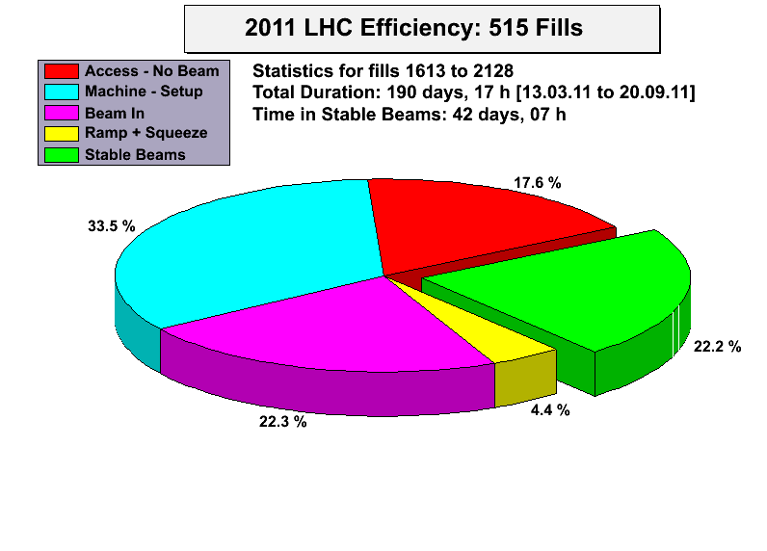
Still – Not so bad!!
Sept 20th 2011
(Midday)
https://lhc-statistics.web.cern.ch/LHC-Statistics/#
Alick Macpherson, Yngve Levinsen and Mario Terra Pinheiro

Slide 32
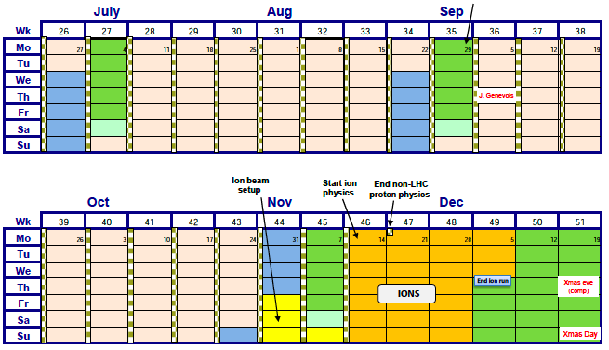
Rest of the year ..
There are 37 days remaining of the proton run
To date we have 3.3 fb⁻¹ delivered
Some time needed for dedicated physics – Totem etc.
At 50pb⁻¹ a day would get >1.5fb⁻¹ more
You can scale with any multiplier you like!
Then:
MD4 block: including a test of Pb-p (no Physics!)
Pb-Pb Physics

Slide 33
Conclusions
The steep performance increase of the LHC continues:
A factor ~5 in peak luminosity since the last LHCC!!
This is not without problems and issues but most are well under control, or in mitigation measures are in hand
What we need now is to exploit the magnificent peak performance and turn it into data on tape.
However we also need to push the machine to perform close to the peak to uncover any weaknesses (SEU) in time for mitigation measures during the Christmas stop.
Life is increasingly difficult juggling the needs of the different experiments since their optimum running conditions are so different!

Slide 34
Thanks for your Attention

Slide 35
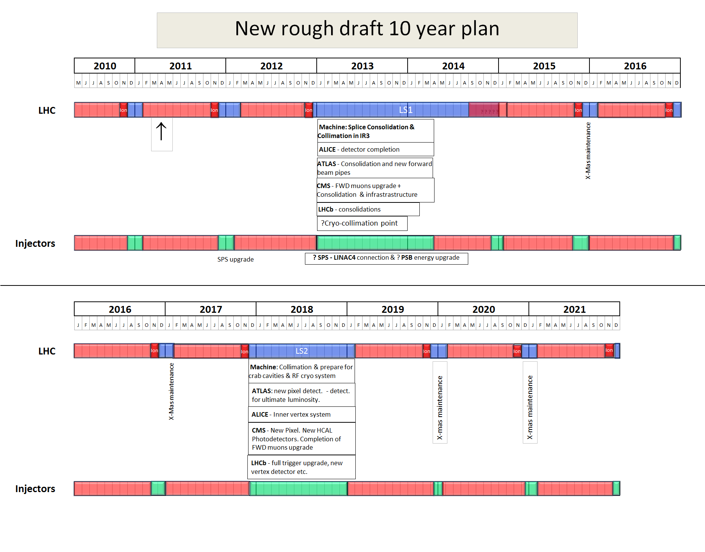
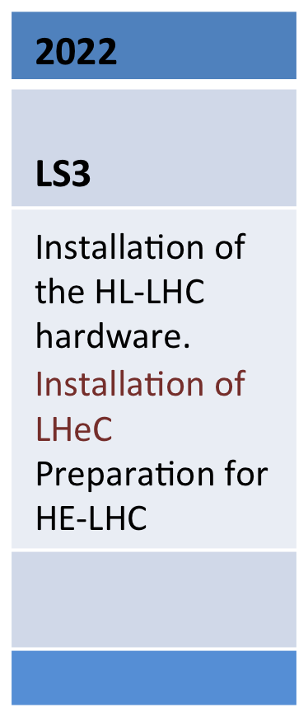
Longer Term Planning
Not yet approved!

Slide 36
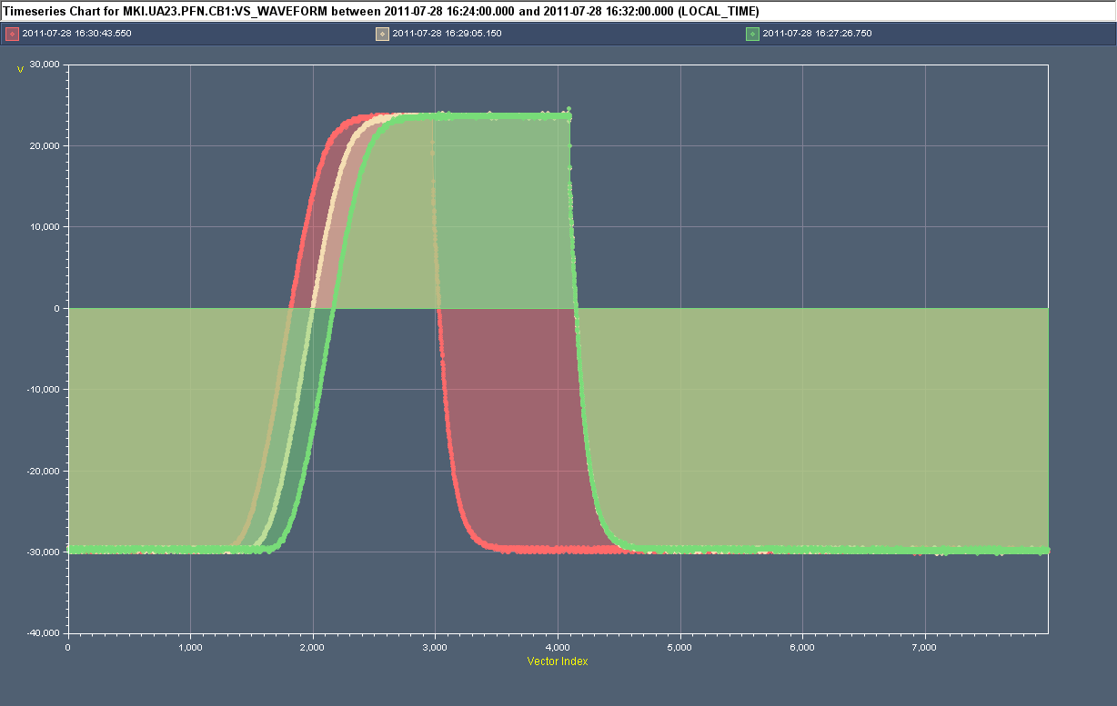
MKI ‘Misfire Events’ (not related to previous slide)
28/7/2011
Normal (triggered) turn-on
Erratic (untriggered) turn-on of MKI2 MS3
Interlocks detected erratic. Control (machine protection) philosophy is to trigger all MS and DS of system (within a delay of 1µs). Hence all 4 kicker magnets pulsed for up to 4.5µs.
Circulating beam was not hit by the kick.
Batch was extracted from SPS but saw no kick at MKI and went straight into the TDI.
Note: this MS was put in place during last TS and has since made 5 erratics (only last 2 affected beam).
M. Barnes

