Slide 1
Xdeps in depth
R. De Maria

Slide 2
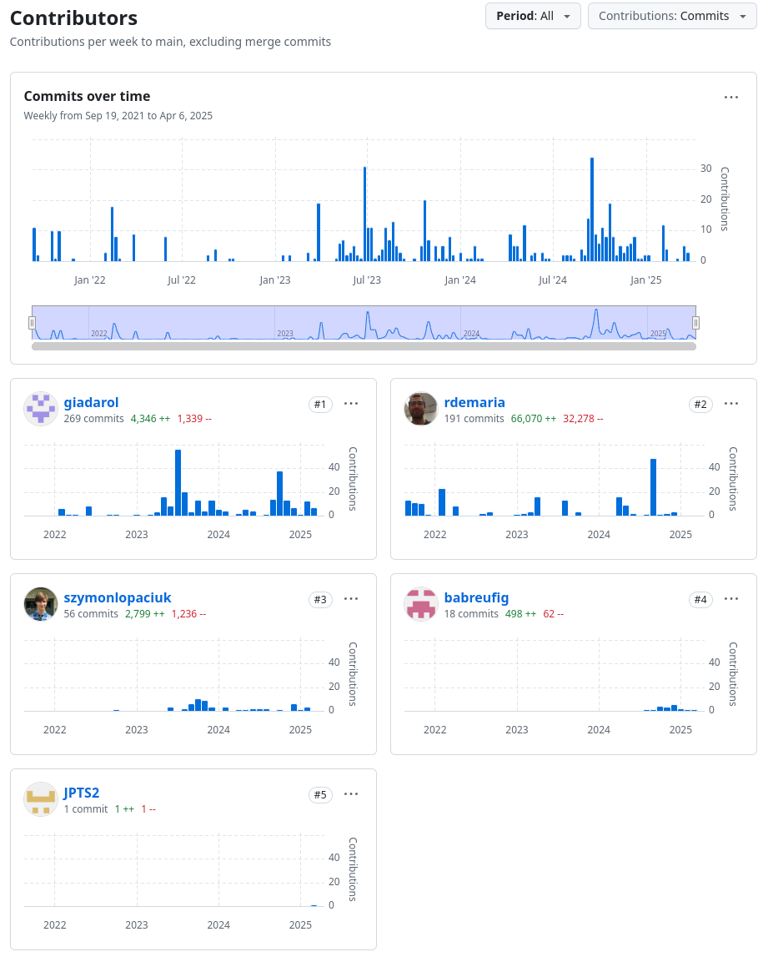
Xdeps package
https://github.com/xsuite/xdeps development started in 2021 shortly after Xtrack to give Xtrack beam elements the ability to be controlled by variables.
We did not want to slow down xtrack.
We did not want to add the functionality without changing xtrack and to be general enough to be future proof.
We want to be compatible with MAD-X semantics.
We wanted a lean and concise Python API.
With time we added in the package also other classes for Optimization and Table, which I will not discuss today.

Slide 3
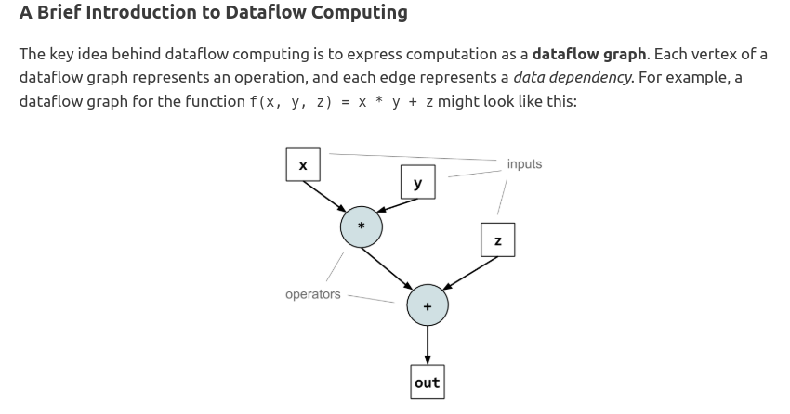
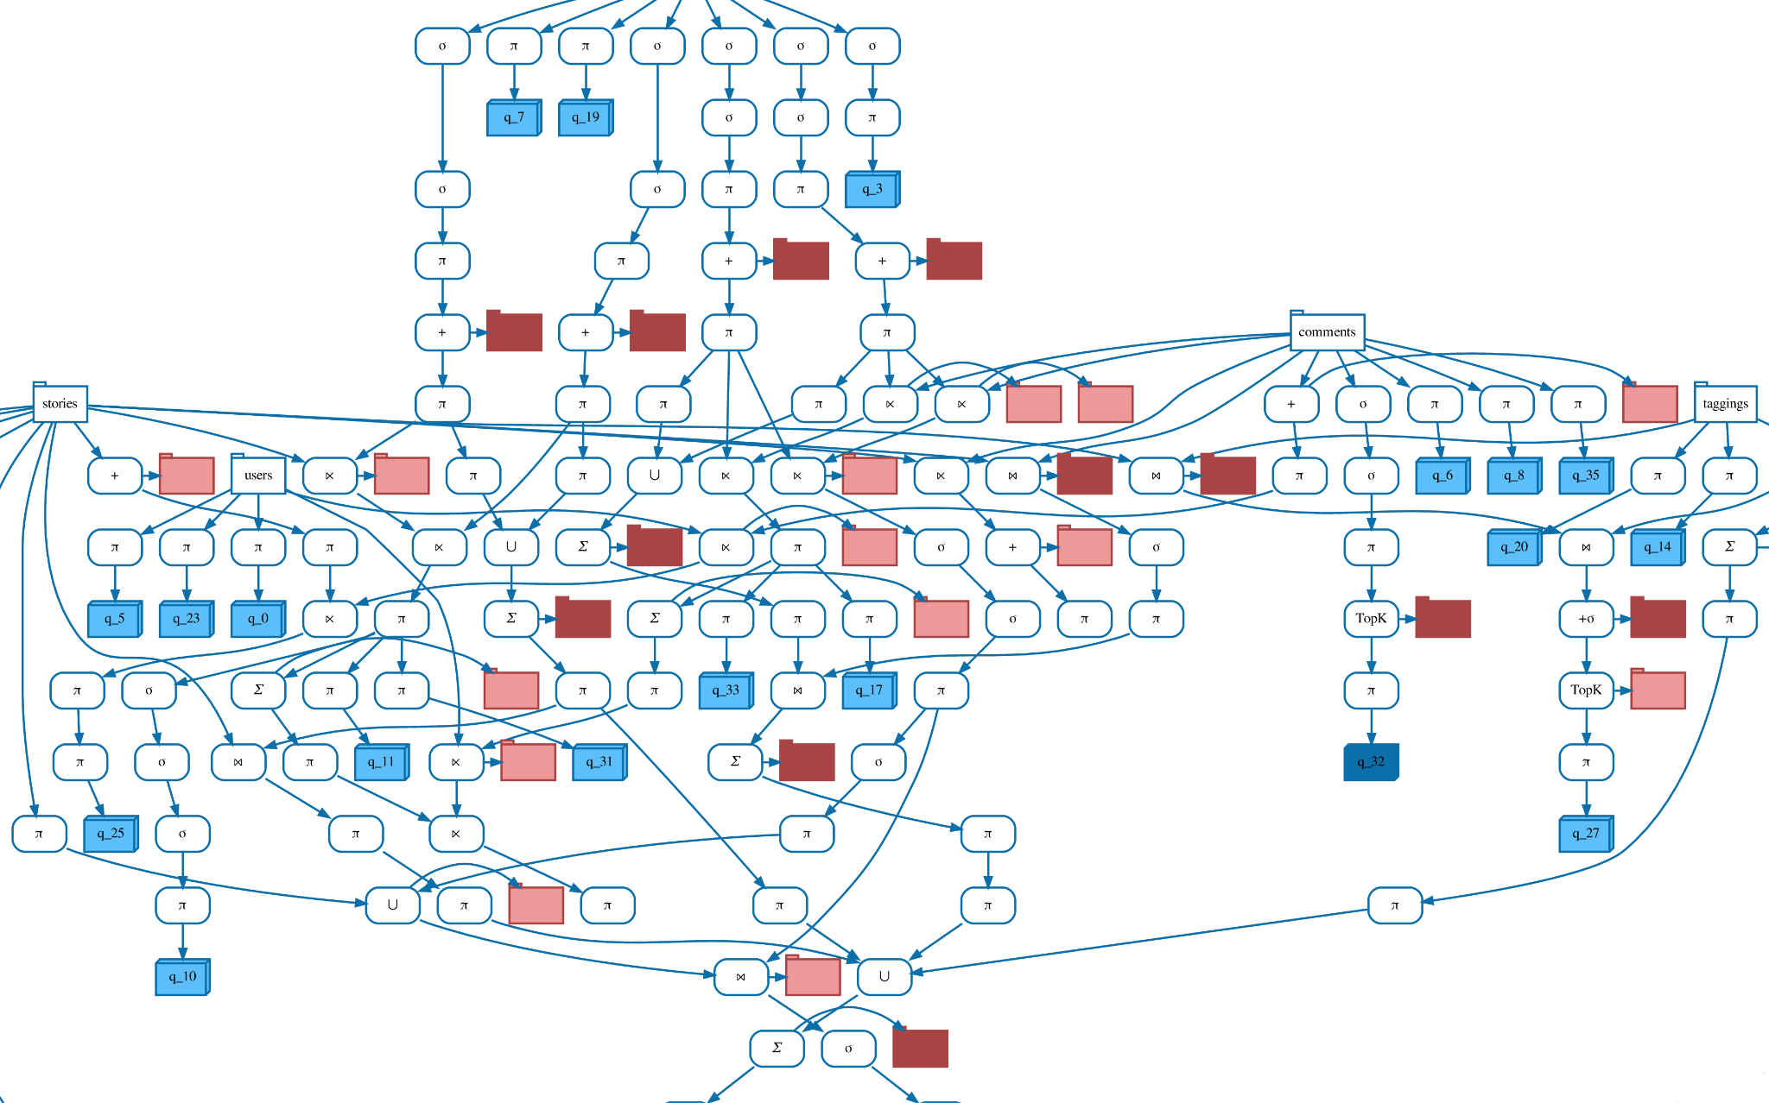
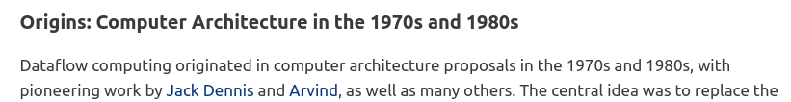
Xdeps implements a dataflow control-flow in Python
https://www.sigops.org/2020/the-remarkable-utility-of-dataflow-computing/

Slide 4
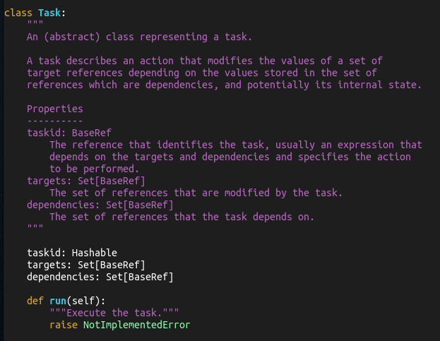

Xdeps: Task
Task: has taskid
run()
Targets
Dependencies
The run method uses dependencies to update targets.
Dependencies and targets are Refs.
In Xtrack we mostly use ExprTask, we may be start using other forms in the future.
Tasks are managed by the manager…

Slide 5
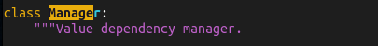
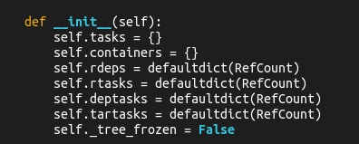
Xdeps: Manager
Tasks are linked when the target of one task is the dependencies of another task.
Task a
Task b
Task d
Task c
The Manager contains
A task dictionary: taskid -> Task
A container dictionary: string -> Python objects
and use this information to update the targets when a dependencies changes by calling run in the correct order.

Slide 6
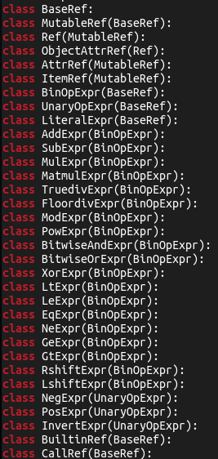
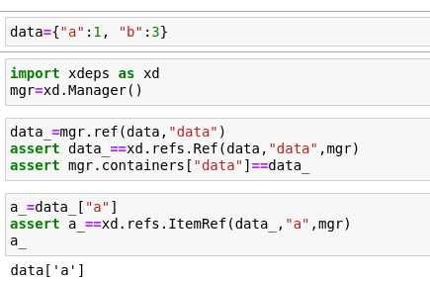
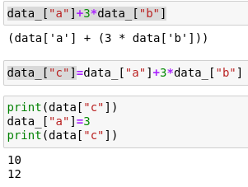
Xdeps: Refs
References is a set of classes that once combined allows to express a computation:
They are used to define a target or dependency, and notify the manager when the user wants to update some data.
They are also used to define and ExprTask.
They are many types of Refs:
Can be used to define a target.
An expressions
Defines an ExprTask

Slide 7
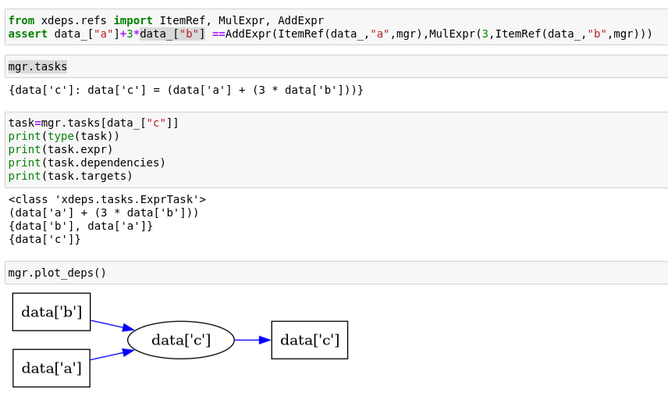
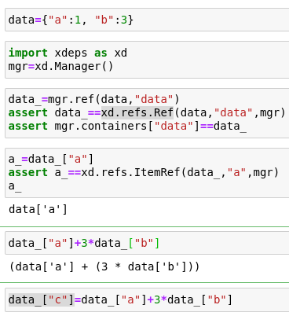
Xdeps: example
The task can be found in tasks
Defines an ExprTask

Slide 8
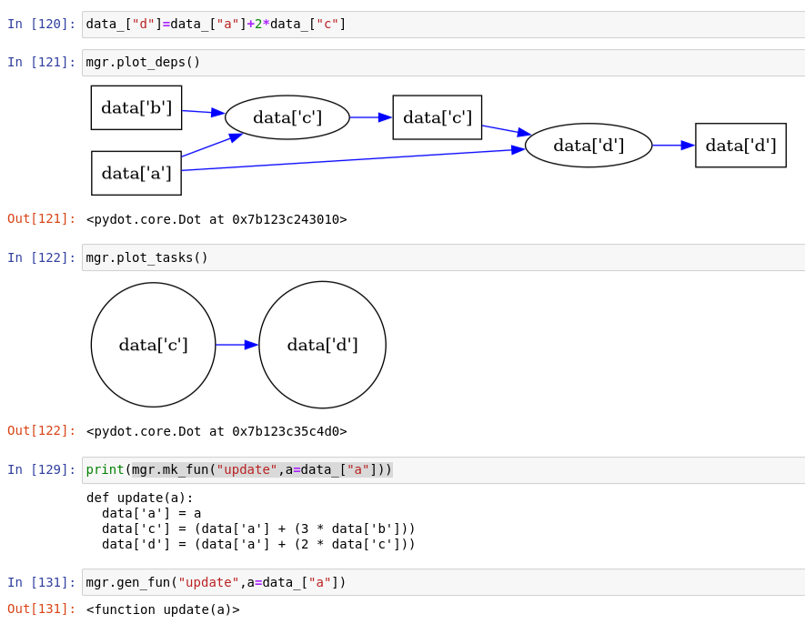

Xdeps: example
String can be used as shortcut to generate expressions
Combination of tasks and ordering
Arbitrary update function can be generated and cached

Slide 9
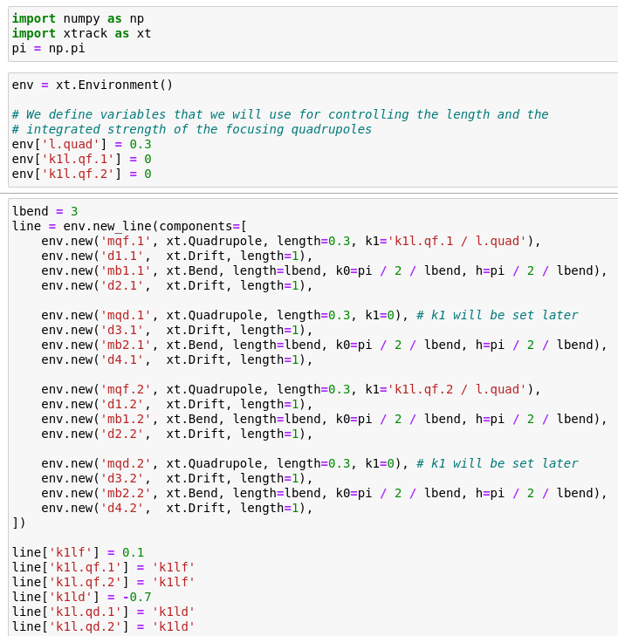
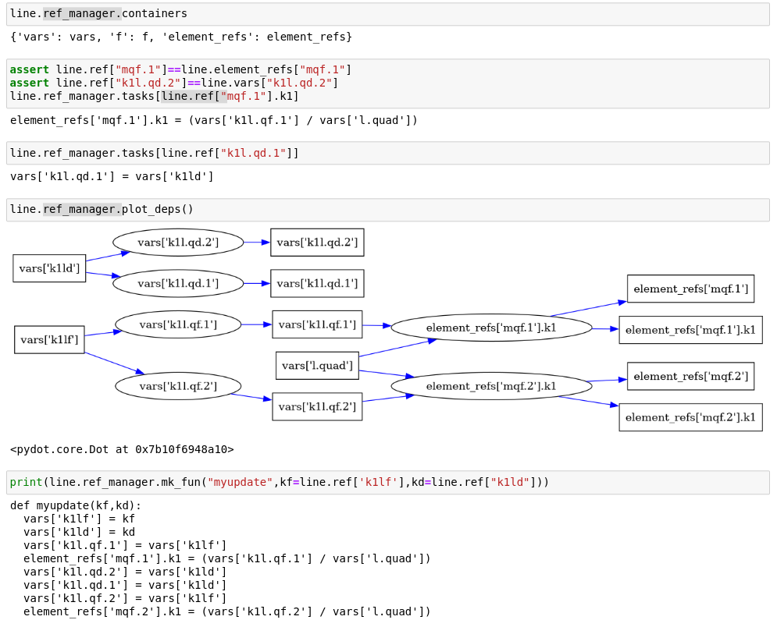
Xdeps: xtrack example
Xtracks adds a few shortcuts and convenience methods to deal with Xdeps logic.

Slide 10
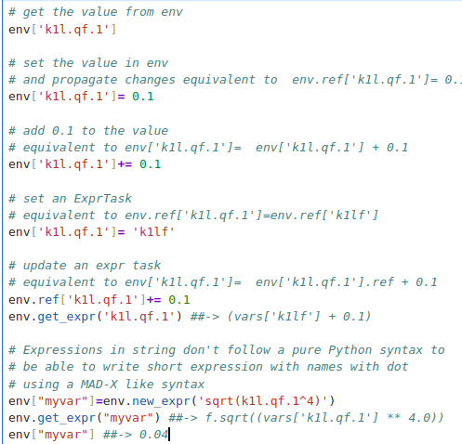
Xdeps: xtrack example
Xtracks adds a few shortcuts and convenience methods to deal with xdeps logic.

