Slide 1
Some info from ESPP Symposium, DG and ATS-director talks

Slide 2
Medium-Term Plan 2026-2030
It covers:
scientific and financial strategy for the 5-year period 2026-2030
draft budget for the year 2026
10-year outlook
Unanimously approved by the Council on 19 June

Slide 3
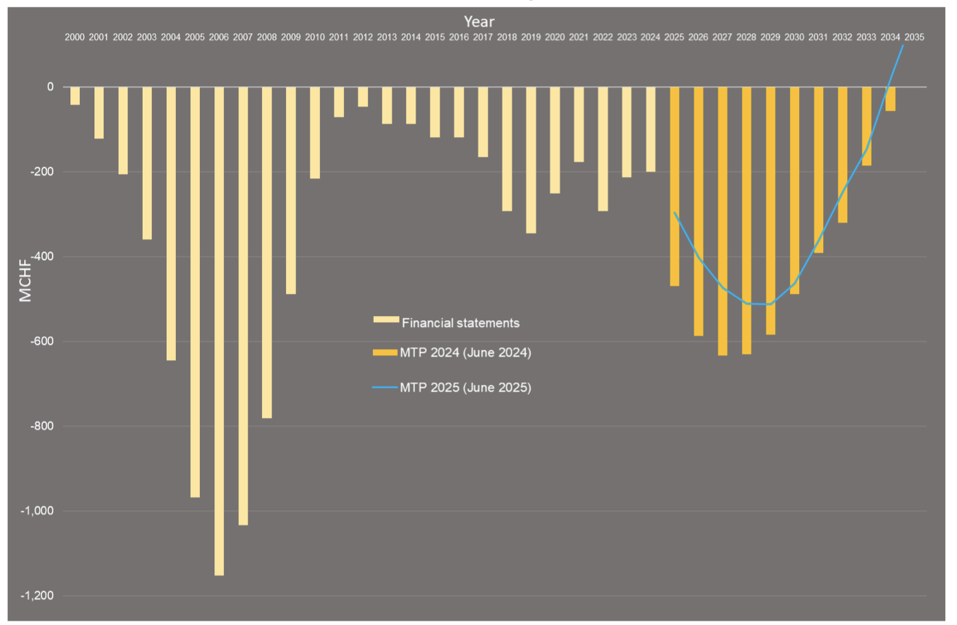
Cumulative budget deficit vs time
Year
MCHF
Financial situation significantly improved compared to 2024 MTP: new expenses are more than offset by additional revenues and savings
CBD peak reduced from -632.8 M in 2024 MTP to -512 M now.
However, due to the new LS3 schedule, the peak moves from 2027 in the 2024 MTP to 2029 now
Despite the peak shift, the deficit reaches zero in 2034, as in 2024 MTP, preserving the early 2030s window for launching a future collider.

Slide 4
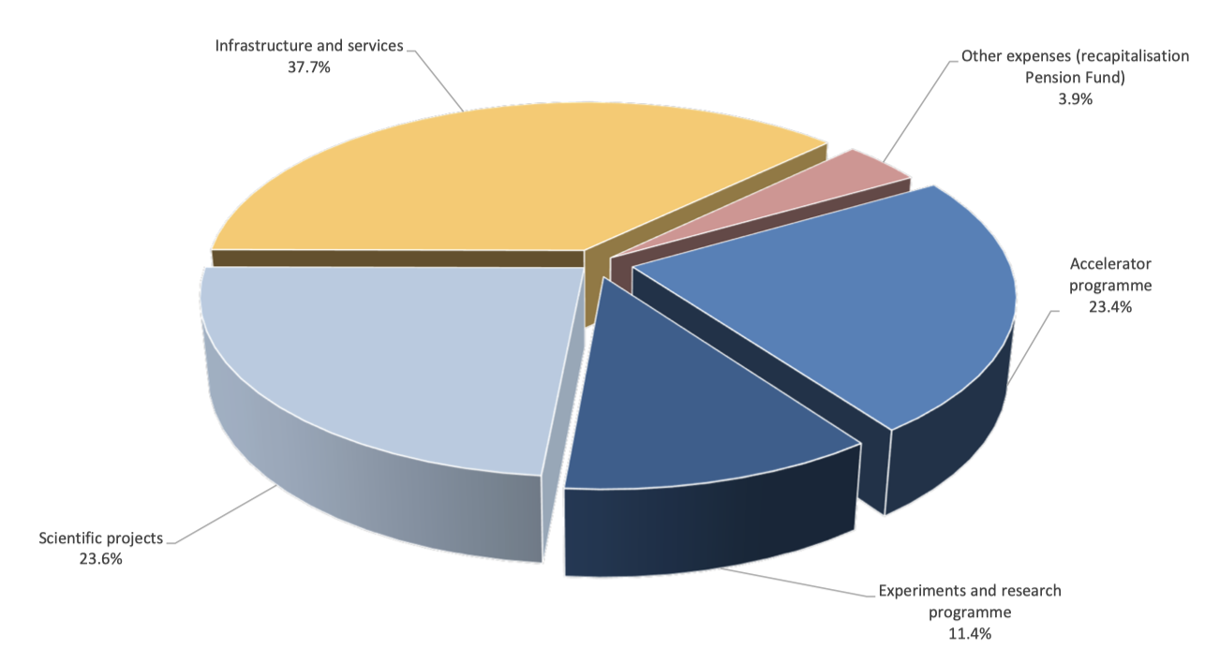
2026 draft expenses (M+P)
Infrastructure, services and centralised expenses^{(*)}
~ 577.4 M (37.7%)
Safety, environment, energy, technical infrastructure,
computing support, buildings and site facilities,
international relations, etc.
(*) Some offset by corresponding revenues
Recapitalisation of Pension Fund:
60 M (3.9%)
Accelerator programme:
~ 358.3 M (23.4%)
Injectors, LHC, accelerator support
Scientific projects
~ 362 M (23.6%)
HL-LHC, detector upgrades
Neutrino Platform
Accelerator R&D, Detector R&D
Future colliders (FCC, CLIC, muon colliders)
Physics Beyond Colliders
Experiments and research programme
~ 174.7 M (11.4%)
LHC and non-LHC experiments, theory,
computing, scientific support
~ 60% of Budget invested directly in the scientific programme
~ 40% for safety, environment and maintenance and renovation of technical and general
infrastructure → attractive lab and efficient services for worldwide CERN community

Slide 5
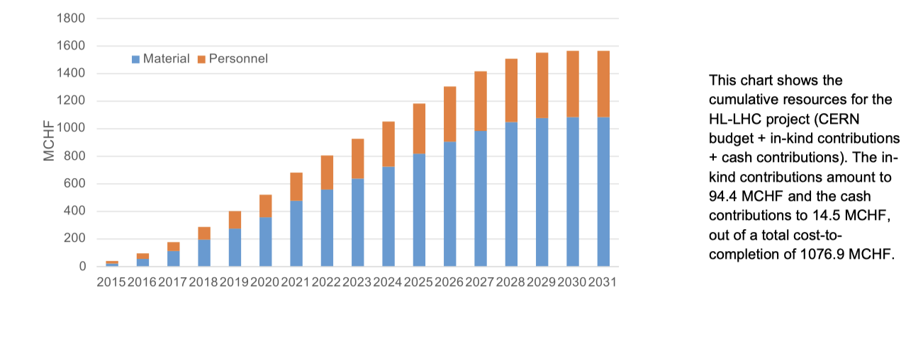
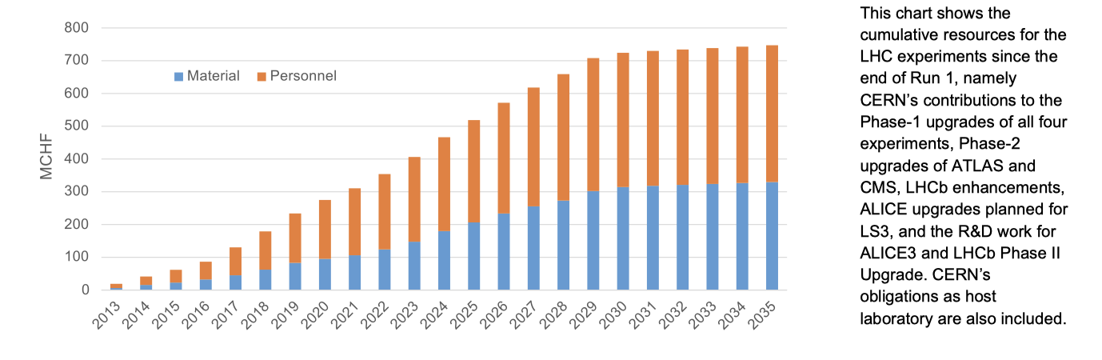
CERN’s investment in HL-LHC and experiments upgrades (our first priority)
HL-LHC accelerator
LHC experiments upgrades

Slide 6
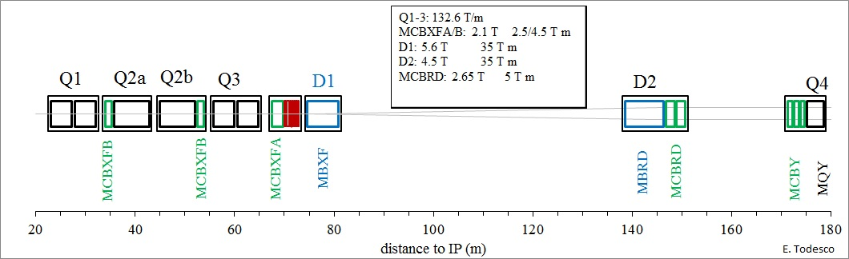
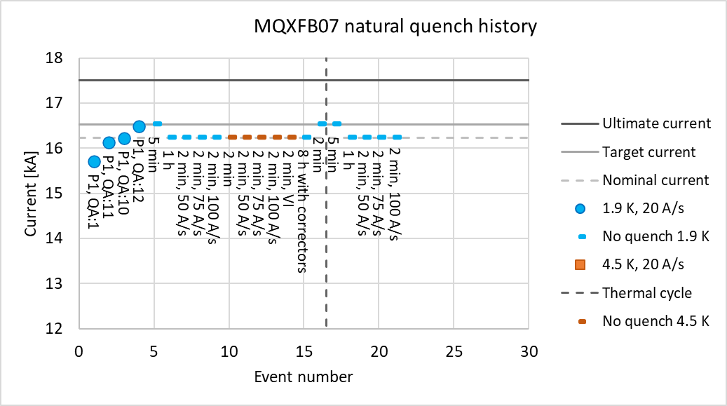
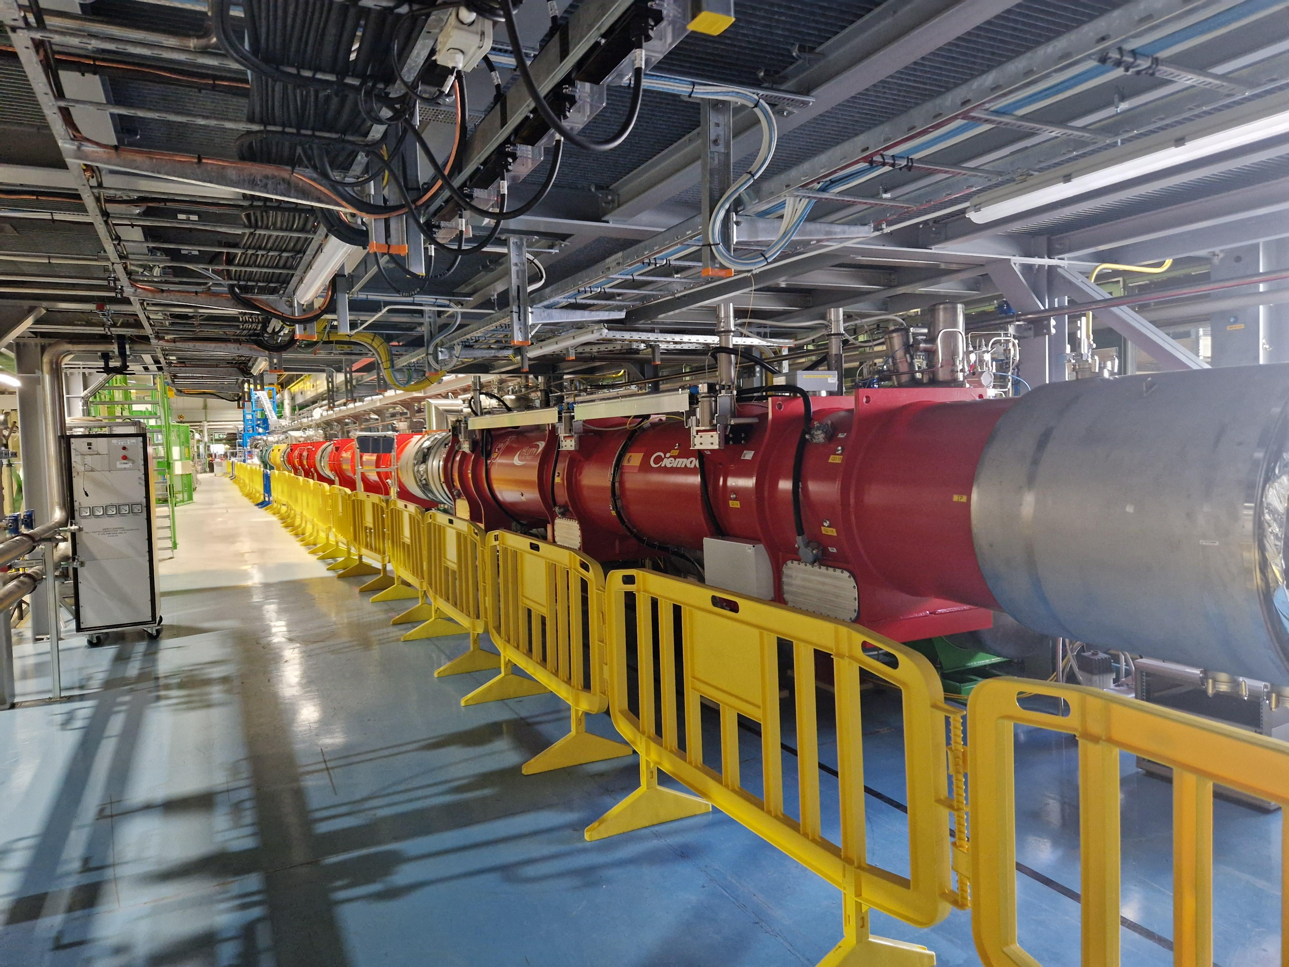
HL-LHC : accelerator upgrade
Nb₃Sn technology for high-field superconducting
magnets demonstrated in the US and at CERN
Inner Triplet (IT) string: test to start in October

Slide 7
Status of the European Strategy for Particle Physics

Slide 8
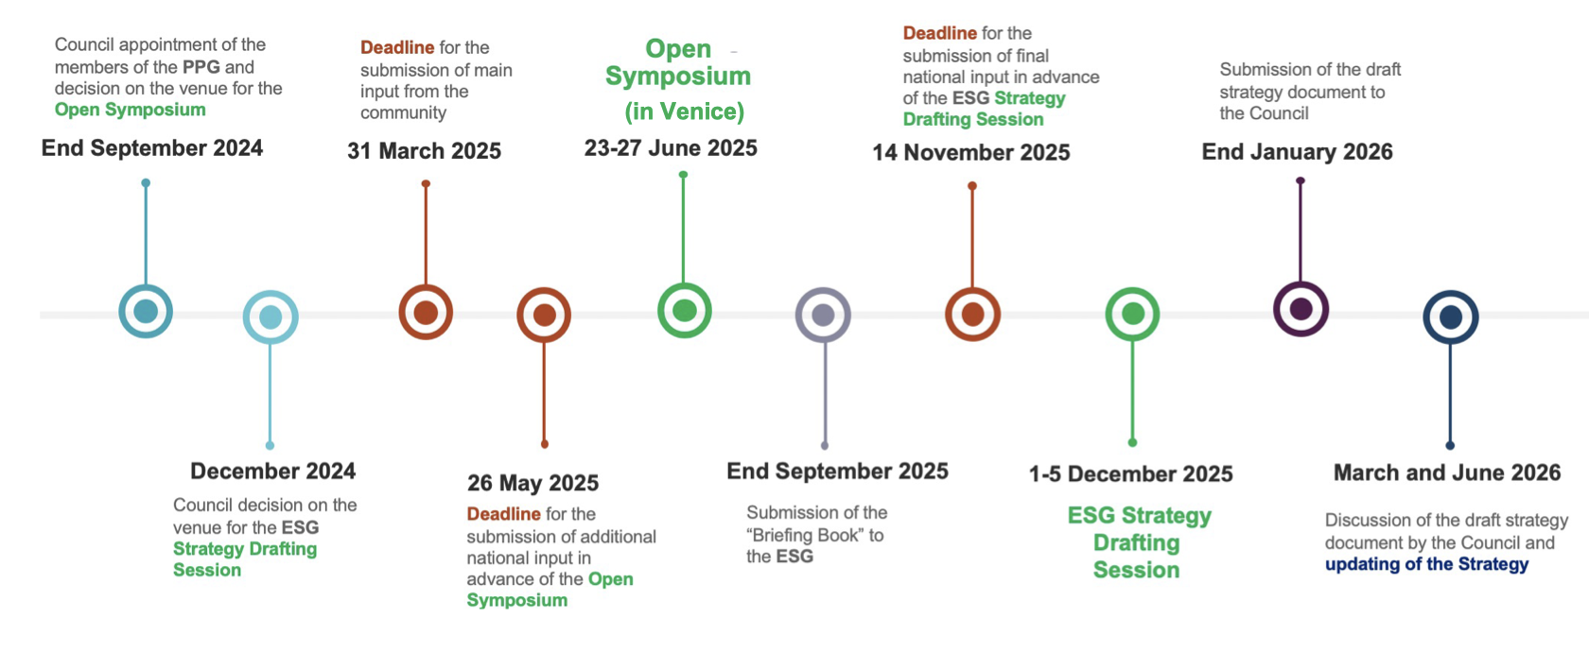

ESPP timeline
Council
approval
of ESPP
timeline
We are here

Slide 9
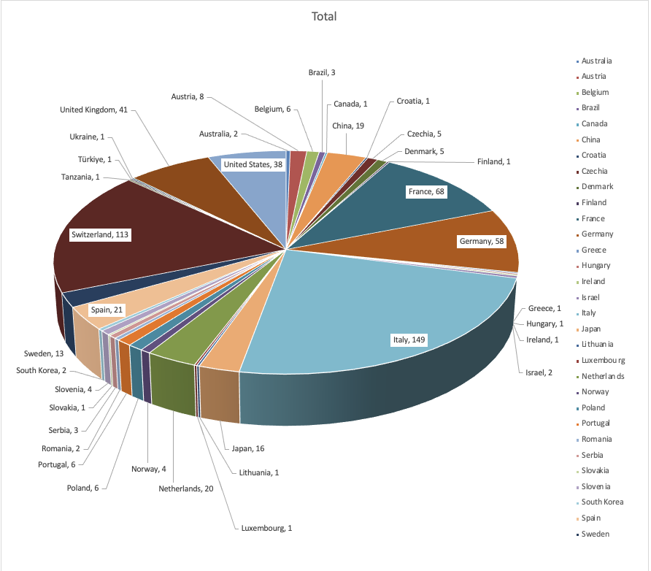
ESPP Open Symposium, Venice, June 23-28
~ 630 in-person participants and ~ 720 remote participants per day
Many thanks to INFN and the Local Organizing Committee chaired by Sandra Malvezzi

Slide 10
European Strategy Group (ESG) remit from Council
The remit of the European Strategy Group (ESG), established in June 2024, is to develop an update of the European Strategy
for Particle Physics and submit it for approval by the Council. The aim of the Strategy update should be to develop a visionary
and concrete plan that greatly advances human knowledge in fundamental physics through the realisation of the next flagship
project at CERN. This plan should attract and value international collaboration and should allow Europe to continue to play a
leading role in the field.
The ESG should take into consideration:
the input of the particle physics community;
the status of implementation of the 2020 Strategy update;
the accomplishments over recent years, including the results from the LHC and other experiments and facilities worldwide,
the progress in the construction of the High-Luminosity LHC, the outcome of the Future Circular Collider Feasibility Study,
and recent technological developments in accelerator, detector and computing; the international landscape of the field.
The Strategy update should include the preferred option for the next collider at CERN and prioritised alternative options to
be pursued if the chosen preferred plan turns out not to be feasible or competitive. The Strategy update should also indicate
areas of priority for exploration complementary to colliders and for other experiments to be considered at CERN and at other laboratories
in Europe, as well as for participation in projects outside Europe.
The ESG should review and update the Strategy and add other items identified as relevant to the field, including accelerator,
detector and computing R&D, the theory frontier, actions to minimise the environmental impact and to improve the sustainability
of accelerator-based particle physics, the strategy and initiatives to attract, train and retain the young generations, public engagement
and outreach.
The ESG should submit the proposed Strategy update to the Council by the end of January 2026.

Slide 11
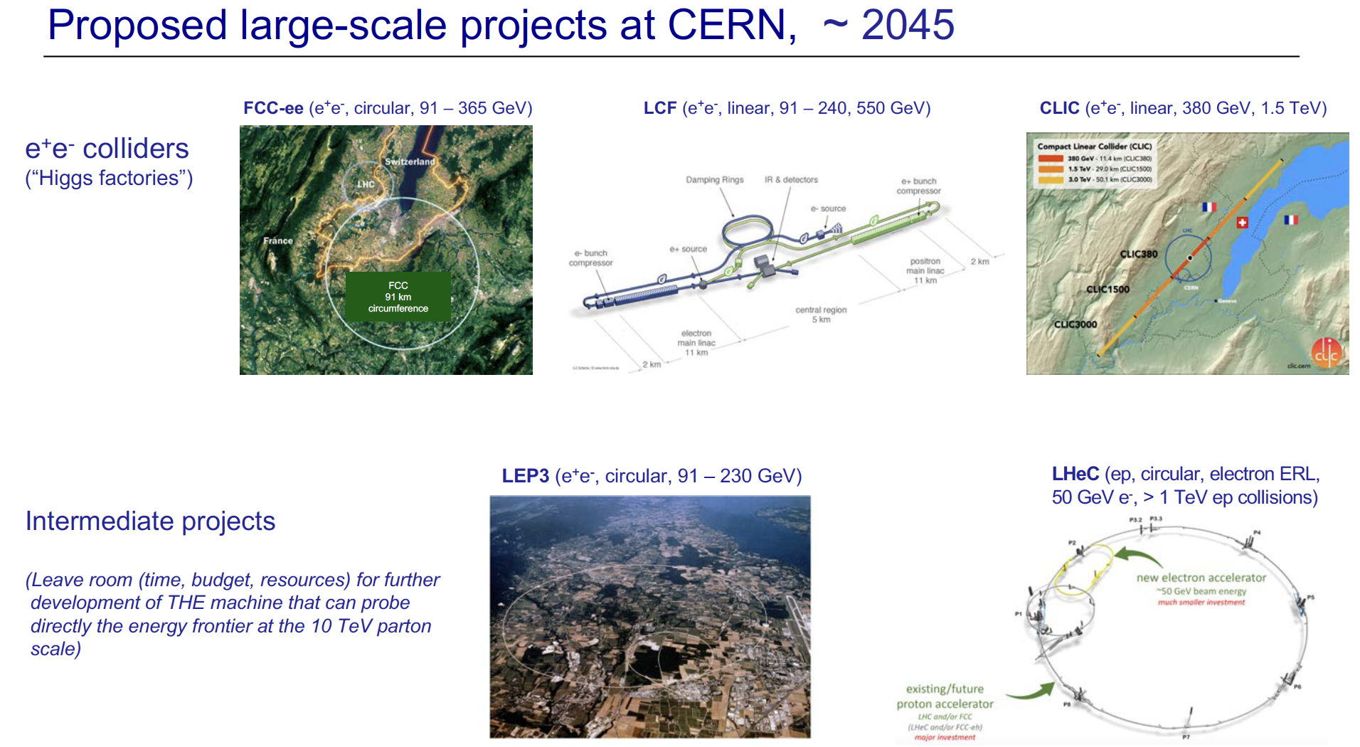

Slide 12
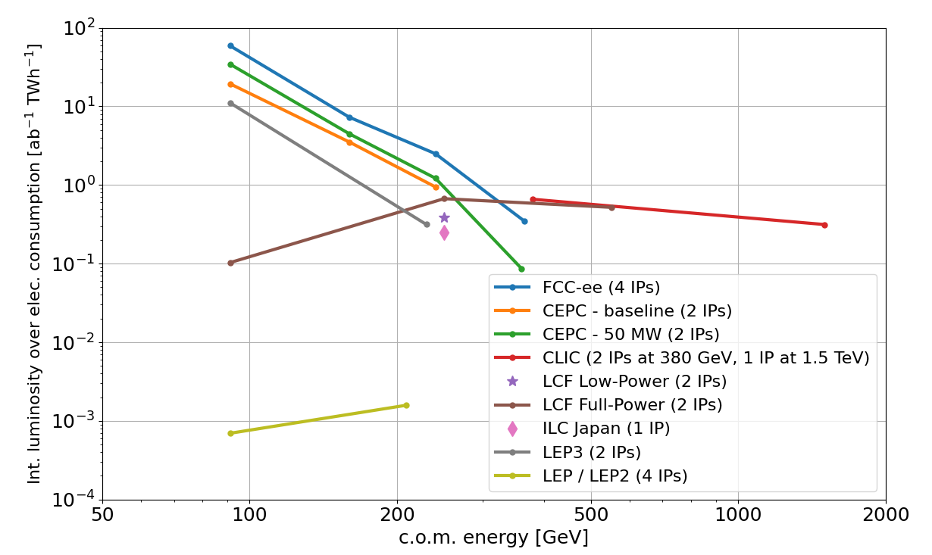
Performance comparison
Circular colliders (CC) are more efficient than Linear Colliders (LC) at energies up to 300-350 GeV. Note the improvement w.r.t. LEP/LEP2
LC can reach the O(TeV) region (no synchrotron radiation loss)
CC can accommodate more experiments operating in parallel
FCC-ee collision energy can be varied between 90 and 240 GeV seamlessly at unparalleled luminosity.
LC baselines include polarized e⁻ beam. For LCF e⁺ too.
LEP3 proposal still at pre-conceptual design level: larger uncertainty on luminosity, power consumption
Notes:
FCC-ee energy flexibility is reduced after the upgrade for operation at the highest energy
and operation at lower energy will be possible, albeit at lower luminosity.

Slide 13
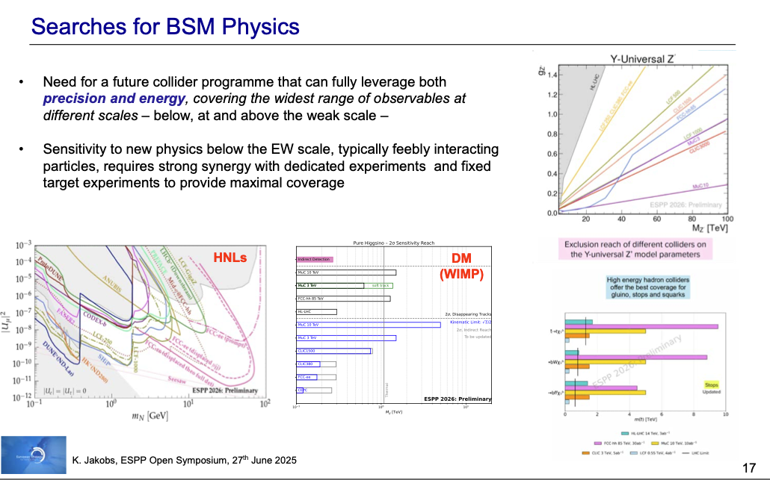

Slide 14
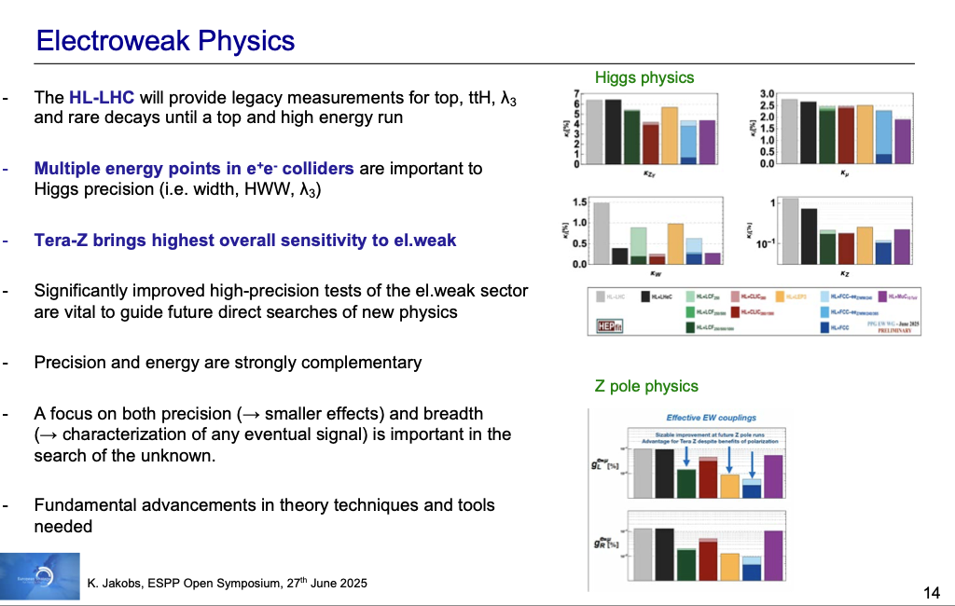

Slide 15
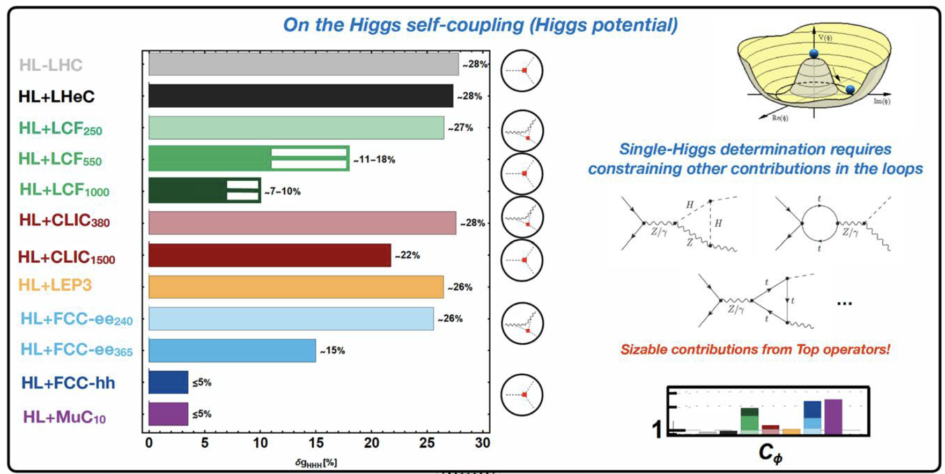

Slide 16
Cost estimates
 |  | BCHF
FCC-ee | + 4 exps. non-CERN cost | 15.3
FCC-hh | following FCC-ee | 19.1
FCC-hh | stand alone | ~28
LCF 250 | low power | 8.5
LCF 550 | following LCF 250 | 5.5
CLIC 380 |  | 7.4
CLIC 1500 | following CLIC 380 | 7.1
MC 3200 | CERN | ~12
MC 7600 | CERN | ~17
MC 10TeV | Green field | ~19
LEP3 | + 2 exps. non-CERN cost | 4.8
LHeC |  | 2.0

Slide 17
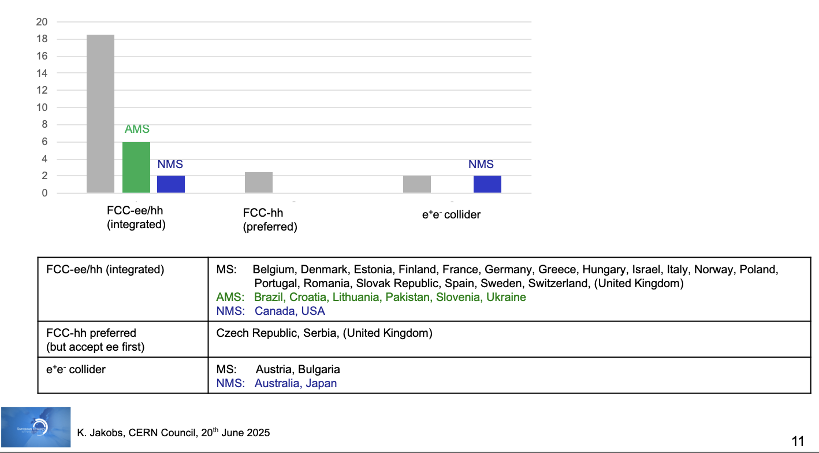
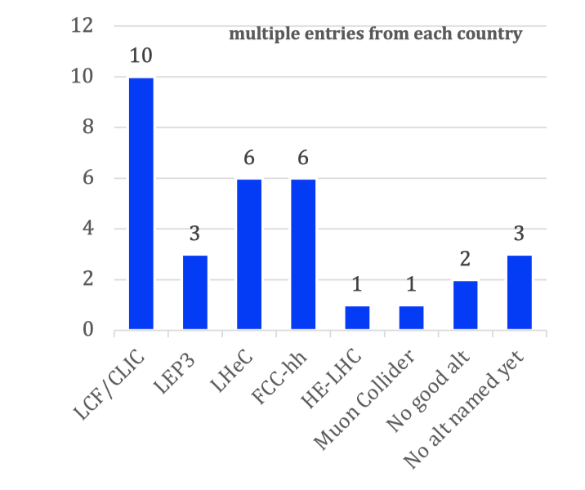
National input to the ESPP
Preferred option
Alternative if preferred option not feasible
MS
Publicly available at: https://indico.cern.ch/event/1439855/contributions/
Summary compiled by European Strategy Group

Slide 18
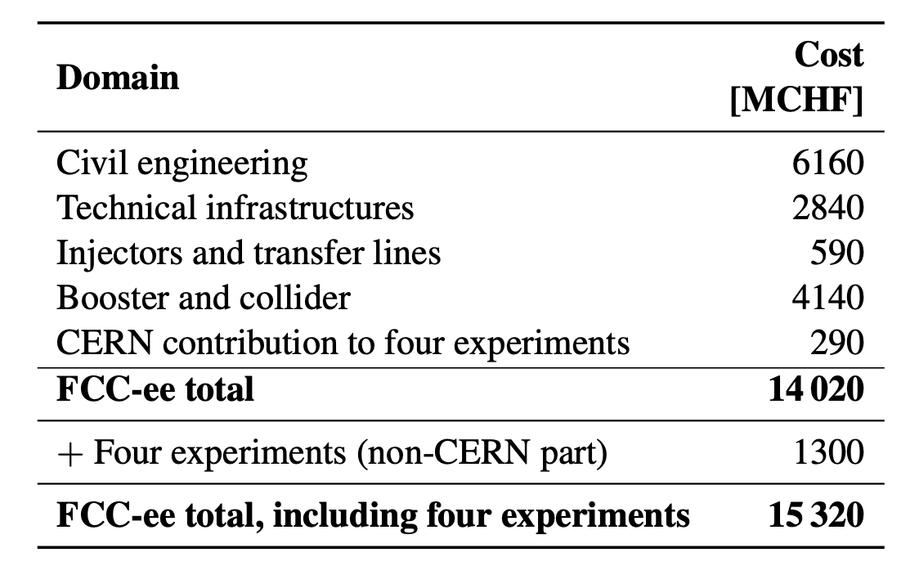
Building a viable financial path
Updated project cost for FCC-ee up to and including
operation at ZH and 4 experiments
t-tbar upgrade requires additional 1.3 BCHF
Funding of FCC (or any other major future collider project) expected to come from two main sources:
CERN Budget (i.e. revenues from Member and Associate Member States): would cover more than 50% of FCC investment cost
External contributions:
- additional voluntary contributions (in-cash or in-kind) from Member and Associate Member States
- contributions from non-Member States
- exploring possible contributions from the European Union in the next Multiannual Financial Framework (MFF 2028-2034)
- exploring possible contributions of private donors (→ in Dec 2024, Council approved “Policy for fundraising from private donors
for scientific activities at CERN ”)
→ good progress over the past months
Several funding scenarios developed, based on different assumptions (e.g. constant or slightly increased CERN Budget)
→ ongoing discussions in Council

Slide 19

Photo Trevor Sherwin
Karl Jakobs: “Key messages from the Symposium”
Venice, Friday 27 June
Final Words
Over the past years very significant progress has been made towards the realisation of the next flagship project at CERN
FCC: Successful completion of the Feasibility Study; No technical showstoppers identified
Overwhelming support for the integrated FCC-ee/hh programme by the HEP communities in the CERN Member
and Associate Member states and beyond;
The strong support is largely based on the superb physics potential and the long-term prospects (FCC-ee /hh)
Discussions on the financial feasibility are ongoing (CERN management and Council)

Slide 20
Photo Trevor Sherwin
Karl Jakobs: “Key messages from the Symposium”
Venice, Friday 27 June
Final Words
Discussions on the prioritisation of alternative options are ongoing
Linear colliders (LCF, CLIC) present as well mature options for a Higgs factory at CERN
LEP3 and LHeC could be considered as “intermediate” collider projects
The differences in the physics potential (→ Physics Briefing Book), review of the technical readiness and the final input from the national HEP communities (due by 14 Nov.) will be important ingredients in the final recommendations by the European Strategy Group

Slide 21
Photo Trevor Sherwin
Karl Jakobs: “Key messages from the Symposium”
Venice, Friday 27 June
Final Words
Keeping a strong complementary physics programme beyond colliders is essential
The areas of Neutrino Physics, Dark Matter Search experiments, astroparticle (covered by the APPEC Roadmap)
and nuclear physics experiments (covered by the NuPPEC Long Run Plan) are also important to complement
the future collider programme

