Slide 1








DC-Coupled Resistive Silicon Detectors
A Status Update
LUCA MENZIO on behalf of the 4D share project
DRD2 WG2 meeting – 29th April 2025

Slide 2
Outline
Introduction
  Resistive Silicon Detectors (RSDs)
  Past Results
The DC-Coupled RSDs
  Design
  FBK production
DC-RSD Test Beam Results
  Set Up
  Space Resolution
  Time Resolution
Summary and Outlook

Slide 3
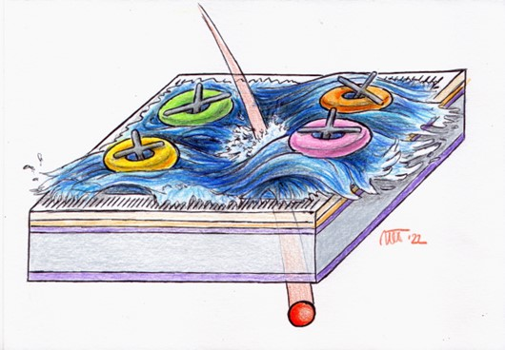
Introduction
Notes:
First of all let’s introduce what tracking is and why we need 4D tracking in the next future

Slide 4


Resistive Silicon Detectors
Electronics
Pixel size
~ 25 x 25 μm²
Pixel size
~ 250 x 250 μm²
~ 150 μm
~ 50 μm
Contacts
--
---
- --
+
++
+++
Silicon bulk
---
- --
++
+++
Resistive implant
Gain implant
Standard Silicon Detector
Resistive Silicon Detector
Notes:
Aggiungere la questione radiation resistance

Slide 5
Resistive Silicon Detectors
Change in silicon sensors paradigm: Resistive Silicon Detector (RSD)
With
Signal Sharing
Excellent position resolution with large pads
Internal gain (LGAD)
Timing
Low channel numbers
Thin sensors
Low power consumption
Low material budget
+ 100 % intrinsic fill factor!
Notes:
Aggiungere la questione radiation resistance

Slide 6
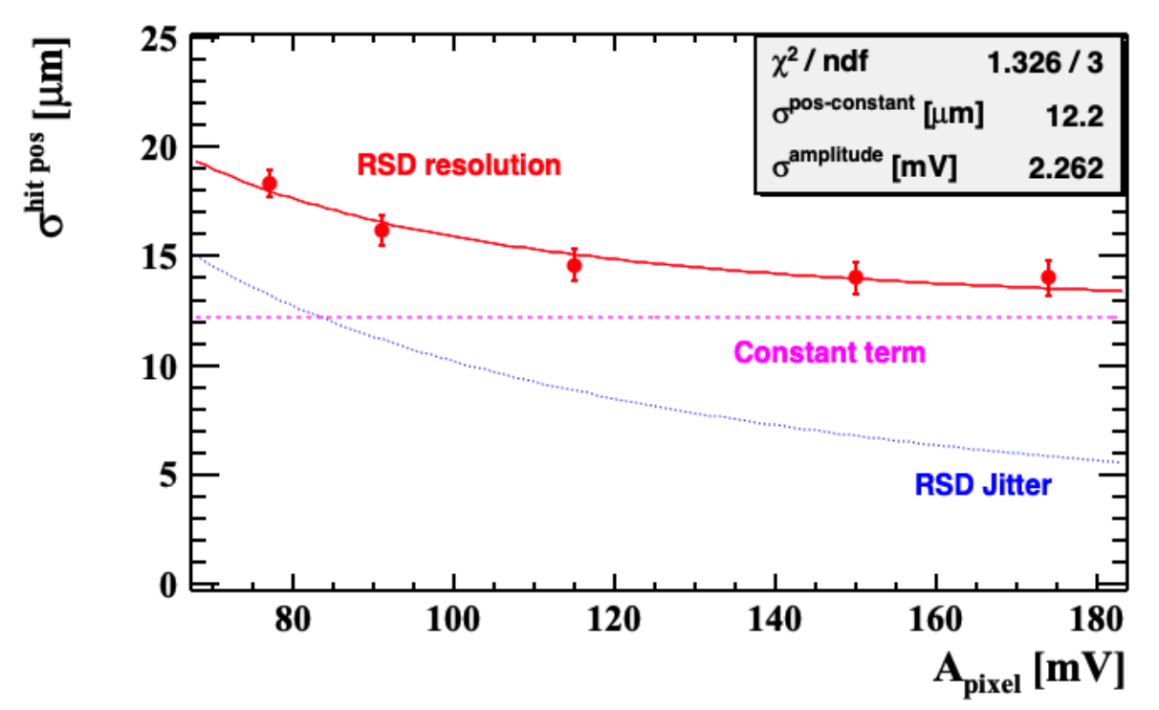
Some RSD Results from the (near) Past
In the past the RSDs electrodes were AC-Coupled (RSD – AC-coupled LGADs) to the n+ layer
RSD2-450-micron pitch
The RSD2 (FBK-2021) production has been extensively explored with laser (TCT) and in several test beams.
Some exceptional results were obtained in terms of spatial resolution – about 3%-4% of the sensor pitch!
These results were obtained with a 16-ch 5 GS/s digitizer by CAEN and with the sensor wire bonded on the FAST2 readout ASIC.
Obtained with an electron beam at DESY
L. Menzio et al, “First test beam measurement of the 4D resolution of an RSD 450 microns pitch pixel matrix connected to a FAST2 ASIC”, )NIMA 1065 (2024), 169526

Slide 7
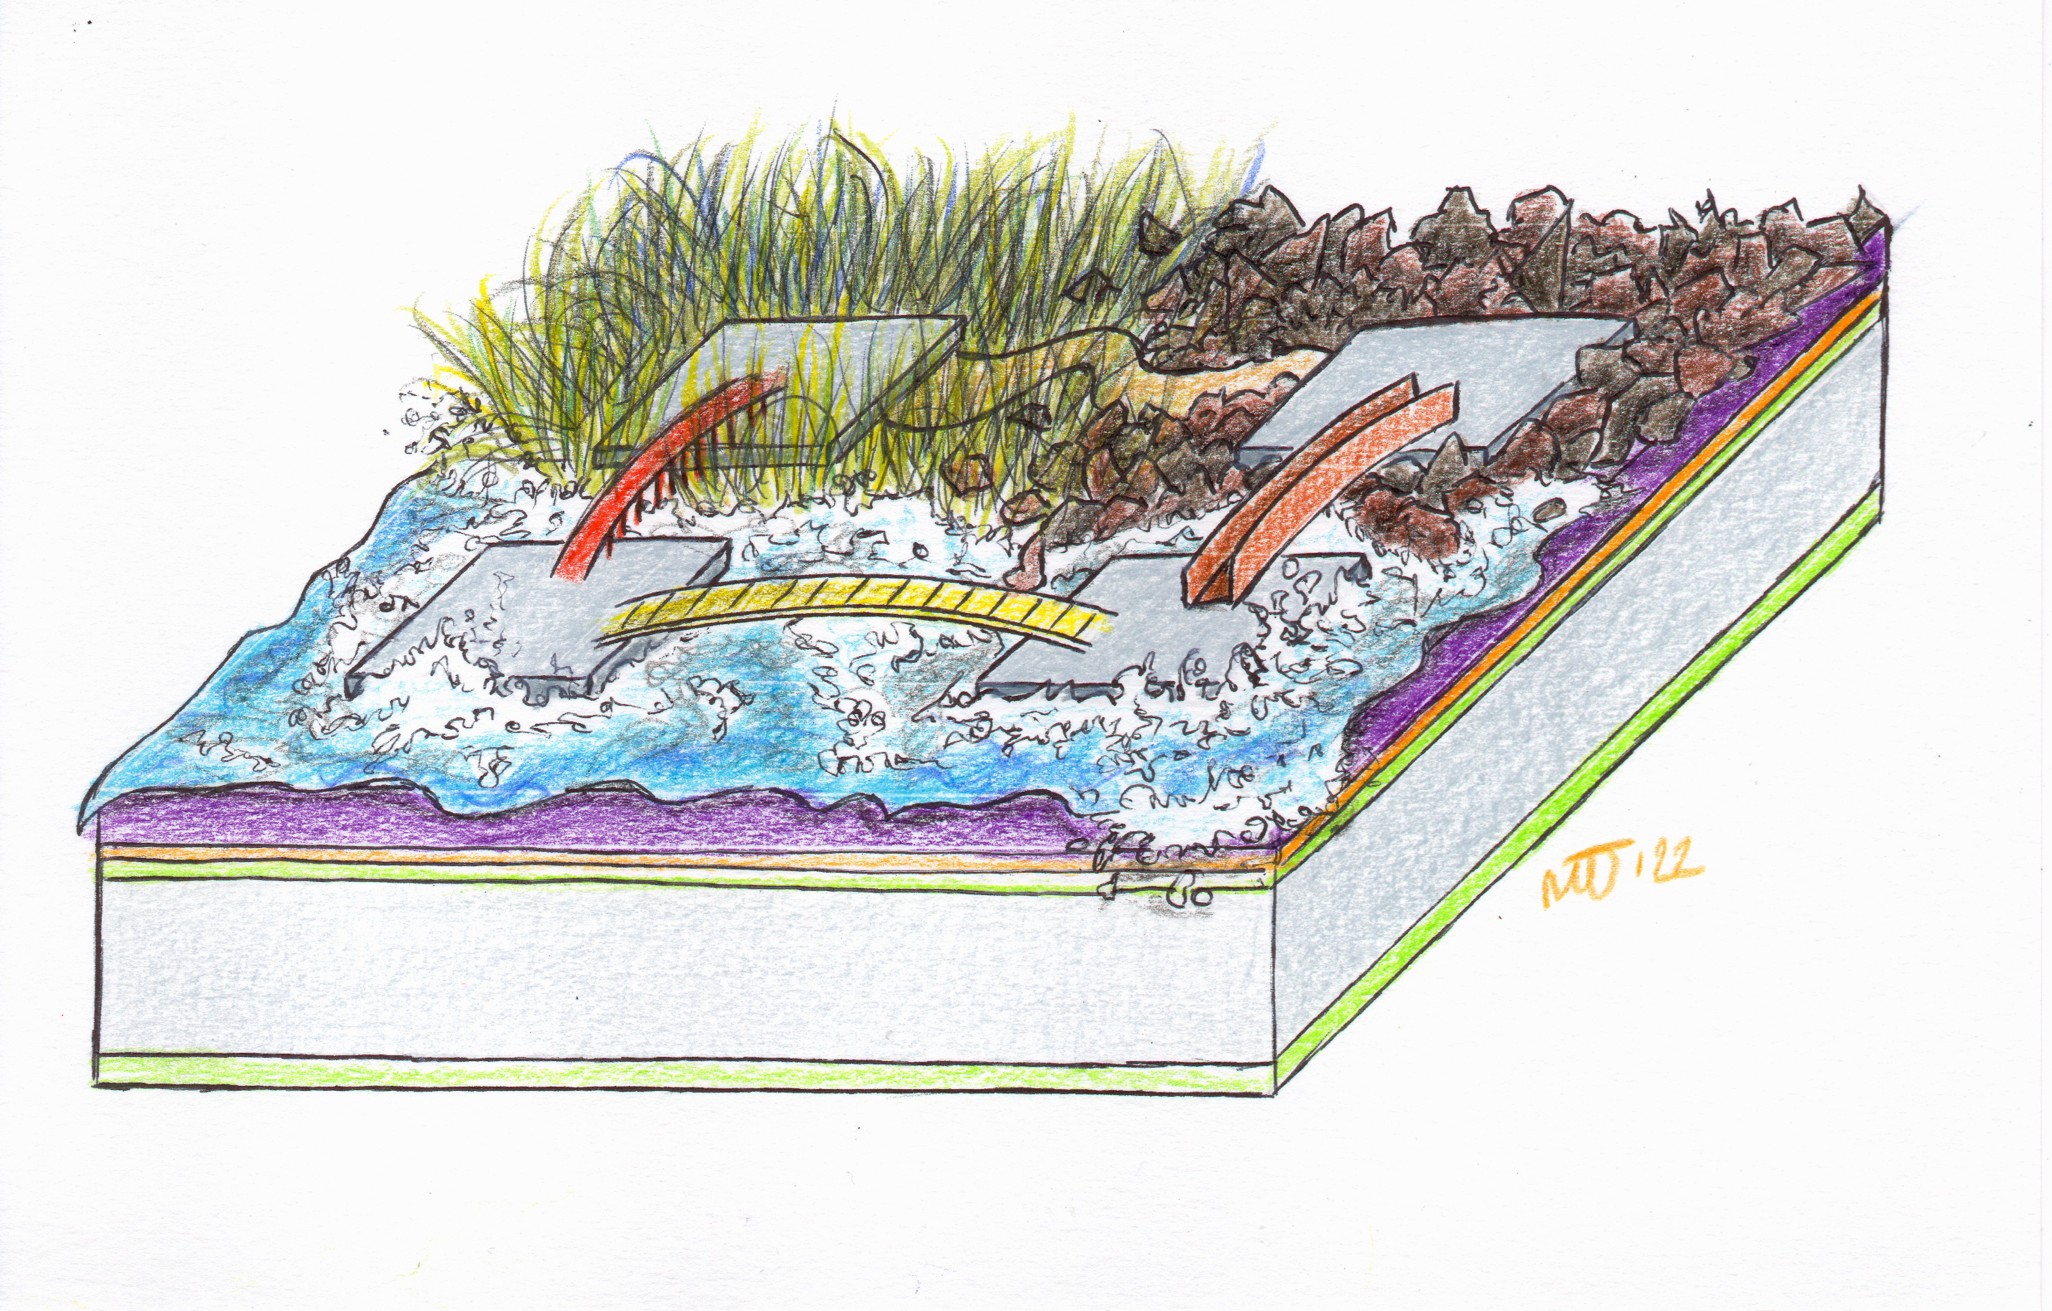
DC-Coupled RSDs

Slide 8
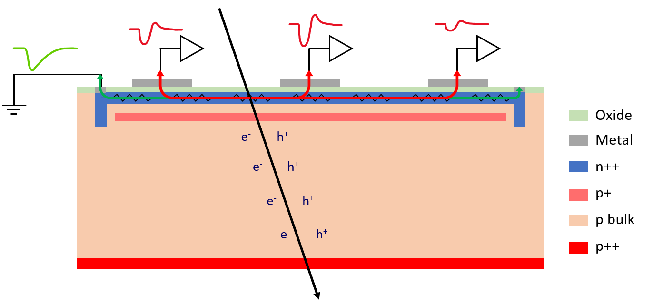
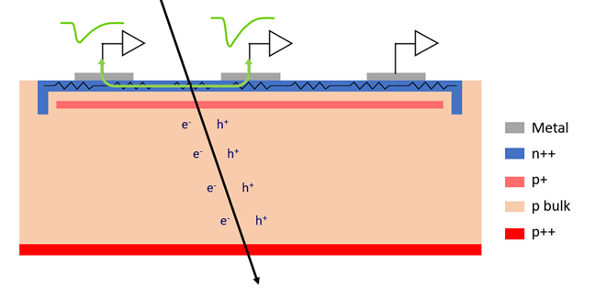
The DC-Coupled RSDs
The RSD have some drawbacks:
Signal is split in a large (>4) and variable number of electrodes – worse spatial and temporal resolution
Baseline fluctuations (leakage current collection only at the edge) in large and/or irradiated devices
Signals are bipolar with rather long tails during the discharge – cannot integrate them
RSD
DC-RSD

Slide 9
The DC-Coupled RSDs
The RSD have some drawbacks:
Signal is split in a large (>4) and variable number of electrodes – worse spatial and temporal resolution
Baseline fluctuations (leakage current collection only at the edge) in large and/or irradiated devices
Signals are bipolar with rather long tails during the discharge – cannot integrate them
DC-coupled electrodes + charge-containment structures
RSD
DC RSD
DC-RSD

Slide 10
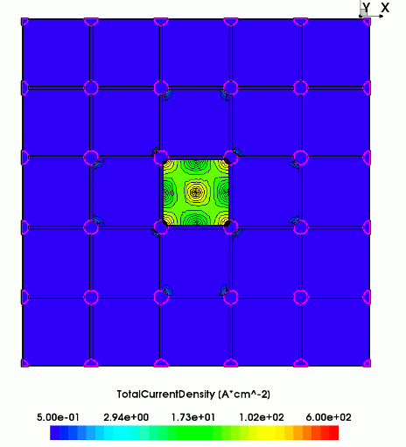
The DC-Coupled RSDs
DC-coupled electrodes + charge-containment structures
Signal is confined
Leakage currents is extracted at each electrode
No bipolar signal → 1-2 ns-long pulses
These devices and the production process was extensively simulated and studied in the past few years
DC-RSD with trenches
DC RSD
current density over device surface
signal confinement
TCAD simulation
DC-RSD
Expected more scalable devices with more uniform performance
F. Moscatelli et al, https://www.sciencedirect.com/science/article/pii/S0168900224003061

Slide 11
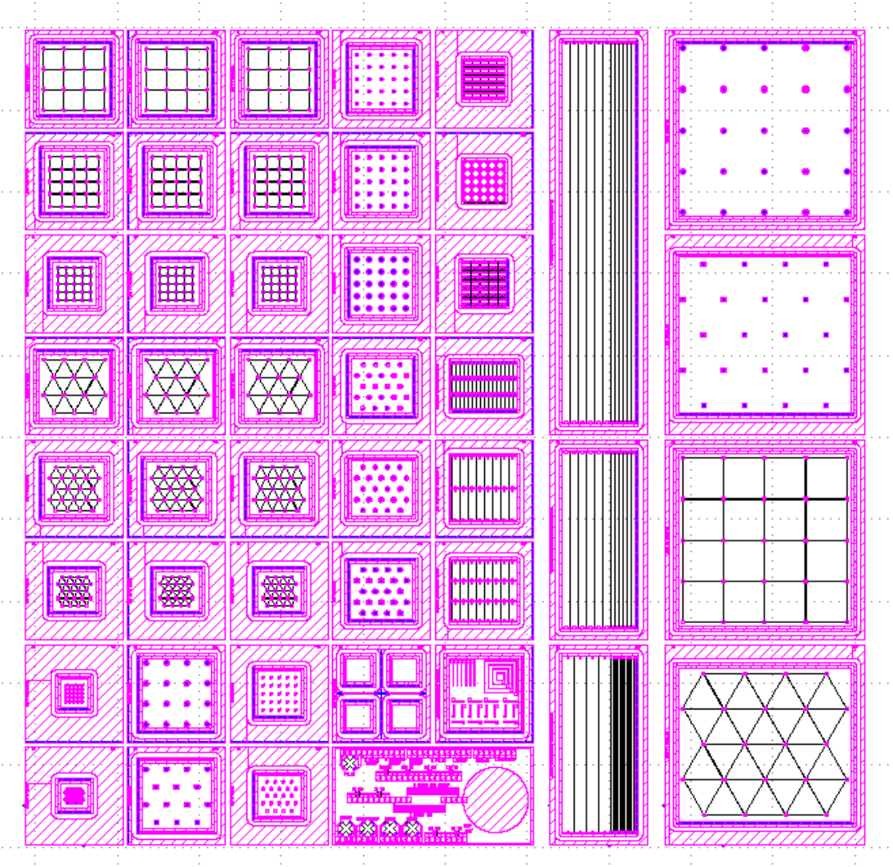
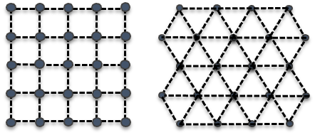
The DC-RSD production by FBK
After 2 years of simulations and short loops, the first DC-RSD production was completed by FBK in November 2024.
  Charge containment: trenches (like SiPMs or TI-LGADs)
Several structures with different purposes are implemented
  Different electrodes disposition - triangles or squares matrixes, strips
  Three trench crossing design
  Many pitches - ranging from 100 um to 1 mm
DC-RSD1 reticle
“square” or “triangle” pixel shape
see M. Centis Vignali’s Talk at TREDI2025 for more information on the DC-RSD1 production

Slide 12
The DC-RSD production by FBK
Today’s presentation reports the first results achieved at a test beam performed at DESY in December 2024 (two weeks after receiving the sensors).
We selected:
The highest n+ resistivity – W3
Best design candidates
Square pixels
3x3 pixel matrix
16 electrods
500- and 1000-μm pitch
Triangle pixels
5x3 pixel matrix
14 electrodes
500- μm pitch
see M. Centis Vignali’s Talk at TREDI2025 for more information on the DC-RSD1 production

Slide 13
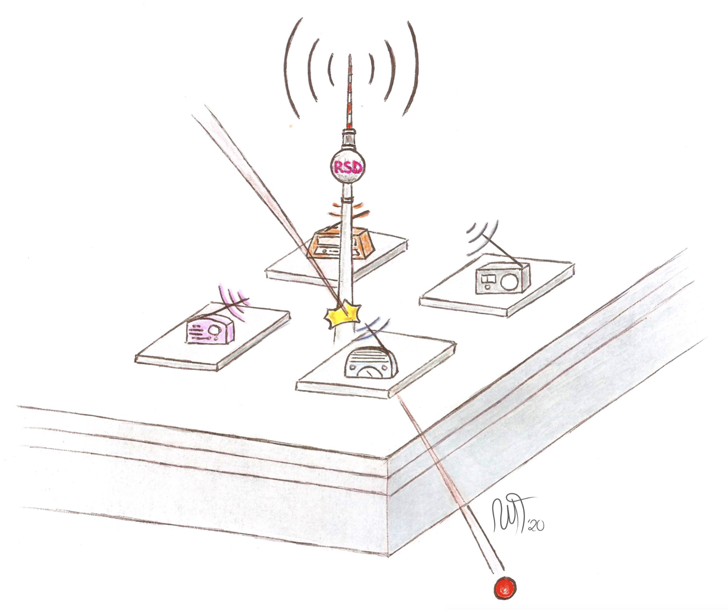
DCRSD Test Beam Preliminary Results

Slide 14
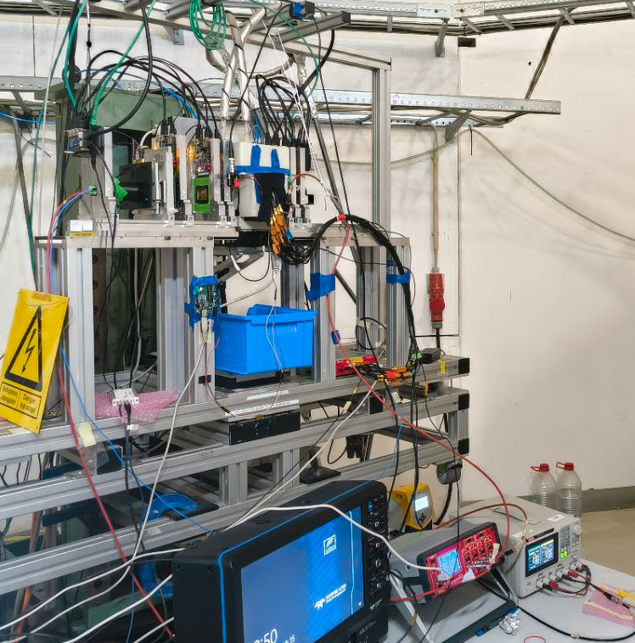

DESY December ’24 Test Beam
  For the Space Resolution studies we read out many pixels using a 16-ch 5 GS/s CAEN digitizer
  Up to 16 electrodes
TLU Tracker
Trigger
DUT
Adenium Tracker
MCP
EUDAQ PC
Oscilloscope
corryvreckan
CAEN
Digitizer
PC

Slide 15
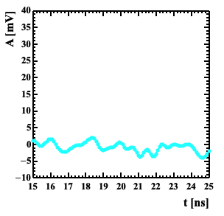
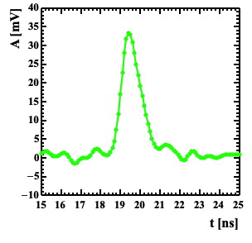
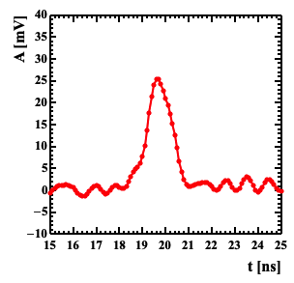
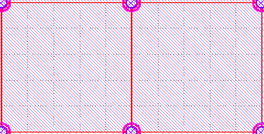
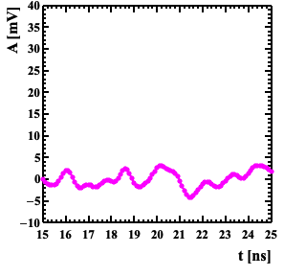
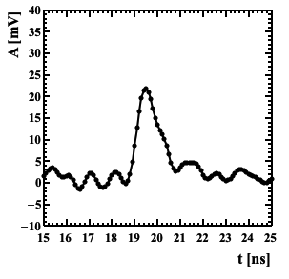
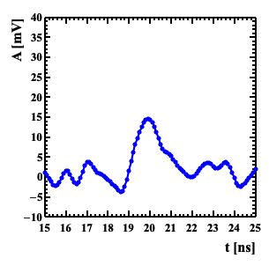
First Signals
Amplitudes recorded by 6 electrodes
The signal is fast, unipolar, same shape of a standard LGAD.
Perfect isolation: the signal is seen only in the electrodes belonging to the hit pixel.

Slide 16
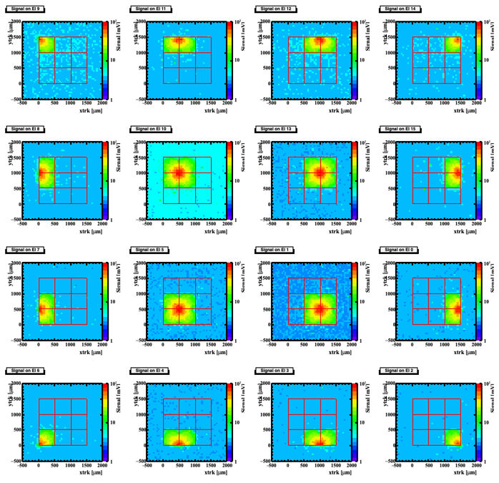
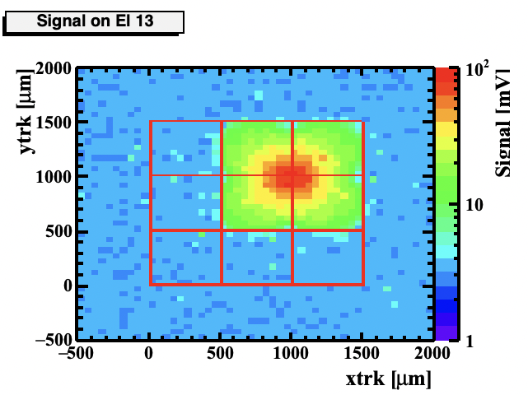
DCRSD - Signal Confinement
Average signal amplitude seen by each electrode as a function of the (X,Y)_{TRACKER}
Very good Signal Confinement is achieved!
Only the interested pixel(s) are involved in the reconstruction

Slide 17
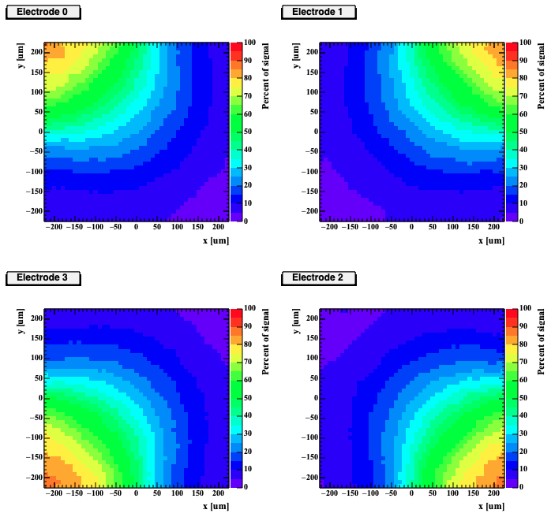
DCRSD – Spatial Reconstruction
Position reconstruction is performed through the use of a template:
4 look-up tables are generated inside a pixel at the best S/N datapoint – they describe how the signal is split between the 4 electrodes vs (x,y). We used the amplitude ratio over the sum of the 4 amplitudes
The hit pixel is identified as the one with the highest amplitudes sum
For each event, the position is reconstructed as the one with the closest match to the 4 templates
The tracker precision, residual misalignments and mis-calibration are sources of error

Slide 18
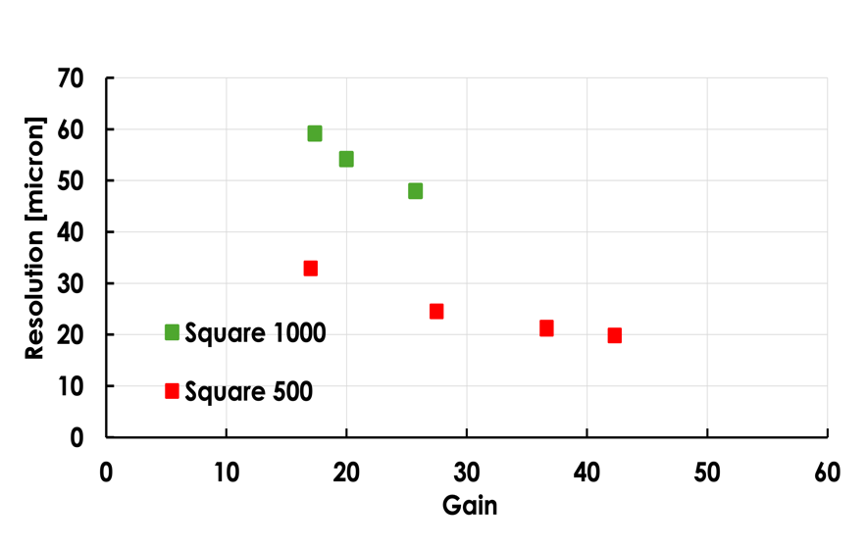
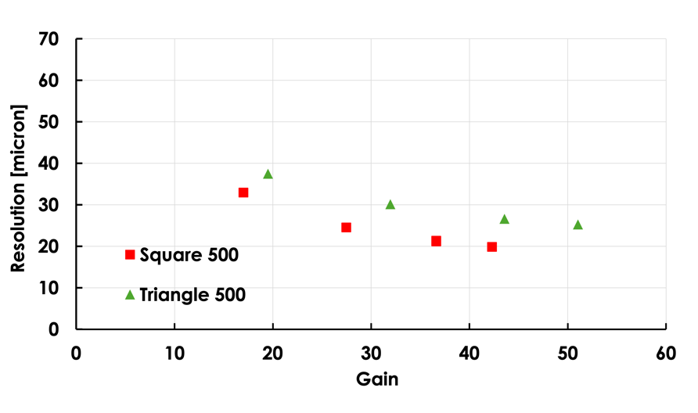
DCRSD – Spatial Reconstruction
500- and 1000-μm pitch squares
500-μm pitch squares and triangles
4DSHARE – preliminary
4DSHARE – preliminary
(tracker resolution ~8 micron subtracted)
All sensors reach a spatial resolution < 5% of their pitch
Still preliminary - optimization of experimental setup and analysis ongoing
Squares seem to outperform triangles

Slide 19
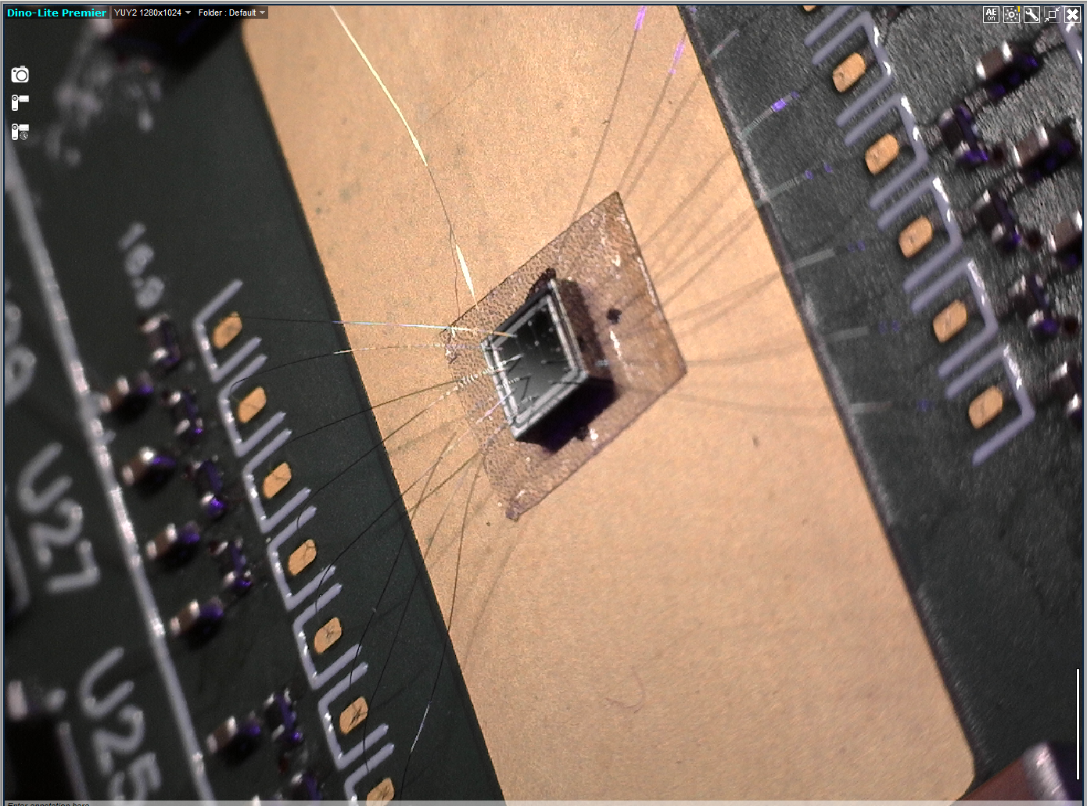
DESY December ’24 Test Beam
  Every structure was wire bonded on 16 channels FNAL boards
  For the Time Resolution studies 2 pixels were read out using an 8-ch 20 GS/s oscilloscope
  Up to 7 electrodes + MCP (time reference)
  Better system time resolution
Trigger
DUT
Adenium Tracker
MCP
Data path
Oscilloscope

Slide 20
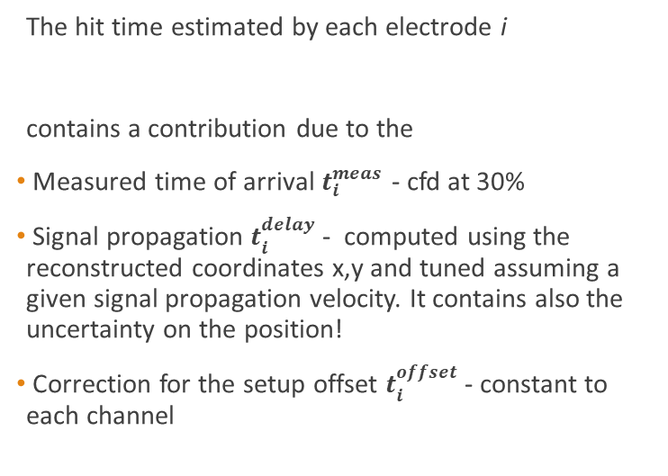

DCRSD – Time Reconstruction
t₁^{offset}
t₁^{meas}
The hit time estimated by each electrode i
contains a contribution due to the
Measured time of arrival $t_{i}^{meas}$ - cfd at 30%
Signal propagation $t_{i}^{delay}$ - computed using the reconstructed coordinates x,y and tuned assuming a given signal propagation velocity. It contains also the uncertainty on the position!
Correction for the setup offset $t_{i}^{offset}$ - constant to each channel
1
t₁^{delay =} v * d_{i}
2
$t_{i}^{hit}=$ $t_{i}^{meas}$ - $t_{i}^{delay}$ - $t_{i}^{offset}$
3
4

Slide 21

DCRSD – Time Reconstruction
t₁^{offset}
t₁^{meas}
The hit time estimated by each electrode i
contains a contribution due to the
Measured time of arrival $t_{i}^{meas}$ - cfd at 30%
Signal propagation $t_{i}^{delay}$ - computed using the reconstructed coordinates x,y and tuned assuming a given signal propagation velocity. It contains also the uncertainty on the position!
Correction for the setup offset $t_{i}^{offset}$ - constant to each channel
1
t₁^{delay =} v * d_{i}
2
$t_{i}^{hit}=$ $t_{i}^{meas}$ - $t_{i}^{delay}$ - $t_{i}^{offset}$
3
4
The particle time of arrival is computed using
$$t^{hit}=\frac{\sum_{1}^{4}{{t_{i}^{hit}A}_{i}^{2}}}{\sum_{1}^{4}{A_{i}^{2}}}$$

Slide 22
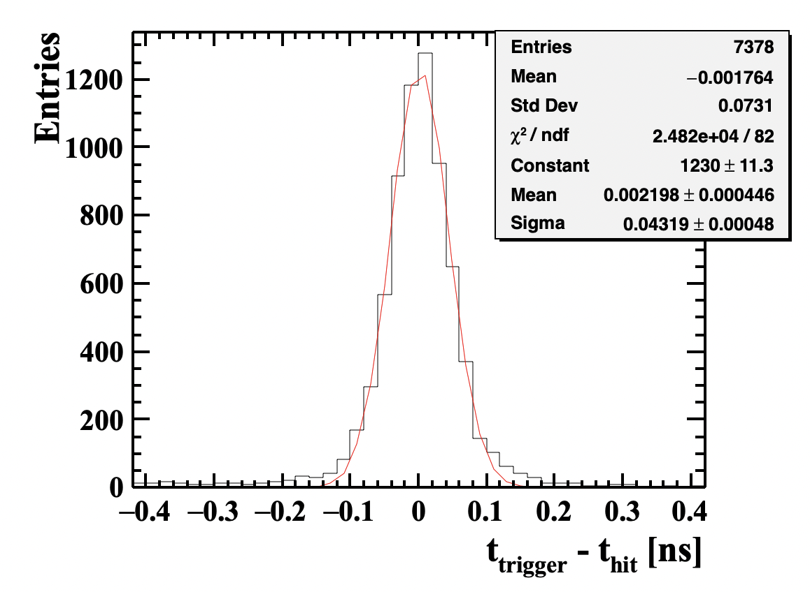
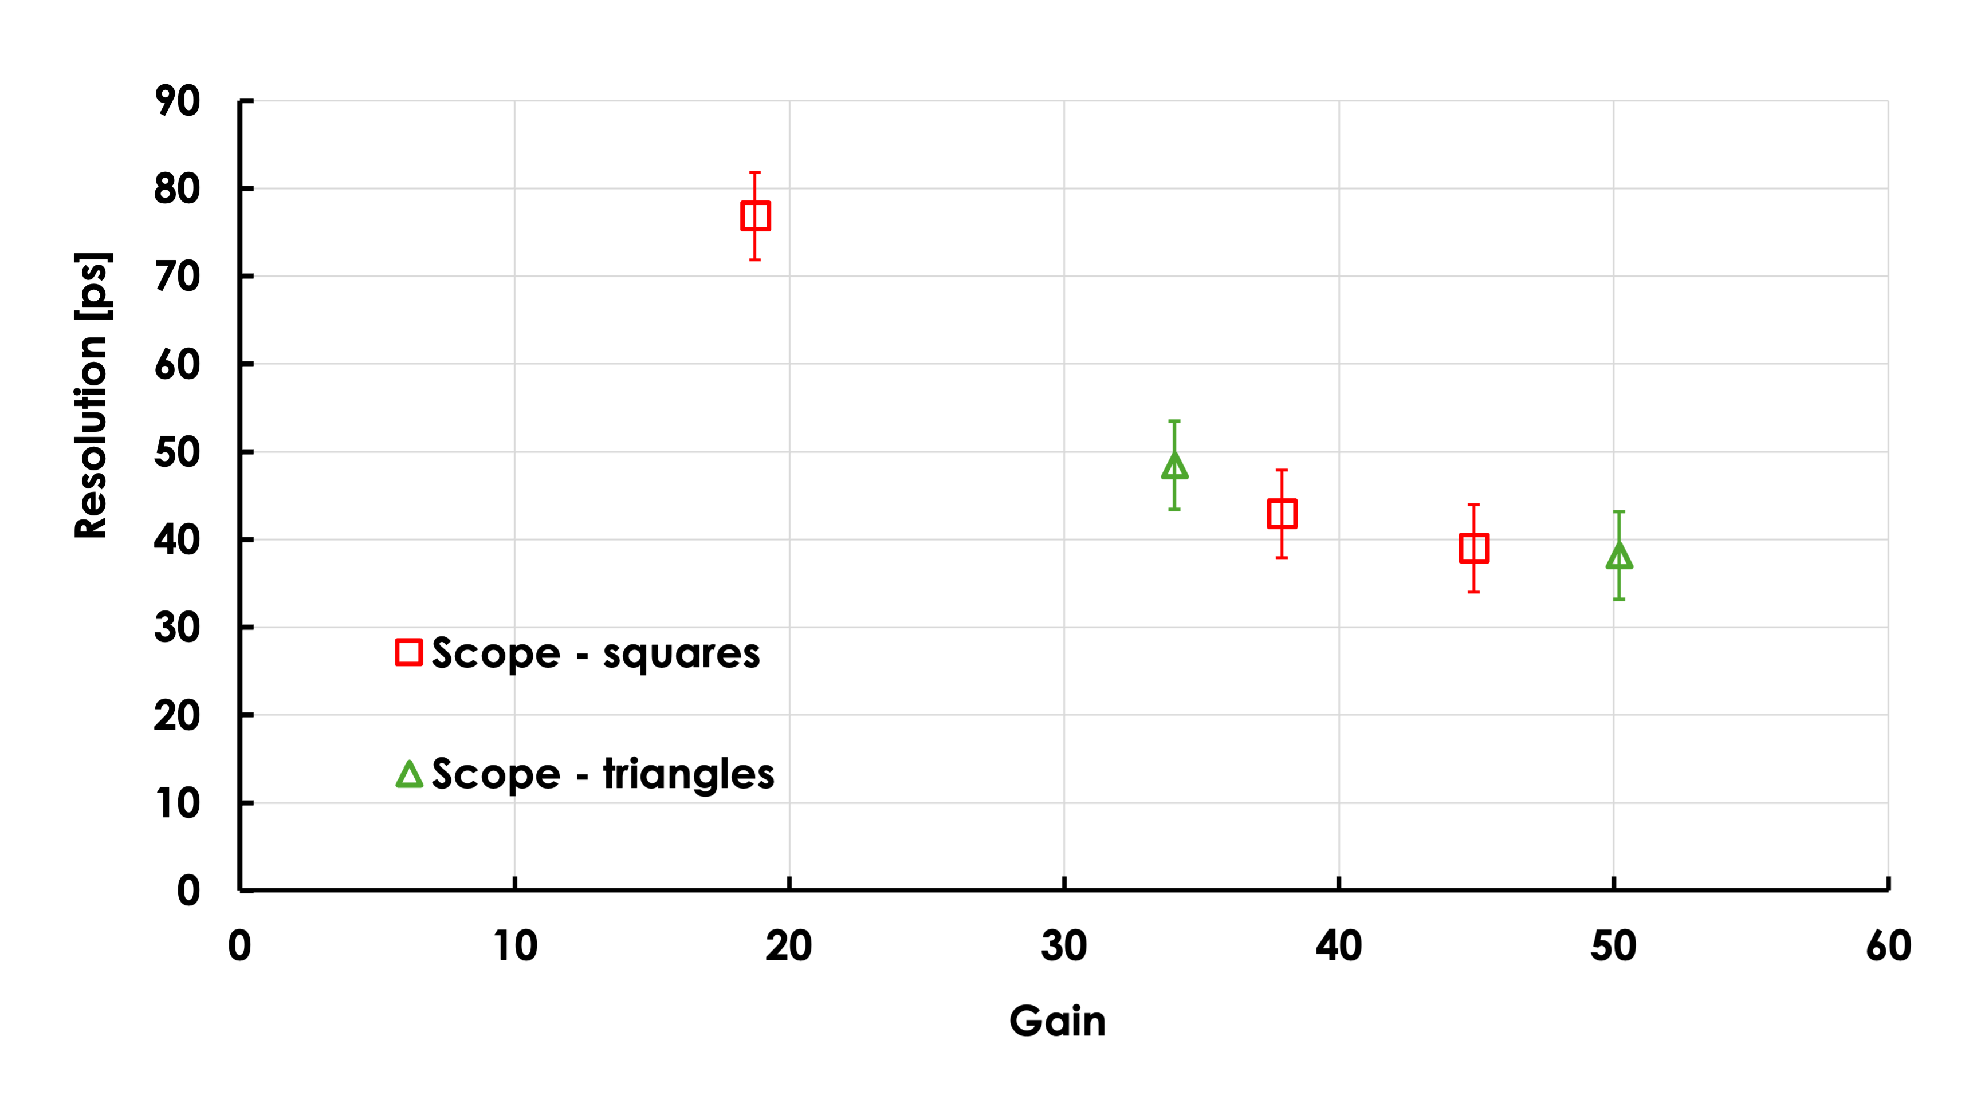

DCRSD – Time Reconstruction
By comparing the RSD time of arrival with the MCP time (30% cfd, ~5 ps resolution)
Time resolution for the 500-μm pitch squared and triangular pixel matrix
4DSHARE – preliminary
$$σ_{t }\sim 43 ps$$
For the 500-μm square matrix, bias = 240 V

Slide 23


Summary & Near Future
After a long journey, the first prototype run of DC-RSD has been completed
These first measurements prove that this design works well
The DC-RSD1 sensors are alive and well
Signals are contained within a pixel
Preliminary measurements of space and time resolution are excellent
Spatial resolution is < 5% of the pitch on all tested devices
In the case of the square 500μm pitch sensor
The analysis of the DESY test beam finished in mid March 2025 is almost finished – smaller DUTs and different resistivity
Full systematic studies of the production with TCT and betas are ongoing
Studies on irradiated RSD2 sensors are ongoing @ KIT
$$σ_{x,y}\sim 20 μm$$
$$σ_{t}\sim 40 ps$$

Slide 24
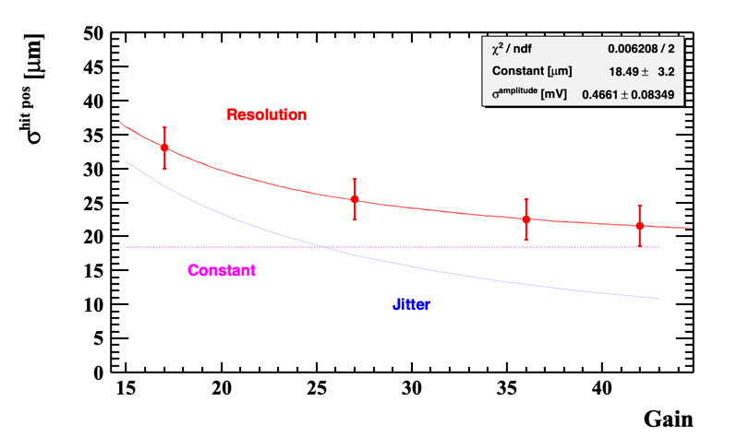
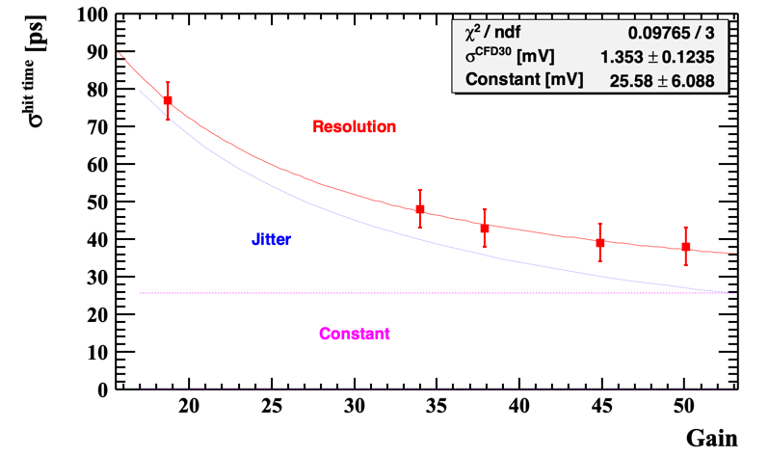
Summary
DCRSD1
500μm pitch
20 μm
40 ps

Slide 25
Acknowledgements
This work has received funding from:
INFN CSN5 through the 4DSHARE research project
PRIN MIUR project 2017L2XKTJ ‘4DInSiDe’
PRIN MIUR project 2022KLK4LB ‘4DSHARE’: European Union-Next Generation EU, CUP C53D23001510006 Compagnia San Paolo (TRAPEZIO grant)
European Union's Horizon Europe research and innovation program under grant agreement no. 101057511 (EuroLABs)
We acknowledge the fruitful discussions with the DRD3 collaboration, CERN.
Measurements leading to these results have been performed at the testbeam facility at DESY Hamburg (Germany), a member of the Helmholtz Association (HGF).
And many thanks to Marta Tornago for the RSD drawings!

Slide 26


Slide 27
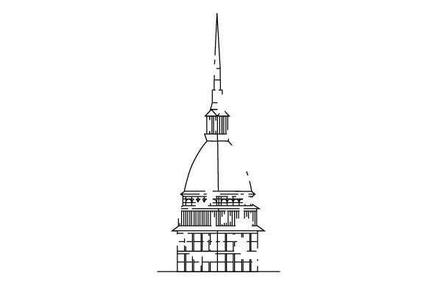
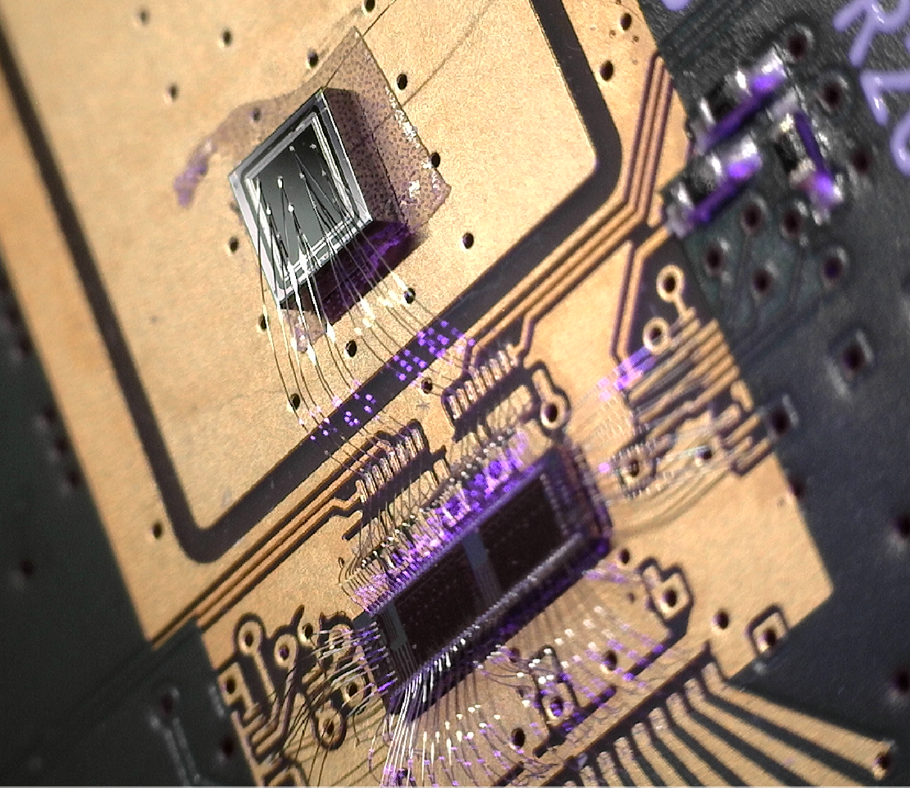

Electronics
FAST3
FNAL Board
We had issues with the first assemblies and decided to use the FNAL board
Luca Menzio – UPO & INFN Toino
Developed in Turin, ASIC UMC 110 nm CMOS
16 channels, ~20 ps jitter, low noise
Adjustable gain
Great results obtained with RSD2
Developed in FNAL, discrete electronics
16 channels, ~25 ps jitter, slightly higher noise
Fixed gain G ≈ 70
Low input impedance ≈ 25 Ohm

Slide 28
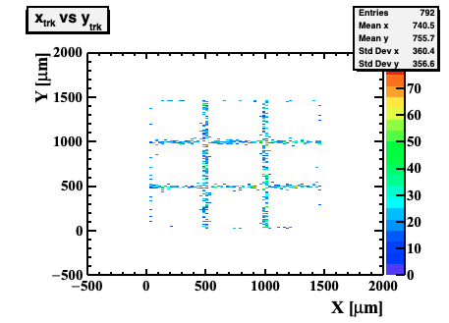
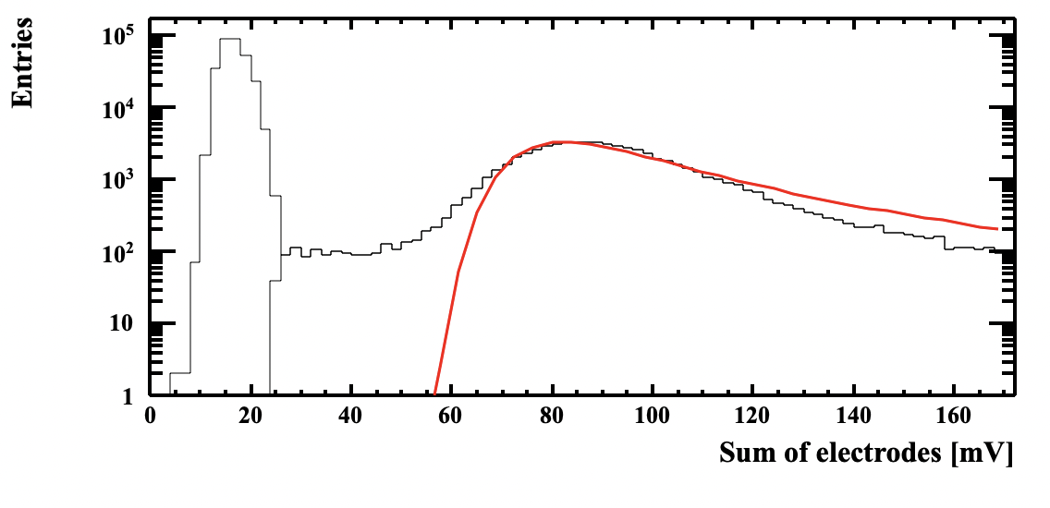
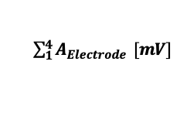
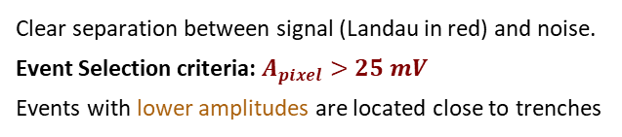
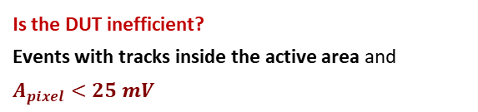
Inefficiencies
The signal collected by a “pixel” is estimated summing the amplitudes seen by the four (three) electrodes defining the squared (or triangular) pixel
Is the DUT inefficient?
Events with tracks inside the active area and $A_{pixel}<25 mV$
$\sum_{1}^{4}{A_{Electrode}} [mV]$
Clear separation between signal (Landau in red) and noise.
Event Selection criteria: $A_{pixel}>25 mV$
Events with lower amplitudes are located close to trenches
mostly aligned with the trenches!
this is not inefficiency but acceptance
(fill factor ~ 99%)

